Slide 1
Laboratori Nazionali di Legnaro – INFN
Study of a photoionization scheme of silver using a ToF-MS
Overview and beginning of activities
R.Bellesi
May 19th, 2025

Slide 2
Outline
Photoionization technique for Ag
Lab. Setup and ToF-MS
Beginning of activities
Notes:
2

Slide 3
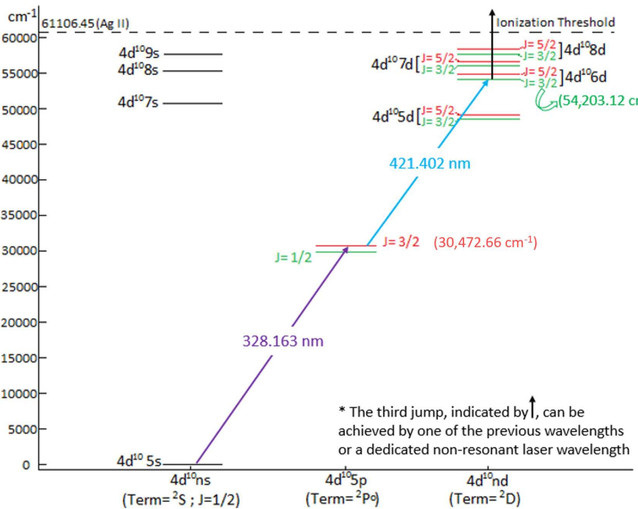
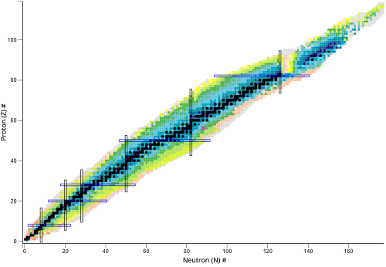
Photoionization technique for Ag
Aim: study of photo-ionization scheme of Ag for the production of the radionuclide Ag-111: T_{1/2} (ß⁻ decay) ∼7.45 days and an average energy ∼360 keV
Technique (general for other radionuclides):
Production of a vapor containing the element of interest, by an ablation laser hitting a solid target.
Laser pulses with resonant λ (specific for an element’s atomic scheme)
Time of flight mass spectrometer (ToF-MS) to distinguish the isotopes
In the online a mass selector chooses the isotope of interest
Resonant scheme for Ag-111
MASS SELECTIVE
Z SELECTIVE
Nuclides map
Notes:
3

Slide 4
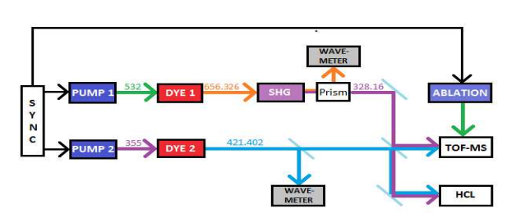
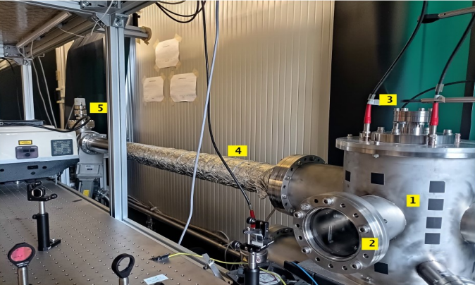
Lab. Setup and ToF-MS
Offline laser laboratory, brief description of the offline setup:
System of two dye lasers for the resonant wavelengths (one delayed in terms of nanoseconds)
Ablation laser (10 Hz) to create the Ag-vapor. Solid target capable of producing Ag isotopes
In the ToF-MS the resonant lasers rightfully synchronized meets the vapor and the Ag ions are accelerated
MCP for ion detection and validation of ionization process
offline lab. map
SPES offline laser lab: ToF-MS picture
Notes:
4

Slide 5
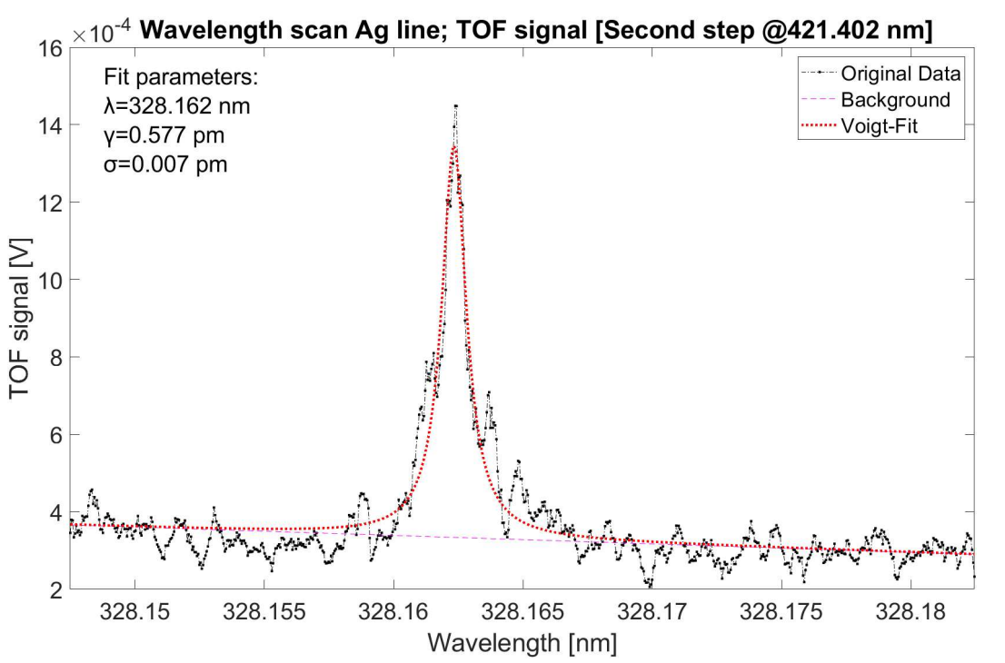
Beginning of activities
Fitting of Ag spectrum, study of different broadening mechanism. Example of useful dataset:
Convolution fit: Voigt function
Lorentzian contribution (natural broadening, power broadening, laser spectral linewidth)
Gaussian contribution
(Doppler broadening)
example from a 2023 dataset
All images from phd_unisi_104857_Khwairakpam
Notes:
5

