Slide 1
Laboratori Nazionali di Legnaro – INFN
Simulation of Ag-111 loaded hydrogel biological samples and first experimental characterization with the DUMBO beta detector
S. Busatto
May 19th, 2025

Slide 2
Outline
First studies
Measurement
Notes:
2

Slide 3
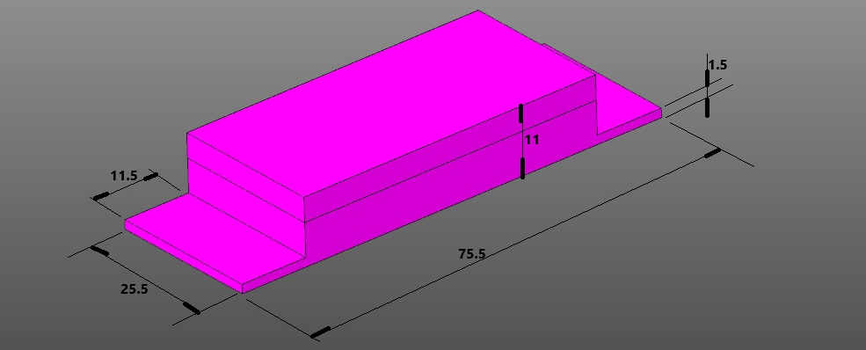
First studies
Study of the geometry of the hydrogel samples in collaboration with UniTn
This is necessary to estimate the resolution of our measurement
Study of the samples’ production process
Geant4 implementation.
Simulation of the measurement
Notes:
3

Slide 4
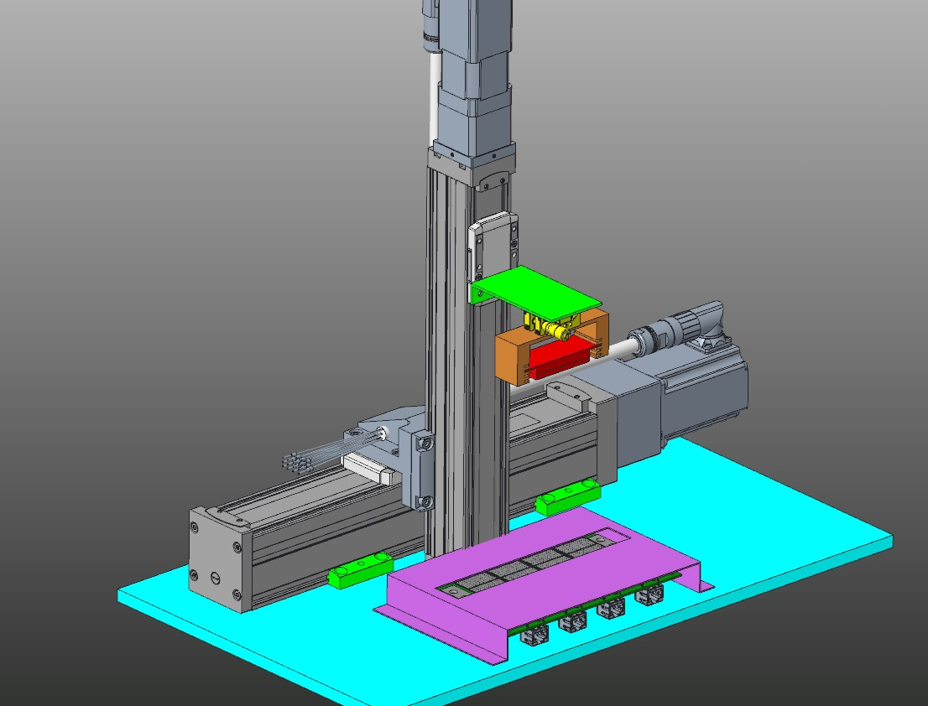
Measurement
Detecting the β-radiation emitted by the ¹¹¹Ag radioisotopes with DUMBO a Silicon pixel planar detector for Beta radiation.
Notes:
4

