Slide 1
Laboratori Nazionali di Legnaro – INFN
Characterization measurements with ADMIRAL detectors on Ag-111-containing biological hydrogel samples
Edoardo Cervi Gambaro
May 19th, 2025

Slide 2
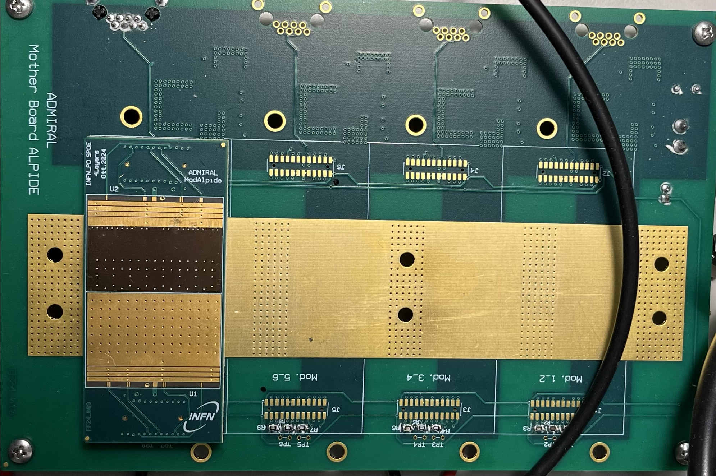
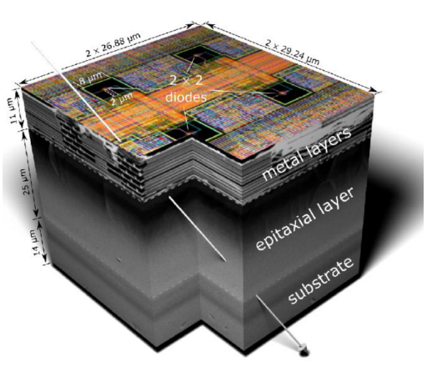
The ALPIDE chip
ALPIDE single pixel 3D representation¹
Top view of one ALPIDE chip placed on its mother board
¹G. on behalf of the ALICE collaboration Contin. “The MAPS-based ITS Upgrade for ALICE”. In: The 28-th International Workshop on Vertex Detectors. 2019. doi: 10.22323/1.373.0003
Notes:
2

Slide 3
Thesis outline
PC interface: how to read and write digital signals
Setting of pixels parameters: threshold, masking…
Imaging 1: how to produce the images to analyze
Imaging 2: activity and dead time evaluation & analyzing images obtained from various β sources
Imaging 3: analyzing images obtained from Ag-111 β emissions in hydrogel
FINAL GOAL
Notes:
3

Slide 4
Thank you for your attention!
Notes:
4

