Slide 1
Laboratori Nazionali di Legnaro – INFN
Geant4 simulation of the ISOLPHARM γ camera for radiopharmacy studies
E. Niero
May 19th, 2025

Slide 2
Outline
The γ camera
The simulation
The experimental session
Notes:
2

Slide 3
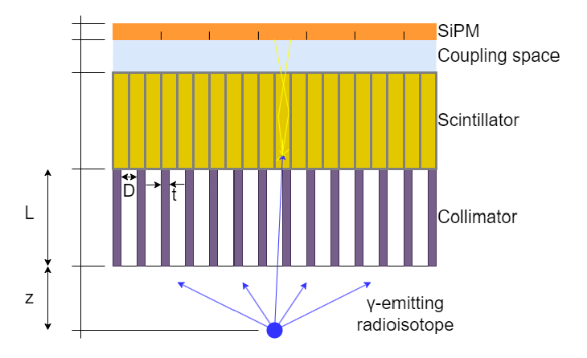
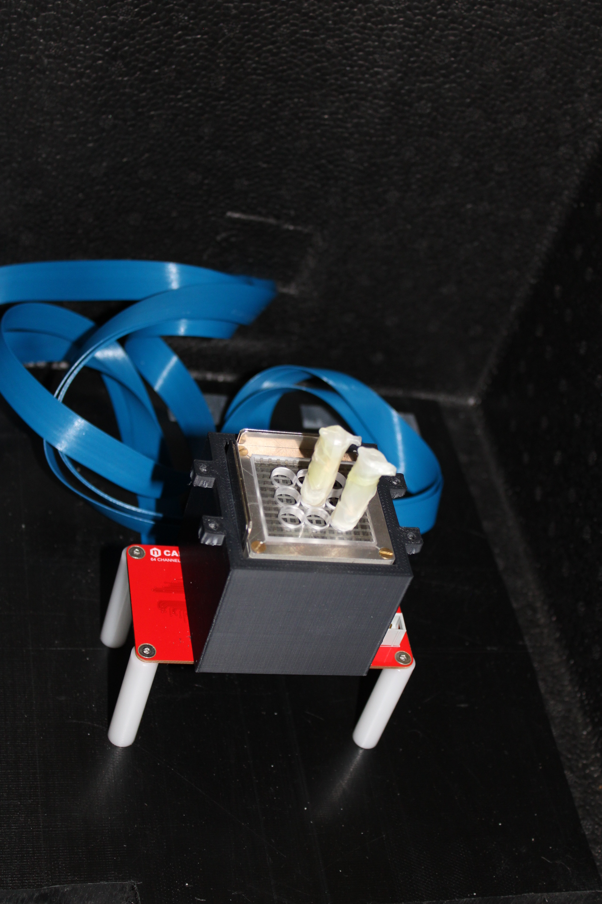
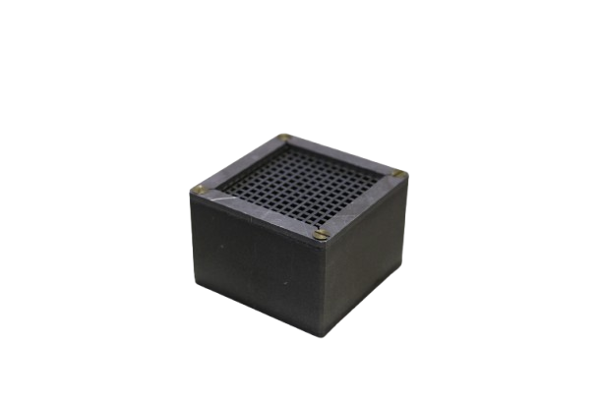
The γ camera
Silicon Photomultiplier sensitive to the optical photons.
8 × 8 channels, each one with
3 × 3 mm² of area.
Inorganic scintillator made with a
GAGG(Ce) crystal (Ce:Gd₃Al₂Ga₃O₁₂).
22 × 22 × 26 mm³ of volume.
Most problematic part for the
simulation!
Ag-111 emitting γ rays with energy 342 keV.
γ camera used at L.E.N.A during the mission of May 15th
Tungsten collimator (𝜌= 19.3 g/cm³), septa are 1 mm thick and holes are
2 mm thick.
Notes:
3

Slide 4
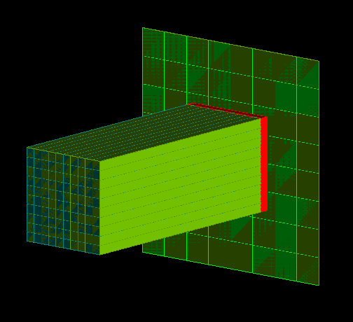
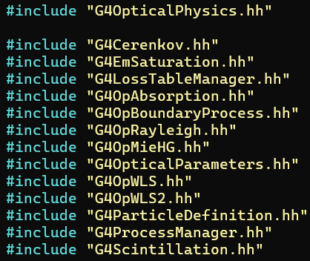
The simulation
Geant4 simulation covers all the parts of the γ camera except for the readout electronics;
For each part of the γ camera, Geant4 requires some parameters in input which have to be optimized to simulate in the best way the experimental data;
For example: the value of absorption length of GAGG(Ce) (G4OpAbsorption);
Longer? Shorter? Constant or energy dependent?
Notes:
4

Slide 5
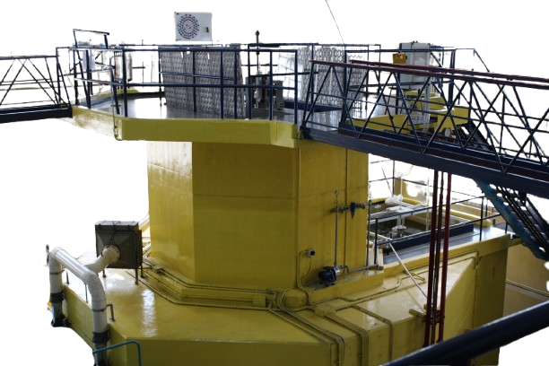
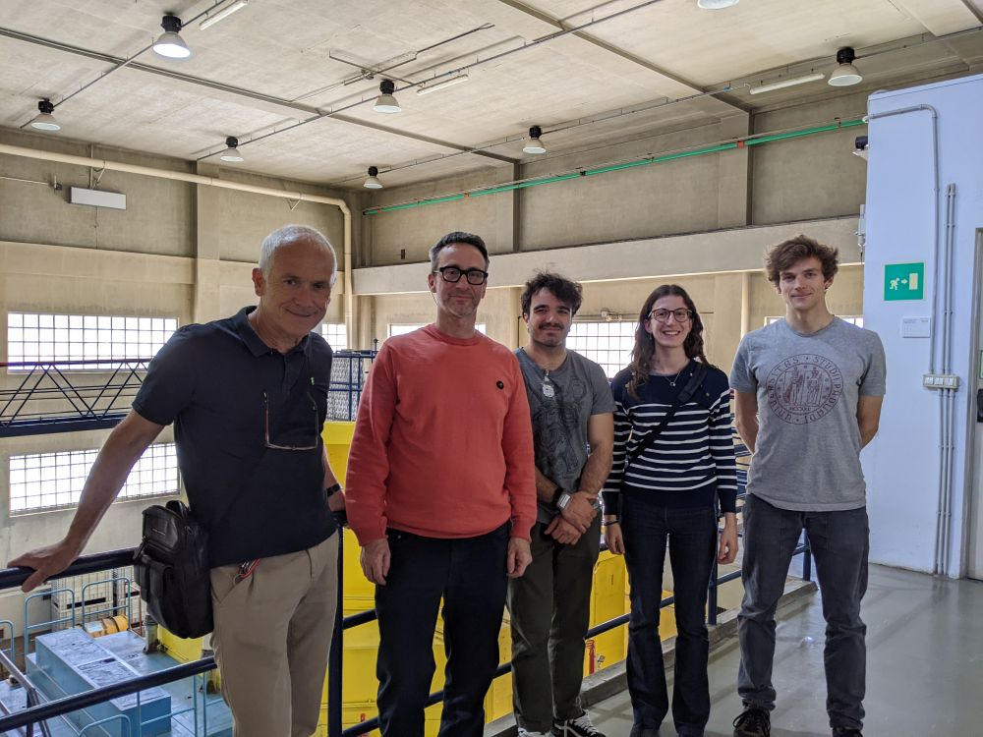
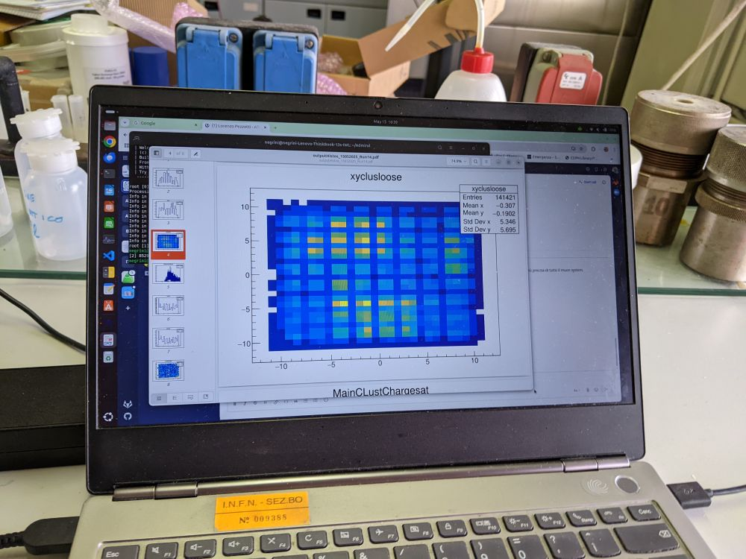
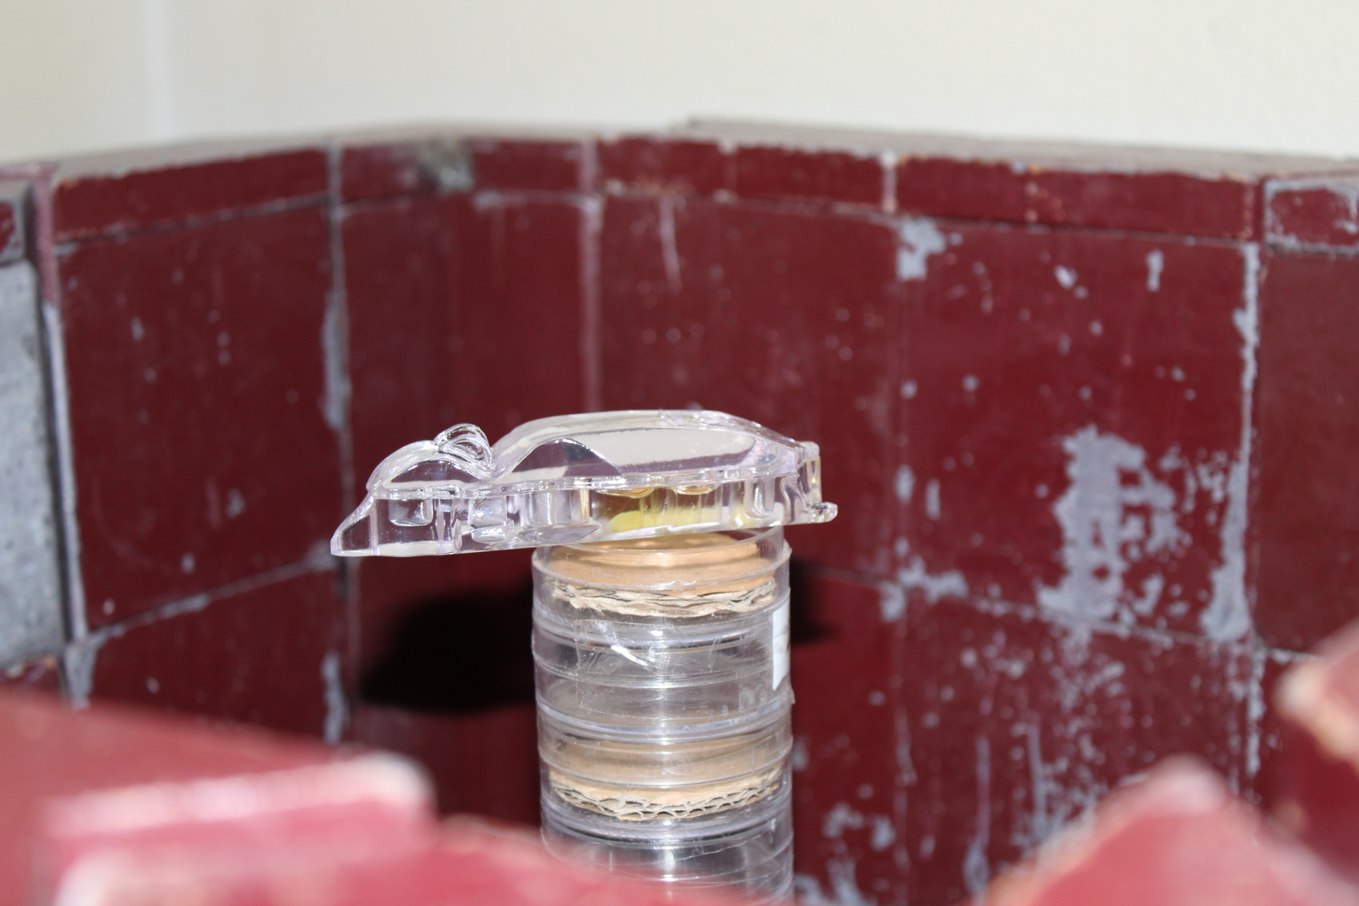
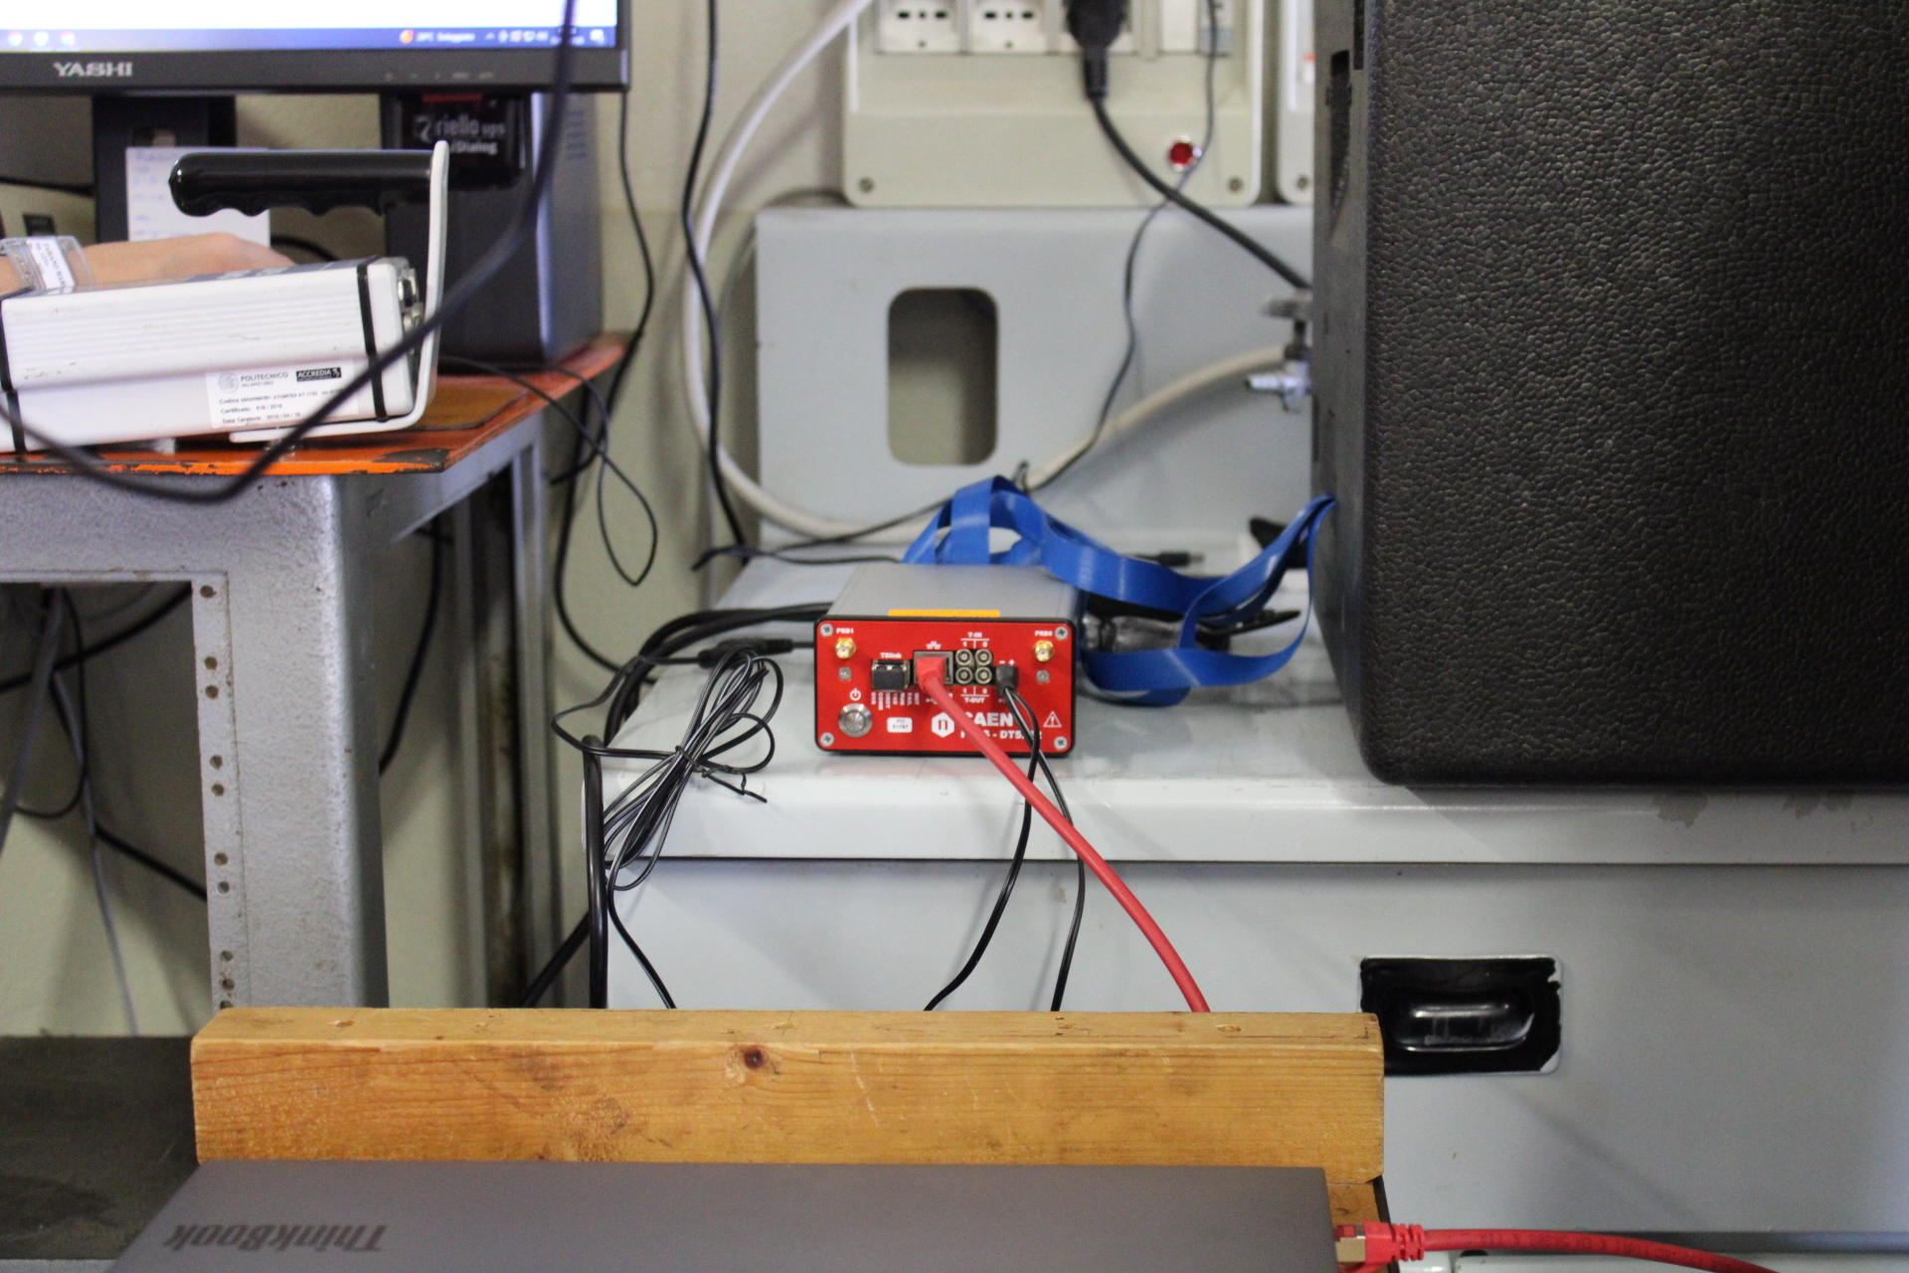
The experimental session
May 15th of 2025 at L.E.N.A. in Pavia
we took useful measurements to
test and characterize our γ camera.
Notes:
5

