Slide 1




Simultaneous determination of the CKM angle γ and parameters related to mixing and CP violation in the charm sector at LHCb
A. Bertolin on behalf of the LHCb collaboration
Outlook:
short introduction to γ
the LHCb γ and charm combination
first result with Run 3 data
example of improved analysis
summary and prospects

Slide 2

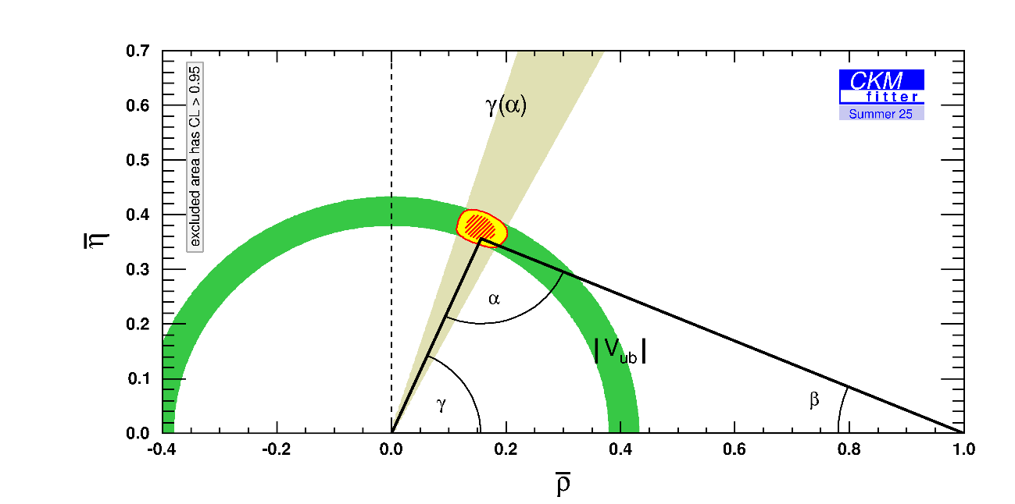
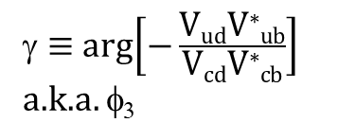
CP violation in the SM
SM charged current weak interactions between quarks are described by the Cabibbo-Kobayashi-Maskawa matrix V, 3 x 3, with V V* = I
3 angles and 1 complex phase (or 3 real and 1 imaginary parameters)
CP violation in the SM arise only through this complex phase
same phase/parameter in all (beauty, charm, …) CP violating processes
unitary condition relevant for beauty decays can be represented by a triangle in a complex plane, with angles α, β and γ
tree processes only
$\text{g}≡$ arg$\left[−\frac{\text{V}\text{ud}\text{V}\text{∗}\text{ub}}{\text{V}\text{cd}\text{V}\text{∗}\text{c}\text{b}}\right]$
a.k.a. φ₃
[JHEP12(2021)141]
γ only angle easily accessible in tree-level decays
assuming no new physics in tree-level decays, the theoretical uncertainties are negligible in such direct measurements i.e., achievable accuracy dominated by experiments
http://ckmfitter.in2p3.fr/www/results/plots_summer25/ckm_res_summer25.html
deviations between these direct measurements and indirect determinations from global CKM fits, which are based on independent observables and assume the validity of the SM and hence unitarity of the CKM matrix, would be a clear indication of physics BSM … due for example to new particles / mediators being exchanged in loops …
at present these direct measurements have a larger uncertainty that the indirect determinations
closing this sensitivity gap is a key physics goal of the LHCb experiment

Slide 3
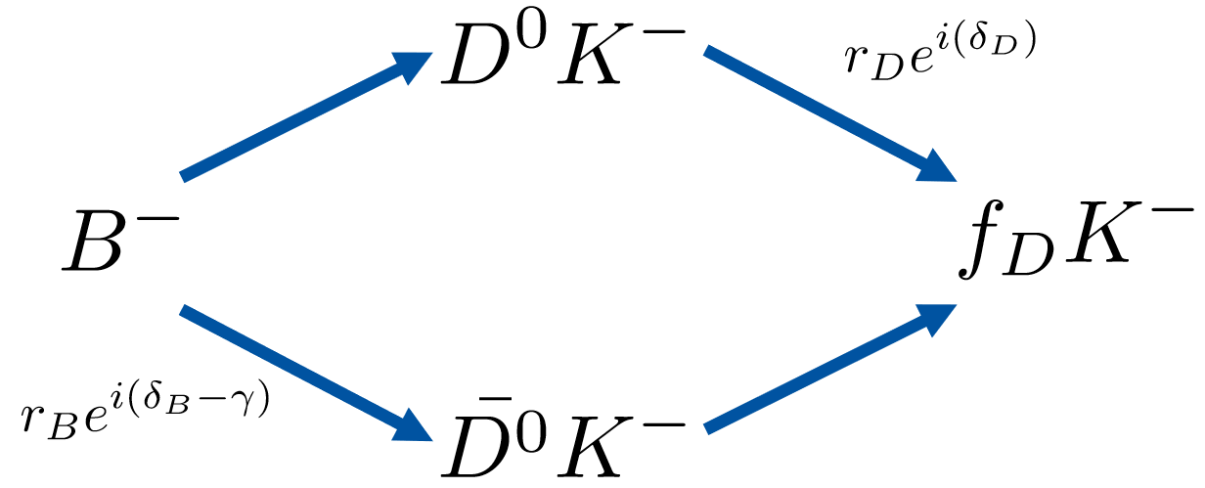
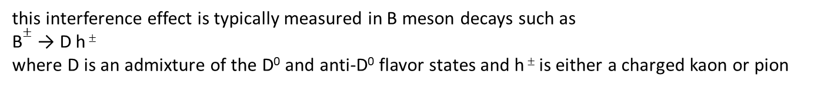
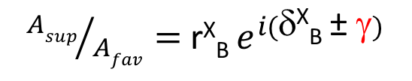
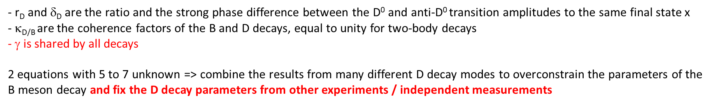
how to measure γ
[JHEP12(2021)141]
γ can be determined by exploiting the interference between
b → c ubar s (V_{cb}), favored
b → u cbar s (V_{ub}), suppressed
transition amplitudes
${Asup}/{Afav}=$ r^{X}_{B} $e^{i(\text{d}\text{X}\text{B} \text{± }\text{g})}$
(− is for b-quark, + for anti-b)
where r^{X}_{B} and δ^{X}_{B} are the ratio and the strong phase differences between the V_{cb} and V_{ub} transition amplitudes for the specific final state X
these must also be simultaneously determined
golden mode for illustration purposes
this interference effect is typically measured in B meson decays such as
B$±$ → D h $\text{±}$
where D is an admixture of the D⁰ and anti-D⁰ flavor states and h $\text{±}$ is either a charged kaon or pion
- r_{D} and $\text{d}$_{D} are the ratio and the strong phase difference between the D⁰ and anti-D⁰ transition amplitudes to the same final state x
- κ_{D/B} are the coherence factors of the B and D decays, equal to unity for two-body decays
- γ is shared by all decays
2 equations with 5 to 7 unknown => combine the results from many different D decay modes to overconstrain the parameters of the B meson decay and fix the D decay parameters from other experiments / independent measurements

Slide 4
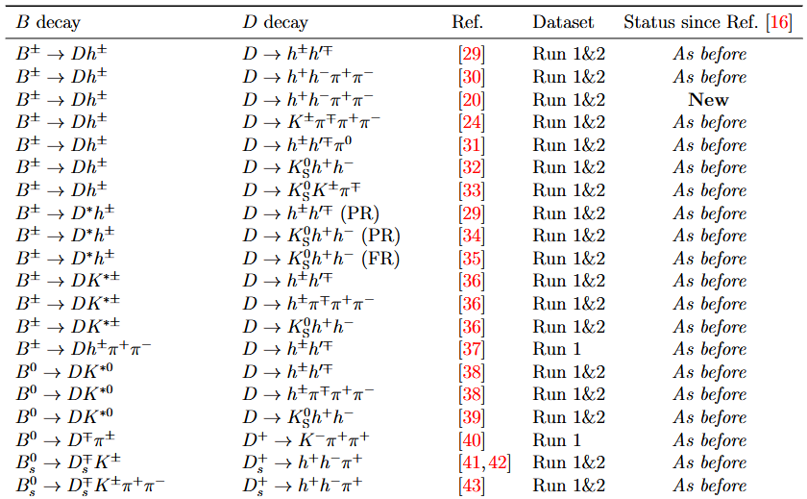
LHCb γ combination: B decay inputs
[JHEP12(2021)141]
[LHCb-CONF-2025-003]
typical B meson final states (h=K,π) ?
B⁺ → D h⁺
B⁺ → D * h⁺
B⁺ → D K^{*+}
B⁰ → D K^{*0}
typical D meson final states ?
CP-eigenstates, D → K⁺ K⁻ and D → π⁺ π⁻: GLW method
[Phys. Lett. B265 (1991) 172, Phys. Lett. B253 (1991) 483]
non CP-eigenstates, D⁰ → π⁻ K⁺: ADS method
[Phys. Rev. D63 (2001) 036005]
self-conjugate multibody D meson decay, like K⁰_{s} π⁺ π⁻, with the D-Dalitz plot distributions: BPGGSZ method
[Phys. Rev. D 68, 054018 (2003), Eur. Phys. J. C 47, 347 (2006)]
current experimental status: most of the B decay inputs updated to Run 1&2 i.e. 9 /fb

Slide 5
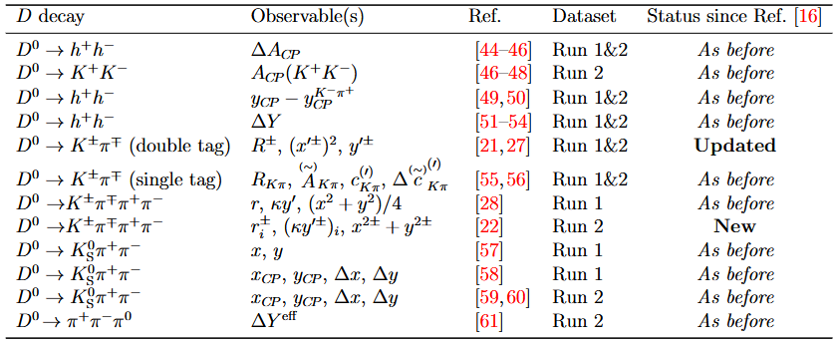
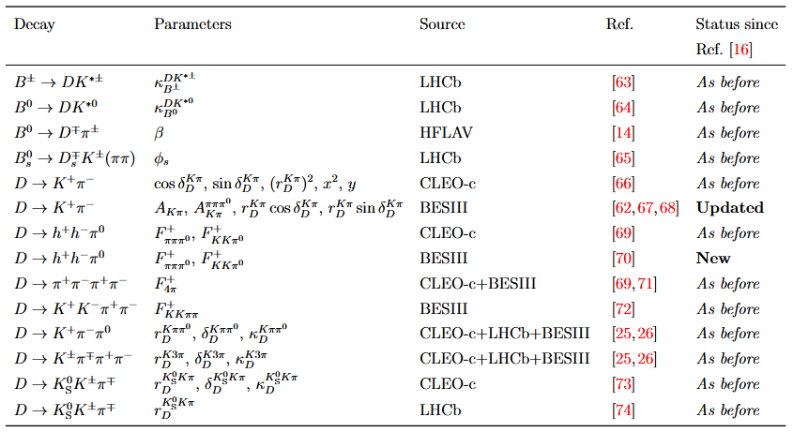
LHCb γ combination: D decay inputs
[JHEP12(2021)141]
[LHCb-CONF-2025-003]
current experimental status: most of the D decay inputs updated to Run 1&2
LHCb γ combination: auxiliary inputs
synergy between LHCb – BESIII (and CLEO-c) is mandatory
if not the uncertainty on the auxiliary inputs will be a limiting factor in the accuracy of the LHCb γ combination

Slide 6
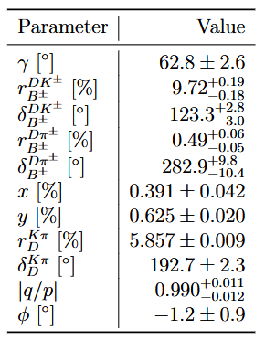






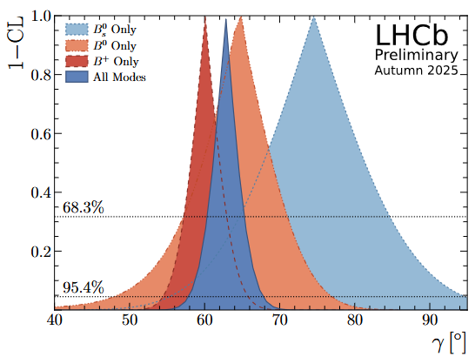

LHCb γ combination: results
235 input observables
64 free parameters
a few results worth to be highlighted:
γ
charm mixing parameters
magnitude and phase of CP violation in charm mixing
[LHCb-CONF-2025-003]
fit also many amplitude ratios and string phase differences
- 2 body and K_{s} h⁺ h⁻ D decays are dominating the combination
- most precise determination of γ from direct measurements to date
- the precision is primarily limited by the statistical uncertainties of the input measurements
- improved constraints on D hadronic parameter for K π and K 3π decays play a major role
good / improved agreement between the different B flavors

Slide 7
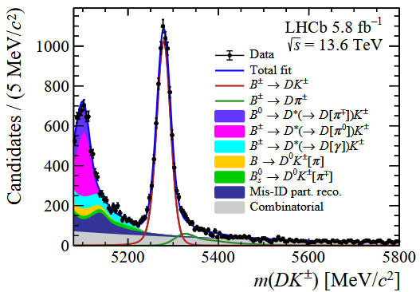



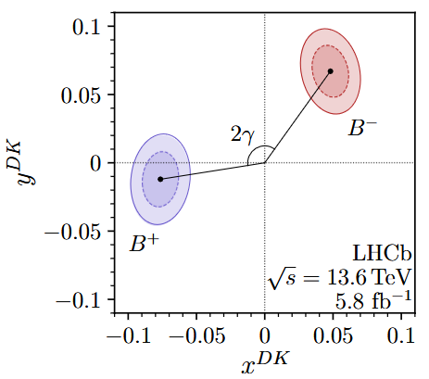
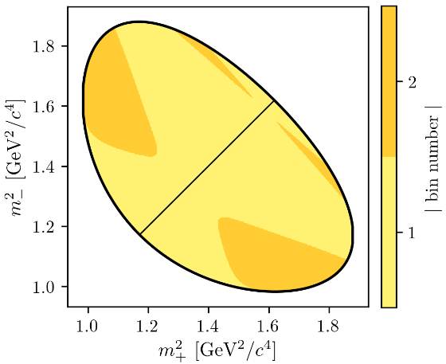

First measurement of γ using Run 3 data:
B⁺ → D h⁺ with D → K⁰_{s} h⁺ h⁻ with h = π or K
[LHCb-PAPER-2026-010]
long K0s
downstream K0s
5.8 \fb collected in 2024
first measurement of γ with Run 3 (Morionw EW 2026)
Run3 advantages: higher luminosity, higher trigger efficiency (removal of L0 + dedicated exclusive HLT2 lines for this decay)
CP violation is observed through differences in the D-Dalitz plot between B⁺ and B⁻ mesons
c (s) ≡ cosine (sine) of the strong-phase difference between the D0 and anti-D0-decay amplitudes at a given point on the Dalitz plot
for D → K⁰_{s} K⁺ K⁻ these are obtained from a combination of BESIII and CLEO data [Phys. Rev. D 102, 052008]
| i | = 1, 2
in good agreement with the corresponding Run 1&2, 9 \fb, result and the LHCb combination
this 5.8 \fb data set show a yield exceeding the one of the previous Run 1&2 analysis (6 solar years of data taking)

Slide 8

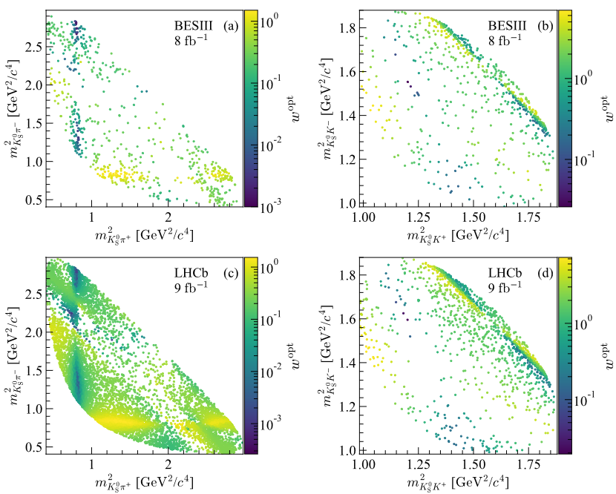
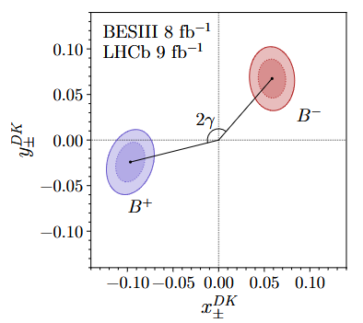
Precise measurement of γ using a novel approach
[submitted to PRL] [submitted to PRD]
process: B⁺ → D h⁺ with D → K⁰_{s} h⁺ h⁻ with h = π or K
CP violation is observed through differences in the D-Dalitz plot between B⁺ and B⁻ mesons
unbinned, optimized, joint fit to both datasets
Fourier expansion (2nd order for K⁰_{s} π⁺ π⁻, 1rst order for K⁰_{s} K⁺ K⁻ ) of the strong-phase difference to capture its variation across the Dalitz plot, smooth irregularities of the binned approach
optimal weight incorporating sensitivity changes due to decay amplitudes, efficiency and background distributions in the D-Dalitz plane
8 /fb of BESIII data, 9 /fb of LHCb data, Run 1&2
optimal weights
K⁰_{s} π⁺ π⁻
K⁰_{s} K⁺ K⁻
the statistical uncertainty is reduced by 5 % wrt the binned analysis performed on the same Run 1&2 data set
BESIII has collected 20 \fb (2021-2024), LHCb will end Run3 (this year) with ≈ 27 \fb
higher-order Fourier expansions
could be extended to other B decays

Slide 9

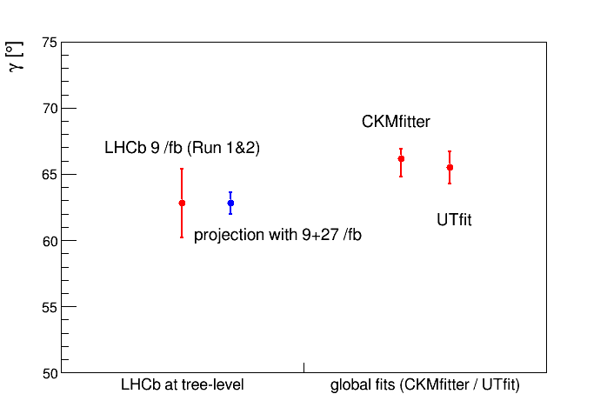
summary and prospects
Difficult to see, the future is
2025 LHCb γ combination based on 9 /fb: (62.8 ± 2.6)º
20 beautiful input measurements that can cross check each other
LHCb result is driving the world average
present uncertainty is not yet what we need
LHCb integrated lumi. increase by mid 2026: + 27 /fb
&& boost in yields due to the fully software Run 3 trigger
⇒ ± 0.8º to ± 1.3º
expect a gradual decrease of the γ uncertainty in the coming releases,
to < 1.5º when all Run 3 measurements will be available
uncertainty will be comparable to CKMfitter / UTfit
moving ahead in the future, LHCb expects to reach an integrated lumi.:
of 50 /fb by the end of Run 4, i.e. 2033
of 300 /fb by the end of Run 5, i.e. 2041
by then, if the accuracy of the external inputs will not be a limiting factor, the γ uncertainty could reach 0.35º
synergy with BESIII is mandatory
other experiments:
- BaBar: (69 + 17 − 16)º
Belle && Belle II: (75.2 ± 7.6)º
with improvements expected in the coming years
- CKMfitter Summer 2025: (66.2 + 0.7 − 1.4)º
- UTfit Summer 2025: (65.5 ± 1.2)º
[Phys. Rev. D87 (2013) 052015]
[JHEP 10 (2024) 143]

Slide 10
Backup material

Slide 11
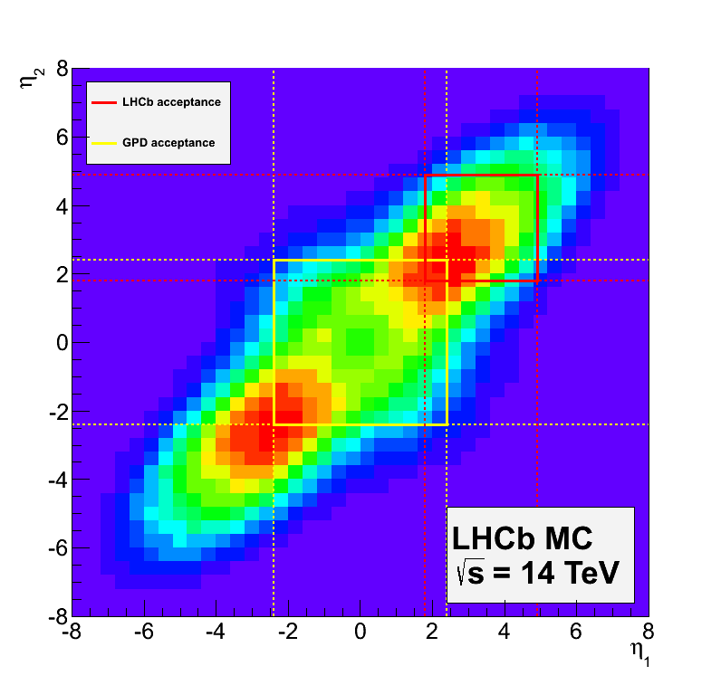
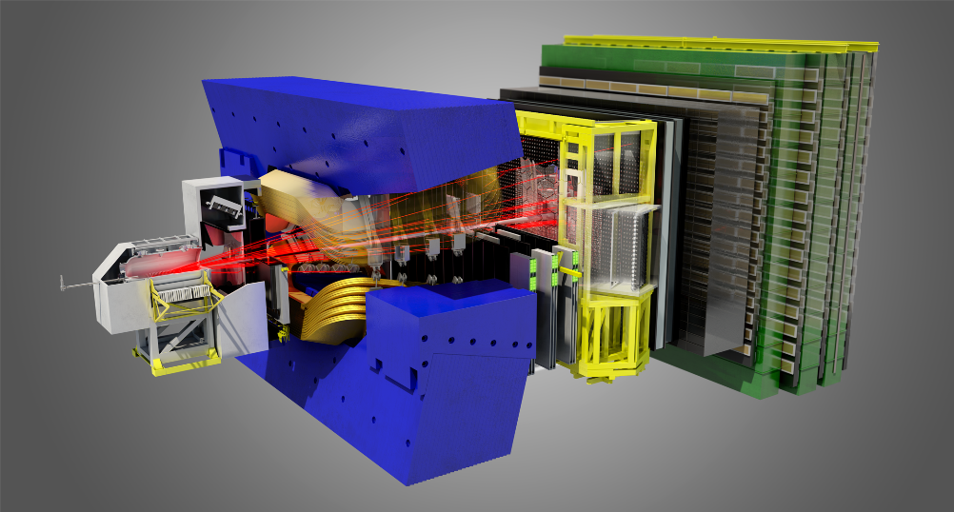
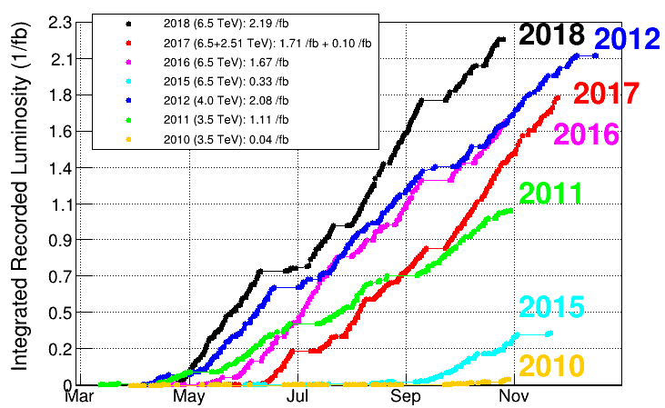
LHCb: the detector and its performances up to Run 2
detector paper:
JINST 3 (2008) S08005
Run 1 performance:
Int. J. Mod. Phys. A30 (2015) 1530022
Run 2 performance:
JINST 14 (2019) P04013
Run 3 performance:
In preparation
single-arm forward spectrometer at the LHC
b anti-b pairs produced
LHCb
η₂
GPD
optimized for beauty and charm physics at 2 < η < 5
η₁
key points:
momentum resolution (σ(p)/p ≈ 0.5 % (low momentum) to 1 % @ 200 GeV/c)
impact parameter resolution (σ(IP) ≈ 15 μm at high p_{T})
primary and secondary vertices reco.
decay time resolution (σ(t) ≈ 50 fs )
‘global’ PID: e / μ / π / K (K id ≈ 95 % π mis-id ≈ 5 %, p < 100 GeV/c)
γ and π⁰ reconstruction
recorded lumi.:
2011→ 2012 (Run 1): 3 /fb
2015 → 2018 (Run 2): 6 /fb

Slide 12
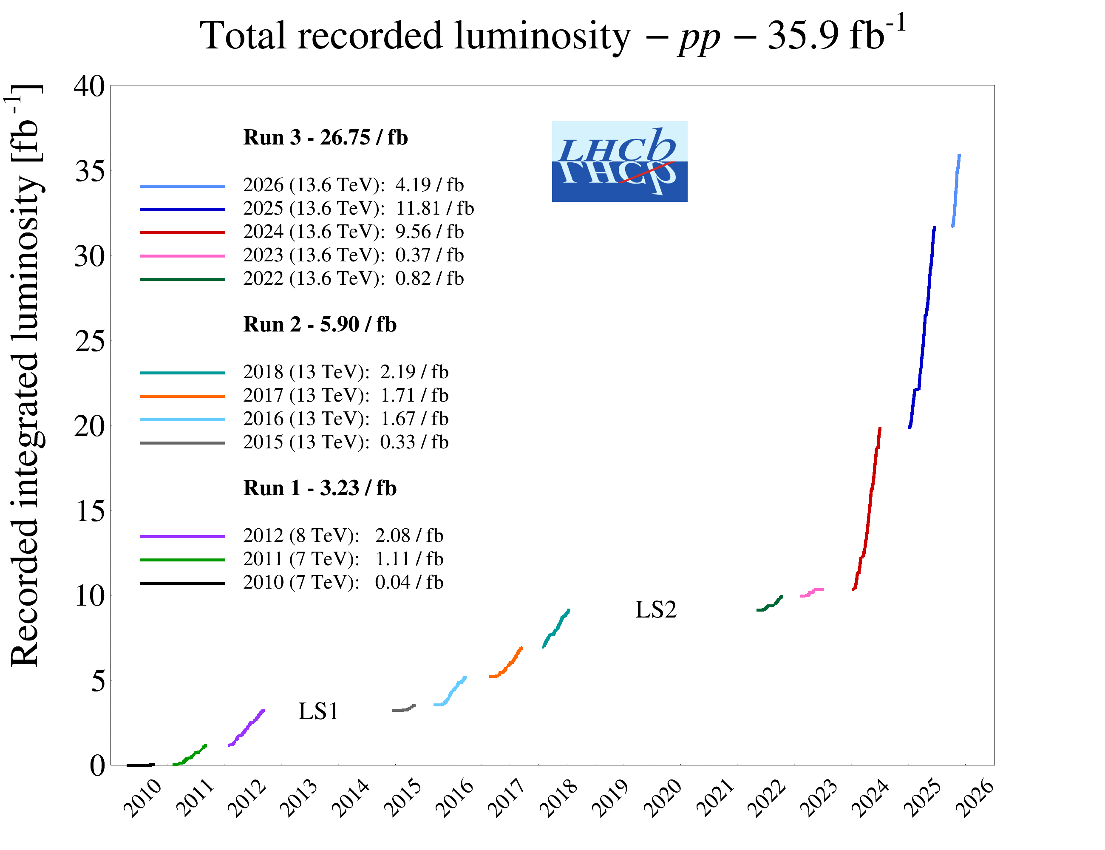
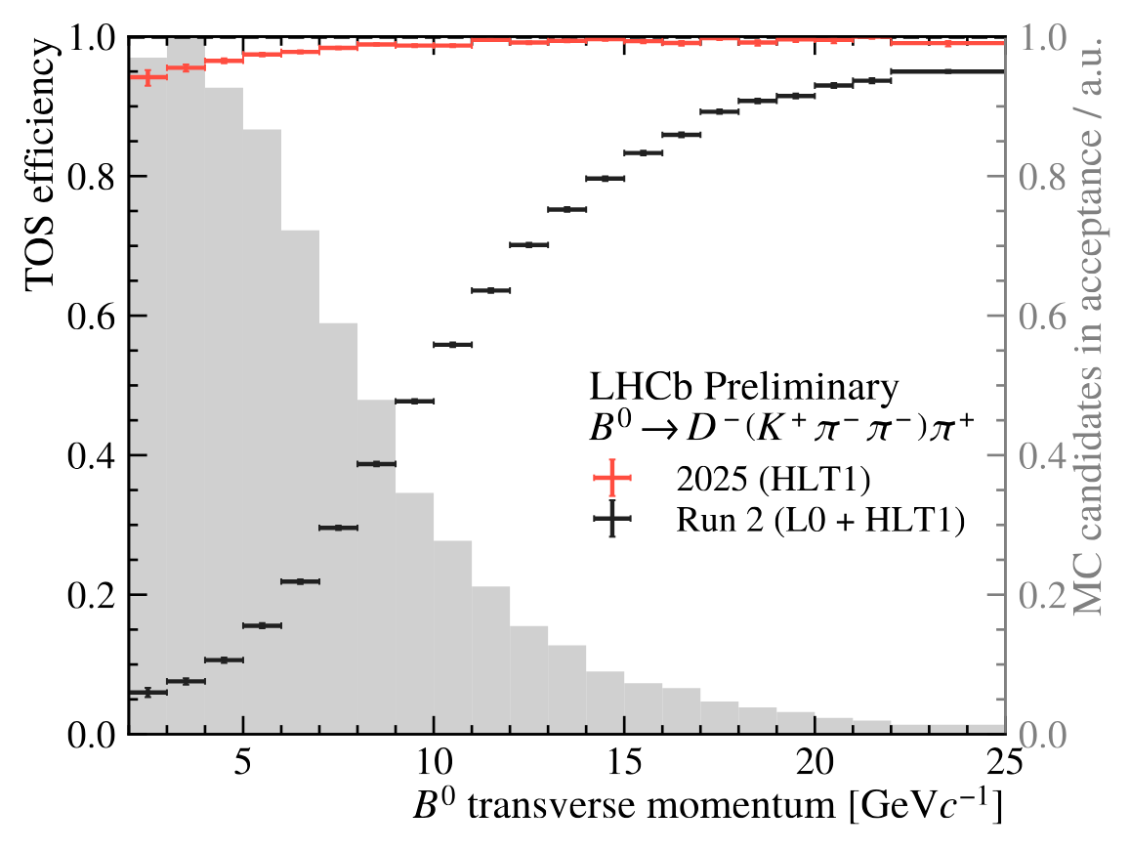
LHCb: the new Run 3 era
https://lbfence.cern.ch/alcm/figure/details/5590
trigger efficiencies for hadronic B decays since 2024 are much more favorable wrt Run 2
yield per luminosity of hadronic B decays in Run 3 are up to 3 times the corresponding Run 2 ones
expect a significant boost in statistic

Slide 13
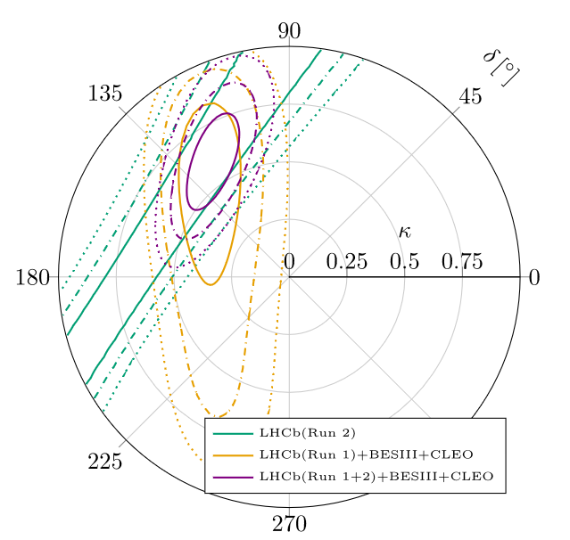
LHCb γ combination: phase of CP violation in charm mixing
[https://arxiv.org/pdf/2510.04963]
coherence factor

Slide 14
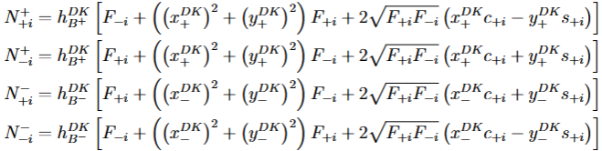
First measurement of γ using Run 3 data:
B⁺ → D h⁺ with D → K⁰_{s} h⁺ h⁻ with h = π or K
[LHCb-PAPER-2026-010]

Slide 15

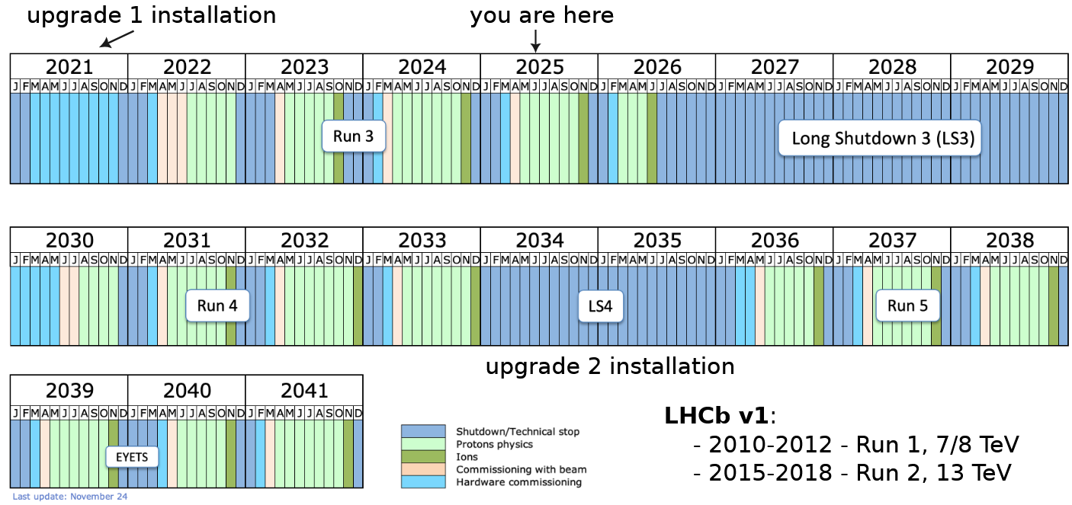
LHC / LHCb schedule up to 2041 …
Difficult to see, the future is

