Slide 1

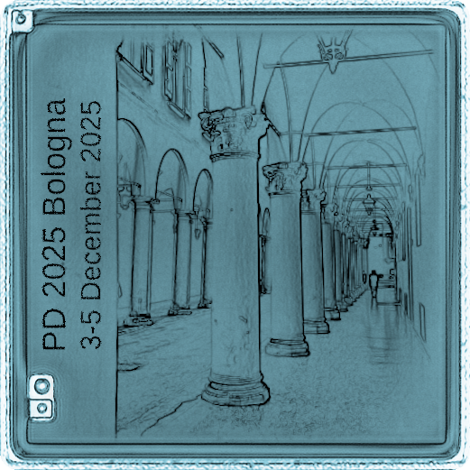


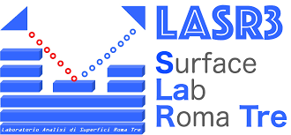
Development of drop-cast
PbS QD detectors – from
X-ray photoresistors to
proton detection
Marco Ruggieri ⁽¹⁾
Andrea Fabbri ⁽¹⁾
Luca Tortora ⁽¹⁾⁽³⁾
Matteo Rapisarda ⁽²⁾
Mattia Scagliotti ⁽²⁾
Francesca Pescosolido ⁽²⁾
Antonio Valletta ⁽²⁾
Muhammad Waqas ⁽¹⁾
Paolo Branchini ⁽¹⁾
INFN Roma Tre, Rome, Italy - (1)
CNR-IMM, Rome, Italy - (2)
Dep. Sciences, Roma Tre Univ., Rome, Italy (3)
7th international workshop on new Photon-Detectors
PD 2025 - 3-5 December 2025 - Bologna, Italy

Slide 2




Outline
Introduction
Solution-processable materials
Quantum dots
Detectors based on QDs
PbS on Silicon
From IR-Vis Devices
Drop-Cast Photodetector
EHD-Jet printed photodetector
From Silicon to PEN
Response to Vis Light
Response to X-rays
Response to Proton Beams
PbS on PEN
…Preliminary!
Conclusions
Marco Ruggieri – INFN Roma Tre
7th international workshop on new Photon-Detectors

Slide 3
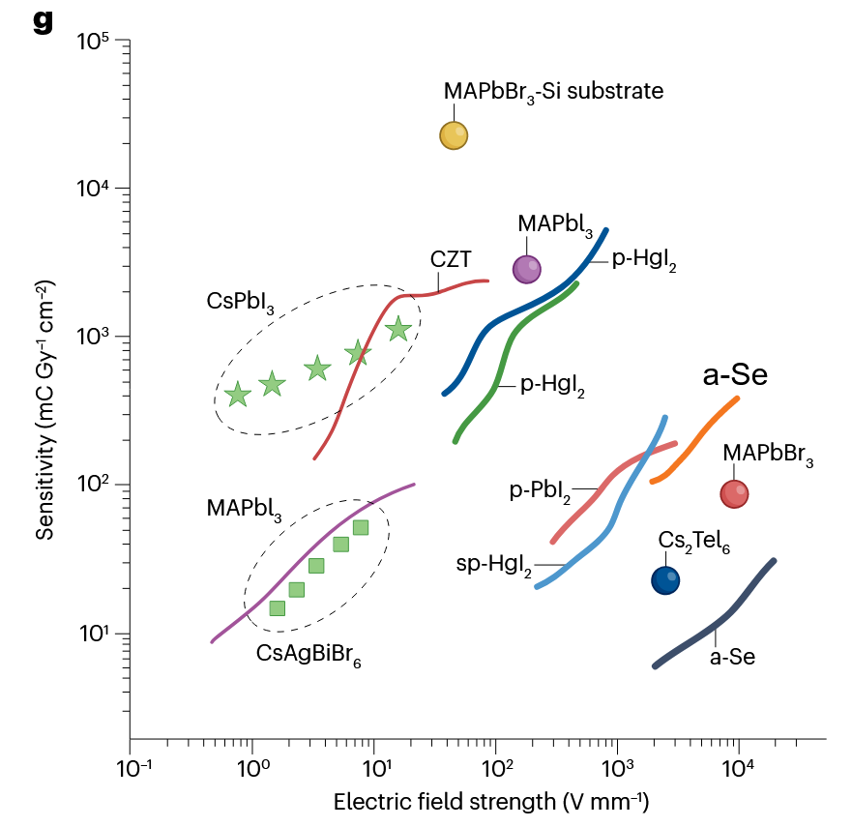
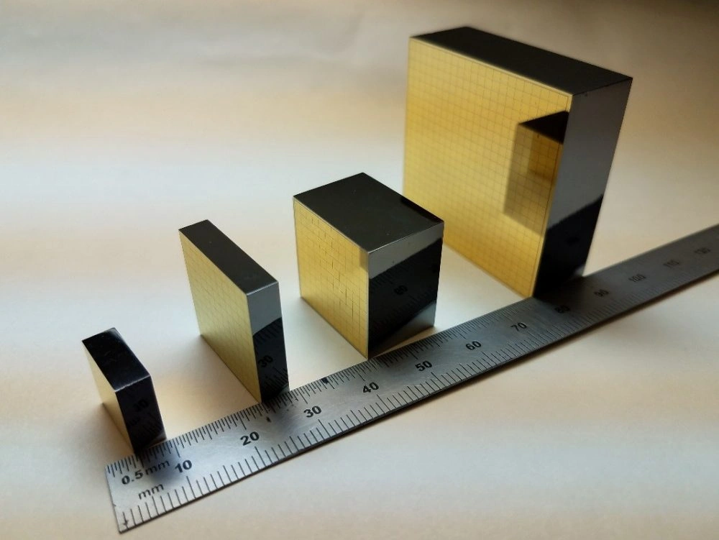

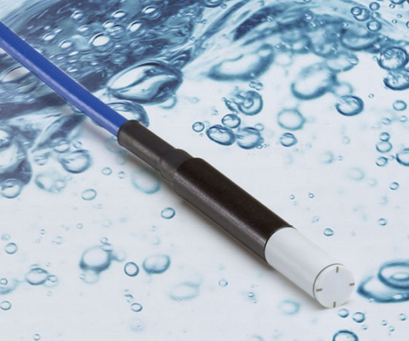
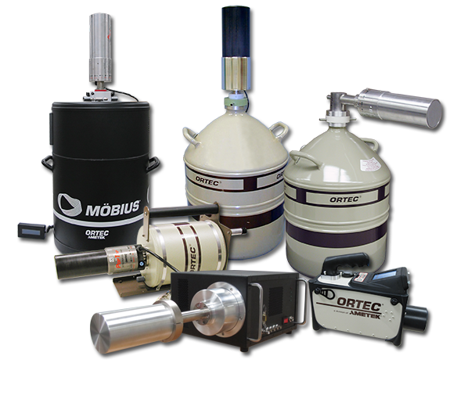

Solution-processable materials
Introduction
CdZnTe
Solid State Semiconductor detectors
Hou, Bo, et al, Nature Reviews Electrical Engineering, 2024
Commercially available Semiconductors offer excellent performance and characteristics!
https://www.kromek.com/czt/
However…
Rigid, brittle
HPGe needs Cryo
Diamond
Expensive
CZT needs High Bias
Solution-processable materials
https://www.ptwdosimetry.com
Lots of research efforts on new materials
Perovskite
Organic Semic.
Quantum Dots
Quantum Dots
HPGe
Inexpensive
Low-power
Bendability
OSC → Tissue Eq.
PVK, QD have High Sensitivity
OSC are Low-Z
Marco Ruggieri – INFN Roma Tre
7th international workshop on new Photon-Detectors

Slide 4
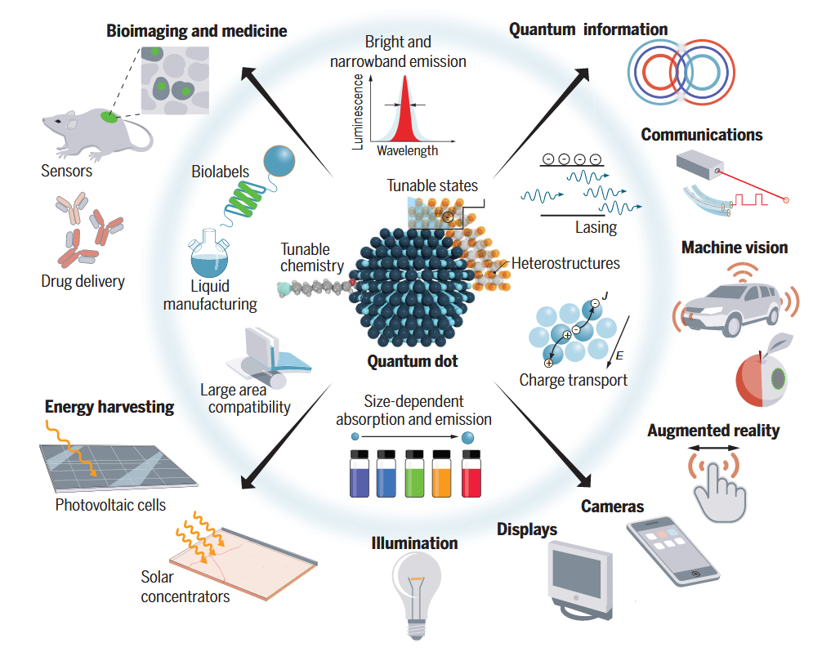
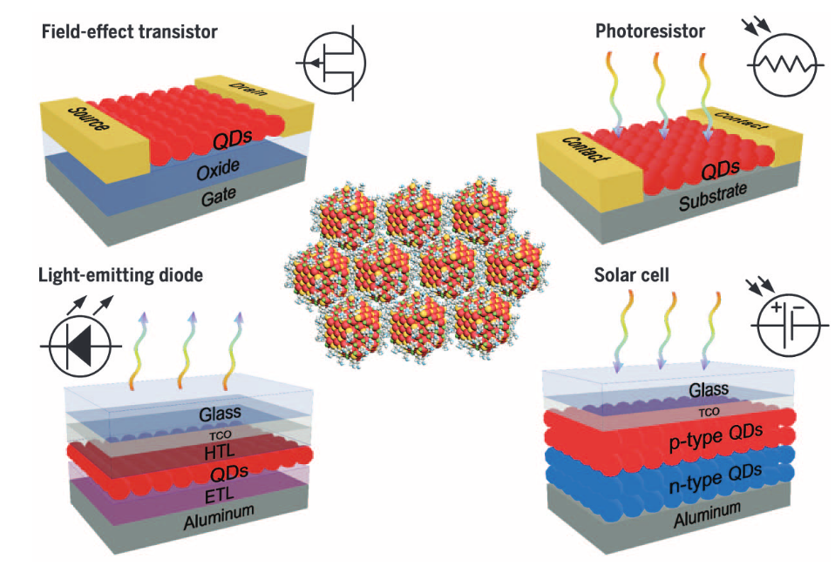
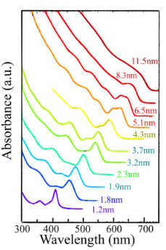
Quantum Dots
Introduction
Colloidal Quantum Dot (QD)
Nanocrystal (2-20 nm) of semiconducting materials that exhibit quantum confinement effects
Solution-processable materials
Size is tunable during synthesis
Size-dependant Optoelectr. Properties
High-Z Materials (PbS, CdTe, PVK…)
Kagan, Cherie R., et al.
Science 2016
Efros, Alexander L., and Louis E. Brus. ACS nano 2021
García de Arquer, F. Pelayo, et al. Science, 2021
Marco Ruggieri – INFN Roma Tre
7th international workshop on new Photon-Detectors

Slide 5
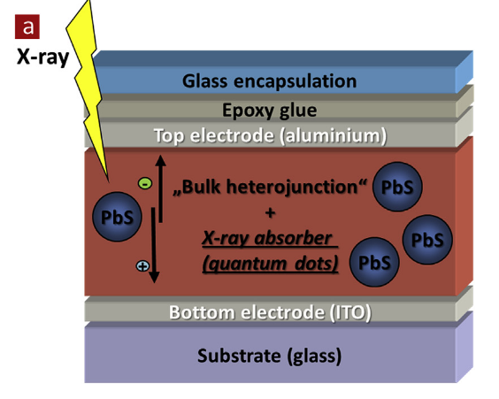
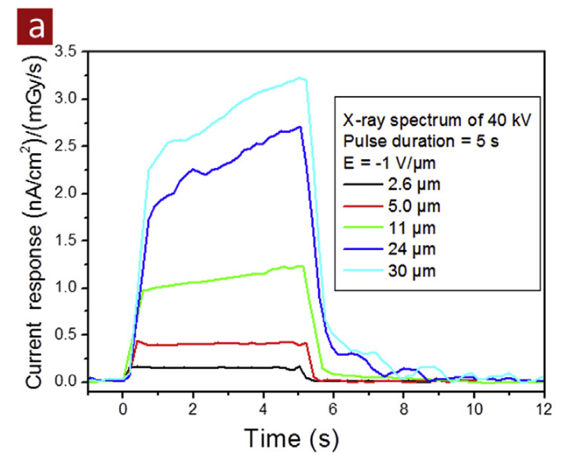
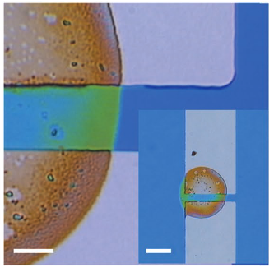
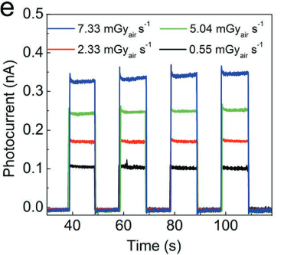
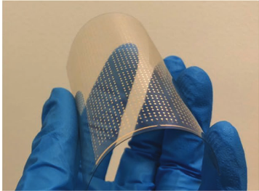
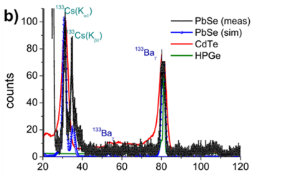
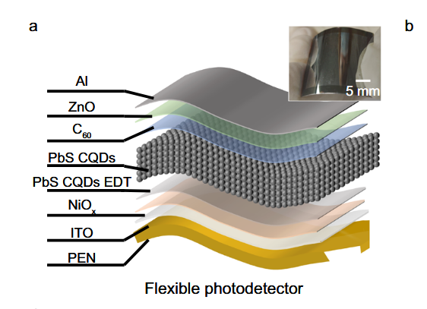
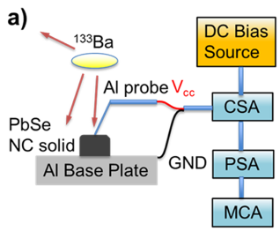
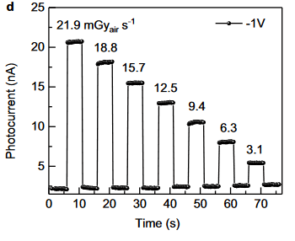
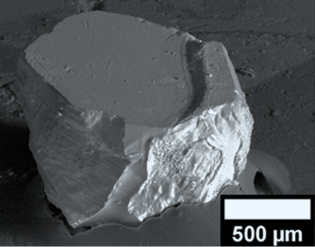
QD-based Detectors
Introduction
Org. Heterojunct. PbS QD Detector
Flexible printed PVK QD detector
Liu, Jingying, et al,
Advanced Materials, 2019
Ankah, G. N., et al.
Organic Electronics, 2016
Spectrometry with PbSe QD solids
Wide-band (IR-X) PbS QD photodiodes
Davis, Brandon J., and Mark D. Hammig.
ACS Applied Nano Materials. 2021
Liu, Jing, et al.
Nature Communications, 2023
Marco Ruggieri – INFN Roma Tre
7th international workshop on new Photon-Detectors

Slide 6
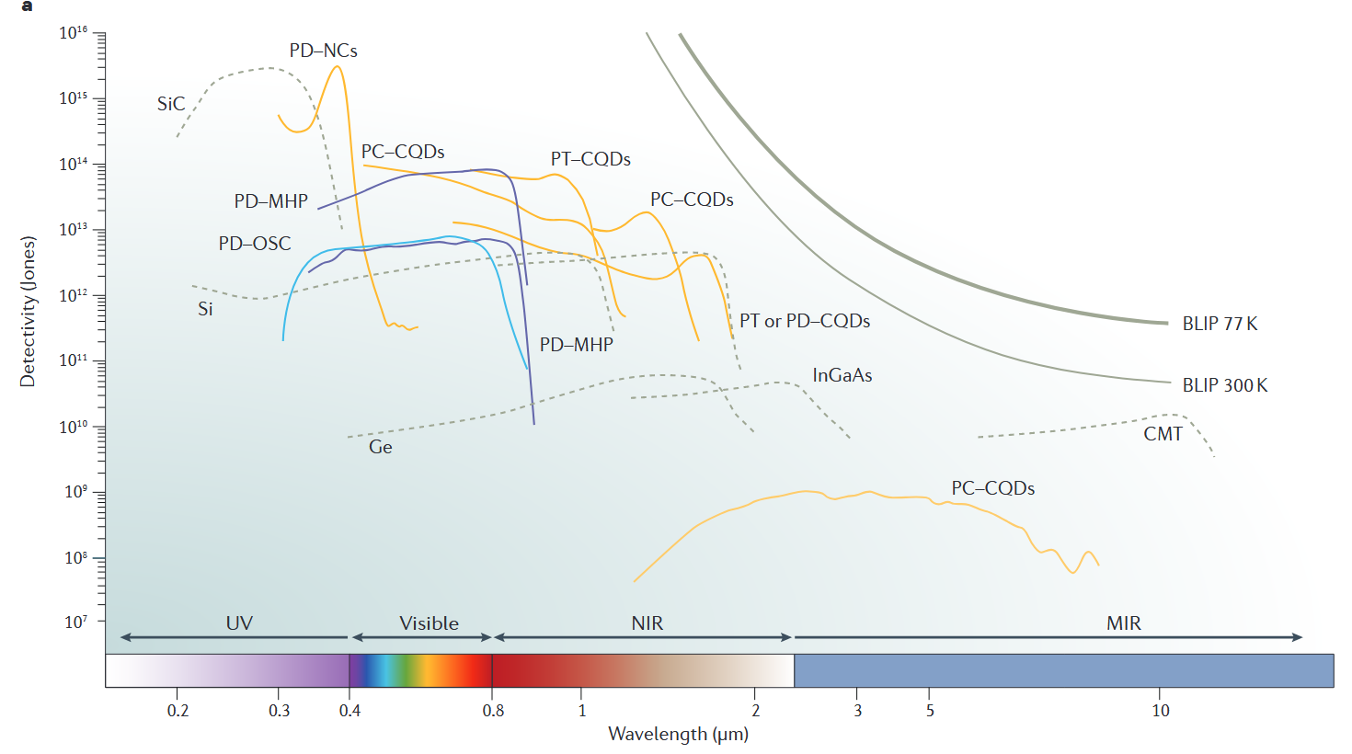
From IR-Vis Devices
PbS on Silicon
García de Arquer, F. Pelayo, et al., Nature Reviews Materials, 2017
Marco Ruggieri – INFN Roma Tre
7th international workshop on new Photon-Detectors

Slide 7
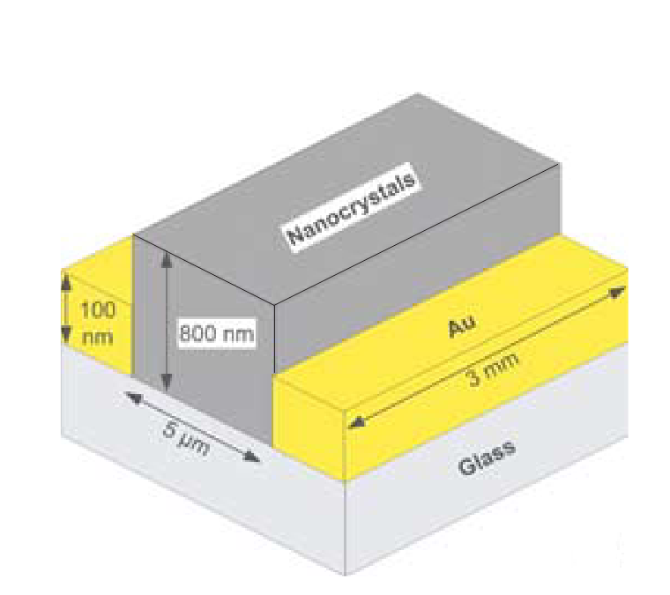
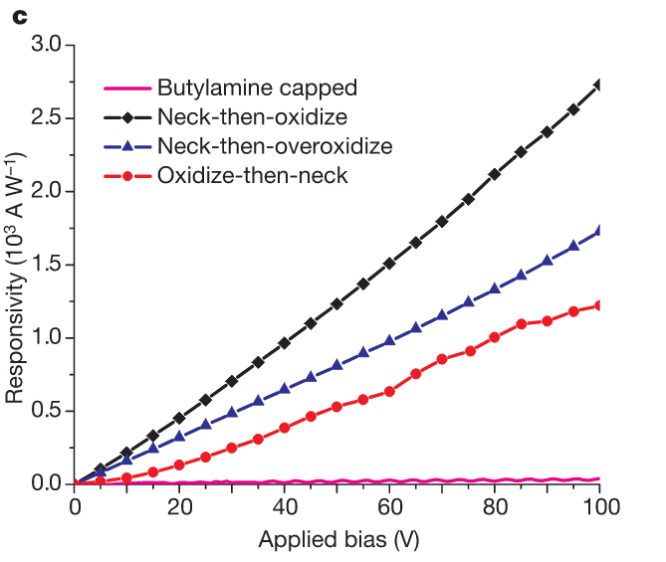



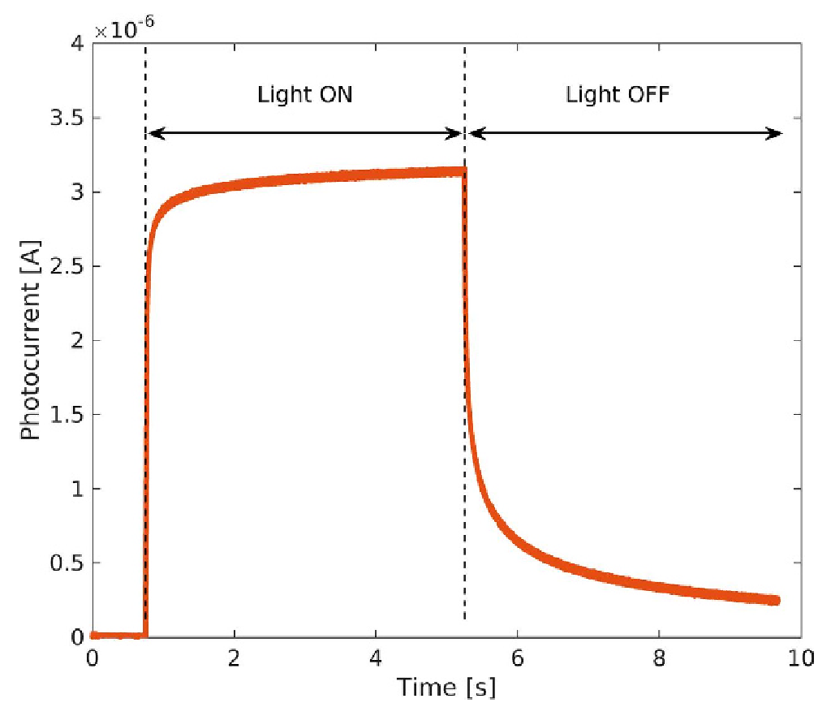
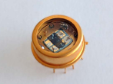

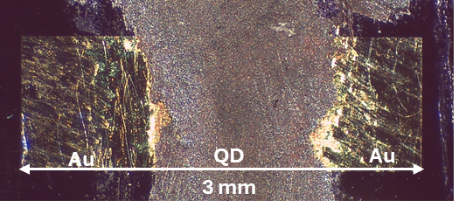
From IR-Vis Devices
PbS on Silicon
PbS QD IR-Vis Photoconductors
Some first, old results (2006) – 10V
Ligand Exchange
Solution-Processed (QD + ligands + solvents)
Layer-by-layer deposition
Photoconductive gain emerges from defects
Stable in air @ RT
Shorter surface ligands promote charge-transfer between QDs → Conductivity increases with decreasing QD distance
Konstantatos,
Gerasimos, et al.
Nature 2006
Ligand
Exchange
Drop
Casting
Butylamine
1.
2.
PbS
3.
But
Au
Au
Au
Au
Low-Power (1V) PbS QD photocond. (2016)
Si
Si
Repeat until
Enough material
5.
PbS
4.
Au
Au
48h
Oxidation
Si
De Iacovo, Andrea, et al. Scientific report, 2016
MeOH
Au
Au
Si
Marco Ruggieri – INFN Roma Tre
7th international workshop on new Photon-Detectors

Slide 8
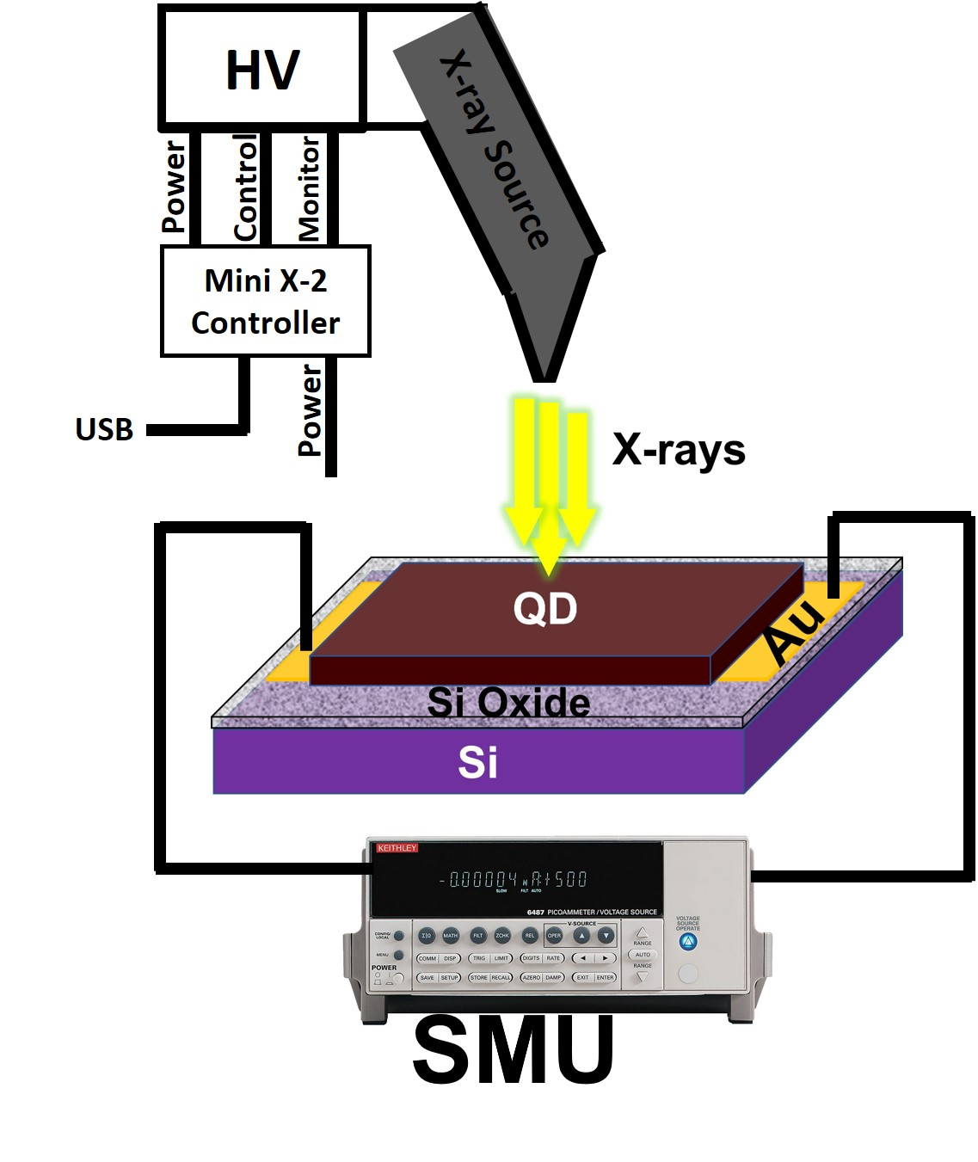
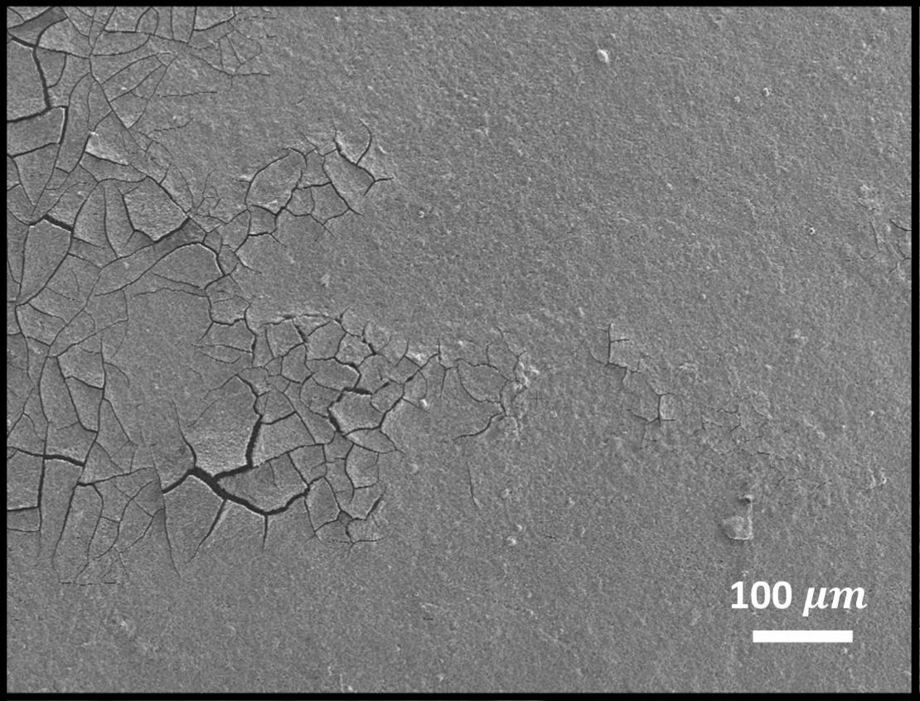
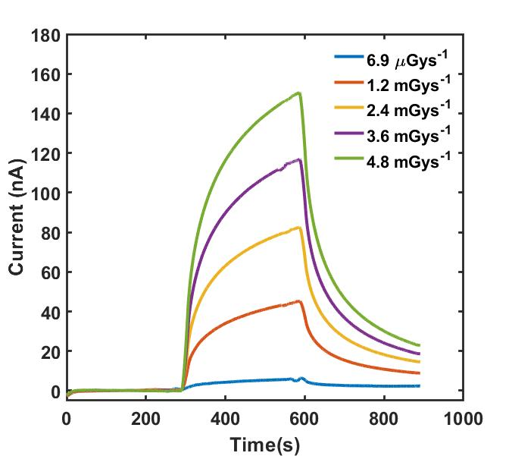
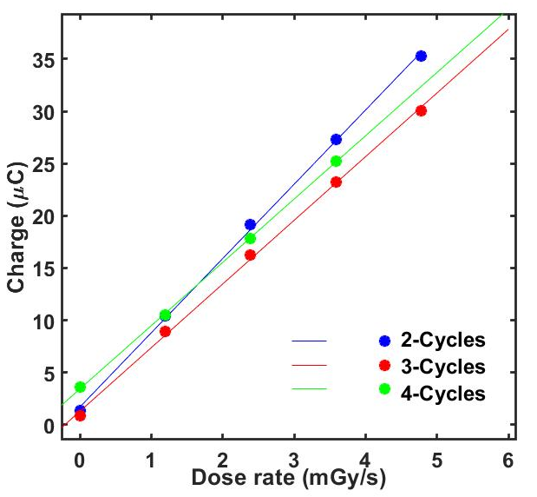
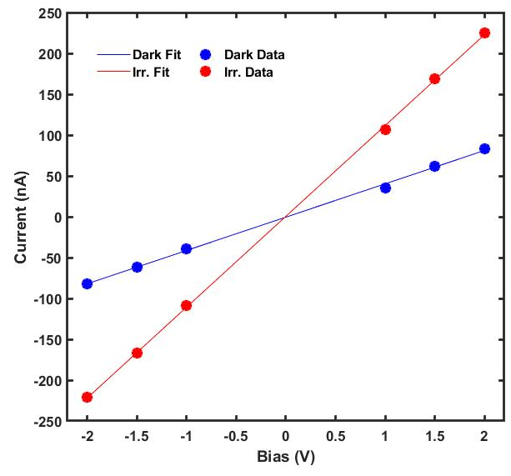


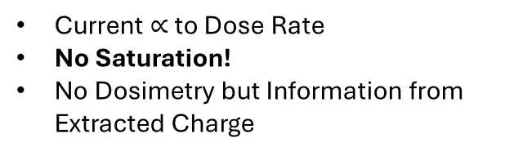
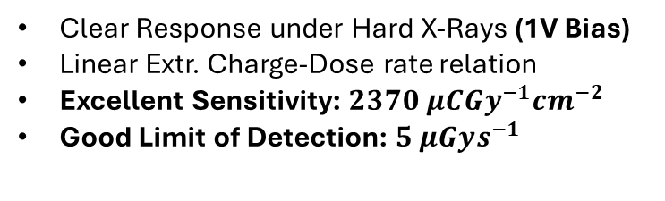
Drop-Cast Photodetector
PbS on Silicon
Drop-Casting
Surface Char.
Slowed down evaporation of solvent
From 2 to 4 cycles of deposition
Uniform coverage of contacts
Uniform topography (SEM)
Fissures and flaking
Presence of OA and But. (ATR-FTIR)
X-ray Response
Dosimetry?
Clear Response under Hard X-Rays (1V Bias)
Linear Extr. Charge-Dose rate relation
Excellent Sensitivity: $2370 μCGy^{−1}cm^{−2}$
Good Limit of Detection: $5 μGys^{−1}$
Current $∝$ to Dose Rate
No Saturation!
No Dosimetry but Information from Extracted Charge
Ruggieri, et al., ACS Applied Electronic Materials - 2023
Photocurrent
Charge-Dose rate
I-V Plot
X-Ray ON
$$S∼ 2.3∗{10}^{3}$$
$$μCGy^{−1}cm^{−2}$$
X-ray Tube
Silver Anode (22 keV $K_{α}$)
Operated at 50kV
Dose rate controlled through Tube Current
Ref. Detector
Boron-doped Diamond
1 nC/Gy Linear Response
No Bias required
Marco Ruggieri – INFN Roma Tre
7th international workshop on new Photon-Detectors

Slide 9
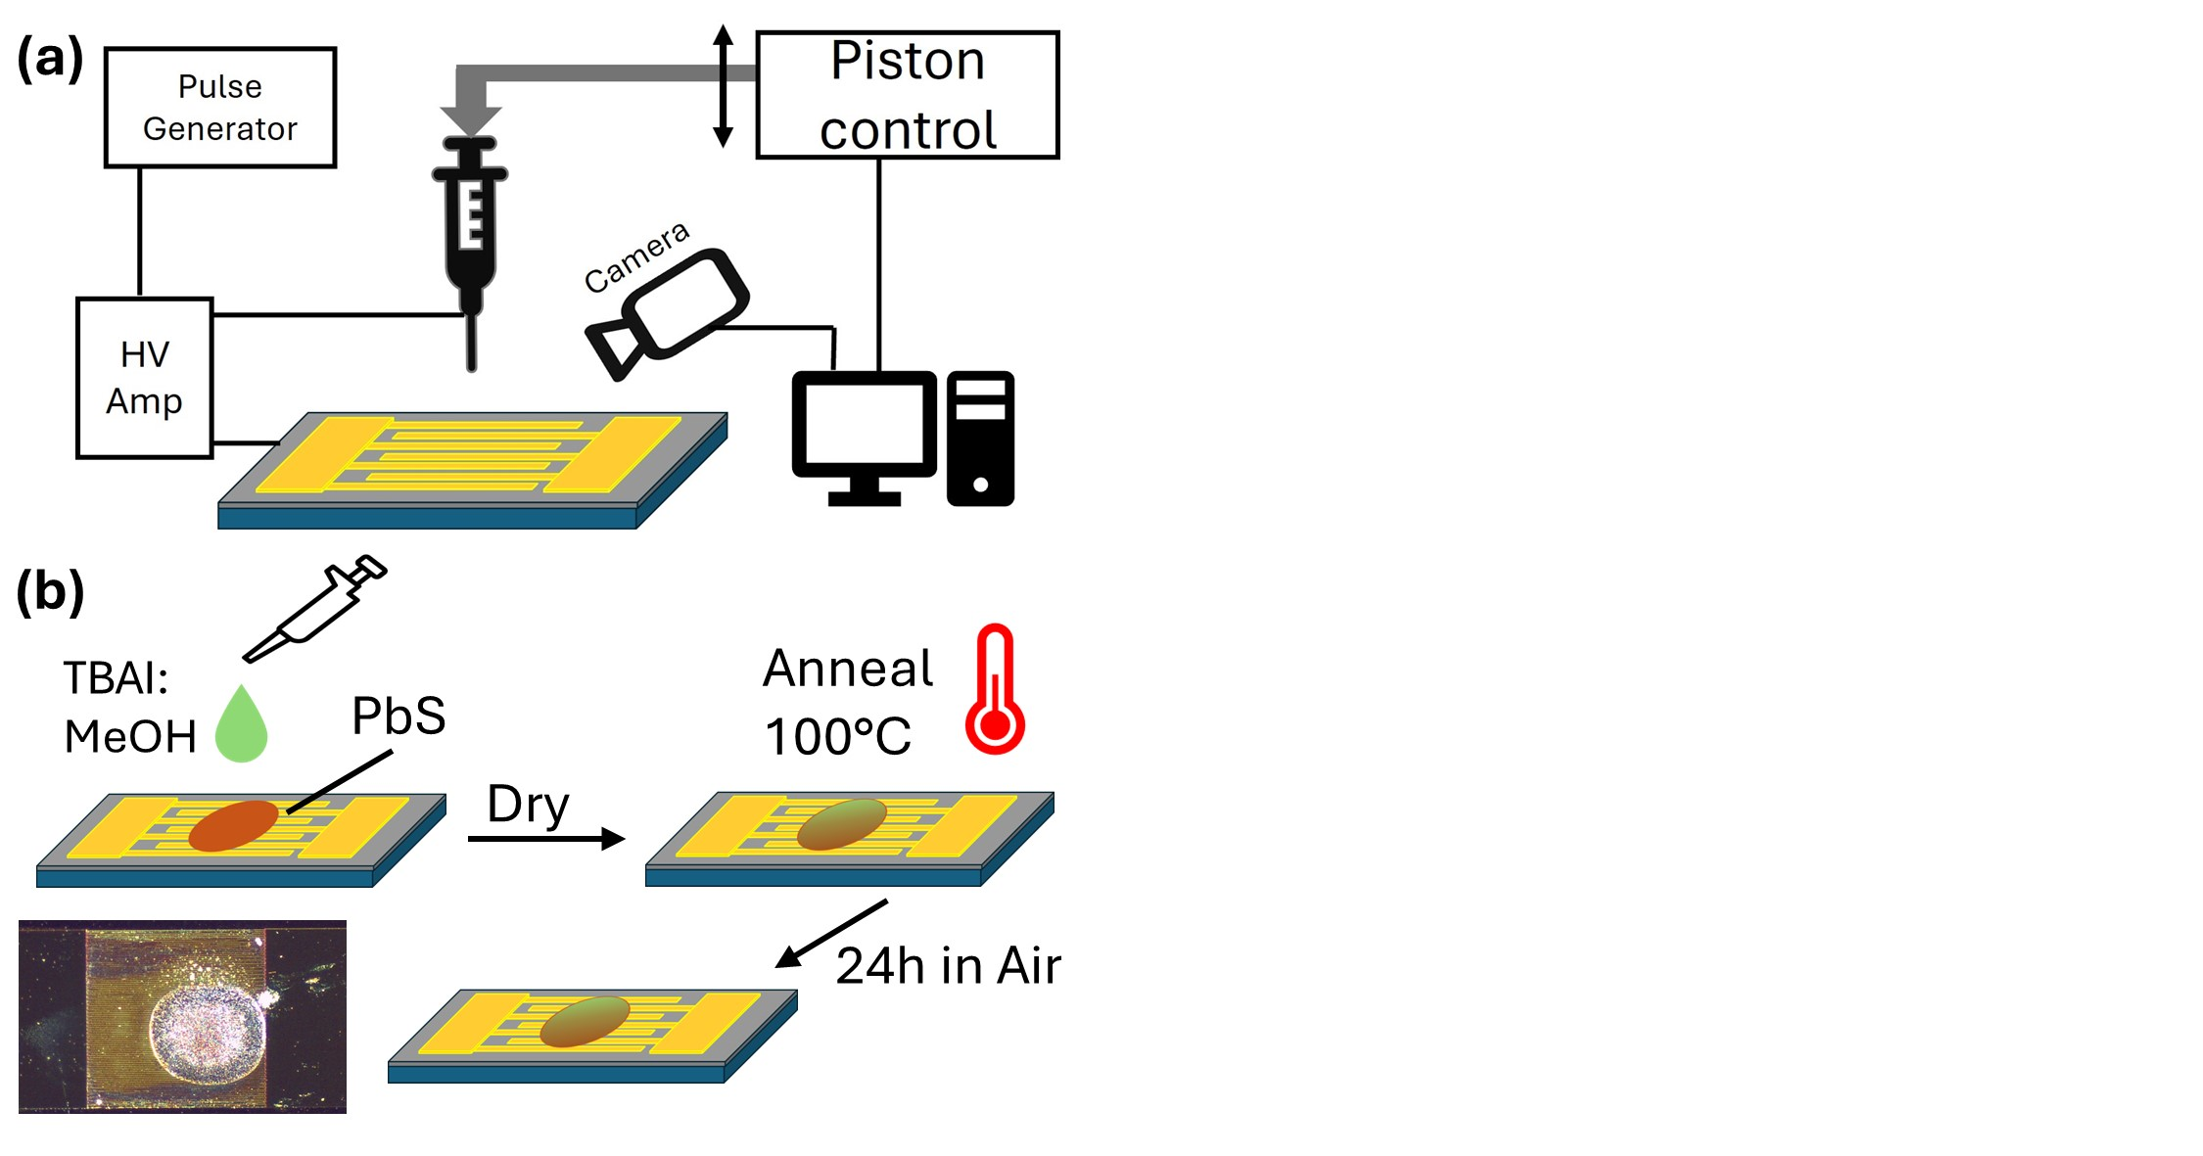
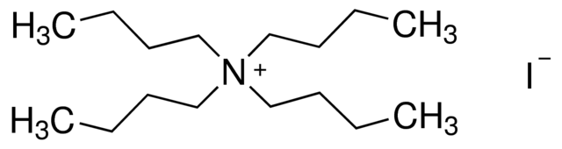
EHD-J Printed Photodet.
PbS on Silicon
2.
Ligand Exchange
Improves carrier transport
Performed in air
Using TBAI
Tetrabutylammonium Iodide
1.
Electrohydrodynamic Jet
Printing
Droplet formation through High Voltage
Drop-on-Demand
Patterning capabilities
Marco Ruggieri – INFN Roma Tre
7th international workshop on new Photon-Detectors

Slide 10
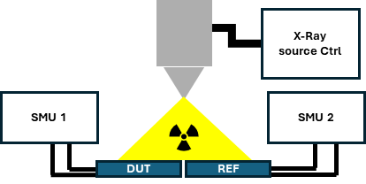
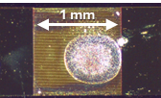
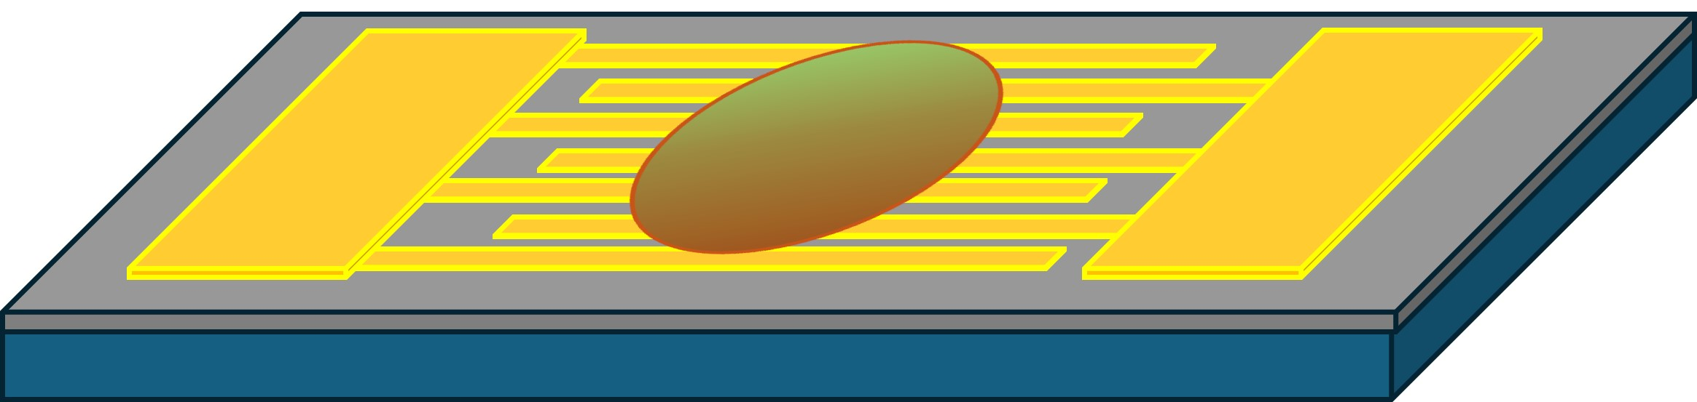
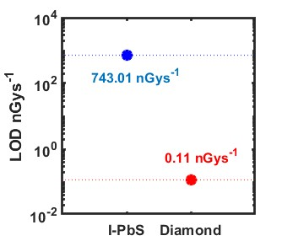
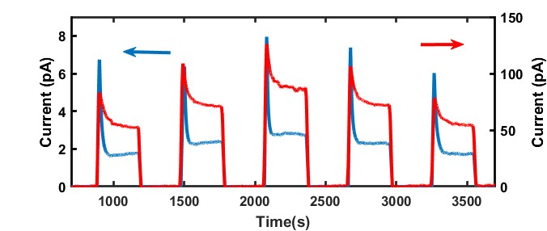
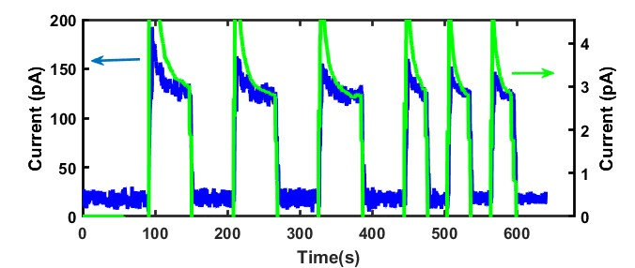

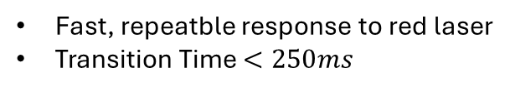
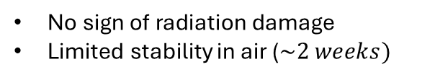
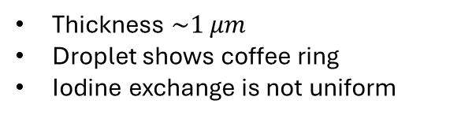
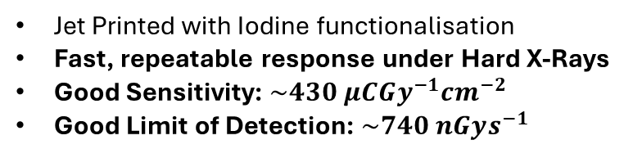
EHD-J Printed Photodet.
PbS on Silicon
Surface Char.
X-ray Response
Thickness $\sim 1 μm$
Droplet shows coffee ring
Iodine exchange is not uniform
Jet Printed with Iodine functionalisation
Fast, repeatable response under Hard X-Rays
Good Sensitivity: $\sim 430 μCGy^{−1}cm^{−2}$
Good Limit of Detection: $\sim 740 nGys^{−1}$
Response to Vis
Fast, repeatble response to red laser
Transition Time $<250ms$
Stability
No sign of radiation damage
Limited stability in air ($\sim 2 weeks)$
Ruggieri, et al., ACS Applied Electronic Materials – 2025
Sensitivity
LoD
X-Ray Irradiation
$$S=431±30 μCGy_{air}^{−1}cm^{−2}$$
QD
Ref
QD
95uA
Tube Current
35uA
65uA
65uA
Diam. Current (pA)
QD Current (pA)
35uA
Ref
X-ray Irradiation (60s & 30s pulses)
QD
Ref
QD Current (pA)
Diam. Current (pA)

Slide 11
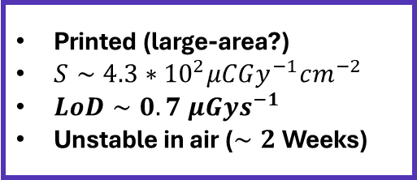
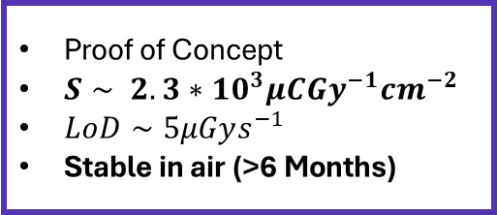
Summing up on Silicon…
PbS on Silicon
Drop-Cast Detector
Proof of Concept
$S∼ 2.3∗{10}^{3}μCGy^{−1}cm^{−2}$
$LoD∼5μGys^{−1}$
Stable in air (>6 Months)
Drop-Cast
EHD-Jet
EHD-Jet Printed Detector
Printed (large-area?)
$S∼4.3∗{10}^{2}μCGy^{−1}cm^{−2}$
$LoD∼0.7 μGys^{−1}$
Unstable in air ($∼2$ Weeks)
Most data from:
Basiricò et al. Advanced Materials Technologies, 2021
Basiricò, Laura, et al. Advanced Materials Technologies 6.1 (2021): 2000475.
Marco Ruggieri – INFN Roma Tre
7th international workshop on new Photon-Detectors

Slide 12

From Silicon to PEN
PbS on PEN
…Preliminary!
Fabrication of PbS QD photodetector on PEN
Current Objective
Photodetection of
X-ray Radiation
First test of response to proton beams
Marco Ruggieri – INFN Roma Tre
7th international workshop on new Photon-Detectors

Slide 13
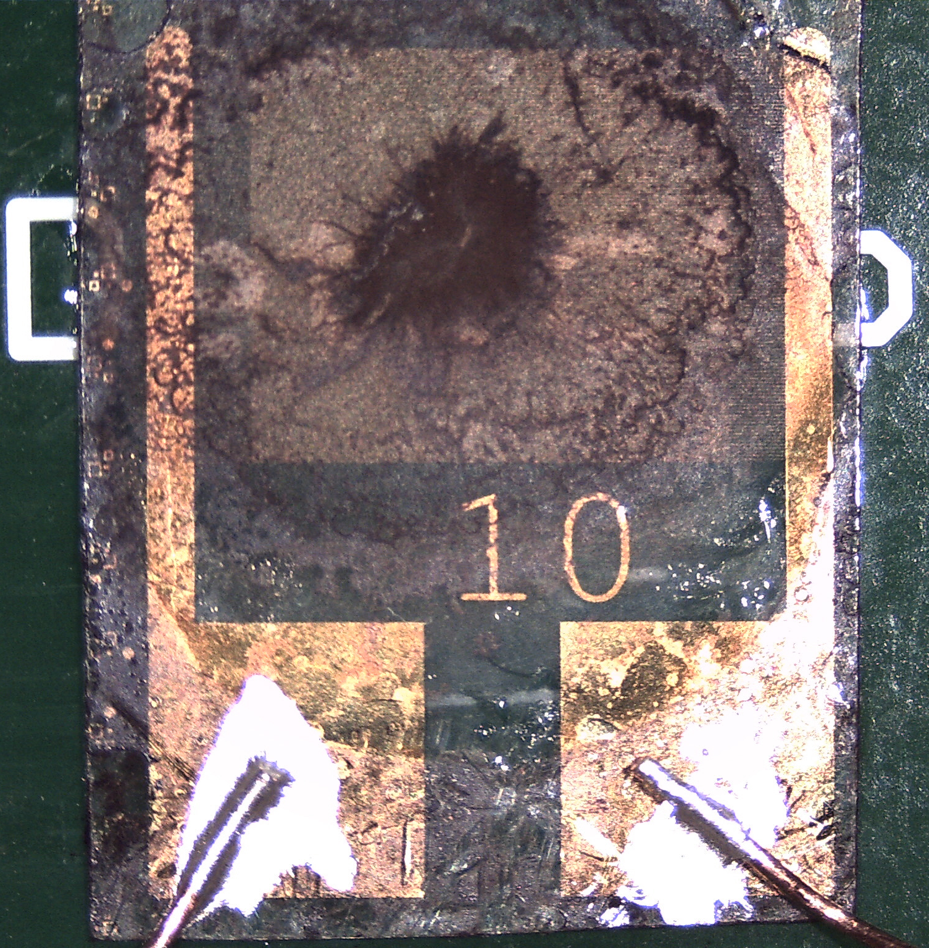
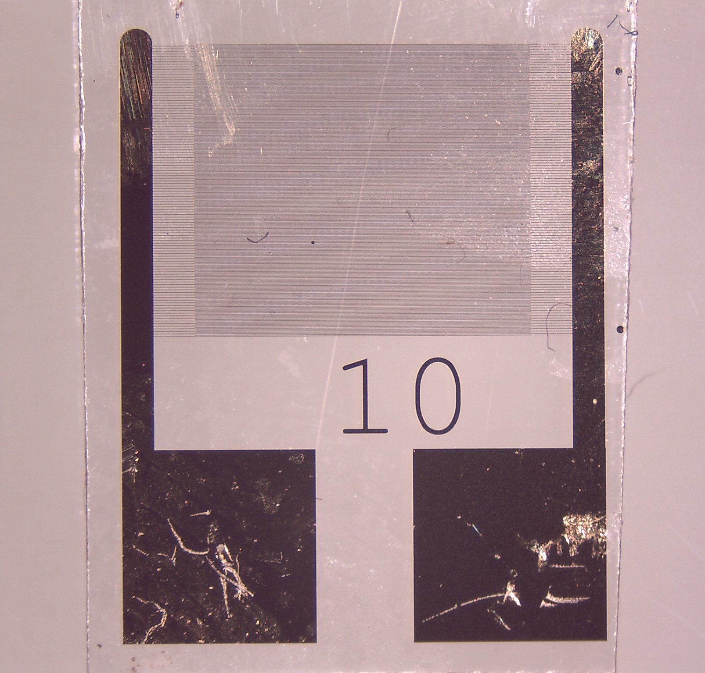
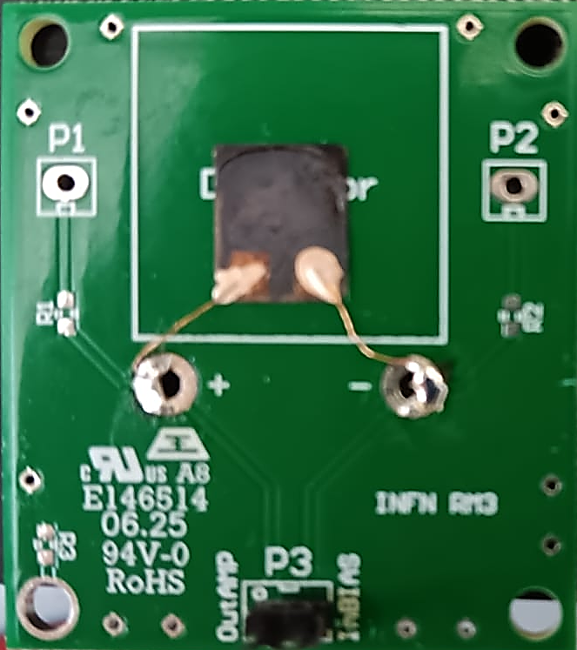
From Silicon to PEN
PbS on PEN
Using the PbS on Silicon Recipe
Improved Recipe for PEN
Same procedure as on Si
Extremely random coverage
Samples hold little amount of material
Samples are always different!
Using Surface Tension to hold PbS Droplet
Casting PbS droplets until complete coverage
One final Ligand Exchange and MeOH
Improved coverage and thickness!
Drop
Casting
2.
PbS
1.
3.
PatternedPEN
On Si
Recipe
Improved
Recipe
PbS
Au
Au
Au
Au
Au
Au
PEN
PEN
PEN
Repeat until
Enough material
4.
5.
PbS
Butylamine → MeOH → Oxid.
PbS
Au
Au
Au
Au
PEN
PEN
Marco Ruggieri – INFN Roma Tre
7th international workshop on new Photon-Detectors

Slide 14





Resp. to Vis Light
PbS on PEN
Photoconductor behaviour
Typical $R_{Dark} ≈1−10 MΩ$
Low Power: $V_{Bias}=1 V$
Benchmark using Vis Light Detection.
Better Response to Vis → Better Response to X-rays
Preliminary
Preliminary
On PEN - Photocurrent observed without bias – Still under Investigation!
Preliminary
Preliminary
Marco Ruggieri – INFN Roma Tre
7th international workshop on new Photon-Detectors

Slide 15





Resp. to X-rays
PbS on PEN
X-ray Tube (Co anode $\sim 6.9 keV$)
Direct Photodetector Behaviour ($V_{Bias}=1 V$)
Linear I-V Char. In Dark and under X-rays
Long Rise and Fall times
Linear Charge-Rad. Intensity Characteristic
No sign of radiation induced damage
$$\frac{{I_{X}}_{ray}}{I_{dark}}\sim 5$$
Tube
Current
However…
X-Ray ON
$$Q(t_{1},t_{0})= \int_{t_{0}}^{t_{1}}{I\left(t\right)−I_{dark}dt}$$
Collected Charge $(μC)$
Marco Ruggieri – INFN Roma Tre
7th international workshop on new Photon-Detectors

Slide 16




Resp. to Proton Beams
PbS on PEN
Very
Premilinary
Irradiated with constant beam of protons in TIFPA (Trento) Exp. Line
No Bias! $V_{Bias}=0 V$
Linear with proton current $>40nA$
Higher $I_{DUT}$ in Run II
No failure of the detector
RUN I
RUN II
Preliminary
Preliminary
The authors gratefully acknowledge Dr. Anna Bianchi (INFN-LNL) and the ATOMIQA project for providing valuable time during their concurrent experimental campaign
Marco Ruggieri – INFN Roma Tre
7th international workshop on new Photon-Detectors

Slide 17
Conclusions
Summing Up
Lead Sulfide QD-based detectors were fabricated and tested
Two Techniques: Drop-casting and EHD-Jet printing
Currently working to optimise transfer on plastic (PEN) substrates
First test with proton irradiation
In Conclusion
PbS on Silicon offers high sensitivity and good stability
Still very slow!
Transfer to PEN is successful! Very similar characteristics
Proportional response to proton beam current variation
Future Objectives
Characterisation on PEN still underway
Investigate proton detection capabilities
Radiation Hardness study
Marco Ruggieri – INFN Roma Tre
7th international workshop on new Photon-Detectors

Slide 18
Development of drop-cast PbS QD detectors – from X-ray photoresistors to proton detection
Thank you!
Marco Ruggieri ⁽¹⁾
Andrea Fabbri ⁽¹⁾
Luca Tortora ⁽¹⁾⁽³⁾
Matteo Rapisarda ⁽²⁾
Mattia Scagliotti ⁽²⁾
Francesca Pescosolido ⁽²⁾
Antonio Valletta ⁽²⁾
Muhammad Waqas ⁽¹⁾
Paolo Branchini ⁽¹⁾
INFN Roma Tre, Rome, Italy - (1)
CNR-IMM, Rome, Italy - (2)
Dep. Sciences, Roma Tre Univ., Rome, Italy (3)
7th international workshop on new Photon-Detectors
PD 2025 - 3-5 December 2025 - Bologna, Italy

Slide 19
Development of drop-cast PbS QD detectors – from X-ray photoresistors to proton detection
Backup
Marco Ruggieri ⁽¹⁾
Andrea Fabbri ⁽¹⁾
Luca Tortora ⁽¹⁾⁽³⁾
Matteo Rapisarda ⁽²⁾
Mattia Scagliotti ⁽²⁾
Francesca Pescosolido ⁽²⁾
Antonio Valletta ⁽²⁾
Muhammad Waqas ⁽¹⁾
Paolo Branchini ⁽¹⁾
INFN Roma Tre, Rome, Italy - (1)
CNR-IMM, Rome, Italy - (2)
Dep. Sciences, Roma Tre Univ., Rome, Italy (3)
7th international workshop on new Photon-Detectors
PD 2025 - 3-5 December 2025 - Bologna, Italy

Slide 20


Quantum Dots

Slide 21




Resp. to Vis Light
PbS on PEN
NO BIAS
Increasing light intensity
Current (au)

Slide 22





Resp. to Proton Beams
PbS on Si + Epoxy
Drop-Cast PbS QD
Preliminary test of Proton Detection by PbS QD with an Epoxy conversion layer
SRIM Simulation

Slide 23


Resp. to e Beams
PbS on Si
Detection near
Single shot
Electron beam
Au
QD
Au
3 mm

