Slide 1
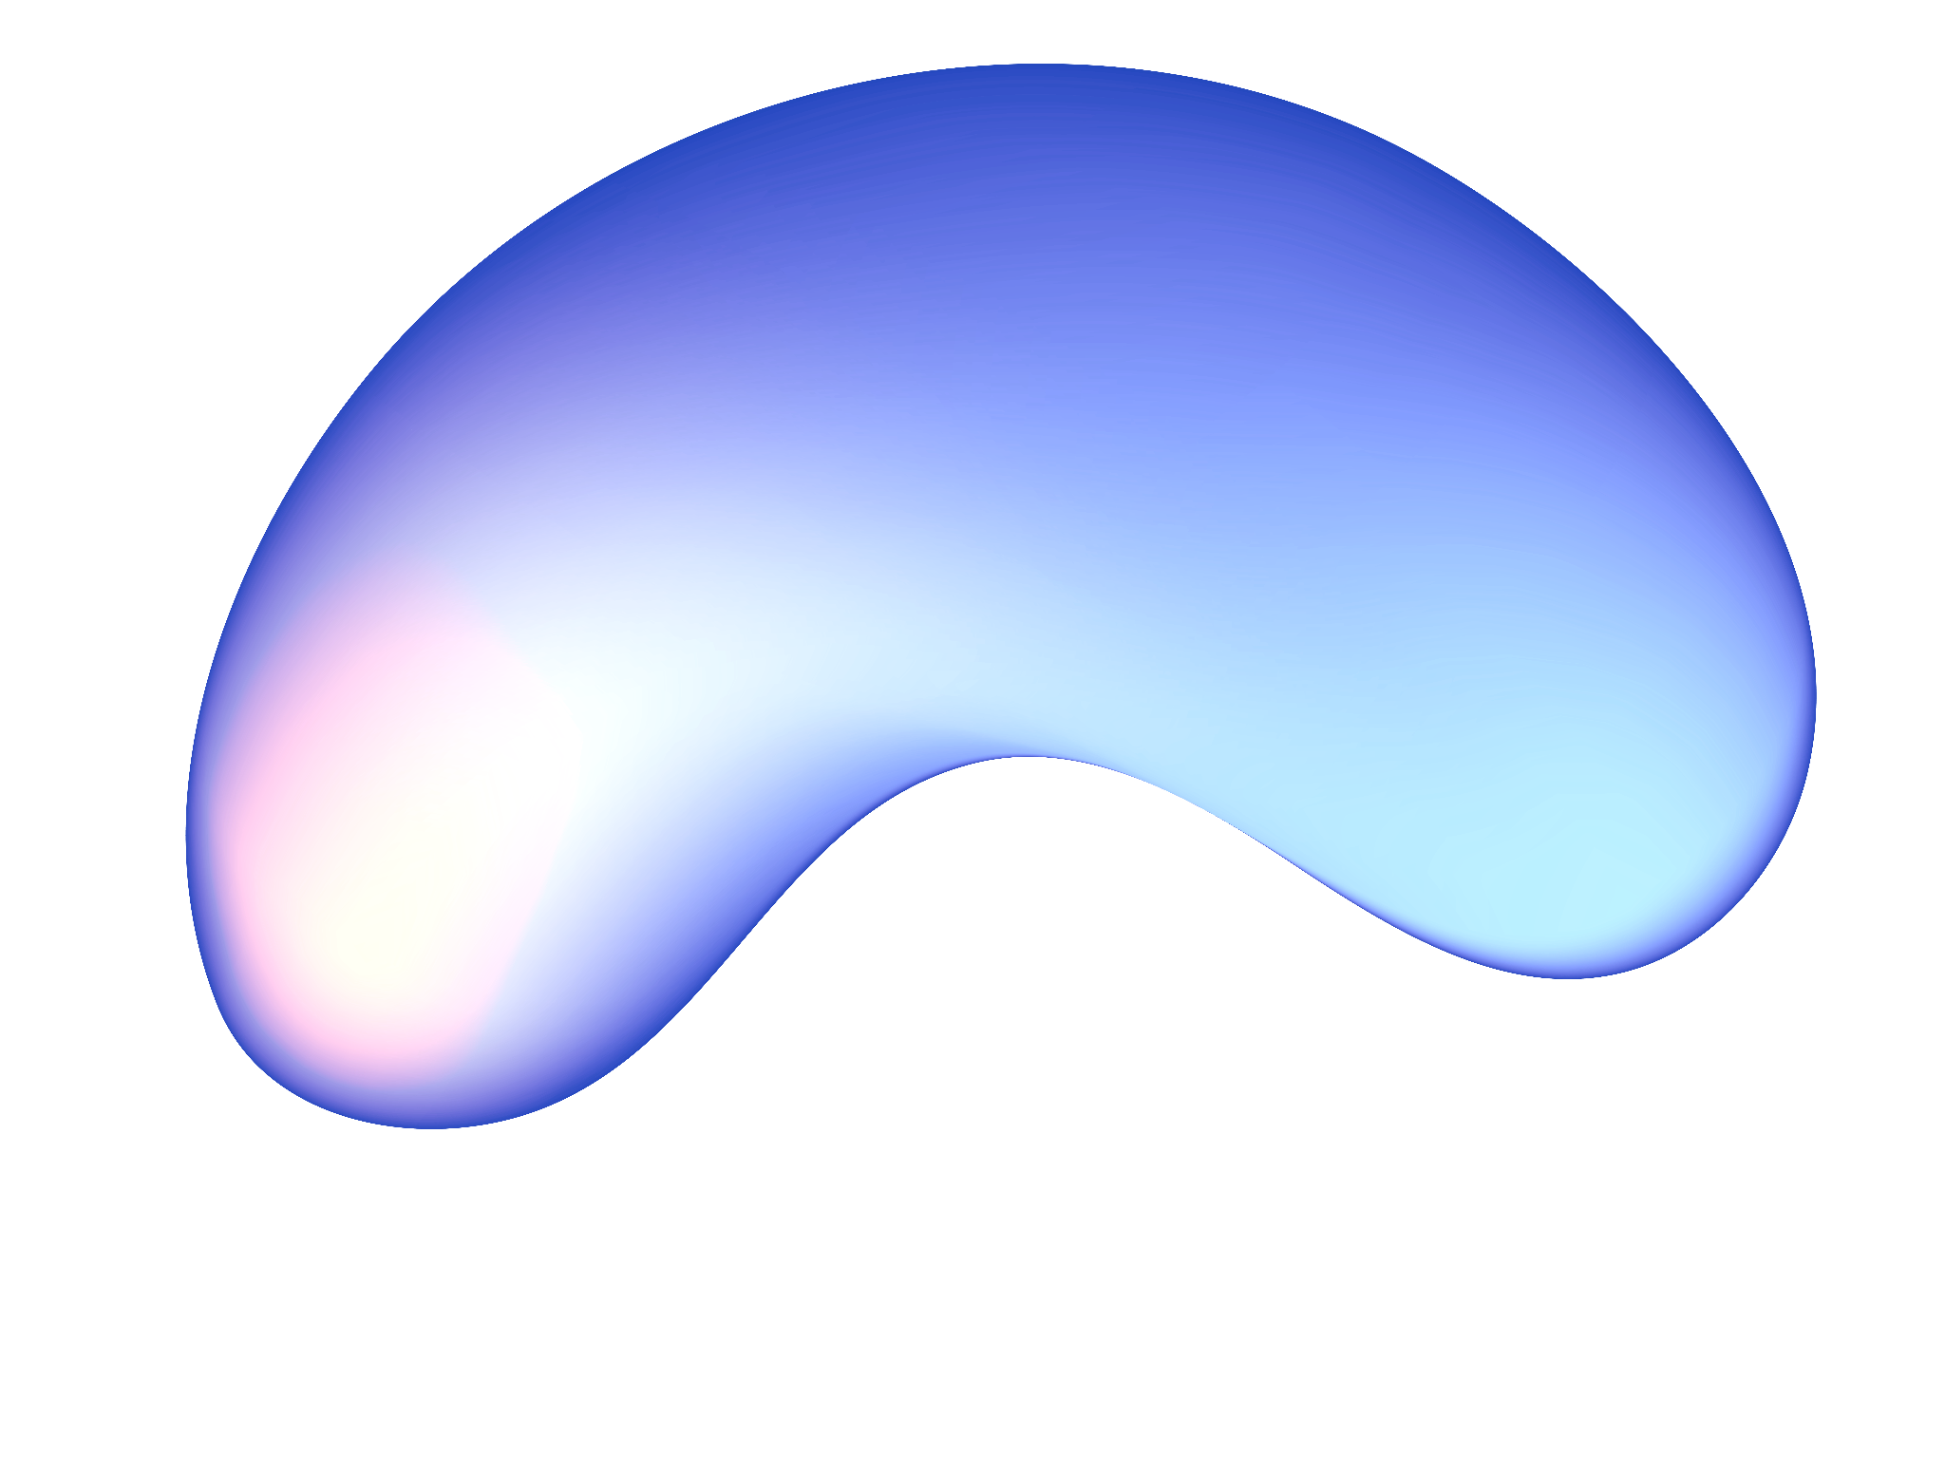
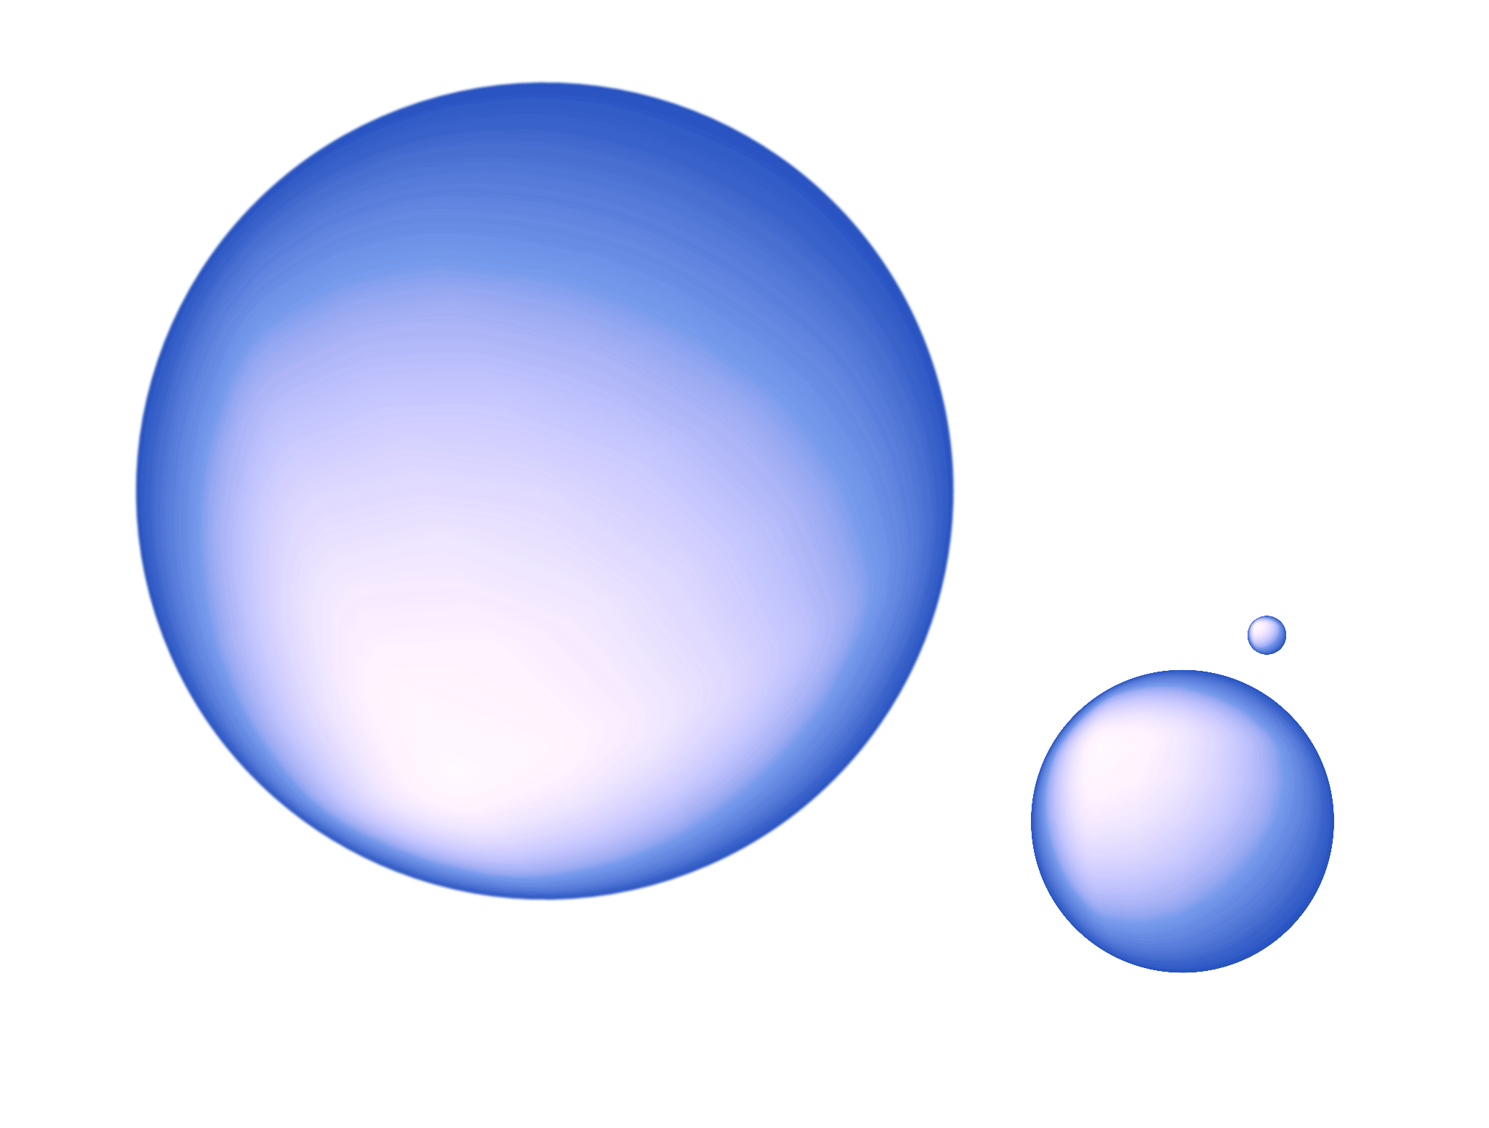
Development and usage of 3D-phantom for AI-based dose verification in radiotherapy
Rossana Lanzillotta

Slide 2
Introduction
In the context of radiotherapy, has been developed a Deep Learning model to convert acquired EPID images into portal dose images, trained on a large dataset paired with Monaco TPS-calculated doses. This work assesses its applicability in an in-vivo alert framework. We evaluate the model’s sensitivity to controlled variations in MU, patient positioning, and thickness. EPID images were acquired using anthropomorphic, modular heterogeneous phantoms, and solid water. Dose difference, normalized dose difference, and gamma passing rate (GPR) were used as evaluation metrics. Results were compared using different DTA and DD criteria.

Slide 3
Methods and materials
Data acquisition and prediction:
EPID Image Acquisition: Electronic Portal Imaging Device (EPID) images were acquired, with voluntary mismatches introduced during acquisition including variations in:
Position
Gantry angles
Material thicknesses along the beam path
Monitor Units (MU)
Deep Learning Model: A Convolutional Neural Network (CNN) was employed to predict Portal Dose (PD) from the acquired EPID images.
Comparative methods:
Predicted PD vs. TPS PD
Acquired EPID vs. EPID Ground Truth
Predicted PD vs. Predicted PD Ground Truth
Evaluation Metrics: For each comparison, the following metrics were calculated:
Gamma Passing Rate (GPR)
Mean Dose Difference
Mean Normalized Dose Difference
GPR Trend Analysis: The trend of the GPR was plotted for selected cases using three different criteria:
DD = 1% , DTA = 1 mm
DD = 2% , DTA = 2 mm
DD = 3% , DTA = 3 mm

Slide 4
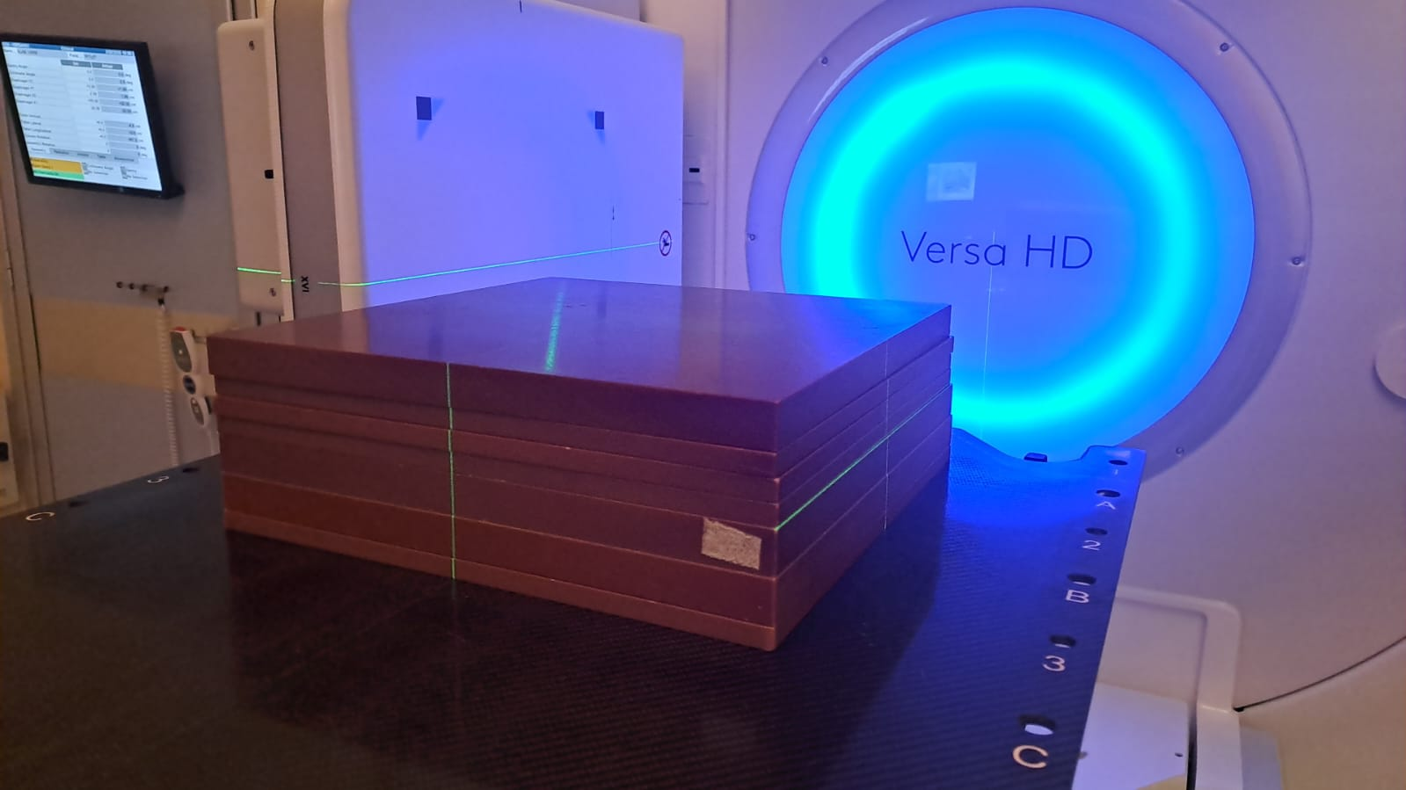
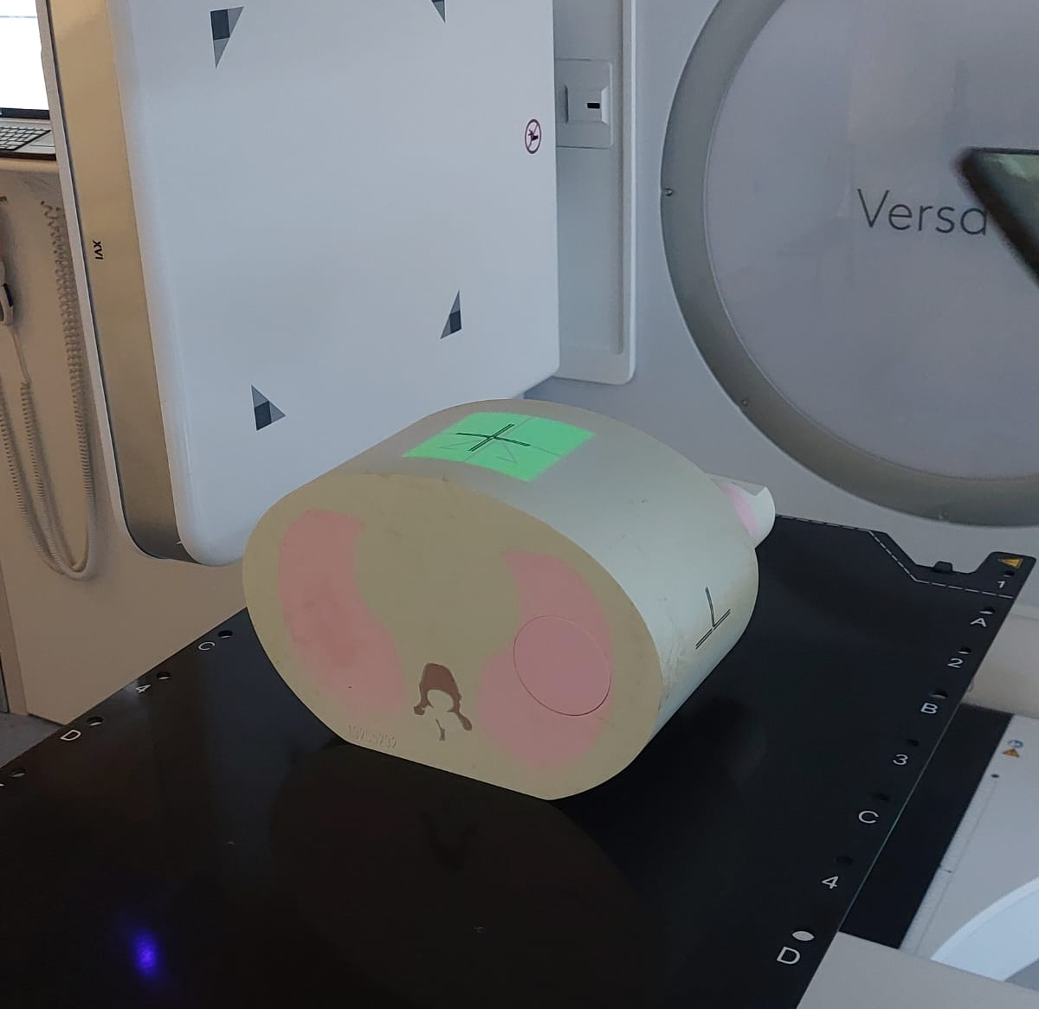
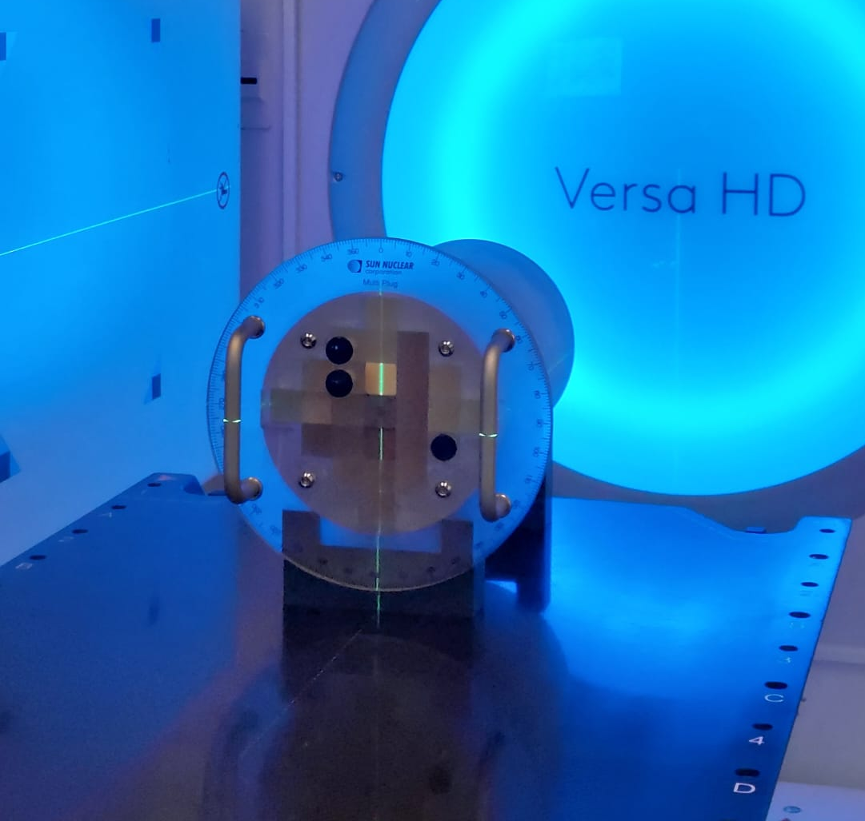
Measurement dataset
Solid water Slabs
CIRS
Multiplug
YF1 (2x2)cm
Different thickness
YF2(5x5)cm
Different thickness
0GF3 (10x10)cm
Different MU
Different position
0GF2 (5x5)cm
Different angle
0R115 (1x15)cm
Different MU
Different position
YF2 (5x5)cm
Different MU
Different position
Different angle

Slide 5
Dose difference (Predicted PD - TPS PD)
TPS PD
Predicted PD
Gamma index map
Dose profiles
Histogram of dose difference on valid pixels
(Predicted PD - TPS PD)

Slide 6
Results

Slide 7
Range of values of PD TPS and Ground truth predicted PD
 | TPS value | PD_GT_pred value
0GF2 | Max: 17.1 Min: 0.09 | Max: 17.88 (17.7)* Min: -0.02 (-0.03)*
0GF3 | Max: 23.2 Min: 0.39 | Max: 24.0 (23.50)* Min: 0.19 (0.17)*
0R115 | Max: 18.07 Min: 0.09 | Max: 17.08 Min:-0.04
YF1 | Max: 51.46 Min: 0 | Max: 53.71 Min: -0.04
YF2 (multiplug) | Max: 22.43 Min: 0 | Max: 22.85 Min: -0.02
YF2 (slab) | Max: 53.99 Min:0.1 | Max: 58.2 Min: 0.03
YF3 | Max: 28.8 Min: 0.3 | Max: 28.72 Min: 0.15
*Results from 12.12.2024 Data

Slide 8
YF1 (2x2)cm Different thicknesses - Solid water SLAB
Dose_Th=3%
Dist_th=3 mm
Cutoff=10%

Slide 9
YF3 (10x10)cm Different thicknesses - Solid Water SLAB
Dose_Th=3%
Dist_th=3 mm
Cutoff=10%
Data of 12.12.2024

Slide 10
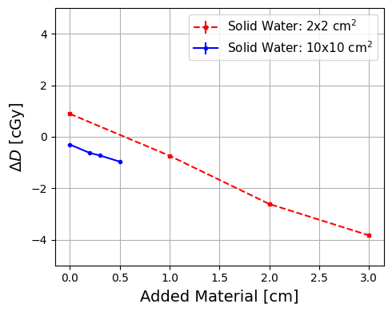
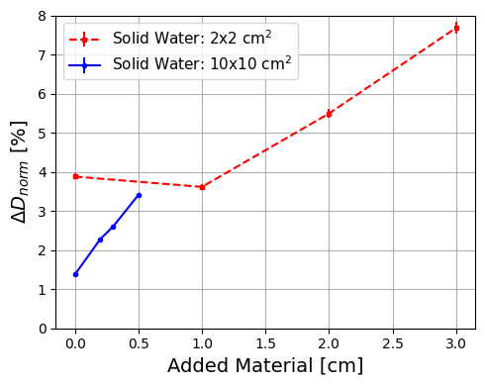
Mean Dose Difference and Mean Normalized Dose Difference Trends vs.
Thickness
The trend between the two fields is different; the smaller field seems to be less sensitive to small variations.
The trend of the two fields is similar

Slide 11
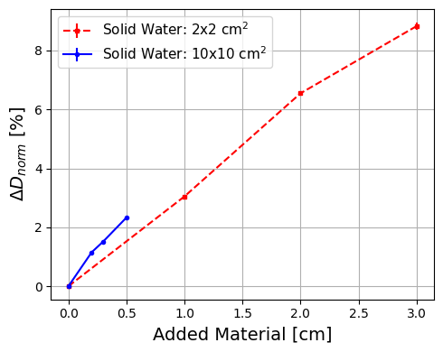
Normalized mean Dose difference trend as a function of thickness using three comparison methods
Predicted PD vs. TPS PD
Predicted PD vs. Predicted PD Ground Truth
EPIDs vs. EPID Ground Truth
The trends obtained by comparing EPID GT with EPID, and predicted PD GT with predicted PD, are practically the same.

Slide 12
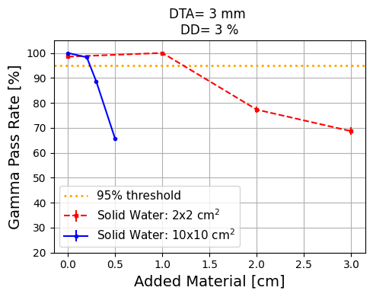
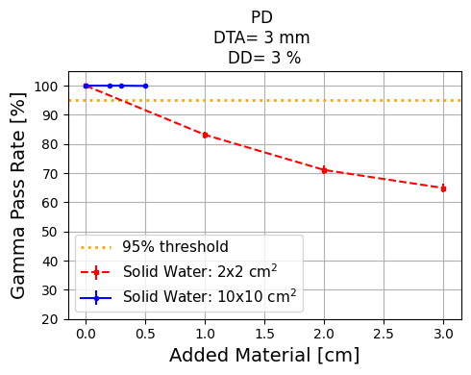
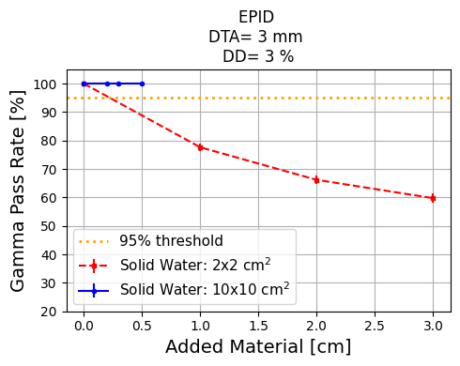
GPR trend as a function of thickness using three comparison methods
Predicted PD vs. TPS PD
Predicted PD vs. Predicted PD Ground Truth
EPIDs vs. EPID Ground Truth
Thickness variations (in both cases) are already detected with DTA = 3 mm and DD = 3%.
The larger field turns out to be insensitive to variations when comparing EPID GT and EPID, and PD GT and predicted PD. However, it proves to be very sensitive in the comparison with the TPS PD.

Slide 13
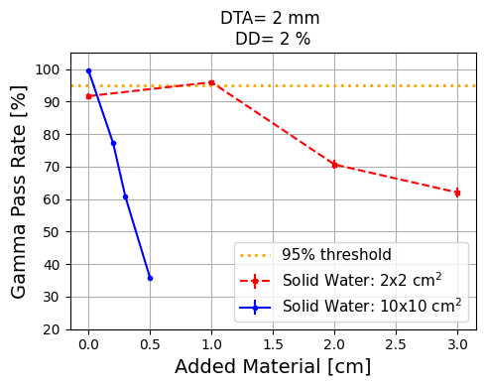
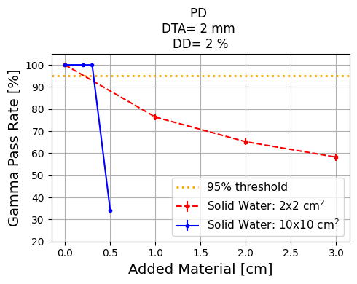
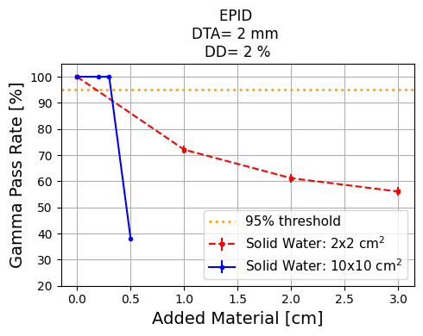
GPR trend as a function of thickness using three comparison methods
Predicted PD vs. TPS PD
Predicted PD vs. Predicted PD Ground Truth
EPIDs vs. EPID Ground Truth

Slide 14
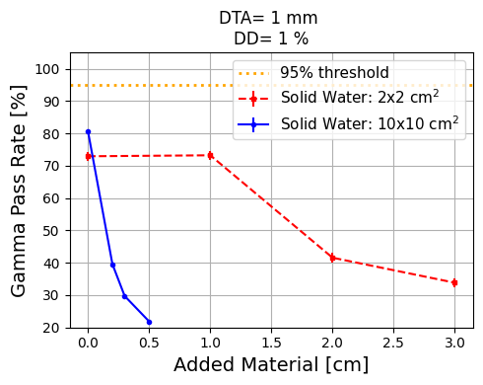
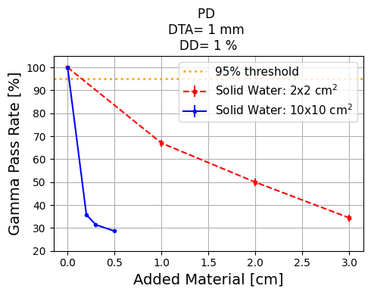
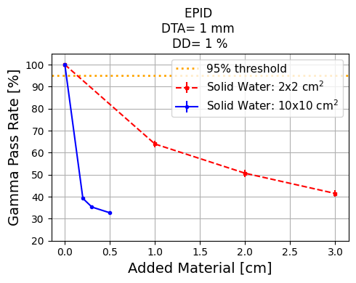
GPR trend as a function of thickness using three comparison methods
Predicted PD vs. TPS PD
Predicted PD vs. Predicted PD Ground Truth
EPIDs vs. EPID Ground Truth

Slide 15
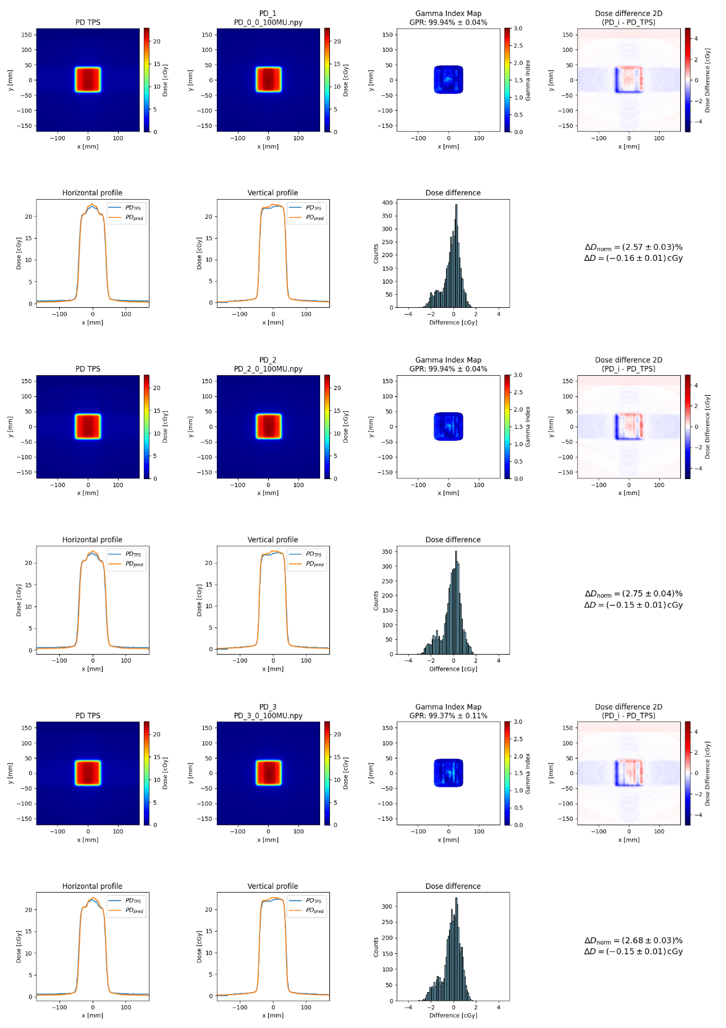
YF2 (5x5)cm Different position - MULTIPLUG
Dose_Th=3%
Dist_th=3 mm
Cutoff=10%

Slide 16
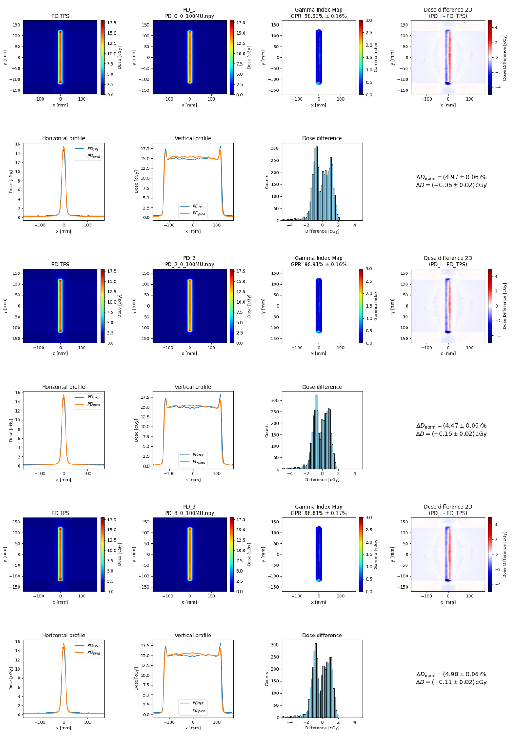
0R115 (1x15)cm Different position - CIRS
Dose_Th=3%
Dist_th=3 mm
Cutoff=10%

Slide 17
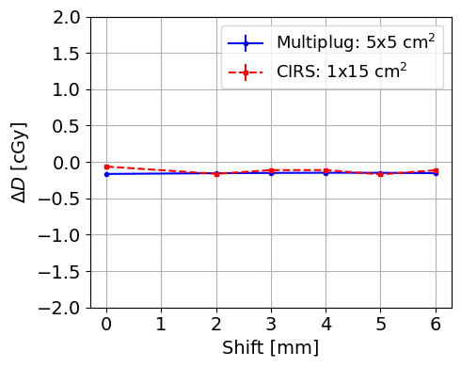
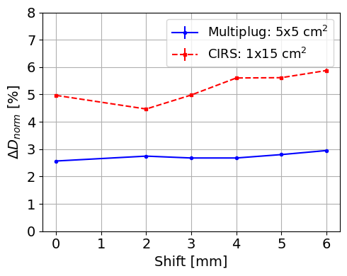
Mean Dose Difference and Normalized Dose Difference Trends vs.
Position

Slide 18
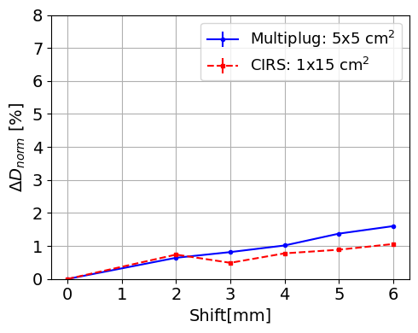
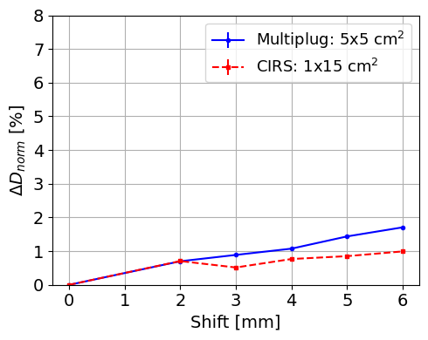
Normalized mean Dose difference trend as a function of position using three comparison methods
Predicted PD vs. TPS PD
Predicted PD vs. Predicted PD Ground Truth
EPIDs vs. EPID Ground Truth

Slide 19
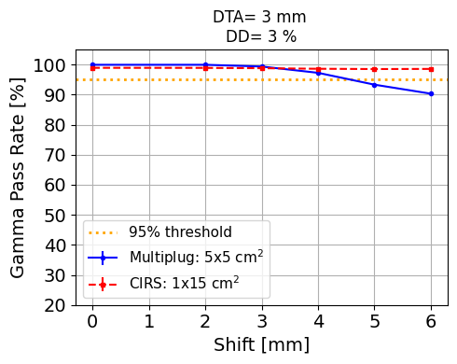
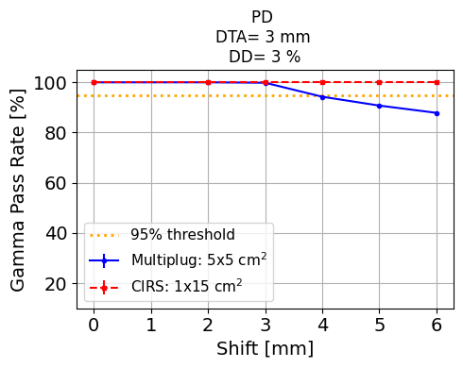
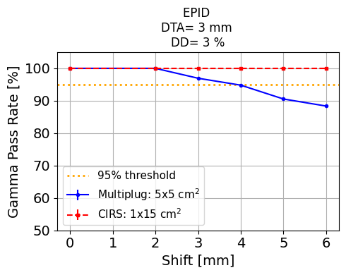
GPR trend as a function of position using three comparison methods
Predicted PD vs. TPS PD
Predicted PD vs. Predicted PD Ground Truth
EPIDs vs. EPID Ground Truth

Slide 20
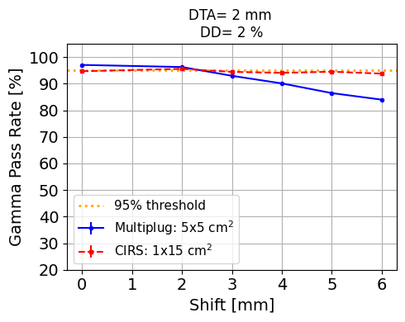
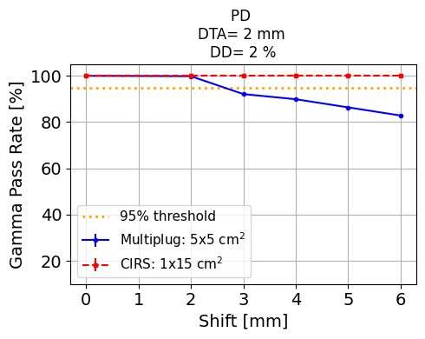
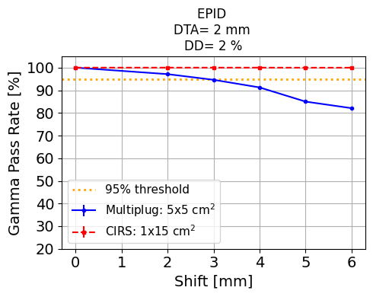
GPR trend as a function of position using three comparison methods
Predicted PD vs. TPS PD
Predicted PD vs. Predicted PD Ground Truth
EPIDs vs. EPID Ground Truth

Slide 21
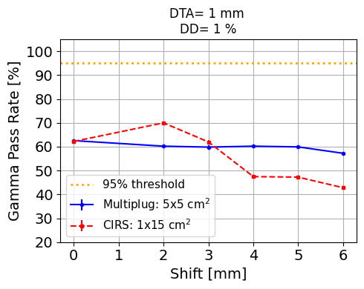
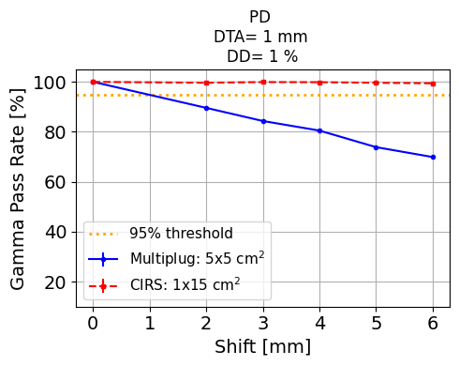
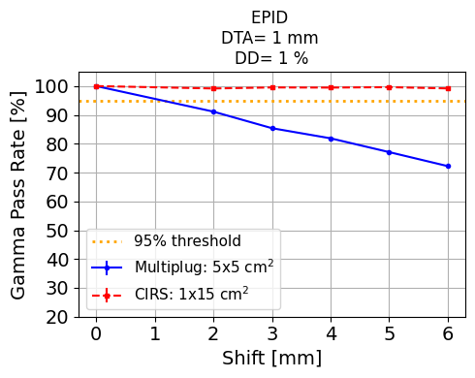
GPR trend as a function of position using three comparison methods
Predicted PD vs. TPS PD
Predicted PD vs. Predicted PD Ground Truth
EPIDs vs. EPID Ground Truth

Slide 22
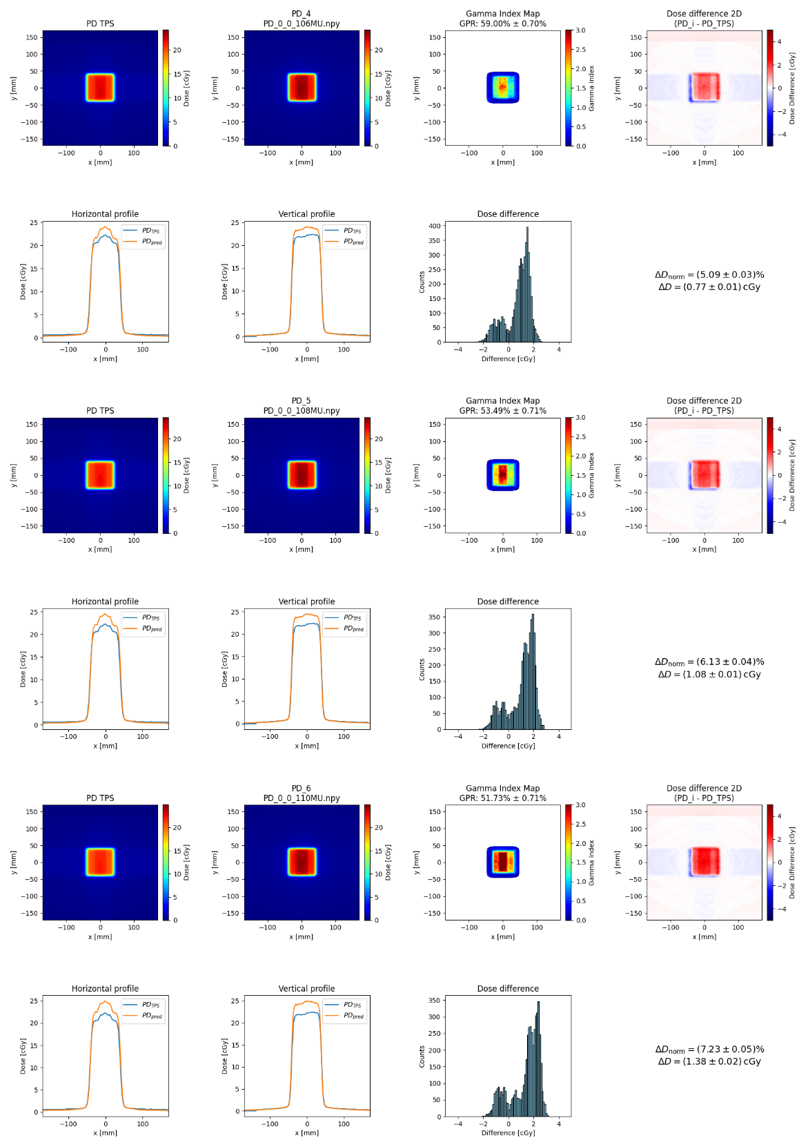
YF2 (5x5)cm Different MU - MULTIPLUG
Dose_Th=3%
Dist_th=3 mm
Cutoff=10%

Slide 23
0R115 (1x15)cm Different MU - CIRS
Dose_Th=3%
Dist_th=3 mm
Cutoff=10%

Slide 24
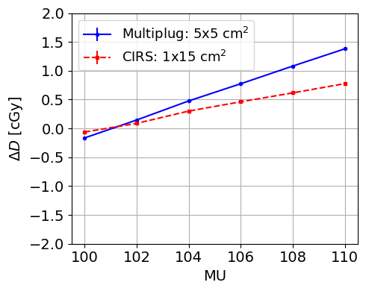
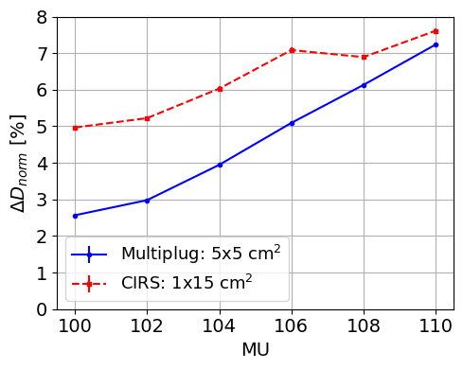
Mean Dose Difference and Normalized Dose Difference Trends vs.
Monitor Units

Slide 25
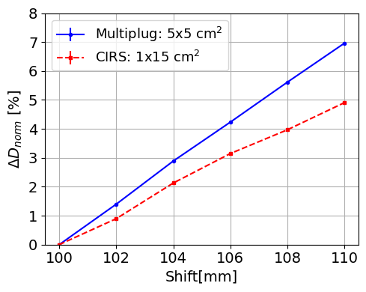
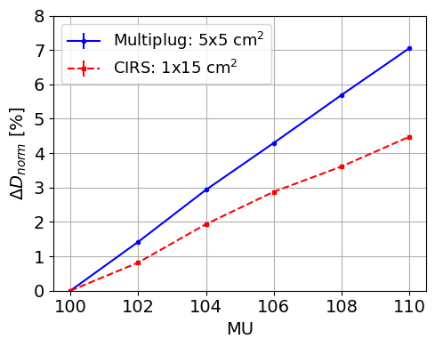
Normalized mean Dose difference trend as a function of Monitor Units using three comparison methods
MU
Predicted PD vs. TPS PD
Predicted PD vs. Predicted PD Ground Truth
EPIDs vs. EPID Ground Truth

Slide 26
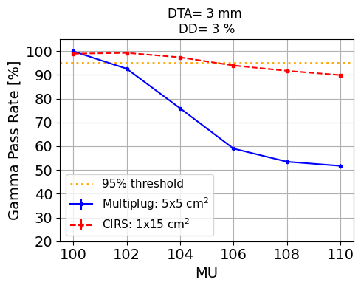
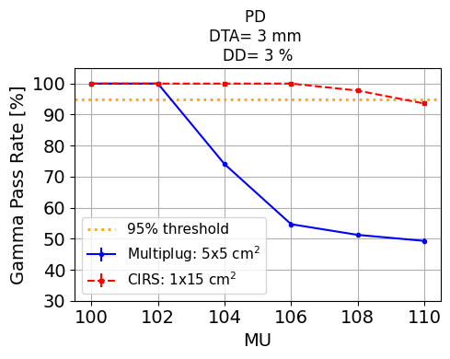
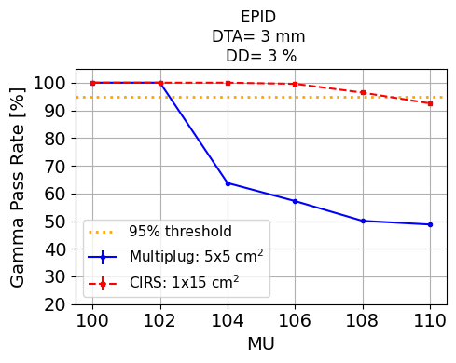
GPR trend as a function of Monitor Units using three comparison methods
Predicted PD vs. TPS PD
Predicted PD vs. Predicted PD Ground Truth
EPIDs vs. EPID Ground Truth

Slide 27
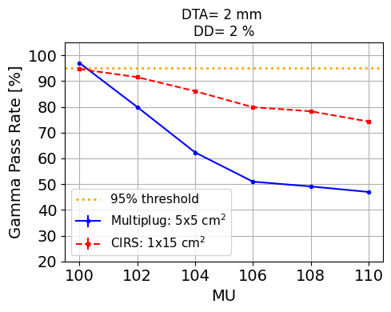
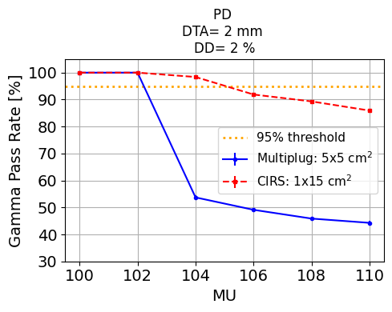
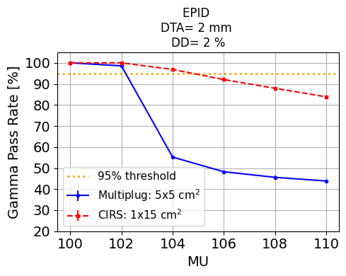
GPR trend as a function of Monitor Units using three comparison methods
Predicted PD vs. TPS PD
Predicted PD vs. Predicted PD Ground Truth
EPIDs vs. EPID Ground Truth

Slide 28
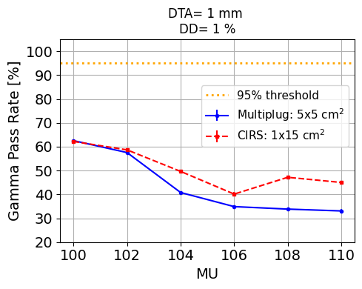
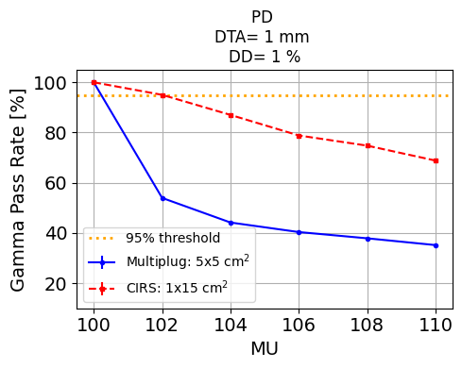
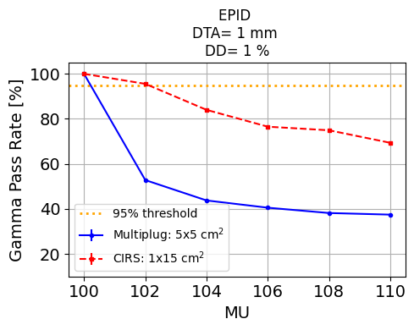
GPR trend as a function of Monitor Units using three comparison methods
Predicted PD vs. TPS PD
Predicted PD vs. Predicted PD Ground Truth
EPIDs vs. EPID Ground Truth

Slide 29
Data of 28.03.2025
0GF2 (5x5)cm Different angles - CIRS
Dose_Th=3%
Dist_th=3 mm
Cutoff=10%

Slide 30
Data of 12.12.2024
0GF2 (5x5)cm Different angles - CIRS
Dose_Th=3%
Dist_th=3 mm
Cutoff=10%

Slide 31
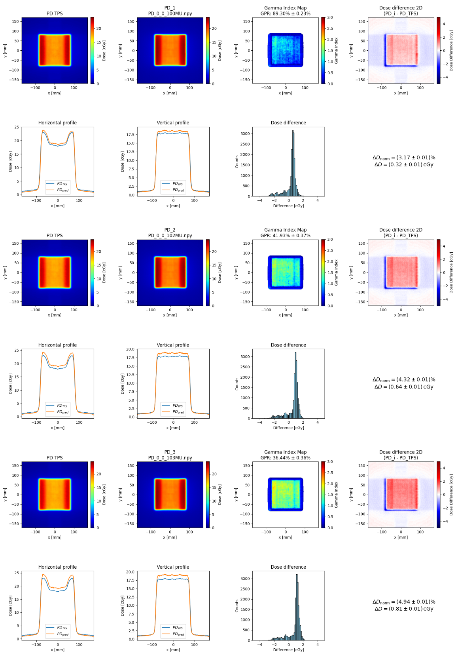
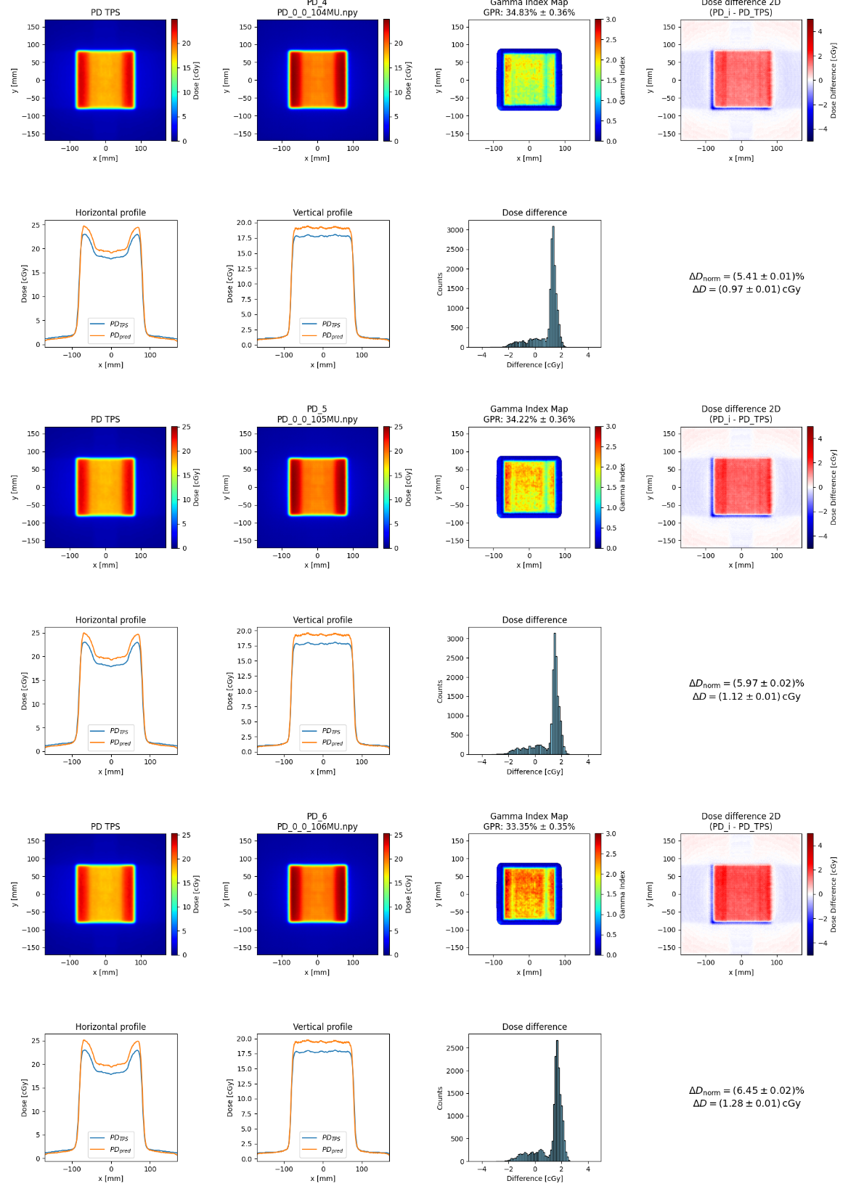
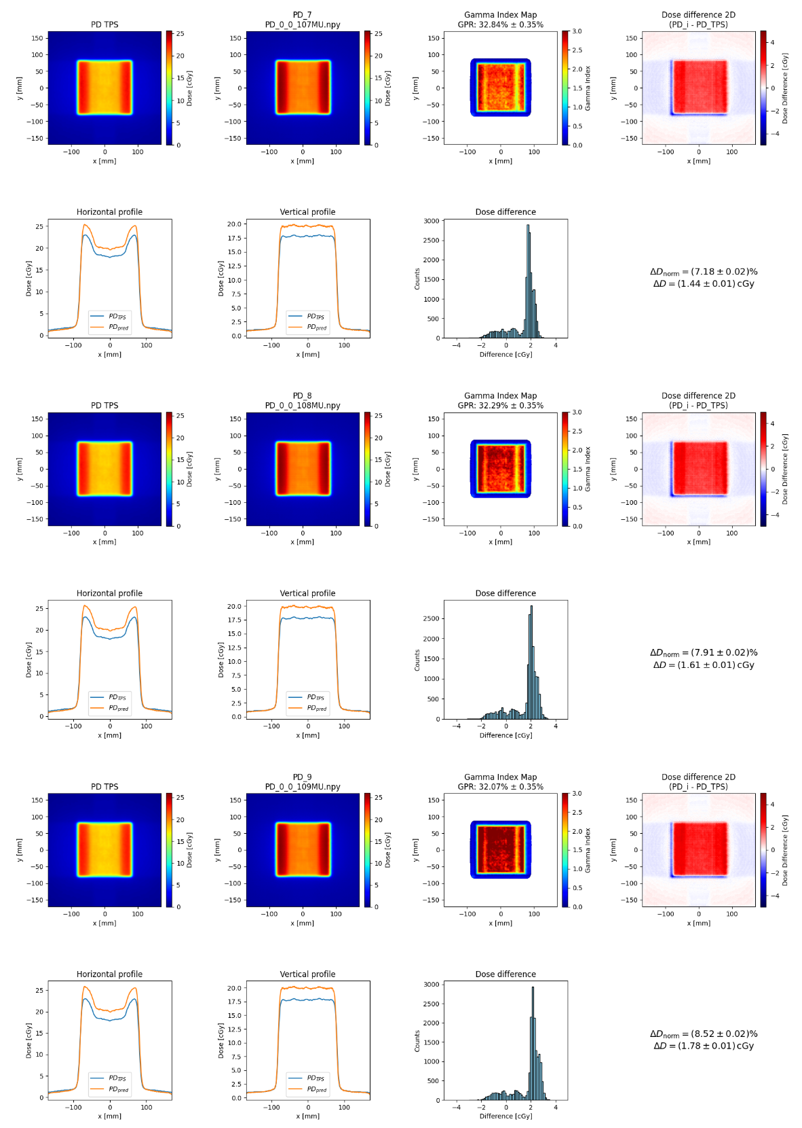
0GF3 (10x10)cm Different MU - CIRS
Data of 28.03.2025
Dose_Th=3%
Dist_th=3 mm
Cutoff=10%

Slide 32
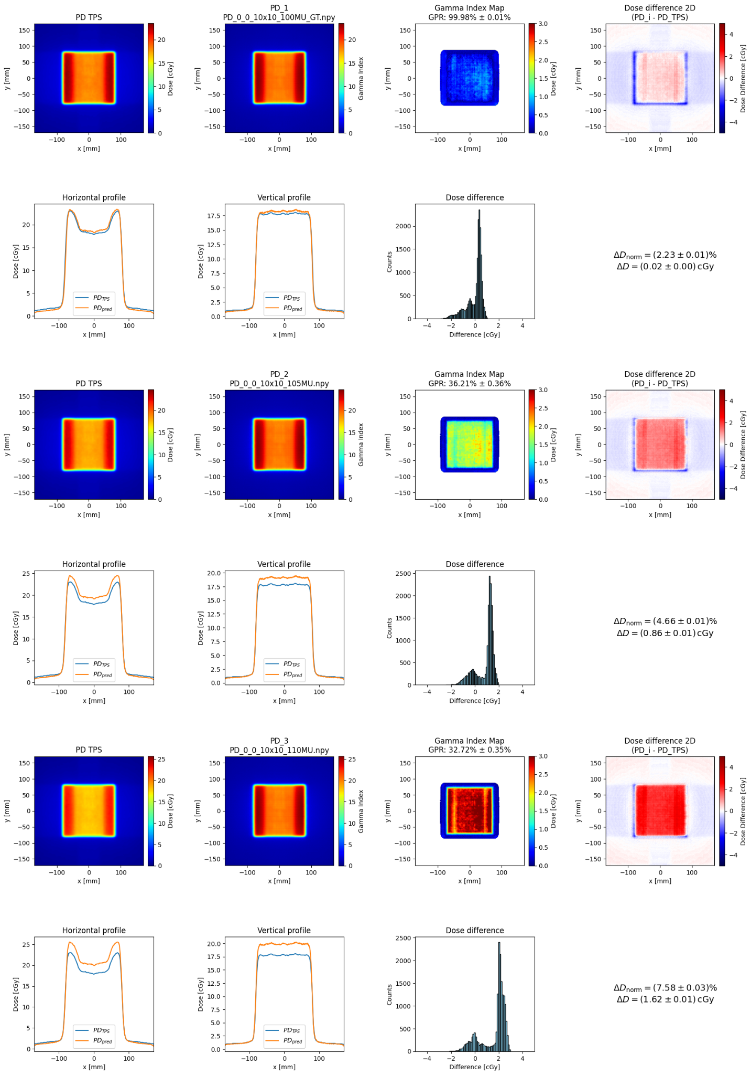
0GF3 (10x10)cm Different MU - CIRS
Data of 12.12.2024
Dose_Th=3%
Dist_th=3 mm
Cutoff=10%

Slide 33
Data of 28.03.2025
0GF3 (10x10)cm Different position - CIRS
Dose_Th=3%
Dist_th=3 mm
Cutoff=10%

Slide 34
Data of 12.12.2024
0GF3 (10x10)cm Different position - CIRS
Dose_Th=3%
Dist_th=3 mm
Cutoff=10%

Slide 35
YF2 (5x5)cm Different angles- MULTIPLUG
Dose_Th=3%
Dist_th=3 mm
Cutoff=10%

Slide 36
YF2 (5x5)cm Different thicknesses- Solid Water SLAB
Dose_Th=3%
Dist_th=3 mm
Cutoff=10%

Slide 37
Conclusions
Data acquired with various phantoms with intentionally introduced errors
Metrics implemented in analysis framework
Different comparison strategies applied for data with controlled errors in MU, shifts and material added
GPR and dose differences depend on phantom/field—> more data would be needed to investigate the dependence on phantom and fields
Investigated how the DL model influences the gamma passing rate and the dose differences: very similar GPR for EPID vs EPID_GT and PD_DL vs PD_DL_GT for all tolerance criteria tested —> DL model can be safely used and doesn’t alter the GPR much

Slide 38
Thank you for your attention

Slide 39
YF1 (2x2)cm Different thicknesses - SLAB
 | PD_TPS vs PD_pred | EPID_GT vs EPIDs | PD_GT vs PD_pred
0 cm
Delta_D [cGy] | 0.89 ± 0.07 | / | /
Delta_D_norm [%] | 3.88 ± 0.08 | / | /
GPR [%] | 98.51 ± 0.38 | / | /
1 cm
Delta_D [cGy] | -0.74 ± 0.07 | -47310.49 ± 838.29 | -1.64 ± 0.03
Delta_D_norm [%] | 3.61 ± 0.07 | 3.05 ± 0.05 | 3.05 ± 0.05
GPR [%] | 100.00 ± 0.00 | 77.63 ± 1.33 | 83.15 ± 1.18
2 cm
Delta_D [cGy] | -2.61 ± 0.07 | -101547.33 ± 1536.65 | -3.52 ± 0.05
Delta_D_norm [%] | 5.49 ± 0.11 | 6.55 ± 0.10 | 6.55 ± 0.09
GPR [%] | 77.28 ± 1.32 | 66.19 ± 1.51 | 71.09 ± 1.43
3 cm
Delta_D [cGy] | -3.84 ± 0.08 | -136978.77 ± 2295.19 | -4.74 ± 0.07
Delta_D_norm [%] | 7.68 ± 0.15 | 8.84 ± 0.15 | 8.83 ± 0.13
GPR [%] | 68.65 ± 1.46 | 59.75 ± 1.57 | 64.91 ± 1.51

Slide 40
YF2 (5x5)cm Different position - MULTIPLUG
 | PD_TPS vs PD_pred | EPID_GT vs EPIDs | PD_GT vs PD_pred
0 mm
Delta_D [cGy] | -0.16 ± 0.01 | / | /
Delta_D_norm [%] | 2.57 ± 0.03 | / | /
GPR [%] | 99.94 ± 0.04 | / | /
2 mm
Delta_D [cGy] | -0.15 ± 0.01 | 289.89 ± 123.00 | 0.01 ± 0.00
Delta_D_norm [%] | 2.75 ± 0.04 | 0.70 ± 0.02 | 0.64 ± 0.01
GPR [%] | 99.94 ± 0.04 | 100.00 ± 0.00 | 100.00 ± 0.00
3 mm
Delta_D [cGy] | -0.15 ± 0.01 | 386.00 ± 164.23 | 0.01 ± 0.00
Delta_D_norm [%] | 2.68 ± 0.03 | 0.89 ± 0.02 | 0.81 ± 0.01
GPR [%] | 99.37 ± 0.11 | 96.94 ± 0.25 | 99.83 ± 0.06

Slide 41
4 mm
Delta_D [cGy] | -0.15 ± 0.01 | 443.34 ± 195.41 | 0.02 ± 0.01
Delta_D_norm [%] | 2.68 ± 0.03 | 1.07 ± 0.02 | 1.02 ± 0.02
GPR [%] | 97.27 ± 0.23 | 94.81 ± 0.32 | 94.26 ± 0.34
5 mm
Delta_D [cGy] | -0.15 ± 0.01 | 428.36 ± 240.44 | 0.02 ± 0.01
Delta_D_norm [%] | 2.80 ± 0.03 | 1.44 ± 0.03 | 1.37 ± 0.02
GPR [%] | 93.33 ± 0.36 | 90.54 ± 0.42 | 90.73 ± 0.42
6 mm
Delta_D [cGy] | -0.15 ± 0.01 | 295.10 ± 269.59 | 0.01 ± 0.01
Delta_D_norm [%] | 2.95 ± 0.03 | 1.71 ± 0.03 | 1.60 ± 0.03
GPR [%] | 90.33 ± 0.42 | 88.36 ± 0.46 | 87.84 ± 0.47

Slide 42
0R115 (1x15)cm Different position - CIRS
 | PD_TPS vs PD_pred | EPID_GT vs EPIDs | PD_GT vs PD_pred
0 mm
Delta_D [cGy] | -0.06 ± 0.02 | / | /
Delta_D_norm [%] | 4.97 ± 0.06 | / | /
GPR [%] | 98.93 ± 0.16 | / | /
2 mm
Delta_D [cGy] | -0.16 ± 0.02 | -2800.57 ± 65.04 | -0.10 ± 0.00
Delta_D_norm [%] | 4.47 ± 0.06 | 0.71 ± 0.01 | 0.74 ± 0.01
GPR [%] | 98.91 ± 0.16 | 100.00 ± 0.00 | 100.00 ± 0.00
3 mm
Delta_D [cGy] | -0.11 ± 0.02 | -1295.80 ± 51.36 | -0.05 ± 0.00
Delta_D_norm [%] | 4.98 ± 0.06 | 0.52 ± 0.01 | 0.49 ± 0.01
GPR [%] | 98.81 ± 0.17 | 100.00 ± 0.00 | 100.00 ± 0.00

Slide 43
4 mm
Delta_D [cGy] | -0.11 ± 0.02 | -1143.66 ± 79.35 | -0.05 ± 0.00
Delta_D_norm [%] | 5.60 ± 0.06 | 0.77 ± 0.01 | 0.78 ± 0.01
GPR [%] | 98.62 ± 0.18 | 100.00 ± 0.00 | 100.00 ± 0.00
5 mm
Delta_D [cGy] | -0.17 ± 0.02 | -2777.34 ± 82.44 | -0.10 ± 0.00
Delta_D_norm [%] | 5.61 ± 0.06 | 0.85 ± 0.01 | 0.89 ± 0.01
GPR [%] | 98.52 ± 0.19 | 100.00 ± 0.00 | 100.00 ± 0.00
6 mm
Delta_D [cGy] | -0.11 ± 0.02 | -1192.79 ± 101.84 | -0.05 ± 0.00
Delta_D_norm [%] | 5.87 ± 0.06 | 0.99 ± 0.01 | 1.06 ± 0.01
GPR [%] | 98.57 ± 0.19 | 100.00 ± 0.00 | 100.00 ± 0.00

Slide 44
0R115 (1x15)cm Different MU - CIRS
 | PD_TPS vs PD_pred | EPID_GT vs EPIDs | PD_GT vs PD_pred
100MU
Delta_D [cGy] | -0.06 ± 0.02 | / | /
Delta_D_norm [%] | 4.97 ± 0.06 | / | /
GPR [%] | 98.93 ± 0.16 | / | /
102MU
Delta_D [cGy] | 0.09 ± 0.02 | 4180.45 ± 53.42 | 0.15 ± 0.00
Delta_D_norm [%] | 5.22 ± 0.06 | 0.82 ± 0.01 | 0.90 ± 0.01
GPR [%] | 99.27 ± 0.13 | 100.00 ± 0.00 | 100.00 ± 0.00
104MU
Delta_D [cGy] | 0.30 ± 0.02 | 10190.85 ± 106.38 | 0.36 ± 0.00
Delta_D_norm [%] | 6.03 ± 0.06 | 1.93 ± 0.02 | 2.13 ± 0.02
GPR [%] | 97.40 ± 0.25 | 100.00 ± 0.00 | 100.00 ± 0.00

Slide 45
106MU
Delta_D [cGy] | 0.46 ± 0.02 | 14885.69 ± 183.66 | 0.53 ± 0.01
Delta_D_norm [%] | 7.08 ± 0.07 | 2.88 ± 0.03 | 3.15 ± 0.03
GPR [%] | 93.95 ± 0.37 | 99.57 ± 0.10 | 100.00 ± 0.00
108MU
Delta_D [cGy] | 0.62 ± 0.02 | 19022.36 ± 180.53 | 0.68 ± 0.01
Delta_D_norm [%] | 6.89 ± 0.07 | 3.61 ± 0.03 | 3.97 ± 0.03
GPR [%] | 91.72 ± 0.43 | 96.40 ± 0.29 | 97.74 ± 0.23
110MU
Delta_D [cGy] | 0.78 ± 0.02 | 23579.23 ± 234.65 | 0.84 ± 0.01
Delta_D_norm [%] | 7.61 ± 0.08 | 4.48 ± 0.04 | 4.90 ± 0.04
GPR [%] | 89.92 ± 0.47 | 92.52 ± 0.41 | 93.57 ± 0.38

Slide 46
YF2 (5x5)cm Different MU - MULTIPLUG
 | PD_TPS vs PD_pred | EPID_GT vs EPIDs | PD_GT vs PD_pred
100MU
Delta_D [cGy] | -0.16 ± 0.01 | / | /
Delta_D_norm [%] | 2.57 ± 0.03 | / | /
GPR [%] | 99.94 ± 0.04 | / | /
102MU
Delta_D [cGy] | 0.15 ± 0.01 | 9497.60 ± 58.78 | 0.32 ± 0.00
Delta_D_norm [%] | 2.98 ± 0.03 | 1.42 ± 0.01 | 1.40 ± 0.01
GPR [%] | 92.59 ± 0.37 | 100.00 ± 0.00 | 100.00 ± 0.00
104MU
Delta_D [cGy] | 0.48 ± 0.01 | 19624.62 ± 119.32 | 0.66 ± 0.00
Delta_D_norm [%] | 3.95 ± 0.03 | 2.93 ± 0.02 | 2.89 ± 0.01
GPR [%] | 75.95 ± 0.61 | 63.75 ± 0.69 | 74.06 ± 0.64

Slide 47
106MU
Delta_D [cGy] | 0.77 ± 0.01 | 28738.73 ± 175.82 | 0.97 ± 0.01
Delta_D_norm [%] | 5.09 ± 0.03 | 4.30 ± 0.03 | 4.23 ± 0.02
GPR [%] | 59.00 ± 0.70 | 57.22 ± 0.71 | 54.68 ± 0.72
108MU
Delta_D [cGy] | 1.08 ± 0.01 | 38068.75 ± 235.06 | 1.28 ± 0.01
Delta_D_norm [%] | 6.13 ± 0.04 | 5.69 ± 0.04 | 5.61 ± 0.03
GPR [%] | 53.49 ± 0.71 | 50.08 ± 0.72 | 51.23 ± 0.73
110MU
Delta_D [cGy] | 1.38 ± 0.02 | 47164.20 ± 293.38 | 1.59 ± 0.01
Delta_D_norm [%] | 7.23 ± 0.05 | 7.05 ± 0.04 | 6.96 ± 0.04
GPR [%] | 51.73 ± 0.71 | 48.75 ± 0.72 | 49.29 ± 0.73

Slide 48
0GF2 (5x5)cm Different angles - CIRS
Dose_Th=3%
Dist_th=3 mm
Cutoff=10%
 | PD_TPS vs PD_pred | EPID_GT vs EPIDs | PD_GT vs PD_pred
0°
Delta_D [cGy] | 0.19 ± 0.01 | / | /
Delta_D_norm [%] | 3.76 ± 0.03 | / | /
GPR [%] | 71.13 ± 0.64 | / | /
2°
Delta_D [cGy] | 0.28 ± 0.01 | 2459.37 ± 44.49 | 0.09 ± 0.00
Delta_D_norm [%] | 3.95 ± 0.03 | 0.60 ± 0.01 | 0.56 ± 0.01
GPR [%] | 67.38 ± 0.66 | 100.00 ± 0.00 | 100.00 ± 0.00
4°
Delta_D [cGy] | 0.27 ± 0.01 | 2224.88 ± 60.33 | 0.08 ± 0.00
Delta_D_norm [%] | 3.72 ± 0.03 | 0.67 ± 0.01 | 0.60 ± 0.01
GPR [%] | 71.21 ± 0.64 | 100.00 ± 0.00 | 100.00 ± 0.00

Slide 49
6°
Delta_D [cGy] | 0.30 ± 0.01 | 2979.73 ± 86.95 | 0.10 ± 0.00
Delta_D_norm [%] | 3.89 ± 0.03 | 0.96 ± 0.01 | 0.90 ± 0.01
GPR [%] | 74.32 ± 0.62 | 99.94 ± 0.03 | 100.00 ± 0.00
8°
Delta_D [cGy] | 0.33 ± 0.01 | 3789.93 ± 138.29 | 0.14 ± 0.00
Delta_D_norm [%] | 3.71 ± 0.03 | 1.29 ± 0.02 | 1.25 ± 0.02
GPR [%] | 75.08 ± 0.61 | 99.72 ± 0.08 | 99.98 ± 0.02
10°
Delta_D [cGy] | 0.35 ± 0.01 | 4470.37 ± 169.35 | 0.16 ± 0.01
Delta_D_norm [%] | 3.93 ± 0.03 | 1.58 ± 0.03 | 1.56 ± 0.03
GPR [%] | 74.52 ± 0.62 | 97.10 ± 0.24 | 98.37 ± 0.18

Slide 50
0GF3 (10x10)cm Different MU - CIRS
Dose_Th=3%
Dist_th=3 mm
Cutoff=10%
 | PD_TPS vs PD_pred | EPID_GT vs EPIDs | PD_GT vs PD_pred
100MU
Delta_D [cGy] | 0.32 ± 0.01 | / | /
Delta_D_norm [%] | 3.17 ± 0.01 | / | /
GPR [%] | 89.30 ± 0.23 | / | /
102MU
Delta_D [cGy] | 0.64 ± 0.01 | 9472.41 ± 32.38 | 0.33 ± 0.00
Delta_D_norm [%] | 4.32 ± 0.01 | 1.37 ± 0.00 | 1.39 ± 0.00
GPR [%] | 41.93 ± 0.37 | 100.00 ± 0.00 | 100.00 ± 0.00
103MU
Delta_D [cGy] | 0.81 ± 0.01 | 14391.90 ± 47.88 | 0.50 ± 0.00
Delta_D_norm [%] | 4.94 ± 0.01 | 2.07 ± 0.01 | 2.10 ± 0.01
GPR [%] | 36.44 ± 0.36 | 97.31 ± 0.12 | 100.00 ± 0.00

Slide 51
104MU
Delta_D [cGy] | 0.97 ± 0.01 | 18995.62 ± 64.33 | 0.66 ± 0.00
Delta_D_norm [%] | 5.41 ± 0.01 | 2.73 ± 0.01 | 2.77 ± 0.01
GPR [%] | 34.83 ± 0.36 | 56.68 ± 0.36 | 84.83 ± 0.27
105MU
Delta_D [cGy] | 1.12 ± 0.01 | 23447.79 ± 79.24 | 0.82 ± 0.00
Delta_D_norm [%] | 5.97 ± 0.02 | 3.37 ± 0.01 | 3.41 ± 0.01
GPR [%] | 34.22 ± 0.36 | 45.65 ± 0.36 | 47.68 ± 0.38
106MU
Delta_D [cGy] | 1.28 ± 0.01 | 28030.72 ± 98.67 | 0.98 ± 0.00
Delta_D_norm [%] | 6.45 ± 0.02 | 4.03 ± 0.01 | 4.09 ± 0.01
GPR [%] | 33.35 ± 0.35 | 40.47 ± 0.35 | 36.80 ± 0.37

Slide 52
107MU
Delta_D [cGy] | 1.44 ± 0.01 | 32921.86 ± 108.58 | 1.15 ± 0.00
Delta_D_norm [%] | 7.18 ± 0.02 | 4.72 ± 0.02 | 4.78 ± 0.01
GPR [%] | 32.84 ± 0.35 | 39.16 ± 0.35 | 33.70 ± 0.36
108MU
Delta_D [cGy] | 1.61 ± 0.01 | 37768.52 ± 122.99 | 1.32 ± 0.00
Delta_D_norm [%] | 7.91 ± 0.02 | 5.41 ± 0.02 | 5.49 ± 0.01
GPR [%] | 32.29 ± 0.35 | 38.43 ± 0.35 | 32.48 ± 0.36
109MU
Delta_D [cGy] | 1.78 ± 0.01 | 42671.66 ± 137.40 | 1.49 ± 0.00
Delta_D_norm [%] | 8.52 ± 0.02 | 6.11 ± 0.02 | 6.20 ± 0.01
GPR [%] | 32.07 ± 0.35 | 37.85 ± 0.35 | 31.62 ± 0.35
110MU
Delta_D [cGy] | 1.93 ± 0.01 | 46978.27 ± 152.63 | 1.64 ± 0.00
Delta_D_norm [%] | 9.12 ± 0.03 | 6.73 ± 0.02 | 6.82 ± 0.02
GPR [%] | 31.76 ± 0.35 | 37.34 ± 0.35 | 31.44 ± 0.35

Slide 53
0GF3 (10x10)cm Different position - CIRS
Dose_Th=3%
Dist_th=3 mm
Cutoff=10%
 | PD_TPS vs PD_pred | EPID_GT vs EPIDs | PD_GT vs PD_pred
0 mm
Delta_D [cGy] | 0.32 ± 0.01 | / | /
Delta_D_norm [%] | 3.17 ± 0.01 | / | /
GPR [%] | 89.30 ± 0.23 | / | /
2 mm
Delta_D [cGy] | 0.34 ± 0.01 | 750.56 ± 26.15 | 0.03 ± 0.00
Delta_D_norm [%] | 3.24 ± 0.02 | 0.28 ± 0.00 | 0.30 ± 0.00
GPR [%] | 87.86 ± 0.25 | 100.00 ± 0.00 | 100.00 ± 0.00
3 mm
Delta_D [cGy] | 0.33 ± 0.01 | 444.32 ± 42.51 | 0.01 ± 0.00
Delta_D_norm [%] | 3.14 ± 0.02 | 0.57 ± 0.00 | 0.58 ± 0.00
GPR [%] | 80.45 ± 0.30 | 100.00 ± 0.00 | 100.00 ± 0.00

Slide 54
4 mm
Delta_D [cGy] | 0.35 ± 0.01 | 988.72 ± 90.03 | 0.03 ± 0.00
Delta_D_norm [%] | 3.22 ± 0.02 | 1.24 ± 0.01 | 1.26 ± 0.01
GPR [%] | 76.57 ± 0.32 | 93.65 ± 0.18 | 98.23 ± 0.10
5 mm
Delta_D [cGy] | 0.34 ± 0.01 | 899.05 ± 108.79 | 0.03 ± 0.00
Delta_D_norm [%] | 3.14 ± 0.02 | 1.54 ± 0.01 | 1.57 ± 0.01
GPR [%] | 76.81 ± 0.32 | 89.83 ± 0.22 | 92.39 ± 0.20
6 mm
Delta_D [cGy] | 0.40 ± 0.01 | 2575.18 ± 175.62 | 0.09 ± 0.01
Delta_D_norm [%] | 3.95 ± 0.02 | 2.42 ± 0.02 | 2.48 ± 0.02
GPR [%] | 66.43 ± 0.36 | 76.06 ± 0.31 | 79.24 ± 0.31

Slide 55
YF2 (5x5)cm Different angles- MULTIPLUG
Dose_Th=3%
Dist_th=3 mm
Cutoff=10%
 | PD_TPS vs PD_pred | EPID_GT vs EPIDs | PD_GT vs PD_pred
0°
Delta_D [cGy] | -0.16 ± 0.01 | / | /
Delta_D_norm [%] | 2.57 ± 0.03 | / | /
GPR [%] | 99.94 ± 0.04 | / | /
2°
Delta_D [cGy] | -0.13 ± 0.01 | 1079.99 ± 68.46 | 0.04 ± 0.00
Delta_D_norm [%] | 2.73 ± 0.03 | 0.41 ± 0.01 | 0.39 ± 0.01
GPR [%] | 99.94 ± 0.04 | 100.00 ± 0.00 | 100.00 ± 0.00
4°
Delta_D [cGy] | -0.14 ± 0.01 | 730.42 ± 110.77 | 0.02 ± 0.00
Delta_D_norm [%] | 2.80 ± 0.03 | 0.62 ± 0.01 | 0.57 ± 0.01
GPR [%] | 99.94 ± 0.04 | 100.00 ± 0.00 | 100.00 ± 0.00

Slide 56
6°
Delta_D [cGy] | -0.13 ± 0.01 | 1094.86 ± 135.84 | 0.04 ± 0.00
Delta_D_norm [%] | 2.76 ± 0.03 | 0.77 ± 0.02 | 0.71 ± 0.01
GPR [%] | 99.73 ± 0.07 | 96.98 ± 0.25 | 99.62 ± 0.09
8°
Delta_D [cGy] | -0.17 ± 0.01 | -119.70 ± 167.80 | -0.00 ± 0.00
Delta_D_norm [%] | 2.74 ± 0.03 | 0.96 ± 0.02 | 0.90 ± 0.02
GPR [%] | 97.04 ± 0.24 | 94.36 ± 0.33 | 95.61 ± 0.30
10°
Delta_D [cGy] | -0.17 ± 0.01 | -205.24 ± 189.99 | -0.01 ± 0.01
Delta_D_norm [%] | 3.03 ± 0.03 | 1.10 ± 0.02 | 1.05 ± 0.02
GPR [%] | 94.04 ± 0.34 | 91.73 ± 0.39 | 94.26 ± 0.34

Slide 57
YF2 (5x5)cm Different thicknesses- SLAB
Dose_Th=3%
Dist_th=3 mm
Cutoff=10%
 | PD_TPS vs PD_pred | EPID_GT vs EPIDs | PD_GT vs PD_pred
0 cm
Delta_D [cGy] | 1.78 ± 0.03 | / | /
Delta_D_norm [%] | 4.17 ± 0.03 | / | /
GPR [%] | 68.06 ± 0.67 | / | /
1 cm
Delta_D [cGy] | -0.47 ± 0.02 | -64518.69 ± 396.97 | -2.27 ± 0.01
Delta_D_norm [%] | 2.52 ± 0.03 | 3.81 ± 0.02 | 3.90 ± 0.02
GPR [%] | 99.98 ± 0.02 | 47.11 ± 0.71 | 50.34 ± 0.72
2 cm
Delta_D [cGy] | -2.45 ± 0.03 | -120782.85 ± 726.27 | -4.25 ± 0.02
Delta_D_norm [%] | 5.36 ± 0.04 | 7.13 ± 0.04 | 7.31 ± 0.04
GPR [%] | 49.44 ± 0.71 | 40.47 ± 0.70 | 41.31 ± 0.71
3 cm
Delta_D [cGy] | -3.94 ± 0.04 | -163252.60 ± 1079.28 | -5.76 ± 0.04
Delta_D_norm [%] | 7.89 ± 0.05 | 9.64 ± 0.06 | 9.90 ± 0.06
GPR [%] | 40.71 ± 0.70 | 36.05 ± 0.69 | 38.02 ± 0.70

