Slide 1
ISOLPHARM
In vitro
Breast cancer cells experiments
Meeting 18/06/2025
Presenter:
Dr. Cristiana Alberghina
cristianaalberghina@cnr.it

Slide 2
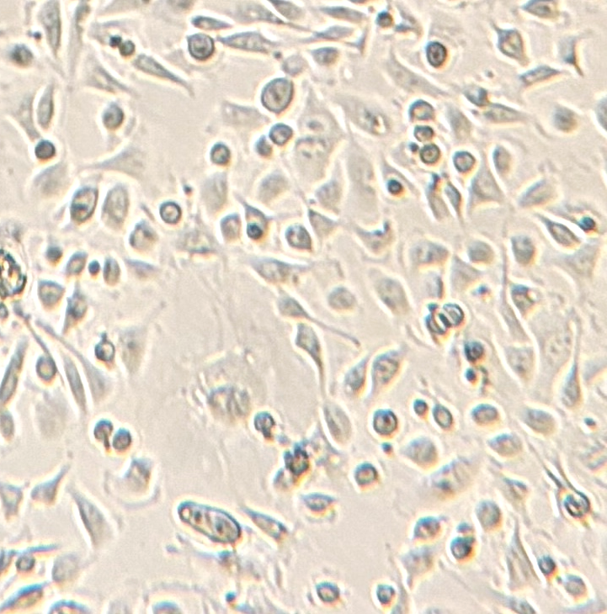
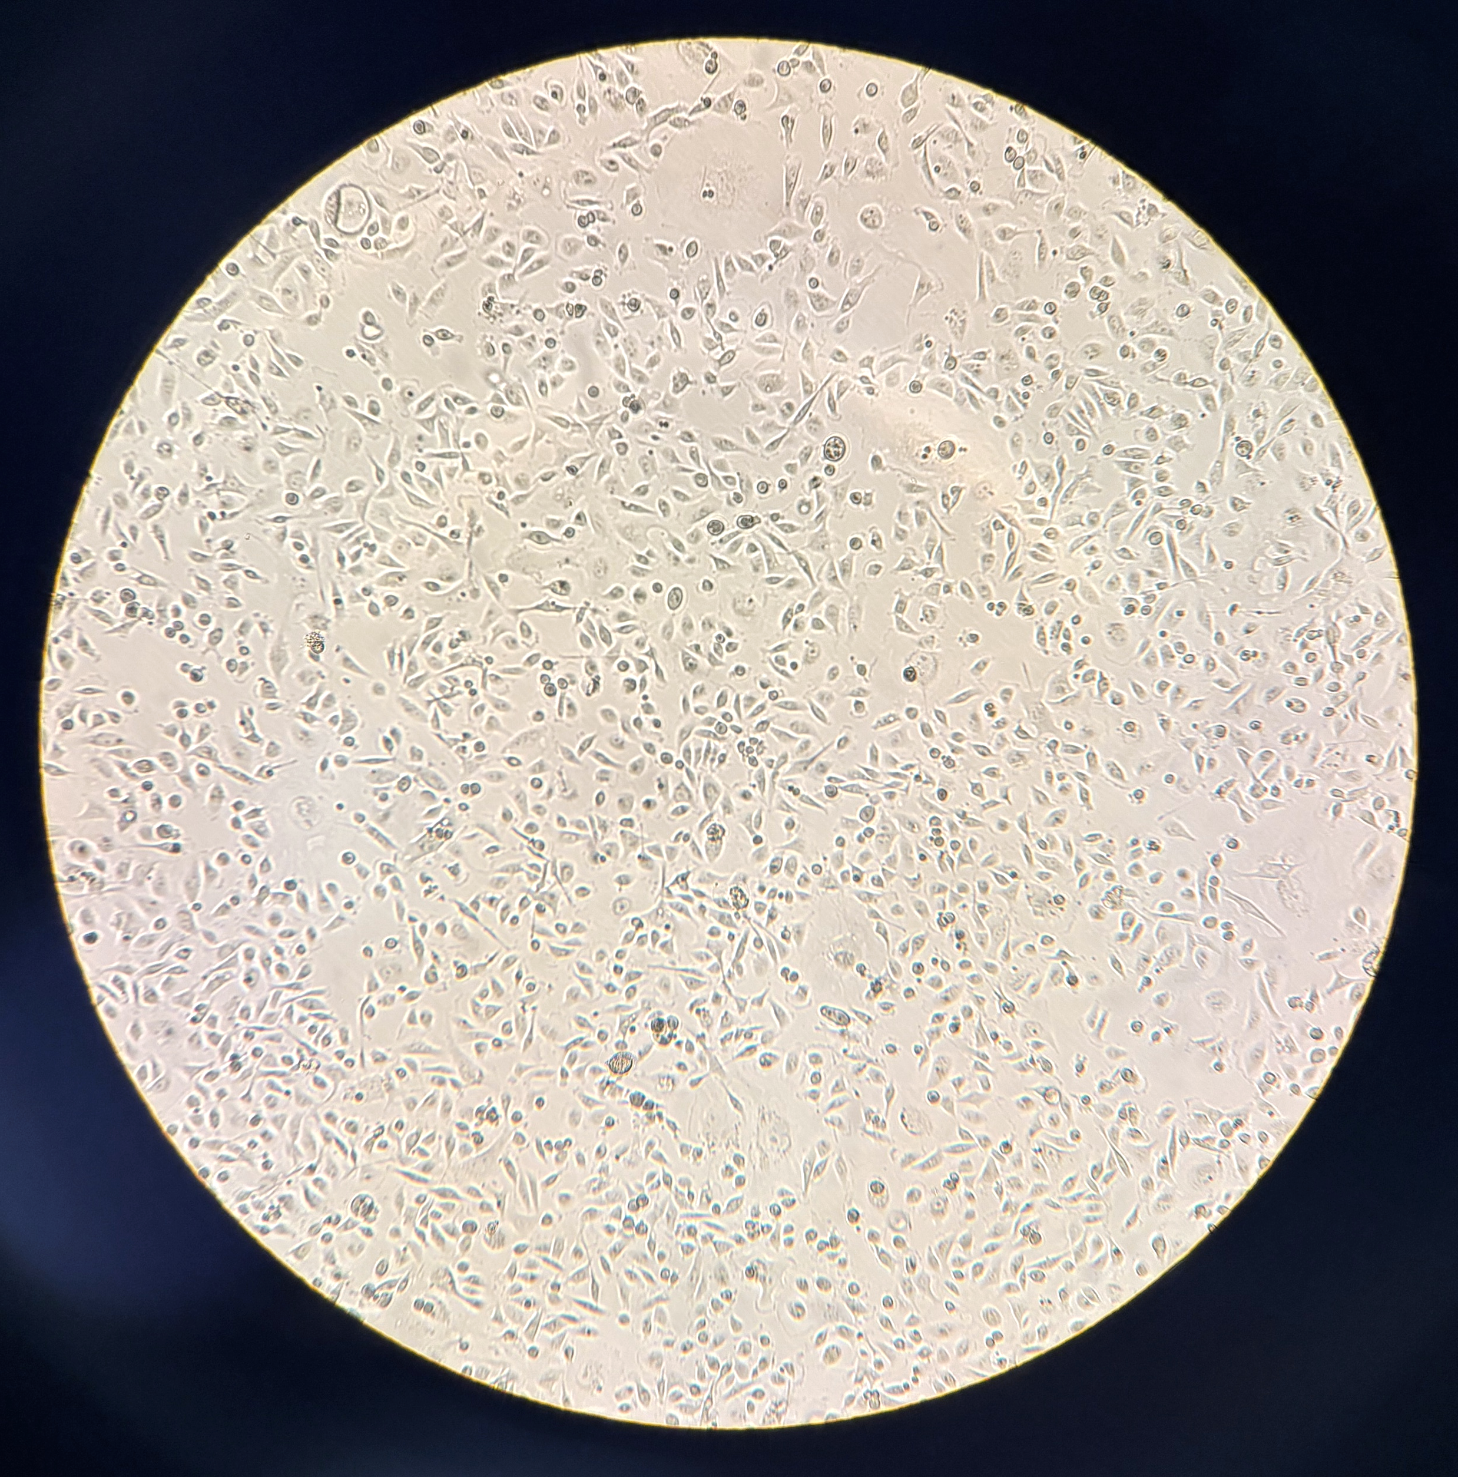
Experiments done - April 2025 Week 07.04.25
MDA-MB-231 cell line
Test in-take→ y-counter + LBC
50KBq - 200-100-50k of cells/well - 3 Timepoint (1-24-72hrs) - 3 replicates/condition
Clonogenic assay
0/1/2/4/8 Gy - 100-300 cells/well - 1 Timepoint (4 days) -
3 replicates/condition

Slide 3
Test in-take→ y-counter + rilevatore 50KBq - 50k of cells/well - 3 Timepoint (1-24-72hrs) - 3 replicates/condition
50KBq 111Ag activity/well
a
b
c
200k
200k
200k
100k
100k
100k
50k
50k
50k
1 hr
24 hrs
72 hrs

Slide 4
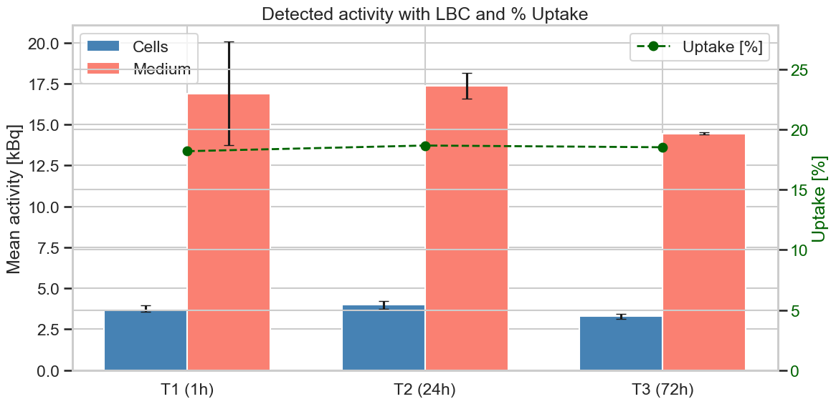
In-take evaluation Catania
Test in-take→ y-counter + LBC
50KBq - 200-100-50k of cells/well - 3 Timepoint (1-24-72hrs) - 3 replicates/condition
GAMMA-COUNTER MEASUREMENT
LBC MEASUREMENT
Plate | N° cells | Cell suspension Act. (Bq) | Supernatant Act. (Bq) | Total Act. (Bq) | % in-take
1 h | 200k | 5.469,00 | 37.597,67 | 43.066,67 | 12,70
24 h | 100k | 5.742,67 | 40.172,33 | 40.172,33 | 14,30
72 h | 50 k | 5.239,33 | 33.356,00 | 33.356,00 | 16,31
Plate | N° cells | Cell suspension Act. (kBq) | Supernatant Act. (kBq) | Total Act. (kBq) | % in-take
1 h | 200k | 3.76 | 16.89 | 20.65 | 18,20
24 h | 100k | 3.99 | 17.37 | 21.36 | 18,70
72 h | 50 k | 3.29 | 14.46 | 17.75 | 18,50

Slide 5
Clonogenic assay 0/1/2/4/8 Gy - 100-300 cells/well - 1 Timepoint (4 days) - 3 replicates/condition
0 Gy
1 Gy
2 Gy
4 Gy
8 Gy
100
100
100
100
150
150
200
200
300
300
100
100
150
200
300
4 DAYS of 111Ag TREATMENT

Slide 6
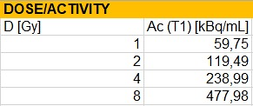
Clonogenic Assay - Catania
Clonogenic assay
0/1/2/4/8 Gy - 100-300 cells/well - 1 Timepoint (4 days) - 3 replicates/condition
GAMMA-COUNTER MEASUREMENT
Plate | N° cells | Cell Suspension Act. (Bq) – CALCULATED | Supernatant Act. (Bq) - REAL | Total Act. (Bq) - CALCULATED | % in-take
0 Gy | 100 | / | / | / | /
1 Gy | 100 | 7.694 | 53.296 | 60.990 | 12,61
2 Gy | 150 | 7.656 | 115.364 | 123.020 | 6,22
4Gy | 200 | 13.149 | 233.930 | 247.080 | 5,32
8 Gy | 300 | 50.771 | 443.388 | 494.160 | 10,27

Slide 7
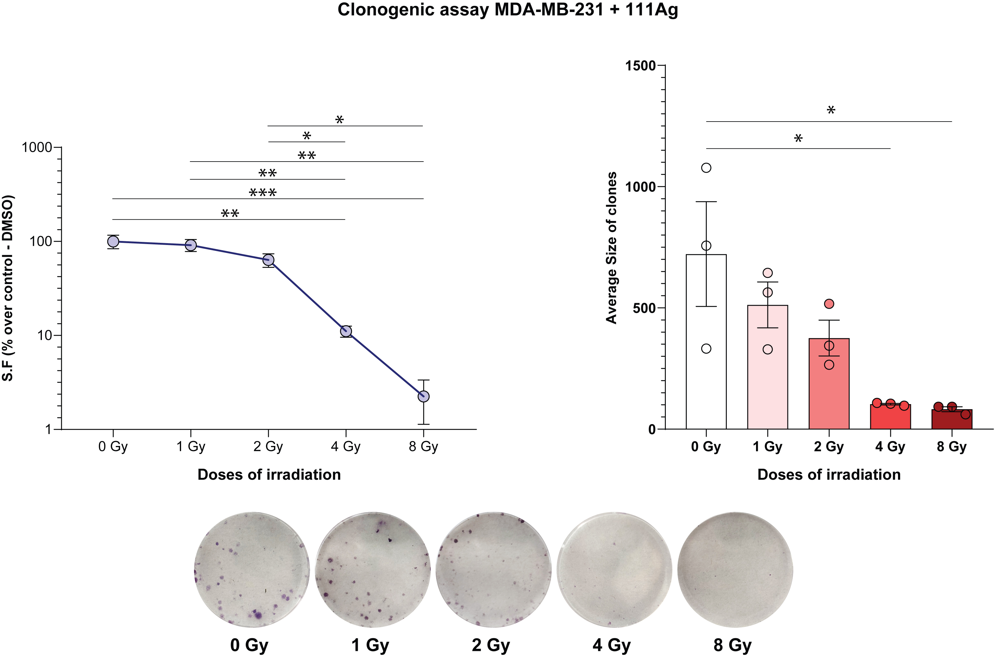
Survival fraction (%) + Average size of clones evaluation
4 DAYS of 111Ag TREATMENT on MDA-MB-231 cells

Slide 8
Next experiments - June 2025 Week 23.06.25
MDA-MB-231 e MCF10 cell lines
Clonogenic assay → 0-1-2-4-8 Gy - 4 days 111Ag treatment
Cell In-take → 1hr/24hrs/72hrs - 50kBq 111Ag activity
Foci H2aX→ 1hrs/2 hrs/24hrs - 50kBq 111Ag activity
Single cell evaluation → 1hr/24hrs - 0/200/400/600/800 KBq 111Ag activity

Slide 9
Clonogenic assay _ 0-1-2-4-8 Gy
4 DAYS of 111Ag TREATMENT
MDA-MB-231
0 Gy
1 Gy
2 Gy
4 Gy
8 Gy
100
100
100
100
100
100
200
200
200
400
400
400
800
800
800
MCF10
0 Gy
1 Gy
2 Gy
4 Gy
8 Gy
100
100
100
100
100
100
200
200
200
400
400
400
800
800
800

Slide 10
In-take cellulare 50kBq - Gamma-counter
50KBq 111Ag activity/well - 50k of cells/well
MDA-MB-231
a
b
c
200k
200k
200k
100k
100k
100k
50k
50k
50k
1 hr
24 hrs
72 hrs
MCF10
a
b
c
200k
200k
200k
100k
100k
100k
50k
50k
50k
1 hr
24 hrs
72 hrs

Slide 11
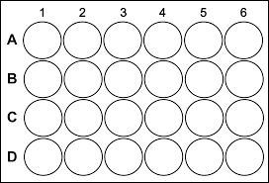
Foci H2aX→ 1hrs-2 hrs e 24hrs
50KBq 111Ag activity/well - 50k of cells/well
MDA-MB-231: 80k cells/well
MCF10: 80k cells/well
STOP AT 1 hr
STOP AT 1 hr
STOP AT 2 hrs
STOP AT 2 hrs
STOP AT 24 hrs
STOP AT 24 hrs
+ 10 uM
CTRL-Veichle
+ 50 KBq
111Ag
+ 10 uM
CTRL-Veichle
+ 50 KBq
111Ag
MDA
1 hr
MDA
2hrs
MDA
24hrs
MCF10
MCF10
MCF10
x1
x1
x1

Slide 12
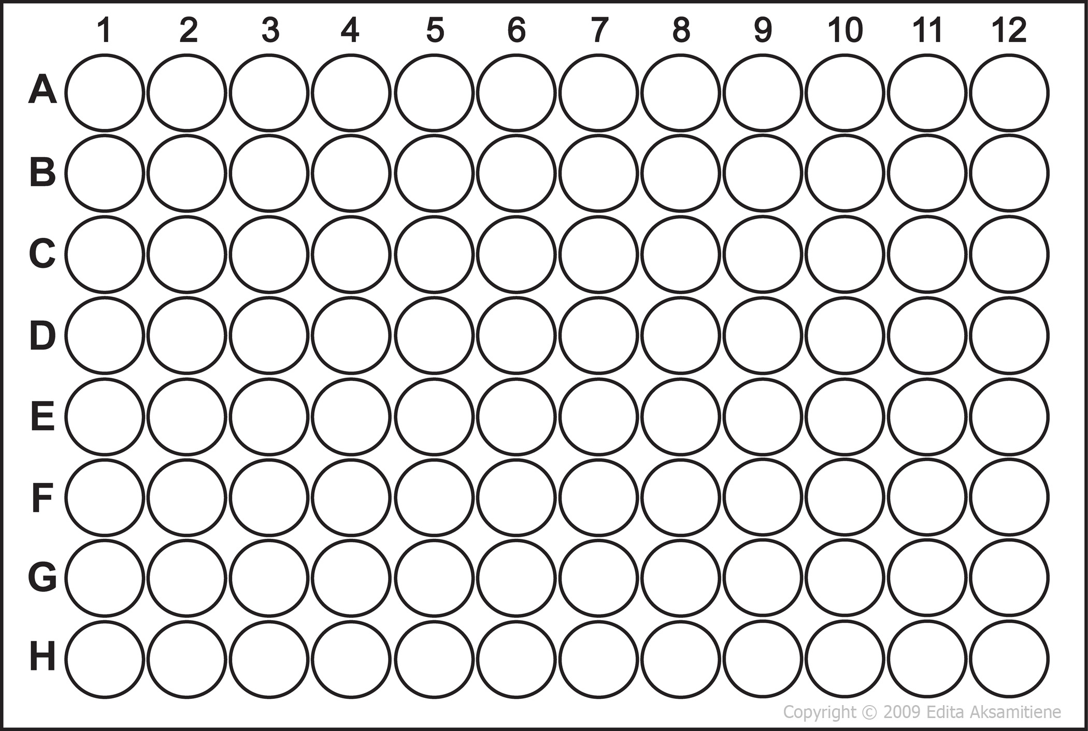
200kBq
Single cell evaluation
10.000 cells/well - 0(ctrl)/200/400/600/800 KBq - 1hr/24hrs timepoints
MDA-MB-231
MCF10
1 hr
24 hrs
CTRL
400kBq
600kBq
800kBq
CTRL
200kBq
400kBq
600kBq
800kBq

