Slide 1
3rd meeting Work Package 1, 2, 3 & 4
Wednesday 18 Jun 2025, 14:00 → 17:00
Alberto Andrighetto
Laboratori Nazionali di Legnaro – INFN

Slide 2
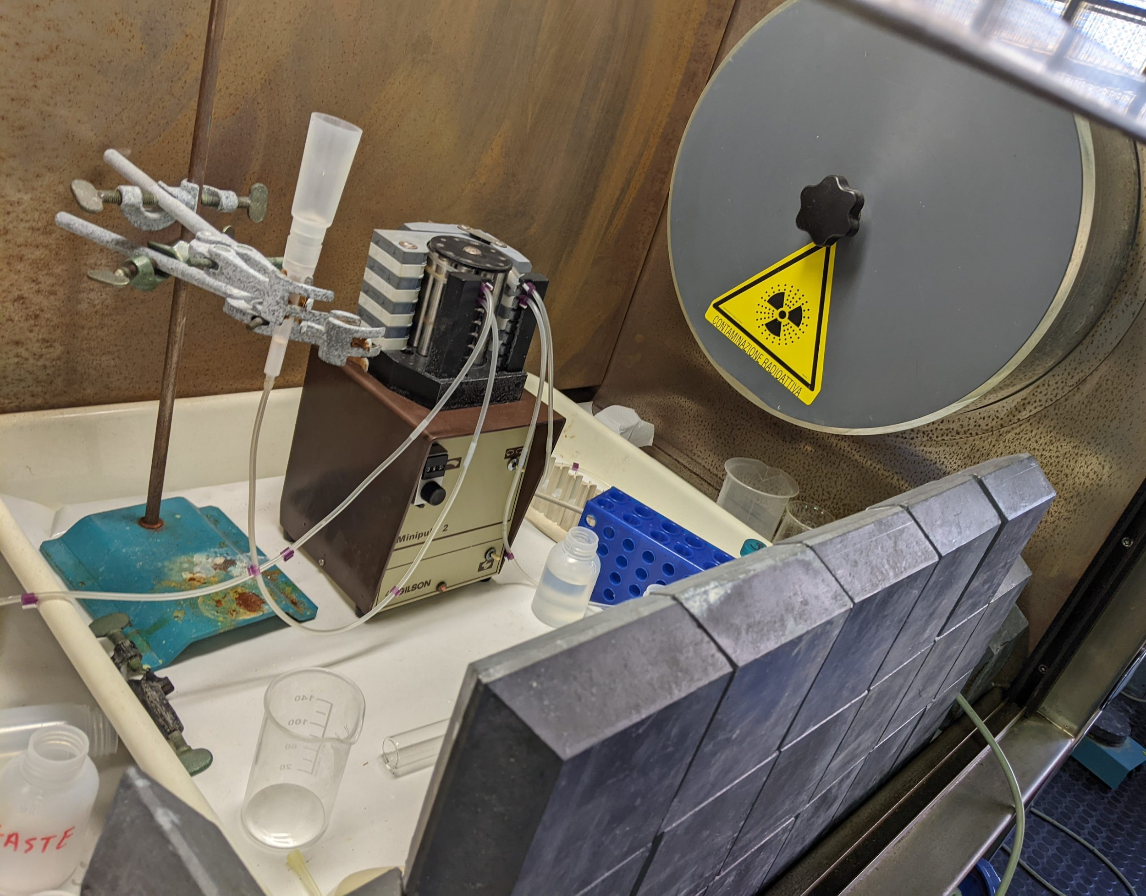
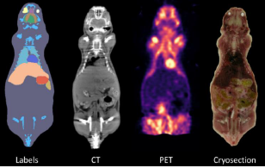
ISOLPHARM: over 10 years of activity
2014 - 2017
Interdisciplinary study group on production of medical radioisotopes at SPES
2018 - 2019
Simulations and feasibility evaluation
of Ag as radiopharmaceutical precursor
2020 - 2022
First production of ¹¹¹Ag in reactor and beginning of in-vitro and in-vivo testing
INFN experiments
2023 - 2025
Characterizing the 2D/3D in-vitro therapeutic effect of ¹¹¹Ag and its imaging capabilities
2025 - 2027
First nuclear measurements of radionuclide production at SPES
PRIN
Technological aspects of radionuclide production (target, ion source, implantation…)
2024 - 2025
2

Slide 3
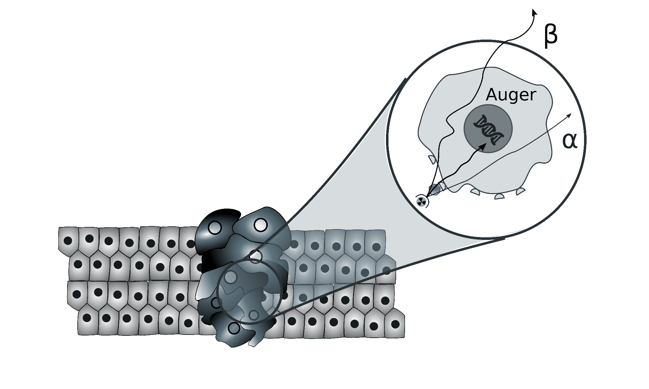
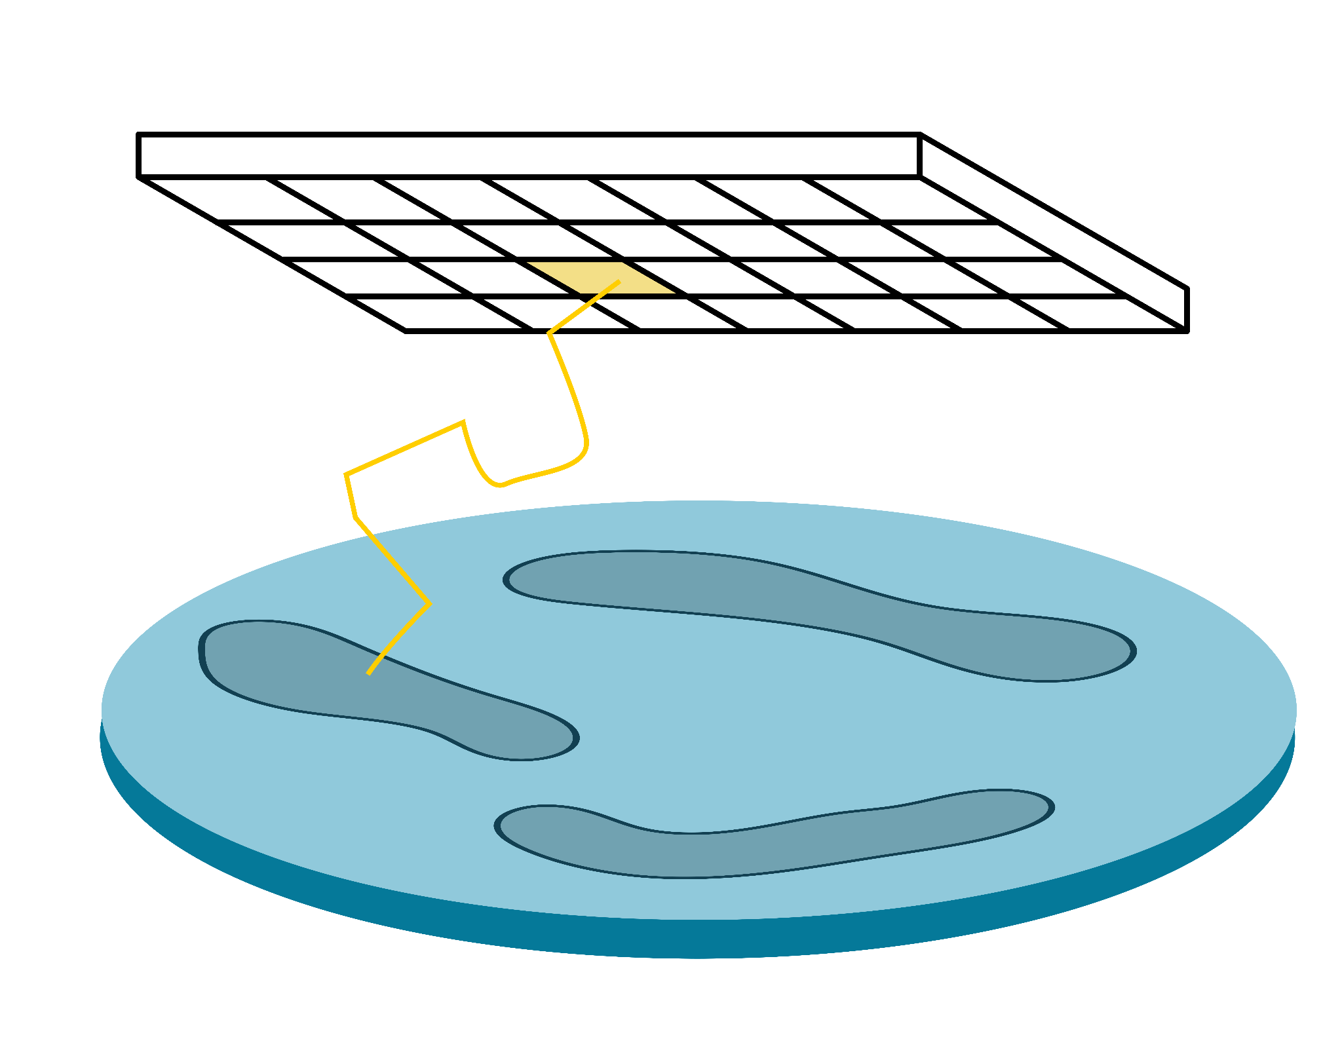
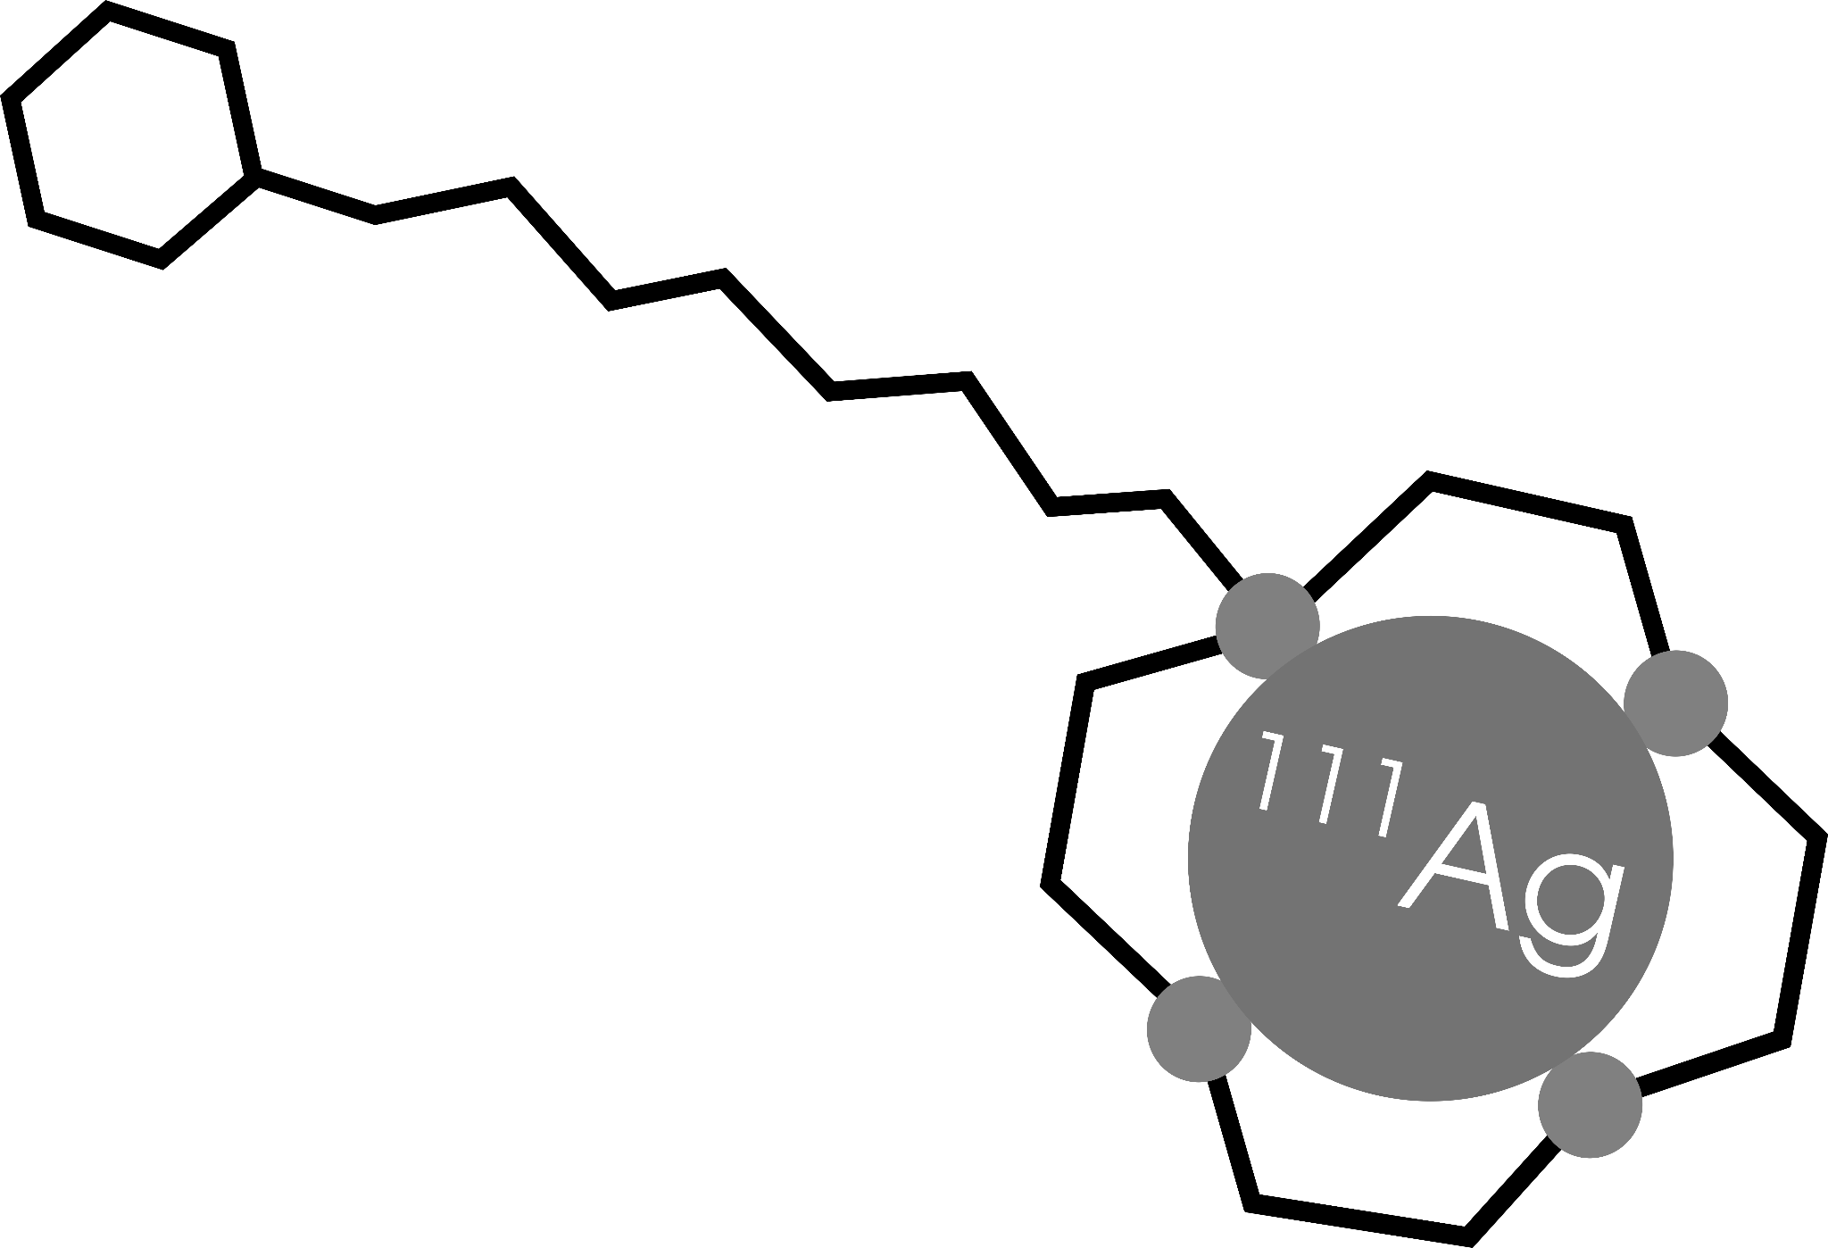
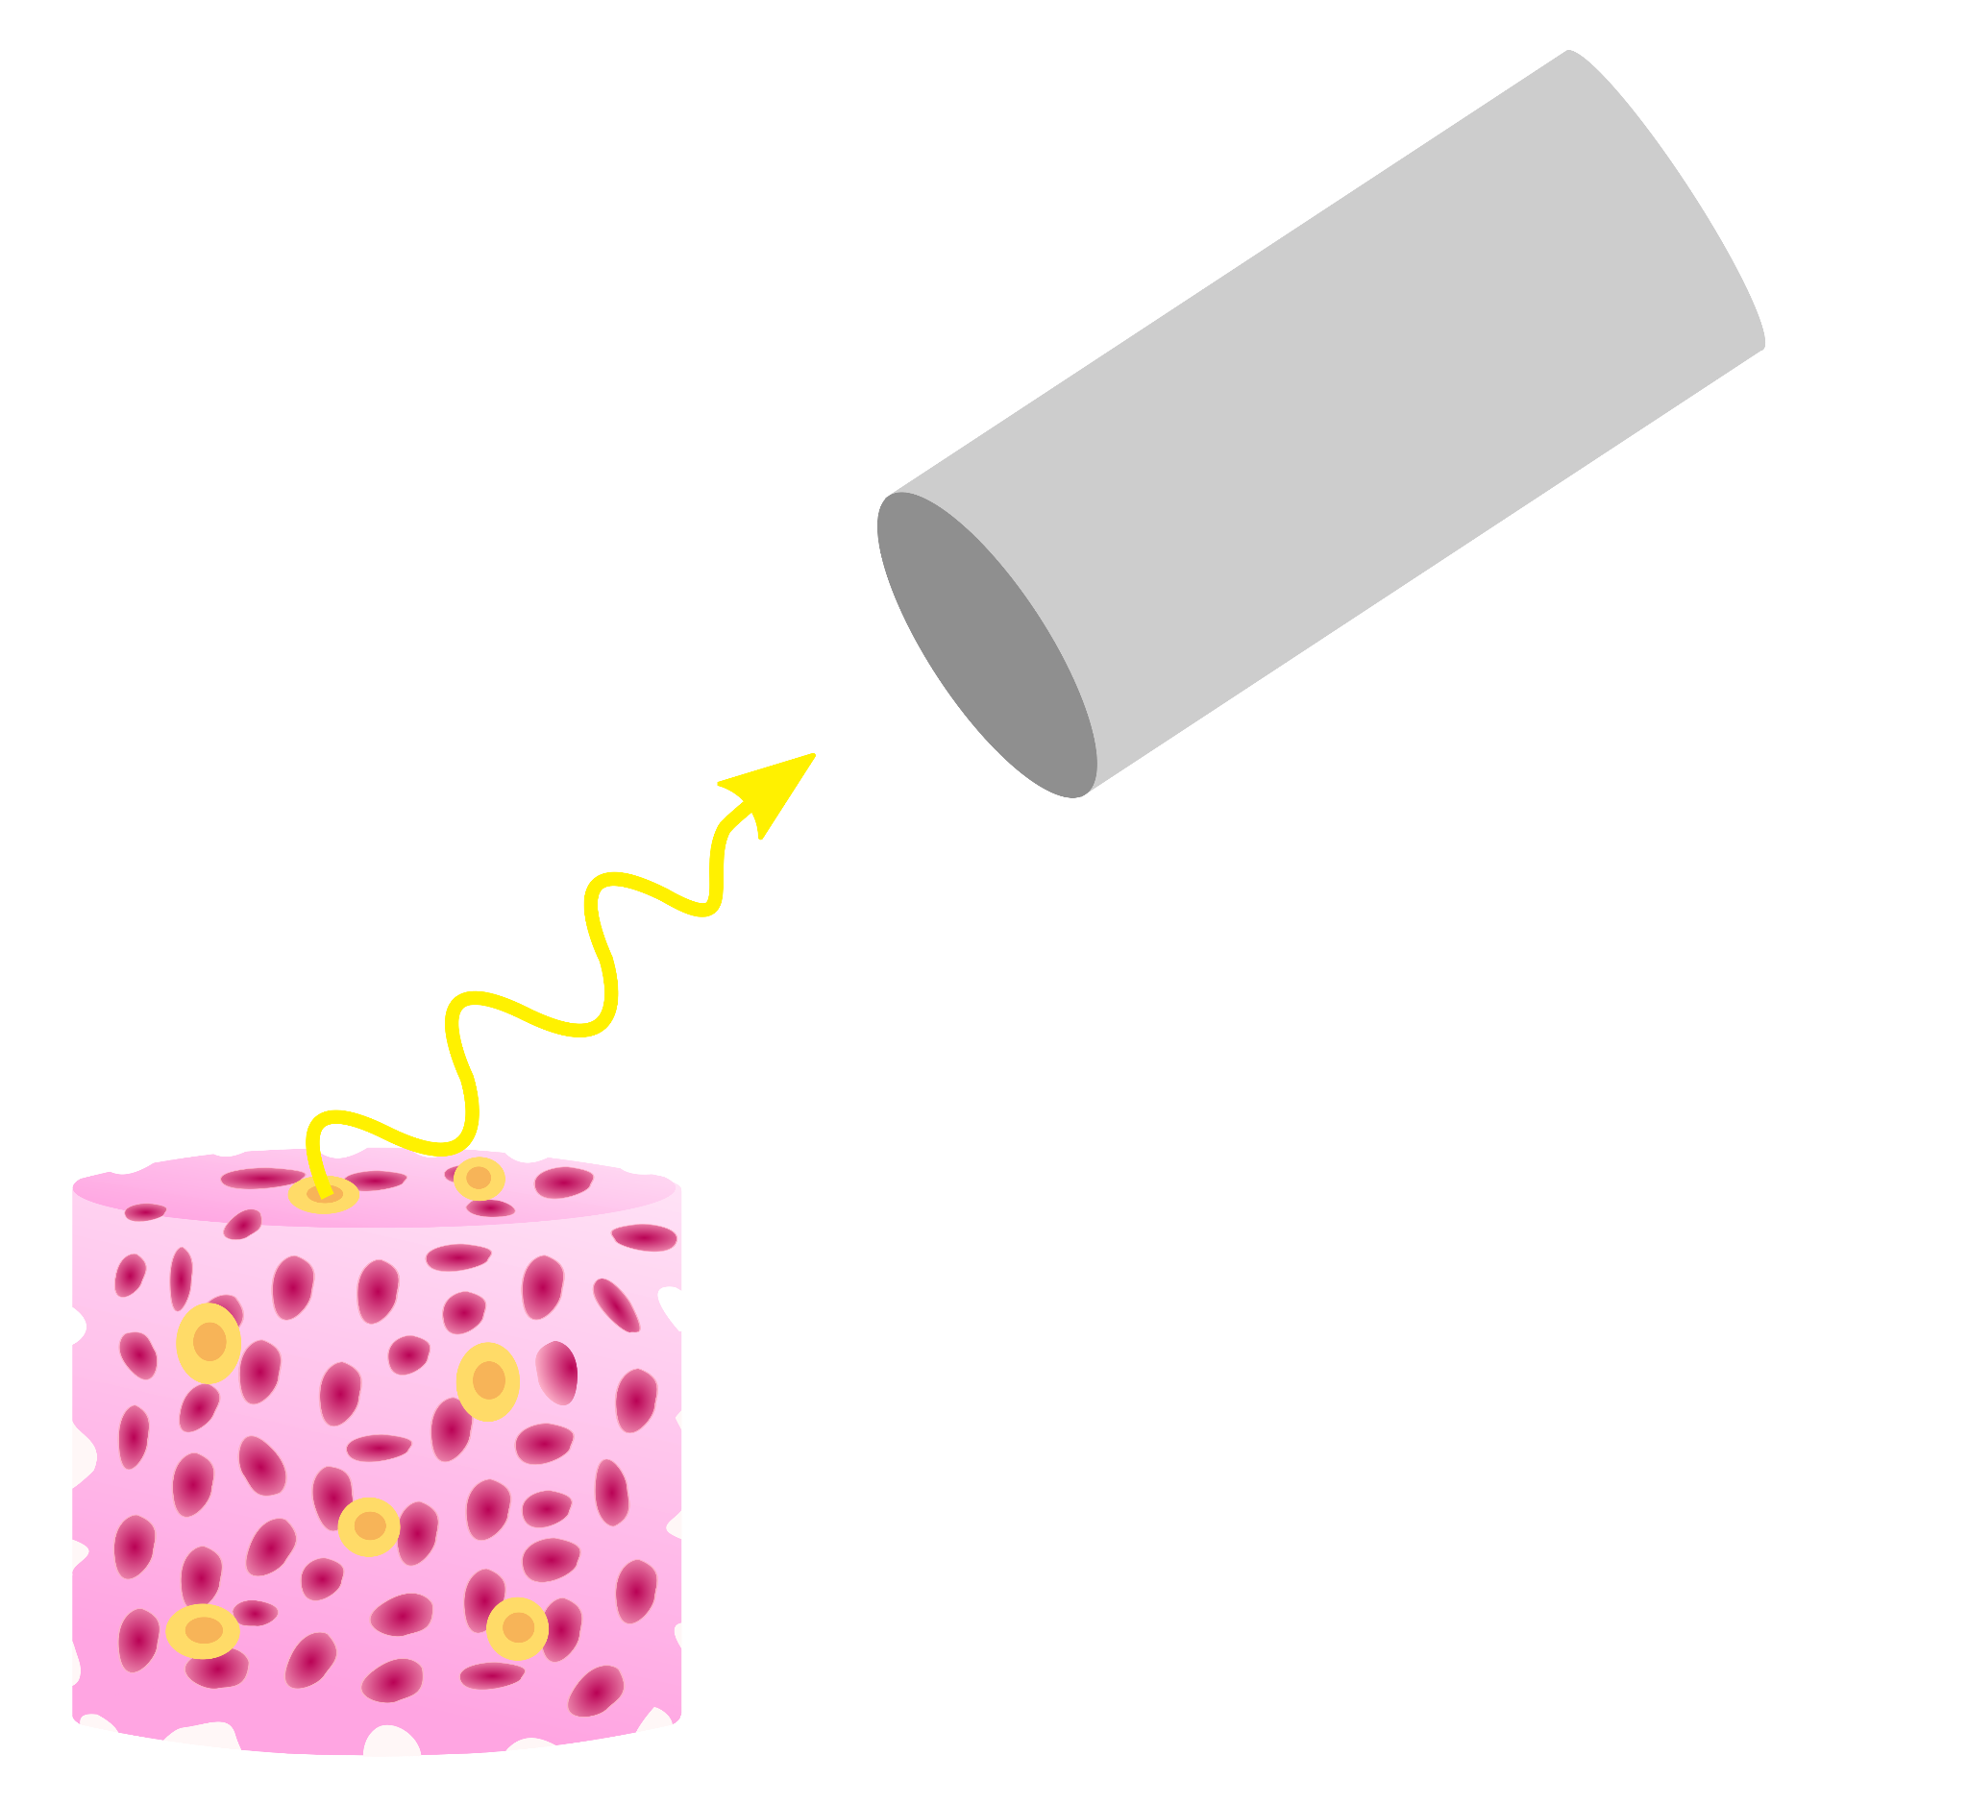
The ISOLPHARM Admiral experiment
Development of a β-imaging
system based on solid-state detector
Radiopharmaceutical
production
Radiobiological characterization
Development of a γ-imaging scintigraphic system

Slide 4
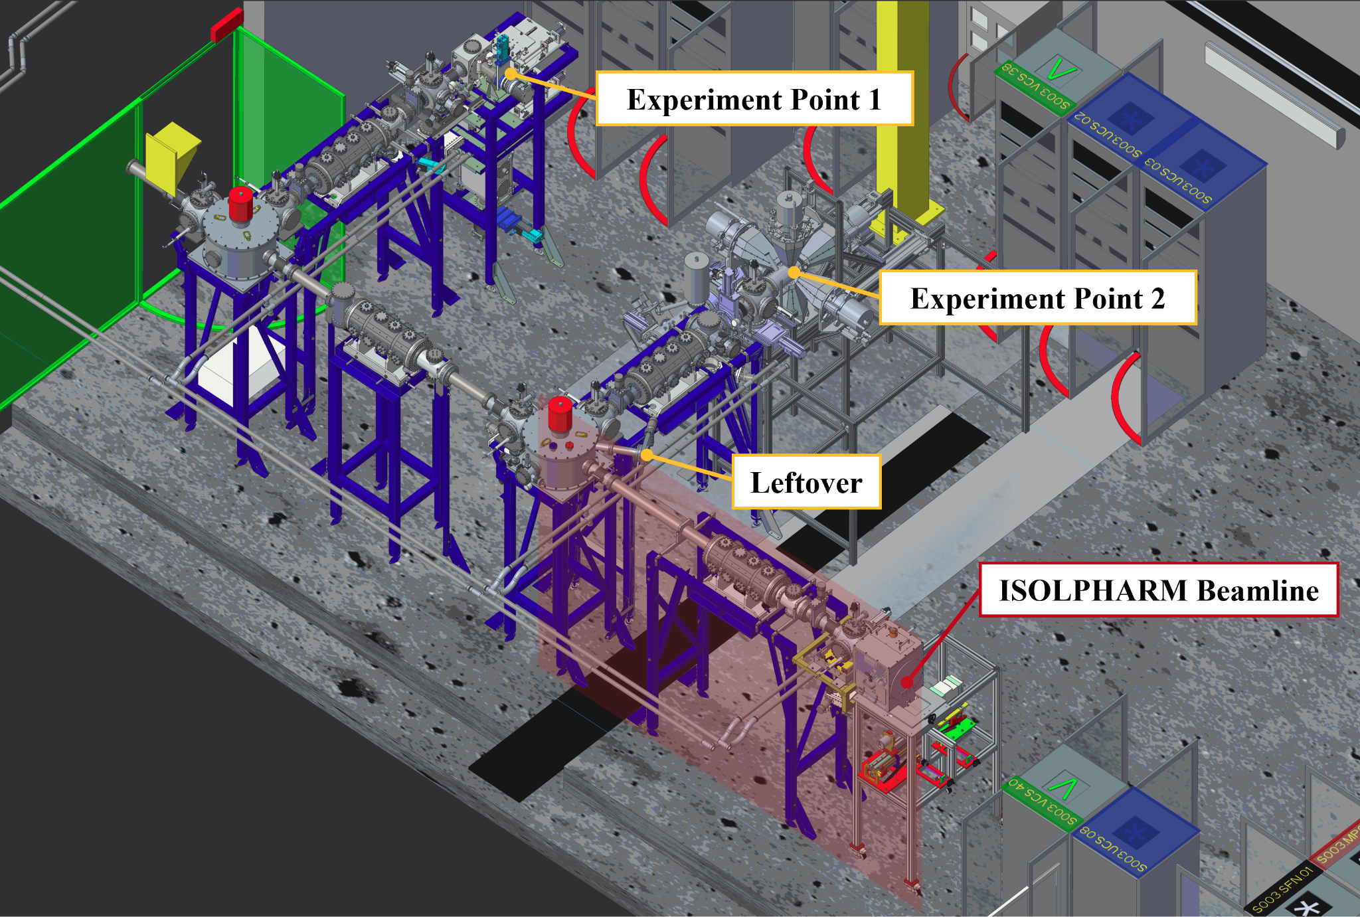
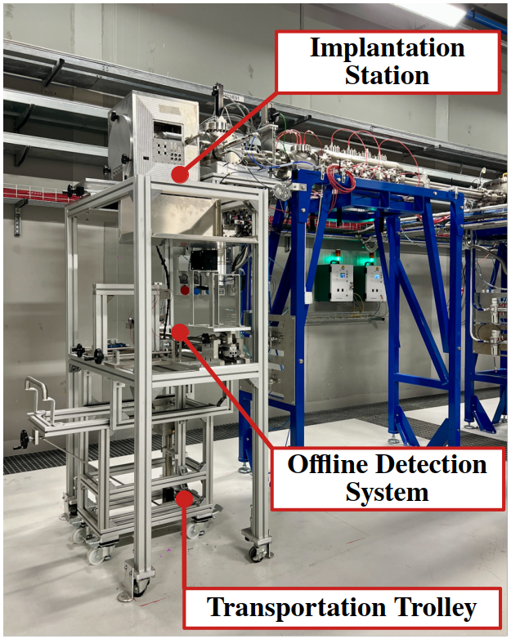
IRIS: ISOLPHARM Radionuclide Implantation Station

Slide 5
ADMIRAL organization
ISOLPHARM_EIRA
INSTRUMENTATION
RADIOBIOLOGY
WP1 :
Radiopharmaceutical
Production
WP2 :
β-imaging
WP3 :
γ-imaging
WP4:
Targeted Radiobiology
Production of Ag-111 at the LENA facilities, purification and quality control
Radiochemistry of Ag-111
Pharmacology
Bioengineering of 3D scaffolds
Mechanics & electronics design
Monte Carlo simulations for mechanics and detector design
Detector characterization and tests with fluorescence
Monte Carlo simulations for detector design
Planar imaging detector construction for Ag-111 γ detection
Characterization and test of the planar system
Cell survival tests in 2D flasks
Cell survival tests in 3D scaffolds
Comparison between different Monte Carlo codes
Dose computation in cell cultures
Q3: Is the ¹¹¹Ag gamma emission
suited for SPECT imaging (theranostic approach)?
Q2: What is the internalisation of our
¹¹¹Ag-based molecules?
Q4: What are the biological effects of
¹¹¹Ag-based radiopharmaceuticals?
Q1: Is it possible to reduce the number
of in-vivo experiments?

Slide 6
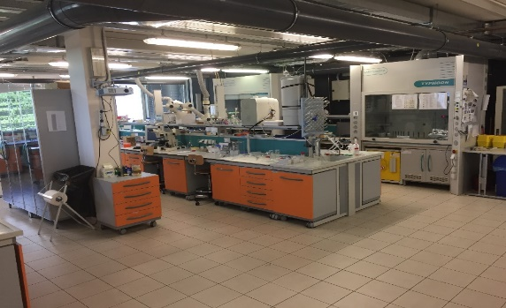
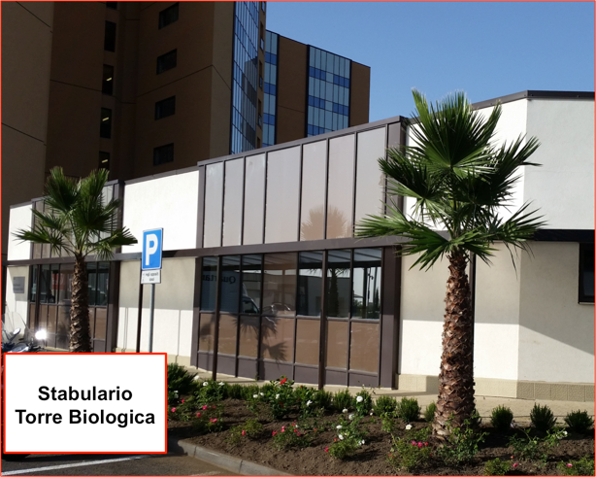
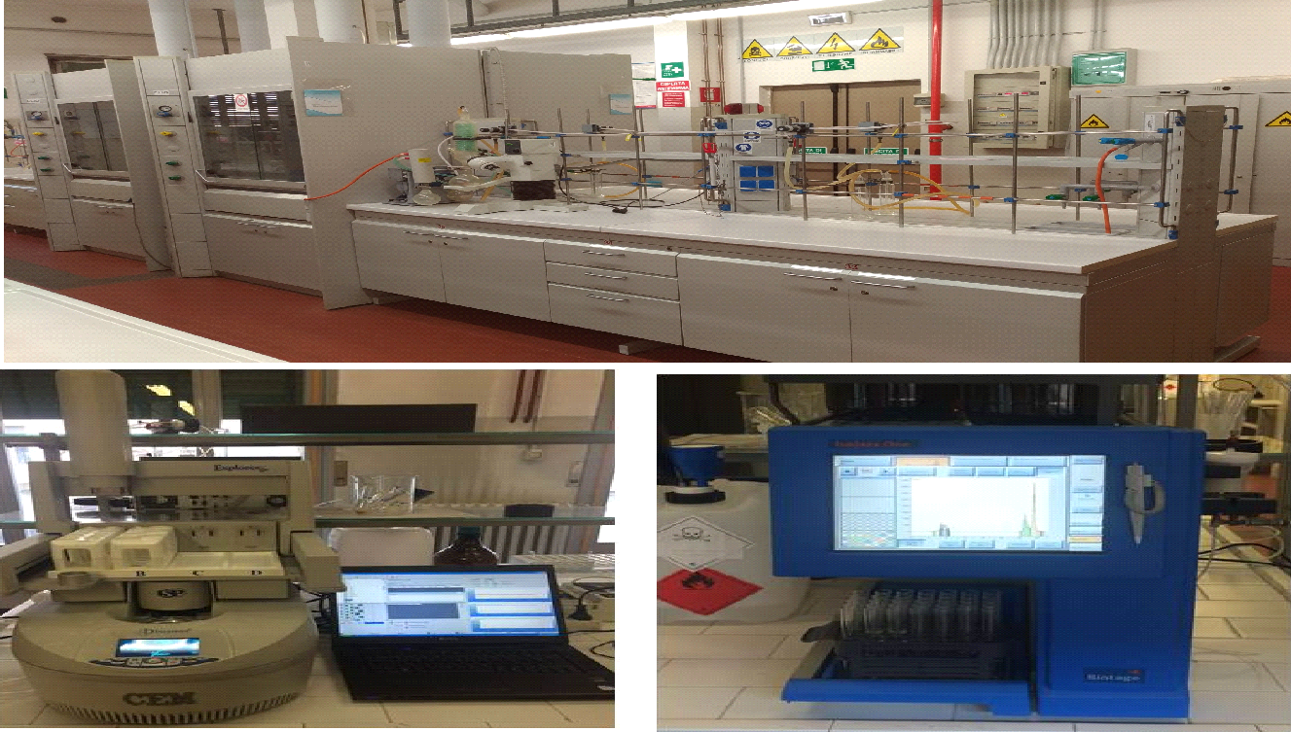
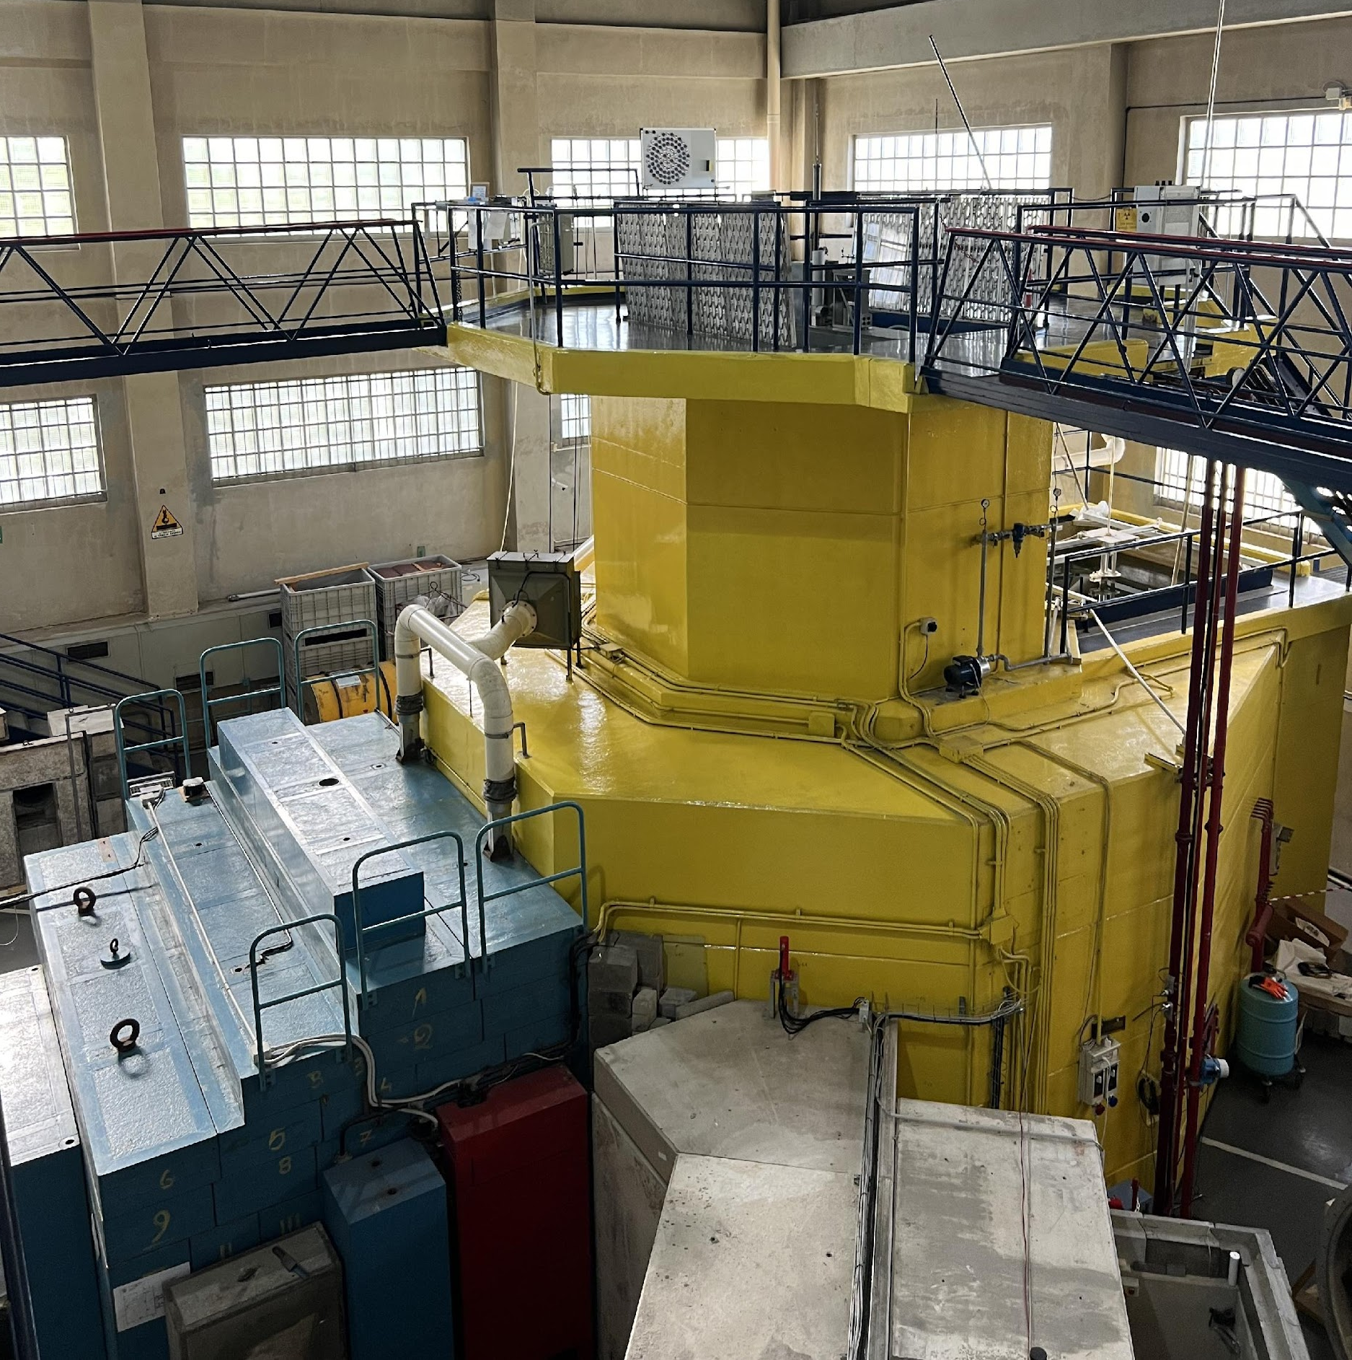
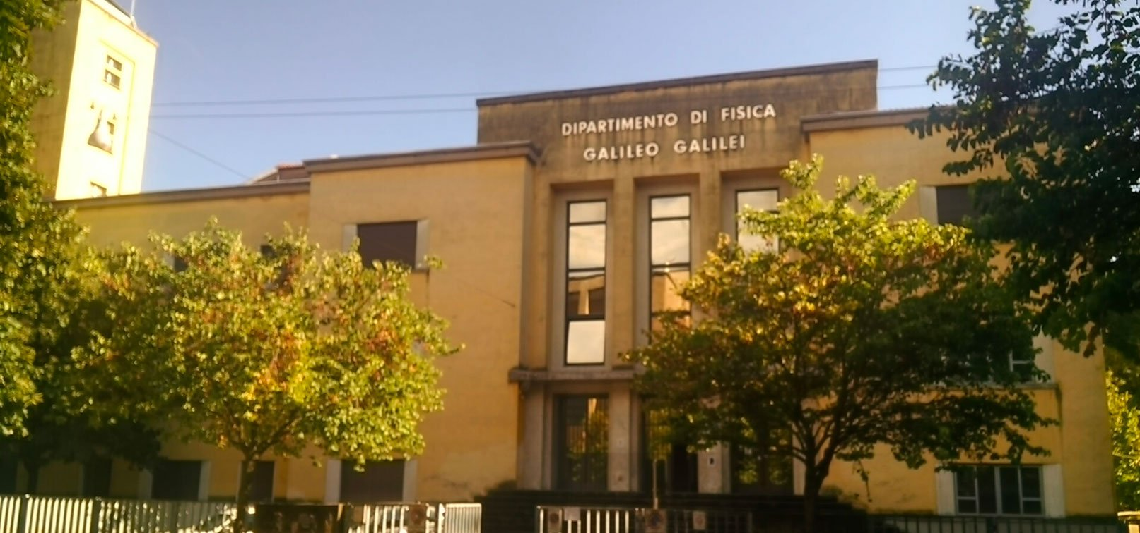
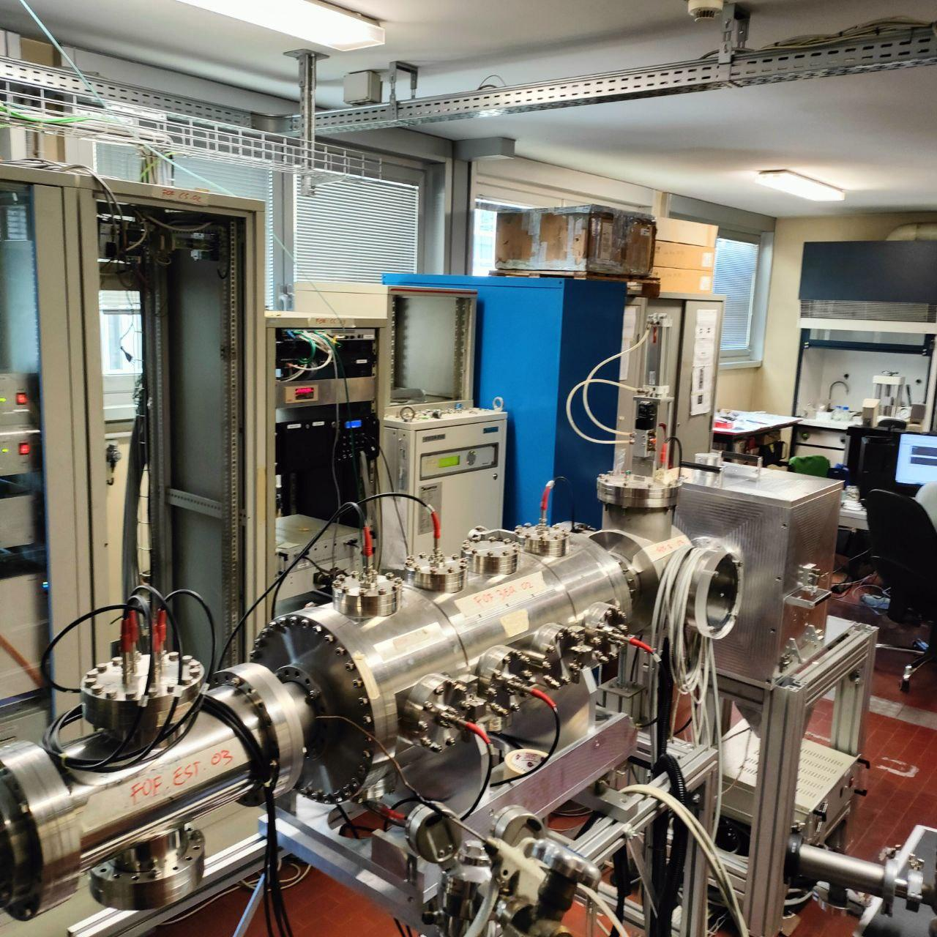
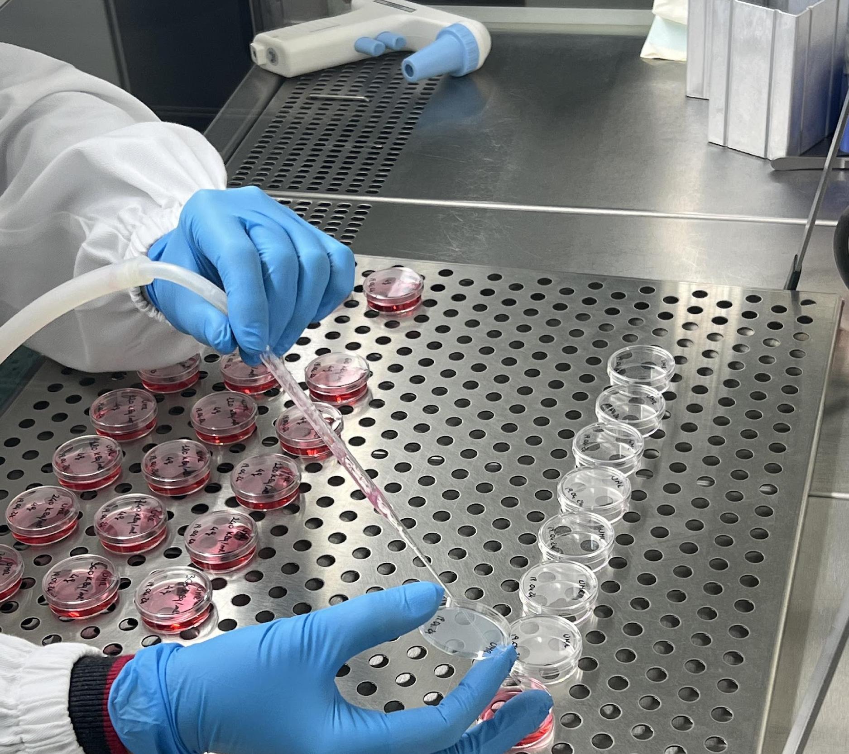
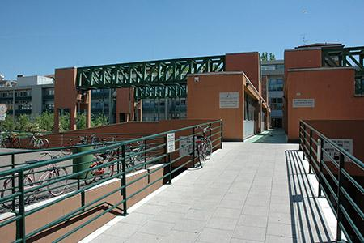
Collaboration infrastructures
WP1
Radiopharmaceutical
Production
WP2
β-imaging
WP3
γ-imaging
WP4
Targeted Radiobiology

Slide 7
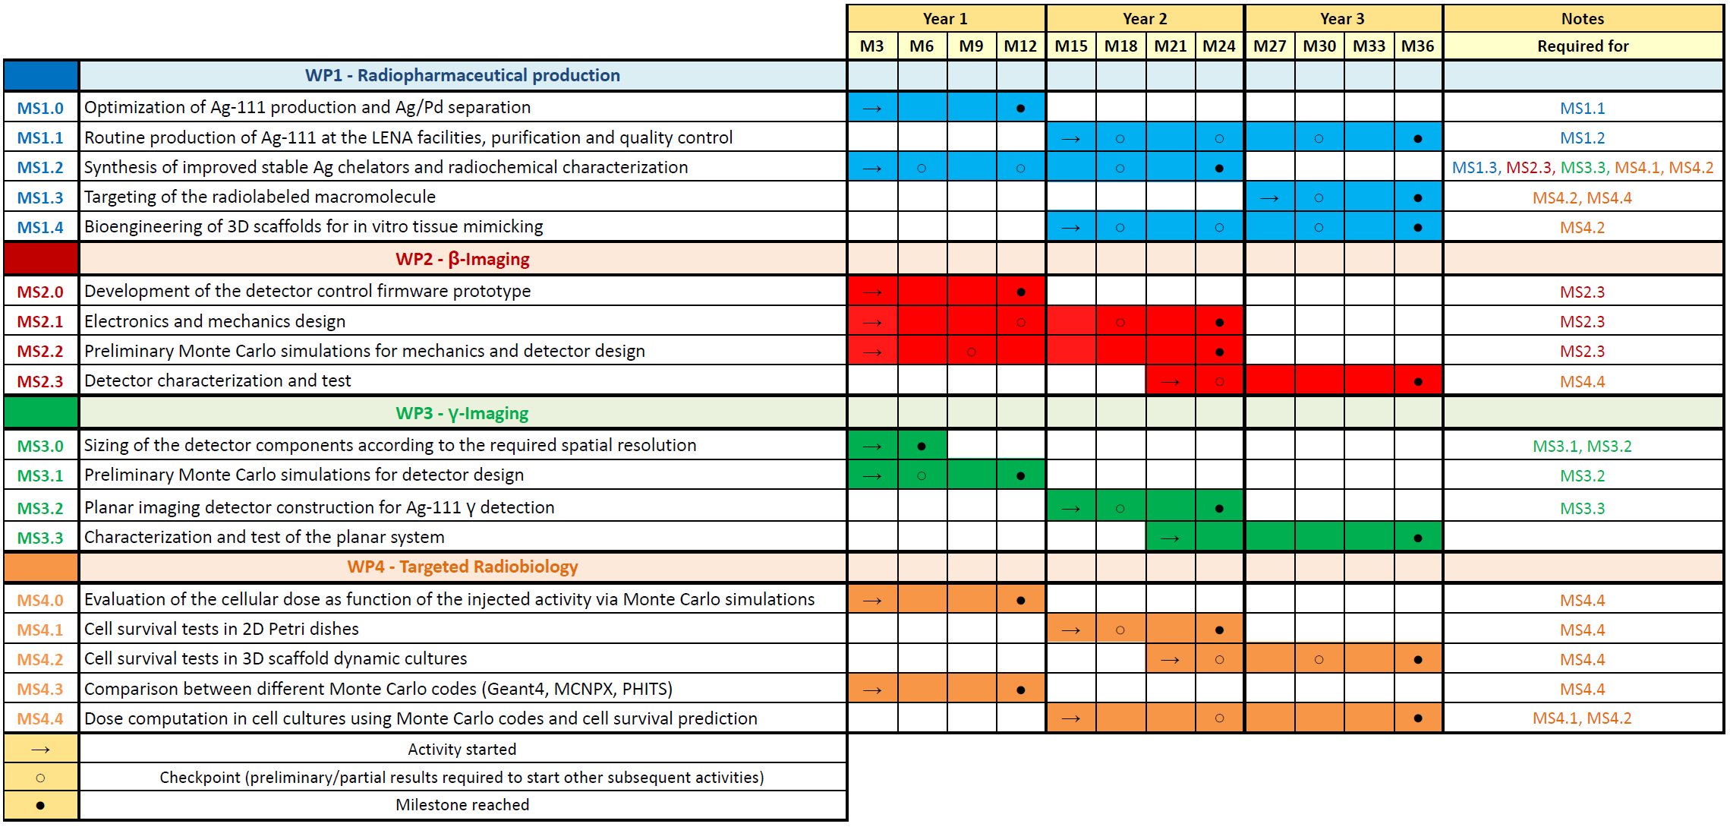
Experiment Milestones
7
Notes:
7

Slide 8
Milestones for 2025
MS1.3: Development of the macromolecule for active targeting
MS1.4: Bioengineering of 3D scaffolds for in vitro tissue mimicking
MS2.3: Beta-detector characterization
MS2.4: beta-imaging test with Ag-111
MS3.3: Characterization of the planar system for gamma-imaging
MS3.4: gamma-imaging test with Ag-111
MS4.2: Cell survival tests in 3D scaffold dynamic cultures
MS4.4: Dose computation in cell cultures using MC codes and cell survival prediction
Notes:
8

Slide 9
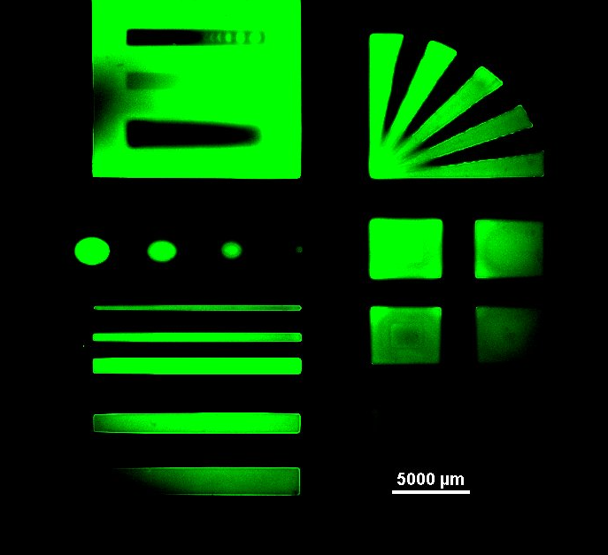
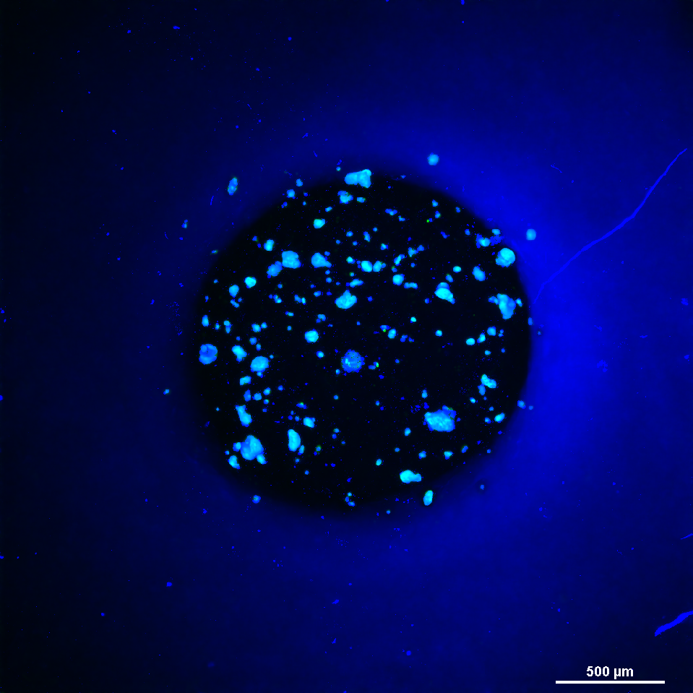
WP1 – 3D scaffold production
MS1.4 – Bioengineering of 3D scaffolds for in vitro tissue mimicking
Test without cells:
Printing tests using a DLP printer with GelMA are being conducted at BIOtech (TN).
Shapes are resolved and a gradient can be observed.
Test with cells:
After choosing a simpler geometry (circles and lines) a printing test with cells was conducted. Cells resulted to remain inside the boundaries of the geometries.
The figure shows one of the circle geometries observed with confocal microscope.
Next step:
Produce supports with Ag-111 inside the GelMA for Beta-detector resolution tests

Slide 10
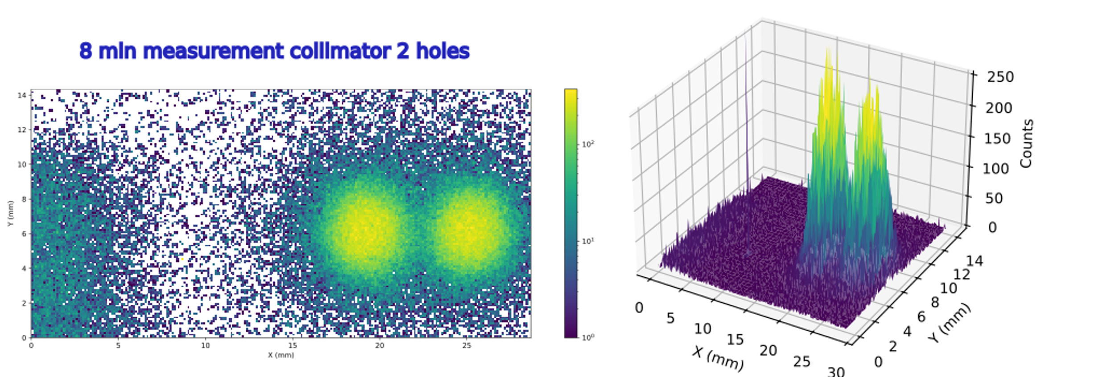
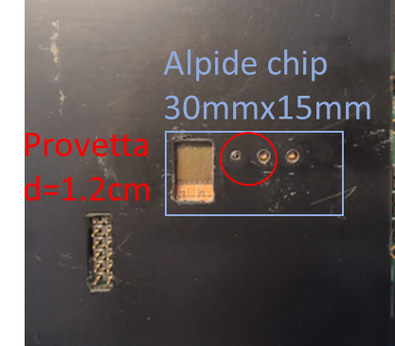
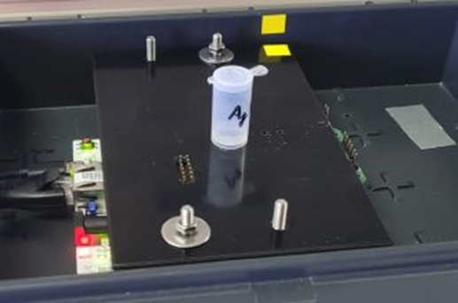
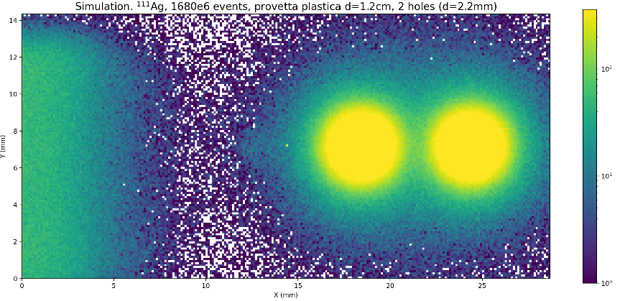
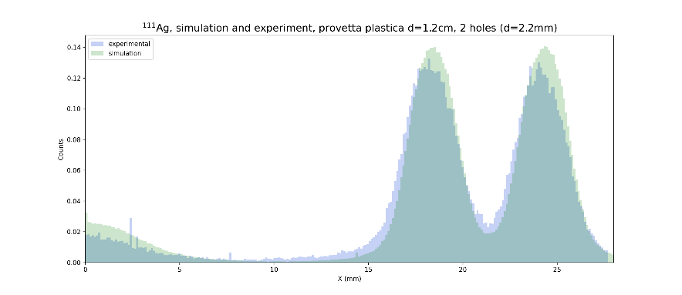
WP2 – Data acquisition with ¹¹¹Ag
MS2.3 – Detector characterization and test
Measurements performed with ¹¹¹Ag of activity A=3.5 MBq, at LENA (19/04/2024).
Only half of the chip (15mm x 15mm) was exposed,
using a collimator in front of the 2 holes.
Experiment
Simulation

Slide 11
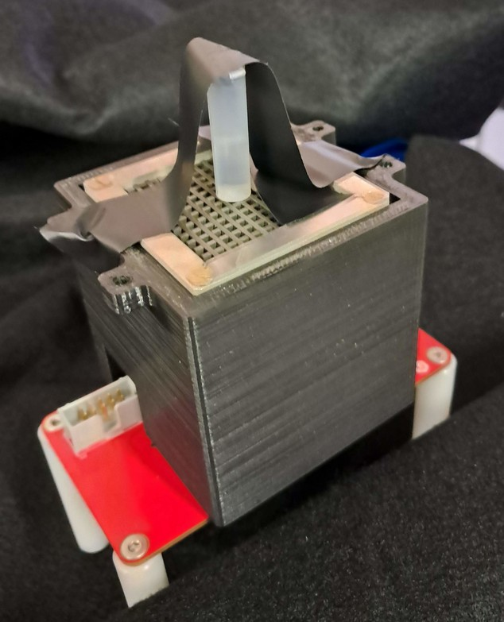
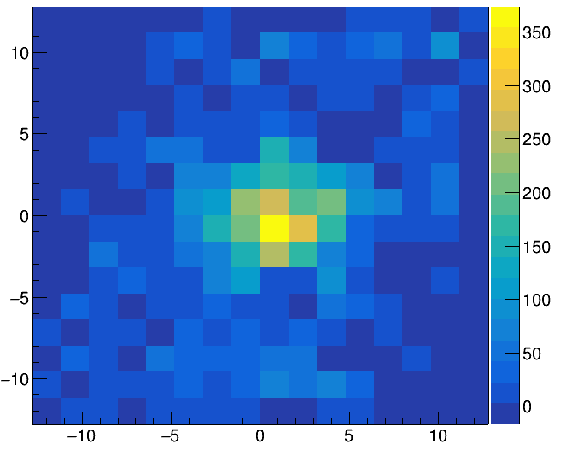
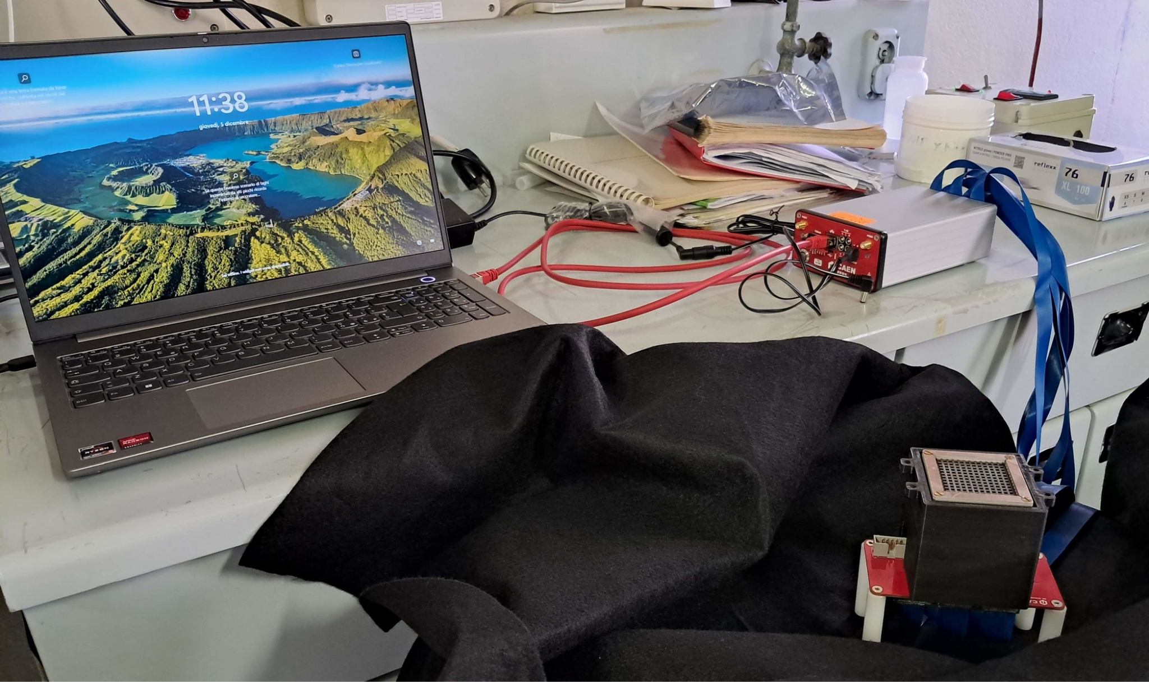
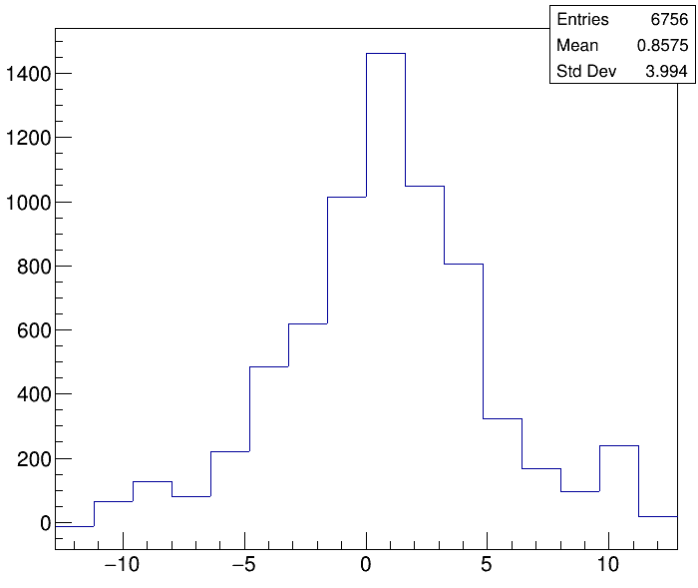
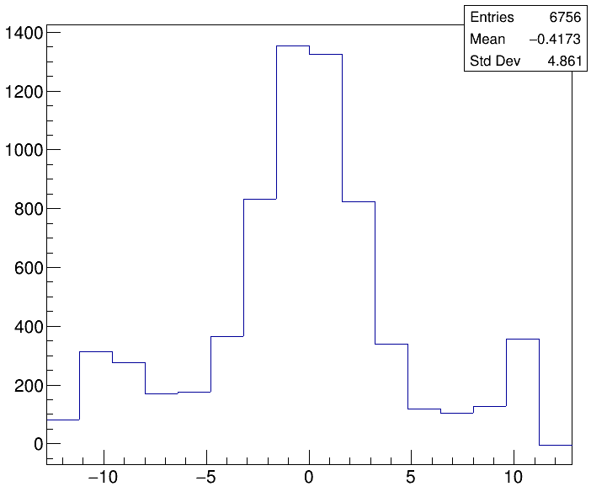
WP3 – System characterization
MS3.3 Characterization and test of the planar system
y (mm)
FERS A5202
Flat cable
γ camera
x (mm)
Experimental setup at LENA
1.35 MBq in 6.0 mm diameter vial
Preliminary results!
x (mm)
y (mm)

Slide 12
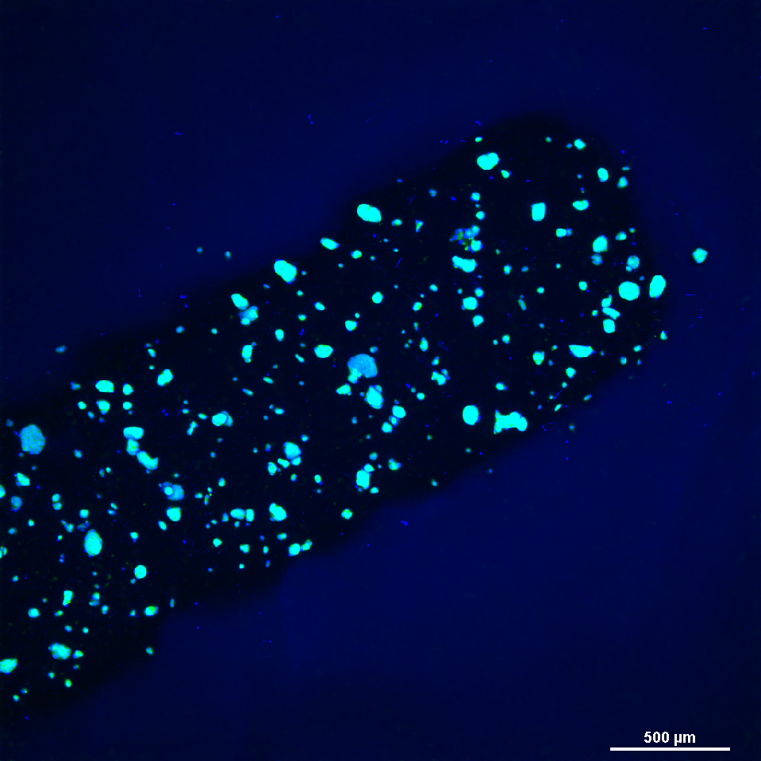
WP4 – 3D scaffold production
MS4.2 – Cell survival tests in 3D scaffold dynamic cultures
Defined protocol and materials to perform scaffold production tests with cells + Ag-111
Performed first cold scaffold production test with LNCaP cells in the GelMA.
Confocal microscopy image of cells in strip of GelMA
Next step: test with cells + Ag-111
Inject Ag-111 in the cell culture
Add irradiated cells in GelMa solution
Solidification via DLP technique in 3D geometry

Slide 13
WP4 – MC simulations
MS4.4 – Dose computation in cell cultures using Monte Carlo codes and cell survival prediction
Considering data coming from literature*, the model for cell survival prediction was validated.
Same comparisons will be performed on data coming from the next in vitro experiments with Ag-111.
Pouget et Al., «Cell membrane is a more sensitive target than cytoplasm to dense ionization produced by auger electrons.» Radiat Res. 2008 Aug;170(2):192-200.

Slide 14
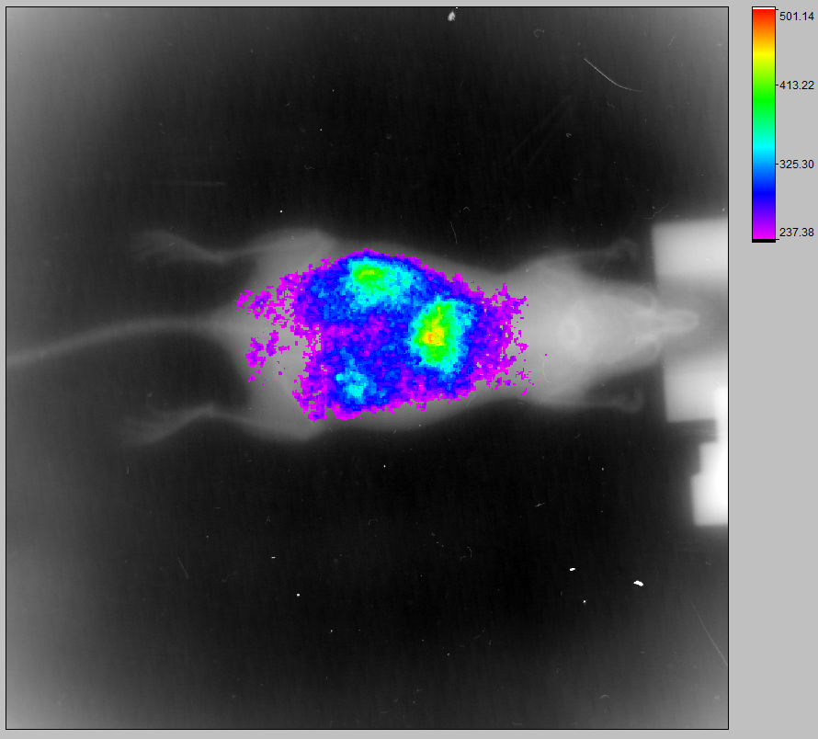
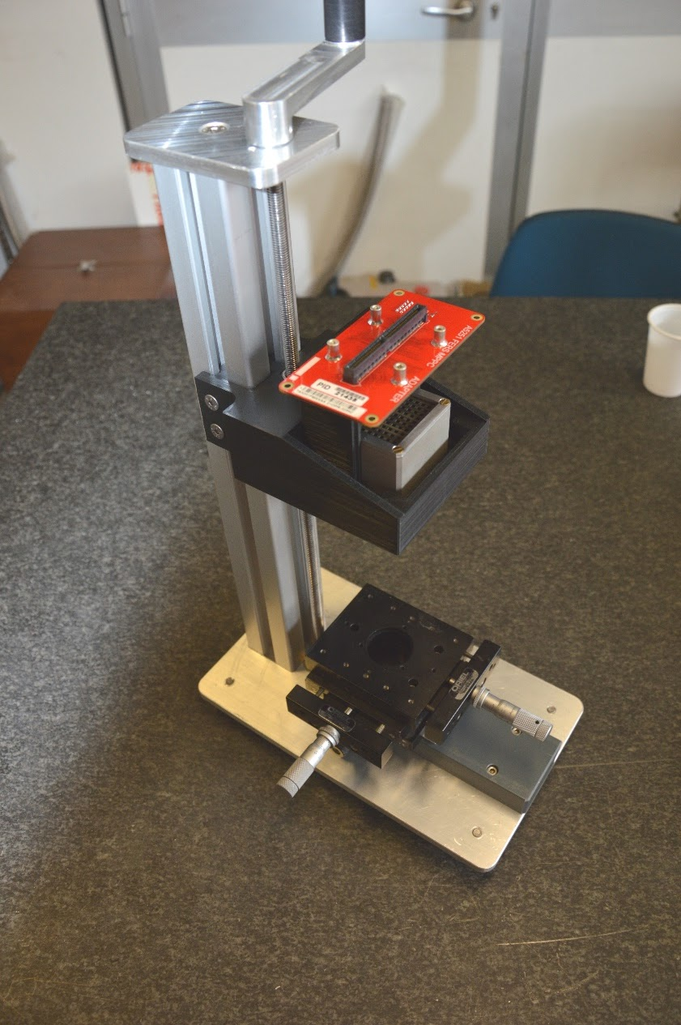
ADMIRAL achievements
WP1 - Radiopharmaceutical production
Optimization of chelators for Ag
Optimization of Ag production and separation
Development of 3D scaffolds for prostatic cancer cells
WP2 - β imaging
2D β imager “DUMBO” construction
Characterization tests with ¹¹¹Ag
WP3 - γ imaging
¹¹¹Ag γ camera prototype development
Characterization tests with ¹¹¹Ag
WP4 - Targeted radiobiology
2D survival of different cell lines treated with free ¹¹¹Ag
Protocol for experiments in 3D scaffolds
Cell dosimetry and DNA damage/repair models
14
Notes:
14

Slide 15
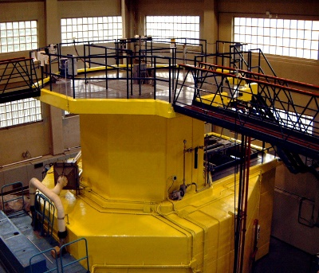
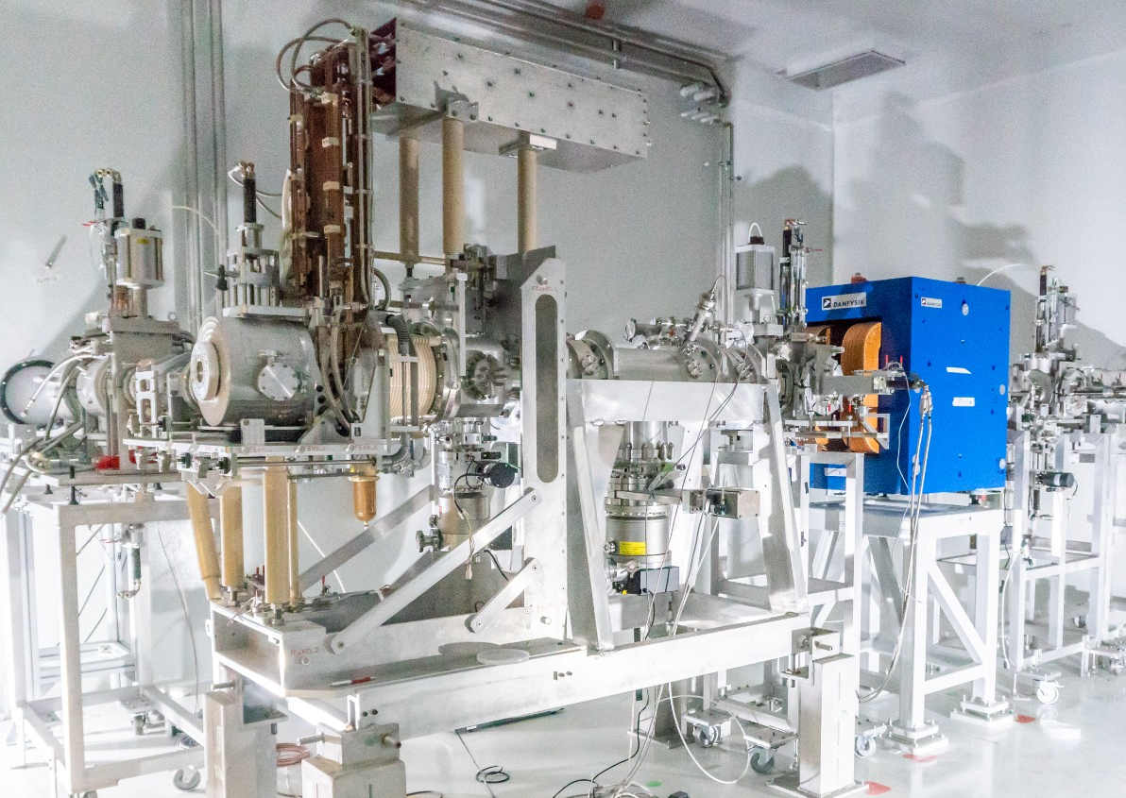
ISOLPHARM_APEX (2026-2028)
Main goals
Understanding the dosimetry of ¹¹¹Ag-PSMA-617 in living systems such as cells, small animals and human patients.
Studying this radiopharmaceutical in cancer cell cultures in 2D monolayers and in 3D tissue-mimicking scaffolds.
Observing the biodistribution and the effects of theranostic ¹¹¹Ag-PSMA-617 on small animals.
Investigating the radiobiological response to low-dose-rate radiation using the first nuclides obtainable at SPES.
¹¹¹Ag-PSMA-617 EXperiments
Main route
Secondary route
Radionuclide production at LENA and SPES
15

Slide 16
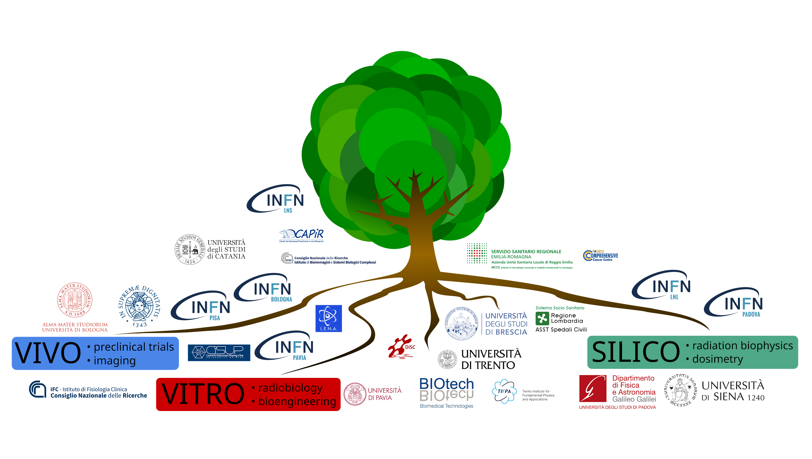
Future: ISOLPHARM_APEX
7 INFN partners:
LNL
Padova
Bologna
LNS
Pavia
Pisa
TIFPA
3 work packages:
WP1: Silico
WP2: Vitro
W3: Vivo
+ several other institutes (8 universities, 5 hospitals, etc.)

