Slide 1
FLASH meeting
WP3: RF Cavity
UPCT, LNF, IFIC (CSIC-UV)
FLASH Meeting
April 30th, 2025

Slide 2
Results TM₀₁₀ and TE₁₁₁
        Refinement of the mesh in CST of the critical points of the gap.
        Calculation of Q factor for TM₀₁₀ and TE₁₁₁ modes.
        Variation of the original position of the gap.

Slide 3
Mode TE₁₁₁
With the refinement of the gap, two quasi-TE₁₁₁ modes were found. One of them seems to be more affected by the gap than the other one.
Mode 1
Mode 2

Slide 4
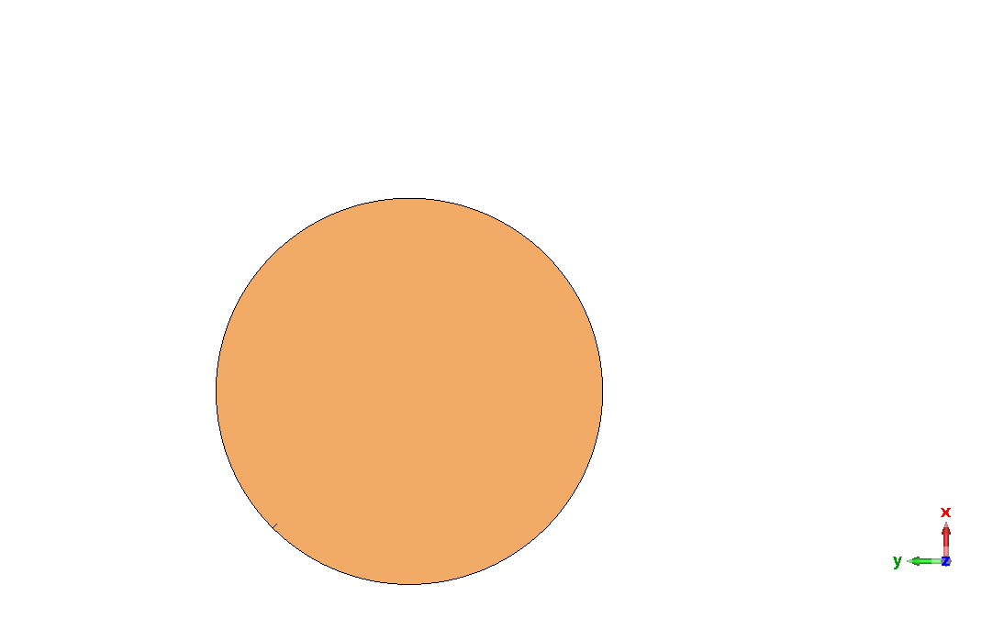
Comparative of the gap position for TE₁₁₁
We have also changed the initial position of the gap, to see if there is any variation. It seems like could be a factor to take into account since we obtain different results.
Old position (up-right)
New position (bottom-left)

Slide 5
RESULTS OF LARGE FLASH CAVITY (for different gap positions)
Old position (up-right)
Quasi - TE Modes (old position) | 𝑸_{rad} | 𝑸_{total} | 𝒇_{𝒓} (MHz)
^{Mode 1} | 2.70e8 | 4.02e5 | 150.136
^{Mode 2} | 4.88e5 | 1.81e5 | 150.165
New position (bottom-left)
Quasi - TE Modes (new position) | 𝑸_{rad} (x10⁵) | 𝑸_{total} (x10⁹) | 𝒇_{𝒓} (MHz)
^{Mode 1} | 1.65e8 | 4.08e5 | 150.124
^{Mode 2} | 5.28e4 | 3.07e4 | 150.231
With the old position, there is a frequency separation of 0.029 MHz while with the new position has a frequency separation of 0.107 MHZ, but has a lower quality factor as well.

