Slide 1
Preliminary results May tests

Slide 2
Setup
New rotameter (less sensitve)
Pipe instead of Z3
No bubbler
Connection to pressurise Z5
PUMP
GC
AIR
NEW
Z5
P
VENT
H2O
PIPE
FLUX
H2O
CH4
4500 ppm

Slide 3
Setup
PUMP
GC
AIR
Test scheme
NEW
Z5
P
VENT
H2O
PIPE
FLUX
H2O
CH4
4500 ppm

Slide 4
Setup
PUMP
GC
AIR
Regeneration scheme
NEW
Z5
P
VENT
H2O
PIPE
FLUX
H2O
CH4
4500 ppm

Slide 5
Setup
PUMP
GC
AIR
Put some pressure in the cartridge with only air
NEW
Z5
P
VENT
H2O
PIPE
FLUX
H2O
CH4
4500 ppm

Slide 6
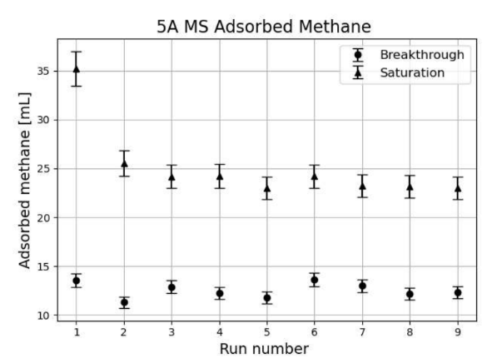
Compatibility with previous tests
media BT B [ml] | media SAT B [ml] | concentration | # test
16.25 | 24.20 | 4509.0 | 3
9.74 | 11.52 | 2254.5 | 3
It seems ok

Slide 7
Preliminary results
Correlation between CH4 concentration and total adsorbtion capacity
2 points are still at low statistics
The curve seems to not be linear
Problem with the point at lower concentration

