Slide 1
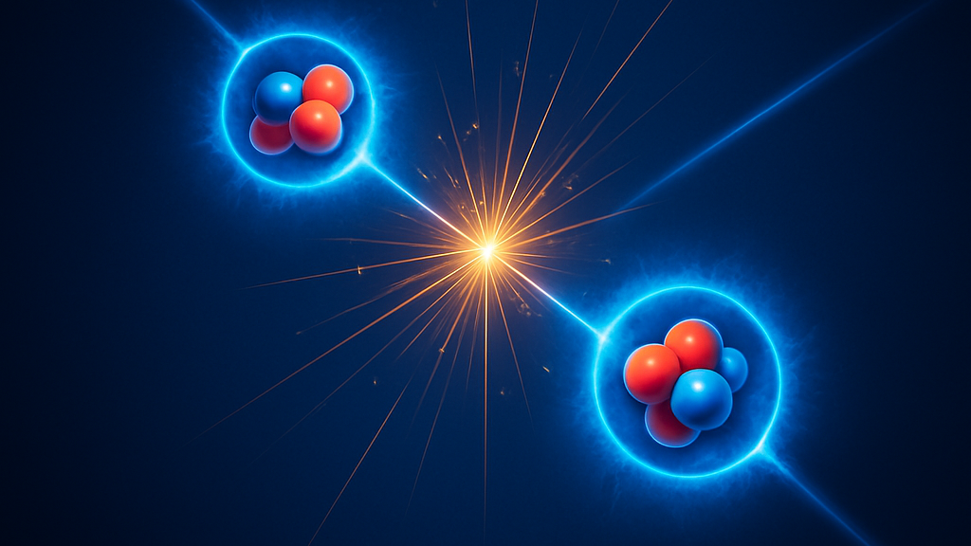
Exotic Spectroscopy
‘Old’ problems and New solutions
Davide Germani

Slide 2
Overview
Introduction
Exotic hadrons
Exotic spectroscopy
Scalar mesons problem
The scalar mesons problem and the QCD instanton
New data
X(3872): compact vs molucule
X(3872) natura from NREFT
Future prospects

Slide 3
Exotic Hadrons
Exotic hadrons are subatomic particles composed of quarks and gluons, but which consist of more than three valence quarks or have an explicit valence gluon content.
R. Jaffe, Phys. Rev. D 15, 267 (1977) DOI: 10.1103/PhysRevD.15.267; H. Fritzsch and M. Gell-Mann, Proceedings of the XVI International Conference on High Energy Physics, Chicago-Batavia (1972).
Pieces: quarks, anti-quarks and gluons
$SU{\left(3\right)}_{C}$ rule: every combination is allowed as long as it respects confinement i.e. boxes forms columns of three elements
$$q$$
$$q$$
$$q$$
$$q$$
$$q$$
$$q$$
$$q$$
$$q$$
$$g$$
$$q$$
$$\overline{q}$$
$$\overline{q}$$
$$\overline{q}$$
$$\overline{q}$$
$$\overline{q}$$
$$q$$
$$g$$
$$q$$
$$g$$
Meson
Baryon
Glueball
Tetraquark
Pentaquark
Hybrid
EXOTIC HADRONS

Slide 4
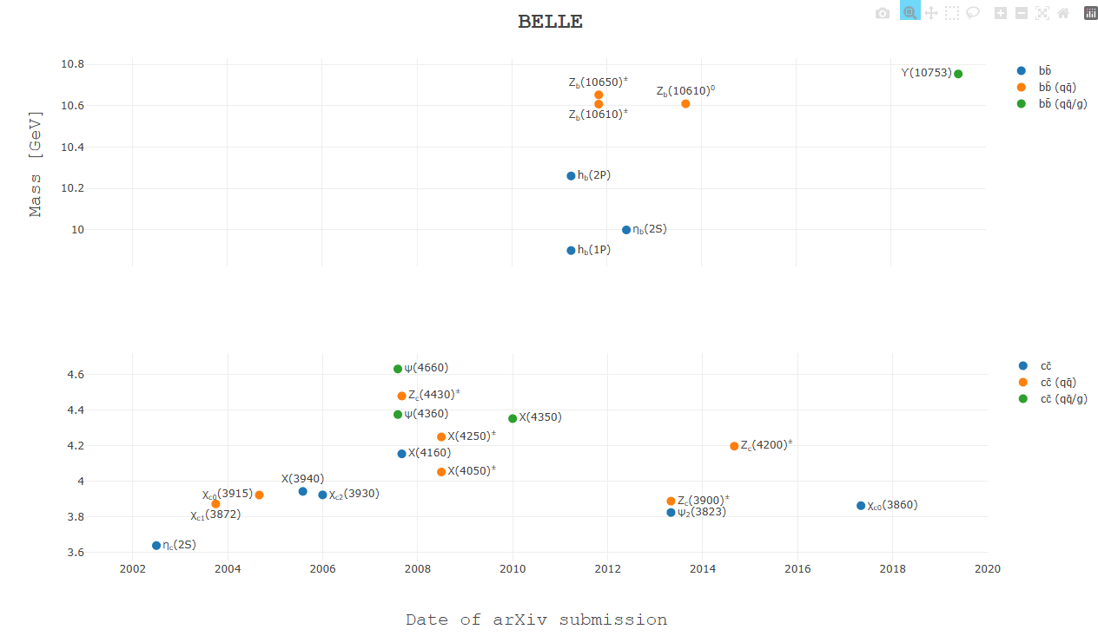
Exotic Hadrons
Although the existence of exotic states had already been theorized in the 1970s, the first exotic particle was discovered in 2003: the X(3872).
LHCb
QWG Exotics hub: https://qwg.ph.nat.tum.de/exoticshub/

Slide 5
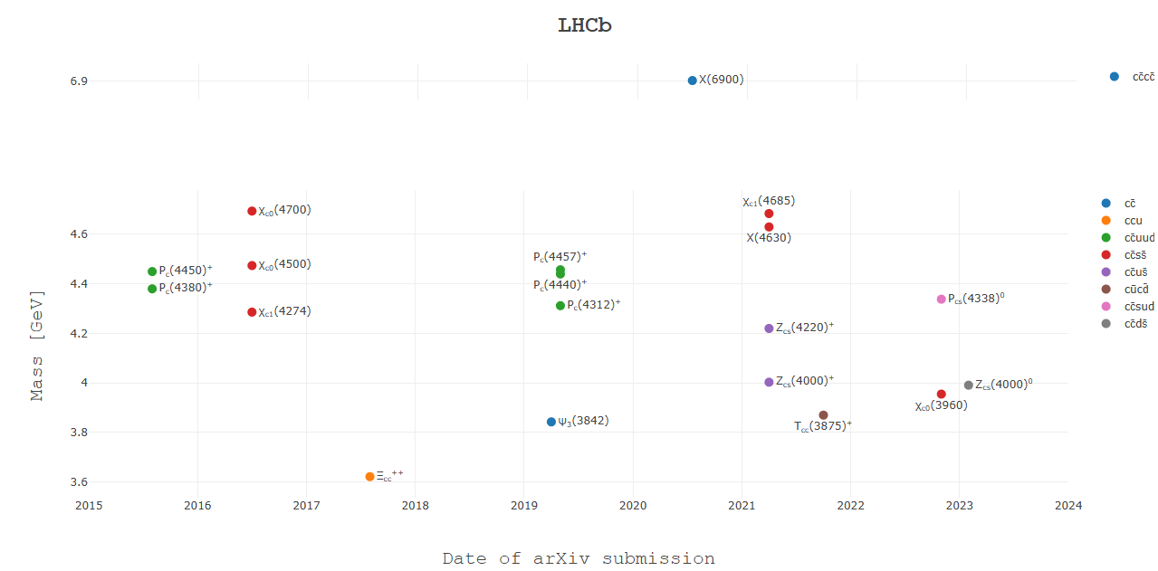
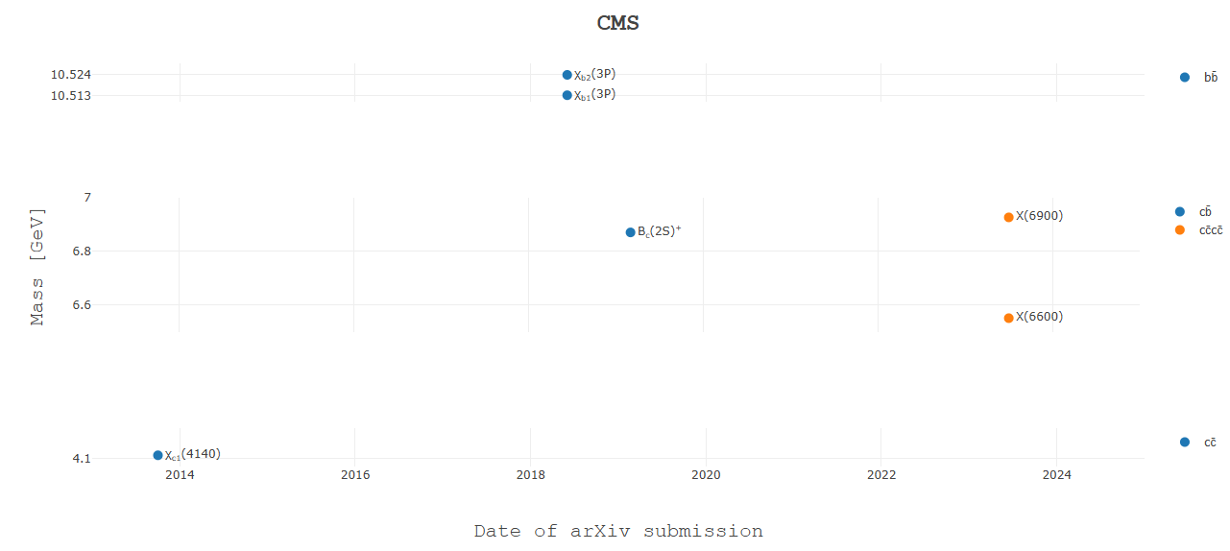
Exotic Hadrons
Although the existence of exotic states had already been theorized in the 1970s, the first exotic particle was discovered in 2003: the X(3872).
LHCb
From that moment...
QWG Exotics hub: https://qwg.ph.nat.tum.de/exoticshub/

Slide 6
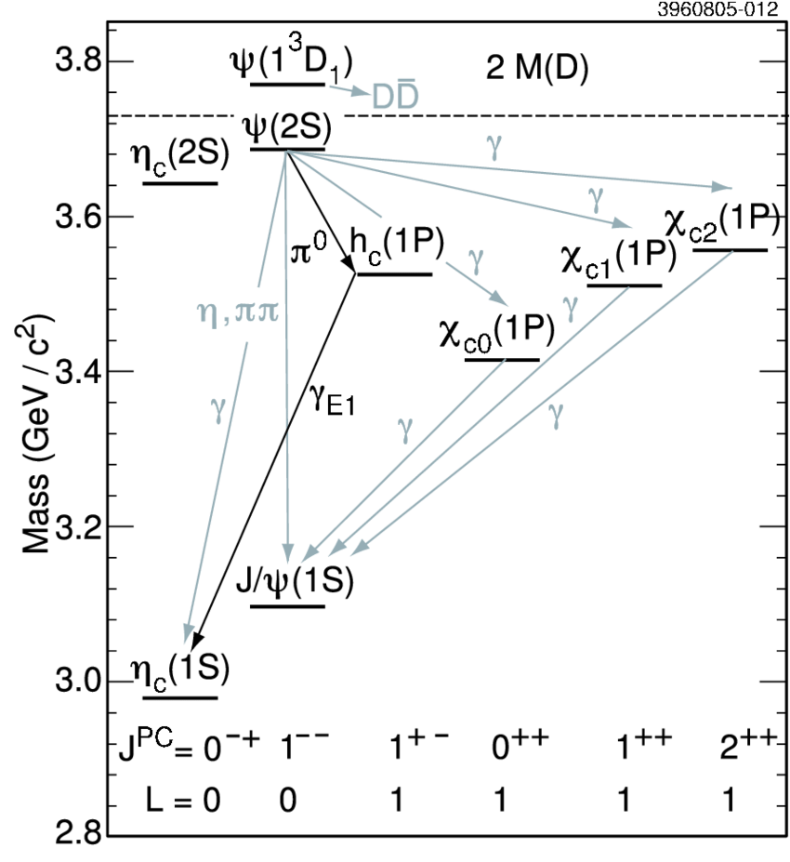
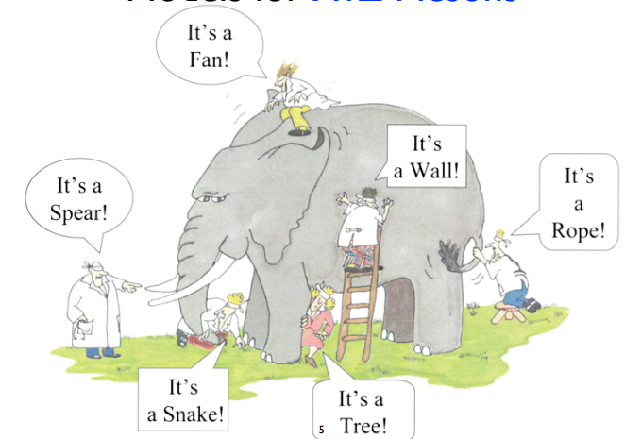
Exotic spectroscopy
Around 50 exotic hadrons with at least one heavy ($c$ or $b$) quark are reported.
N. Hüsken, E. Spadaro Norella, I. Polyakov arXiv:2410.06923 [hep-ph]
Exotic spectroscopy is a branch of particle physics that focuses on studying the properties of exotic hadrons.
Provide a theoretical explanation of the experimentally observed properties, grounded as much as possible in first principles (QCD).
Make predictions about the masses and quantum numbers of exotic hadrons to test hypotheses on the non-confining dynamics of QCD.
Idea
Reality
[CLEO Collaboration], Phys. Rev. D 72, 092004 (2005)
Figure from E. Braaten talk: Charm 2020 conference

Slide 7
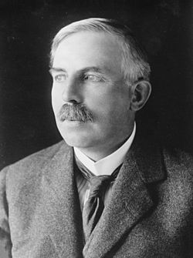
Exotic spectroscopy: ‘old’ foundamental question
Which is the internal structure of an exotic hadron? Are tetraquarks ‘elementary’ particles like protons and neutrons, or are they meson-antimeson bound states, much like the deuteron?
Over a century after the discovery of the atom’s nuclear structure, particle physics is still addressing similar core questions: what does it mean elementary? Could there be something more fundamental inside what we are observing?

Slide 8
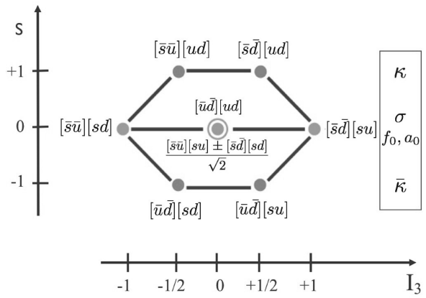
The scalar mesons ‘old’ problem
Scalar mesons are heavier than pseudoscalar ones.
$q\overline{q}$ must have $L=1$ since $P=+1$
heavier than pseudoscalars
$$J^{P}=0^{+}$$
heaviest (as the Kaons)
heaviest
Masses: between $500$ MeV ($σ$) and $1$ GeV

Slide 9
The scalar mesons: light tetraquarks
Scalar mesons are heavier than pseudoscalar ones.
R. Jaffe, Phys. Rev. D 15, 267 (1977) DOI: 10.1103/PhysRevD.15.267
$q\overline{q}q\overline{q}$ h$ave L=0$
$$m_{4q}>m_{2q}$$
$$J^{P}=0^{+}$$
They are heavier due to their strange–antistrange quark content
Masses: between $500$ MeV ($σ$) and $1$ GeV
$\left[qq\right]$: diquark with $S=0, F=3, C=\overline{3}$

Slide 10
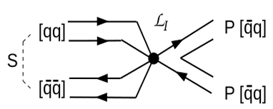
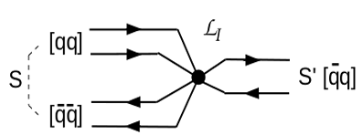
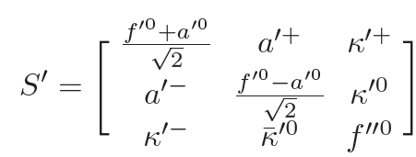
The scalar mesons: instanton interaction
$f_{0}\left(980\right)→ππ$ decay rate cannot be explained by $f_{0}−σ$ mixing alone.
G. ’t Hooft, et al., Phys.Lett.B662 (2008) 10.1016/j.physletb.2008.03.036
Zweig-rule violating $S→PP$ amplitude.
The scalar tetraquark nonet mixes with the scalar meson nonet.
Heavier than the $κ^{′}$
$$f_{0}(1310)$$
$$f_{0}(1710)$$

Slide 11
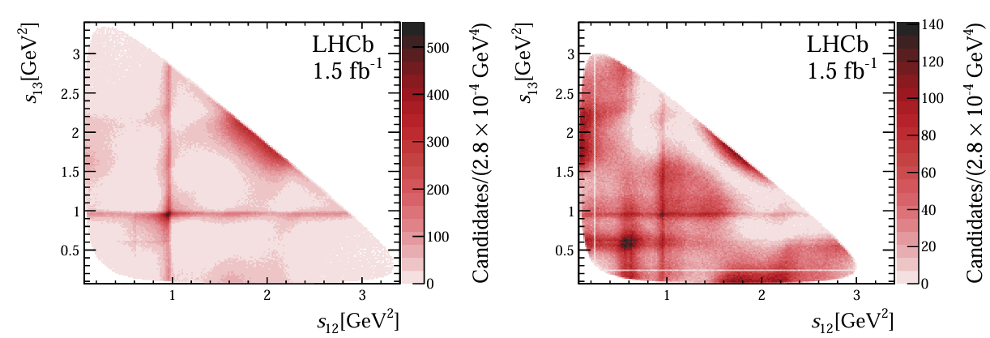
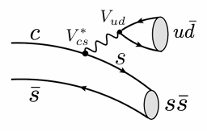
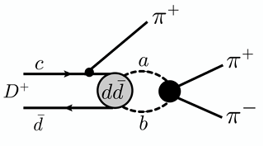
The scalar mesons: new data
New informations on the nature of the light scalar mesons come from the $D_{s}^{+}→π^{+} π^{−} π^{+}$ and $D→π^{+} π^{−} π^{+}$decays
[LHCb], JHEP07(2023)204 10.1007/JHEP07(2023)204; [LHCb], JHEP 06 (2023) 044 10.1007/JHEP06(2023)044
$$D_{s}^{+}→π^{+} π^{−} π^{+}$$
$$D→π^{+} π^{−} π^{+}$$
$$f_{0}\left(1370\right)→ππ$$
$$f_{0}\left(1370\right)→ππ$$
$$σ→ππ$$
$$σ→ππ$$
$$f_{0}(980)→ππ$$
$$f_{0}(980)→ππ$$
$σ$ is dominated by the light quarks component
How can I produce the $f_{0}(1370)$ in both cases?
How can I produce the $f_{0}(980)$ in both cases?

Slide 12
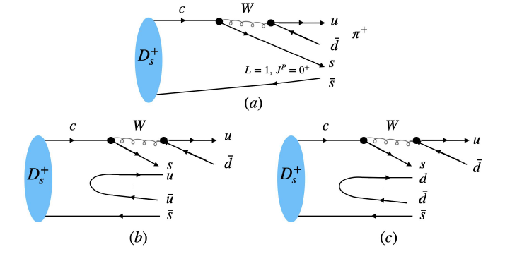
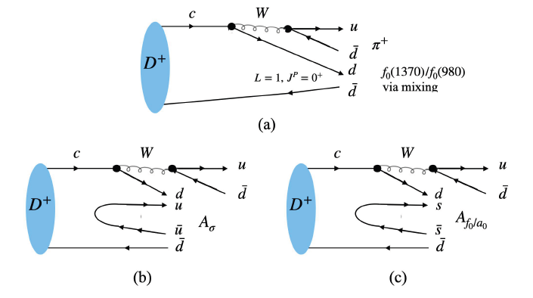
The scalar mesons: instaton interaction
New informations on the nature of the light scalar mesons come from the $D_{s}^{+}→π^{+} π^{−} π^{+}$ and $D→π^{+} π^{−} π^{+}$decais
$$D_{s}^{+}→π^{+} π^{−} π^{+}$$
${f_{0}(1710)}/σ$ mixing
$$D→π^{+} π^{−} π^{+}$$

Slide 13
Who is the X(3872)?
$${I(J}^{PC})={0(1}^{++})$$
Exotic Meson $[Q\overline{Q}q\overline{q}]$
Isosinglet
DISTINGUISHING FEATURES:
Threshold distance:
Main decay channel:
$X\left(3872\right)⟶D^{0}{\overline{D}}^{0∗}⟶D^{0}{\overline{D}}^{0}π^{0}$
$$\left(55±28\right)\%$$
Isospin violating decay:
Mass: $3871.65±0.06 MeV$
S. Navas et al. (Particle Data Group), Phys. Rev. D 110, 030001 (2024)

Slide 14
Compact objects vs Molecules
The X(3872)’s closeness to the $D^{0}D^{∗0}$ threshold makes it challenging to clearly determine whether the state is molecular or compact.
C. Z. Yuan and S. L. Olsen Nat Rev Phys 1, 480-494 (2019)

Slide 15
Non-relativistic EFT: Effective range & Nature of Poles
At low energies, the scattering amplitude depends on two parameters.
Limit $k→0$:
Scattering length
Effective range
The sign of $r_{0}$​ is related to whether the particle is a molecule or a compact state (Weinberg 1965).
Weinberg Phys. Rev. 137, B672 (1965)
$a_{s}>0$: the pole is related to a real particle;
$r_{0}≥0$: The particle is a bound state;
$a_{s}<0$: the pole is related to a virtual particle.
$r_{0}<0$: The particle is a compact state.

Slide 16
Proton – Neutron: the dibarion field (aka deuteron)
D. B. Kaplan, Nucl. Phys. B 494(1997), 471–484, nucl-th/9610052.
Dibarion field
The dibarion’s kinetic term is defined up to a sign $σ=±1$
Trilinear coupling between the two nucleons and the dibarion

Slide 17
Proton – Neutron: the dibarion field (aka deuteron)
D. B. Kaplan, Nucl. Phys. B 494(1997), 471–484, nucl-th/9610052.
$σ=+1$: ‘Classical’ kinetic term and $r_{0}<0$. The field represents a compact particle if $μ<0$.
$σ=−1$: ‘Inverted’ kinetic term and $r_{0}>0$. The field represents a bound state if $μ>0$.

Slide 18
The XEFT
A. Esposito et al. arXiv:2502.02505 [hep-ph]
A lot of fields...
and interactions

Slide 19
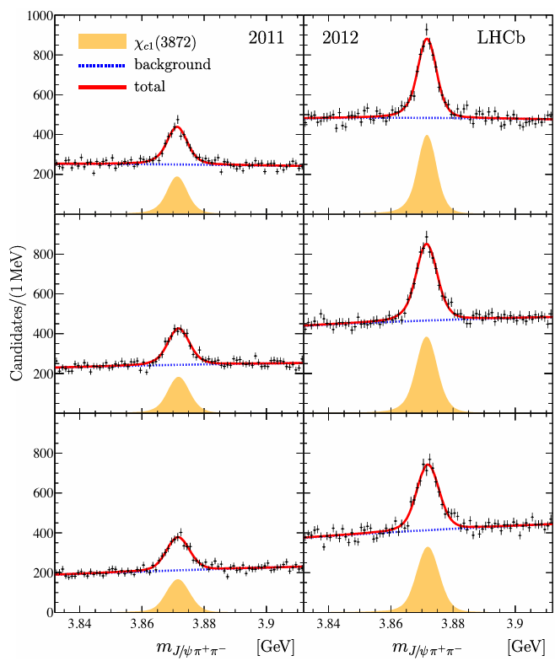
The XEFT: what can we do?
R. Aaij, et al. [LHCb], Phys. Rev. D 102, 9 (2020),092005, 2005.13419.
A. Esposito et al. arXiv:2502.02505 [hep-ph]

Slide 20
The XEFT: what needs to be done
In the previous Lagrangian, it is also possible to add a field for the isospin triplet $X_{t}$​, that we expect since SU(2) is a good symmetry of QCD. By doing so, we can generate loops that turn the isosinglet $X(3872)$ into its neutral isotriplet partner $X_{t}^{0}$.
$$ρ$$
$$D$$
$$D$$
$$X(3872)$$
$$X_{t}^{0}$$
$$\overline{D}$$
$${\overline{D}}^{∗}$$
$$J/ψ$$
$${\overline{D}}^{∗}$$
The enhancement of theisospin violating decay could be due to mixing between the isosinglet and isotriplet, induced by 𝐷-meson loops.

Slide 21
Conclusions
The scalar meson nonet exhibits unusual properties compared to their pseudoscalar partners, such as the mass inversion between the 𝜅 and the 𝑎₀/𝑓₀. New data on the decays of 𝐷 and 𝐷ₛ mesons point toward a tetraquark nature for the light mesons and highlight the fundamental role of instanton interactions in QCD dynamics.
Since 2003, the nature of the X(3872) has eluded our understanding. In a NREFT framework, we can infer the nature of the resonance by analyzing the kinetic term in the Lagrangian. So far, LHCb data suggest a compact nature for the resonance. By introducing the isospin triplet partners, the isospin-violating decay can be explained through the mixing induced by 𝐷 and $D^{∗}$ mesons.
$$ρ$$
$$D$$
$$D$$
$$X(3872)$$
$$X_{t}^{0}$$
$$\overline{D}$$
$${\overline{D}}^{∗}$$
$$J/ψ$$
$${\overline{D}}^{∗}$$

