Slide 1
DPDF Meeting
29 Apr. 25

Slide 2
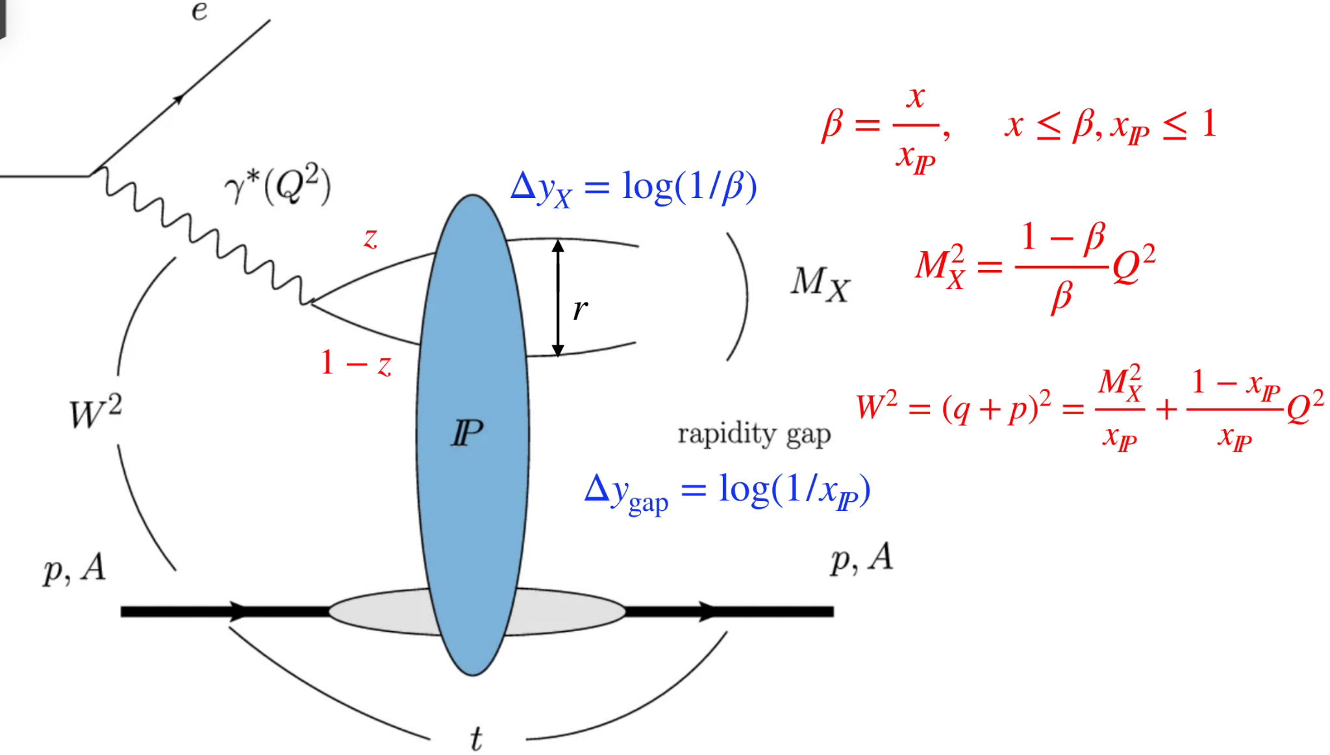
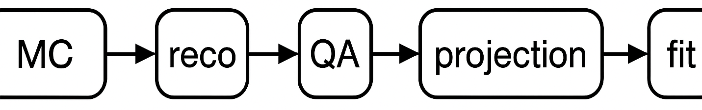
Year 1 - Ru/Cu (ep) diffraction (Hadi)
Advancing Diffractive DIS at the EIC: From MC to DPDF Precision
Diffractive Deep Inelastic Scattering (DDIS) opens a unique window into nucleon and gluon structure at small Bjorken x, especially relevant for Year 1 Ru/Cu and ep early science.
Inclusive diffraction (via RAPGAP, later SARTRE¹) enables benchmarking of detector performance and early structure function extraction.
Our long-term goal is to enable precise DPDF extraction at EIC using:
Pseudo Data (Projected)
Neural network parameterization
A robust fitting code
1) See Tobias talk, next Tuesday
https://indico.bnl.gov/event/27723/

Slide 3
Year 1 - Ru/Cu (ep) diffraction (Hadi)
Simulation & Reconstruction Pipeline
Generator Setup:
Generator: RAPGAP v3.310, 100k events with radiative corrections (another 100k without RC pending)
Beam config: 10x100 GeV, matching early EIC setup
Event normalization target: 10 fb⁻¹ → ~42 million events planned
SARTRE will follow for comparison (pending beta release)
Detector & Reconstruction:
Latest EICRecon used for full detector simulation and truth matching
Variables reconstructed: Q², x, y, t
Issue: Known bug in RAPGAP HepMC3 format (multi-beam particle events) → reported, workaround

Slide 4
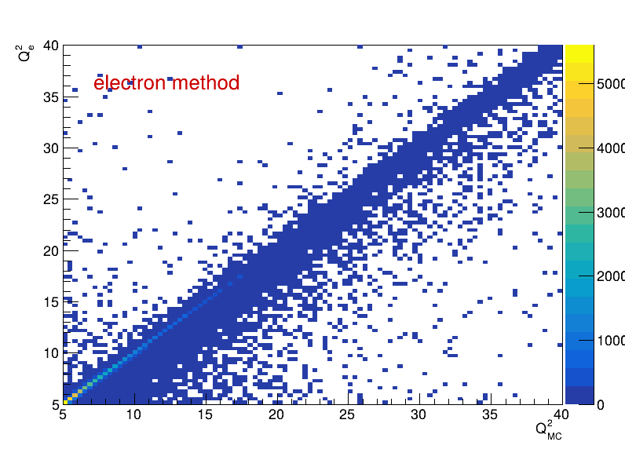
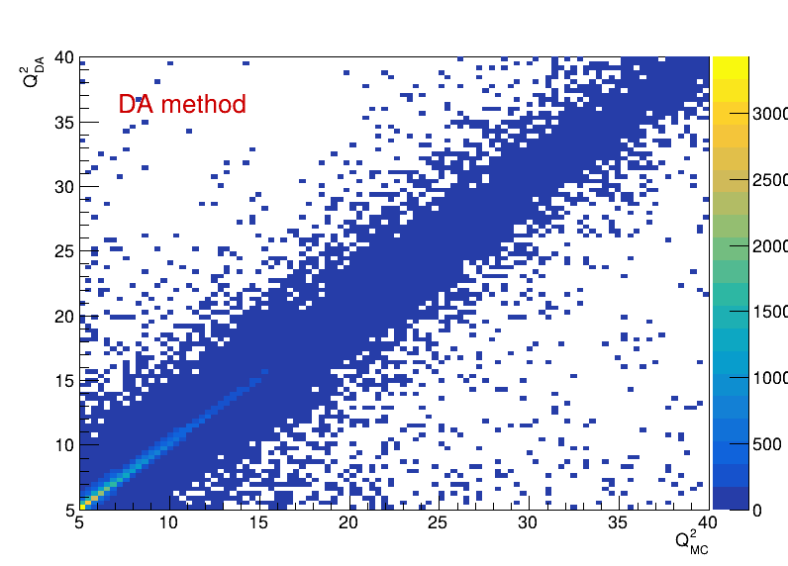
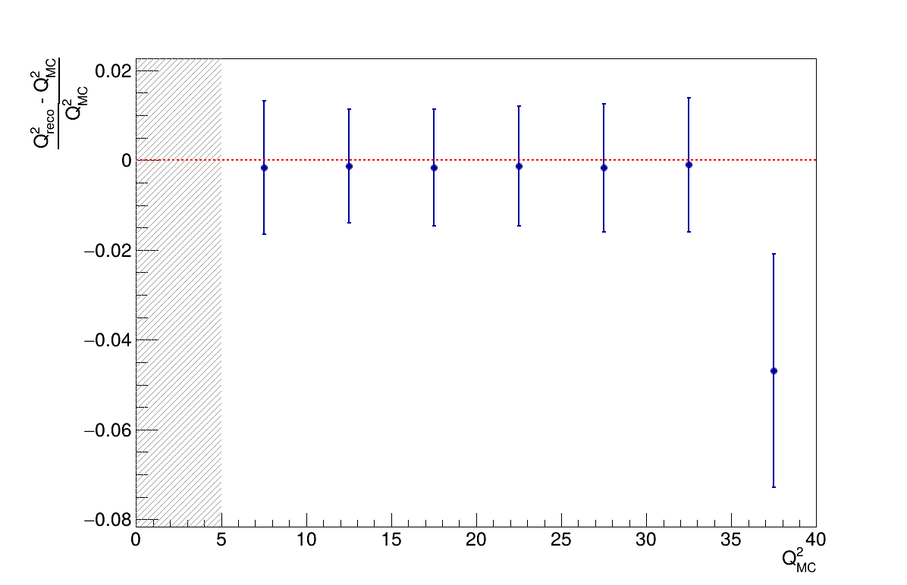
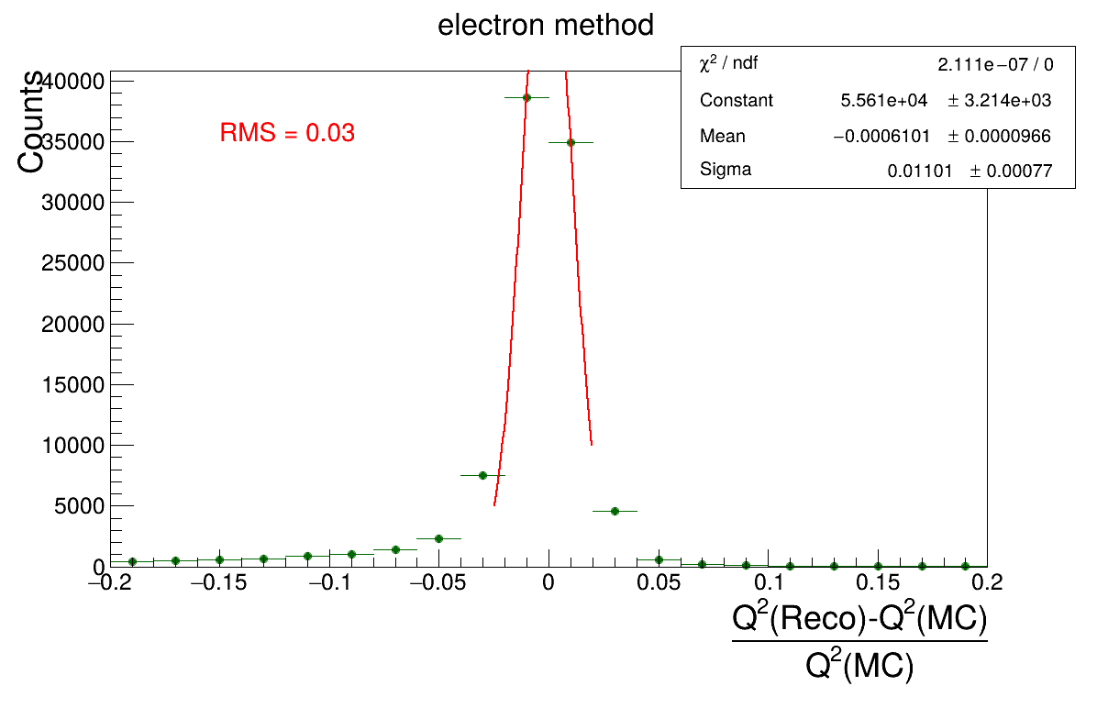
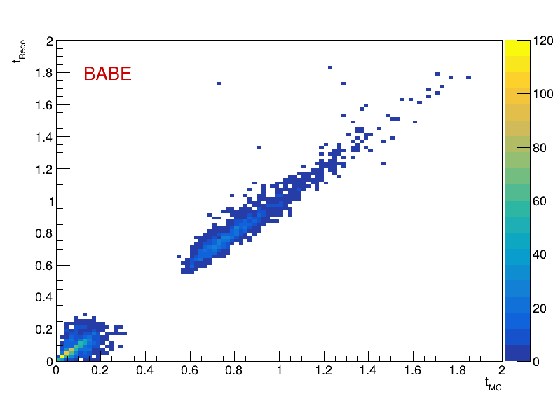
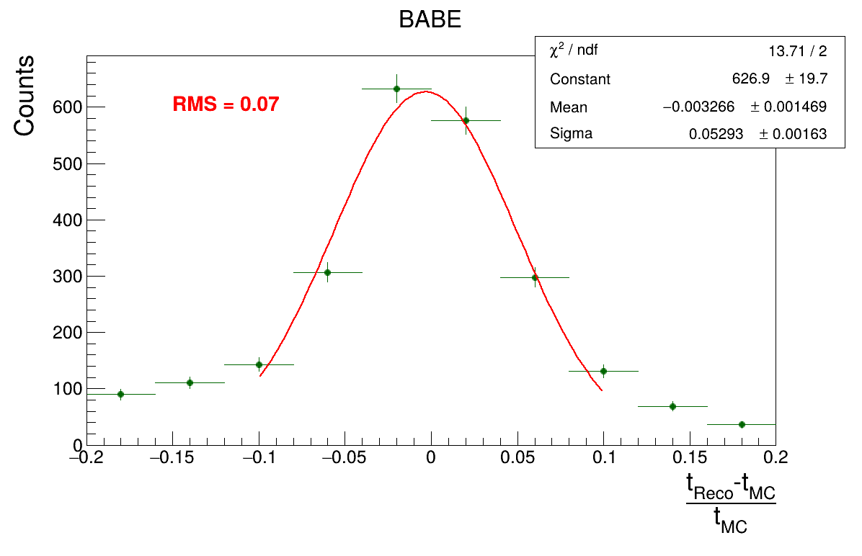
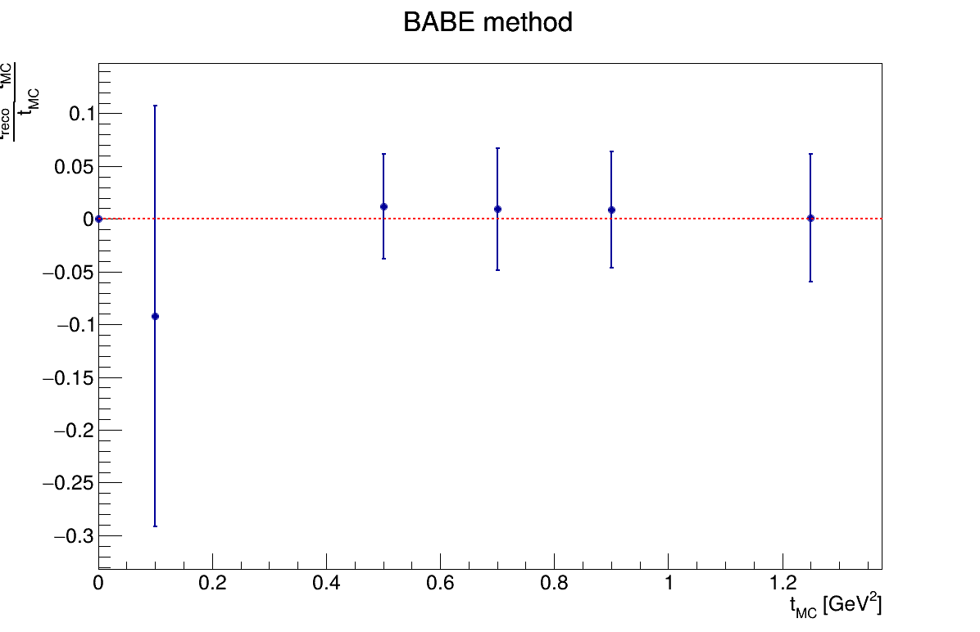
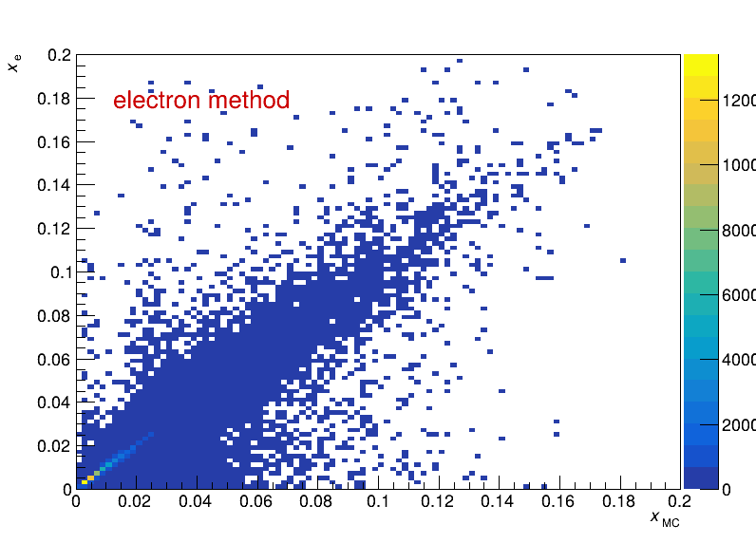
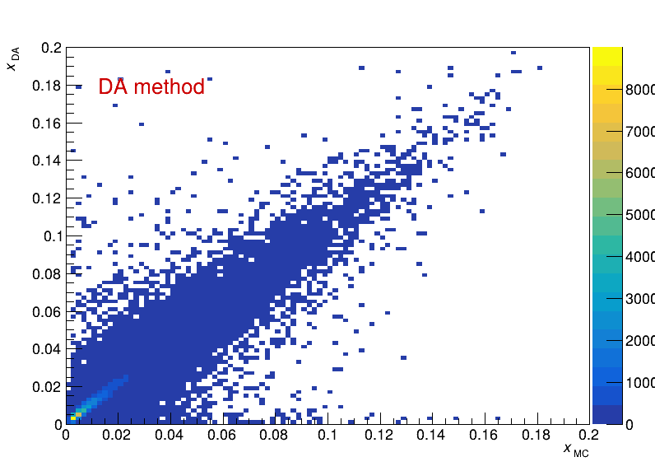
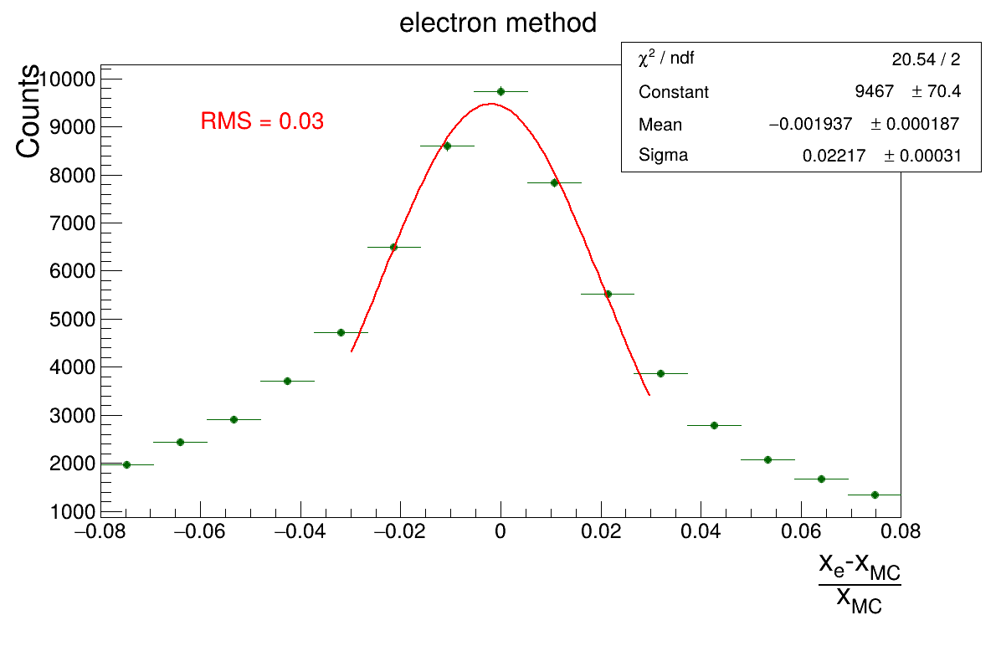
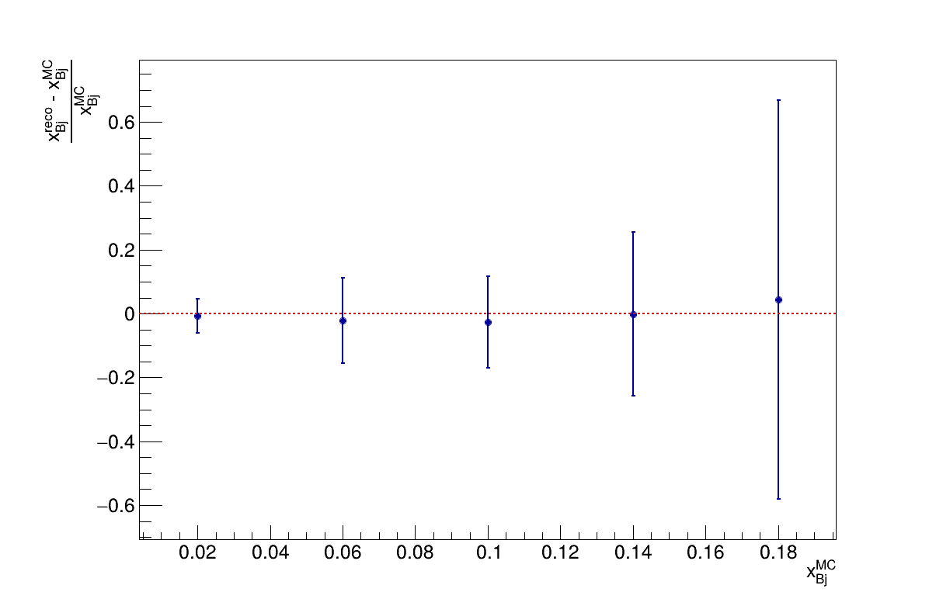
Year 1 - Ru/Cu (ep) diffraction (Hadi)
Kinematic Resolution and Reco Validation
tReco convention:
https://indico.bnl.gov/event/26525/
RP B0

Slide 5
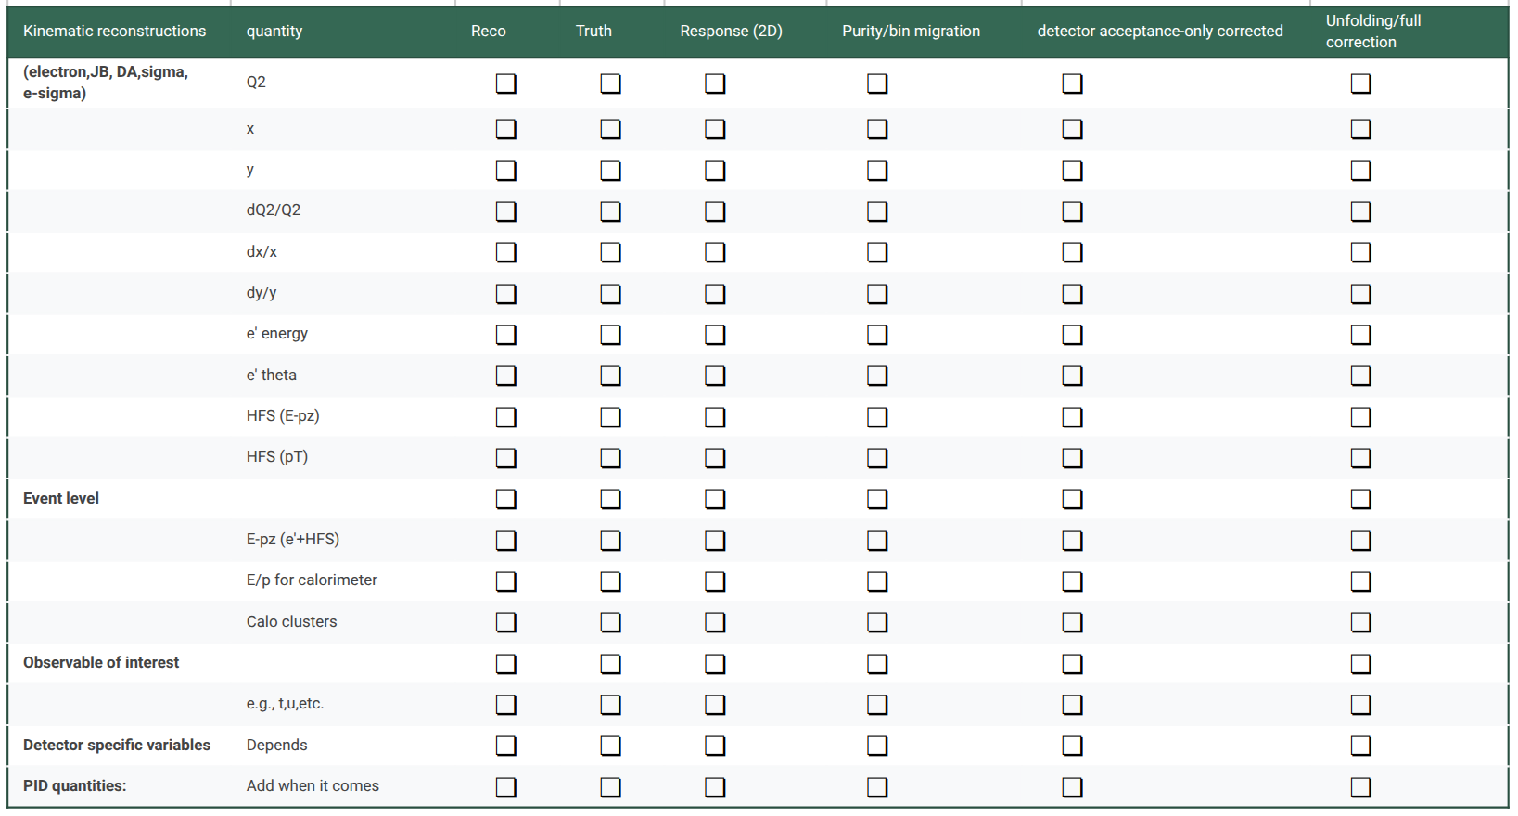
Year 1 - Ru/Cu (ep) diffraction (Hadi)
🧭 Current Status:
✅ Reco + resolution plots complete
⚙️ Generator-level samples w/ and w/o radiative corrections in hand
❗ Still pending: proper acceptance corrections, bin-by-bin unfolding
✖ Luminosity not scaled yet
🎯 Working on binning, acceptance corrections, and projection code
📈 Path to σ_{red}^{D(3)}​ and Comparison with HERA
Extract reduced cross section in bins of Q²,β,x_{Pom}​
Normalize with generator-level cross section and/or scale to early science luminosity
Compare samples w and w/o radiative corrections, compare RAPGAP and SARTRE
Compare with HERA (H1/ZEUS) coverage and values
✔
✔
✔
✔
✔
✔
✔
✔
✔
✔
✔
eA inclusive diffraction study is still in the early phase due to the readiness of the Sartre model; we are working closely with them to get this ready.

Slide 6
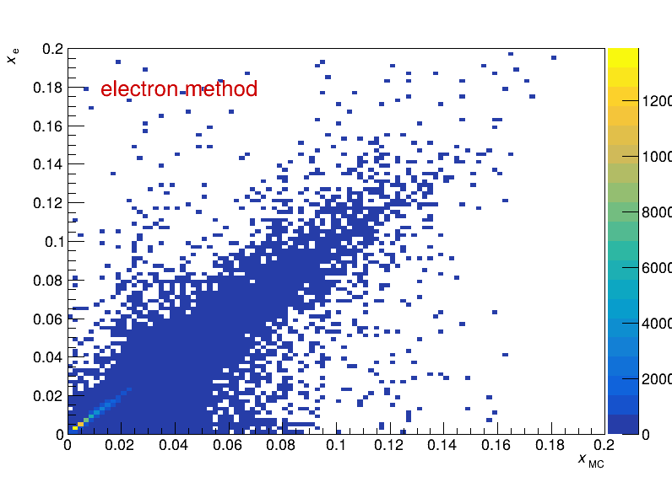

No Rad. Corr. W/ Rad. Corr.

Slide 7
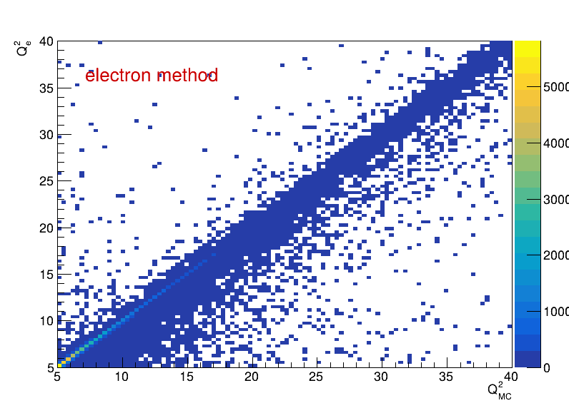
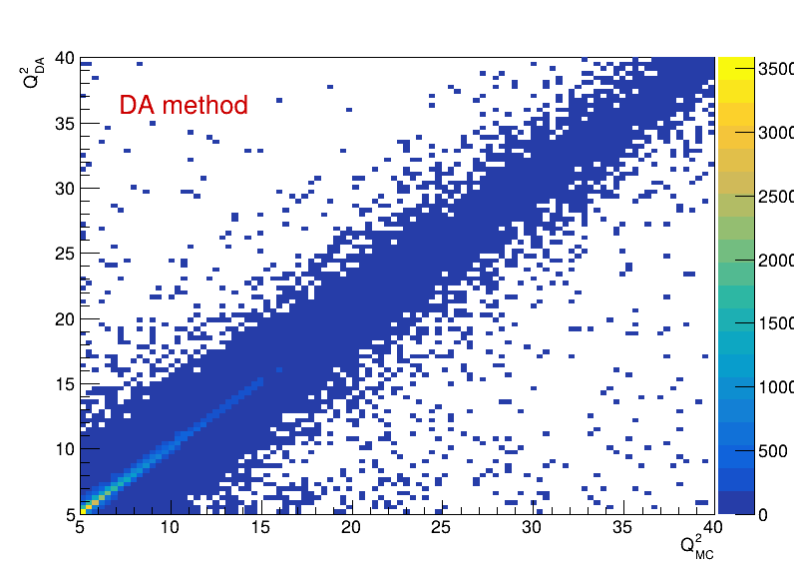
No Rad. Corr. W/ Rad. Corr.

Slide 8

No Rad. Corr. W/ Rad. Corr.

Slide 9
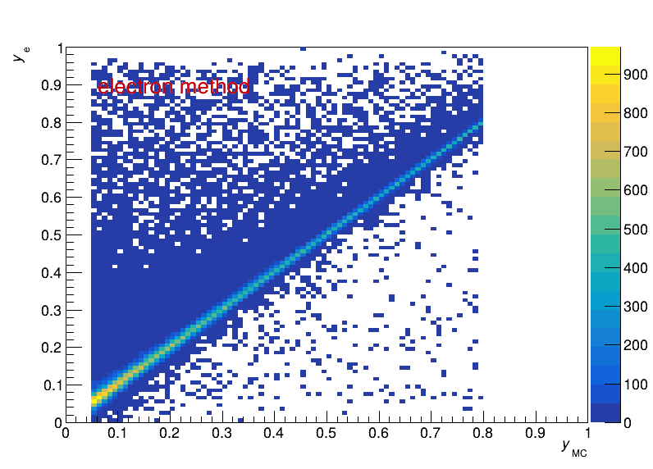
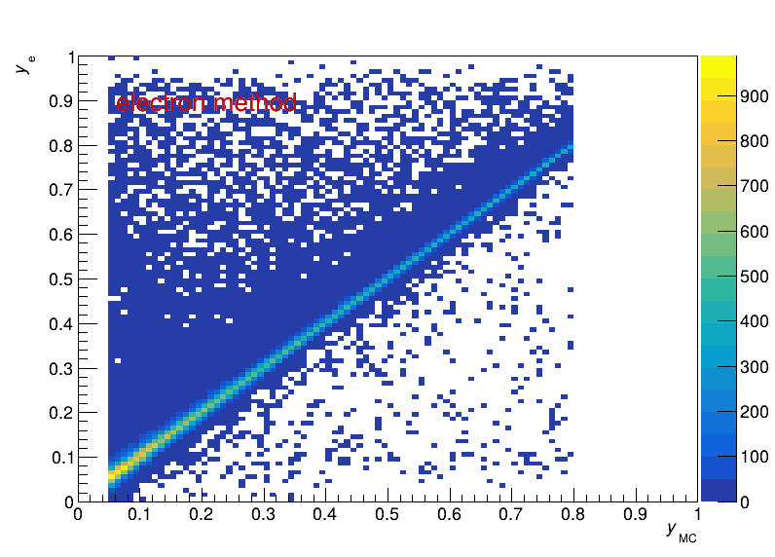
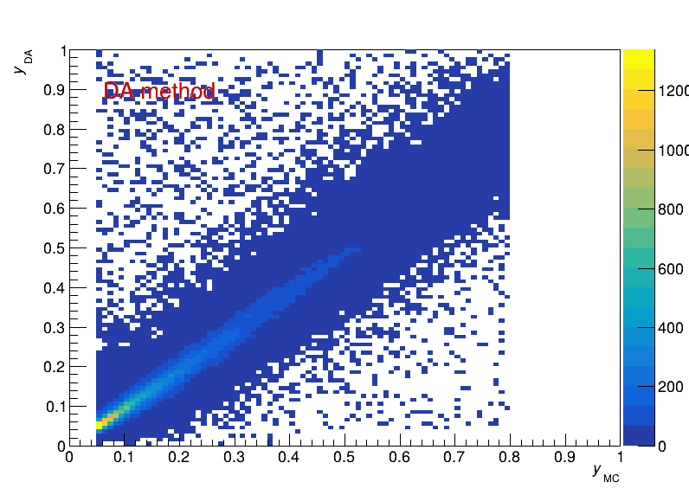
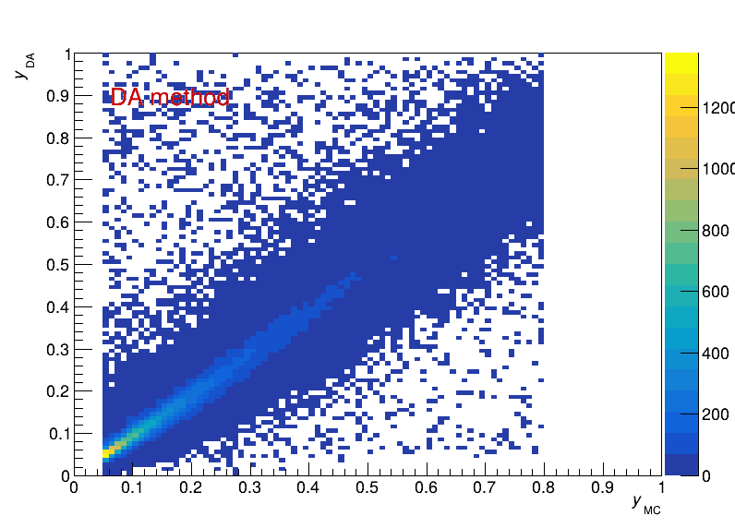
No Rad. Corr. W/ Rad. Corr.

Slide 10
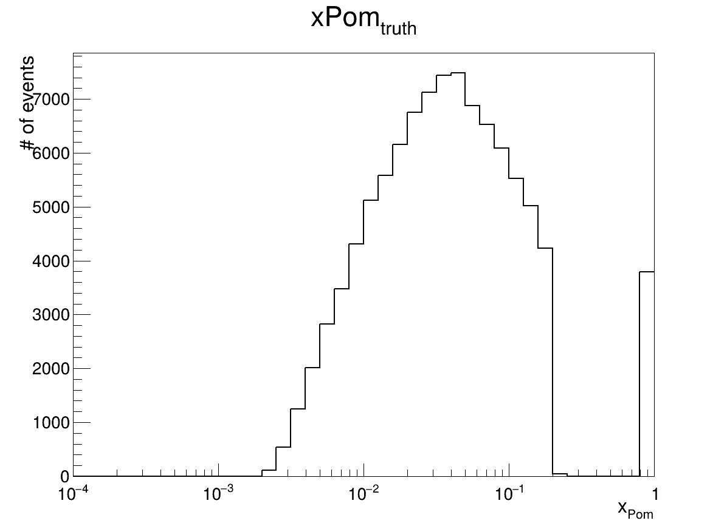
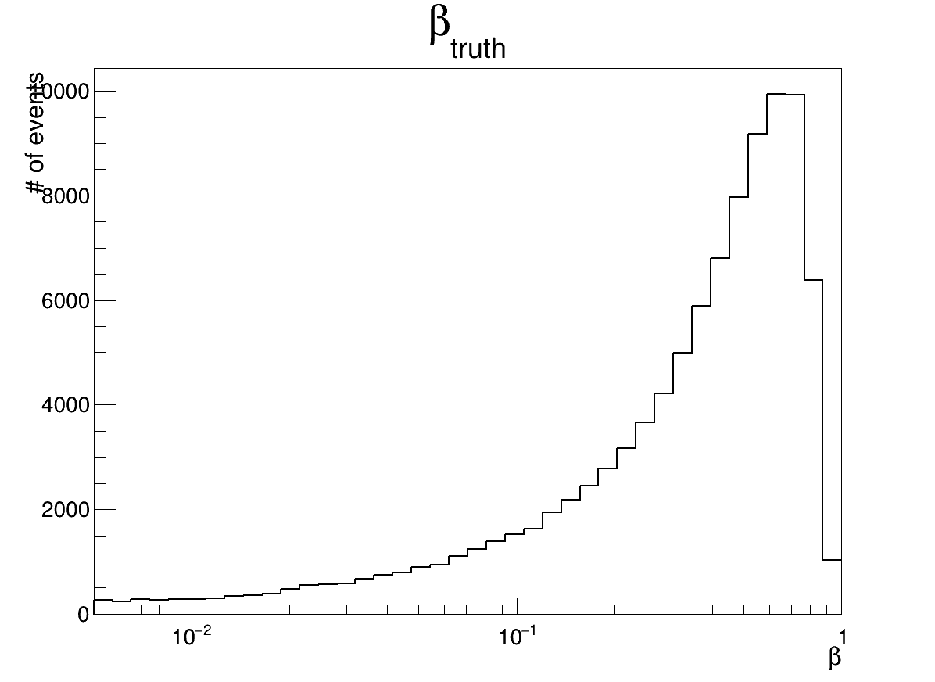
New Results - w/o RC

Slide 11

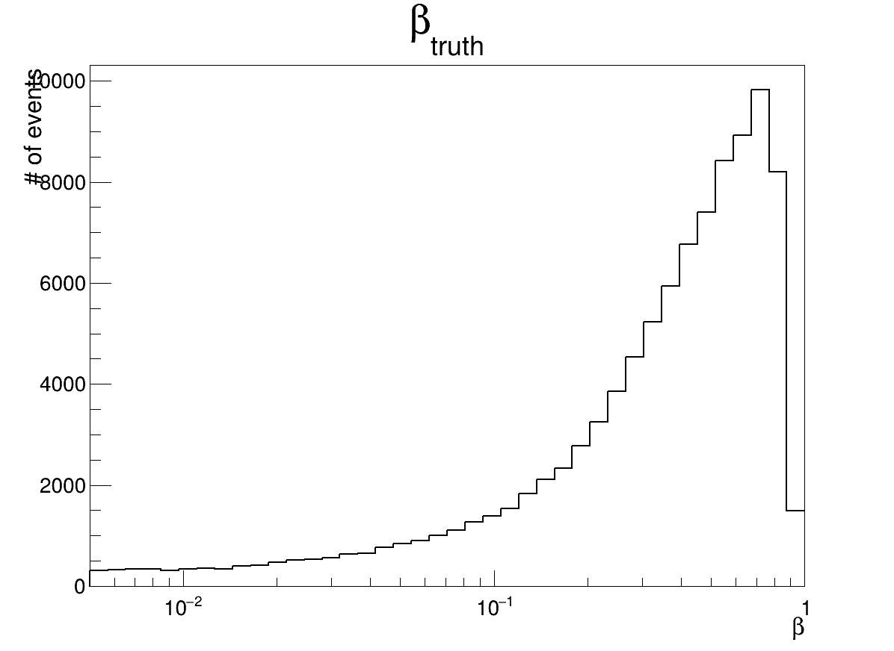
New Results - w/ RC

