Slide 1


Meeting of the EURO-LABS WP2.5.2 Collaboration
May 15th, 2025 (Online)
Target manufacturing activities at INFN-LNL
J. Esposito, on behalf of INFN- Legnaro National labs (LNL) targets group- juan.esposito@lnl.infn.it
A quick review of techniques focused on different topics
“Target production” for nuclear physics (NP) experiments
“Target production” for applied NP (radioisotopes production)
“Quality Control techniques: nuclear targets characterization ”

Slide 2

Target production at LNL
Nuclear Physics (NP) studies

Slide 3
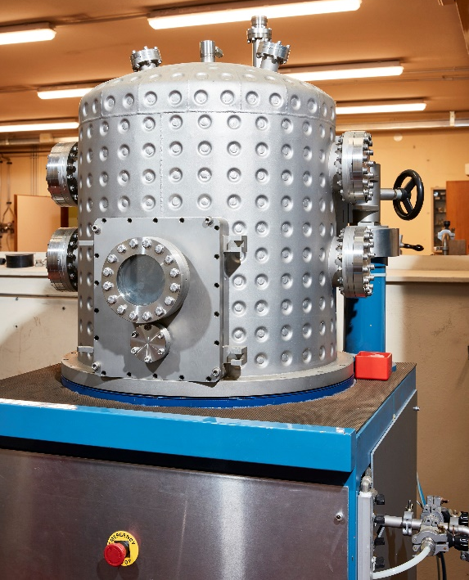
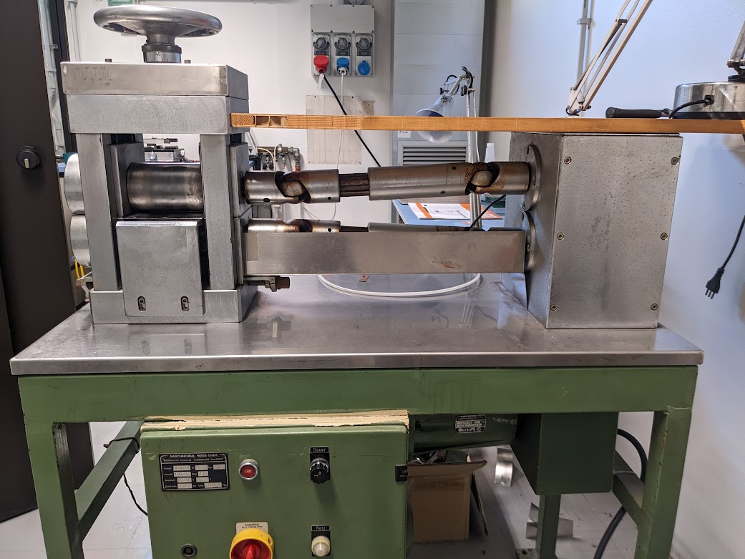
Target production at LNL
NP studies
Target production at LNL – Nuclear physics studies
Text
Targets for nuclear physics experiments typically are thin films of enriched isotopes obtained by various techniques:
- lamination (few mg/cm²)
- vacuum evaporation (few tens - few hundred ug/cm²)
There are different types of fabrication:
• self supporting
• with backing
• strip-targets
sandwich-target
• plunger – target

Slide 4
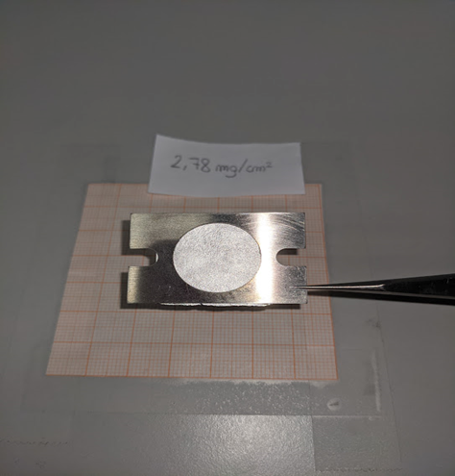

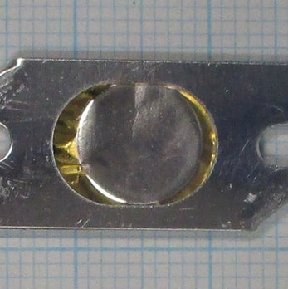
Target production at LNL – Nuclear physics studies
Text
Self supporting target of ¹¹²Sn produced by cold rolling; the achieved thickness of 2.78 mg/cm².
(e.g. in the picture a target used for an experiment at ANL USA (June 2023)
Thickness below the minimum stated in the literature (4 mg/cm²)
Adhesion improved by special heat treatment on the Au backing
Target of ¹⁰⁸Pd, thickness 1.3 mg/cm², on Au backing of 3.8 mg/cm² obtained by thermal evaporation (Thermal-based PVD) in vacuum (W crucible). The Au backing was previously prepared by rolling.

Slide 5
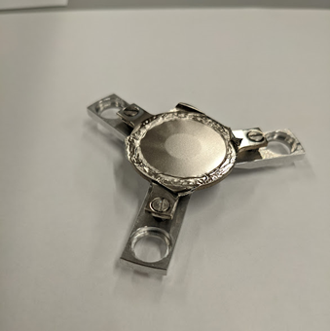
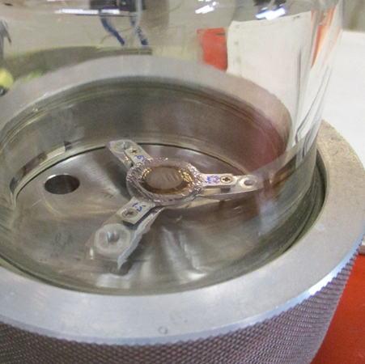
Target production at LNL – Nuclear physics studies
Text
⁶⁴Ni/⁶⁸Zn/⁶⁴Ni - "Plunger"-type sandwich target consisting of a 2 mg/cm² Zn core body, obtained by rolling and bonded on Plunger frame, on which a 0.4 mg/cm² Ni film was evaporated on both sides. Subsequently "stretched" with a special cone.
Plunger-type target of ¹⁴⁸Sm thickness 1 mg/cm² attached to a 1.5 mg/cm² backing of Ta.
The target is stored under vacuum (4.5·10⁻⁷ mbar) to prevent oxidation of ¹⁴⁸Sm.

Slide 6
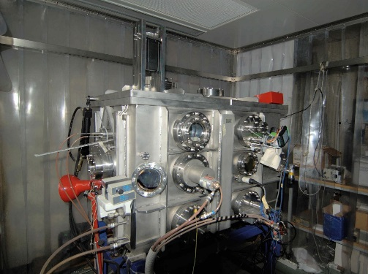
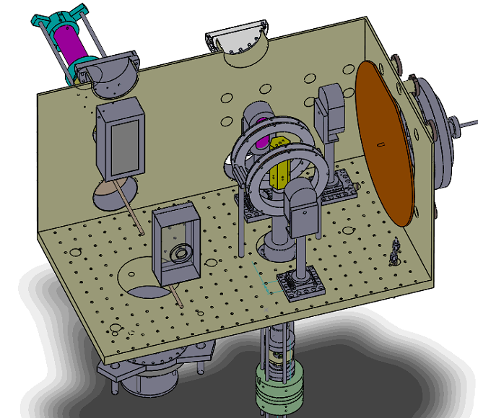

LNL Sputtering chamber and design
Target production at LNL – Nuclear physics studies
Characteristics:
3 sputtering source (50mm x 140mm)
2 sputtering source (150mm x 230mm)
Active gettering system (porous Ti /Ba/Al)
Optical emission plasma diagnostics for reactive processes (deposition of compound layes
Different power supply technologies:
High-power Impulse Magnetron Sputtering (HiPIMS, DC, pulsed-DC, or RF)
2 different sample holder

Slide 7
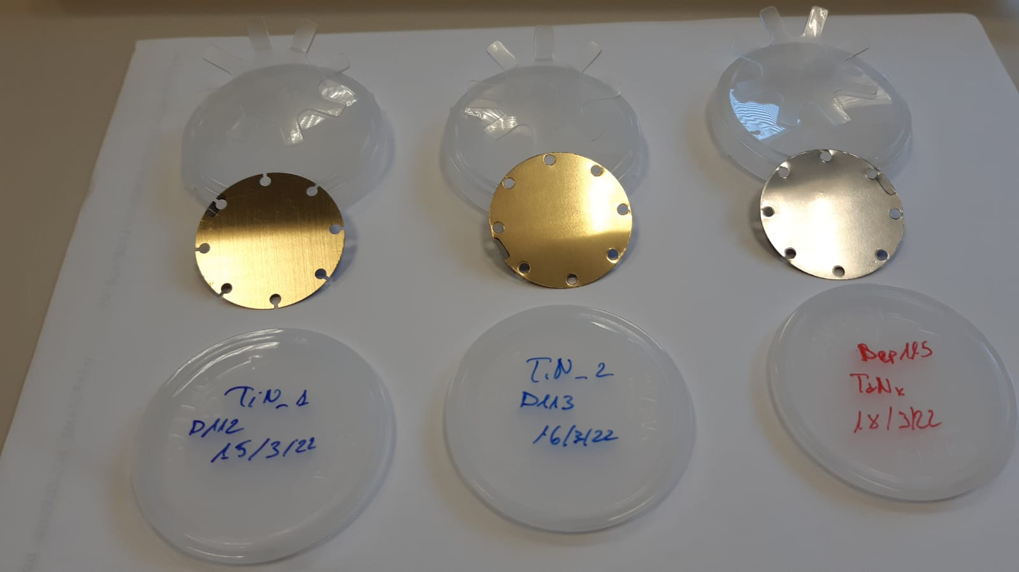
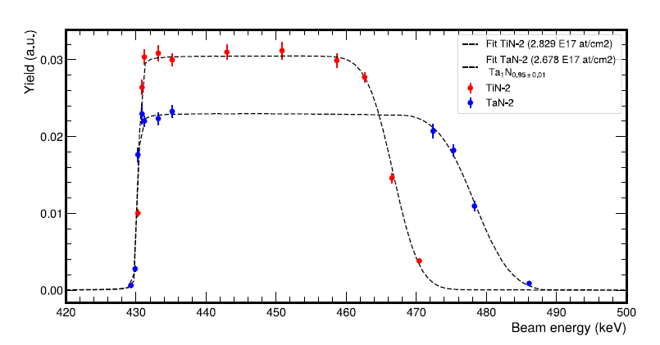
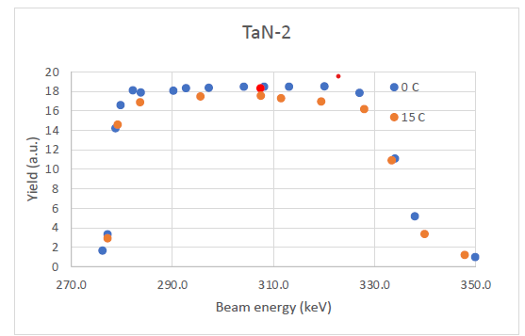
Target production at LNL – Nuclear physics studies
LUNA solid target development by PVD magnetron sputtering technology
Targets preparation for LUNA experiments (Gran Sasso Laboratory):
Nitrides (Ta^{nat}N, Zr^{nat}N, Ti^{nat}N)
High-Z metals nitrides for reduction of neutrons production for LUNA-MV
TaN target produced by PVD technics using ¹⁴N enriched gas
Production and EBS characterization performed @ LNL (AN2000)
Low energy resonance scan and endurance test performed @ LNGS (LUNA400)
429 keV ¹⁵N resonance scan
of TaN and TiN
TaN 2.8*10¹⁸ atoms/cm² deposited on 7.8*10¹⁷ atoms/cm² of high purity Ta interlayer Tantalum substrate
TiN 2.7*10¹⁸ atoms/cm² deposited Tantalum substrate and Silicon substrate (for EBS analysis)
EBS analyses
Ti
278 keV ¹⁴N resonance
scan of TaN
After an irradiation of 15 C
Ta
Analysis A. Compagnucci

Slide 8
Target production at LNL
Applied NP studies
(emerging radioisotopes production for thenanostics radiopharmaceuticals)

Slide 9
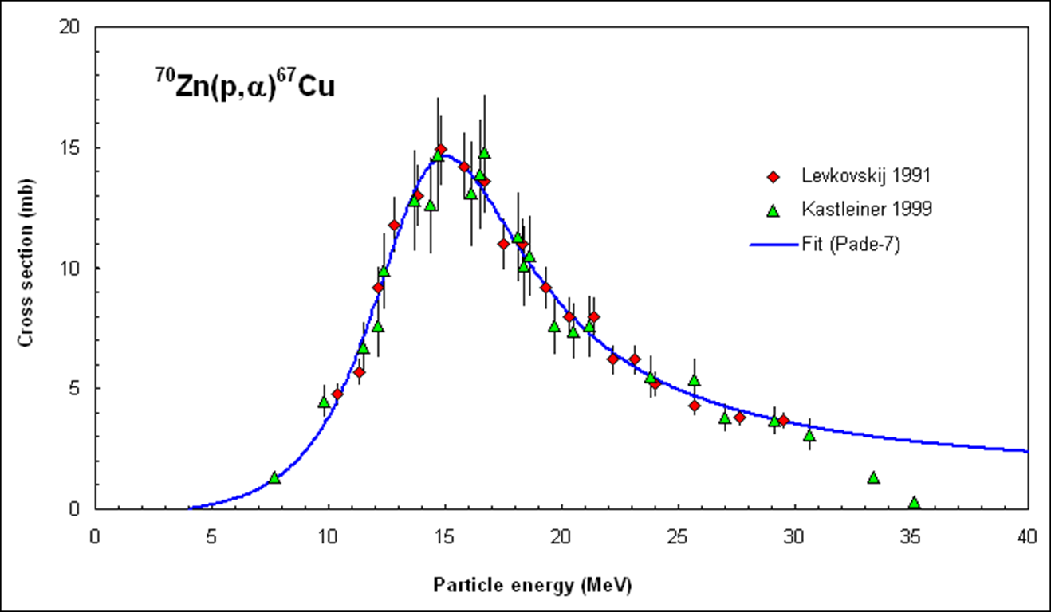
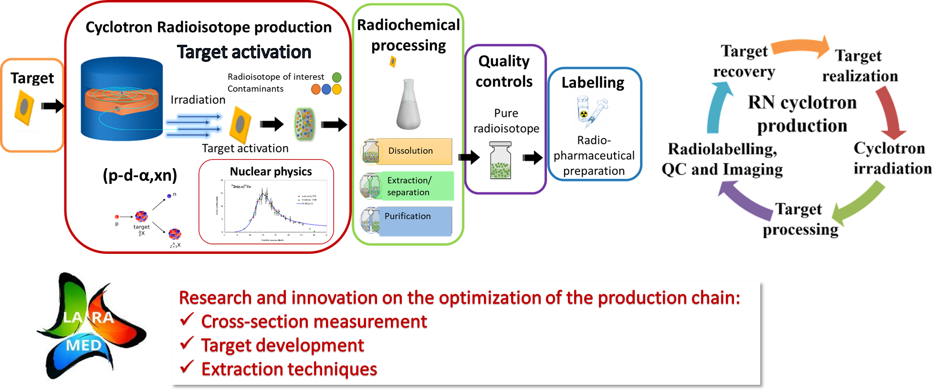
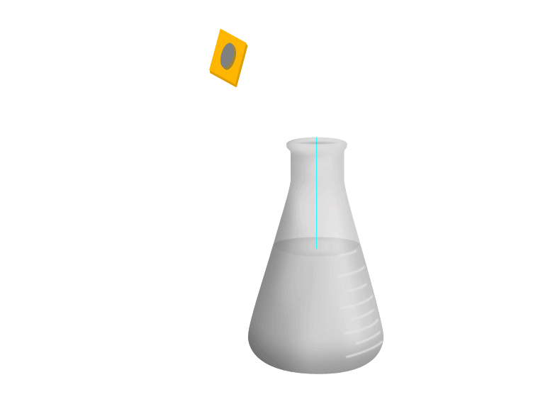
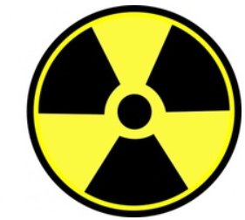
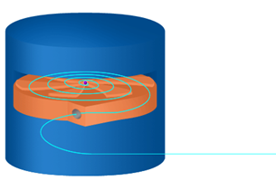
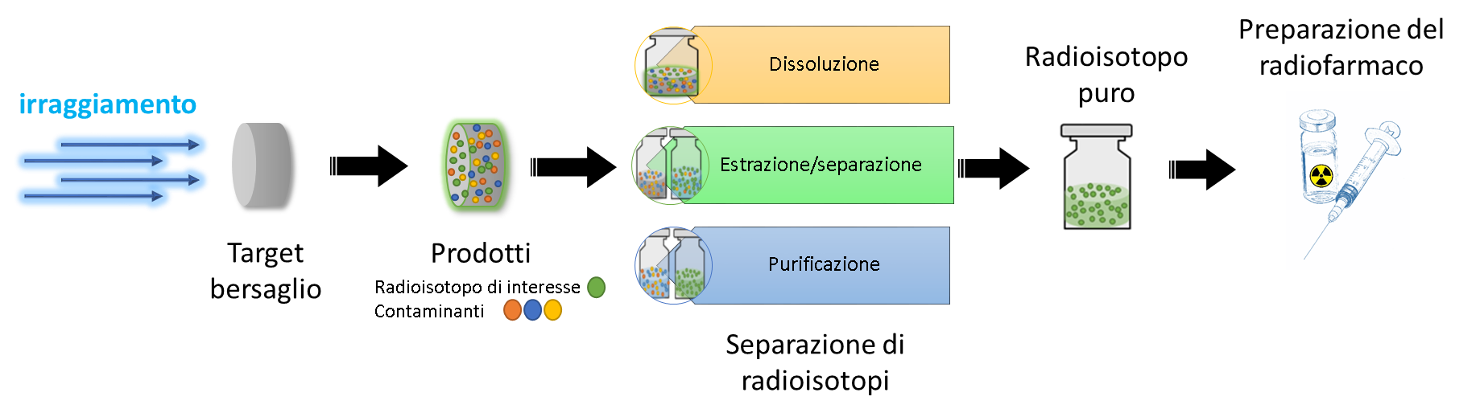
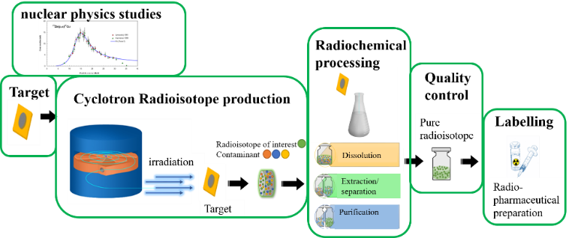
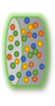

Target production at LNL – Nuclear physics applications
Cyclotron production cycle
Nuclear physics studies
Target
preparation
Radiochemistry
process
Quality Control
Radio-
pharmaceutical
preparation
Cyclotron irradiation
Radioisotope of Interest
Contaminants
Dissolution
Extraction/
separation
Target activation
Pure radioisotope
Purification
Target recovery

Slide 10


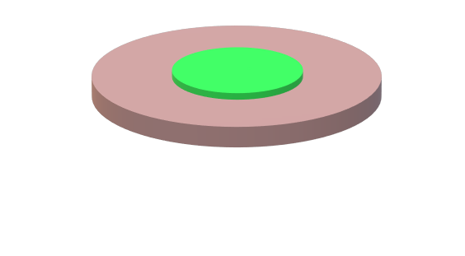
Target production at LNL – Nuclear physics applications
Solid targets for medical application: requirements
based on nuclear physics reaction for the production of the specific RN
Target material to be irradiated
Often isotopically enriched material→
very expensive how is it provided?(powder, crystal bar, foils..)
For nuclear cross section
For production
Optimal thickness
1-10 µm (100s µg/cm²)
The information on the exact amount is mandatory
Usually >150 µm
to exploit the optimal energy range to maximize production
Material used as monitor foil (e.g., Al foil 25 µm thick)
Chemical inertness
High thermal conductivity
Mechanical strenght
Low activation under the beam
Selected backing material
thermo-mechanical strenght to withstand the thermal power deposited during the irradiation
Target system
easily handled for safety during the dismount after the irradiation
Ø and thickness based on the cyclotron target station
easily handled for safe radiochemistry process in hot-cell

Slide 11
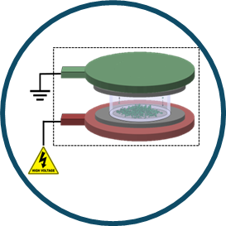

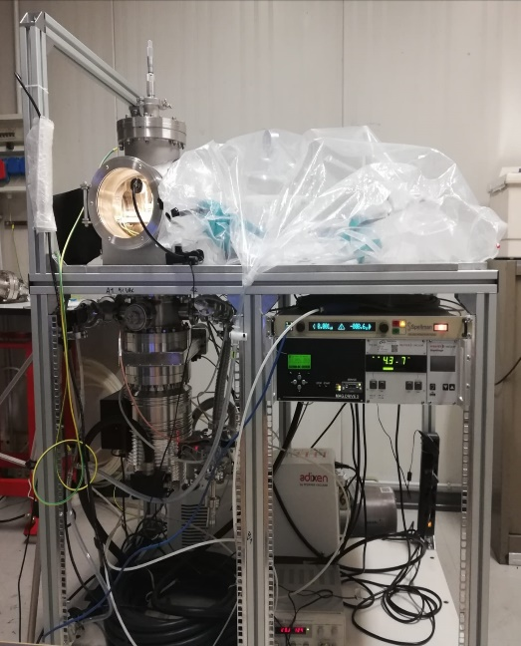
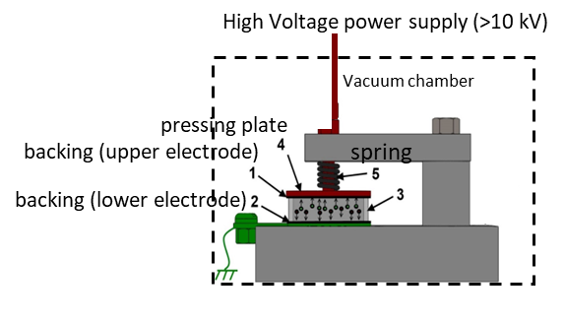
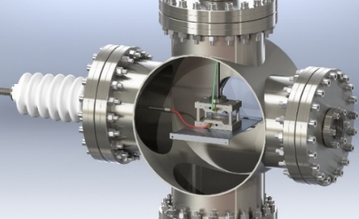
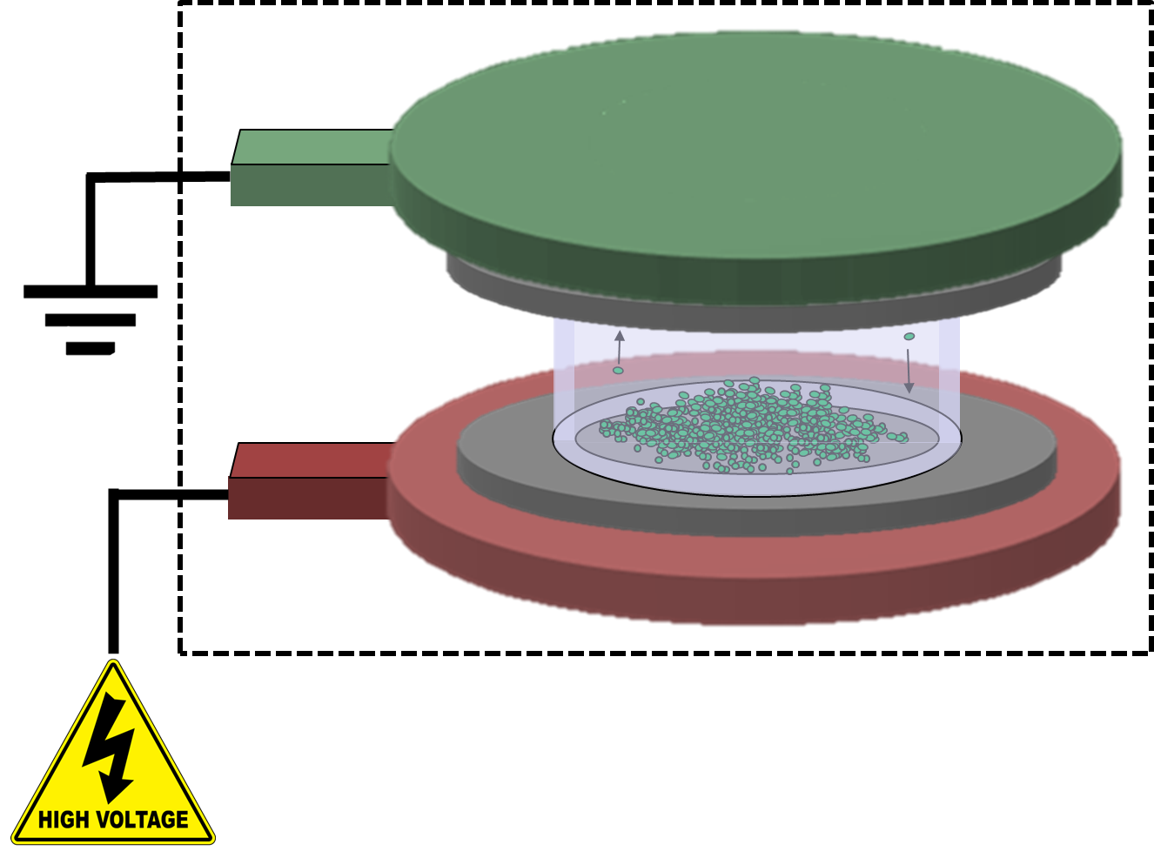
Target production at LNL – Nuclear physics applications
High Energy Vibrational Powder Plating (HIVIPP)
For thin targets aimed at nuclear cross-section measurements
This deposition technique exploits the phenomenon of vibrational motion of metallic powder in a static electric field
HIVIPP apparatus @LNL
Advantages
Starting material→ powder
Efficiency 95-98%→ no losses of material
Low amount of starting material is needed
Thickness: 0.1-20 µm
Two targets are deposited simultaneously
Process duration 10-40 h
I. Sugai, Nuclear Instruments and Methods A, 1997
Requirements:
Metal substrates
Metal powder (irregular shape and small size <20 µm)
H. Skliarova, S. Cisternino, et al., Nuclear Instruments and Methods A, 2020
S. Cisternino, et al., Instruments, 2022
S. Cisternino, et al., Materials, 2023

Slide 12
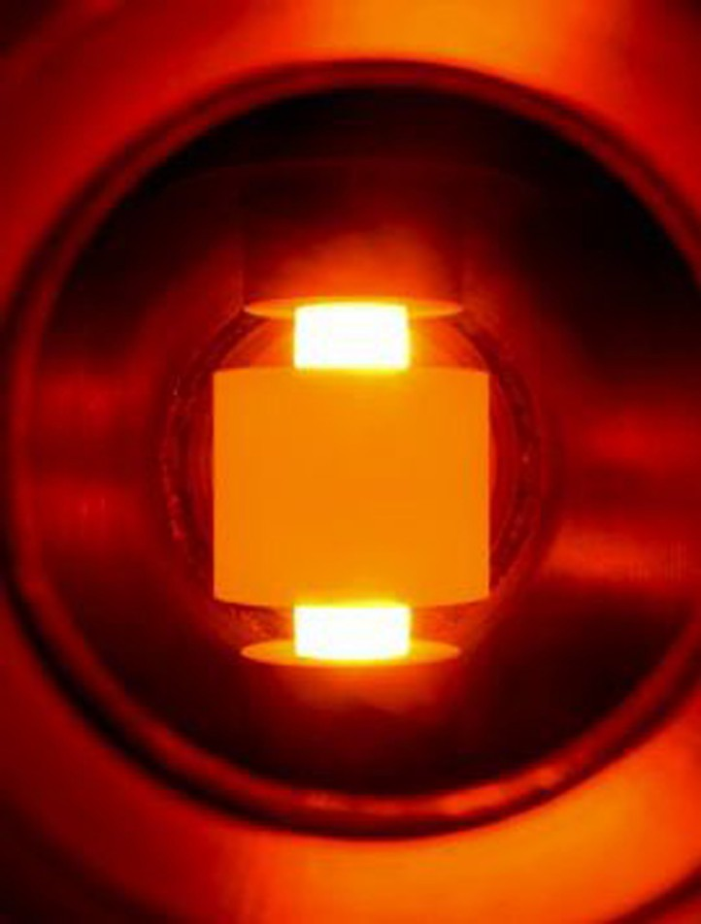
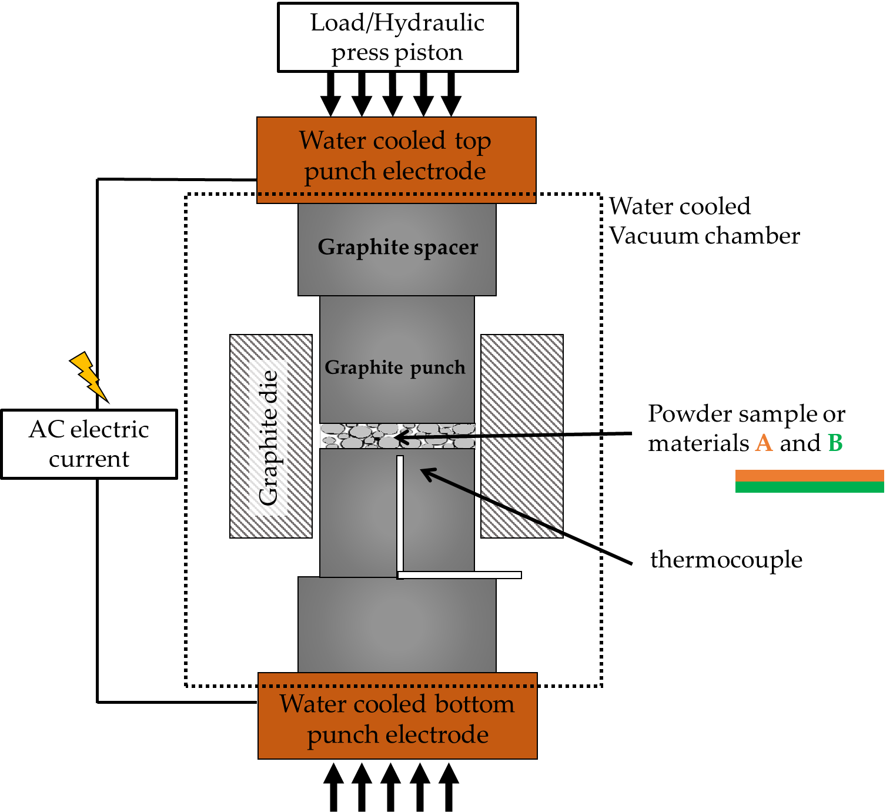
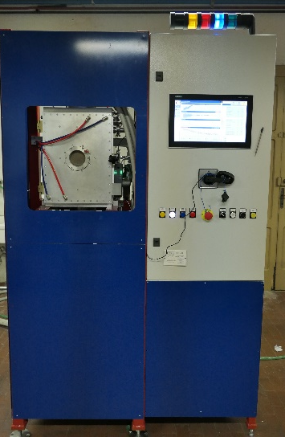
Target production at LNL – Nuclear physics applications
Spark Plasma Sintering (SPS)
fast and versatile sintering technique used for several applications in different fields
Advantages for cyclotron solid targets:
Starting materials→ powder or foil
97% efficiency→ No loss of isotope-enriched material
Directly bonding of different materials→ (target and backing)
  protective thin layer in between instead of costly inert material backings
150 μm - mm thickness pellet→ targets for production
Sintering of high melting point materials (metal or oxide)
Advantages respect to conventional sintering
  High heating rates (up to 1000 °C/min)
  Very short sintering times (min instead of hours)
Typical experimental conditions:
Voltage 5-10 V
Current intensity 10³-10⁴ A
Pressure 5-100 MPa
Dedicated SPS machine (TT_Sinter) tailored for targets manufacturing (for research)
Components:
water-cooled vacuum chamber
vacuum system
vertical single-axis hydraulic press
specially designed water-cooled punch electrodes
AC generator
temperature and other sensors
PLC controlling all the sintering parameters
custom graphite punches and die
Very fast process cycle
Customizable tooling
Easy to use and maintain
Affordability
Skliarova et al., J. Phys: Conf. Ser., 2020;
Sciacca et al., Molecules 2021;
Cisternino et al., NMB 2022
Cisternino et al., Ceramics International, 2025

Slide 13
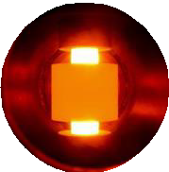
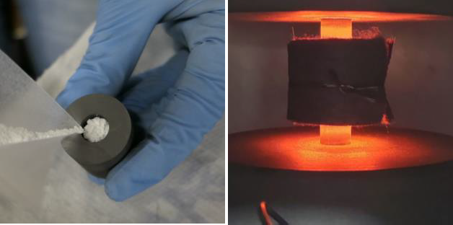
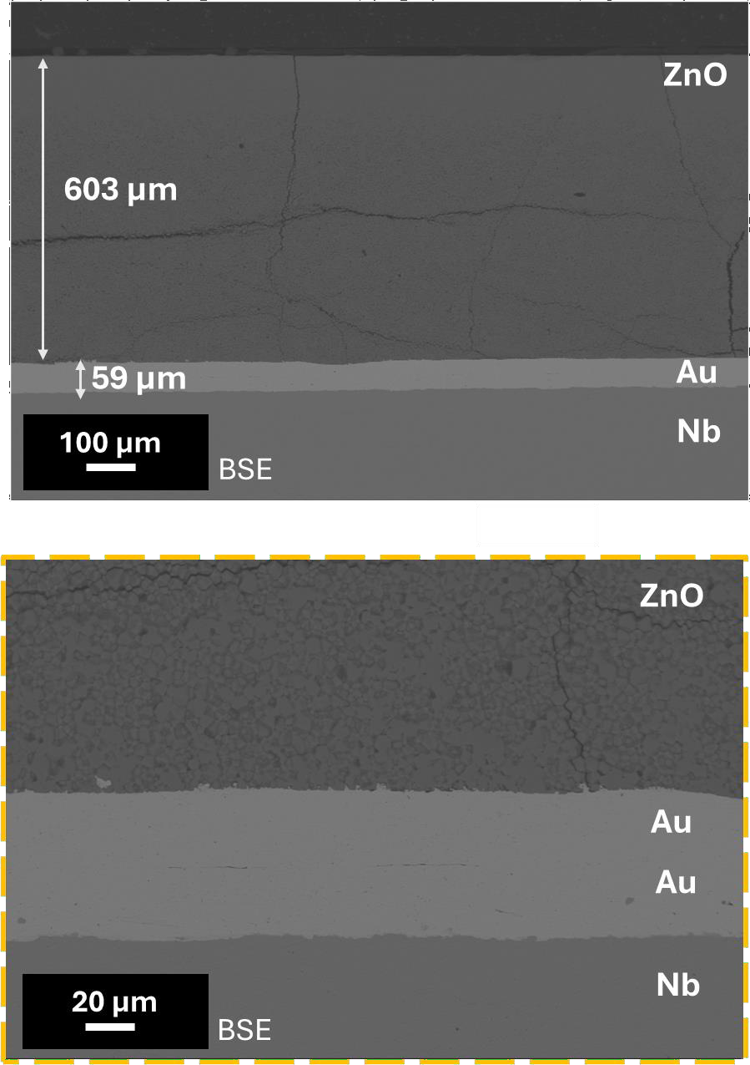
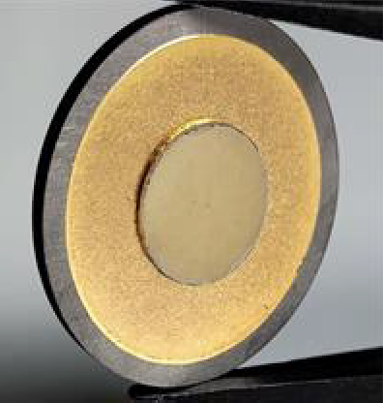
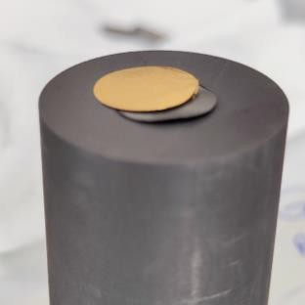
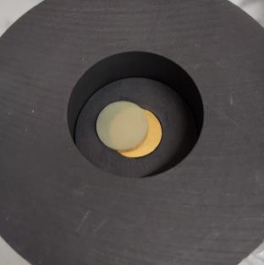
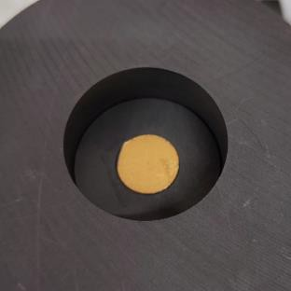
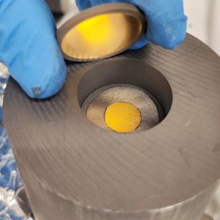
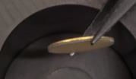
Spark Plasma Sintering (SPS): ZnO target example
12
SPS process
Main procedure steps
Metallurgical interface analysis – SEM
ZnO powder sintering
Final results: ZnO target coin
ZnO pellet-Au foil adhesion
Target (ZnO-Au/Au-Nb)
Cisternino et al.,Ceramics International,2025

Slide 14
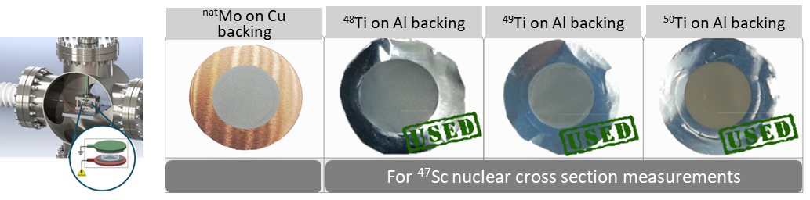
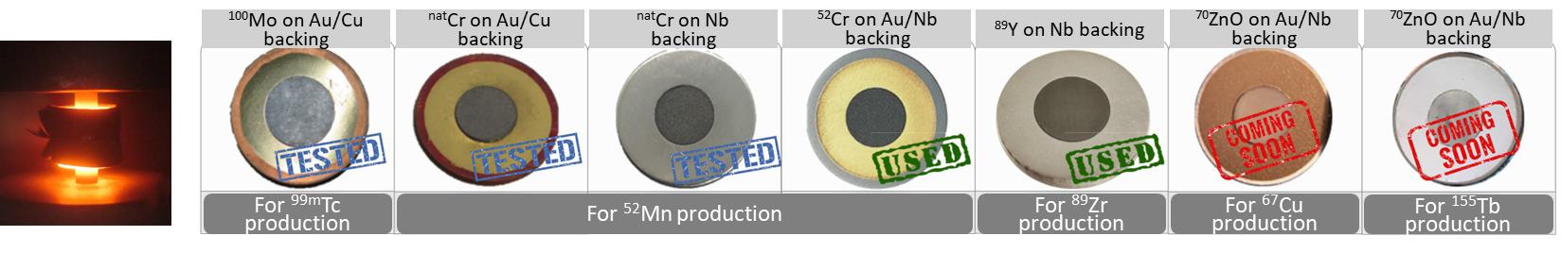

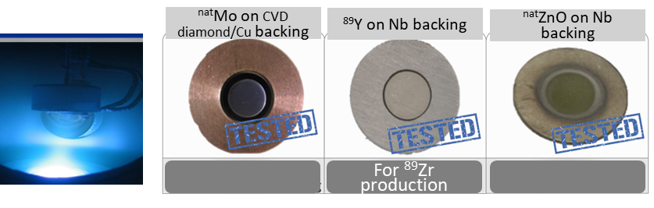
Target production at LNL – Nuclear physics applications
Some examples of tested targets
High Energy Vibrational Powder Plating (HIVIPP) for xs measurements targets
Skliarova et al., NIMA 2020;
Cisternino et al., Instruments 2022;
Cisternino et al., Materials 2023
Spark Plasma Sintering (SPS) for thick target >150 µm
Skliarova et al.,J.Phys:Conf.Ser.,2020;
Sciacca et al., Molecules 2021;
Cisternino et al., NMB 2022
Cisternino et al.,Ceramics International,2025
Magnetron sputtering (MS) for thin and thick targets
INFN patent WO/2019/053570, 2019
Skliarova et al., Instruments 2019;
Skliarova Molecules 2019;
Kotliarenko et al., Materials 2023

Slide 15
Target production at LNL
Quality Control (QC) techniques: nuclear targets characterization

Slide 16
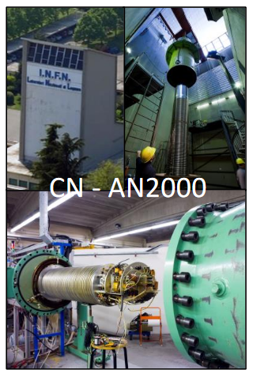
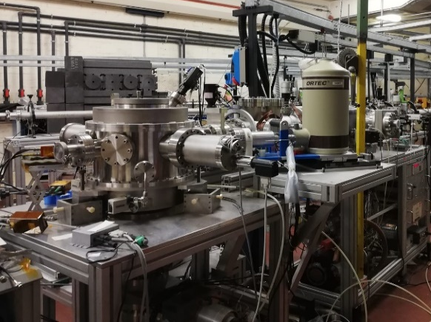
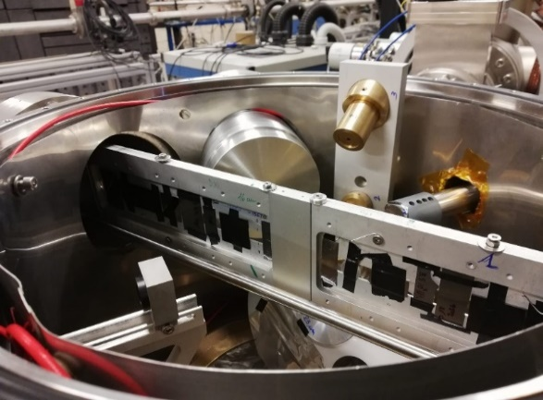
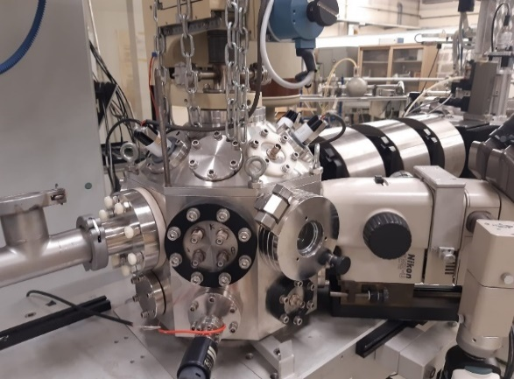
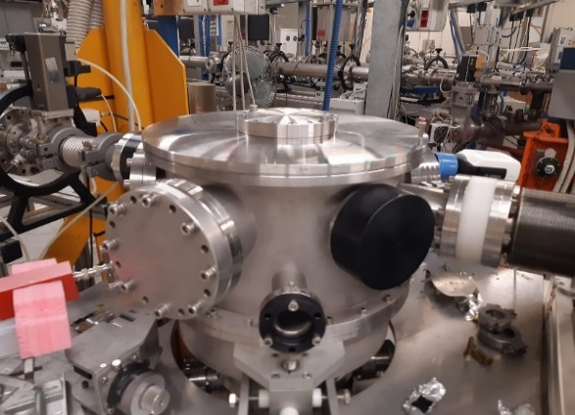
Target characterization at LNL
IBA facilities for nuclear target characterization @ LNL
quantitative determination of composition
thickness measurements in terms of dose (at/cm²)
depth profiles analysis
a)
b)
non-destructive
High accuracy and resolution
c)
d)
-15° beam line at CN facility [a), b)]
EBS analysis
PIXE analysis
PIGE analysis
0° beam line (μ-beam) at AN2000 facility [c)]
EBS analysis
PIXE analysis
60° beam line at AN2000 facility [d)]
EBS analysis
ERDA analysis

Slide 17
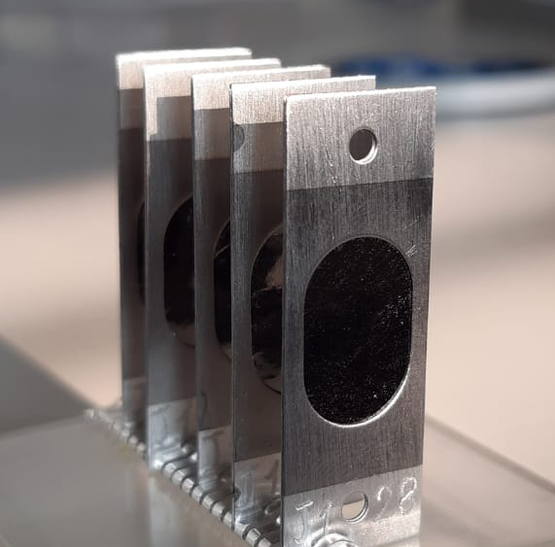
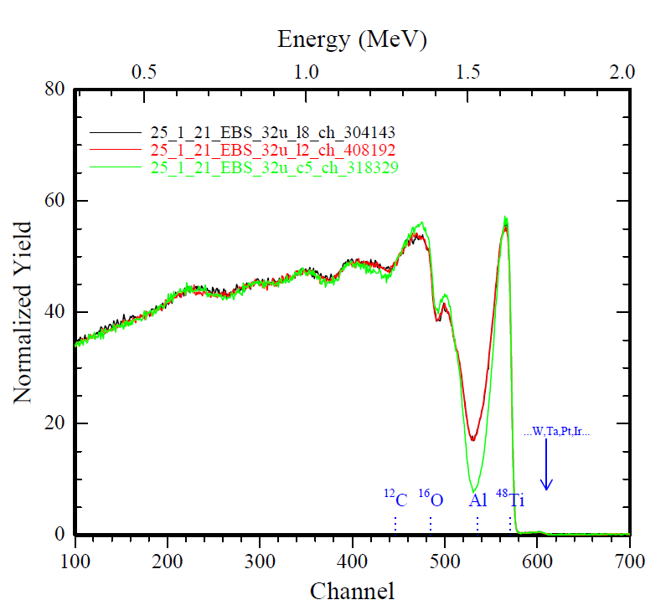
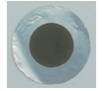
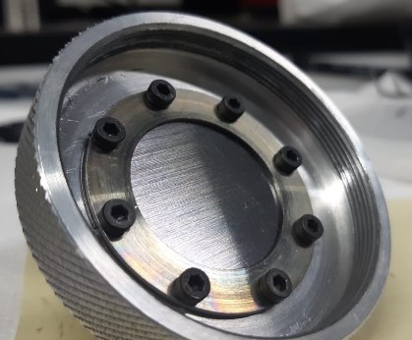
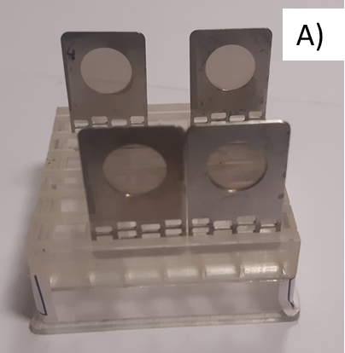


Target characterization at LNL
IBA facilities for nuclear target characterization @ LNL
Dedicated experiments in nuclear target analysis:
Deposition of Elements on Substrates (DES) involved in NUMEN project
Elastic backscattering spectrometry (EBS)
Characterization of HIVIPP targets for REMIX project (HIX) involved in LARAMED project
Elastic backscattering spectrometry (EBS)
Advances Nuclear Target (ANT)
involved in SALVIA project, LUNA collaboration (target development) and LNL target service (target characterization)
Elastic backscattering spectrometry (EBS)
Nuclear Reaction Analysis (NRA)
particle induced X-ray emission (PIXE)
particle induced γ-ray emission (PIGE)

Slide 18

Target characterization at LNL

Slide 19

Target characterization at LNL

Slide 20

EURO-LABS WP2.5.2 Collaboration meeting
May 15th, 2025 (Online)
Thank you from target makers group @LNL
Massimo Loriggiola
Lorenzo Loriggiola
Matteo Campostrini
Valentino Rigato
Sara Carturan
Sara Cisternino
Alisa Kotliarenko
Gaja Piteo (PhD UNIPD)
Stefano Corradetti
Juan Esposito

