Slide 1
ASPIDES meeting 4
Tommaso Floris
03/05/2025

Slide 2
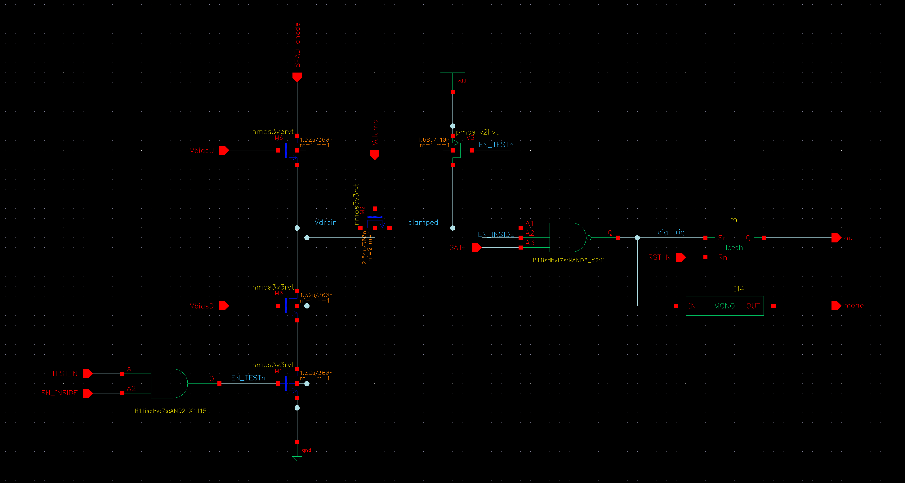
FrontEnd

Slide 3
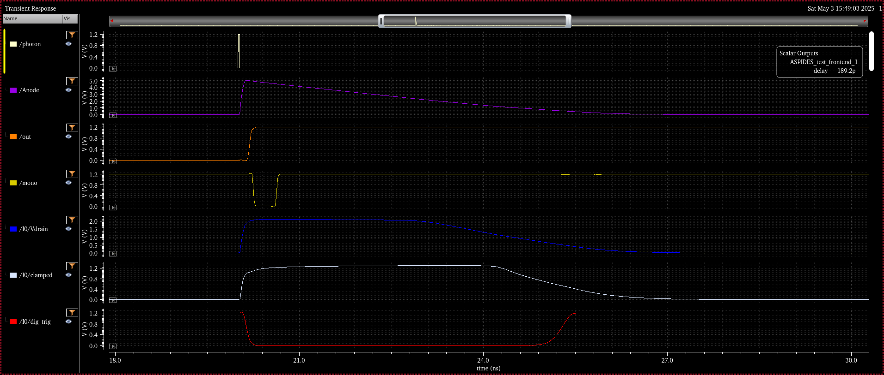
FrontEnd, Photon

Slide 4
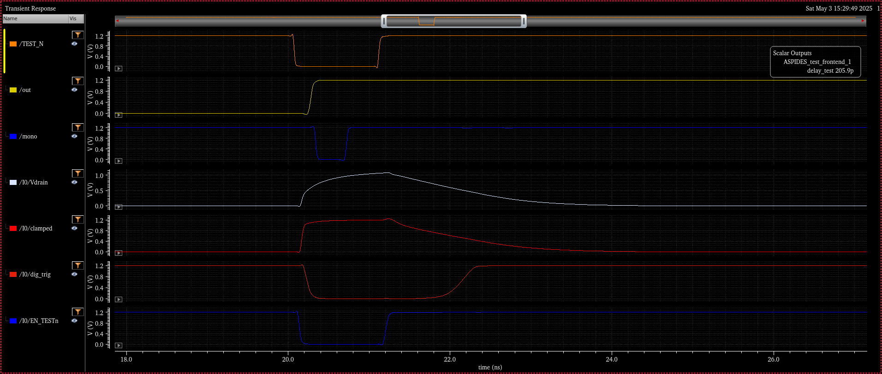
FrontEnd, Test

Slide 5
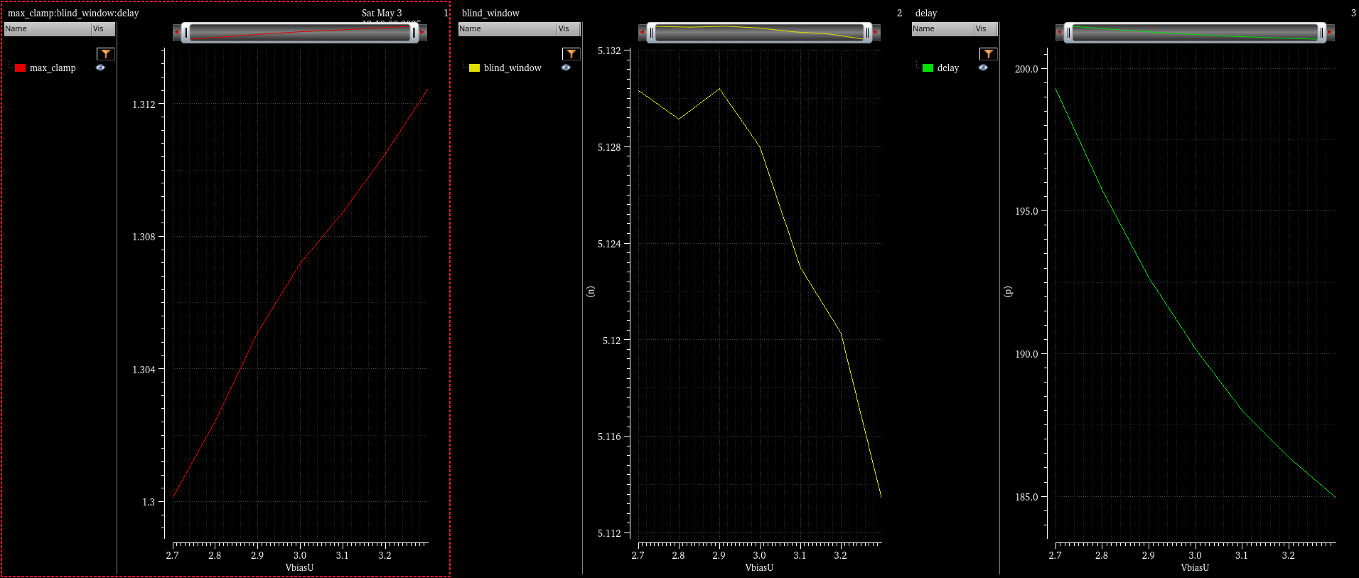
FrontEnd, VbiasU

Slide 6
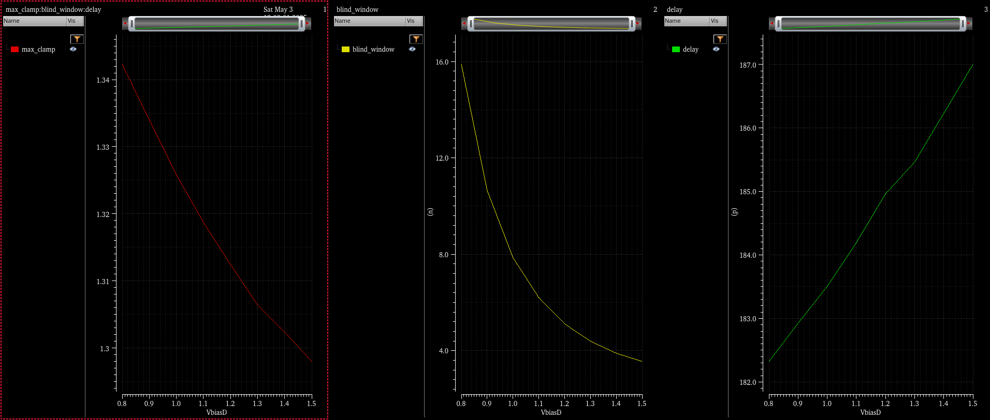
FrontEnd, VbiasD

Slide 7
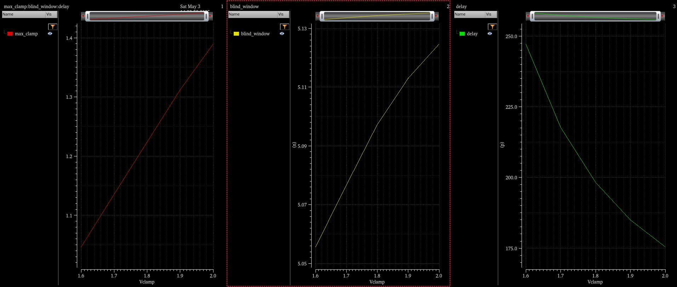
FrontEnd, Vclamp

Slide 8
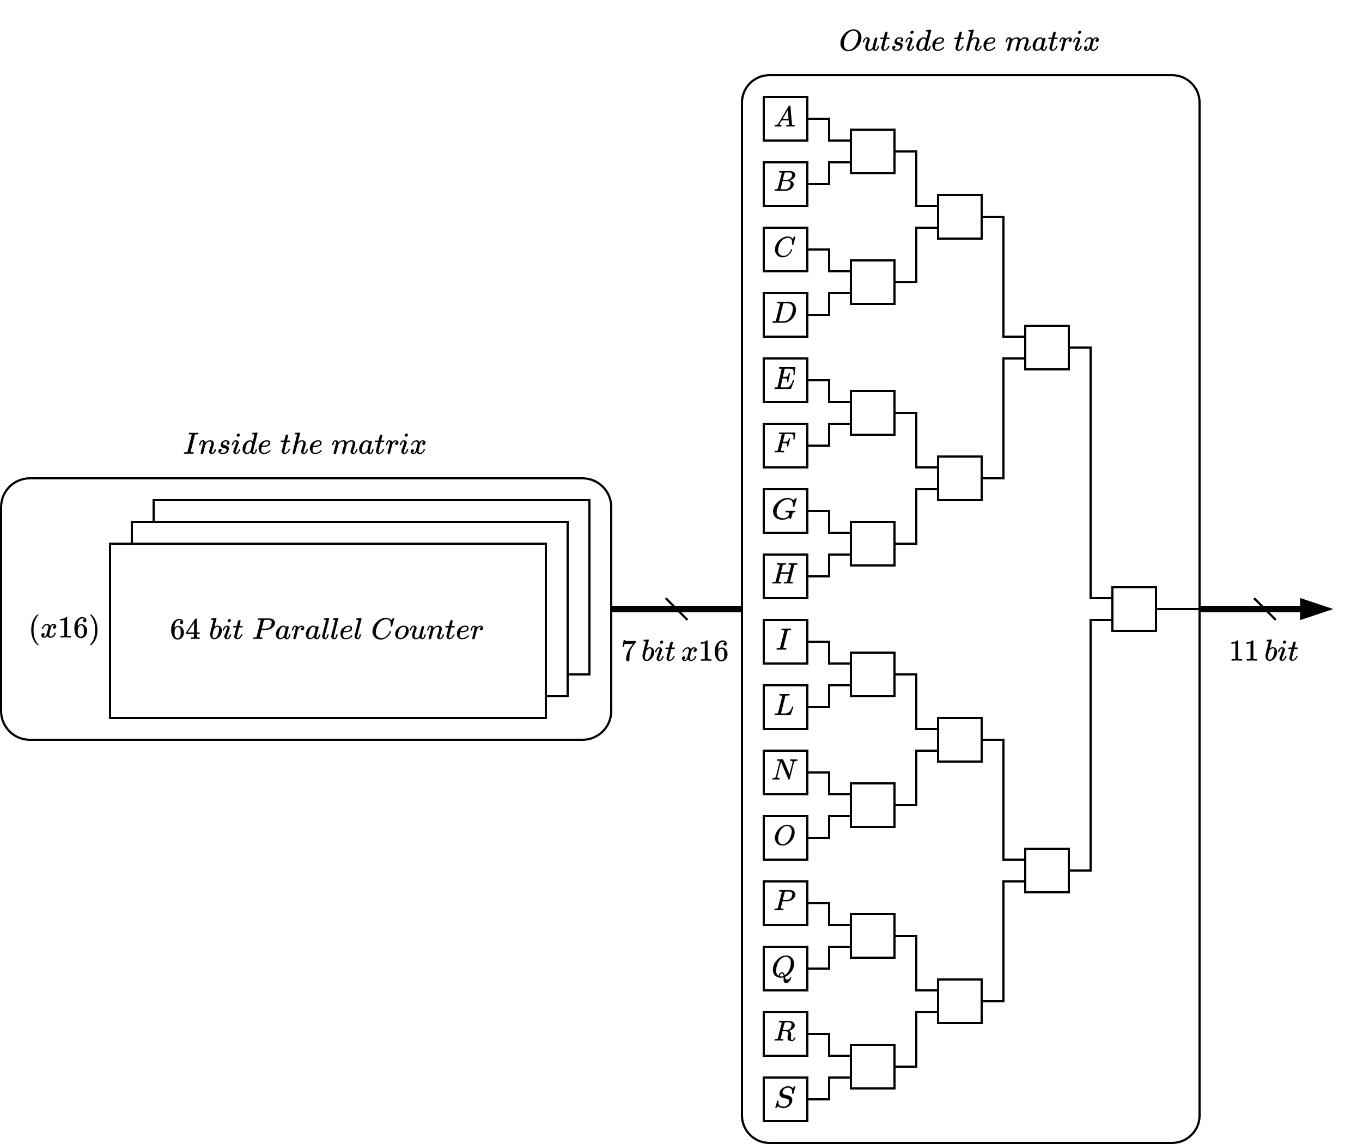
Split the Parallel Counter

Slide 9
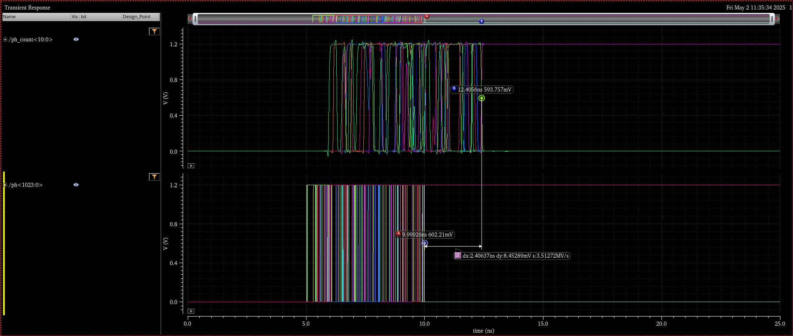
Delay, 10 photons each row : 2,4 ns

Slide 10
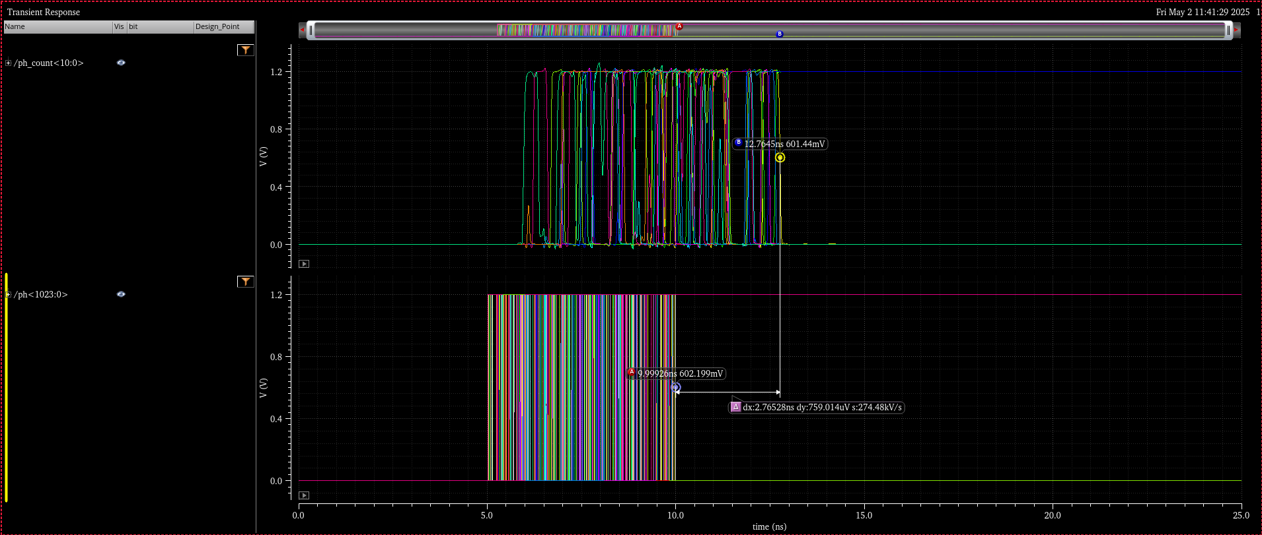
Delay, 20 photons each row : 2,76 ns

Slide 11
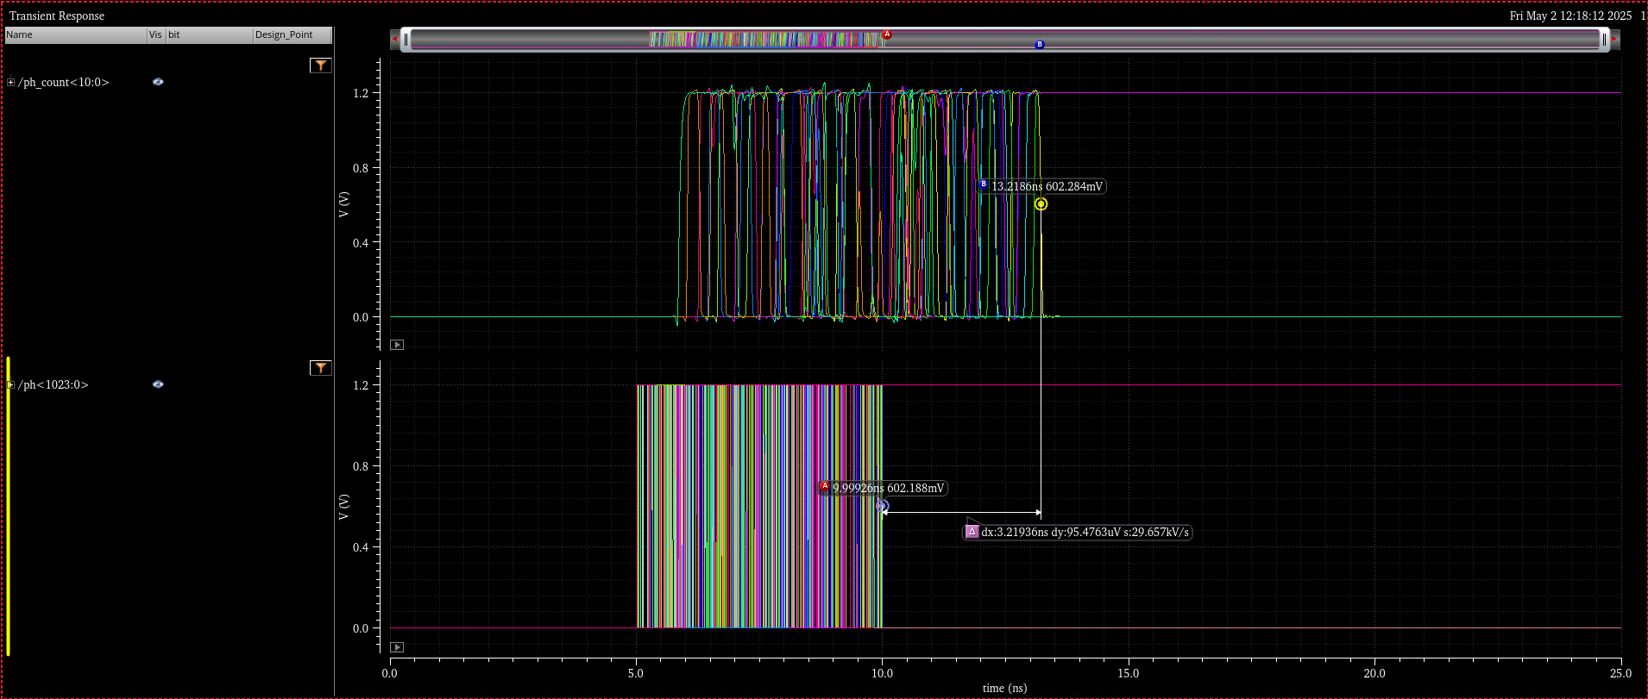
Delay, 30 photons each row : 3,2 ns

Slide 12
Buffer tree, reset propagation

Slide 13
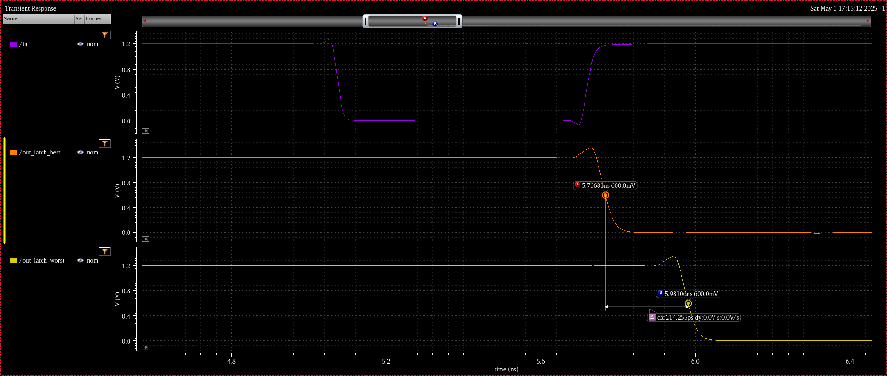
Buffer tree, reset propagation

Slide 14
Buffer tree, reset propagation, corners
 | TT | FF | SS | FS | SF
Worst | 905.7 ps | 761.1 ps | 1.196 ns | 948.3 ps | 940.5 ps
Best | 691.4 ps | 540.9 ps | 979 ps | 717.8 ps | 736.9 ps

