Slide 1

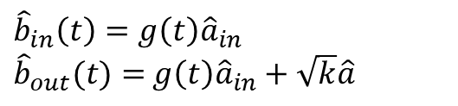


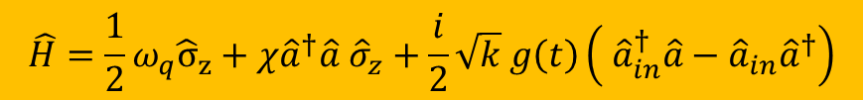




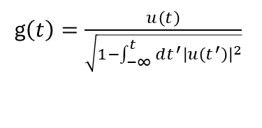

Model
$${\hat{a}}_{in}$$
$$\hat{a}$$
$${\hat{σ}}_{z}$$
$$k$$
$$χ$$
$${\hat{b}}_{in}$$
$${\hat{b}}_{out}$$
Field
Cavity
Qubit
$$\hat{H}={\frac{1}{2}ω}_{q}{\hat{σ}}_{z}+χ{\hat{a}}^{†}\hat{a} {\hat{σ}}_{z}+\frac{i}{2}\sqrt{k} g\left(t\right)\left( {\hat{a}}_{in}^{†}\hat{a}−{\hat{a}}_{in}{\hat{a}}^{†}\right)$$
$${\hat{b}}_{in}\left(t\right)=g\left(t\right){\hat{a}}_{in}$$
${\hat{b}}_{out}(t)=$ $g\left(t\right){\hat{a}}_{in}+\sqrt{k}\hat{a}$
g$\left(t\right)=\frac{u\left(t\right)}{\sqrt{1−\int_{−∞}^{t}{dt^{′}}{\left|u\left(t^{′}\right)\right|}^{2}}}$
$u\left(t\right)=\sqrt{\frac{σ}{\sqrt{π}}e^{−σ^{2}t^{2}}}$

Slide 2
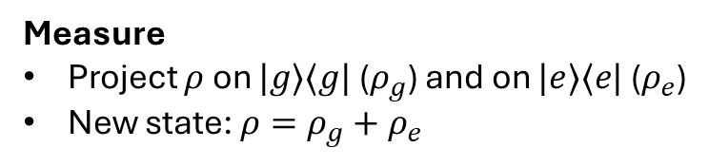



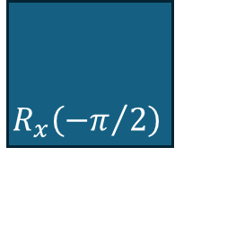

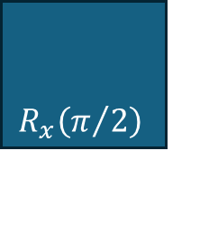



Measurement protocol
Field
$$|1⟩$$
$$R_{x}\left(π/2\right)$$
$$R_{x}\left({−π}/2\right)$$
$$Measure$$
Cavity
$$|0⟩$$
Qubit
$$|g⟩$$
Evolution
Measure
Project $ρ$ on $|g⟩⟨g|$ ($ρ_{g}$) and on $|e⟩⟨e|$ ($ρ_{e}$)
New state: $ρ=ρ_{g}+ρ_{e}$
Field
$$|1⟩$$
Cavity
$$|0⟩$$
Qubit
$$|g⟩$$

Slide 3
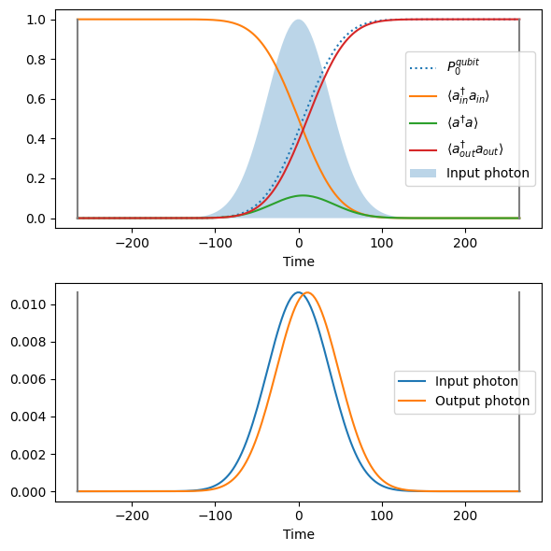
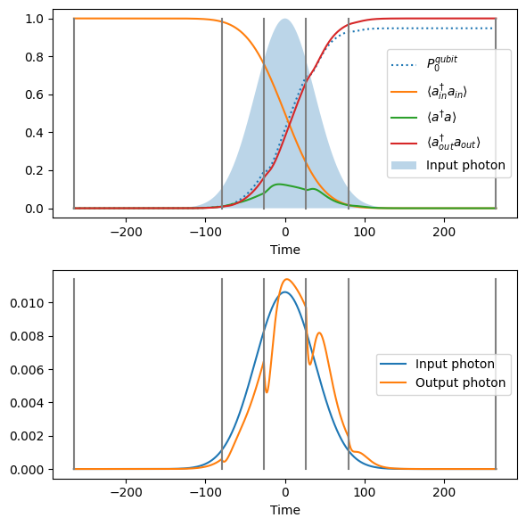


$$σ=0.1k, χ=0.5k$$
$$P_{0}^{qubit}$$
0.011
0.194
0.695
0.931
0.948

Slide 4
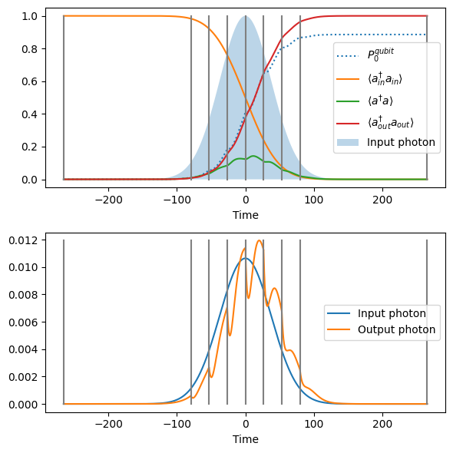


$$P_{0}^{qubit}$$
0.011
0.194
0.695
0.931
0.948
$$P_{0}^{qubit}$$
0.011
0.056
0.184
0.409
0.650
0.806
0.868
0.886
Correlations?

Slide 5
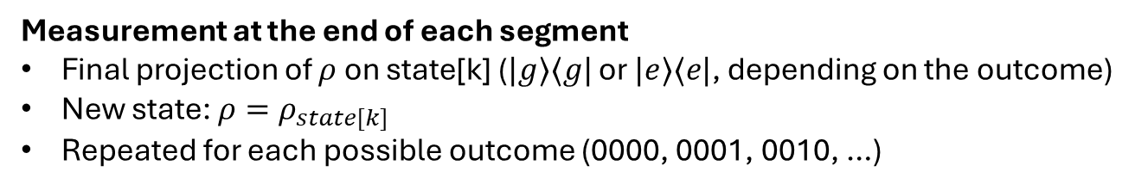
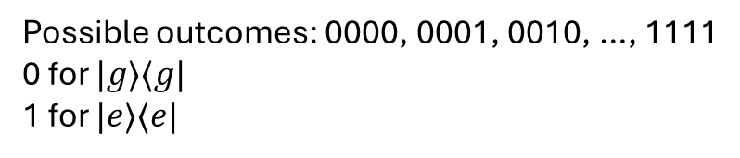



Measurement protocol
Field
$$|1⟩$$
$$R_{x}\left(π/2\right)$$
$$R_{x}\left({−π}/2\right)$$
$$Measure$$
Cavity
$$|0⟩$$
Qubit
$$|g⟩$$
Evolution
Field
$$|1⟩$$
1
2
3
4
Possible outcomes: 0000, 0001, 0010, …, 1111
0 for $|g⟩⟨g|$
1 for $|e⟩⟨e|$
Cavity
$$|0⟩$$
Qubit
$$|g⟩$$
Measurement at the end of each segment
Final projection of $ρ$ on state[k] ($|g⟩⟨g|$ or $|e⟩⟨e|$, depending on the outcome)
New state: $ρ=ρ_{state[k]}$
Repeated for each possible outcome (0000, 0001, 0010, …)

Slide 6
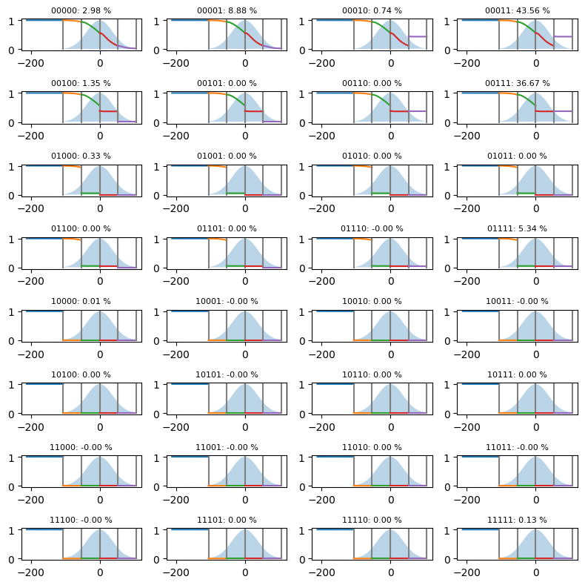
Rivelata eccitazione
Nessuna: p = 2.98%
Almeno 1: p = 97.02%
Almeno 2: p = 85.71%
Almeno 3: p = 42.14%
Almeno 4: p = 5.47%
Tutte e 5 : p = 0.13%

