Slide 1












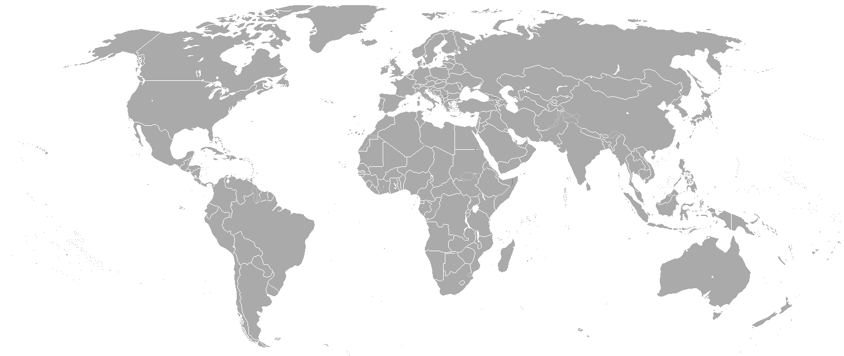










Relic neutrinos detection and mass measurement in the PTOLEMY project.
Seminario all’Universita’ di Milano Bicocca May 28th 2025
M Messina, LNGS-INFN

Slide 2
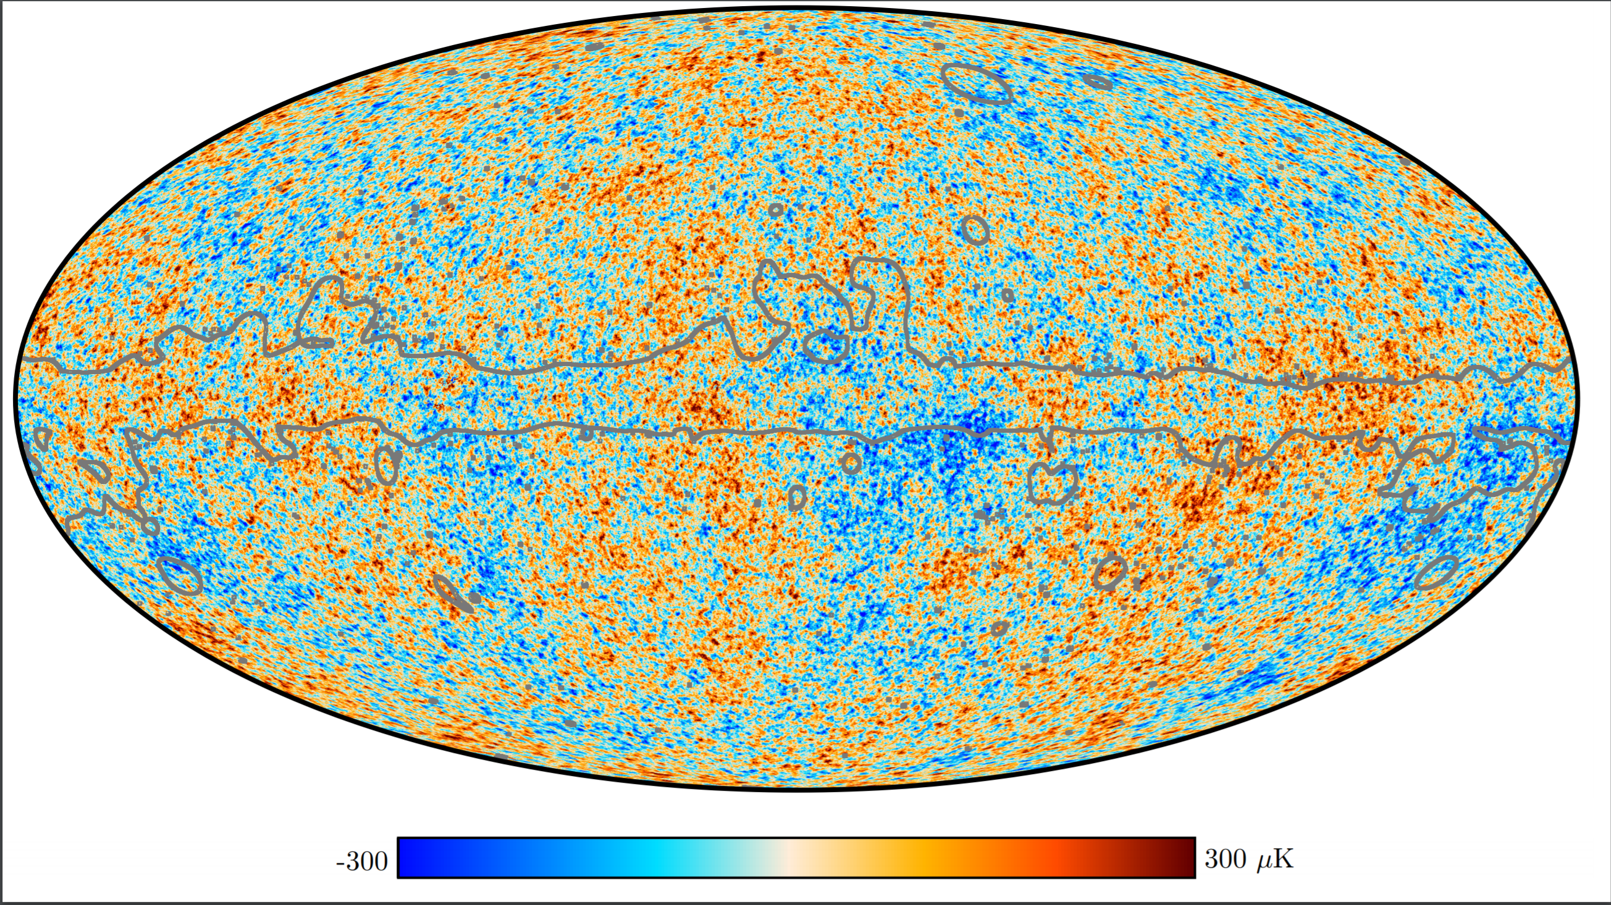
Why we believe in the Big Bang?
Expansion of Universe
Light element abundances
Cosmic Microwave Background

Slide 3
Why believe Big Bang?
Expansion of Universe
Light element abundances
Cosmic Microwave Background
Cosmic Neutrino Background

Slide 4
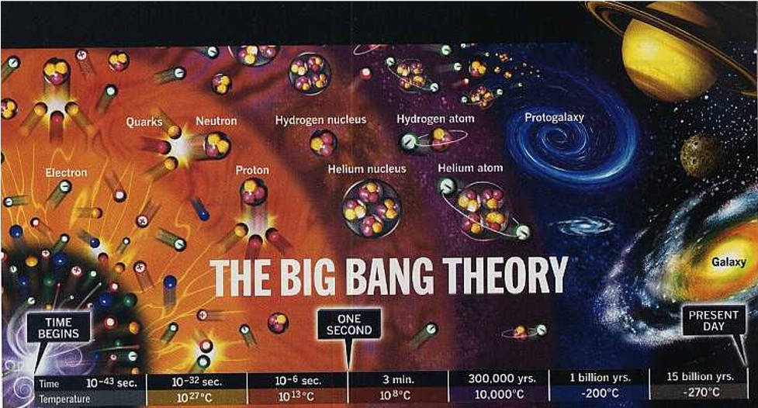
Big Bang
10⁻³⁶ sec
1 sec
380.000 year
6 November 2023

Slide 5
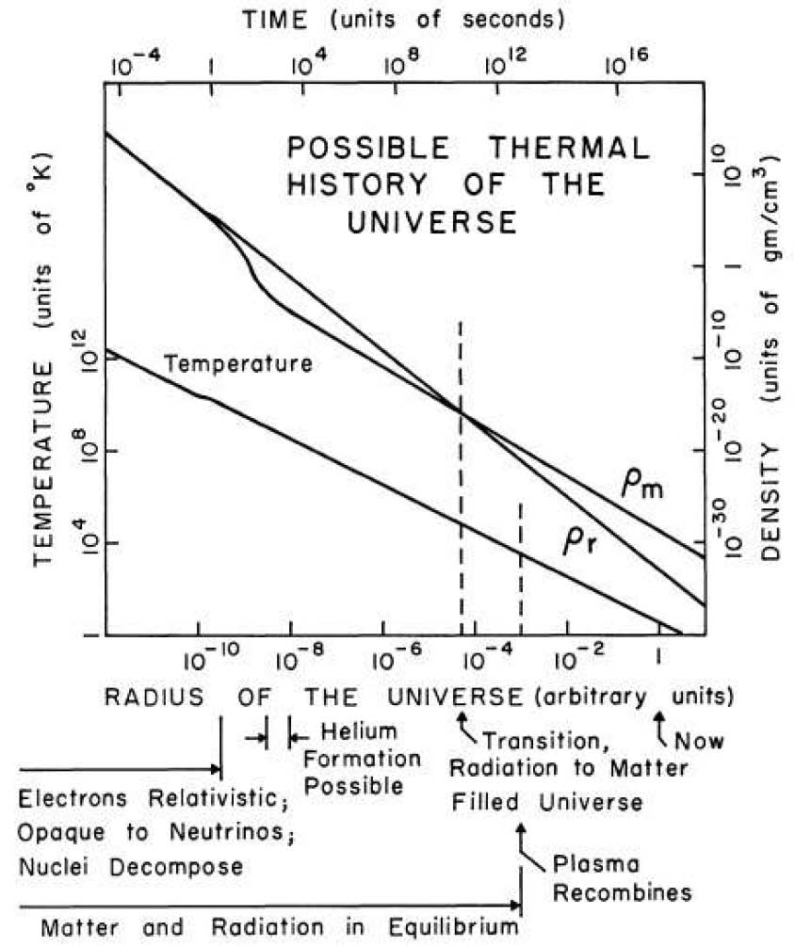
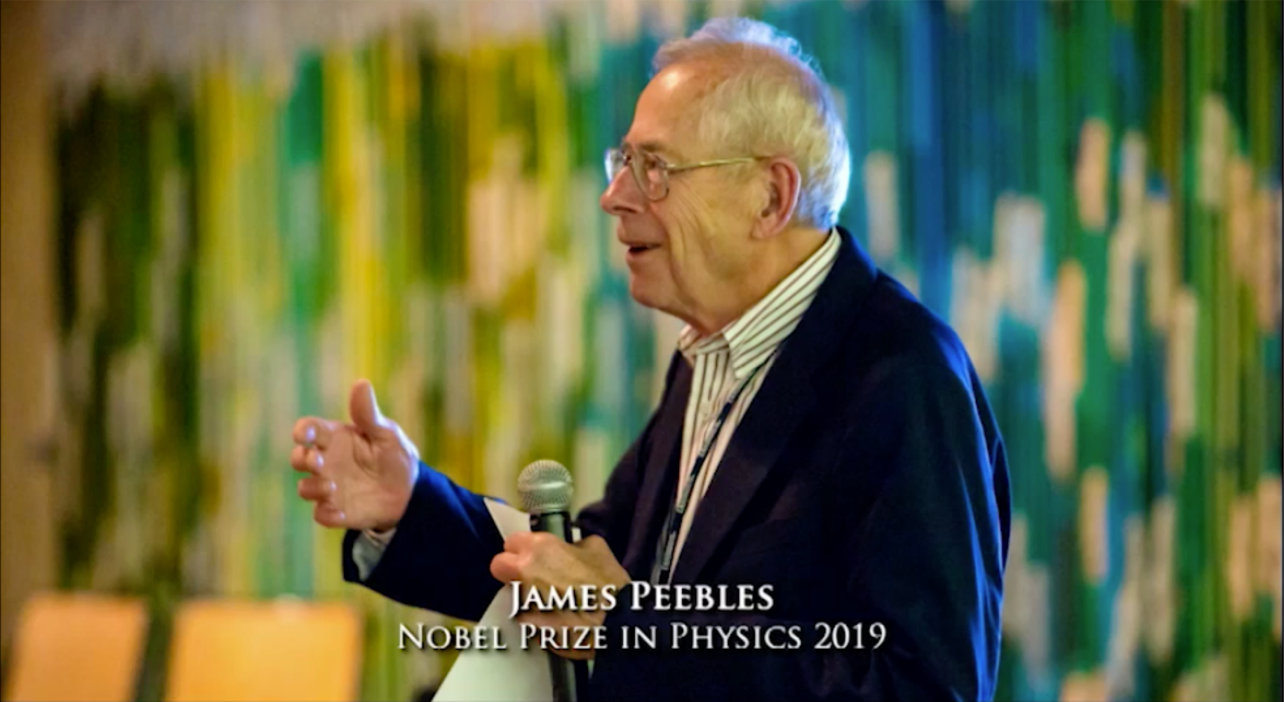
Cosmic Neutrino Background
1 sec
Number density:
n_{ν} = 112/cm³
Radiation ~1/a⁴
Temperature:
T_{ν} ~ 1.95K
Matter
~1/a³
Time of decoupling:
t_{ν} ~ 1 second
~50% of the Total Energy Density
of the Universe @ 1 sec
    neutron/proton ratio
    @start of nucleosynthesis
⁴He
²H
(³He)
⁷Li
Dicke, Peebles*, Roll, Wilkinson (1965)
Cosmology's Century (2020)
*
Notes:
Now back to the early Universe. This is a paper from 1965 by … and describes the thermal history of the Universe. It shows how in the hot Big Bang model that there is a point in time when the Universe transitioned from a radiation dominated Universe to a matter dominated Universe – matter-radiation equality. In fact, I saw Jim Peebles in the coffee shop in Princeton yesterday and I asked him how the matter was estimated (since the ideas about dark matter were still being figured out). He discussed it with me as if he had posted it on the arxiv the night before – not over half a century ago. He said it was estimated based on measures that involved total gravitational potential – it’s not just the baryonic matter in this plot. After matter dominates, the plasma of the early Universe can sustain semi-relativistic sounds waves and that gives rise to much of the wealth of information that we measure in the CMB. At an early point in time, the Universe was so dense that even neutrinos were in thermal equilibrium – meaning there was no difference between a proton and neutron because the neutrino would transform one into the other. At one second the Universe became transparent to neutrinos. We know a lot about them based on the predictions from this model.
In fact, the existence of neutrons in the present day Universe is also a paradox. Free neutrinos only live 15 minutes – the Universe had to cool down within a couple minutes to a temperature where the lightest element, Deuterium, was stable against dissociation by thermal radiation. By binding them into nuclei, they were able to continue to exist to the present day.

Slide 6
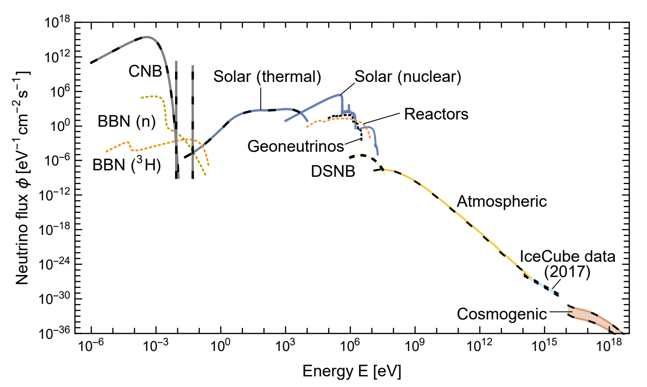
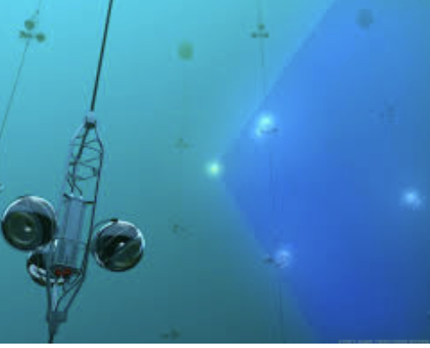
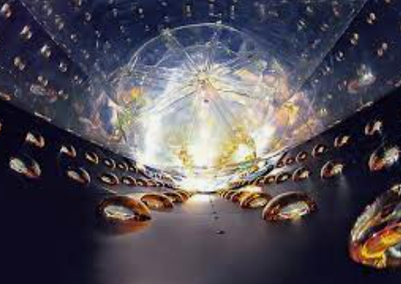
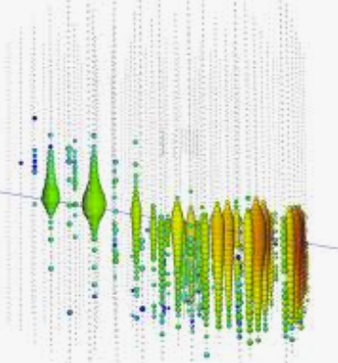
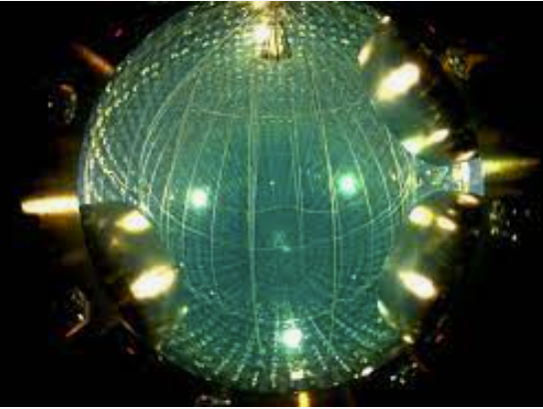
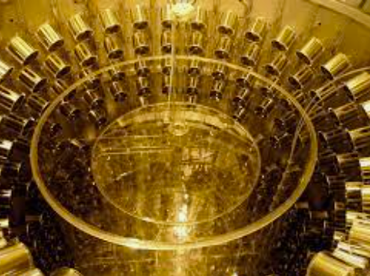
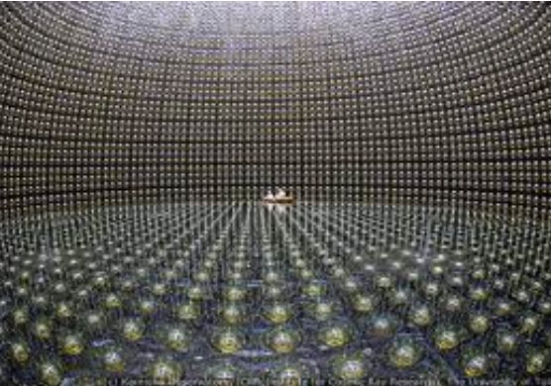

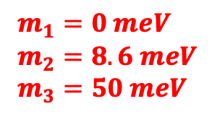


Grand Unified Neutrino Spectrum
$$m_{1}$$
$$m_{2}$$
$$m_{3}$$
https://arxiv.org/pdf/1910.11878.pdf
$m_{1}=0 meV$
$m_{2}=8.6 meV$
$m_{3}=50 meV$
threshold

Slide 7
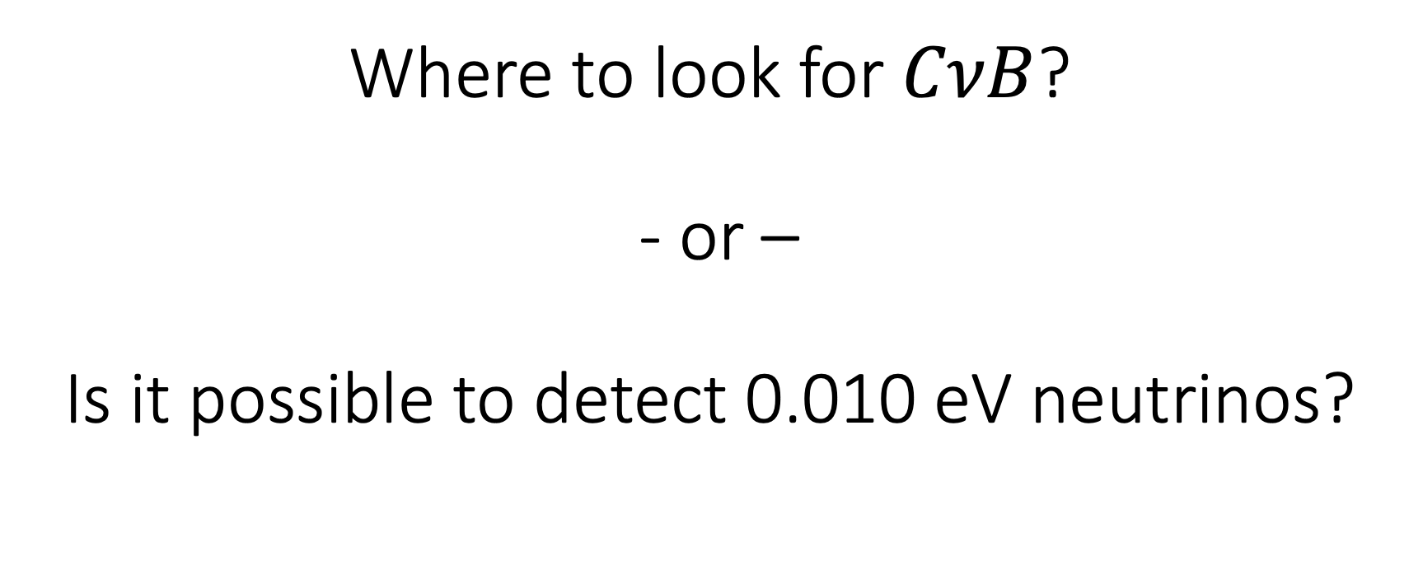
Where to look for $CνB$?
- or –
Is it possible to detect 0.010 eV neutrinos?

Slide 8
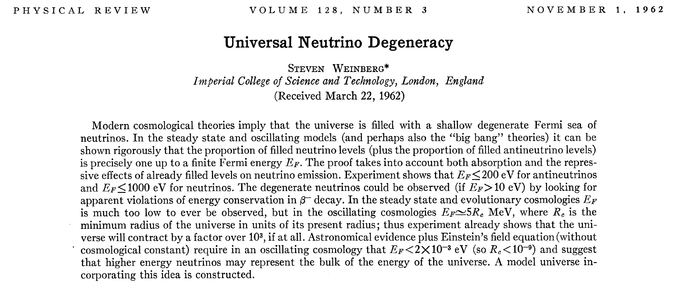
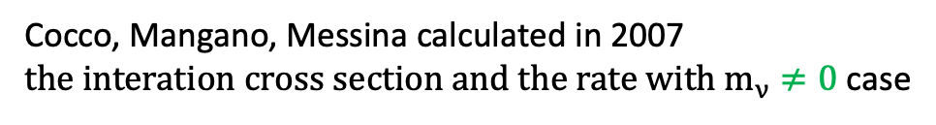

Induced beta decay
$m_{ν}=0$
Cocco, Mangano, Messina calculated in 2007
${the interation cross section and the rate with m}_{ν}≠0$ case
JCAP 0706:015,2007

Slide 9
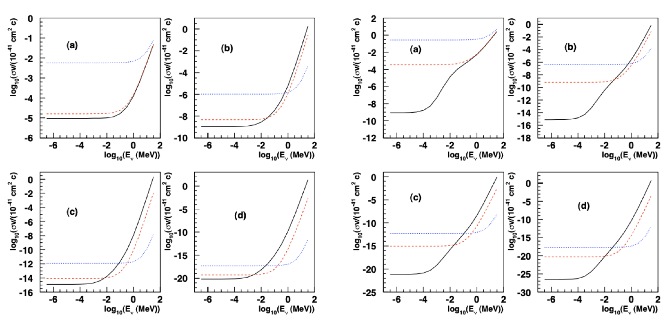
CROSS SECTIONS
Tritium has the largest product of capture cross section and lifetime
Detailed evaluation on 2007
JCAP 06 (2007) 015
of 𝜎x𝜏 renewed the dormant discussion on relic neutrino detection and paved the view to a possible experiment.
Several authors confirmed the cross section evaluation and added informations:
J. Phys. G: Nucl. Part. Phys. 35 025001
JCAP 08 (2014) 038

Slide 10
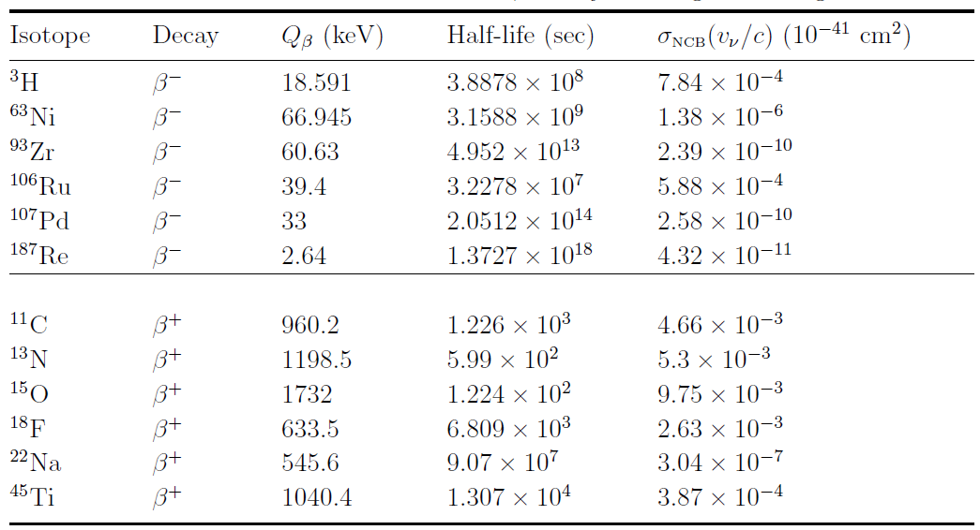
Selection of target
“Highish” cross-section
“Longish” lifetime

Slide 11
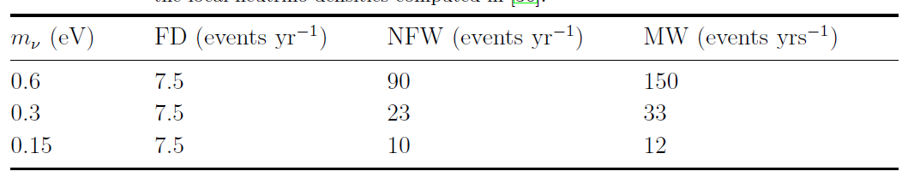
Expected rate: 100 gram-year exposure
JCAP 0706:015,2007
x0.5
x0.5
x0.5
Dirac
Majorana
JCAP 076:015, 2007
JCAP 1408 (2014) 038

Slide 12
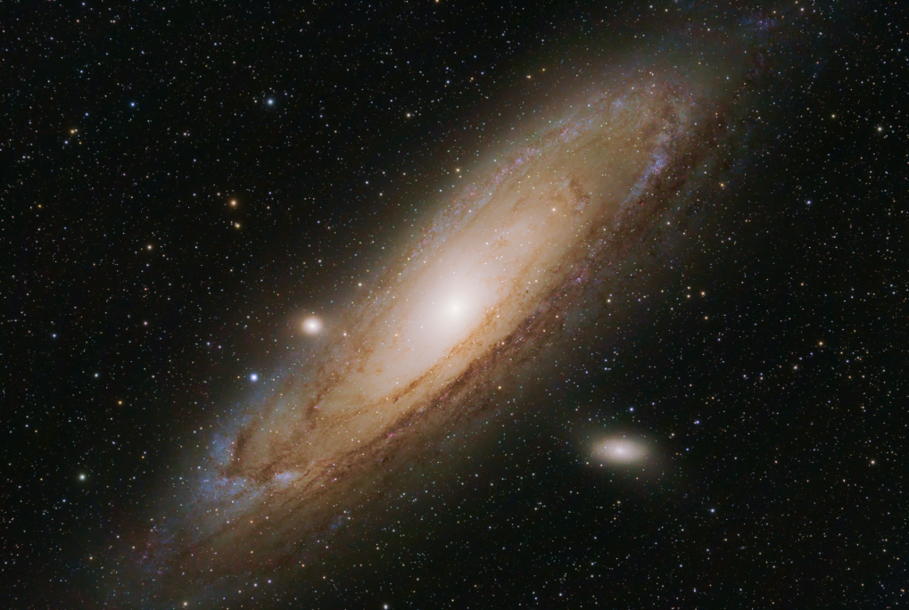
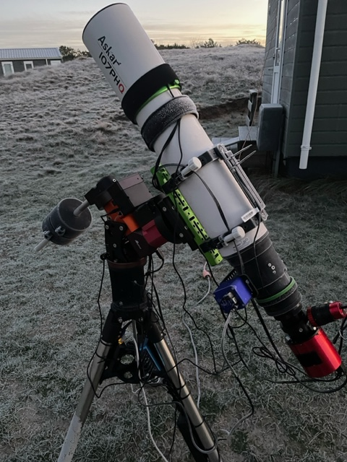
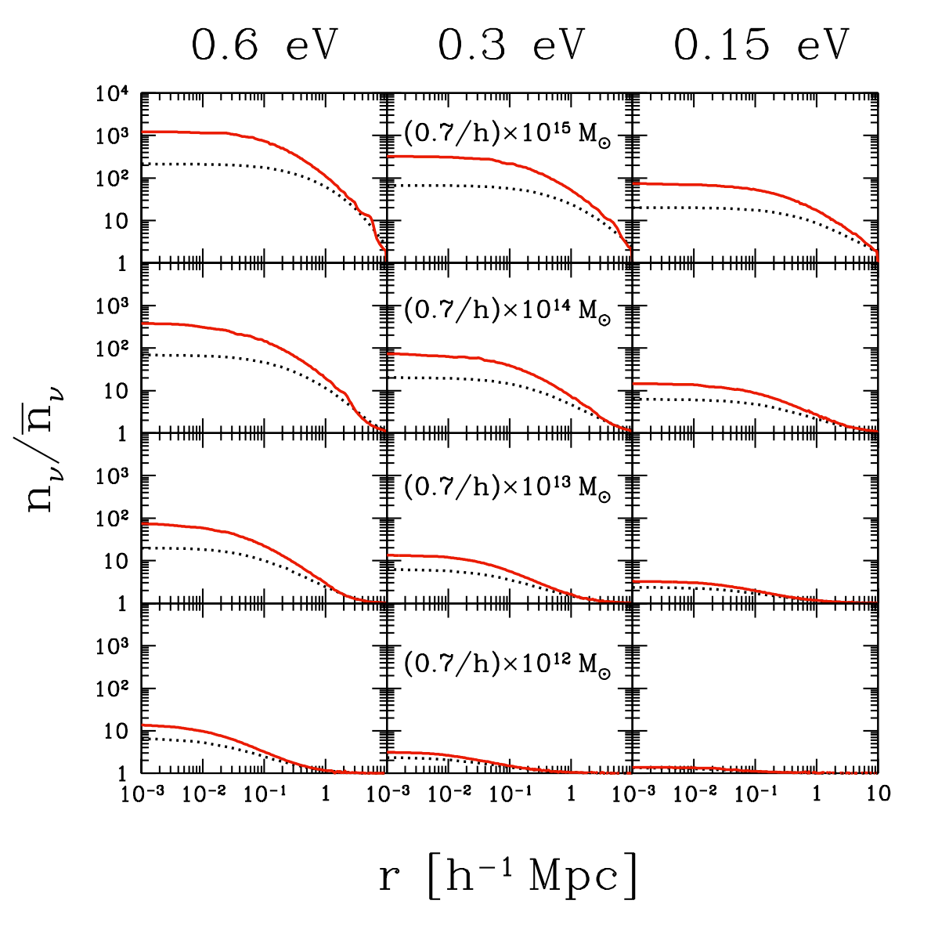
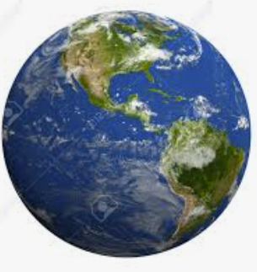
Expected rate
Gravitational clustering
© A.P.Colijn astrophotography
https://arxiv.org/pdf/hep-ph/0408241.pdf

Slide 13
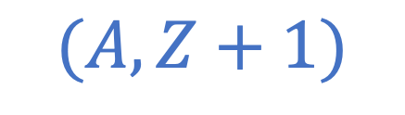
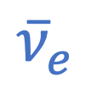
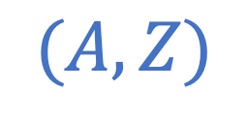


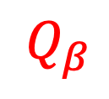
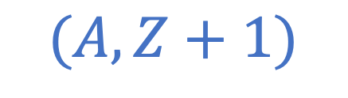
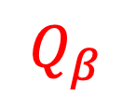
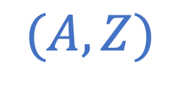
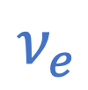
Signature of relic neutrinos
$$e^{−}$$
$${\overline{ν}}_{e}$$
$$Q_{β}$$
$$(A,Z)$$
$$(A,Z+1)$$
T_{e}
m_{ν}
$$ν_{e}$$
$$e^{−}$$
$$Q_{β}$$
$$(A,Z)$$
$$(A,Z+1)$$
T_{e}
m_{ν}
m_{ν}

Slide 14
Detection concept: Neutrino Capture on 𝛽 unstable nuclei
Basic concept for relic neutrino detection rooted in a paper by Steven Weinberg in 1962 [Phys. Rev. 128:3, 1457]; applied for the first time, in case of massive neutrinos, to lay out a proposal for their direct experimental detection in 2007 by A.G.Cocco, G.Mangano and M.Messina. [JCAP 06(2007)015 DOI: 10.1088/1475-7516/2007/06/015]
What do we know?
Gap (2m) constrained to
m ≲ 200meV
from precision cosmology
M.G. Betti et al JCAP 07(2019)047
CνB Detection Requires:
energy resolution set by m_{ν}
Electron flavor expected with
m ≳50meV
from neutrino oscillations
PTOLEMY target resolution: ~ 50 meV
14

Slide 15
Before carrying on we can’t miss to mention the KATRIN experiment

Slide 16
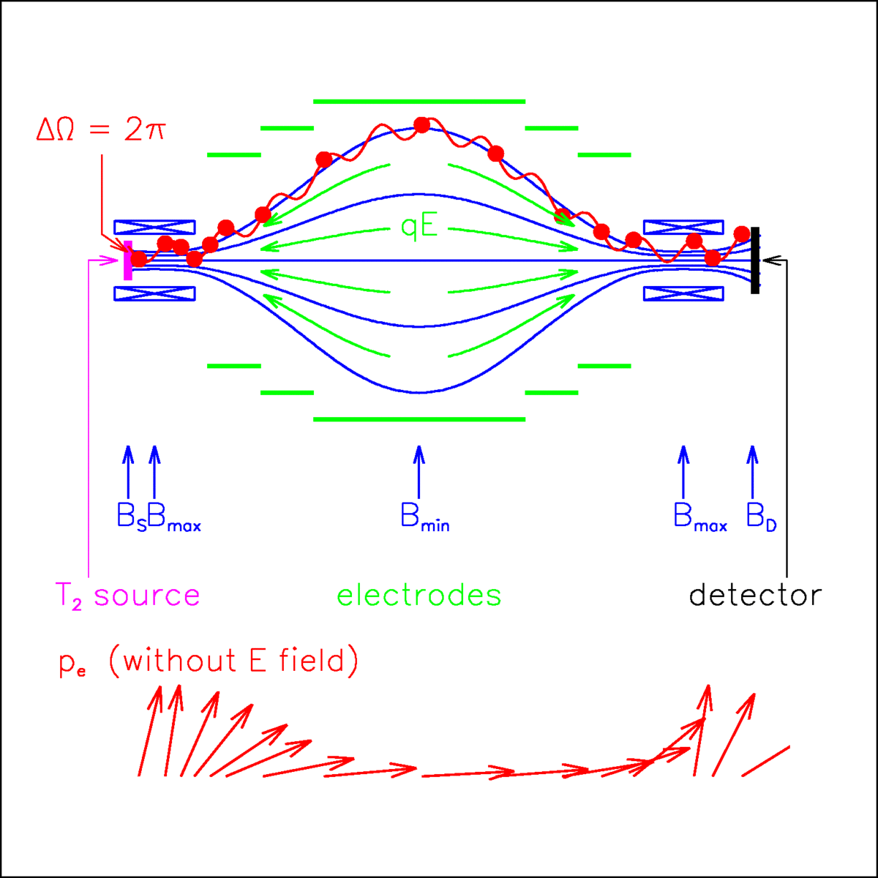
The principle of the Mac-E filter*
Two superconducting solenoids produce a magnetic field B. The beta electrons, which are starting from the tritium source in the left solenoid, are guided magnetically on a cyclotron motion around the magnetic field lines into the spectrometer (2p solid angle).
*from Katrin webpage

Slide 17

The principle of the Mac-E filter (I)
On their way to the center of the spectrometer the magnetic field B drops by many orders of magnitude. Therefore, the magnetic gradient force
Remember, few T
transforms most of the cyclotron energy into longitudinal motion. Thus, because of the slowly varying magnetic field B the momentum transforms adiabatically, therefore the magnetic moment µ that in a non-relativistic approximation is:
does not change! Condition of adiabaticity

Slide 18
Features and LIMITS of the
KATRIN detector
Pros:
Simple Filter concept
Cons:
Too large volume
Poor energy resolution
To increase sensitivity, one musts increase volume
Collecting electron from any direction

Slide 19
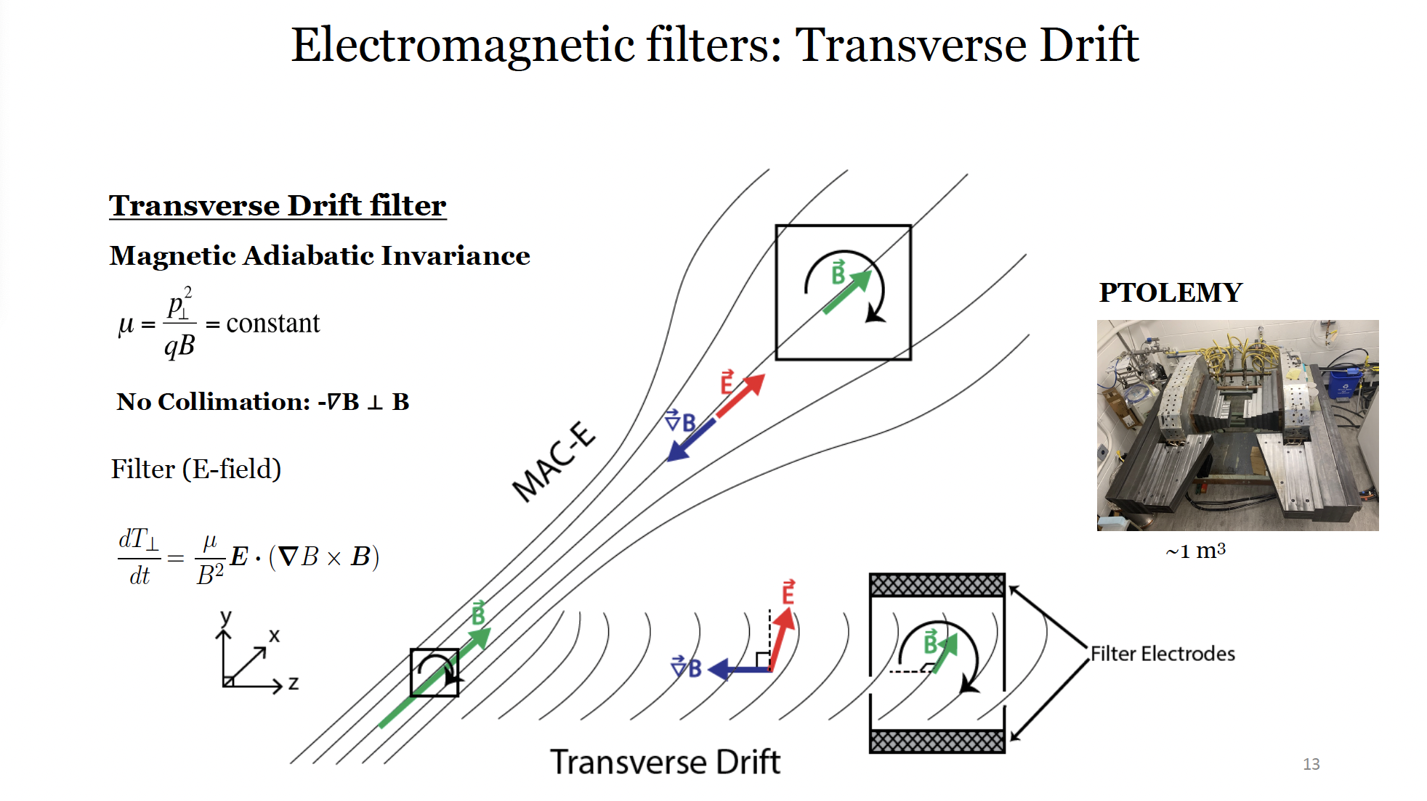
New Filter concept

Slide 20
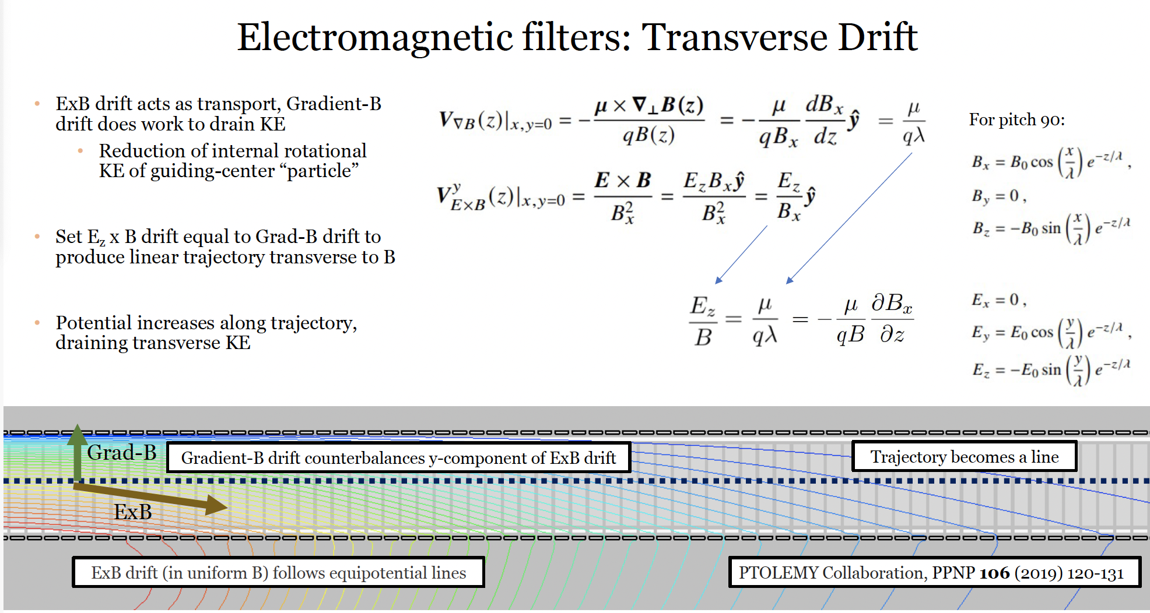
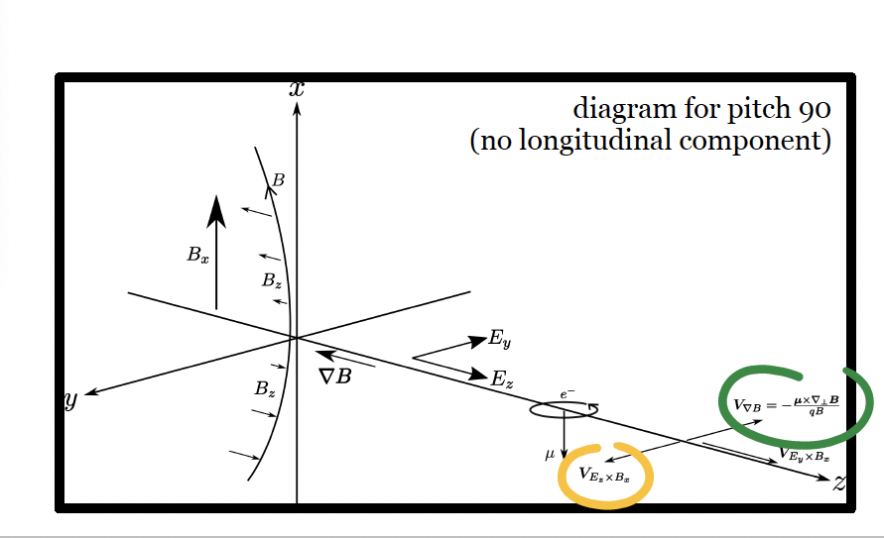
New filter concept: transverse drift

Slide 21
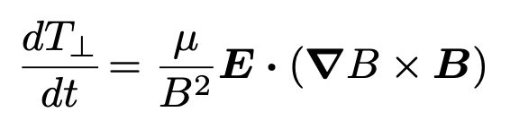
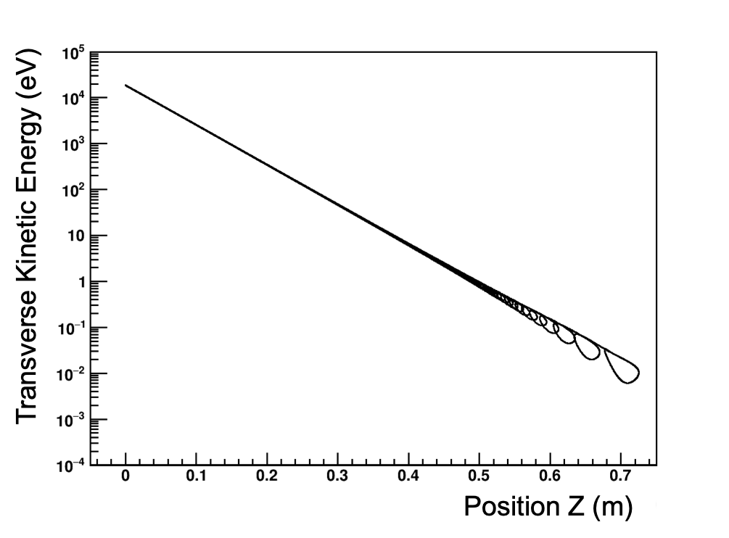
Kinetic energy degradation
Prog.Part.Nucl.Phys. 106 (2019) 120-131
New concept: Transverse drift filter
18.6 keV ➠ 0.01 keV in 0.7 meters
Once the kinetic energy is reduced high performance calorimetric measurements can be done
simulated in KASSIOPEIA
software by the KATRIN collaboration

Slide 22
Measurement summary
Extreme energy resolution
New filter to cope with high rate
Atomic Tritium on graphene support
β decay
Sig and Bkg vs K
Events
3x10¹⁶ e⁻/s
CNB
MG.Betti et al JCAP 07 (2019) 047
10 events/yr per 100g ³H
2m_{ν}
Q_{β}
m_{ν}
K
endpoint
m_{ν}<0.45 eV
KATRIN
arXiv:2406.13516v1 [nucl-ex] 19 Jun 2024

Slide 23
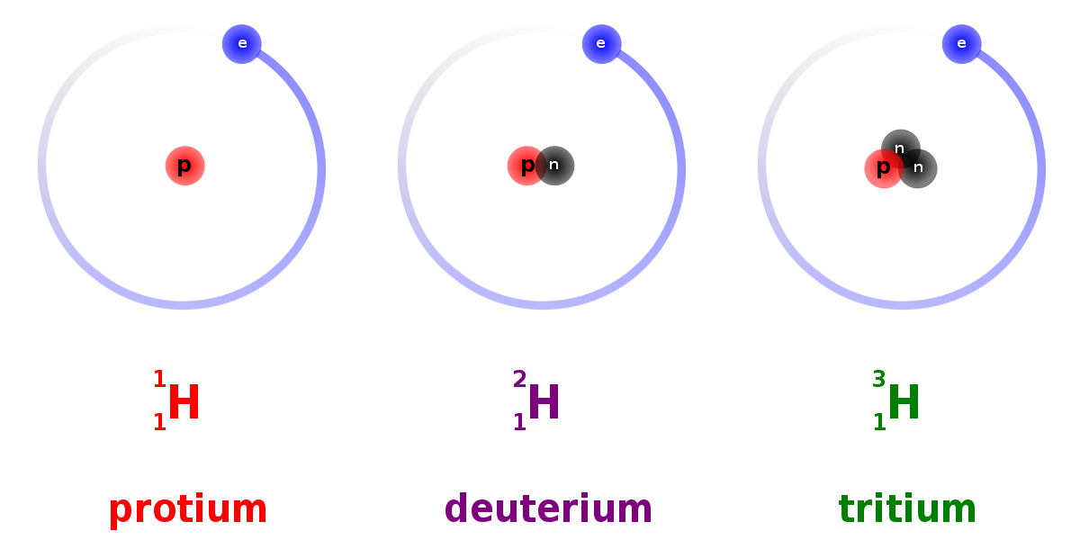

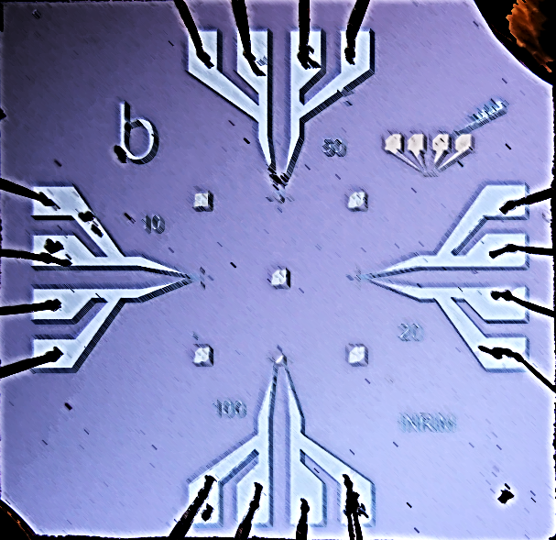
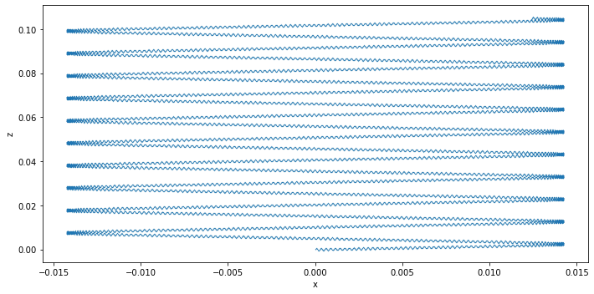






PTOLEMY detector schema
PonTecorvo / PrinceTon Observatory for Light Early-universe Massive-neutrino Yield
$$|B_{x}|$$
$$x$$
$$z$$
Target
RF-tracker
Transverse drift filter
TES µCal
$$ν$$
$$e^{−}$$
p
18.6 keV
© James Mead
$$E_{total}=q\left(V_{TES}−V_{target}\right)+E_{RF}+E_{cal}$$
23
Notes:
Cryogenic transition edge sensor gives us the energy resolution BUT requires <100Hz rate to avoid saturation
Hence this 18.6 keV slowing potential and this EM filter BUT for this filter to be effective it needs to have a fast dynamic setting
To provide the trajectory information for the fast dynamic setting an CR-based tracking system is required between the target and the filter (NIKHEF)
Atomic tritium (to avoid smearing from molecular excitations) embedded on graphene will be the target for the prototype (this introduces its own problems)

Slide 24
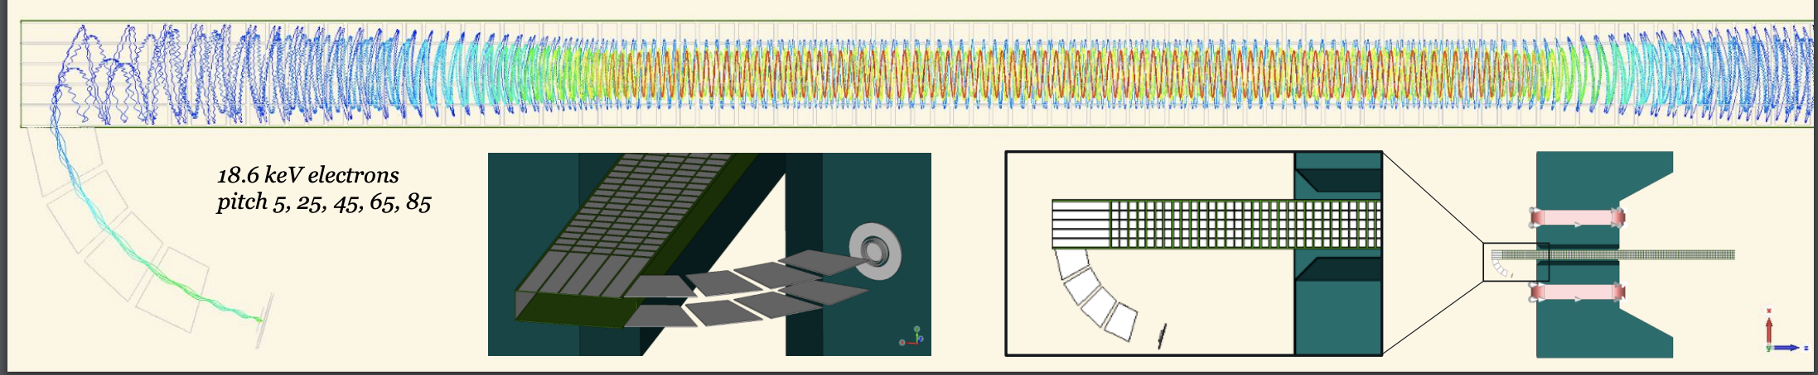
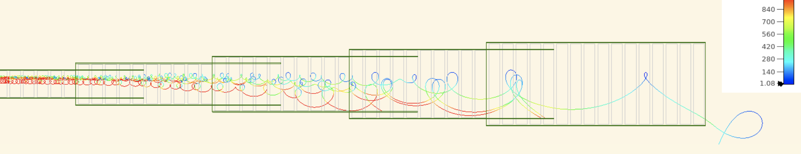
Full demonstrator simulation (Princeton)

Slide 25
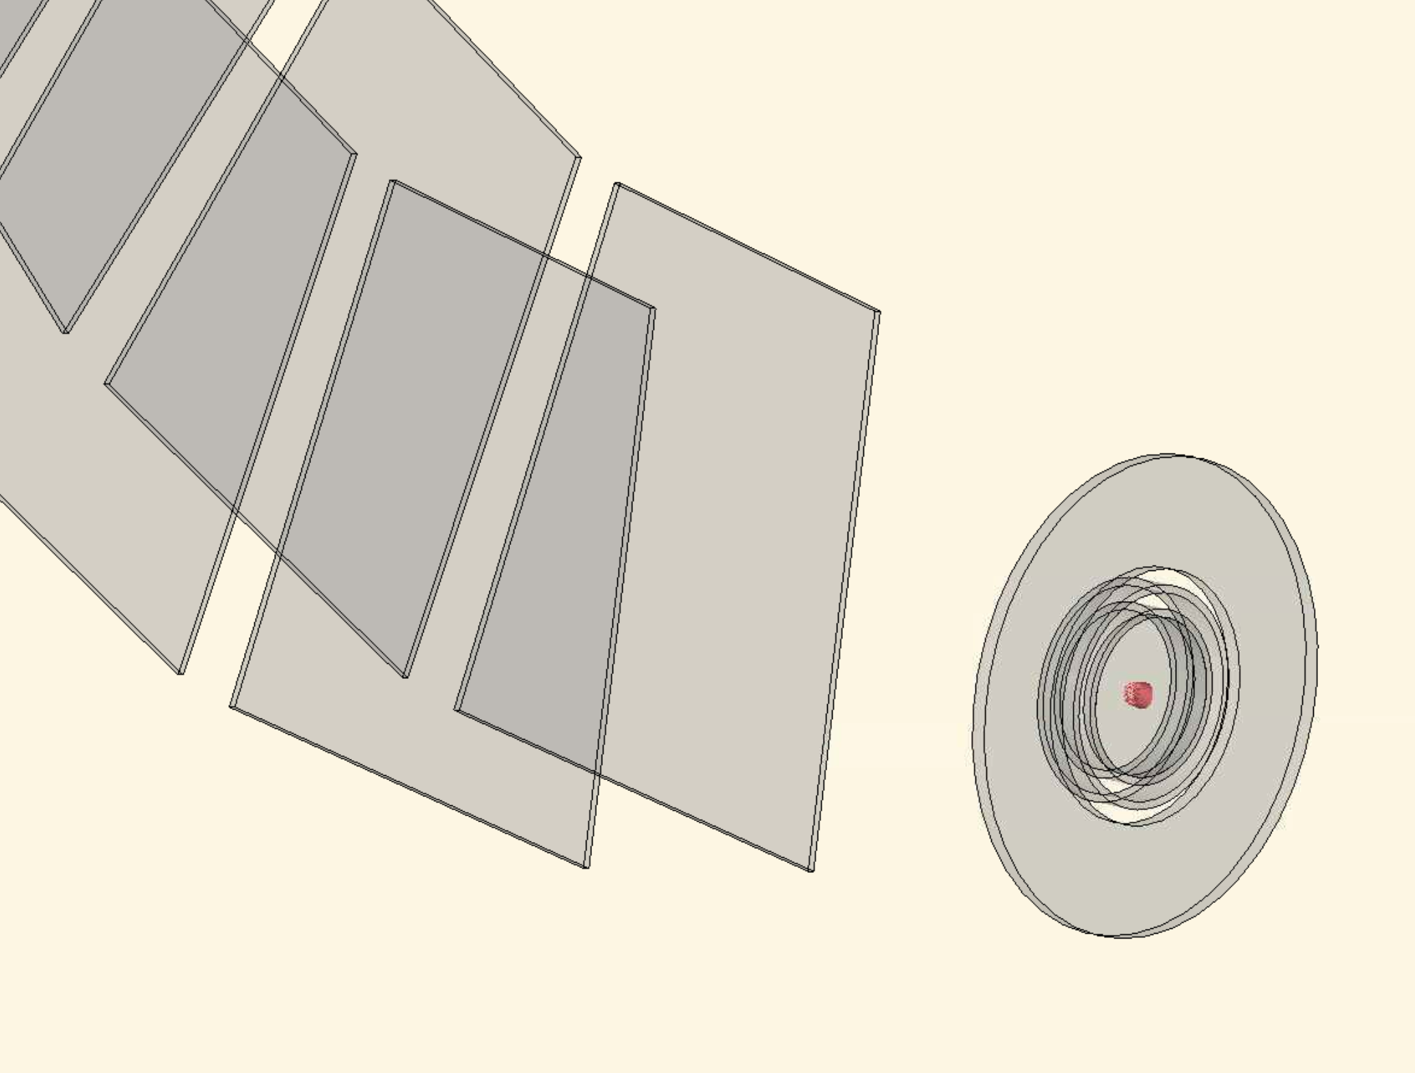
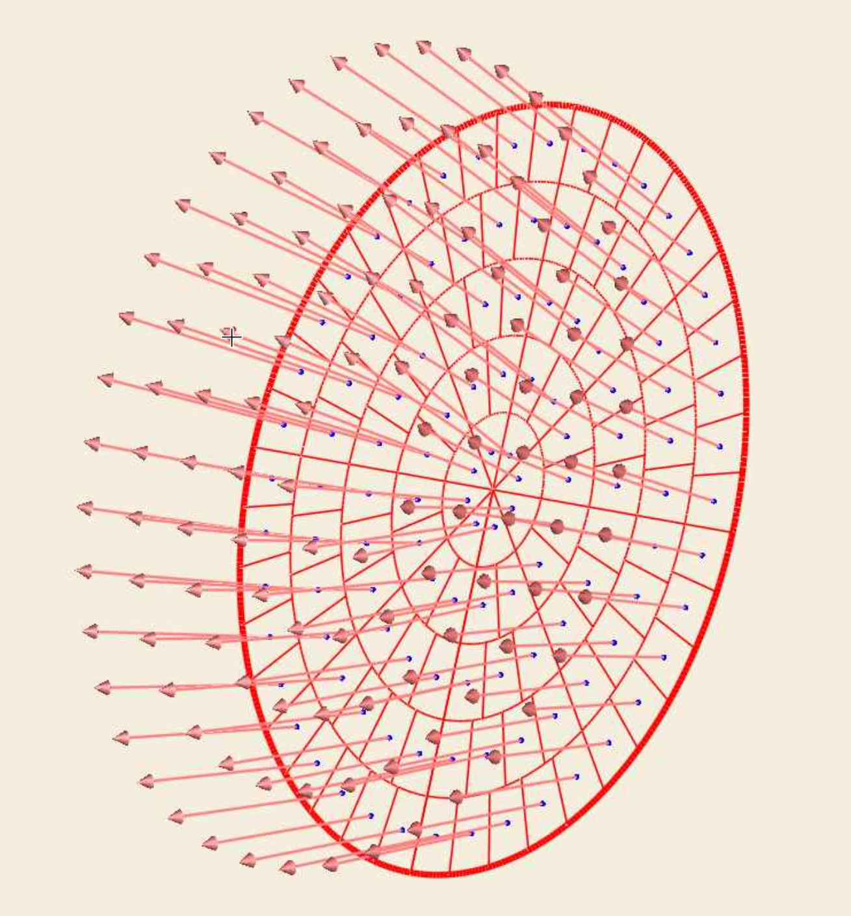
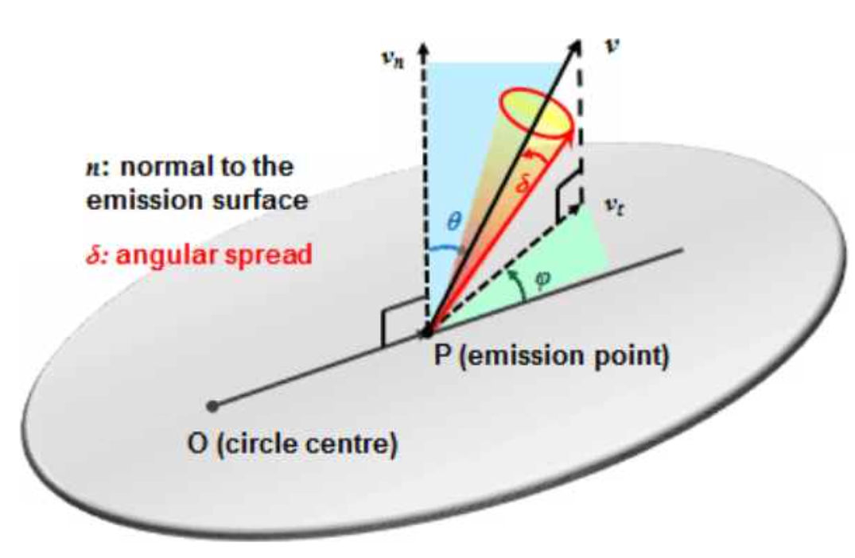
Transmission Simulation Setup
1 mm radius circular area split into 50 rings (5 shown)
50 rings = 10,200 particles
Uniform distribution of pitch θ within a 10 degree window
8 fixed phi Φ emission angles
All electrons with initial KE = 18.6 keV
E.g.
  θ = 30±5, Φ = 0 (N=10,200)
  θ = 30±5, Φ = 45 (N=10,200)
  …
  θ = 30±5, Φ = 315 (N=10,200)
θ = 30±5, Φ = 0..315 → N=81,600
θ = 40±5, Φ = 0..315 → N=81,600
…
1mm radius
(5 rings)

Slide 26
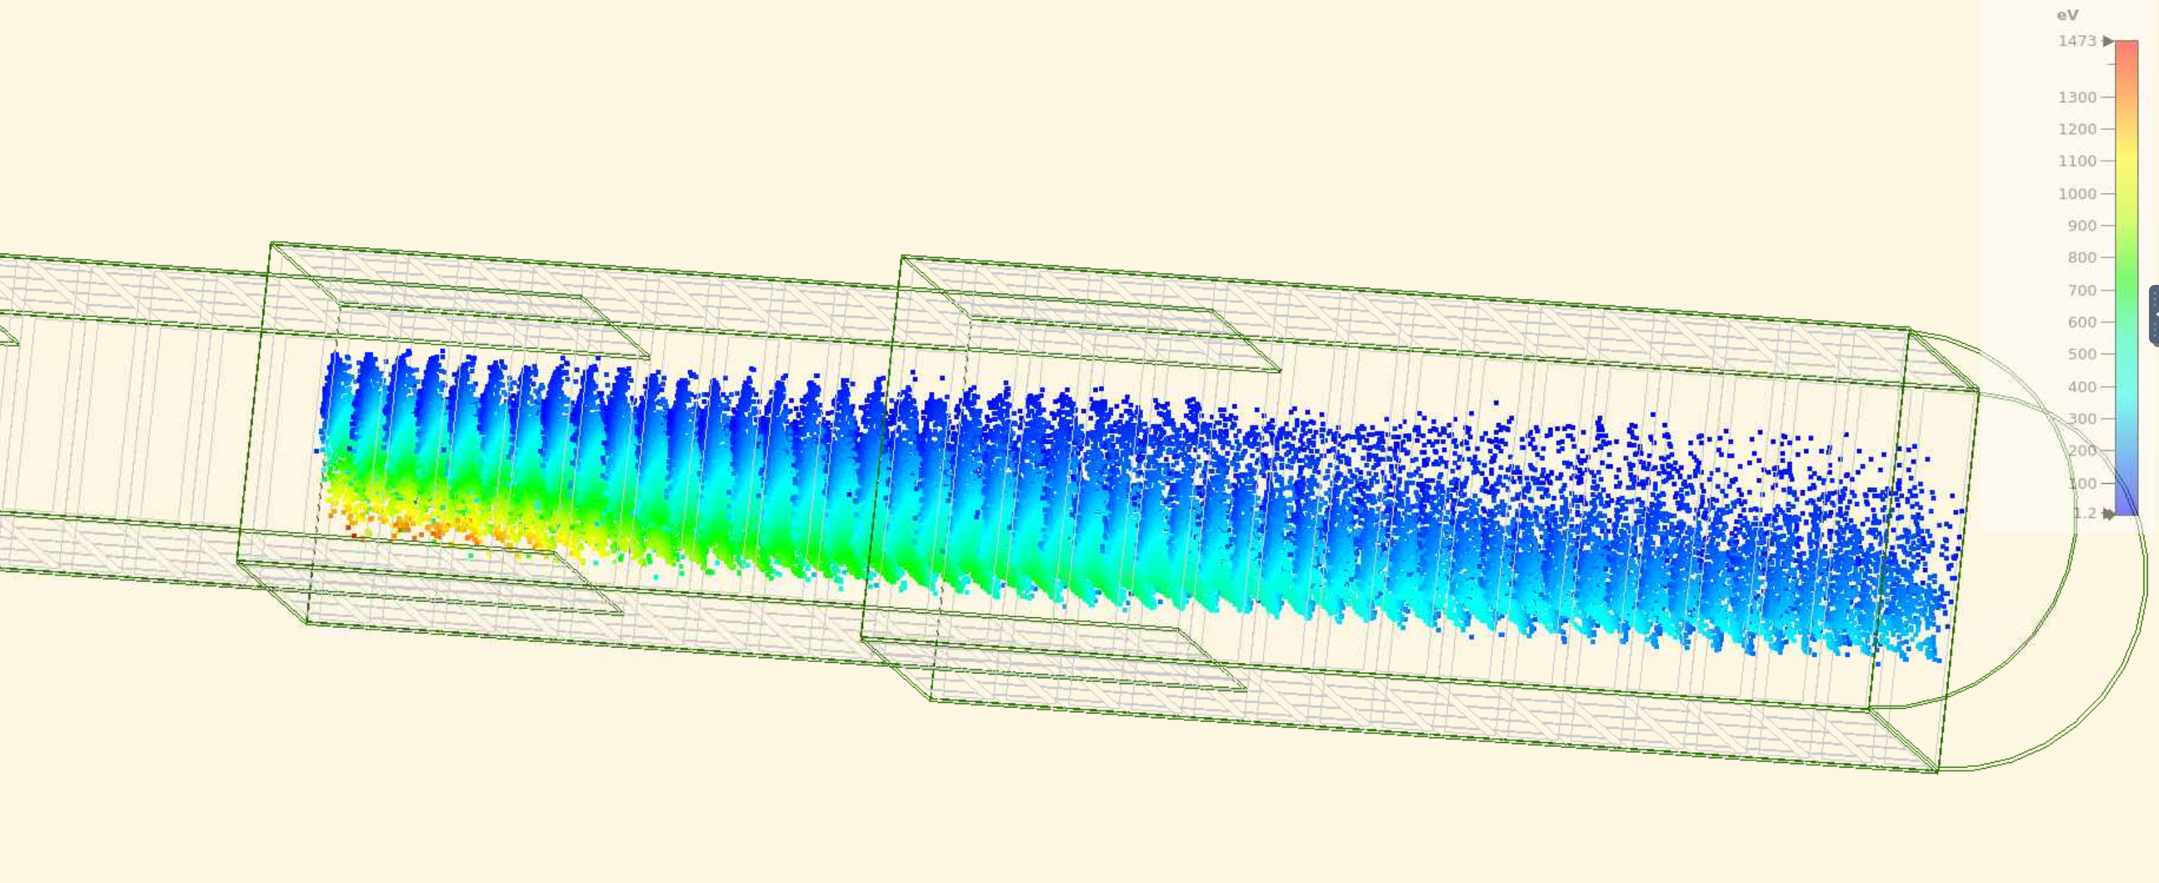
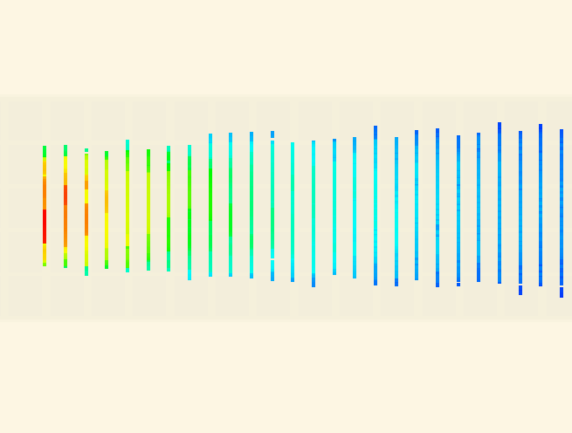
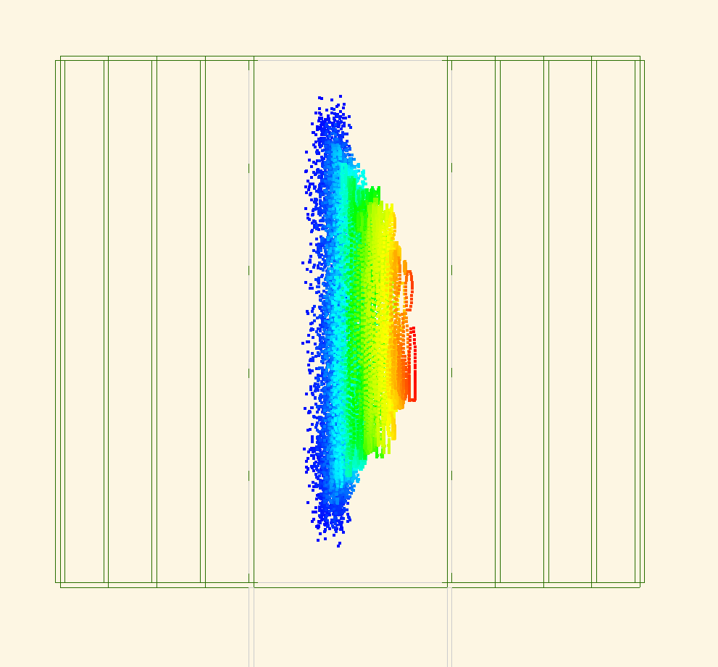
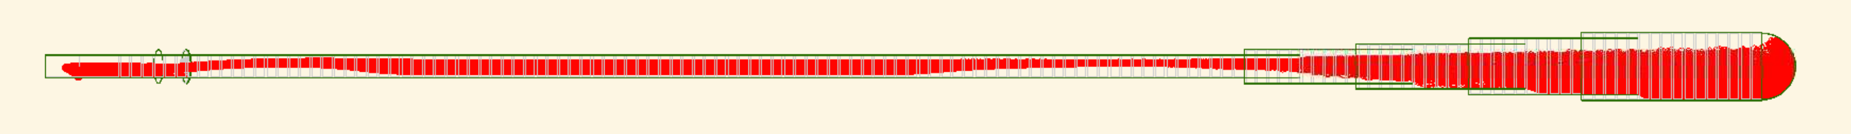
Methodology
2D plane monitors placed every 1 cm in z
  11x6 cm in (x,y) centered at (0,0)
Record individual particle hit information (incl. multiple hits per particle due to cyclotron motion)
At each Z coordinate:
Transmission efficiency: Extract # of unique particle hits per plane, express as percentage of N
Average KE: Take average over all hits (incl. duplicates)
Pitch angle: Calculate instantaneous pitch angle from momentum components for hits within 5mm of x=0, then take average pitch over these hits
x
z
+/-5mm
x
z
y

Slide 27
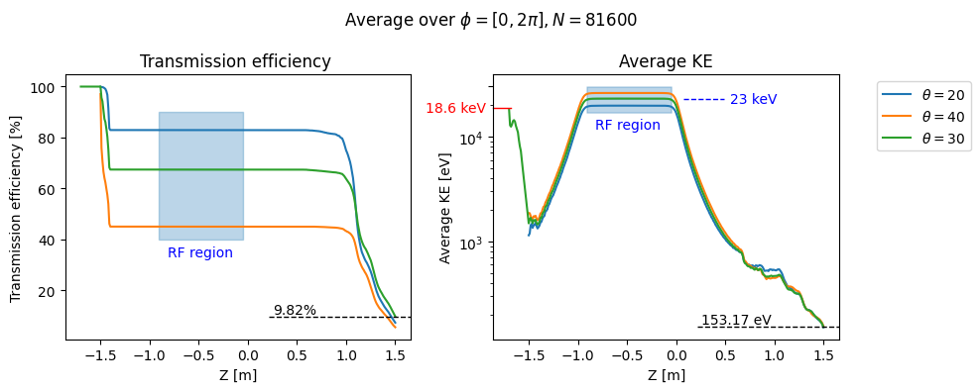
Showing θ = 20±5, 30±5, 40±5
averaged over Φ bin
Entrance High
field region
Filter entrance
Filter exit

Slide 28

PTOLEMY: Energy
Energy measurement from $ΔV$and calorimeter:
$$E_{e}=e \left(V_{cal}−V_{source}\right)+E_{RF}+E_{cal}$$
Calorimeter energy resolution must be O(50meV)
  Transition Edge Sensors
  State-of-the-art 50 meV@100eV with photons
Voltage stability (alias overall energy scale) better than 10-20mV
NOTE: internal voltages are actively adjusted for each interesting electron

Slide 29

Sensitivity as a function of tritium mass
Remarks:
- the sensitivity is weakly dependent upon the energy resolution (500 meV is already a good starting point)
- 1 μg is potentially comparable or even better than the projection of the best technology on the market
- 100 μg (0.5 m²) can potentially probe the neutrino mass down to the IO scenario
In preparation a theory paper on solid state effects on the electron spectrum, and consequent theory systematics on m_{ν.} extraction (A. Casale, A. Esposito G. Menichetti, V. Tozzini)

Slide 30



Systematics
$$|B_{x}|$$
$$x$$
RF-tracker
$$z$$
Target
Transverse drift filter
TES µCal
$$ν$$
$$e^{−}$$
p
18.6 keV
© James Mead
Theory aspects:
further understanding of e ground level is needed
https://arxiv.org/pdf/2504.13259
2) Overall energy scale know at < 10 meV
3) RF correction known at better than 10 %

Slide 31
Overview of the R&Ds in the PTOLEMY project
RF measurement from single electron emission (LNGS/Nikhef)
Graphene loading capability (Roma1)
Graphene transmission measurement and electrostatic analyser (Roma3)
TES design optimization at National Institute of Metrology (INRiM)
Demonstrator SC magnet design and construction (LNGS/Princeton)
HV system development setting the overall energy scale (LNGS)

Slide 32
PTOLEMY Demonstrator at LNGS
We aim at
Proof the capability of the new filter concept to transport the electrons from Target/source to the electron calorimeter and simultaneously select electrons in the ROI (10-100 eV around the T endpoint)
The baseline option of the demonstrator setup is (Phase-0):
Run the filter with full functionalities
Electron provided by calibration sources
Energy measurement realized by means of a standard Silicon Drift Detector
In a second step (Phase-1, 2027-) we aim at exploiting the features of Transition Edge Sensor (TES) calorimeters with the targeted energy resolution and start to use T loaded graphene

Slide 33

Assembly of the DEMONSTRATOR

Slide 34




PTOLEMY: tritium target
Use atomic ³T
  No ro-vibrational modes in final state like for ³He-³T final state.
  Limit to energy resolution not determined by target itself
dE/dx of electrons imposes extremely thin targets
We investigate ³T loosely bound to graphene
  Theoretical maximum is about 0.2 mg tritium per m²
Max 1-tritium for every C

Slide 35
Hydrogen and Deuterium loading on graphene and nano-porous graphene at Roma3
atomic H as a tool to ‘pinch’ the sp2 bonds towards an sp3 configuration while maintaining the planar nature of graphene
sp3 H-C bond
Notes:
35

Slide 36
method: atomic H at ~0.2 eV kinetic energy by hot-capillary in vacuum
H₂ flow into a capillary with hot-spot (~2000 C) in UHV → more than 95% molecules cracked in atomic H concentrated onto the sample
Bischler and Bertel, J. Vac. Sci. Technol. A 11, 458 (1993)

Slide 37
Betti et all, Nano Lett. 22, 2971 (2022)

Slide 38


T-loading setup in Roma1 we need a lab. capable to deal with T gas system tested with H²

Slide 39
Single electron RF emission detection
Aim: Detect single electron RF emission signal @ 27 GHz at low intensity (~ 1 fW)
in a relatively short time (hopefully below 100 μs)
Purpose(s): First measurement of this kind in the PTOLEMY Collaboration
First step toward the demonstrator
Key steps to build the GANTTChart for funding agencies
Setup: Permanent magnet (1 Tesla field) hosting an “electron trap”

Slide 40

RF detection setup at LNGS: electron trap

Slide 41





Electron cyclotron RF radiation studies
carrier
CST simulation
simulation of the pattern of RF radiation
sideband
secondary
sideband
Kr inlet
RF detection

Slide 42

Candidate electron events
RF emission frequency vs time of single electron in the permanent magnet
P[W]
Carrier
Secondary

Slide 43


Electron signature: trigger rate (data)
Source closed
(t=0)
Source: ⁸⁵Rb-> ^{83m}Kr
Lifetime Kr=158.1 min
Source open
(RUN11)
Source closed
(RUN12)
Freq_{RF}=26GHz
P_{RF}=1fW
BKG=14/1/25
RUN11-12=30/5/24
Electronic chain:
Low noise amplification +
down-conversion
Freq_{IF}=550MHz
P_{RF}=2μW

Slide 44

Recent Project 8 Tritium RF Measurement
RF measurement background levels extremely low.
No events observed above endpoint,
Setting upper limit on background rate
< 3x10⁻¹⁰ /eV/s (90% CL)
Background Rate
< 1 event per eV in 100 years!
https://arxiv.org/abs/2203.07349
44

Slide 45



RF readout electronics
T_{c}
RF
IF
LNA
DIPLEXER
DAQ
LNA
RTO64 used for DAQ
Dedicated downconverter developed @ NIKHEF
DAQ with FPGA trigger under development @ NIKHEF

Slide 46




A special Magnet
Being rebuilt in a larger size and will be installed at the LNGS
Key elements to realize the transverse drift and the Demonstrator of the PTOLEMY project
Princeton magnet test bench
Filter electrodes
Measured B field shape as expected
Construction ASG/Suprasys consortium of a SC dipole with
special attention to the fringe fleld
Saddle point key features of the field map
Simulated B-map
< 200 cm

Slide 47




Electron Transport: RF pickup & Filter
RF Antenna Region
Dynamic EM Filter Region
← Target
Calorimeter →
$$\vec{∇}|\vec{B}|$$

Slide 48




PTOLEMY filter: years of development
Particle trajectories can be calculated/predicted analytically
From 18 keV to O(1 eV) in 50 cm
Vs 70 m in the case of KATRIN
Implementation and optimization of the PTOLEMY transverse drift electromagnetic filter
A.Apponi et al, JINST 17 (2022) 05, P05021
A design for an electromagnetic filter for precision energy measurements at the tritium endpoint
M.G.Betti et al, Prog.Part.Nucl.Phys. 106 (2019) 120-131
FOCUSING
with Einzel lens
Microcalorimeter

Slide 49




Demonstrator parts under constructions: magnet, order issued
Magnet commissioning by summer
Magnet: Key subsystem
ASG (Genova)/Suprasys(Bilbao)

Slide 50

Demonstrator parts under constructions: vacuum chamber
Cylindrical volume
hosting future electron detector. Not drawn
HV filter electrodes feedthrough
ALCA technology (Vicenza)
order issued
Vacuum gauge
Antenna signal FT
top or bottom or both
Cold source
For vacuum
environment
Volume hosting G-T sample
with standard CF flanges with
possibility to make it longer and
connected to vacuum suitcase
for G-T transfer. Possible adapter to be added afterword
200 mm OD
Vacuum
station
120 cm OD
Vacuum gauge
not visible

Slide 51







High precision e⁻ measurement: TES μCal
e⁻
Thin sensors:
~1 eV electron can be stopped with very small C
τ =
C
E
G
C
50x50 µm
10x10 µm
20x20 µm
100x100 µm
C. Pepe, E. Monticone, M. Rajteri
Mauro Rajteri, Eugenio Monticone and others, https://doi.org/10.1007/s10909-019-02271-x
“TES Microcalorimeter for PTOLEMY”, J. Low Temp. Phys. 199 (2020) 138-142.

Slide 52






Calorimetry at INRiM
𝝙EFWHM = 0.05 eV @ 10 eV
𝝙EFWHM = 0.022 eV @ 0.8 eV
Based on the expertise of the INRiM electron detection with TES!
Key elements: high quality TES and new e-source based on nanotubes
Further improvement
In few months resolution at <0.2 eV
Phys.Rev.Applied 22 (2024) 4, L041007
First measurement of electrons at 100 V with a resolution ~1-1.5 eV

Slide 53













Alternative energy measurement
Electrostatic electron analyser
Electron optic basic equation
Electrostatic lenses
Helmholtz – Lagrange law
$$x_{t}$$
$$x_{a}$$
E_{p} + δE
$$θ_{a}$$
$$x_{t}θ_{t}\sqrt{E_{k}}=x_{a}θ_{a}\sqrt{E_{p}}$$
$$θ_{t}$$
$$E_{k}$$
E_{p}
$$E_{p}$$
E_{p}- δE
Two concentric hemispheres
for the energy selection
$$M_{θ}M_{l}$$
Ptolemy e.m. filter
Energy resolution
(bandpass energy)
Delay Line
MCP
Position sensitive detector (MCP+delay line)
allows parallel acquisition
$$\frac{∆E}{E_{p}}=\frac{x}{2R_{0}}+\frac{θ^{2}}{4}$$
preamp.
CFD
TDC
Anode
ΔE: energy resolution
E_{p} : pass energy
x: slit width
R₀: mean radius
θ: accepted angle

Slide 54


Commercial Electron analyser
from Scientaomicron

Slide 55


HV High precision stability (LNGS)
Vin
Vout
E
Differential Amp
Precision
Multimeter
HV Capacitor (?)
Diode
chain
Field
Mill
Climatic chamber - N2
Single board
(1 kV)
σ = 0.3 mV

Slide 56
To Conclude
A message to young researchers that are considering to join this project
The PTOLEMY project is very challenging, and we have a long way in front of us.
However, there are so many import and interesting results that we can gain, while pushing further the knowledge, that makes the path more as interesting as the final goal.
We aim at showing the demonstrator functioning at LNGS by next year
Contact: marcello.messina@lngs.infn.it; web: https://ptolemy.lngs.infn.it/

Slide 57
BACKUP

Slide 58



1. Neutrino wind – coherent scatter
Velocity of solar system w.r.t CMB frame $β≈{10}^{−3}$
Coherent Acceleration - $σ_{νN} ∝G_{F}^{2}$
  De Broglie $λ≈2−3$mm
  $a_{NR−D/M}=O\left({10}^{−27}\frac{cm}{s^{2}}\right)$ for non-relativistic neutrinos
$a≈{10}^{−13}cm/s^{2}$ achieved so far
… and worry about solar $ν$ and WIMP backgrounds

Slide 59



2. Cosmic neutrinos
Interact with high energy $ν$:
Signature:
  Dip of high energy $ν$ flux
  Exces of high energy $γ,$ proton flux
$$E_{ν_{i}}≈4⋅{10}^{21}\left(\frac{eV}{m_{ν_{i}}}\right)eV$$

Slide 60




PTOLEMY Demonstrator at LNGS: filter electrodes prototype
Electrode Voltages

Slide 61



First Version of the PTOLEMY magnet
PTOLEMY filter@Princeton
x
RF pickup region
Filter region
z
Supported by:
Zero field (location for TES microcalorimeter)

Slide 62



Ways to solve?
Strategy 1: find other target material
Strategy 2: alternative ³H storage
from Mendeleyev et al
from A. Esposito

Slide 63


World-record TES calorimeter 50 meV resolution for CNB neutrinos
baseline
amplitude
min
time (100ns/div)
counts
0 photons
λ= 1540 nm
Infrared
Photons
1 photon
(0.8 eV)
2 photons
3 photons
PTOLEMY
C. Pepe, E. Monticone, M. Rajteri

Slide 64
Funding:
CSN2 (2018-2021): 205 kE
CSN5 (2022-): 50 kE
Call of the “Agenzia per la coesione territoriale”, participation as partner of a bigger LNGS project on metal 3D printing. 400 kE out of 2ME for the PTOLEMY project (First in the ranking but not yet delivered).This 300 kE will be dvoted to the of the SC demonstrator magnet. 100 kE for researhc contract.
PRIN2022: Proposal for a budget of 250 kE mainly to run demonstraor. Waiting for the answer.
Dutch Research Council (NL) (2021-): 1.3 million Euro
Research Grant of “One Second after the Big Bang”
The topic of the grant is ”RF antenna design and large scale readout chain implementation.”
LNGS is a partner in this grant. One PhD position is awarded and one PostDoc, 60% based at LNGS with 100 kE budget, are foreseen.
Princeton Univ., Simons and Templeton Foundations (2016-): 1 M$ from J Templeton Foundation and 1.3 M$ from J Simons Foundation out of which 0.75 M$ will go in TES development and demonstrator running.
With this financial plan, even though with have some uncertainty, we are sure to be able to accomplish
Pahse-0: running the new filter and measure the end to end electron transfer function from target to the measuring
point where electron energy will be measured by means of an SDD.
Then endpoint measurement of T loaded on graphene will follow.

Slide 65



Bobsledding (pushing electron up potential)
Dynamically Adjusted
(side channels)
to Total Energy “Selector”
Transverse “Selector”
(one channel)

Slide 66

Data set at 10000 V

Slide 67

Conduction Cooled Superconducting Coils
LNGS magnet specifications within ~20% of an Open MRI system made by ASG/Suprasys
(about 10 commercial systems delivered per year)
Order issued, concept design frozen and the construction phase has started
SC coils magnet
Packed with multi-layer
thermal insulation

Slide 68






Sample preparation: graphene growth and transfer on TEM grid
Mono-/tri- layer graphene on nickel TEM grid:
G2000HAN - Ted Pella Inc.
2000 mesh per inch $→$ 12.5 $μ$m pitch
Hole width 6.5 $μ$m
Nominal geometrical transmission 41%
SLG/Cu
PMMA/SLG/Cu
PMMA/SLG
PMMA spin coating
Cu etching
Transfer
SLG
on TEM grid
PMMA/SLG
on TEM grid
Removing PMMA
Camilla Coletti talk tomorrow
PMMA = Poly-methyl-methacrylate (C5O2H8)n

Slide 69





The LASEC experimental layout (Roma3)
XPS / EELS layout
MONOCHROMATIZATION
+
FOCUSING
Al K$α$ source:
hv = 1486.7 eV
Resolution 0.35 eV
Analyser wf = 4.3 eV
Tot resolution = 0.46 eV
X-RAYS SOURCE
ELECTRON
ANALYZER
68°
Custom-made monochromatic electron gun:
Continuous electron beam
Tuneable energy 30 - 900 eV
Resolution = 45 meV
SAMPLE
120°
ELECTRON
GUN
UH-Vacuum
~1·10⁻⁹ mbar

Slide 70



Transmission through mono- and tri- layer graphene
$\frac{I_{NOG}}{I_{0}}⟶$grid without graphene
(i.e. geometrical transmission)
$\frac{I_{xLG}}{I_{0}⋅0.39}⟶$ grid with graphene (net of the 39% grid transparency )
Nominal geometrical transmission 41%
Uncertainty 1.7% (not shown ~same size of the dots)
~ 39%

Slide 71
QUANTUM SPREAD
Distributing tritium on flat graphene has one drawback
Spatially
localized tritium
Uncertainty
on tritium momentum
Spread in final
electron energy
energy and momentum conservation returns
A semi-classical estimate:
fluctuating momenta
larger than desired
Spread of initial tritium wave
Function
Slide by Angelo Esposito at NuMass 2022

Slide 72

PTOLEMY Concept simulation
Target
Injection
RF antenna
Filter
TES

Slide 73




Transport coils
PRELIMINARY

Slide 74

PTOLEMY Experiment: how to make a snapshot of the first second of the Universe
n_{𝜐} = 56 cm⁻³ for each flavor
and
K∼ 10⁻⁴ eV, T=1.95 K,
<v_{𝝂}> ∼ T_{𝝂}/m_{𝝂}
Relic neutrino
CMB

Slide 75



1. Early Universe & beyond
$N_{eff}≈3$. They exists
${Σm}_{ν}≤0.12eV.$ They are light.

Slide 76





Tritium
$${}_{}^{3}T$$
$${}_{}^{3}{He}$$
$$ν_{e}$$
$$e^{−}$$
High cross-section for neutrino capture
No energy threshold
Sizeable lifetime
Low Q-value of 18.6 keV
Tritium beta decay ~10¹⁵ Bq/gram

Slide 77
The principle of the Mac-E filter (II)
The beta electrons, emitted at the source into any direction, are transformed into a broad beam of electrons flying almost parallel to the magnetic field lines. This parallel beam of electrons is running against an electrostatic potential. All electrons with enough energy to pass the electrostatic barrier are reaccelerated and collimated onto a detector, all others are reflected. Thus the spectrometer acts as an integrating high-energy pass filter. The relative sharpness of this filter is:

Slide 78



Electromagnetic Filters
MAC-E filter
Magnetic Adiabatic Invariance
Collimation: -𝛻B||B
KATRIN
~1200m³
Reflect for E<E_{filter}
Pass for E>E_{filter}
m_{ν} < 0.8 eV/c² (90% CL)
https://arxiv.org/abs/2105.08533
0.2 eV/c² Sensitivity Goal
(~1 eV energy resolution)

Slide 79







PTOLEMY: Transverse drift filter
$$\vec{∇}B$$
$\vec{∇}B$ drift
arxiv:1810.06703
Total drift
18.6 keV, $β=β_{⊥}$
$\vec{E}×\vec{B}$ drift
$$\vec{E}$$
0.01 eV
After filter, only component of $β$ parallel to B is left.
Can be reduced by retarding potential

Slide 80


Electrostatic potential wells needed to exploit drift terms and push electrons against electrostatic hills to reduce transverse and longitudinal momentum
Simulation done with the KASSIOPEIA code (from the KATRIN collaboration)
in fully agreement with Lorentz4 code developed by the PTOLEMY
collaboration (much faster, simple and flexible code to study efficiencies)

Slide 81


e⁻ sources to be used in the electron trap
Electron Gun: Kimball 1-20 keV @ LNGS
pro: tunable pitch angle
cons: electron insertion in the high B field region
Gas ⁸³Rb/^{83m}Kr: source (20 kBq) already available
pro: monocromatic electrons (30 keV)
Solid ¹⁴C/⁹⁰Sr: if needed (can provide high RF power)

Slide 82
PTOLEMY experiment - concept
$$E_{e}=e \left(V_{calorimeter}−V_{source}\right)+E_{calorimeter}$$
V_{source}
V_{calorimeter}
Retarding potential

Slide 83





PTOLEMY experiment - concept
$$E_{e}=e \left(V_{calorimeter}−V_{source}\right)+E_{calorimeter}$$
Electric fields are conservative
Magnetic fields don’t work
V_{source}
V_{calorimeter}
Retarding potential

Slide 84

Injection in magnet
PRELIMINARY²

Slide 85


Slide 86
Electromagnetic Filters
Transverse Drift filter
Magnetic Adiabatic Invariance
No Collimation: -𝛻B⟂B
PTOLEMY
~1m³

Slide 87





Preliminary RF signal FFT analysis (CST)
Pitch angle
45º
LO
60º
time (samples)
CST RF signal
+
simulated mixing
LO = 26.7 GHz
+
re-sampling (0.1 ns)
+
FFT
83º
freq
5 GHz

Slide 88
QUANTUM SPREAD
Distributing tritium on flat graphene has one drawback
Spatially
localized tritium
Uncertainty
on tritium momentum
Spread in final
electron energy
energy and momentum conservation returns
A semi-classical estimate:
fluctuating momenta
larger than desired
Spread of initial tritium wave
Function
Slide by Angelo Esposito at NuMass 2022

Slide 90

PTOLEMY Collaboration, A. Apponi et all, DOI: 10.1103/PhysRevD.106.053002

Slide 91
Collaboration with Savannah River National Laboratory for Tritium Loading
CNT, NPG, CVD-G, and De-localized Atomic T Geometries
~2Å flat potential – not chemically active

Slide 92


From target to RF

