Slide 1



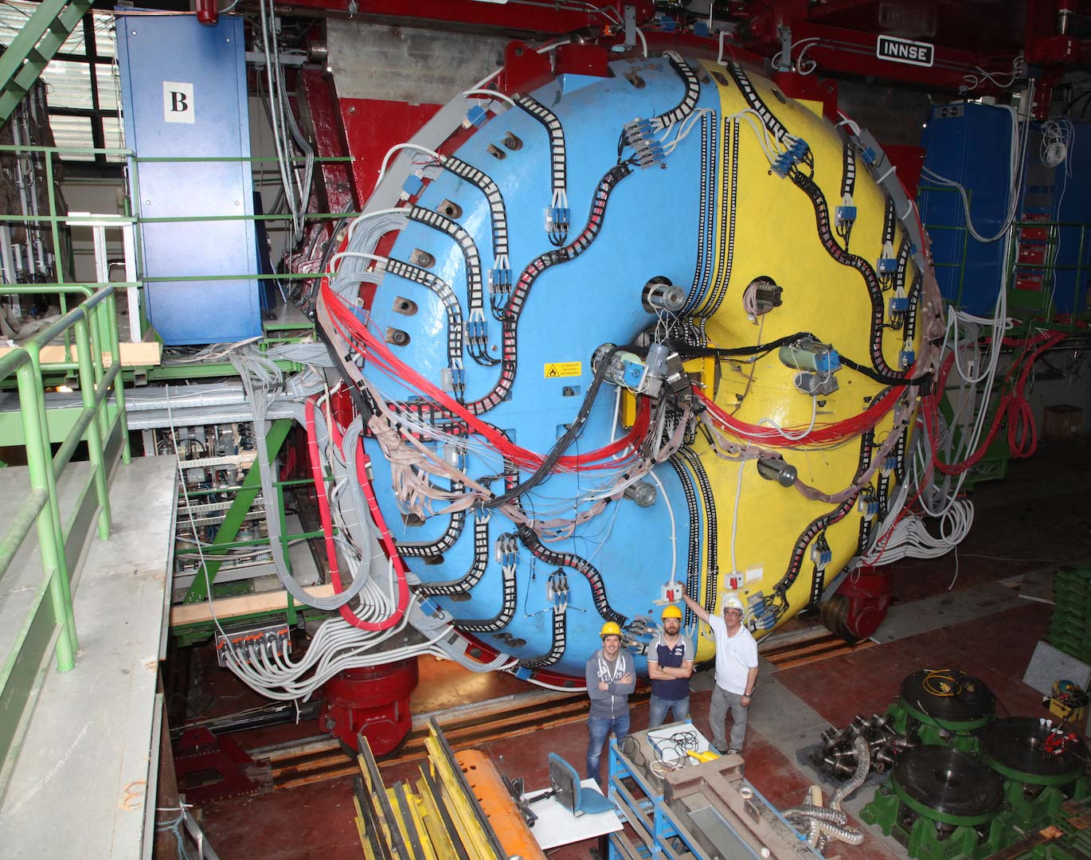
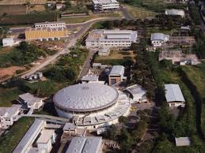
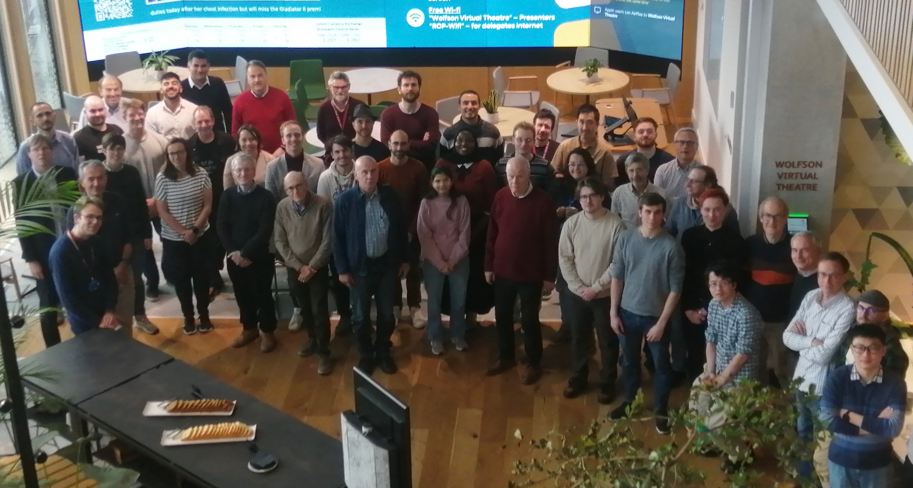
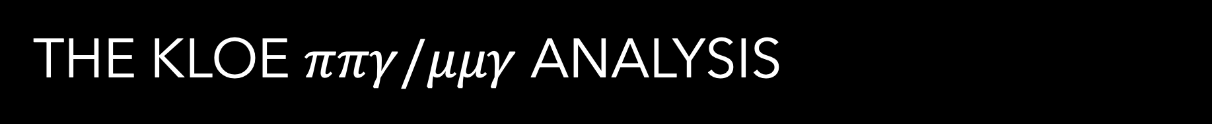
The KLOE $ππγ/μμγ$ Analysis
Estifa’a Zaid on behalf of the KLOE-2 Collaboration, university of Liverpool

Slide 2
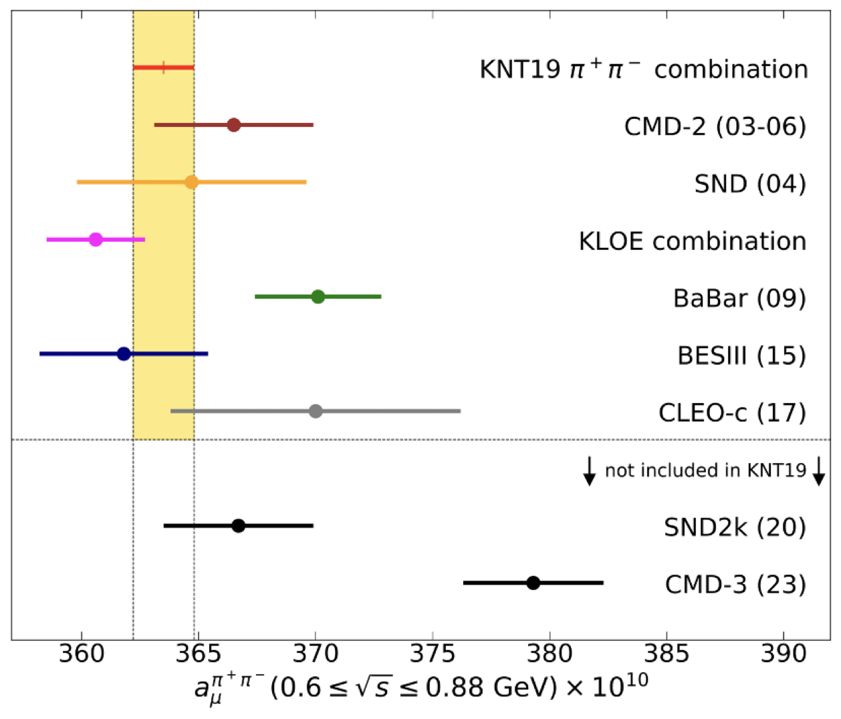
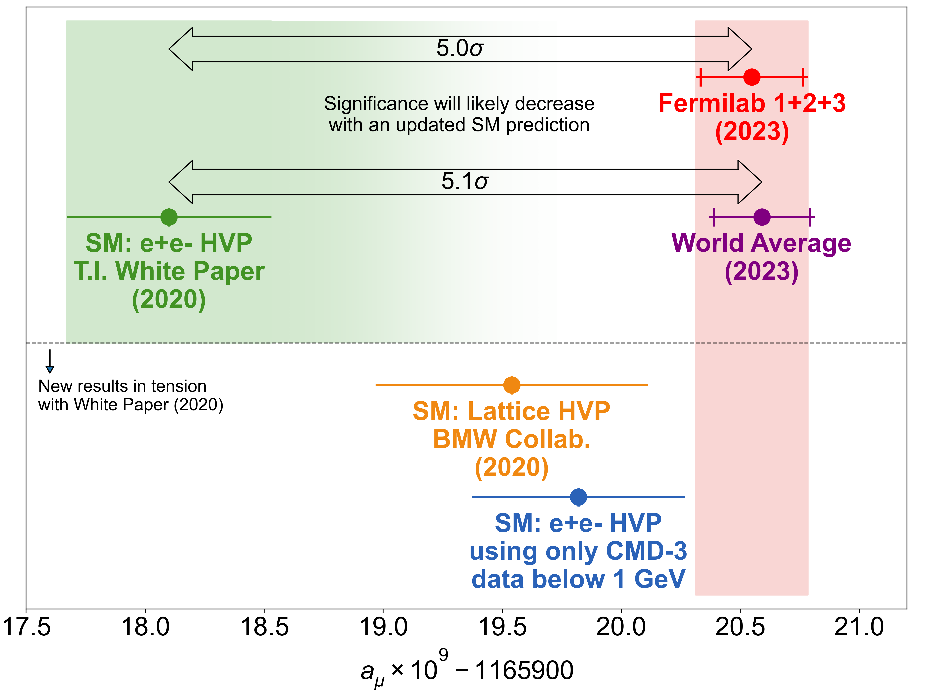

The muon g-2 Landscape
The KLOE measurements have been instrumental in shaping the current landscape of muon g-2.

Slide 3
The current effort

Slide 4
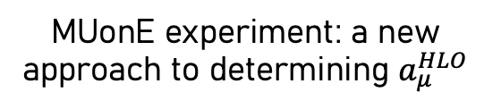
The Current Effort
The Leverhulme Trust grant which was awarded to Graziano Venanzoni in 2022 has funded a large group in Liverpool (12 postdocs and 8 PhD students) with the aim of clarifying the muon g-2 puzzle.
Muon g-2 Experiment at Fermilab Run 4+5+6
New KLOE hadronic cross section measurement
MUonE experiment: a new approach to determining $a_{μ}^{HLO}$

Slide 5
The Current Effort
New KLOE hadronic cross section measurement
Large experimental group of 15 members at Liverpool University working on the KLOE analysis as well as collaborators from Pisa, Dresden and Krakow institutes.
RadioMonteCarLow 2
Leading updated comparisons of Monte Carlo generators for low-energy physics.
  Combined effort with theory members at Liverpool University to cross check Radiative Corrections for published analyses, calculate higher order radiative corrections and develop NNLO MC generators for the new analysis.

Slide 6
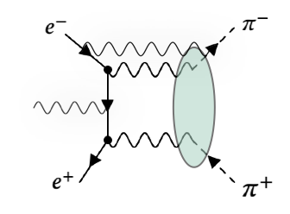
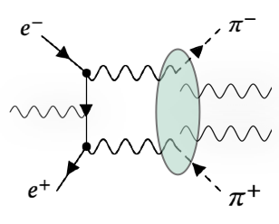
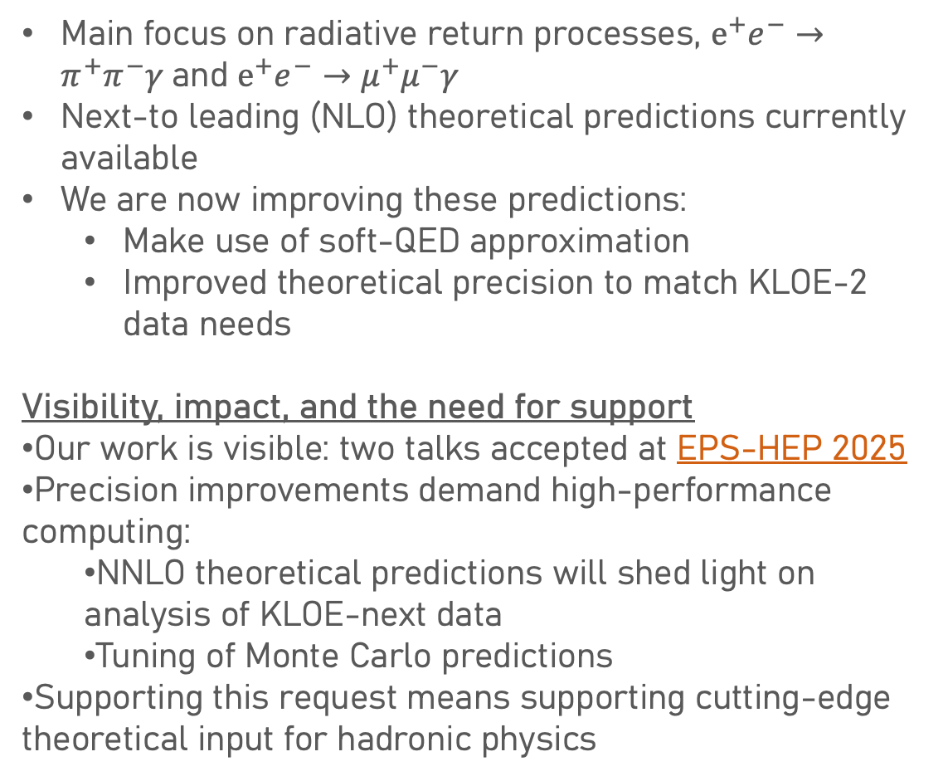
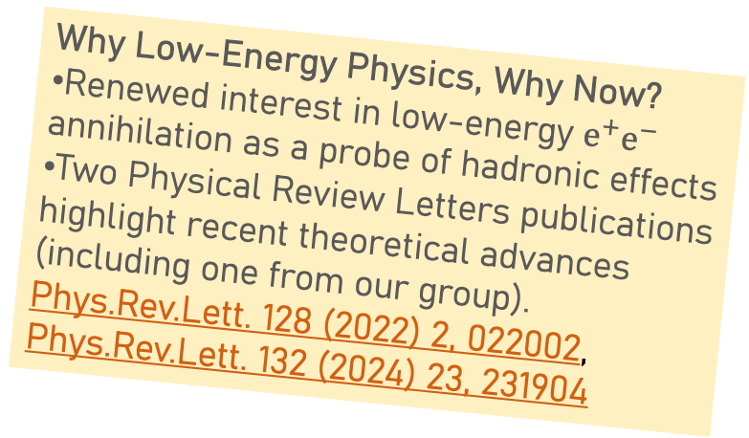
Theoretical support for the KLOE experiment
Main focus on radiative return processes, $e^{+}e^{−}→π^{+}π^{−}γ$and $e^{+}e^{−}→μ^{+}μ^{−}γ$
Next-to leading (NLO) theoretical predictions currently available
We are now improving these predictions:
  Make use of soft-QED approximation
  Improved theoretical precision to match KLOE-2 data needs
Visibility, impact, and the need for support
Our work is visible: two talks accepted at EPS-HEP 2025
Precision improvements demand high-performance computing:
  NNLO theoretical predictions will shed light on analysis of KLOE-next data
  Tuning of Monte Carlo predictions
Supporting this request means supporting cutting-edge theoretical input for hadronic physics
Why Low-Energy Physics, Why Now?
Renewed interest in low-energy $e^{+}e^{−}$ annihilation as a probe of hadronic effects
Two Physical Review Letters publications highlight recent theoretical advances (including one from our group).
Phys.Rev.Lett. 128 (2022) 2, 022002, Phys.Rev.Lett. 132 (2024) 23, 231904

Slide 7
Current KLOE hadronic cross section analysis

Slide 8
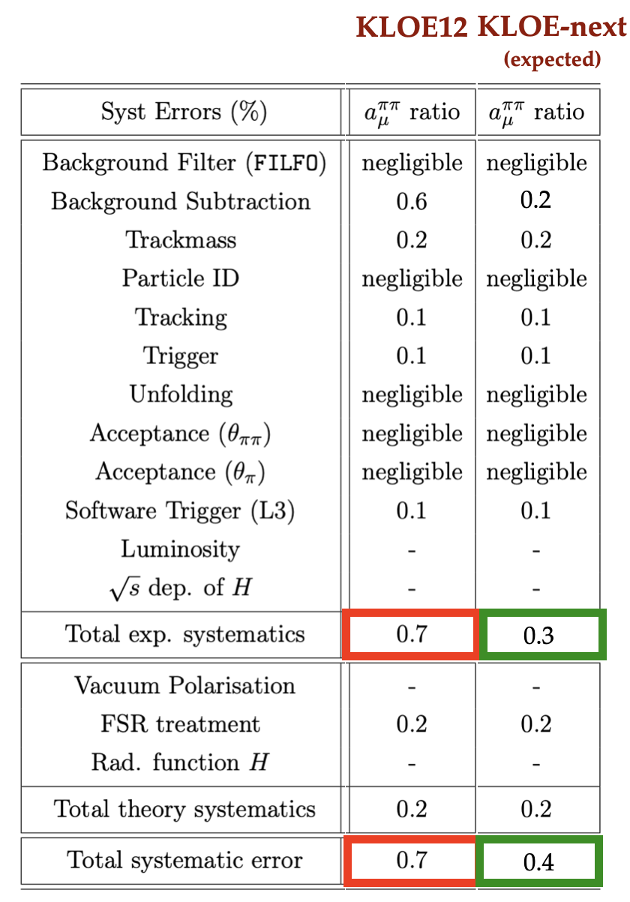
Current KLOE hadronic cross section analysis

Slide 9
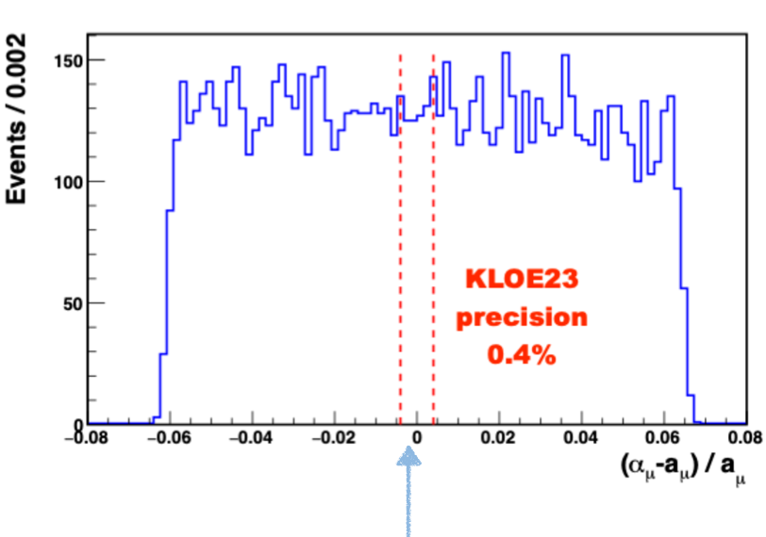
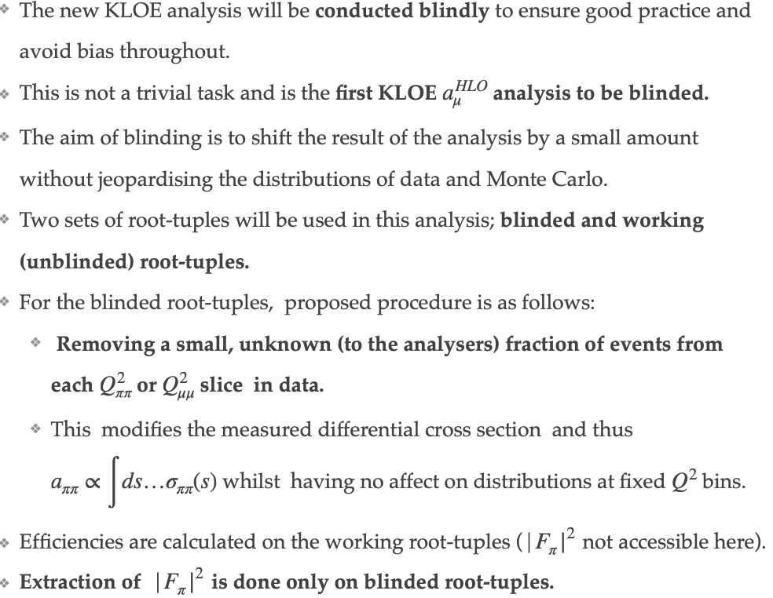
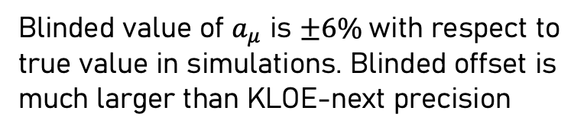
A Blinded analysis
KLOE-next precision 0.4%.
Blinded value of $a_{μ}$ is $±6\%$with respect to true value in simulations. Blinded offset is much larger than KLOE-next precision
Blinding procedure has been documented and undergone an internal review process.

Slide 10
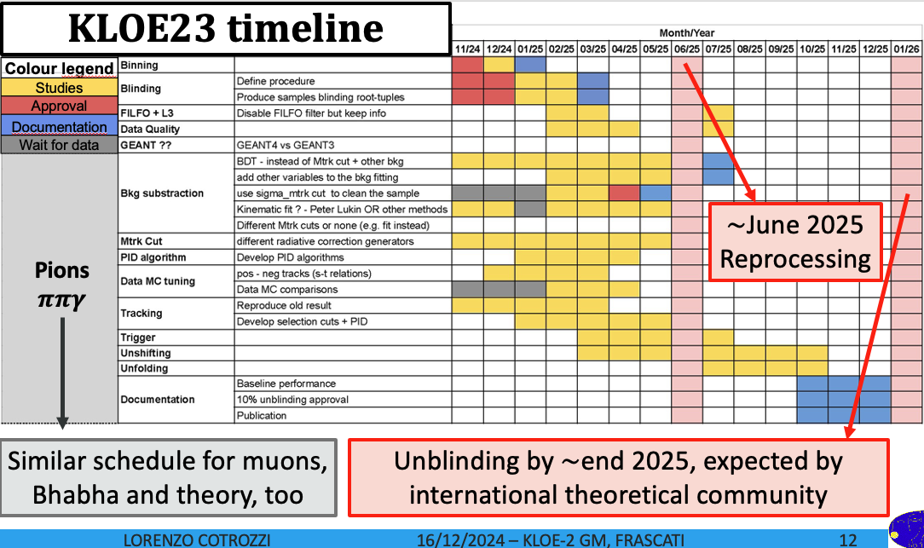

Slide 11

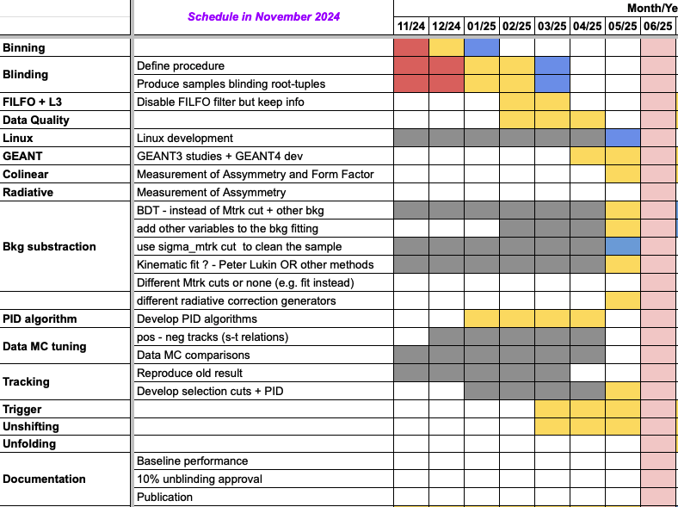
Main analysis areas are stalled due to the old tape library being down.
It is important for the scientific impact of this result that we keep to the timeline.
To achieve this goal, we have a clear roadmap detailing what we will need to do once we have data and have allocated the person power needed.
But .. we need access to data as a matter of urgency and to ensure that the tape library stays up and running.

Slide 12

Thank you Very Much
We look forward to support from the laboratory

