Slide 1
EuPRAXIA: Project status summary
Massimo Ferrario (INFN-LNF)
On behalf of the EuPRAXIA@SPARC_LAB TDR Team
This project has received funding from the European Union´s Horizon Europe research and innovation program under grant agreement No. 101079773
LNF Scientific Committee, May 14 , 2025

Slide 2
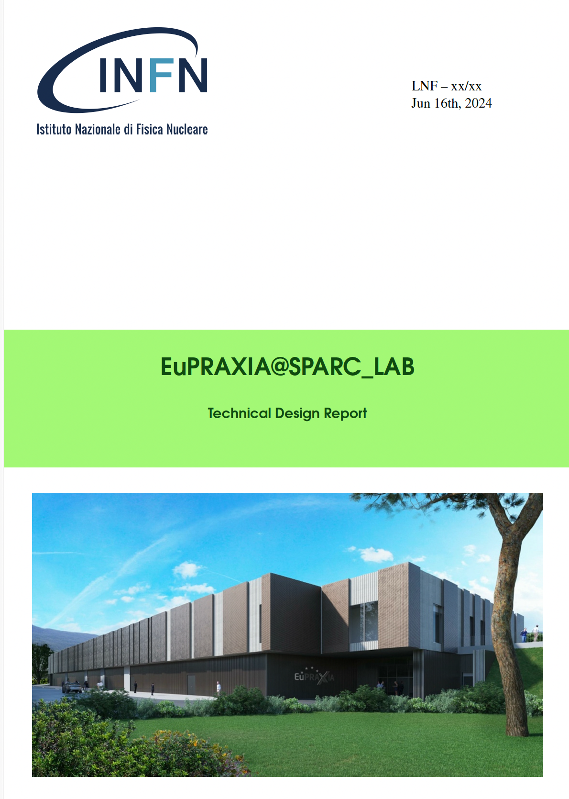
Scientific Committee Recommendation
68th MEETING OF THE LNF SCIENTIFIC Committee – 20-21/11/2024
Recommendations EuPRAXIA:
A timely and successful realization of EuPRAXIA@SPARC_LAB is of paramount im-portance for LNF’s future science program and reputation. Therefore, the finaliza-tion of the TDR and the call for tender preparation for building and components needs highest priority.

Slide 3
TDR Status and Plans
The goal of the Technical Design Report (TDR) of the EuPRAXIA@SPARC_LAB facility is to provide a technical description for the construction and scientific exploitation of the next-generation research infrastructure based on plasma wakefield acceleration.
The TDR aims to:
Define the Scientific and Technological Objectives
Outline the Scientific User Cases and User Applications
Provide a Complete Technical Description of the Facility
Demonstrate Feasibility Through Simulations and Design Studies
Ensure Technical Readiness and Identify Risks
Support Funding and Stakeholder Engagement

Slide 4
TDR Status and Plans
May 15 – TDR draft version ready for evaluation
May 31 – TDR completed
June 16 – TDR Review Committee Meeting
July – TDR Review Committee Report available
September – Final version ready for INFN-Giunta
September/November – Dedicated review committee meetings to enable the start of procurement for critical components (RF, Plasma, Undulators, etc. ) following the final approval from the Giunta

Slide 5
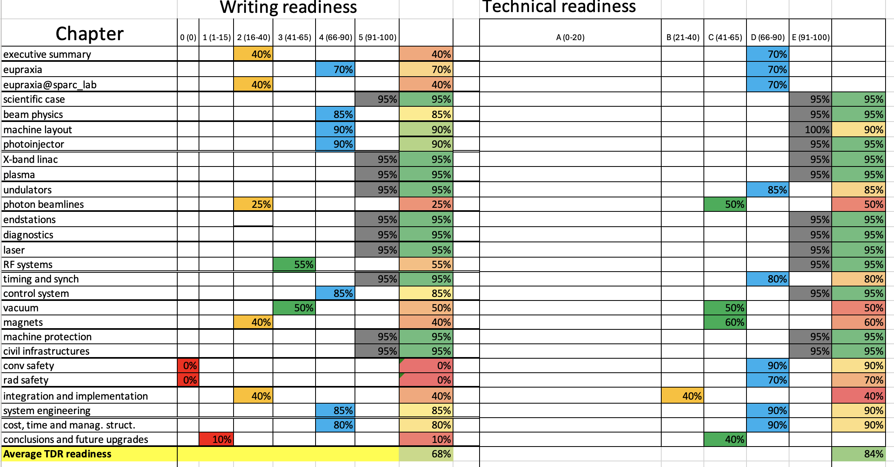
27 TDR chapter foreseen, avergae technical rediness 80%,average writing readiness 62%
10 of the main chapters are ready for the final revision. Completion between 91% and 100%.
7 chapters fully describe the intended main topics and most of the sections include the details needed, few sections are missing some details (mainly due to interactions with other sections). Completion between 66% and 90%.
7 chapters stilll in progress but with very high technical readiness
2 chapters still on a critical path
Courtesy F. Villa

Slide 6
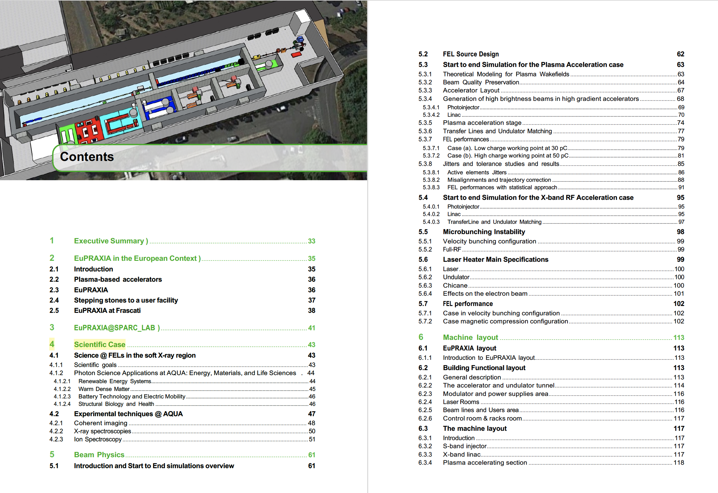
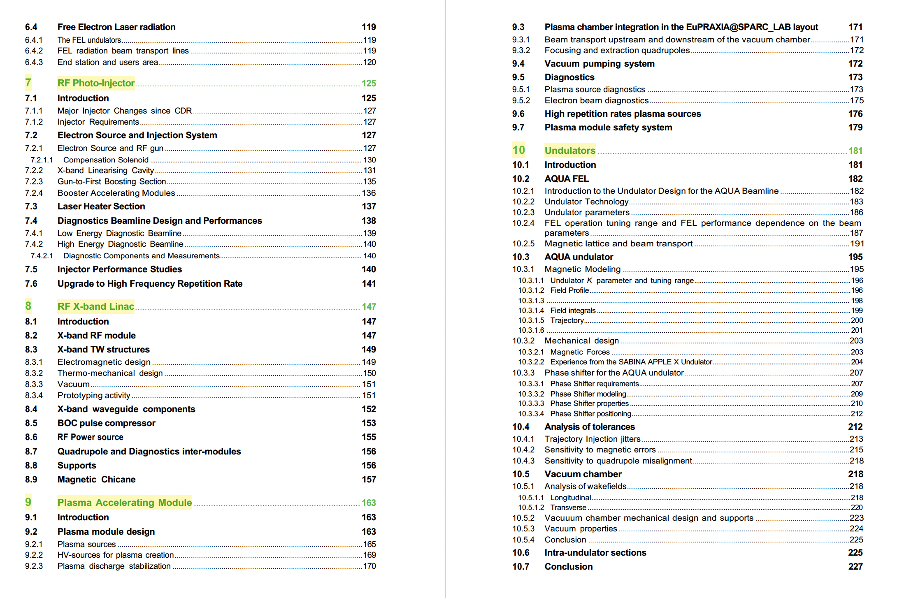
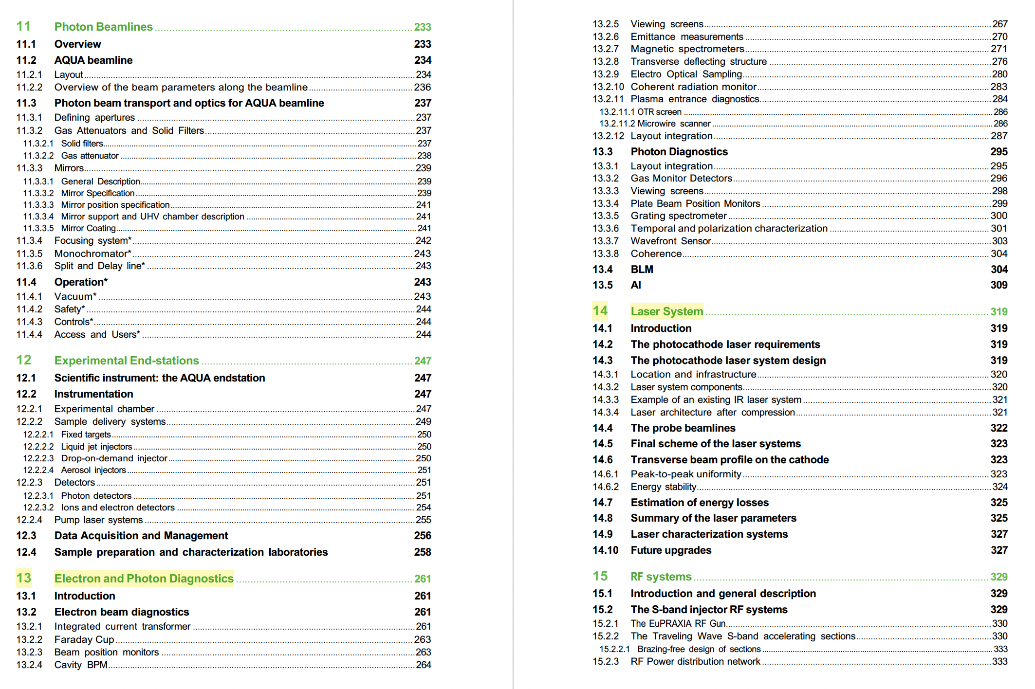
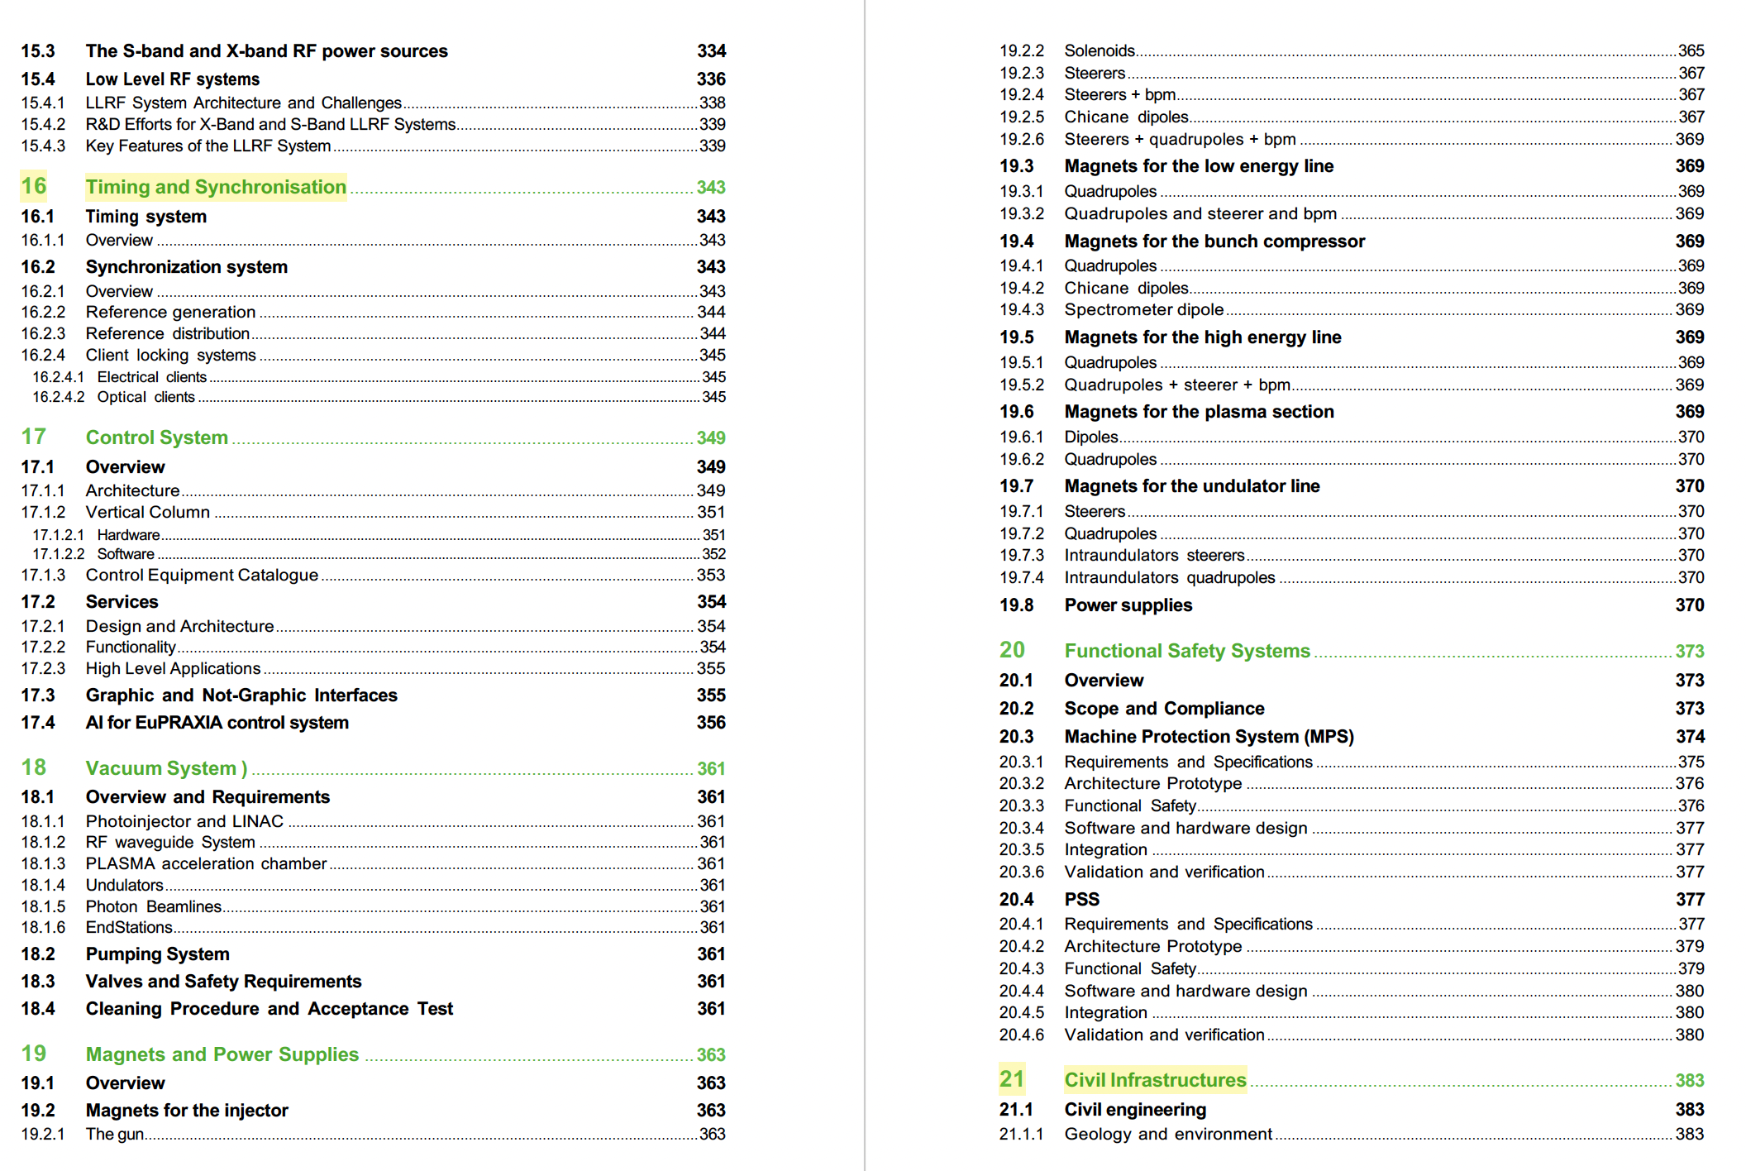
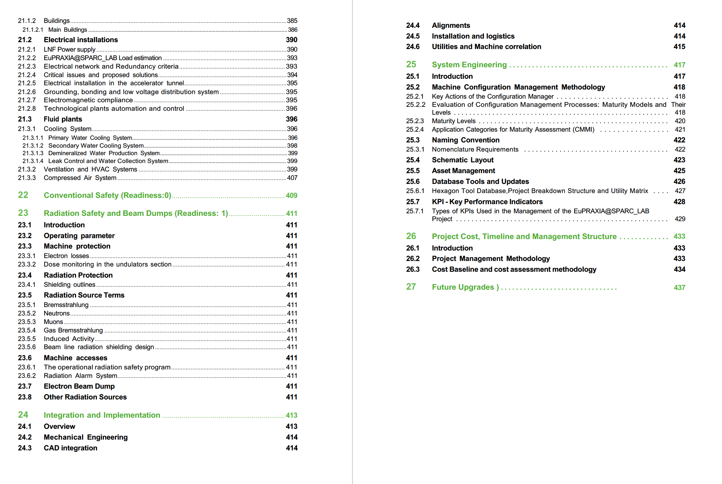

Slide 7
Important Milestone Achieved
EuPRAXIA selects ELI for the Laser-Driven Accelerator Site
https://www.eupraxia-facility.org/post/eupraxia-selects-eli-for-second-laser-driven-accelerator-site
The EuPRAXIA Consortium selected the ELI Beamlines Facility in Dolní Břežany, Czech Republic, as the site for its laser-driven plasma accelerator pillar. ELI Beamlines was selected for its infrastructure readiness, state-of-the-art laser systems, and comprehensive technical expertise.
EuPRAXIA also recognises the important roles of the other candidates for the second site, EPAC and CNR-INO.
EPAC will contribute to EuPRAXIA as a centre for R&D, focusing on advancing research towards achieving a high-quality 5 GeV electron beam. While CNR-INO will function as EuPRAXIA's National Node in Italy and laser test facility.
Courtesy P. Campana

Slide 8
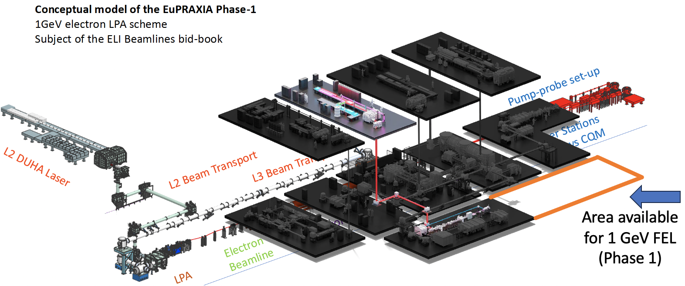
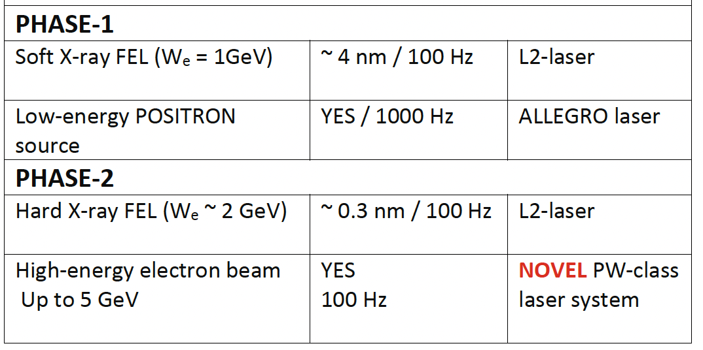
EuPRAXIA@ELI LPAW based facility
With it’s advanced high-power, high-repetition-rate laser systems, including the newly developed L2 DUHA laser (aiming to 200 TW, 100 Hz) , and versatile experimental setups, ELI is ideally equipped to implement and operate the Laser-Plasma-Accelerator-based 1-GeV Free-Electron Laser (FEL) envisioned by EuPRAXIA.

Slide 9
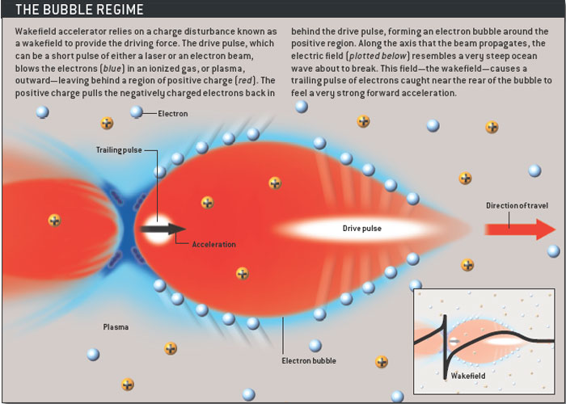
Design goals
The purpose of the EuPRAXIA@SPARC_LAB user facility is to establish a research infrastructure that pioneers the use of plasma wakefield acceleration (PWFA) for driving a high-brightness Free-Electron Laser (FEL) in the soft X-ray regime.
As described in the Conceptual Design Report (CDR) in 2018, EuPRAXIA@SPARC_LAB will be located at the INFN Frascati National Laboratories and will serve a dual role as both a scientific instrument and a technological demonstrator of the beam driven PWFA.
It will validate the integration of high-gradient plasma acceleration into a user-grade light source, laying the groundwork for future compact user facilities.
The design philosophy behind the facility combines high brightness photoinjector and advanced X-band RF acceleration techniques with compact plasma-based modules, enabling high-gradient acceleration while preserving beam quality sufficient for FEL operation.
EuPRAXIA@SPARC_LAB will deliver a 1.2 GeV electron beam to generate ultrashort (<10 fs), high-brightness X-ray pulses in the water window spectral range (3–5 nm) via the Self-Amplified Spontaneous Emission (SASE) Free Electron Laser (FEL) mechanism in short period undulators.

Slide 10
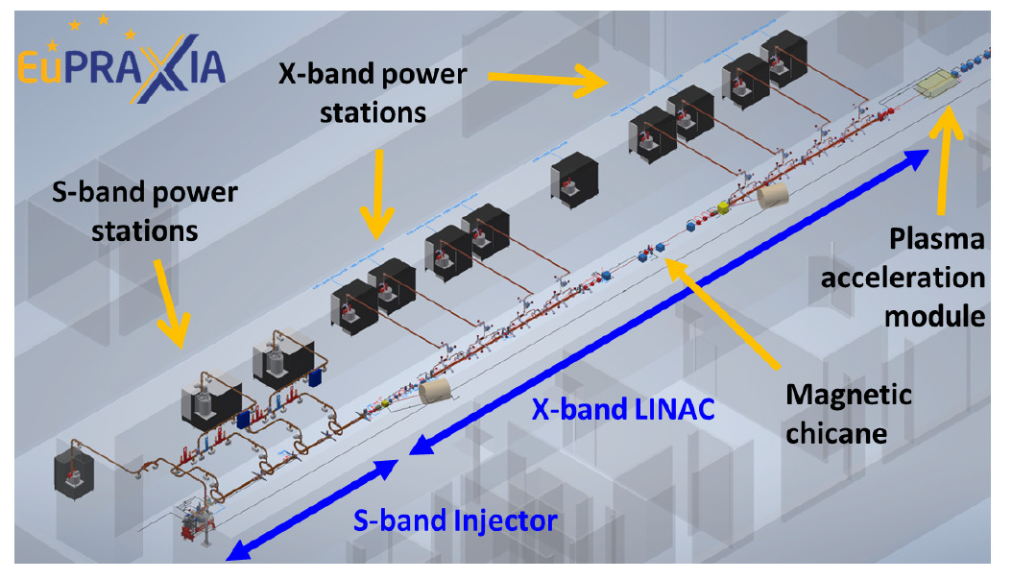
EuPRAXIA@SPARC_LAB
The facility aims to operate in two modes:
a full-RF mode for initial commissioning, and
a hybrid RF+PWFA mode that serves as a demonstrator for plasma-driven FELs user operation.
The modularity and flexibility of the design are intended to support both immediate scientific applications and long-term technological development.
The facility is expected to begin operations in 2029

Slide 11
EuPRAXIA@SPARC_LAB Start to End Simulation Results
Radiation Parameter | Unit | PWFA | Full X-band
Wavelength | nm | 3-5 | 4
Pulse length (fwhm) | fs | 10.0 | -
Photons per Pulse | $$×{10}^{12}$$ | 0.1- 0.25 | 1
Photon Bandwidth | % | 0.1 | 0.5
Undulator Area Length | m | 26 | 30
𝜌(1D/3D) | $$×{10}^{−3}$$ | 1 | 1
Photon Brilliance per shot | $$\left(\begin{aligned}s {mm}^{2}{mrad}^{2} \\ bw\left(0.1\%\right)\end{aligned}\right)$$ | 1$−2 ×{10}^{28}$ | $$1 ×{10}^{27}$$
Electron Beam Parameter | Unit | PWFA | Full X-band
Electron Energy | GeV | 1-1.2 | 1.2
Bunch Charge | pC | 30 - 50 | 200-500
Peak Current | kA | ~ 2.2 | 1-2
RMS Energy Spread | % | < 1 | 0.1
RMS Bunch Length | 𝜇m | 3-6 | 24-20
RMS norm. Emittance | 𝜇m | 0.7 – 1.2 | 1
Slice Energy Spread | % | ≤0.05 | ≤0.05
Slice norm Emittance | mm-mrad | 0.5 – 0.8 | 0.5
Energy jitter | % | < 1 | 0.1
Bold values indicate the main working point
Courtesy A. Giribono, C. Vaccarezza
Notes:
Equazione circa

Slide 12
X-ray FEL Projects Around the World
FLASH: first soft X-ray, high rep rate (MHz), 2007
LCLS: first hard X-ray, 2009. LCLS2: high rep rate, 2023.
SACLA: compact hard X-ray, 2011
FERMI: first soft X-ray seeded-FEL, 2013
PAL-XFEL: hard X-ray with low (20 fs) timing jitter, 2016
E-XFEL: hard X-ray, high rep rate, 2017
SwissFEL: compact hard X-ray, low emittance, 2017
SHINE: hard X-ray, high rep rate, from 2025
EuPRAXIA soft X-ray, 100 Hz
FLASH
FERMI
E-XFEL
PAL
XFEL
EuPRAXIA
LCLS
SwissFEL
SACLA
LCLS-II
SHINE
All present facilities are based on SASE, except FERMI.
Most facilities have the option of self-seeding
EuPRAXIA will be the first FEL driven by a Plasma Accelerator
Courtesy Pratt

Slide 13
Major Short-Wavelength FEL User Facilities
The AQUA beamline is the scientific heart of EuPRAXIA@SPARC_LAB, designed to deliver high-brilliance soft X-ray pulses in the water-window spectral range, specifically between 3 and 5 nanometers (corresponding to photon energies of 300–600 eV) and up to 10 nm.
Facility | Location | Wavelength Range [nm] | Linac Length [km] | Electron Energy [GeV] | RF Band [MV/m] | Key Features
AQUA | Frascati, Italy | 3-10 | < 0.05 | 1.2 | X/Plasma 60/1000 | Compactness. Targets the water window; 3D bio-imaging.
FLASH | Hamburg, Germany | 4.1–45 | 0.28 | 1.25 | L 30 | Pioneering SASE FEL; test facility for FEL technologies.
FERMI | Trieste, Italy | 10–100 | 0.15 | 1.5 | S 28 | Seeded FEL; high spectral purity in VUV–soft X-ray range.
LCLS 1 | SLAC, USA | 0.13–6.2 | 1 | 14 | S 25 | First hard X-ray FEL; ultrafast imaging capabilities.
European XFEL | Hamburg, Germany | 0.05–4.7 | 2.1 | 17.5 | L 24 | High repetition rate; multiple beamlines.
SACLA | Harima, Japan | 0.06–0.2 | 0.4 | 8.5 | C 38 | Compact design; operates in hard X-ray regime.
SwissFEL | Villigen, Switzerland | 0.1–5.0 | 0.5 | 5.8 | C 28 | Two beamlines covering hard and soft X-rays.
PAL-XFEL | Pohang, South Korea | 0.06–4.5 | 0.78 | 10 | S 27 | Covers both hard and soft X-rays.
Compact Design: With an accelerating length of under 50 meters, AQUA is the most compact facility in the list. This reflects its use of the combination of high-gradient X-band linac technology and plasma acceleration.
Moderate Energy with High Impact: Operating at around 1 GeV, AQUA delivers radiation in the “water window” (2–4 nm). This range is crucial for imaging biological specimens in aqueous environments without damaging or staining them, positioning AQUA as a valuable tool for structural biology, chemistry, and material science.
Complementarity and Accessibility: AQUA complements X-ray FELs by addressing a different spectral and experimental niche, enhancing accessibility to FEL science for smaller research groups and regional users.
Technology Demonstrator: AQUA is also a strategic testbed for integrating advanced acceleration schemes and short period undulators into user-oriented FELs marking a paradigm shift toward compact and cost-effective light sources.

Slide 14
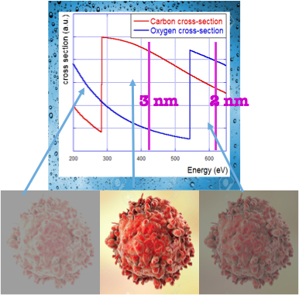
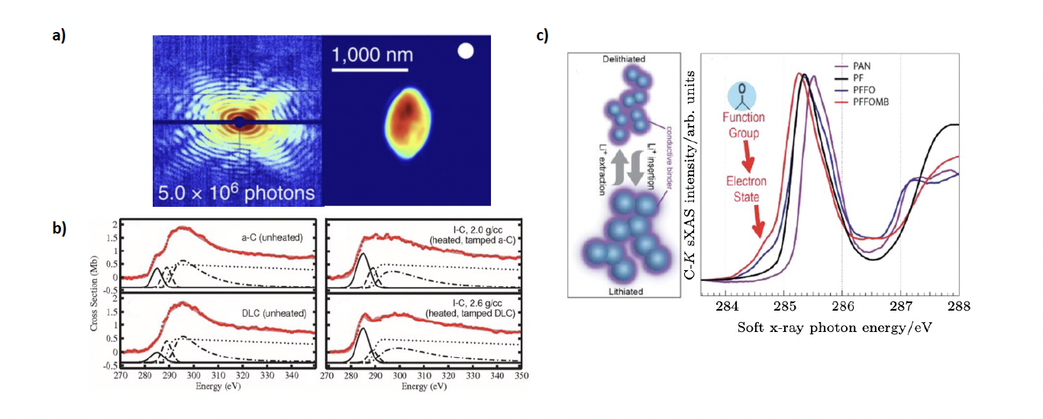
Scientific Case and Applications
Application Area | Scientific Focus | Techniques | Key Impact
Renewable Energy | • Charge transport in solar cells & catalysts • Photocatalytic H₂ production • PFAS/PClAS analysis | XAS, XES, PI-MS | • Efficient solar materials • Clean hydrogen production • Environmental remediation
Warm Dense Matter (WDM) | • Extreme temperature/density • Astrophysics & fusion | Time-resolved XAS, TR-XES | • Stellar/planetary modeling • Fusion research support
Battery Technology | • Ion migration & interfaces • Solid-state battery study | XAS, non-linear X-ray spectroscopy | • Safer, longer-life batteries • High energy density
Structural Biology | • Live-cell imaging • Cellular processes (stress, DNA damage) | CDI, XAS, CEI | • Real-time biomolecular studies • Disease mechanism insight
Health & Radiobiology | • DNA damage by radiation | X-ray pump–probe, photo-fragmentation | • Radioprotection • Cancer treatment improvement
Atmospheric Chemistry | • VOC/NOx oxidation • Aerosol dynamics | PI-MS, ion spectroscopy | • Pollution models • Climate studies
Astrochemistry | • Radiation chemistry in space • Organic molecule formation | XAS, photochemistry | • Space molecular evolution
Courtesy F. Stellato

Slide 15
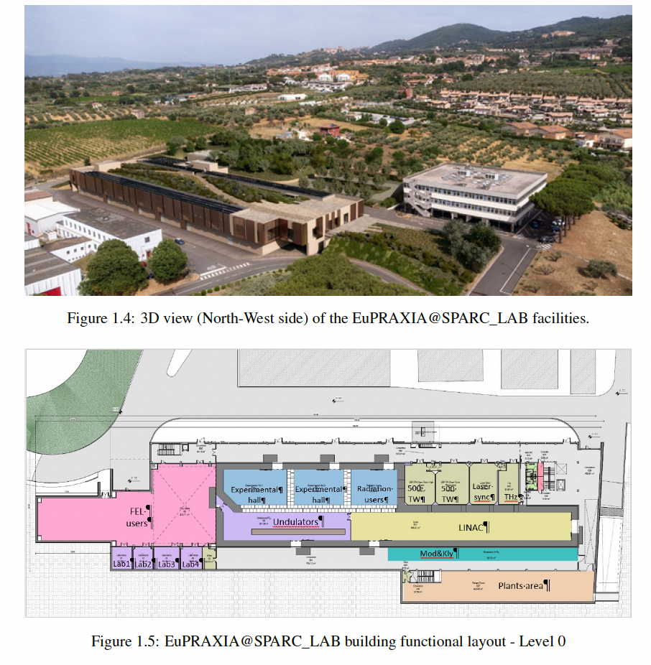
Civil Infrastructures
The main infrastructure includes a new building of approximately 5,600 square meters, purpose-built to house the accelerator, the FEL, various experimental areas, and supporting technical rooms.
At its maximum extension above ground, the building is approximately 140 m long and 45 m wide, with a narrowing to 36 m towards the north-west; it ends on the ground floor with a rectangular appendix measuring 21 m by 13 m completely underground.
This structure has been carefully engineered to accommodate complex equipment with stringent requirements on radiation shielding and vibration suppression.
Reinforced concrete walls and roofs, up to 2 meters thick, ensure safety and operational integrity, while structural joints isolate sensitive experimental spaces from mechanical vibrations.
Building construction is expected to start by the end of 2026 and to be completed in 3 years.
Courtesy U. Rotundo

Slide 16
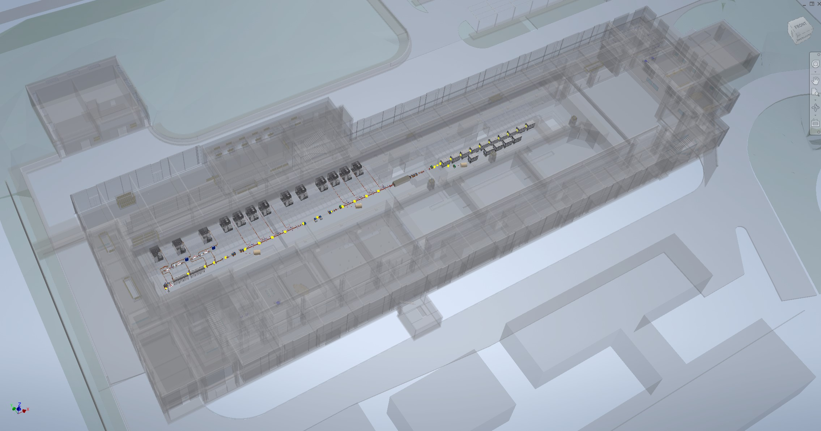
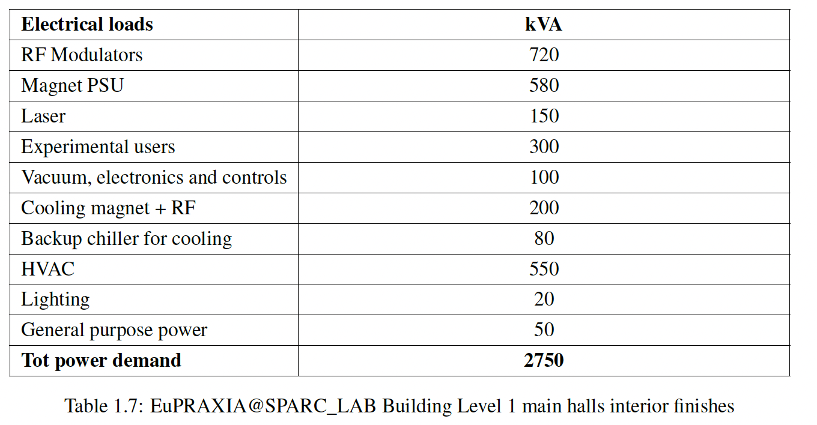
Machine Layout
Courtesy M. Del Franco

Slide 17
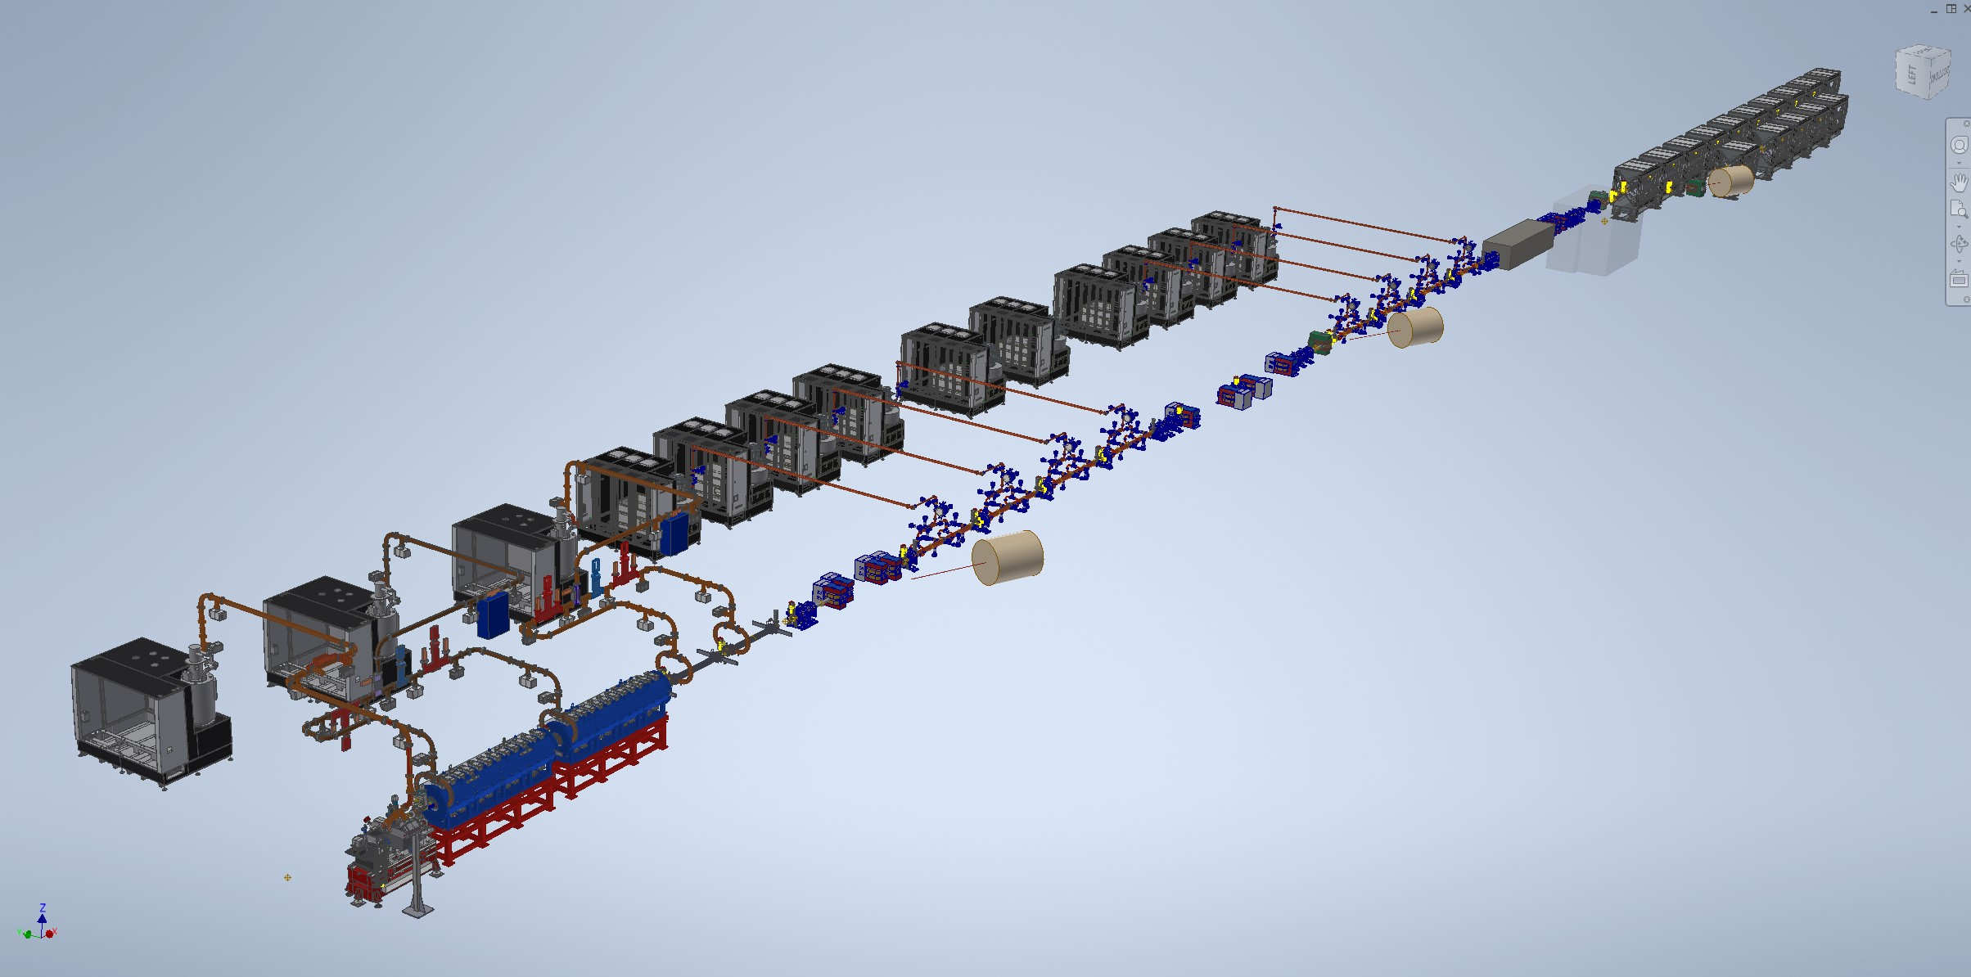
All Component included
Courtesy M. Del Franco

Slide 19
EuPRAXIA@SPARC_LAB Layout
159 m
Technical rooms
Klystron & power supplies hall
Preparations labs
AQUA beamline
45 m
Accelerator tunnel
Plasma
module
Undulator tunnel
ARIA beamline
Experimental hall
Lasers clean rooms
Laser and particle user rooms

Slide 20
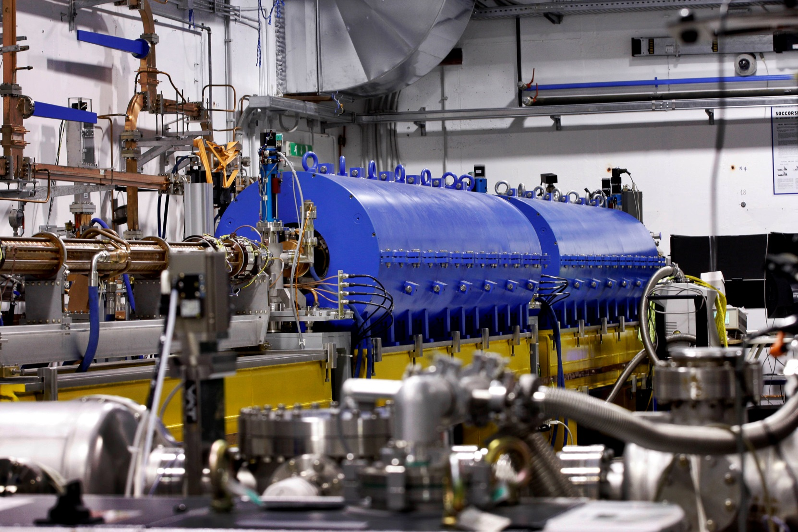
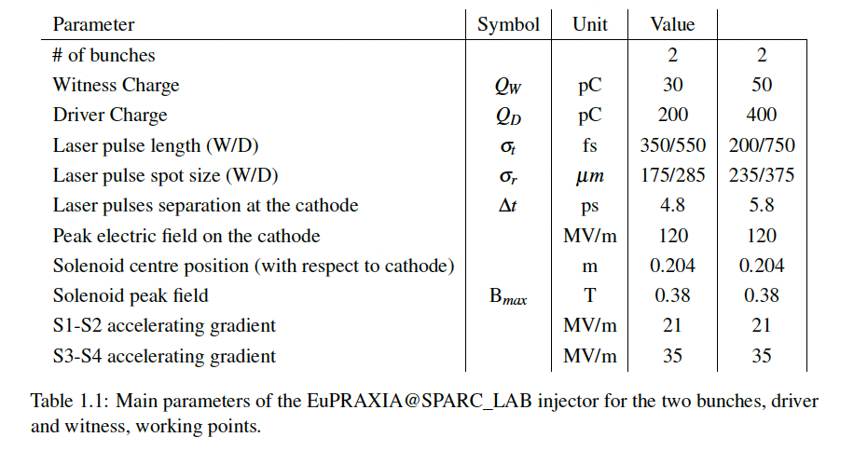
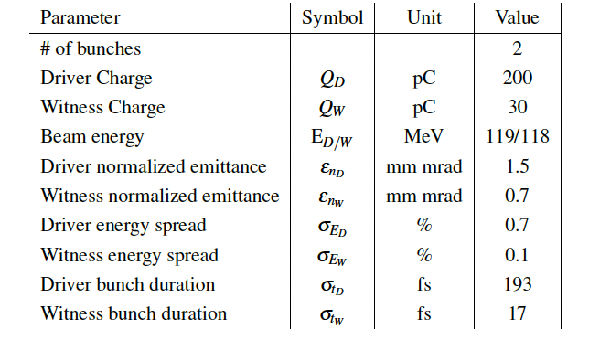
Injector
10 m
Courtesy E. Chiadroni

Slide 21
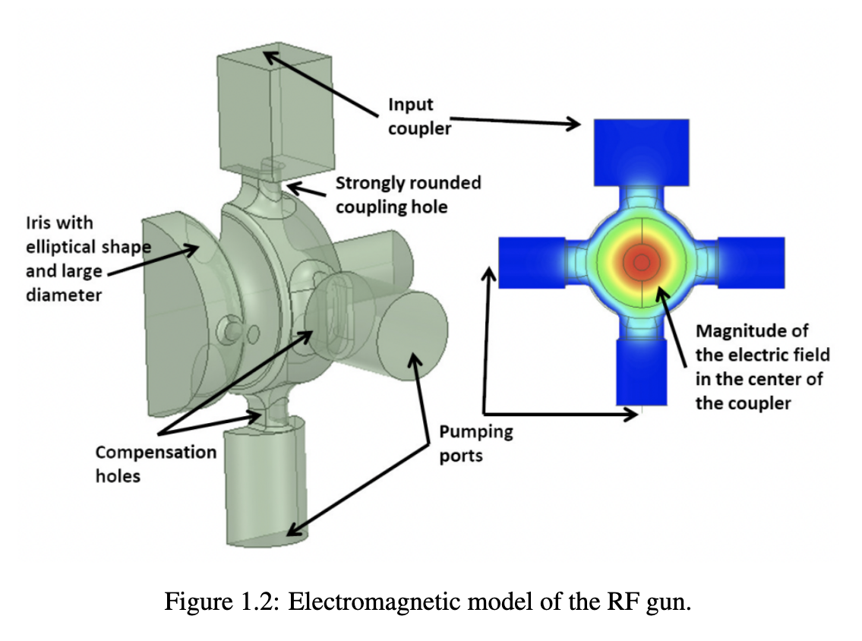
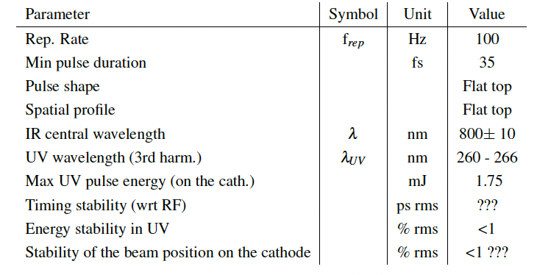
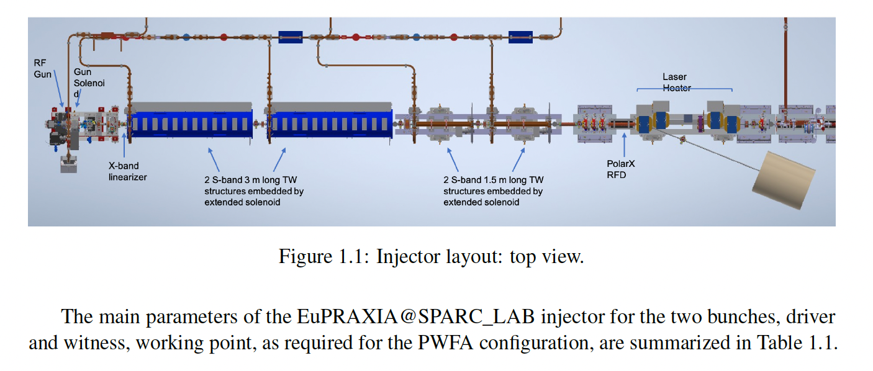
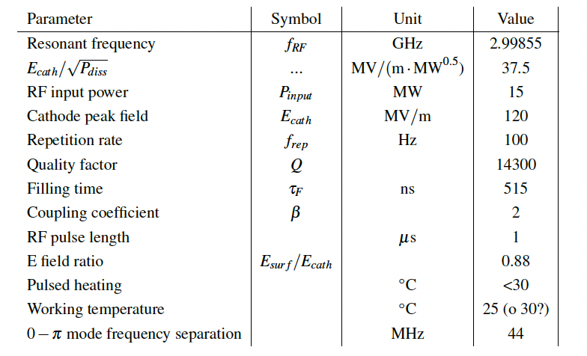
Injector

Slide 22
Injector
Subsystem | Parameter | Value
Solenoid | Peak field | 0.38 T (3,800 Gauss)
 | Position from cathode | 0.204 m
 | Additional element | Skew quadrupole for emittance correction
X-band Lineariser | Frequency | 11.9942 GHz
 | Accelerating field | 20 MV/m
 | Peak field | 38 MV/m
 | Input power | 400 kW
 | Number of cells | 7
 | Length | 10 cm
Booster Section | S-band structures | 2 × 3 m + 2 × 1.5 m TW
 | Operating mode | 2π/3
 | Accelerating gradient (3 m / 1.5 m) | 25 MV/m / 35 MV/m
 | Total beam energy | up to 250 MeV
Diagnostics | Low energy diagnostics | YAG screen, Faraday cup, BPMs
 | High energy diagnostics | Quadrupole scan, PolariX TDS
Laser Heater | Undulator length | 60 cm
 | Purpose | Energy modulation for microbunching control
Upgrade Option | High rep-rate injector | 2.6-cell C-band gun @ 5.712 GHz
 | Peak cathode field | 160–180 MV/m
 | Pulse length (RF) | 300 ns

Slide 23
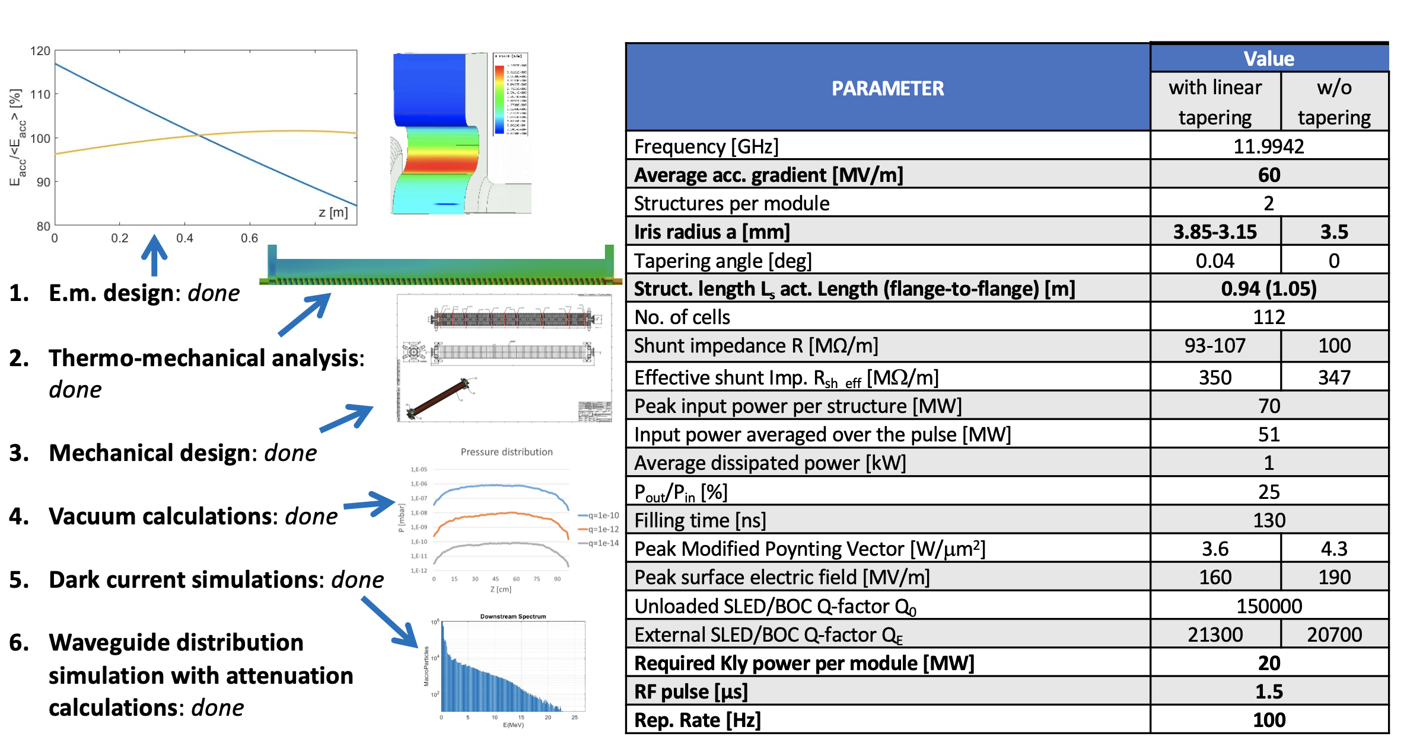
X-band Linac
55 m
Courtesy D. Alesini

Slide 24
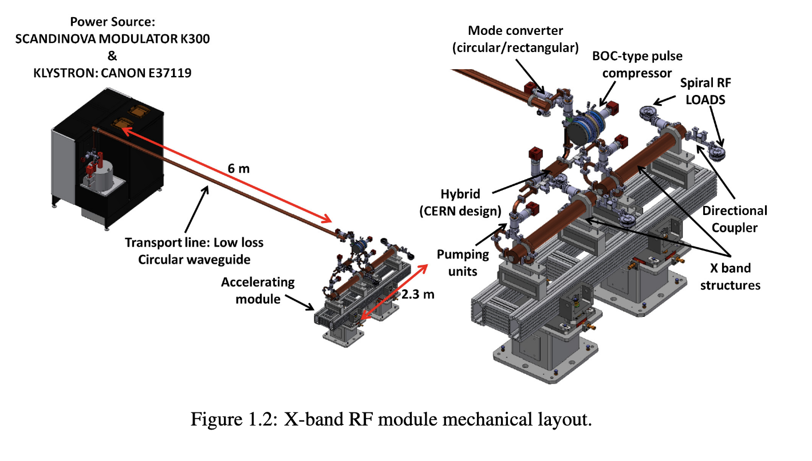
X-band Linac
The system consists of 16 traveling wave accelerating structures, grouped into eight modules of two structures, each powered by a 25 MW klystron through a Barrel Open Cavity (BOC) pulse compressor. These components deliver up to 70 MW peak power pulses for each structure, enabling accelerating gradients up to 60 MV/m within a compact 0.9-meter section.
When the facility is operating in the hybrid RF-PWFA mode the accelerating gradient of the X-band linac is reduced to 30 MV/m giving an energy of 550 MeV at the linac exit. The target final 1 GeV energy is provided by the plasma accelerating module (PWFA)

Slide 25
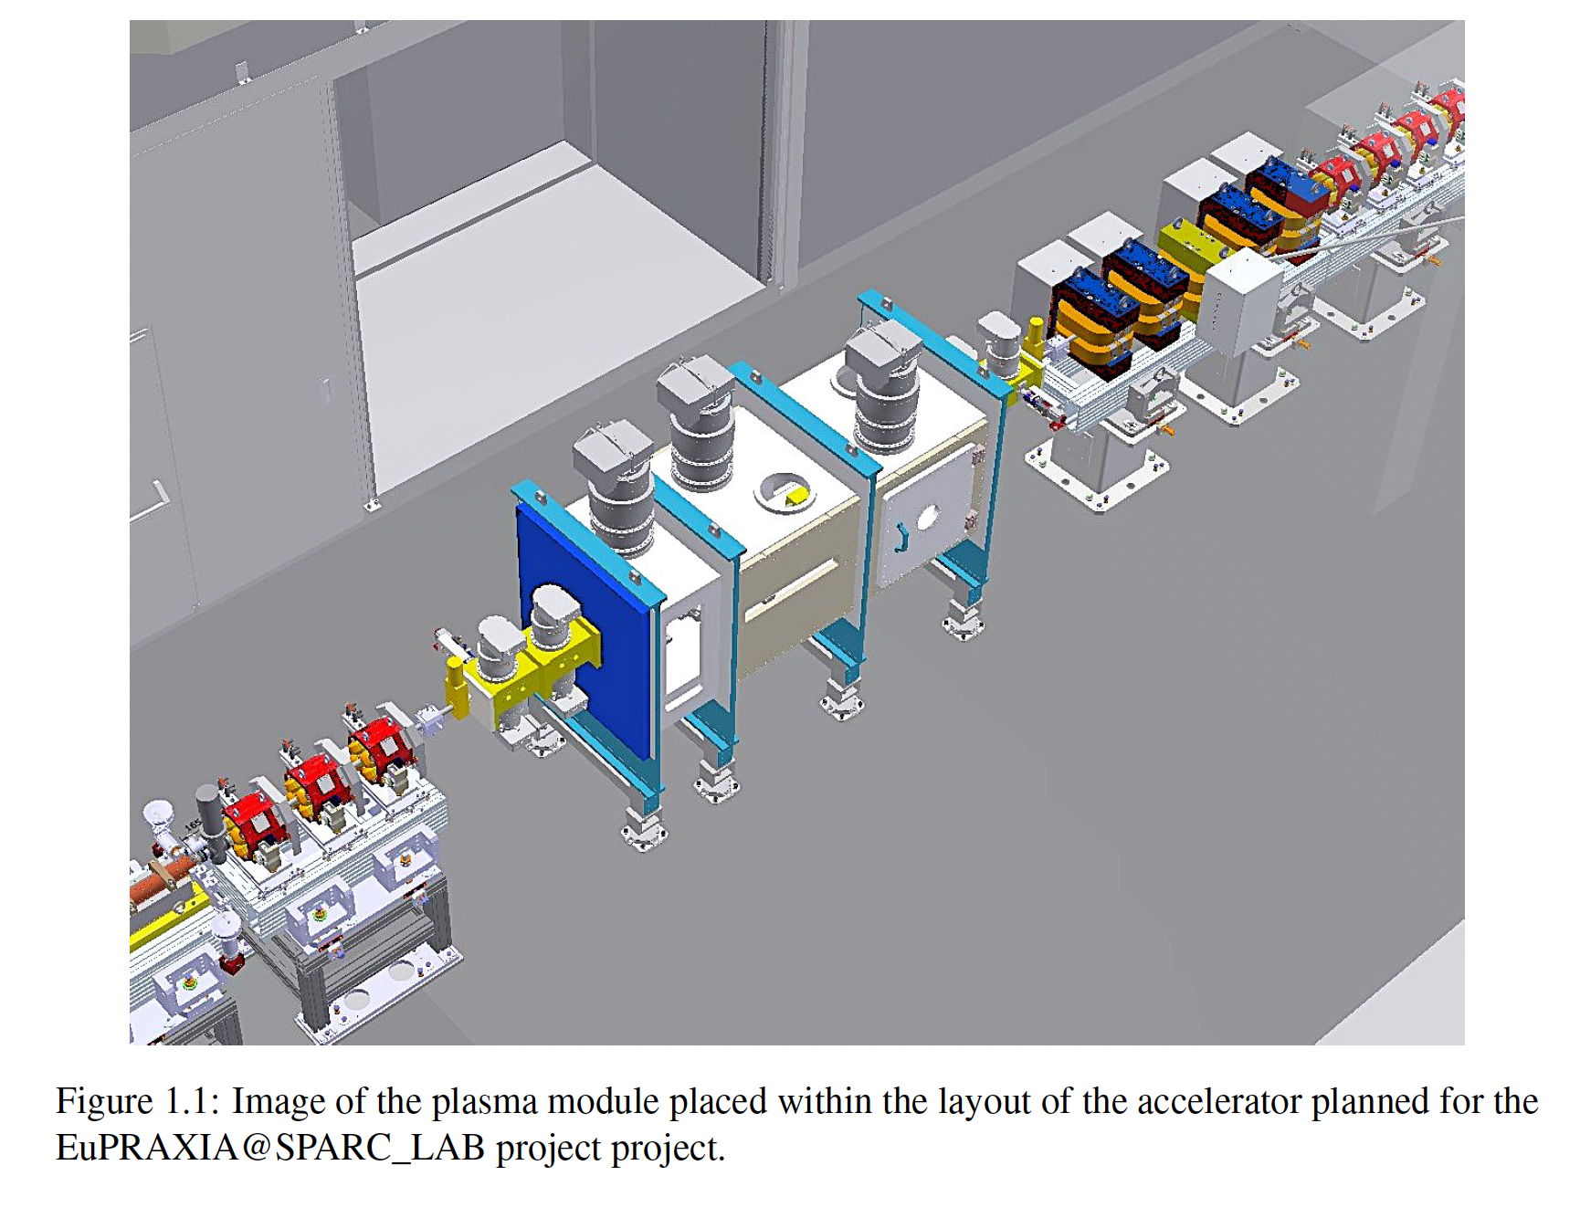
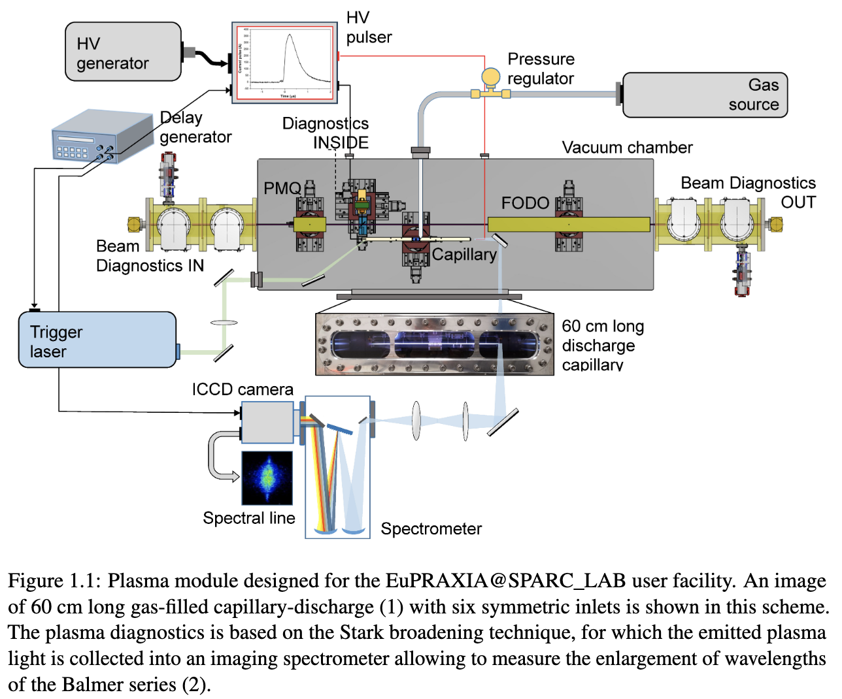
Plasma Module
Capillaries are made from advanced ceramics like Macor and Shapal to ensure thermal stability and machinability under high repetition rates (up to 400 Hz). Plasma generation is achieved using high-voltage pulses (10–15 kV) applied across tungsten electrodes, with stabilization from a synchronized laser pulse to reduce discharge jitter. Multiple gas inlets distribute neutral gas along the capillary, shaping plasma density profiles for optimal beam acceleration. Diagnostics based on Stark broadening techniques are used to measure electron density distributions inside the plasma channel.

Slide 26
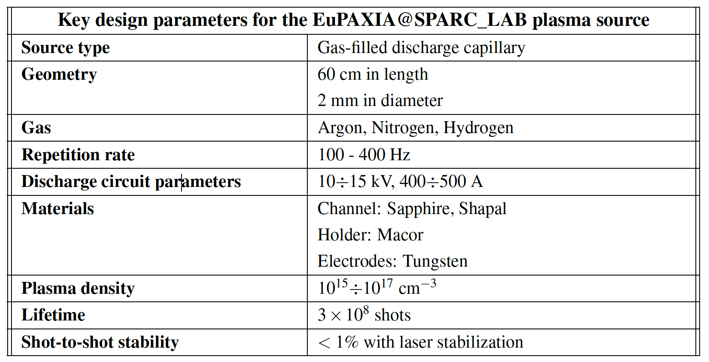
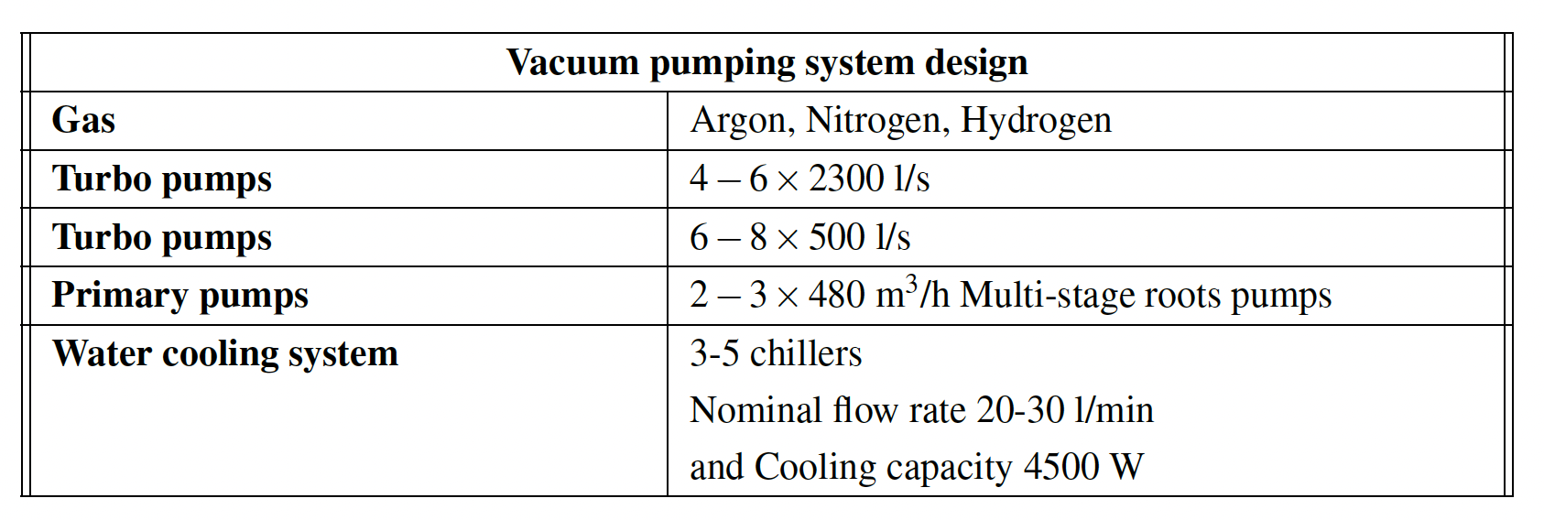
Plasma Module
Courtesy A. Biagioni, R. Pompili

Slide 27
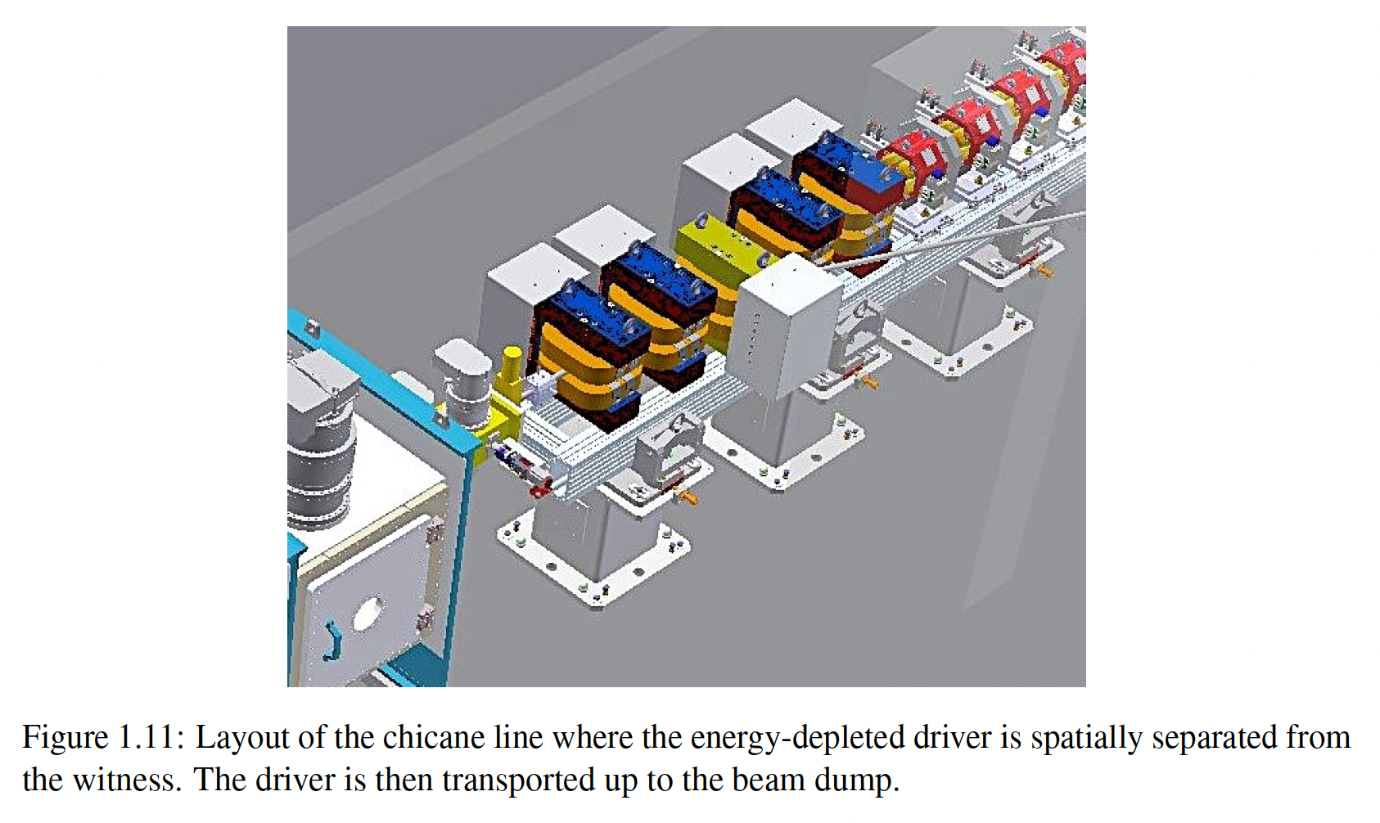
Driver/Witness Separator (Chicane)

Slide 28
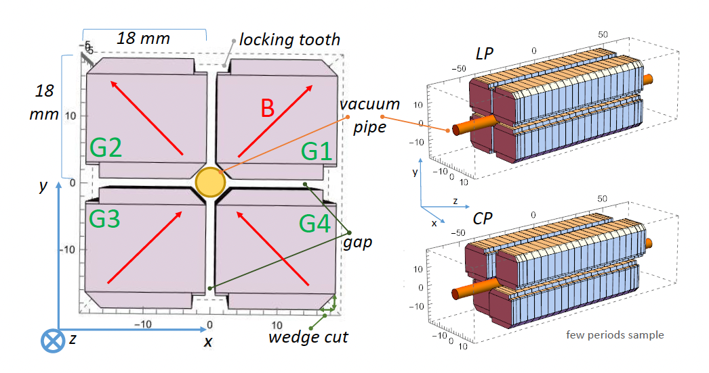
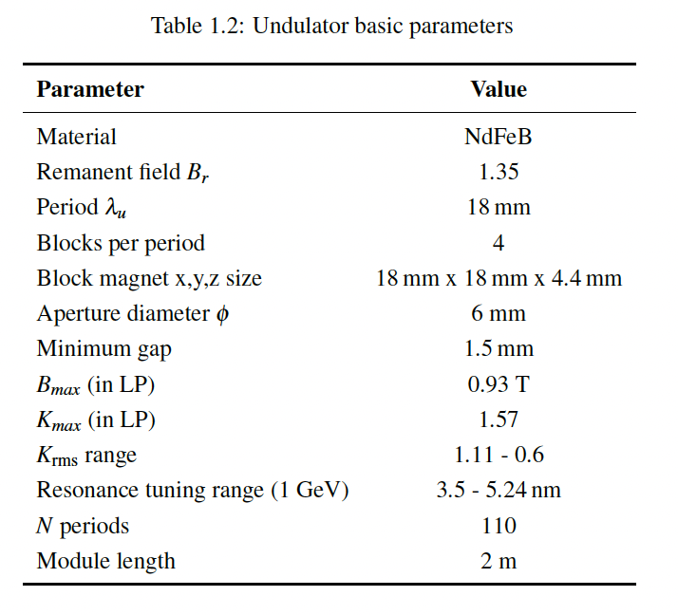
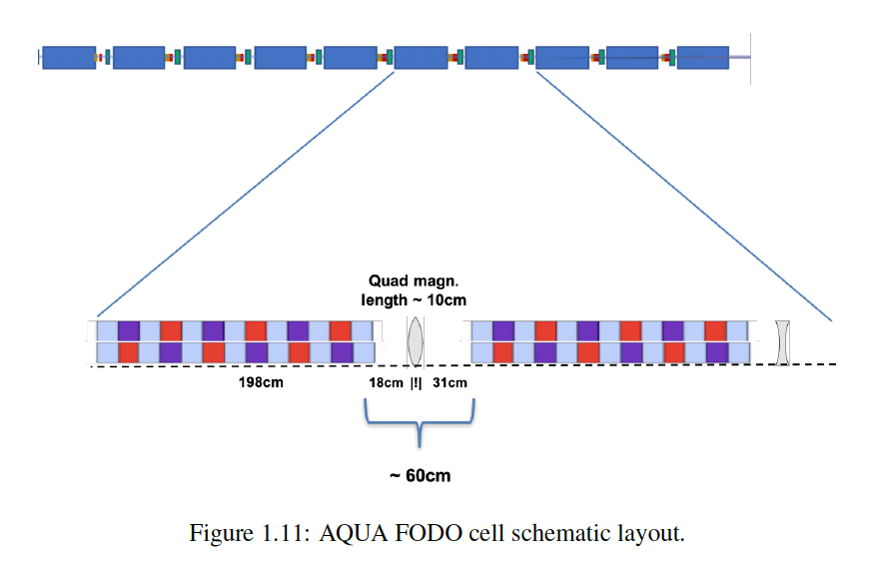
AQUA Undulators
The AQUA FEL design foresees 6 undulator modules, each module is approximately 2 meters long, and they are interleaved with quadrupoles and diagnostics in a FODO lattice configuration.
The AQUA FEL employs the APPLE X permanent magnet configuration, chosen for its high field strength, polarization flexibility, and compact footprint.
The baseline undulator has an 18 mm period, 1.5 mm minimum gap, and consists of NdFeB magnets arranged to allow both linear and circular polarization with tunable wavelengths.
Simulation results show photon output exceeding 10¹⁰ photons per pulse in the 3–5 nm range with a 0.2 % bandwith. Longer wavelength up to 15 nm are also compatible with the current design.
Courtesy L. Giannessi

Slide 29
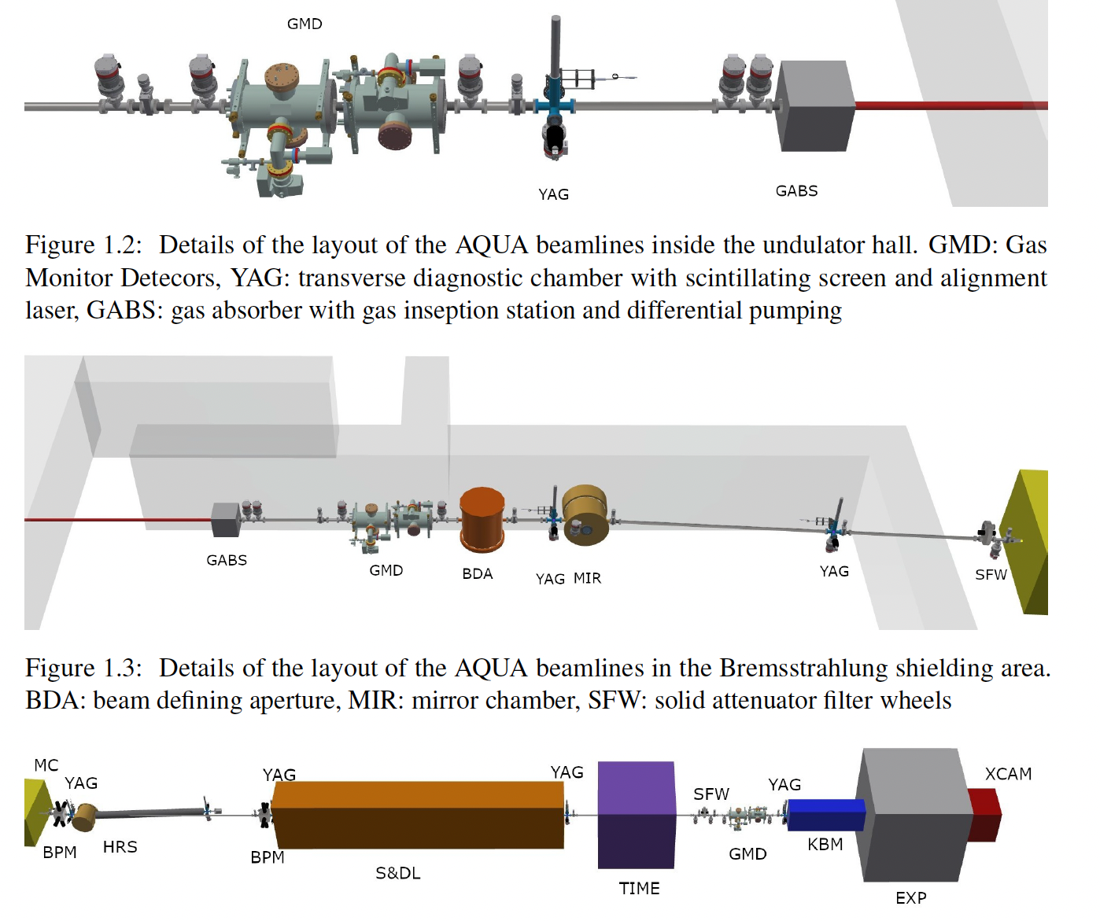
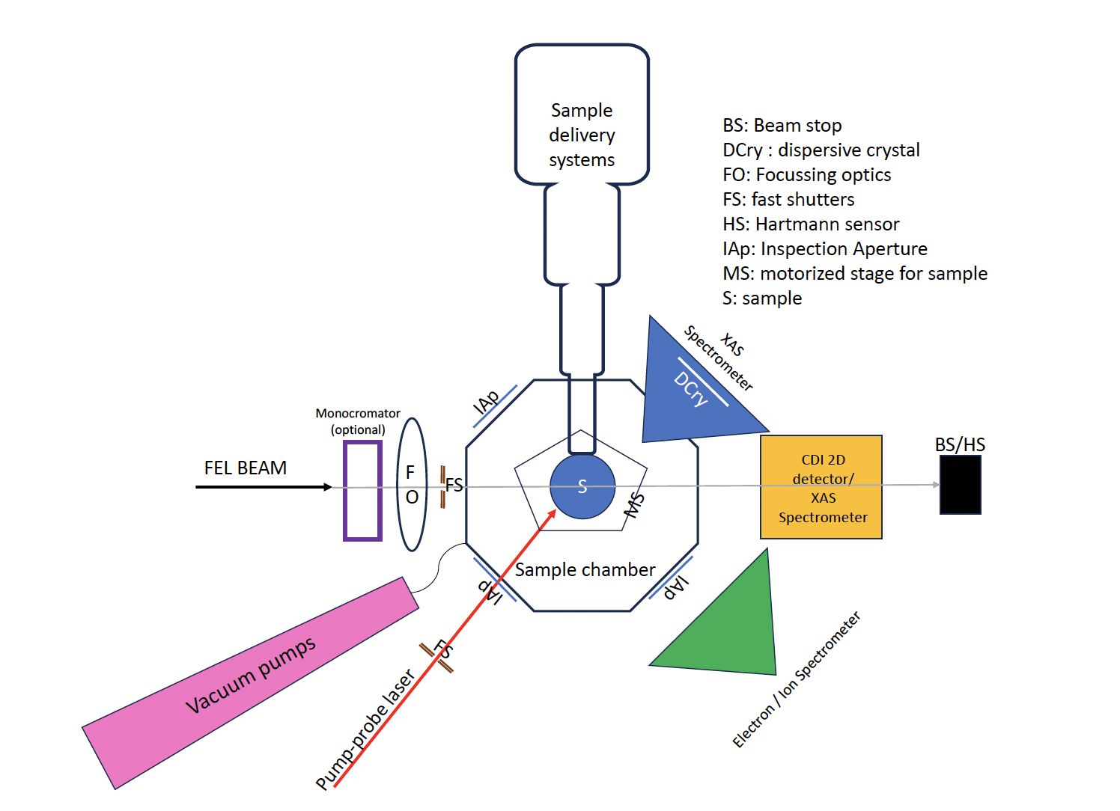
Photon Beam Line and Endstations
Photon beamline is optimized to preserve the spectral purity, temporal coherence, and intensity of the FEL radiation in and near the water window spectral range (3–10 nm).
The actual distance from the source to the target is about 50 m.
Optical coatings such as carbon, nickel, and gold provide high reflectivity in the soft X-ray range.
A flexible focusing system allows the beam to be tightly focused at the experimental station.
The endstation includes a highly modular and flexible experimental chamber compatible with vacuum operation down to 10⁻⁸ mbar.
It supports a wide variety of experimental techniques including X-ray imaging, scattering, and time-resolved pump–probe measurements.
Beamline components such as optional monochromators, diagnostics, and focusing optics are integrated to allow spectral control and high spatial resolution.
Courtesy F. Villa

Slide 30
Courtesy A. Falone

Slide 31
Courtesy A. Falone

Slide 32
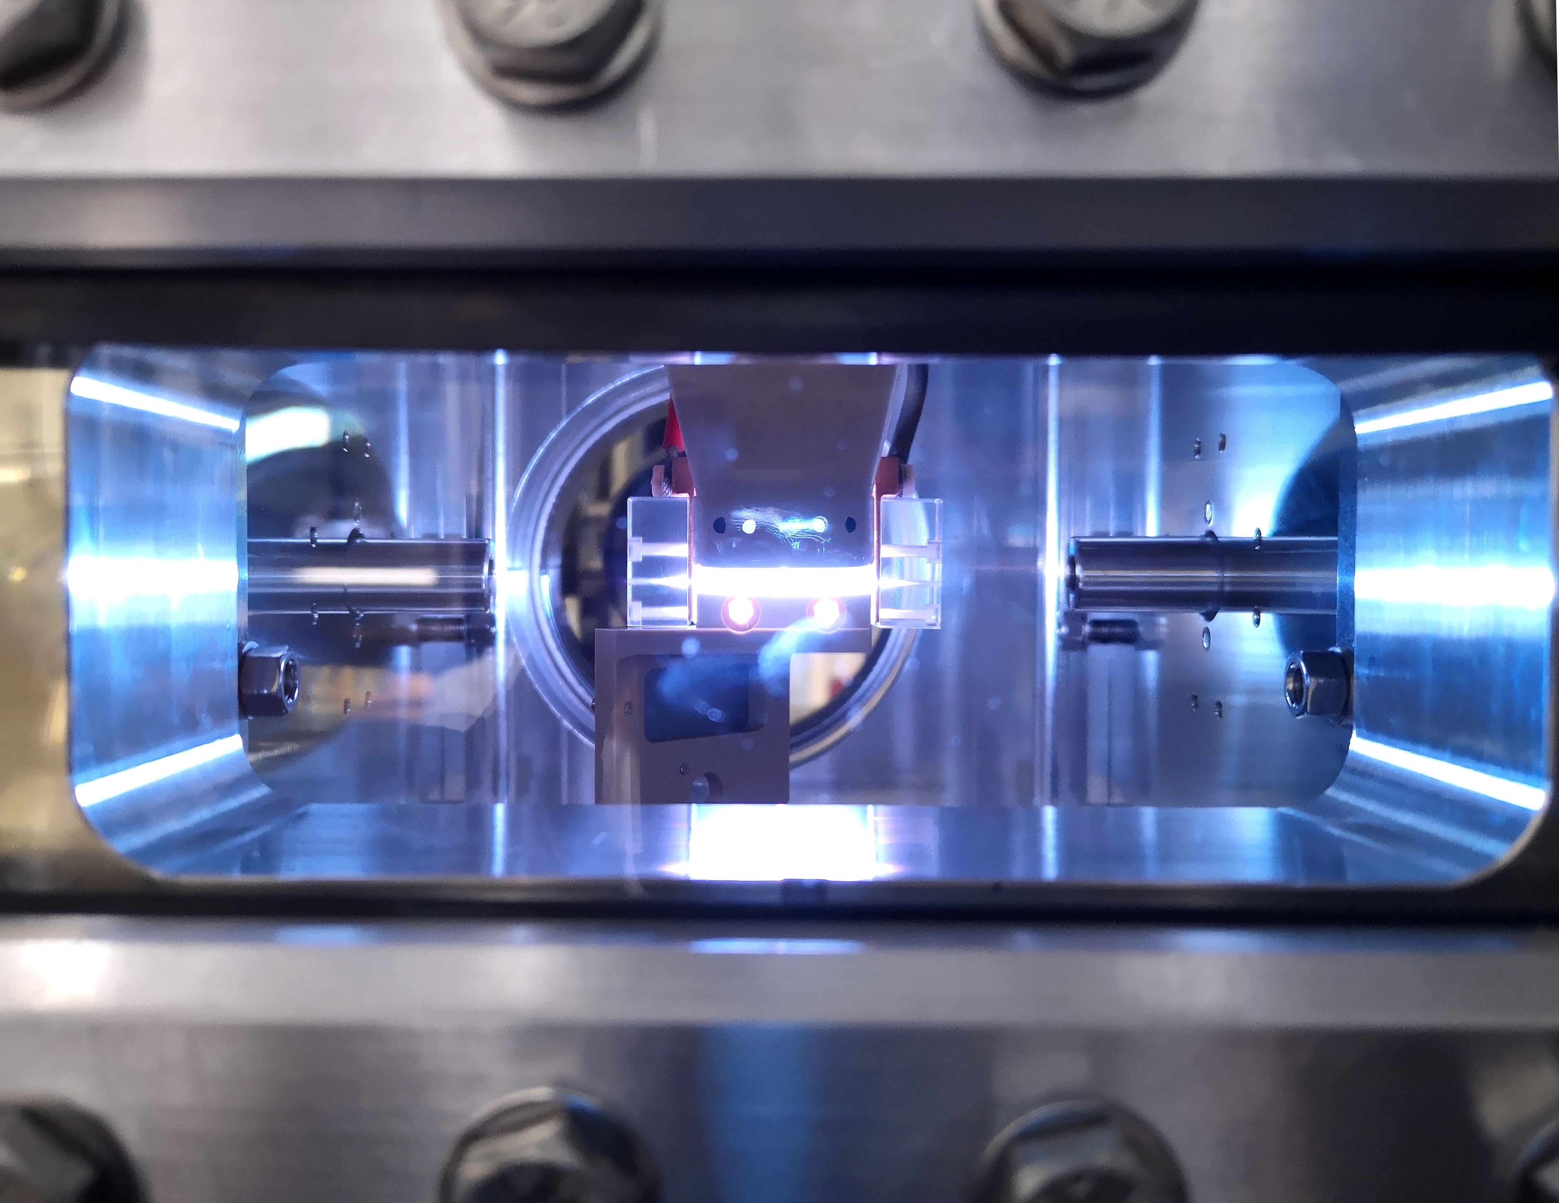
Thank for your attention

Slide 33
EuPRAXIA@SPARC_LAB baseline timeline

Slide 34
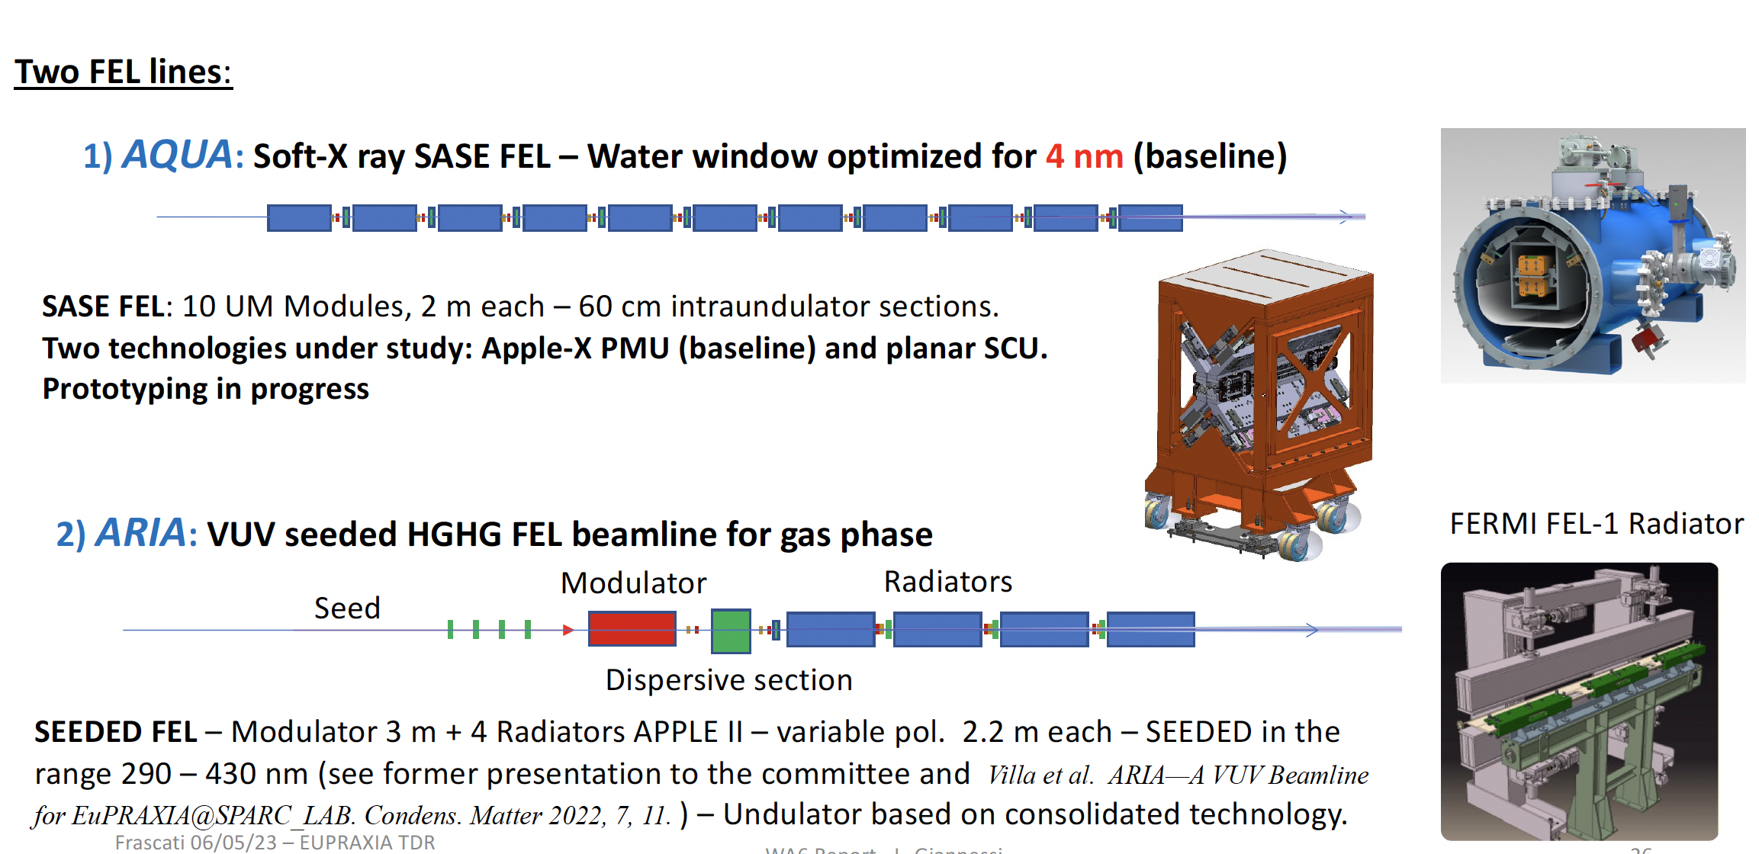
Undulators
50-100
40 m
Courtesy L. Giannessi

