Slide 1
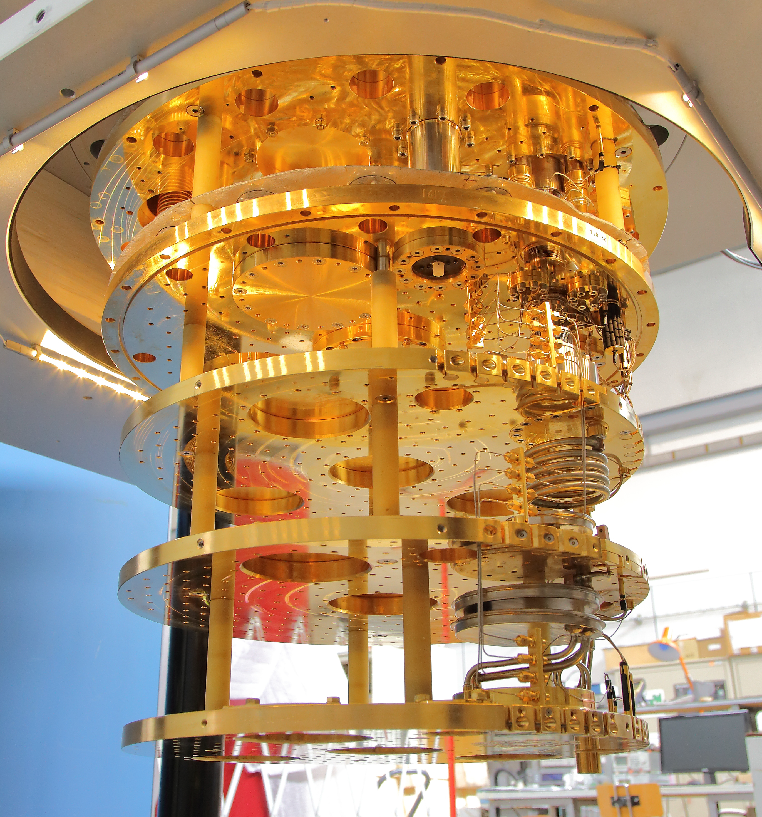

Status of FLASH and COLD lab
Simone Tocci
69th LNF Scientific Committee
May 14th 2025

Slide 2
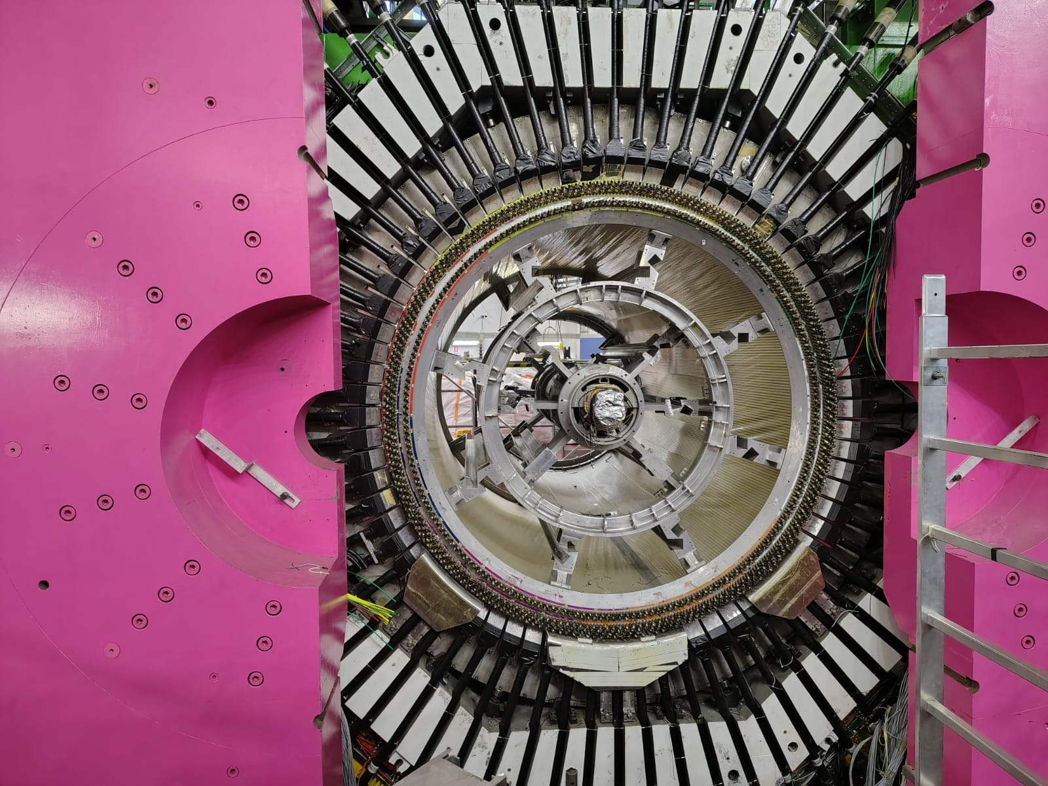
Outline
FLASH
  Status of FINUDA decommissioning
  Status design
QUAX@LNF
Quantum Devices
Conclusions

Slide 3

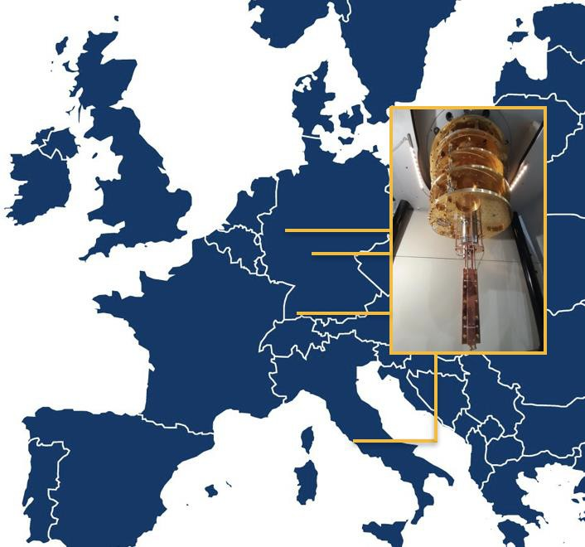
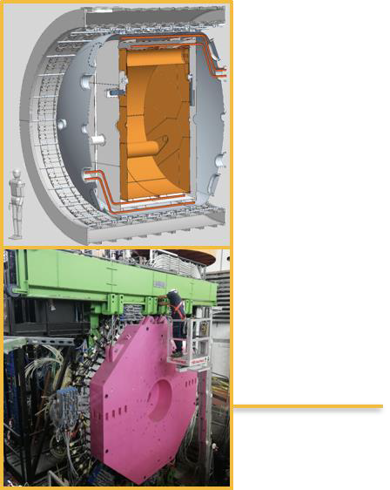
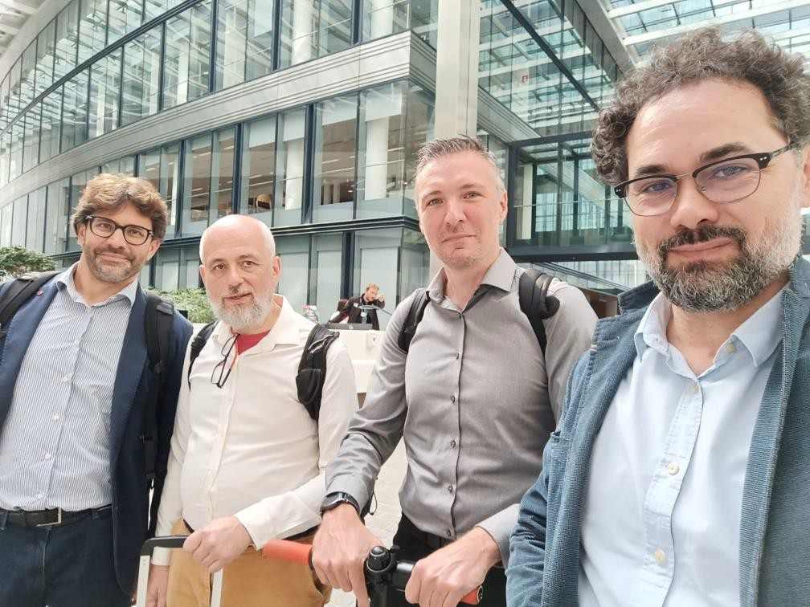

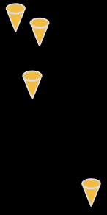
GravNet: A Global Network to Search for High Frequency Gravitational Waves
ERC Synergy funded with 10 Meuro

Slide 4

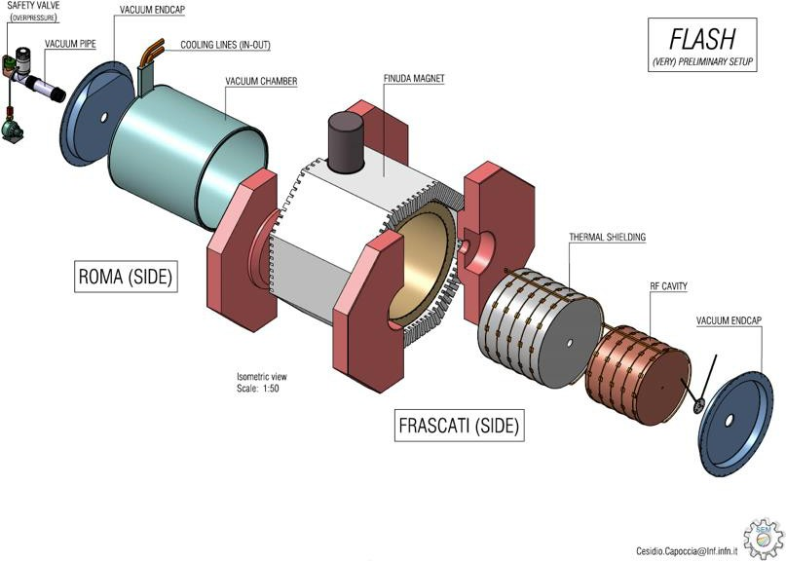
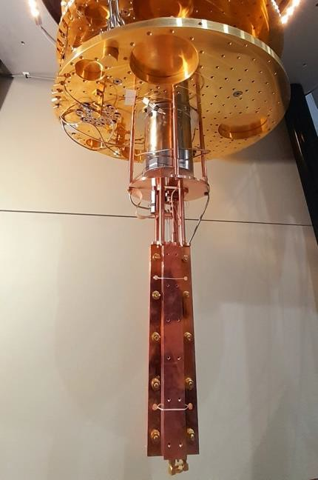
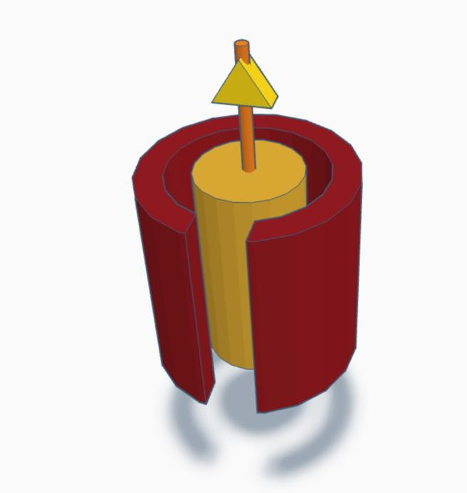
LNF Tasks
QUAX
100 MHz GW search
5-10 GHz GW search
Signal Amplification and
Photon Counting

Slide 5
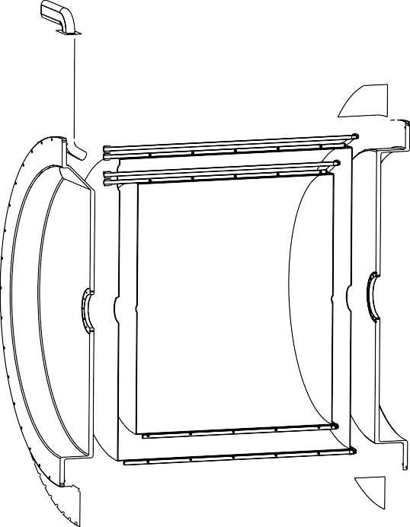

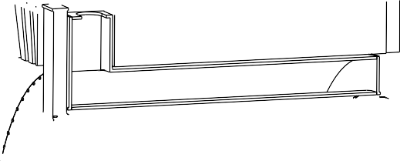







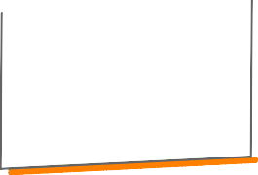












FLASH Project Timeline
2025
  Finuda decomissioning
  Design FLASH and R&D
  Formalization of FLASH Collaboration
2026
  Certification and maintenance of the cryogenic system and magnet
  Design FLASH
  Fabrication 500 MHz FLASH cavity prototype (Bonn University)
  Protoype characterization at 4K
2027
  Technical Design Report
  Call of tender for cavity cryostat and RF cavity
2028
  Start fabrication
2029
  FLASH commissioning
2030
  Data taking
2031
  End of GravNet project
C. Capoccia LNF

Slide 6
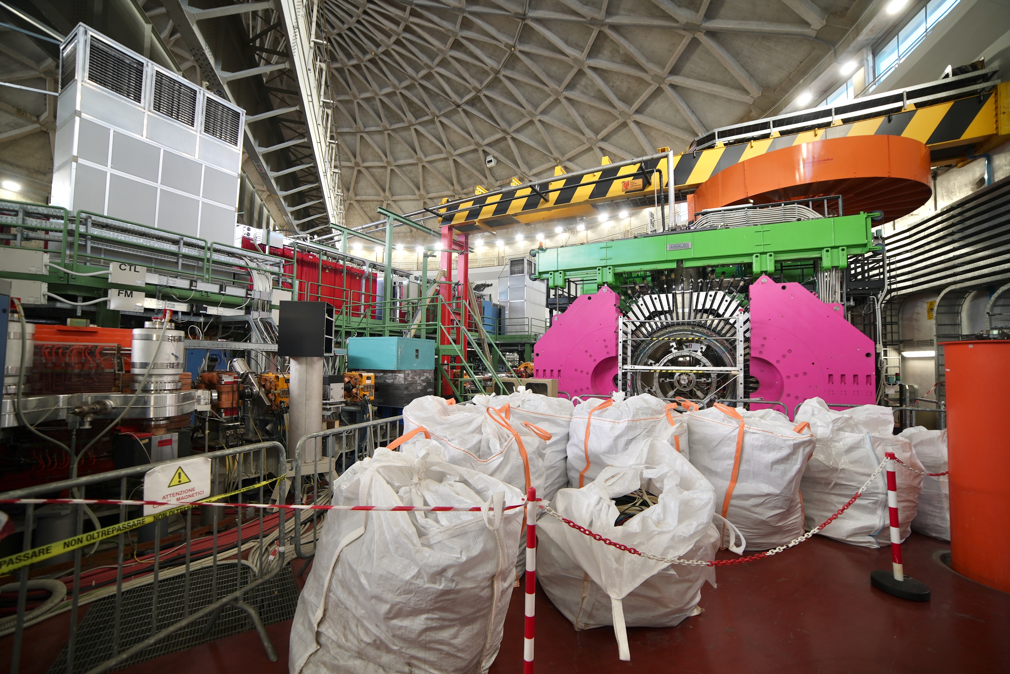
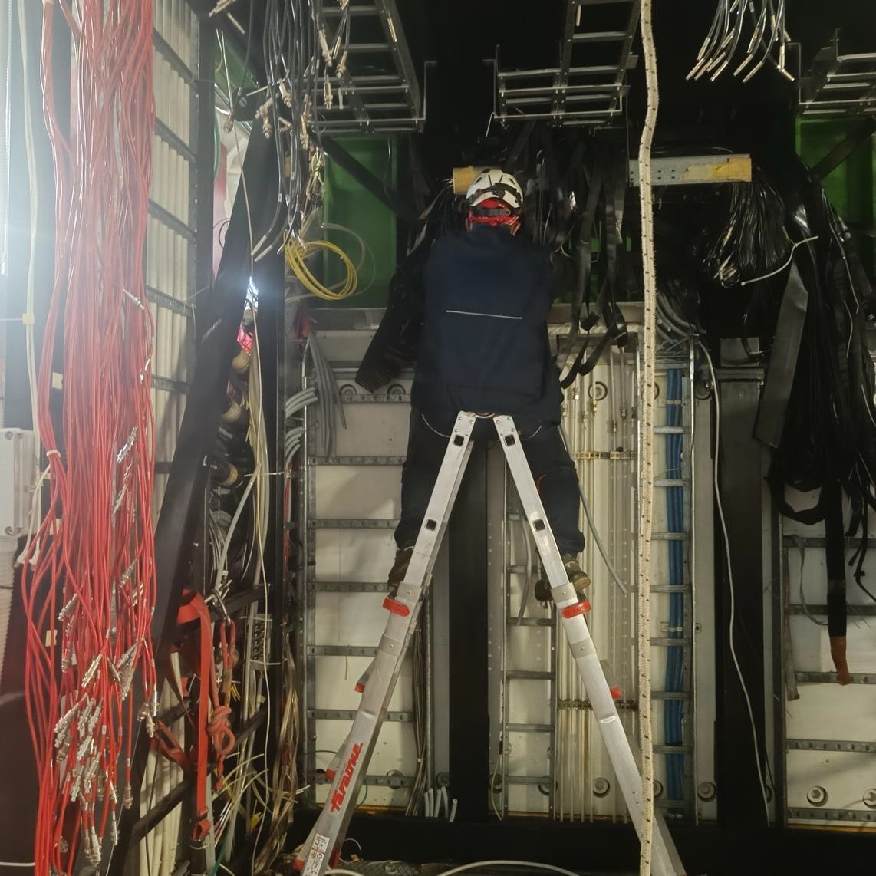
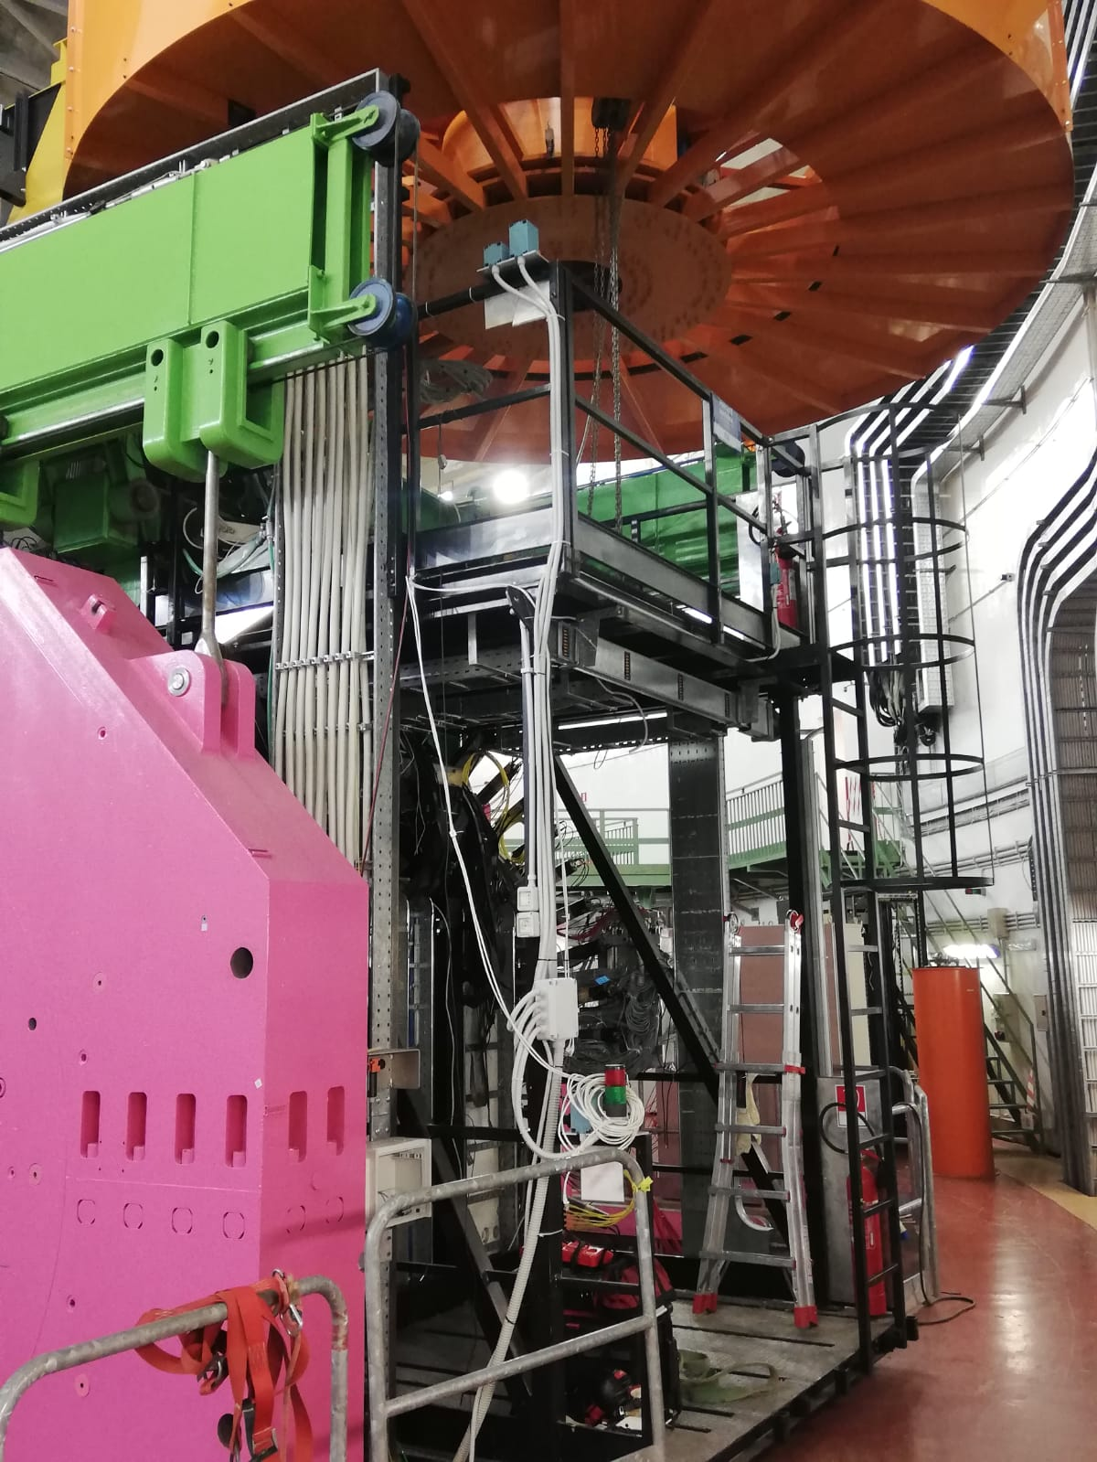
FLASH
FINUDA Decommissioning
The FINUDA detector is being dismantled in 2025 to make the magnet available for the FLASH experiment:
On March 3rd, the decommissioning officially began.
Done:
Thanks to S. Tomassini, the endcaps were opened
So far, electrical and gas cables, as well as electronics racks were removed (see upper picture)
FINUDA assembly tools have been recovered for the clepsydra dismantling.
Disassembly procedures identified and are in the finalisation phase

Slide 7
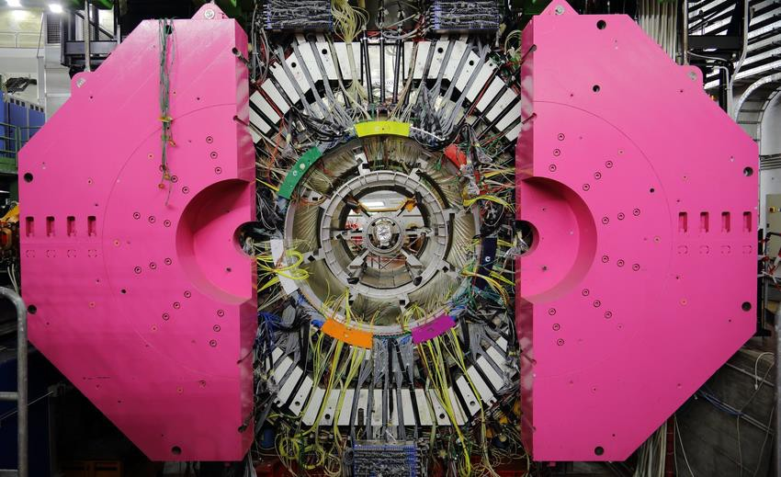
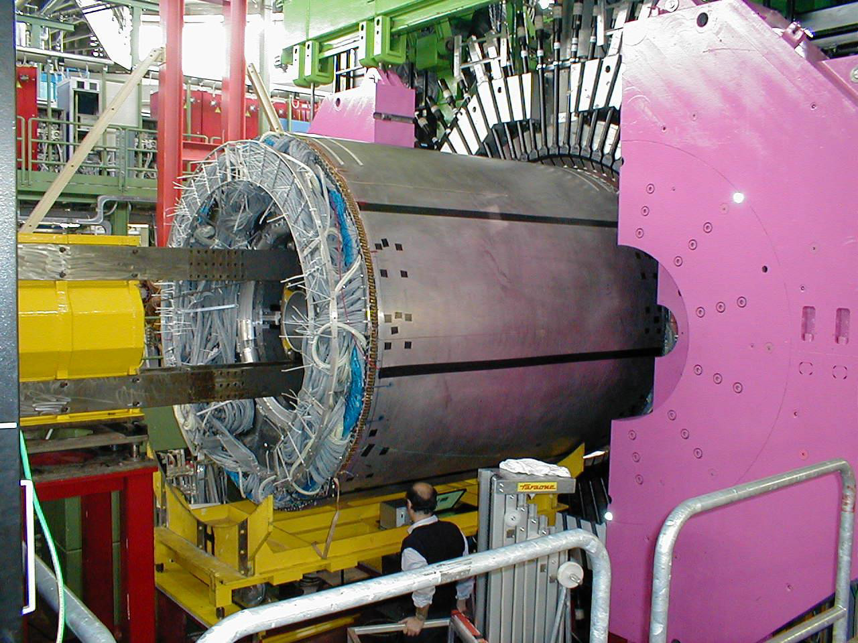
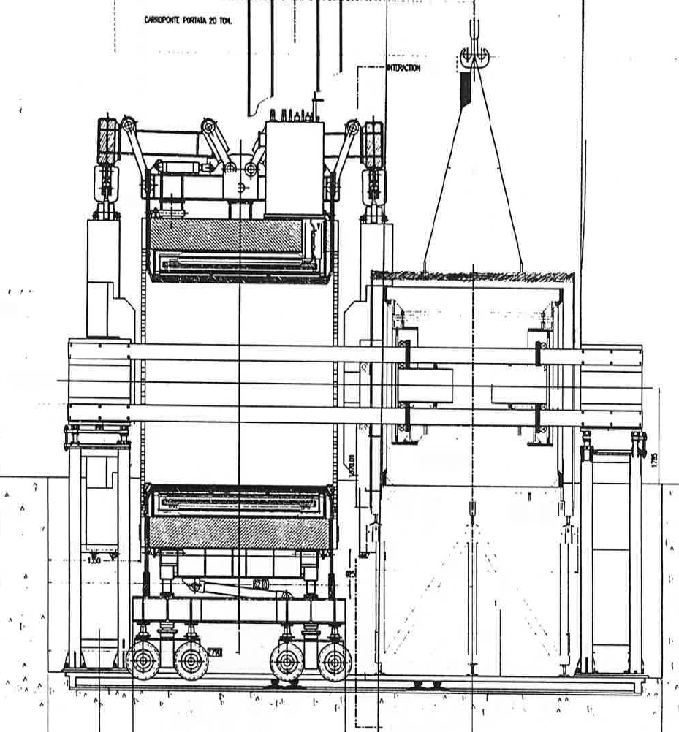
Disassembly procedures
We are finalizing the procedure for the extraction of the beam-pipe and Clepsydra. To avoid disconnecting the cryogenic lines, a critical point is to avoid moving the FINUDA Magnet for both FINUDA decommissioning and FLASH commissioning. Therefore, the decommissioning process will be different from the installation process used in 1997.
Remove the beam pipe
Extraction of the FINUDA Clepsydra
Disassembly of scintillators and phototubes
Scintillators
Clepsydra
Beam pipe
Phototubes
Insertion of the clessidra during FINUDA (1997) commissioning

Slide 8
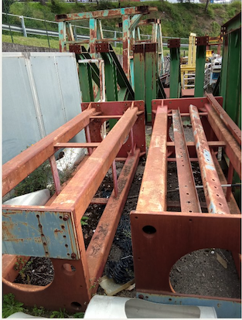
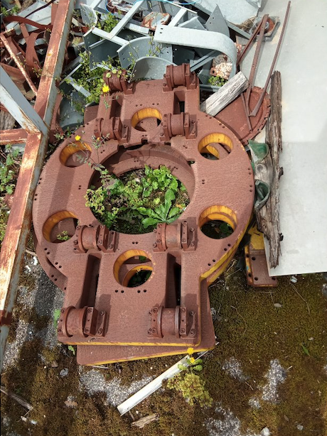
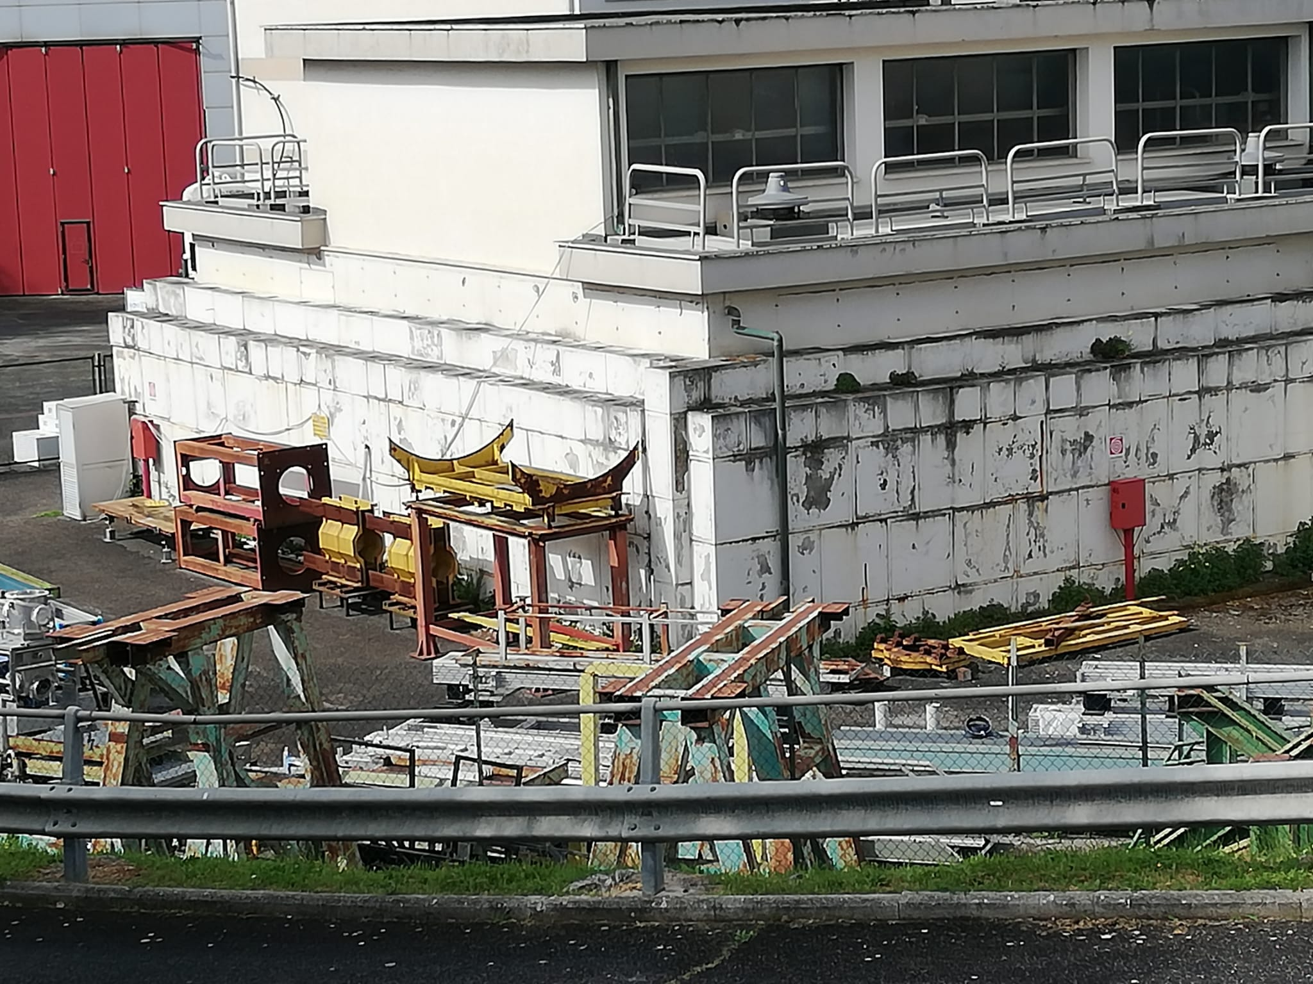
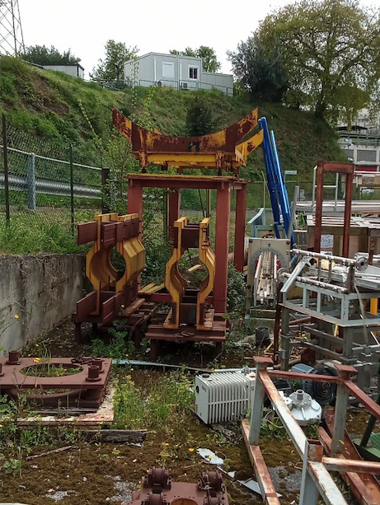
FINUDA assembly tools
The tools for the installation of FINUDA were collected and put aside in an area near to DAFNE.
They will have to be renovated and possibly adapted to the new disassembly process. Some simple parts need to be redone

Slide 9
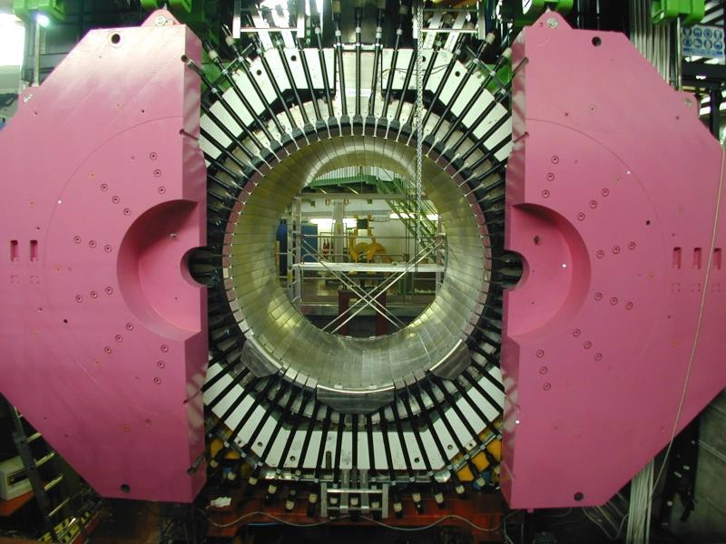
FLASH
FINUDA Decommissioning
The following components will not be disassembled during the operation:
Iron Joke
Magnet
Endcaps
Cryogenic components
Before the insertion of the clessidra during FINUDA (1997) commissioning

Slide 10
FLASH
FINUDA Decommissioning
Next steps are:
Refurbishing of the assembly tools
Beam pipe removal
Extraction of the FINUDA Clepsydra
Disassembly of scintillators and phototubes
Maintenance of the hydraulic movement system and endcap handling system
Maintenance of magnet cryostat service turret
Maintenance and certification of DAFNE cryogenic system (ongoing)
Before the insertion of the clessidra during FINUDA (1997) commissioning

Slide 11
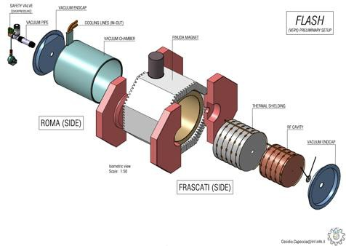





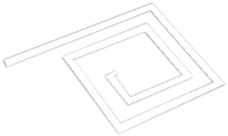
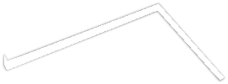






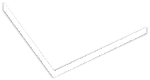










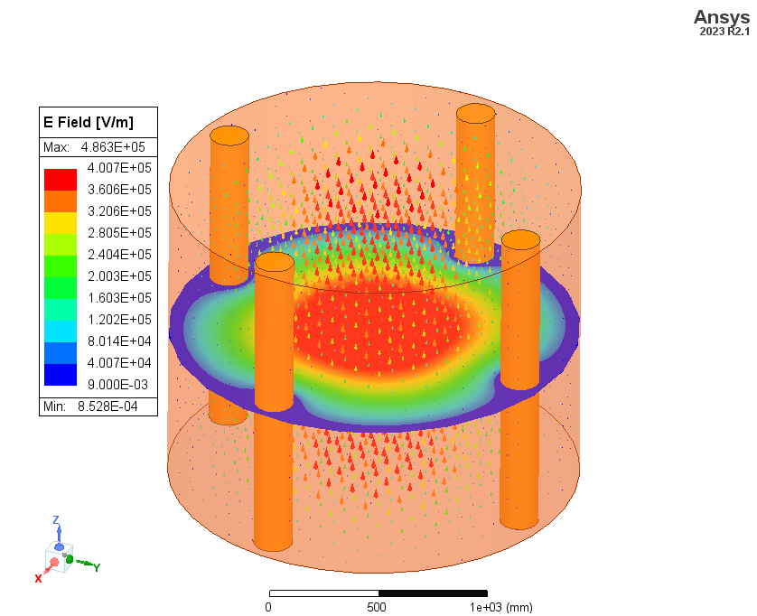
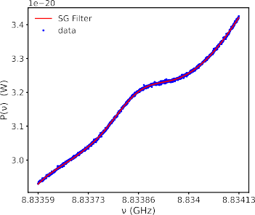





Design Study and R&D for the TDR
Approved by INFN in September 2024, Goal: TDR ready in 2026
Mechanical Design and Cryogenics
Signal Amplification and DAQ
≈
Data Analysis and Computing
RF Cavity

Slide 12
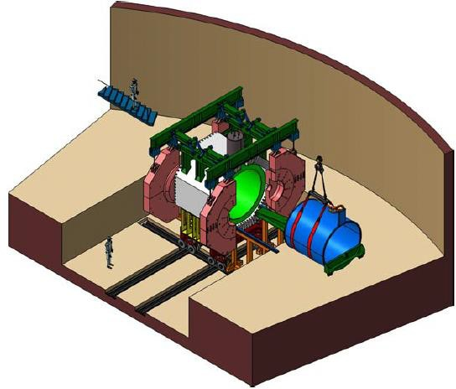
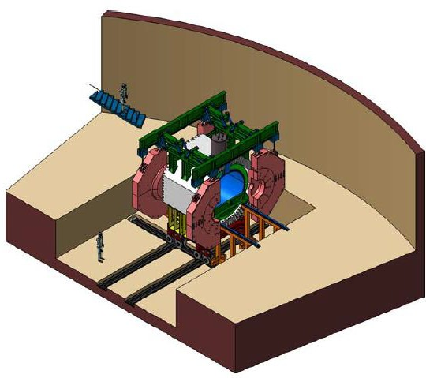
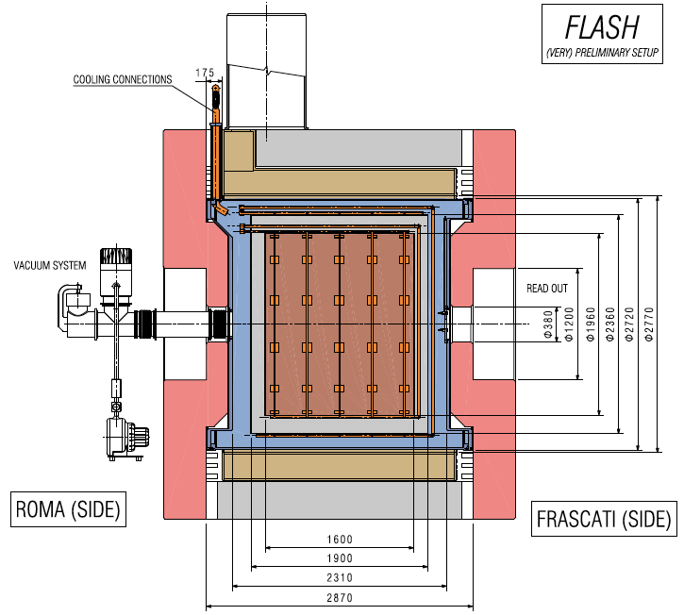
Vacuum vessel design and insertion scheme
An initial version of the vacuum vessel design has been completed but is being constantly updated (C. Capoccia).
The available volume for the RF cavity has been defined.
An initial procedure for inserting the vacuum vessel has been defined and the first mechanical drawings for the necessary tools have been made.
From this study we can safely say that the installation can be done without moving the magnet.
C. Capoccia LNF

Slide 13
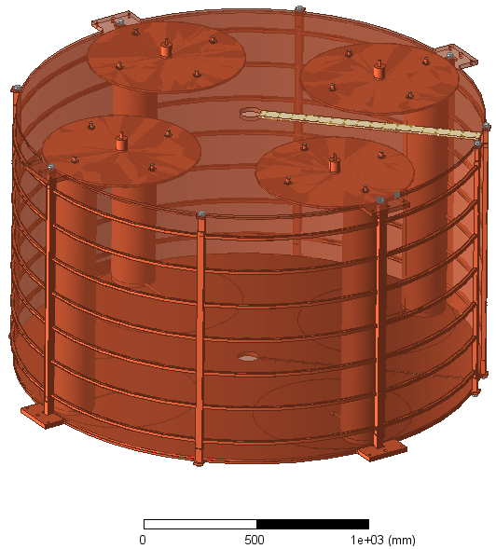
RF cavity
Mode | Resonant Frequency [MHz] | Q₀ factor (@4°K)
TE111 | 136 | 450e3
TE112 | 220 | 510e3
TE211 | 190.5 | 483e3
TE011 | 218.2 | 1.05e6
TE212 | 257.4 | 646e3
Mode | Resonant Frequency [MHz] | Q₀ factor (@4°K)
TM010 | 130 | 595e3
TM011 | 163.5 | 505e3
TM012 | 238 | 610e3
TM110 | 204.4 | 765e3
TM111 | 227.5 | 605e3
TM112 | 286 | 678e3
TM210 | 259.3 | 950e3
TM211 | 278 | 720e3
TM212 | 350 | 702e3
TM020 | 290.2 | 953e3
The electromagnetic cavity project has begun:
The frequency tuning system has been updated to meet the new HFGW target.
The main parameters of the TE and TM modes of interest for GW and axions have been identified and calculated.
A first mechanical model of the cavity and its tuning system has already been developed (S. Tomassini).
Next steps:
Study the effects of the cavity mechanical model on the main electromagnetic parameters for axion and HFGW searches.
Study the effect of possible mechanical vibrations on the electromagnetic response (PhD position opened at La Sapienza University).
Identify the RF components required for FLASH operation.
S. Tomassini LNF
DeltaF TM010 = 120 MHz
Tuning % = 48%
Work done in close collaboration with the Universities of Valencia and Cartagena

Slide 14
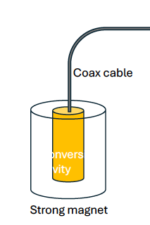
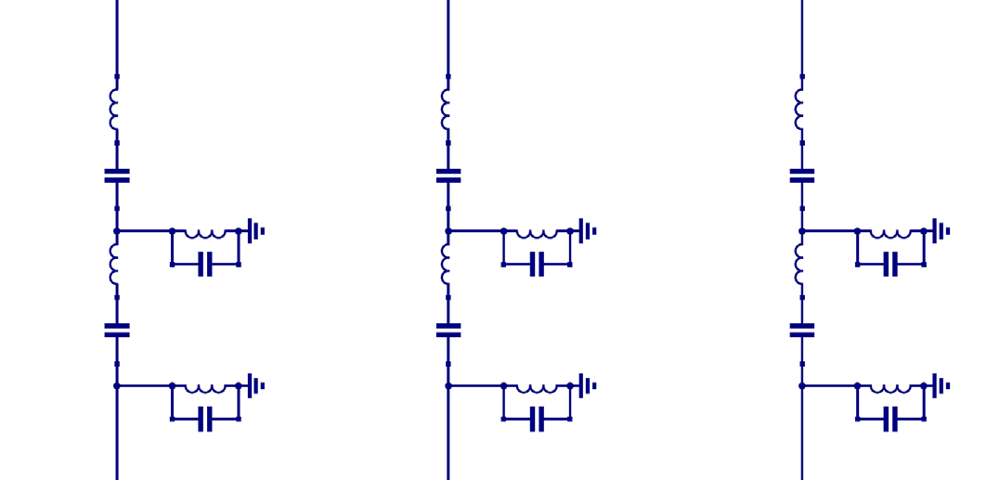

Signal Amplification and DAQ Computing
TIPFA Trento received the SQUID amplifier with post-amplification electronics and cables. These will be distributed to the University of Pisa and the University of Camerino to start the tests.
The characterization of noise and gain in a temperature range from mK to 4 K is planned for the autumn (4 K in Trento, mK in Pisa, 1 to 4 K in Camerino).
The University of Liverpool will design the magnetic shielding of the SQUID to be tested in Camerino in with a DC magnetic field.
TM,TE mode
Cavity
SQUID (MSA)
X
X
SQUID (MSA)
X
X
SQUID (MSA)
X
X
Cloud
ADC
FPGA
PC
Signal out
100MHz – 200MHz
Signal out
200MHz – 300MHz
Signal out
300MHz - …
DAQ based on MIDAS acquisition software under development
MIDAS is also being implemented on the QUAX@LNF experiment and in GravNet
Signal amplification based on parallel measurement of multiple cavity modes

Slide 15

COLD Lab

Slide 16
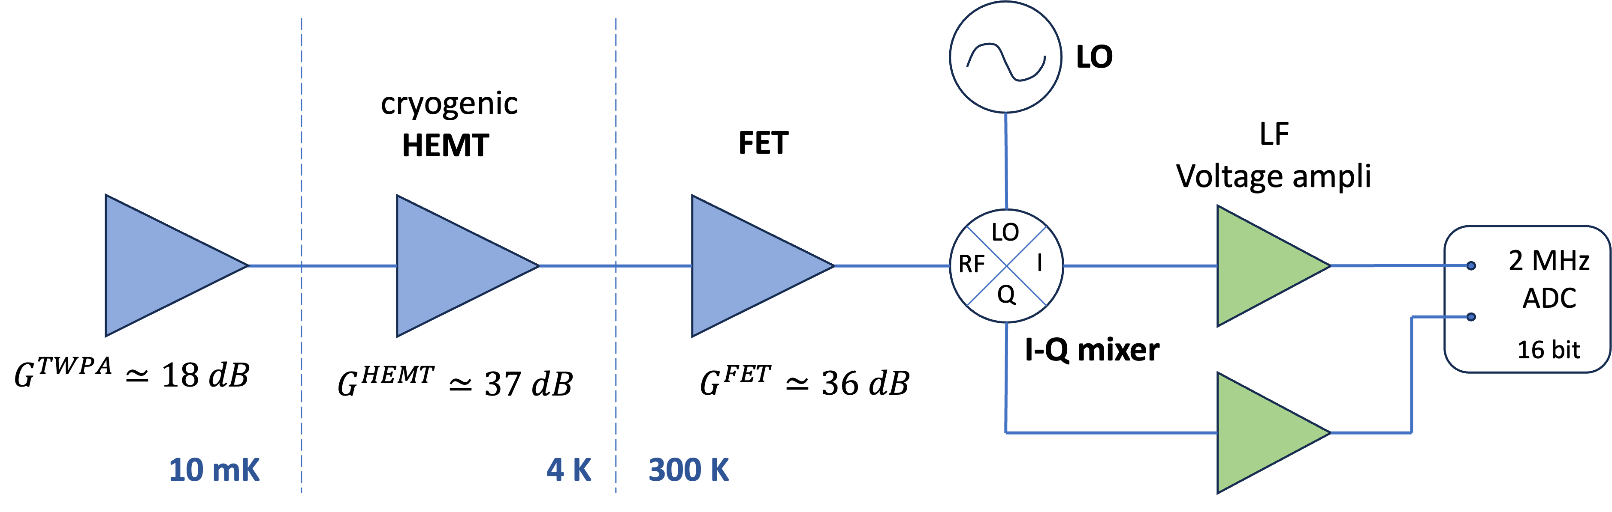
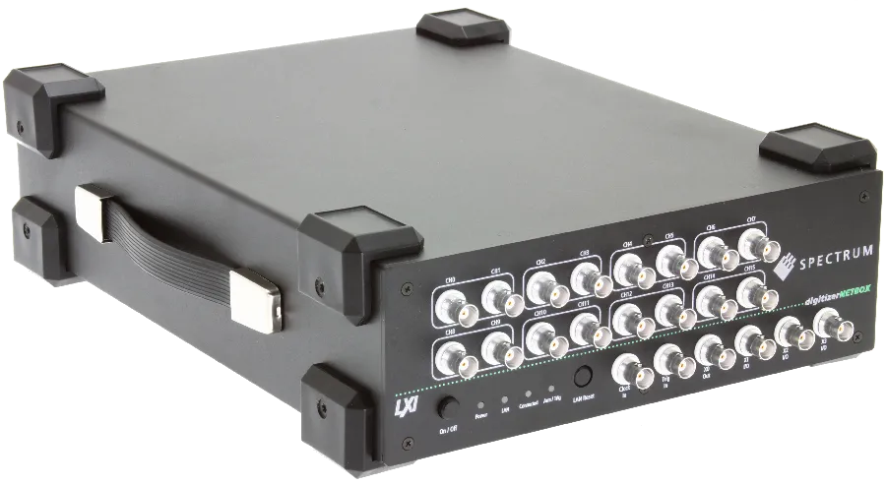
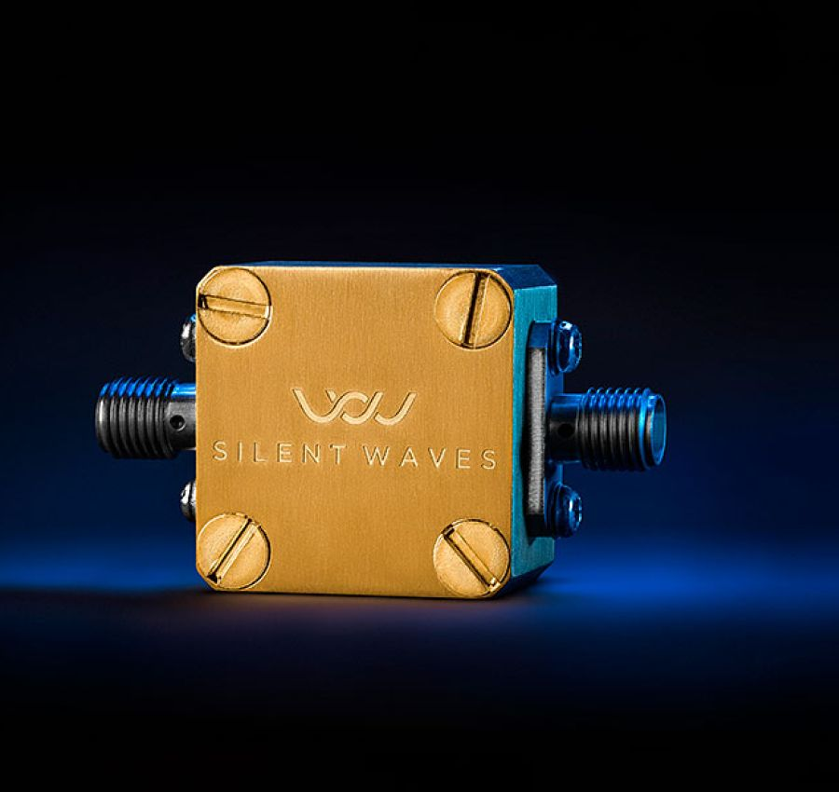
QUAX: Improvements Amplification chain
Coming soon:
New ADC
We placed an order for a new ADC model with larger bandwidth: NETBOX DN2.59x digitiser - (8 channels)
We placed an order for two TWPA amplifiers to cover the QUAX@LNF frequency region up to 9.5 GHz. Since the JPA from NIST was suffering from unexpected reflections.
We plan to carry out the next QUAX@LNF data acquisition in Fall 2025
Coming soon:
TWPA

Slide 17
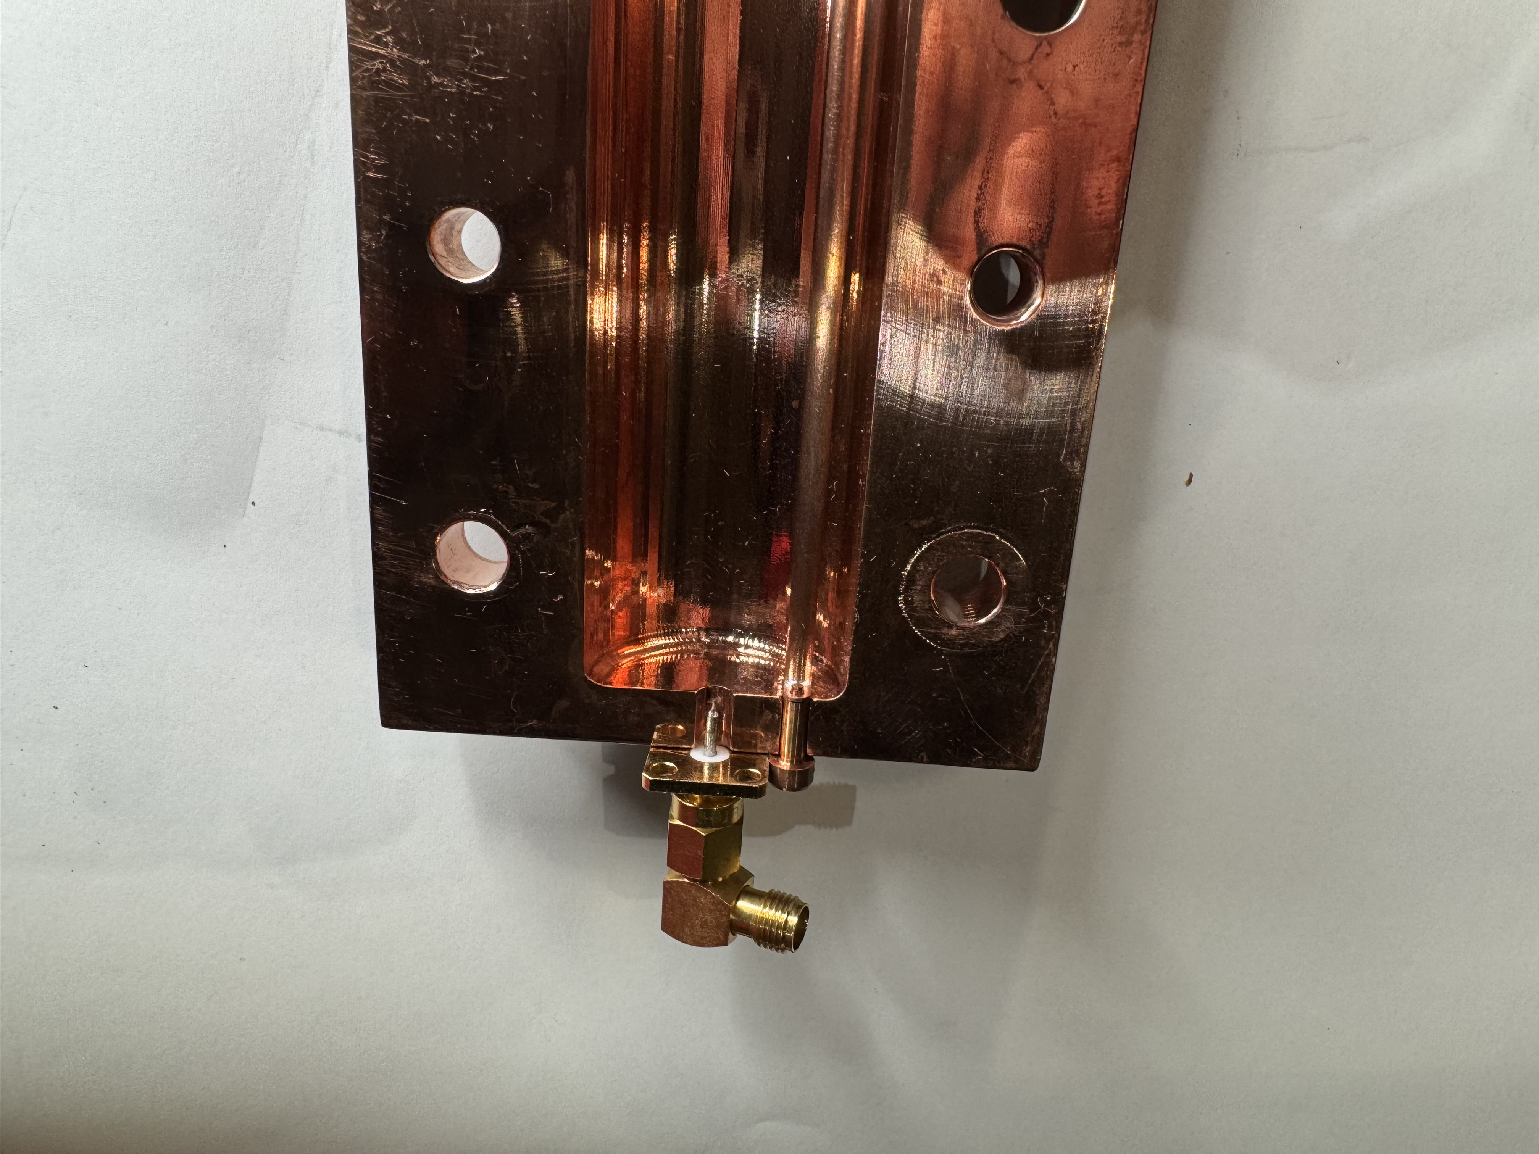
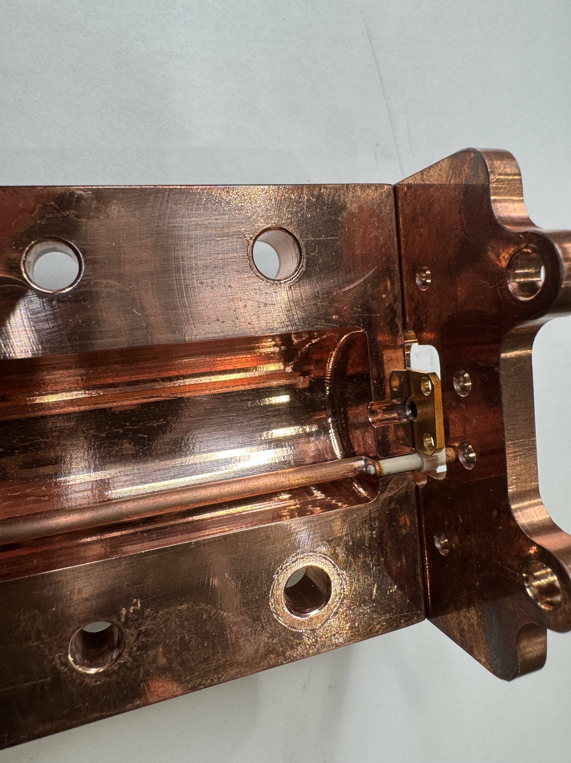
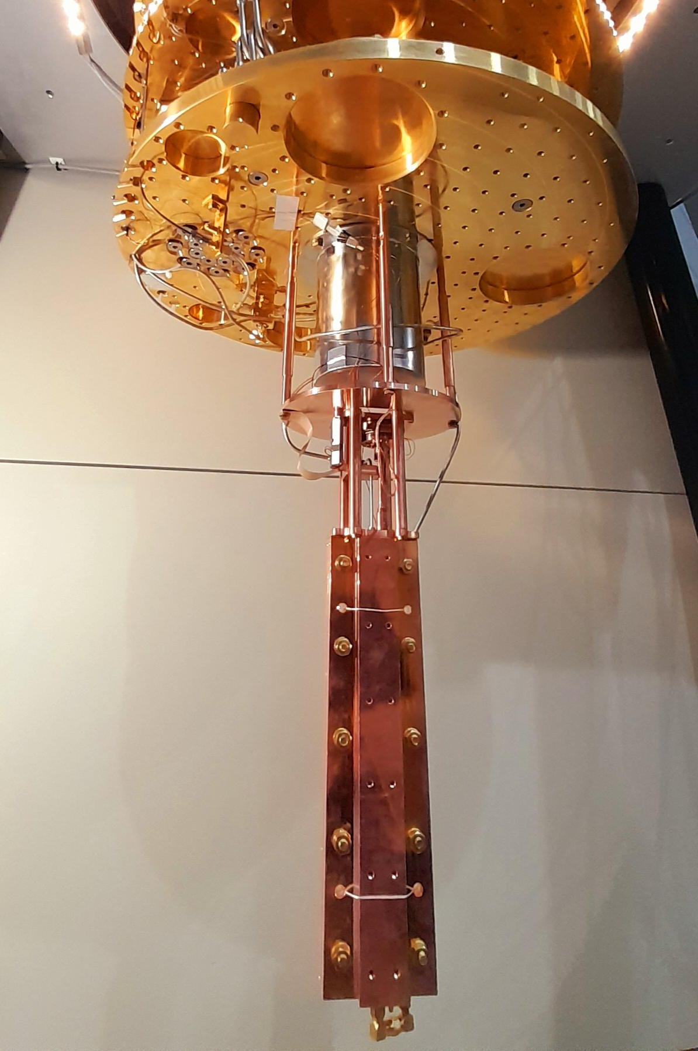
QUAX@LNF
HEMT
amplifier
Mixing Chamber
plate
Circulator
Mu metal + Al Shield
PEEK
Copper
2 piezo motors
Tuner
Tunable Antenna
A new tuner was made to improve the measurement stability (vibrations) and the cavity quality factor by reducing the losses of the previous tuner.
In April, test measurements were taken at 20 mK to verify the functioning of the system, without obtain the expected quality factor improvements.
We are investigating what was wrong with the new design.
Resonant cavity
Undercoupled antenna

Slide 18
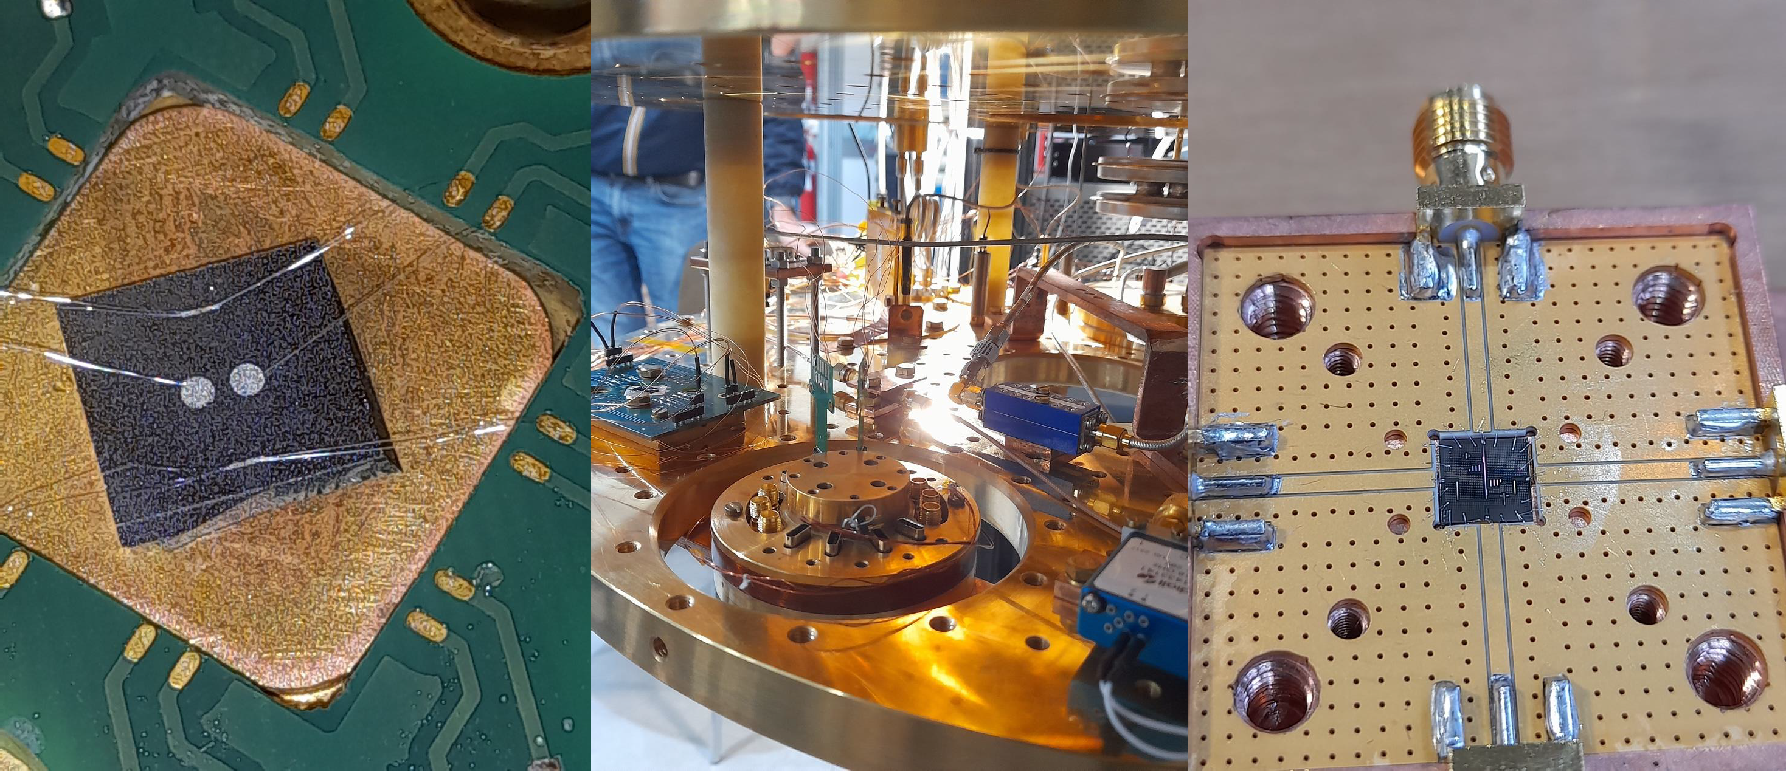

Quantum Devices

Slide 19

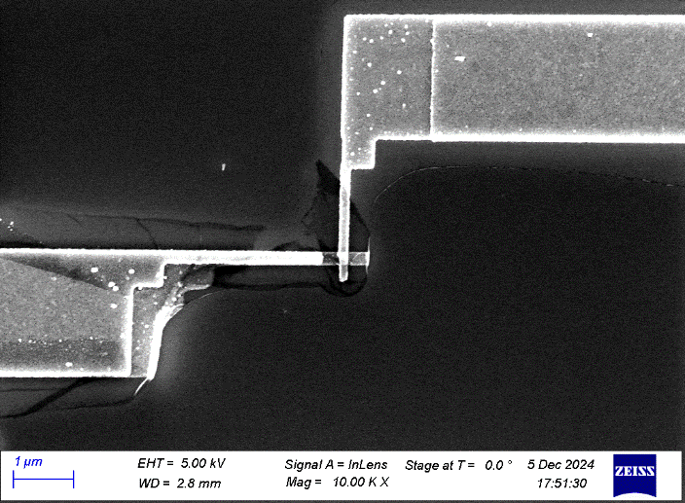
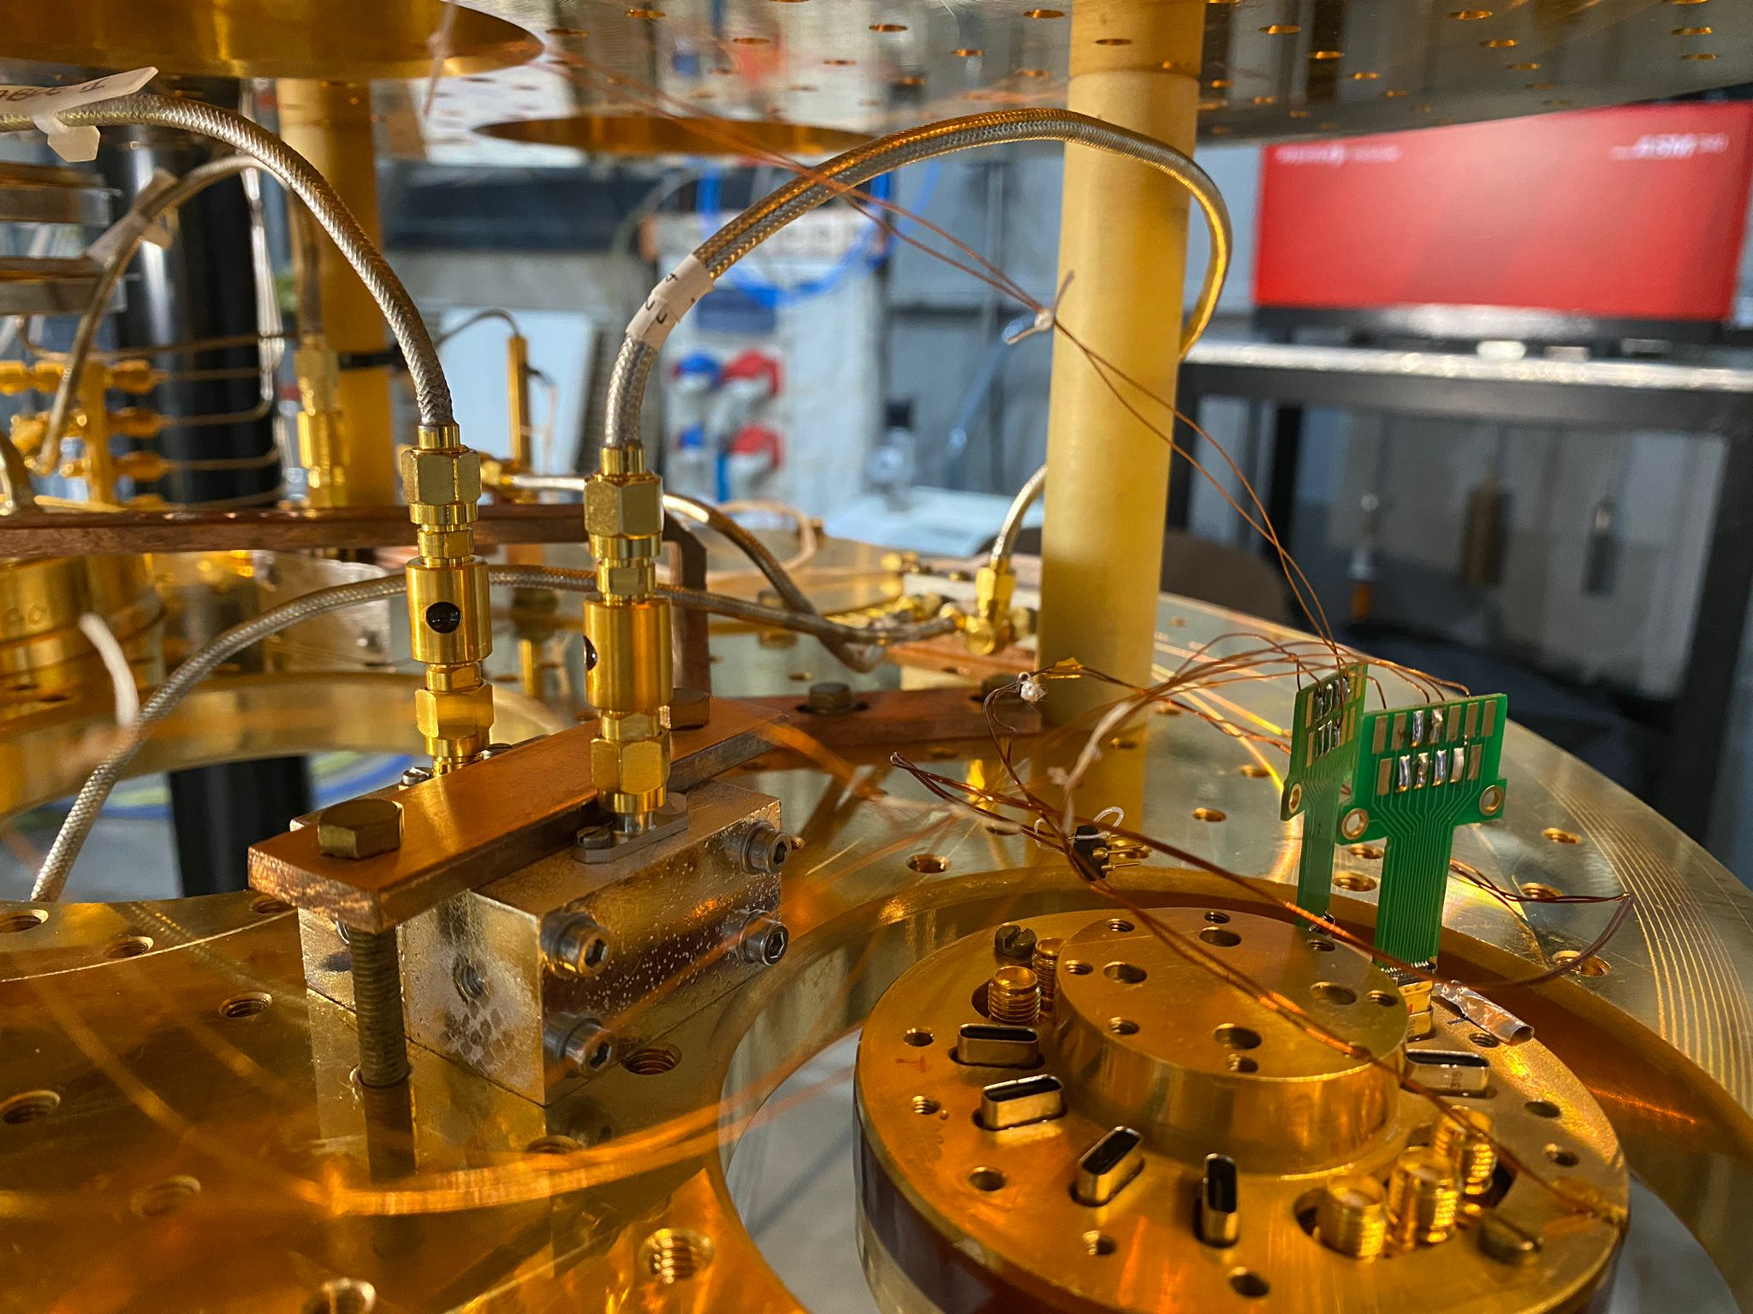

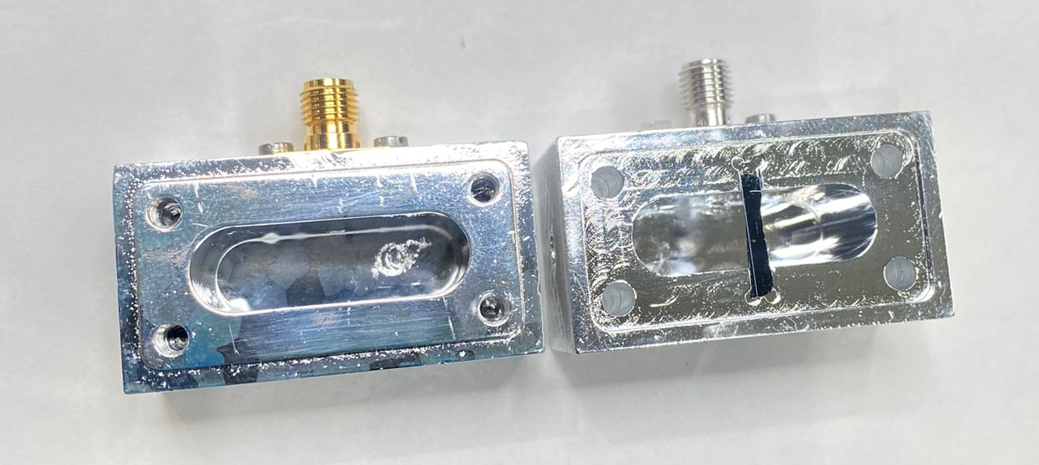




Results from First Fabrication of 3D Al Qubit
JJ Area:
216 x 148 nm²
Ic=20 nA
Qubit Spectroscopy
Our first 3D qubit fabricated at CNR-IFN in Rome shows descrete levels as expected with an anharmonicity of about 350 MHz
$$\frac{f_{03}}{2}$$
Transmission (S21)
Qubit drive Power (dbm)
$$\frac{f_{02}}{2}$$
$$f_{12}$$
$$f_{01}$$
Qubit drive frequency (GHz)
3D Transmon
CNR-IFN, INFN, MiB

Slide 20
Results from First Fabrication of 3D Al Qubit
JJ Area:
216 x 148 nm²
Ic=20 nA
The quality of the qubit must be improved. We were however able to detect and count single photons in the resonant cavity.
Number of photons in cavity
4 3 2 1 0
3D Transmon
CNR-IFN, INFN, MiB

Slide 21
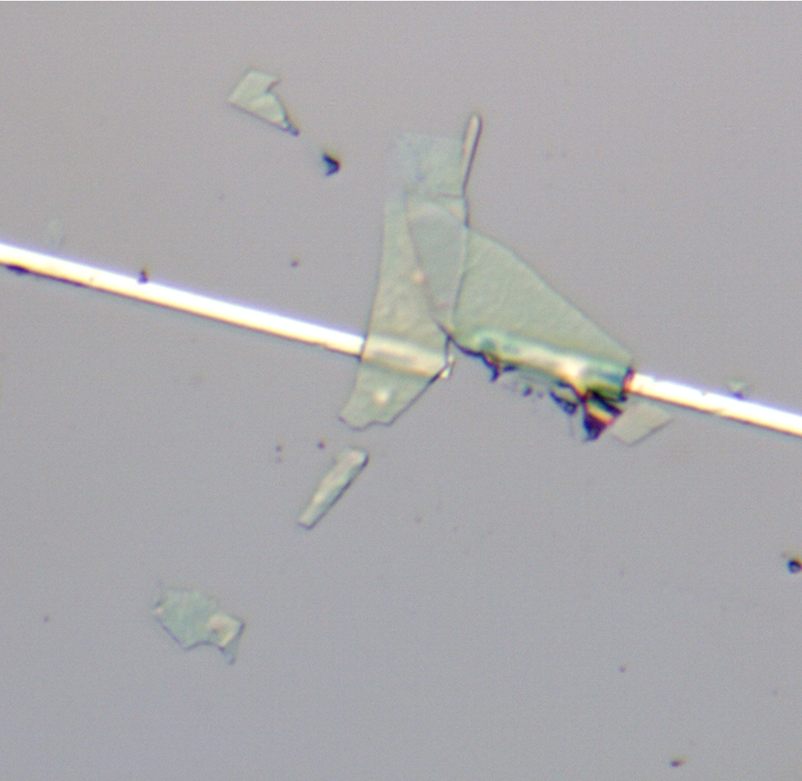
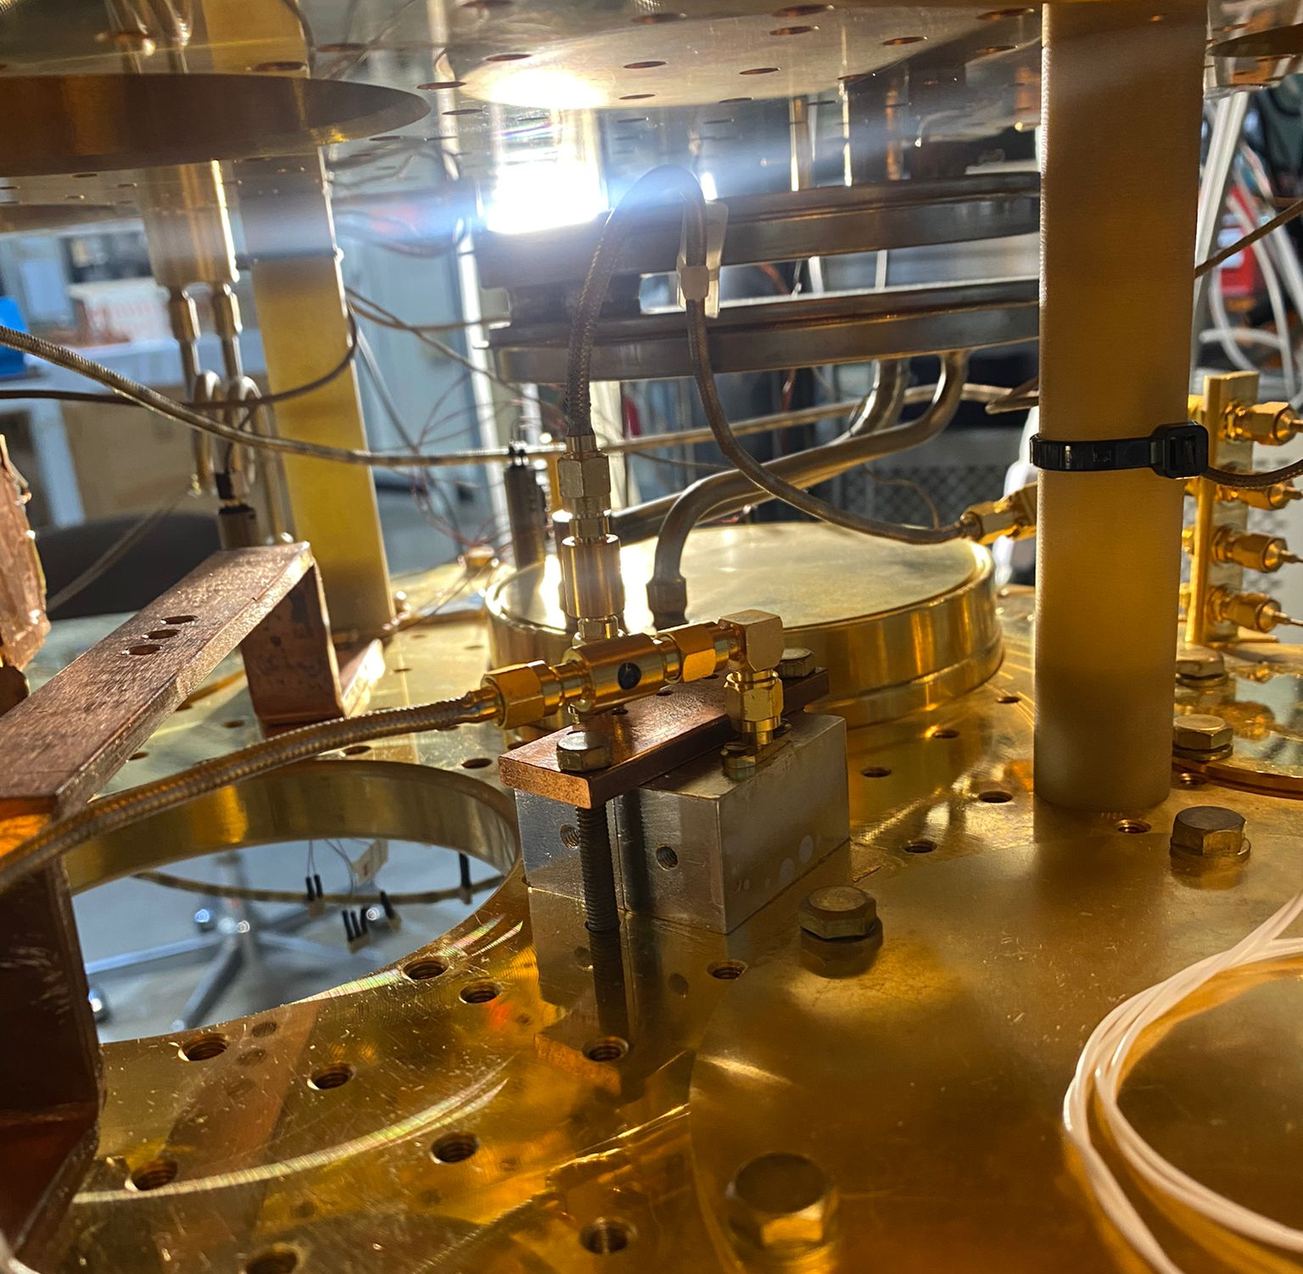

NbSe₂ 3D qubit
Principal Investigator: A. D’Elia (LNF INFN)

Slide 22
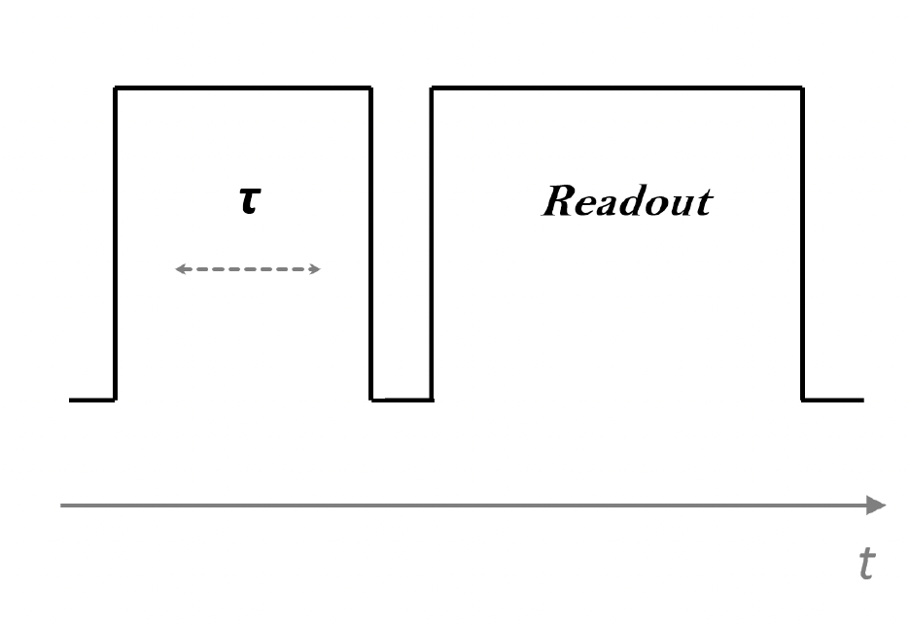
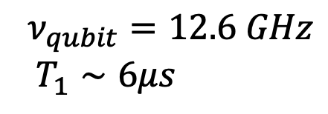
Rabi-Like Oscillation in NbSe₂ 3D qubit
$$ν_{qubit}=12.6 GHz$$
$T_{1}∼6μs$
More details from A. D’Elia during closed sessions
Principal Investigator: A. D’Elia (LNF INFN)

Slide 23
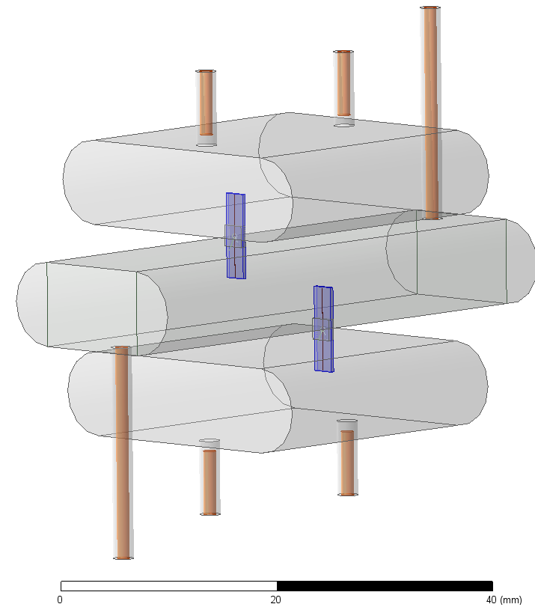


Two Qubits Detector
Readout Cavity 2
Storage Cavity
Qubits
Readout Cavity 1
We have completed the design of the two-qubit detector
INFN-LNL has completed the mechanical design and started fabrication of the pure aluminum triple cavity.

Slide 24
Conclusions
FLASH
The decommissioning of the FINUDA detector is in progress in order to make the magnet available for the FLASH experiment. We foresee this complex process to be completed by the end of 2025. In the meantime, the design studies for the FLASH TDR are running at full speed
QUAX
We foresee a QUAX@LNF scan of 50 MHz at 8.8 GHz in the Fall of 2025.
Quantum Devices
The development of quantum devices, in particular a two-qubit detector, is ongoing, and the mechanical design of the aluminum triple cavity has been completed.
COLD LAB
We are about to expand the COLD lab, to host two new cryostats

Slide 25
GravNet Budget
Total ERC funds at INFN 3.75 Meuro:
0.5 Meuro INFN Overhead
0.25 Meuro LNF Overhead
0.5 Meuro from timesheet
0.7 Meuro for recruitment
1.5 Meuro full capitalized costs (fo FLASH detector)
0.25 Meuro consumables
0.05 Meuro travel + audit.
Expected costs:
FLASH 1.8 Meuro
FINUDA Magnet cryogenics 50 keuro
FINUDA Decommissioning 50 keuro
Travel 50 keuro
Contracts 0.7 Meuro
PhD 70 keuro
Quantum Sensing (COLD Lab) 200 keuro
Audit 30 keuro
Additionally:
DAFNE Cryogenics Refurbishment (with LNF overheads)

