Slide 1
DAFNE: Future plans
A. Gallo for the DAFNE Accelerator Team
The DAFNE Team:
C. Milardi, D. Alesini, S. Bilanishvili, S. Bini, M. Boscolo, B. Buonomo, S. Cantarella, A. Ciarma, A. De Santis, E. Di Pasquale, D. Di Giovenale, C. Di Giulio, G. Di Pirro, L. Foggetta, G. Franzini, A. Gallo, R. Gargana, S. Incremona, A. Liedl, A. Michelotti, L. Pellegrino, L. Piersanti, D. Quartullo, R. Ricci, U. Rotundo, S. Spampinati, A. Stella, A. Vannozzi, M. Zobov
LNF – INFN Frascati, Italy
Contributions from:
O. R. Blanco-García, ALBA, Spain; G. Broggi, Univ. Roma “La Sapienza”, INFN LNF & CERN; O. Etisken Kirikalle University, Turkey; J. Chavanne, G. Le Bec, ESRF, Grenoble, France; P. Raimondi, Fermilab, US.
69th Scientific Committee Meeting, May 14-15 2025

Slide 2
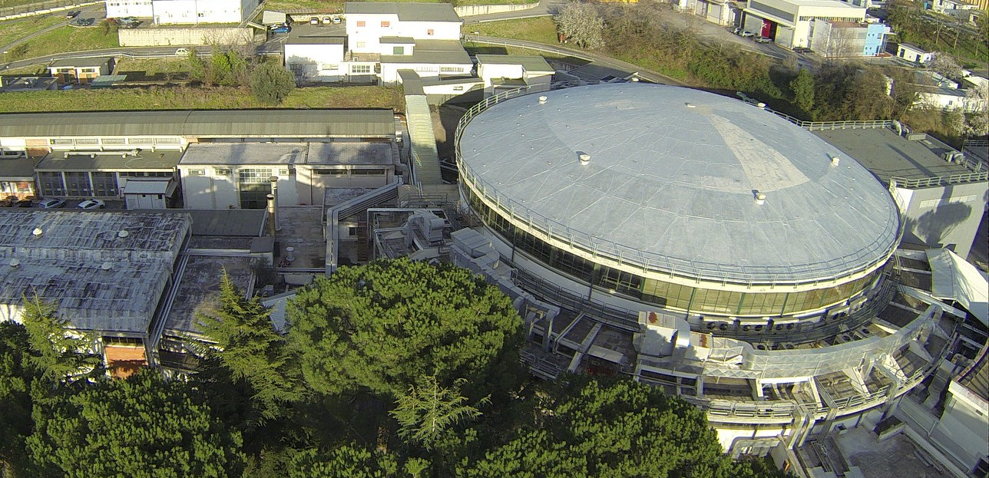
A. Gallo - DAFNE: Future plans
Summary
Introduction: goal of the presentation, historical remarks, premises
Present situation: machine status, scientific proposals already defined (EXKALIBUR), possible continuation of DAFNE-LUCE activity, running costs.
The roadmap for the preparation of a complete scientific program to exploit DAFNE as Test Facility of future lepton colliders.
Consolidation update (for a medium-term program, not including the specific needs of an FCC_ee oriented R&D facility) in the context of the present and future LNF initiatives
Conclusions
2
69th Scientific Committee Meeting, May 14-15 2025

Slide 3
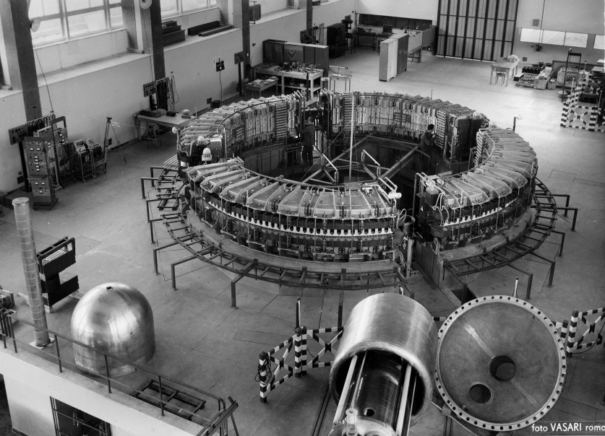
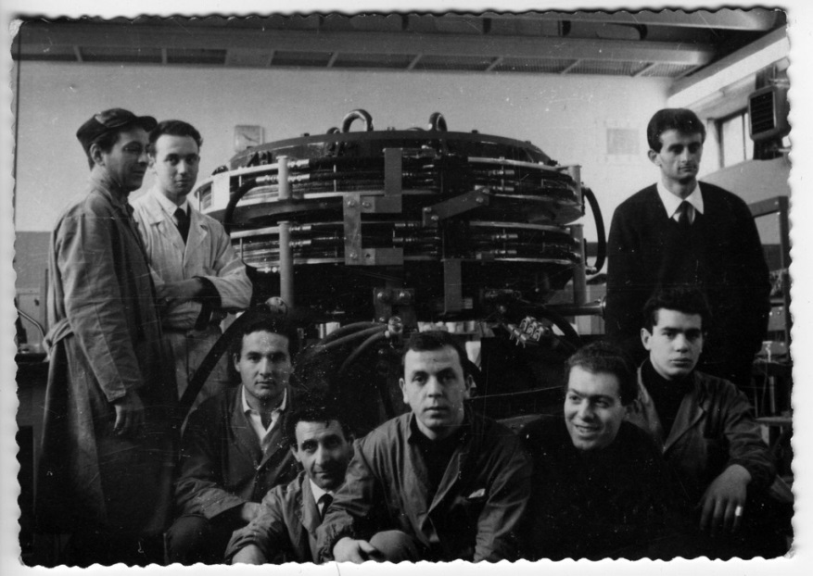
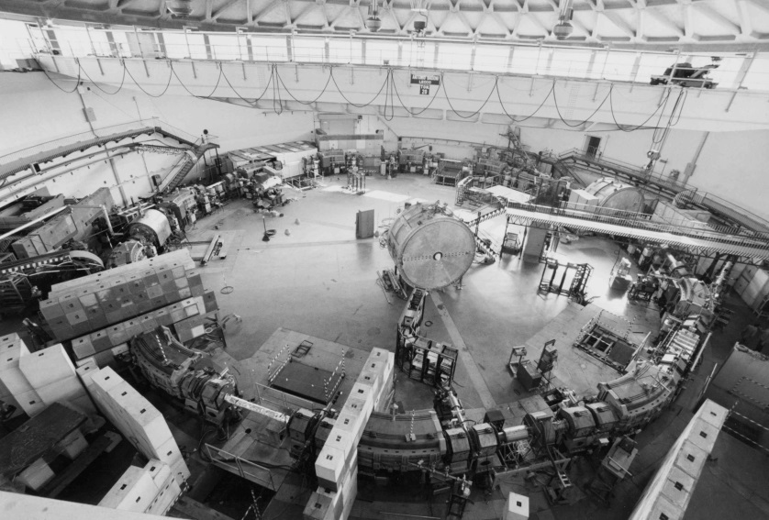
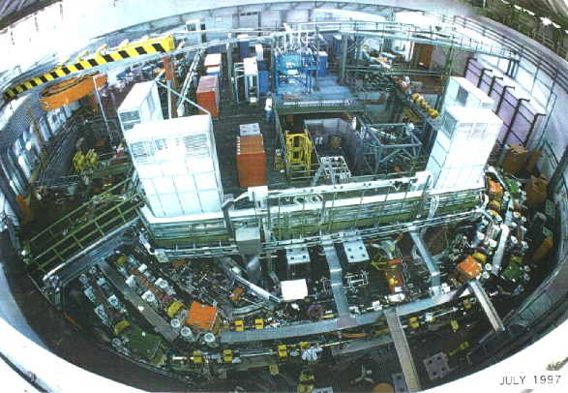
A. Gallo - DAFNE: Future plans
Particle accelerators have always been at the core of the INFN Frascati Labs!
LNF is born historically as a HEP accelerator based Lab for users from the sub-atomic and nuclear physics community. In the second-half of the past century this has been the exclusive mission of the Lab
This is a slide I typically show in any presentation for general public, students or scientific event welcome.
It is intended to remark how central and identitary for the Lab is the history and the heritage of its circular accelerators devoted to fundamental physics
Electro-synchrotron, 1959
ADA, 1961
ADONE, 1969
DAΦNE, 1997-today
3
63rd Scientific Committee Meeting, May 16-17 2022

Slide 4
A. Gallo - DAFNE: Future plans
Premises
DAFNE construction has been approved by INFN in 1990. In late 1993 the ADONE operation was terminated, and the machine decommissioning began. The DAFNE injector complex (Linac + Damping Ring) was completed in 1996, while the collider rings were completed in 1997. The collider commissioning with temporary interaction regions was completed in about 1 year, and the KLOE detector rolled-in in 1999.
Since then, the machine has been kept constantly in operation alternating data-taking runs with shutdown periods of different duration depending on the specific activities planned (ordinary maintenance, experiment changeover, major maintenance and/or machine modification/upgrade).
Hardware upgrades over the machine lifetime were very limited, and mostly concentrated in the IRs. The most noticeable one was the installation of a new IR1 in 2007 to implement the crabbed waist concept. The wiggler pole profiles were also shimmed to increase field uniformity and decrease the coil excitation currents.
Apart from the mentioned modifications + some other upgrades/updates in selected sub-systems, the bulk of the machine (vacuum chambers, magnets, major power supplies, RF power plants, FBK kickers …) is still made by the original hardware.
The SIDDHARTA-2 run was successfully completed (beyond the experiment request!) thanks to the machine staff best effort to keep going all necessary sub-systems, but we are aware that some of them are at risk of causing fatal stops in case of a major fault (for instance: the main ring RF klystrons).
4
69th Scientific Committee Meeting, May 14-15 2025

Slide 5
A. Gallo: DAFNE beyond the SIDDHARTA-2 run
Scientific Committee Requests
from 68th LNF Sci-Com Findings & Recommendations:
The committee encourages the DAΦNE team, in collaboration with the CERN FCC-ee project team, to identify and prioritize a set of activities and tests, to be conducted at the collider (or its complex), that could be validate models, concepts, hardware choices considered for FCC-ee.
Feasibility, possible timelines and resources requirements should be evaluated.
Compatibility with physics operation should be assessed.
We suggest involving the younger members of the DAΦNE team in this process as they are expected to implement it.
An analysis of the necessary maintenance and consolidation of the DAΦNE complex should be conducted and possible descoping options identified with the associated risks. The result of the above work should be presented at the next SC to allow sufficient time for decisions, preparation and implementation.
Work in progress. Not mature enough for a plenary presentation, a roadmap is outlined and presented here
Lacking a specific and detailed plan only a generic consolidation scenario can be sketched and presented here, based on the preservation of the machine performances of the last run over a medium-term time frame.
5
69th Scientific Committee Meeting, May 14-15 2025

Slide 6
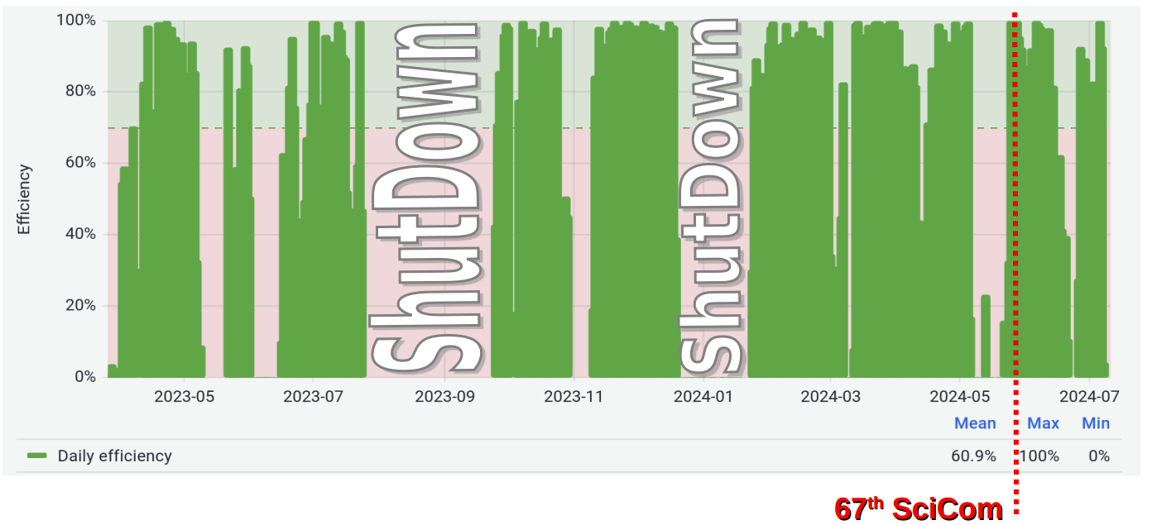
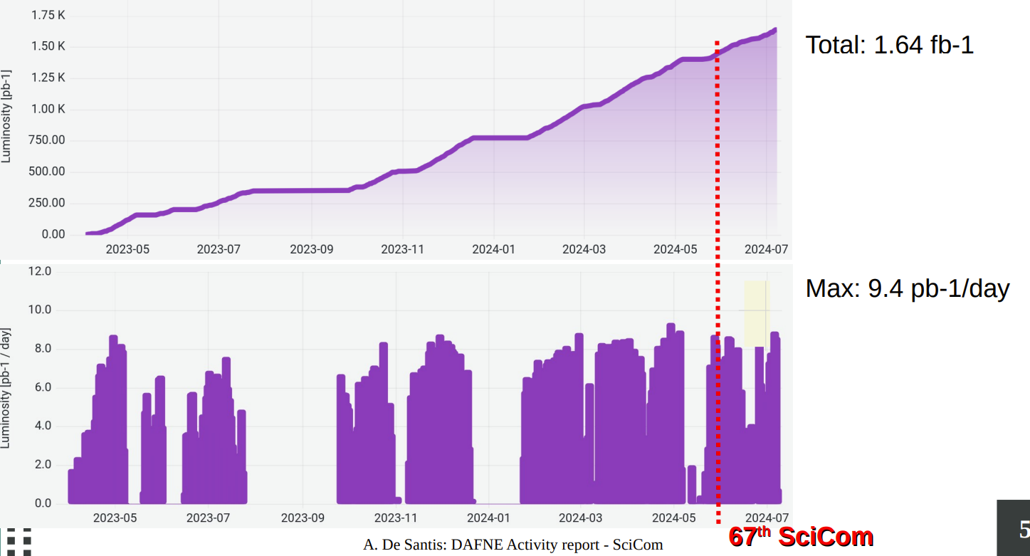
A. Gallo - DAFNE: Future plans
DAFNE present status and future proposals
DAFNE Efficiency over the last 16 months of operation for SIDDHARTA-2
The SIDDHARTA-2 run has been successfully concluded in summer 2024, thanks to the considerable effort of the DAFNE team lead by C. Milardi. The run trend and results demonstrated that the collider and most of its hardware are still exploitable for scientific programs.
Total: 1.64 fb⁻¹
Courtesy of C. Milardi & A. De Santis
However, some components are at end of life, or obsolete, or unmaintainable. Each of them represents a single-point-of-failure and no credible/reliable scientific medium-term programs can be proposed in absence of a consolidation/mitigation plan to remove the weak points and reduce the machine vulnerability. Costs, timescale, manpower and compatibility with already assessed LNF scientific plans are also crucial aspects to be considered.
Max: 9.4 pb⁻¹/day
6
69th Scientific Committee Meeting, May 14-15 2025

Slide 7
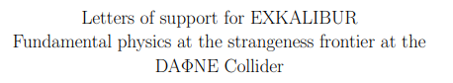
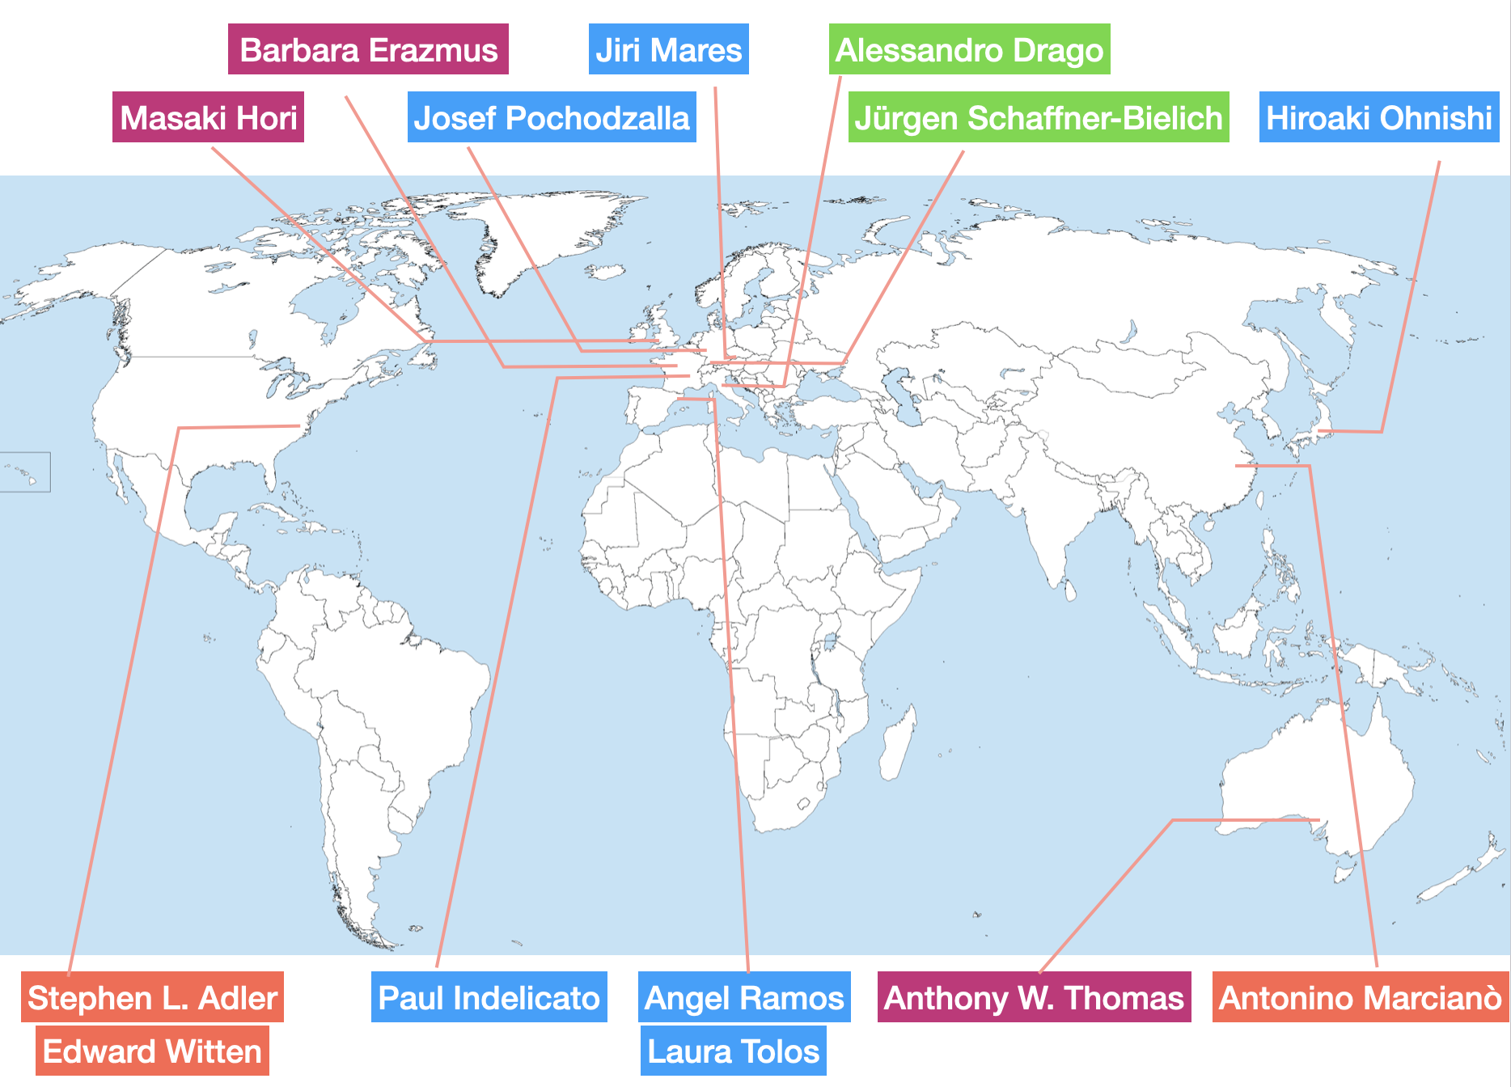
A. Gallo - DAFNE: Future plans
EXKALIBUR – A future plans beyond SIDDHARTA-2
EXtensive
Kaonic
Atoms research: from
LIthium and
Beryllium to
URanium
proposal to perform fundamental physics at the strangeness frontier at DAFNE
for a 3-years period (post-SIDDHARTA-2)
- already presented at 62nd LNF Scientific Committee Meeting, November 8, 2021
EXKALIBUR proposes to conduct a series of unique kaonic atom measurements with a total integrated luminosity ranging from approximately 600 (but also 400) pb to 1500 pb. It is a feasible, comprehensive scientific program that can be executed modularly (i.e., over a few months each year) in the next 2-3 years, becoming a global reference for research on strangeness.
To be underlined that the program is elastic, and one can extend it from 400 pb to more than 1000, in various runs periods; we are available for discussions and reschedule our plans function of machine and beam time availability.
Courtesy of C. Curceanu
EXKALIBUR
7
69th Scientific Committee Meeting, May 14-15 2025

Slide 8
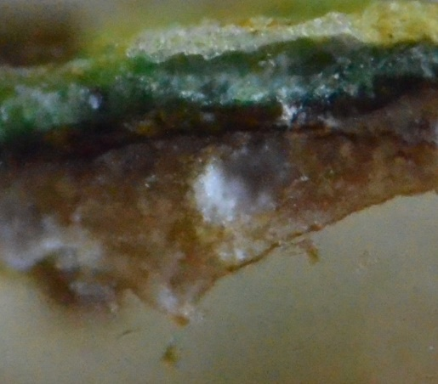
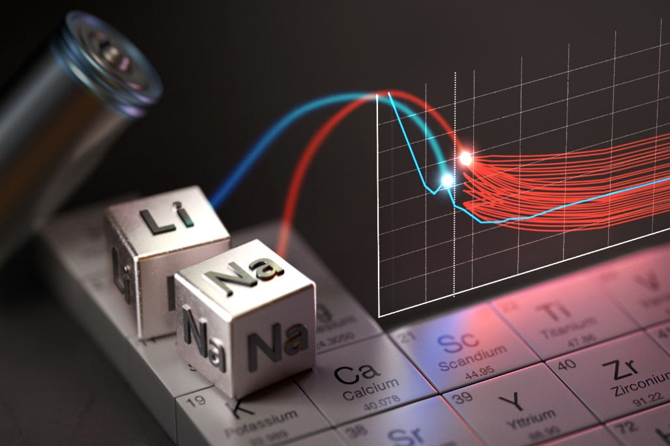
A. Gallo - DAFNE: Future plans
Perspectives of the DAFNE-Light facility
Courtesy of A. Balerna
Due to the DAFNE shutdown the facility is still opening to users 2 calls/ years for proposals using IR and X ray conventional sources. Fast proposals and tests, that can be rapidly perfomed, can be submitted during the whole year and if accepted are performed as soon as possible taking into account the ongoing activities. The brigthness and countinuous photon energy range achievable with DAFNE CANNOT be substituted with any conventional source!
IR (FTIR) and XAFS soft-Xray beamlines available in European SR sources are relatively few and always over-booked, leaving a wide space for potential users at DAFNE .
If there will be in the future the possibility to restart using DAFNE with stable beam conditions according to a precise time-schedule, then DAFNE-Light would be pleased to re-open dedicated calls for proposals.
At the soft X-ray beamline we received requests of information on the possibility to perform measurements at the sodium and magnesium K edge on new batteries. Due to the shortage of the lithium element potential alternatives can be sodium ion batteries (SIB) and magnesium ion batteries (MIB).
Lithium-ion batteries are experiencing supply shortages and price volatility which makes studies on alternatives very urgent. The requested kind of measurements can be done only using synchrotron radiation!
There is at the moment a really huge number of EU projects in this field due to its importance - if in the near future there will be the possibility to use again the DAΦNE SR beam from a scientific point of view it would be really great.
https://news.stanford.edu/stories/2025/01/sodium-ion-batteries-need-breakthroughs-to-compete
100 μm
Some very thin sections of paintings needed to achieve information on the the very complex multi-layered structure of paintings need to be studied using FTIR and SR.
8
69th Scientific Committee Meeting, May 14-15 2025

Slide 9
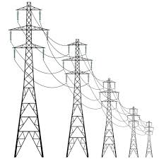


A. Gallo - DAFNE: Future plans
DAFNE running costs and manpower
ELECTRIC POWER CONSUPTION:
The electric power absorption by the whole DAFNE complex in the SIDDHARTA2 run configuration was 2,95 MW
At the present energy cost of the LNF provider the run energy bill is therefore ≈ 450 k€/month
MANPOWER:
DAFNE run requires 4 operators in shift 24/7. The 4-operators group can run the BTF facility in parallel, while the operation of BTF alone requires 2 operators. The DAFNE run therefore needs ≈ 24 FTE from the shifters. Then it fully commits the facility responsible, 1 run coordinator and requires scientific and technical assistance from the staff and the services of the Accelerator and Technical Divisions. A prudent estimate brings the total manpower required for run support to ≈ 30 FTE
ORDINARY MAINTENANCE:
Because of the uncertainty on the collider future activity, the ordinary maintenance has been reduced significantly during the last SIDDHARTA2 runs. In the previous years the collider ordinary maintenance absorbed about 1/3rd of the Accelerator Division annual budget corresponding to an average expense of ≈ 300 k€/year
9
69th Scientific Committee Meeting, May 14-15 2025

Slide 10
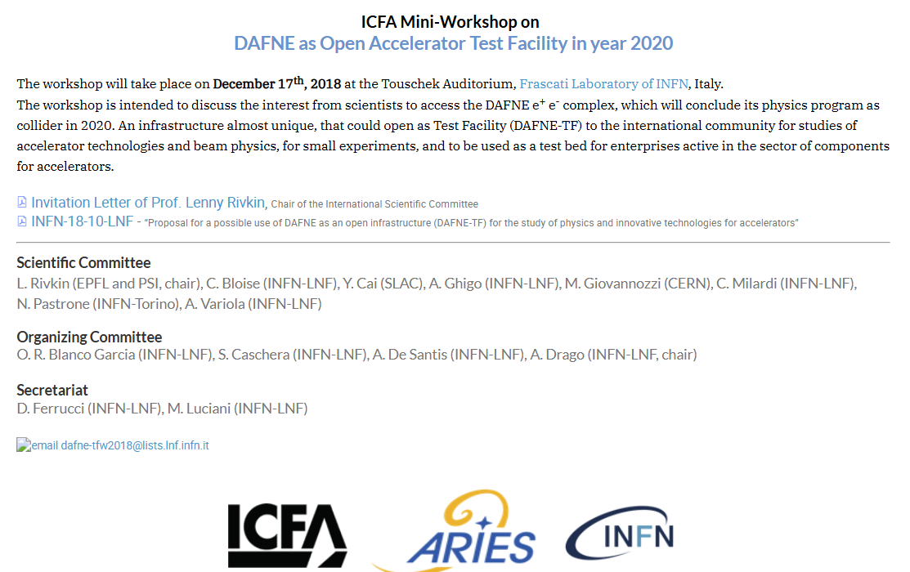
A. Gallo - DAFNE: Future plans
DAFNE as a Test Facility for future collider
A roadmap toward an accelerator physics measurement program
The idea of using DAFNE as a Test Facility for future collider, eventually in combination with an extension of the operation for fundamental physics users, is not so recent. It has been the object of formal and informal discussions culminated in a dedicated workshop held at LNF in the pre-COVID era (December 17th 2018).
Discussions have been always very rich of suggestions and alive, but mostly limited to the brainstorming phase.
While approaching the end of the SIDDHARTA2 run the evolution of brainstorming material into a structured comprehensive measurement plan became a clear task for our collider physics team.
https://agenda.infn.it/event/16334/page/2177-program-timetable
10
69th Scientific Committee Meeting, May 14-15 2025

Slide 11
A. Gallo - DAFNE: Future plans
DAFNE as a Test Facility for future collider
COLLIDER MODE
  Collision dedicated
  Collision monochromatization, study the possibility to use PM steering magnets.
  Interplay between Beam - Beam and FBK systems by using a calibrated and tunable source of noise
  Collision time-sharing
  Validation of eCloud and Ion Trapping code [CERN: Metter]
  Mitigation of eCloud [CERN: Kersevan]
  Background simulation code [CERN: Broggi/Redaelli]
HIGH IMPACT ACTIVITY
NEVER TESTED
Compatible with Physics operations (e.g. EXKALIBUR)
Devisable in short runs (few months)
Collider was ready. Activity-driven consolidation needed
CERN peoples interested
Optics studies for monochromatizion are not yet conclusive
11
69th Scientific Committee Meeting, May 14-15 2025

Slide 12
A. Gallo - DAFNE: Future plans
DAFNE as a Test Facility for future collider
STORAGE RING MODE
  Dedicated beam with additional equipments/diagnostics:
  Longitudinal injection [Dutheil]
  Crystal collimation with leptons [Redaelli]
  Additional options:
  Photo-electron emission measurements
  Dust injection to test SBL check dust injector
HIGH IMPACT ACTIVITY NEVER TESTED
Activity planning
Circular Collider experts will contribute to a dedicated team coordinated by A. De Santis to work out the proposal according to the guidelines already given by the Sci. Com.
Regular meeting are planned in order to discuss and revise every single item for the proposal
“Draft” version of the “white paper” should be ready for the 70th Sci Com Meeting in November
12
69th Scientific Committee Meeting, May 14-15 2025

Slide 13
A. Gallo - DAFNE: Future plans
DAFNE as a Test Facility for future collider
The list of the proposed measurements is very long and rich. To elaborate a program each different experiment should be studied and evaluated regarding:
Relevance - How much the specific study is related to critical aspects of the future colliders
Scalability - Are the results of the DAFNE measurement scalable to energies and dimensions 3 orders of magnitude larger?
Priority – Urgency of the measurement for the future collider design
Feasibility
Implementation aspects – What is needed on the machine and its controls to perform the measurement, including manpower
Time duration
Global costs – Including required machine modifications and cost of the run
The involvement of international collaborators and institutions, primarily the CERN, for the preparation of the collider physics measurements proposal is crucial. Collaboration agreements and MoUs with international partners must be promoted to sustain the effort. Potential collaborators have to be therefore involved since the beginning of this project.
13
69th Scientific Committee Meeting, May 14-15 2025

Slide 14
A. Gallo - DAFNE: Future plans
Consolidation: electron accelerators of the DAFNE era
DAFNE has represented the backbone of LNF activity for a quarter of century and today is a well exploited scientific investment.
Most of the lepton accelerators of the DAFNE era (colliders or synchrotron radiation sources) have been either stopped or renewed for lifetime extension.
Only one B-factory survived (SUPERKEKB), a new tau-charm factory project (SCTF) is waiting for approval in China, the Russian colliders at lower energy are still in operation.
Essentially all synchrotron radiation sources are moving from 3rd to 4th generation (ESRF was the first one to complete the transition).
14
69th Scientific Committee Meeting, May 14-15 2025

Slide 15
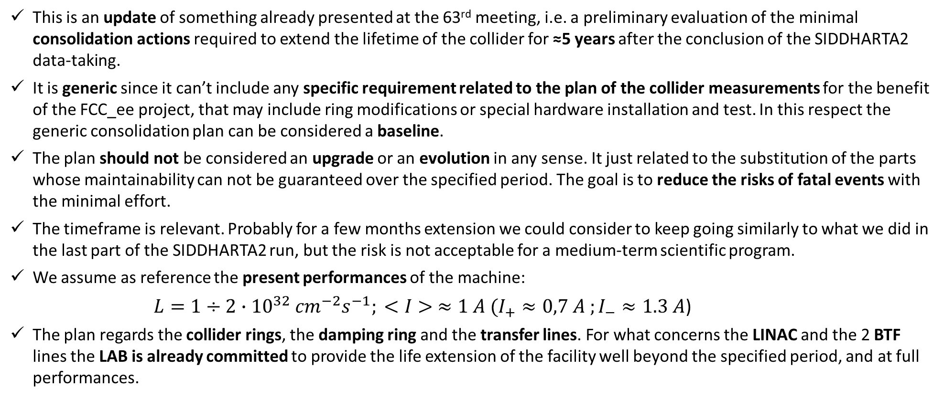
A. Gallo - DAFNE: Future plans
Generic DAFNE consolidation plan
minimal needs for an operation extension of ≈5 years
This is an update of something already presented at the 63rd meeting, i.e. a preliminary evaluation of the minimal consolidation actions required to extend the lifetime of the collider for ≈5 years after the conclusion of the SIDDHARTA2 data-taking.
It is generic since it can’t include any specific requirement related to the plan of the collider measurements for the benefit of the FCC_ee project, that may include ring modifications or special hardware installation and test. In this respect the generic consolidation plan can be considered a baseline.
The plan should not be considered an upgrade or an evolution in any sense. It just related to the substitution of the parts whose maintainability can not be guaranteed over the specified period. The goal is to reduce the risks of fatal events with the minimal effort.
The timeframe is relevant. Probably for a few months extension we could consider to keep going similarly to what we did in the last part of the SIDDHARTA2 run, but the risk is not acceptable for a medium-term scientific program.
We assume as reference the present performances of the machine:
$L=1÷2∙{10}^{32}$ ${cm}^{−2}s^{−1}; <I> ≈1 A (I_{+}≈0,7 A ;I_{−}≈1.3 A$)
The plan regards the collider rings, the damping ring and the transfer lines. For what concerns the LINAC and the 2 BTF lines the LAB is already committed to provide the life extension of the facility well beyond the specified period, and at full performances.
15
69th Scientific Committee Meeting, May 14-15 2025

Slide 16
A. Gallo - DAFNE: Future plans
MAGNETS: General Considerations
Most of magnet power supplies have been in operation for ≈25 years. The present fault rate can not be assumed to remain constant over a long time scale, more realistically it is expected to grow rapidly.
The providers (mainly OCEM e Danfysik) do not produce, support and provide spares of most of the inside power devices and electronic boards. The only fully reliable approach would be a complete substitution of these machines.
The presented estimate is based on a compromise: we propose to replace ≈25% of these power supplies, using the removed machines as spare parts reserve for the other old ones left in operation.
This approach does not ensure 100% of reliability, but is expected to strongly reduce the probability of fatal consequences (show stop) of some unavoidable faults.
Transfer line pulsed magnets (TT01 e TT02) are powered by special power supplies characterized by peculiar topology, specific rise time, pulse shape and interface vs. the machine timing systems. These are really custom products that can not be found "on shelf". The estimate cost of maintenance for these machines is very preliminary and rough, it will require weeks to be elaborated more reliably together with potential suppliers.
On the 25% of new machines the control system interface would mandatory migrates from serial RS485 to Ethernet. This is expected to produce a major workload impact on the Control System group.
On the base of the current settings, the main rings quadrupole and sextupole new power supplies can be underspecified (300A and 200 A respectively) with respect to the existing ones (585 A and 336 A). This approach needs to be validated by the lattice group.
Courtesy of A. Vannozzi & F. Iungo
16
69th Scientific Committee Meeting, May 14-15 2025

Slide 17
A. Gallo - DAFNE: Future plans
MAGNETS
Courtesy of A. Vannozzi & F. Iungo
This scenario foresees the substitution of almost 25% of the current PSs aiming to reduce the possible definitive machine shut-down. Only a full PSs substitution could guarantee full machine performance, but 25% renewal would allow using dismissed PSs as spare part reserve.
For the pulsed TT transfer line PS, it is necessary a deeper review with the companies to define a proper price (these are not PS “off the shelf”).
Not included in the Table 2 spare coils for 2° injection septa (estimated value ≈5 k€)
The operation of some essential power supplies (including the wiggler ones) relies on the in-house spare parts that are not available on the market anymore. These are a risk factor that should be taken into consideration.
Extimated time: The material procurement will need more or less 12/16 months. Installation time: 4-6 months. PS commissioning: 1-2 months.
Manpower: this activity will saturate all the manpower of the service. Currently it would not be possible a compatibility with other activities (EuPraxia above all). Therefore it would require at least 2 extra technicians in the magnet group.
17
69th Scientific Committee Meeting, May 14-15 2025

Slide 18
A. Gallo - DAFNE: Future plans
CONTROL SYSTEM
Many components of the DAFNE Control System are End Of Life (EOL), meaning no support and spare parts available on the market.
The general philosophy of the operation extension is therefore:
  Buy spare parts for 5 years wherever available before they expire;
  Redesign and reassemble the systems whose components are not available anymore already today (for instance all subsystems based on VME standard bus).
  Transition to EPICS!
The ≈75% of magnet power supplies preserved (see magnet slides) will require in any case a new “retrofit” interface box toward the Control System to fix a nasty unsolved communication problem.
Manpower needed: 2 expert software developers + 1 IT systems engineer fully dedicated for 1 year, with the machine complex operation stopped (but compatible with the operation of the LINAC/BTF facility).
Courtesy of A. Michelotti & A. Stecchi
18
69th Scientific Committee Meeting, May 14-15 2025

Slide 19
A. Gallo - DAFNE: Future plans
BEAM DIAGNOSTICS
Courtesy of A. Stella
This includes:
Pulsing system for injection kickers in the Main Rings and Damping Ring
Acquisition hardware of the Beam Position Monitor system for the Main Rings
Timing system for the event generation part
Signal acquisition instrumentation installed in the Dafne control room
CCD camera system for beam size diagnostics in the transfer lines
RF power amplifier for main Rings Feedback
Severity | System | Short Description | Why | Cost [k€] | ManPower
CITICAL | MR + DR injection kickers | Exhausted Thyratron replacement MainRing kicker vacuum feedthrough cleaning HV power supply new Timing Boards | consumption obsolescence no spare parts | 120 | 1FTE x 6months
CRITICAL | Main Rings Orbit | Update DAQ HW standard (pesently VME) | no spare parts obsolescence | 100 | 1FTE x 6months
CRITICAL | Timing | Event Generator (ex dispatcher) system RF Divider boards | obsolescence no spare parts end of life | 50 | 1FTE x 6months
CRITICAL | Yag Screen Transnfer Lines | 13x CCD replacement new Data Acquisition | obsolescence no spare parts | 20 | 1FTE x 3months
CRITICAL | Dafne Control Room Instrumentation | Sampling scopes and related DAQ | obsolete broken | 30 | 1FTE x 1months
CRITICAL | Main Rings Beam Feedback | 2 x RF Power Amplifier (longitudinal) 2x RF Power Amplifier (transverse) 1 x Dimtel 12bit Feedback | end of life no spare parts | 80 80 40 | 1FTE x 2months
TOTAL CRITICAL |  |  |  | 520 k€ | 22 FTE month
19
69th Scientific Committee Meeting, May 14-15 2025

Slide 20
A. Gallo - DAFNE: Future plans
BEAM DIAGNOSTICS
Courtesy of A. Stella
Severity | System | Short Description | Why | Cost [k€] | Manpower
SUGGESTED | DCCT Main Rings + Acc | pickup & electronics replacement (can be avoided accepting performance reduction) | no spare parts obsolete | 3 x 70 | 1FTE x 3months
SUGGESTED | Sinchrotron Light Monitors | replacement of 2 x CCD + mirrors + UHV windows + DAQ | end of life no spare parts | 20 | 1FTE x 1months
SUGGESTED | Tune Measurement | Spectrum Analyzer DAQ | no spare parts | 10 | 1FTE x 2weeks
TOTAL SUGGESTED |  |  |  | 240 k€ | 4,5 month FTE
IF REQUESTED | ICT Transfer Lines | electronics update HW+SW | obsolete | 50 | 1FTE x 3months
IF REQUESTED | Bunch Length Monitor | Streak camera Hamamatsu refurbishment DAQ system update | end of live no spare parts obsolescence | 20 | 1 FTE x 1months
IF REQUESTED | ICE power supplies | new DC HV PS | no spare parts obsolete broken | 50 | 1FTEx 3months
TOTAL IF REQUESTED |  |  |  | 120 k€ | 3 FTE month
20
69th Scientific Committee Meeting, May 14-15 2025

Slide 21
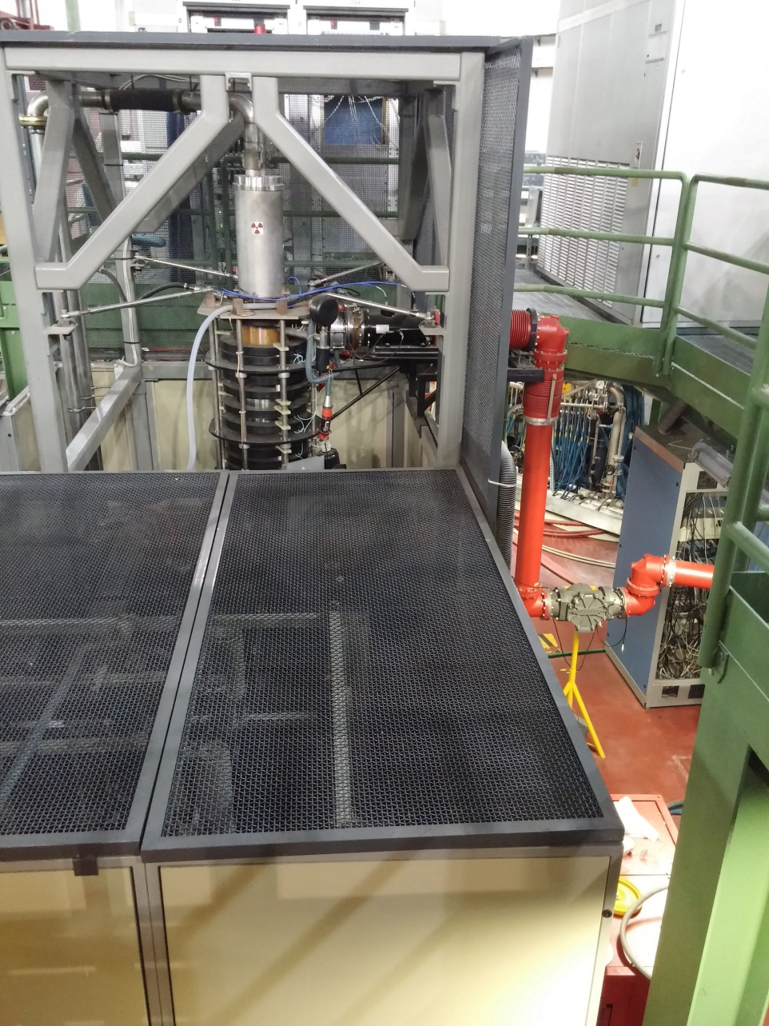
A. Gallo - DAFNE: Future plans
RING RF SYSTEM
We have 3 large RF plants (2 in the main ring and 1 in the damping ring) that have been declared obsolete for years, but they have a different impact in terms of operations, cost, and replacement/upgrade priority:
High priority: Main Ring RF power plants (150 kW CW 368 MHz)
  Thales does not have any klystrons in-house, has declared the project obsolete for years, and is requesting an amount comparable to the cost of a new plant just to resume and update the project, without any guarantee on the final result
  We have two spare klystrons, but both failed and were repaired in-house (with power testing confirming the effectiveness of the repair for only one of the klystrons)
  This is a critical ITEM even for a short-term scenario!
Medium priority: Damping ring RF plant (12.5 kW CW 73 MHz)
  Obsolete, limited possibility of repairs until components are exhausted
  Good number of spares in-house, sufficient for short term operation
Low-level RF systems: equally obsolete, we have spare full modules as well as individual electronic components available. Given the difficulties encountered in the past with the upgrade to digital systems, we do not believe it is appropriate to proceed with an upgrade of this system in any scenario
Courtesy of L. Piersanti
The most viable solution is to purchase 1 or 2 brand new RF stations based on RF solid state technology that was unavailable 30 years ago. According to our experience 80 kW stations are fully adequate for operation with present machine parameters.
21
69th Scientific Committee Meeting, May 14-15 2025

Slide 22
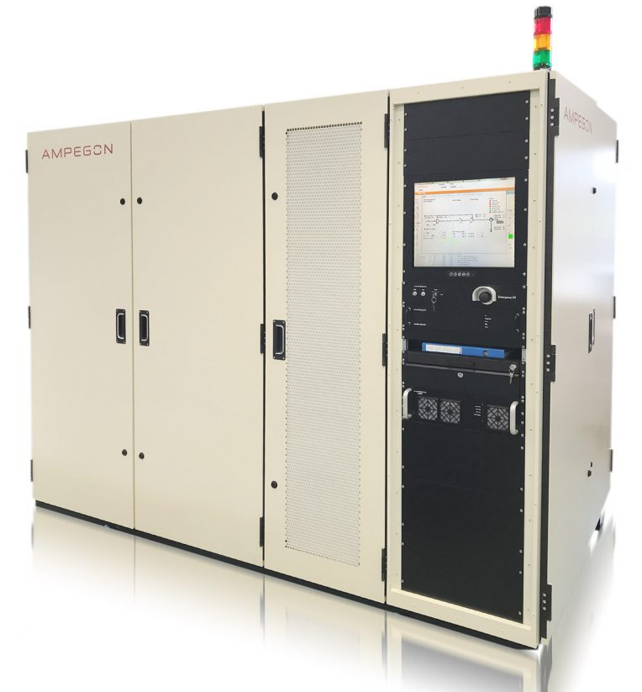
A. Gallo - DAFNE: Future plans
RING RF SYSTEM
The minimal impact strategy would be the dismissing of 1 klystron based station, to be used as a source of spare parts for the remaining one, replacing it with a brand new 80 kW solid state amplifier.
The Damping Ring RF station (73.6 MHz, 12 kW) is already based on solid state technology, but it is quite old and not supported anymore by the producer. It would be preferable to replace it with a new one.
Manpower required: 1 engineer + 3 technicians (almost the whole group) at ≈50% for 1 year
Time from t₀: 10 months for procurement + 8 months for construction +
+ 1-2 months for installation and tests -> ≈20 months in total
Activity | Exp. Duration | Manpower | Exp. cost
Main ring 1x RF plant replacement with solid-state amp (with circulator and related electronics) | ≈12 months procurement 8-10 months production 1 week (install.) 1 month (commissioning & debug) | 3 technicians + 1 RF engineer * 3 months; | ≈ 600 k€
Damping ring RF plant replacement with solid-state system | ≈12 months procurement 8-10 months production 1 week (install.) 1 month (commissioning & debug) | 3 technicians + 1 RF engineer * 2 months; | ≈ 100 k€
RF components acquisition | < 3 months for order and shipping |  | ≈ 10 k€
TOTAL RF |  | 20 FTE months | 710 k€
Same tender
Courtesy of L. Piersanti
22
69th Scientific Committee Meeting, May 14-15 2025

Slide 23
A. Gallo - DAFNE: Future plans
VACUUM SYSTEM
Courtesy of A. Liedl
Activity |  | Manpower | Exp. cost | Notes
Synchrotron Radiation absorbers spares |  | 3 FTE months (technician) 1 FTE months (Vacuum engineer) | 250 k€ | Too many different types, acquisition of a complete set of spares is unrealistic. Critical part are the cooling ducts. Copper stock provisioning + drawings and tooling preparation is the proposed strategy. In case of failure a spare can be prepared and installed in ≈1,5 months.
Ionic Pump spares |  |  | 100 k€
Ionic Pump power supplies |  |  | 35 k€
Sublimators (including power supplies) |  |  | 120 k€
Valves and vacuum guages spares |  | 1 FTE months (technician) | 100 k€ | Installed controllers obsolete, a rack hosting updated controllers need to be prepared ready for use n case of faults
Flag movement spares |  |  | 35 k€
Spare tuner for Damping Ring RF cavity |  | 2 FTE months (technician) 1 FTE months (Vacuum engineer) | 50 k€ | No spare avaiable, technical drawings need to be re-created prior proceeding with contruction and test
TOTAL VACUUM |  | 8 FTE months | 690 k€
23
69th Scientific Committee Meeting, May 14-15 2025

Slide 24
A. Gallo - DAFNE: Future plans
BUDGETARY COST EVALUATION from LNF TECHNICAL DIVISION
ELECTRIC POWER DISTRIBUTION
COOLING FLUID PLANTS
Courtesy of S. Cantarella & R. Ricci
24
69th Scientific Committee Meeting, May 14-15 2025

Slide 25
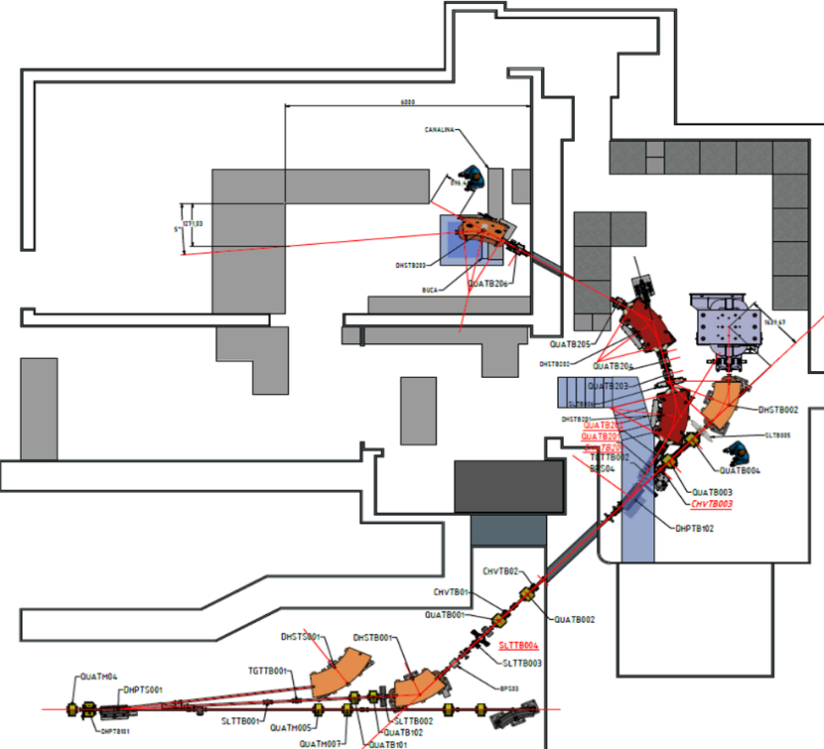
A. Gallo - DAFNE: Future plans
LINAC / BTF
The future of the LINAC and the 2 BTF stations is independent on the decision on the collider life extension. The BTF is an appreciated asset of the LAB, serving a broad user community and giving visibility to LNF.
This program has to be considered uncorrelated with the collider lifetime extension plane. It is more ambitious, seeking to an improvement of performances and offered services. This will be granted in any case.
The only piece of hardware specifically needed for the injection in the rings and requiring consolidation is the pulsed power supply for the dipole diverting selected beam pulses from the LINAC into the BTF lines or in the hodoscope.
It is a very custom apparatus that needs to be renewed because of malfunctioning. The estimate cost is 170 k€. Procurement, construction, installation and commissioning are expected to require ≈18 months, with an associated workload for LNF personnel of 5 FTE*months.
BTF EXP. HALL 1 (BTFEH1)
Experiments
BTF2
12m²
BTF1 bend
20m²
BTF1 straight
1m²
BTFEH2
BTF-common line
Courtesy of L. Foggetta & A. Vannozzi
25
69th Scientific Committee Meeting, May 14-15 2025

Slide 26
A. Gallo - DAFNE: Future plans
OTHER INVOLVED GROUPS (at various extents)
Collider Physics:
this group will be fully engaged with the preparation of the collider experimental study program. Its role will be however much relevant in addressing and following the consolidation activity, especially to define and implement the ring modifications specifically required for the experimental program.
Mechanical Engineering:
the group is weakly impacted for a basic consolidation program, apart from routinely activities such as alignment check and readjust. However new installations and/or layout modifications (for instance on the IRs) could be eventually required by the collider experimental program in preparation.
Laser:
not present in the DAFNE complex
Cryogenics:
unless new machine components and/or detectors requiring SC magnets are taken into consideration, there is no impact on the group. The present main activity of the group is giving support to the COLD LAB facility of LNF for preparation and run of light axions search experiments, primarily the reactivation of the SC solenoid of the old FINUDA detector for the FLASH experiment, which is located in the DAFNE hall and it is incompatible with the collider operation (possible added conflicts on operation priority attributions).
26
69th Scientific Committee Meeting, May 14-15 2025

Slide 27
A. Gallo - DAFNE: Future plans
SUMMARY
The costs estimated by the various LNF Accelerator Division groups and by the LNF Technical Division services are summarized here:
SYSTEMTOTAL | COST [K€] | MANPOWER
MAGNETS | 2200 | 40 FTE*month
CONTROLS | 310 | 36 FTE*month
BEAM DIAGNOSTICS (only Critical items) | 520 | 22 FTE*month
RF | 710 | 24 FTE*month
VACUUM | 690 | 8 FTE*month
LINAC (only pulsed magnet PS) | 170 | 5 FTE*month
COOLING (Tech. Division) | 1350
ELECTRIC POWER (Tech. Division) | 450
TOTAL | 6400 | 135 FTE*month (DA only)
27
69th Scientific Committee Meeting, May 14-15 2025

Slide 28
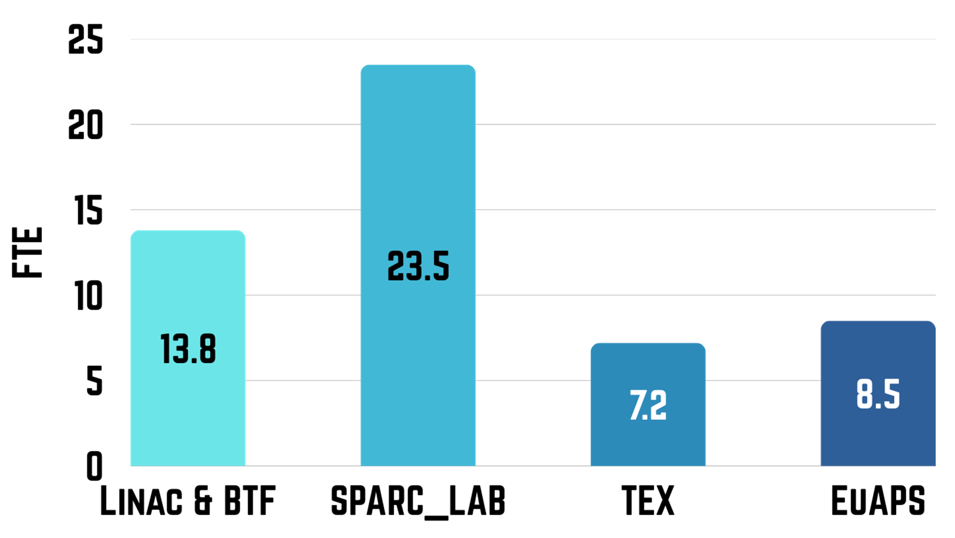
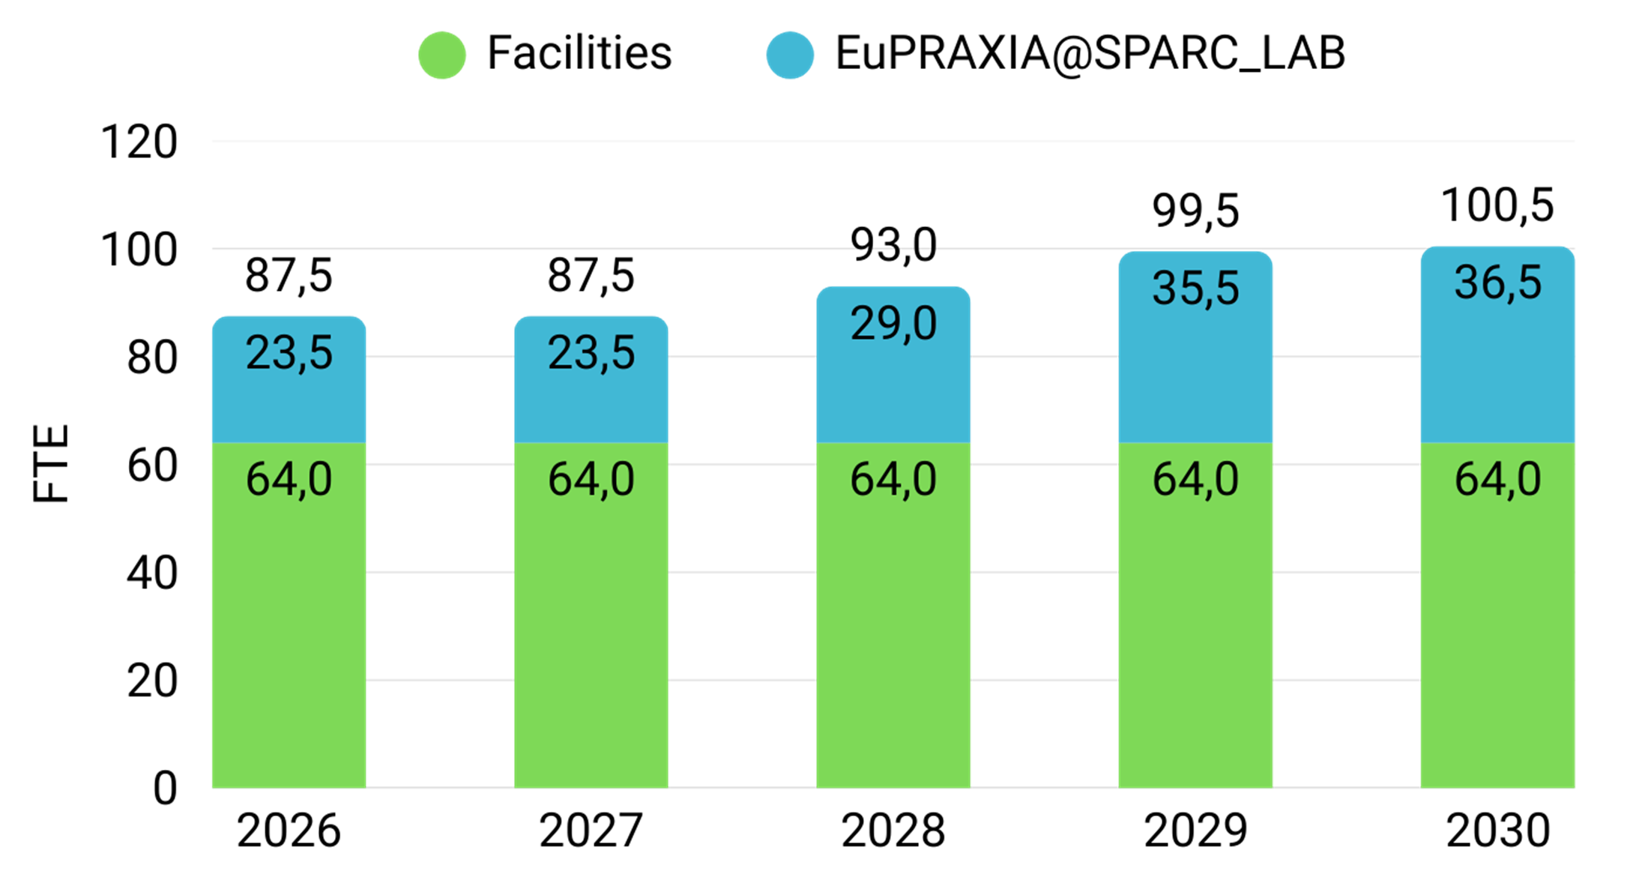
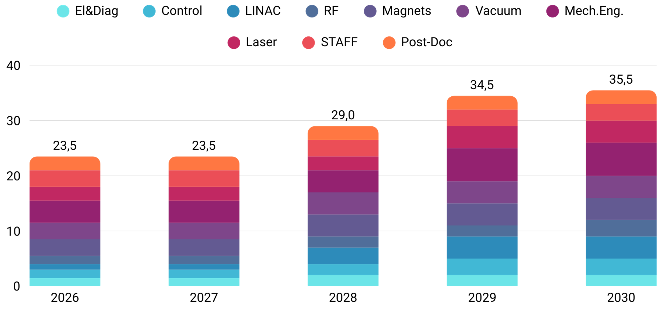
A. Gallo - DAFNE: Future plans
ASSESSED WORKLOAD IN THE 2025-2030 PERIOD
FTE allocated for the operation of the existing facilities within the Accelerator Division
A future run of DAFNE for users and/or collider physics experiments would add workload on top of the already assessed commitments
DA resources
FTE allocation for EUPRAXIA@SPARCLAB construction in the next 5-years
Estimated total Workload for the LNF personnel (mostly in the Accelerator Division) to run the facilities we are committed to, and to procure the parts, construct and commission the EUPRAXIA@SPARCLAB new facility.
Courtesy of A. Falone
28
69th Scientific Committee Meeting, May 14-15 2025

Slide 29
A. Gallo - DAFNE: Future plans
CONCLUSIONS #1
Despite its age, DAFNE has successfully completed the SIDDHARTA-2 run exceeding the experiment request. The flexible, medium-term nuclear physics program EXKALIBUR, aimed at continuing the research in the kaonic atoms sector, has been prepared and already illustrated to the Committee. The DAFNE-Light facility would be pleased to re-open calls for users based on DAFNE synchrotron radiation whenever granted plans of machine return to operation were announced;
A set of lepton collider physics measurements, aimed at exploiting the potentiality of DAFNE as test facility for FCC_ee and other future enterprises, has been preliminary discussed and sketched over the last years. A complete and comprehensive plan is in preparation. The LNF storage ring physics team is fully committed to complete in <1 year time this activity under the coordination of A. De Santis.
The involvement of international collaborators and institutions, primarily the CERN, for the preparation of the collider physics measurements proposal is crucial. The object of the plan is to produce experimental results needed for future huge enterprises. LNF are willing to give a contribution to these exciting developments, but it is clear that they can not sustain entirely the effort, from both financial and workload points of view.
For each of the proposed measurement the plan will assess the priority, feasibility, implementation aspects, time duration and global costs.
29
69th Scientific Committee Meeting, May 14-15 2025

Slide 30
A. Gallo - DAFNE: Future plans
CONCLUSIONS #2
DAFNE is an aged machine. Most of the lepton accelerators of the DAFNE era (colliders or synchrotron radiation sources) have been either stopped or renewed for lifetime extension;
Many DAFNE components are at end of life, or obsolete, or unmaintainable, representing single-points-of-failure. A credible/reliable scientific medium-term program must be based on a consolidation/mitigation plan to remove the weak points and reduce the machine vulnerability
A generic, minimal consolidation plan presented at the 63rd LNF SciCom meeting has been recently updated to extend the collider lifetime for ≈5 years. Neither upgrades nor performance improvements (only preserved in the best case) have been considered, just reduction of the risk of fatal events with minimal effort. Machine modifications eventually required by the collider physics measurements plan could not be included.
Expected budgetary costs are: 4.6 M€ (DA) + 1.8 M€ (DT) -> 6.4 M€ Total. LINAC/BTF consolidation cost has not been included since we assume it granted for continuing the operation of the BTF facility.
The associated impact on manpower workload is especially worrying since the consolidation program would rely essentially on the DA/DT staff, already heavily committed (beyond 100 %) on the operation of the other Lab facilities and construction of the new EuPRAXIA@SPARCLAB infrastructure. Availability of extra resources from external collaborations should be explored at the highest priority also for this task.
30
69th Scientific Committee Meeting, May 14-15 2025

Slide 31
A. Gallo - DAFNE: Future plans
DAFNE as a Test Facility for future collider
Interplay between Beam - Beam and FBK systems by using a calibrated and tunable source of noise
Validation of Background simulation code (Broggi)
Validation of e-cloud and ion simulation codes (Lotta Metter)
Preparatory phase for monochromatization, study the possibility to use PM steering magnets.
Longitudinal injection (Dutheil )
Photo-electron emission measurements
Crystal collimation studies, never tested with leptons (Redaelli )
This activity might be synergic with possible future experiments at LNF (see also DAFNE-TF Workshop)
Test of vacuum chambers with different treatments and coating
Test of innovative beam pipes with winglets and photon stops at the DAFNE positron ring
Monochromatization test
Dust injection to test SBL check dust injector
31
69th Scientific Committee Meeting, May 14-15 2025

