Slide 1
MMX17 Multiplex Micromegas for X17 experiment

Slide 2
Needs: ~ tracker
Detector sketch
Detector specification
Active area: 400 x 400 mm²
0,78 pitch pixel connected in X and Y strip
512 X and 512 Y strip
Spatial resolution X and Y: ~200 µm
Work in min TPC mode: 30 mm drift
Standard drift field standard, ~ 3 Kv for 3 cm
resist plain layer of ~5 Mohm/square
Work with magnetic Field ~ 500 gauss (50 mT)
Electronics:
Dream 1 card (512 ch) / detector
4 MEC8 connector on 2 side
Cable to 4 cards electronics in rack (x32)
Multiplexing independent (on ad hoc pcb)
400 mm
450 mm
~480 mm

Slide 3
Detector schematic
HV resist contact

Slide 4
Pixels layout
X strips connected to yellow pixels
X1
X2
X3
X4
YZ Cut view, along Y1 strip
X1
Y1
X3
Y1
Y1
X1 strip
X2 strip
X3 strip
X4 strip
Y1 strip
filling
512 pixel of 0,78 = 400 mm
262 144 pixel (512 x 512)
Connected with 512 X and 512 Y strip
Y2
X2
Y2
X4
Y2
Y strips connected to green pixels
Pixel
Pitch: 0,78 mm
700² µmcpixel
~80 µm inter
Via ~200 µm ring
Via Cu filled
X1
Y3
X3
Y3
Y3
Y4
X2
Y4
X4
Y4

Slide 5
Stacks
1) Top: resist on kapton
Open on ground
2) Kapton foil with resist silk-screen print and HV resist contact
3) 512x512 pixel
4) 512 X strip
5) 512 Y strip
6) Ground

Slide 6
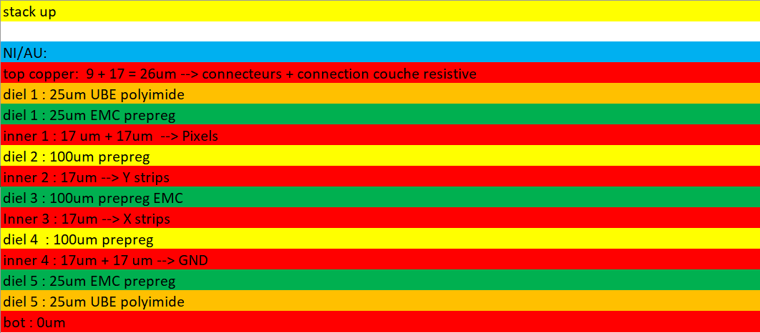
Stack Total thickness: 428 µm + 1 mm CF

Slide 7
Section view - Not in scale
resist
HV contact
4mm large
frame
mesh
Kapton
joint
FR4
Coupe A-A
15 mm
B
B
25 mm
A
Ground (3 mm large)
with soldering
A
7
Connector
(GMI 30)
Coupe B-B
25 mm
~40 ??? mm

Slide 8
Section view - Not in scale
Connector (GMI 30)
Pin spacer = 1,27 mm,
~12x60 mm²
4 vis M3
Connector
(MEC8 70 rigth)
~ 30 mm
~40 mm
450 mm
480 mm
~ 520 mm

Slide 9
Multiplexing connectors
Multi plex PCB
Independent multiplexing PCB on each side
3 type on Multi PCB, M1, M2, M4
M1 = no multiplex
512 channels
8 MEC8 connector
M2 = multiplex by 2
256 channels
4 MEC8 connector
M4 = multiplex by 4
128 channels
2 MEC8 connector
Connectors
Readout to Multi:
No connector on readout = printed
Multi to DREAM: MEC8 female on multi.
MEC8

Slide 10
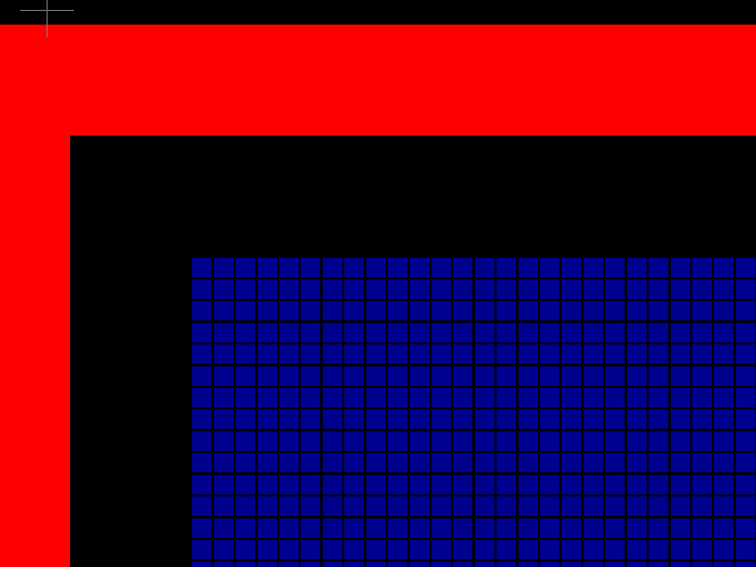
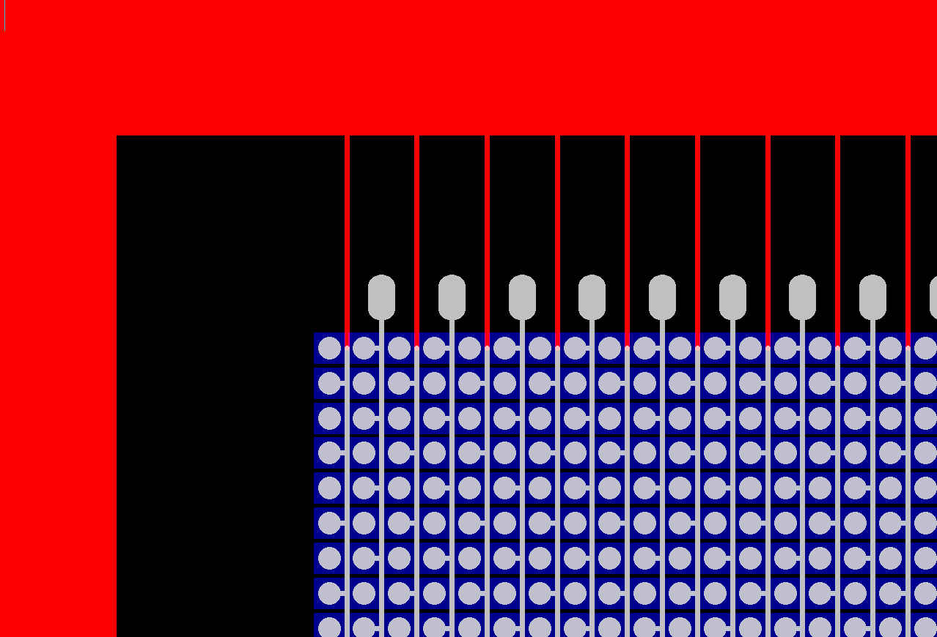
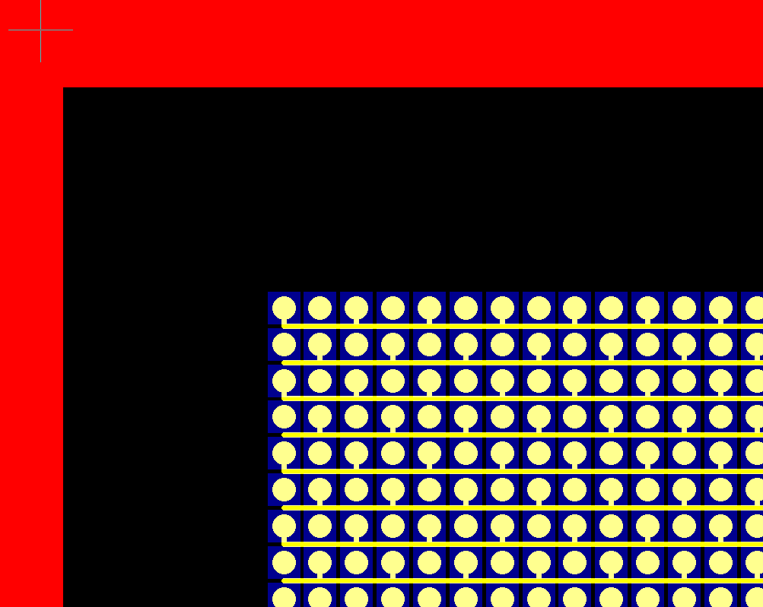
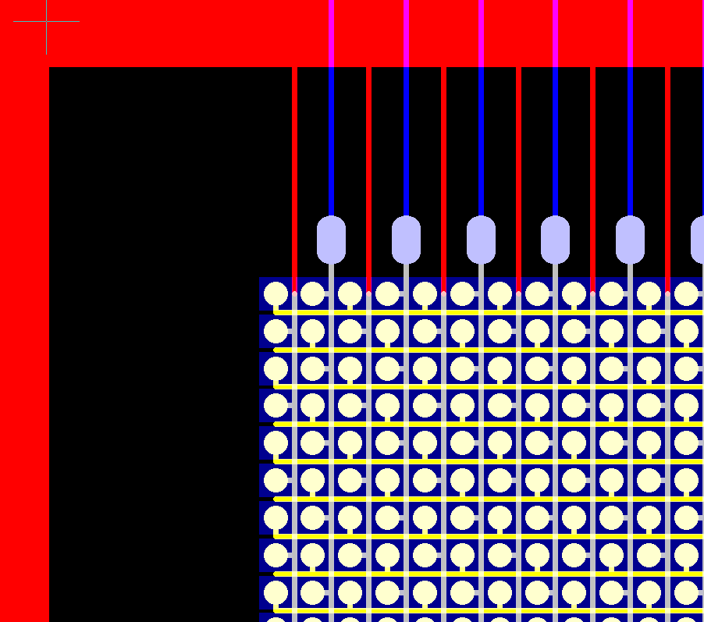
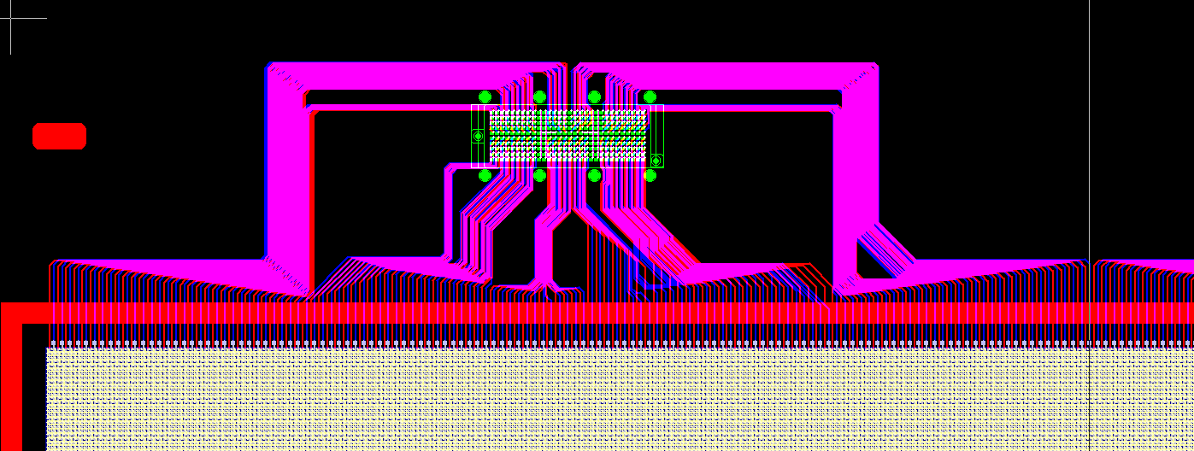
GERBER FILES
Pads close view + X connections
Pads close view
Pads close view + Y connections
Pads + x and Y lines
GMI Y connector

Slide 11
Connector MEC8
Connector MEC8:
MEC8-135-02-L-D-RA1

Slide 12
3D MMX17 PCB with connectors
SHV connectors
Multiplexer PCB
Drif frame (30 mm)
400x400 mm active area
Gas inlet

Slide 13
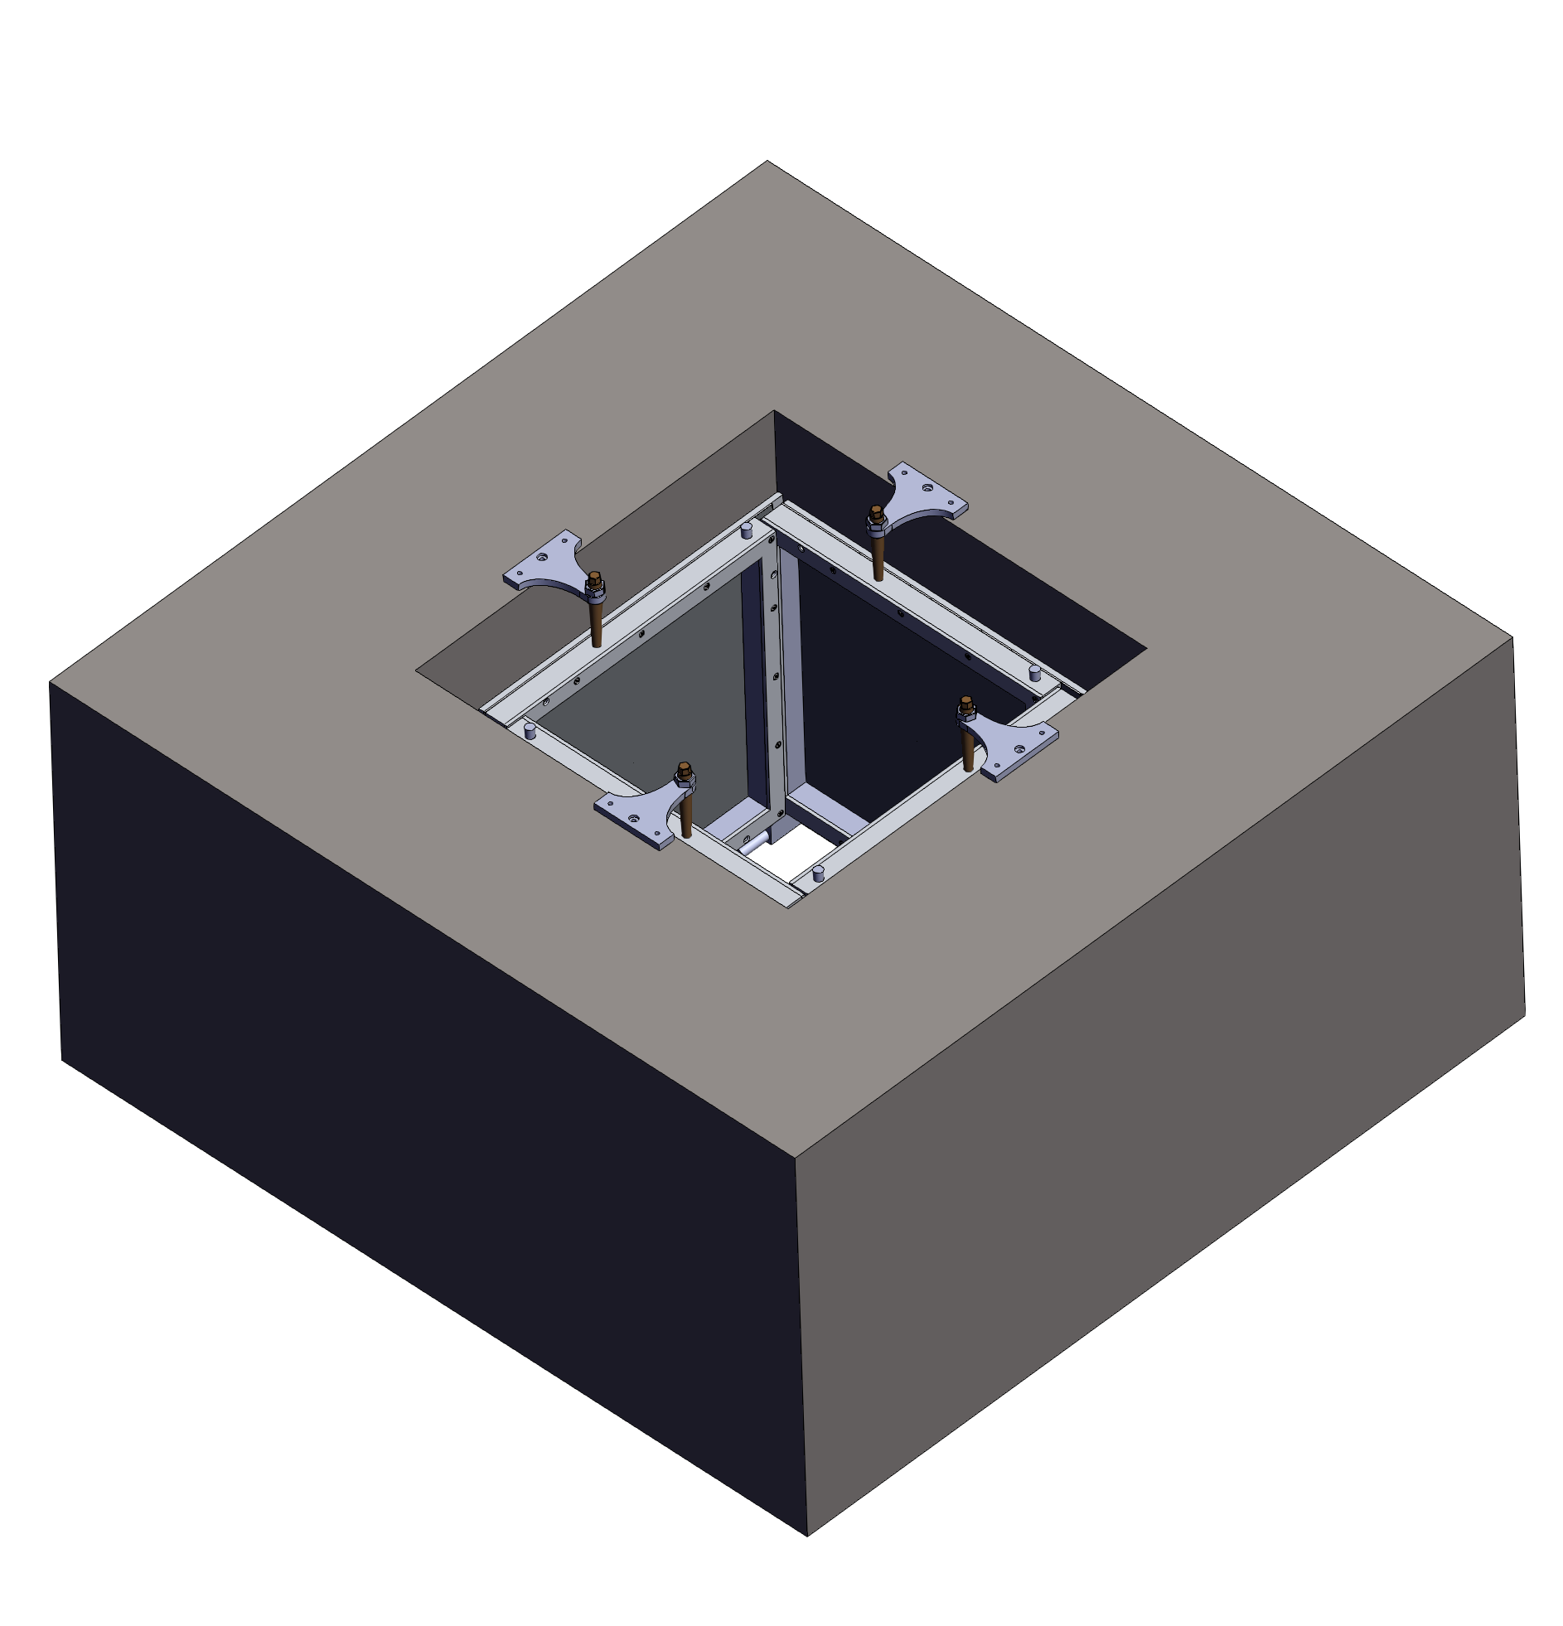
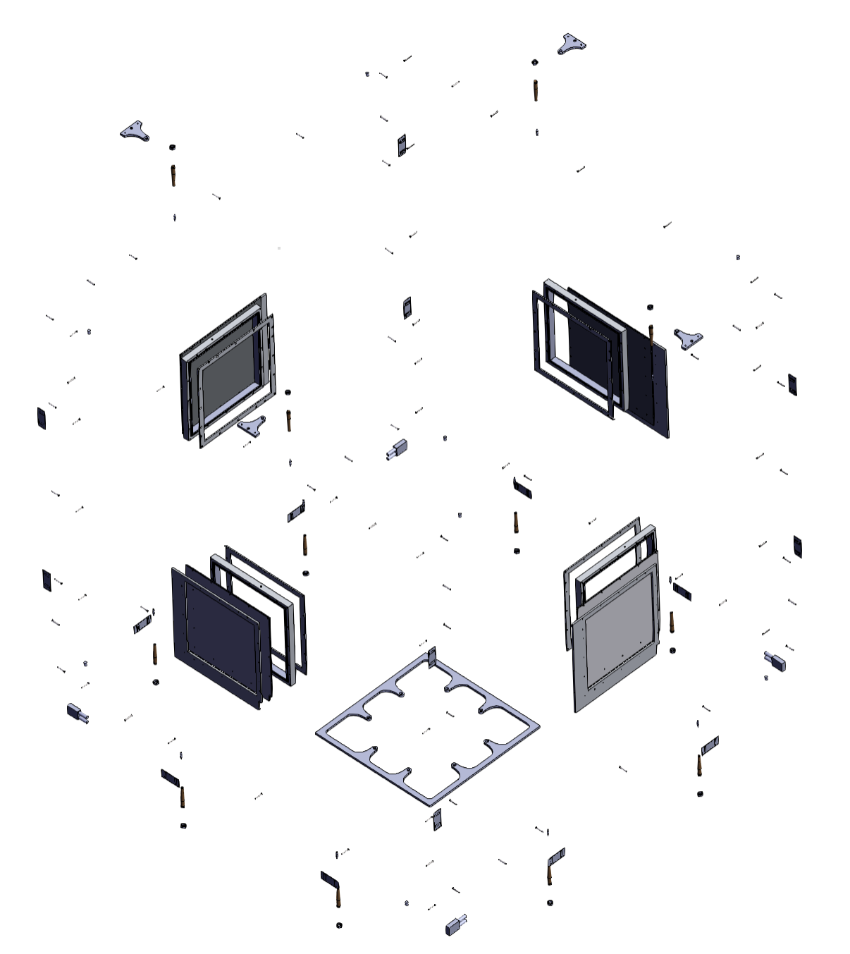
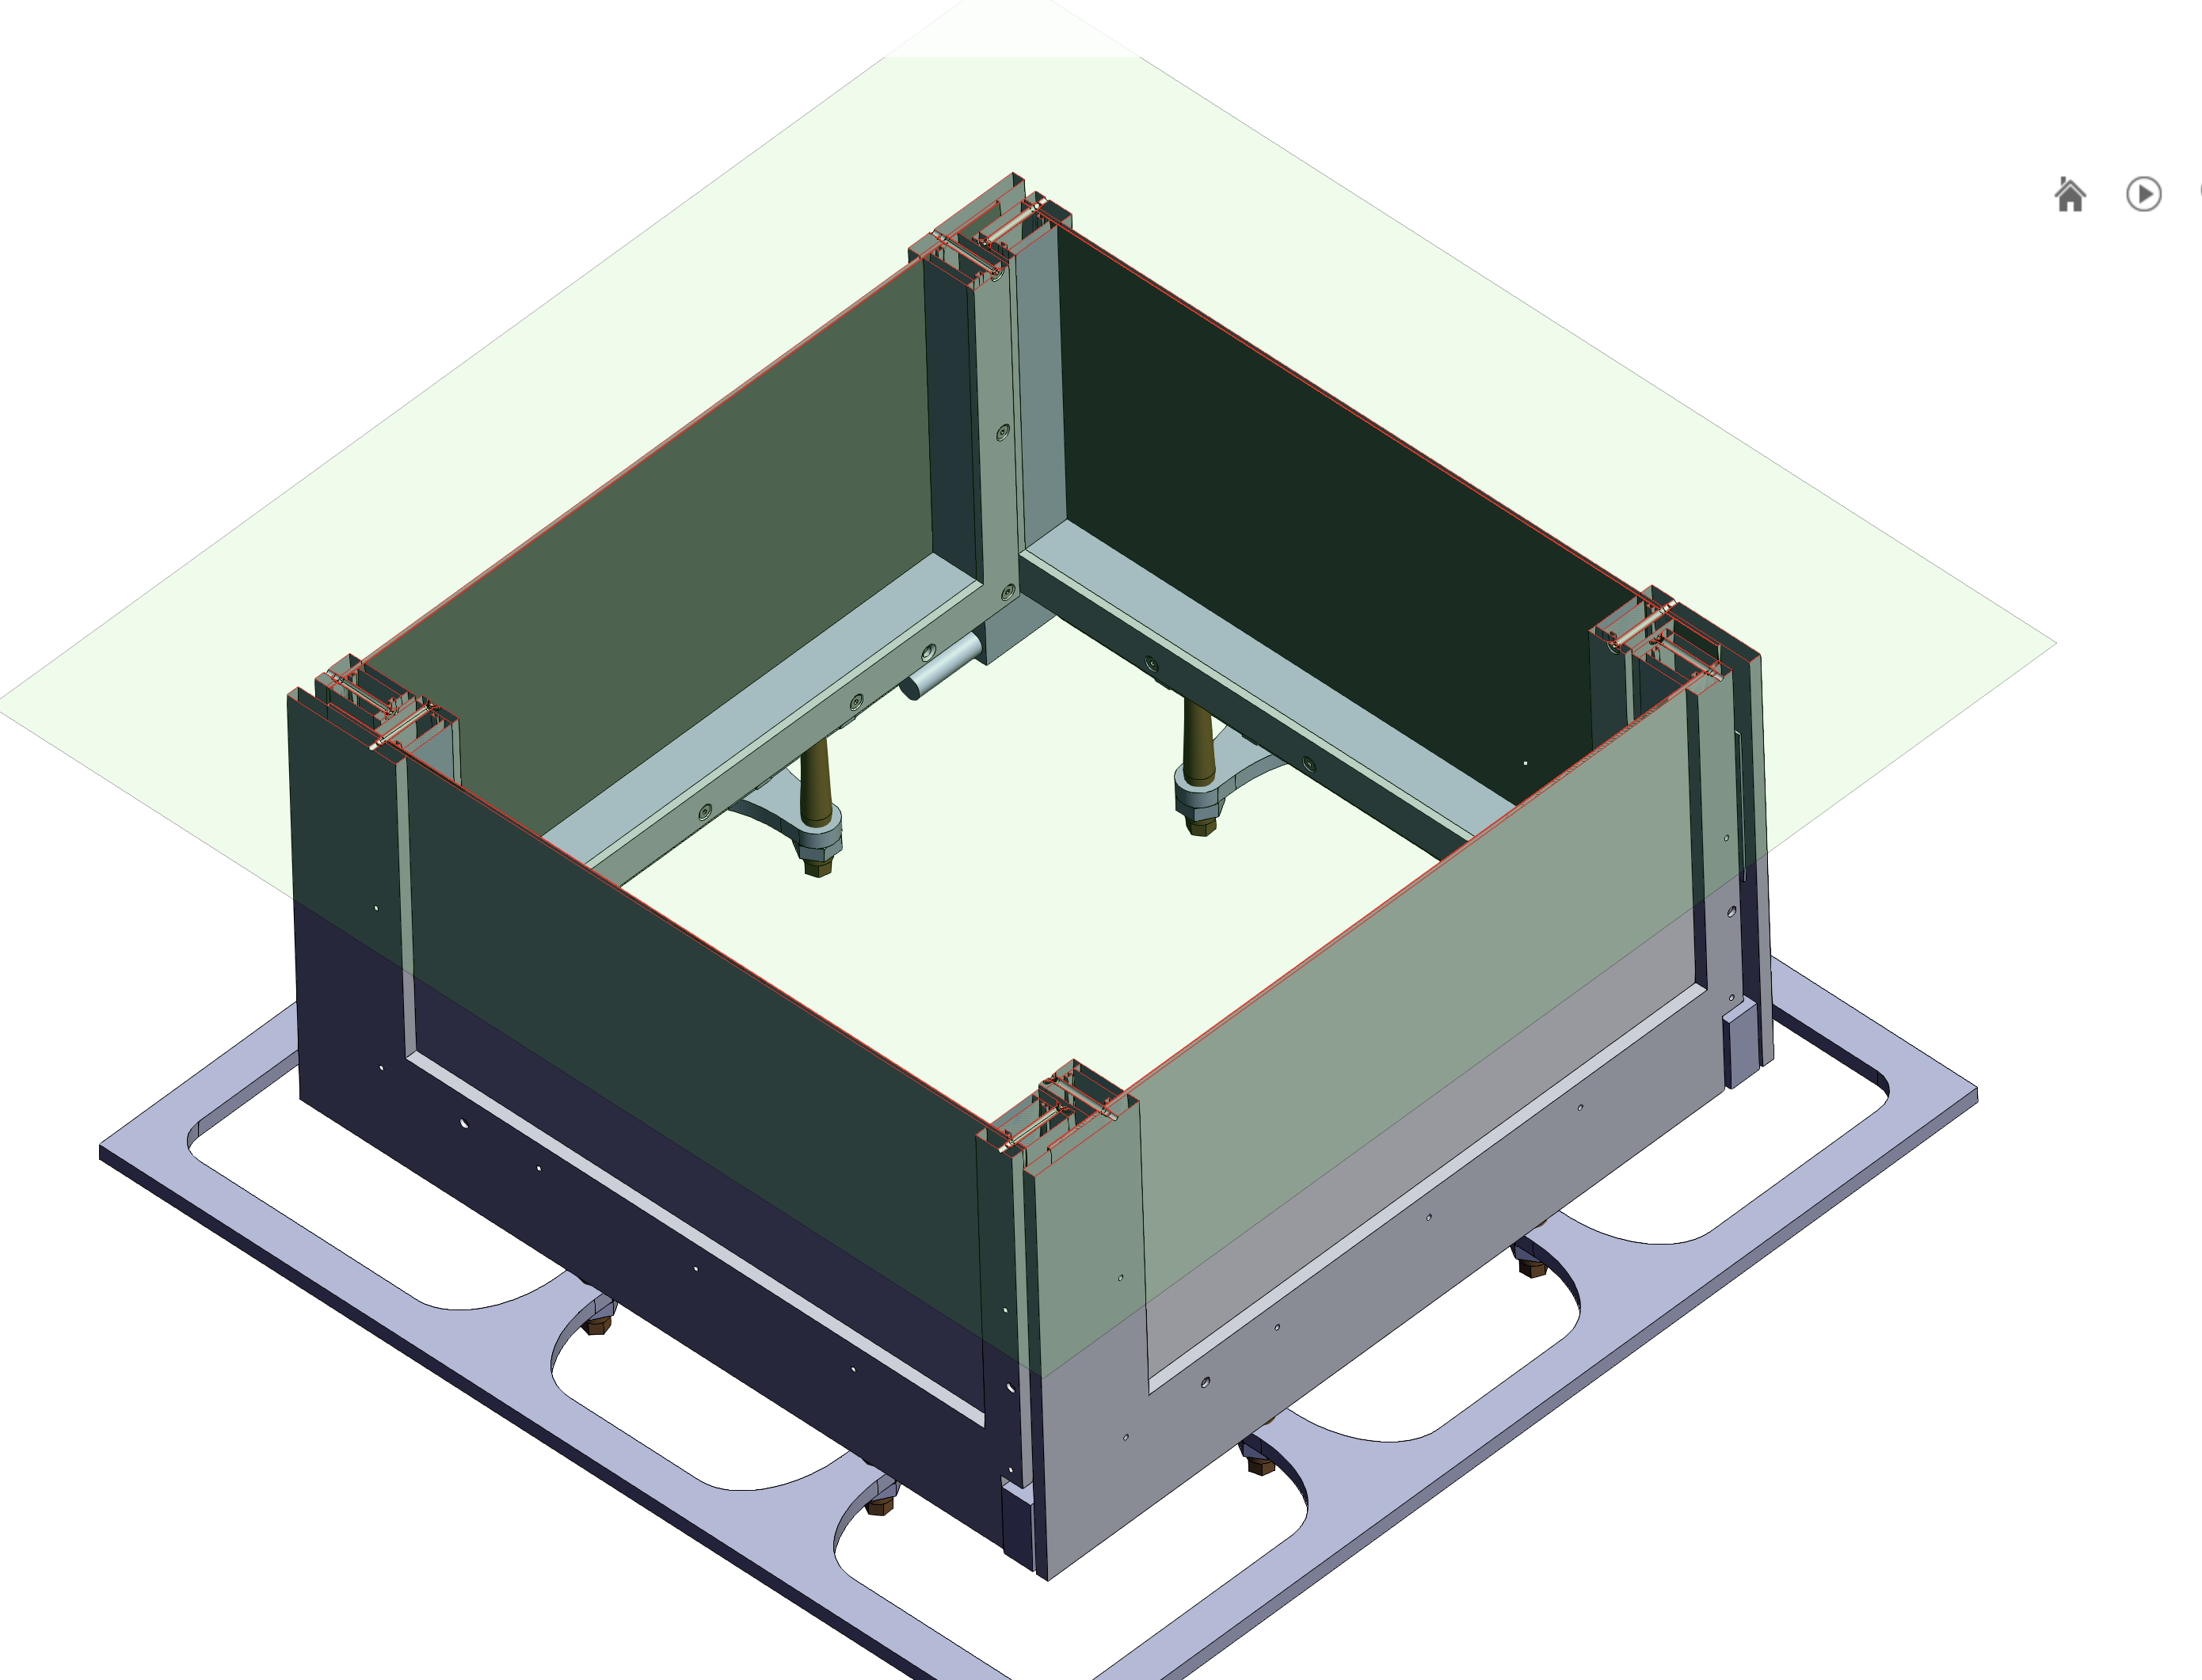
Detector Assembly

Slide 14
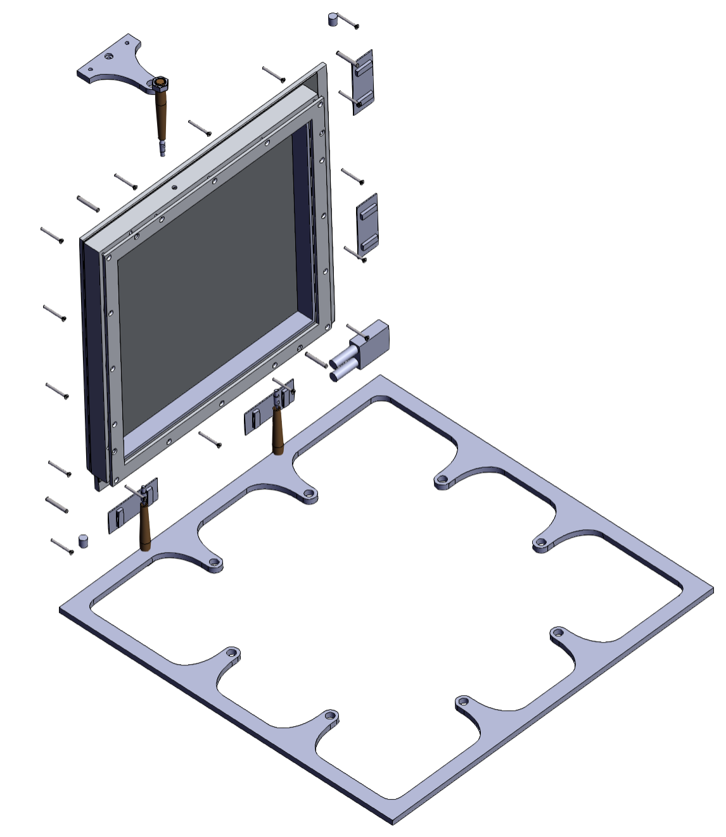
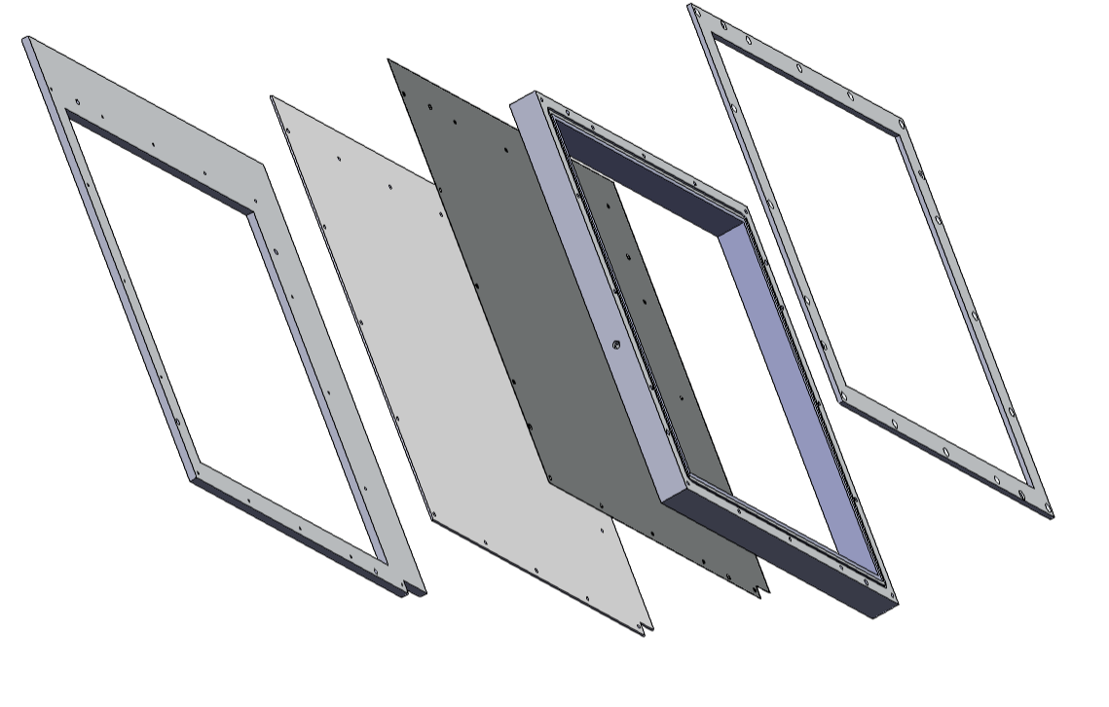
Detector Assembly
Lower frame
MM PCB
Entrance window frame
CF back plate
Drift frame (30 mm)

Slide 15
WORKING AND COSTS PLAN
Work | Cost | Expected delivery
PCB design work –Gerber file | 2500 CHF | End of April
Design of the Mecahnical structure | Free of Charge | End of April
production of 8 boards (4 detectors working + one for testing) | 8 x 2300 CHF = 18400 CHF | End of June
tooling for producing the boards. | 750 CHF
production multiplexing of the strips ( 350 CHF per card ) | 1800 CHF for design and 600 CHF for tooling | End of June
Detectors shipping costs | 250 CHF
Total cost | 2500 + 18400 +750+250 = 21900 CHF
Production of mechanical structure | Free/2000 Eur | End of june
Serigraphy of the resistive layer | Free of charge | Half of July
Production of 4 bulk Micromegas (if everything goes well with photoresist replacement) | Free of charge | End of july
Integration and debug of one prototype | Free of charge | Second week of July
Integration of the remaning 3 detectors (If no modifications are needed) | Free of charge | End of July
Beam test | Free of charge | September

