Slide 2
The technique has been validated !!
Finally possible to measure inelastic cross sections at n_TOF (after 24 years !!).
Not suitable for all nuclei (due to energy resolution), but for many of them.
While originally skeptical on the use of LaBr3 detectors at n_TOF, CIEMAT is now procuring several detectors for joining the new program.

Slide 3
Measurement to be performed at the end of the year (to wait for the new detectors from CIEMAT, my guess we will still use the old ones).
New mounts for detectors now being built in UoM
LiF being procured

Slide 4
New development: use of LaBr3 in EAR2 in capture measurements (87Sr)

Slide 5
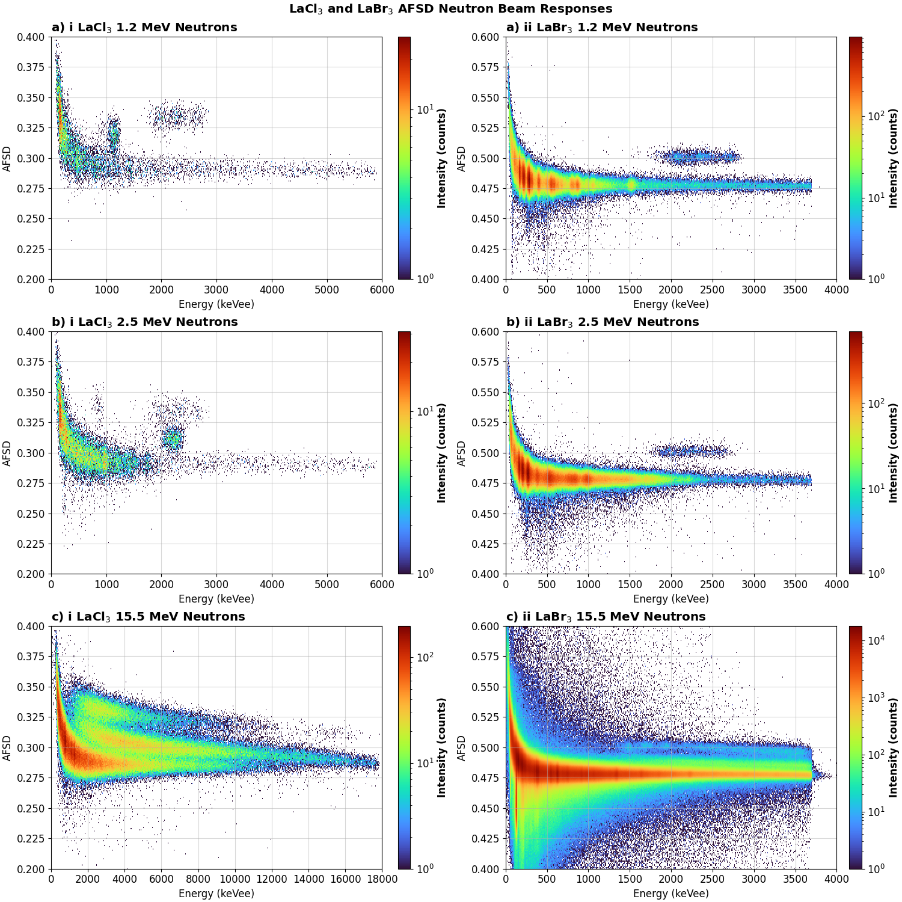
Test of the INFN LaCl3 crystal (Scionix) under the monoenergetic neutron beam at NPL

