Slide 1



Advances in the Gd-160 capture cross section data analysis
M. Mastromarco, A. Mazzone, A. Mengoni, N. Colonna, S. Cristallo, G. Tagliente, C. Massimi and U. Koester

Slide 2
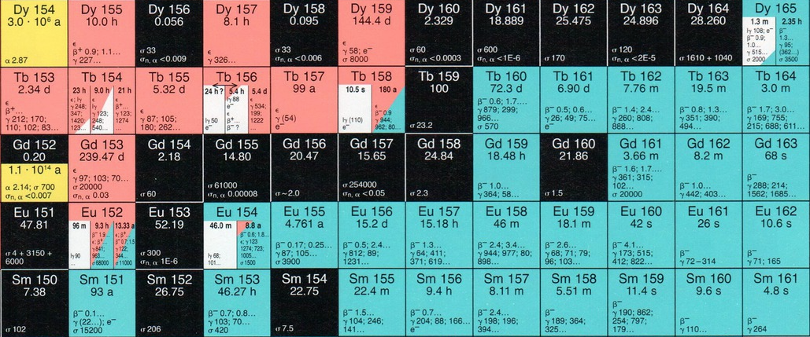
Motivations
A. Mazzone et al. (The n_TOF Collaboration), Physics Letters B 804, 135405 (2020)
M. Mastromarco et al. (The n_TOF Collaboration), EPJA 55, 9 (2019)
¹⁶¹Tb is a clinically interesting isotope for theranostics!!!

Slide 3
Motivations
¹⁶¹Tb is a clinically interesting isotope for theranostics!!!

Slide 4
(Medical Motivations: terbium-161 production)
Chemically similar to lutetium-177 (used in theranostic as γ and β⁻ emitter)
Similar half-life T_{1/2} = 6.9 d (against 6.7 d of Lu-177)
In addiction to being a γ and β⁻ emitter (like Lu-177), Tb-161 is also an emitter of Auger and conversion electrons;
The higher LET (compared to Lu-177) can be effective in reducing the survival probability of tumors cells.
Notes:
It has chemical-physical properties very similar to those of Lu-177 (largely used in theranostic as y and Beta- emitter); in addiction termbium is also an Auger and conversion e- emitter, so an higher LET compared to Lu-177 is expected.

Slide 5
Motivations
…and influences the abundance of Dy in stars!!!

Slide 6
Motivations
A. Mazzone et al. (The n_TOF Collaboration), Physics Letters B 804, 135405 (2020)
M. Mastromarco et al. (The n_TOF Collaboration), EPJA 55, 9 (2019)
…and influences the abundance of Dy in stars!!!

Slide 7
Motivations: Model Calculations against Observations
Notes:
Con le sezioni d’urto attuali, abbiamo eseguito calcoli di modelli stellari con masse M=2M_solari in fase AGB (con metallicità Z=0.01 e Z=Z_solare), che sono rappresentative delle "parent stars" dove si sono formati in precedenza i grani pre-solari di carbonati silice (SiC). Nel corso della fase di AGB , entrambi i modelli si muovono verso concentrazioni sensibilmente diverse di Dy-161 e Dy-163 (come indicato dai grani) o verso abbondanze sensibilmente più alte di Dy-164. L'accordo con i grani (per quanto riguarda il rapporto 161Dy/162Dy) potrebbe migliorare presupponendo un diverso valore della sezione d'urto del Gd160(n,g).

Slide 8
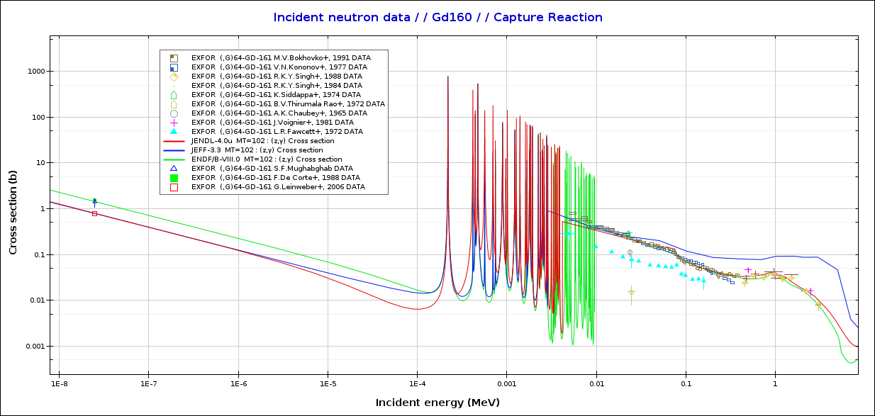
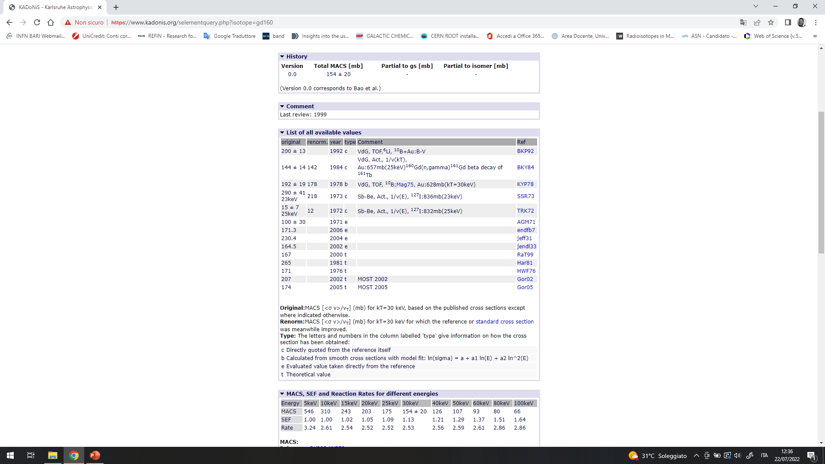
Motivations: State of the Art
Exp. Data and Main Evaluations
Karzavina et al.
MACS @ kT=30 keV
source: https://exp-astro.de/kadonis1.0/
Kang et al.
> 70% discrepancy!!!
> 30% discrepancy
Large discr. in RRR and URR

Slide 9
Motivations:
Unsatisfactory situation triggered the n_TOF Collaboration to perform a new measurement of the ¹⁶⁰Gd(n, γ) reaction from thermal up to 300 keV at n_TOF facility (CERN)

Slide 10
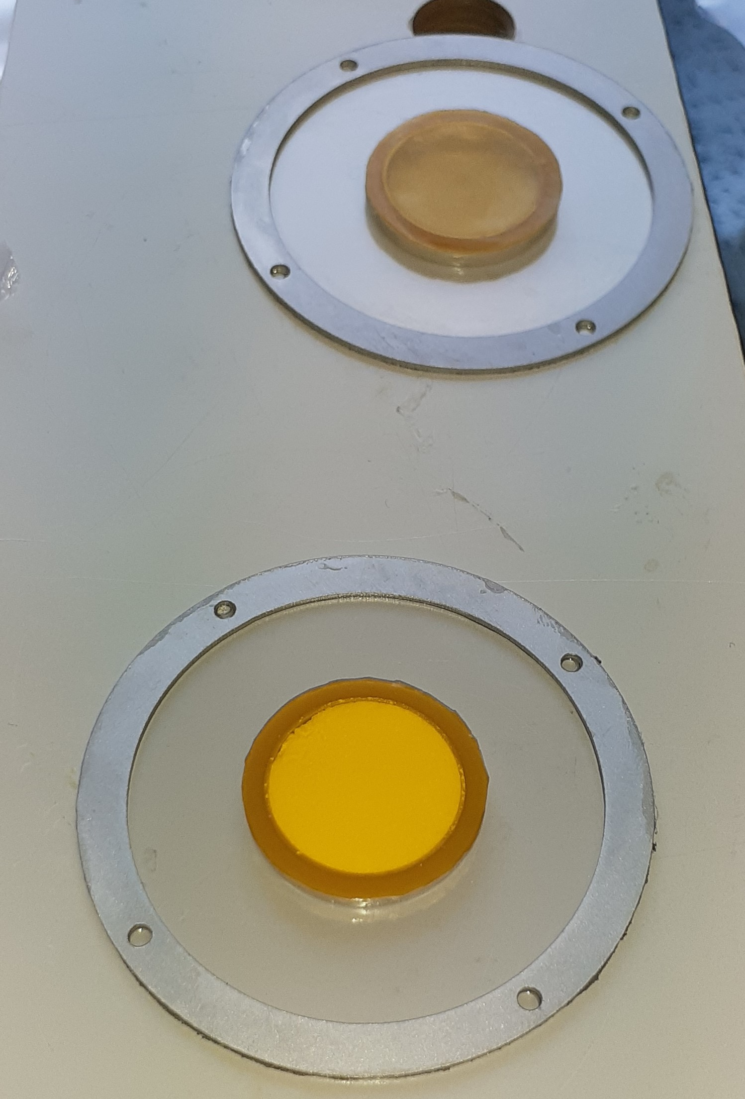
Samples: Gd sample and Dummy
(Sample available in the form of powdred Gd oxide!!!)
Step by step samples preparation…
START
PEEK
Dummy
Gd oxide
Kapton
enclosing
END
Gd sample

Slide 11
Samples: Gd sample and Gd₂O₃ Composition
 | mass [mg]
Gd oxide container total mass | 1459
Gd oxide container after oxide removal | 1141
Gd₂O₃ | 318
PEEK capsule | 795
kapton | 17
glue | 114
dummy (capsule + glue + kapton) | 926
Gd₂O₃ | 317
Gd oxide sample (oxide + PEEK) | 1243
Gd mass (oxide is Gd₂O₃) | 276
Gd-160 mass (98.1 % enrichment) | 270
In the past the ¹⁶⁰Gd(n, γ) measurement was hampered by the natural isotopic presence of
¹⁵⁵Gd and ¹⁵⁷Gd

Slide 12
Samples: Gd sample and Gd₂O₃ Composition
 | mass [mg]
Gd oxide container total mass | 1459
Gd oxide container after oxide removal | 1141
Gd₂O₃ | 318
PEEK capsule | 795
kapton | 17
glue | 114
dummy (capsule + glue + kapton) | 926
Gd₂O₃ | 317
Gd oxide sample (oxide + PEEK) | 1243
Gd mass (oxide is Gd₂O₃) | 276
Gd-160 mass (98.1 % enrichment) | 270
But this time…
Sample irradiated for 55 days at the thermal reactor of ILL: ¹⁵⁵Gd and ¹⁵⁷Gd burned out!!!
Gd-160 enrichment:
Isotope | [%]
Gd-152 | 3.80E-05
Gd-153 | 3.90E-10
Gd-154 | 0.02
Gd-155 | 3.30E-05
Gd-156 | 0.59
Gd-157 | 4.20E-06
Gd-158 | 1.29
Gd-160 | 98.1

Slide 13
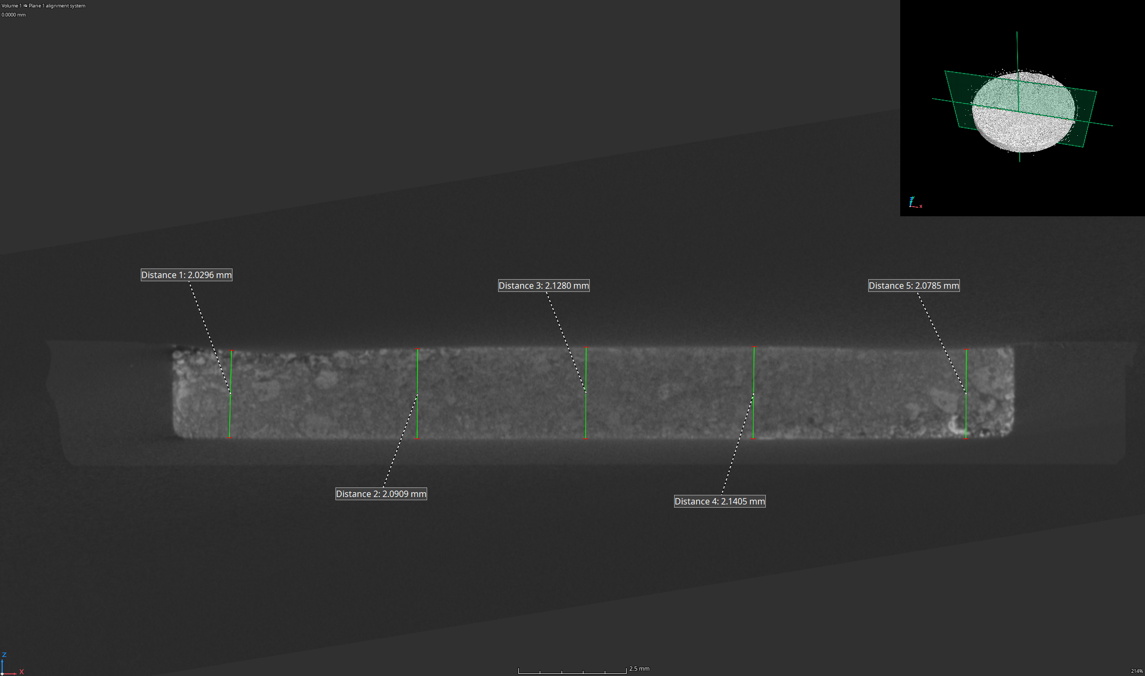
Samples: Gd sample, X-ray Spectroscopy
Average thickness ~ 2.10 +/- 0.01 mm

Slide 14
Experimental Setup @ EAR1 and EAR2
Liquid scintillation detectors with deutered benzene:
(C₆D₆ & sTED)
Low neutron sensitivity
Low γ-ray detection efficiency
EAR1
Flight Path: 185 m
Flux: 10⁶/cm²/Proton Bunch
Very High Resolution: < 10⁻³
The total energy detection principle by combining the detection system with the so-called Pulse Height Weighting Technique (PHWT).
For details see:
P. Schillebeeckx et al., Nucl. Data Sheets 113, 3054 (2012)
A. Borella, G. Aerts, F. Gunsing et al., Nucl. Instr. Meth. A 577, 626 (2007)

Slide 15
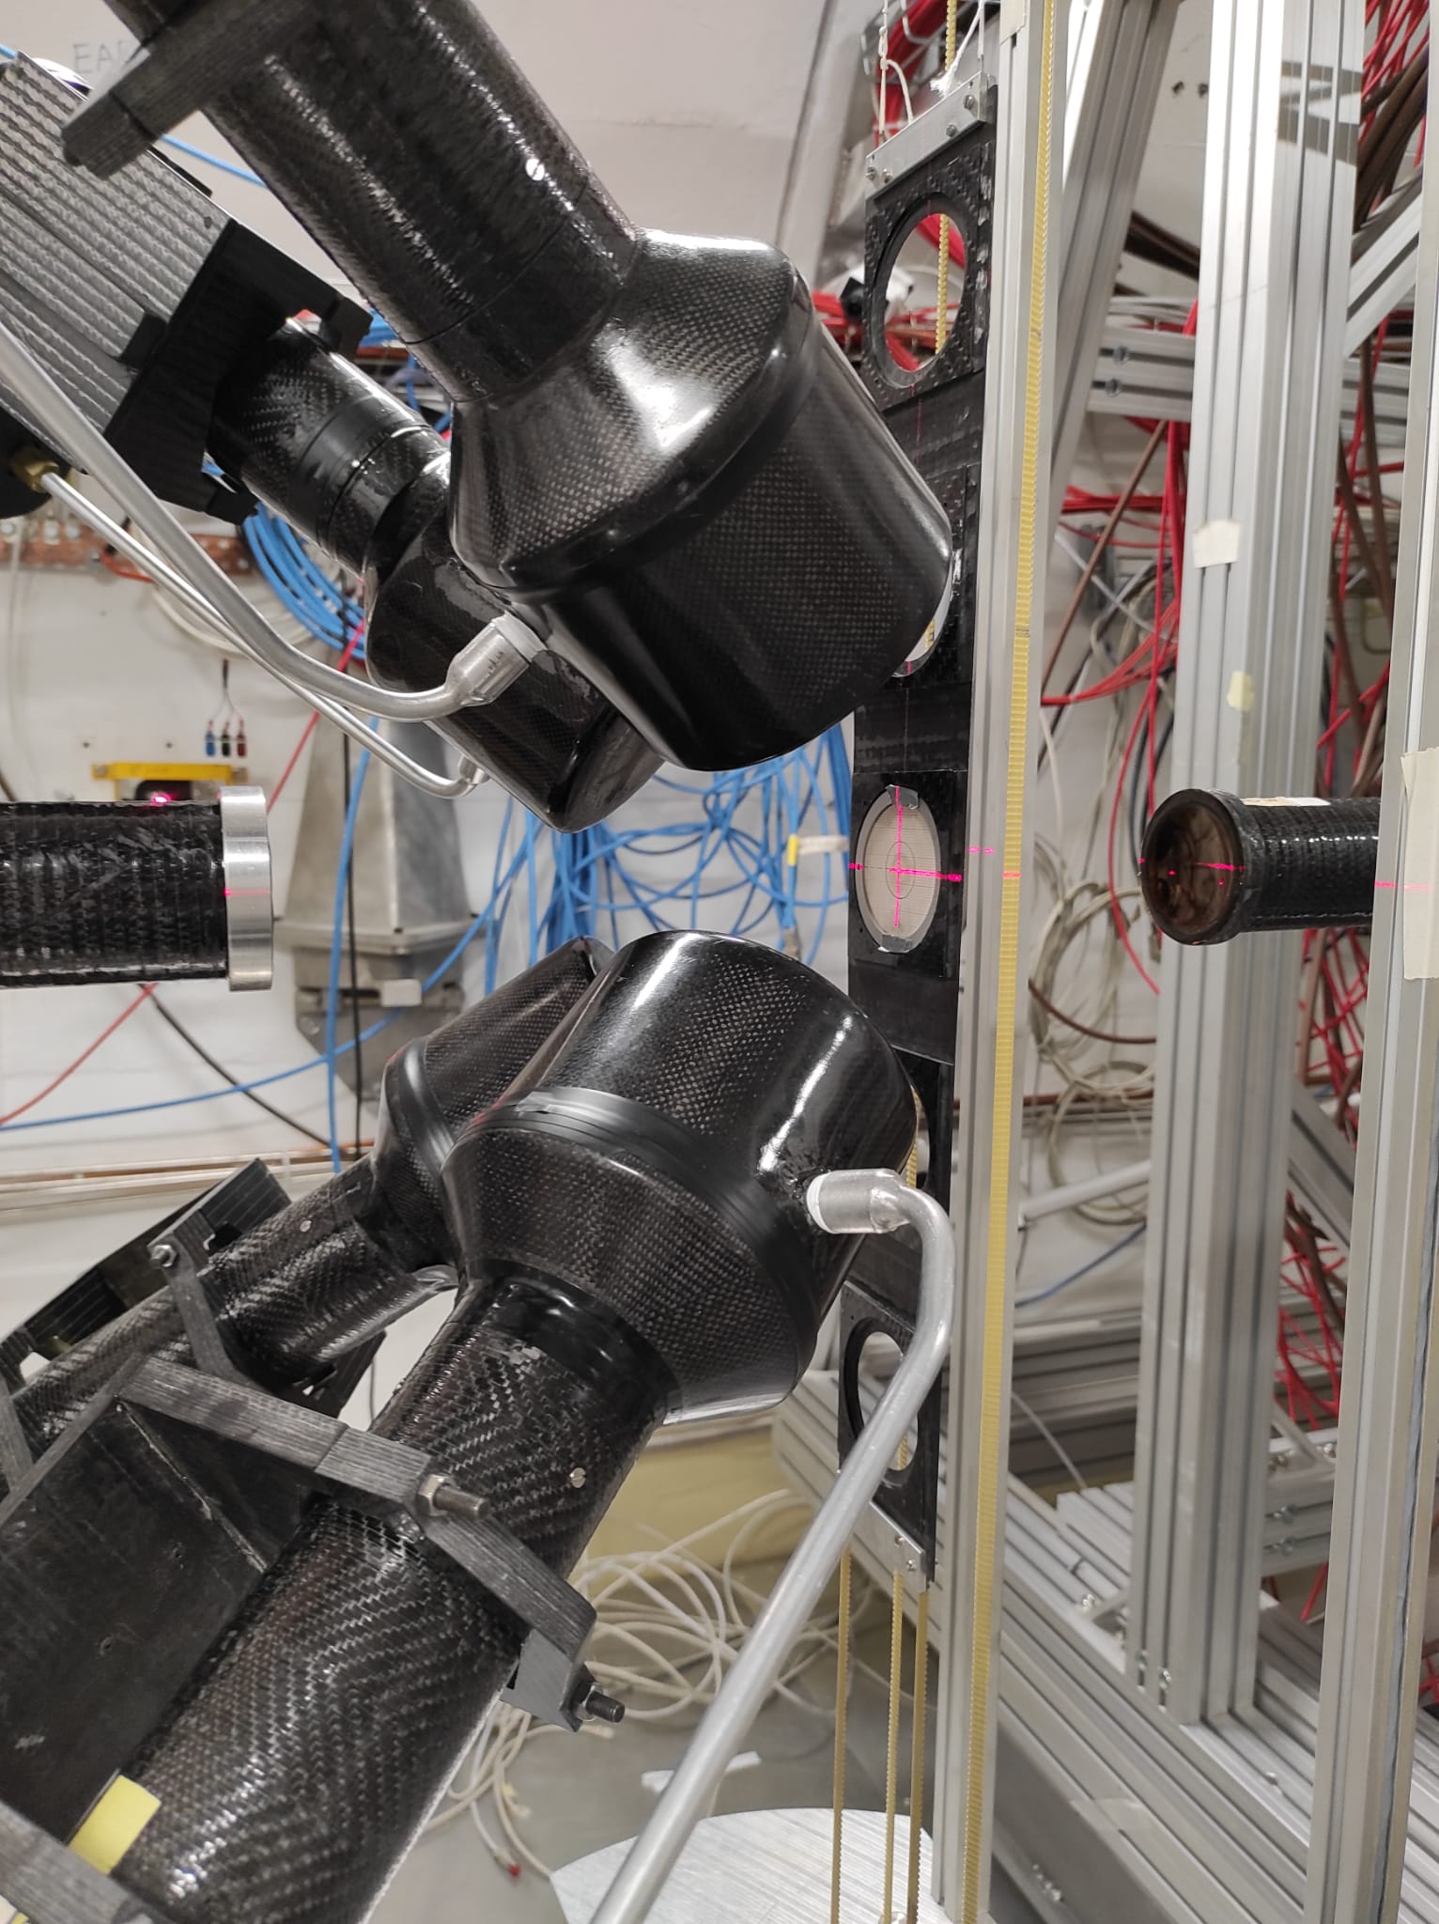
Experimental Setup @ EAR1 and EAR2
EAR1: 4 C₆D₆
Liquid scintillation detectors with deutered benzene:
(C₆D₆ & sTED)
Low neutron sensitivity
Low γ-ray detection efficiency
The total energy detection principle by combining the detection system with the so-called Pulse Height Weighting Technique (PHWT).
For details see:
P. Schillebeeckx et al., Nucl. Data Sheets 113, 3054 (2012)
A. Borella, G. Aerts, F. Gunsing et al., Nucl. Instr. Meth. A 577, 626 (2007)

Slide 16
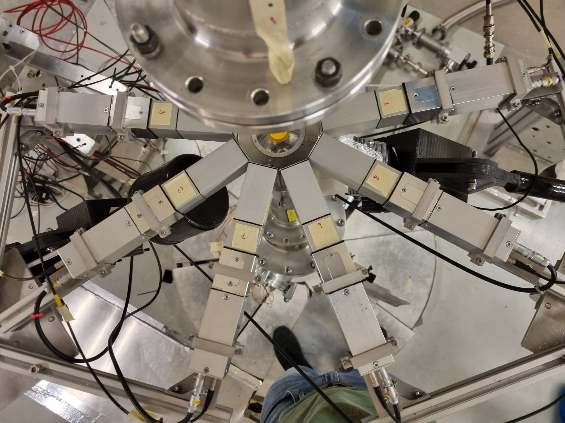
Experimental Setup @ EAR1 and EAR2
Liquid scintillation detectors with deutered benzene:
(C₆D₆ & sTED)
Low neutron sensitivity
Low γ-ray detection efficiency
EAR2: 2 C₆D₆ + 9 sTED
EAR2
Flight Path: 19 m
Flux: 10⁷/cm²/Proton Bunch
Lower Resolution: < 10⁻²
sTED
sTED
C₆D₆
Sample
sTED
The total energy detection principle by combining the detection system with the so-called Pulse Height Weighting Technique (PHWT).
For details see:
P. Schillebeeckx et al., Nucl. Data Sheets 113, 3054 (2012)
A. Borella, G. Aerts, F. Gunsing et al., Nucl. Instr. Meth. A 577, 626 (2007)
C₆D₆
sTED
sTED
Neutron Beam
sTED

Slide 17
EAR1
(Resolved and Unresolved Resonances Region)

Slide 18
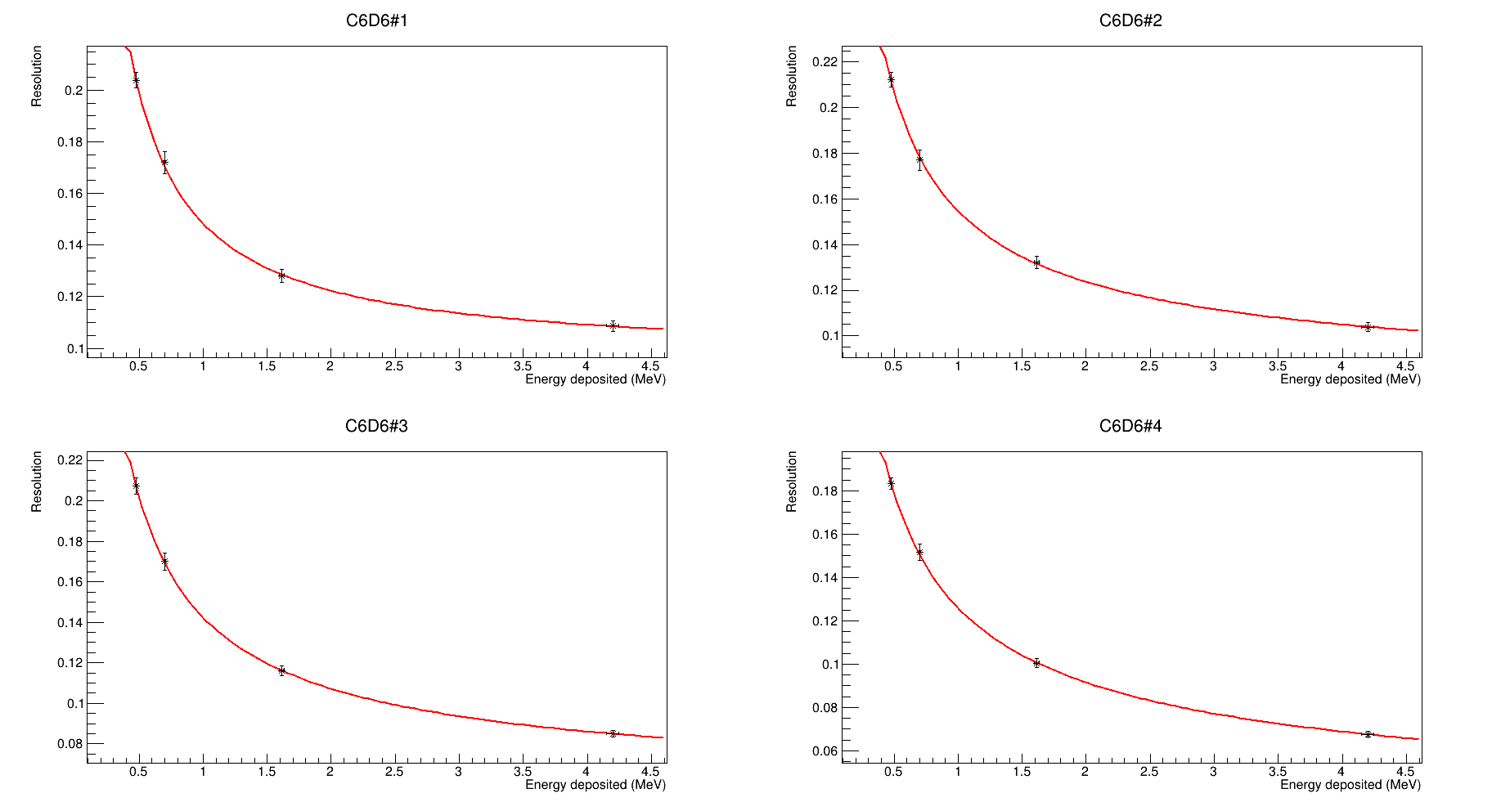
Resolution, calibration (+ MC)

Slide 19
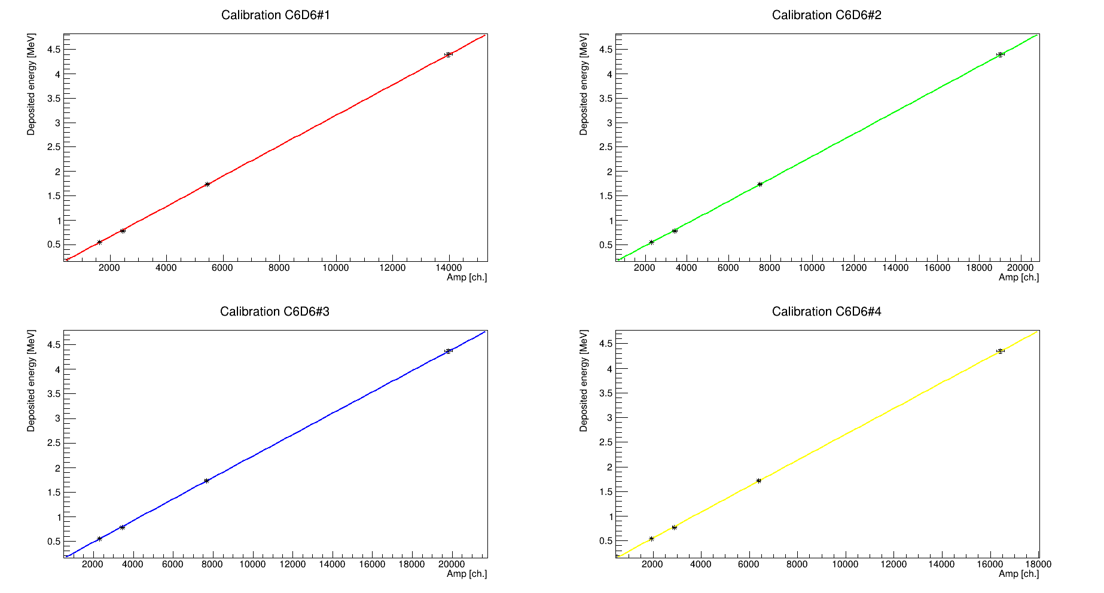
Resolution, calibration (+ MC)

Slide 20
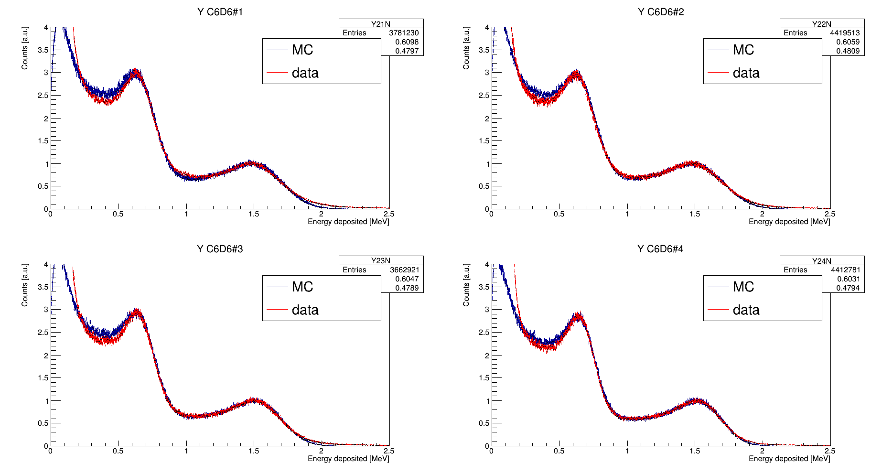
Resolution, calibration (+ MC)

Slide 21
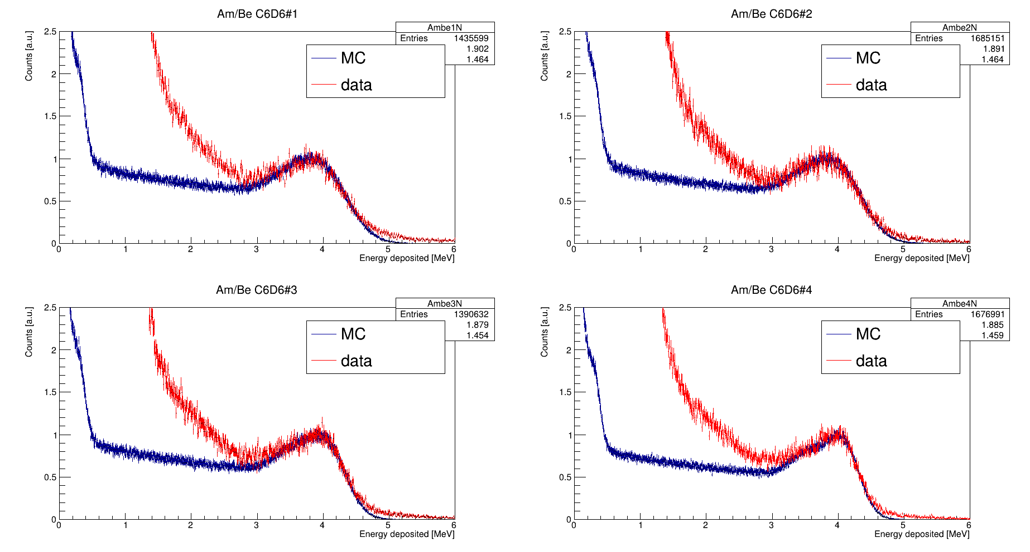
Resolution, calibration (+ MC)

Slide 22
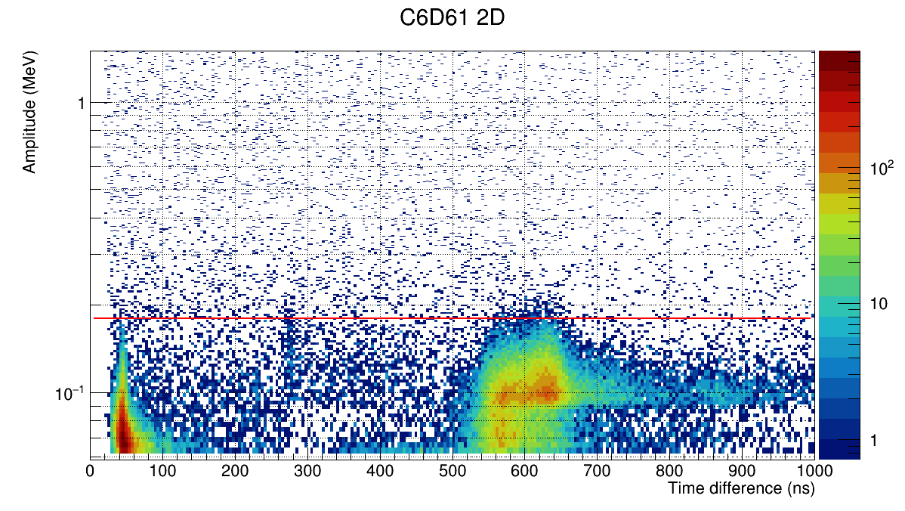
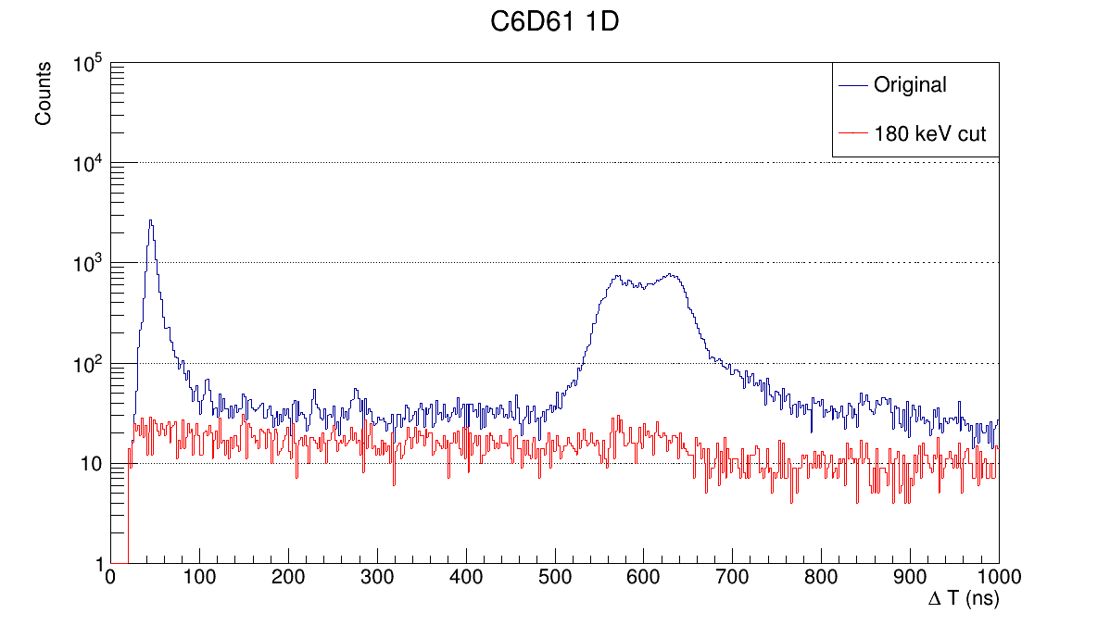
Low Thresholds: after pulse rejection and dead-time
40 ns
180 keV

Slide 23
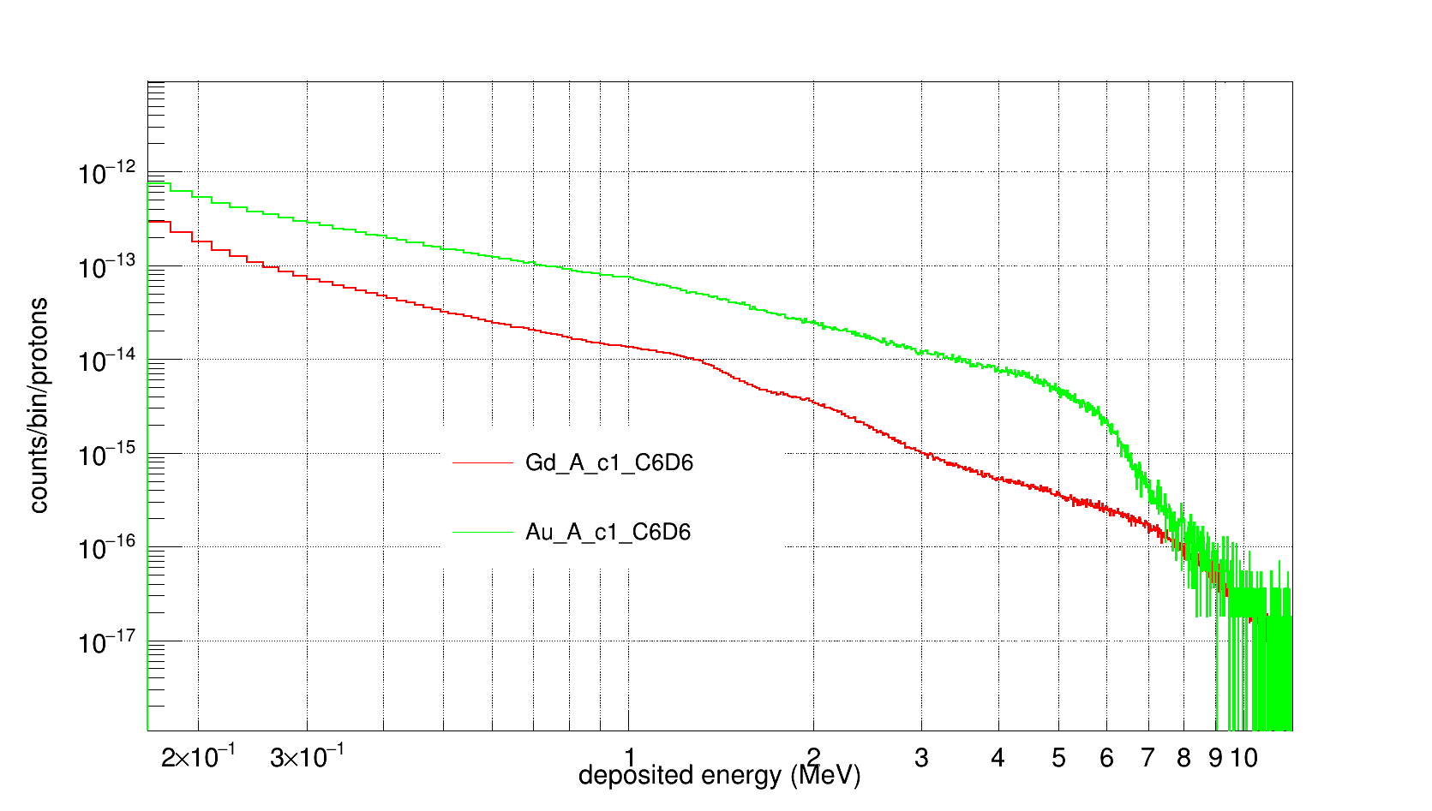
High Thresholds: HE background rejection
Sn_Au = 6.5 MeV
Sn_Gd = 5.6 MeV

Slide 24

High Thresholds: HE background rejection
Sn_Au = 6.5 MeV
Sn_Gd = 5.6 MeV
$$≈8.5 MeV$$

Slide 25
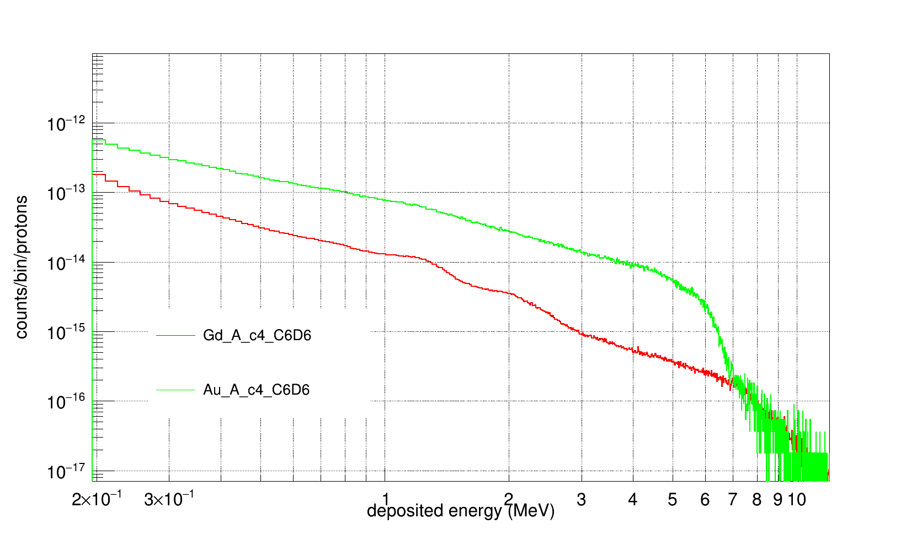
High Thresholds: HE background rejection
Sn_Au = 6.5 MeV
Sn_Gd = 5.6 MeV
$$≈8.5 MeV$$

Slide 26

High Thresholds: HE background rejection
Sn_Au = 6.5 MeV
Sn_Gd = 5.6 MeV
$$≈8.5 MeV$$
$$≈7.5 MeV$$

Slide 27
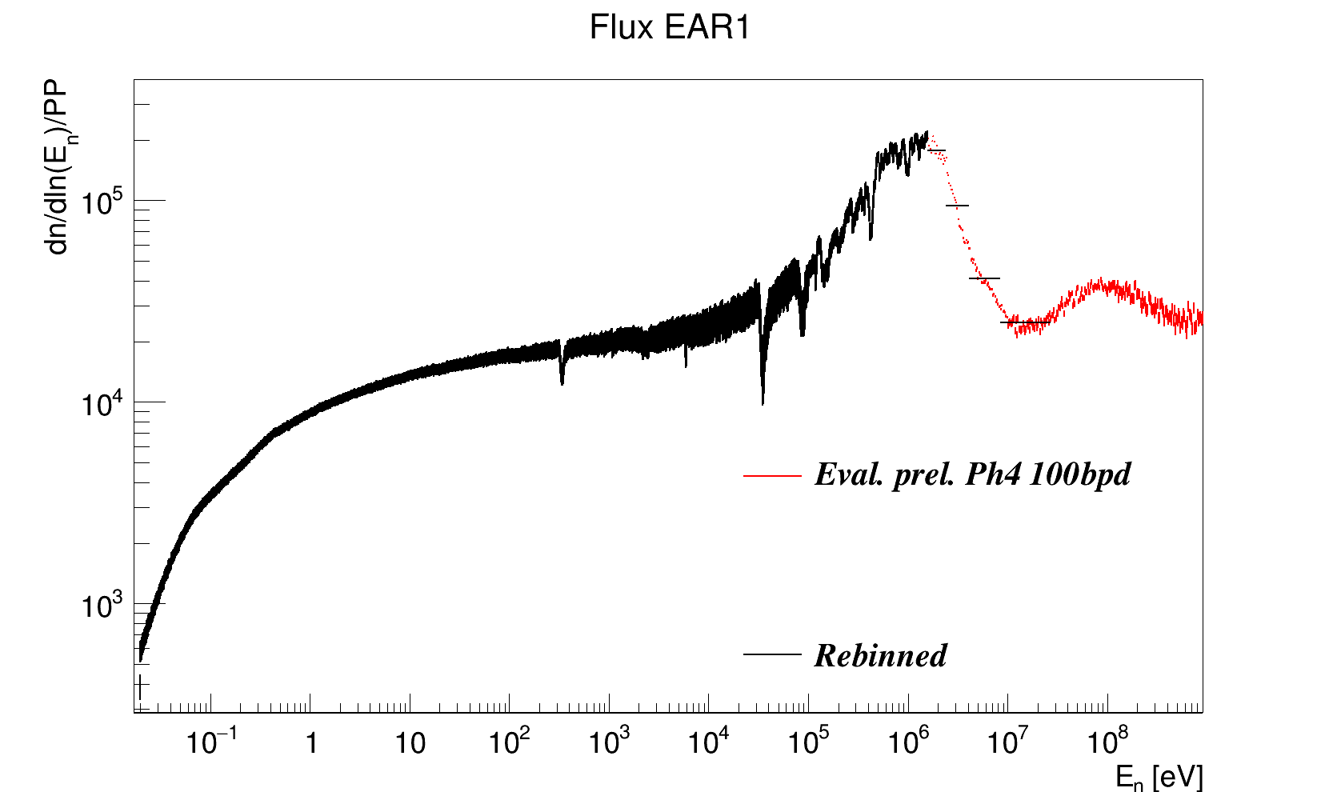
Evaluated Flux

Slide 28
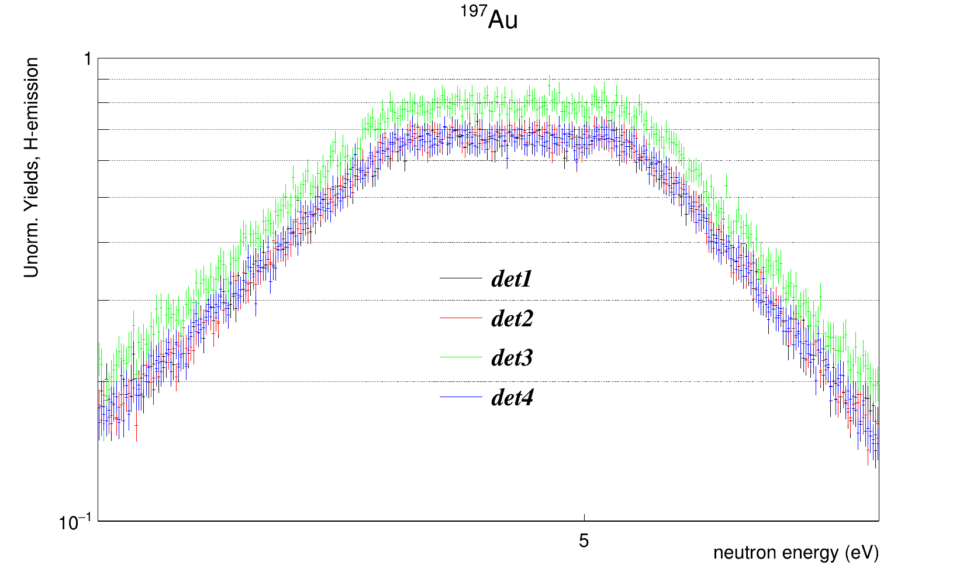
Au-197: normalization factors

Slide 29


Au-197: normalization factors
$$BIF ≈0.80$$
$$BIF ≈0.68$$

Slide 30
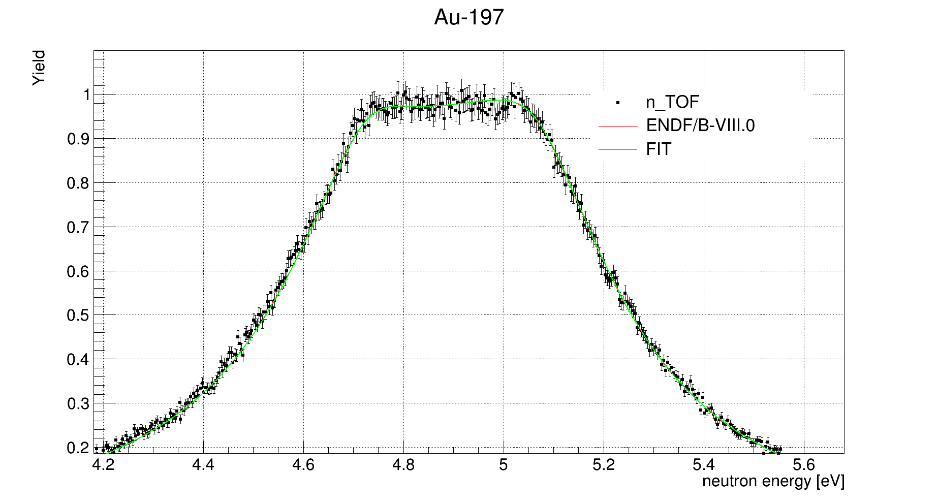
Au-197: TOF – neutron energy check
(transport code and SAMMY)

Slide 31
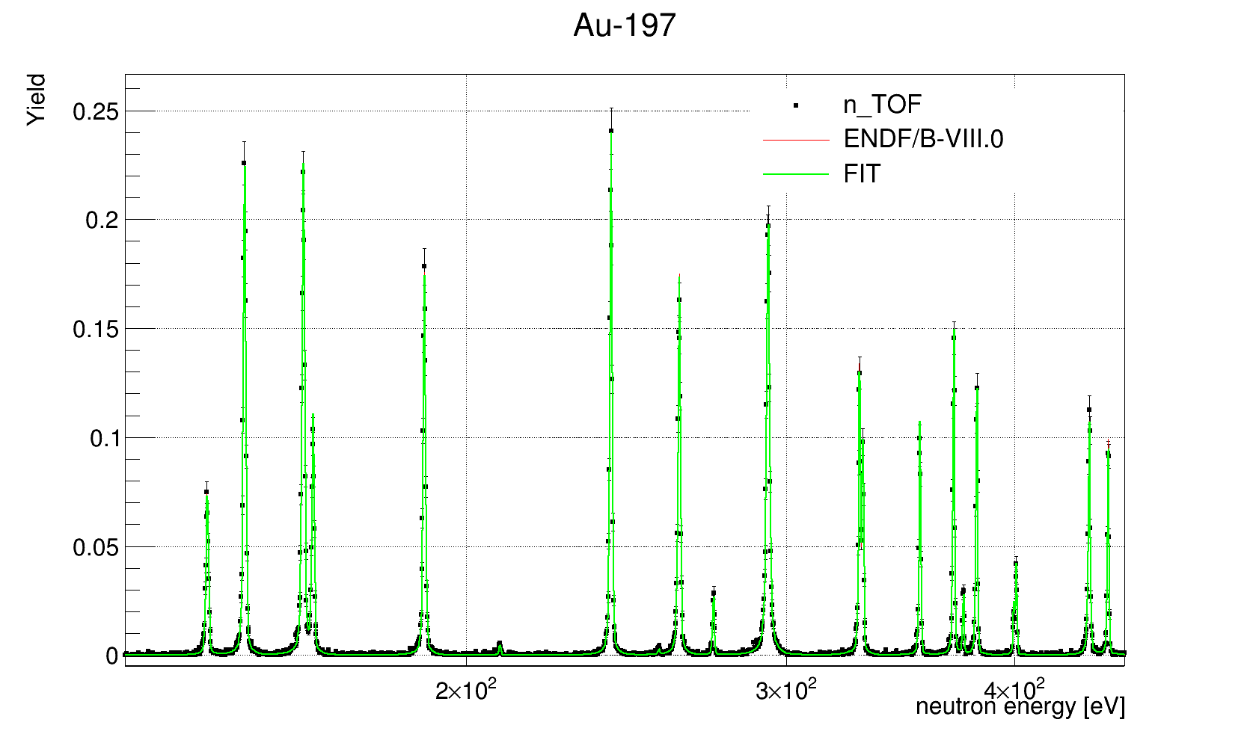
Au-197: TOF – neutron energy check
(transport code and SAMMY)

Slide 32
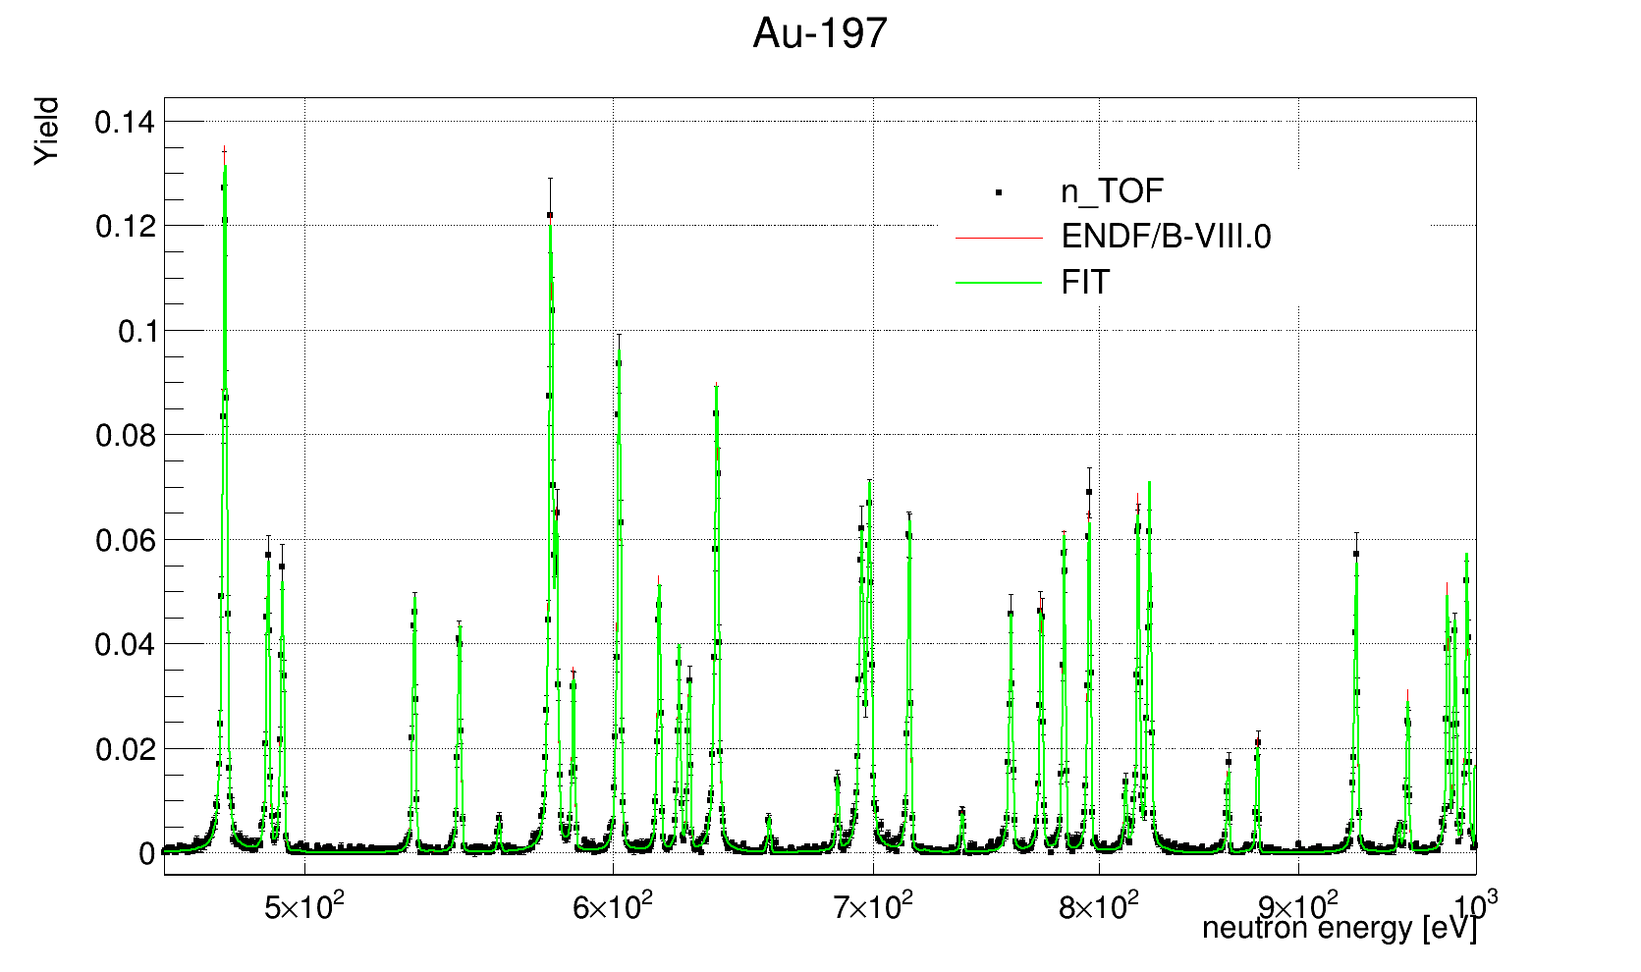
Au-197: TOF – neutron energy check
(transport code and SAMMY)

Slide 33
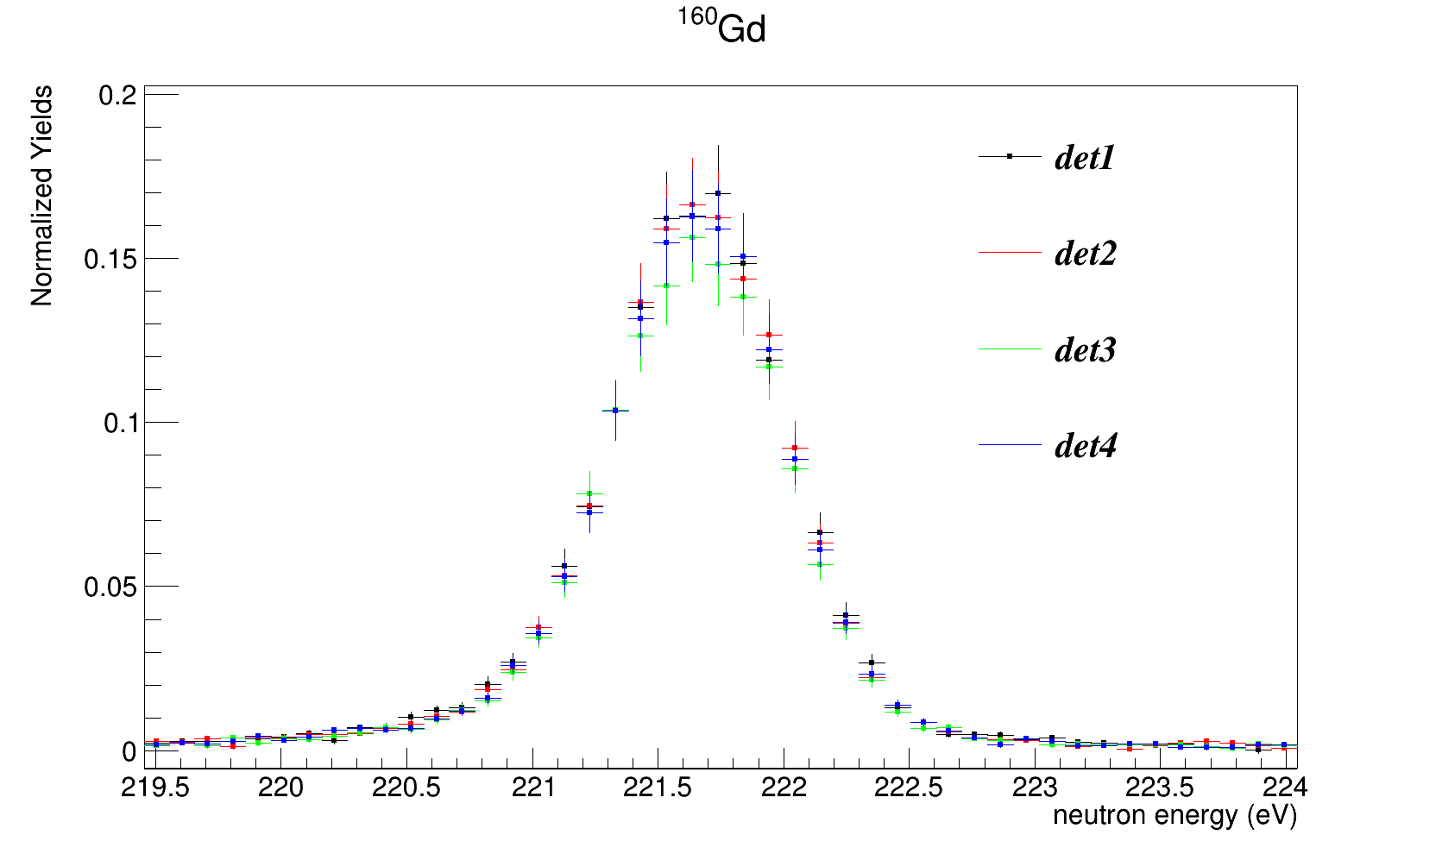
Gd-160: normalization factors

Slide 34
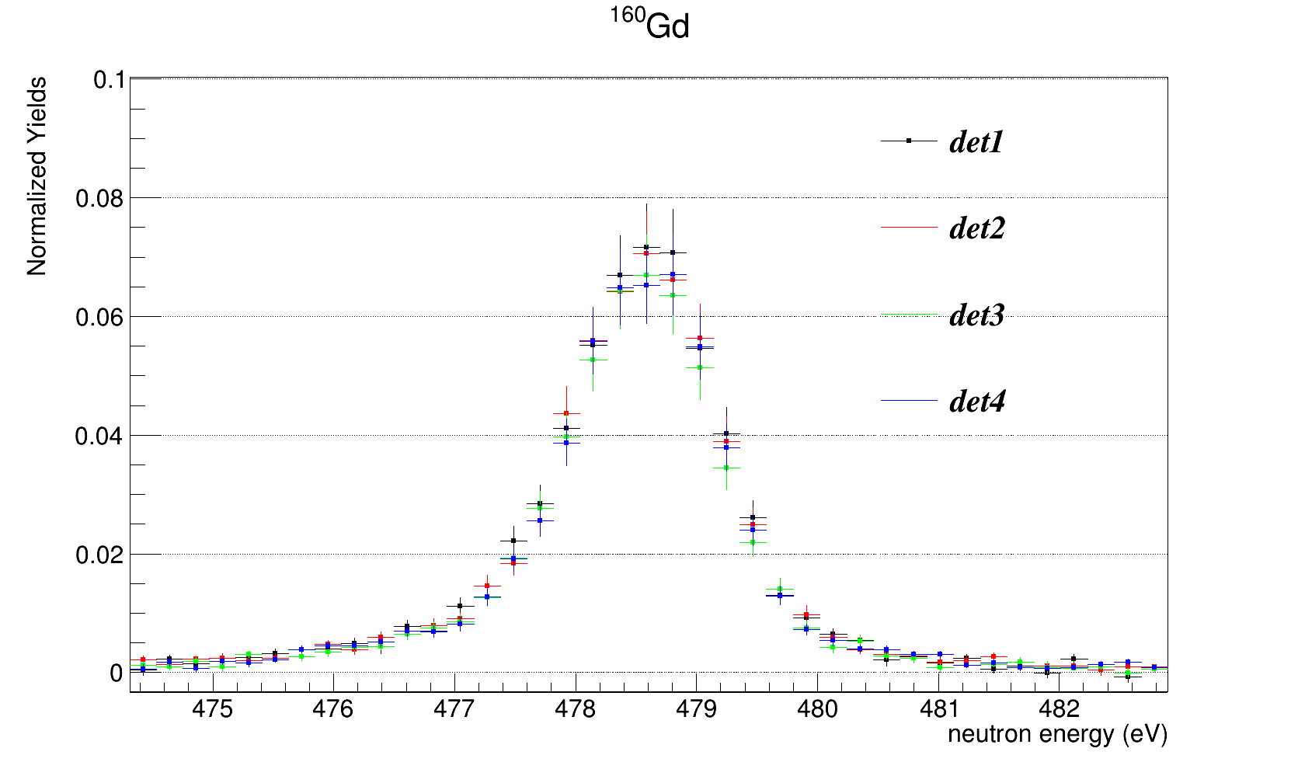
Gd-160: normalization factors

Slide 35
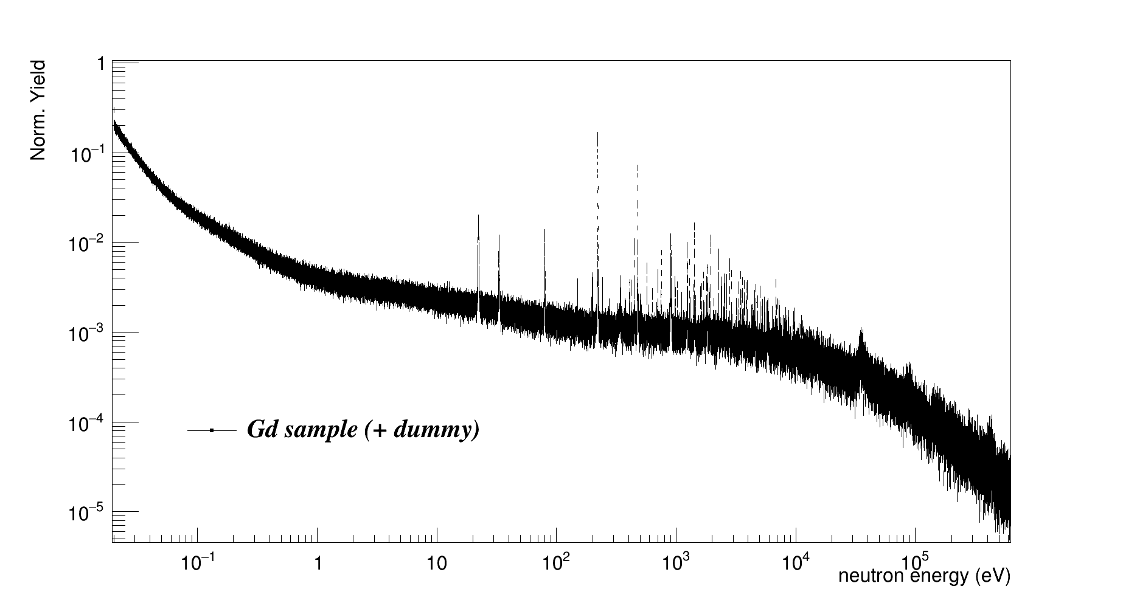
Yields…

Slide 36
Yields…
First ¹⁶⁰Gd resonance @220eV!!!

Slide 37
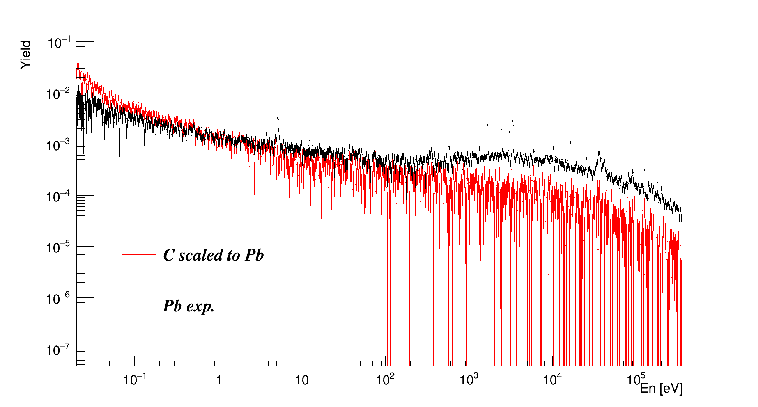
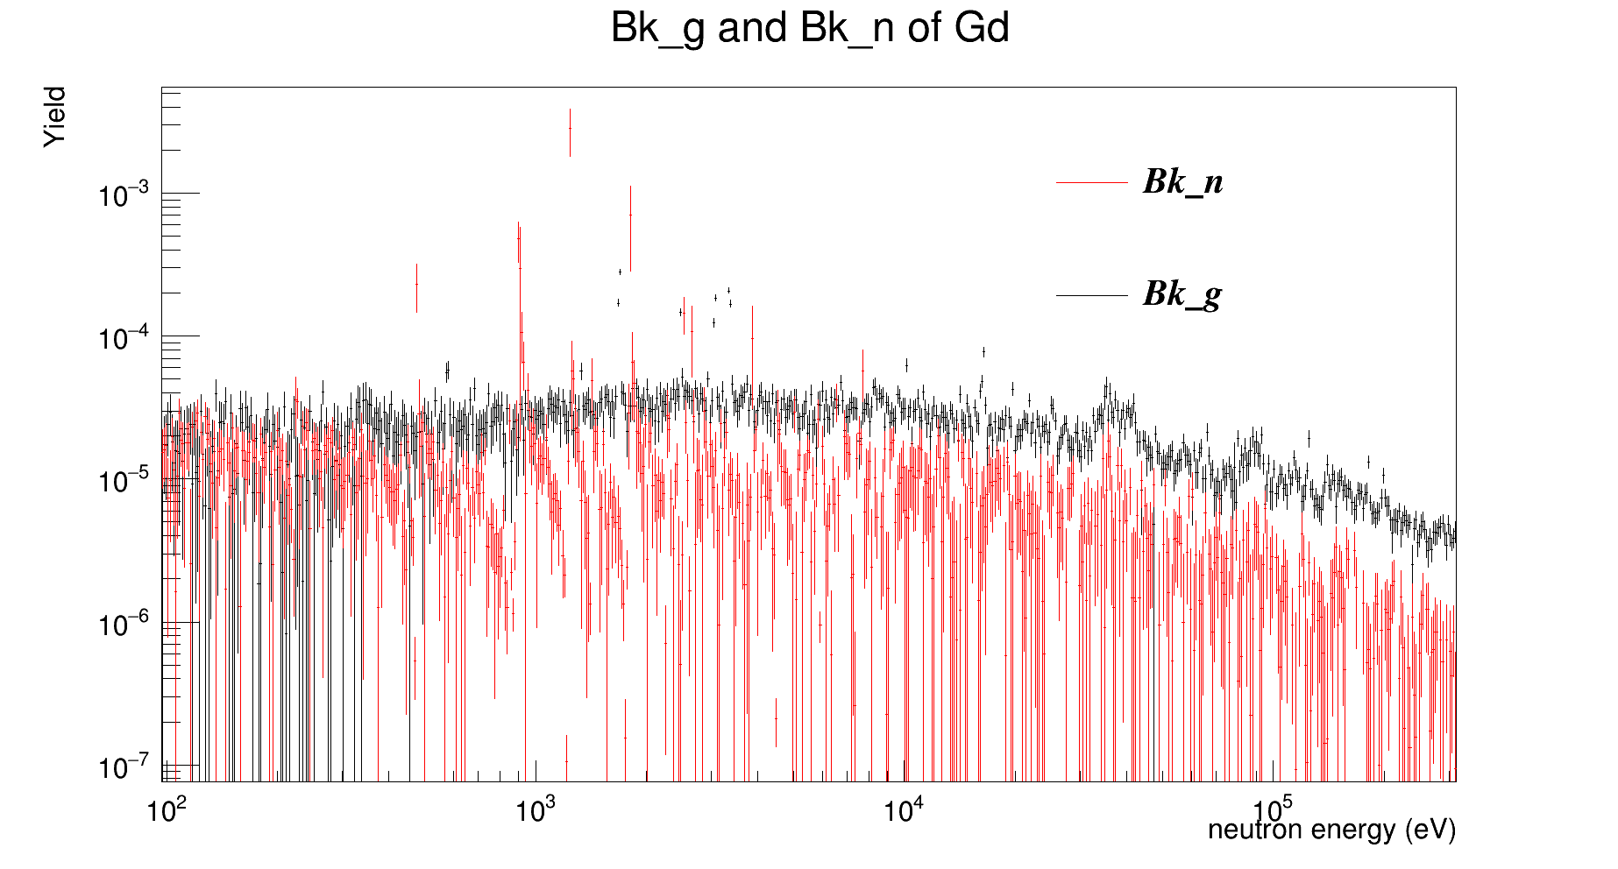
Elastic and Gamma background estimation

Slide 38
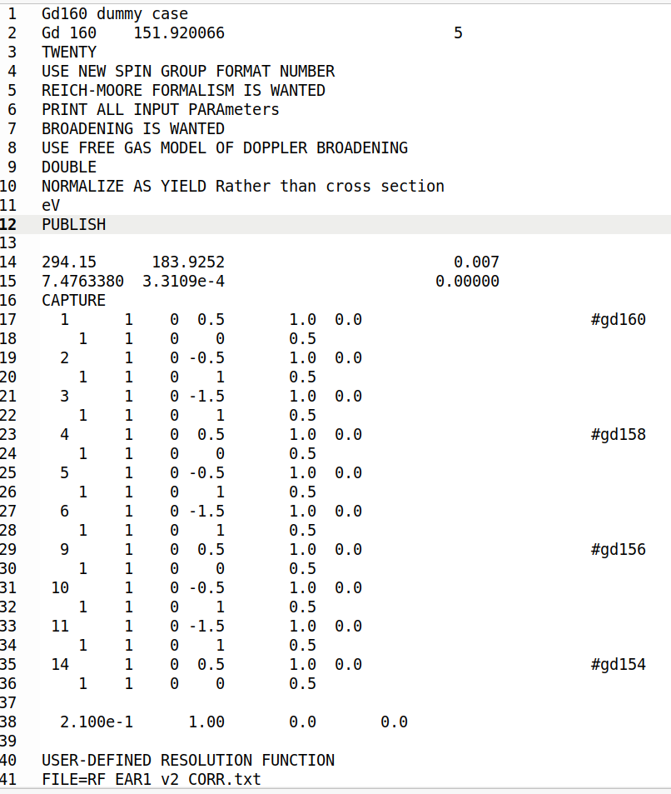
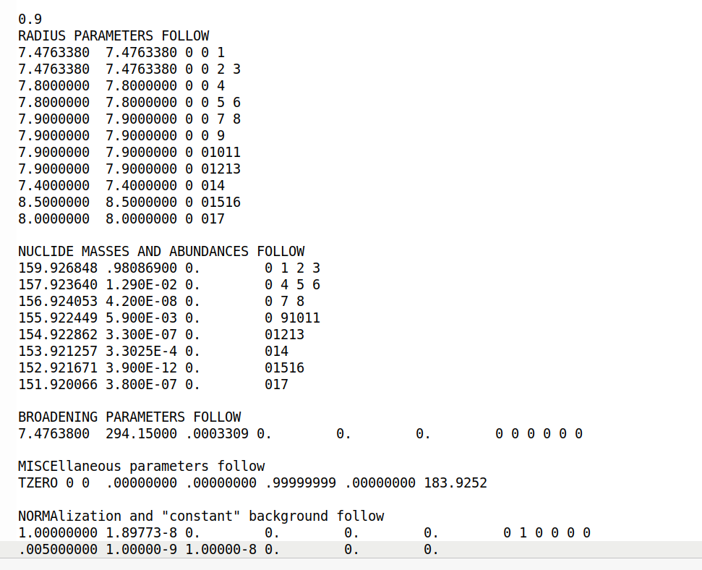
RSA by SAMMY code

Slide 39
RSA by SAMMY code

Slide 40
RSA by SAMMY code

Slide 41
RSA by SAMMY code

Slide 42
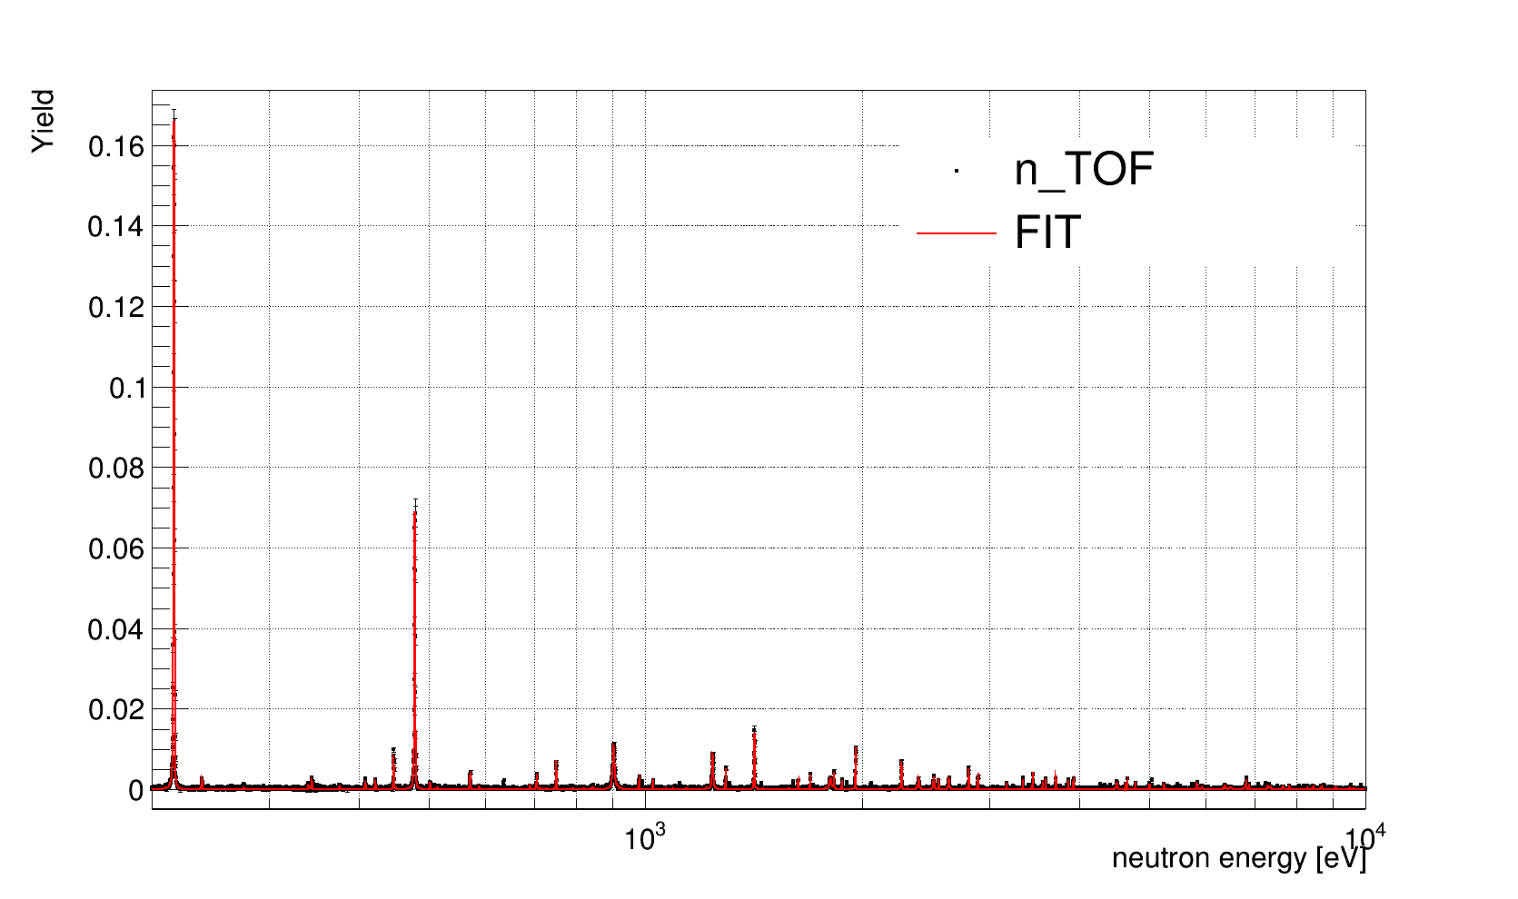
RSA up to 10 keV
ENDF/B-VIII.0 as initial parameters

Slide 43
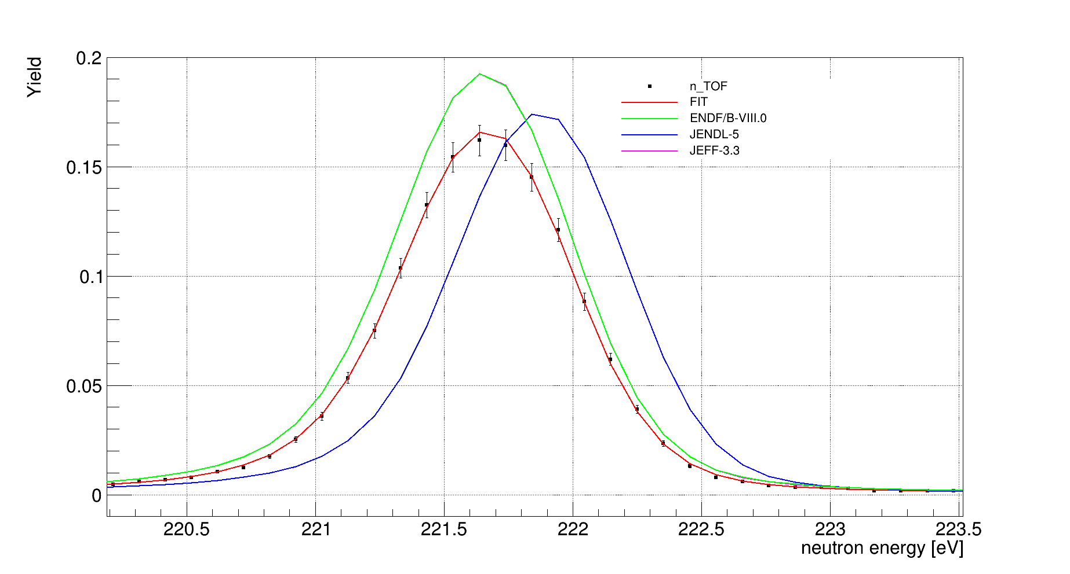
Main ¹⁶⁰Gd capture resonance

Slide 44
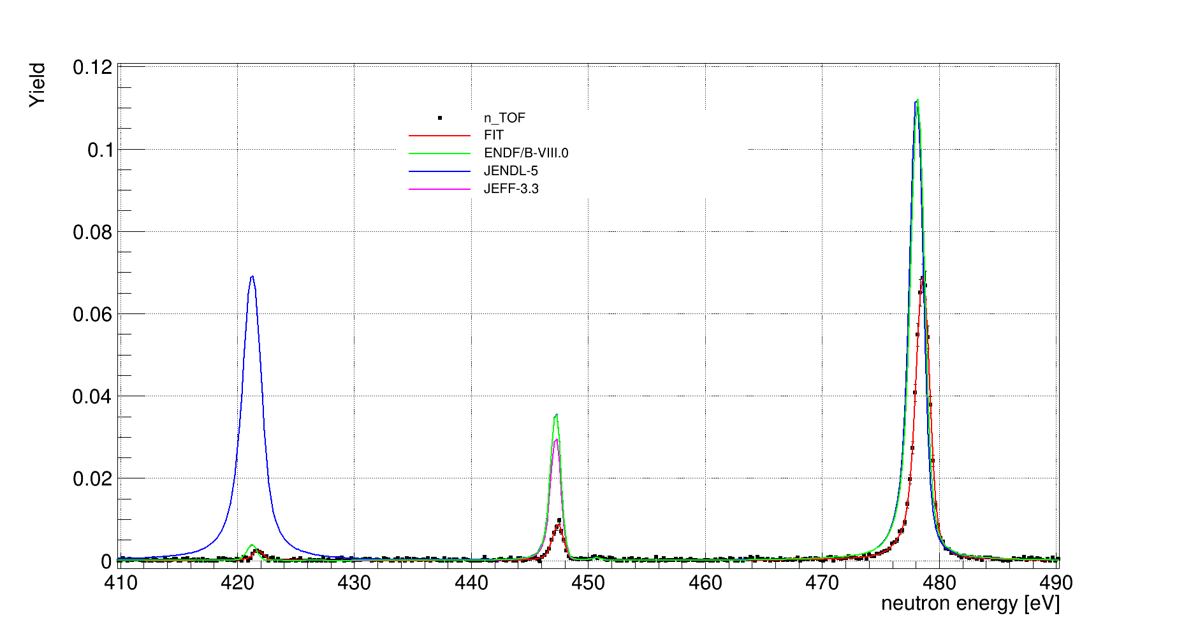
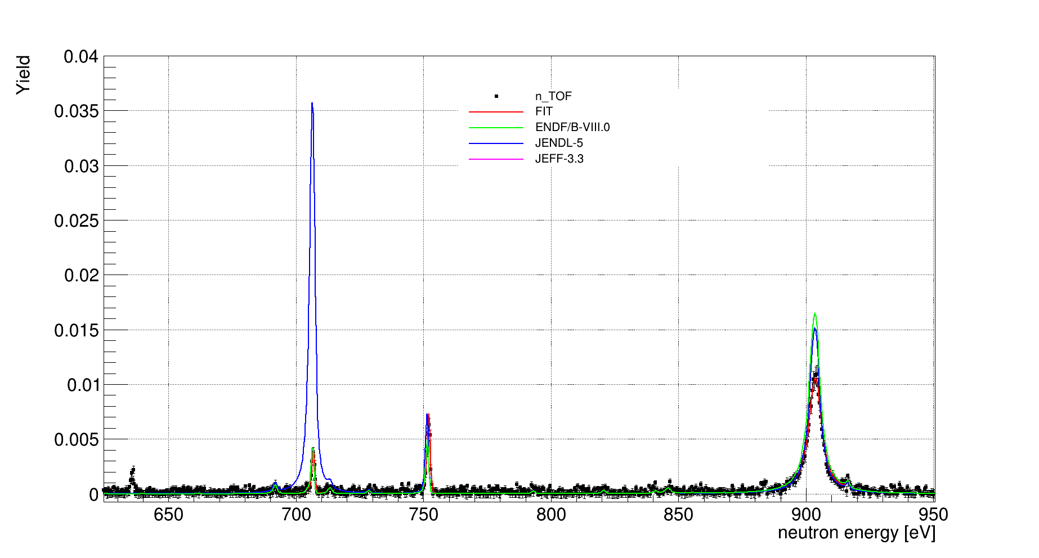
RSA…

Slide 45
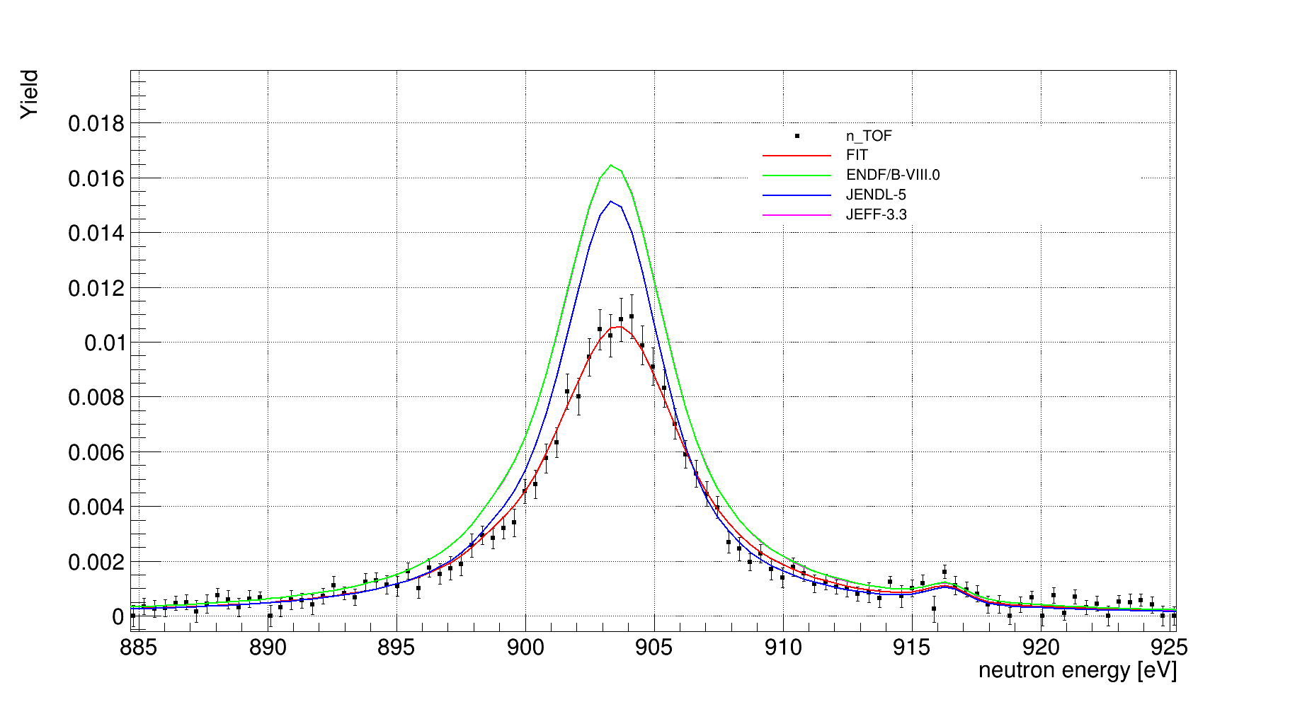
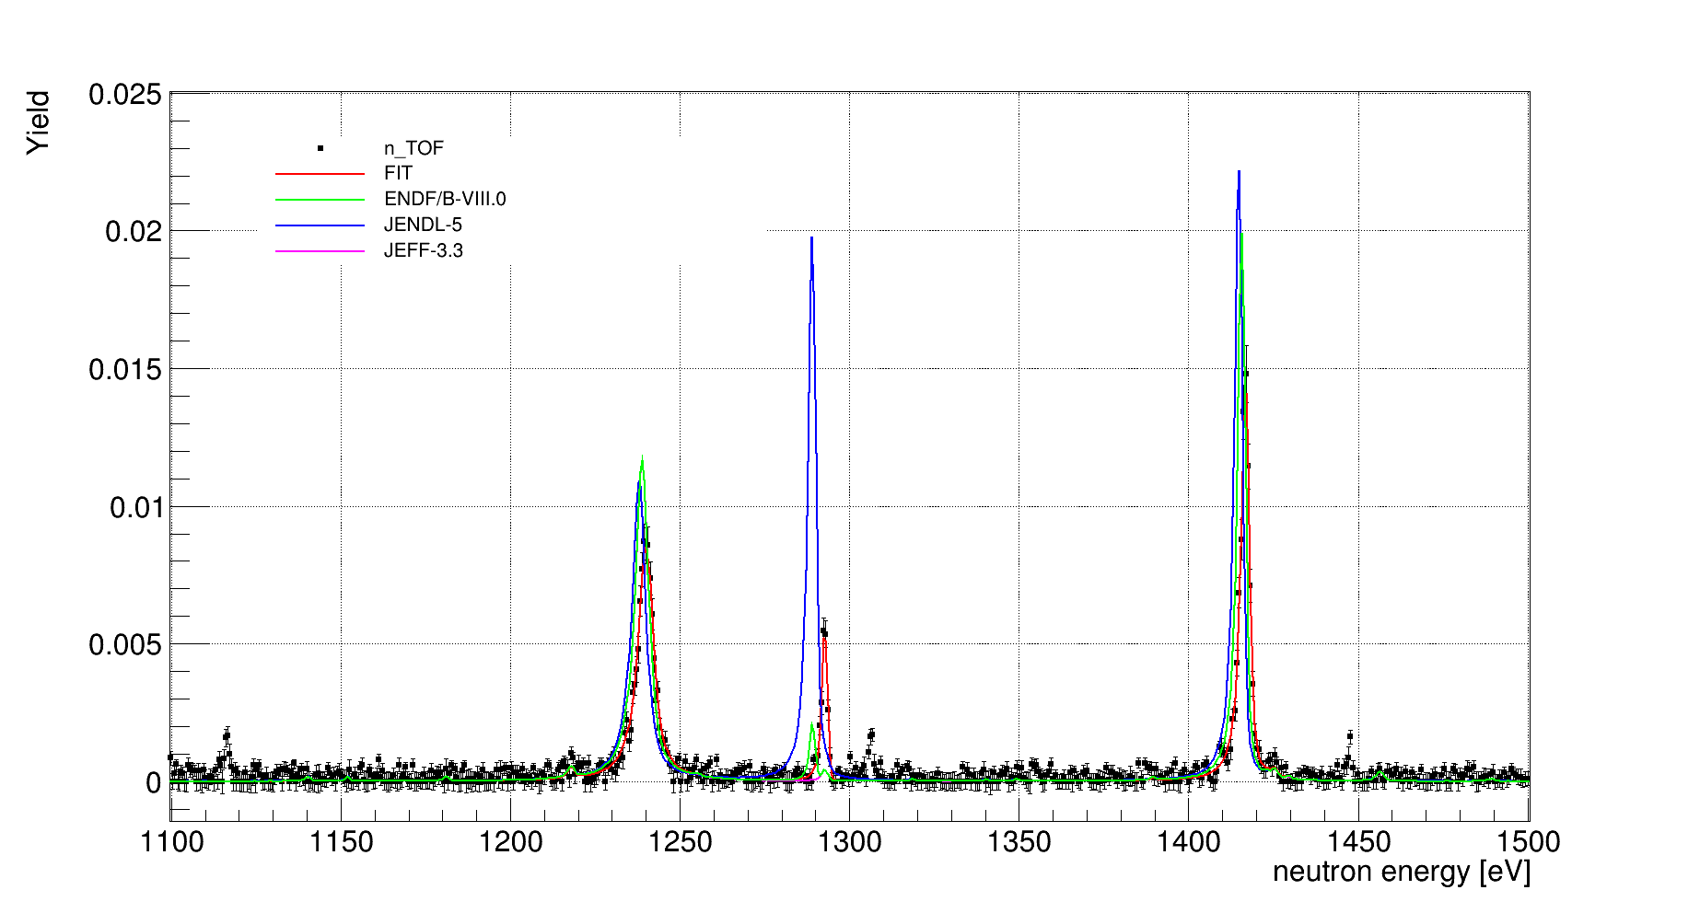
RSA…

Slide 46
unricognized structures
RSA…

Slide 47
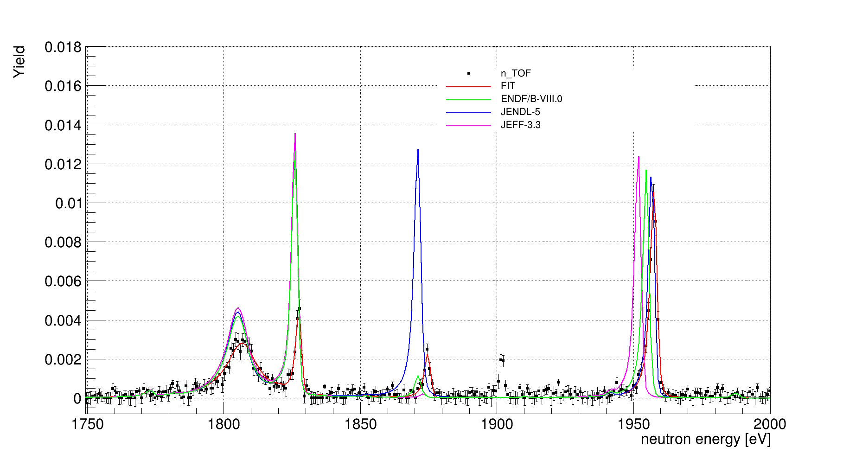
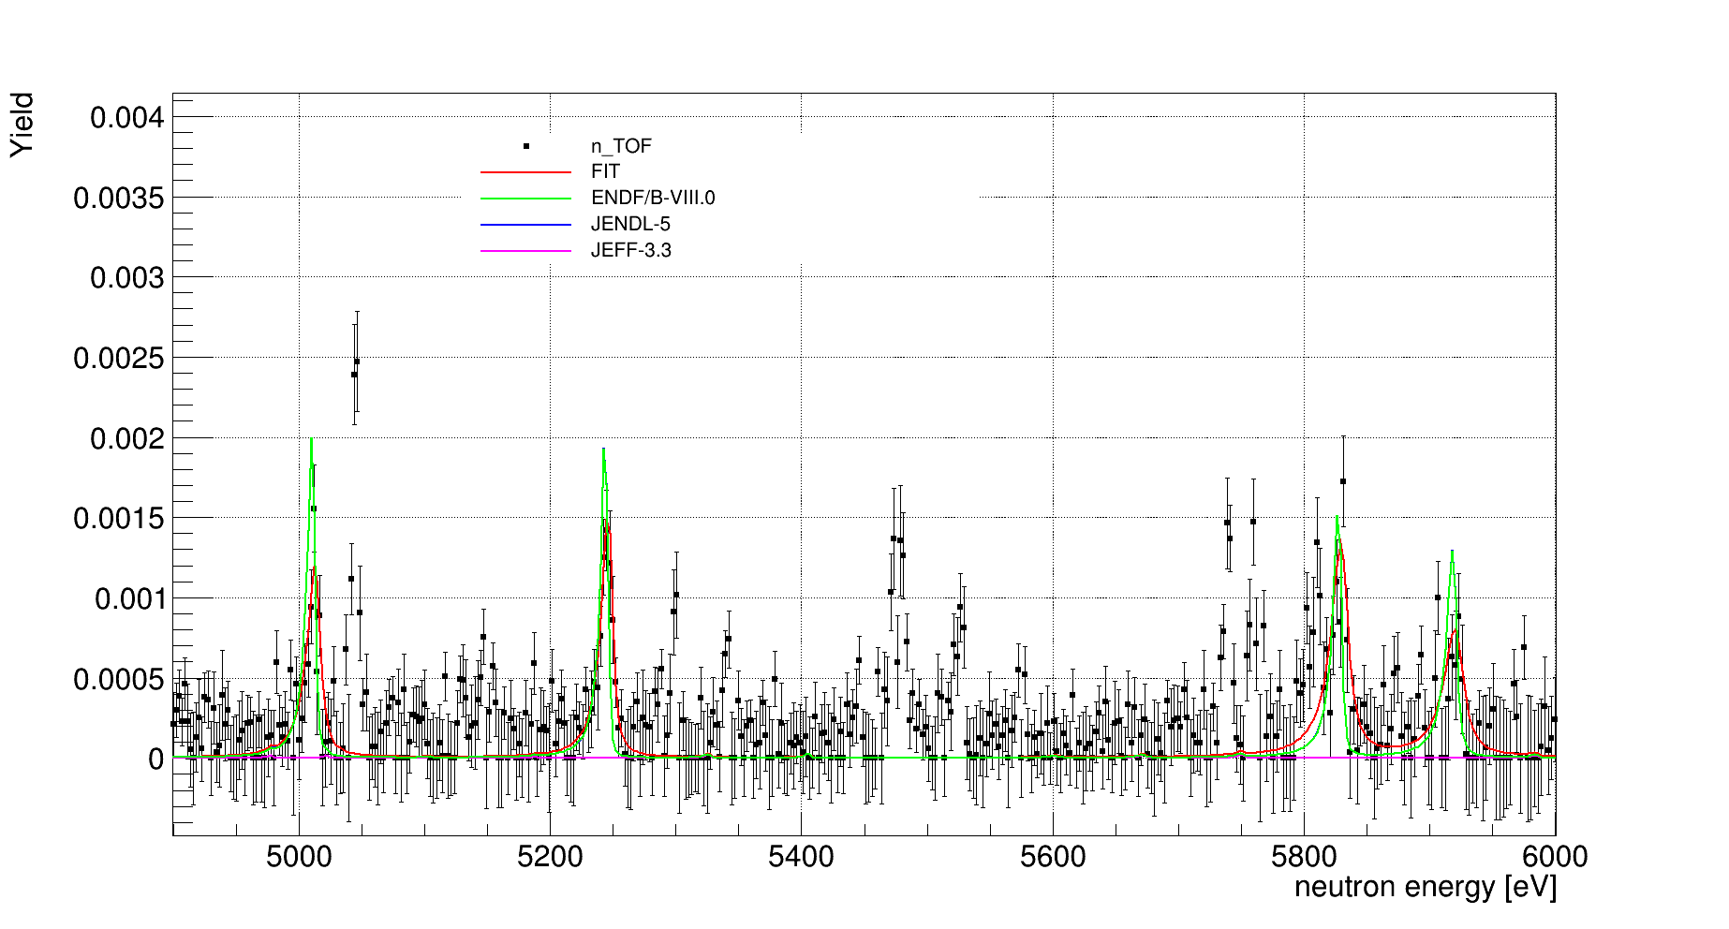
unricognized structures
RSA…
Mario Mastromarco @ n_TOF Italia, 9-10 Novembre, Trieste (IT)
47

Slide 48
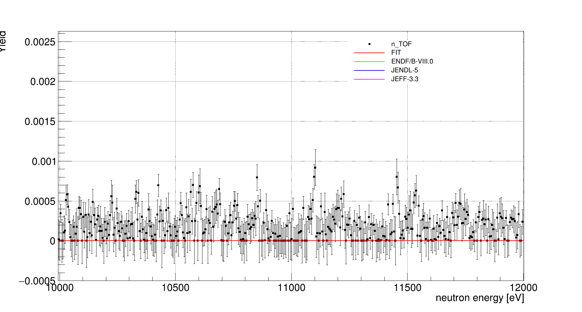
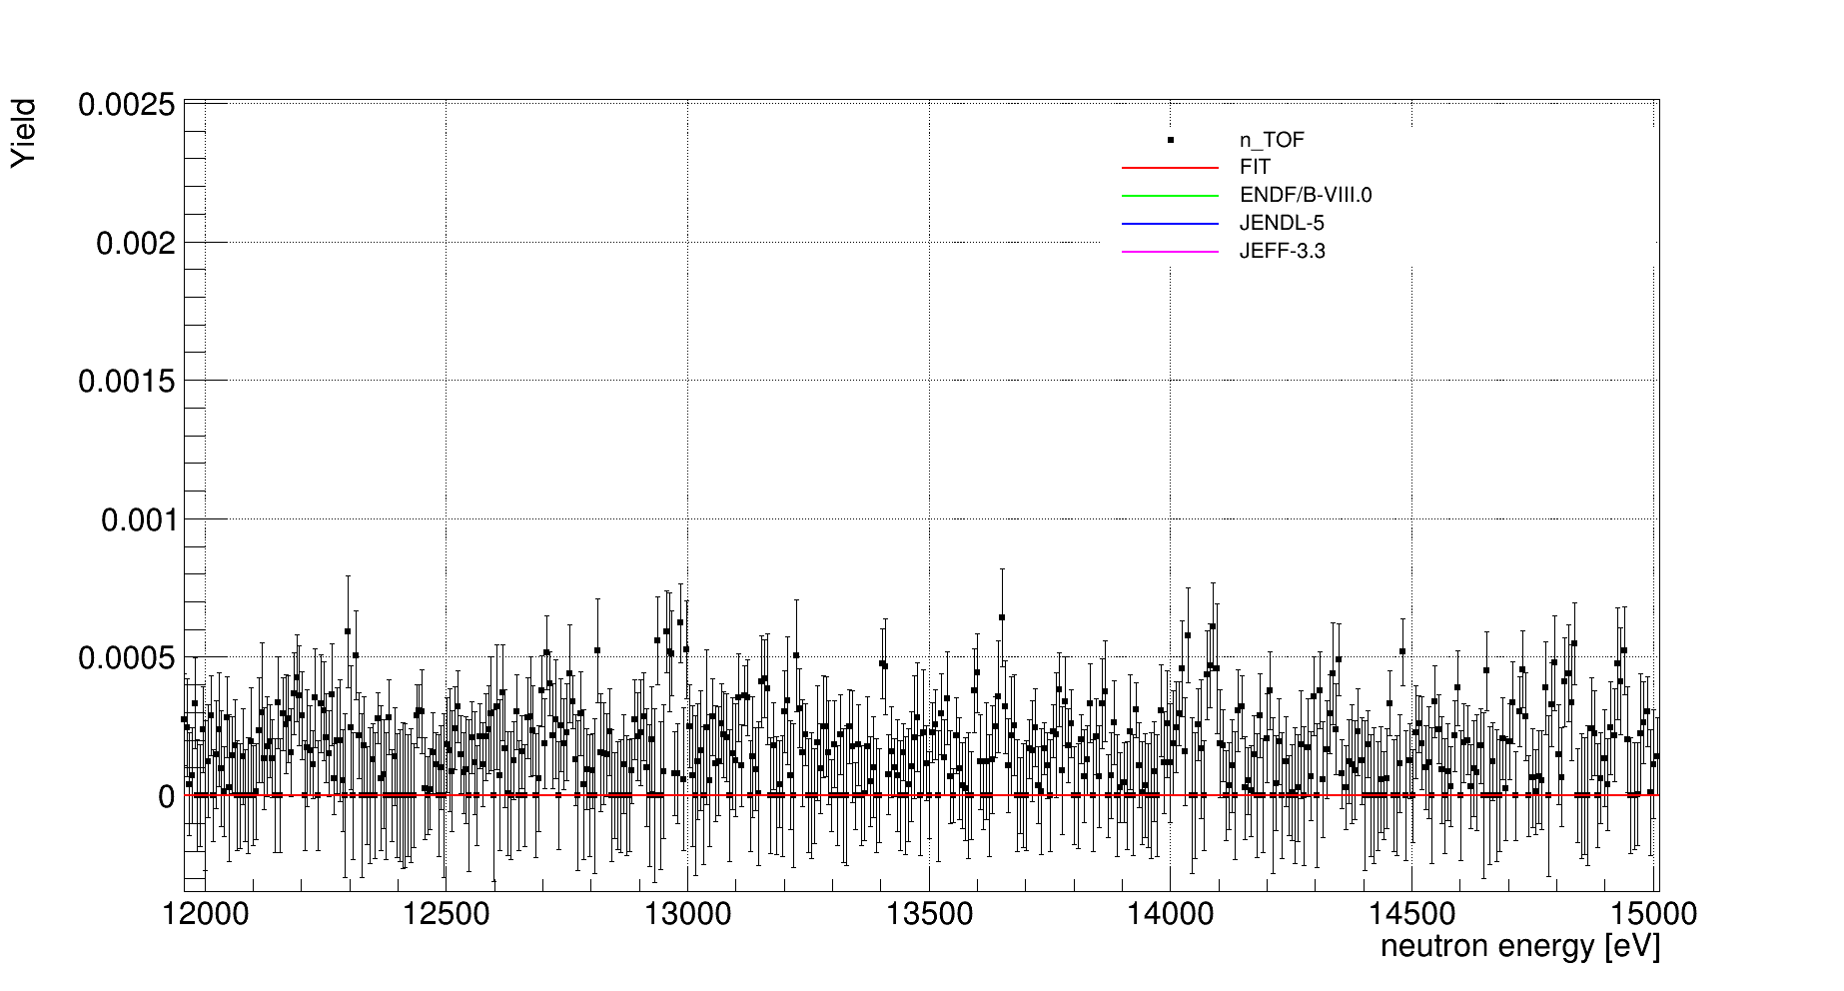
unricognized structures above 10 keV

Slide 49
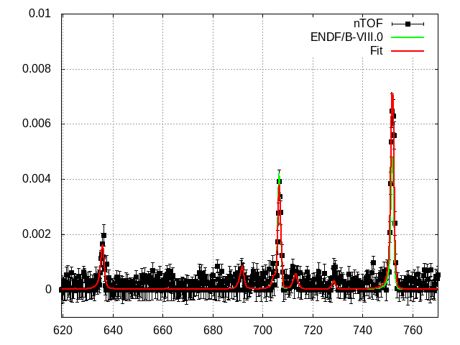
structure @ 635 eV

Slide 50
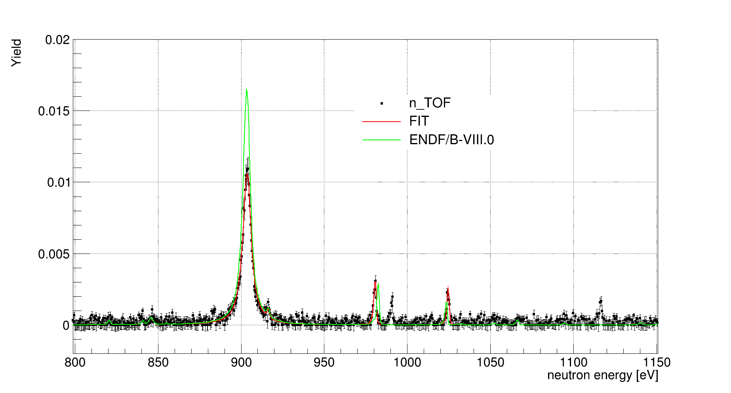
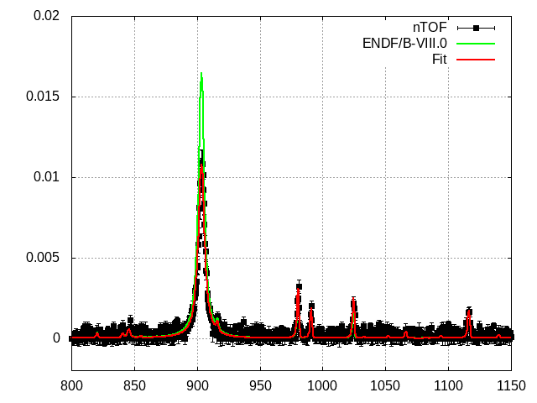
structures between 800 and 1150 eV

Slide 51
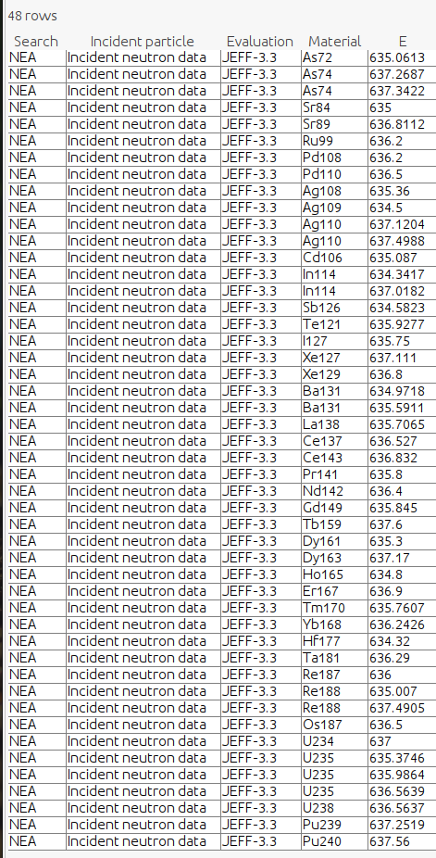
JEFF
tructure @ 635 eV

Slide 52
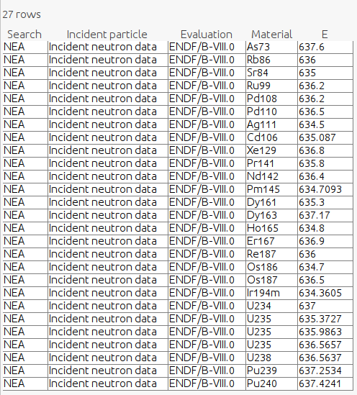
JEFF
tructure @ 635 eV
ENDF

Slide 53
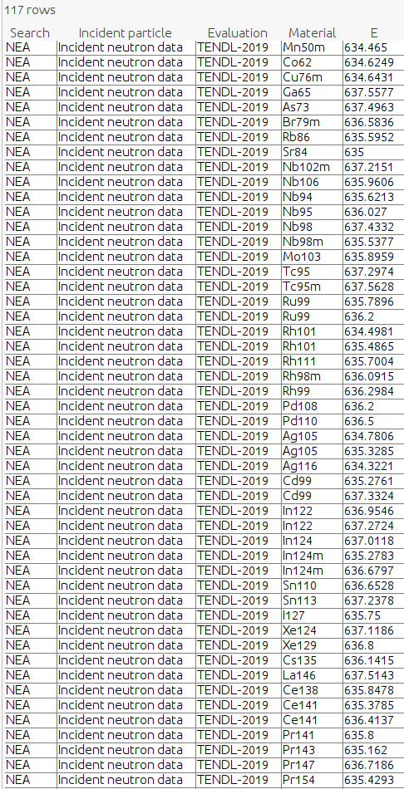
JEFF
TENDL
tructure @ 635 eV
ENDF

Slide 54
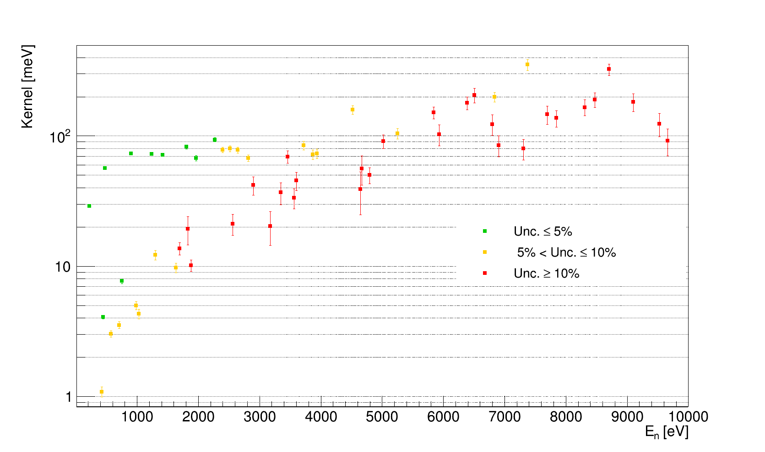
Extracted kernels

Slide 55
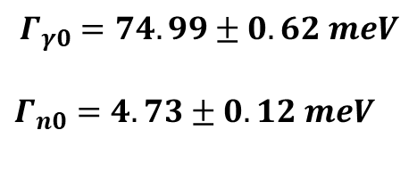
Extracted kernels
$$Γ_{γ0}=74.99±0.62 meV$$
$Γ_{n0}=4.73±0.12 meV$

Slide 56
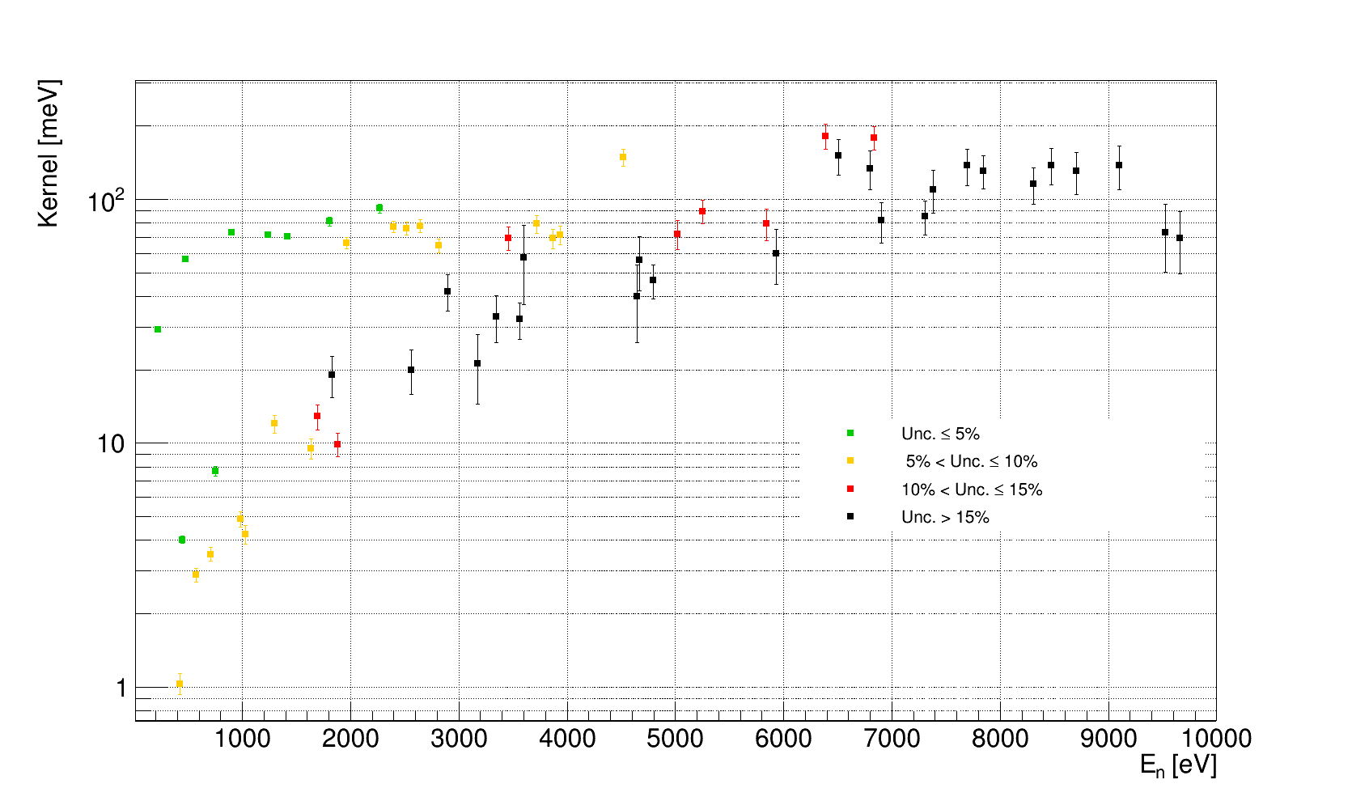
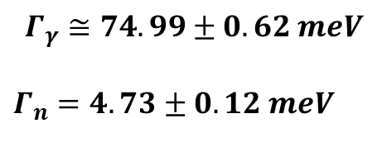
Extracted kernels (Known)
$$Γ_{γ}≅74.99±0.62 meV$$
$Γ_{n}=4.73±0.12 meV$

Slide 57
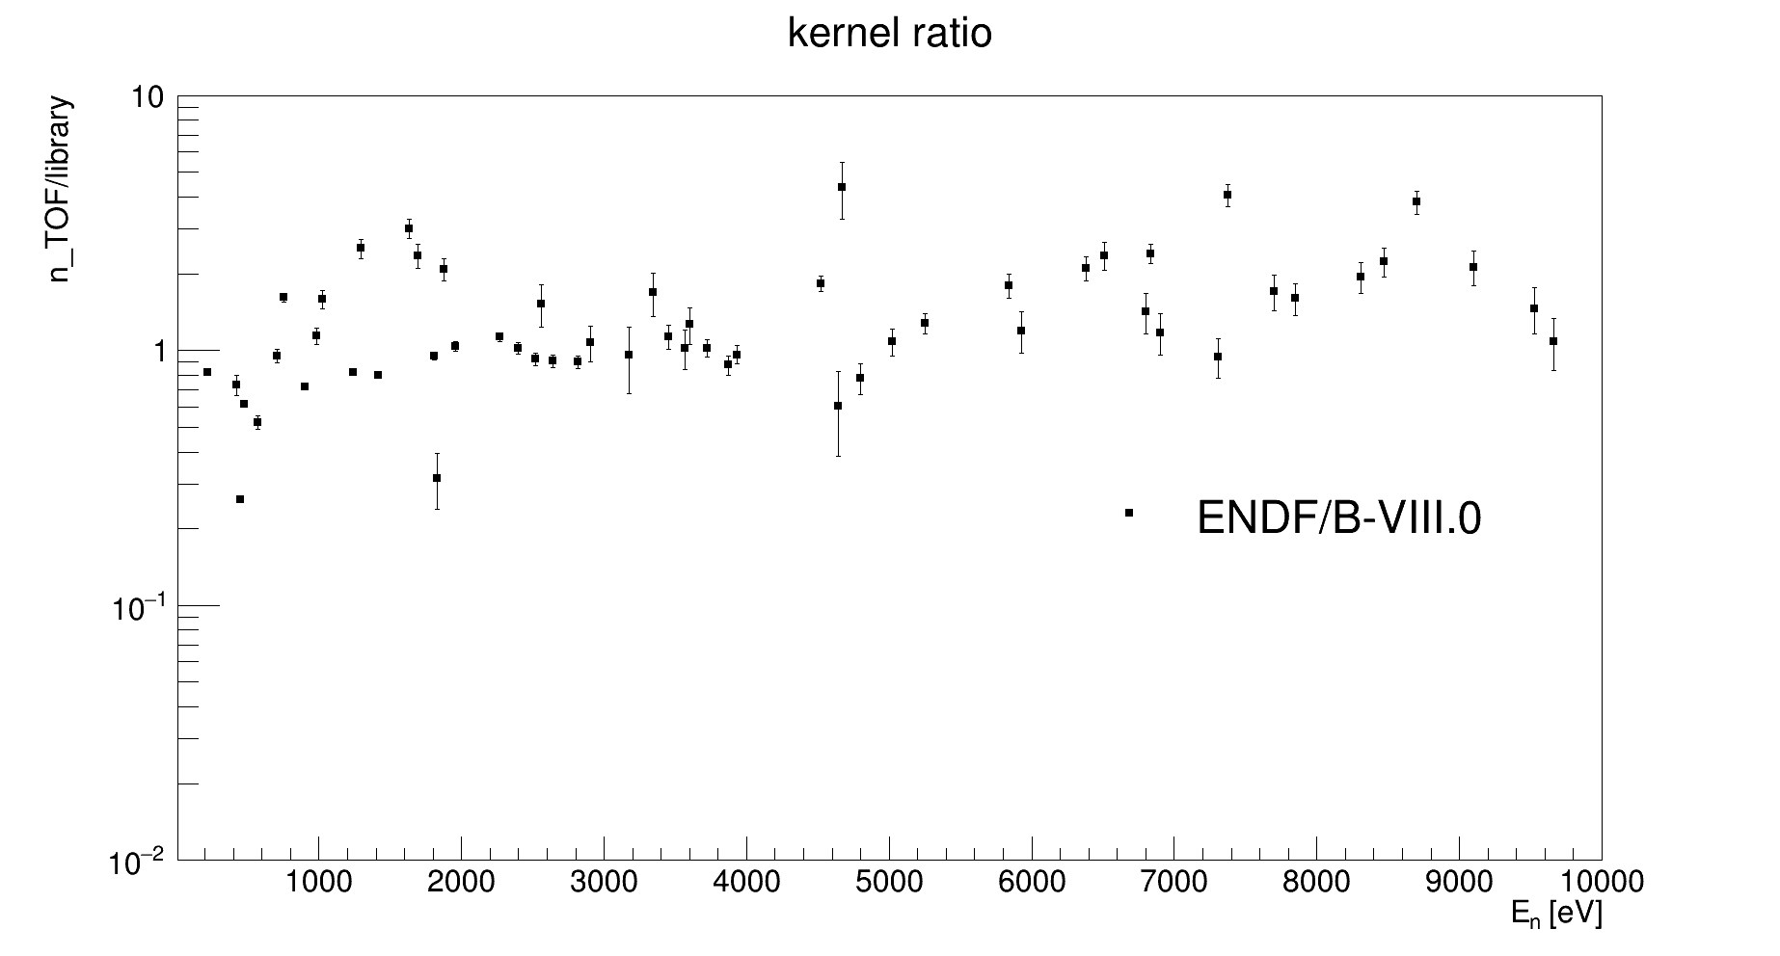
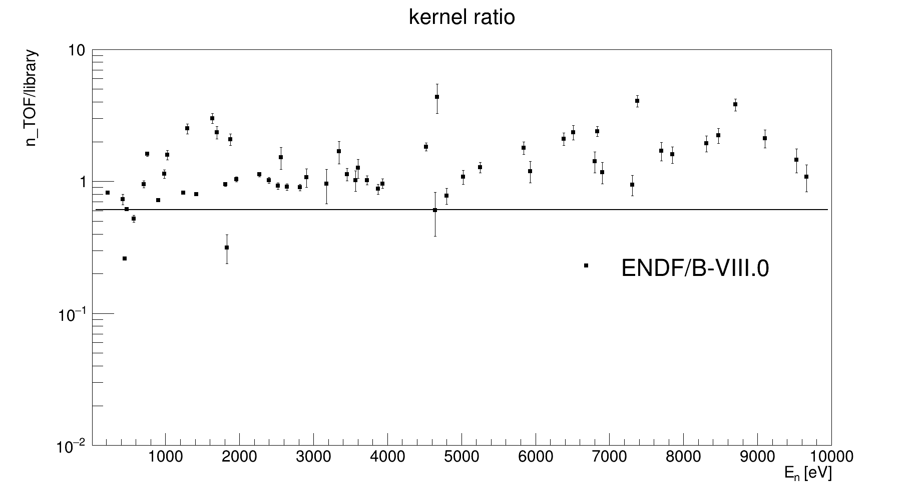
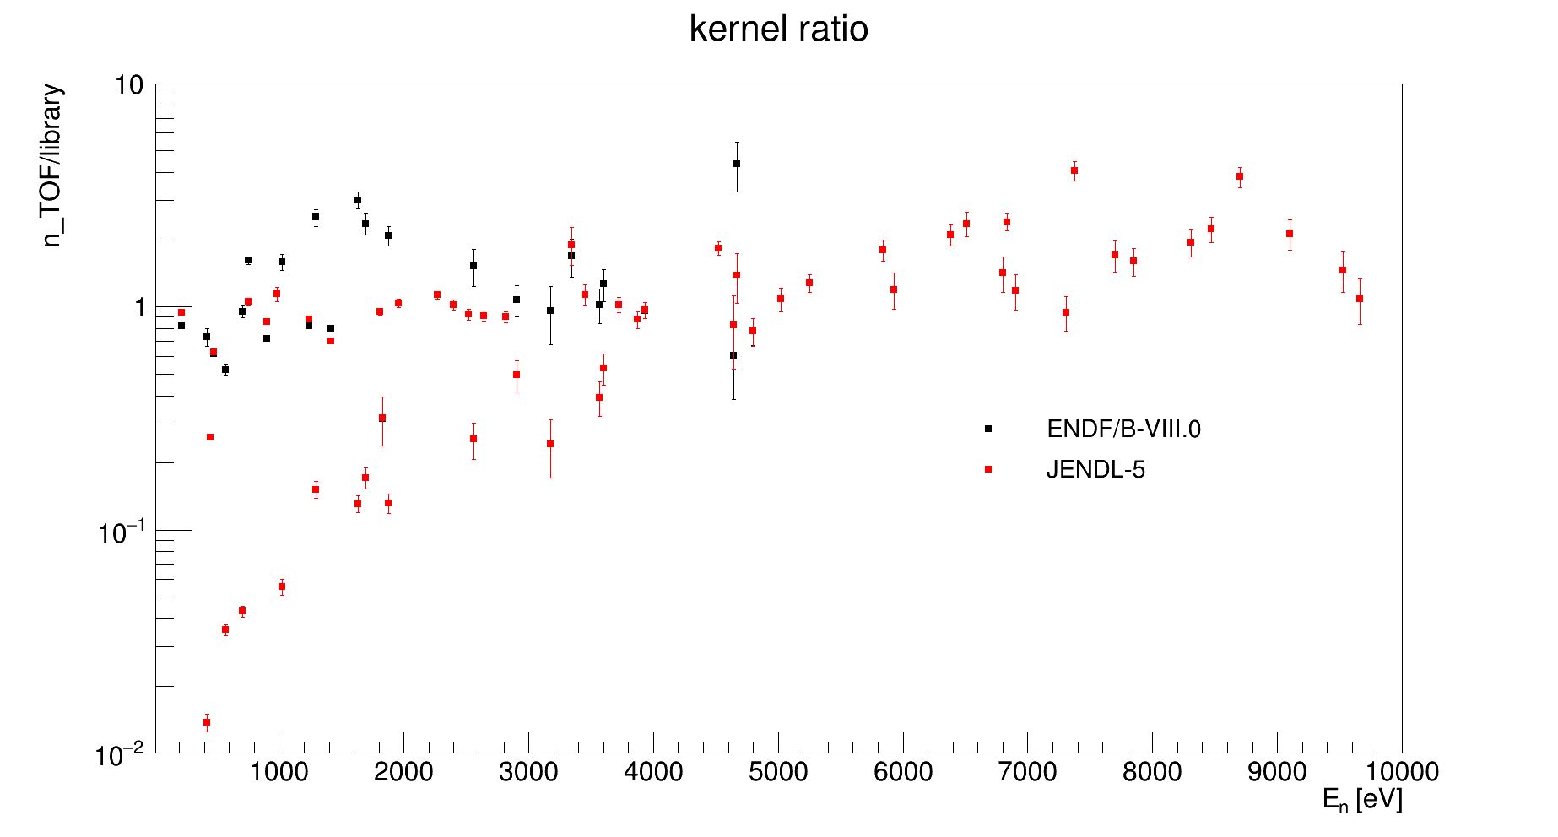



Extracted kernels (Known)
n_TOF/ENDF $≈0.61$
n_TOF/JENDL $≈0.05$

Slide 58

Extracted kernels (new Resonances)

Slide 59


URR
Bk SUBTRACTED

Slide 60
URR

Slide 61
EAR2
(Thermal and Resolved Resonances Region)

Slide 62
sTED scintillators
Whole Energy Range
Thermal Region

Slide 63
sTED scintillators: Calibrations and Resolutions

Slide 64
sTED scintillators: Calibrations and Resolutions

Slide 65
sTED scintillators: Calibrations and Resolutions

Slide 66
Gold normalization @ 4.9 eV

Slide 67

Gold normalization @ 4.9 eV (after correction)

Slide 68


Comparison with previous work
Without Fdtpu correction
Fdtpu corrected

Slide 69
Conclusions
EAR1: CONCLUDED
Kernel average uncertainty ≤ 12.0 %
Dummy background subtracted + in beam γ-rays
RRR analized by R-matrix SAMMY Code + unsigned structures + URR
EAR2: DONE and TO DO
Implementation of the Setup geometry and energy loss (MC code) to get the WF for the PHWT
Dedicated pile-up and dead time corrections by MC code
Background subtraction and capture yield analysis

Slide 70
Thank You

Slide 71
backup

Slide 72
Conclusions (EAR2)
The ¹⁶⁰Gd(n,γ) has been measured from thermal to a few hundreds of keV in both n_TOF experimental area
The preliminary results have a good S/B ratio in the thermal and in RRR
TO DO
Implementation of the Setup geometry and energy loss (MC code) to get the WF for the PHWT
Extract the Yield from Weighted Counts and normalize at @4.9 eV of Au
Study of the reaction at low neutron energies and the RRR

Slide 73

Samples: Gd sample, X-ray Spectroscopy
Negligible inhomogeneity!!!

