Slide 1
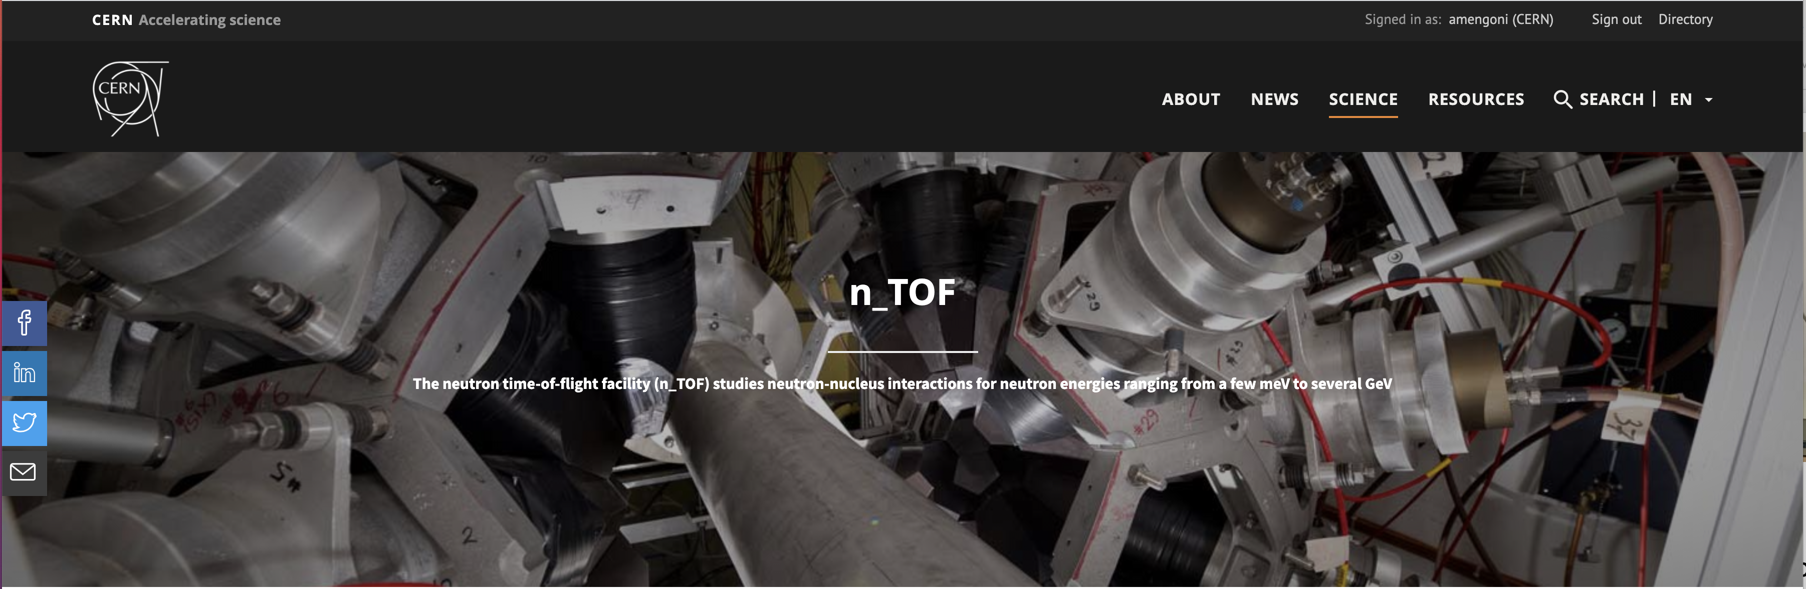

News from CERN
29 April 2025
www.cern.ch/n_TOF
alberto.mengoni@cern.ch

Slide 2
News from CERN
Meetings in May
22-23 May (THU-FRI), 23 May CB
EURO-LABS
INTC-P-689 (RAMEN) – (Nicholas P, Alice B)
INTC-P-732 (Mg-25) – (Cristian M, Rudra S, Roberto Z, Diego V)
n_ACT@BFD

Slide 3
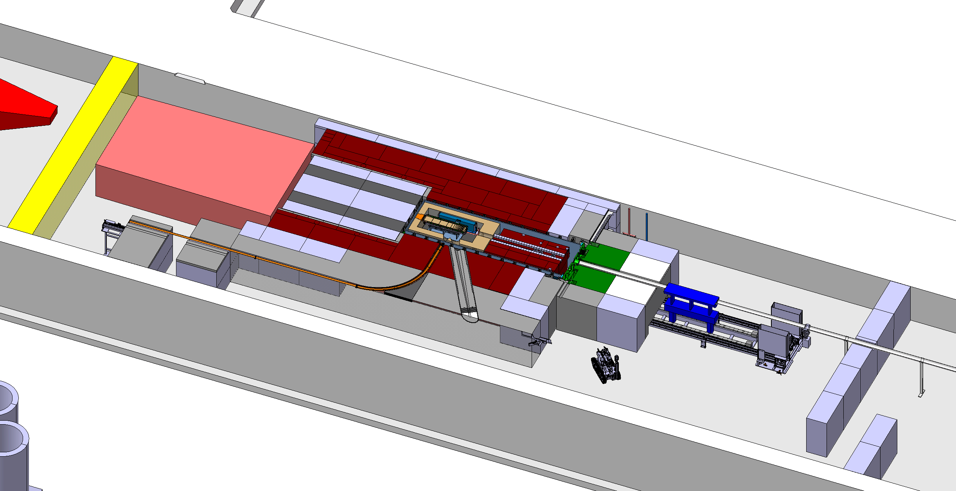
n_ACT@BDF

Slide 4
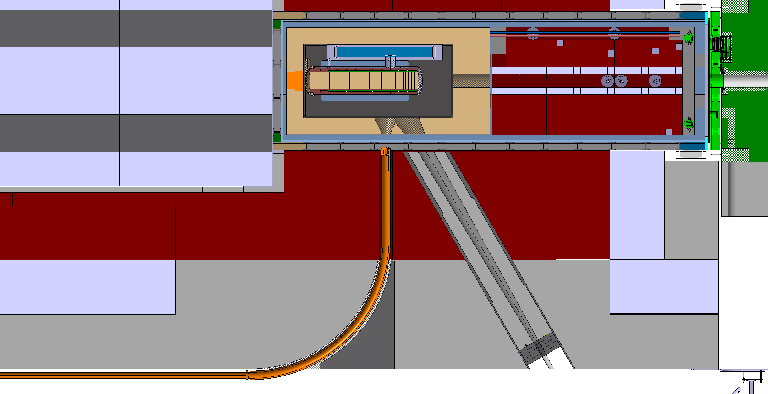
n_ACT@BDF

Slide 5
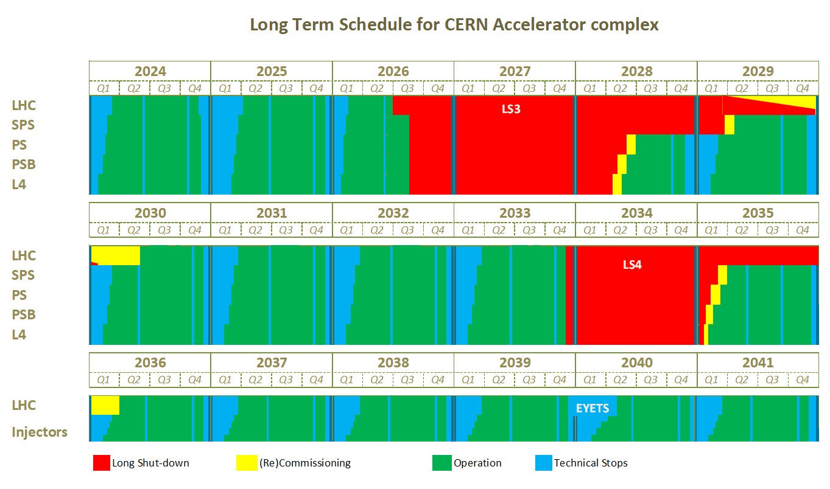
released on 19 February 2025

Slide 6
The End

