Slide 1
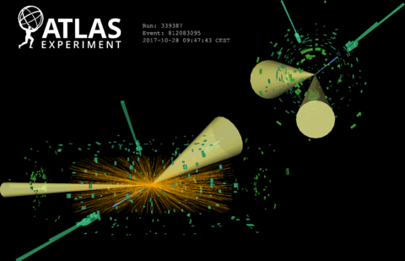
Università degli Studi di Milano
Facoltà di Scienze e Tecnologie
Tesi di Laurea Triennale in Fisica
Energy calibration for close-by e⁺e– in the search for Higgs boson decays into a low-mass dilepton system and a photon
Tesi di laurea di:
MATTEO SERRAGLIA
Matricola 955446
Relatore
Prof. Leonardo Carminati
Correlatori
Dott. Ruggero Turra
Dott.ssa Laura Nasella
Anno Accademico 2024 / 2025

Slide 2
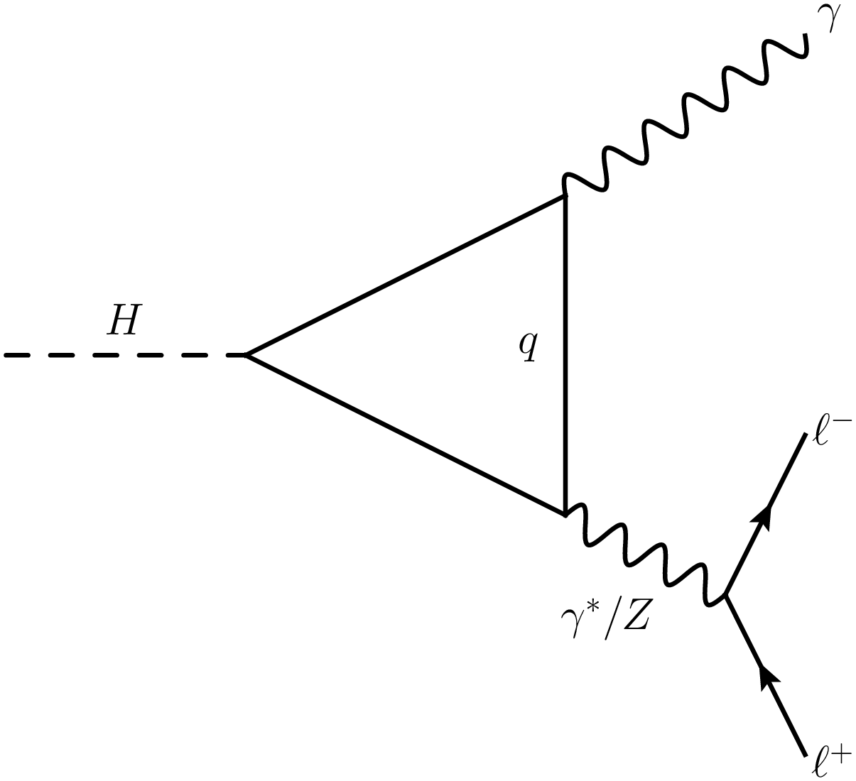
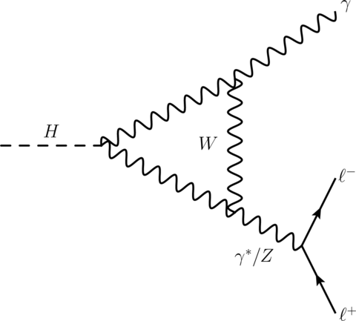
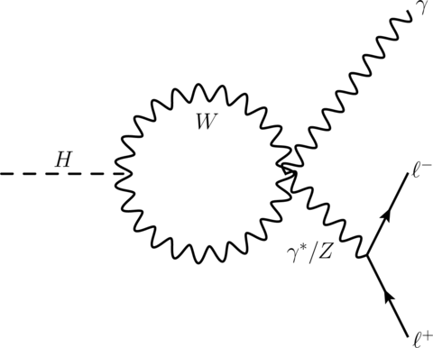
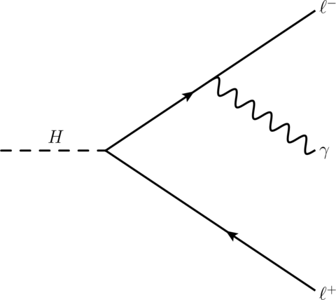
Decay Channel H→γγ* →γl⁺l⁻
Higgs Boson:
Explains the origin of the masses for elementary particle through the Electroweak Symmetry Breaking
Observed in 2012 at CERN by the ATLAS and CMS collaboration
All measurements since 2012 are all in agreement with the predictions of the SM
Most of the main decays are already observed, yet some rare decays are not experimentally proven
Evidence of H→ γl⁺l⁻ (l=e/μ) decay₋ with a significance of 3.2 σ from previous ATLAS analysis

Slide 3
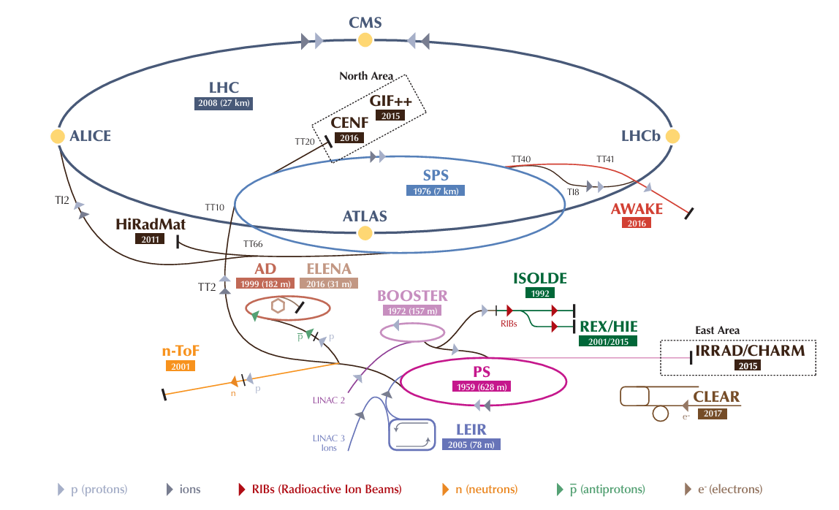
The Large Hadron Collider (LHC)
LHC (Large Hadron Collider) ~6.8 TeV per beam, ~13.6 TeV center of mass (√S)
Run 1: 2009-2013, √S= 7-8 TeV
Run 2: 2015-2018, √S= 13 TeV
Run 3: 2022-2026, √S= 13,6 TeV

Slide 4
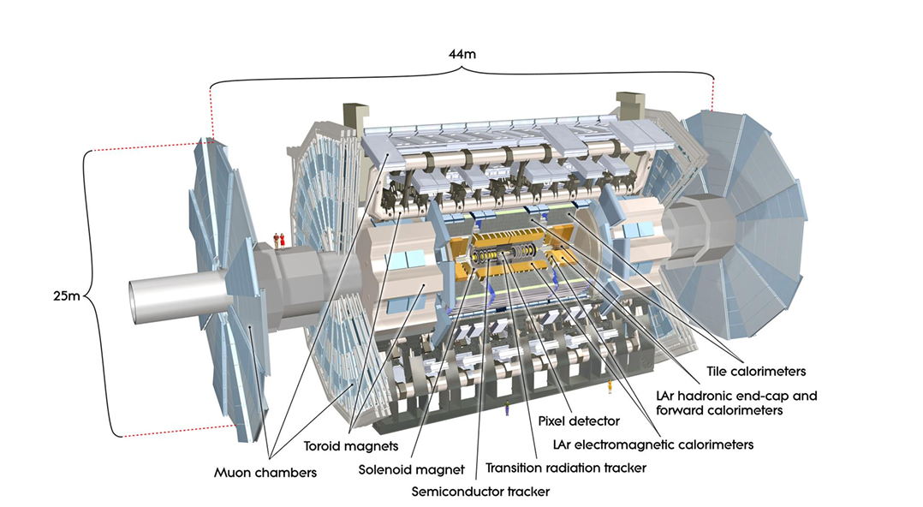
The ATLAS Detector Components
Inner Detector
Magnet System (Central Solenoid, Barrel/Endcap Toroids)
Calorimeters ( EM and Hadronic)
Muon Spectrometer

Slide 5
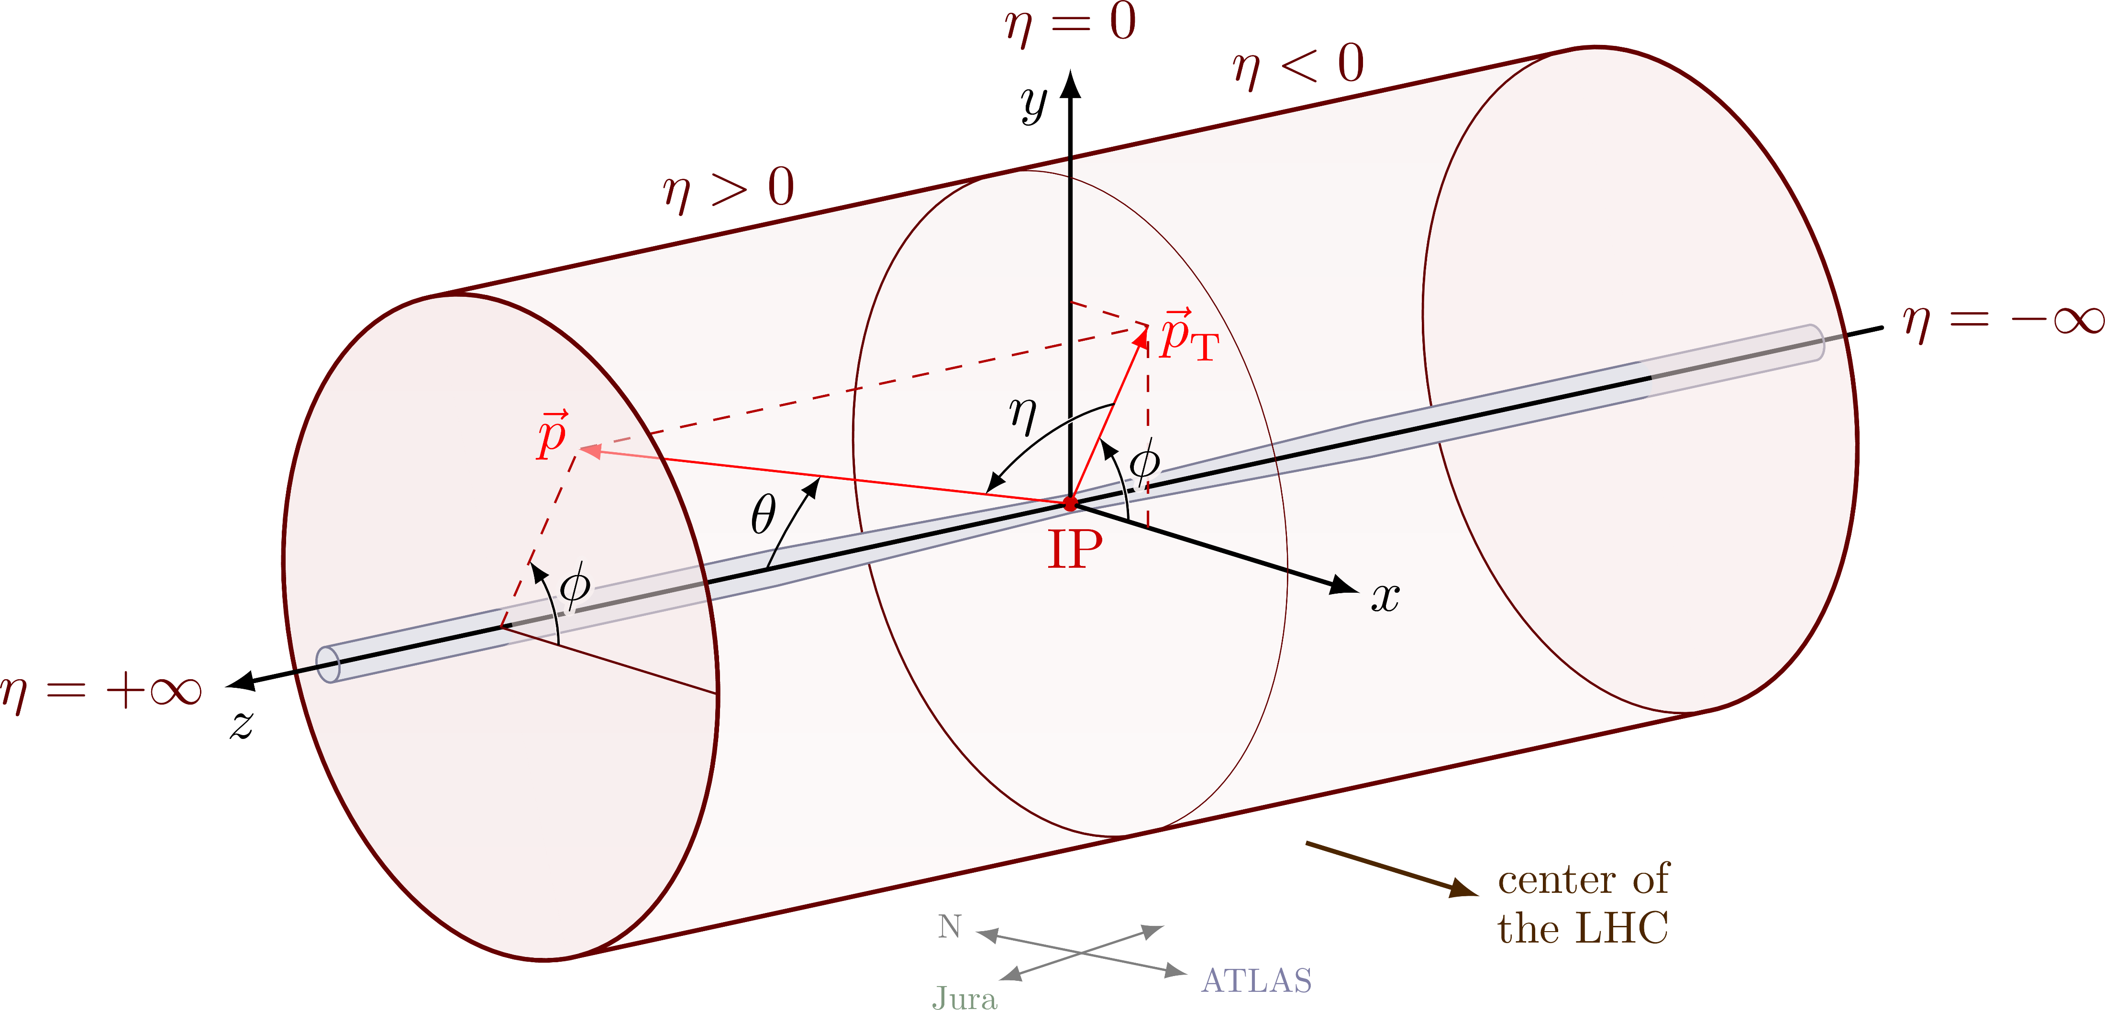
The ATLAS Detector Coordinate System
η =0, Perpenducular to the beam
|η|= ∞, Parallel to the beam

Slide 6
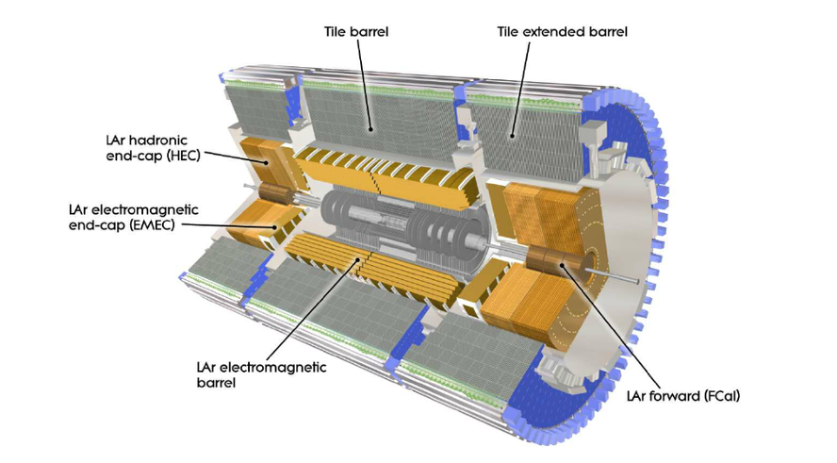
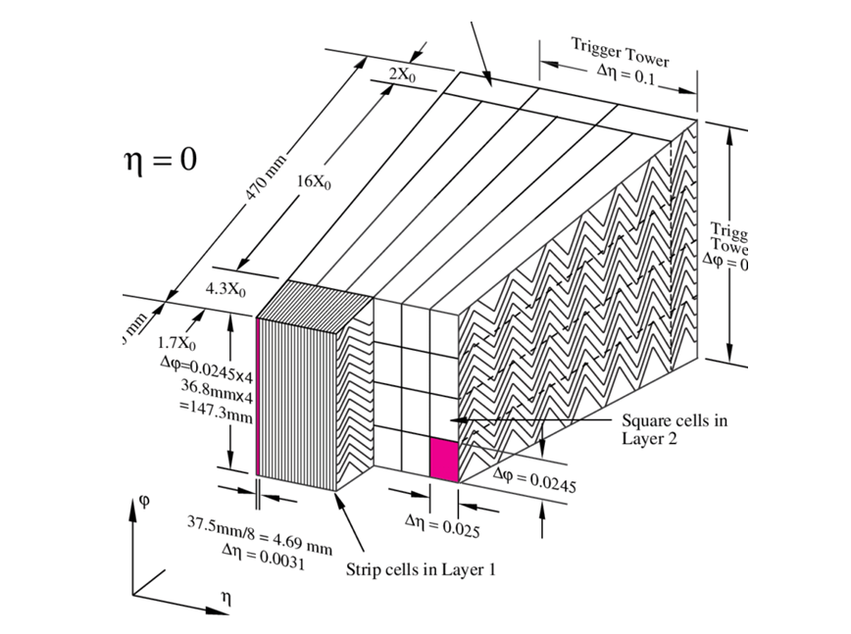
The ATLAS Hadronic and EM Calorimeters
|η| < 1.37, Barrel Region
1.37 < |η| < 1.52, Crack Region
1.52 < |η|< 2.5, End-Cap Region

Slide 7
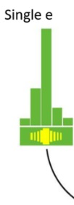
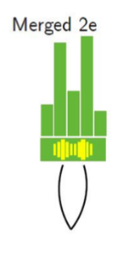
Photons and Electrons Reconstruction
Electron Reconstruction
Energy calibration
Merged Electron Reconstruction

Slide 8
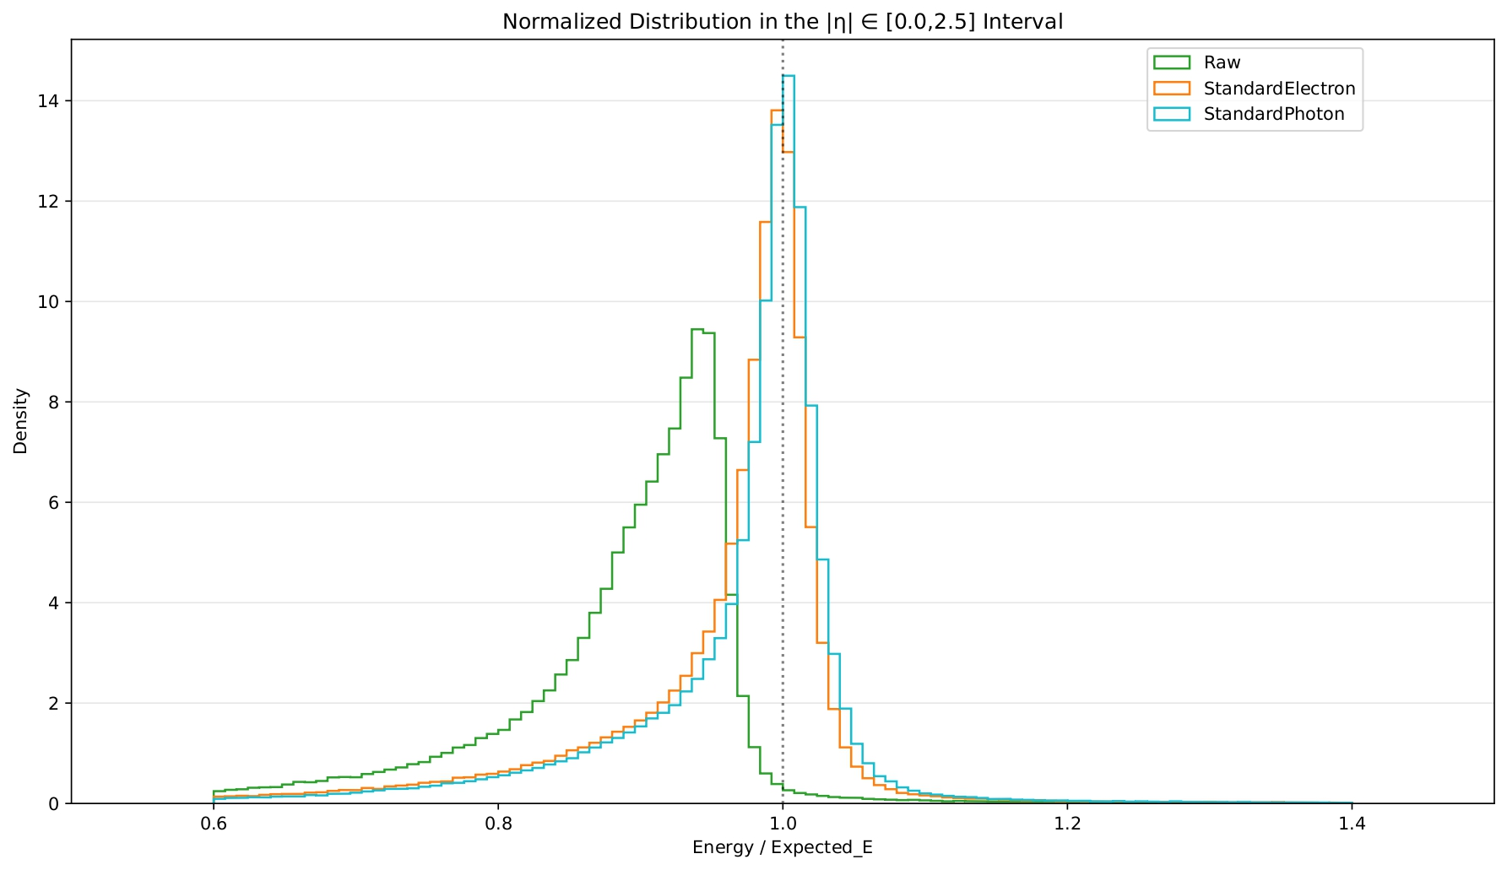
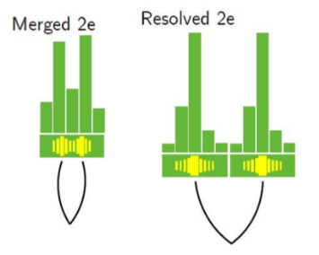
Merged Electron Calibrations
ATLAS Resolved photon Calibration with R=30mm

Slide 9
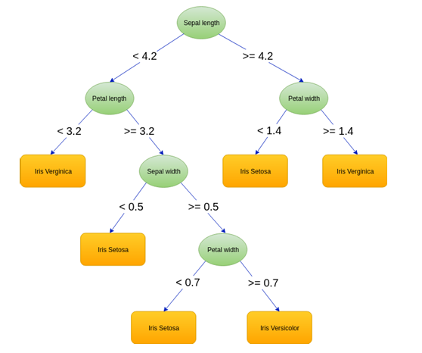
Machine Learning and BDT
Supervised Learning: $f$(E_{raw}, η, Φ…)= E_{expected}
Loss Function: L₁=$\frac{1}{N}\sum_{i=1}^{N}{|Ei,Raw−Ei,Calibrated|}$
Gradient Boosting
LightGBM
Hyperparameters (Early Stopping, n-leaf, learning rate… )

Slide 10
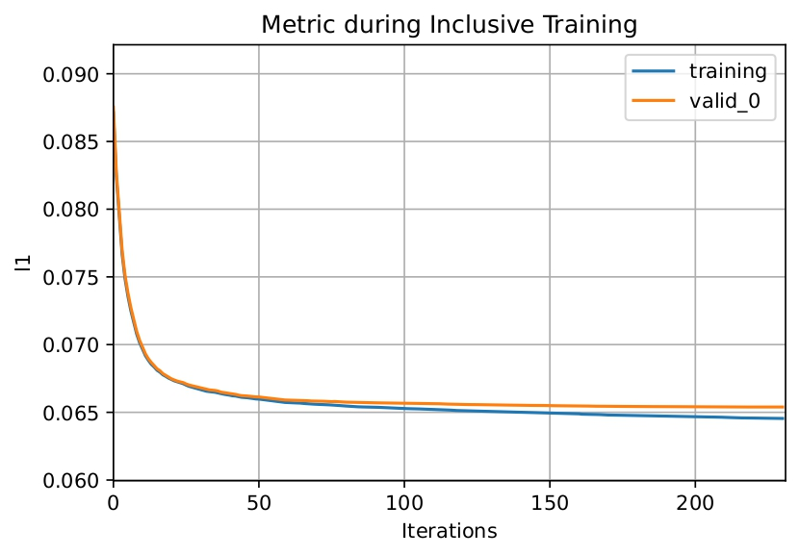
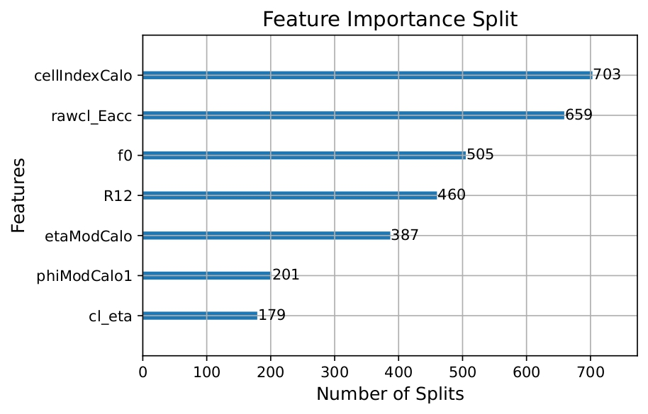
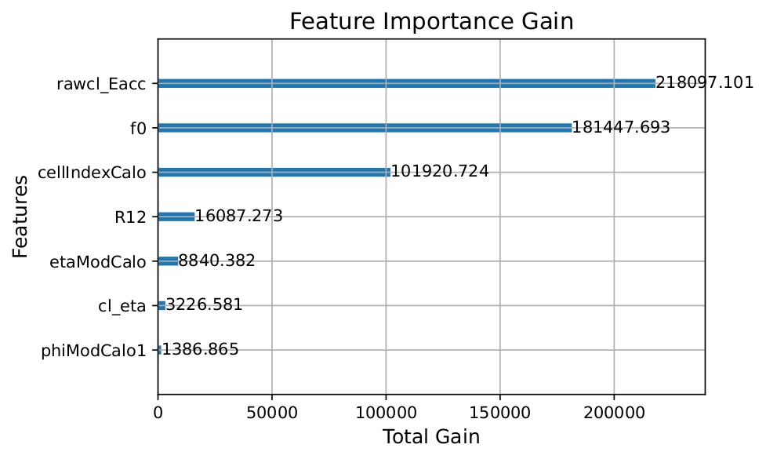
1.Recreating Standard Electron Calibration
Standard Calibration Variables:
Sample of:
Electrons for
the ATLAS electron calibration
Merged Electrons for
my electron calibration
• rawcl_Eacc, R12, f0
• cl_eta, etaModCalo
• phiModCalo1
• cellIndexCalo

Slide 11
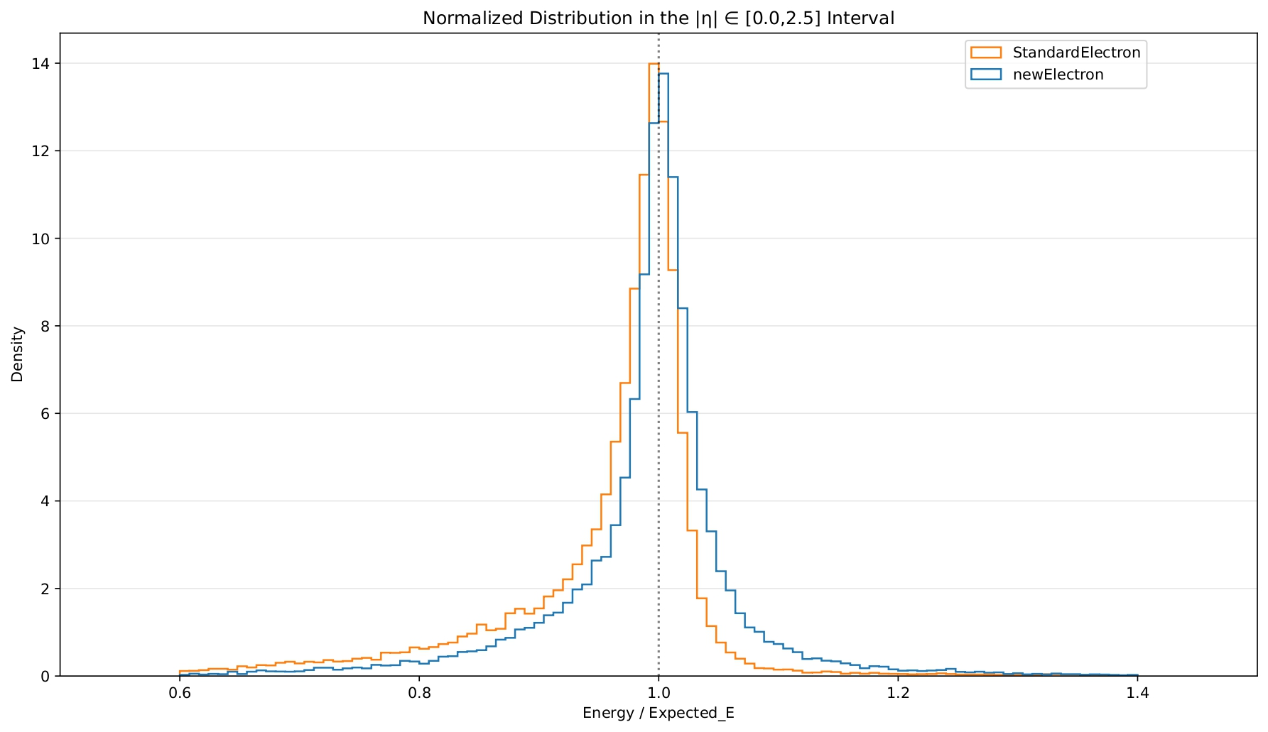
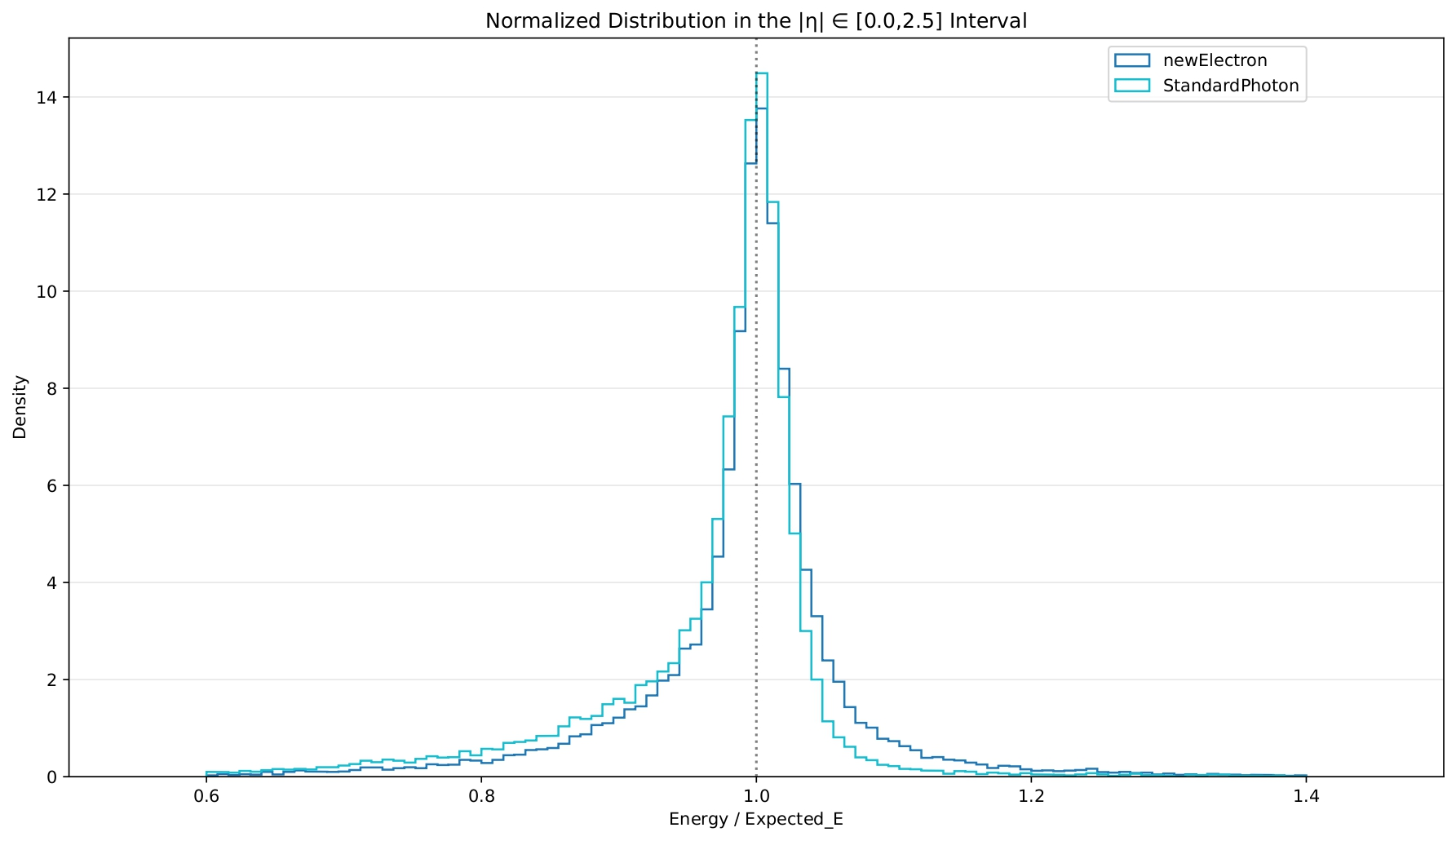
1.Recreating the Standard Electron Calibration

Slide 12
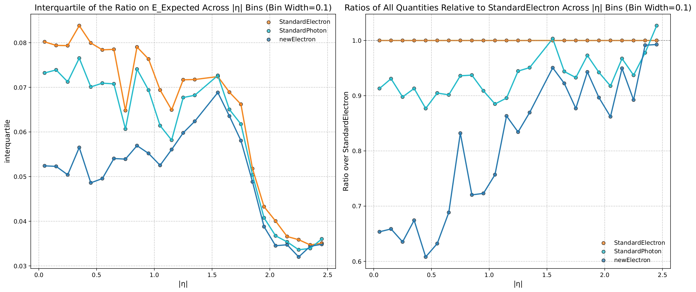
1.Recreating the Standard Electron Calibration

Slide 13
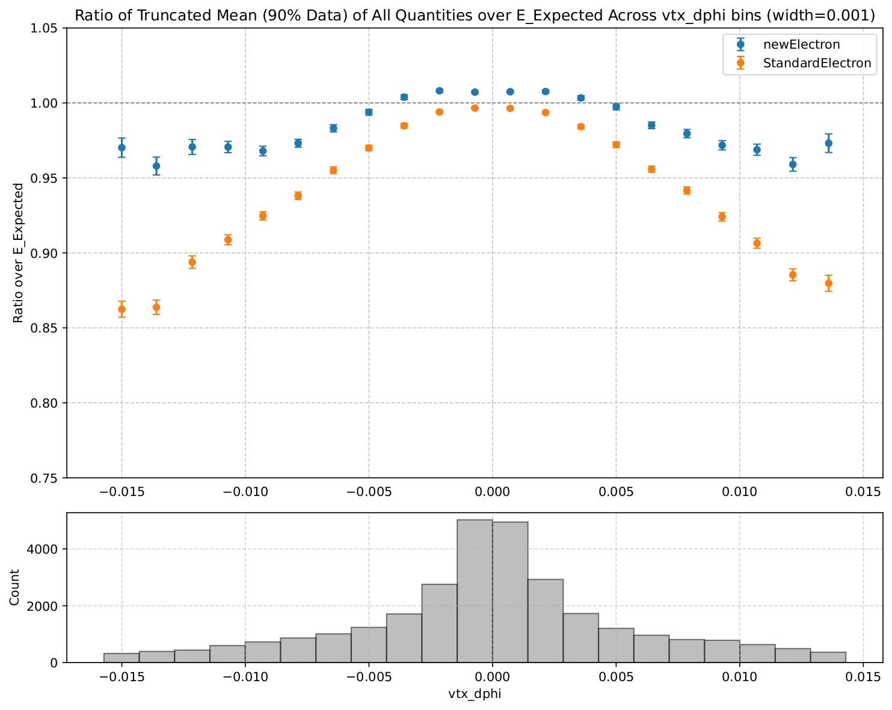
2.Selecting Relevant Variables
Vtx_dphi: represents the angular difference ∆φ between the azimuthal angle φ of the merged electron reconstructed vertex and the φ of the calorimeter cluster in the EM2 layer.

Slide 14
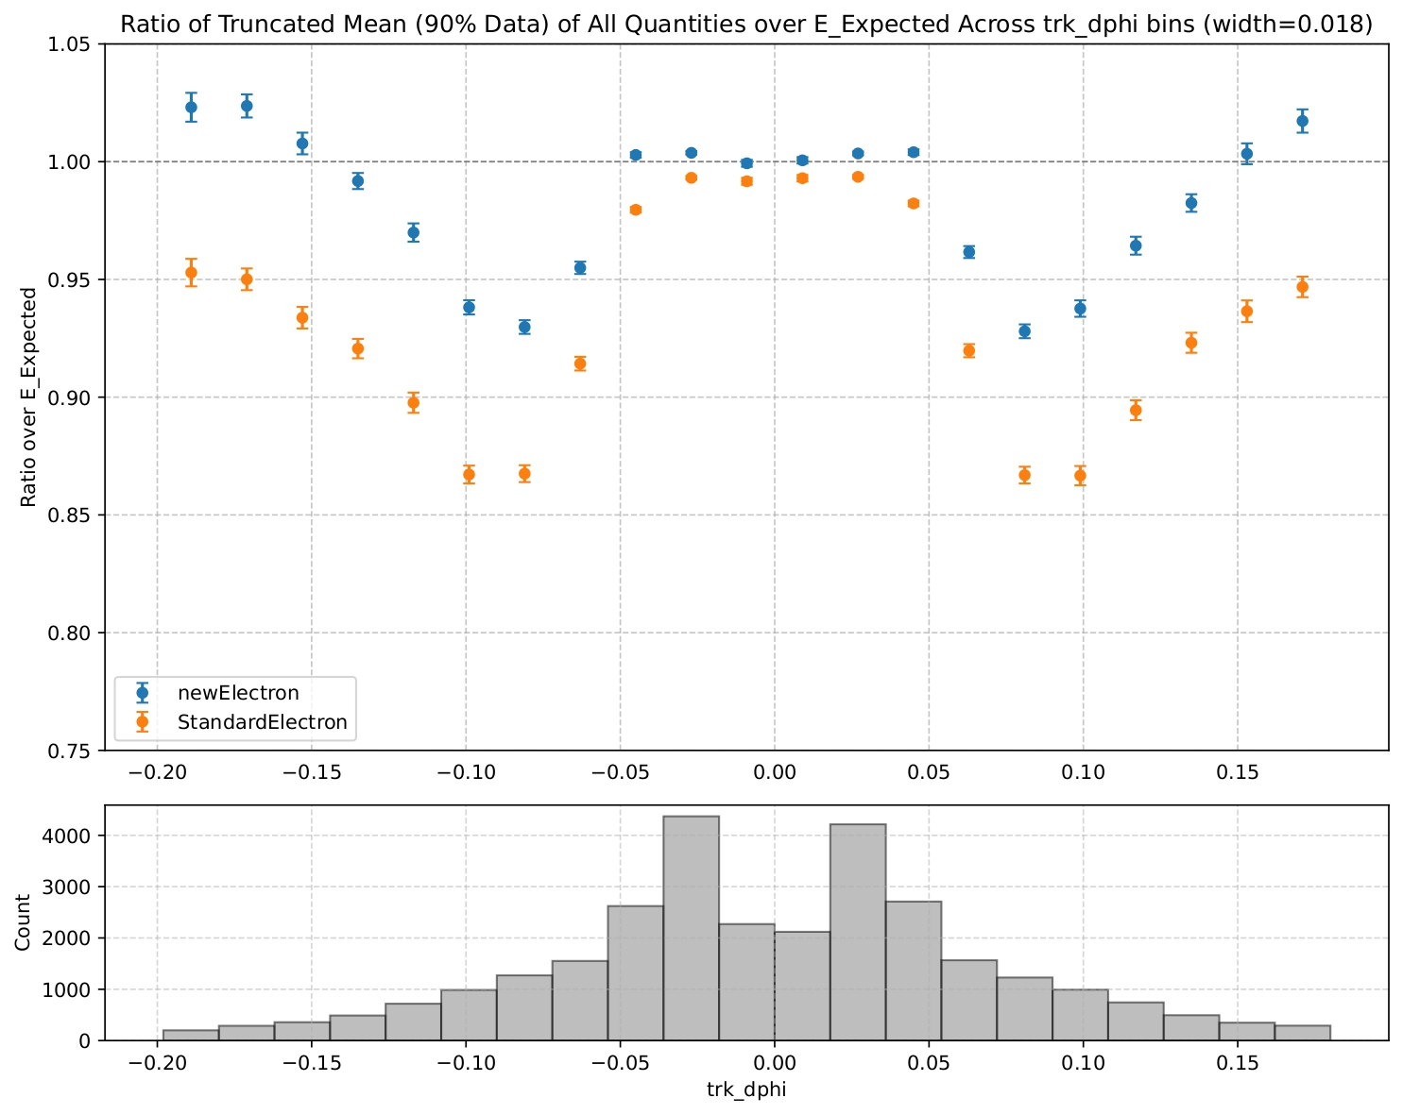
2.Selecting Relevant Variables
Trk_dphi: represents the difference between the φ of the two tracks extrapolated to the second sampling layer of the EM calorimeter.

Slide 15
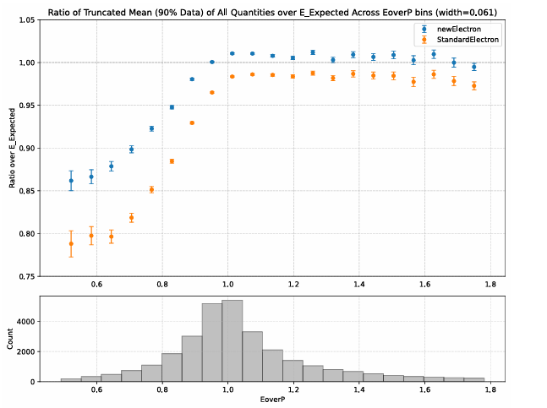
2.Selecting Relevant Variables
EoverP: is the ratio between E, the energy of the cluster, and P, the sum of the transverse momentum of the two electrons.

Slide 16
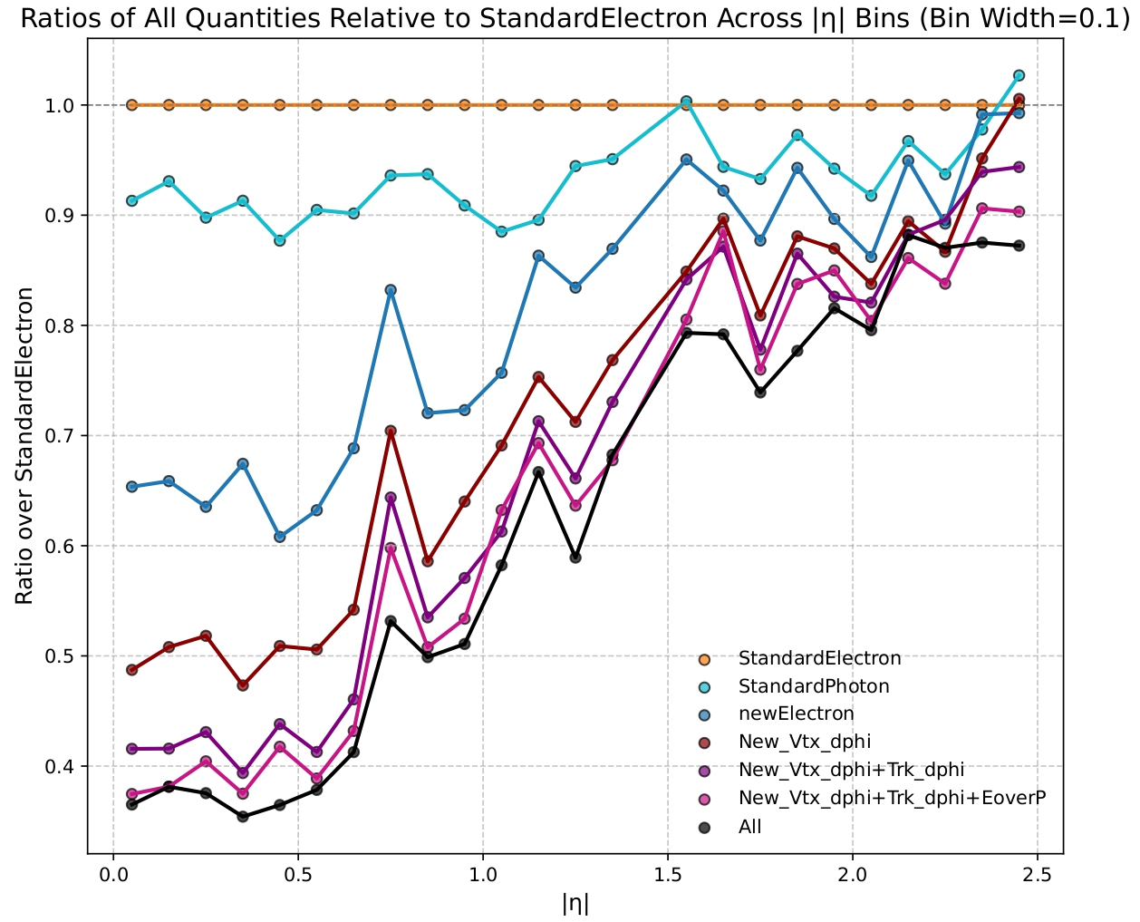
4.Calibration Resolutions
Calibrations over the sample of merged electrons compared to the Standard ATLAS Calibration:
The ATLAS Photon Calibration brings an improvement of 10%
My new Standard Calibration shows an improvement of 35%
Adding new input the variables brings an improvement of 60%
The All calibration with 10 variables shows the maximum improvement

Slide 17
Conclusions
The search for the rare decay of the Higgs boson in γe⁺e– requires a dedicated energy calibration for the topology of the merged electrons.
Firstly, the Standard Electron calibration, on a sample of merged electron, has been recreated with an improvement of 30% on the resolution with respect to the previuos Standard Electron calibration.
Secondly, variables related to the topology of merged electrons were selected.
Finally, the training of new calibrations adding progressively the selected variables showed an improvement of 60% over the resolution of the Standard Electron Calibration. The calibration with three extra variables has been chosen because it captures the most improvement with the least number of variables.
Since the results are promising, this calibration will be included in the analysis of the Run 3 data.

Slide 18
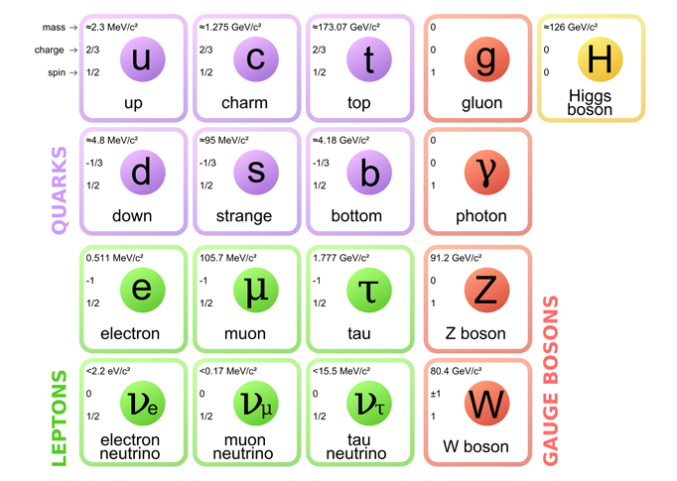
Standard Model and Higgs Boson
Problem of spontaneous symmetry breaking of the electroweak symmetry
m_{H} =125.09±0.21(stat)±0.11(syst)GeV
Q=0
S=0
P=+1
C=+1
CP-invariante

Slide 19
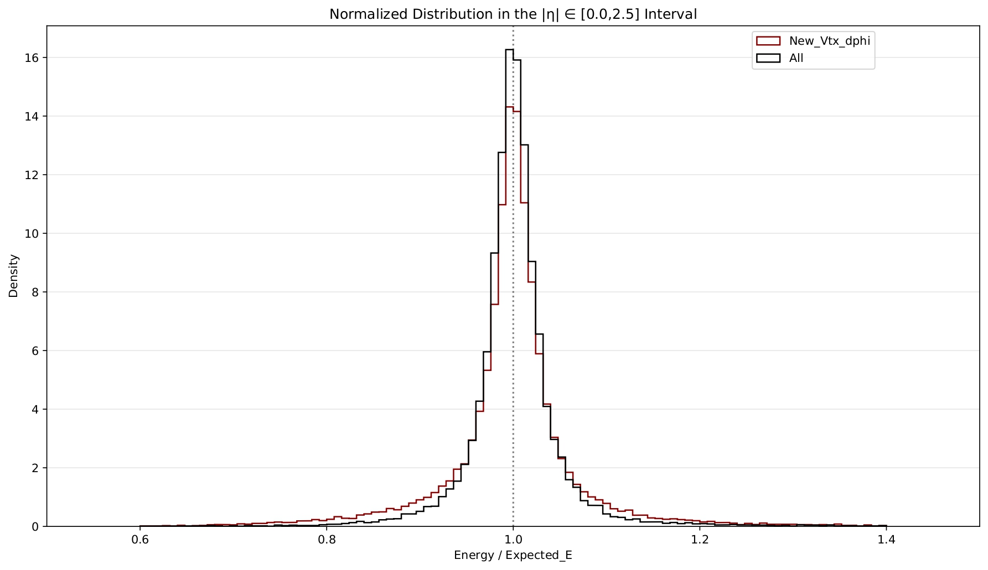
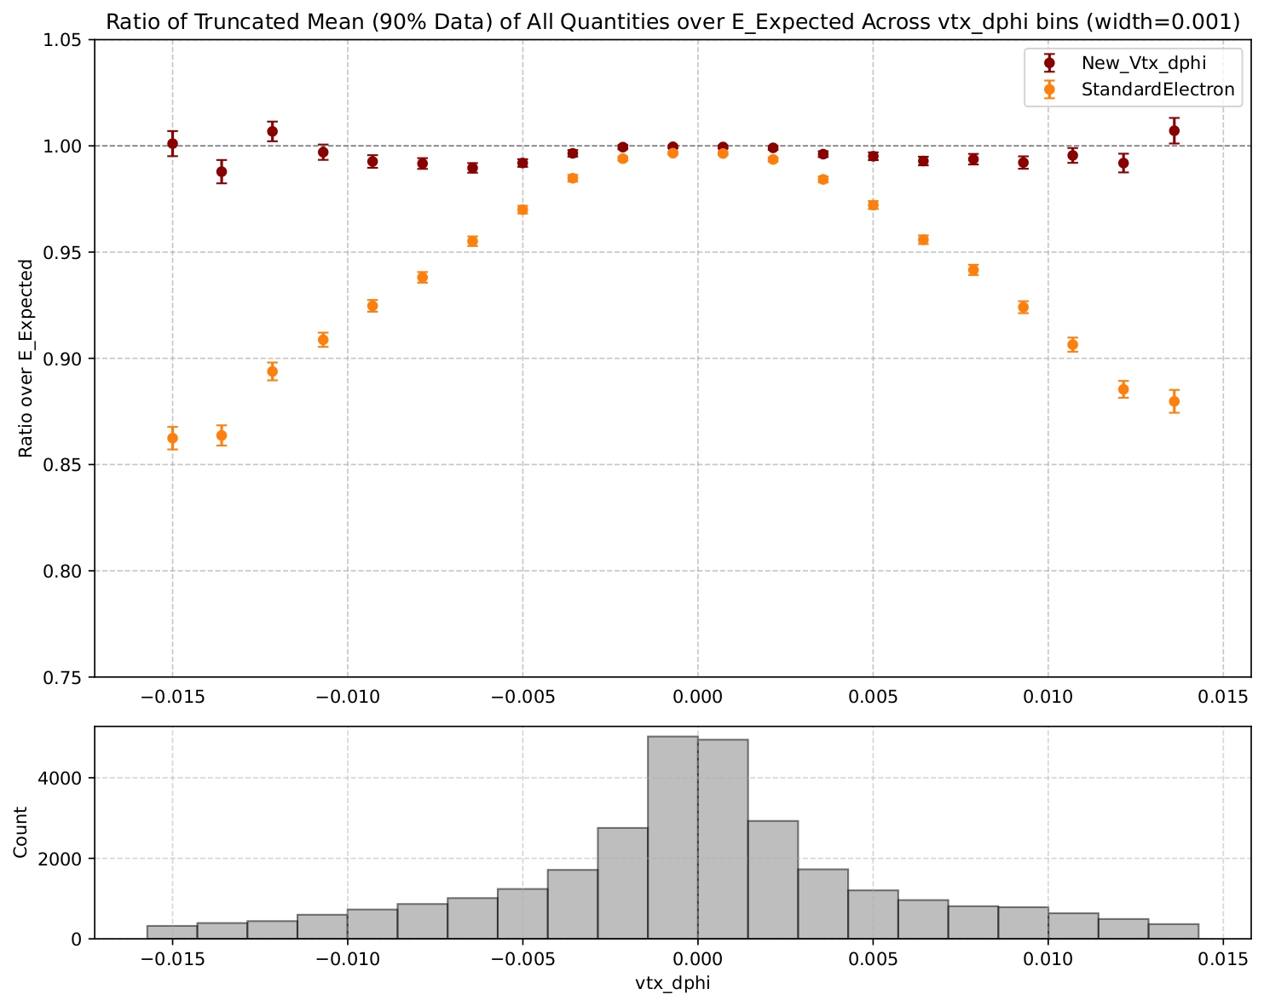
Progressive Calibrations: Vtx_dphi

Slide 20
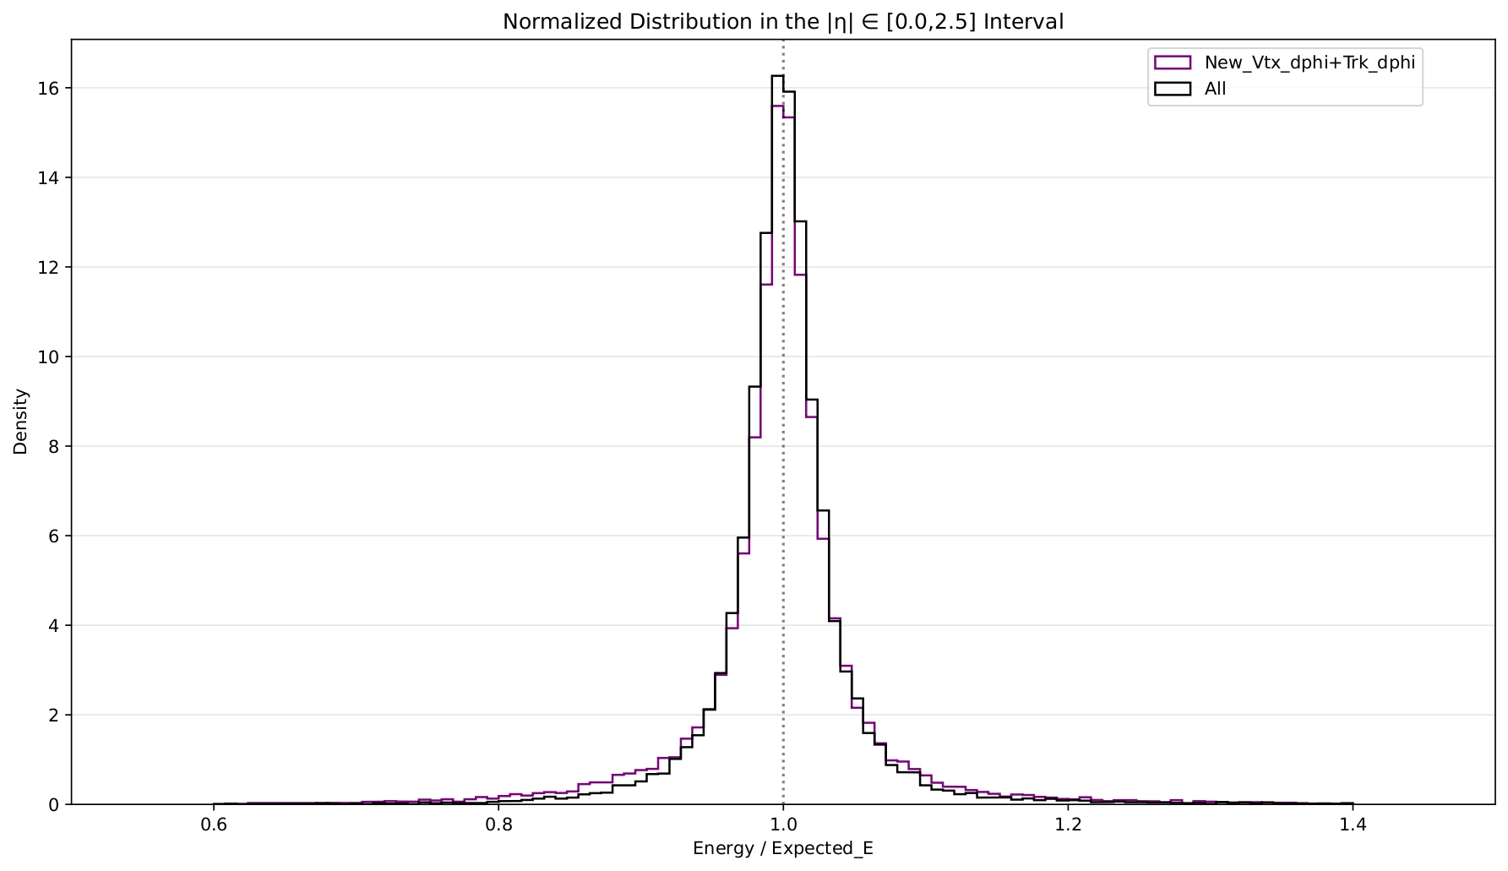
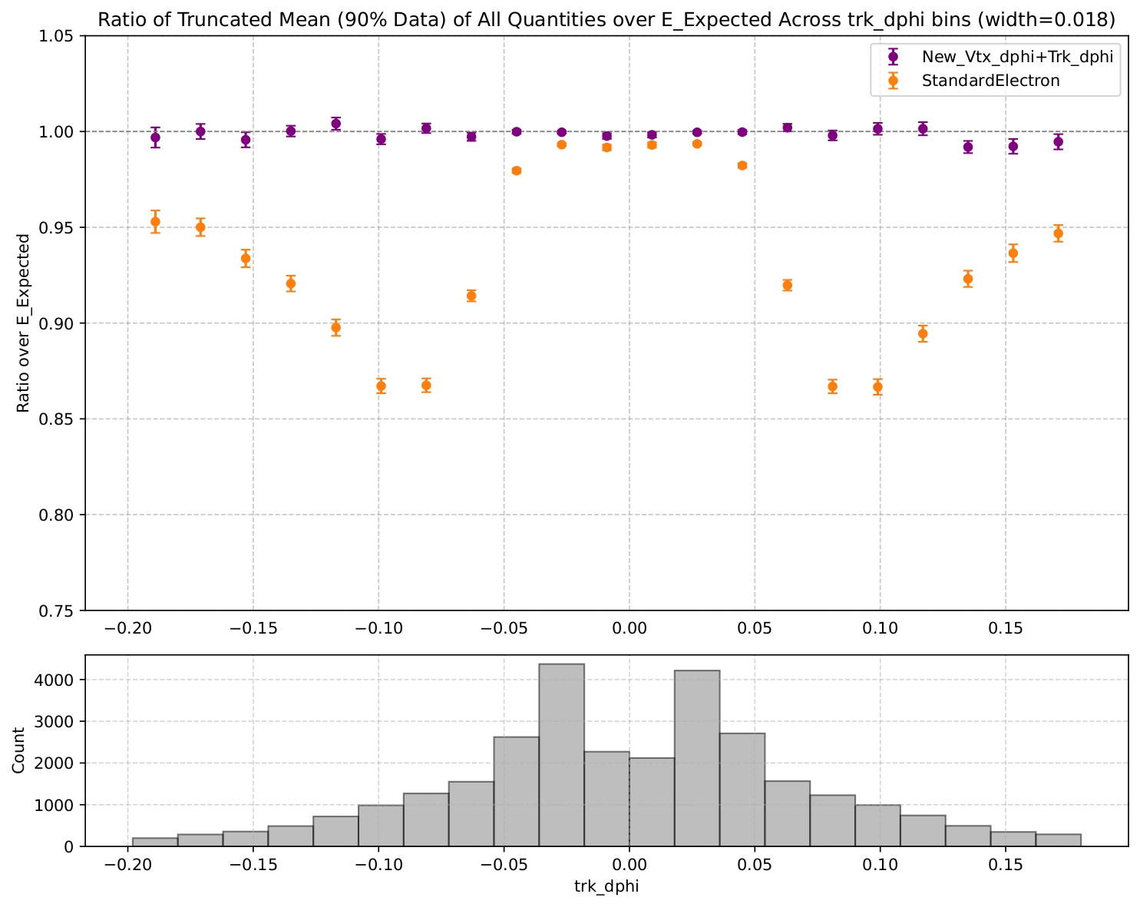
Progressive Calibrations: Trk_dphi

Slide 21
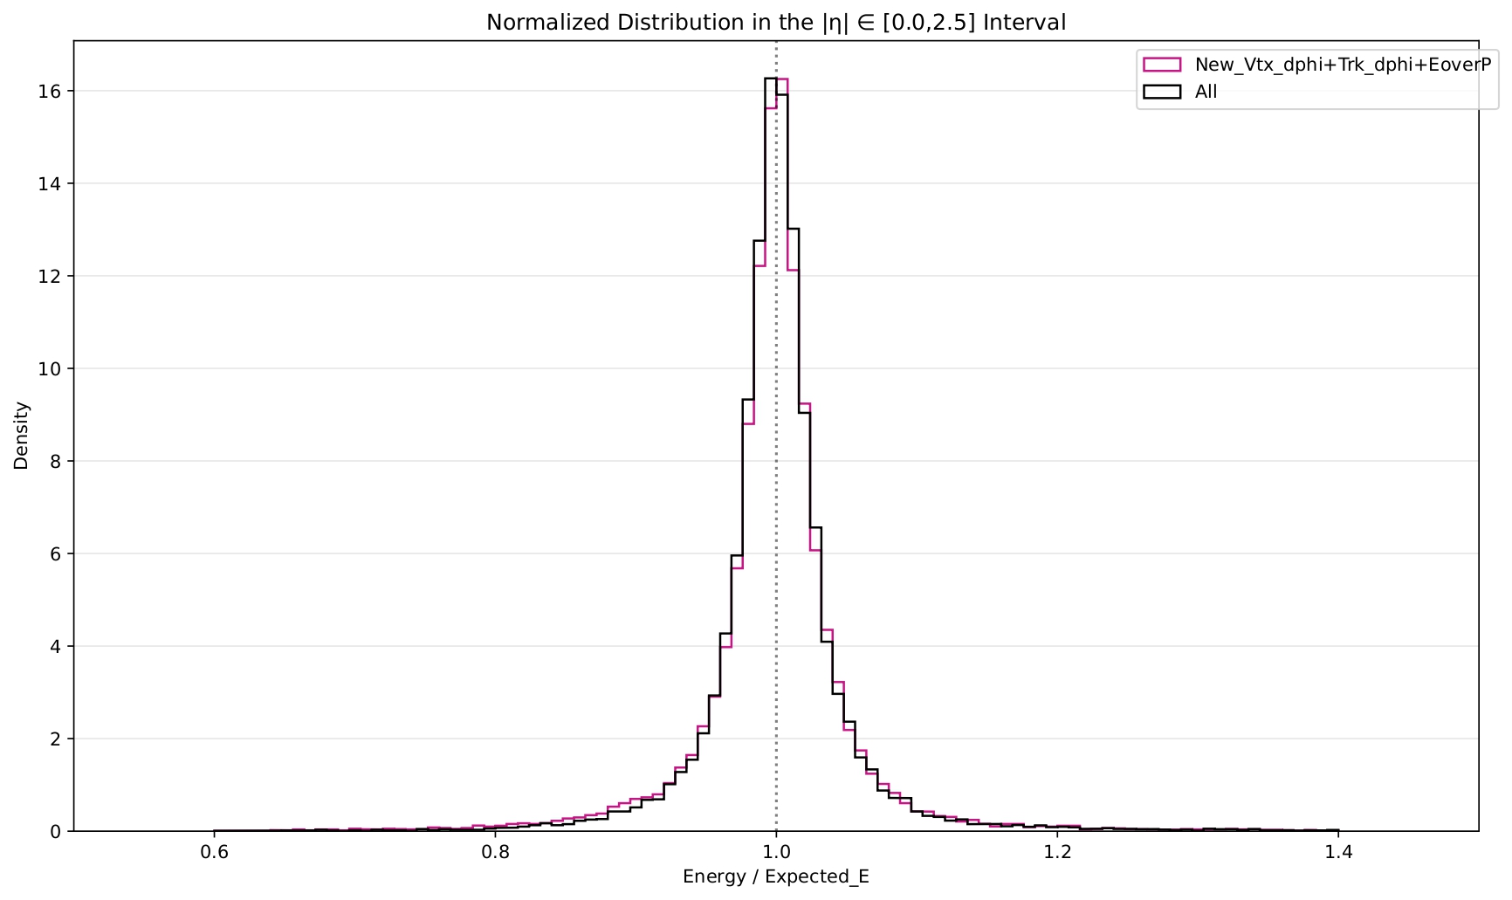
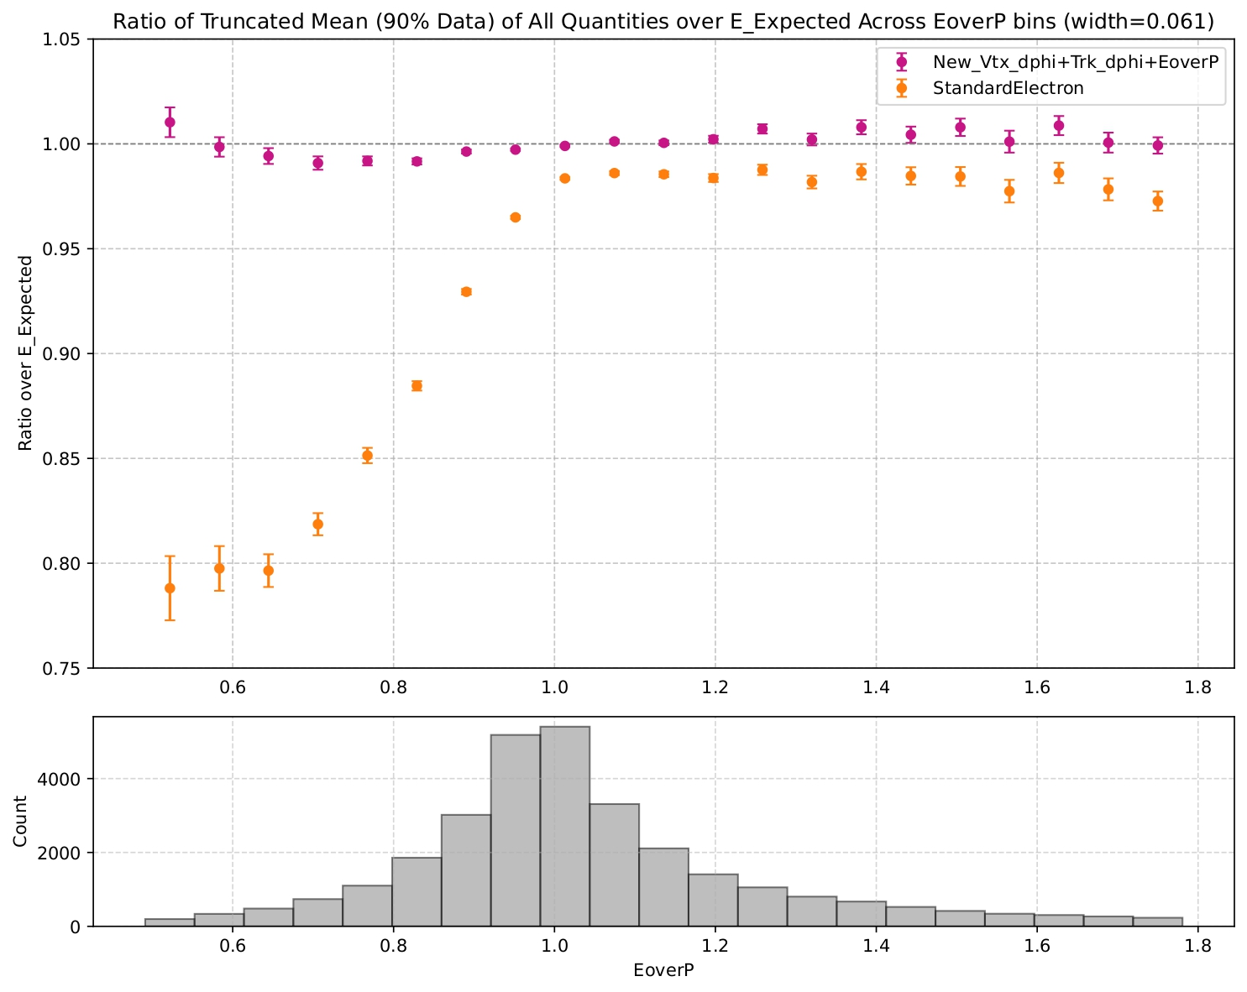
Progressive Calibrations: EoverP

Slide 22
Electron-photon interaction with the EM calorimeter
Parallel reconstruction
Creation of ambiguity
Ambiguity resolution
Partial overlap retention
Calibration of reconstructed objects
Identification and isolation

Slide 23
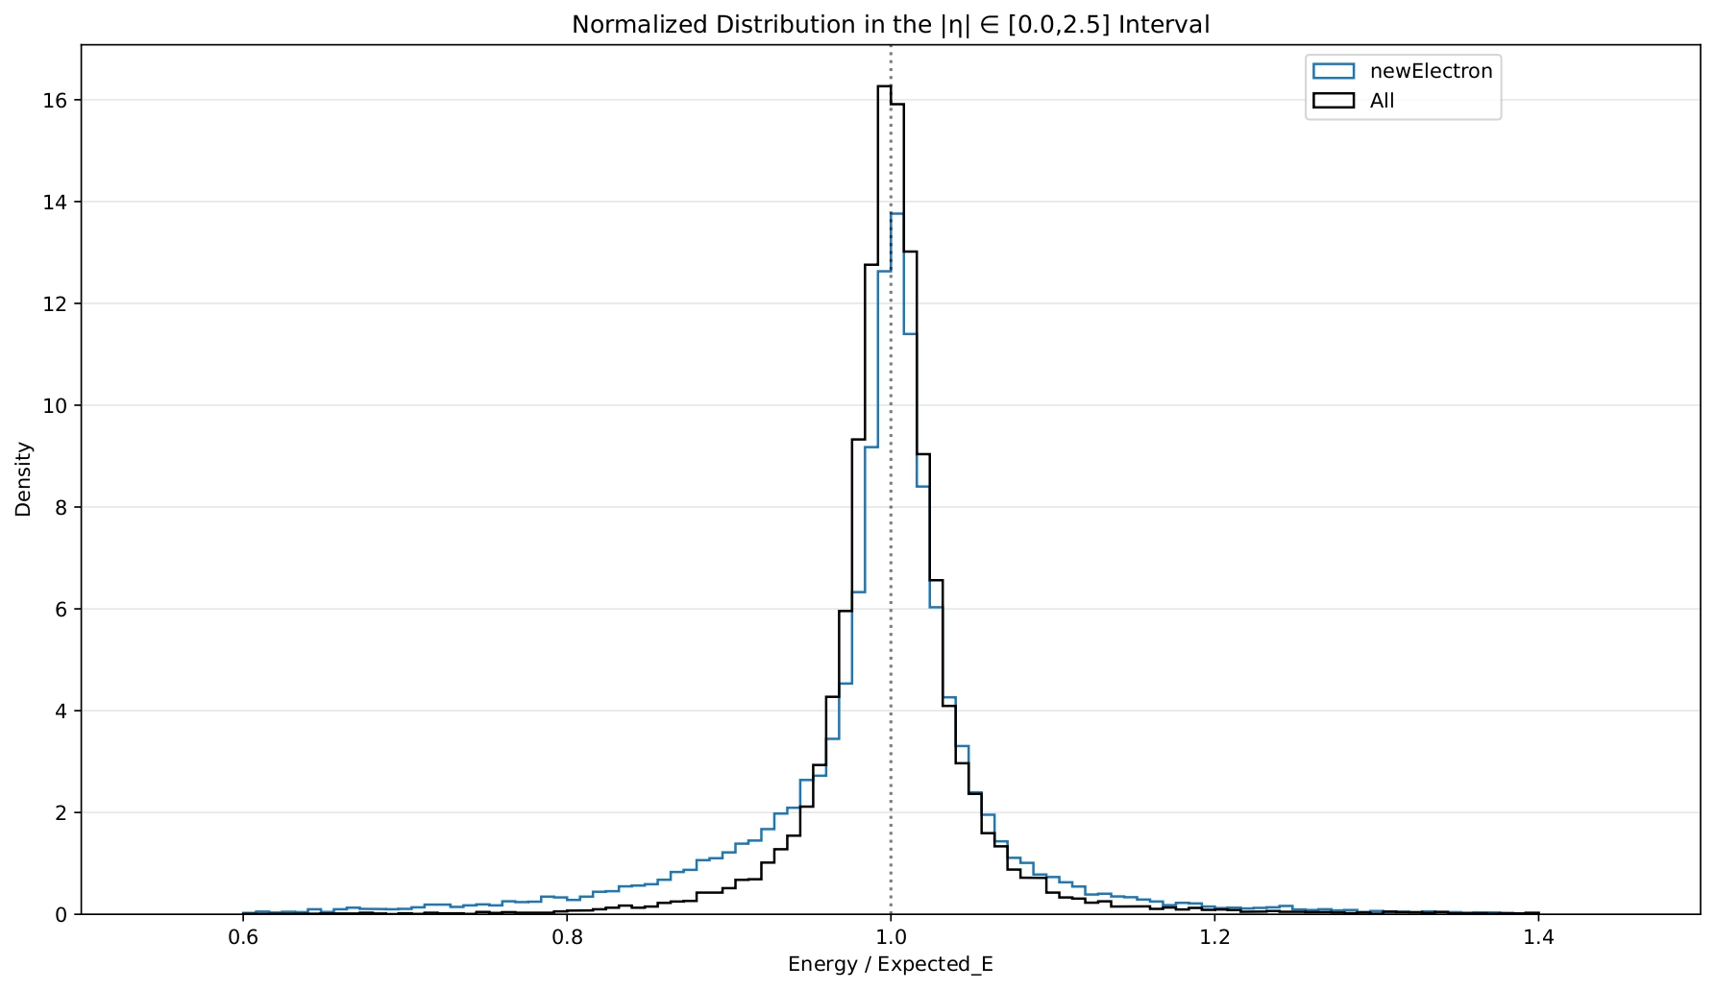
2.Calibration with Additional Variables

Slide 24
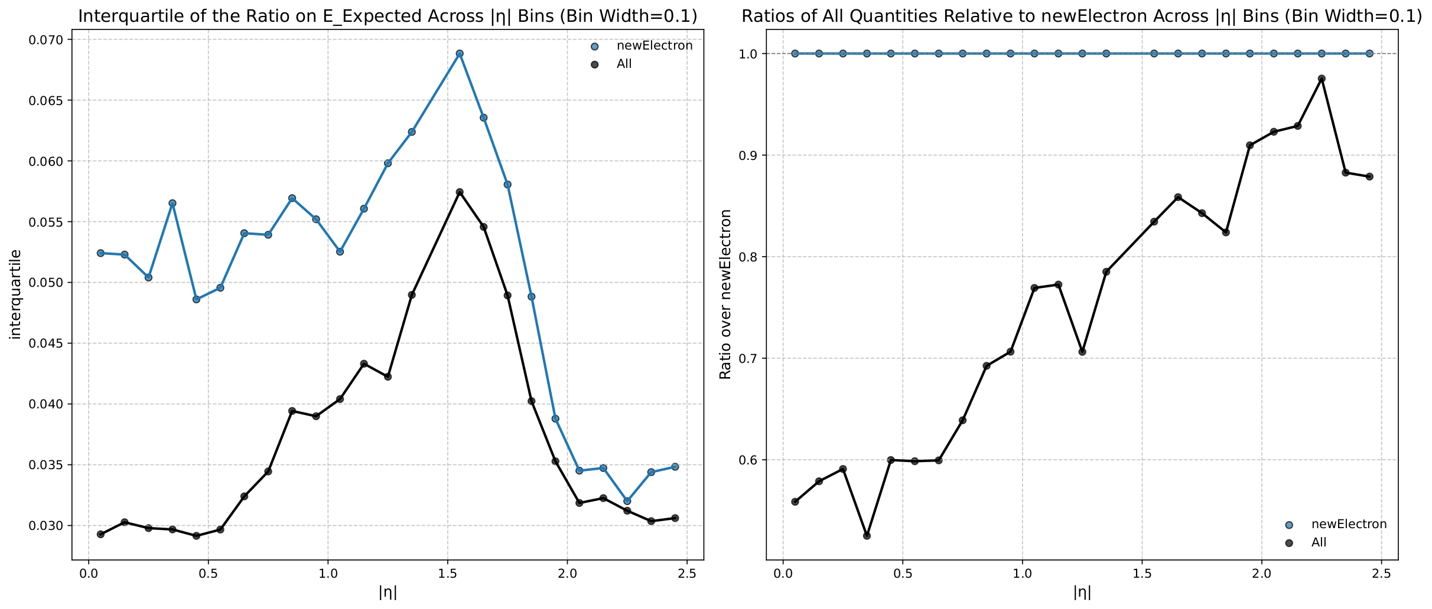
2.Resolution of the All Calibrartion

Slide 25
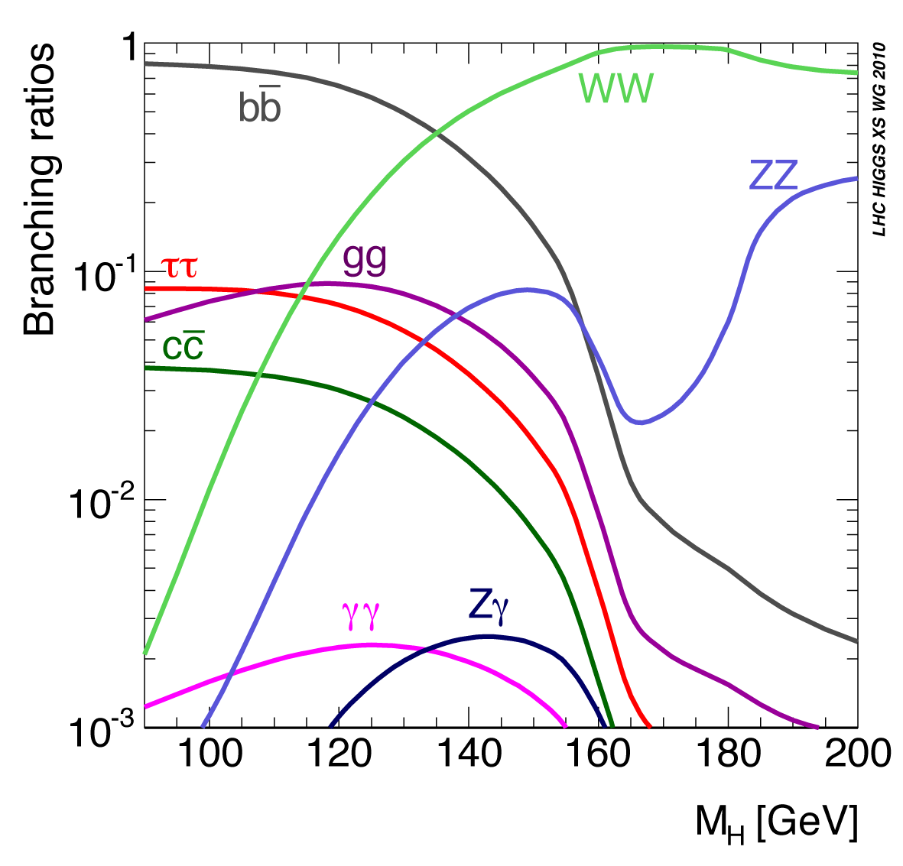
Higgs branching fractions

Slide 26
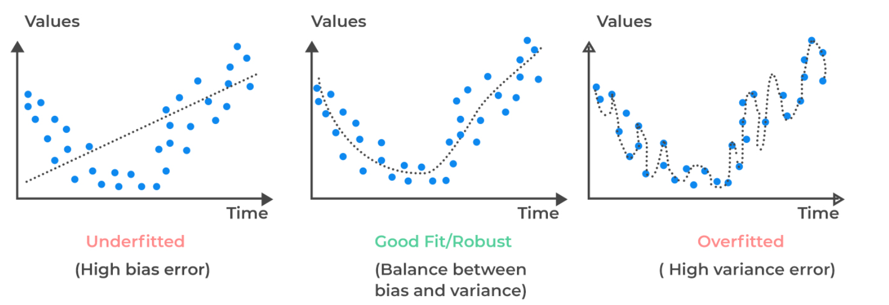
Hyperparameters
learning_rate: Controls the contribution of each tree in the boosting process. A smaller learning rate typically improves generalization but requires more trees.
num_leaves: Determines the maximum number of leaves in one tree. This parameter directly impacts the complexity and flexibility of the model.
early_stopping: This parameter stops the training of the model after a number of iterations during which the value of Loss function is not decreased
param_grid = { ’learning_rate’: [0.20, 0.25], ’num_leaves’: [15, 20],
‘early_stopping’=10 }

Slide 27
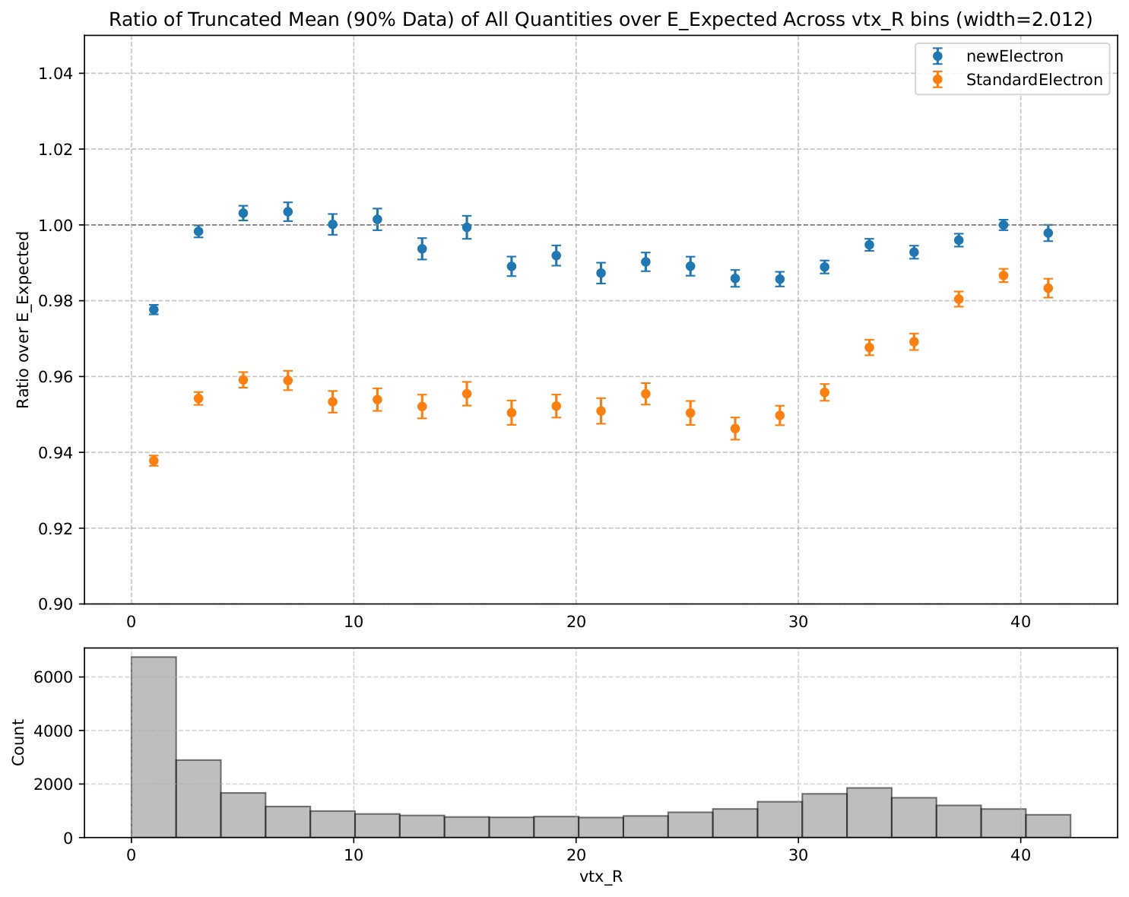
Other merged electron variables
Vtx_R: represents the reconstructed conversion vertex position in mm (from the nominal interaction point) when the merged electrons are treated as a converted photon.

Slide 28
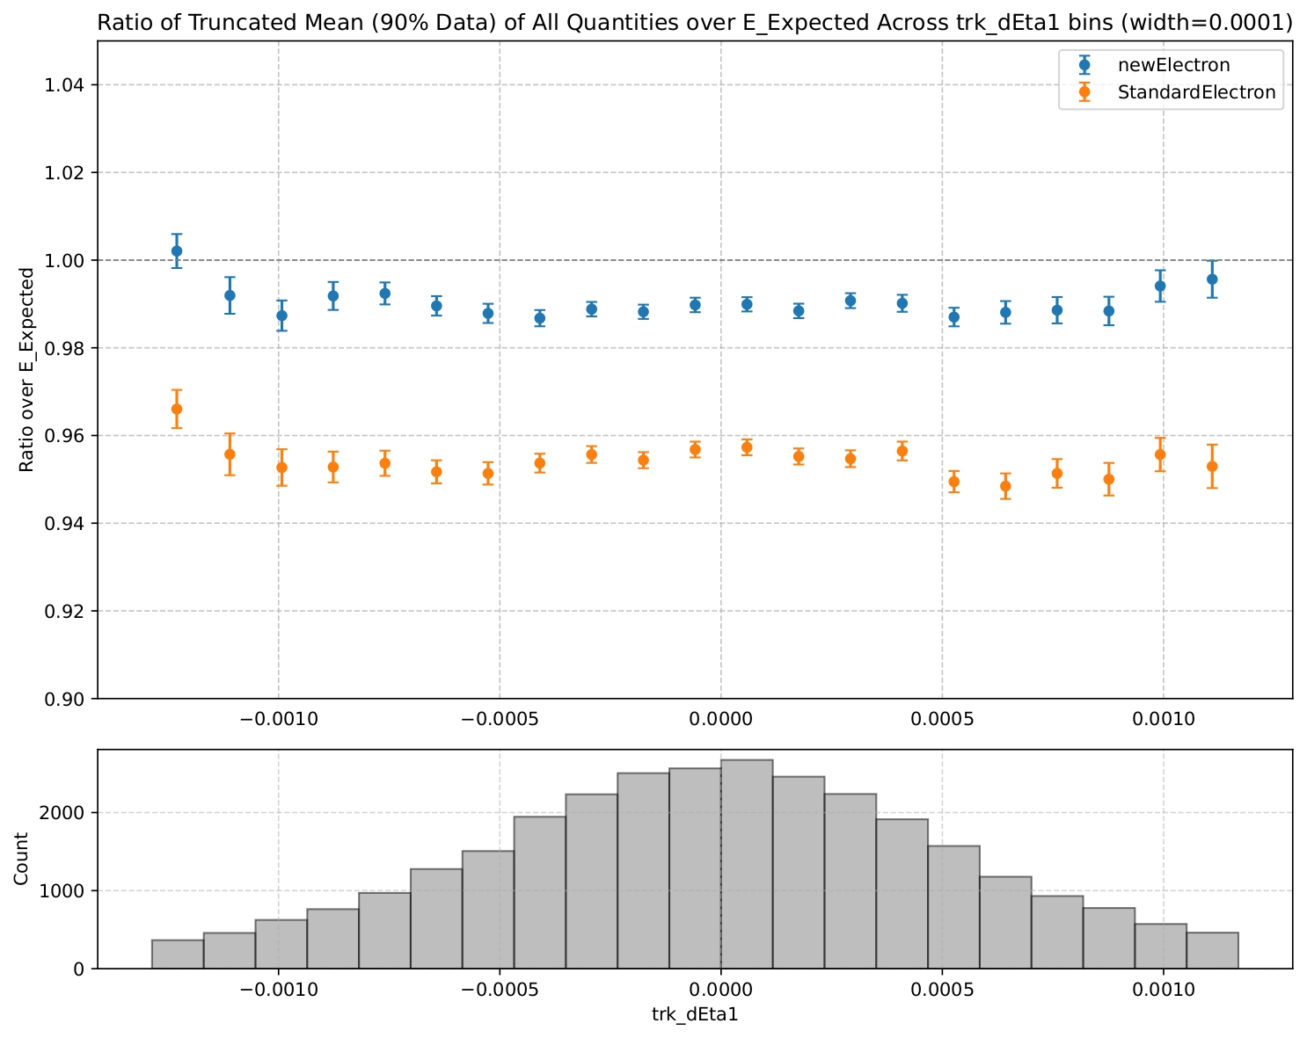
Other merged electron variables
Trk1_deta: represents the delta eta (∆η) between the eta of the cluster and the extrapolated eta at EM2 for the first track

Slide 29
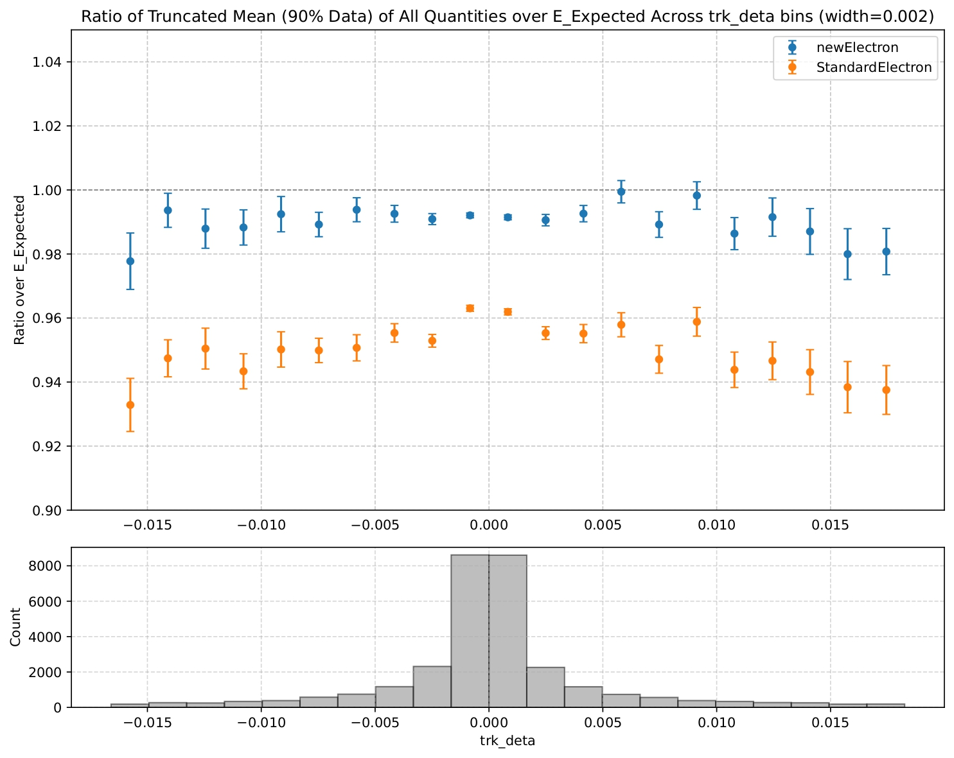
Other merged electron variables
Trk_deta: represents the difference deltaEta_2 between the two eta2 obtained from the extrapolations of the two tracks at EM2.

