Slide 1





All-order QED corrections on kaonic atoms
Paul Indelicato
workshop on Fundamental Physics with Exotic Atoms
June 23-25, 2025, INFN, Frascati

Slide 2

Outline
Introduction: QED contributions for atoms
Tests of QED in exotic atoms: more sensitive to the vacuum structure
QED
  Exemple of strange QED effects int exotic atoms
  Exact vacuum polarization
Kaonic atoms
  Theoretical results
  Comparison with DaΦne expriment
Other examples: antinuclei atoms
Conclusion
Kaons INFN 2025

Slide 3
Collaboration
Simone Manti (LNF-INFN, Frascati, Italy)
Jonas Sommerfeldt (Laboratoire Kastler Brossel, Sorbonne University, Paris, France)
Peter J. Mohr (NIST Gaithersburg, USA)
Kaons INFN 2025

Slide 4
QED contributions
Involved QED diagrams
Kaons INFN 2025

Slide 5
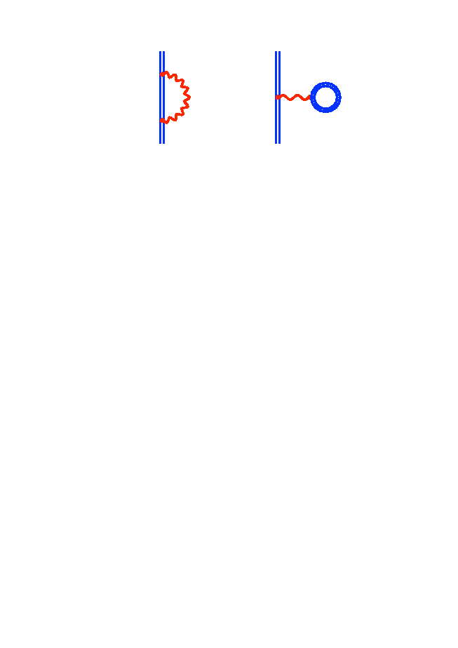



one electron QED at order α
Self Energy
Vacuum Polarization
H-like “One Photon” order (α/π)
Many calculations, very accurate down to Z=1
Kaons INFN 2025

Slide 6
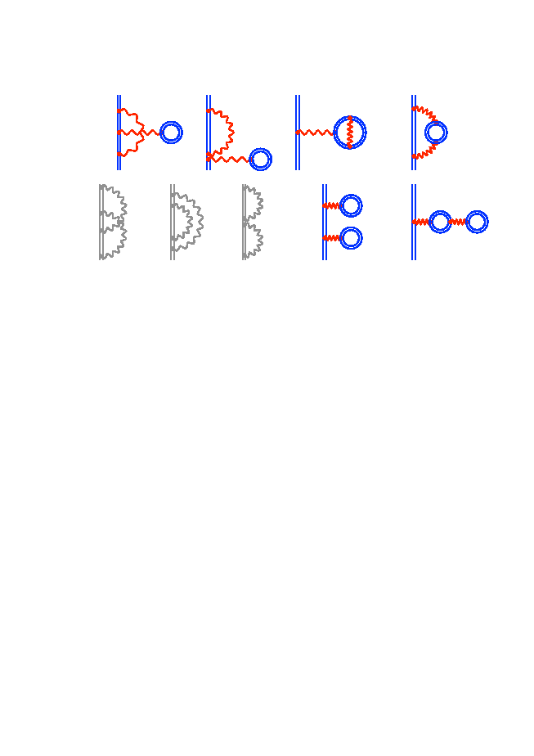
one electron QED at order α²
H-like “Two Photon” order (α/π)²
Kaons INFN 2025

Slide 7
Closed fermion loops 2nd order diagrams
10 diagrams with ± signs
so compensation
next order?
SE-VP
Uelhing
in Dirac Eq.
Källén & Sabri potential
S(VP)E
VP-VP
Yerokhin, V. A., P. Indelicato and V. M. Shabaev (2008), Phys. Rev. A 77 (6): 062510 (062512).
Lindgren, et al. (1993), J. Phys. B: 26: L503-L509.
Mitrushenkov, A., L. Labzowsky, I. Lindgren, H. Persson and S. Salomonson (1995). Phys. Lett. A 200: 51-55.
Kaons INFN 2025

Slide 8
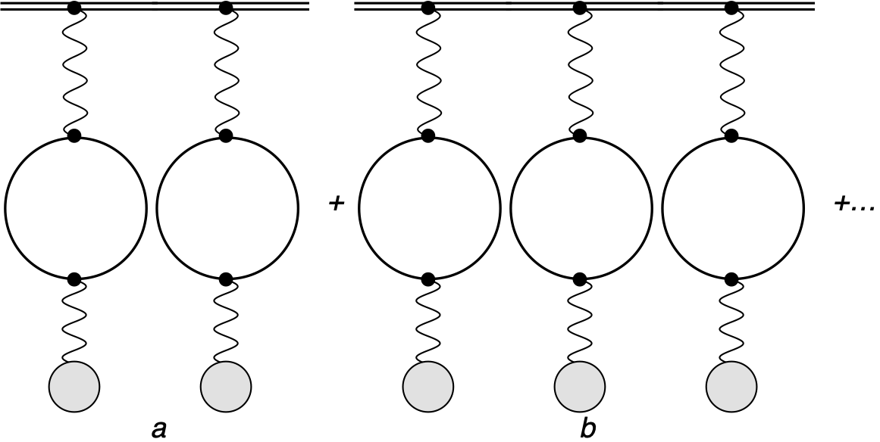
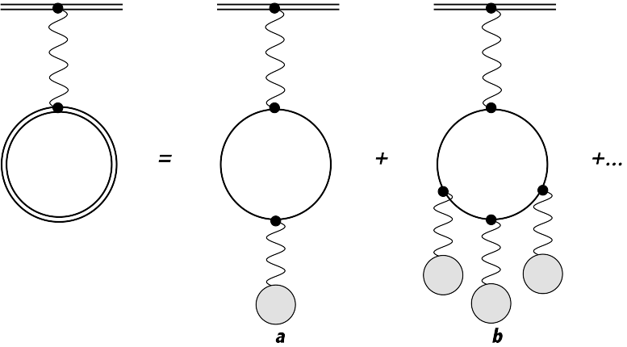
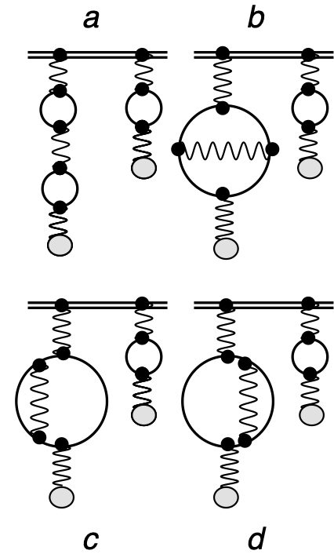
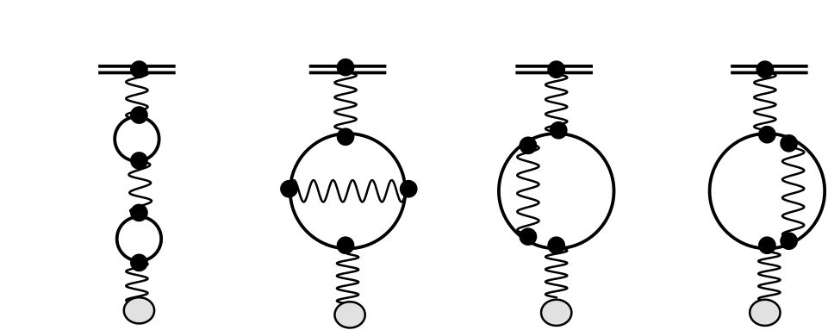
Contributions included to all-order
All-order: the charge distribution is included exactly in the wavefunction and in the operator, when relevant. Higher order Vacuum Polarization contribution included by numerical solution of the Dirac equation
Kaolin & Sabry
All-orders+FNS
P. Indelicato. Phys. Rev. A 87, 022501 (2013).
Kaons INFN 2025

Slide 9
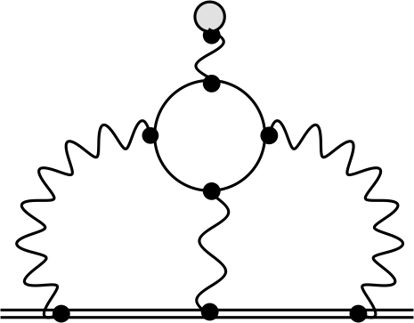
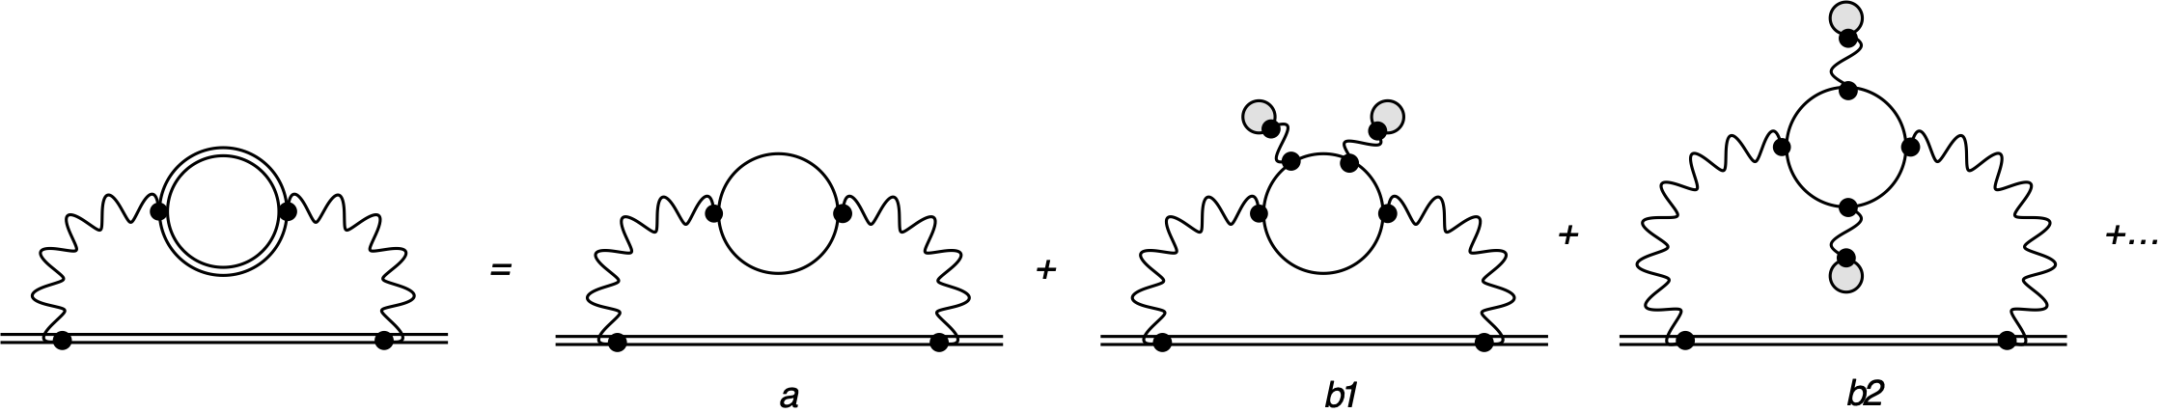
Light by light scattering in muonic atoms
Diagrams with 4 vertex with external lines in an electron-positron loop
Wichman & Kroll V13(r)~ α(Zα)³
approx. to V15(r)~ α(Zα)⁵ and V17(r)~ α(Zα)⁷ also included
No FNS for higher orders!
All-orders+FNS
Uehling V11(r)~ α(Zα)
a is a renormalization term: no contribution
b1 and b2: virtual Delbrück scattering V22(r)~ α²(Zα)²
(part of the expansion of S(VP)E)
3rd order V31(r)~ α³(Zα)~V13(r)/Z²
E. Borie and G. A. Rinker, Rev. Mod. Phys. 54, 67 (1982).
E. Y. Korzinin, V. A. Shelyuto, V. G. Ivanov, R. Szafron, and S. G. Karshenboim, Phys. Rev. A 98, 062519 (2018).
Kaons INFN 2025

Slide 10
Exotic atoms and QED
Nuclear effects and QED contributions
Kaons INFN 2025

Slide 11
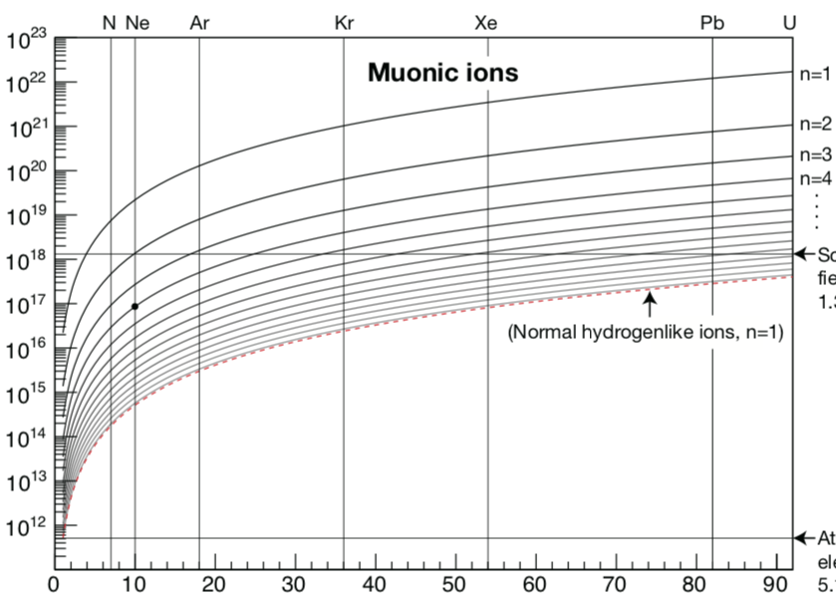
Strong-field QED with muonic atoms
}
muon
.
.
.
n=10
Energy levels in muonic ions
Schwinger
Limit
}
Electric field [V/m]
GSI
H-like HCI, n=1
Energy levels in HCI
First experiments
@ JPARC
Equivalent field!
Atomic unit of electric field
electron
Atomic number [Z]
n=1
Exotic atoms:
(strong field) x (Rydberg states)
Vanishing nuclear uncertainties!
N. Paul et al, « Testing Quantum Electrodynamics with Exotic Atoms » PRL 126, 173001 (2021)
Kaons INFN 2025
Notes:
On peut se concentrer sur les transitions entre les états de Rydberg circulaire avec très peu de recouvrement avec le noyau. Donc on garde des transitions en champ fort, mais on se débarrasse des incertitude nucléaires. Ceci est un nouveau paradigme dans les tests de la QED, dont notre groupe est à l’origine, et que j’aimerai developper par la suite.
Pendant mon postdoc j’ai analysé les résultats des calculs QED pour articuler ce nouveau concept dans un article qui vient d’être accepté au PRL.

Slide 12
could one get precise QED tests with exotic atoms?
Look at Rydberg states
Use circular Rydberg states (no interaction with the nucleus)
Yrast transitions (highest l for a given n)
Check ratio of first and second order QED correction to finite nuclear size as a function of n
Such systems enable to explore beyond the Schwinger limit
N. Paul, G. Bian, T. Azuma, S. Okada, and P. Indelicato, Phys. Rev. Lett. 126, 173001 (2021).
Kaons INFN 2025

Slide 13
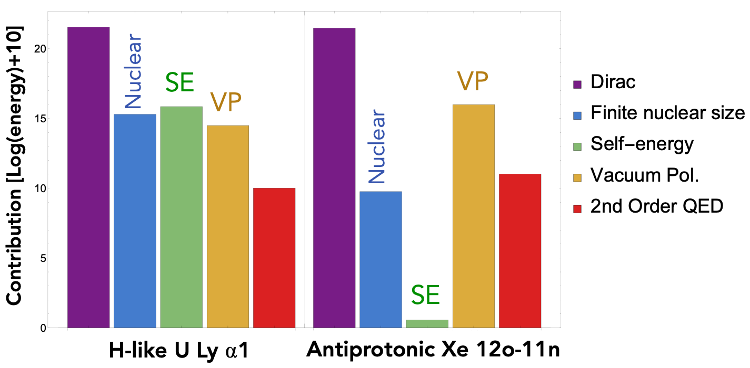
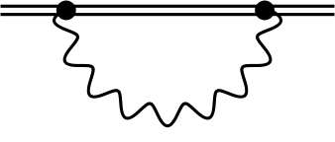
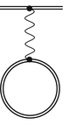
HCI and Exotic Atoms: a complementary pair
Self energy (SE)
Vacuum pol. (VP)
Highly charged ion: SE>VP
Exotic atom: VP>SE
Self-energy is dominant in HCI, vacuum polarization is dominant in exotic atoms
Unique probe of vacuum polarization, « one of the most interesting phenomena predicted by contemporary quantum electrodynamics » (Foldy and Eriksen, Physical Review (1954))
Complementary to vacuum studies with high-intensity lasers
Kaons INFN 2025

Slide 14
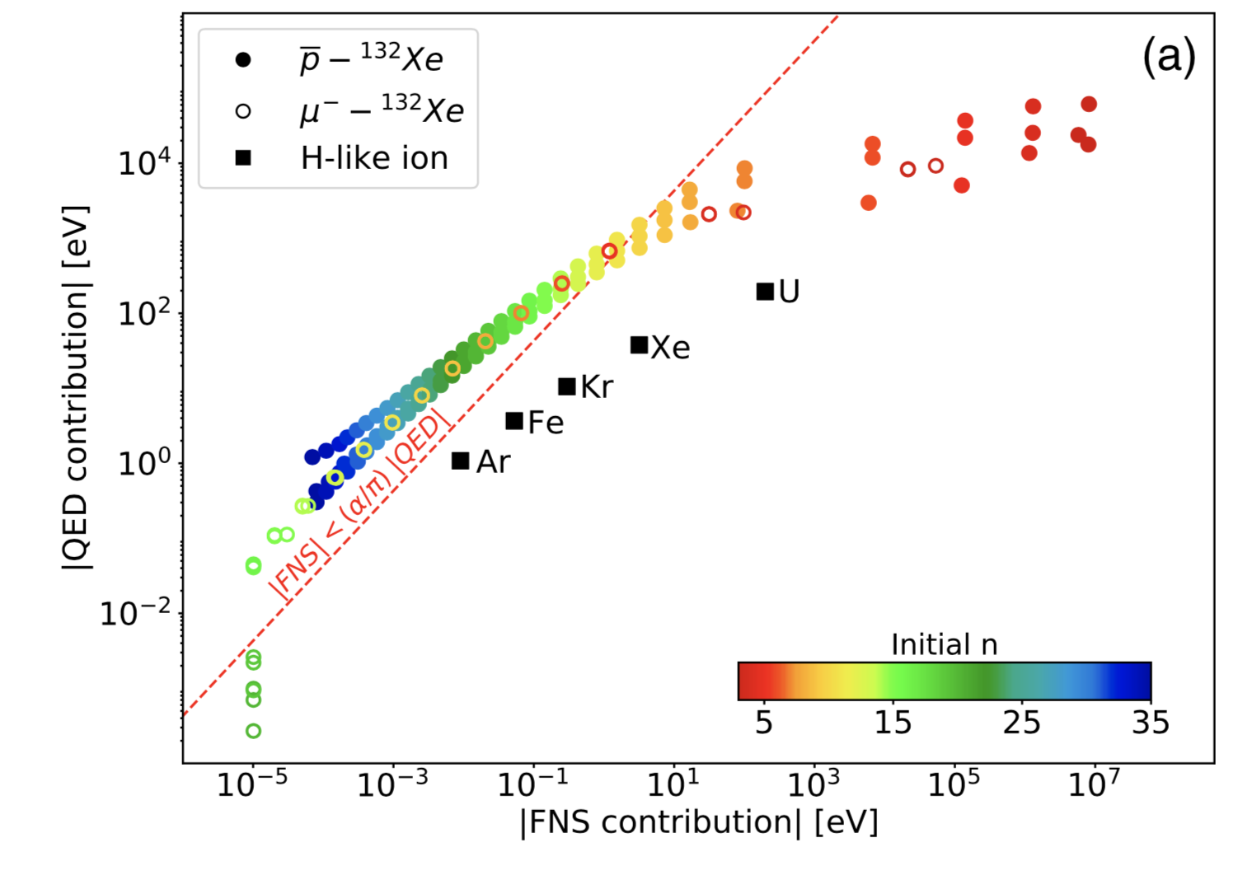
QED vs Finite Nuclear Size
QED theory calculations
Precision QED calculations performed for radiative cascade in muonic atoms from H →U
Multiconfiguration Dirac Fock code (MCDFGME, P. Indelicato, J.P. Desclaux)
One order of magnitude gain in sensitivity compared to normal H-like ions, by avoiding nuclear physics uncertainties
Kaons INFN 2025

Slide 15
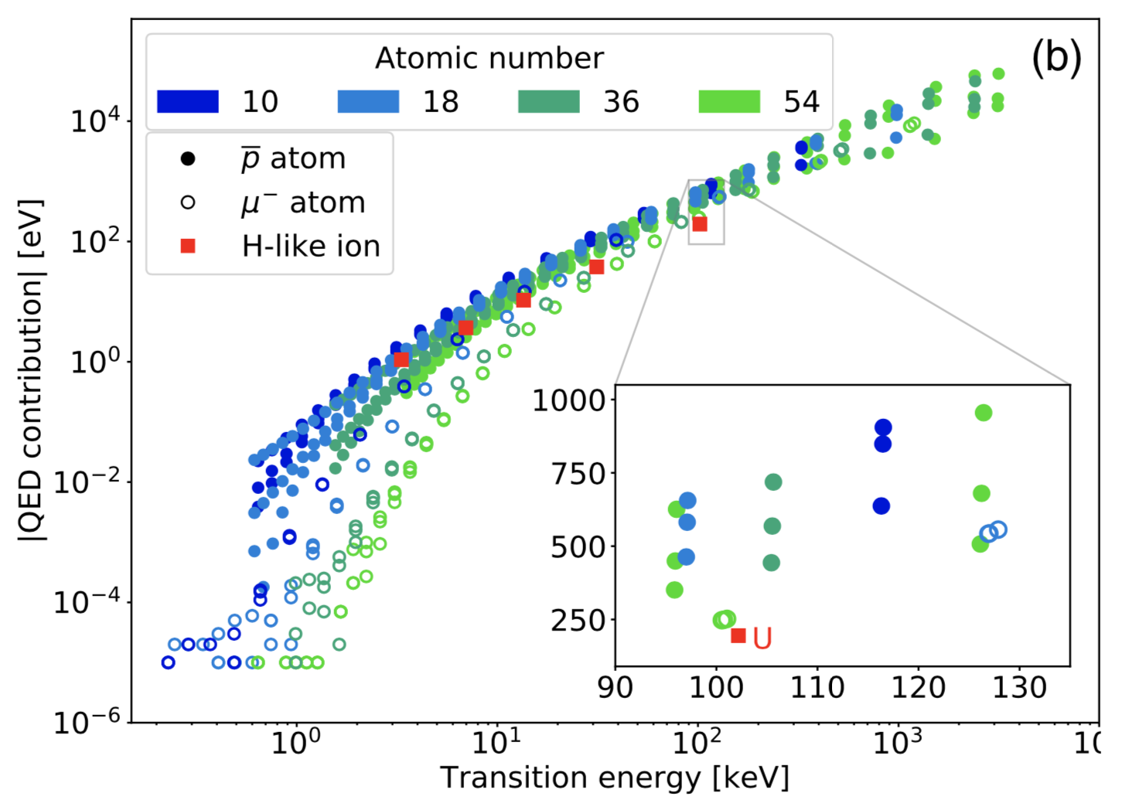
QED vs Transition Energy
Ge detection range
p
Larger QED contributions to transition energies, accessible for lower-Z ions
Factor of 2-10 gain in QED enhancement for a given detection range
QED effects in exotic atoms are larger for a given Z, thus easier to measure
Kaons INFN 2025

Slide 16
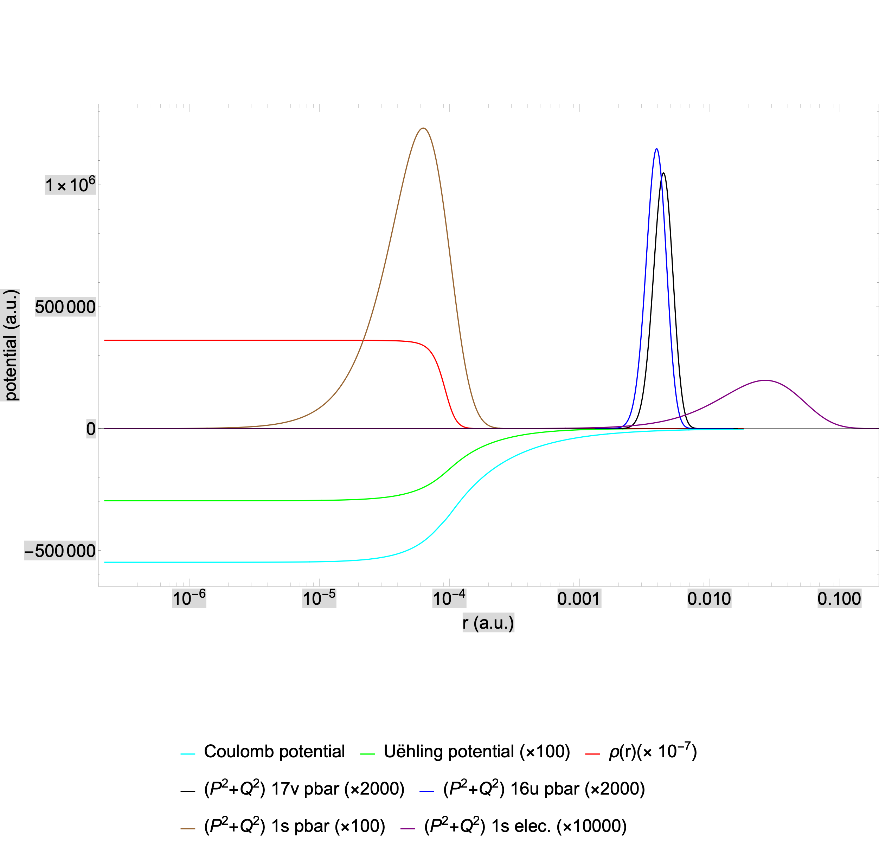
Wavefunctions and potentials
Kaons INFN 2025

Slide 17
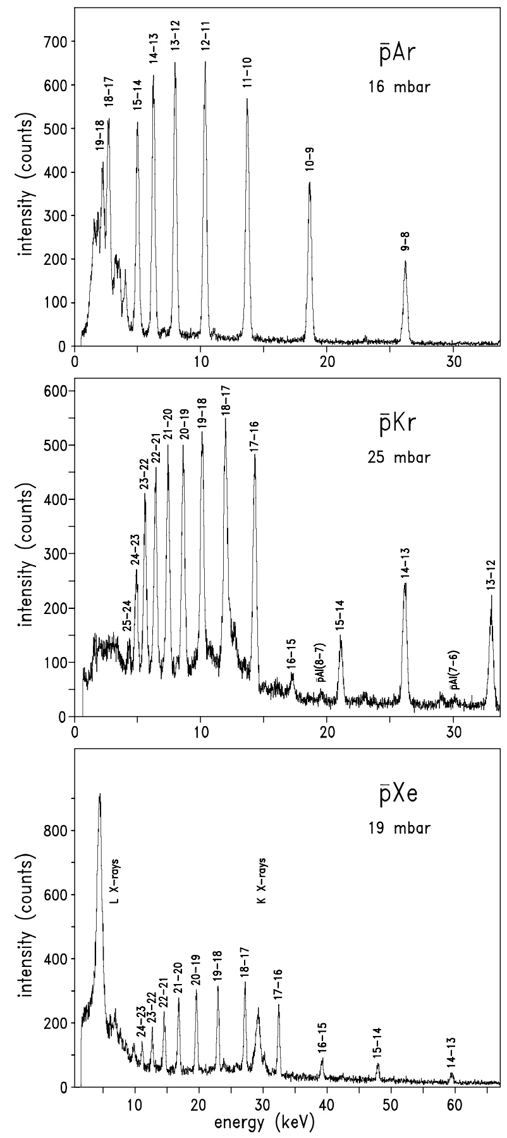
Cascade in antiprotonic atoms
High-n Rydberg-state Yrast transitions
observed with a gard-ring Si(Li) detector at the “Low Energy Antiproton Ring” (LEAR) at CERN
The Future comes using higher-resolution
microcalorimeters (typically 20 times better)
D. Gotta, K. Rashid, B. Fricke, P. Indelicato, and L. M. Simons, Eur. Phys. J D 47, 11 (2008).
Kaons INFN 2025

Slide 18
Strange effects on some QED confections
Muonic atoms self-energy
Kaons INFN 2025

Slide 19
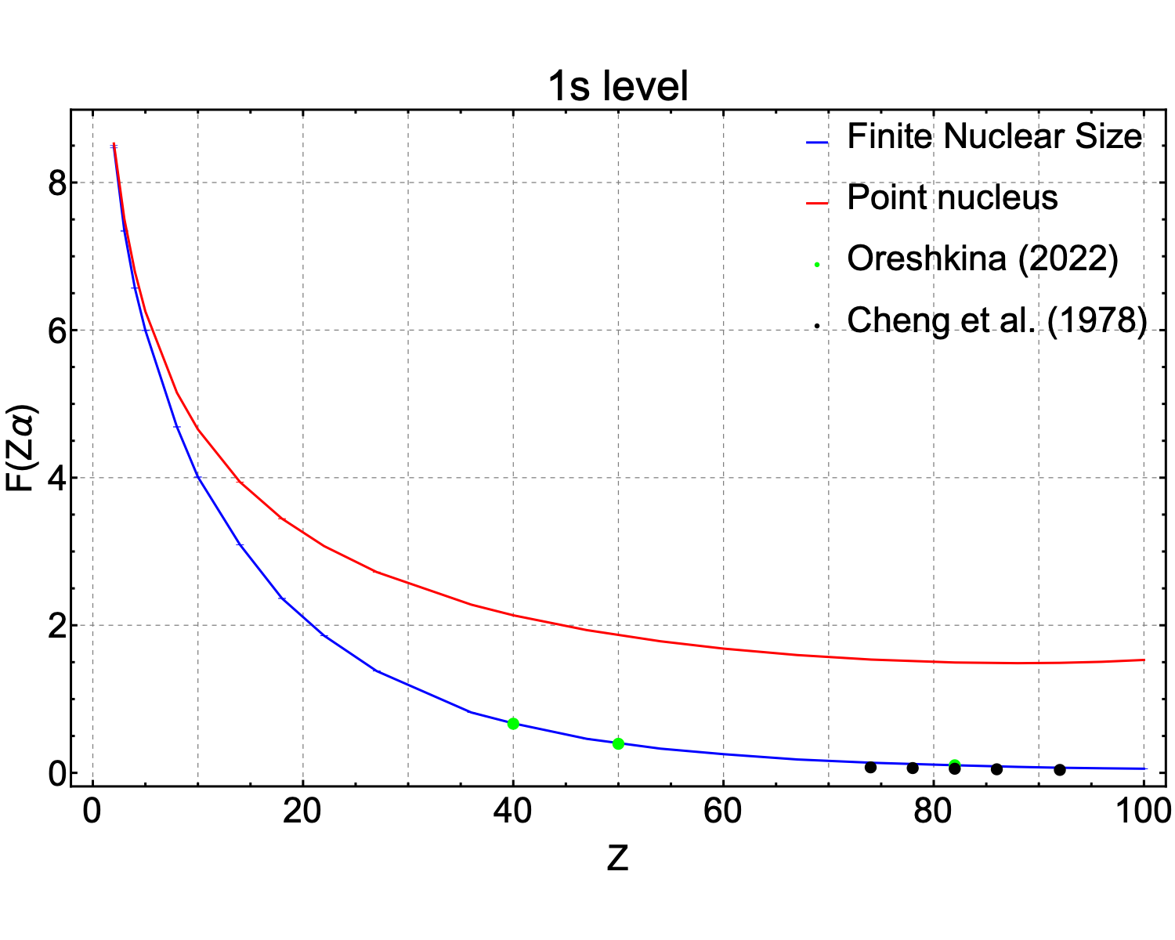
Muonic atoms Self-energy with FNS
Indelicato and Mohr, unpublished
Kaons INFN 2025

Slide 20
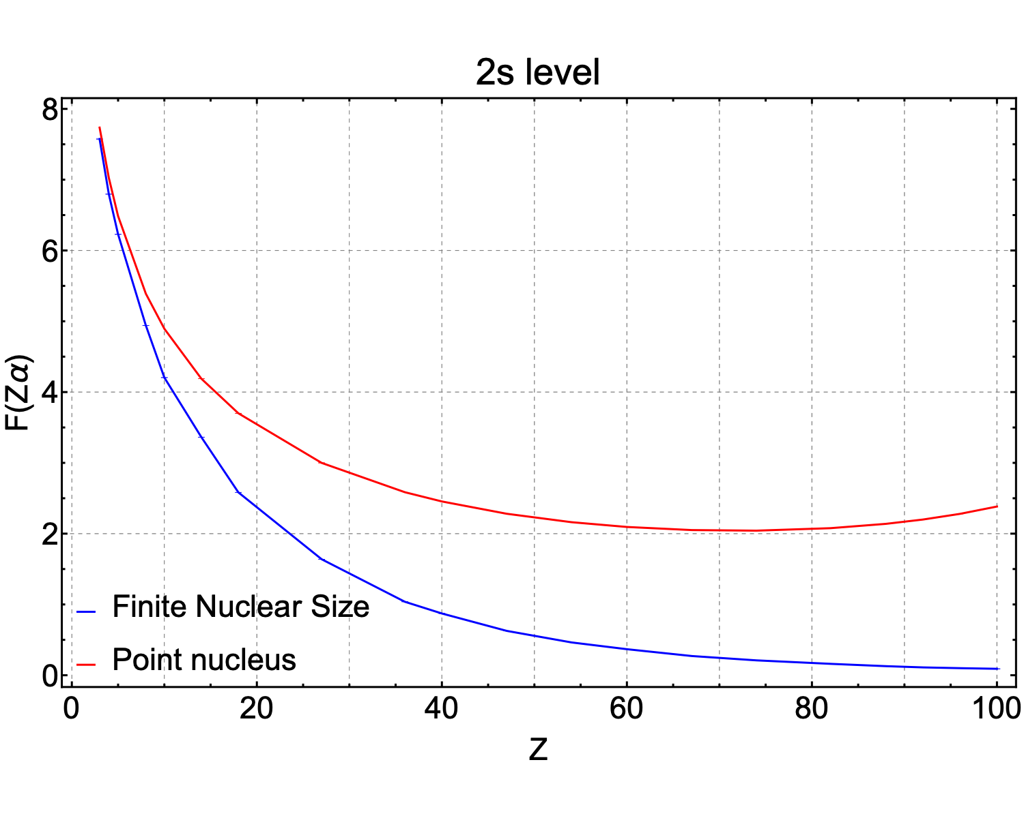
Muonic atoms Self-energy with FNS
Indelicato and Mohr, unpublished
Kaons INFN 2025

Slide 21
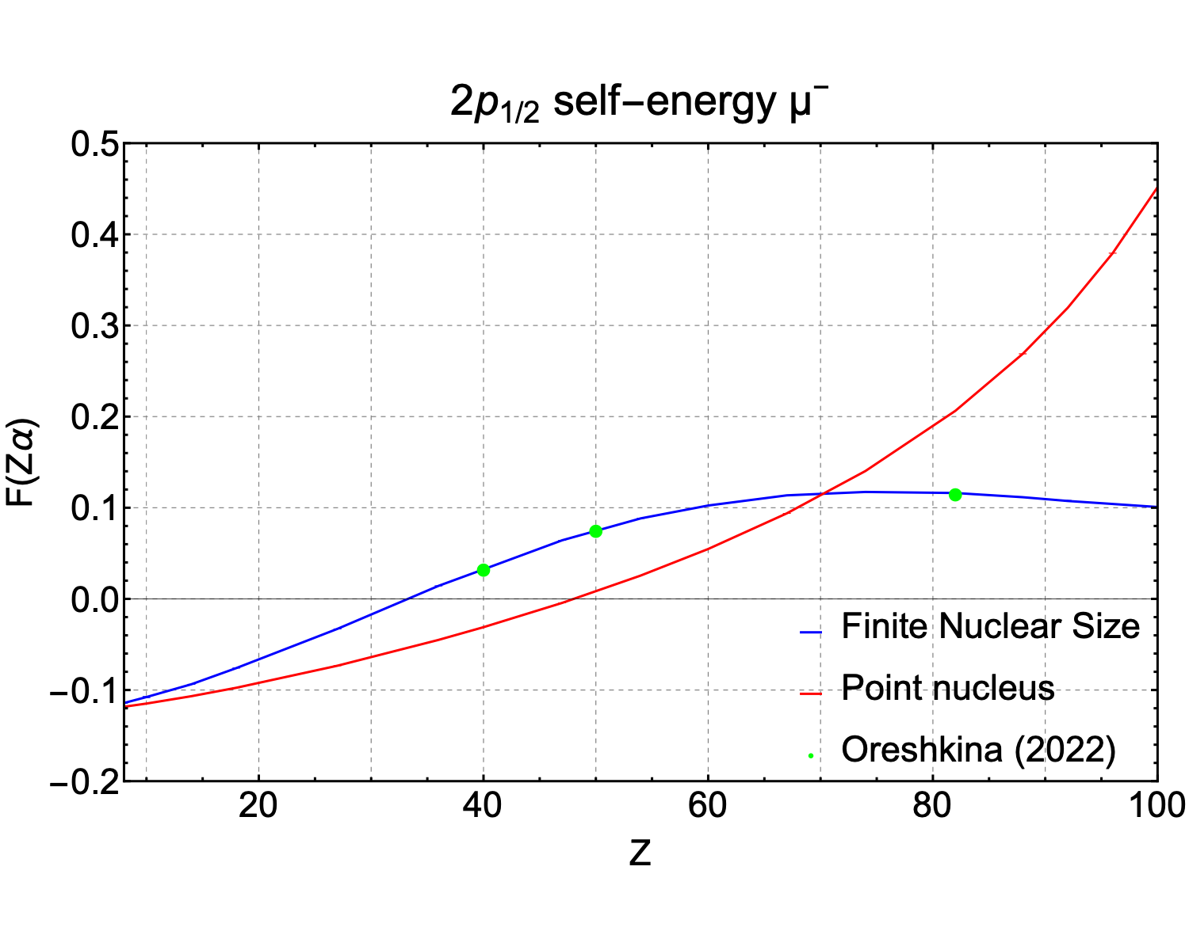

Muonic atoms Self-energy with FNS
Indelicato and Mohr, unpublished
Kaons INFN 2025

Slide 22
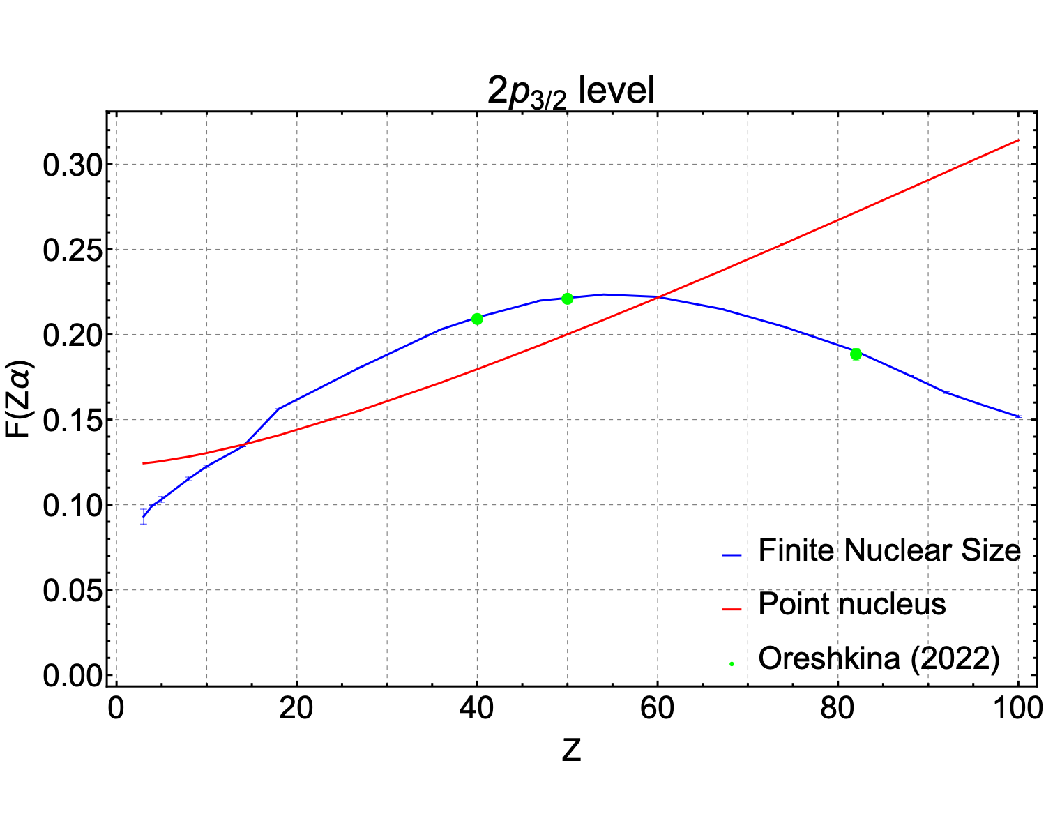
Muonic atoms Self-energy with FNS
Indelicato and Mohr, unpublished
Kaons INFN 2025

Slide 23
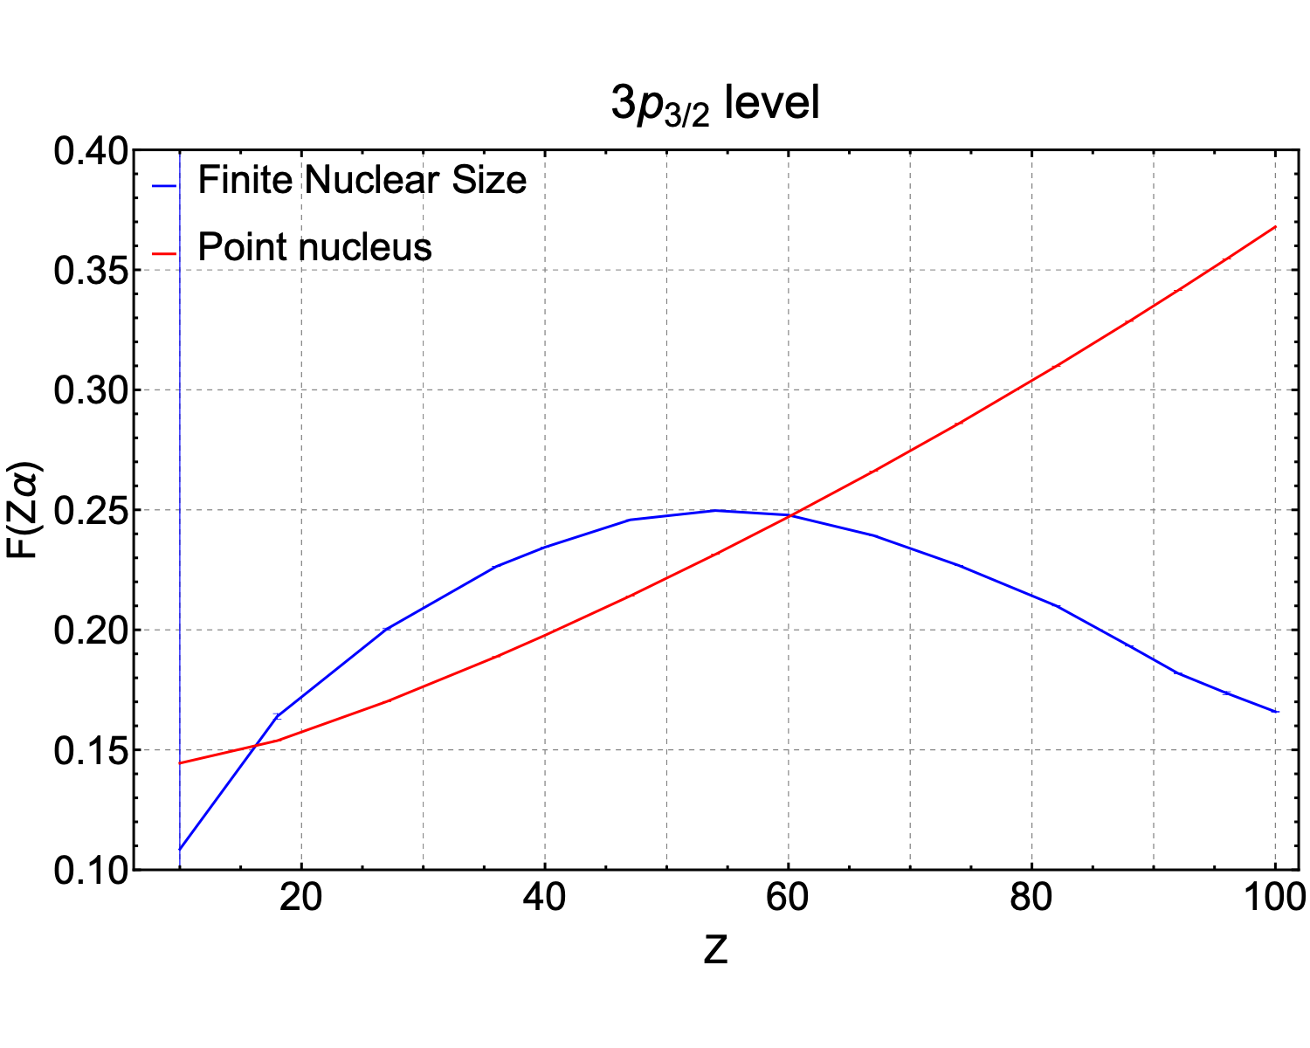
Muonic atoms Self-energy with FNS
Indelicato and Mohr, unpublished
Kaons INFN 2025

Slide 24
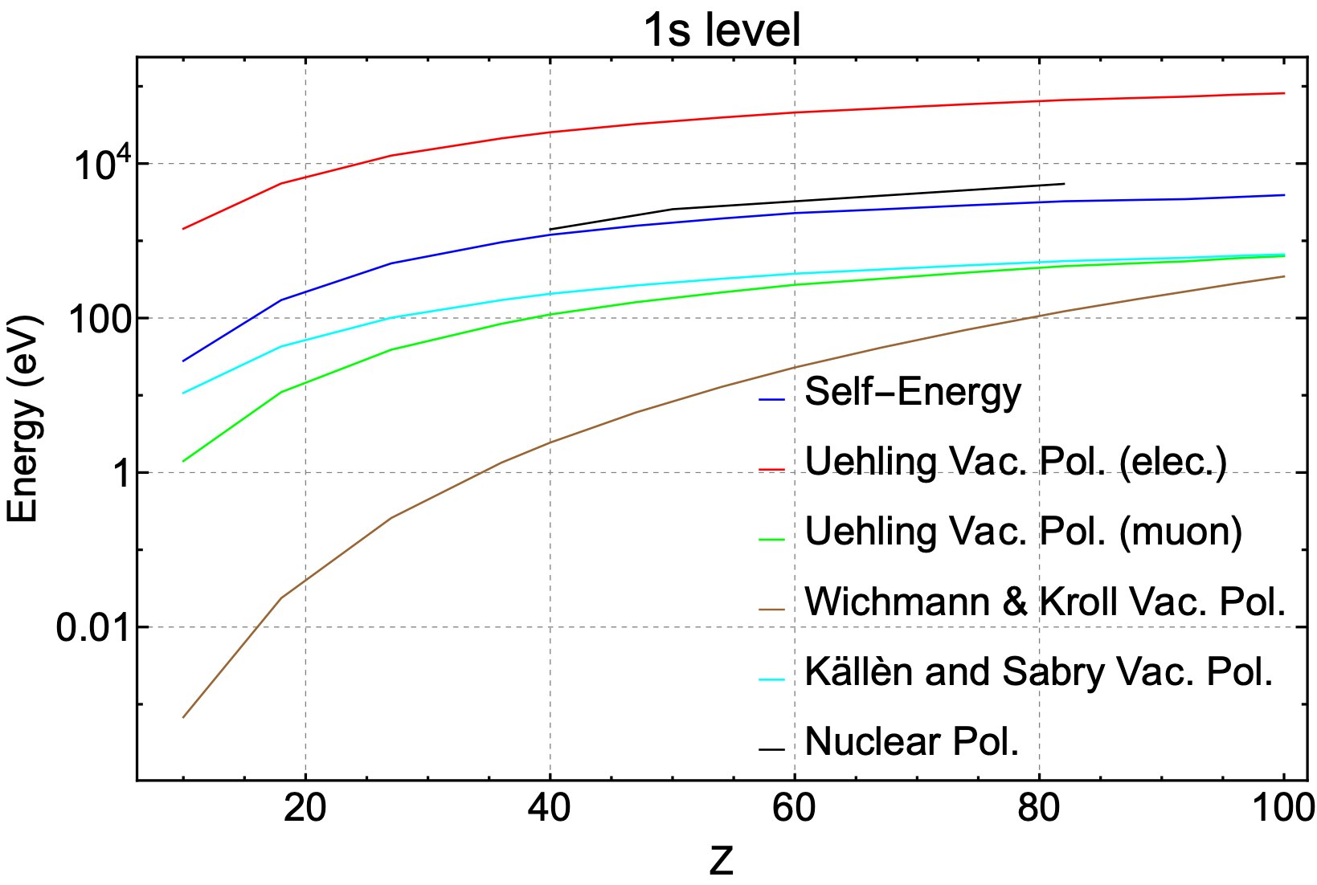
Contributions to muonic atoms
SE with FNS: Indelicato and Mohr (2023)
Nuclear Polarization: Oreshkina (2022)
Kaons INFN 2025

Slide 25
Kaonic atoms
Comparison to Daphne Kaonic Ne Results
Kaons INFN 2025

Slide 26
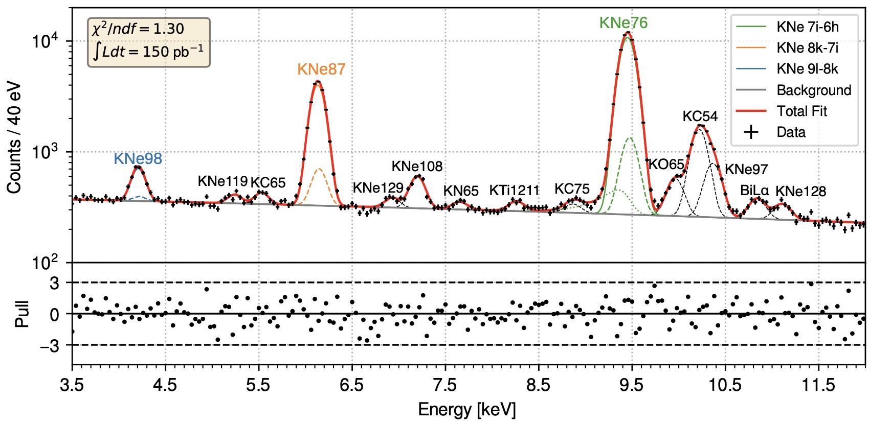
Kaonic Ne
Kaons INFN 2025

Slide 27
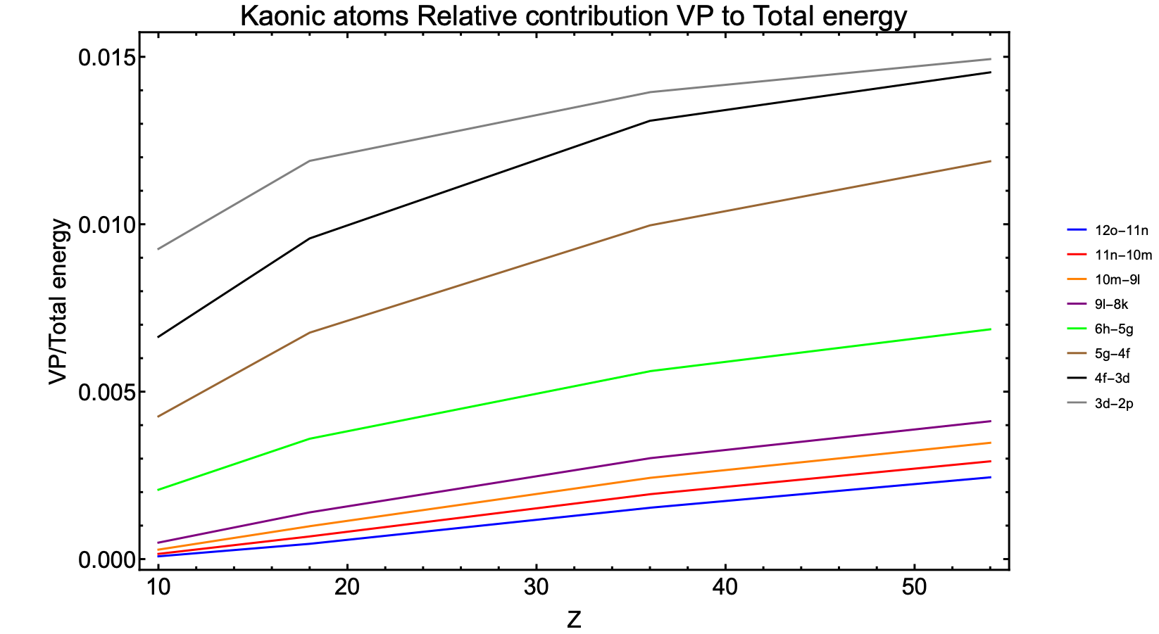
Evolution with Z
Kaons INFN 2025

Slide 28
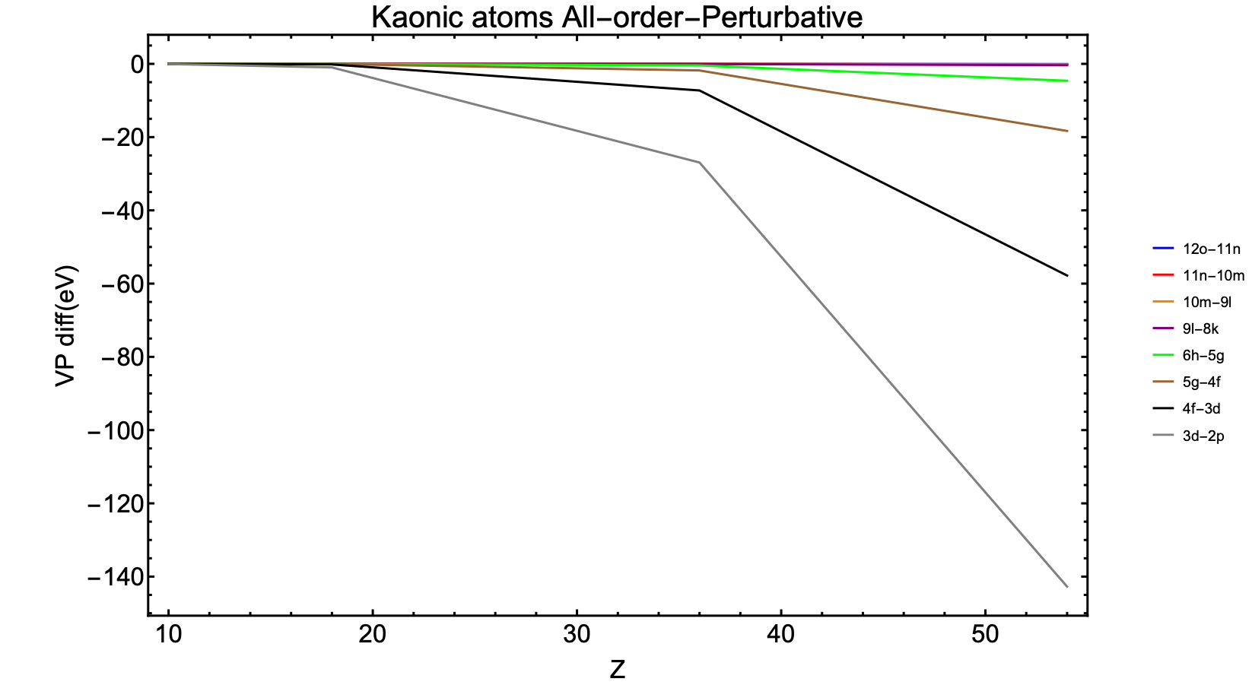
Evolution with Z
Kaons INFN 2025

Slide 29
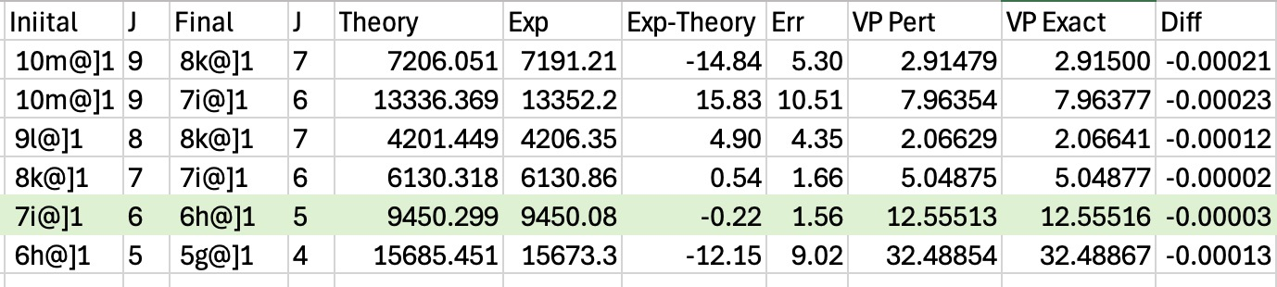
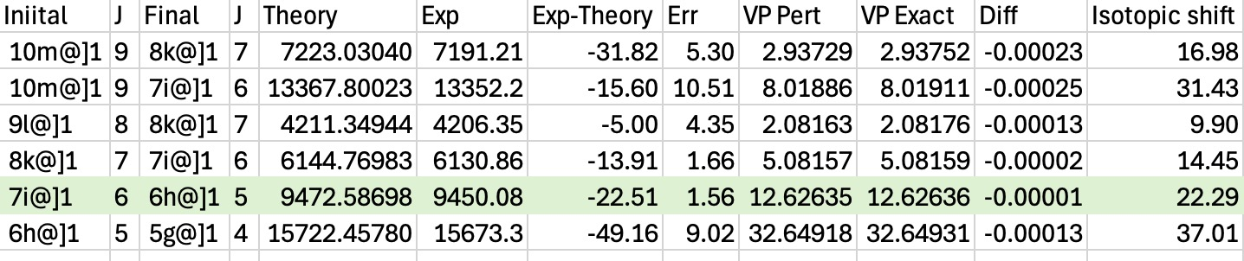
Comparison Theory experiment for Kaonic Ne
²⁰Ne
²²Ne
Kaons INFN 2025

Slide 30
Sensitivity to BSM particles
Setting the interaction strength limit
Kaons INFN 2025

Slide 31
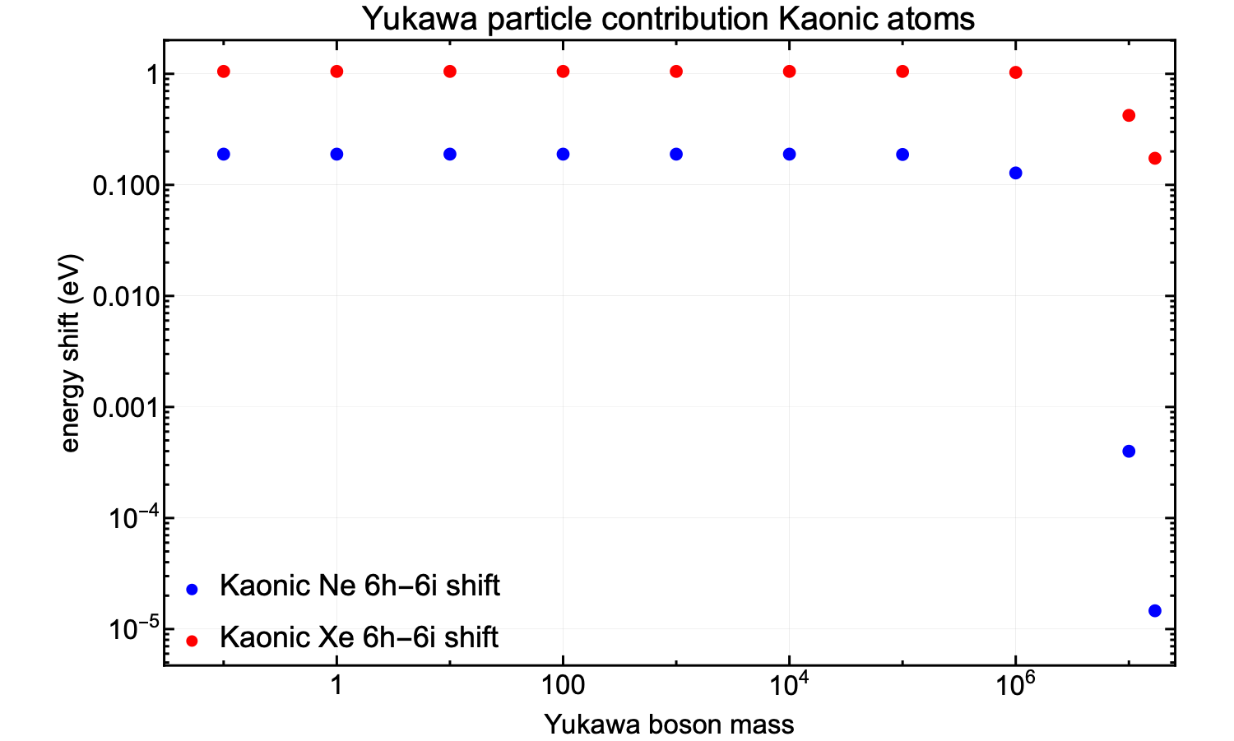
Yukawa particle effect on muonic atoms
Must set interaction strength to 10⁻⁴ to match experiment-theory difference in Kaonic Ne
Sensitivity decreases for large masses, like X17 mass
Kaons INFN 2025

Slide 32
Antiprotonic atoms and beyond
New results from CERN first tests with TES microcalorimeter
Kaons INFN 2025

Slide 33
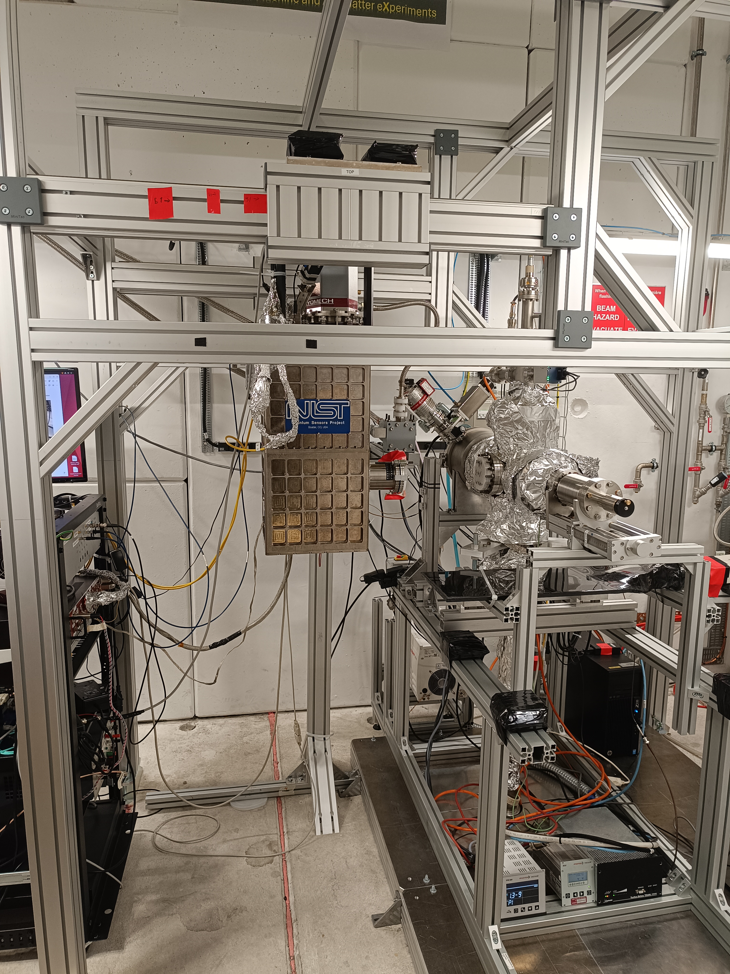
New installation on ELENA
TES test detector
TELMAX beam line
Kaons INFN 2025

Slide 34
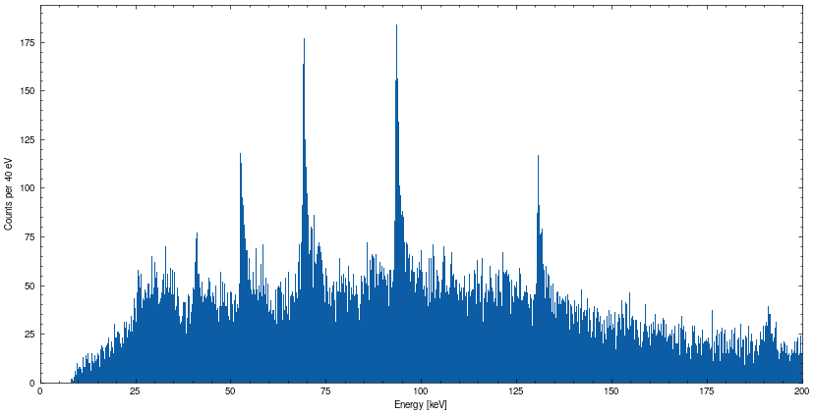
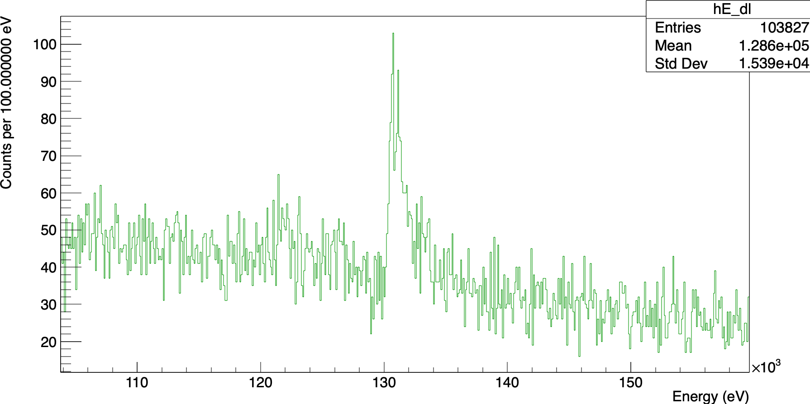
First spectrum
Antiprotonic Zr
Fine structure!
Kaons INFN 2025

Slide 35
Future with antinuclei atoms
Search for Dark matter in cosmic rays
Kaons INFN 2025

Slide 36
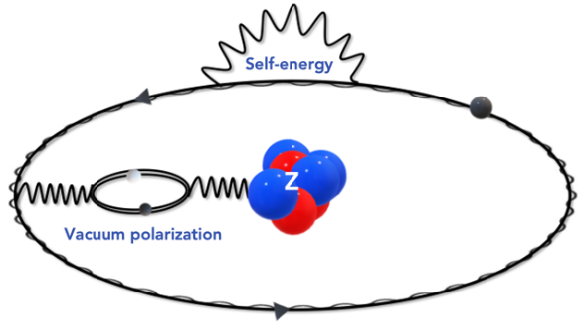
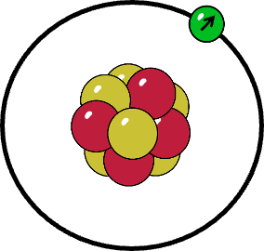
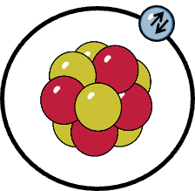
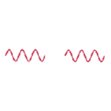



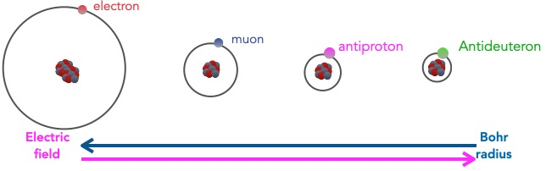
QED in bound state systems
p, s=1/2
D, s=1
e⁻, s=1/2
terms of order (𝛼/𝜋)
No bound state with spin 1
particle studied up to now
  Orbital size: 1 1/207 1/1836 1/3670 (~me/m)
EXEQT

Slide 37
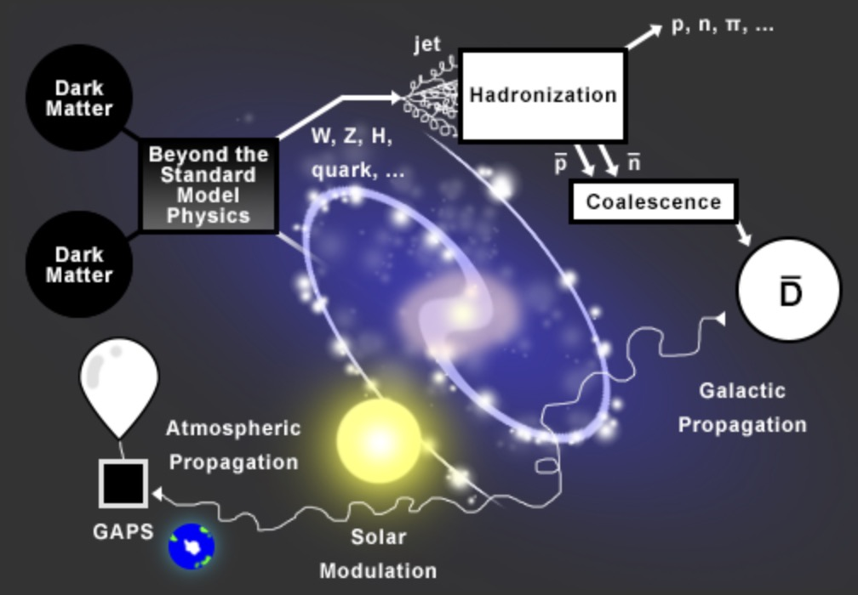
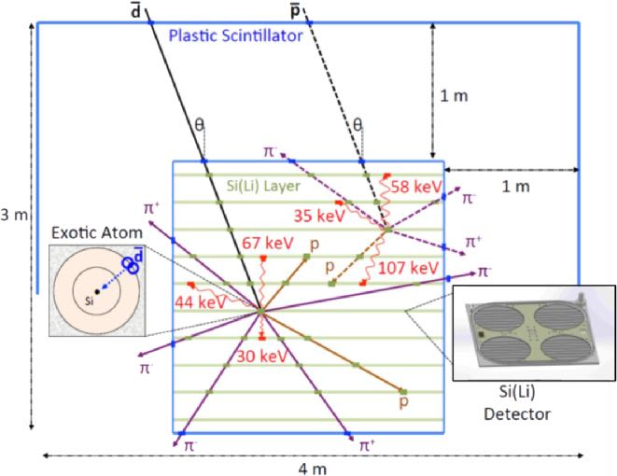
New spectra for QED tests and Cosmic rays detection
  GAPS (General AntiParticle Spectrometer)-Balloon (fly December 2025)
  GAPS (General AntiParticle Spectrometer)-Balloon (fly December 2025)
  Next spectrum with PAX: Si!!
Kaons INFN 2025

Slide 38
Future project
  Add new nuclei to the mdfgme code
  Already done: anti-triton (spin ½)
  Next: anti-helion (spin ½) and anti-alpha (spin 0)
  Then antideuton: difficult as spin 1, never done before in th general case (point nucleus by H. C. Corben and J. Schwinger in 1940!)
  Vacuum polarization gets stronger and stronger with mass
  Impact on second order QED?
  Experiment: The AD/ELENA staff push for doing anti-deuton beams
  100/pulse vs 10⁷/pulse for antiprotons
  Added to the 2025 CERN report
  Possibly done after the LS3 in 2028
Kaons INFN 2025

Slide 39
Conclusion
All-order QED corrections with finite size corrections can be now performed for any exotic atoms (for normals atoms too!)
Good agreement with Kaonic Ne stronger line but All-orders correction is negligible
Would be interesting to go to heavier Kaonic Atoms (Ar, Kr, Xe?)
Use of TES detector on antiprotonic atoms gives very high resolution, but calibration and data analysis difficult (perturbation by pions from antiproton annihilation, variable magnetic field due to cycling of AD and ELENA magnets
Future projects to develop theory and possibly do experiments at AD/ELENA on anti-deutons
Establish the theory for heavier antinuclei for possible detection ins cosmic rays
Kaons INFN 2025

