Slide 1

KAMEO
(Kaonic Atoms Measuring nuclear resonance Effects Observables)
Probing E2 Nuclear Resonance in Kaonic Molybdenum Isotopes
Luca De Paolis
Workshop of fundamental physics with exotic atoms
Laboratori Nazionali di Frascati (LNF-INFN)
24/06/2025

Slide 2













The E2 Nuclear Resonance Effect
In the atomic system, when an atomic de-excitation energy is closely matched by a nuclear excitation energy, a resonance condition occurs, which produces an attenuation of some of the atomic x-ray lines from a resonant versus a normal isotope target – as Mo(98).
$${}_{42}^{98}{Mo}$$
n=7
$${}_{42}^{98}{Mo}$$
n=7
n=6
n=6
n=5
n=5
n=4
n=4
$$K^{−}$$
$$K^{−}$$
$$2^{+}$$
$$0^{+}$$
$$0^{+}$$
$$K^{−}$$
$$K^{−}$$
$$K^{−}$$
$$K^{−}$$
$$K^{−}$$
$$K^{−}$$
$$K^{−}$$
$$K^{−}$$
$$K^{−}$$
$$e^{−}$$
$$e^{−}$$
$$E_{6→4}^{0^{+}}\left(keV\right)≅798,2$$
$$E_{4}^{{0^{+}→2}^{+}}\left(keV\right)≅787,4$$

Slide 3

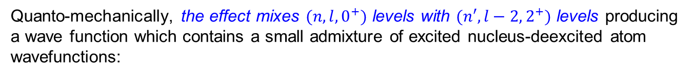

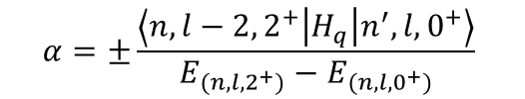
The E2 Nuclear Resonance Effect
The E2 Nuclear Resonance effect is a mixing of the atomic states due to the electrical quadrupole excitations of nuclear rotational states.
Quanto-mechanically, the effect mixes $(n,l,0^{+})$ levels with $(n′,l−2,2^{+})$ levels producing a wave function which contains a small admixture of excited nucleus-deexcited atom wavefunctions:
$$ψ=\sqrt{1−{\left|α\right|}^{2}} φ\left(n,l,0^{+}\right)+α φ\left(n^{′},l−2, 2^{+}\right)$$
where the admixture coefficient
$$α=±\frac{\left\langle n,l−2,2^{+} | H_{q} | n^{′},l,0^{+}\right\rangle }{E_{(n,l,2^{+})}−E_{(n,l,0^{+})}}$$
(very small), and $H_{Q}$
expresses the electric quadrupole interaction between hadron and nucleus.
As example, for the nuclear E2 resonance effect in $K^{−}−Mo$ isotopes:
$$ψ=\sqrt{1−{\left|α\right|}^{2}} φ\left(6h,0^{+}\right)+α φ(4f,2^{+})$$
$$α=±\frac{\left\langle 4f,2^{+} | H_{q} | 6h,0^{+}\right\rangle }{E_{(4f,2^{+})}−E_{(6h,0^{+})}}$$
with

Slide 4


The E2 Nuclear Resonance Effect
The matrix element $\left\langle H_{Q}\right\rangle$ for a spin-zero hadron is given by:
$$\left\langle H_{Q}\right\rangle =±\frac{1}{2}e^{2}Q_{0}\left\langle r^{−3}\right\rangle {[\left(2l+1\right)\left(2l′+1\right)\left(2l+1\right)\left(2l′+1\right)]}^{\frac{1}{2}} ×\left({2 \atop 0}{I \atop −K}{I′ \atop K}\right)\left({2 \atop 0}{l \atop 0}{l′ \atop 0}\right)\left\{\begin{matrix}2 & I & I′ \\ F & l′ & l\end{matrix}\right\}$$
$Q_{0}$ is the nuclear quadrupole strength
$I,I^{′},K,K^{′},l,l^{′},F$ are angular momentum factors
$\left\langle r^{−3}\right\rangle$ is the quadrupole orbital radius
H.L. Acker, Nucl. Phys. 87, 153, 1966
$Q_{0}$ comes directly from the measured Coulomb excitation cross-sections ($B(E2↑)$ values).
$\left\langle r^{−3}\right\rangle$ can be evaluated using point Coulomb wave functions
$I,I^{′},K,K^{′},l,l^{′},F$ can be with angular-momentum rules (i.e. for spin one-half $l→j, etc…$)
CALCULATIONS ARE INDEPENDENT OF ANY PARTICULAR NUCLEAR MODEL

Slide 5

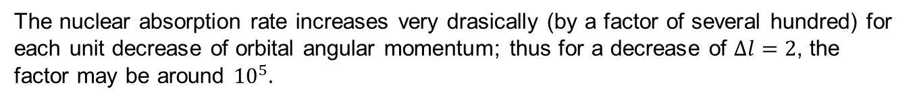
The E2 Nuclear Resonance Effect
HADRONIC ATOMS ARE VERY SENSITIVE TO QUITE AMOUNTS OF CONFIGURATION MIXING
The nuclear absorption rate increases very drasically (by a factor of several hundred) for each unit decrease of orbital angular momentum; thus for a decrease of $∆l=2$, the factor may be around ${10}^{5}.$
A very small admixture coefficient a (typically 1%) can mean a significant induced width!
INDUCED WIDTH:
$$Γ_{n,l}^{Ind}=\left|a^{2}\right|Γ_{n^{′},l−2}^{0}$$
A significant weakening/attenuation of corresponding hadronic x-ray line and any lower lines can be observed.
Moreover, comparing the ratio of intensities (attenuated line/reference) from the resonant isotope (thicklish) to a non resonant one, we have the direct measure of the fraction of hadrons absorbed by the excited nucleus.

Slide 6



The pionic cadmium 112 experiment
An experiment measuring E2 resonance effect cadmium 112 was performed in 1975 by J. N. Bradbury, H.Daniel, J. Reidy and M. Leon at the biomedical pion beam of Los Alamos Meson Physics Facility (LAMPF).
$${Cd}_{112}$$
6h
In pionic cadmium (112), the energy difference between 5g and 3d levels, 618.8 keV, is very nearly equal to the nuclear excitation energy of 617.4 keV.
105 keV
$$2^{+}$$
5g
194 keV
617.4 keV
618.8 keV
4f
$$0^{+}$$
3d
424 keV
Experimental apparatus and measurement features:
The experiment consisted of placing enriched isotope targets of Cd(111) e Cd(112) in turn into the negative pion beam for 2 hours.
The spectra were collected using a germanium detector feeding a pulse height analyzer.
Natural Cadmio was exposed for a shorter time to provide consistency check.

Slide 7
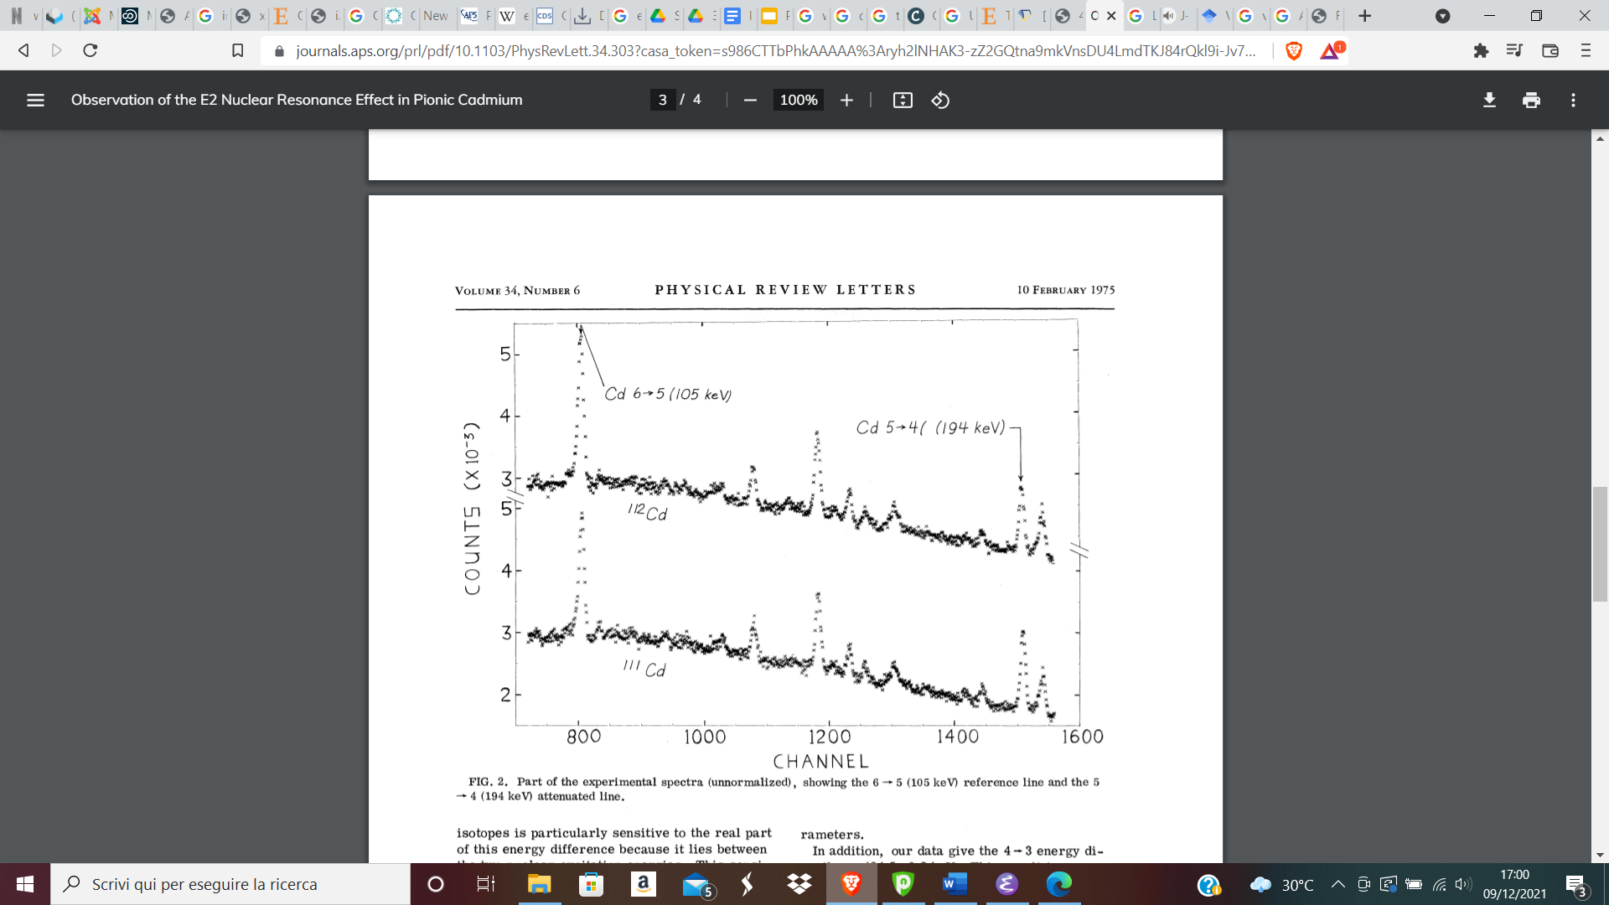
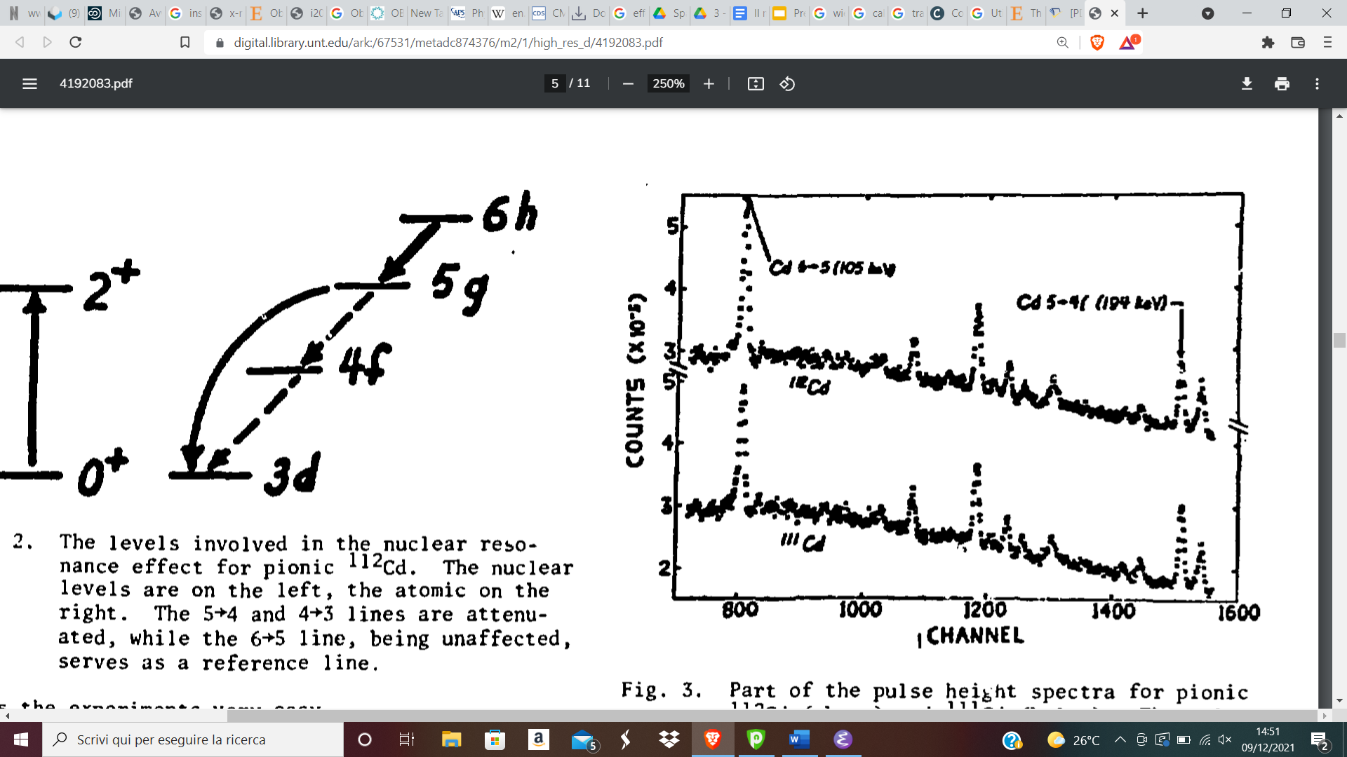
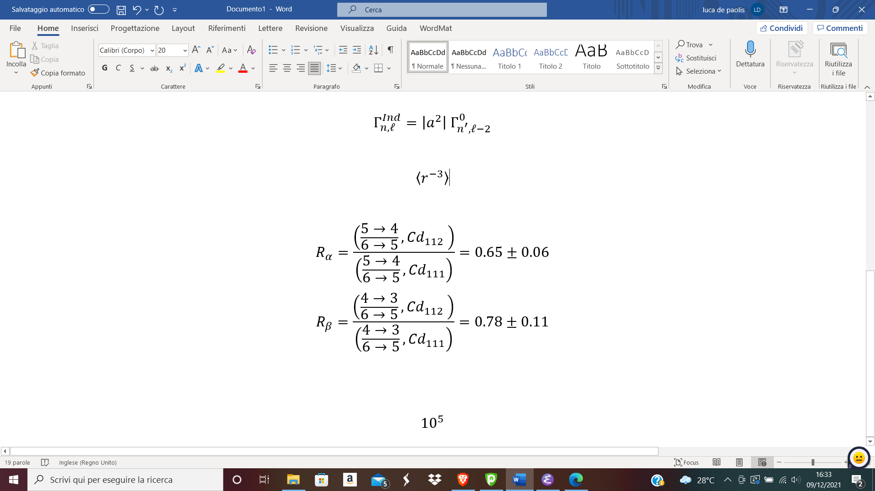
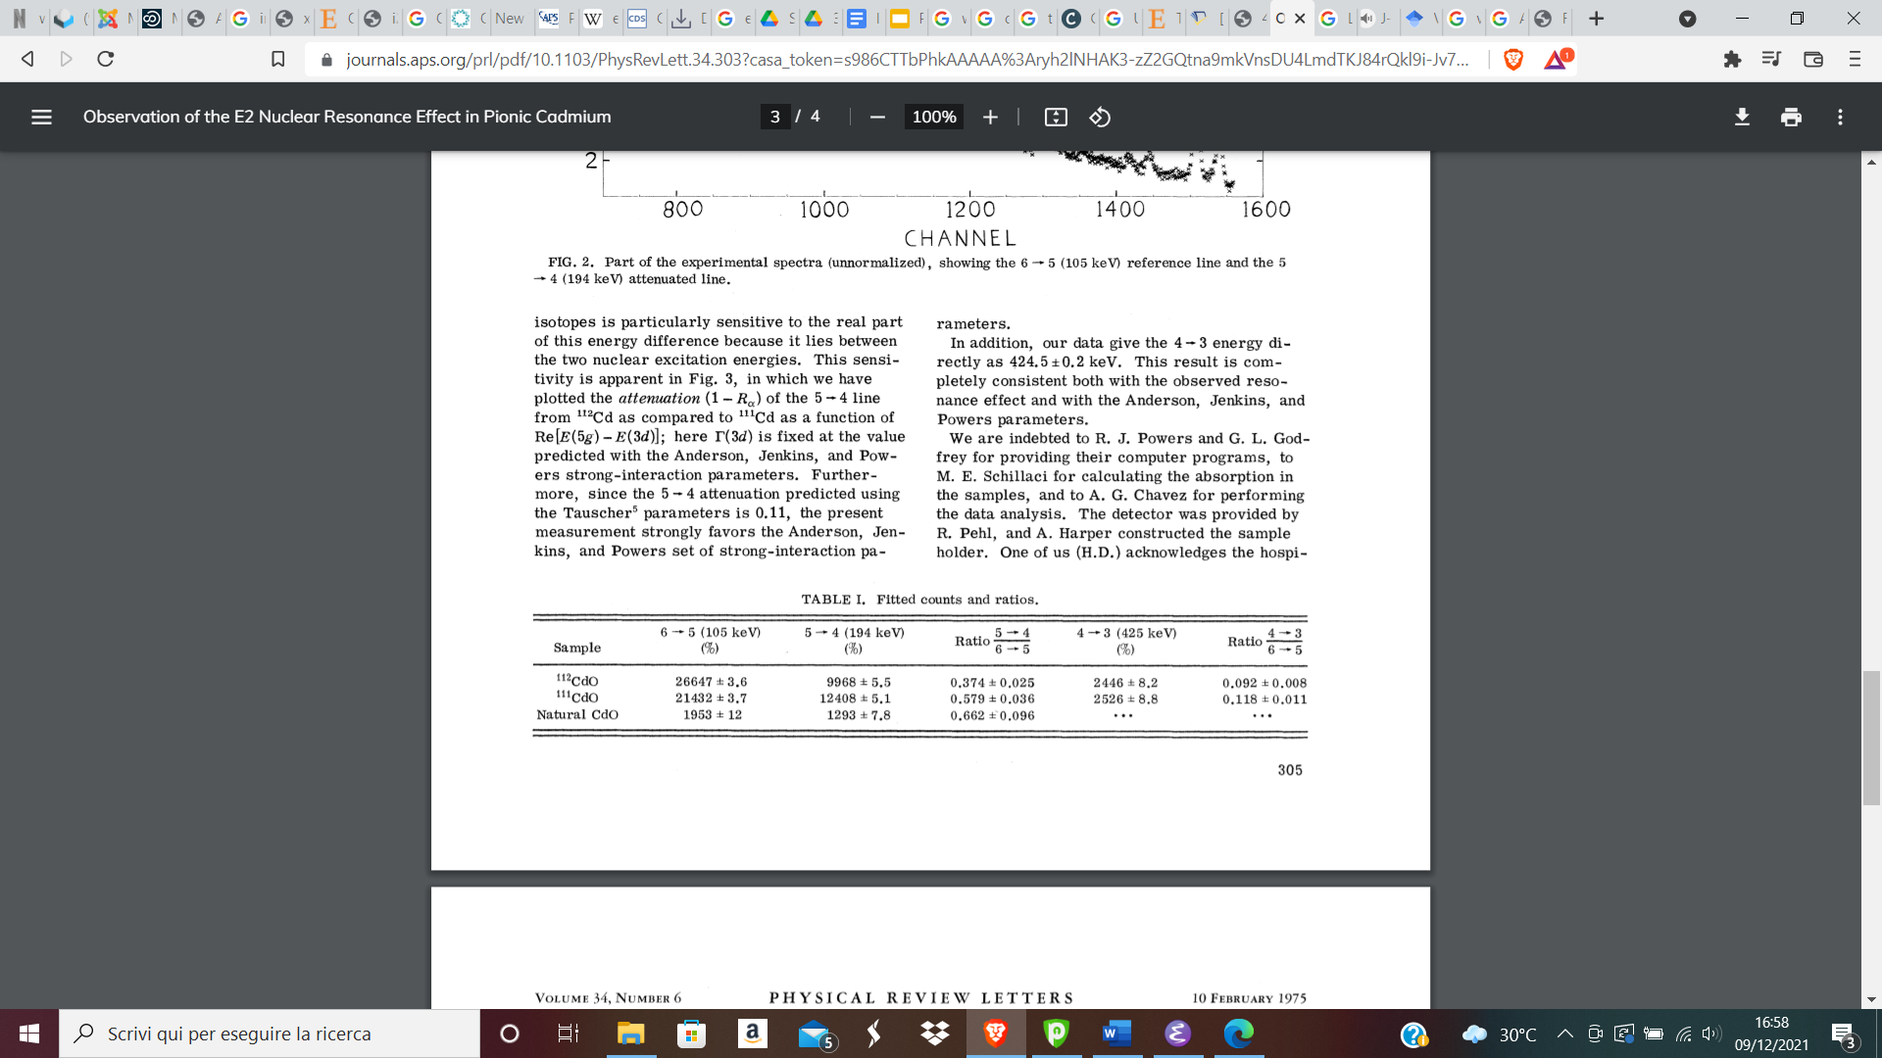
Pionic cadmium 112 measurement
These results demonstrate the existence of the Nuclear Resonance Effect: the ratios are very significantly different from one.

Slide 8
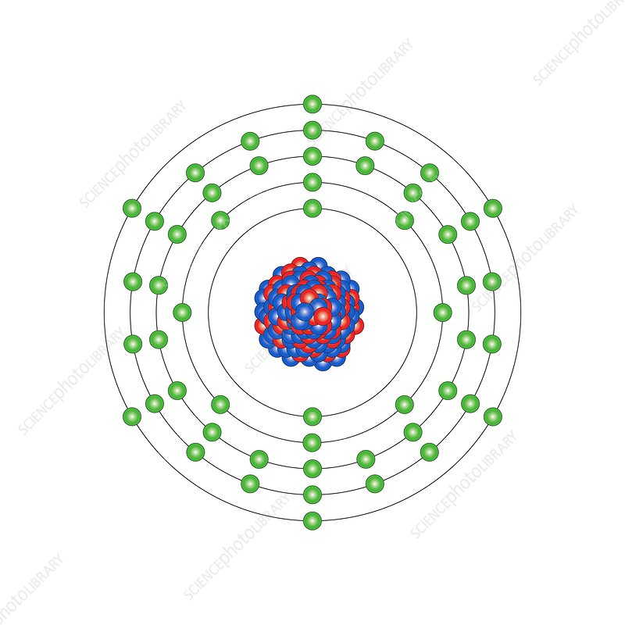
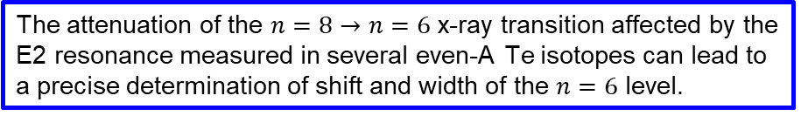
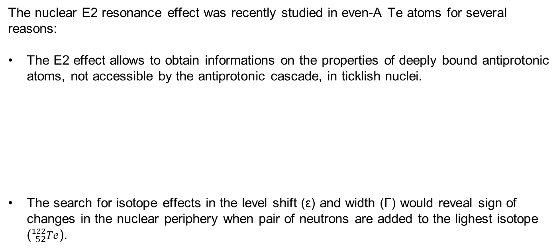
E2 effect in antiprotonic Te atoms
The nuclear E2 resonance effect was recently studied in even-A Te atoms for several reasons:
The E2 effect allows to obtain informations on the properties of deeply bound antiprotonic atoms, not accessible by the antiprotonic cascade, in ticklish nuclei.
The search for isotope effects in the level shift (ε) and width (Γ) would reveal sign of changes in the nuclear periphery when pair of neutrons are added to the lighest isotope (${}_{52}^{122}{Te}$).
Tellurium atom
The attenuation of the $n=8→n=6$ x-ray transition affected by the E2 resonance measured in several even-A Te isotopes can lead to a precise determination of shift and width of the $n=6$ level.
SAME TOPICS COULD BE INVESTIGATED WITH KAONIC MOLYBDENUM ATOMS (4 even-A ISOTOPES)

Slide 9
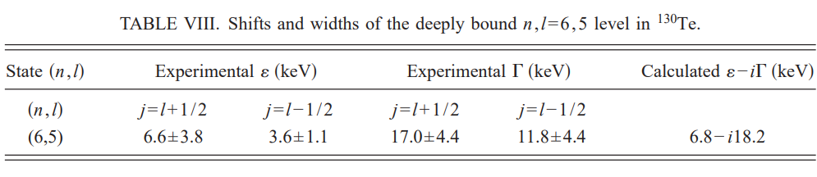

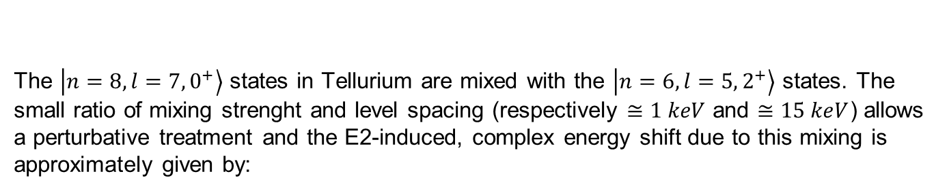
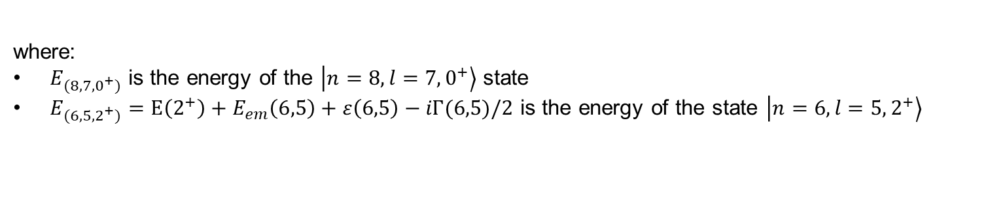
The antiprotonic Te experiment
The $\left.\left|n=8,l=7,0^{+}\right.\right\rangle$ states in Tellurium are mixed with the $\left.\left|n=6,l=5,2^{+}\right.\right\rangle$ states. The small ratio of mixing strenght and level spacing (respectively $≅1 keV$ and $≅15 keV$) allows a perturbative treatment and the E2-induced, complex energy shift due to this mixing is approximately given by:
$$ε\left(E2;8,7\right)−i\frac{Γ(E2;8,7)}{2}≅\frac{{\left\langle 8,7;0^{+} | H_{q} | 6,5;2^{+}\right\rangle }^{2}}{E_{(8,7,0^{+})}−E_{(6,5,2^{+})}}$$
where:
$E_{(8,7,0^{+})}$ is the energy of the $\left.\left|n=8,l=7,0^{+}\right.\right\rangle$ state
$E_{(6,5,2^{+})}=E\left(2^{+}\right)+E_{em}\left(6,5\right)+ε\left(6,5\right)−iΓ(6,5)/2$ is the energy of the state $\left.\left|n=6,l=5,2^{+}\right.\right\rangle$
B. Klos, S. Wycech et al., PHYS. REV. C 69, 044311 (2004)

Slide 10
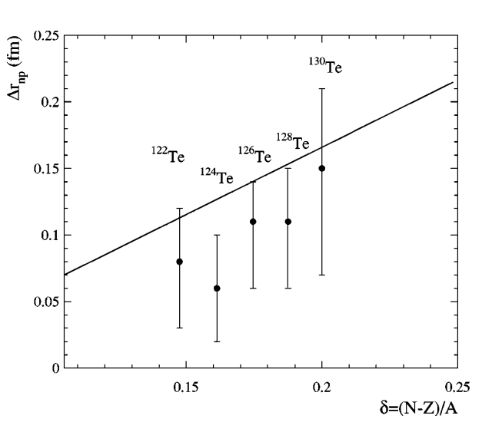
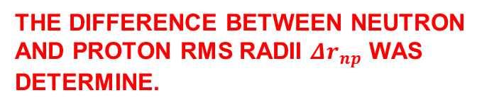
The antiprotonic Te experiment
The measured level shifts (ε) and widths (Γ) of the energy levels n=8,6 in even-A antiprotonic tellurium isotopes allowed the investigation toward the neutron density in nuclear periphery.
Neutron and proton distribution in the Te nuclei were described with two-parameter Fermi model.
The rms neutron radius was adjusted through experimental data.
THE DIFFERENCE BETWEEN NEUTRON AND PROTON RMS RADII $Δr_{np}$ WAS DETERMINE.

Slide 11

The Molybdenum 98 experiment
An experiment measuring E2 Nuclear Resonance Effects in Molybdenum 98 was performed in 1975 by G. L. Goldfrey, G- K. Lum and C. E. Wiegand at Lawrence Berkeley Laboratory (LBL) in California.
In kaonic molybdenum (98), the energy difference between 6h and 4f levels, 798.2 keV, is very nearly equal to the nuclear excitation energy of 787.4 keV.
$${Mo}_{98}$$
7i
171 keV
$$2^{+}$$
6h
284 keV
787.4 keV
798.2 keV
5g
$$0^{+}$$
4f
514 keV
Experimental apparatus and measurement features:
The experiment was performed with a negative kaon beam, turning the targets of Mo(98), and Mo(92) as reference.
The spectra were collected using germanium detectors feeding a pulse height analyzer.

Slide 12
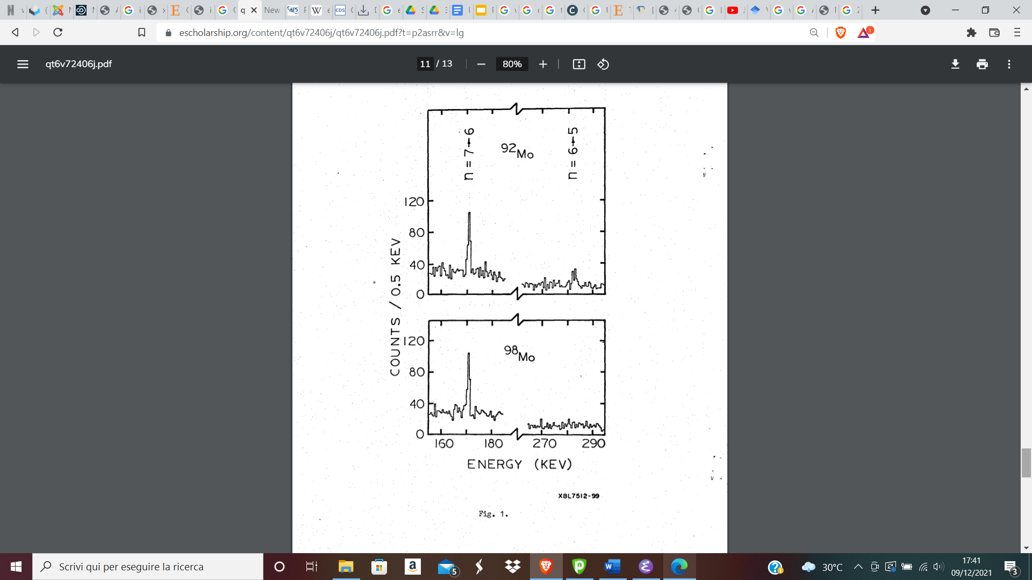
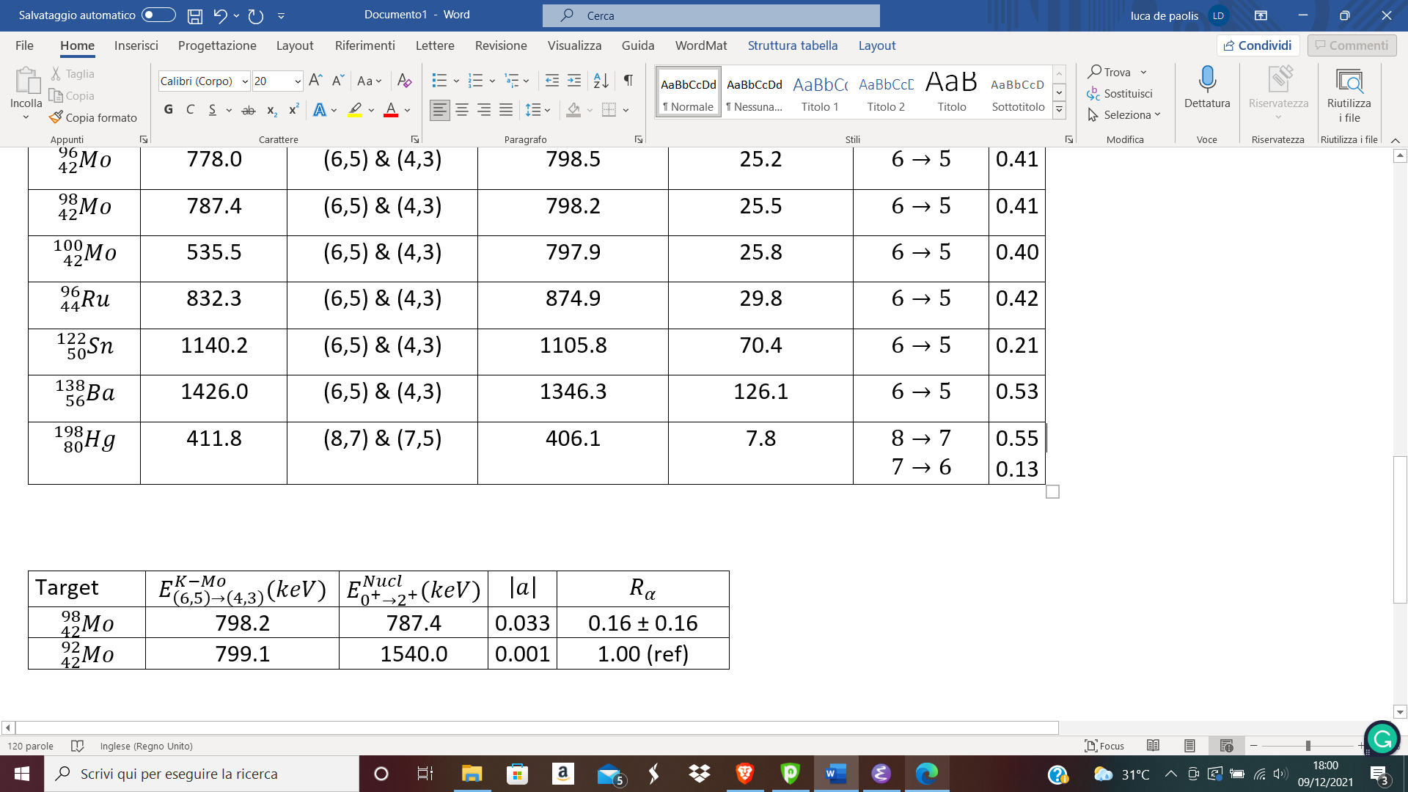
The Molybdenum 98 experiment
The E2 Nuclear Resonance effect was observed $K^{−}−{}_{42}^{98}{Mo}$, expressed as the attenuation of x-ray line .
Only 25 hours of data taking with K-beam was not enough for a conclusive result!!
IMPROVABLE WITH MODERN DETECTORS AND MORE DATA TAKING TIME

Slide 13
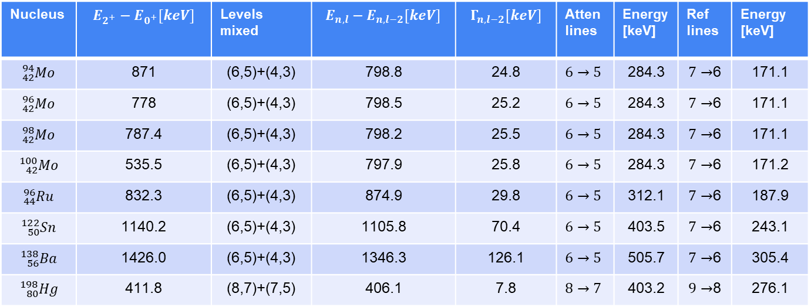
Nuclear Resonance in Kaonic atoms
Nuclear Resonances are expected also for kaonic atoms. Such predictions have been obtained by integrating the Klein-Gordon equation with a phenomenological kaon-nucleon potential.
Nucleus | $$E_{2^{+}}−E_{0^{+}}[keV]$$ | Levels mixed | $$E_{n,l}−E_{n,l−2}[keV]$$ | $$Γ_{n,l−2}[keV]$$ | Atten lines | Energy [keV] | Ref lines | Energy [keV]
$${}_{42}^{94}{Mo}$$ | 871 | (6,5)+(4,3) | 798.8 | 24.8 | $$6→5$$ | 284.3 | $7→$6 | 171.1
$${}_{42}^{96}{Mo}$$ | 778 | (6,5)+(4,3) | 798.5 | 25.2 | $$6→5$$ | 284.3 | $7→$6 | 171.1
$${}_{42}^{98}{Mo}$$ | 787.4 | (6,5)+(4,3) | 798.2 | 25.5 | $$6→5$$ | 284.3 | $7→$6 | 171.1
$${}_{42}^{100}{Mo}$$ | 535.5 | (6,5)+(4,3) | 797.9 | 25.8 | $$6→5$$ | 284.3 | $7→$6 | 171.2
$${}_{44}^{96}{Ru}$$ | 832.3 | (6,5)+(4,3) | 874.9 | 29.8 | $$6→5$$ | 312.1 | $7→$6 | 187.9
$${}_{50}^{122}{Sn}$$ | 1140.2 | (6,5)+(4,3) | 1105.8 | 70.4 | $$6→5$$ | 403.5 | $7→$6 | 243.1
$${}_{56}^{138}{Ba}$$ | 1426.0 | (6,5)+(4,3) | 1346.3 | 126.1 | $$6→5$$ | 505.7 | $7→$6 | 305.4
$${}_{80}^{198}{Hg}$$ | 411.8 | (8,7)+(7,5) | 406.1 | 7.8 | $$8→7$$ | 403.2 | $9→$8 | 276.1
MOLYBDENUM OFFERS A UNIQUE OPPORTUNITY TO INVESTIGATE WITH NUCLEAR RESONANCES THE STRONG $K^{−}−N$ INTERACTION

Slide 14
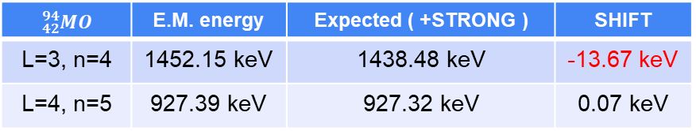
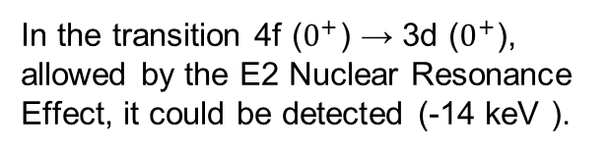
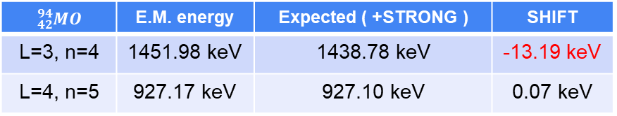
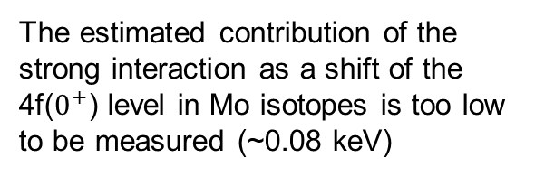
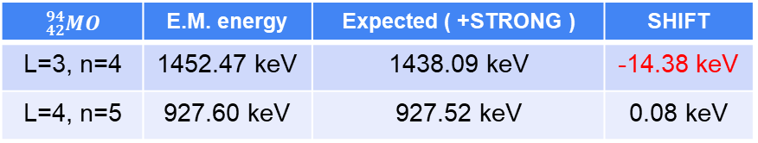
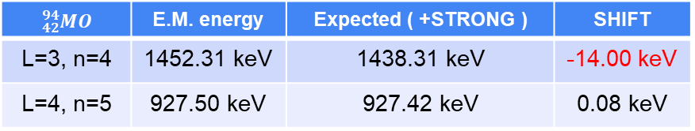
Calculations
PRELIMINARY!!
$${}_{42}^{94}{MO}$$ | E.M. energy | Expected ( +STRONG ) | SHIFT
L=3, n=4 | 1451.98 keV | 1438.78 keV | -13.19 keV
L=4, n=5 | 927.17 keV | 927.10 keV | 0.07 keV
The estimated contribution of the strong interaction as a shift of the 4f($0^{+}$) level in Mo isotopes is too low to be measured (~0.08 keV)
$${}_{42}^{94}{MO}$$ | E.M. energy | Expected ( +STRONG ) | SHIFT
L=3, n=4 | 1452.15 keV | 1438.48 keV | -13.67 keV
L=4, n=5 | 927.39 keV | 927.32 keV | 0.07 keV
In the transition 4f ($0^{+}$) → 3d ($0^{+}$), allowed by the E2 Nuclear Resonance Effect, it could be detected (-14 keV ).
$${}_{42}^{94}{MO}$$ | E.M. energy | Expected ( +STRONG ) | SHIFT
L=3, n=4 | 1452.31 keV | 1438.31 keV | -14.00 keV
L=4, n=5 | 927.50 keV | 927.42 keV | 0.08 keV
All calculation are performed not considering the 2+ state of nucleus
CALCULATION INCLUDING EXCITED NUCLEUS STATE ARE BEING PERFORMED
$${}_{42}^{94}{MO}$$ | E.M. energy | Expected ( +STRONG ) | SHIFT
L=3, n=4 | 1452.47 keV | 1438.09 keV | -14.38 keV
L=4, n=5 | 927.60 keV | 927.52 keV | 0.08 keV
NEW FUTURE PERSPECTIVES??

Slide 15

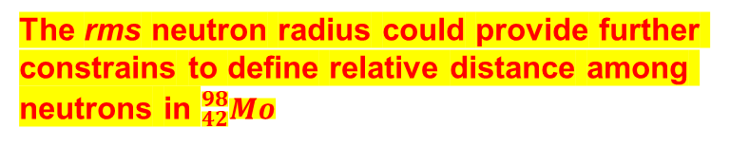


Double-β decay in Mo-98 isotope
Double beta (ββ) decay is a nuclear process in which two neutrons turn in two protons (or vice versa) and two electrons are emitted.
STANDARD double-beta decay:
$${}_{42}^{98}{Mo→{}_{44}^{98}{Ru}+e^{−}+e^{−}+2\overline{ν_{e}}}$$
Lepton number conserved
Neutrinoless double-beta decay:
$${}_{42}^{98}{Mo→{}_{44}^{98}{Ru}+e^{−}+e^{−}}$$
VIOLATION OF LEPTON NUMBER CONSERVATION LAW
Neutrinoless double-beta decay is only possible if neutrino is a Majorana particle
The ββ-decay nuclear matrix elements can be calculated using two different theory frameworks: proton-neutron quasiparticle random phase approximation (pnQRPA) and microscopic interacting boson model (IBM-2)
These model depends on the relative distance between the two neutron decays, which is estimated to be:
The rms neutron radius could provide further constrains to define relative distance among neutrons in ${}_{42}^{98}{Mo}$
$$r_{12}≤2R_{nucl}$$
with
$$R_{nucl}≈1.2A^{1/3}$$

Slide 16
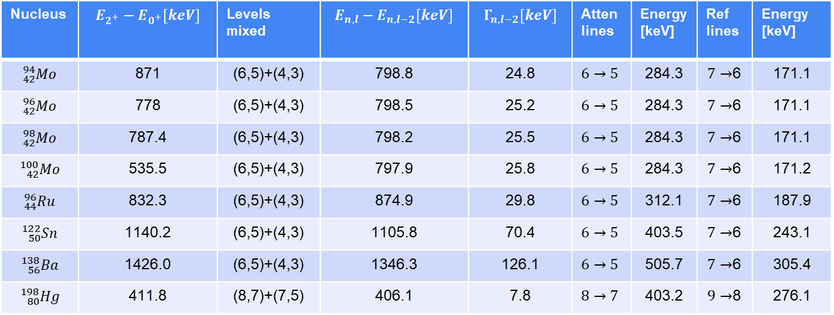

Possible imprecision in Mo-98 isotope
Nucleus | $$E_{2^{+}}−E_{0^{+}}[keV]$$ | Levels mixed | $$E_{n,l}−E_{n,l−2}[keV]$$ | $$Γ_{n,l−2}[keV]$$ | Atten lines | Energy [keV] | Ref lines | Energy [keV]
$${}_{42}^{94}{Mo}$$ | 871 | (6,5)+(4,3) | 798.8 | 24.8 | $$6→5$$ | 284.3 | $7→$6 | 171.1
$${}_{42}^{96}{Mo}$$ | 778 | (6,5)+(4,3) | 798.5 | 25.2 | $$6→5$$ | 284.3 | $7→$6 | 171.1
$${}_{42}^{98}{Mo}$$ | 787.4 | (6,5)+(4,3) | 798.2 | 25.5 | $$6→5$$ | 284.3 | $7→$6 | 171.1
$${}_{42}^{100}{Mo}$$ | 535.5 | (6,5)+(4,3) | 797.9 | 25.8 | $$6→5$$ | 284.3 | $7→$6 | 171.2
$${}_{44}^{96}{Ru}$$ | 832.3 | (6,5)+(4,3) | 874.9 | 29.8 | $$6→5$$ | 312.1 | $7→$6 | 187.9
$${}_{50}^{122}{Sn}$$ | 1140.2 | (6,5)+(4,3) | 1105.8 | 70.4 | $$6→5$$ | 403.5 | $7→$6 | 243.1
$${}_{56}^{138}{Ba}$$ | 1426.0 | (6,5)+(4,3) | 1346.3 | 126.1 | $$6→5$$ | 505.7 | $7→$6 | 305.4
$${}_{80}^{198}{Hg}$$ | 411.8 | (8,7)+(7,5) | 406.1 | 7.8 | $$8→7$$ | 403.2 | $9→$8 | 276.1
A PRECISE MEASUREMENT OF THE R.M.S. NEUTRON RADIUS COULD BE PERFORMED FOR MO-100 (${}_{42}^{100}{Mo→{}_{44}^{100}{Ru}+e^{−}+e^{−}}$ $+2\overline{ν_{e}}(?)$), BUT NEW CALCULATION FOR THE EXCITATION NUCLEAR ENERGY IS NEEDED.

Slide 17
Advanced investigation of Nuclear properties with kaonic Mo isotopes
The nuclear properties of MO isotopes are studied by several experiments, because of the large number of stable isotopes of this element
As example, a precise study of the electromagnetic properties of MO-100, mapping quadrupoles grades of freedom:
Wrzosek-Lipska et al., Electromagnetic properties of 100Mo: Experimental results and theoretical description of quadrupole degrees of freedom, K., PHYSICAL REVIEW C 86, 064305 (2012)
The E2 Nuclear Resonance effects in Kaonic Mo isotopes is due to electrical quadrupole excitations of rotational states of the nucleus.
With such precise theorical description, supported by the experimental results, the measurement of E2 nuclear resonance effects in Kaonic Mo Isotopes become a precious source to investigate: nuclear properties, strong interaction and Nuclear structure approaching with a Kaon (strangeness).

Slide 18
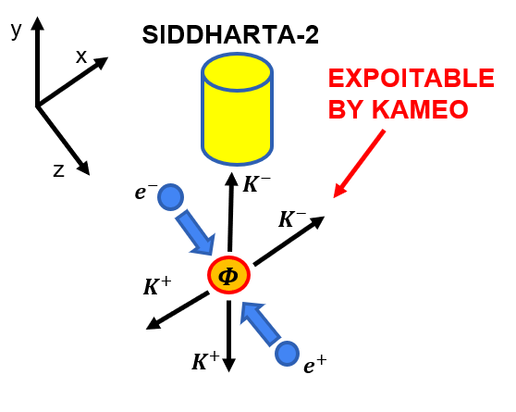
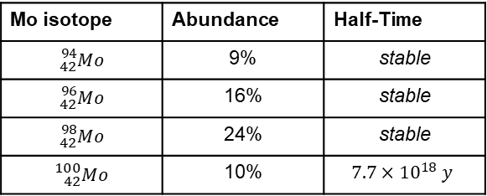
EXPERIMENTAL PROPOSAL: KAMEO
Kaonic Atoms Measuring nuclear resonance Effects Observables
The measurement of Nuclear resonance E2 effects in Molybdenum kaonic isotopes could be performed during the EXKALIBUR data taking period, exploiting the horizontal emitted kaons with dedicated targets and a High-Purity Germanium (HPGe) detector.
EXCALIBUR
Mo isotope | Abundance | Half-Time
$${}_{42}^{94}{Mo}$$ | 9% | stable
$${}_{42}^{96}{Mo}$$ | 16% | stable
$${}_{42}^{98}{Mo}$$ | 24% | stable
$${}_{42}^{100}{Mo}$$ | 10% | $$7.7×{10}^{18} y$$
Enriched (>99%) solid strip target of Mo isotopes 94, 96, 98, 100 and 92 (non-resonant suitable as refernce) will be exposed to the HPGe detector.
4 cm
8 cm

Slide 19
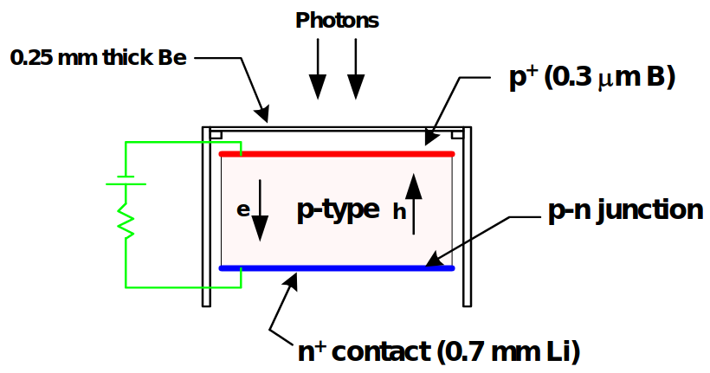
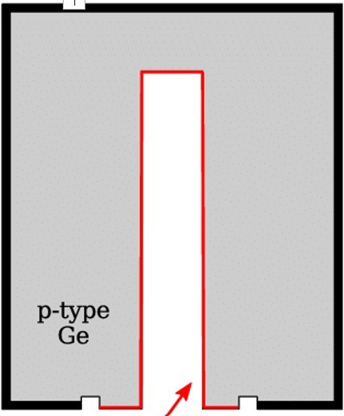
HPGe detector
A High Purity p-type Germanium Detector (HPGe), designed by Baltic Scientific Instruments, could be used covering a wide energy range from hundred keV to a few MeV.
Such detector is able to work under high-rate conditions (to 150 kHz) and is ideal to perform the measurements in the DAΦNE facility.
The HPGe detector has a cylindrical active volume with 59.3 mm of height and 59.8 mm of base diameter.
The detector need a cryogenic cooling for high-quality performances (refilling of liquid helium every week).
The detector is subject to RADIATION DAMAGE

Slide 20
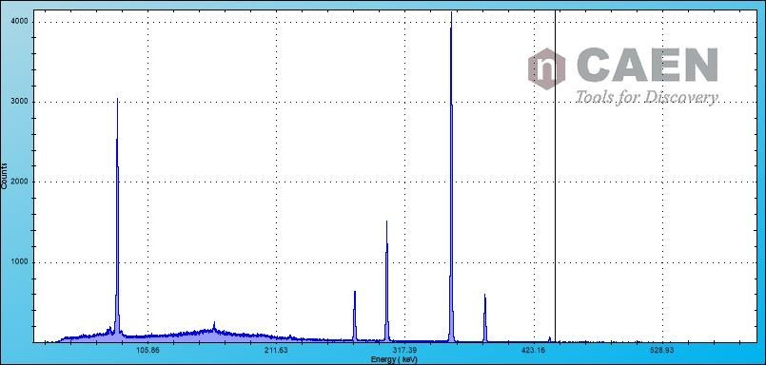
HPGe detector
Resolutions (FWHM) obtained with ⁶⁰Co, ¹³³Ba
0.870 keV | @ | 81 keV
1.106 keV | @ | 302.9 keV
1.143 keV | @ | 356 keV
1.167 keV | @ | 1330 keV

Slide 21
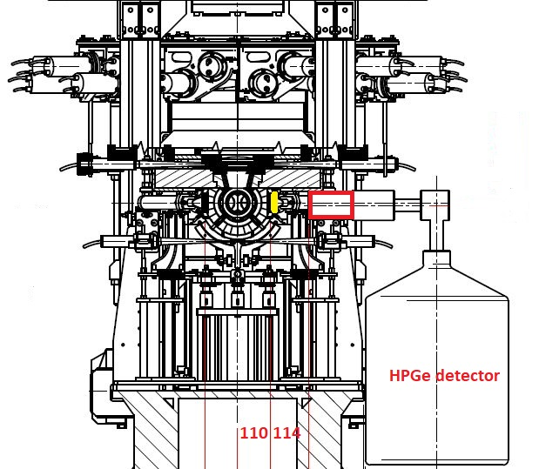
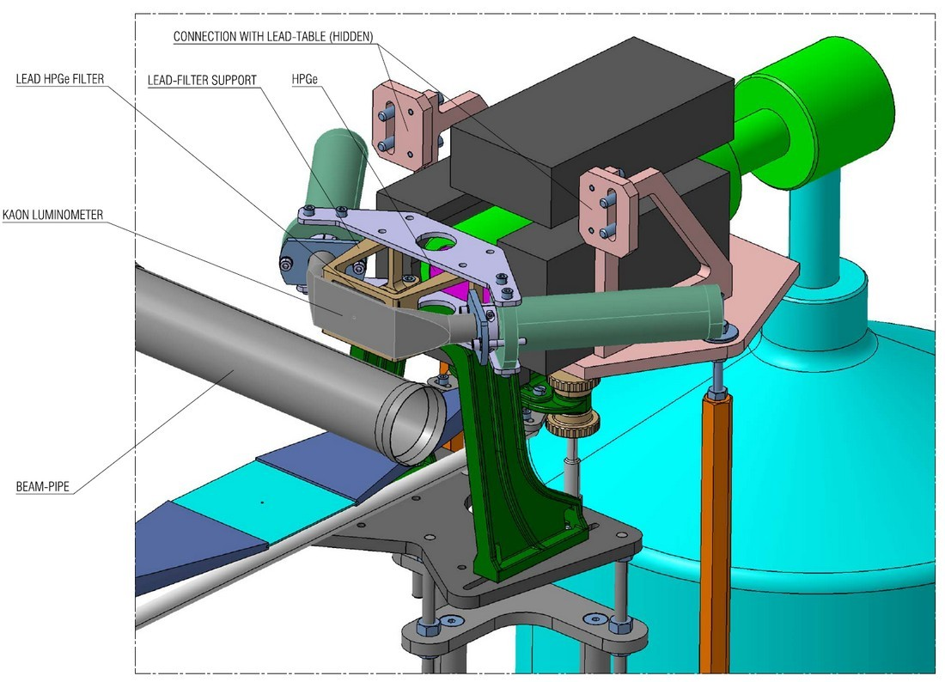
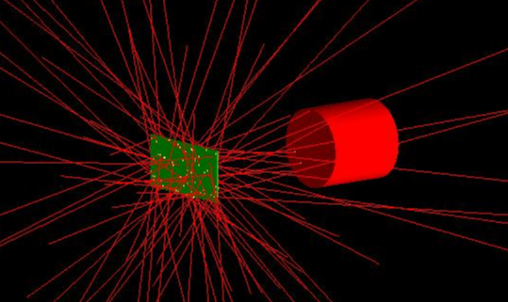
KAMEO setup with HPGe detector
Monte Carlo simulation to estimate target dimensions, timing and signal/background ratio.
Molibdenum solid target
Able to run in parallel with SIDDHARTA-2

Slide 22
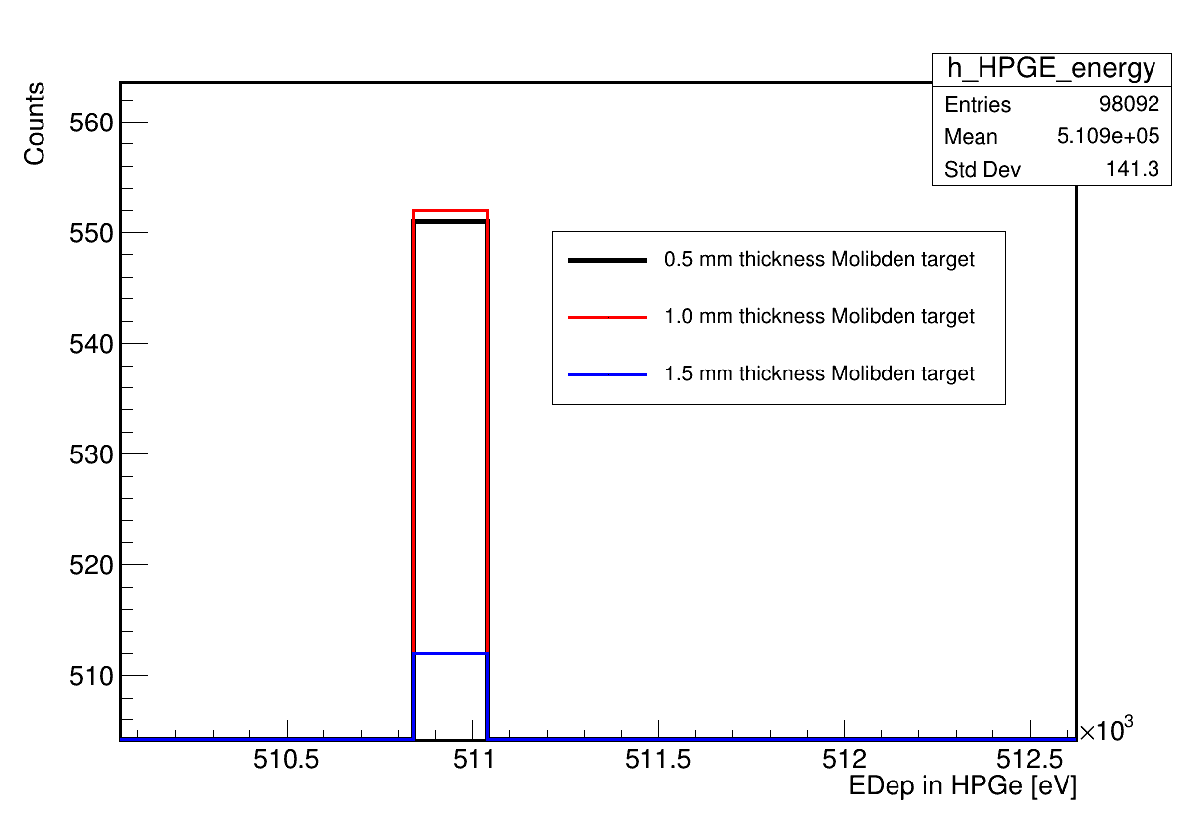
First estimation from MC simulation
With a dedicated MC simulation we estimated the best thickness for the Mo target.
As result, targets with thickness of 1 mm will be realized for the KAMEO experiment
Background data are currently being collected using an HPGe detector at the DAFNE collider to estimate the time required for a valid measurement.
A generic Mo target is being acquired to assess the stability and power of the apparatus.

Slide 23
SCIENTICIC IMPORTANCE OF KAMEO
To obtain informations on the properties of deeply bound kaonic atoms, not accessible by the kaonic cascade, in ticklish nuclei $→$ shift and width of the $n=4, 3$ levels in $2^{+}$ state
In $K^{−}−{}_{42}^{98}{Mo}$ the attenuation coefficient (α) due to the nuclear resonance effect can be measured with higher precision.
The α coefficient can be measured in ${}_{42}^{94}{Mo}$, ${}_{42}^{96}{Mo}$ and ${}_{42}^{100}{Mo}$ for the first time, providing new reference value for theorical models.
The comparison of measurements in ${}_{42}^{94}{Mo}$, ${}_{42}^{96}{Mo}$, ${}_{42}^{98}{Mo}$ and ${}_{42}^{100}{Mo}$ could reveal new properties of strong kaon-nucleon interaction (also ${}_{44}^{96}{Ru}$).
The search for isotope effects would reveal sign of changes in the nuclear periphery when pair of neutrons are added to the lighest isotope (${}_{42}^{94}{Mo}$)
To study nuclear distribution in ${}_{42}^{98}{Mo}$, providing important details to investigate neutrinoless double beta (0νββ) and two-neutrino double beta decay (2νββ)
To highlight nuclear properties due to the kaon approach and the strong interaction.

Slide 24
WHAT ARE WE DOING?
1. Estimating shifts and width of 4f and 3d level in K-Mo isotopes in nuclear excited 2+ state due to the strong kaon-nucleus interaction, to evaluate needed precision for an experimental measurement
2. Upgrading the Monte Carlo simulation for a better estimation of experimental parameters and timing.
3. Analizing the collected data with HPGe detector to estimate the background
4. A preliminary measurement with generic Mo target of 1 mm thick is being projected to set the best experimental data taking and setup conditions.
5. Looking for further information and parameters that can be extracted investigating the E2 nuclear resonance in kaonic atoms.
ANY SUGGESTION???

Slide 25





THANK YOU FOR YOUR ATTENTION!!!
$${}_{42}^{94}{Mo}$$
$${}_{42}^{96}{Mo}$$
$${}_{42}^{98}{Mo}$$
$${}_{42}^{100}{Mo}$$

Slide 26

Double-β decay in Mo-100 isotope
Double beta (ββ) decay is a nuclear process in which two neutrons turn in two protons (or vice versa) and two electrons are emitted.
STANDARD double-beta decay:
$${}_{42}^{100}{Mo→{}_{44}^{100}{Ru}+e^{−}+e^{−}+2\overline{ν_{e}}}$$
Lepton number conserved
Neutrinoless double-beta decay:
$${}_{42}^{100}{Mo→{}_{44}^{100}{Ru}+e^{−}+e^{−}}$$
VIOLATION OF LEPTON NUMBER CONSERVATION LAW
Neutrinoless double-beta decay is only possible if neutrino is a Majorana particle
The ββ-decay nuclear matrix elements can be calculated using two different theory frameworks: proton-neutron quasiparticle random phase approximation (pnQRPA) and microscopic interacting boson model (IBM-2)
These model depends on the relative distance between the two neutron decays, which is estimated to be:
The rms neutron radius could provide further constrains to define relative distance among neutrons in ${}_{42}^{98}{Mo}$
$$r_{12}≤2R_{nucl}$$
with
$$R_{nucl}≈1.2A^{1/3}$$

Slide 27


Ligth Kaonic atoms
Light kaonic atoms, like kaonic Hydrogen and Deuterium, provides fundamental informations on strong kaon-nucleon interaction by measure of x-ray transition yields, and energy shift (ε) and width (Г) of the innermost atomic levels.
The kaon is captured in a higly excited state of the atom and starts a de-excitation cascade process.
In ligth kaonic atoms experiments, it is essential to favor the cascade process down to the innermost atomic levels, in which shift (ε) and width (Г) due to strong kaon-nucleon interaction become measurable.
Nuclear Absorption
ε
Г
$$K^{−}$$
ε
Г
$$K^{−}$$
$$e^{−}$$
$$K^{−}$$
$$K^{−}$$
$$e^{−}$$
Finally, the kaon is absorbed by the nucleus

Slide 28

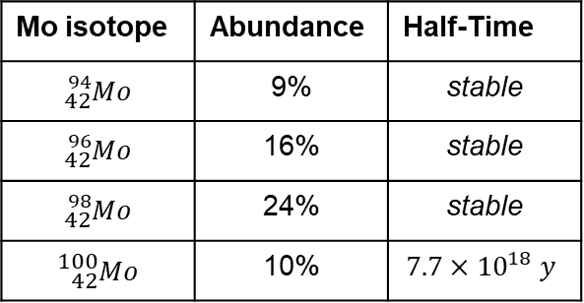





EXPERIMENTAL PROPOSAL: KAMEO
Kaonic Atoms Measuring nuclear resonance Effects Observables
The measurement of Nuclear resonance E2 effects in Molybdenum kaonic isotopes could be performed also during the SIDDHARTA-2 data taking period, exploiting the horizontal emitted kaons with dedicated targets.
y
SIDDHARTA-2
Mo isotope | Abundance | Half-Time
$${}_{42}^{94}{Mo}$$ | 9% | stable
$${}_{42}^{96}{Mo}$$ | 16% | stable
$${}_{42}^{98}{Mo}$$ | 24% | stable
$${}_{42}^{100}{Mo}$$ | 10% | $$7.7×{10}^{18} y$$
x
EXPOITABLE BY KAMEO
z
$$e^{−}$$
$$K^{−}$$
$$K^{−}$$
$$K^{+}$$
$$Φ$$
The measure could be performed with two different detectors:
$$K^{+}$$
$$e^{+}$$
Cadmium-Zinc-Telluride (CdZnTe)
High Purity Germanium Detector (HPGe)

Slide 29
REFERENCES
Gary L. Godfrey, Gary K. Lum, Clyde E. Wiegand, «OBSERVATION OF DYNAMIC E2 MIXING VIA KAONIC X-RAY INTENSITIES », Phys. Lett B, https://escholarship.org/uc/item/6v72406j, 1975
M. Leon, «Hadronic Atoms and Ticklish Nuclei: The E2 Nuclear Resonance Effect», Informal report, United States: N. p., 1975. Web. doi:10.2172/4192083.
J. N. Bradbury, M. Leon, H. Daniel and J. J. Reidy, «Observation of the E2 Nuclear Resonance Effect in Pionic Cadmium», Phys. Rev. Lett. 34, 303, 1975, https://journals.aps.org/prl/abstract/10.1103/PhysRevLett.34.303
C. E. Wiegand and G. L. Godfrey, «Measurements of x rays and γ rays from stopped kaons», Phys. Rev. A, 9, 2282, 1974, https://journals.aps.org/pra/abstract/10.1103/PhysRevA.9.2282

Slide 30

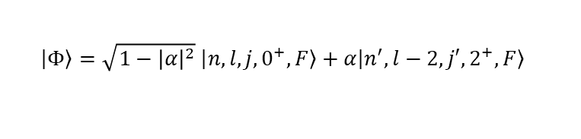

The E2 Nuclear Resonance Effect
The E2 Nuclear Resonance effect is a mixing of the atomic states due to the electrical quadrupole excitations of nuclear rotational states.
Quanto-mechanically, the effect mixes $(n,l,0^{+})$ levels with $(n′,l−2,2^{+})$ levels producing a wave function which contains a small admixture of excited nucleus-deexcited atom wavefunctions.
The nucleus is excited to the $2^{+}$ rotational state by the electric quadrupole interaction:
$$V_{q}=−\frac{e^{2}}{2r^{3}}Q_{2μ}Y_{2μ}$$
where $μ$ is the $K^{−}−N$reduced mass, $Q_{2μ}$ is the nuclear quadrupole operator and $Y_{2μ}$ are the spherical harmonics.
$$\left.\left|Φ\right.\right\rangle =\sqrt{1−{\left|α\right|}^{2}} \left|\left.n, l, j,0^{+},F\right\rangle +α\left|\left.n^{′},l−2, j′,2^{+},F\right\rangle \right. \right.$$

Slide 31
Pionic cadmium 112 measurement
These results demonstrate the existence of the Nuclear Resonance Effect: the ratios are very significantly different from one.

Slide 32
The E2 Nuclear Resonance Effect
Light kaonic atoms, like kaonic Hydrogen and Deuterium, provides fundamental informations on strong kaon-nucleon interaction by measure of x-ray transition yields, and energy shift (ε) and width (Г) of the innermost atomic levels.
The kaon is captured in a higly excited state of the atom and starts a de-excitation cascade process.
In ligth kaonic atoms experiments, it is essential to favor the cascade process down to the innermost atomic levels, in which shift (ε) and width (Г) due to strong kaon-nucleon interaction become measurable.
Nuclear Absorption
ε
Г
$$K^{−}$$
ε
Г
$$K^{−}$$
$$e^{−}$$
$$K^{−}$$
$$K^{−}$$
$$e^{−}$$
Finally, the kaon is absorbed by the nucleus

Slide 33

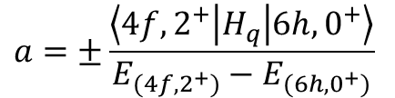
The E2 Nuclear Resonance Effect
The classical analogy would be to have the period of a hadron in its elliptical orbital match the natural vibration frequency of the nucleus, so that every pass through perigee the hadron strokes the nucleus at just the right time, and hence builds up a large nuclear oscillation.
Quanto-mechanically, the noncentral coupling between the hadron and the nucleus produces configuration mixing (E2), so that the energy eigenfunction contains a small admixture of excited nucleus-deexcited atom wavefunction:
$$ψ=\sqrt{1−a} φ\left(6h,0^{+}\right)+a φ(4f,2^{+})$$
$$a=±\frac{\left\langle 4f,2^{+} | H_{q} | 6h,0^{+}\right\rangle }{E_{(4f,2^{+})}−E_{(6h,0^{+})}}$$
where the admixture coefficient
(very small), and $H_{Q}$
expresses the electric quadrupole interaction between hadron and nucleus.

Slide 34
The E2 Nuclear Resonance Effect
The matrix element $\left\langle H_{Q}\right\rangle$ for a spin-zero hadron is given by:
$$\left\langle H_{Q}\right\rangle =±\frac{1}{2}e^{2}Q_{0}\left\langle r^{−3}\right\rangle {[\left(2l+1\right)\left(2l′+1\right)\left(2l+1\right)\left(2l′+1\right)]}^{\frac{1}{2}} ×\left({2 \atop 0}{I \atop −K}{I′ \atop K}\right)\left({2 \atop 0}{l \atop 0}{l′ \atop 0}\right)\left\{\begin{matrix}2 & I & I′ \\ F & l′ & l\end{matrix}\right\}$$
$Q_{0}$ is the nuclear quadrupole strength
$I,I^{′},K,K^{′},l,l^{′},F$ are angular momentum factors
$\left\langle r^{−3}\right\rangle$ is the quadrupole orbital radius
H.L. Acker, Nucl. Phys. 87, 153, 1966
$Q_{0}$ comes directly from the measured Coulomb excitation cross-sections ($B(E2↑)$ values).
$\left\langle r^{−3}\right\rangle$ can be evaluated using point Coulomb wave functions
$I,I^{′},K,K^{′},l,l^{′},F$ can be with angular-momentum rules (i.e. for spin one-half $l→j, etc…$)
CALCULATIONS ARE INDEPENDENT OF ANY PARTICULAR NUCLEAR MODEL

Slide 35
The pionic cadmium 112 experiment
An experiment measuring E2 resonance effect cadmium 112 was performed in 1975 by J. N. Bradbury, H.Daniel, J. Reidy and M. Leon at the biomedical pion beam of Los Alamos Meson Physics Facility (LAMPF).
$${Cd}_{112}$$
6h
In pionic cadmium (112), the energy difference between 5g and 3d levels, 618.8 keV, is very nearly equal to the nuclear excitation energy of 617.4 keV.
105 keV
$$2^{+}$$
5g
194 keV
617.4 keV
618.8 keV
4f
$$0^{+}$$
3d
424 keV
Experimental apparatus and measurement features:
The experiment consisted of placing enriched isotope targets of Cd(111) e Cd(112) in turn into the negative pion beam for 2 hours.
The spectra were collected using a germanium detector feeding a pulse height analyzer.
Natural Cadmio was exposed for a shorter time to provide consistency check.

Slide 36
Pionic cadmium 112 measurement
These results demonstrate the existence of the Nuclear Resonance Effect: the ratios are very significantly different from one.

Slide 37
Pionic cadmium 112 measurement
These results demonstrate the existence of the Nuclear Resonance Effect: the ratios are very significantly different from one.

Slide 38
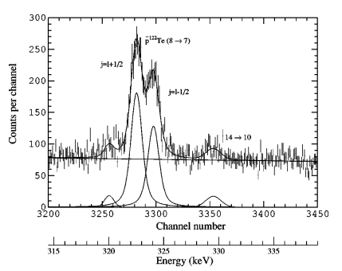
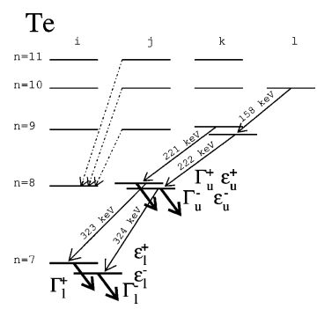
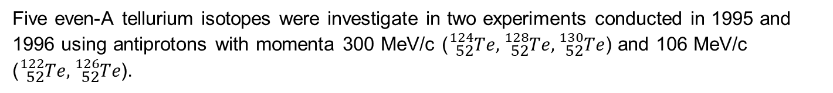
The antiprotonic Te experiment
Five even-A tellurium isotopes were investigate in two experiments conducted in 1995 and 1996 using antiprotons with momenta 300 MeV/c (${}_{52}^{124}{Te},{}_{52}^{128}{Te},{}_{52}^{130}{Te}$) and 106 MeV/c (${}_{52}^{122}{Te},{}_{52}^{126}{Te}$).
High Purity Germanium (HPGe) detectors were employed for the x-ray measurement. The energy resolution was about 1 keV at 200 keV (relative efficiency was about 19%)

Slide 39
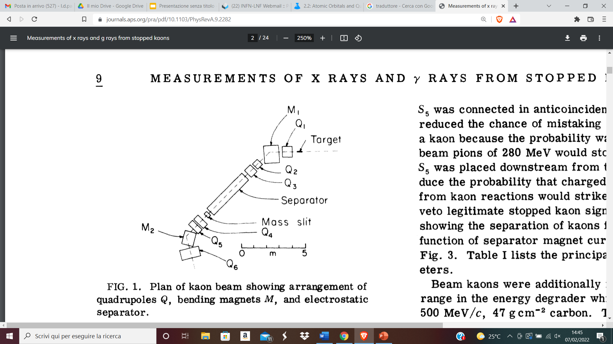
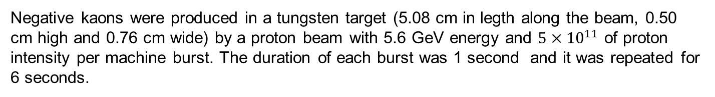
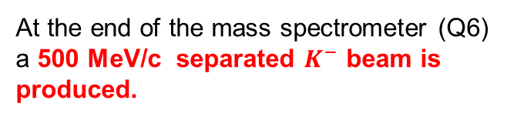
The kaon beam at Bevatron
Negative kaons were produced in a tungsten target (5.08 cm in legth along the beam, 0.50 cm high and 0.76 cm wide) by a proton beam with 5.6 GeV energy and $5×{10}^{11}$ of proton intensity per machine burst. The duration of each burst was 1 second and it was repeated for 6 seconds.
Kaons and other particles produced in the forward diections entered a mass spectrometer, consisting of 6 Quadrupoles (Q) two bending magnets (M), a separator and a «mass» slit.
A scintillator (S1) was placed behind the mass slit for kaon identification.
At the end of the mass spectrometer (Q6) a 500 MeV/c separated $K^{−}$ beam is produced.

Slide 40
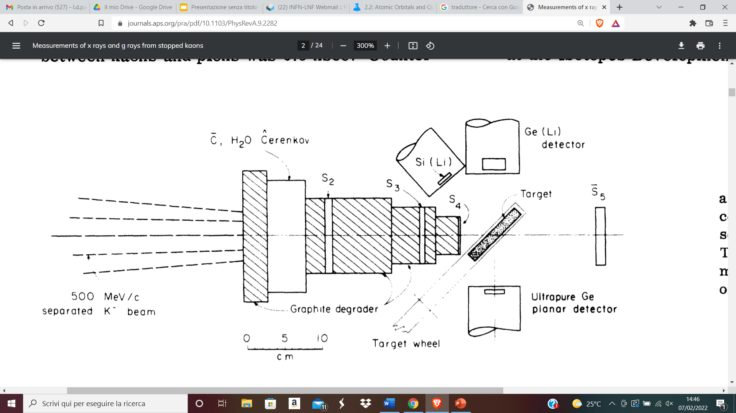
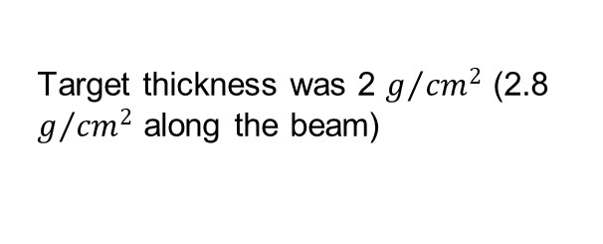
The kaon beam at Bevatron
Downstream from Q6, a group of counters consisting of water Cerenkov counter, and 4 scintillators (S2, S3, S4, S5) were installed to discriminate kaons from pions, with the use of time of flight and anticoincidence with Cerenkov counter, and from background.
The target consists in a pill-box-shaped vessel made from stock methyl-methacrylate tubing 10.16 cm outside diameter (8.9 cm inside diameter).
Target thickness was 2 $g/{{cm}^{2}}$ (2.8 $g/{{cm}^{2}}$ along the beam)
The target was filled with 99% pure isotopes of Molybdenum 92 and 98, alternatively.
The flat sides of the container was of Mylar, less than 0.0127 cm thickness

Slide 41
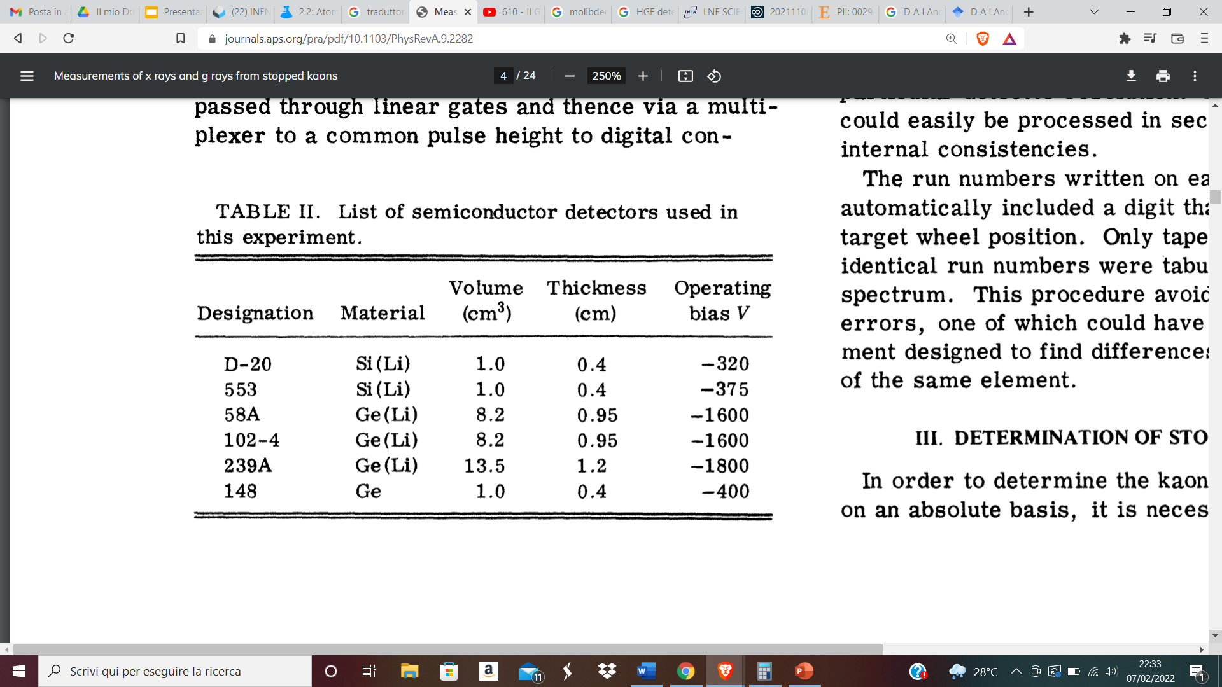
The Germanium Detectors
The x-ray spectra coming from $K^{−}−{}_{42}^{98}{Mo}$ and $K^{−}−{}_{42}^{92}{Mo}$ were collected with ultrapure Germanium and Ge(Li) detectors, whose resolutions was estimated with the formula:
$$∆E\left(FWHM\right)={\left[P^{2}+{\left(2.36\right)}^{2}EεF\right]}^{1/2}$$
where F=0.08 is the Fano Factor, $ε=2.94 eV$ is the average energy to make an electron-gole in Germanium, E is the energy deposited in the detector and P is the random noise
The ultrapure Ge detector is 0.4 cm thickness and has 1.8 cm of diameter, and provided a resolution of 580 eV FWHM at 85 keV
Ge(Li) detectors provided a resolution of 400 eV FWHM at 100 keV

Slide 42
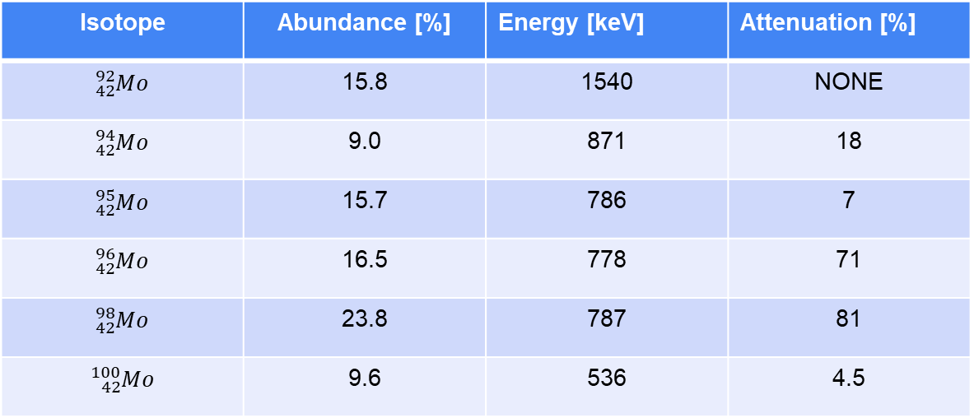
$K^{−}Mo$Predicted Nuclear Resonance effects
Isotope | Abundance [%] | Energy [keV] | Attenuation [%]
$${}_{42}^{92}{Mo}$$ | 15.8 | 1540 | NONE
$${}_{42}^{94}{Mo}$$ | 9.0 | 871 | 18
$${}_{42}^{95}{Mo}$$ | 15.7 | 786 | 7
$${}_{42}^{96}{Mo}$$ | 16.5 | 778 | 71
$${}_{42}^{98}{Mo}$$ | 23.8 | 787 | 81
$${}_{42}^{100}{Mo}$$ | 9.6 | 536 | 4.5
The molybdenum costs 45 $ per Kg. Some experiments carried out in Warsaw used ${}_{42}^{98}{Mo}$ and ${}_{42}^{100}{Mo}$ targets. Informations about enriched Mo isotopes target could be found.
M. Leon, Phys. Rev. A260, 461-473 (1976)

Slide 43







EXPERIMENTAL PROPOSAL
y
SIDDHARTA-2
x
GE DETECTOR
DAFNE luminosity: $L={10}^{32}{cm}^{−2}s^{−1}$
Number of ϕ particles produced per second:
$$N_{φ}={10}^{32}{cm}^{−2}s^{−1}×\left(1968×{10}^{−33}{cm}^{2}\right)=197 s^{−1}$$
z
$$e^{−}$$
$$K^{−}$$
X-rays
Probability of $K^{−}$ production: $P_{φ→K^{+}K^{−}}=48,9\%$
$$K^{−}$$
Number of $K^{−}$ particles produced per second:
$N_{K^{−}}=197 s^{−1}∗0,489=96{ s}^{−1}$
$$Φ$$
MO TARGET
$$K^{+}$$
Minimum target distance: $d_{min}=7.5 cm$
$$K^{+}$$
$$e^{+}$$
Spherical $K^{−}$ distribution: $S=4π{∙d}_{min}^{2}=706.86 {cm}^{2}$
Minimum solid Mo target dimention:
Number of $K^{−}$ on target: $N_{K^{−}}^{T}<\frac{N_{K^{−}}}{S}∙\left(32 {cm}^{2}\right)≈4 K^{−} s^{−1}$
4 cm
Signal/background should been exstimated with MC to understand precision of measurement
8 cm
Thickness to be determined with Monte-Carlo

Slide 44






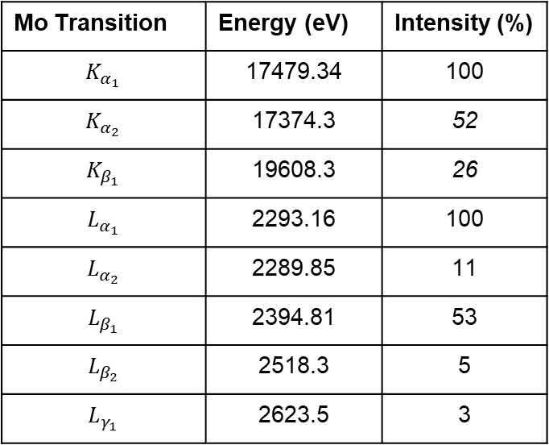
EXPERIMENTAL PROPOSAL
The measurement of Nuclear resonance E2 effects in Molybdenum kaonic isotopes could be performed during the SIDDHARTA-2 data taking period, exploiting the horizontal emitted kaons with dedicated targets and a Germanium detector.
The measurement don’t affect SIDDHARTA-2
y
SIDDHARTA-2
Mo Transition | Energy (eV) | Intensity (%)
$$K_{α_{1}}$$ | 17479.34 | 100
$$K_{α_{2}}$$ | 17374.3 | 52
$$K_{β_{1}}$$ | 19608.3 | 26
$$L_{α_{1}}$$ | 2293.16 | 100
$$L_{α_{2}}$$ | 2289.85 | 11
$$L_{β_{1}}$$ | 2394.81 | 53
$$L_{β_{2}}$$ | 2518.3 | 5
$$L_{γ_{1}}$$ | 2623.5 | 3
x
GE DETECTOR
z
$$e^{−}$$
$$K^{−}$$
X-rays
$$K^{−}$$
$$Φ$$
MO TARGET
$$K^{+}$$
$$K^{+}$$
$$e^{+}$$

