Slide 1


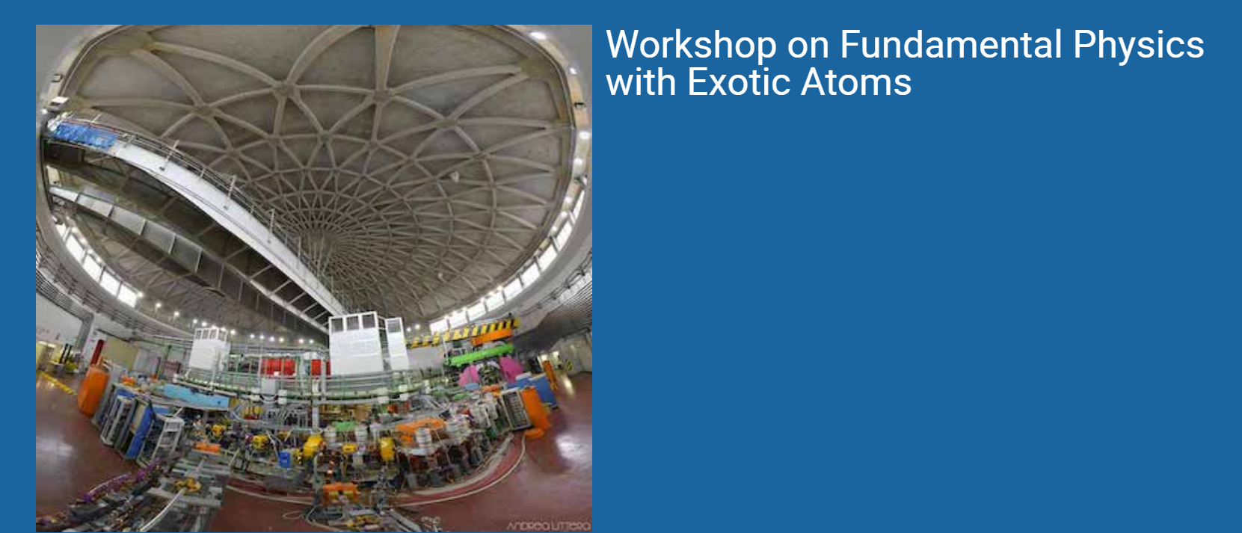
Kaonic nuclei: progress and prospects at J-PARC
F. Sakuma, RIKEN
on behalf of the J-PARC E15/E31/E73/E80/E89 collaboration
sakuma@ribf.riken.jp
23–25 Jun 2025,
INFN-LNF, Frascati

Slide 2
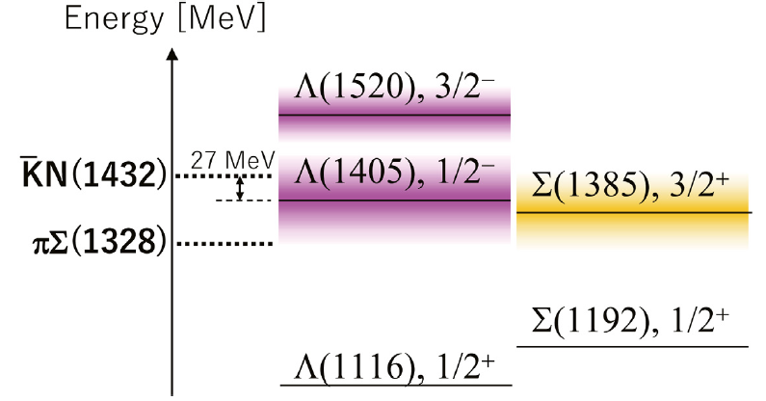
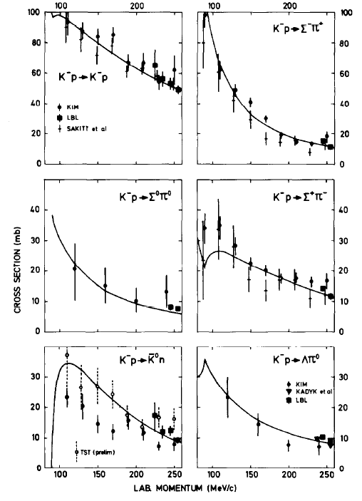
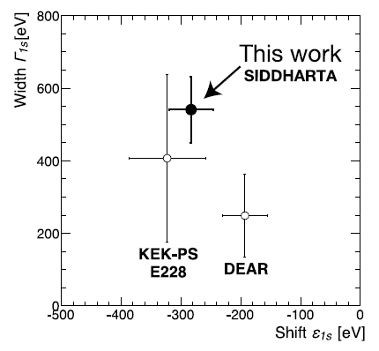
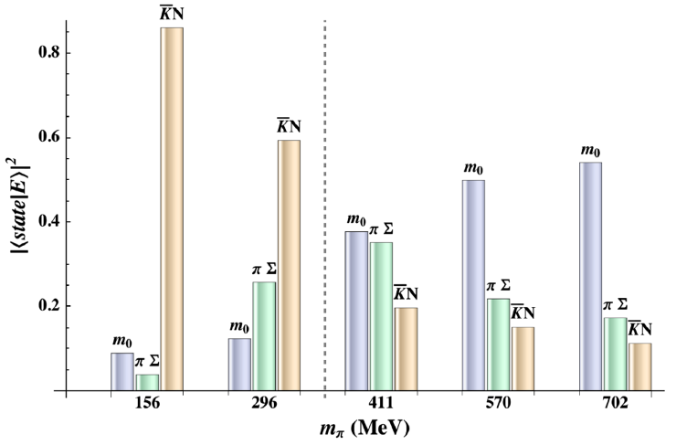
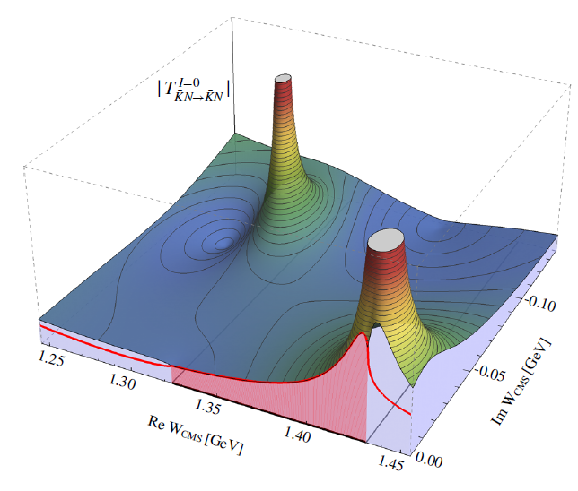


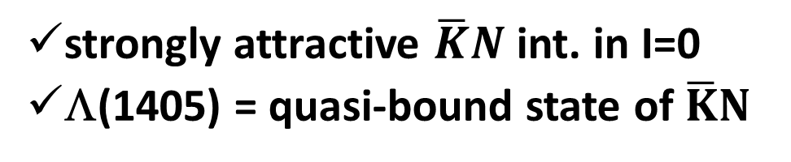


$\overline{K}N$ Interaction
and Λ(1405)
K⁻p scattering
NPB179(1981)33.
K⁻p atom
PLB704(2011)113.
Λ(1405) in LQCD
RPL114(2015)132002.
prob. of
$$\overline{K}N$$
Λ(1405) in chiral unitary model
EPJ ST230(2021)1593.
coupled to
$$πΣ$$
strongly attractive $\overline{K}N$ int. in I=0
Λ(1405) = quasi-bound state of $\overline{K}N$
coupled to
$$\overline{K}N$$

Slide 3
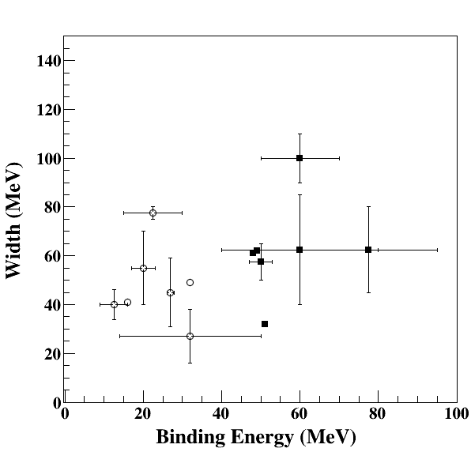
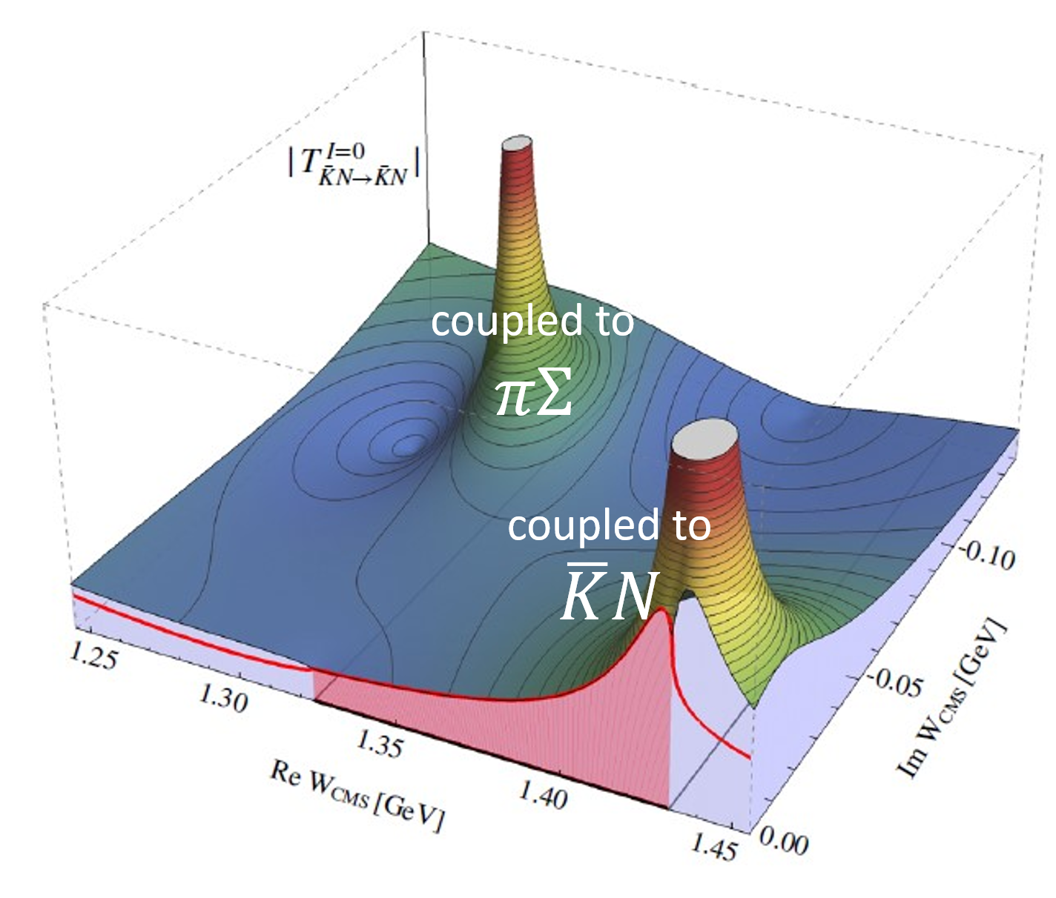
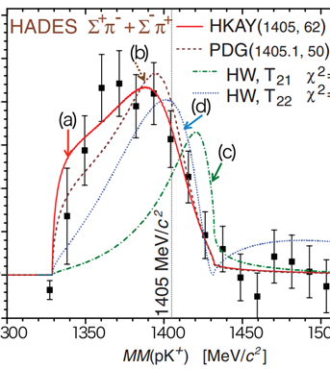
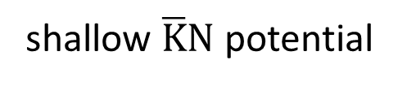

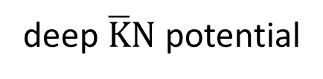
Theoretical Calculations of $\overline{K}NN$
Chiral unitary model (energy dependent)
Phenomenological model (energy independent)
M_{Λ(1405)}~1420, double pole
M_{Λ(1405)}~1405, single pole
shallow $\overline{K}N$ potential
deep $\overline{K}N$ potential
B.E. ~ 10-30 MeV
B.E. ~ 40-70 MeV
suggesting a more compact and dense system

Slide 4
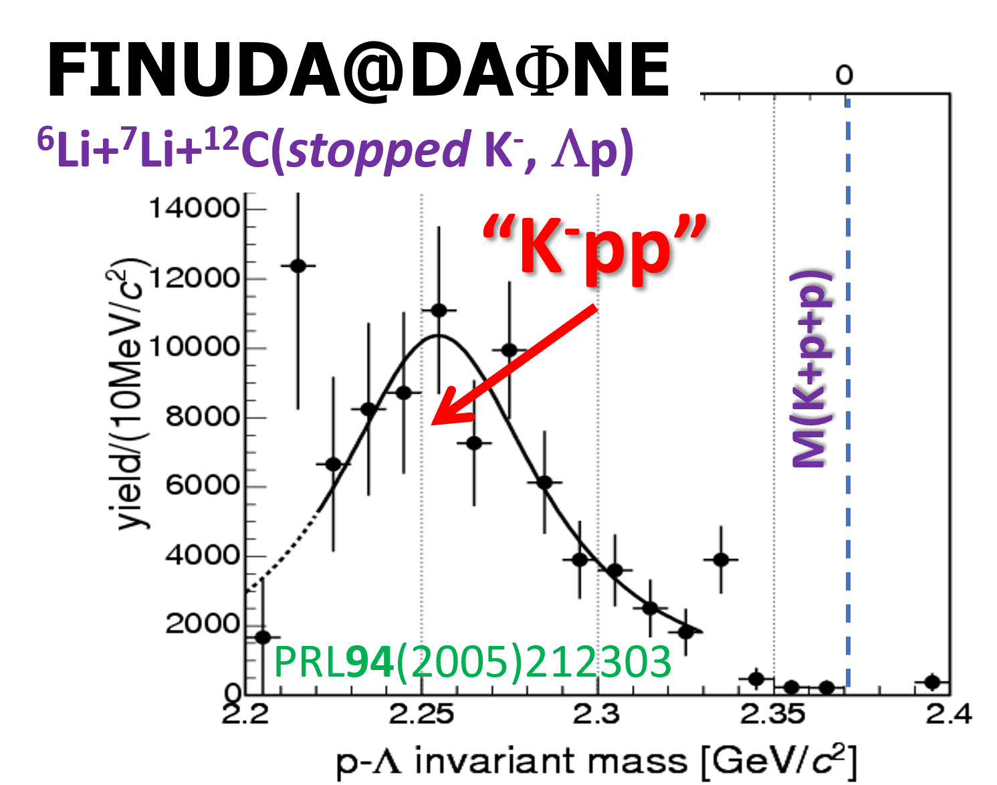
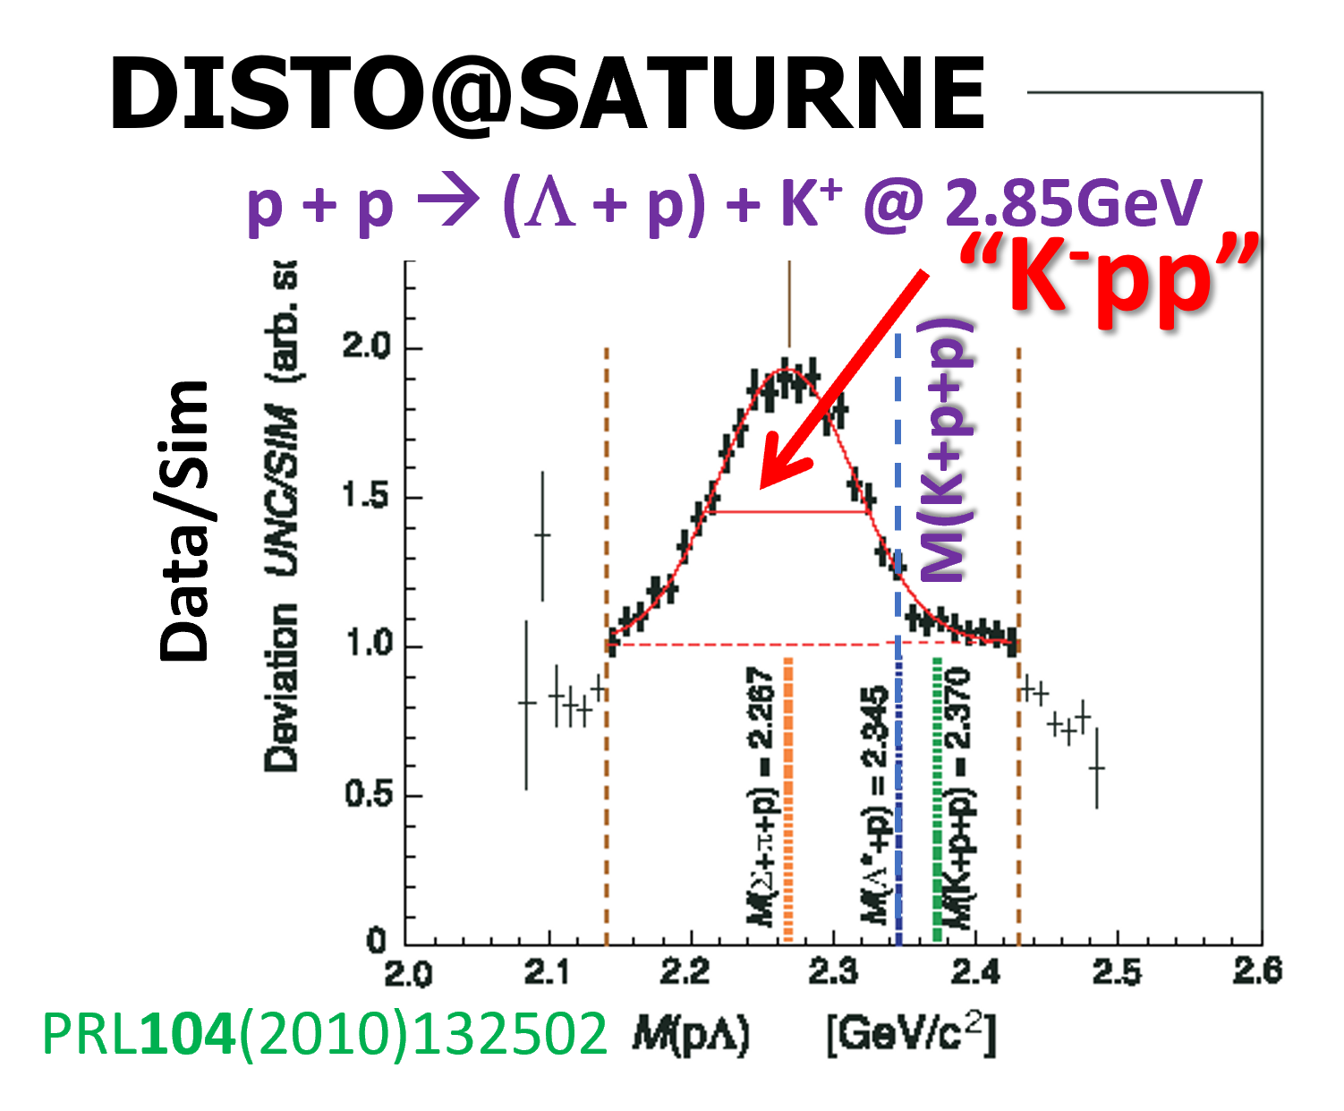
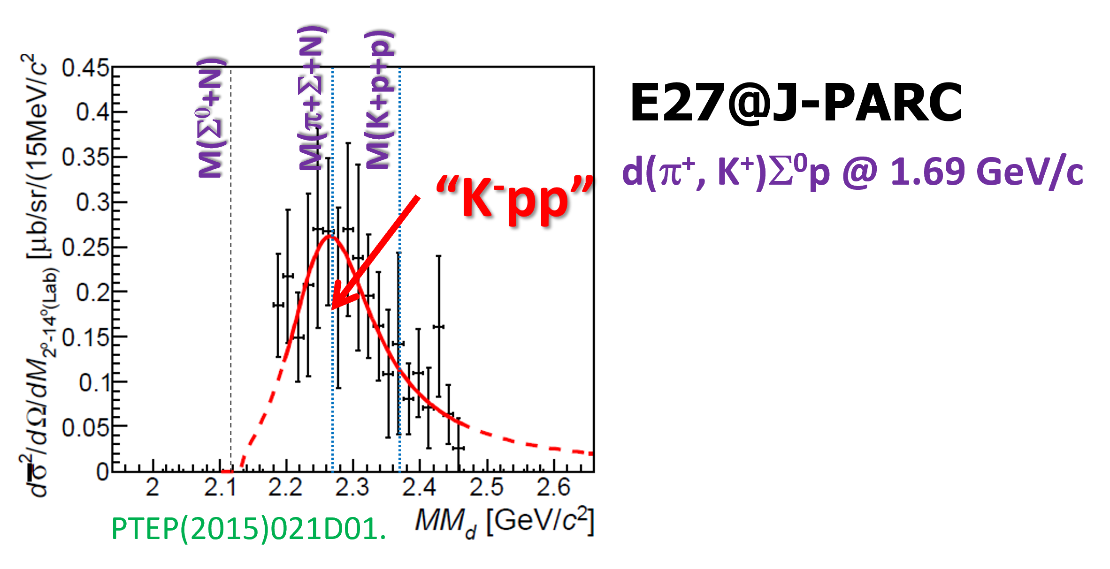
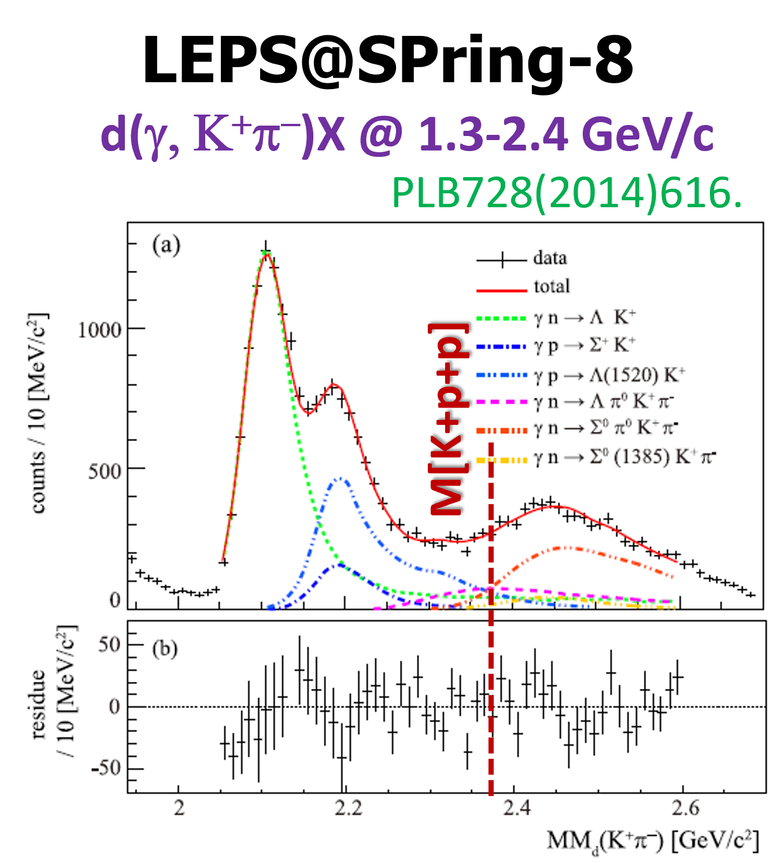
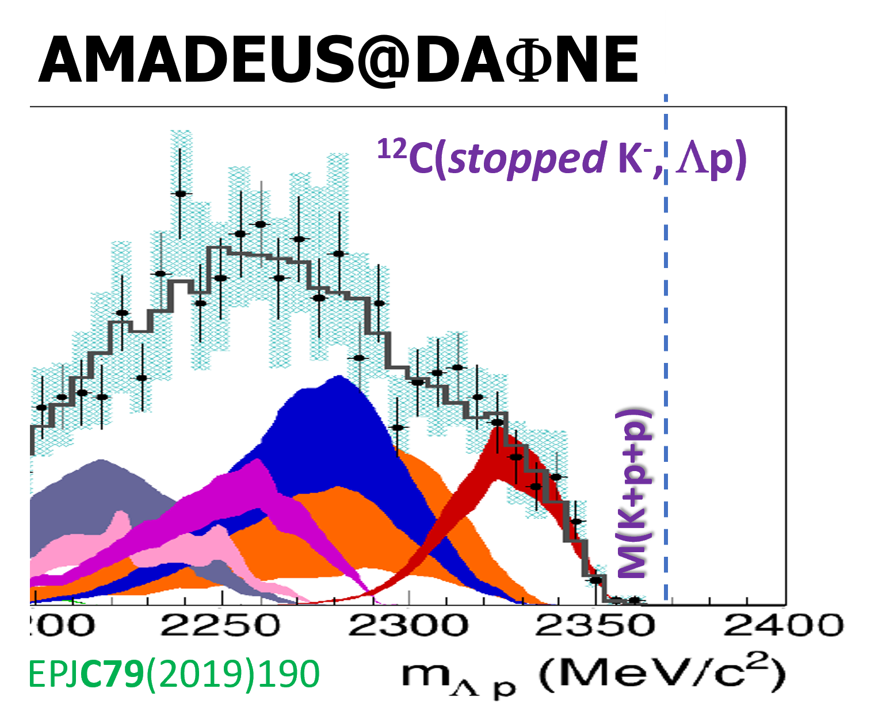
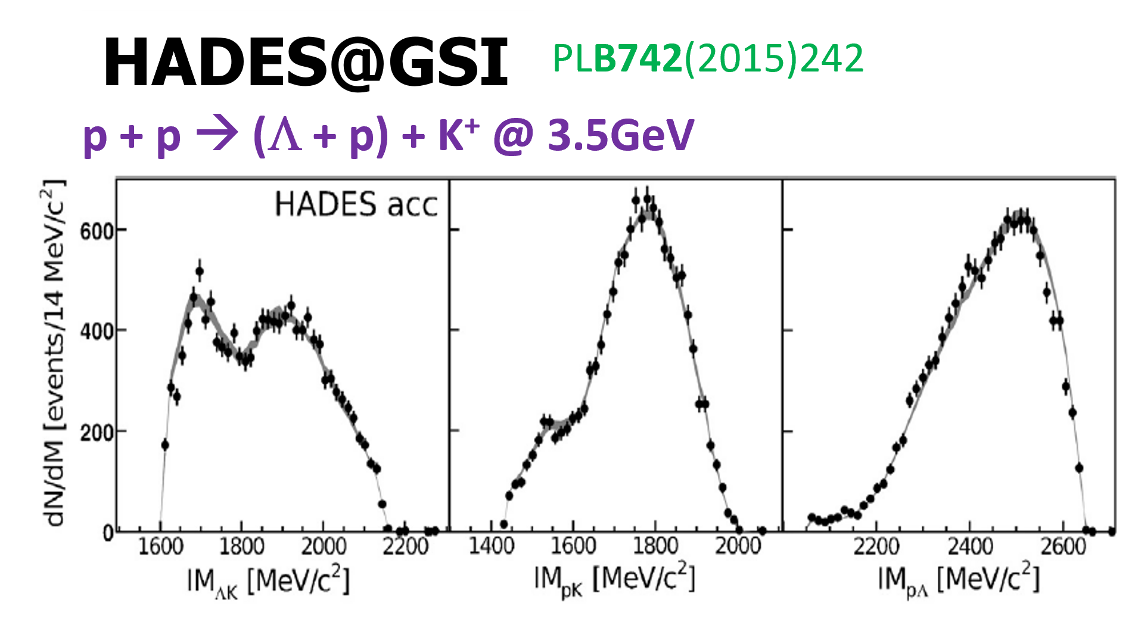
“K⁻pp” Bound State Searches
?
?
?
N*?
multi-NA?
acceptance?
No “K⁻pp”
No “K⁻pp”
No “K⁻pp”
Despite of many “K-pp” searches, NO conclusive results
  Complex reactions & difficult to understand background

Slide 5
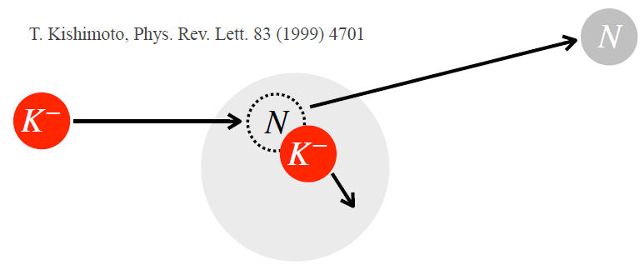
Experimental Investigations at J-PARC
– via in-flight (K-,n) reactions –

Slide 6

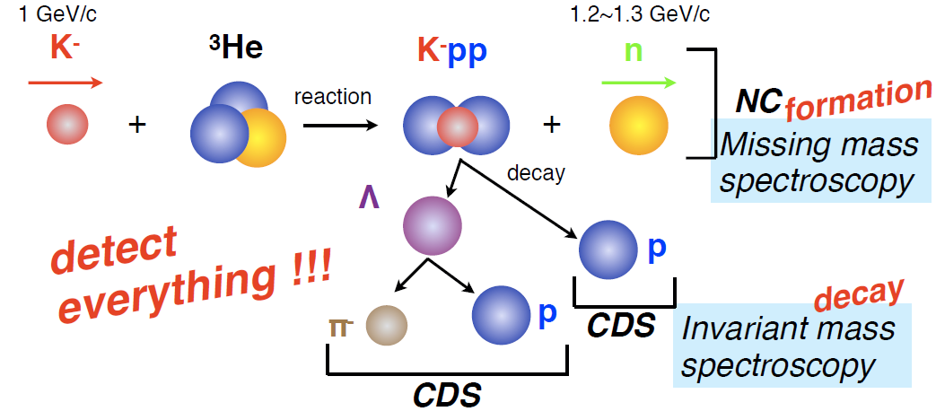
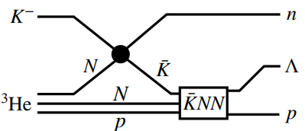

“K⁻pp” Search ＠ J-PARC E15
³He(in-flight K⁻,n) reaction @ 1.0 GeV/c
  multi-NA and Y decays can be discriminated kinematically
with intense K⁻ bean @ J-PARC
Low momentum $\overline{K}$

Slide 7
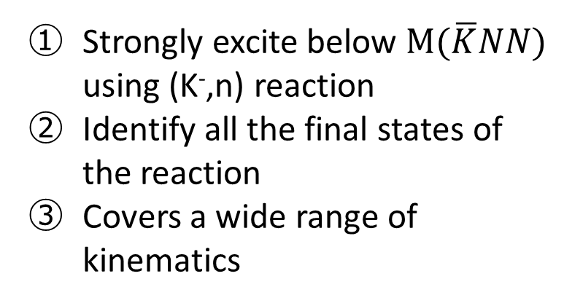
“K⁻pp” Search ＠ J-PARC E15
³He(in-flight K⁻,n) reaction @ 1.0 GeV/c
  multi-NA and Y decays can be discriminated kinematically
semi-inclusive ³He(K⁻,n)
PTEP (2015) 061D01.
Key points of the experiment
Strongly excite below $M(\overline{K}NN)$ using (K⁻,n) reaction
Identify all the final states of the reaction
Covers a wide range of kinematics
exclusive (K⁻,Λp)n_{missing}
PTEP (2016) 051D01.,
PLB789(2019)620., PRC102(2020)044002.

Slide 8
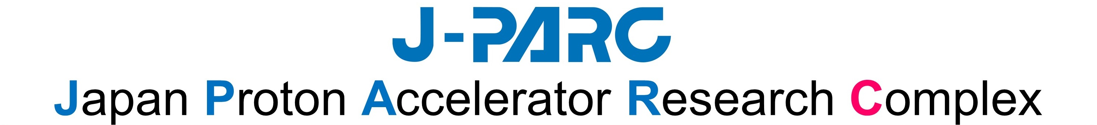


1,000m
Hadron
Experimental
Facility
3-GeV
Synchrotron
Main Ring
Synchrotron
Linac
Neutrino Experimental Facility
Material and Life Science Experimental Facility

Slide 9
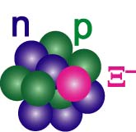
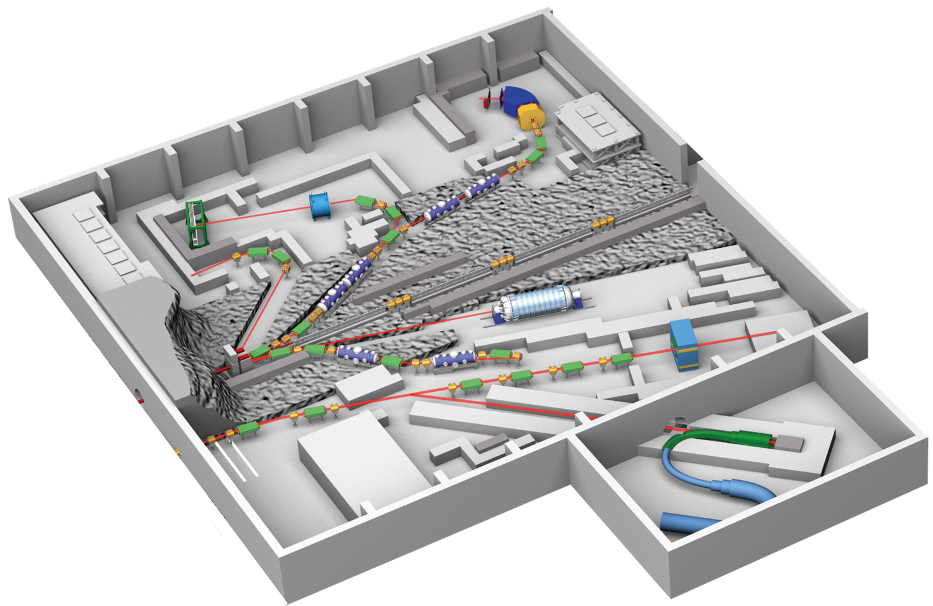
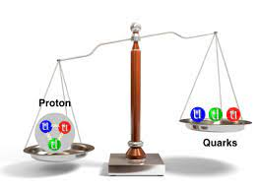

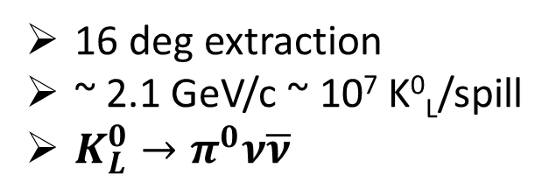
Hadron Experimental Facility (HEF)
< 2.0 GeV/c
~ 10⁶ K⁻/spill
S=-1 and S=-2 hypernuclei
< 1.1 GeV/c
~ 5x10⁵ K⁻/spill
Kaon in nuclei
K1.8
56 m
K1.8BR
16 deg extraction
~ 2.1 GeV/c ~ 10⁷ K⁰_{L}/spill
${K_{L}^{0}→π}^{0}ν\overline{ν}$
KL
charged
Au Target
< 95 kW
T1 target
high-p
launched in 2020
neutral
30 GeV proton ~ 10¹⁰
< 31 GeV/c unsepa. π ~ 10⁷
Hadron physics
primary 30GeV
muon
30 GeV proton beam
93kW (8x10¹³ ppp, 4.2s)
[as of 2025, May]
COMET
μ⁻ beam
μ-e conversion
will start in 2023

Slide 10
Hadron Experimental Facility (HEF)
< 2.0 GeV/c
~ 10⁶ K⁻/spill
S=-1 and S=-2 hypernuclei
< 1.1 GeV/c
~ 5x10⁵ K⁻/spill
Kaon in nuclei
K1.8
56 m
K1.8BR
16 deg extraction
~ 2.1 GeV/c ~ 10⁷ K⁰_{L}/spill
${K_{L}^{0}→π}^{0}ν\overline{ν}$
KL
charged
Au Target
< 95 kW
T1 target
high-p
launched in 2020
neutral
30 GeV proton ~ 10¹⁰
< 31 GeV/c unsepa. π ~ 10⁷
Hadron physics
primary 30GeV
muon
30 GeV proton beam
93kW (8x10¹³ ppp, 4.2s)
[as of 2025, May]
COMET
μ⁻ beam
μ-e conversion
will start in 2023

Slide 11
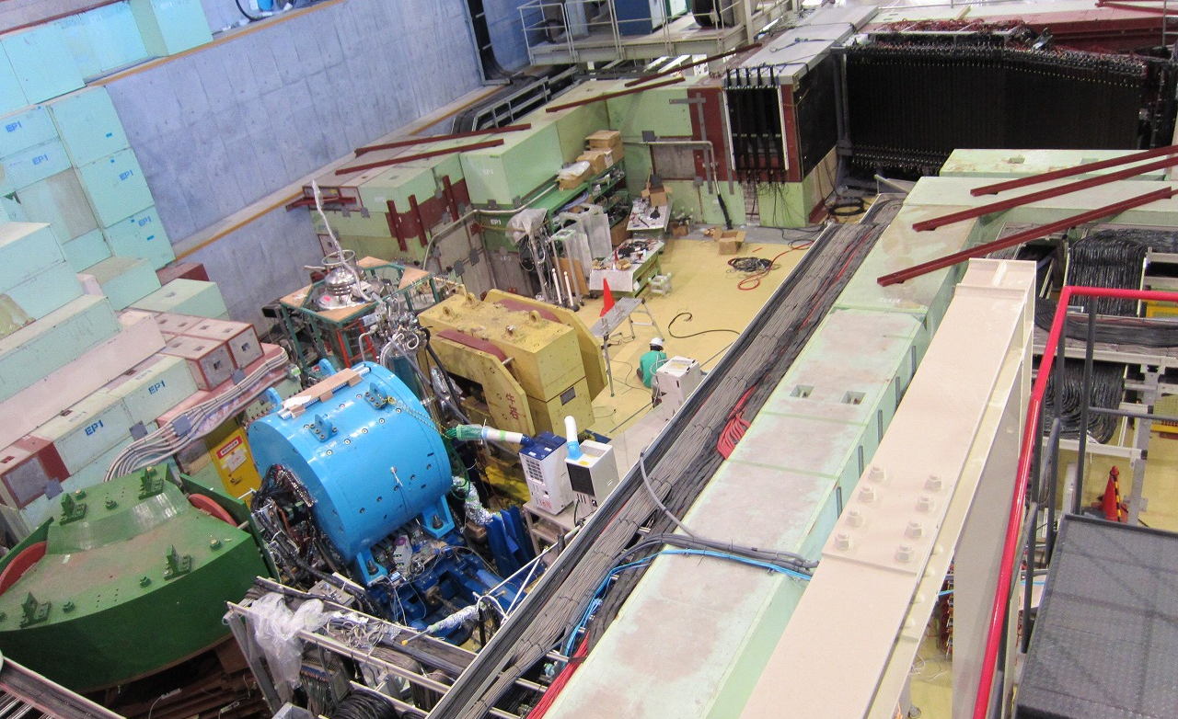
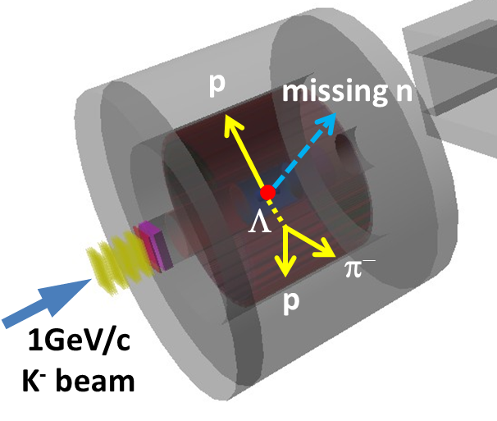
Experimental Setup @ K1.8BR
K.Agari et, al., PTEP(2012)02B011
Beam Dump
Beam Sweeping Magnet
Neutron Counter
Charge Veto Counter
Proton Counter
Liquid ³He-target System
Cylindrica Detector System
(CDS)
Beam Line
Spectrometer

Slide 12
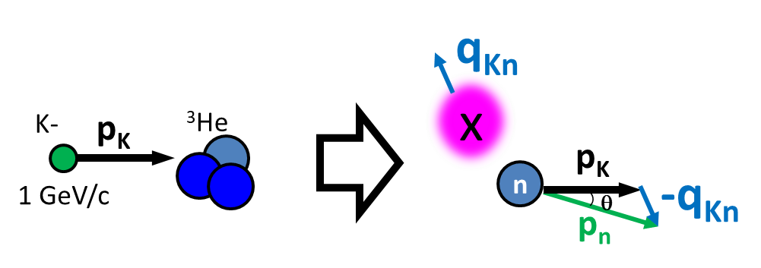
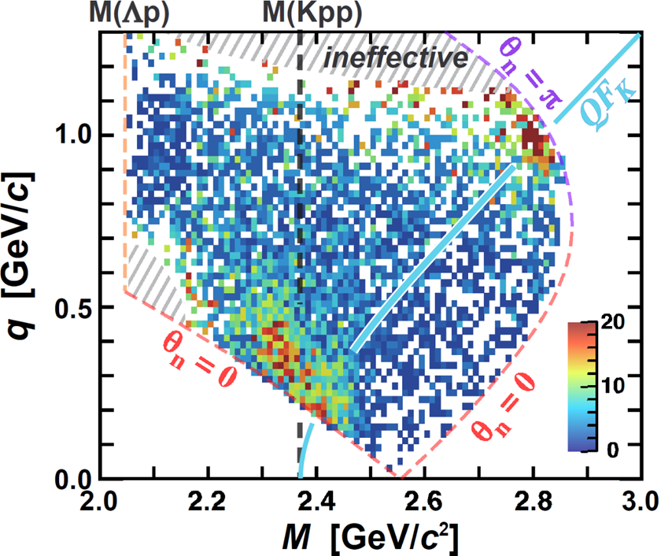
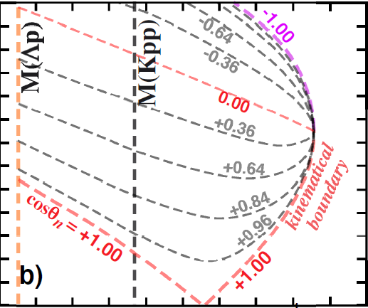
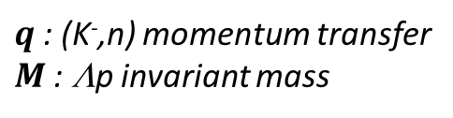
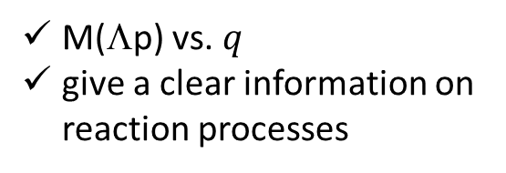
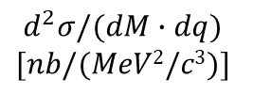
“K⁻pp” Search w/ Momentum Transfer Analysis
$$d^{2}σ/(dM∙dq)$$
$$[nb/(MeV2/c3)]$$
K⁻
³He
1 GeV/c
Bound
Un-bound
“x”
n
p
Momentum transfer analysis using the (K⁻,n) reaction
n
acceptance &
efficiency
corrected
Λ
  M(Λp) vs. $q$
  give a clear information on reaction processes
If a bound state exists, there is a peak structure independent of q below the M(Kpp)
$q$: (K⁻,n) momentum transfer
$M$: Λp invariant mass

Slide 13
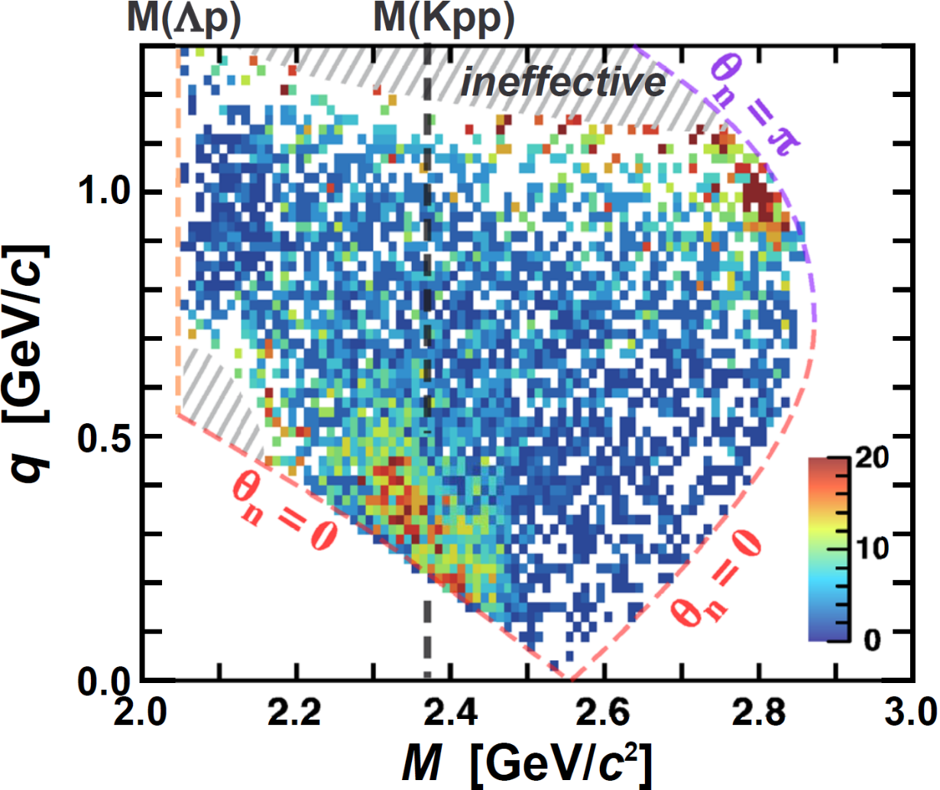
“K⁻pp” Search w/ Momentum Transfer Analysis
PLB789(2019)620., PRC102(2020)044002.
$$d^{2}σ/(dM∙dq)$$
$$[nb/(MeV2/c3)]$$
K⁻
³He
1 GeV/c
Bound
Un-bound
“x”
n
p
Momentum transfer analysis using the (K⁻,n) reaction
n
acceptance &
efficiency
corrected
Λ
  M(Λp) vs. $q$
  give a clear information on reaction processes
A peak structure independent of q =
A bound state exists
$q$: (K⁻,n) momentum transfer
$M$: Λp invariant mass

Slide 14
“K⁻pp” Search w/ Momentum Transfer Analysis
Quasi-free K⁻ scattering
（+2NA absorption）
PLB789(2019)620., PRC102(2020)044002.
$$d^{2}σ/(dM∙dq)$$
$$[nb/(MeV2/c3)]$$
K⁻
³He
1 GeV/c
Bound
Un-bound
p
K⁻
n
p
p
Momentum transfer analysis using the (K⁻,n) reaction
n
acceptance &
efficiency
corrected
Λ
  M(Λp) vs. $q$
  give a clear information on reaction processes
A peak structure independent of q =
A bound state exists
$q$: (K⁻,n) momentum transfer
$M$: Λp invariant mass

Slide 15

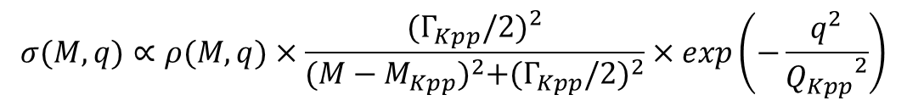
A PWIA-based Interpretation
Energy term (BW type) from time integral
Momentum term from spatial integral
Plane Wave Impulse Approximation
$$σ(M,q)∝ρ(M,q)×\frac{{(Γ_{Kpp}/2)}^{2}}{{(M−M_{Kpp})}^{2}+{(Γ_{Kpp}/2)}^{2}}×exp\left(−\frac{q^{2}}{{Q_{Kpp}}^{2}}\right)$$
Fit with PWIA
PRC102(2020)044002.
Deep binding = Strong K^{bar}N int.
Large Q = Suggesting a compact system
B_{Kpp}(BW) ~ 40 MeV, Γ_{Kpp}(BW) ~ 100 MeV
Q_{kpp} ~ 400 MeV
Binding energy
Decay width
Form factor

Slide 16
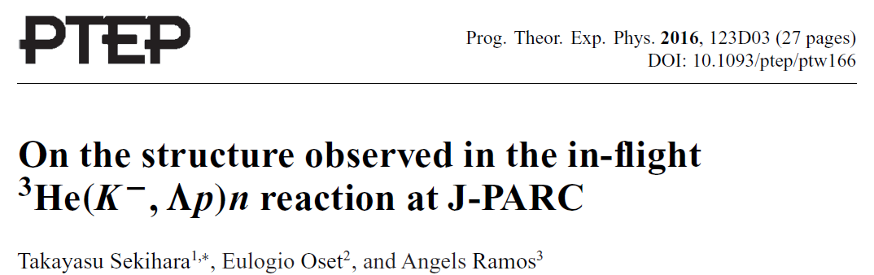
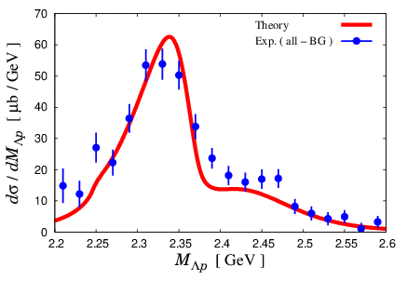
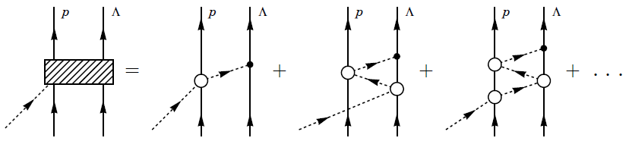
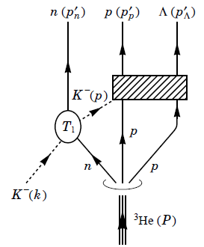

A Theoretical Interpretation
A calculation based on chiral unitary approach reproduces the data well using the $\overline{K}NN$ bound state
K^{bar}NN
bound state
Quasi-free K⁻ scattering
M(Kpp)
Theoretical investigations are indispensable!
(BG subtracted)
T.Sekihara 2022

Slide 17
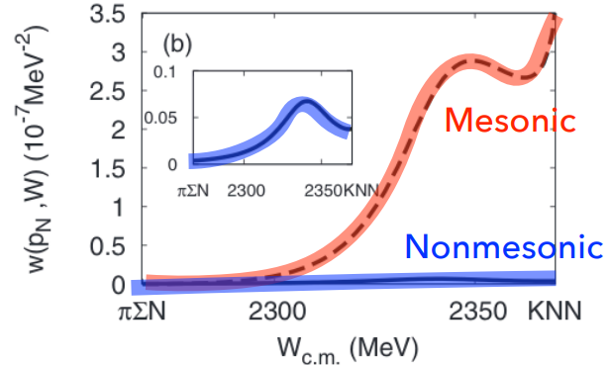
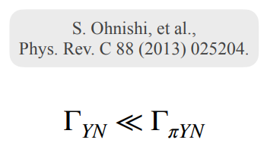
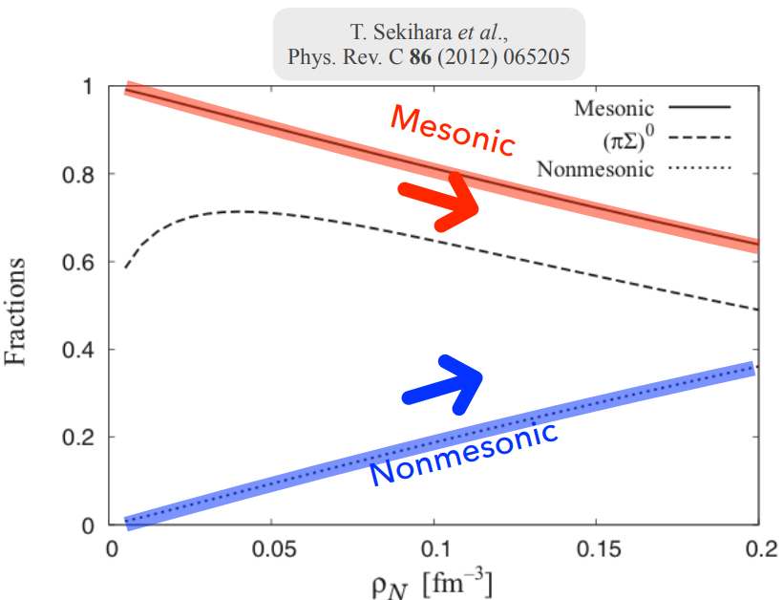
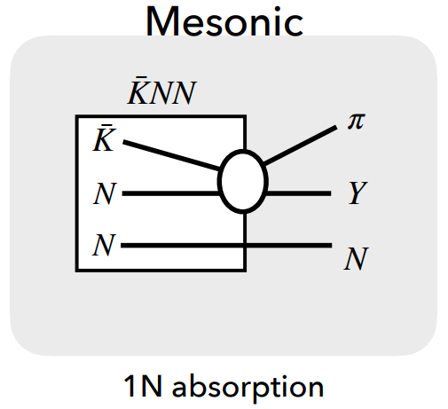
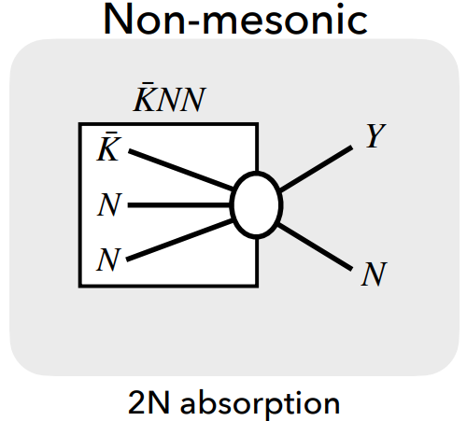
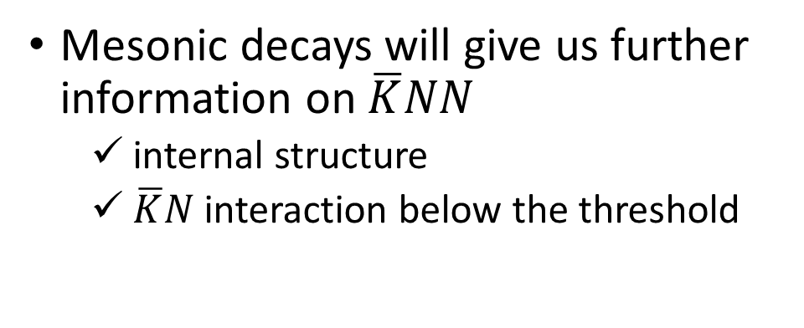

Mesonic Decay Modes of $\overline{K}NN$
Mesonic decays will give us further information on $\overline{K}NN$
  internal structure
  $\overline{K}N$ interaction below the threshold
Mesonic
Non-mesonic

Slide 18
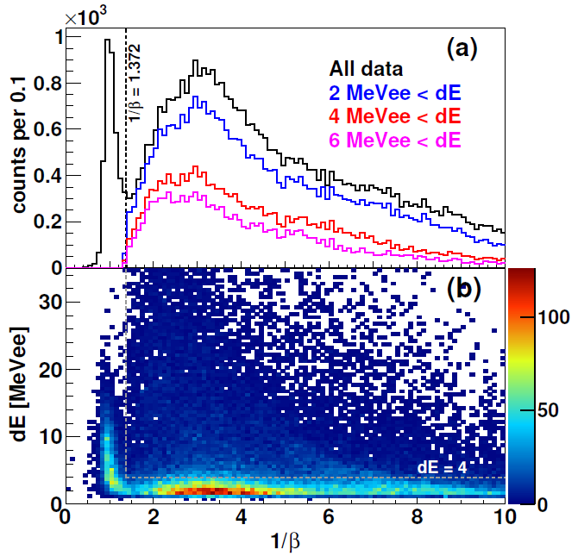
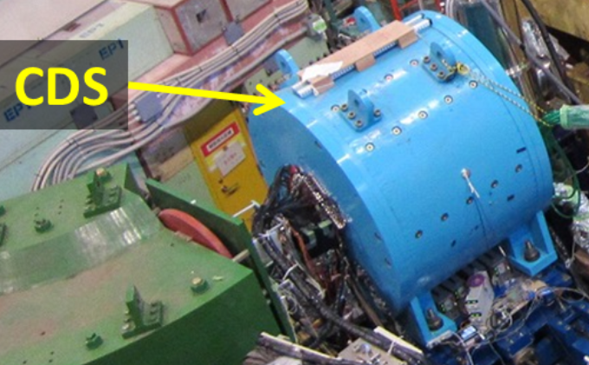
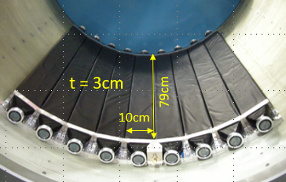








πYN Mesonic Decay Analysis
PRC110(2024) 014002.
with neutron detection using a thin scintillation counter array (CDH)
  small efficiency (3~9%)
  BG from the inner wall of the magnet
$$"K^{−}pp"→Λp$$
$$"K^{−}pp"→π^{±}Σ^{∓}p$$
$$"K^{−}pp"→π^{+}Λn$$
$$"{\overline{K}}^{0}nn"→π^{−}Λp$$
+

Slide 19




πYN Mesonic Decay Analysis
PRC110(2024) 014002.
with neutron detection using a thin scintillation counter array (CDH)
  small efficiency (3~9%)
  BG from the inner wall of the magnet
$$"K^{−}pp"→Λp$$
$$"K^{−}pp"→π^{±}Σ^{∓}p$$
$$"K^{−}pp"→π^{+}Λn$$
$$"{\overline{K}}^{0}nn"→π^{−}Λp$$
2NA w/ p_{Fermi}
x1/5
Similar but not clear peak below M(KNN) due to the phase space

Slide 20




πYN Mesonic Decay Analysis
PRC110(2024) 014002.
Phase space
Momentum term from spatial integral
Plane Wave Impulse Approximation
$$σ(M,q)∝ρ(M,q)×\frac{{(Γ_{Kpp}/2)}^{2}}{{(M−M_{Kpp})}^{2}+{(Γ_{Kpp}/2)}^{2}}×exp\left(−\frac{q^{2}}{{Q_{Kpp}}^{2}}\right)$$
Fit with PWIA
Energy term (BW type) from time integral
$$"K^{−}pp"→Λp$$
$$"K^{−}pp"→π^{±}Σ^{∓}p$$
$$"K^{−}pp"→π^{+}Λn$$
$$"{\overline{K}}^{0}nn"→π^{−}Λp$$
Employ the same model func. for KNN & QF, with each phase space

Slide 21



πYN Mesonic Decay Analysis
PRC110(2024) 014002.
Phase space
Momentum term from spatial integral
Plane Wave Impulse Approximation
$$σ(M,q)∝ρ(M,q)×\frac{{(Γ_{Kpp}/2)}^{2}}{{(M−M_{Kpp})}^{2}+{(Γ_{Kpp}/2)}^{2}}×exp\left(−\frac{q^{2}}{{Q_{Kpp}}^{2}}\right)$$
Fit with PWIA
Energy term (BW type) from time integral
$$"K^{−}pp"→Λp$$
$$"K^{−}pp"→π^{±}Σ^{∓}p$$
$$"K^{−}pp"→π^{+}Λn$$
$$"{\overline{K}}^{0}nn"→π^{−}Λp$$
Fit the 1D spectra in 0.3<q<0.6 with the same model func.

Slide 22




πYN Mesonic Decay Analysis
PRC110(2024) 014002.
Phase space
Momentum term from spatial integral
Plane Wave Impulse Approximation
$$σ(M,q)∝ρ(M,q)×\frac{{(Γ_{Kpp}/2)}^{2}}{{(M−M_{Kpp})}^{2}+{(Γ_{Kpp}/2)}^{2}}×exp\left(−\frac{q^{2}}{{Q_{Kpp}}^{2}}\right)$$
Fit with PWIA
Energy term (BW type) from time integral
$$"K^{−}pp"→Λp$$
$$"K^{−}pp"→π^{±}Σ^{∓}p$$
$$"K^{−}pp"→π^{+}Λn$$
$$"{\overline{K}}^{0}nn"→π^{−}Λp$$
With the model func., the spectra are consistently explained.

Slide 23









πYN Mesonic Decay Analysis
PRC110(2024) 014002.
Γ_{YN} << Γ_{πYN} : mesonic decay is dominant
Γ_{πΣN} ~ Γ_{πΛN} : significant contribution of the I_{KN} = 1 as well as I_{KN} = 0
Γ_{π+Λn} / Γ_{π−Λp} ~ 2 : if we assume Br_{K-pp→π+Λn} = Br_{K0nn→π−Λp}→ σ_{K-pp} / σ_{K0nn} ~ 2
$$"K^{−}pp"→Λp$$
$$"K^{−}pp"→π^{+}Σ^{−}p$$
$$"K^{−}pp"→π^{+}Λn$$
$$"{\overline{K}}^{0}nn"→π^{−}Λp$$
$$σ_{\overline{K}NN}^{tot}×Br \left(μb\right)=$$
$9.3±{0.8}_{−1.0}^{+1.4}$ [all]
$5.5±{0.5}_{−0.6}^{+0.8}$ [<M(KNN)]
$$σ_{\overline{K}NN}^{tot}×Br \left(μb\right)=$$
$38±3±3$ [all]
$3.2±0.2±0.2$ [<M(KNN)]
$$σ_{\overline{K}NN}^{tot}×Br \left(μb\right)=$$
$62±11±9$ [all]
$15.5±2.7±2.1$ [<M(KNN)]
$$σ_{\overline{K}NN}^{tot}×Br \left(μb\right)=$$
$29±3±3$ [all]
$7.2±0.6±0.$7 [<M(KNN)]
$$"K^{−}pp"→Σ^{0}p$$
$$"K^{−}pp"→π^{−}Σ^{+}p$$
$$σ_{\overline{K}NN}^{tot}×Br \left(μb\right)=$$
$5.3±{0.4}_{−0.6}^{+0.8}$ [all]
$3.1±{0.2}_{−0.4}^{+0.5}$ [<M(KNN)]
More precise measurements and theoretical investigations are needed
$$σ_{\overline{K}NN}^{tot}×Br \left(μb\right)=$$
$110±8±8$ [all]
$9.4±0.4±0.$7 [<M(KNN)]

Slide 24

Need Further Investigations
to establish the kaonic nuclei
Λ(1405) state
  $\overline{K}N$ qusi-bound state as considered?
  Relation between $\overline{K}N$ and $\overline{K}NN$?
Further details of the $\overline{K}NN$
  Mesonic decay modes?
  Spin and parity of the “K⁻pp”?
  Compact and dense system?
Heavier kaonic nuclei
  Mass number dependence?
Double kaonic nuclei
  Much compact and dense system?
→PRC110(2024)014002.
…
K⁻K⁻pp

Slide 25


Mass Number Dependence of Kaonic Nuclei
B.E.
the larger nuclei → the larger B.E.
Γ
→similar width
(mesonic only)
= without multi-N absorption
AY: PRC65(2002)044005, PLB535(2002)70.
WG: PRC79(2009)014001.
BGL: PLB712(2012)132.
OHHMH: PRC95(2017)065202.
Kanada: EPJA57(2021)185.
Systematic measurements will provide more conclusive evidence of the kaonic nuclei

Slide 26

“K⁻ppn” Search with K⁻⁴He → Λdn
An analysis of the Λdn final state with K⁻⁴He reaction at 1 GeV/c has been conducted
  T77: lifetime measurement of ⁴_{Λ}H in 2020
The results will be updated with a part of the E73 controlled data
  E73: lifetime measurement of ³_{Λ}H in 2024-25
4
d
Experiment | K⁻ on target
E15 (³He) | ~42 x 10⁹
T77 (⁴He) | ~6 x 10⁹
E73 (⁴He) | ~12 x 10⁹

Slide 27




“K⁻ppn” Search with K⁻⁴He → Λdn
q
q
⁴He(T77)
³He(E15)
M(Kppn)
M(Kpp)
PLB789(2019)620
Preliminary
before acceptance correction
before acceptance correction
Two distributions are quite similar
structure below the threshold (seems q-independent), QF-K, BG

Slide 28




“K⁻ppn” Search with K⁻⁴He → Λdn
2D fit on the (M,q) space with similar shapes to E15:
Breit-Wigner wtih Gaus. form factor (PWIA), QF-K⁻, and Broad BG
$$σ(M,q)∝ρ(M,q)×\frac{{(Γ_{X}/2)}^{2}}{{(M−M_{X})}^{2}+{(Γ_{X}/2)}^{2}}×exp\left(−\frac{q^{2}}{{Q_{X}}^{2}}\right)$$
M(Kppn)
Preliminary
0.3 <q_{x} < 0.6 GeV/c
Preliminary
$$B_{X} = 64±11\left(stat\right) MeV$$
$$Γ_{X} =\sim 100 MeV$$
$$σ_{X→Λd} \sim 4 μb$$

Slide 29
If the Observed Structure Is “K⁻ppn”,
B.E.
Γ
More precise studies
are needed
AY: PRC65(2002)044005, PLB535(2002)70.
WG: PRC79(2009)014001.
BGL: PLB712(2012)132.
OHHMH: PRC95(2017)065202.
Kanada: EPJA57(2021)185.
The binding energy is comparable with some theoretical predictions
The width is larger than theoretical predictions

Slide 30
Need Further Investigations
to establish the kaonic nuclei
Λ(1405) state
  $\overline{K}N$ qusi-bound state as considered?
  Relation between $\overline{K}N$ and $\overline{K}NN$?
Further details of the $\overline{K}NN$
  Mesonic decay modes?
  Spin and parity of the “K⁻pp”?
  Compact and dense system?
Heavier kaonic nuclei
  Mass number dependence?
Double kaonic nuclei
  Much compact and dense system?
→PRC110(2024)014002.
…
K⁻K⁻pp

Slide 31





J-PARC E31
K⁻d→n$Σ^{±}π^{∓}$/$Σ^{0}π^{0}$
@ θ_{n}=0
PLB837(2023)137637.
d(K⁻,n)πΣ reaction at θ_{n}~0 degree
➔ enhance S-wave K^{bar}N→πΣ reaction
K-
d
Λ(1405)
~0.25 GeV/c
n
1 GeV/c
~1.25 GeV/c
Σ
s
π
n
π

Slide 32


J-PARC E31
K⁻d→n$Σ^{±}π^{∓}$/$Σ^{0}π^{0}$
@ θ_{n}=0
PLB837(2023)137637.
Λ(1405) pole : ${1417.7}_{−7.4}^{+6.0}{\left(fit\right)}_{−1.0}^{+1.1}\left(syst\right)−i\left[{26.1}_{−7.9}^{+6.0}{\left(fit\right)}_{−2.0}^{+1.7}\left(syst\right)\right]$

Slide 33

New Kaonic Nuclei Project at J-PARC
– from the $\overline{K}N$ to $\overline{K}NNNN$ systems and more –
…

Slide 34


Systematic investigation of the light kaonic nuclei
Systematic measurement will be promoted at J-PARC
  mass number dependence
    binding energy, branching ratio, q dependence, ..
  spin/parity determination
Extract internal structure with theoretical investigations
 | Reaction | Key Decay Mode
$$\overline{K}N$$ | d(K⁻,n) | π^{±0}Σ^{∓0}
$$\overline{K}NN$$ | ³He(K⁻,N) | Λp/Λn
$$\overline{K}NNN$$ | ⁴He(K⁻,N) | Λd/Λpn
$$\overline{K}NNNN$$ | ⁶Li(K⁻,d) | Λt/Λdn
$$\overline{K}NNNNN$$ | ⁶Li(K⁻,N) | Λα/Λdd/Λdpn
$$\overline{K}NNNNNN$$ | ⁷Li(K⁻,N) | Λαn/Λddn
$$\overline{K}\overline{K}NN$$ | $\overline{p}$ + ³He | ΛΛ
…

Slide 35




$\overline{K}NNN$ @ E80
via ⁴He(1 GeV/c K⁻, n) reaction
Establish the existence of $\overline{K}NNN$
    “K-ppn”→Λd 2-body decay
Study the multi-particle decay mode of $\overline{K}NNN$ toward understanding its internal structure
    “K-ppn”→Λpn 3-body decay
⁴He data
(T77 ~3 days)
q
0.3 <q < 0.6 GeV/c
M(Kppn)
acceptance
not corrected
Preliminary
all
“K-ppn”
BG
QF_{KA}
the sign of the “K⁻ppn”

Slide 36





$\overline{K}NN$ @ E89
via ³He(1 GeV/c K⁻, n) reaction
Search for “${\overline{K}}^{0}$nn”, isospin partner of “K⁻pp”
    “${\overline{K}}^{0}$nn”→Λn/Σ⁻p
Determine the spin/parity of $\overline{K}NN$
    spin-spin correlation measurement of “K⁻pp”→Λp
There are two possible configurations for the $\overline{K}NN$ ground state.

Slide 37


New Cylindrical Detector System (CDS)
Present CDS
New CDS
  Solid angle: x1.6 (59% → 93%)
  Neutron eff.: x7 (3% → 12%x1.6)
  + forward TOF counter
  + proton polarimeter (in future)
to be completed in 2026

Slide 38







Construction Status of the CDS
Return York:
completed
SC Solenoid:
completed
CDC:
completed, in commissioning
CNC:
development with prototypes, to be completed this year
  The experiment will be ready in early 2027

Slide 39

Summary
We observed the “K⁻pp” bound state in ³He(K⁻,Λp)n
  PLB789(2019)620., PRC102(2020)044002.
We also obtained hints of mesonic decays of “K-pp”
  PRC110(2024)014002.
We observed the sign of the “K⁻ppn” in ⁴He(K⁻,Λd)n
  will be published soon with x3 statistics
New project has started from E80, “K⁻ppn”, aiming at the systematic study of the kaonic nuclei
  Constructing a large solenoid spectrometer
  will start in early 2027

Slide 40









J-PARC E80 Collaboration
We're looking for new collaborators!

Slide 41

Thank you for your attention!
High intense K beam
New large CDS
ÖWA/Harald Ritsch
New era of kaonic nuclei
A first step of the project
via in-flight ⁴He(K⁻,N)

Slide 43

T.Yamaga, 39th J-PARC PAC

Slide 44
T.Yamaga, 39th J-PARC PAC

Slide 45

T.Yamaga, 39th J-PARC PAC

Slide 47


Slide 48




What We Observed at E15?
A peak structure below the mass threshold M(Kpp) that does NOT depend on momentum transfer
  A bound state exists
  ~10 times the binding energy of normal light nuclei
  Generated by large momentum transfer
Evidence of quasi-free K⁻ scattering
  An intermediate $\overline{K}$ exists during the reaction
Consistent with a theoretical calculation using “K-pp”
Observed structure = “K-pp” bound state

Slide 49






K⁻⁴He → Λdn Analysis with the T77 Data
BE (MeV)
What is the observed structure?
“X”→Λd decay mode is unique evidence of I_{”X”} = 0
  I(J^{P}) : Λ = 0(1/2⁺), d = 0(1⁺), K⁻ = 1/2(0⁻), ³He = 1/2(1/2⁺) , ⁴He = 0(0⁺)
“X”=“K⁻ppn” with J_{”X”} = 1/2 would be likely
  J_{”X”} = 1/2:
    ⁴He initial state is I(J) = 0(0), and remaining “NNN” would be I(J) = 1/2(1/2)
    low-momentum intermediate $\overline{K}$ would react with “NNN” in S-wave
  Exclusion of “X”=“Y*(I=1)NN”:
    “NN” is I(J) = 1(0)
    “Y*(I=1)NN”→Λd decay would be suppressed
      spin/isospin flip is needed to reconfigure “NN” into “d” [I(J) = 0(1)]
      Λpn decay would be dominant for “Y*(I=1)NN”
0
$$M(\overline{K}NNN)$$
27
$${M(Λ}^{∗}NN)$$
50
${M(Σ}^{∗}NN$)
100
$$M(πΣNN)$$
180
$$M(πΛNN)$$
4
“X”
n
d

Slide 51
H.Noumi, HIN2025

Slide 52

H.Noumi, HIN2025

Slide 53

H.Noumi, HIN2025

Slide 54

H.Noumi, HIN2025

Slide 56






$\overline{K}NNN$ Searches so far
E471/E549@KEK
FINUDA@DAΦNE
FOPI@GSI
⁴He(stopped-K⁻,p/n/Yd)
  Li/C(stopped-K⁻,Λd)
  Λd in Ni+Ni
MM(K-,p)
MM(K-,n)
PLB659(2008)107, PLB688(2010)43,
IM(Λd)
PLB654(2007)80
PRC76(2007)068202
EXA05 Conference (2005)
Σ0d
Λd
No conclusive results.
multi-N absorption in stopped-K reaction makes interpretation difficult

Slide 57




Acceptance for K⁻⁴He reaction
Λd in CDS
Λpn in CDS
M(Kppn)
M(Kppn)

