Slide 1
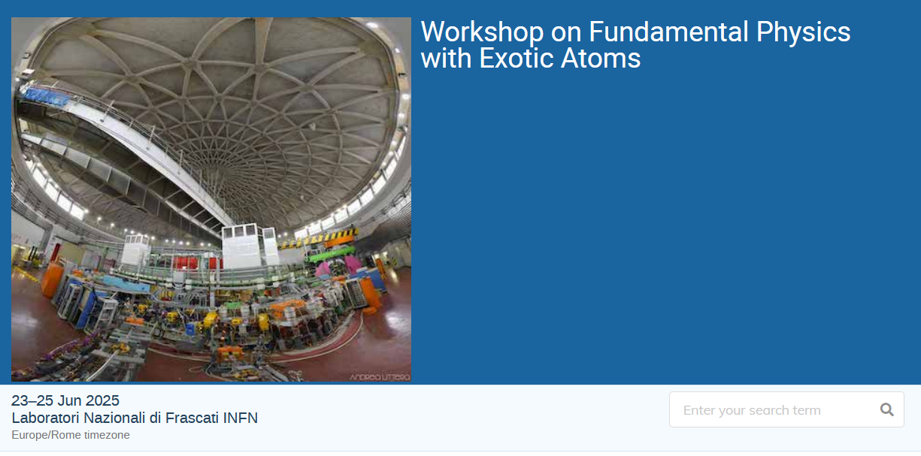

Slide 2
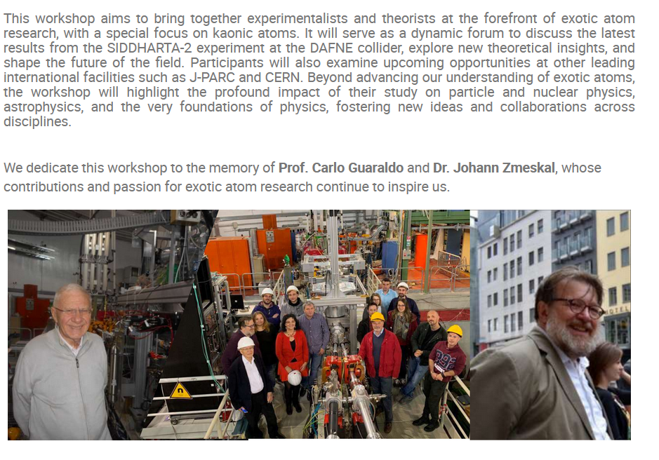

Slide 3
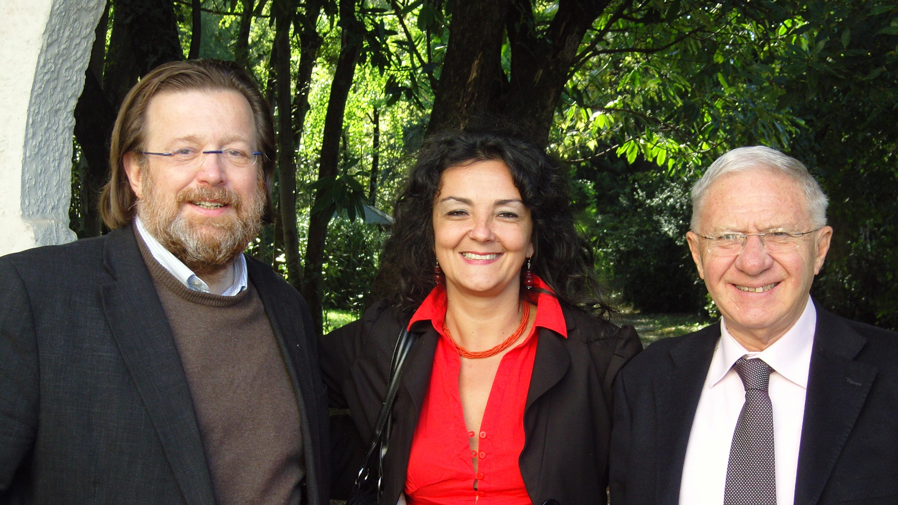
More than 25 years of friendship and work together

Slide 4
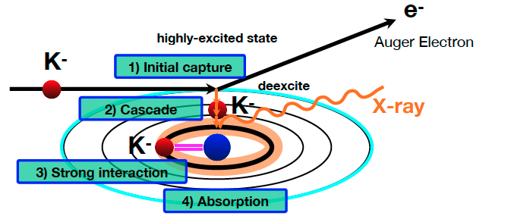
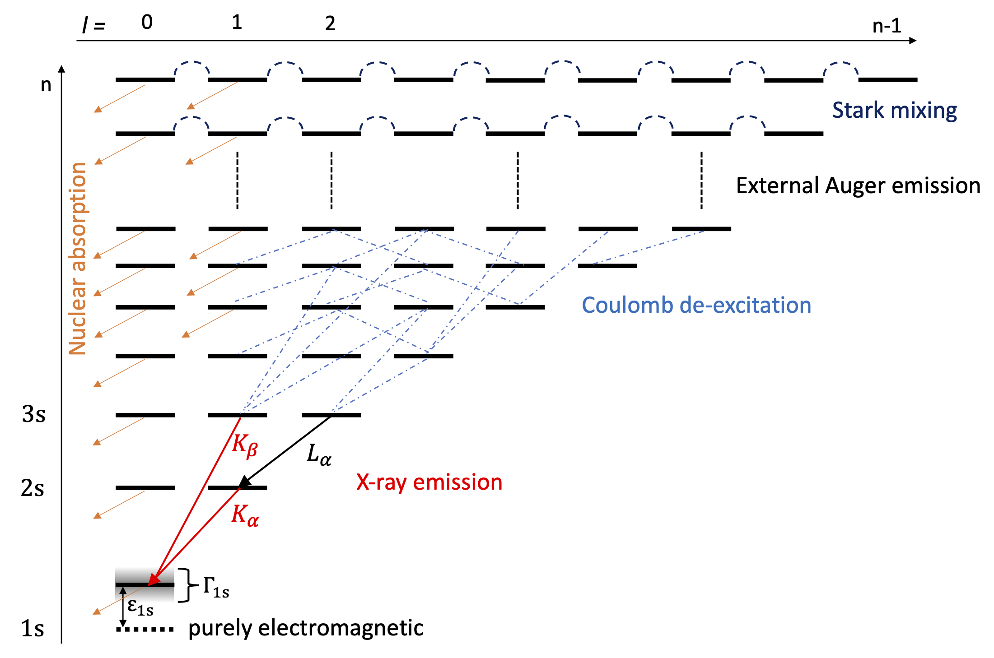
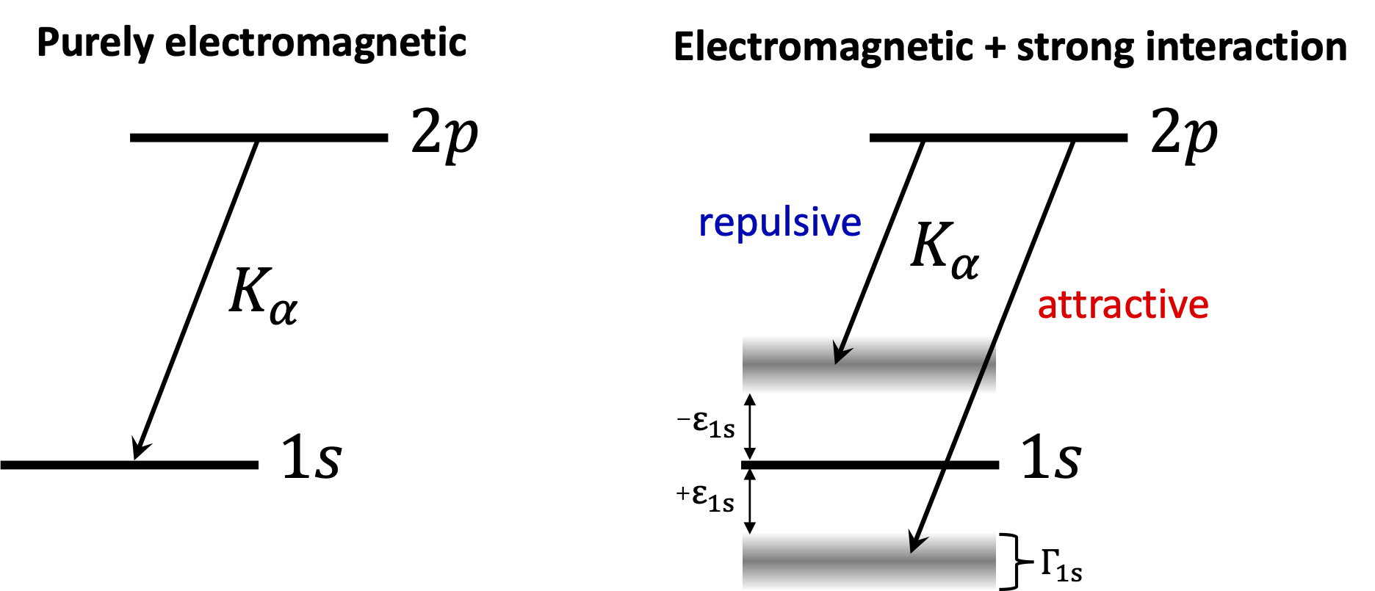
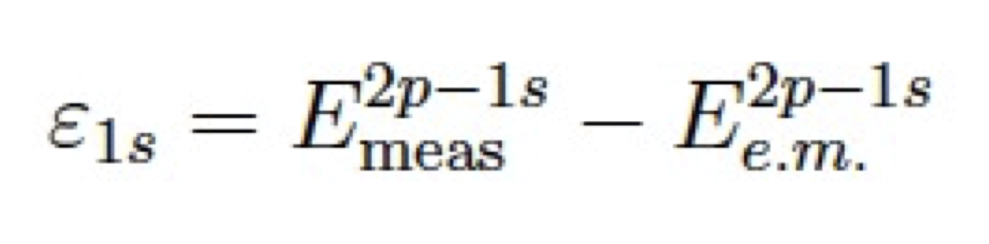
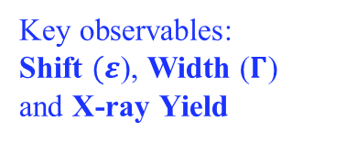
Exotic Atoms Spectroscopy (an example)
Kaons, muons, pions, antiprotons, e+e-….
Kaonic atom formation
QED
n ~ sqrt(M*/me) n’ ~ 25 (for K-p)
(M* : K-p reduced mass)
QCD
Key observables:
Shift $(ε$), Width ($Γ$)
and X-ray Yield

Slide 5
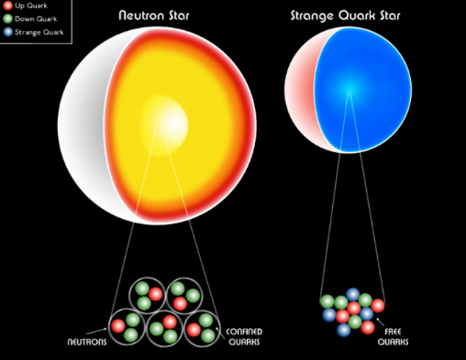
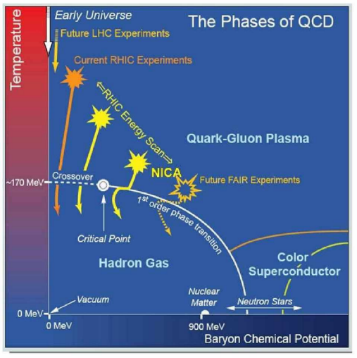
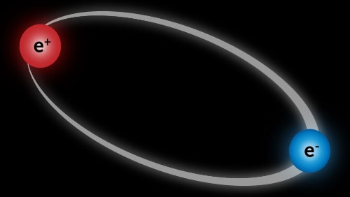
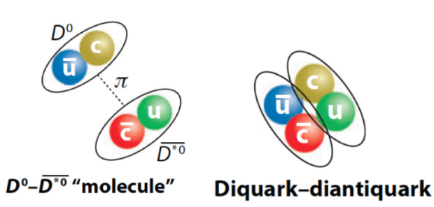
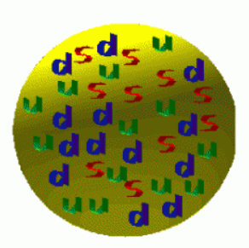
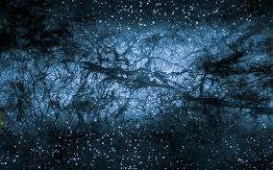
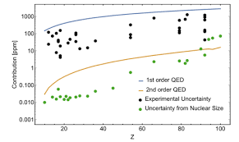
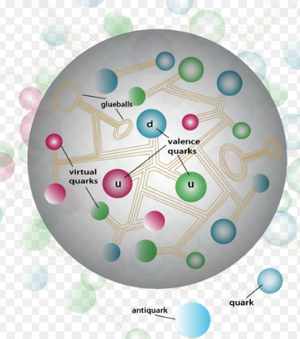
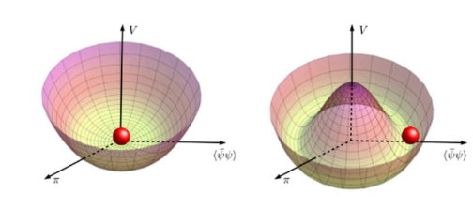
Neutron star EOS
CPT & Symmetries
Particles structure
Cold Dense matter
Fundamental Physics with Exotic Atoms
Mass generation, visible Universe
QCD Chiral symm.
QED Precision (BSQED)
Dark Matter (and Strangelets)

Slide 6
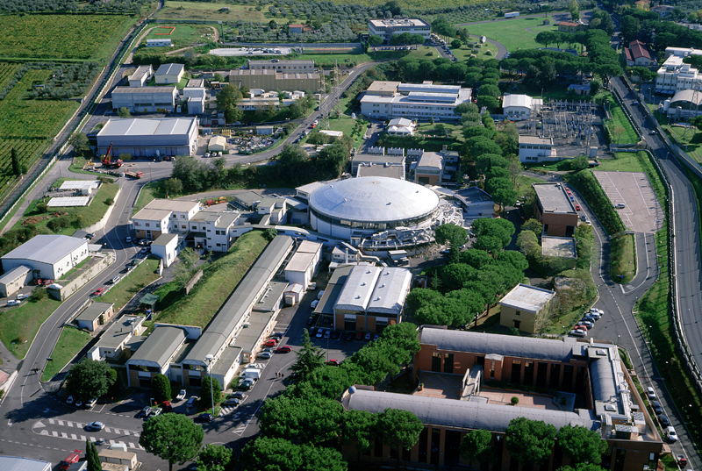
Laboratori Nazionali di Frascati, info: http://www.lnf.infn.it/sis/
ADA e ADONE
ATLAS
NAUTILUS
KLOE
OPERA
Centro di
Calcolo
DAFNE
DAFNE-L
BTF
FISA
FINUDA
DEAR
Auditorium

Slide 7
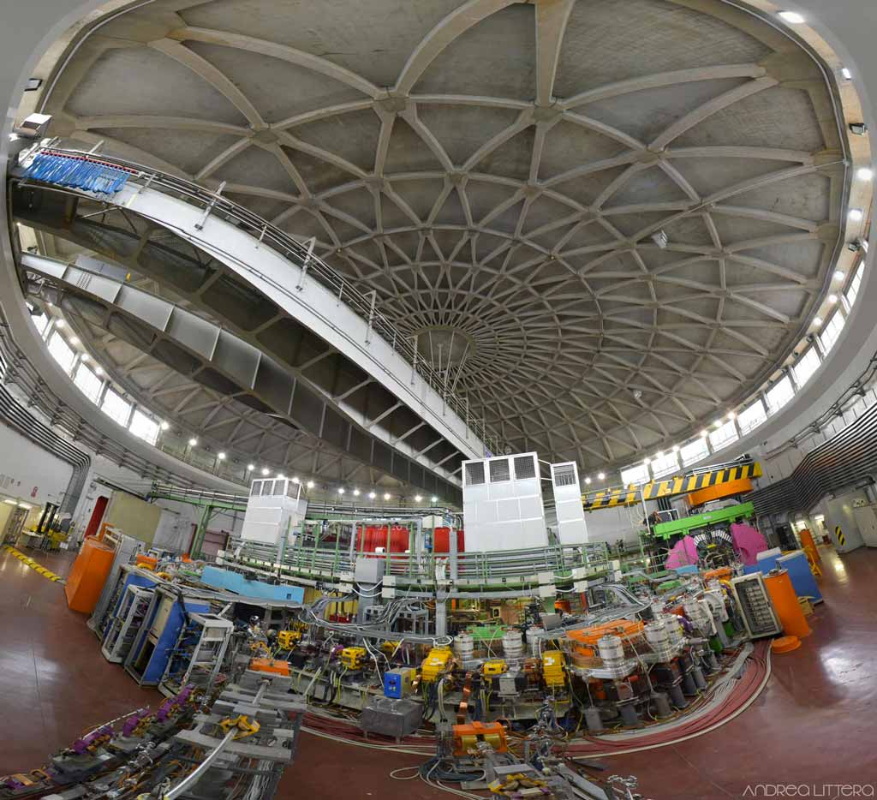

Slide 8
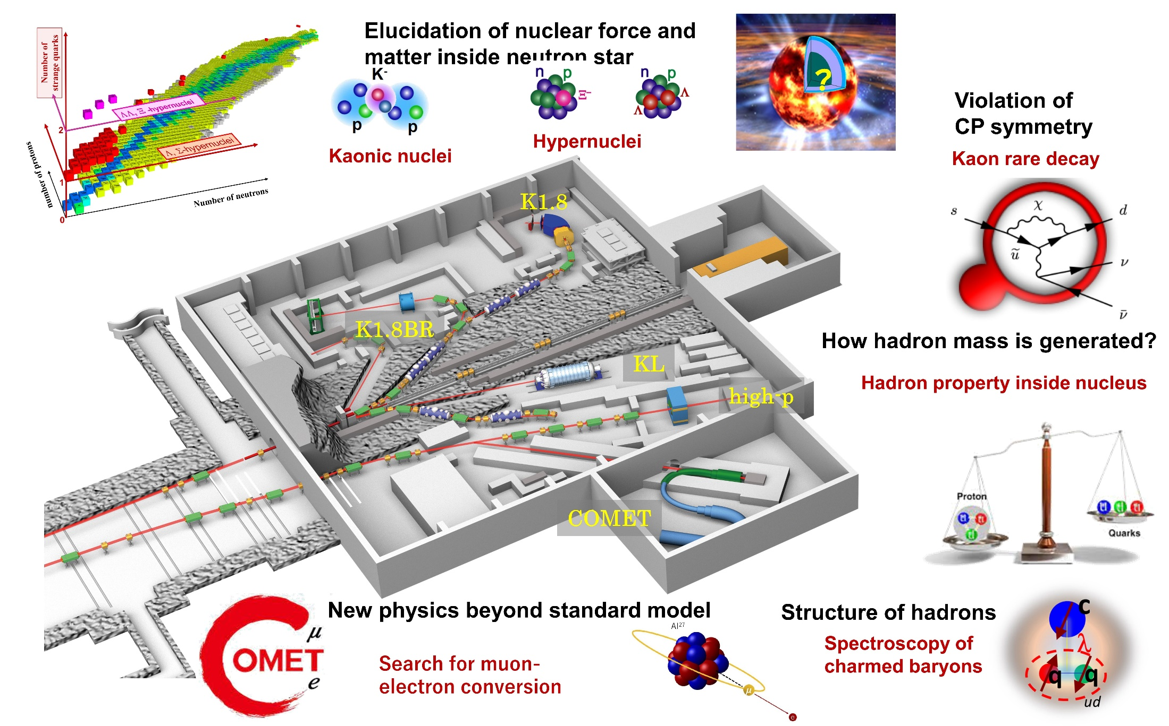
J-PARC

Slide 9
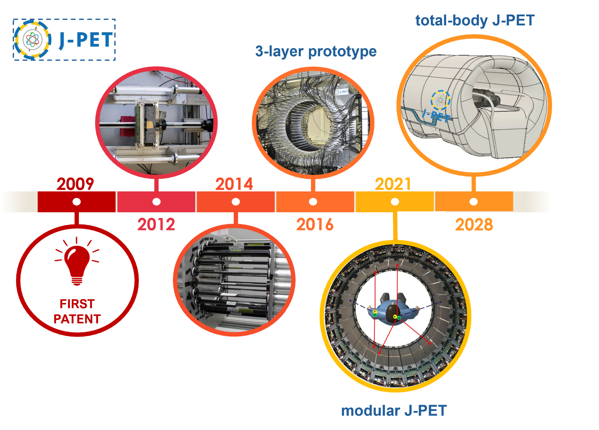
J-PET

Slide 10
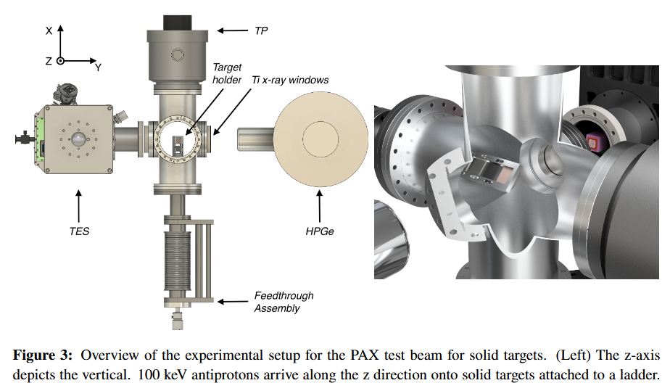
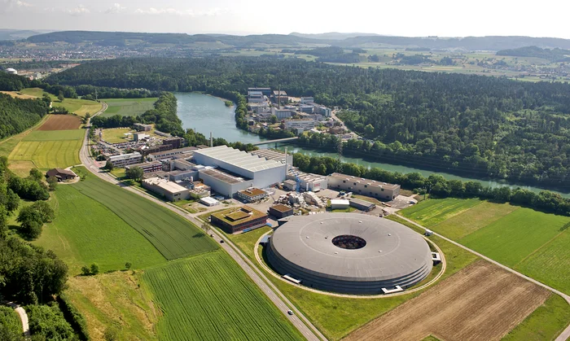
Exotic atoms:
CERN
PSI
…..

Slide 11
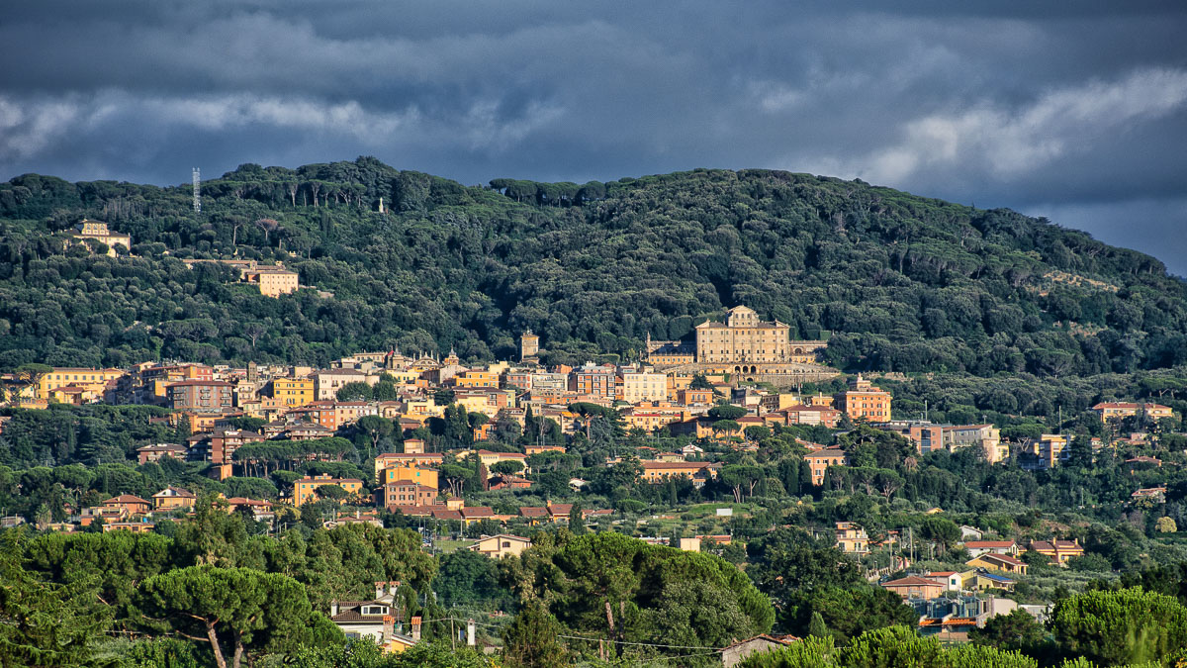

Slide 12
23th June:
Chair: Catalina Curceanu
10:15 – 10:30 Arrival and Registration
10:30 – 11:00 Welcome (Catalina Curceanu)
11:00 – 11:45 Coffee Break
11:45 – 12:15 Diana Sirghi: The physics of the kaonic atoms in the last 25 years
12:15 – 12:45 Catia Milardi, DAFNE setup and optimization for the kaonic deuterium run of SIDDHARTA-2
12:45 – 13:15 Oton Vazquez Doce: Latest measurements with strangeness (and more) using femtoscopy (online)
13:30 – 15:00 Lunch
Chair: Magda Skurzok
15:00 – 15:30 Florin Sirghi: Overview of Technological Challenges in Exotic Atom Precision Experiments
15:30 – 16:00 Antonino Marciano: A stochastic gradient flow approach to nuclear and atomic physics, and the measurement problem
16:00 – 16:30 Coffee Break
16:30 – 17:00 Johann Marton: Exotic atom research and related topics - work with Hannes Zmeskal 1980 – 2024
17:00 – 17:30 Fuminori Sakuma: Kaonic nuclei – progress and prospects at J-PARC
17:30 – 18:00 Slawomir Wycech: ON A QUARK COMPONENT TO Λ(1405) (online)

Slide 13
24th June:
Chair: Johann Marton
9:30 – 10:00 Luca De Paolis: KAMEO: Probing E2 Nuclear Resonance in Kaonic Molybdenum Isotopes
10:00 – 10:30 Francesco Sgaramella: Kaonic Atoms X-ray Spectroscopy with SIDDHARTA-2: The First Measurement of Kaonic Deuterium
10:30 – 11:00 Paul Indelicato: All-order QED corrections on kaonic atoms
11:00 – 11:45 Coffee Break
11:45 – 12:15 Simone Manti: Kaonic Neon Spectroscopy: Testing Bound-State QED, Extracting the Kaon Mass and Probing Beyond Standard Model Physics
12:15 – 12:45 Tadashi Hashimoto: Kaonic atom experiments at J-PARC
12:45 – 13:15 Jaroslava Obertova: Recent results on kaonic atoms from theory
13:30 – 15:00 Lunch
Chair: Simone Manti
15:00 – 15:30 Pawel Moskal: Advancement in Positronium and Quantum Entanglement Imaging with J-PET
15:30 – 16:00 Damir Bosnar: Kaonic atoms in DAFNE with HPGe detector
16:00 – 16:30 Coffee Break
16:30 – 17:00 Nicola Bortolotti: QFT with generalized statistics and quantum gravity phenomenology (online)
17:00 – 17:30 Kristian Piscicchia: Quantum foundations phenomenology in underground experiments at LNGS
17:30 – 18:00 Masaki Hori: Laser spectroscopy of kaonic helium at DAPHNE

Slide 14
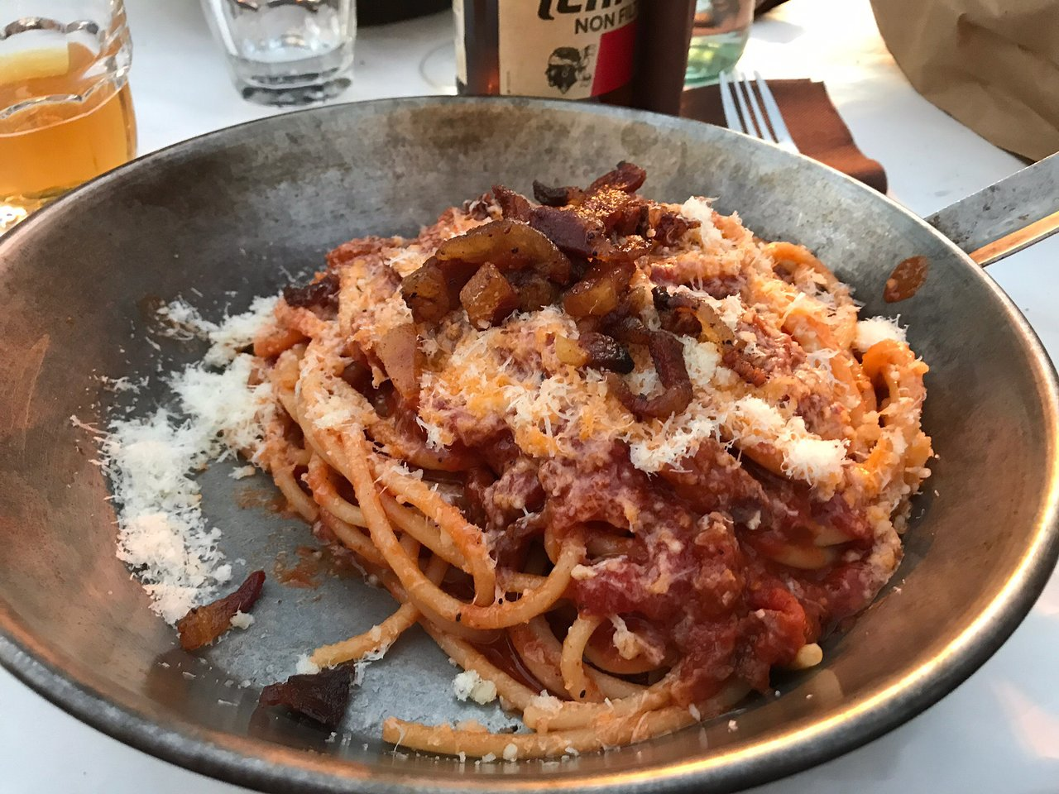
Workshop Dinner
24th June 2025 at 8 pm
Ostaria San Rocco Piacente
Frascati

Slide 15
25th June:
Chair: Francesco Sgaramella
10:00 – 10:30 Francesco Artibani: Novel CZT Detectors for kaonic atoms spectroscopy
10:30 – 11:00 Francesco Clozza; Silicon Drift Detectors for the new generation of Kaonic Atoms measurements
11:00 – 11:45 Coffee Break
11:45 – 12:15 Alexander Khreptak: Positronium: An Exotic Atom at the Edge of Matter and Antimatter
12:15 – 12:45 Magdalena Skurzok: Dalitz plot determination for oPs->3gamma decay using J-PET detection system
12:45 – 13:15 Mihai Iliescu: SPHINX: Structure Probing by Holographic Imaging at Nanometer scale with X-ray lasers
13:15 – 13:30 Discussions
13:30 – 15:00 Lunch

Slide 16
Workshop Chair:
Catalina Oana Curceanu, INFN-LNF, Frascati, Italy
Organizing Committee:
Mihail Iliescu, INFN-LNF, Frascati, Italy
Simone Manti, INFN-LNF, Frascati, Italy
Diana Laura Sirghi, INFN-LNF, Frascati, Italy
Florin Sirghi, INFN-LNF, Frascati, Italy
Alessandro Scordo, INFN-LNF, Frascati, Italy
Francesco Sgaramella, INFN-LNF, Frascati, Italy
Magdalena Skurzok, Jagiellonian University, Krakow, Poland and INFN-LNF, Frascati, Italy
Luca De Paolis, INFN-LNF, Frascati, Italy
Secretariat:
Alessandra Tamborrino Orsini (secretariat)

Slide 17
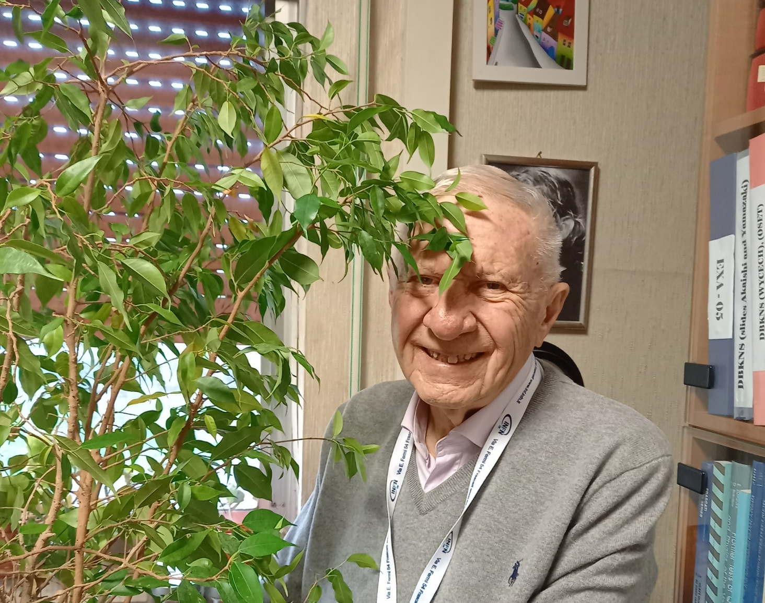
Carlo in his office at LNF

Slide 18
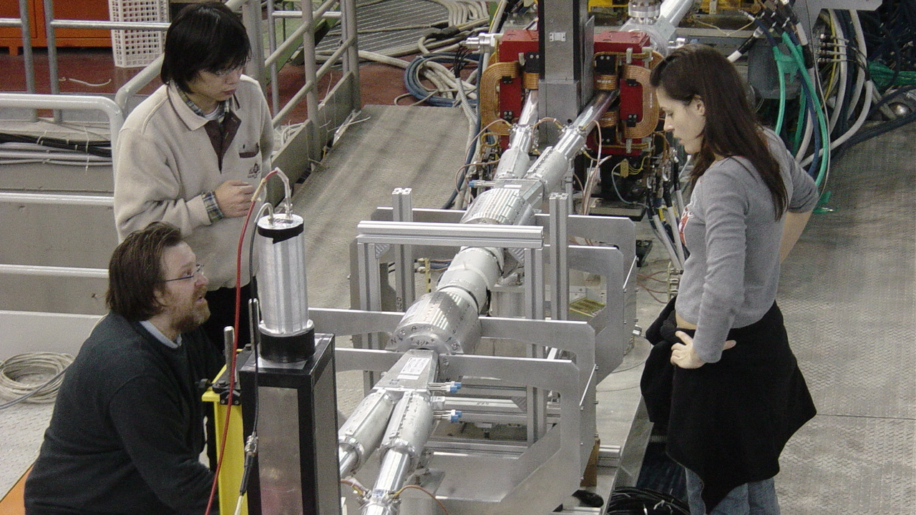

Slide 19
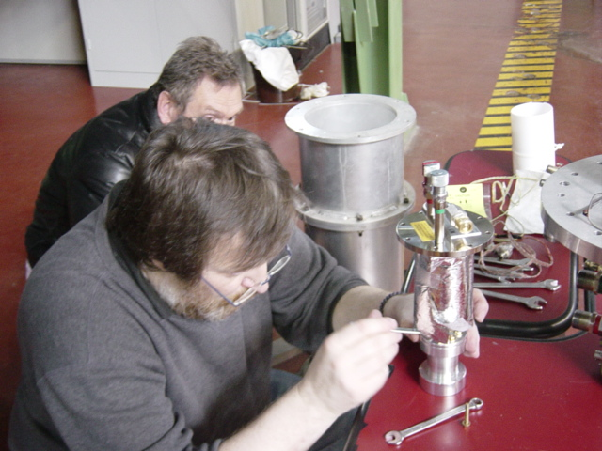
SIDDHARTA preparation

Slide 20
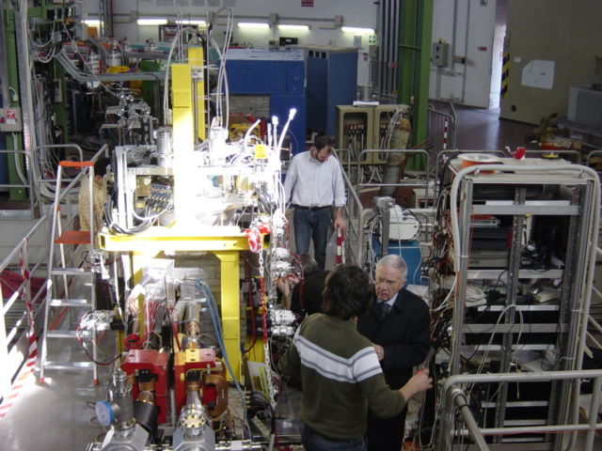
Discussions

Slide 21
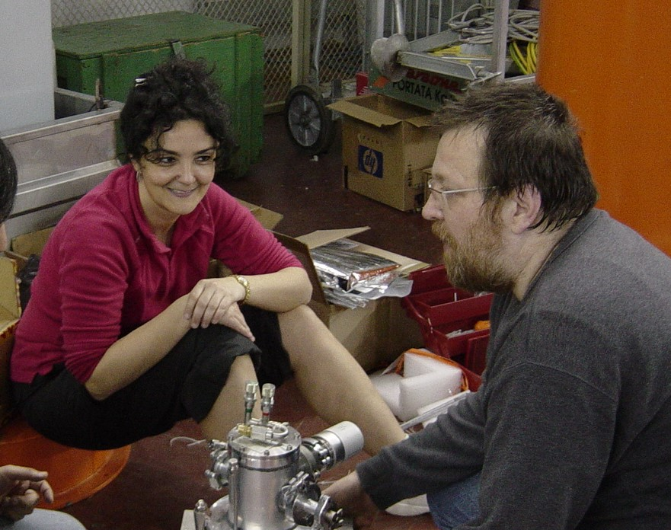
SIDDHARTA installation

Slide 22
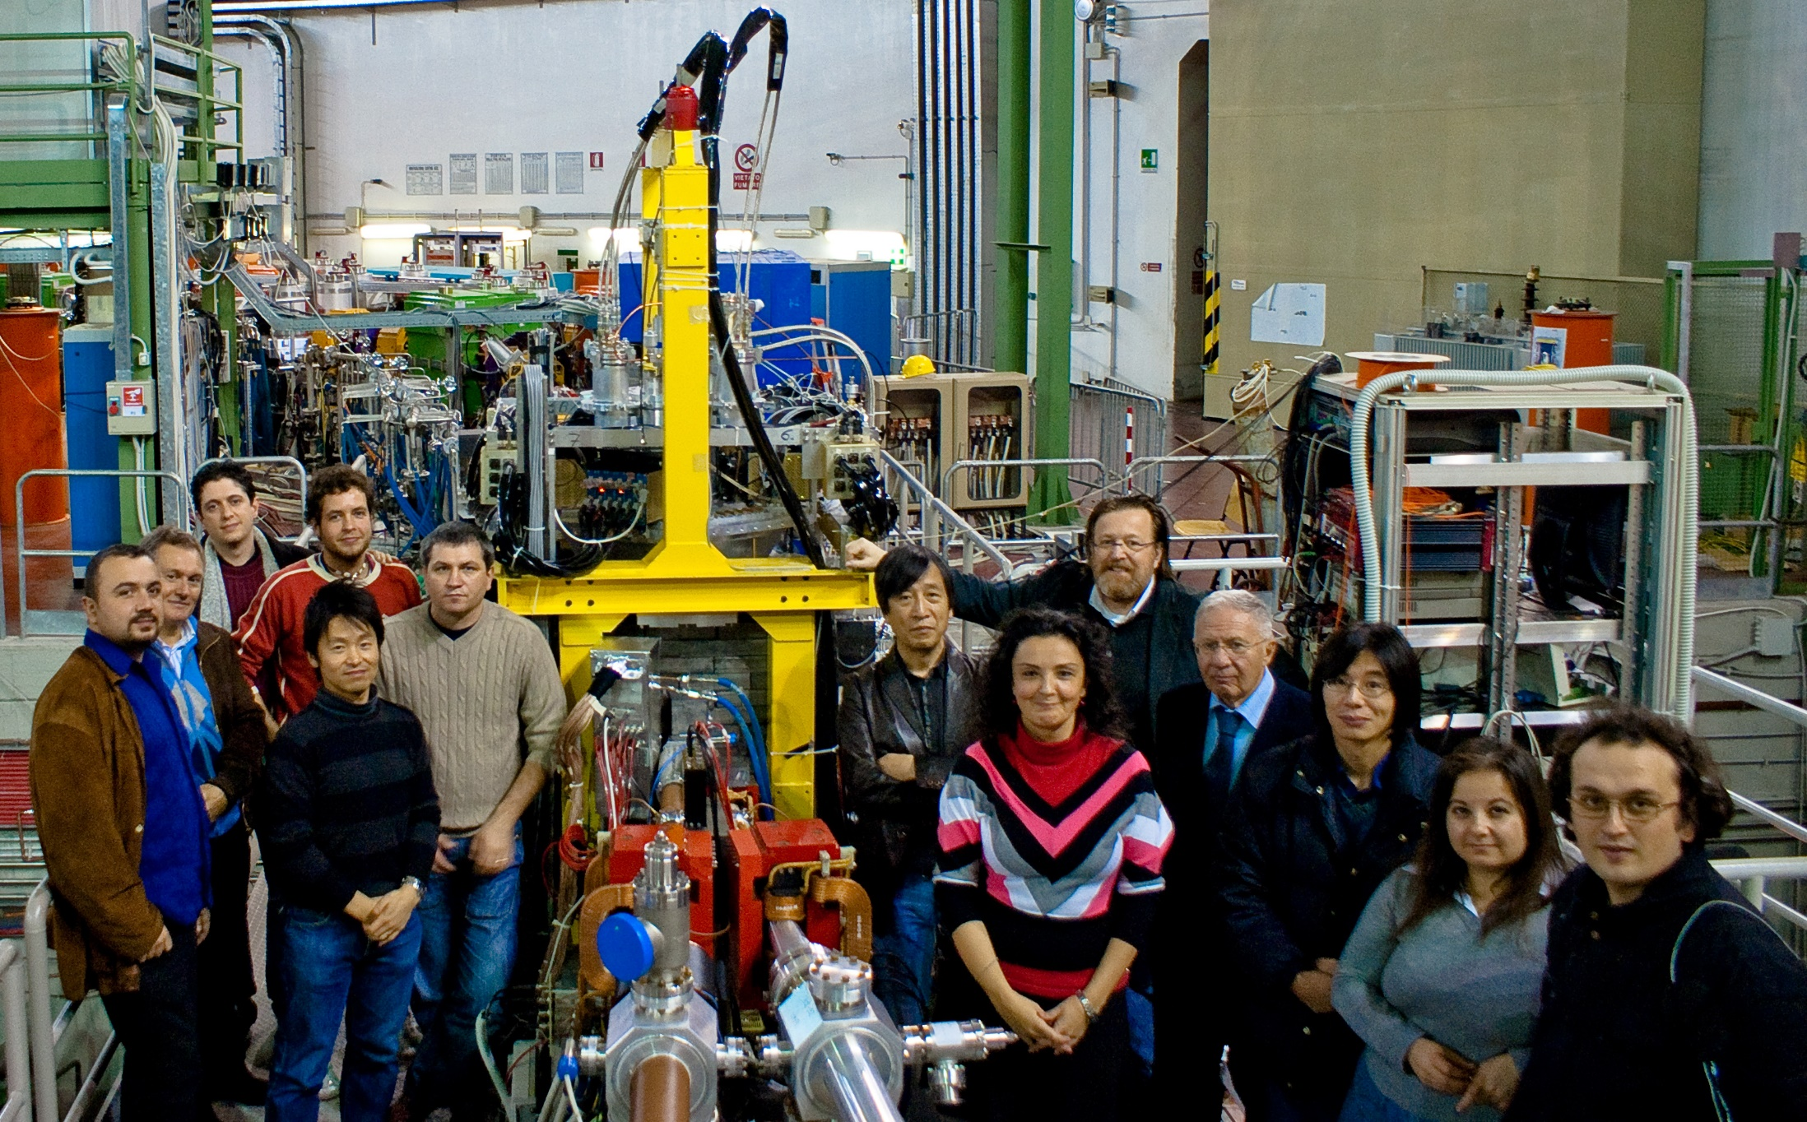
SIDDHARTA

Slide 23
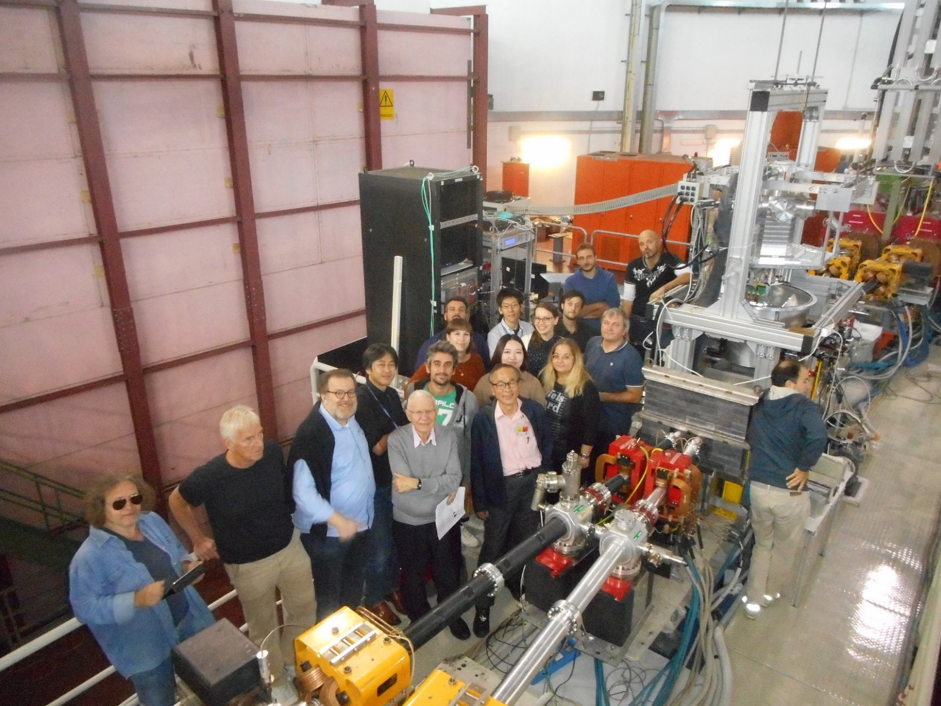
SIDDHARTA-2

Slide 24
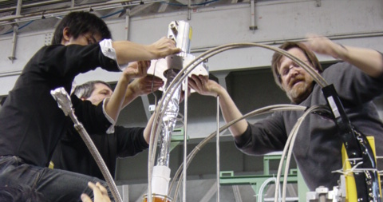

Slide 25
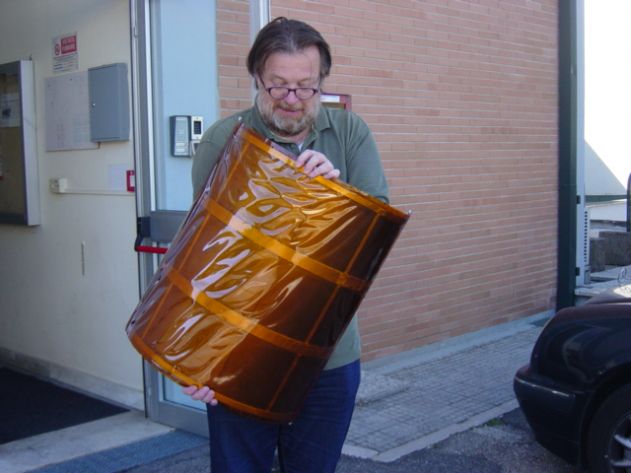
AMADEUS
Carbon Target

Slide 26
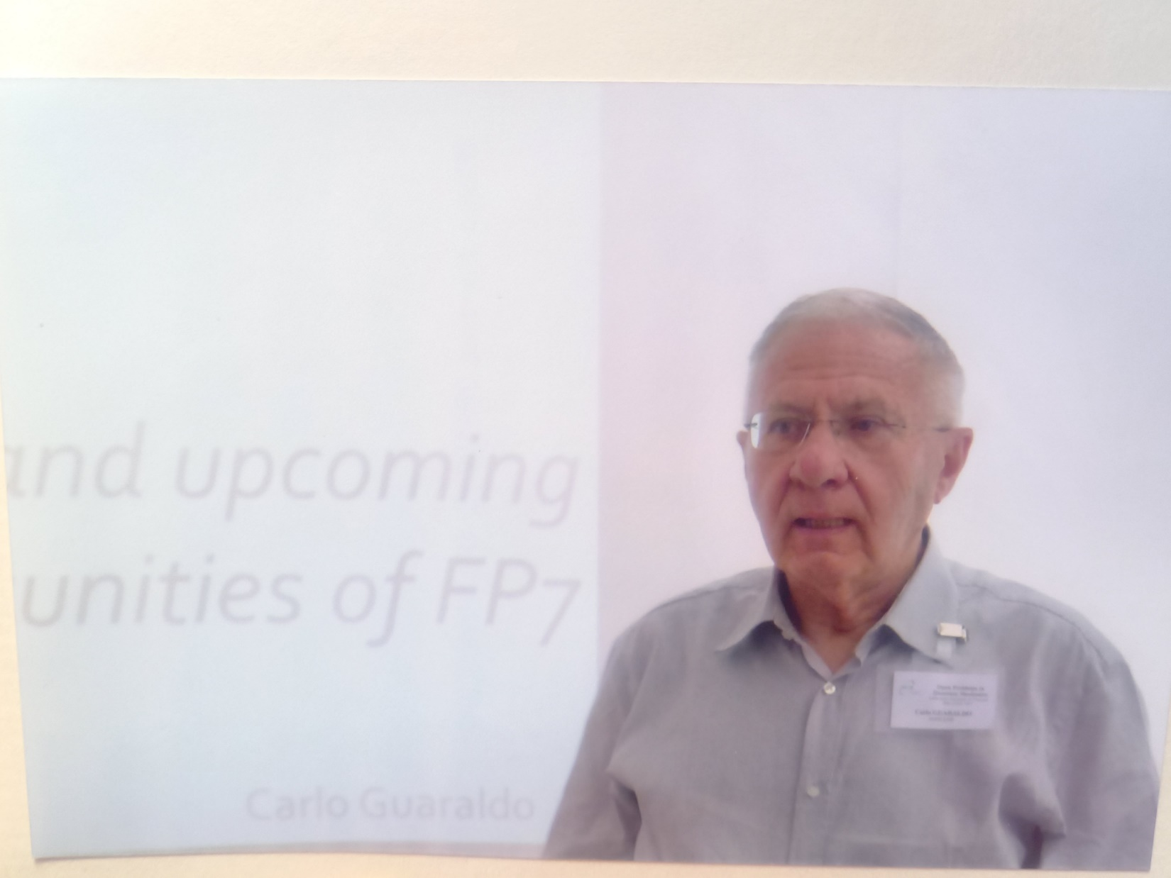

Slide 27
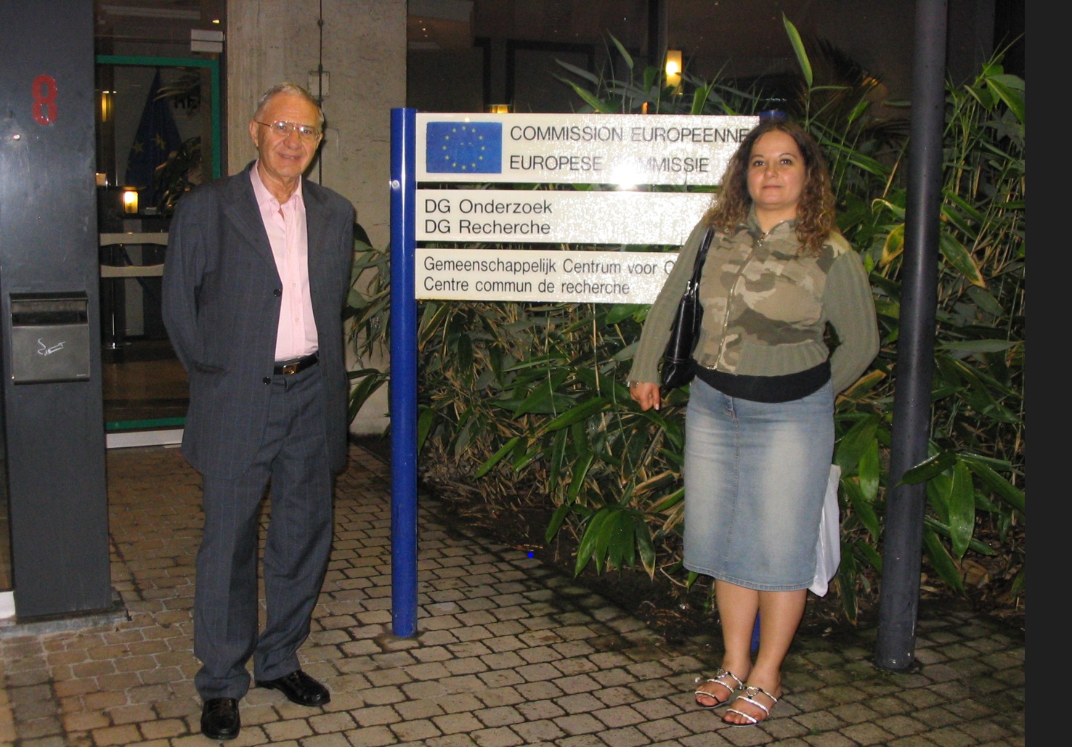
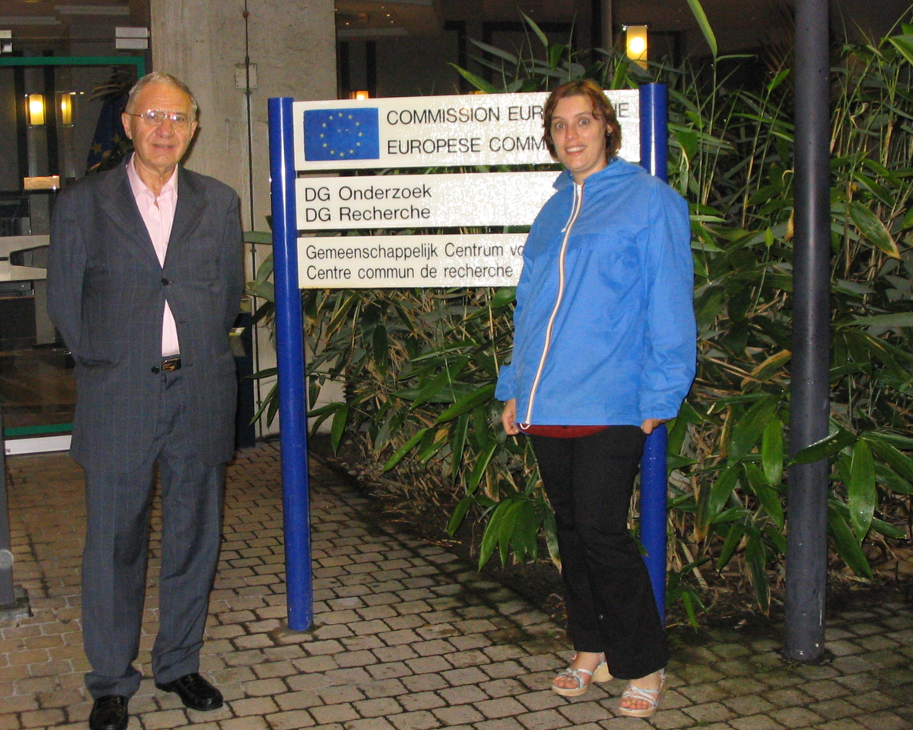

Slide 28
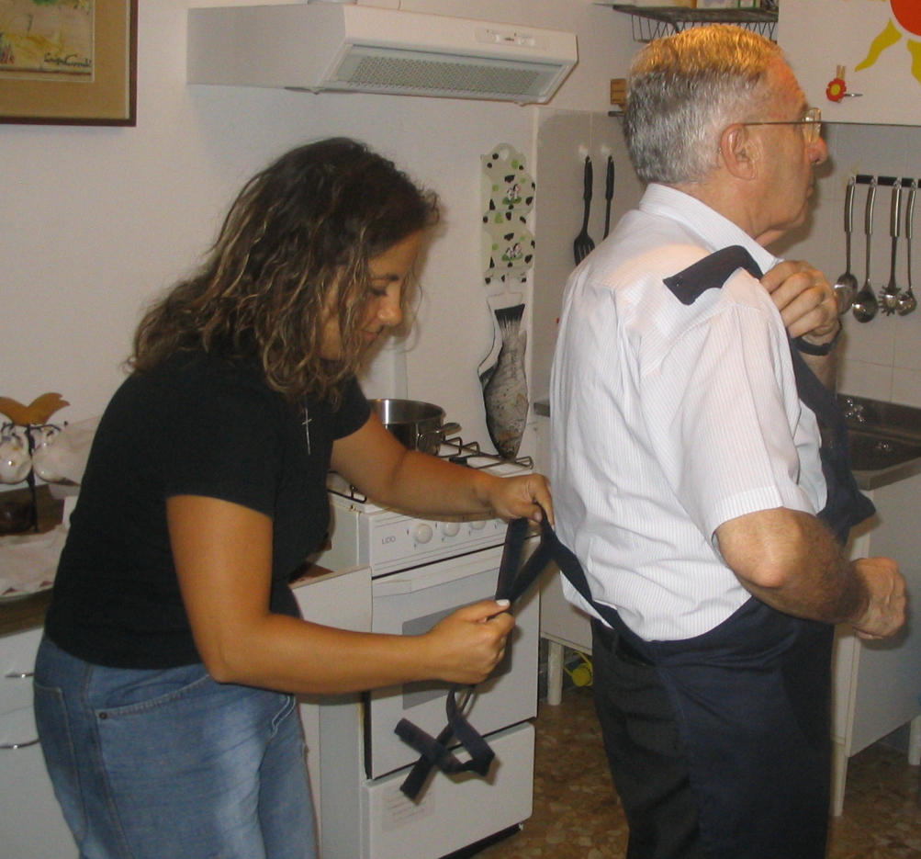
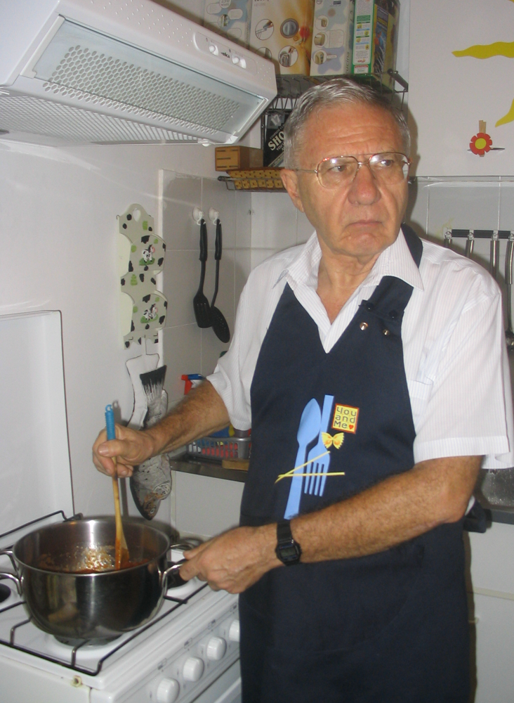

Slide 29
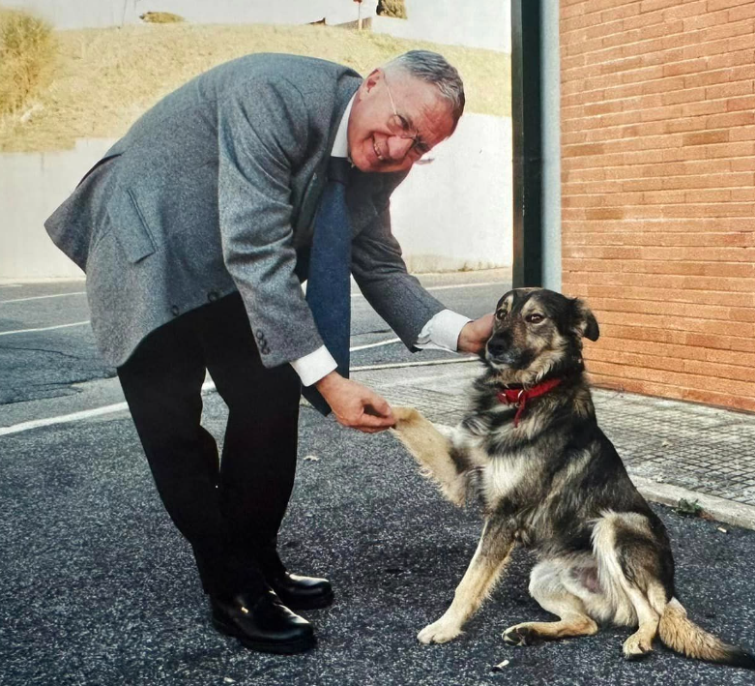

Slide 30
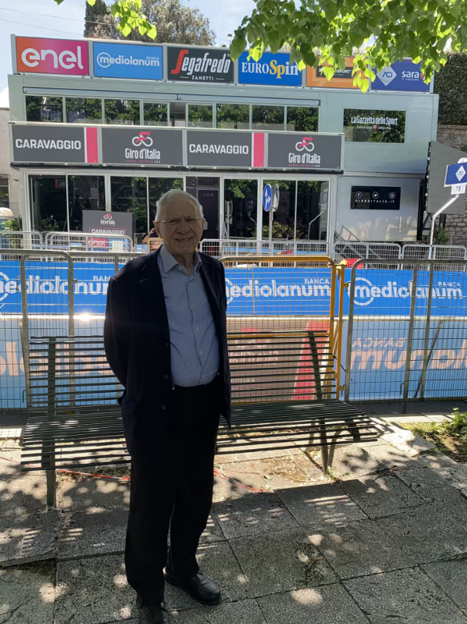
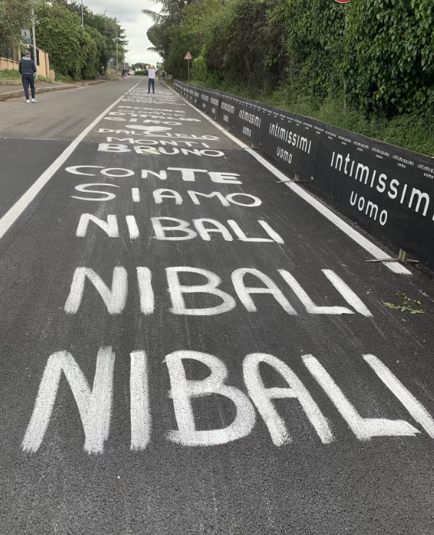

Slide 31
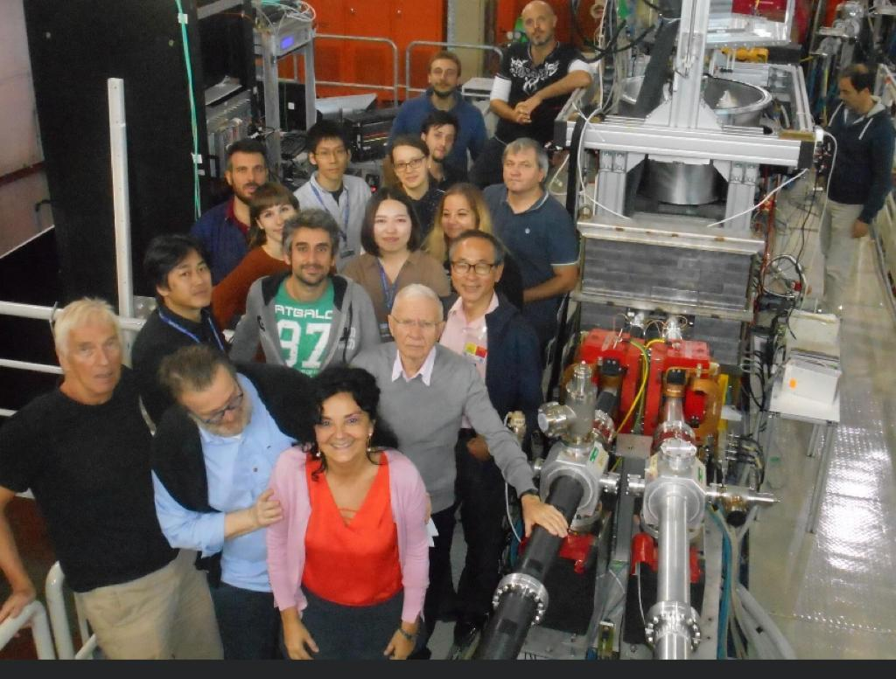

Slide 32
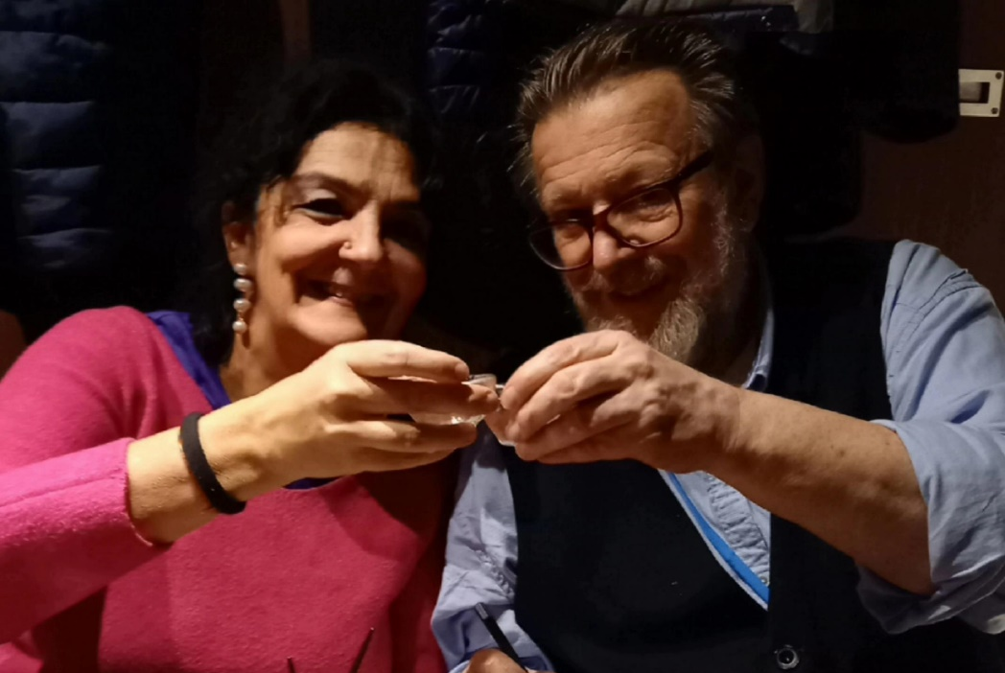
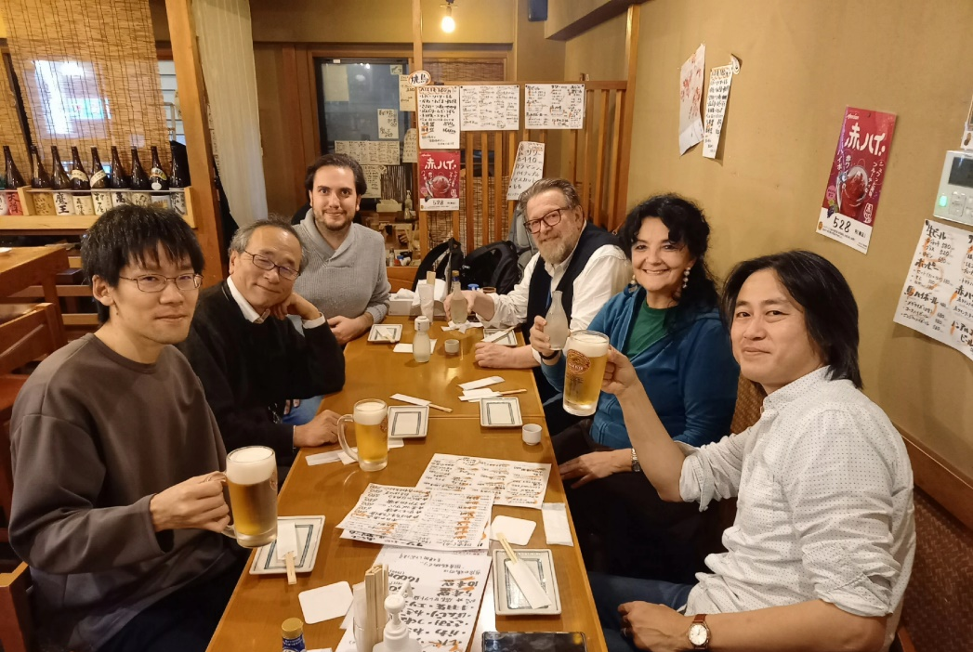
Last time I met Hannes (Japan, December 2023)

Slide 33
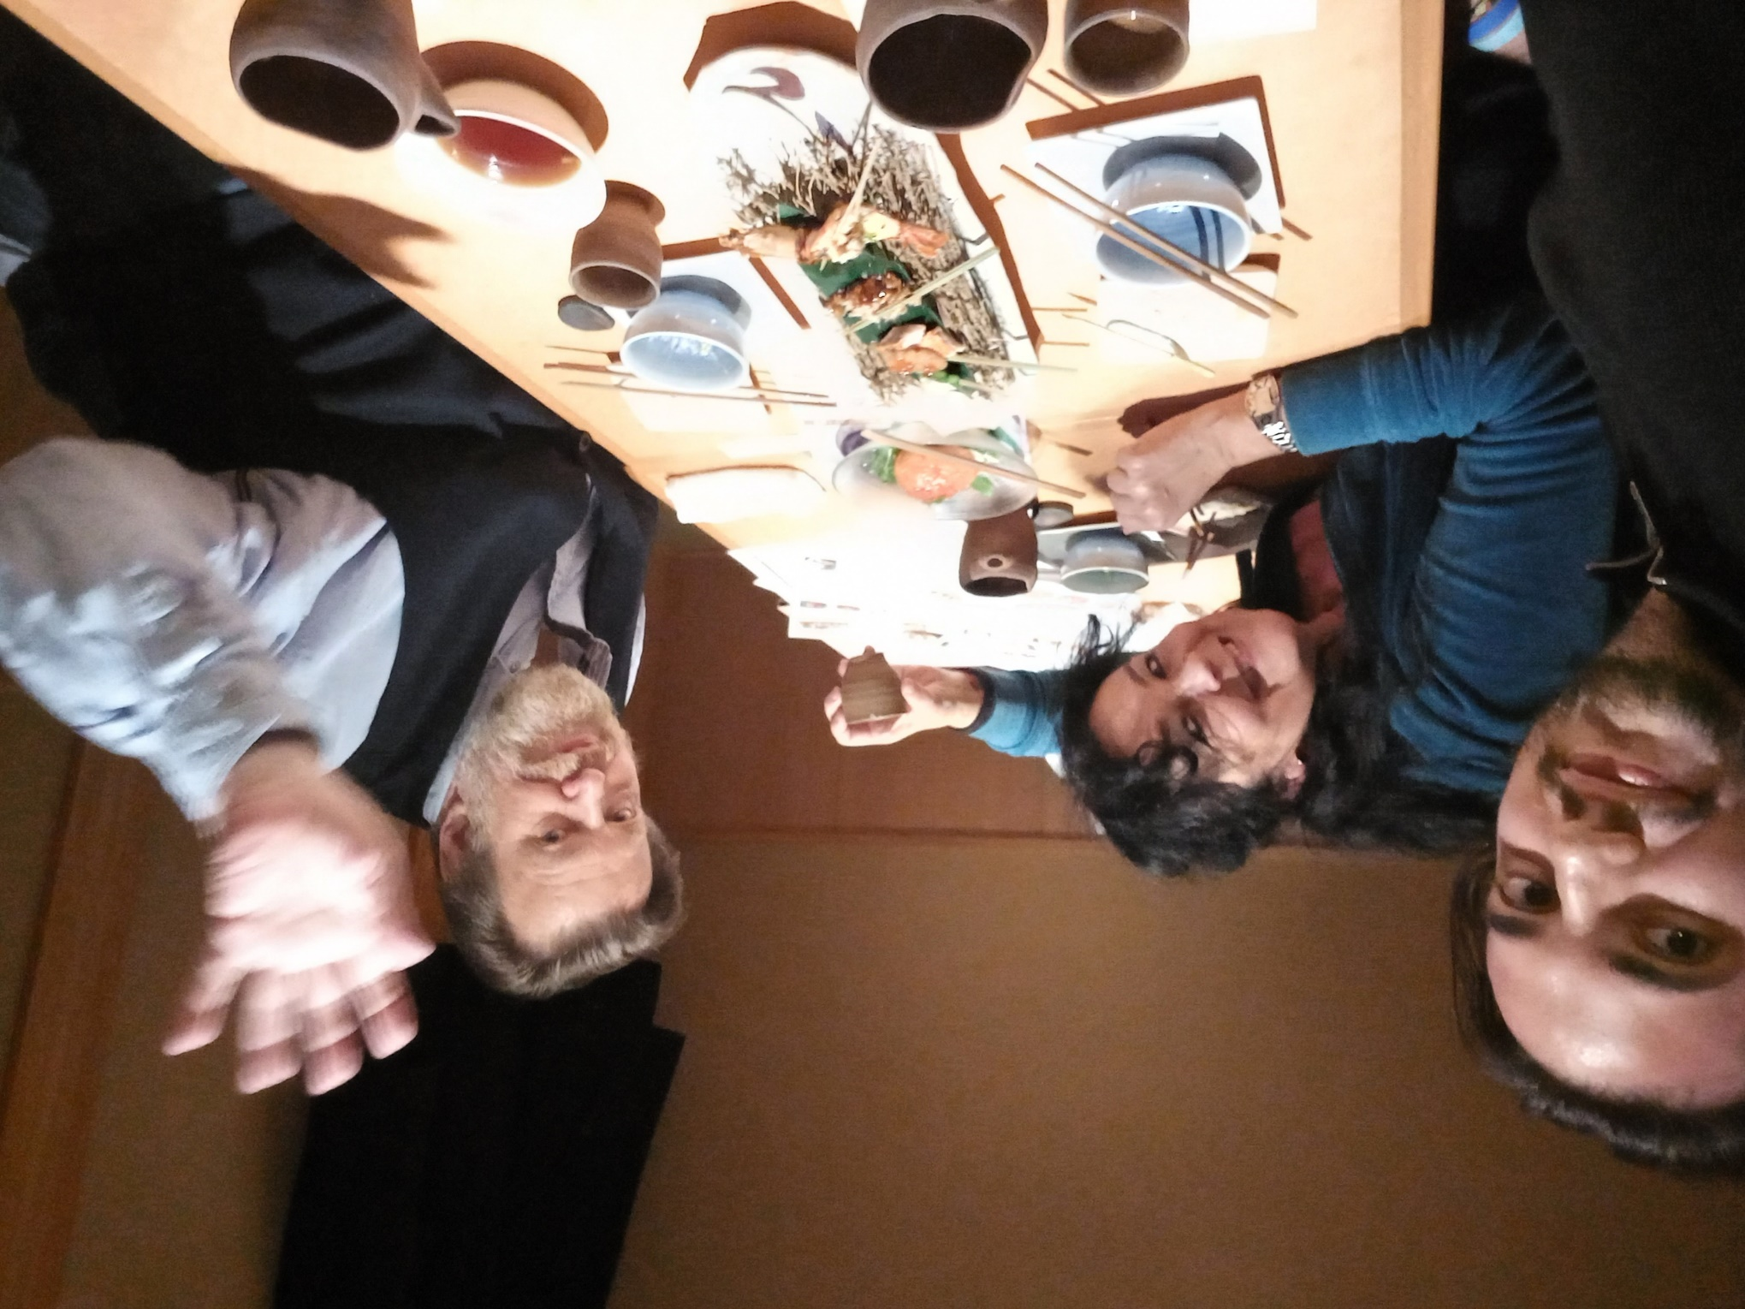

Slide 34
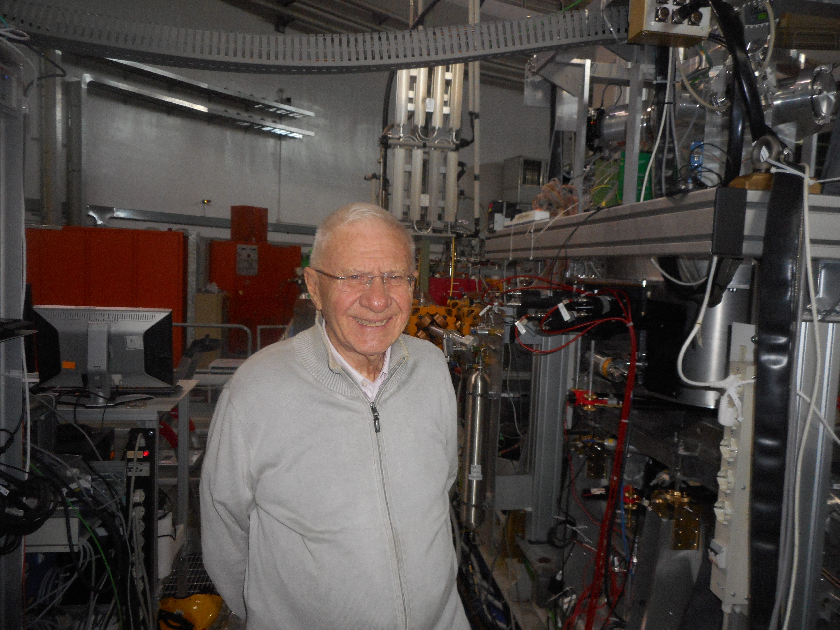
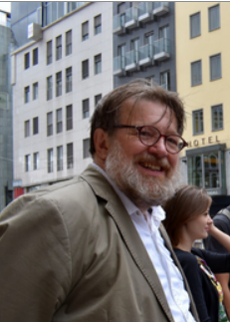
We did it, Carlo and Hannes!

Slide 35
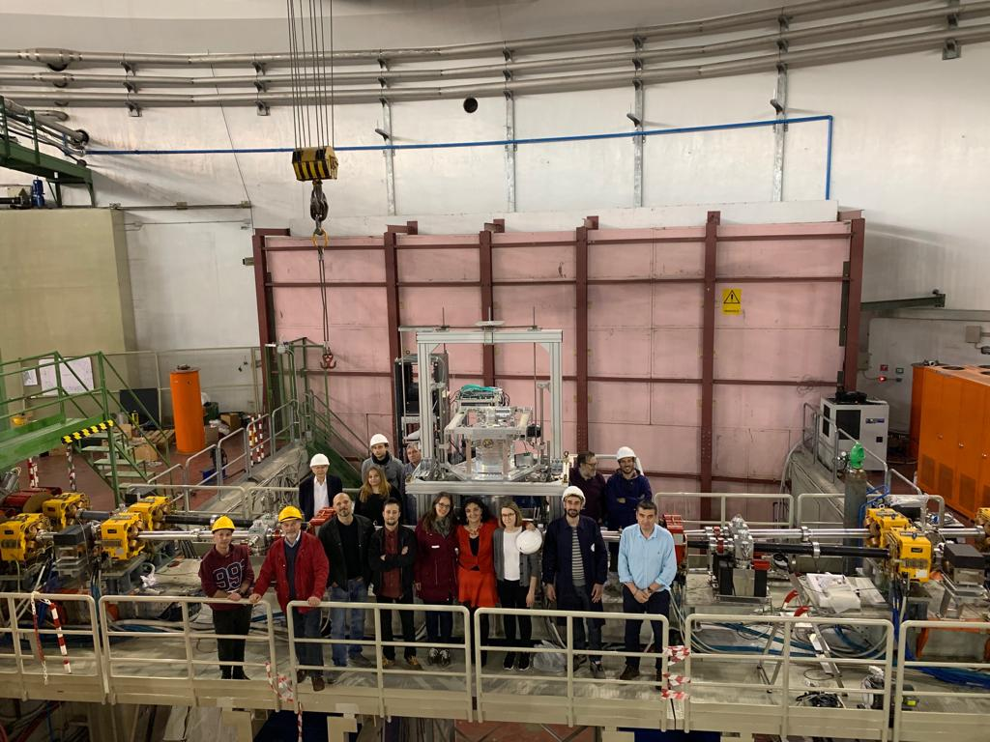
ThanK You
Immortals are never alien to one another.
― Homer, The Odyssey
Grazie Carlo, grazie Hannes!
No one dies as long as he lives in the hearts and minds of those who remain

