Slide 1
Amplitudes and Gravity
Francesco Campanella

Slide 2
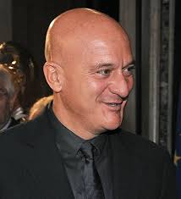
Introduction
We want to recover the results of classical General Relativity through scattering amplitudes of Quantum Field Theory.
What do we want?
How can we use QFT to describe massive objects in General Relativity?
No-hair theorem:
A black-hole is
characterized at most
by 3 parameters:
its mass, its charge
And its angular momentum.
Roughly, if we are far enough, we can describe big objects as particles:
Schwarzschild (scalar);
Reissner-Nordstrom (charged scalar);
Kerr (particle with spin).
Why is it useful?
Gravity is described as a fundamental interaction (as we believe it is);
It allows for analytical solutions.

Slide 3
Gravity in Quantum Field Theory
In the Quantum Field Theory formalism, gravitational interaction is formulated as a gauge theory, which is a theory described by a particular symmetry [Donoghue, Ivanov and Shkerin, 2017].
The transformations associated with gravitational interaction are the General Coordinate Transformations (GCT):
To maintain invariance of the theory, we introduce the curved spacetime metric g_{µν} and the action becomes:
The mediator of gravitational interaction is a spin-2 field, called graviton, which is introduced as a perturbation of the metric:
With k is the coupling constant, which is proportional to G^½.

Slide 4
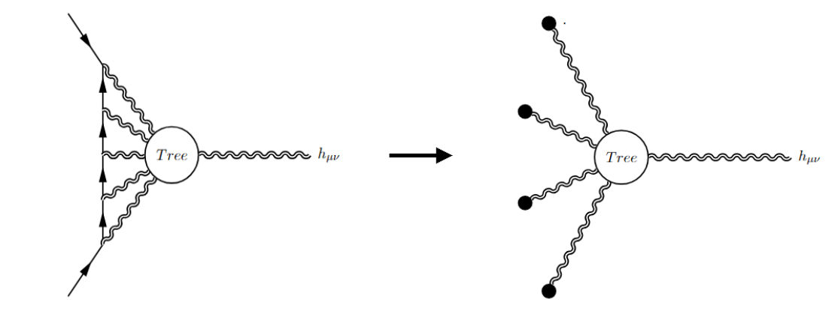
CLASSICAL LIMIT
We want to recover classical observables from Quantum Field Theory
Generally, we consider the loop expansion as an expansion in ℏ, but this is not true. There are loops that presents classical contribution, i.e. non-vanishing in the limit ℏ → 0 [Holstein, Donoghue, 2004].
These terms are manifest in the limit in which the mass of the field is much bigger the momenta inside the loop.
On the left there is one of these kind of diagrams and on the right its effective description in the large mass limit, which gives the classical contributions [Bjerrum-Bohr, Damgaard, Festuccia et all, 2018].
(Note: The contributions where the mass is lower or equal to the
loop momenta gives contributions that goes away when ℏ → 0, so
we don't care here.)
N-loops correspond to order G^^{(N+1)} in the post-Minkowskian expansion.

Slide 5
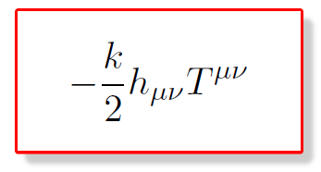
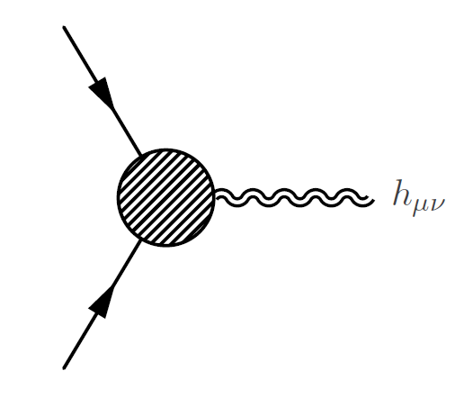
Observables from scattering amplitudes
The classical contributions from loops can be used to derive observables.
As an example, the graviton field in the action couples to the Energy-Momentum Tensor of a massive particle as follows:
The Energy-Momentum Tensor is associated to the absorption or emission of a graviton [Mougiakakos, Vanhove, 2020].
We are considering a process with two massive particles interacting with a graviton.

Slide 6
METRIC FROM SCATTERING AMPLITUDES
Now we want to use this relation to find a connection bewteen graviton and Stress-Energy Tensor, to find observables through amplitudes.
From the relation before we have that the n-loop integrals can be related to the Energy-Momentum Tensor:
Where ϵ=0,1 if we are talking about fermions or bosons, respectively.
Finally, if we are in the harmonic gauge (Γ_{ρ} = 0), the relation between the Tensor T and the perturbation h of the metric is:
In this way we find the Post-Minkowskian expansion of the metric of some objects (Schwarzschild, Reissner-Nordstrom, Kerr ecc).

Slide 7
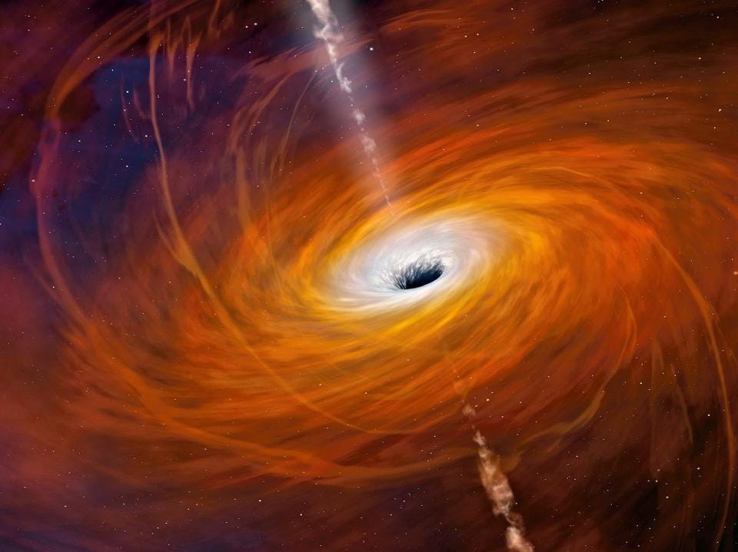
MULTIPOLE EXPANSION
Particular case is the interaction between spinning matter and gravity.
We can define an object that embeds the information about the spin representation of the field, which is the Lorentz Tensor.
In the classical limit the Lorentz Tensor gives birth to the Spin Tensor [Gambino, Pani, Riccioni, 2024].
The procedure to recover the metric leads to a multipole expansion, whose orden depends on the spin of the particle (we find at most the 2s-th order, where s is the spin of the field).
In particular, the simplest amplitude (minimal coupling) leads to the Kerr Metric for every spin.
a Black-Hole is the simplest solution coming from scattering amplitude.

Slide 8
HAWKING RADIATION
Another way to consider amplitudes with gravity is considering the metric as a classical background in the action (no real graviton field).
We want a form for the background, which is similiar to the perturbated one.
Some solution of Einstein Equations can be put in the Kerr-Schild Coordinates (e.g Schwarzschild), which have the form:
This is non-perturbative and the solution is exact (we find an all order G solution).
Calculating all the L-loop diagrams and resumming them, we find an amplitude which corresponds to one of the two Bogoliubov coefficients (Schwarzschild case). [Aoude, O'Connell, Sergola, 2024]
It's simple to go from one coefficients to another through swapping the energy sign.
The modulus square of this is the black body spectrum of Hawking radiation.

Slide 9
RECAP
In the effective theory of gravity, we find the observables in a recursive way:
We calculate the three point amplitude with h as a field
We use the relation of the linear interaction of Energy-Momentum Tensor with gravity to relate the tensor T to the amplitude
We use the particular gauge to relate the Energy-Momentum Tensor to h, now perturbation of the metric.
We can use a similiar procedure to calculate higher point amplitudes (e.g 5 points amplitude can be used to calculate the waveforms of gravitational waves arising from the merging of two black-holes) [Buonanno, Khalil, O'Connell, Roiban, Solon, Zeng, 2022]
We can find other observables, using the second way to describe gravity with amplitudes, i.e. as a background:
The Hawking spectrum radiation;
Angle scattering of a probe to big massive objects.

Slide 10
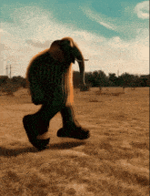
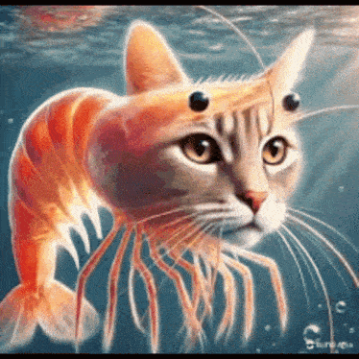
Thanks for your attention

