Slide 1
“Food Pairing Unveiled: Exploring Recipe Creation Dynamics through Recommender Systems”
Giovanni Palermo (Sapienza - CREF)
Claudio Caprioli (UNICT)
Giambattista Albora (JRC – Siviglia)

Slide 2
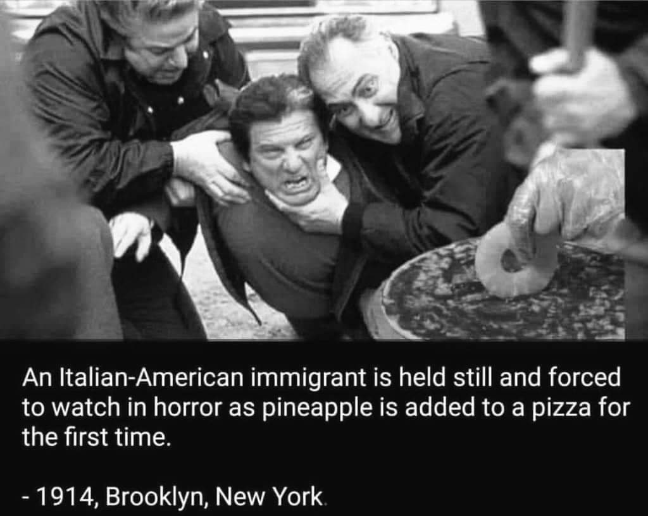
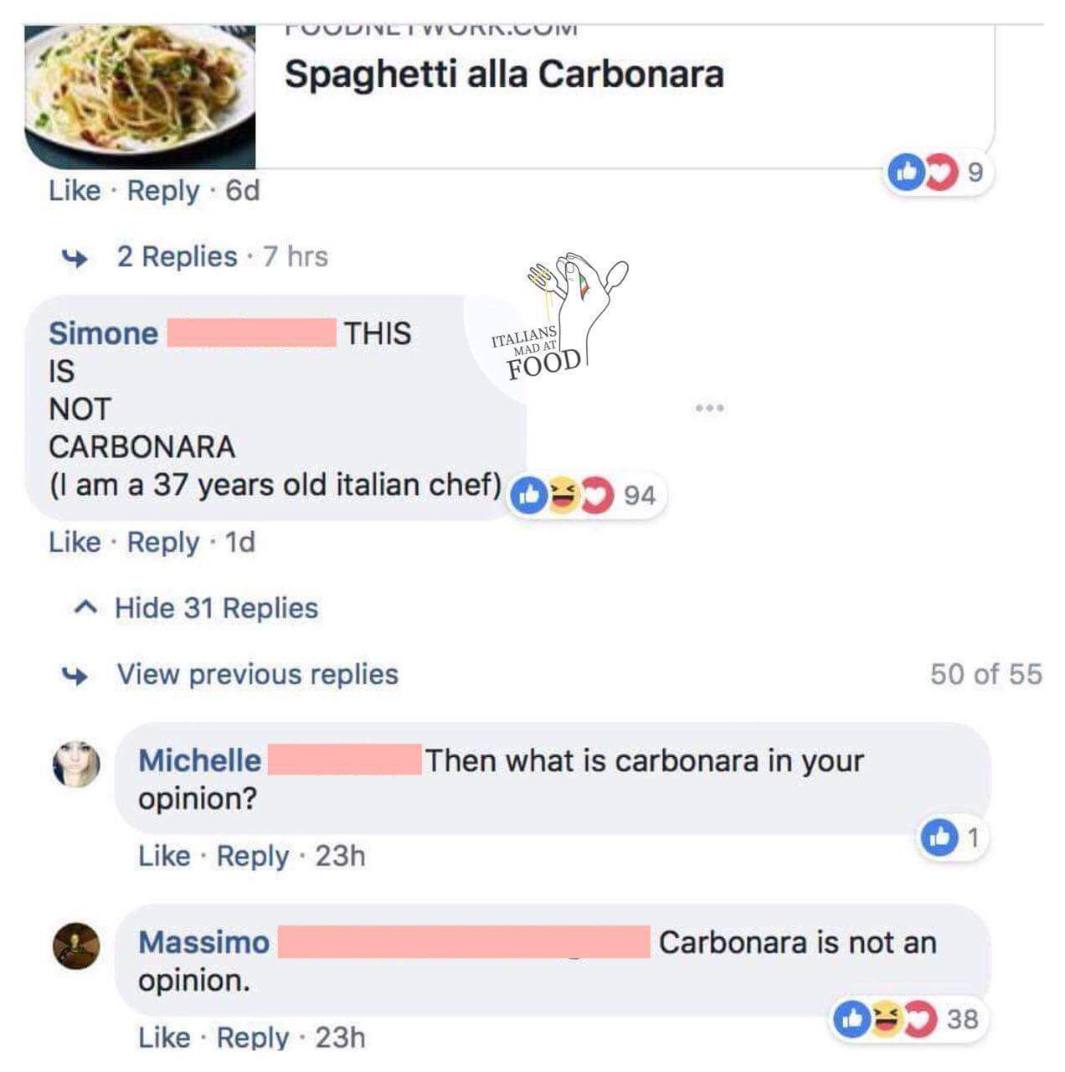
DISCLAIMER

Slide 3
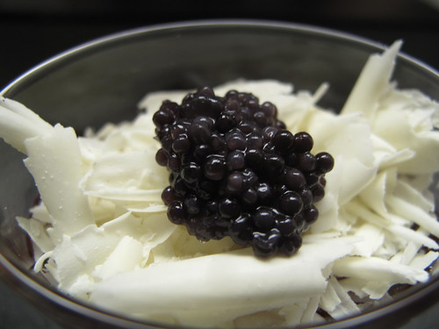
What is food pairing?
In the early 2000s, Heston Blumenthal, *** Michelin star chef at The Fat Duck (UK), discovered that white chocolate and caviar are a perfect match. He commissioned a company that dealt with essences to find out why and obtained an unequivocal answer:
White chocolate and caviar contain a large amount of amines*
From that experience, Blumenthal derived the hypothesis of food pairing: Foods match each other when they share many flavor compounds
* Organic compounds derived from ammonia

Slide 4
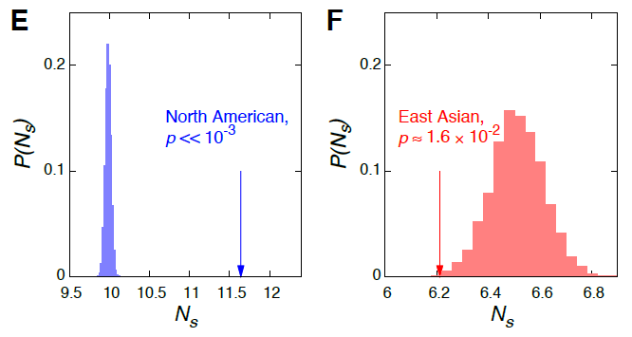
Do we already use food pairing?
… What if dishes that already exist used food pairing?
https://www.nature.com/articles/srep00196
In 2011 Ahn et al. tested food pairing on a dataset of recipes Result: the ingredients share more flavor compounds than randomly generated recipes with a null model. In oriental cuisine the opposite would happen!

Slide 5
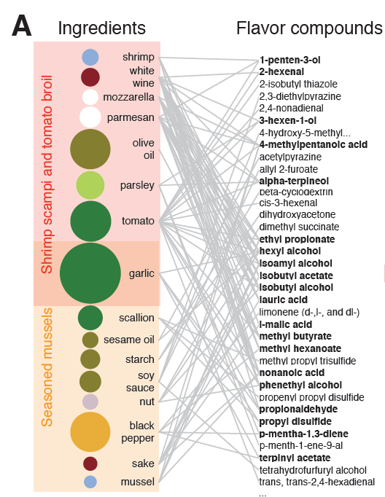
The dataset
# Recipes: 57K
Label: country
# Ingredients: 1530
Label: category
# Compounds : 1021
Sources:
allrecipes.com (USA)
epicurious.com (USA)
menupan.com (Korea)

Slide 6
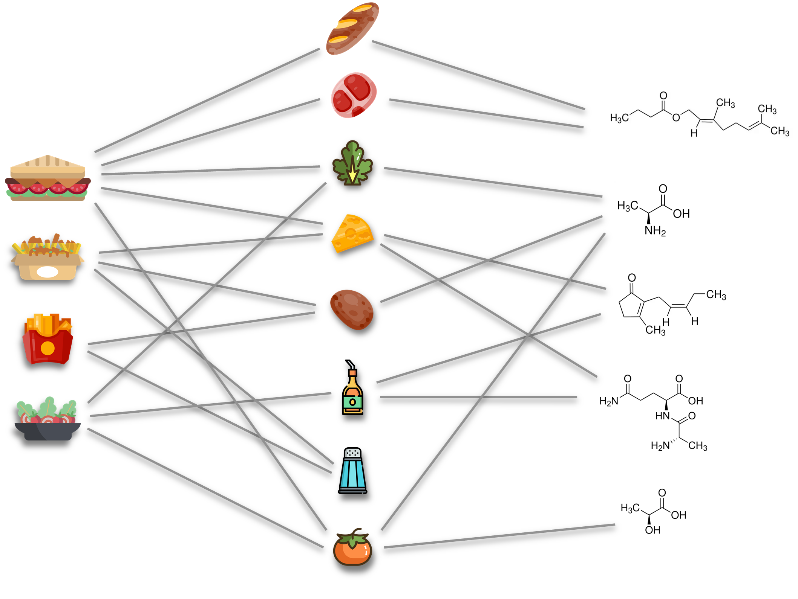
Dataset
1530 Ingredients
57K Recipes
1021 Flavor compounds

Slide 7
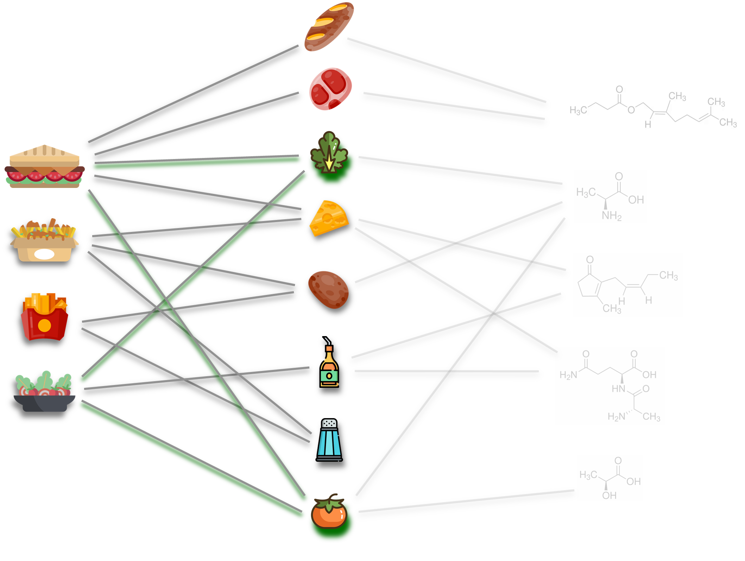
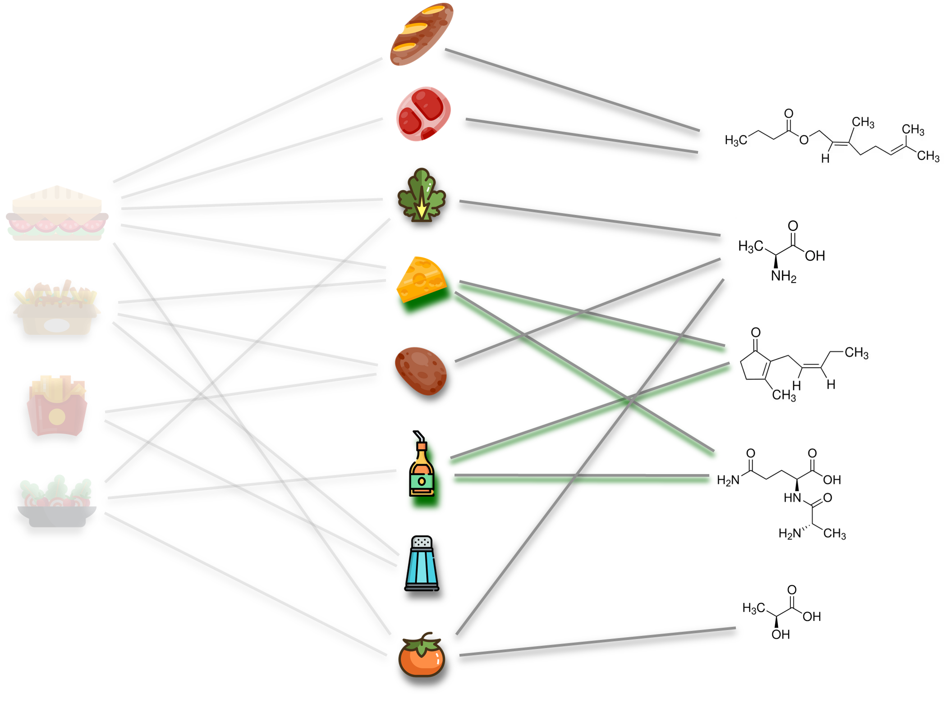
Recommender (collaborative filtering)
Food pairing is in here!
Recipe-Ingredient recommender
Ingredient-Compound recommender
Uses the info on how ingredients appear in recipes
Uses the flavor compounds foods have

Slide 8
Collaborative filtering
There are many methods to calculate similarity
We test the performance of the algorithms by checking if they recommend the right foods to the recipes we know
Algorithm:
Choose a method Removes 1 ingredient from 10% of recipes
Compute similarities and scores Check if the removed ingredient is strongly recommended (calculate mAP and HR@20)
Similarities:
Adamic Adar
Common neighbors
Cosine similarity
Hub depressed index
Hub promoted index
Jaccard similarity
LHN
Pearson
Probabilistic spreading
Resource allocation
Sapling
Sorensen
Taxonomy network
Bonus:
LightGCN

Slide 9
Collaborative filtering
For the recommender, we use collaborative filtering
Similarity between ingredient $α$ e $λ$
Score of recommendation for ingredient $α$ to recipe $i$
Bi-adjacency matrix
$$S_{iα}^{(ing)}=\frac{\sum_{λ}{B_{αλ}^{(ing)}M_{iλ}}}{\sum_{λ}{\left|B_{αλ}^{(ing)}\right|}}$$

Slide 10
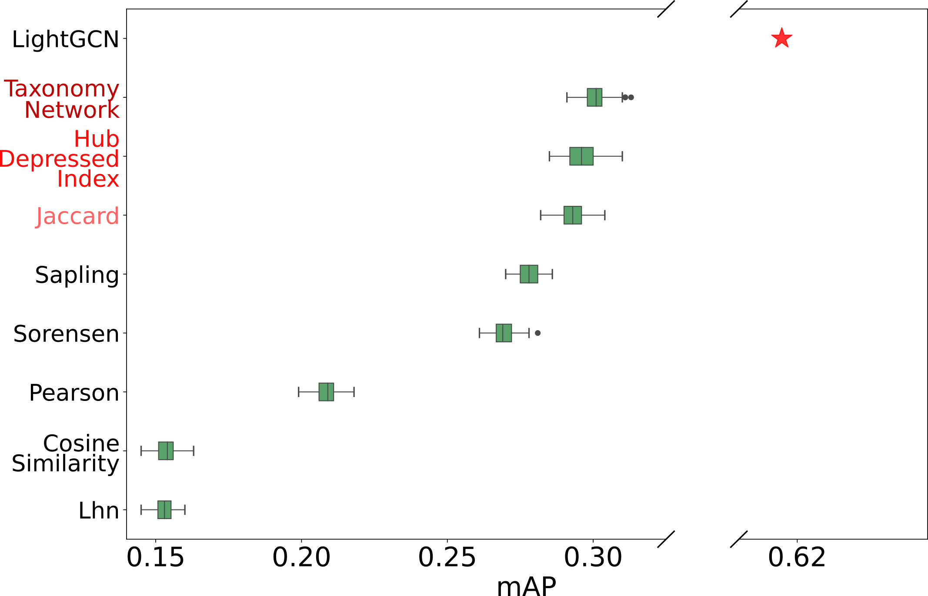
Does the recommender work?
The recommenders work!
Different methods to exploit the information of the dataset with collaborative filtering
mAP = mean Average Precision (ability of retrieving missing ingredients from recipes)

Slide 11
Recommender to the test
We can test it on a custom recipe.
Ingredienti
['Olive_oil', 'Mozzarella_cheese', 'Tomato']
Best recommendations for chosen recipe:
['basil', 'garlic', 'black_pepper', 'macaroni', 'onion', 'parmesan_cheese', 'oregano', 'pepper', 'cayenne', 'bell_pepper’]
Taxonomy Network gives basil as the first recommended ingredient and suggests all things that make sense!

Slide 12
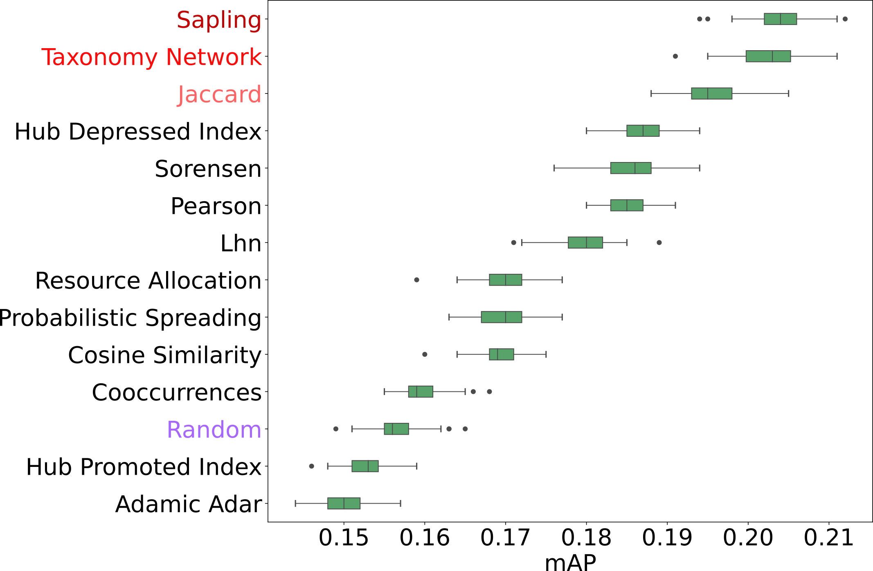
Does the recommender work?
It also works if we use the information about flavor compounds

Slide 13
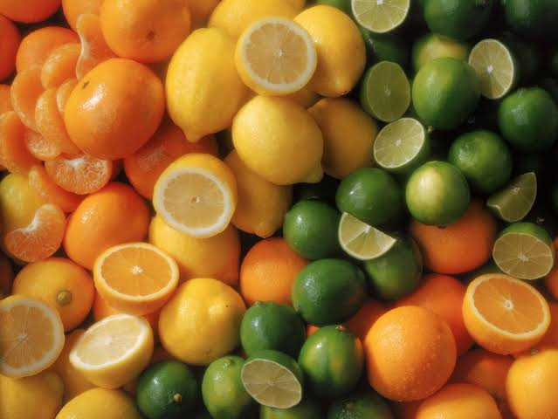
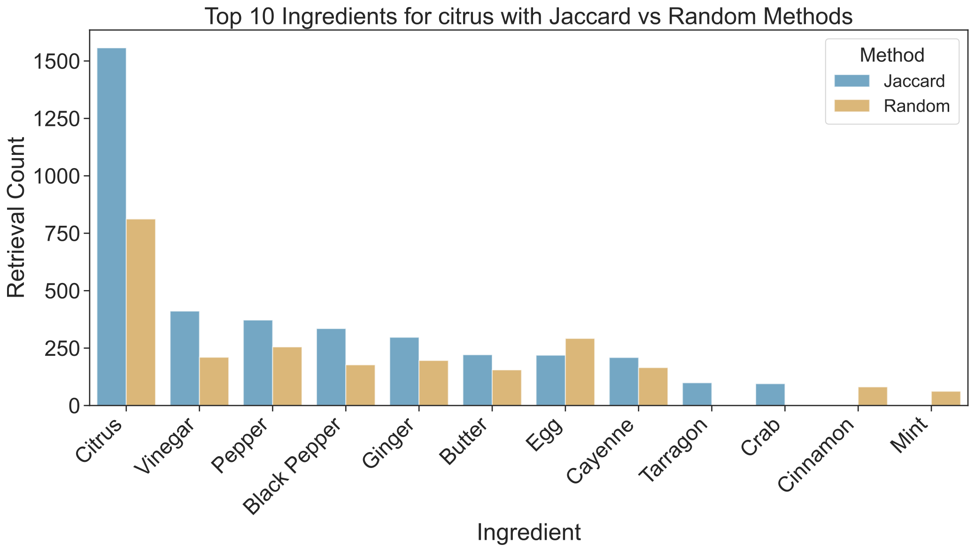
Why the compounds work
Citrus fruits are retrieved by the compounds-based recommender because there are other citrus fruits in the recipe!
The recommender works for a trivial coupling of foods...
But when can use the information about the flavor compounds anyway!

Slide 14
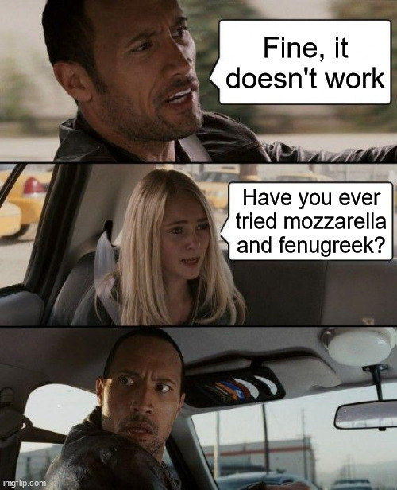
Food pairing for recommendation?
Will Jaccard be able to find the basil again?
Ingredients
['Olive_oil', 'Mozzarella_cheese', 'Tomato']
Best recommended herb for chosen recipe:
['fenugreek’,
'peppermint’,
'spearmint’,
'lovage’,
'mint’,
'dill’,
'thyme’,
'cilantro’,
'lemongrass’,
'marjoram’]
It doesn't seem to work... But who said that they are not good recommendations? 383 ingredients appear in the recipes, but we have the aromatic compounds of 1500!

Slide 15
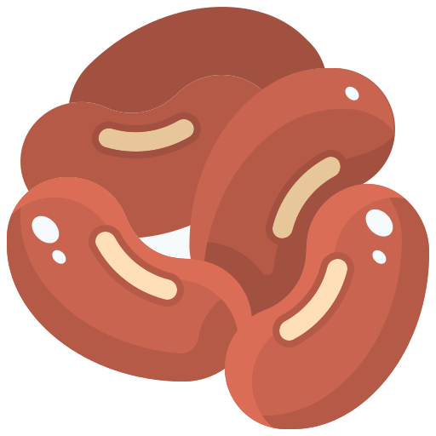
Time for a test
There is no ground truth to validate the new pairings The only way is to try!
Banana
Basil
Beans
We will disclose the food pairing betweens these foods only after the test!

Slide 16
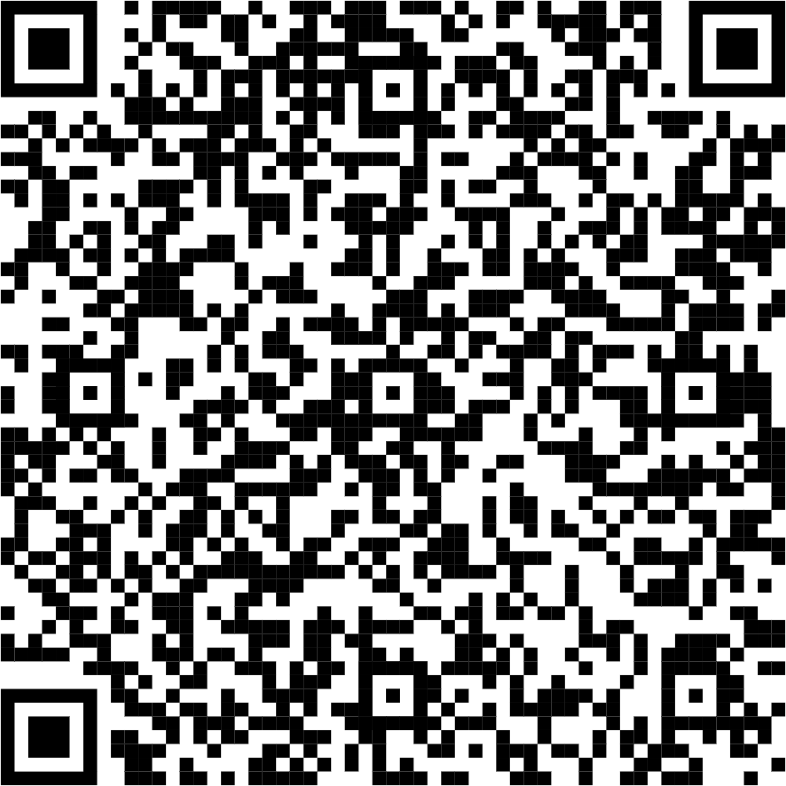
Scan this to express your taste!
Rate each food combination from 1 to 5

Slide 17
Time to unveil the scores!
0.01
0.19
0.02

Slide 18
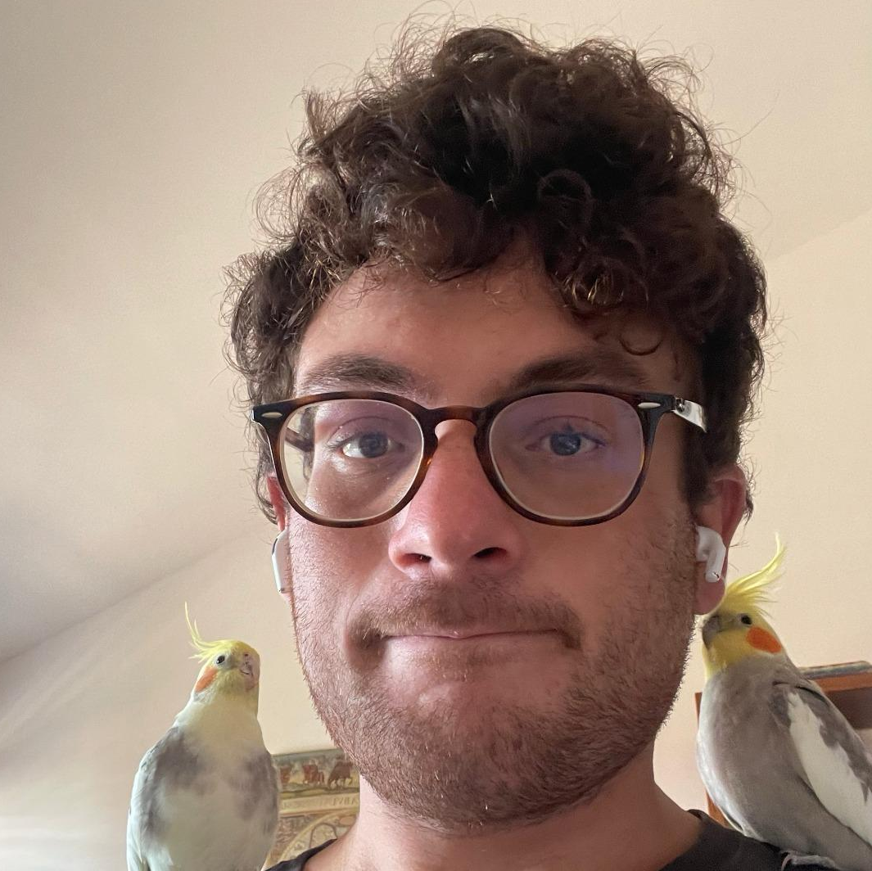
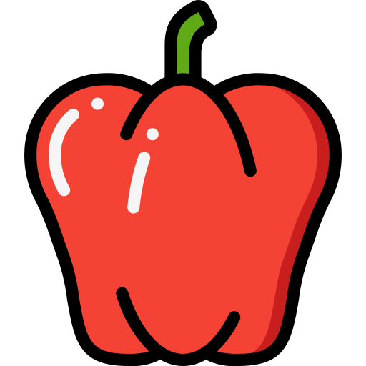
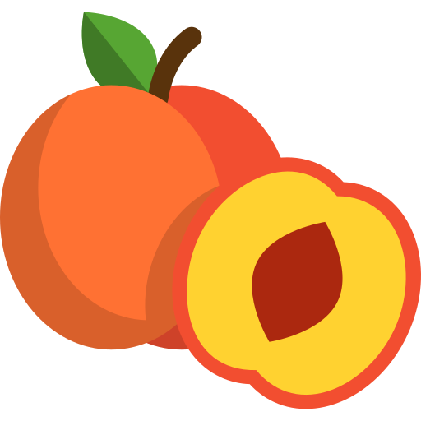
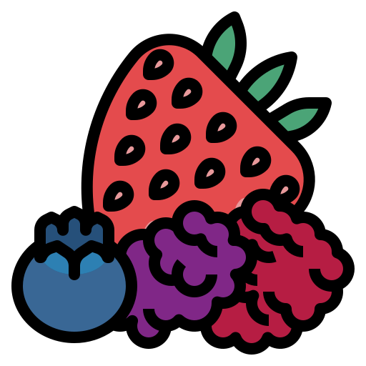
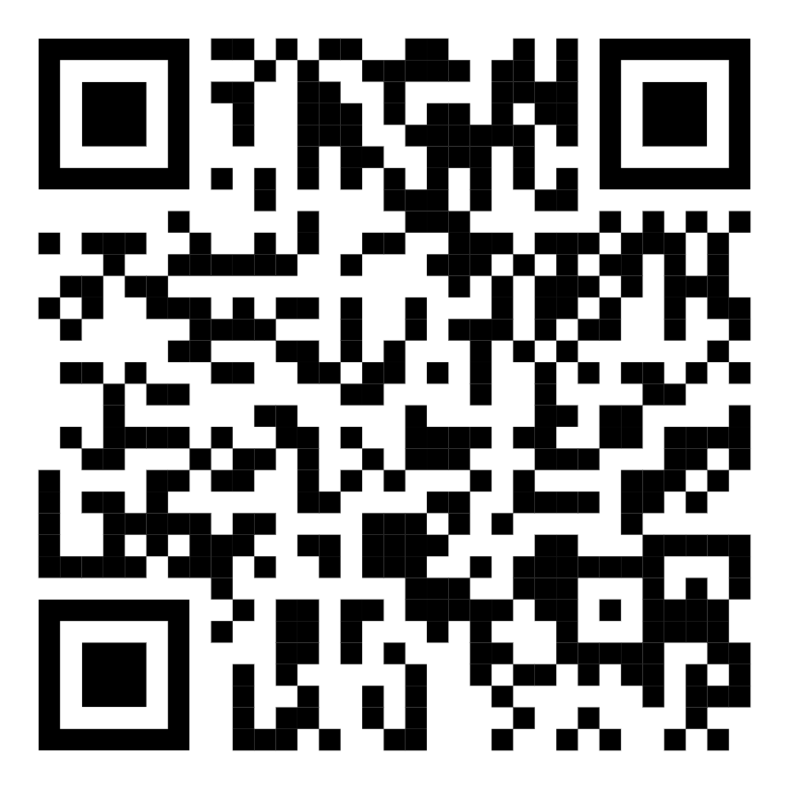
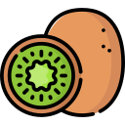
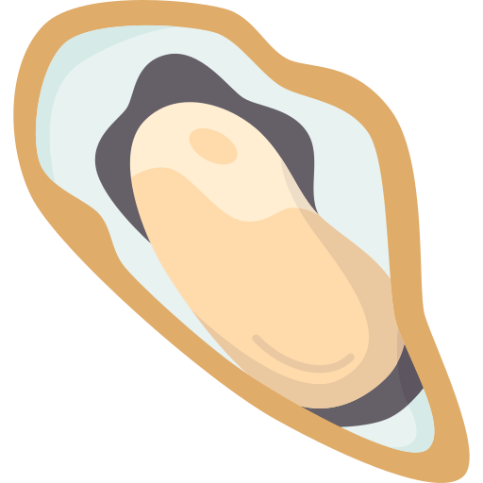
Try these!
New things to try!
Team
Peaches and bell peppers
Mussels and pecorino
Giambattista Albora JRC - Siviglia
Claudio Caprioli UNICT
Paper
Kiwi and dill
Oysters and berries
Thank you for your attention

