Slide 1


Il progetto FCC ed il futuro della fisica delle alte energie
Visita Studenti UniUD al CERN 2025
5 May 2025
Work supported by the European Commission under the HORIZON 2020 projects EuroCirCol, grant agreement 654305; EASITrain, grant agreement no. 764879; iFAST, grant agreement 101004730, FCCIS, grant agreement 951754; E-JADE, contract no. 645479; EAJADE, contract number 101086276; and by the Swiss CHART program

Slide 2

Cosa abbiamo capito?

Slide 3
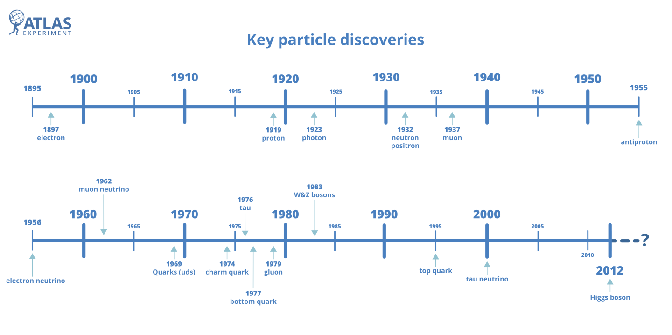
Una breve storia della fisica delle particelle
LHC era

Slide 4
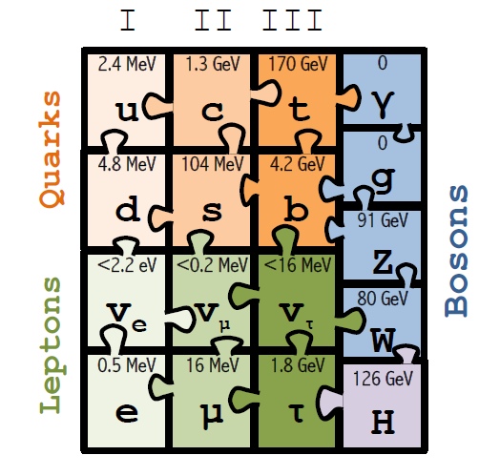
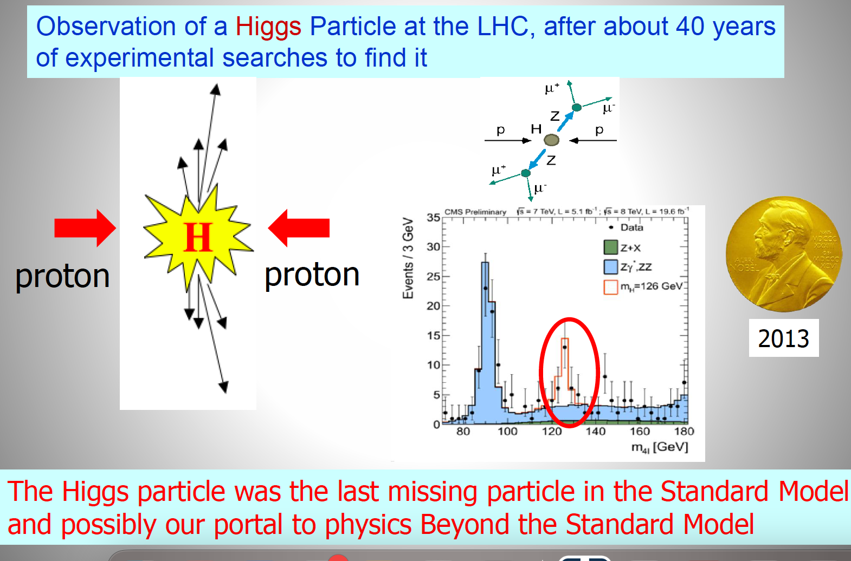
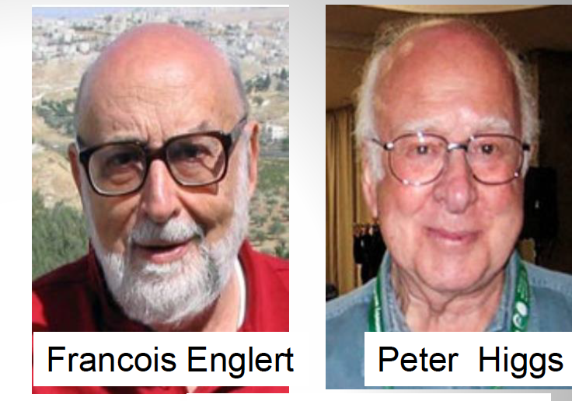
2012: la scoperta dell’ Higgs
Oseervazione della particella di Higgs all’ LHC dopo
40 anni di ricerca sperimentale
?
La particella di Higgs era l’ultima mancante nel Modello Standard, possibile portale verso Nuova Fisica

Slide 5
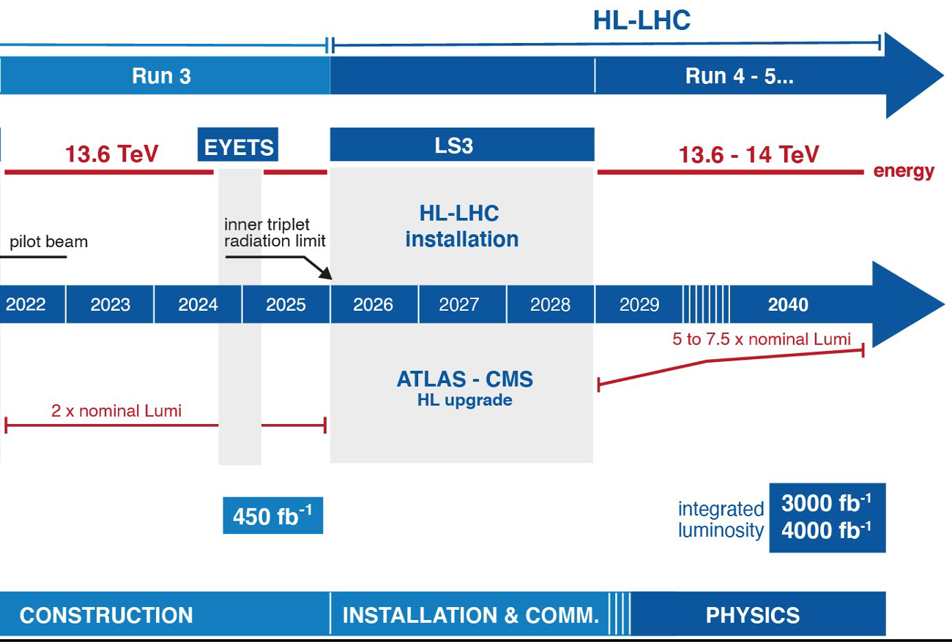
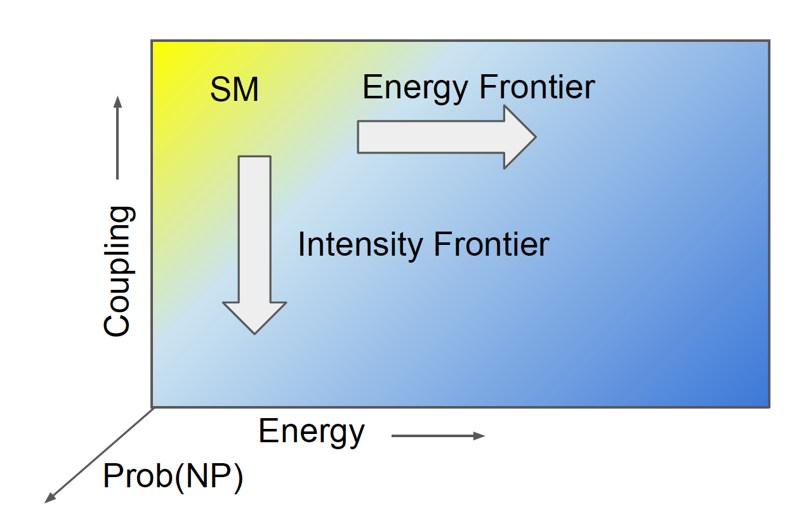
HL-LHC: timeline
43 istituzioni
19 paesi
Notes:
The experimenst at CERN are undergoing a series of detector upgrades over the next few years to prepare for the the High-Luminosity Large Hadron Collider (HL-LHC) project. The upgrades are designed to maintain or improve detector performance, even with
the instantaneous luminosity needed to deliver a total of 3000 fb−1 of proton-proton collision √
data at s = 14 TeV . This goal should be reached in a dozen of years.
New physics can show up at the intensity/precision frontier before the energy frontier, due to the mass reach of quantum loops. Ordinary beta-decay at MeV energies informs us of a virtual mediator at 80 GeV (the W). The GIM mechanism indicated the existence of charm, before the discovery of charm. The discovery of CP violation and its accommodation in the CKM matrix required the third generation before the discovery of beauty and top. The observation of neutral currents were evidence for the Z before the discovery of the Z.

Slide 6
Cosa non abbiamo capito?

Slide 7

Non abbiamo ancora per esempio..
Un formalismo valido per inserire la gravità nel Modello Standard
Un candidato per la Materia Oscura
Una spiegazione per le masse dei fermioni
Una spiegazione della asimmetria materia-antimateria
Al momento:
NO evidenze sperimentali
e NO teoria che guidi
Scenario?
Notes:
Theory is advancing rapidly along two main lines: new ideas and
approaches for dark matter and naturalness, and more precise calculations of SM processes that
are relevant for on-going experiments.

Slide 8
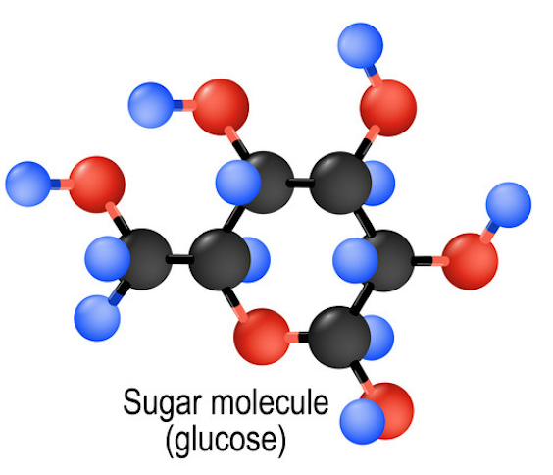
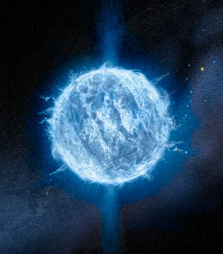

Materia Visibile ed Oscura
Ipotizziamo oggi che la materia barionica visibile costituisca il 16% di tutta la materia nel nostro Universo: 73% è Idrogeno, 25% Elio. Il resto: 2%
Ma la fenomenologia della materia visibile non è quella dell’idrogeno, e con quel 16% osserviamo una straordinaria complessità!
Il settore visibile è ricco, perché la materia oscura dovrebbe essere differente?

Slide 9
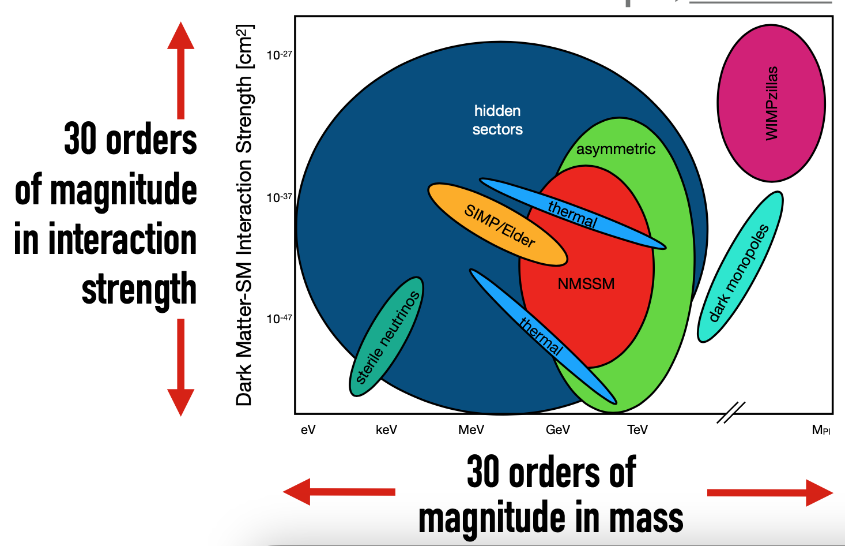


Si cerca in ogni angolo..
30 ordini di grandezza
nell’intensità della forza
30 ordini di grandezza
in massa
Notes:
One of the most important scientific goals of the next decade is to reveal the nature of dark matter (DM). To accomplish this goal, we must delve deep, to cover high priority targets including weakly-interacting massive particles (WIMPs), and search wide, to explore as much motivated DM parameter space as possible.
Cartoon figure of the model space for direct detection. Included are candidates of thermal dark matter, supersymmetry, asymmetric dark matter [16], SIMP/Elder [220–223], dark monopoles [226], WIM- Pzillas [18], and hidden sector dark matter [25]. Note that the interaction cross-section can be for either scattering with nucleons or electrons, depending on the specific model. Particle DM is well-motivated and encompasses a wealth of scenarios that can explain the observed properties of DM, with characteristic mass scales from 1 eV to the Planck scale. A diverse, continuous portfolio of experiments at large, medium, and small scales that includes both direct and indirect detection techniques maximizes the probability of discovering particle DM. Dark matter dominates the matter content of the universe, but its identity is still a mystery. Indeed, some theorists speculate about the existence of an entire “dark sector” made up of dark photons and multiple species of dark matter. Numerous approaches are being pursued to detect dark matter directly, and these are complemented by searches at the LHC, surveys of large-scale structure and attempts to observe high-energy particles from dark-matter annihilation or decay in or around our Galaxy. Regarding direct detection, experiments are advancing steadily in sensitivity: the latest examples reported at ICHEP came from LUX in the US and PandaX-II in China, and already they exclude a substantial fraction of the parameter space of supersymmetric dark-matter candidates. Information on dark energy can be gleaned using both optical surveys of large-scale structure and data from surveying the cosmic microwave background. The are numerous probes of dark energy: the distribution of objects of known brightness in the sky, the angular diameter of objects of known size as a function of distance, structure growth in the universe as a function of redshift or time by counting clusters or through the measurment of weak lensing.

Slide 10
Cosa potremo capire?

Slide 11
Un nuovo acceleratore?
Aumento luminosità -> Precisione: evidenza indiretta
Aumento Energia: accesso diretto a nuove particelle

Slide 12
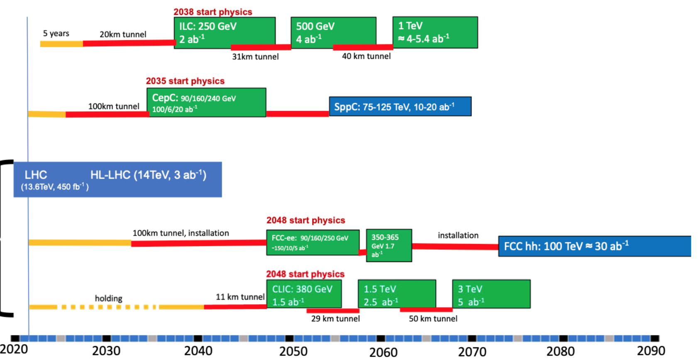
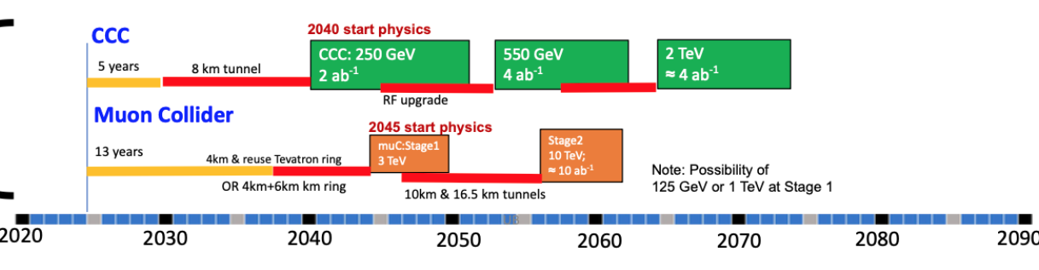
Progetti Futuri
ILC
Japan
CepC
China
FCC
CERN
CLIC
USA

Slide 13

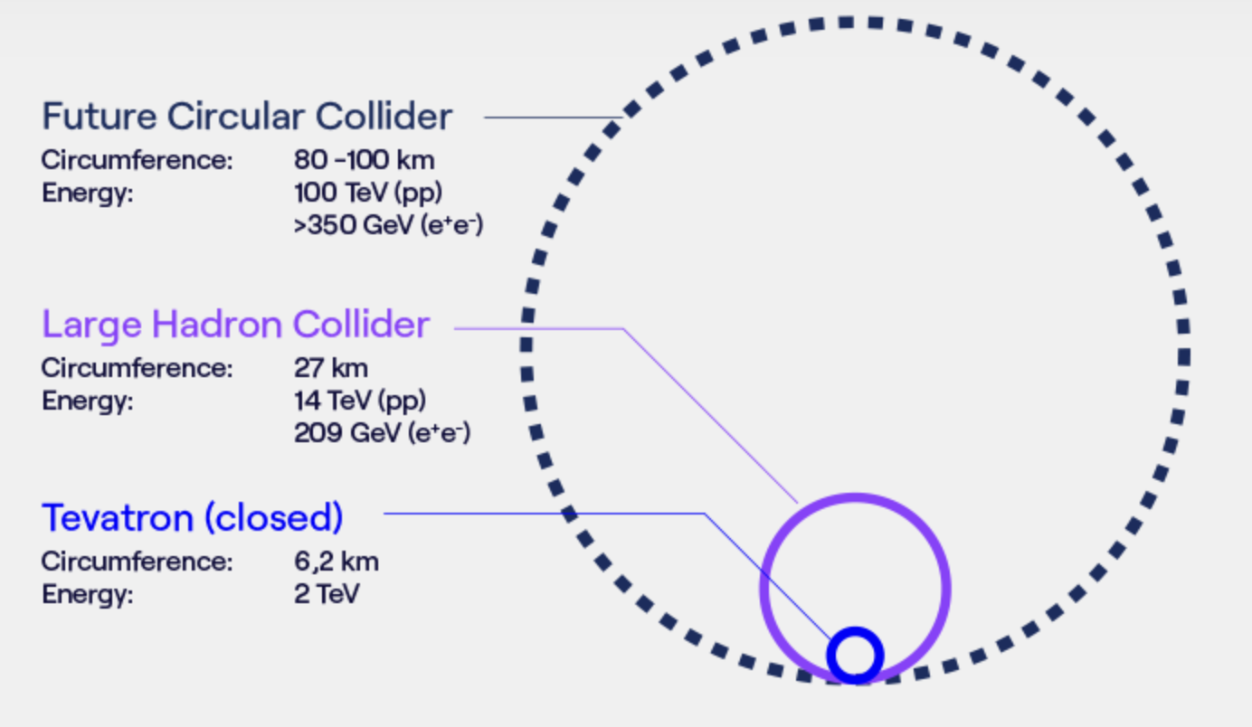
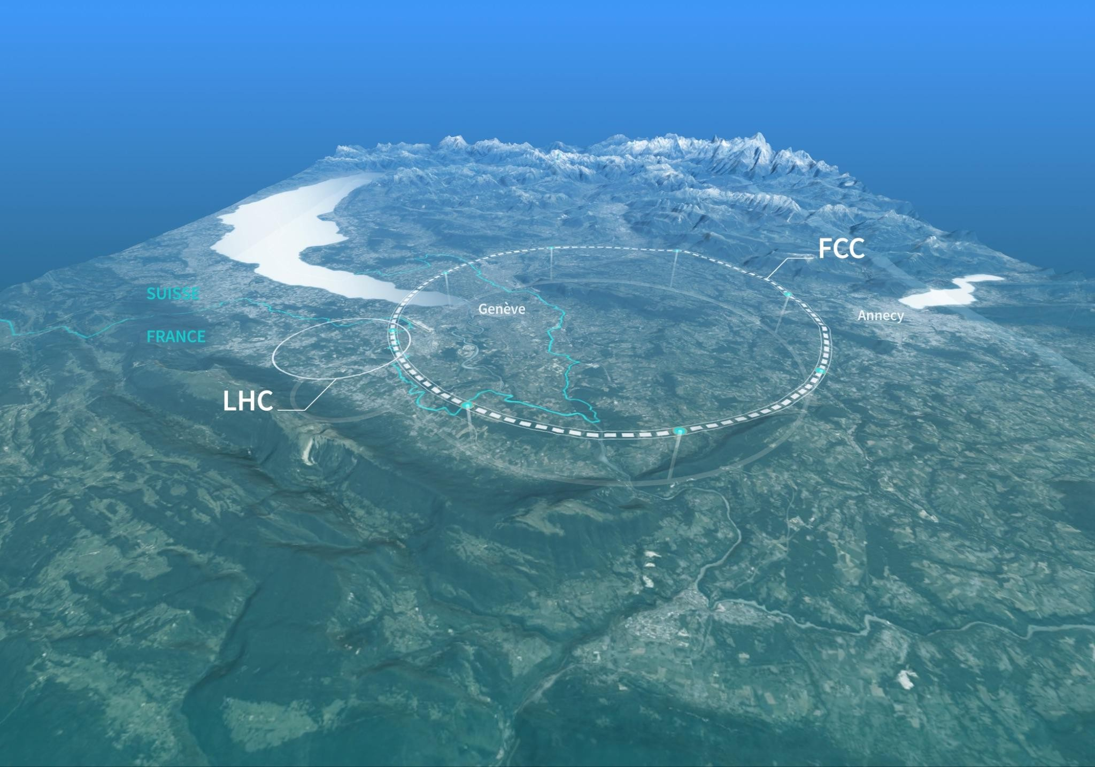
Il progetto FCC
2020 Update of the European Strategy for Particle Physics
“Europe, together with its international partners, should investigate the technical and financial feasibility of a future hadron collider at CERN with a centre-of-mass energy of at least 100 TeV and with an electron-positron Higgs and electroweak factory as a possible first stage.”
FCC: proposed post-LHC CERN’s flagship project to push the frontiers of the unknown

Slide 14
Il progetto FCC
Energy & Intensity frontiers: complementary in the search for new physics
INTENSITY FRONTIER Precision (electron-positron)
1st stage collider, FCC-ee: collisions 90-365 GeV
Construction: 2033-2045 / Physics operation: 2048-2063
Stress-test the SM limits → Indirect / low mass BSM sensitivity
ENERGY FRONTIER Discovery (hadron-hadron)
  2nd stage collider, FCC-hh: collisions at ~100 TeV
  Construction: 2058-2070 / Physics operation: ~ 2070-2095
  Maximizing potential for BSM discovery → Direct / high mass BSM sensitivity

Slide 15
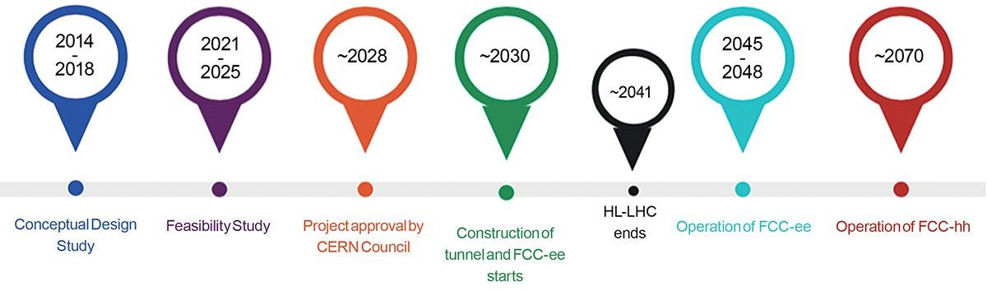

Il progetto FCC
We are here
FCC Feasibility Study (public in March 2025) → no show-stopper identified
Vol. 1: Physics Experiments and Detectors ($\sim$200 pages) + many notes
Vol. 2: Accelerators, Technical Infrastructure, Safety Concepts ($\sim$400 pages)
Vol 3: Civil Engineering, Implementation and Sustainability ($\sim$200 pages)
Executive Summary $(\sim$40 pages)
15 years of FCC-ee
10 years of shutdown to dismantle the lepton collider and install the hadron one
25 years of FCC-hh

Slide 16
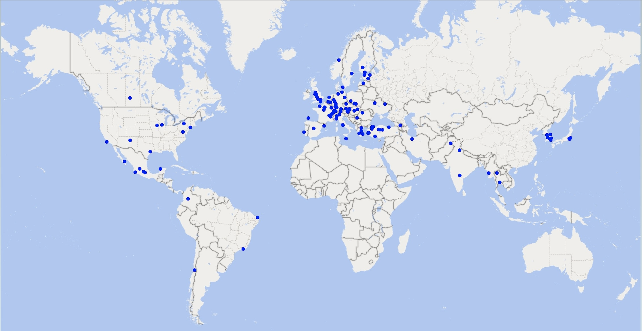


International Collaboration
Increasing international collaboration is a prerequisite for success:
→links with science, research & development and high-tech industry will be essential to prepare the FCC implementation
38 Participating Countries
Austria – Belgium – Brazil – Canada – Chile – Colombia – Czech Republic – Denmark – Estonia – Finland – France – Georgia – Germany – Greece – Hungary – India – Iran – Italy – Japan – Latvia – Malta – Mexico – Netherlands – Norway – Pakistan – Poland – Portugal – Republic of Korea – Romania – Serbia – Spain – Sweden – Switzerland – Thailand – Türkiye – Ukraine – United Kingdom – United States of America
161 Institutes
38 Countries
+
CERN

Slide 17
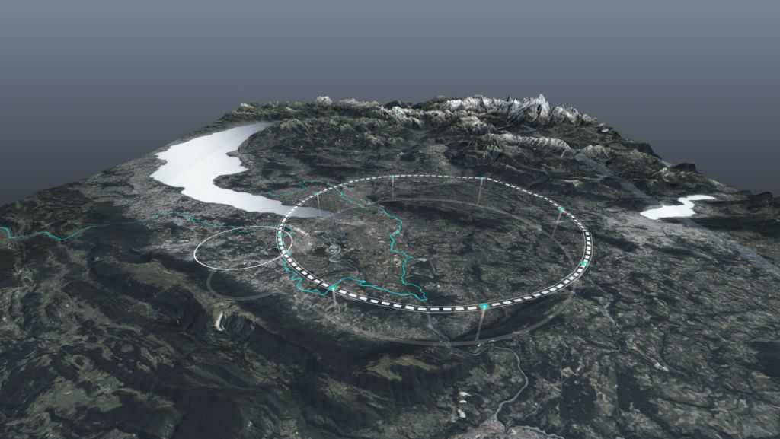
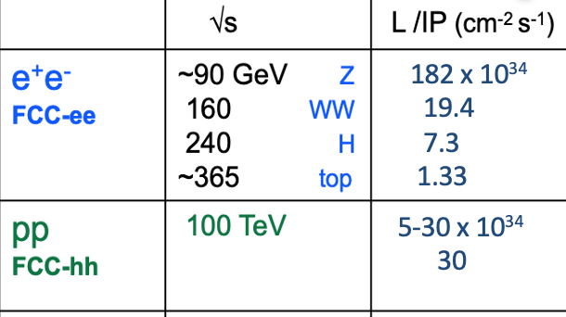
FCC: la baseline di 90.7 km
Minor rischio: anello di 90.7 km, 8 punti in superficie,
2-4 esperimenti
Tutto il progetto si sta adattando a questa configurazione

Slide 18


FCC-ee: la frontiera dell’intensità
Ricerche di nuova fisica
Higgs
3 years
2 x 10⁶ H
Fino a x 10 miglioramento sugli accoppiamenti misurati a HL-LHC
Scoperte indirette fino a 70 TeV
Scoperte dirette di WINP tra 5-100 GeV
FCC-ee
Top
5 years
2 x 10⁶ tt pairs
Produzione di flavour
Miglioramenti x 10-50 su tutte le
osservabili elettrodeboli
x10 statistica di Belle per b, c, τ

Slide 19
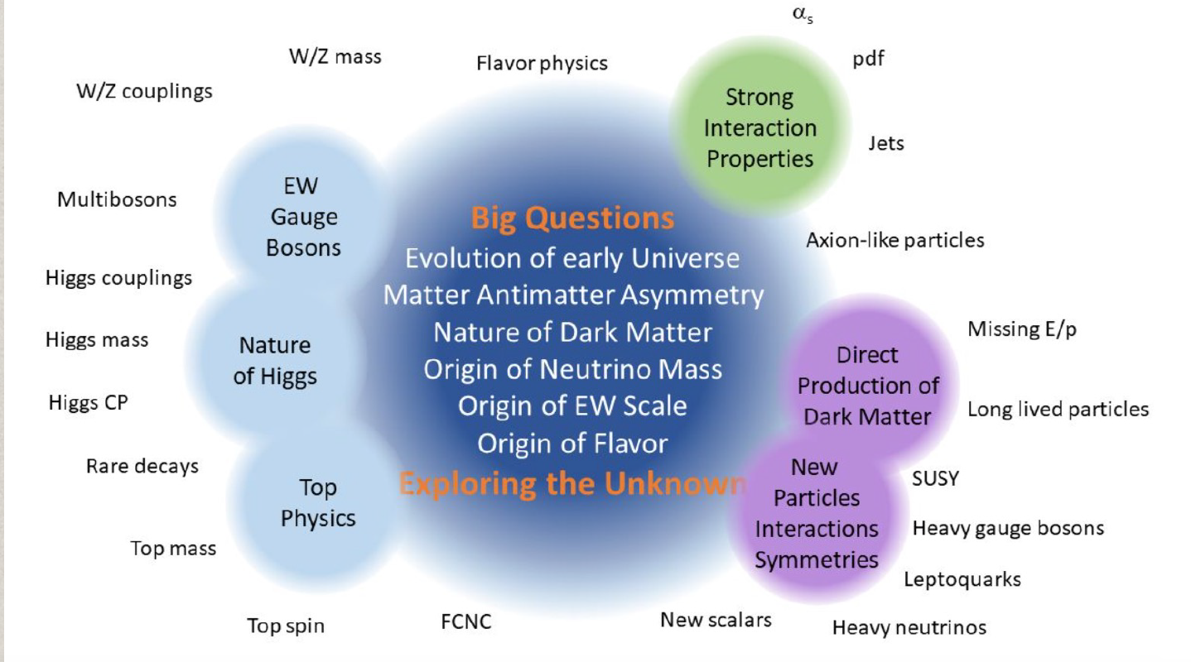
FCC-hh: la frontiera dell’energia
Formidabile potenziale di fisica
Potenziale di scoperta diretta fino a ~ 40 TeV
Misura dell’ Higgs self coupling (~ 5%) e ttH ( ~ 1%)
Misure di alta precisione/model-independent di decadimenti rari dell’ Higgs)
Conclusione su Materia Oscura WIMP

Slide 20
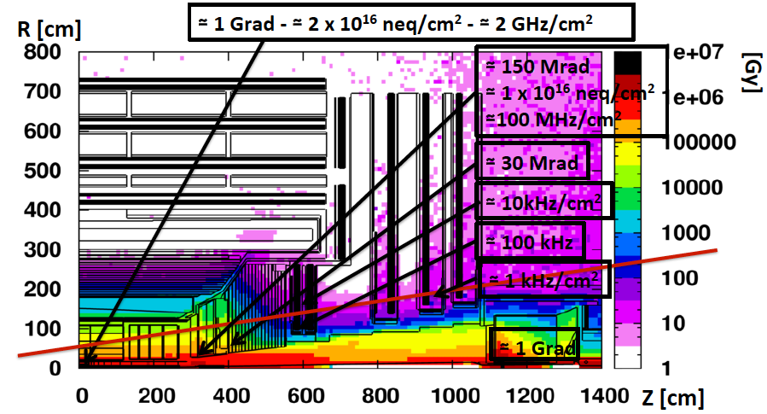
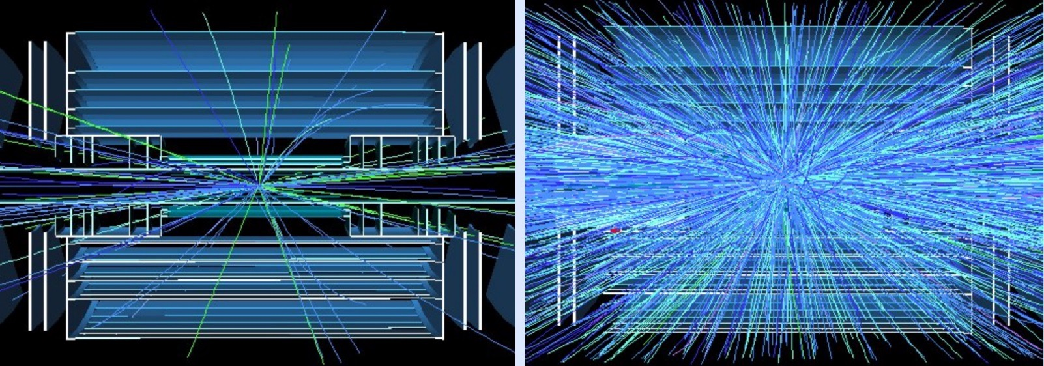
HL-LHC: sfide sperimentali
Alta luminosità ➔ 200 interazioni protone-protone per ogni incrocio dei pacchetti
  aumento della complessità combinatoriale, del rate di tracce false, di segnali spurii nei calorimetri, del volume dei dati da essere letti per ogni evento.
Elementi del rilevatore ed elettronica esposti ad alte dosi di radiazione. Necessari: nuovo tracciatore, nuovi calorimetri e rivelatori di muoni in avanti, nuovi sistemi di read-out.
25 pileup
200 pileup

Slide 21
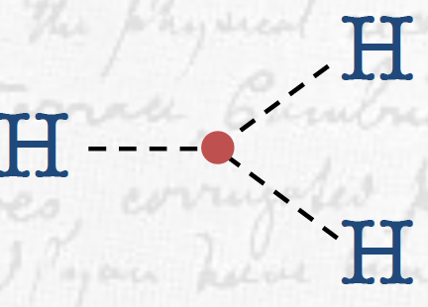
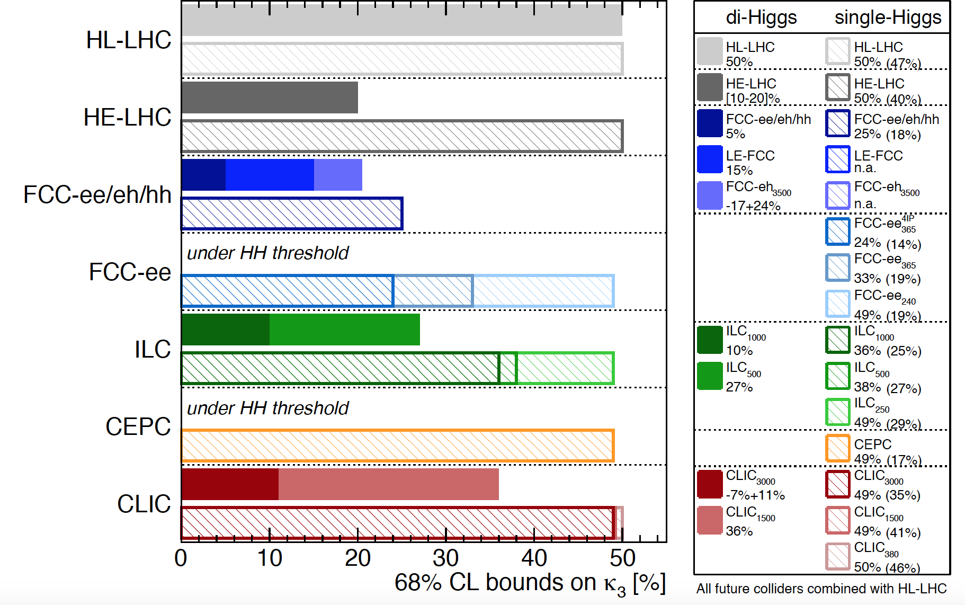
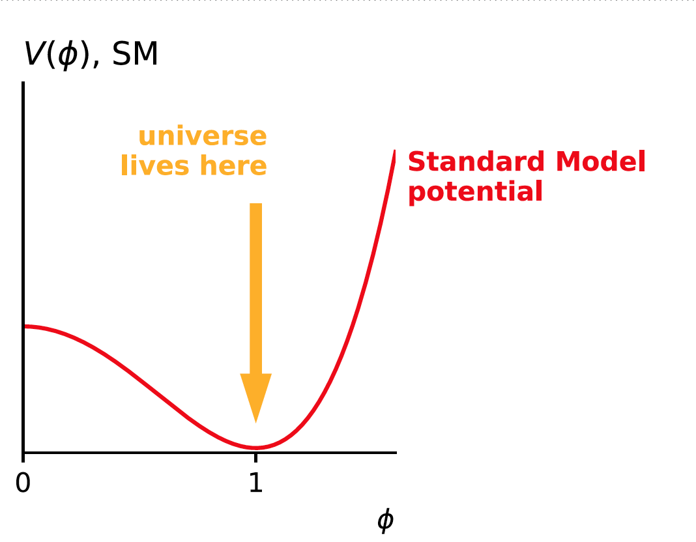
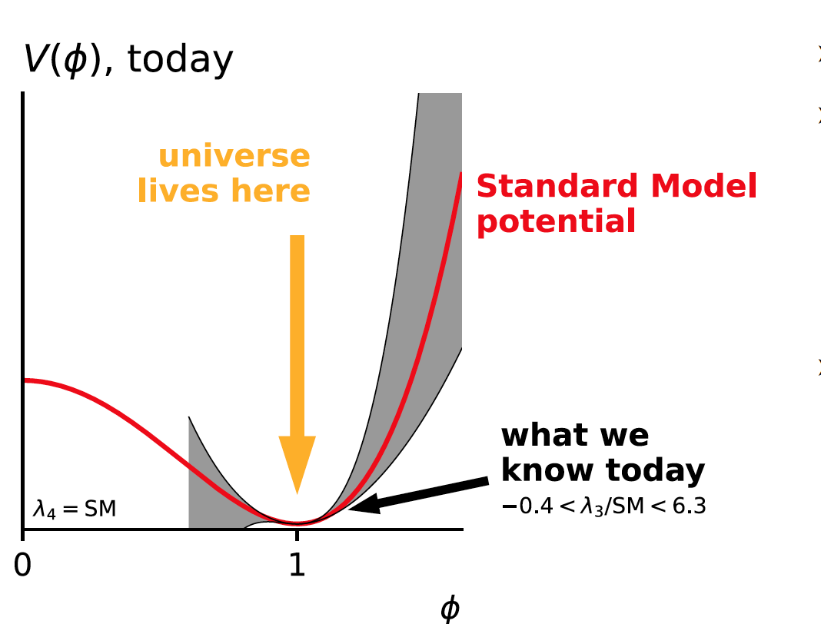
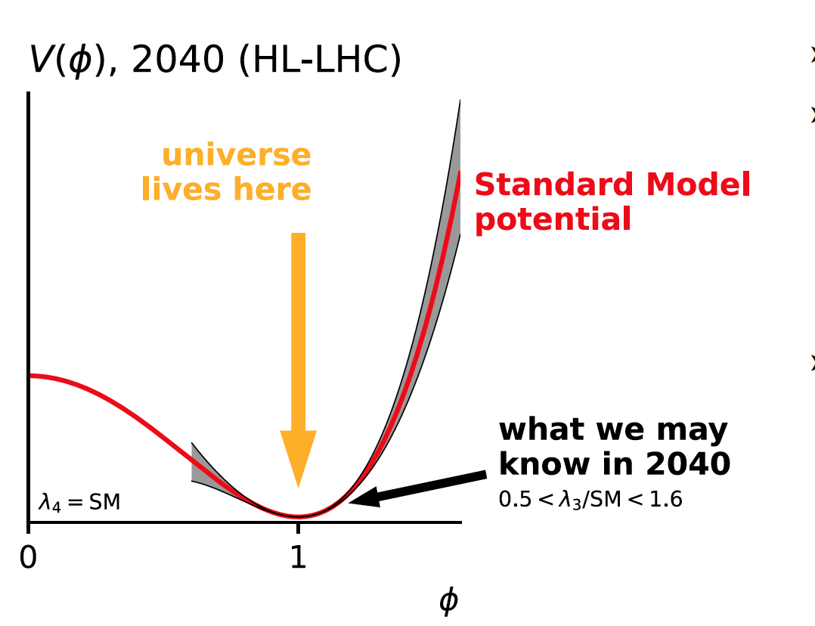
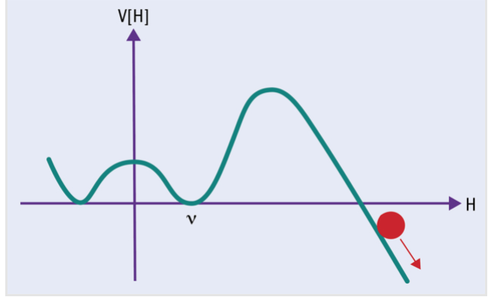
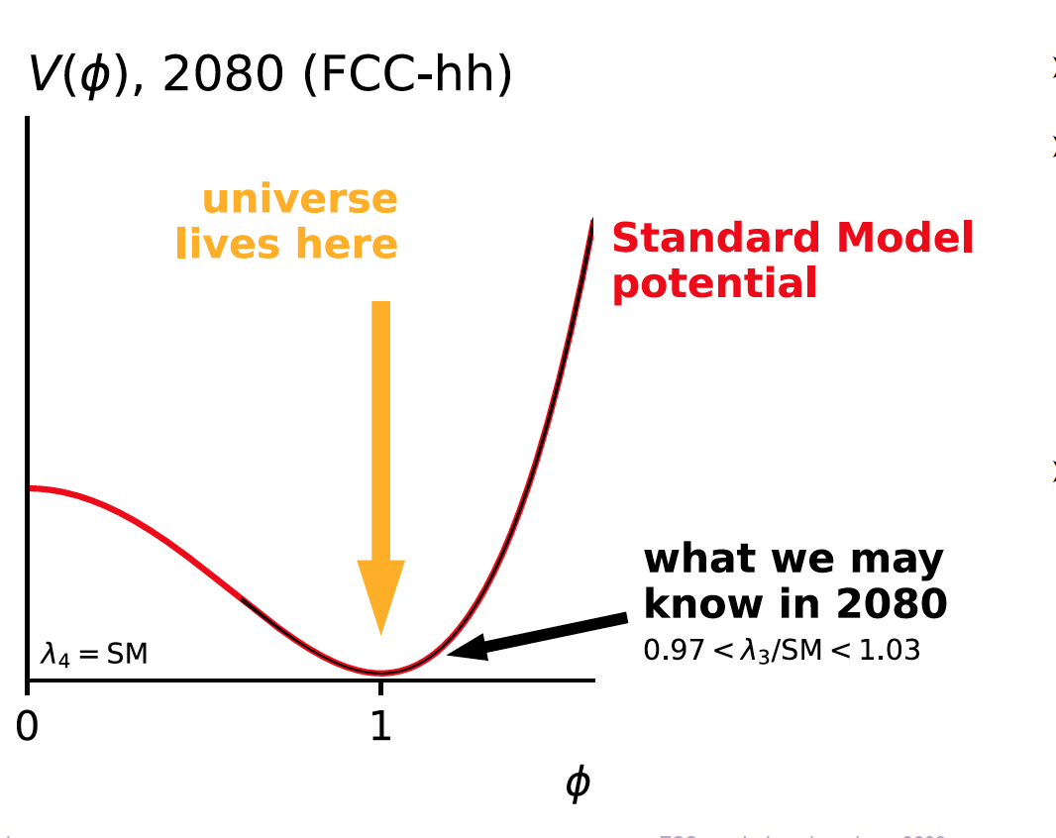
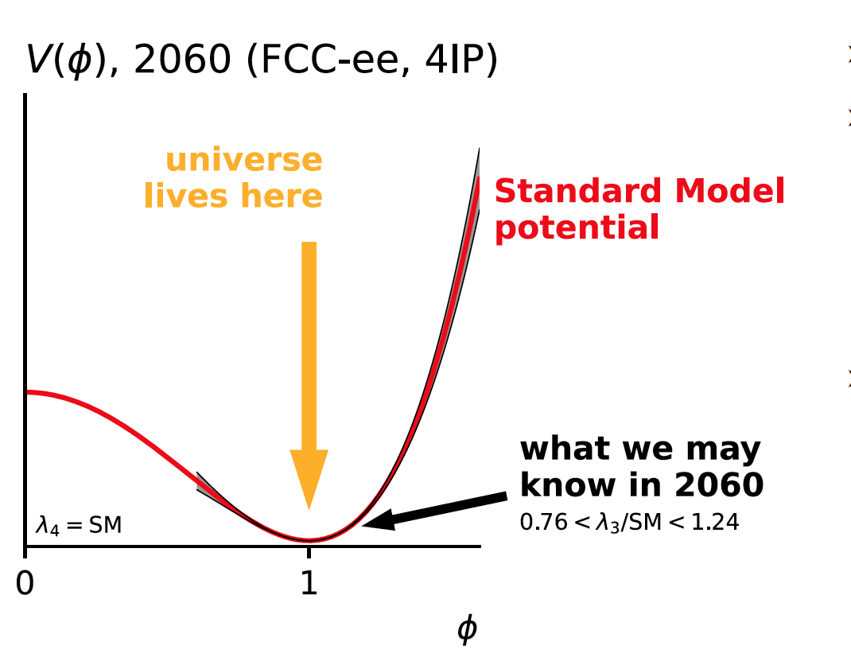
Il self-coupling dell’ Higgs
Le macchine future potranno farci capire la struttura del potenziale di Higgs
λ₃
1905.03764
Il programma integrato di FCC potrà misurare λ3 al 5%
G. Salam
Notes:
The Higgs must also have a dynamical property– it should be able to interact not only with other particles, but also with itself. What is the shape of the symmetry breaking potential and how is restored at high scales? The observable is the Higgs self-coupling cross section. It is difficult to measure due to the small cross section at LHC, but at a 100 TeV collider (FCC or a similar machine in China known as the CppC), with a much larger cross-section, it can be well- measured. The LHC will only probe the small quadratic oscillations around the symmetry breaking vacuum while a 100 TeV collider will give sensitivity to the functional form of the potential . The self-interaction is also expected to impact processes in which only a single Higgs boson is produced. This is due to the presence of higher order corrections to the single Higgs cross-section, accounting for a small contribution to the total production of single Higgs of approximately 1-5%. However, considering the single-Higgs production rate is three orders of magnitude higher than the di-Higgs process, and is thus measured with much higher precision, the contribution of the Higgs self-interaction to single-Higgs measurements is not negligible.
By combining the single- and di-Higgs measurement, the ATLAS Collaboration has derived stringent constraints on the Higgs boson self-coupling with respect to its Standard-Model prediction

Slide 22
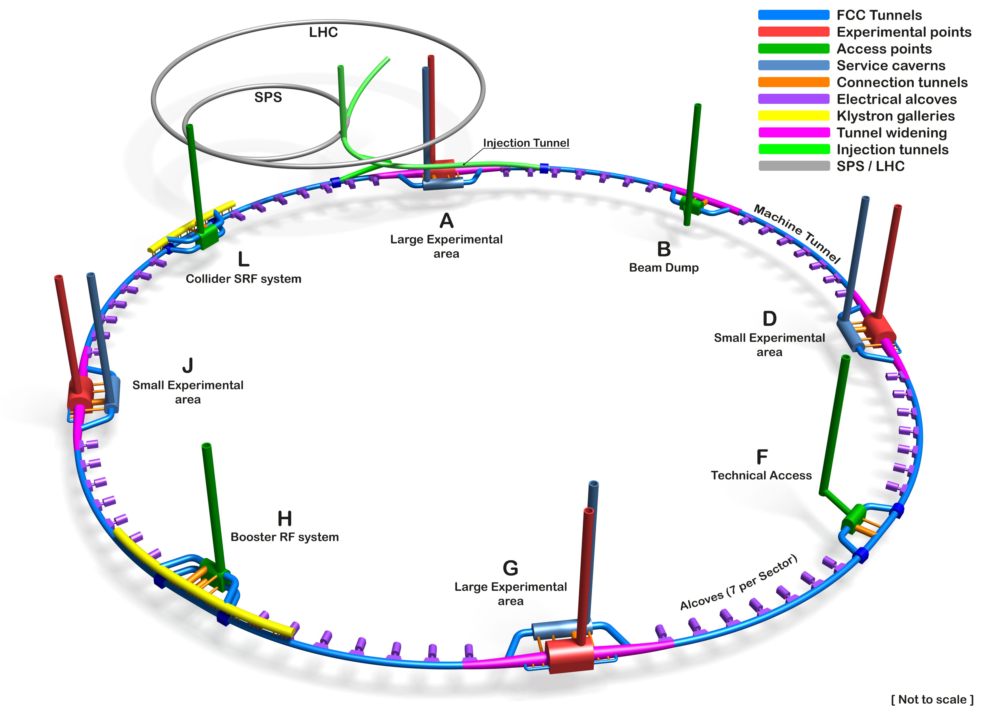
Schematic of the Underground Civil Engineering
FCC: Ingegneria Civile
Tunnel Circumference: 90.7 km
Excavated vol: 6.2M m3 (In the ground)
Access shafts: 12
Construction shafts: 1
Large experiment areas: 2
Small experiment areas: 2
Technical points: 4
Deepest shaft: 400m
Average shaft depth: 243m

Slide 23
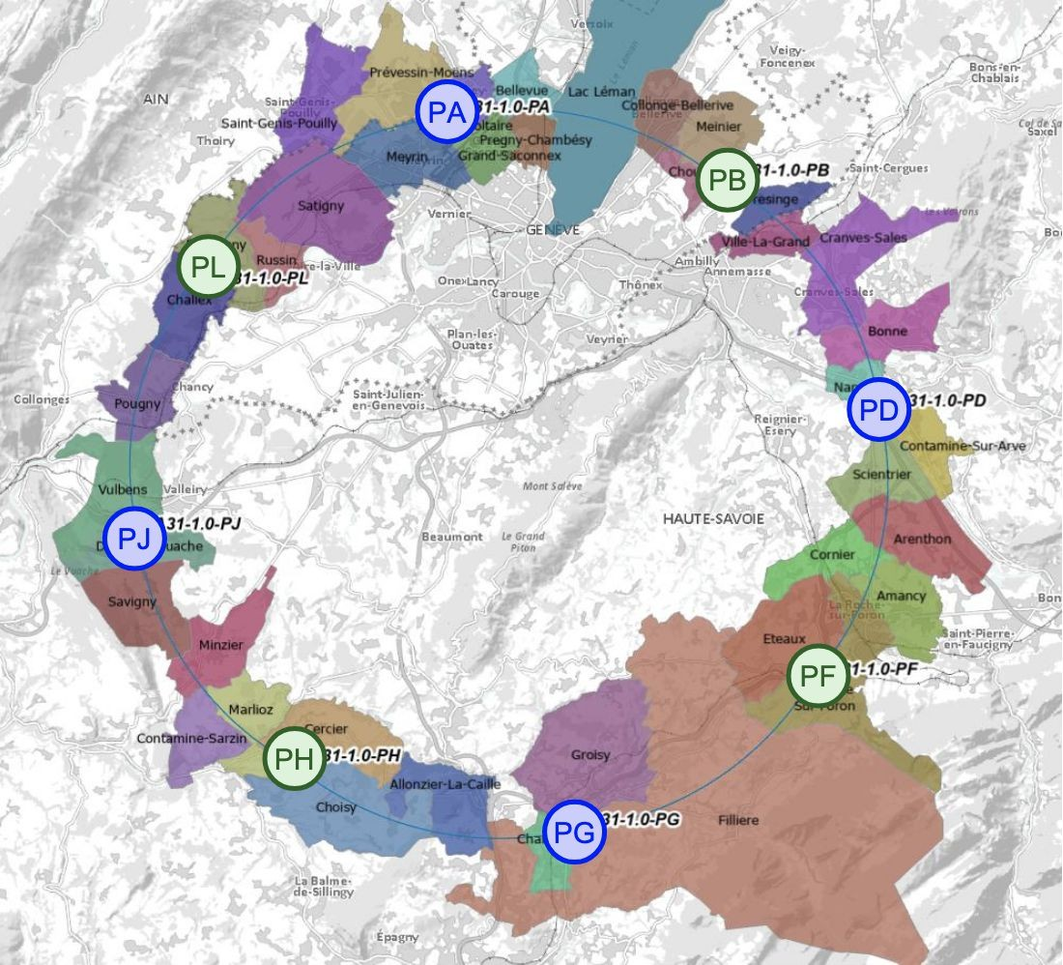
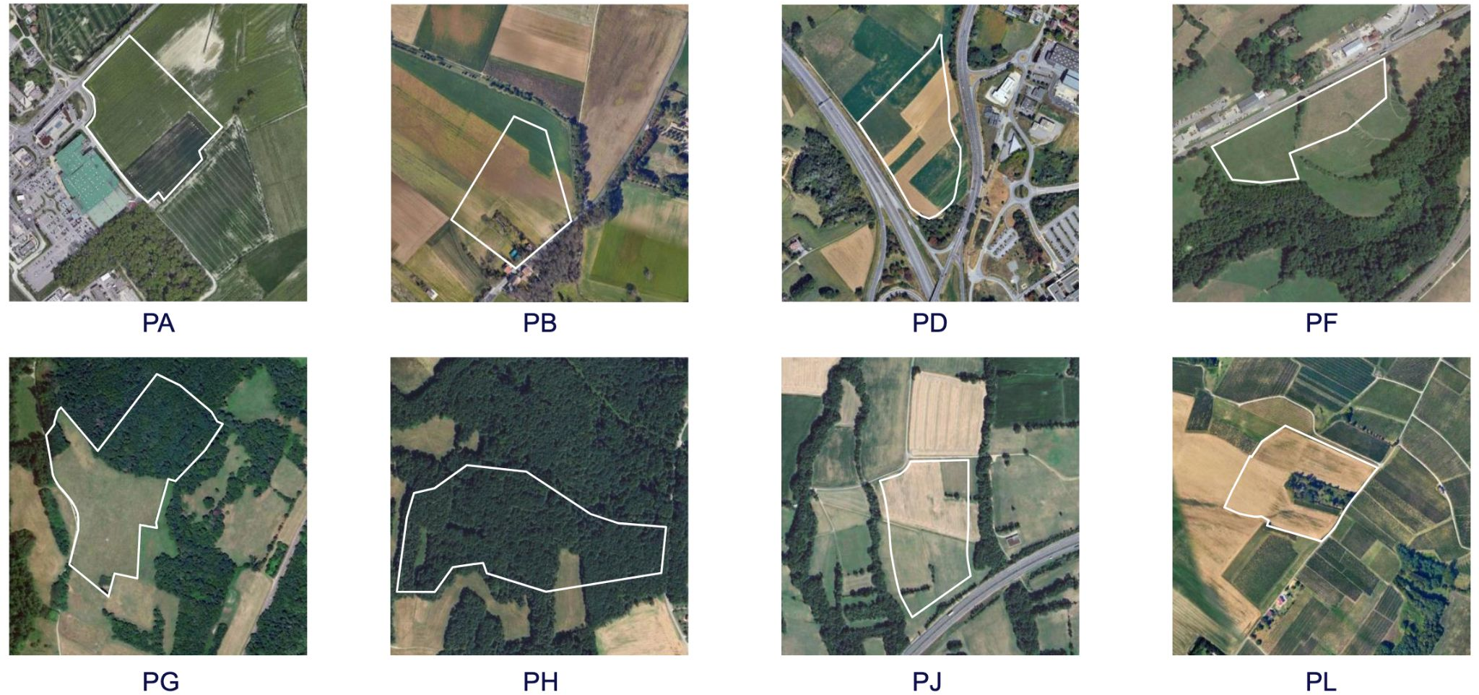
FCC: costruzione
Baseline accelerator design: 90.7 km,
8 surface points, 4 interaction points.
Average tunnel depth: 200 m.
Demonstrate geological, technical, environmental, and administrative feasibility of subsurface and surface elements and optimise the placement of the ring
Meetings with municipalities in France (31) and Switzerland (10) occurred

Slide 24
Stima dei costi
Cost includes construction of entire new infrastructure and all equipment for operation at the Z, WW and ZH working points.
Domain | Cost class | Cost [MHCF]
Civil engineering | 3 | 6,160
Technical infrastructures | 3 | 2,840
Injectors and transfer lines | 3 | 590
Booster and collider | 3 | 4,140
CERN contribution to four experiments | 4 | 290
FCC-ee total | 3 | 14,020
+ four experiments (non-CERN part) | 4 | 1,300
FCC-ee total incl. four experiments | 3 | 15,320
Operation of the FCC collider at the $\text{t}\overline{\text{t}}$working point will require later installation of additional RF cavities and associated cryogenic cooling infrastructure with a corresponding total cost of 1,260 MCHF.
Cost class 3: low-range uncertainty -10% to -20%; high-range uncertainty +10% to +30%
Cost class 4: low-range uncertainty -15% to -30%; high-range uncertainty +20% to +50%

Slide 25

Conclusioni I
Non abbiamo più il faro del Modello Standard a guidarci mentre navighiamo nel tentativo di capire come funziona il nostro Universo.
La fisica delle particelle richiede ora grandi macchine, grandi investimenti, e tempi lunghi (diversi decenni) per dare risultati
Ma c’è ancora tanto da capire e scoprire: dovremmo avere la forza e il coraggio di costruire la prossima macchina per farlo.

Slide 26
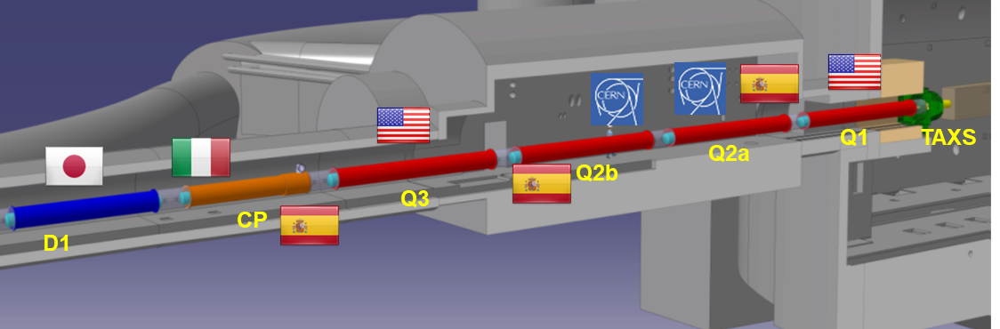
Progress with the Nb₃Sn Interaction Region Magnets
16 MQXFA ( 4.2m long US Magnets) to be installed
  Endurance test (50 quenches) of 4.2m long magnet successful
  6 out of 8 magnets so far accepted after cold tests
  First 2 magnet cold-mass assembled & successfully tested
8 MQXFB (7.2m long CERN Magnets) to be installed
  Performance limitations identified in first 3 prototypes
  Studied in detail with 3 issues to be addressed
    Revised welding procedure (successfully tested)
    Revised assembly procedures (successfully tested)
    New coil production procedure (underway)

Slide 27
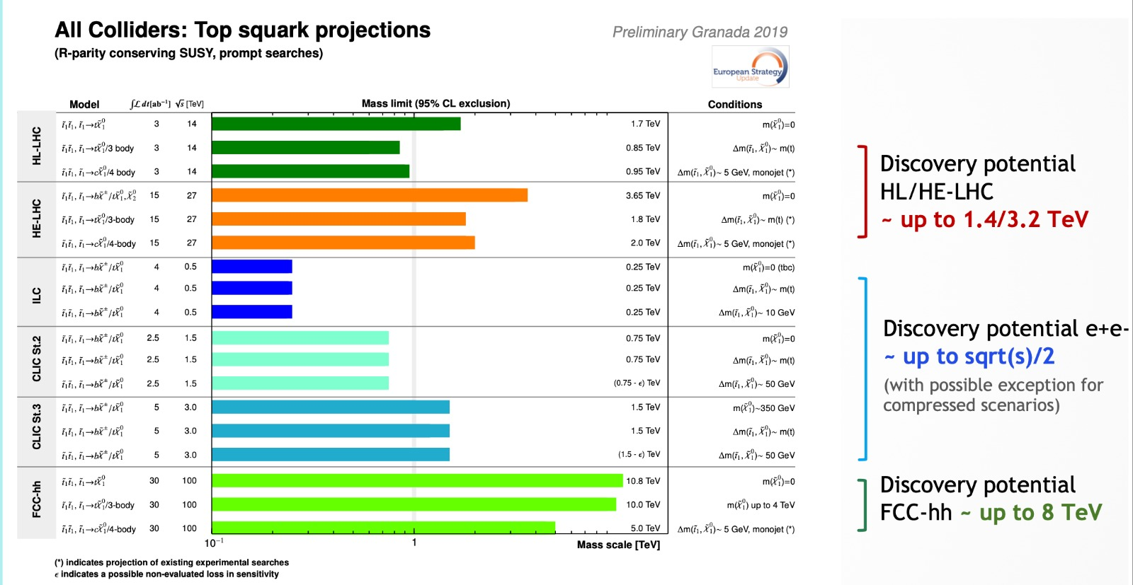

Slide 28
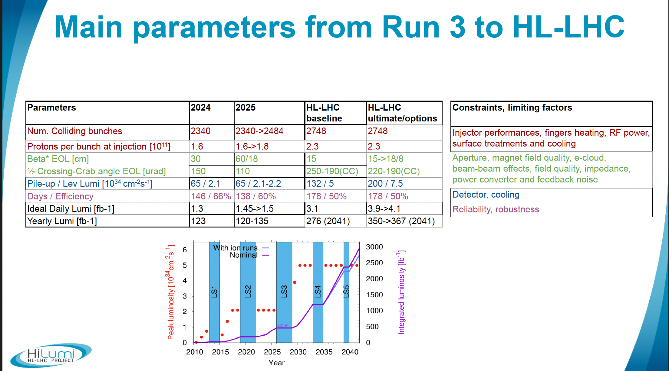

Slide 29
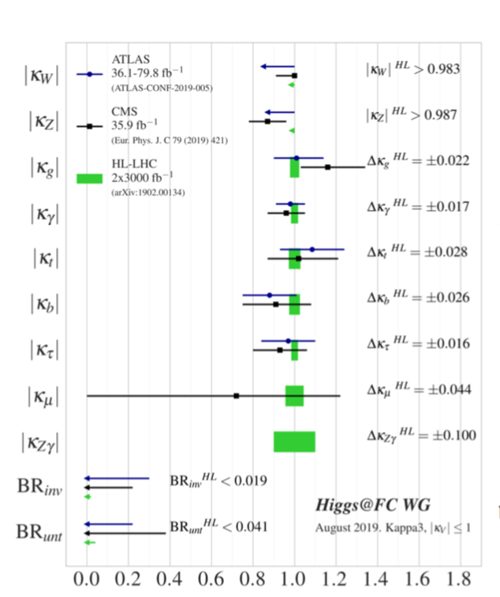
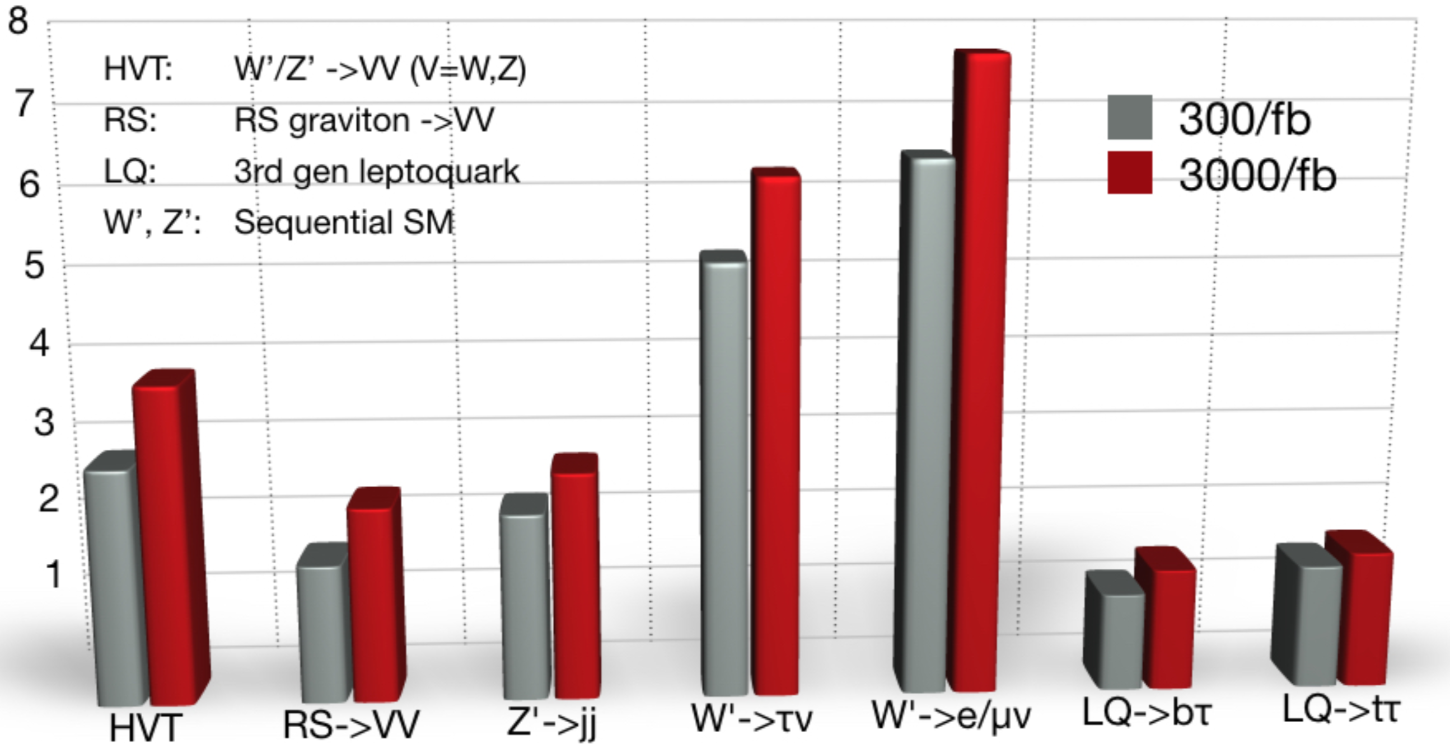
HL-LHC: potenziale di fisica
Precisione sugli accoppiamenti dell’ Higgs (normalizzati alle previsioni del MS) oggi e dopo HL-LHC
Ricerca di fotoni oscuri di massa fino a 10 GeV o più
Massa raggiungibile (TeV) per una scoperta a 5𝜎
Courtesy
M. Mangano
29
→ Miglioramento per un fattore 5-10
Notes:
TeV mass particles are needed in essentially all models of new physics. The search for them is imperative and integrally linked to searches for dark matter and rare processes. heavy vector triplet (HVT), The most popular extension of the Standard Model is Supersymmetry (SUSY), the only unused symmetry of the Poincaré Group. There is a long list of reasons why SUSY is attractive. Among them: a solution to the hierarchy (naturalness) problem; a rationale for scalars; unification of the forces; a dark matter candidate; needed by string theory; helps the cosmological constant problem (10-120 is reduced to 10-60). It is important to remember that SUSY is complex: it is not a single model but a large framework (Figure 8). SUSY is too big to explore without some assumptions. 0
a second set of parameterizations is considered. The so-called κ-framework [15] introduces scale factors acting on the different coupling parameters in the leading order matrix elements of Higgs boson production and decay processes. This allows to gain a re- fined sensitivity to deviations from the SM expectations e.g. in processes evolving through loops. These parameters only only reflect changes in the overall rate
.

Slide 30
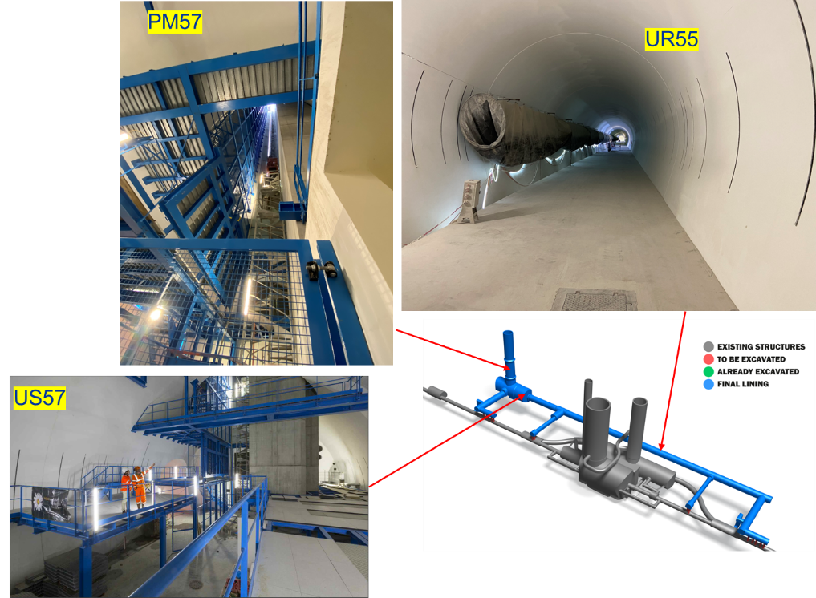
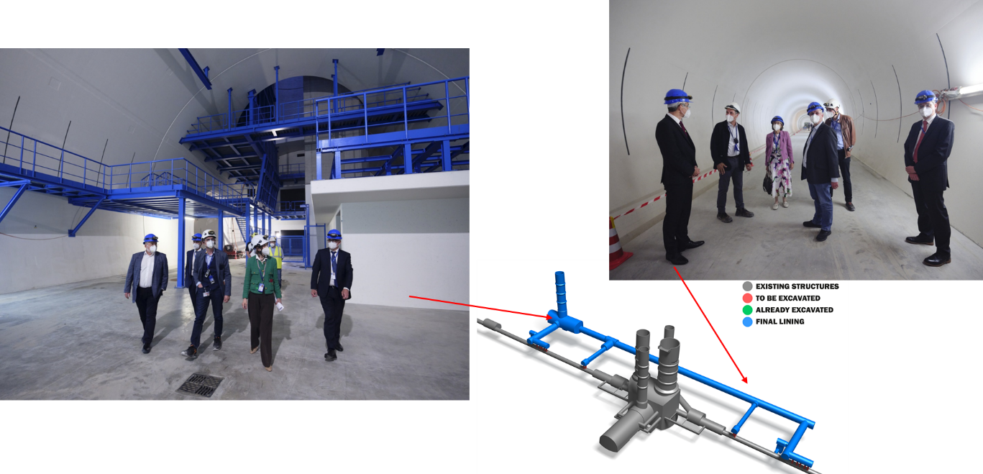
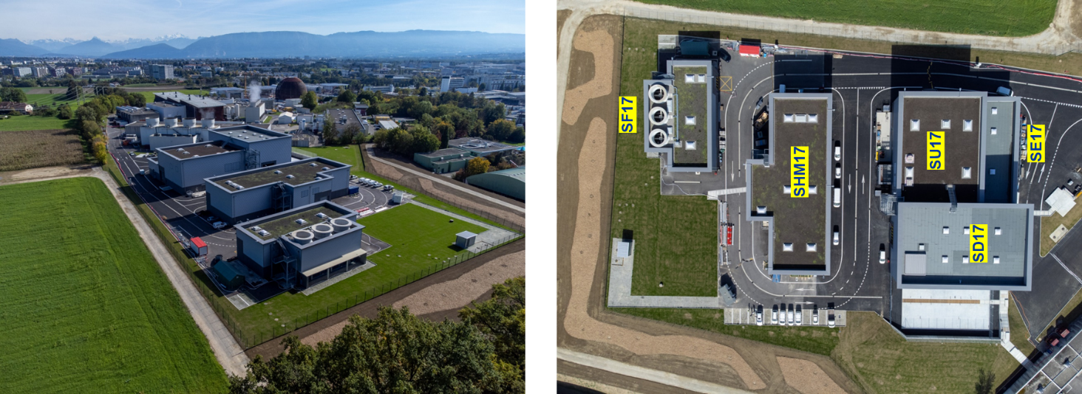
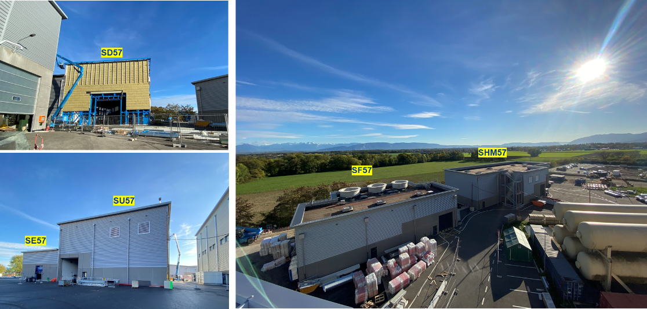
HL-LHC Civil Engineering Completed
Point 1
Point 5

Slide 31
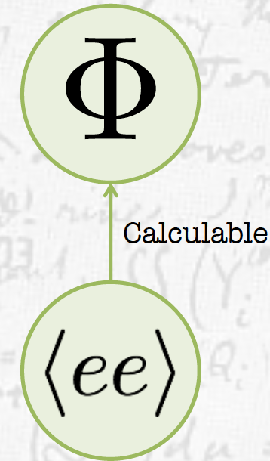
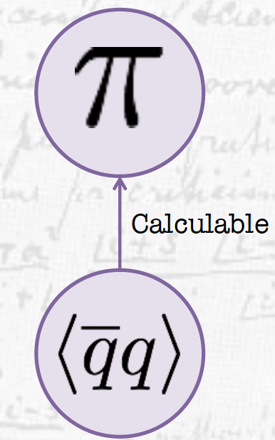
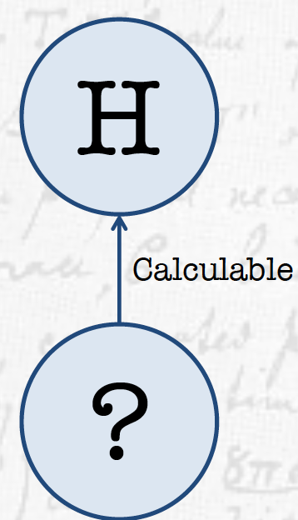
Quanto bene conosciamo il bosone di Higgs?
Ogni scalare incontrato sinora ha proprietà (massa, vev..) calcolabili a partire da una teoria microscopica più fondamentale (riduzionismo)
λ_{Η} ≈10⁻¹⁷ m
λ_{10 TeV}≈10⁻¹⁹ m
Il Modello Standard potrebbe essere una «teoria effettiva» che deve essere sostituita da una
Teoria più fondamentale alle corte distanze?

Slide 32
Backup

Slide 33
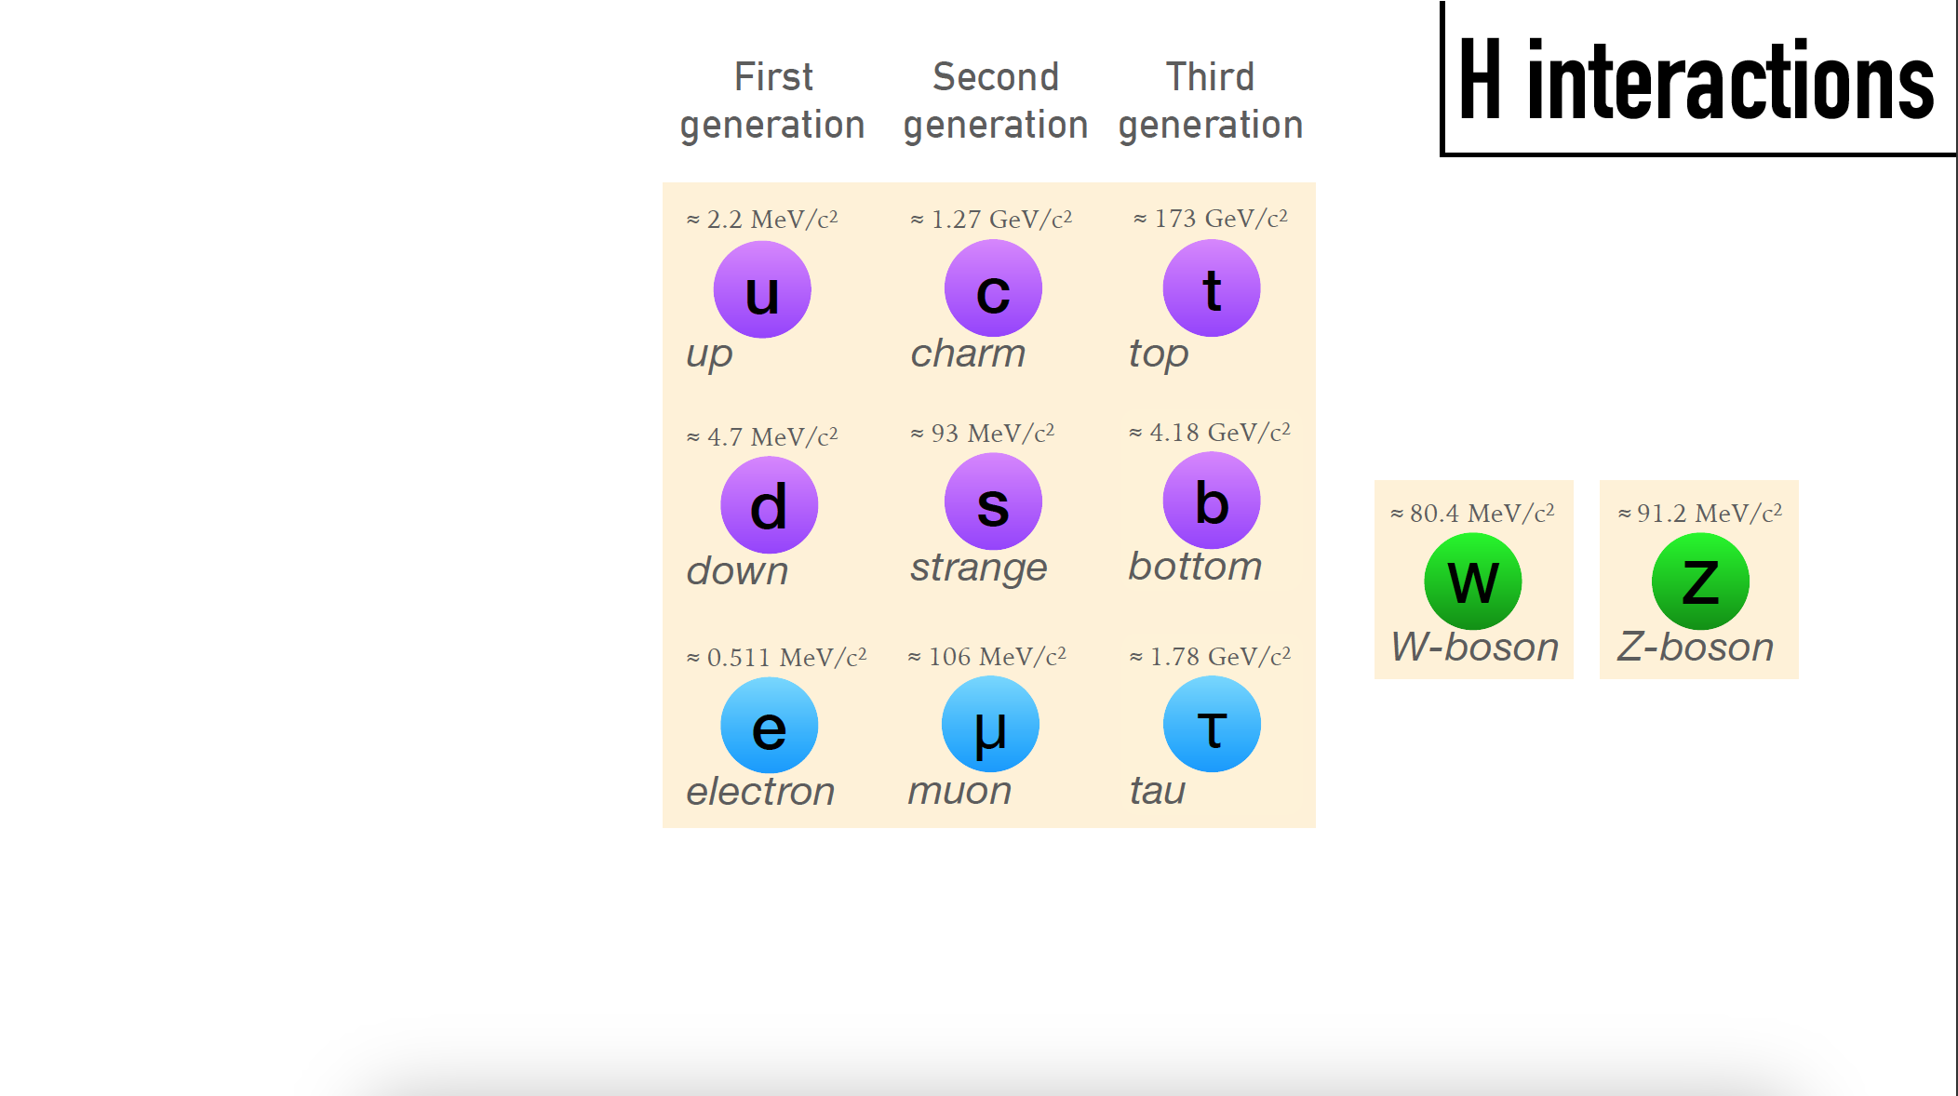
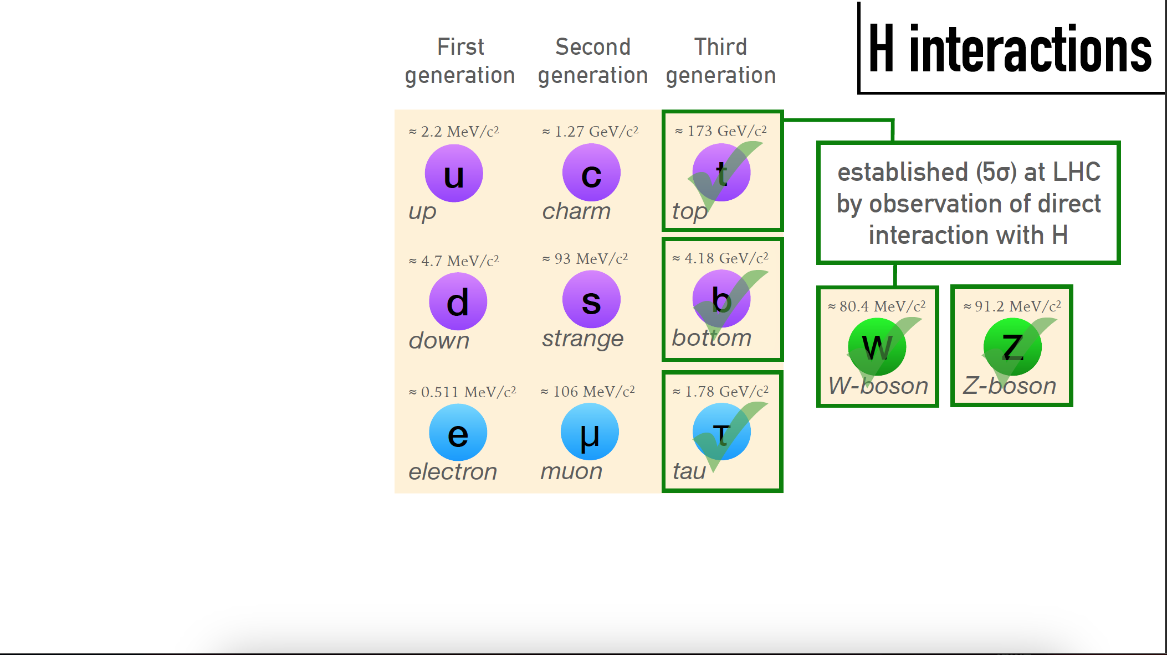
Individuati (5σ) ad LHC
Osservazione di diretta
interazione con H
Ancora mancante l’ evidenza sperimentale che i quark up e down, e l’elettrone, acquistino massa attraverso l’accoppiamento di Yukawa.
Notes:
Up to today all measurements of the spin and CP quantum numbers as well as the production properties are compatible with the SM predictions. . As a direct consequence of the symmetry breaking mechanism, its coupling properties to the vector bosons of the SM are predicted as a function of the Higgs boson mass, which itself is a free parameter of the theory. In addition, couplings of fermions to the Higgs field are introduced via Yukawa couplings, which describe fermion masses via dimensionless coupling constants.

Slide 34
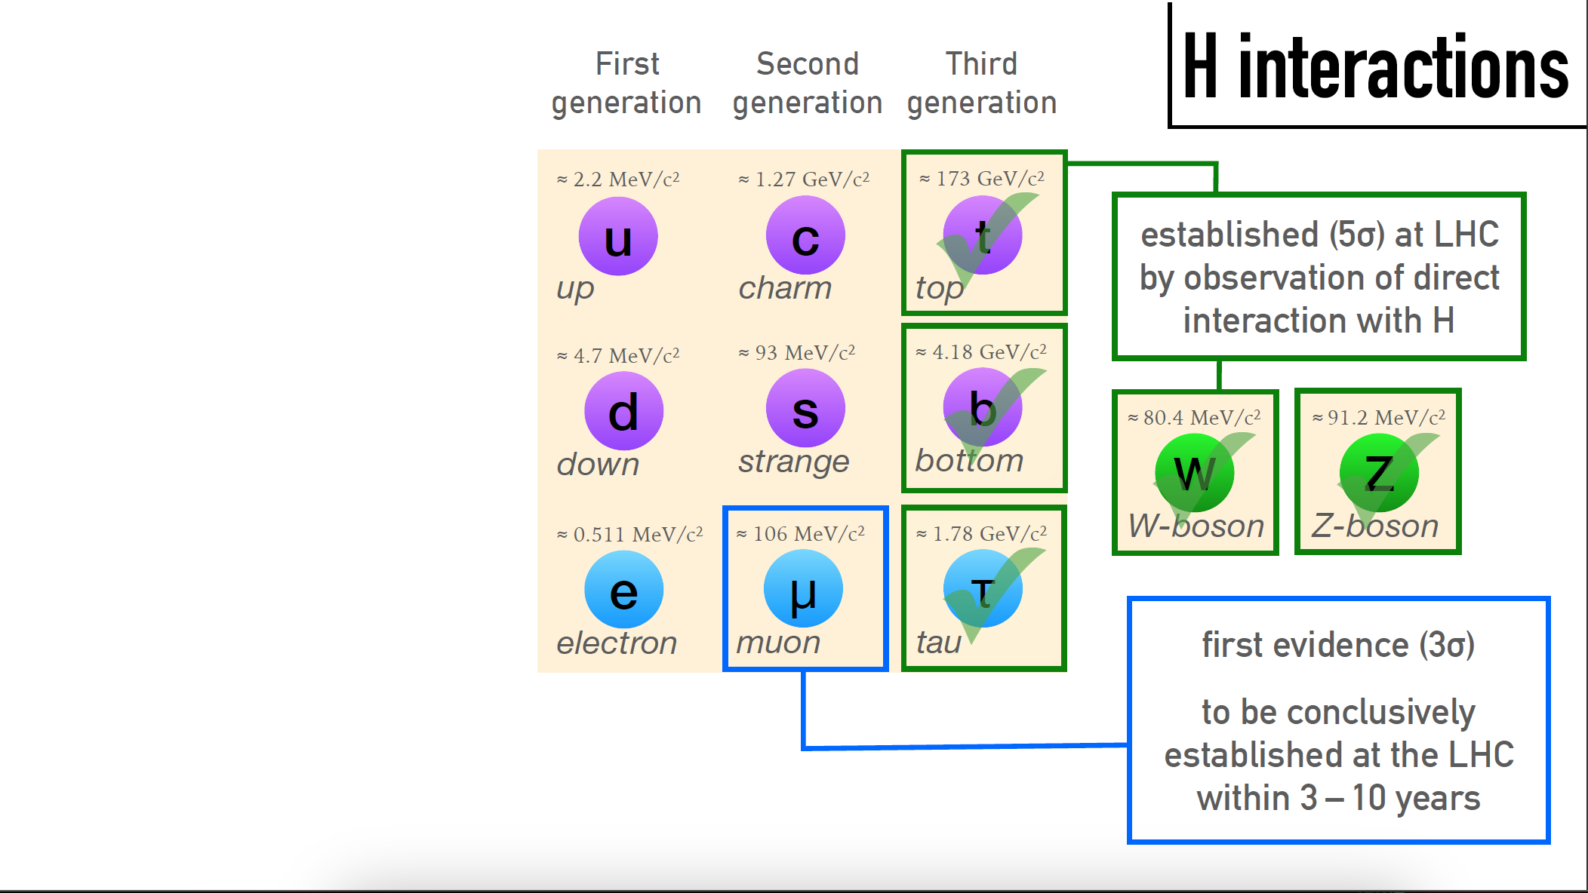
Misurabile ad HL/LHC
Individuati (5σ) ad LHC
Osservazione di diretta
interazione con H
Prima Evidenza (3σ)
Da confermare ad LHC/ HL-LHC nei prossimi 3-5 anni

Slide 35
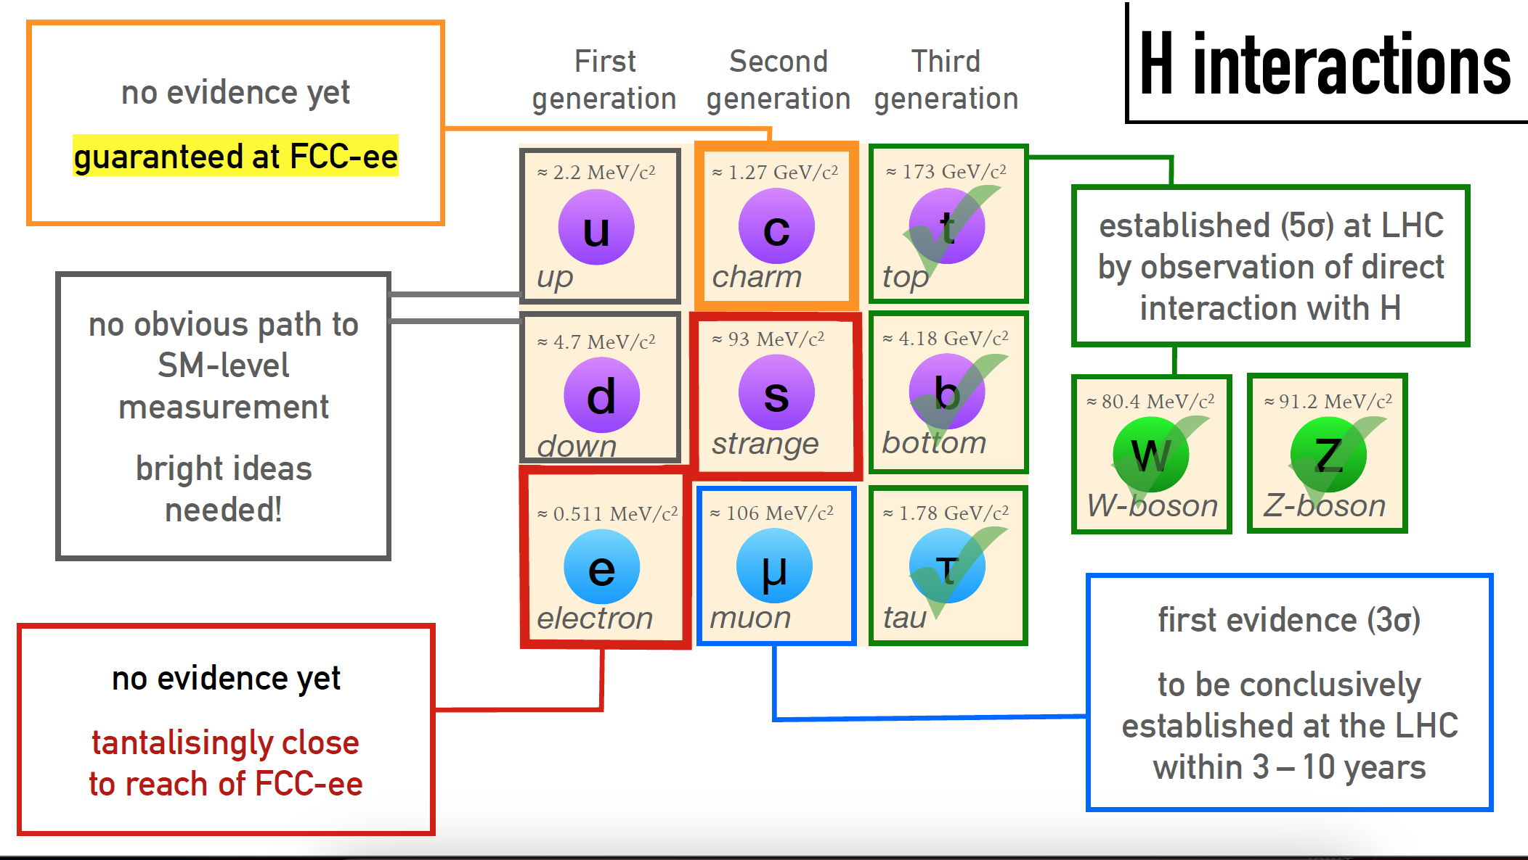
Garantito a Fcc-ee,
misura indipendente
dal modello
Individuati (5σ) ad LHC
Osservazione di diretta
interazione con H
Non chiaro come fare
Servono nuove idee!
Prima Evidenza (3σ)
Da confermare ad LHC/ HL-LHC nei prossimi 3-5 anni
Non ancora visto
Potrebbe essere nelle possibilità di FCC-ee

Slide 36
Individuati (5σ) ad LHC
Osservazione di diretta
interazione con H
Prima Evidenza (3σ)
Da confermare ad LHC/ HL-LHC nei prossimi 3-5 anni

Slide 37
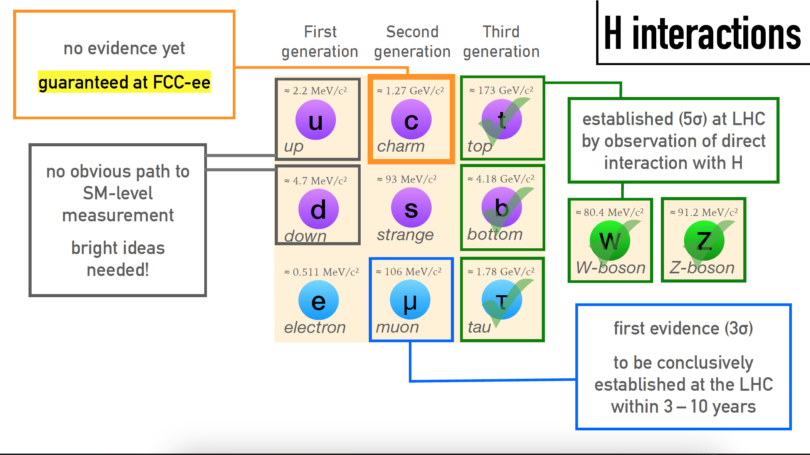
Garantito a Fcc-ee,
misura indipendente
dal modello
Individuati (5σ) ad LHC
Osservazione di diretta
interazione con H
Non chiaro come fare
Servono nuove idee!
Prima Evidenza (3σ)
Da confermare ad LHC/ HL-LHC nei prossimi 3-5 anni

Slide 38
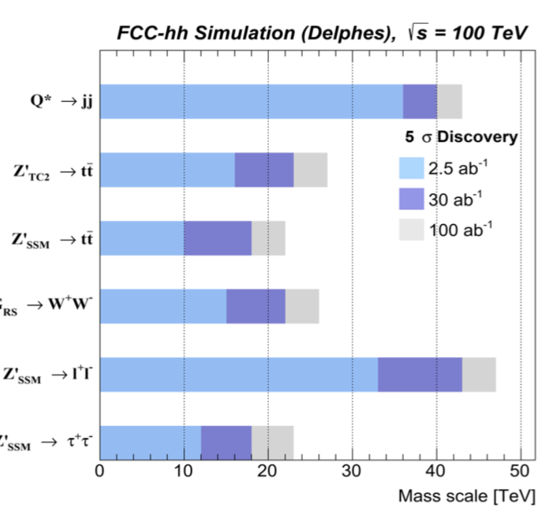
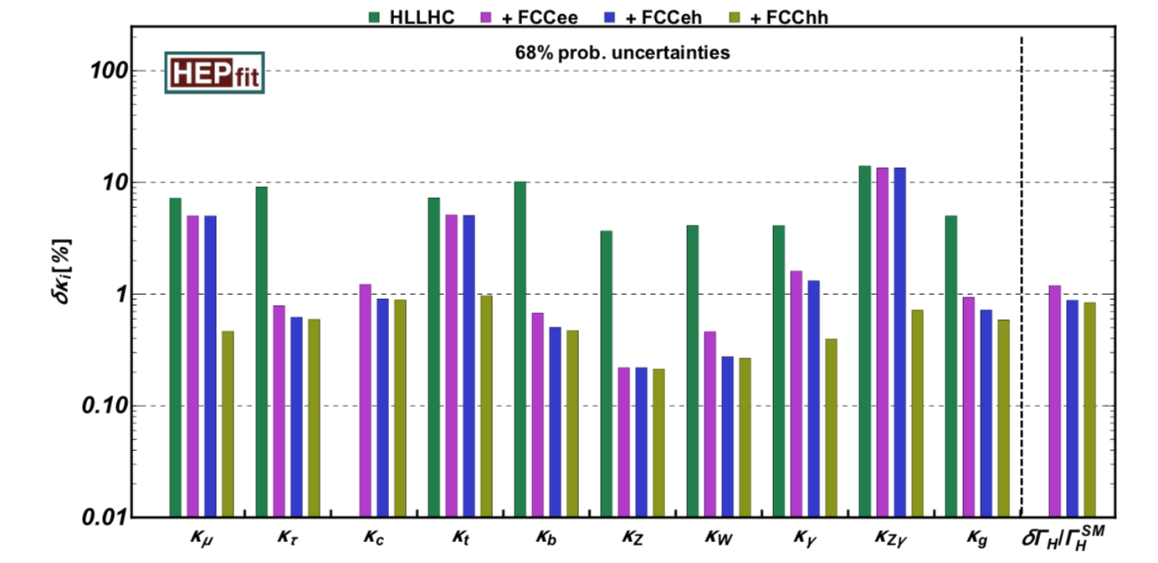
Perchè FCC ? Potenziale di fisica
δk_{i} (%)
HL-LHC
HL-LHC: SM width and 𝜿_{c}=1
FCC-ee
FCC-eh
FCC-hh
Incertezza %
1%
Accoppiamenti Higgs- altre particelle
Notes:
A 100 TeV collider will improve the reach for general direct searches by at least a factor of 5 (Figure 9). Taking natural SUSY as an example, stops and gluinos are light, but the first two generations may be heavier than 5 TeV. At 100 TeV, the reach for a heavy squark goes up to 35 TeV. The 100 TeV collider reach for neutralino dark matter is similarly impressive. While LHC can discover SUSY particles, to understand the type of SUSY we have found will take higher energies. At the moment, however, SUSY is not proving as simple to find, as was once thought it would be

