Slide 1




Study of Gamma-Ray Counterparts of Galactic and Extragalactic
Multi-messenger Sources
37th PhD cycle
Curriculum: Nuclear, Subnuclear and Astroparticle Physics
PhD candidate:
Supervisors:
Coordinator:
Riccardo Di Tria
Prof. Domenico Di Bari
Prof. Francesco Giordano
Prof. Elisabetta Bissaldi
Final exam: 07/04/2025

Slide 2

Summary
  Introduction
  Messengers from the High-Energy Universe
    Neutral messengers vs charged messengers
    Gamma-ray emitters as CR sources
  Gamma-ray instruments for the exploration of Cosmic Rays sources
    Past gamma-ray astronomy
    Current gamma-ray astronomy
  A case of study: the supernova remnant W44
    SNR paradigm
    Fermi-LAT and MAGIC observations of the W44 SNR
    Acceleration and escape of CRs from the W44 SNR
  Long-term goal: a concept for the exploration of the MeV band

Slide 3
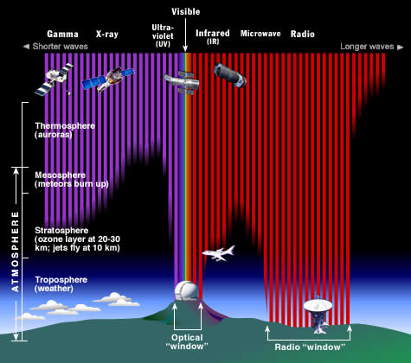
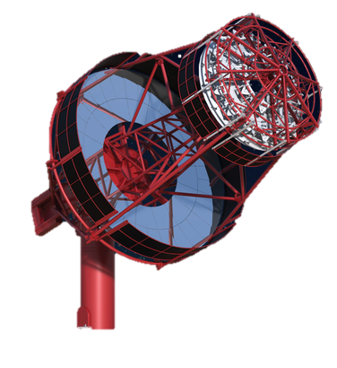
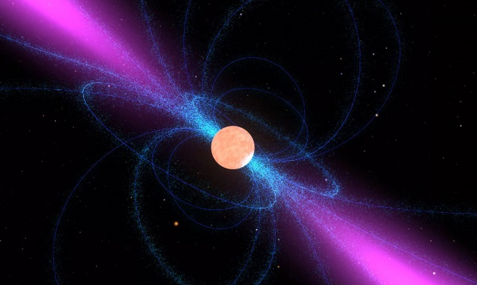
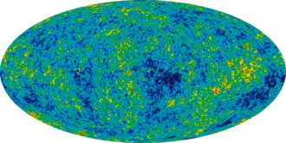
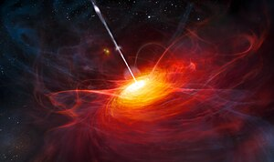
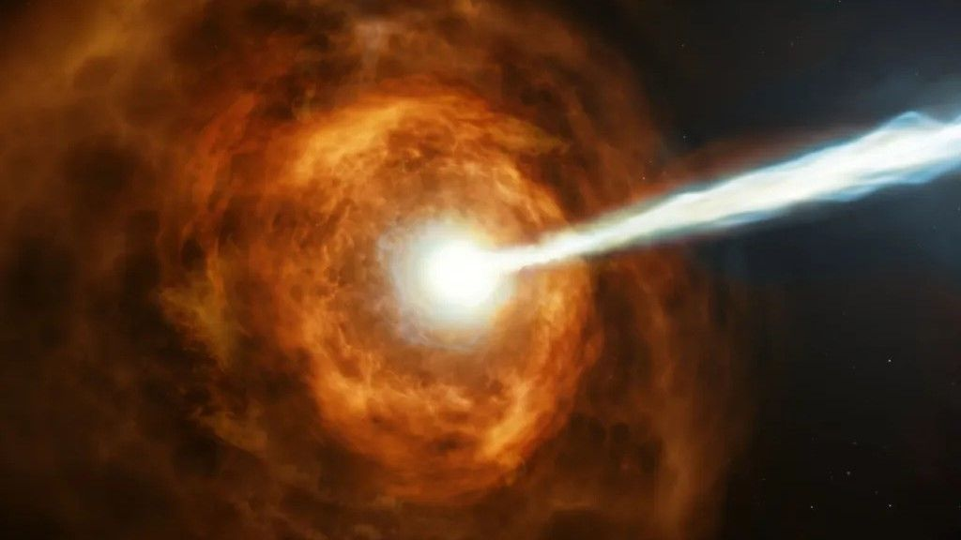
Introduction
Up to first decades 20th century:
observation possible only in the visible
Late 1950s a revolution occurred:
  Opening of the e.m. spectrum: larger observation field
  First observations in the radio waveband and later in the IR, the X-ray and the gamma-ray bands led to exciting discoveries
  Combination of information coming from different experiments working at various frequencies
    birth of Multi-wavelength astronomy
  Development of new detectors allowed the use of new probes for the study of the Cosmos
    evolution towards Multi-messenger astronomy
pulsars
CMB
quasars
gamma-ray
bursts

Slide 4
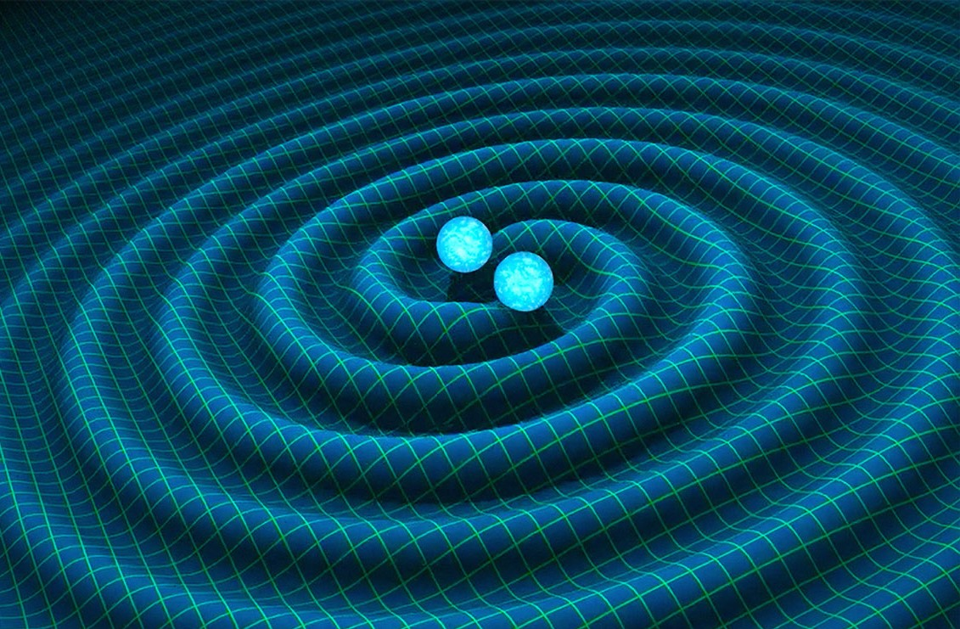
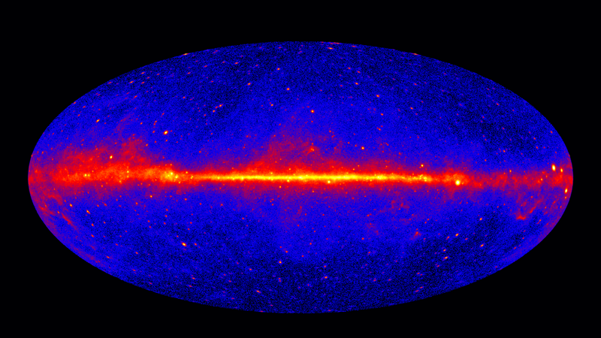
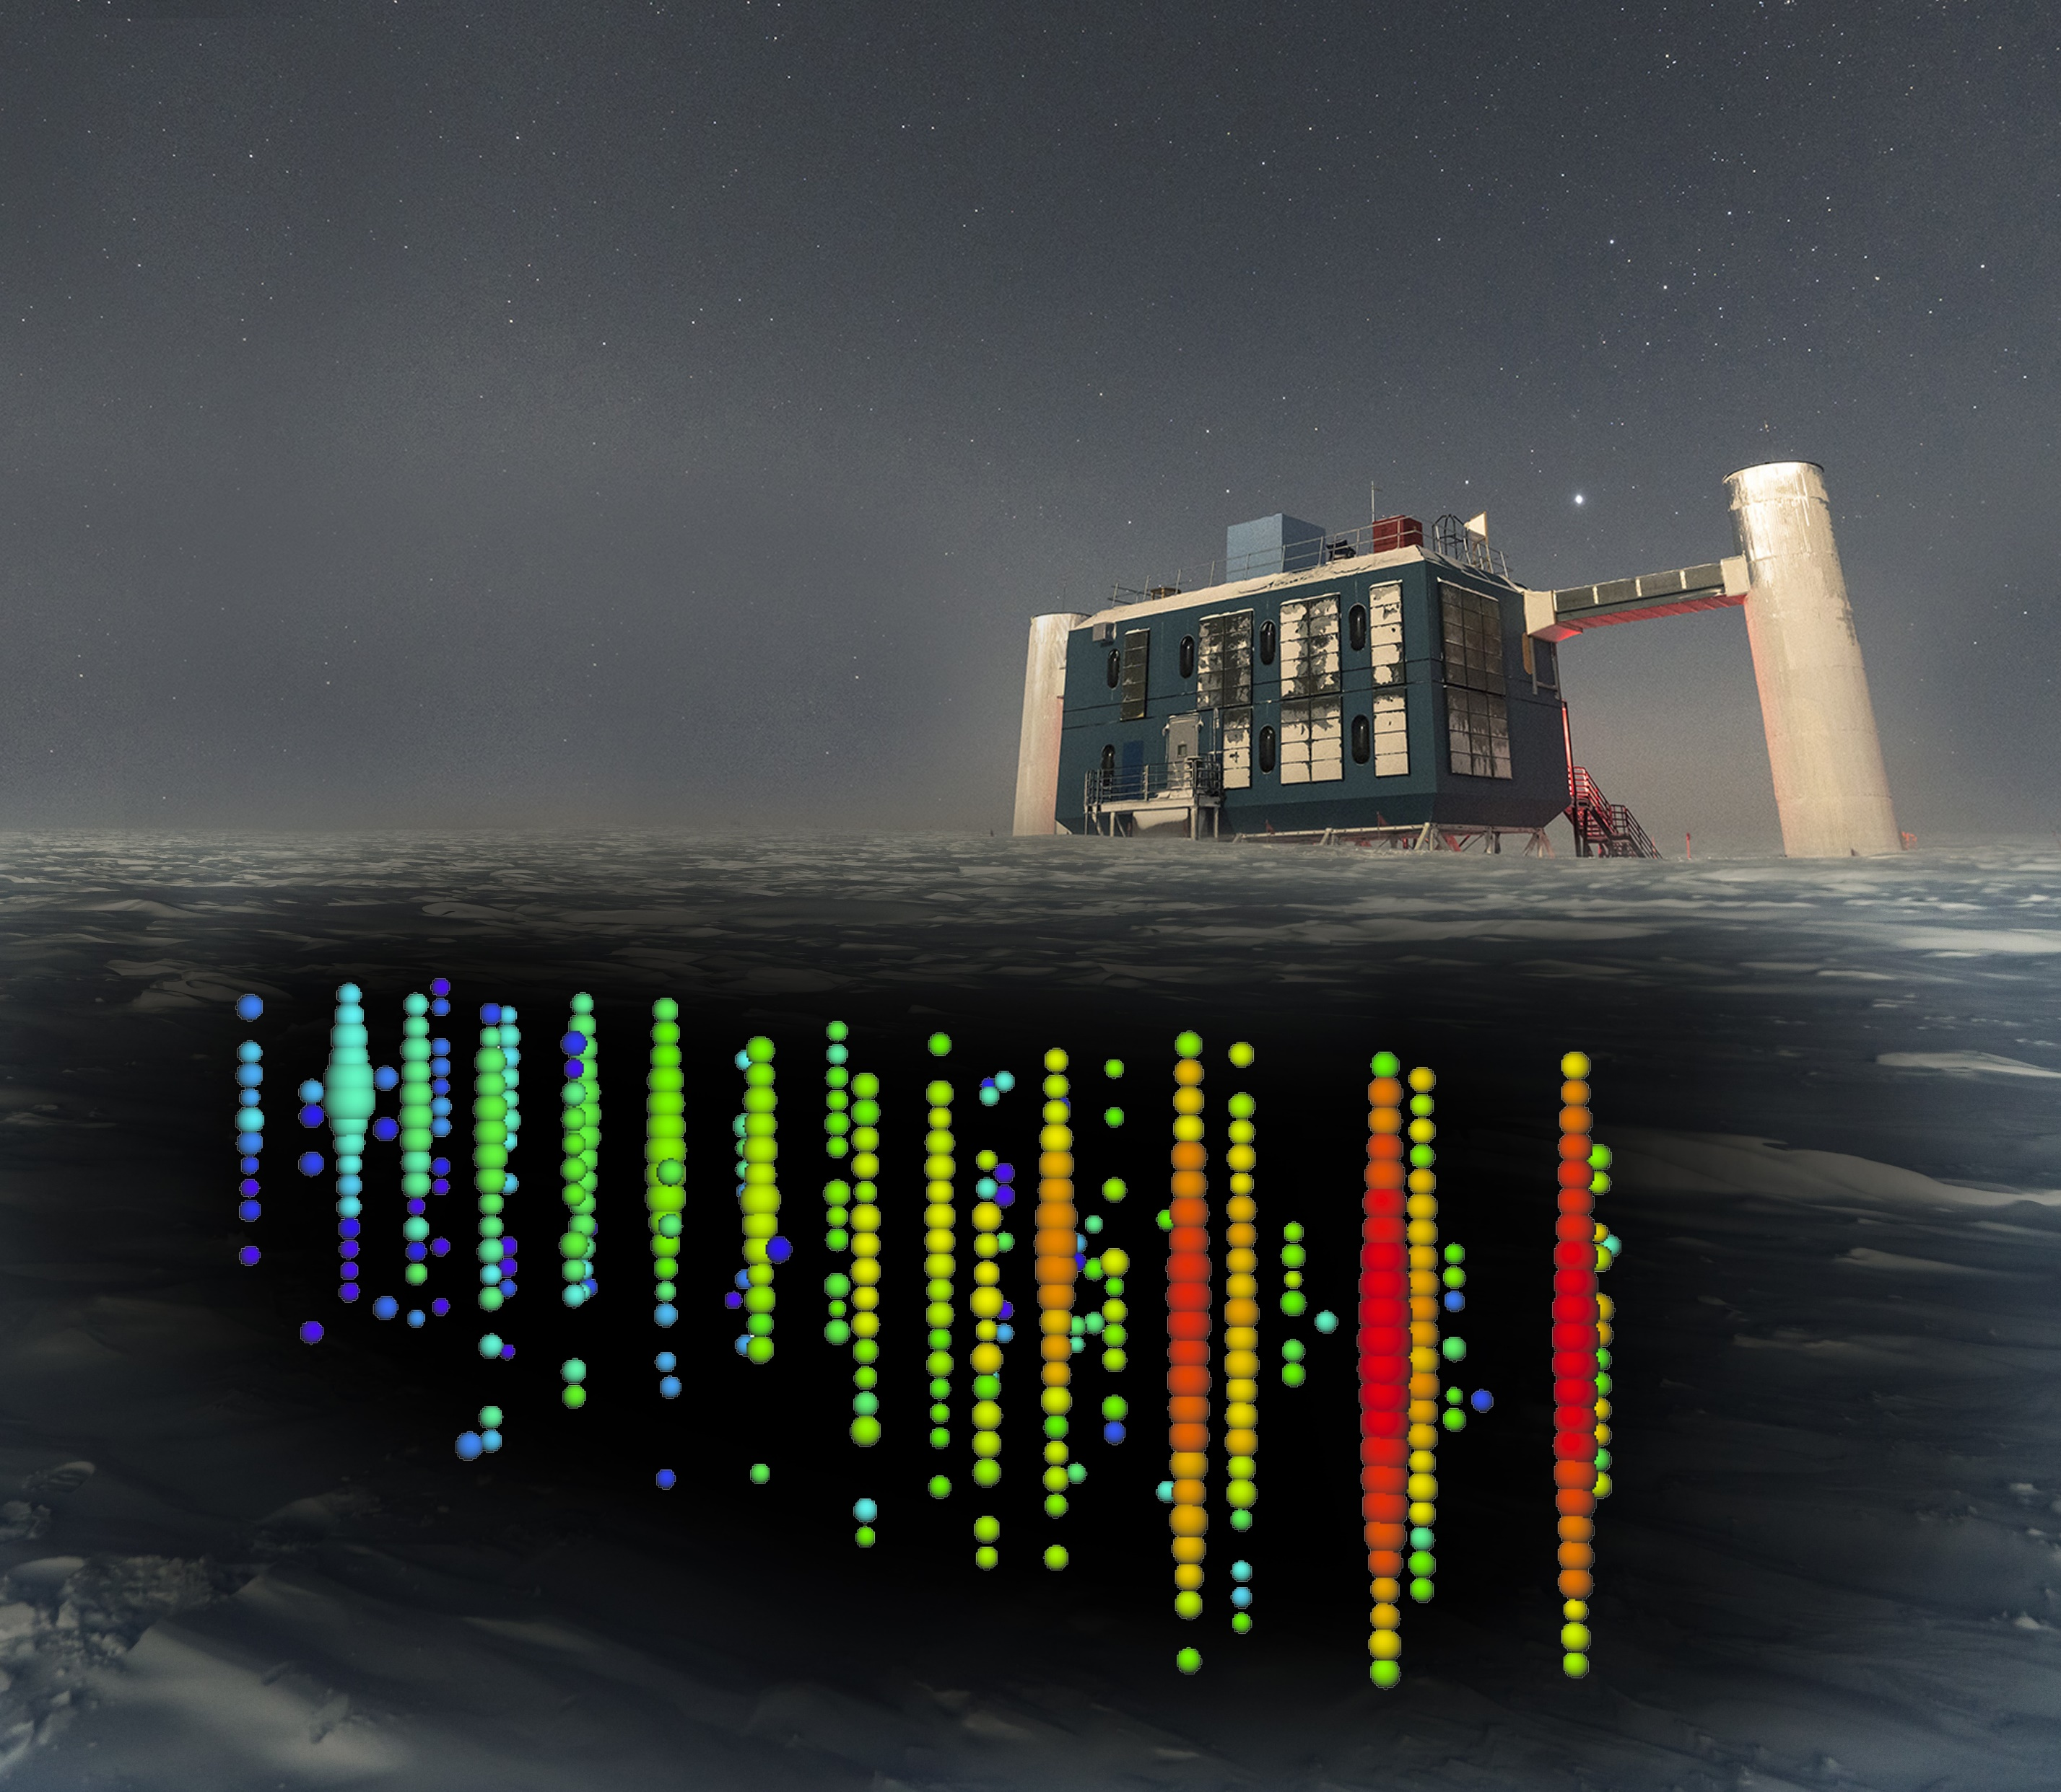
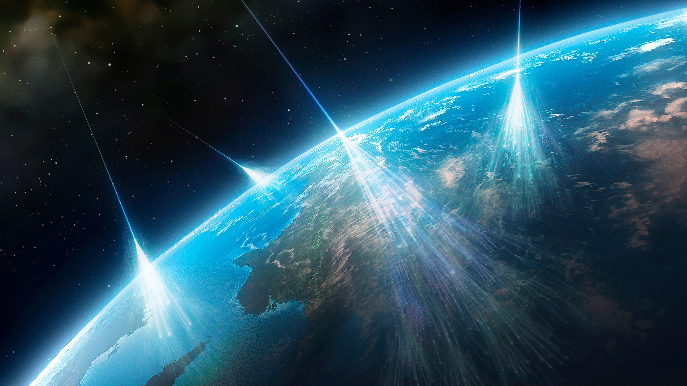
Messengers from the High-Energy Universe
Information about the phenomena occurring in our Universe can be retrieved through various types of messengers:
Neutral
Charged
Gravitational waves
Gamma rays
Neutrinos
Cosmic
rays

Slide 5
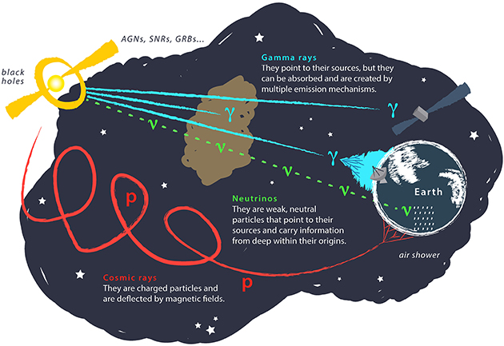

Messengers from the High-Energy Universe
Charged CRs are deflected due to galactic magnetic fields → not reliable to localize CRs sources
Neutral messengers like $γ$ and $ν$ necessary to gain information about production and acceleration sites of CRs
While $ν$ are very elusive, $γ$ nowadays can be detected both from space and the ground
$γ$-ray emission can be explained in terms of:
  Leptonic model: $γ$ emitted due to energy losses of high-energy electrons propagating through the ISM
  Hadronic model: HE radiation signature of the presence of accelerated protons
Emission spectrum of the sources fundamental to disentangle between the two models

Slide 6
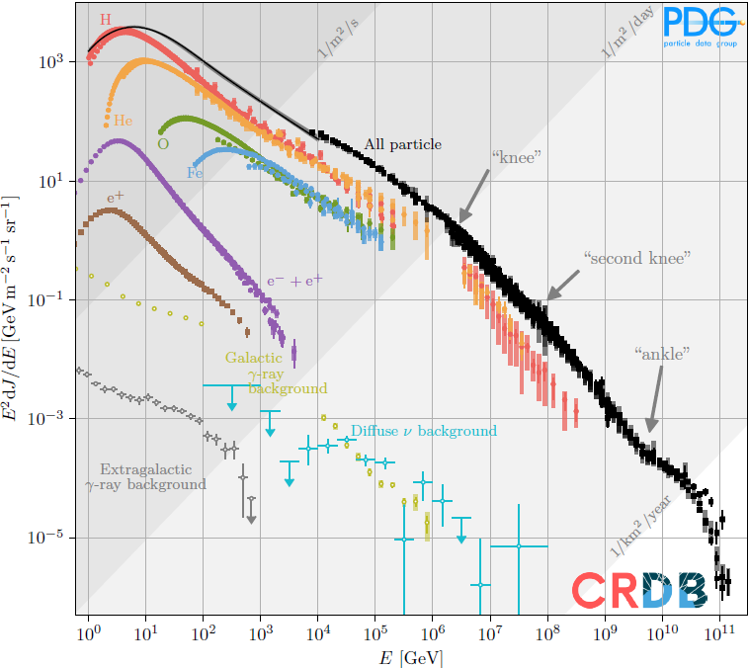

Messengers from the High-Energy Universe
Charged Cosmic Rays
Charged particles coming from the outer space
Primary CRs: stable HE particles produced at the source
Secondary CRs: results of the interaction between the primaries and ISM or Earth’s atmosphere
Spectrum: covers wide energy range
  Steepening at the knee $\sim 5 ∙ {10}^{15}eV$
  Hardening at the ankle $\sim 5 ∙ {10}^{18}eV$
  Strong decrease above $\sim 5 ∙ {10}^{19}eV$
Composition
  $\sim 98 \%$ are protons and heavier nuclei
  Remaining fraction composed of $e^{±}, ν, γ$
Notes:
Bassa energia: prodotti nelle vicinanze del Sistema solare
Media energia: prodotti nella galassia, passaggio da ginocchio a secondo ginocchio è frutto di cut-off dei vari nuclei da H al C
Alte energie: prodotti al di fuori della galassia
Cut-off a 10^20: gzk mechanism → interazione con CMB

Slide 7

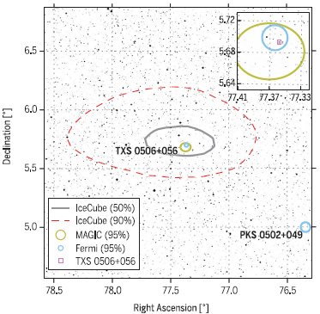


$γ$-ray emitters as CRs sources
Gamma-ray astronomy provides excellent view of non-thermal Universe and helps detecting good candidate CRs sources
Best candidates for acceleration of CRs to UHE: Active Galactic Nuclei (AGN)
  Extragalactic $γ$-ray emitters powered by central supermassive black holes (SMBHs)
  Not possible morphological studies due to poor spatial resolution of $γ$-ray telescopes
  $γ$rays + other data (e.g. radio)
  helps understanding presence of acceleration regions within these sources, in the vicinity of the central BH
Galactic regions: $γ$ rays detected by several types of sources e.g. pulsars, pulsar wind nebulae (PWN), microquasars, supernova remnants (SNRs)
Science361, eaat1378 (2018)
DOI:10.1126/science.aat1378
Notes:
Plot AGN

Slide 8
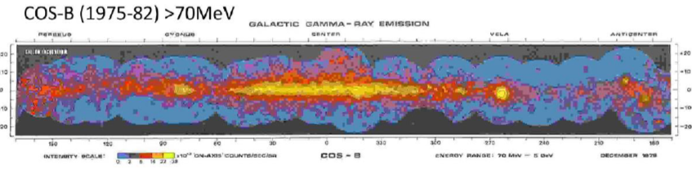
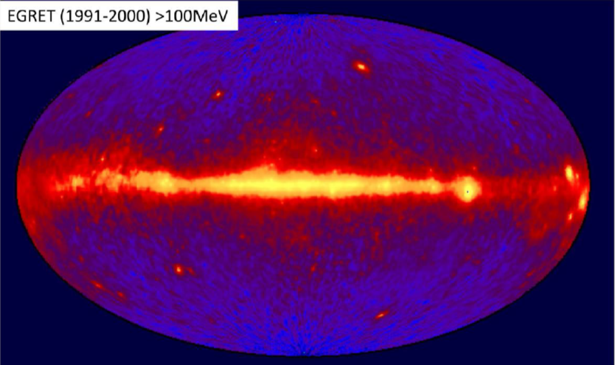

Gamma-ray instruments for the exploration of CRs sources
Gamma-ray astronomy in 20th century
In space:
  1961 - Explorer XI mission (first $γ$ rays revealed)
  Early 1970s - SAS-2 mission (8000 photons )
  Late 1970s - COS-B mission (25 galactic sources)
On the ground:
  Early 1970s - First VHE photons observed by Cherenkov telescopes
  1980s – First UHE photons ($\sim {10}^{15}eV$) observed by EAS arrays
Turning point
Compton Gamma-Ray Observatory (CGRO)
  Operational between 1991 – 2000
  4 experiments: BATSE – OSSE – COMPTEL - EGRET
Whipple Cherenkov telescope
  First telescope adopting IACT technique
  Crab nebula detected at $9σ$ above 0.7 TeV
SAS-2 satellite
COS-B: first counts map
EGRET sky map
Notes:
Early 1970s - First VHE photons observed by Cherenkov telescopes of Crimean Observatory (from Cygnus X-3)
1980s – First UHE photons from Haverah park EAS array

Slide 9
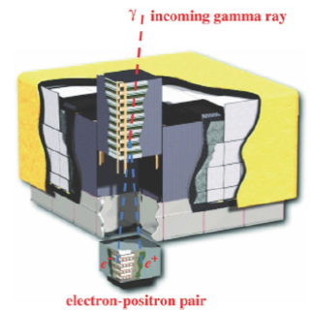
Gamma-ray instruments for the exploration of CRs sources
Current view of the GeV sky: the Fermi space observatory
Launched by NASA on 2008 June 11, still working
Orbiting at 565 km, inclination of 25.6° wrt Earth’s equator
Hosts two experiments:
  Large Area Telescope (LAT)
  Gamma-Ray Burst Monitor (GBM)
LAT
Imaging, pair-conversion gamma-ray telescope
Working between few tens of MeV up to few TeV
Composed of
  Precision converter/tracker
  Calorimeter
  Anticoincidence Detector

Slide 10
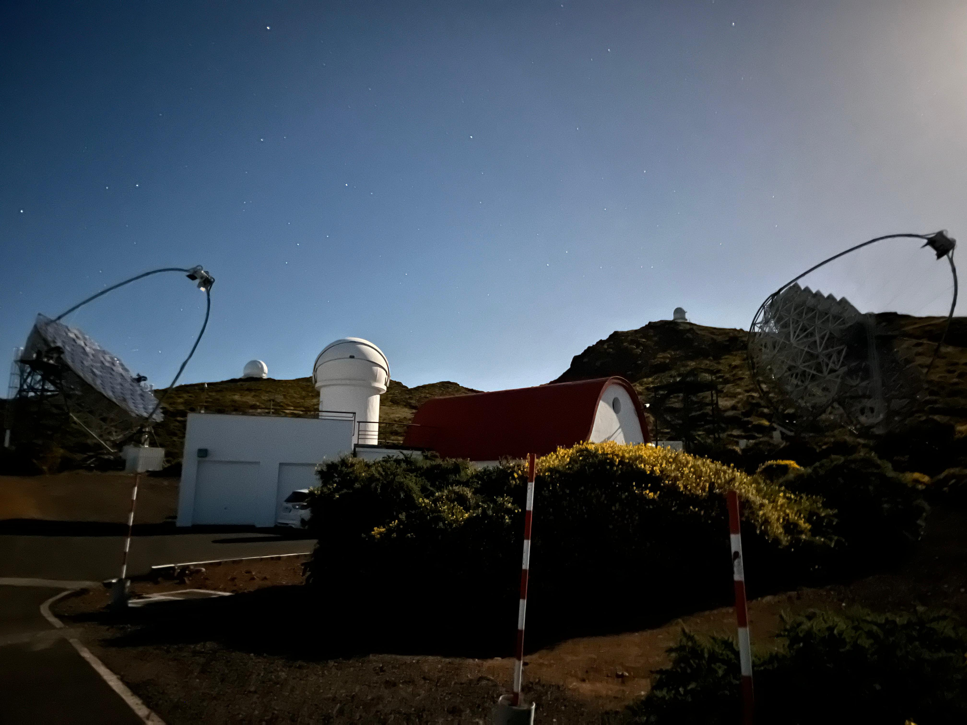

Gamma-ray instruments for the exploration of CRs sources
Current view of the TeV sky: modern Cherenkov telescopes
Based on Imaging Atmospheric Cherenkov (IAC) technique
Four main experiments:
  Major Atmospheric Gamma-ray Imaging Cherenkov (MAGIC) telescopes - La Palma, Canary islands
  High Energy Stereoscopic System (H.E.S.S.) - Namibia
  Very Energetic Radiation Imaging Telescope Array System (VERITAS) – Arizona, USA
  Large-Size Telescope 1 (LST-1) - La Palma, first of future
  Cherenkov Telescope Array Observatory (CTAO)
  ASTRI Horn - Mount Etna, prototype for future
  ASTRI mini-array
The MAGIC telescopes
System of two IACTs at 2200 m a.s.l.
Carbon fiber-epoxy and aluminum structure
17-meter parabolic reflectors consisting of 247 individual panels
Cameras composed of 1039 PMTs with a FoV of $≅3.5°$
MAGIC site July 2024
Notes:
Main exp: LST as part of future CTAO
MAGIC: shifter

Slide 11

Probing CRs acceleration and escape through γ rays: the case of the W44 SNR
SNR: combination of shock wave, expanding ejecta, swept up ambient gas and turbulent magnetic fields
Many of the HE 𝛾-ray emitters correspond positionally to SNRs
1st order Fermi acceleration mechanism or Diffusive Shock Acceleration (DSA) at strong shocks naturally produces a spectrum of cosmic rays close to what is observed, in particular up to the knee ($∼3 ∙ {10}^{6}$ GeV)
SNRs are among the strongest candidates as accelerators of CRs
  Shocks driven by expanding ejecta from supernovae optimal for acceleration of Galactic Cosmic Rays through DSA
  Environments providing ideal targets for the interactions with CRs, e.g. molecular clouds and photon fields
The supernova remnant paradigm

Slide 12

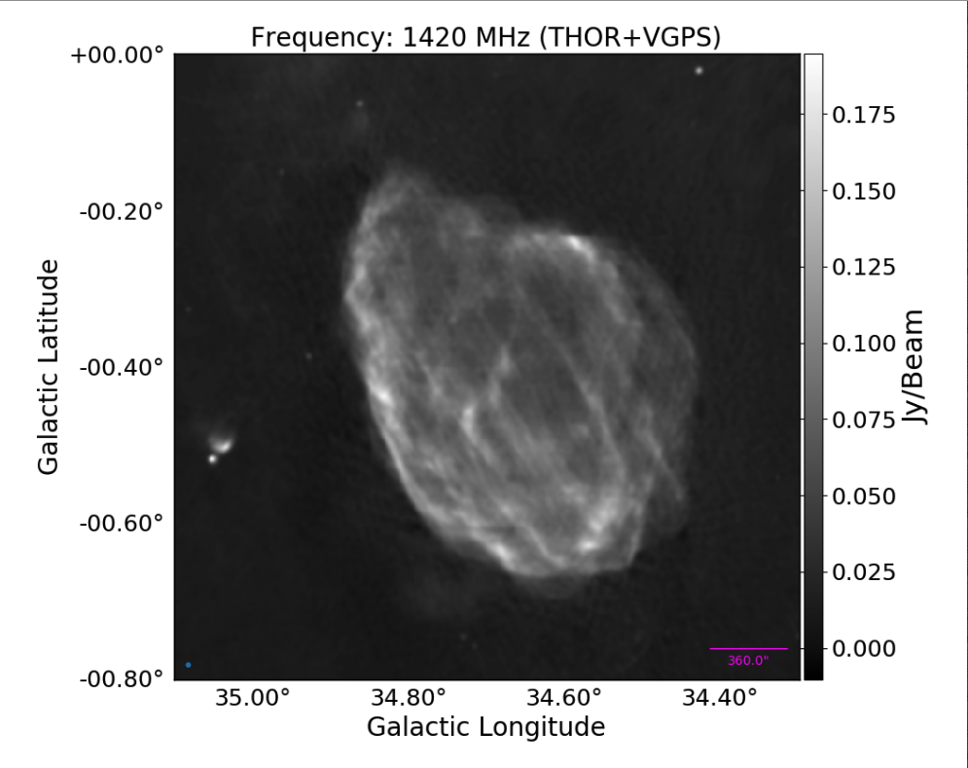
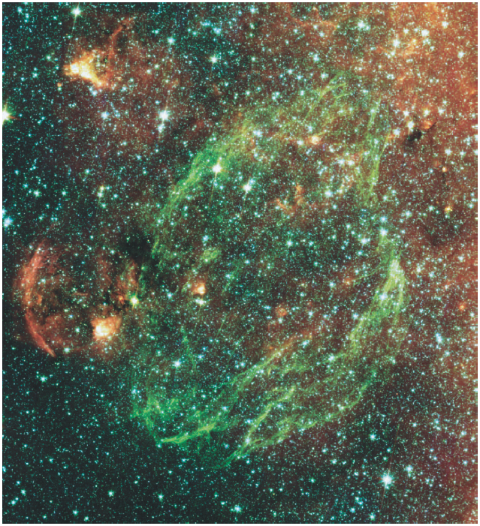
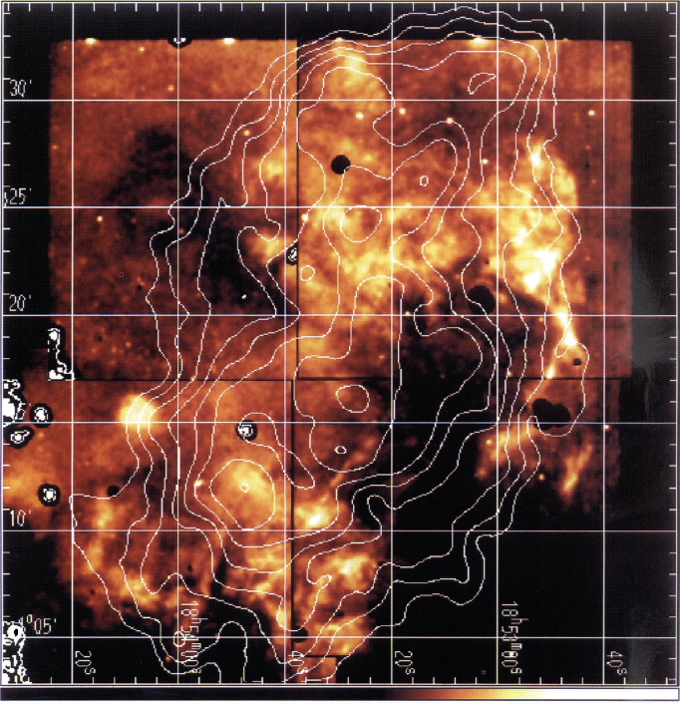

Probing CRs acceleration and escape through γ rays: the case of the W44 SNR
The extended SNR W44
Age $\sim 2∙{10}^{4} yr$
$\left(GLON,GLAT\right)=(34.7°, −0.4°)$
$\left(RA,DEC\right)=(284.0°, 1.37°)$
Distance $\sim 2−3 kpc$
Composite SNR:
    shell
    PWN surrounding PSR B1853+01 extending $\sim 1′−2 ′$
W44 observations:
    Radio and IR: distorted shell elongated SE-NW, extent $\sim 25−30 pc$, filamentary and clumpsy emission
    Optical: filaments immersed in a diffuse emission
    X-rays: centrally concentrated
SNR-MC observations:
    SNR interacting with parent MC complex
    Extent $\sim 100 pc$

Slide 13
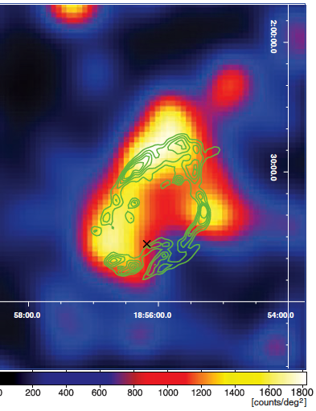
Probing CRs acceleration and escape through γ rays: the case of the W44 SNR
The extended SNR W44 – previous GeV observations
  Significantly extended GeV emission
    The bulk of the GeV emission comes from the shell
    not possible to attribute most of the 𝛾-rays to the pulsar or its PWN
    Quasi-elliptical pattern: first template for W44 morphology
Observations of the surroundings: 2 extended residuals
  Uchiyama - 2012: modelled as disks of radius 0.4° (SRC1, SRC2)
  Peron - 2020: modelled as disks of radius 0.42° (SRC1/NW) and 0.15° (SRC2/SE)
A. Abdo et al. 2010 Science 327
A. Giuliani et al 2011 ApJL 742 L30
Uchiyama et al 2012 ApJL 749 L35
Peron et al 2020 ApJL 896 L23
Notes:
(Abdo 2010): elliptical ring resembling IR ring

Slide 14
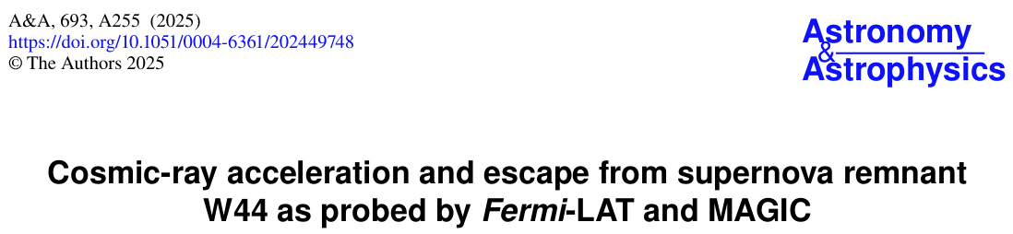
Probing CRs acceleration and escape through γ rays: the case of the W44 SNR
Recently published!
A&A, 693 (2025) A255
https://doi.org/10.1051/0004-6361/202449748
Fermi-LAT analysis setup
142 months of data
Energy range: 100 MeV – 2 TeV
Analysis in two steps:
  Morphological analysis:
    1 GeV – 2 TeV -> better PSF, reduced source confusion
  Spectral analysis:
    100 MeV – 2 TeV
Source model map created:
  sources from 4th Fermi-LAT catalog version DR2
  Latest Galactic and Isotropic background models
MAGIC analysis setup
Data: april 2013 and august 2014 for 173.7 h
Zenith angle: 25° - 45°
Energy range: above 130 GeV
High-level spatial likelihood analysis based on Fermi HE results
  Included in source region model info related to localization and extension of sources found in Fermi analysis
Notes:
SOURCE class is the recommended selection for steady point-like or moderately extended sources

Slide 15


Probing CRs acceleration and escape through γ rays: the case of the W44 SNR
Fermi-LAT morphological analysis
Energy range: 1 GeV– 2 TeV
Selected events with best reconstruction quality for direction
Re-modelling of inner Region of Interest (RoI): 1° deg around the center
  All sources in this range erased from model
  Algorithm for the identification of sources applied
  Sources having significance higher than threshold added to source model
Test for evidence of spatial extension (compared to point-like source)
Test for evidence of spectral curvature (compared to power law spectrum)
Akaike Information Criterion (AIC) used to compare different models
$$TS=2\left(lnL_{1}−lnL_{0}\right)>25$$
$${TS}_{ext}=2\left({logL}_{ext} − {logL}_{ps}\right)>25$$
$${TS}_{curv}=2\left({logL}_{curv} − {logL}_{PL}\right)>20$$
$$AIC=2k−2ln⁡(\hat{L})$$

Slide 16
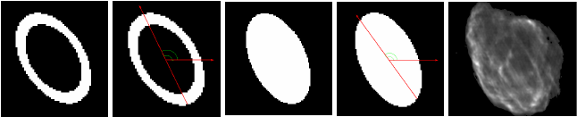
Probing CRs acceleration and escape through γ rays: the case of the W44 SNR
Fermi-LAT morphological analysis – W44 morphology
W44 spatial features described through several templates:
  Elliptical ring, from 4FGL-DR2 catalog (a)
  Full ellipse template (b)
  Elliptical templates divided in half and fitted separately (c - d)
  Radio (1420 MHz) template from THOR survey (e)
Source-finding procedure repeated 5 times, each time with a different spatial template for the W44 SNR
a)
b)
c)
d)
e)

Slide 17
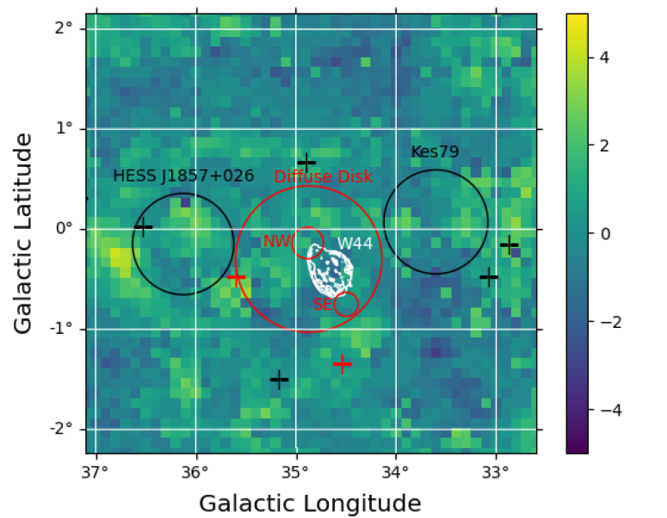

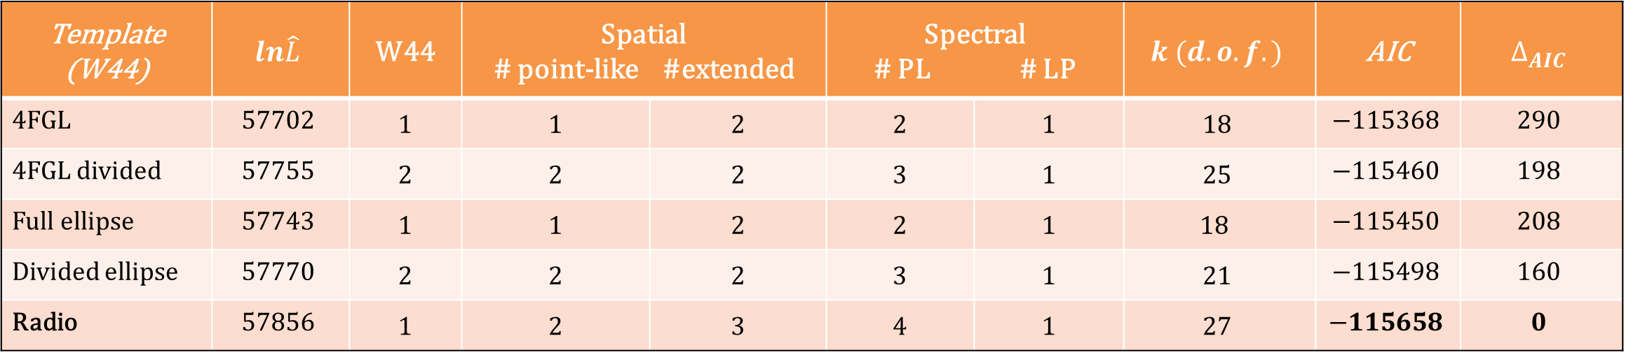
Probing CRs acceleration and escape through γ rays: the case of the W44 SNR
High energy morphological analysis
Best model of RoI obtained with the following configuration:
  Radio template used for W44
  Two small Radial Disk sources found in the NW and SE regions
  Large extended diffuse source (called Diffuse Disk in the map)
$$σ$$
Template (W44) | $$ln\hat{L}$$ | W44 | Spatial # point-like #extended |  | Spectral # PL # LP |  | $$k (d.o.f.)$$ | AIC | $$∆_{AIC}$$
4FGL | $$57702$$ | 1 | 1 | 2 | 2 | 1 | $$18$$ | $$−115368$$ | $$290$$
4FGL divided | $$57755$$ | 2 | 2 | 2 | 3 | 1 | $$25$$ | $$−115460$$ | $$198$$
Full ellipse | $$57743$$ | 1 | 1 | 2 | 2 | 1 | $$18$$ | $$−115450$$ | $$208$$
Divided ellipse | $$57770$$ | 2 | 2 | 2 | 3 | 1 | $$21$$ | $$−115498$$ | $$160$$
Radio | $$57856$$ | 1 | 2 | 3 | 4 | 1 | $$27$$ | $$−115658$$ | $$0$$

Slide 18
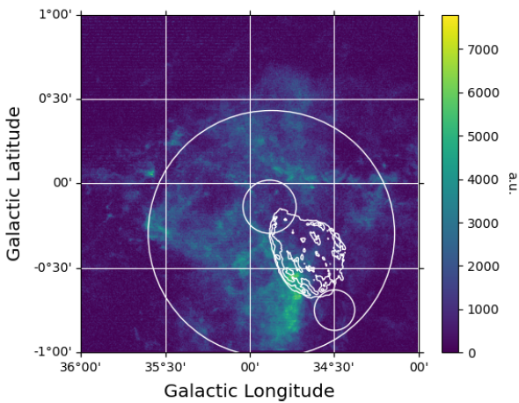

Probing CRs acceleration and escape through γ rays: the case of the W44 SNR
High energy morphological analysis – Diffuse Disk
Possible associations with gas complexes
Analysis repeated with previous best-fit model replacing Diffuse Disk with new templates
Templates derived from ¹²CO and ¹³CO data
Selected 9 velocity intervals between 30 km/s and 90 km/s
Diffuse Disk spatial model still statistically preferred with $ΔAIC=10.6$
(38.6 - 49.8) km/s
Notes:
Radial velocity interval large in order to include all the extension, in depth, of the molecular cloud in which the SNR is embedded

Slide 19
Probing CRs acceleration and escape through γ rays: the case of the W44 SNR
Fermi - LAT Spectral analysis
Energy range: 100 MeV – 2 TeV
Morphology set on the results of HE analysis
Repeated curvature test with log-Parabola, Broken Power Law (compared to a simple PL spectrum)
Weighted likelihood procedure for mitigating effect of systematics (mainly due to imperfect knowledge of Galactic background emission)
Sources reasonably well resolved above 1GeV

Slide 20
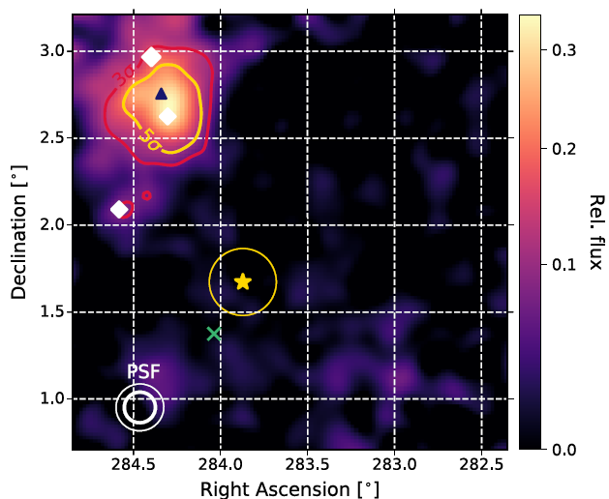
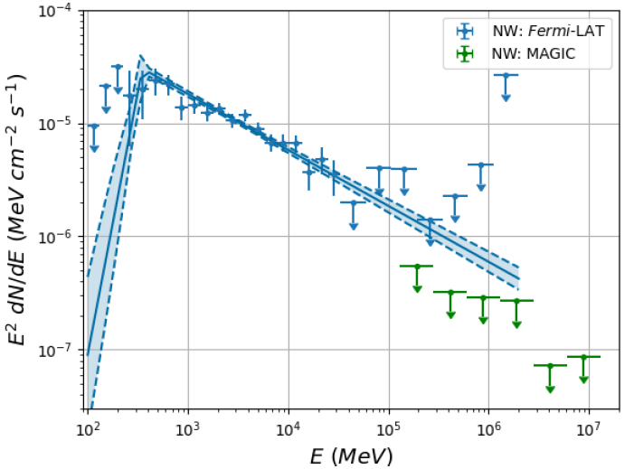
Probing CRs acceleration and escape through γ rays: the case of the W44 SNR
Hints in the TeV regime: MAGIC observations
Looking for a signal corresponding to NW source
No significant detection was found
Evaluated ULs at 95% CL constraining the emission at very-high energies
NW
W44

Slide 21
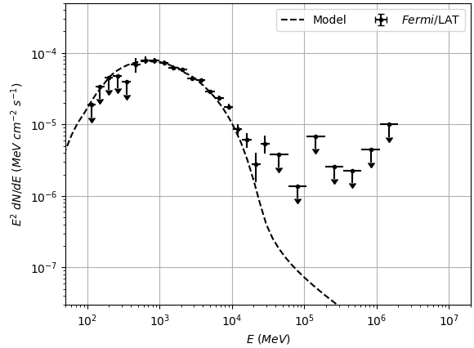
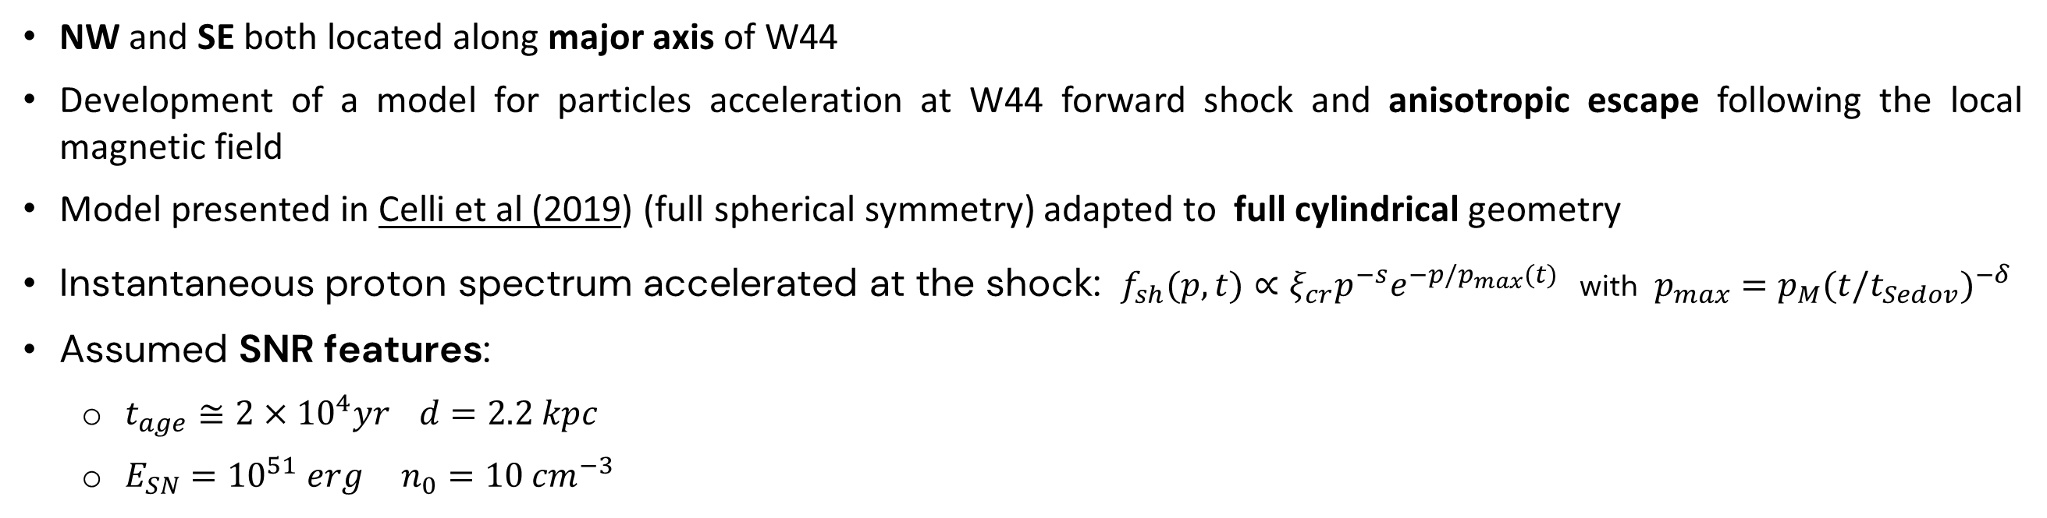
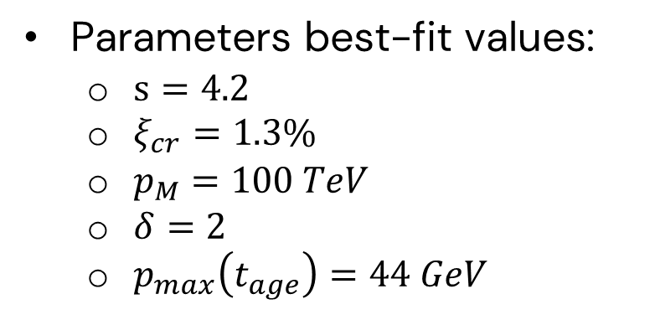
Probing CRs acceleration and escape through γ rays: the case of the W44 SNR
A hadronic model: acceleration and escape of CRs from the SNR W44
NW and SE both located along major axis of W44
Development of a model for particles acceleration at W44 forward shock and anisotropic escape following the local magnetic field
Model presented in Celli et al (2019) (full spherical symmetry) adapted to full cylindrical geometry
Instantaneous proton spectrum accelerated at the shock: $f_{sh}(p,t)∝ξ_{cr}p^{−s}e^{−p/p_{max}(t)}$ with $p_{max}=p_{M}{(t/t_{Sedov})}^{−δ}$
Assumed SNR features:
  $t_{age}≅2×{10}^{4}yr$ $d=2.2 kpc$
  $E_{SN}={10}^{51} erg$ $n_{0}=10 {cm}^{−3}$
Parameters best-fit values:
  $s=4.2$
  $ξ_{cr}=1.3\%$
  $p_{M}=100 TeV$
  $δ=2$
  $p_{max}\left(t_{age}\right)=44 GeV$

Slide 22
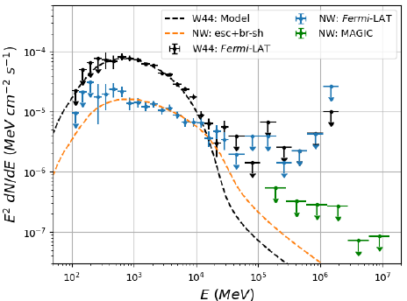
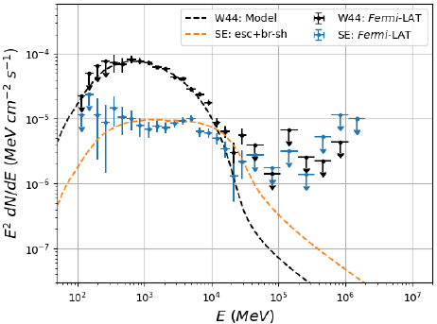

Probing CRs acceleration and escape through γ rays: the case of the W44 SNR
A hadronic model: emissions from the NW and SE clouds
HE emissions from NW and SE well modelled assuming
  Same distance as the SNR: $d=2.2 kpc$
  Distances W44 – clouds: $17.3 pc \left(NW\right), 15.7 pc (SE)$
Low energy emission underestimated, necessary to add further component
Broken-shock scenario helps reducing the gap
  Middle-aged SNR expanding in inhomogeneous medium
  Shock surface possibly broken where upstream medium is denser
  Certain amount of particles having energy smaller than $E_{max}⁡(t_{age} )$ able to escape from a small portion $f_{br}$of the shock surface
    $f_{br}=0.2$ (NW), $0.1$ (SE)
W44 and NW spectra observed and modelled
W44 and SE spectra observed and modelled

Slide 23
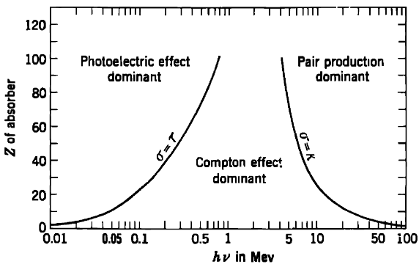
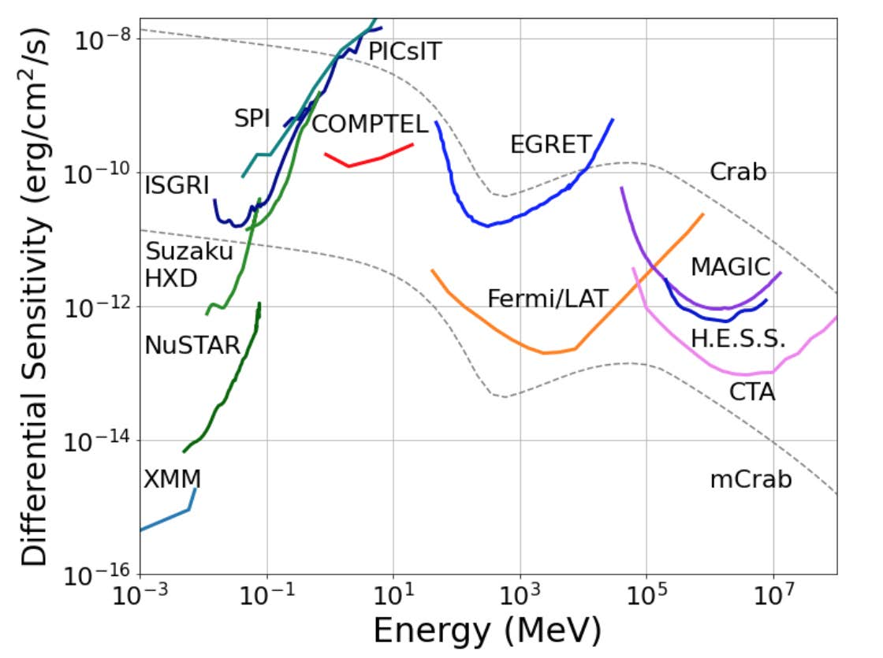

A long-term goal: the MeV band gap
The Compton Gamma-Ray Observatory
Rich scientific potential:
  Disentangling between hadronic and leptonic models in SNRs
  LE gamma-ray counterparts of MM events
  Investigate nuclear processes in the Galaxy
Poorly explored energy range due to physical, technological and environmental issues
  Low $γ/$matter interaction cross-section
  Dominant process: Compton scattering
  Needed detectors with large volumes and $d_{I}\sim 10 g/{cm}^{2}$
COMPTEL only instrument so far able to provide a view of the MeV sky
  Modest sensitivity limited by large background, mainly instrumental
  Relatively low effective area
  Poor angular resolution
Notes:
Neutron stars, black holes, magnetars with extreme magnetic fields, and AGN with relativistic jets are natural accelerators emitting gamma rays through processes like bremsstrahlung, inverse Compton, and synchrotron radiation.

Slide 24
A long-term goal: the MeV band gap
New telescopes for the exploration of the MeV regime
New generation of Compton telescopes based on semiconductors (Si)
Instead of double-scatterer geometry (COMPTEL-like), new multi-layer design with several thin layers
Lighter and compact architecture
Reconstruction of recoil electron track becomes possible
  Help to constrain original photon direction
  Improve background rejection
Use of semiconductors requires segmentation: strips or pixels
Two main proposals presented until now:
  The ASTROGAM Observatory - Si strips (2017)
  The All-sky Medium Energy Gamma-ray Observatory (AMEGO) – Si pixels (2021)
Double-scatterer geometry
Electron-tracking geometry
Notes:
New concepts to explore the MeV regime. Comptel was not able to track recoil electron. New geometry with several layers of semiconductor materials: effort to reconstruct completely the kinematics

Slide 25


A long-term goal: the MeV band gap
Concept of a demonstrator for the MeV regime
Preliminary study for a new concept of Compton telescope, following the electron-tracking approach
Monte Carlo simulations: Geant4, v.10.04.02
First study: large geometry
Tracker: 100 layers of silicon (G4_Si) having dimensions $\left(50×50\right){cm}^{2}$
Thickness of the layers between $50μm$ and $1 mm$
Calorimeter: 1 layer of CsI (G4_CESIUM_IODIDE), same dimensions of the tracker and thickness of 10 cm
Energies of the primary photon between 250 keV and 50 MeV
Photons impinging perpendicularly at the center of the top layer
$$γ$$
Notes:
Due to the growing interest this field is gaining over time, a certain amount of the PhD project was dedicated to start an R&D activity for the development of a concept of a Compton telescope
For the thickness several values were taken into account between 50 μm and 1 mm, in order to understand which one could represent the best trade-off between the need of material to let the first interaction occur, and the number of layers thin
Aim of the large geometry: study the evolution of the system of particles produced in Compton scattering events, i.e. the recoil electron and the scattered photon, from their emission up to their absorption.

Slide 26

A long-term goal: the MeV band gap
Concept of a demonstrator for the MeV regime
Main problem faced even with thinnest layers ($50μm$): Multiple scattering
The information retrieved from the reconstructed electron direction does not help enough
For events triggered by primary photons with energy below 1 MeV, the reconstruction of the electron track is hardly possible
“Good” events, few hits in the tracker and scattered photon absorbed in the calorimeter are, actually, quite difficult to reconstruct
“Bad” events, with electron tracks spiralizing
26

Slide 27

A long-term goal: the MeV band gap
Concept of a demonstrator for the MeV regime
Second study: small geometry
Tracker: 9 layers of silicon (G4_Si) having dimensions $\left(3×1.5\right){cm}^{2}$
Thickness of the layers fixed at $50μm$
Reproduction of A9 stack developed for Pixel Chamber
No Calorimeter: focus entirely on the capability of tracking the electron
Energies of the primary photon between 250 keV and 10 MeV
Photons impinging tangentially on the central layer of the stack
Digitization of the datasets dividing layers into pixels, each having dimension $≈28μm$ → $(1024×512) {pix}^{2}$ per layer
Notes:
The Pixel Chamber project aims to produce a solid state active target capable of performing continuous, high-resolution (O(μm)) 3D tracking. The A9 stack represents the basic Pixel Chamber unit and consists of a stack of 9 ALPIDE sensors, designed for the upgrade of the Inner Tracking System of the ALICE experiment at the CERN LHC.
Impact point the 3-cm long lateral side of the central layer

Slide 28
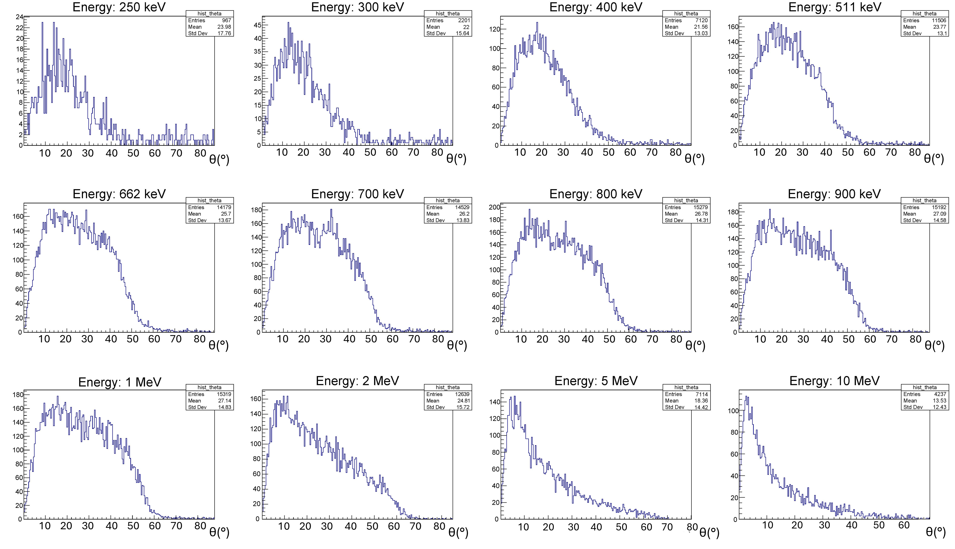

Gamma-ray instruments for the exploration of CRs sources
Concept of a demonstrator for the MeV regime
Preliminary reconstruction of the electron tracks with linear fit
Preliminary
Next ESA call M8
Notes:
Distributions of the angles separating the true direction and the reconstructed direction of the recoil electrons.
The angles, which essentially represent the uncertainty on the reconstruction of the electrons’ track, are relatively wide.
For sure, more refined techniques should be applied to reconstruct the direction of the recoil electron, in particular to deal more efficiently with the effects of multiple scattering.

Slide 29
,
Conclusions and outlook
Multi-wavelength (MW) and Multi-messenger (MM) astronomy rapidly growing disciplines thanks to the opening of new observational windows and strategies
Important contribution from gamma-ray astronomy thanks to experiments for direct detection (e.g. CGRO, Fermi-LAT) and indirect detection (IACTs) of high-energy photons
Gamma-ray emitters possible acceleration sites of CRs
Best candidates: SNRs, considered most important CRs factories and accelerators in the Galaxy
  Case of study: middle-aged SNR W44
  Observations from Fermi-LAT and MAGIC provide clear connection between HE/VHE emission and CRs acceleration in that region (indeed hadronic model works well)
Future developments
  Exploration of MeV band fundamental: bridge between thermal and non-thermal Universe and for gamma-ray counterparts of MM events
  R&D activity started during the PhD for a new concept of electron-tracking MeV telescope
Thank you for your attention!
Notes:
Unire con la precedente
Futuro con IACT su SNR o sorgenti galattiche

Slide 30
Lista delle pubblicazioni
Cosmic-ray acceleration and escape from W44 SNR as probed by Fermi-LAT and MAGIC
S. Abe,… R. Di Tria et al., A&A, 693 (2025) A255, https://doi.org/10.1051/0004-6361/202449748
GRB 221009A: the B.O.A.T Burst that Shines in Gamma Rays
M. Axelsson, ..., R. Di Tria, ... et al., 2025 ApJS 277 24, DOI: 10.3847/1538-4365/ada272
Prospects for a survey of the Galactic plane with the Cherenkov Telescope Array
S. Abe, … R. Di Tria, … et al., 2024
Accepted for publication in JCAP.
https://doi.org/10.48550/arXiv.2310.02828
Constraints on VHE gamma-ray emission of Flat Spectrum Radio Quasars with the MAGIC telescopes
S. Abe, … R. Di Tria, … et al., Monthly Notices of the Royal Astronomical Society, stae2313, October 2024
https://doi.org/10.1093/mnras/stae2313
Constraints on Lorentz invariance violation from the extraordinary Mrk 421 ﬂare of 2014 using a novel analysis method
S. Abe, … R. Di Tria, … et al., JCAP, Volume 2024, Number 7, July 2024
https://dx.doi.org/10.1088/1475-7516/2024/07/044
Observations of the Crab Nebula and Pulsar with the Large-Sized Telescope Prototype of the Cherenkov Telescope Array
H. Abe, … R. Di Tria, … et al., The Astrophysical Journal, Volume 956, Number 2, October 2023, https://dx.doi.org/10.3847/1538-4357/ace89d
Sensitivity of the Cherenkov Telescope Array to TeV photon emission from the Large Magellanic Cloud
A. Acharyya, … R. Di Tria, … et al., MNRAS, Volume 523, Issue 4, August 2023, Pages 5353–5387
https://doi.org/10.1093/mnras/stad1576

Slide 31
Lista delle pubblicazioni
Multiwavelength study of the galactic PeVatron candidate LHAASO J2108+5157
S. Abe, … R. Di Tria, … et al., A&A, Volume 673, Number A75, May 2023
https://doi.org/10.1051/0004-6361/202245086
Prospects for gamma-ray observations of the Perseus galaxy cluster with the Cherenkov Telescope Array
K. Abe, … R. Di Tria, … et al.
Submitted to JCAP.
https://doi.org/10.48550/arXiv.2309.03712
Sensitivity of the Cherenkov Telescope Array to spectral signatures of hadronic PeVatrons with application to Galactic Supernova Remnants
F. Acero, … R. Di Tria, … et al., Astroparticle Physics, Volume 150, 2023
https://doi.org/10.48550/arXiv.2309.03712
Hunting for gamma-ray emission from fast radio bursts
G. Principe, ..., R. Di Tria et al., A&A, Volume 675, Number A99, July 2023
https://doi.org/10.1051/0004-6361/202346492
Cosmic Rays origin studies in the W44 region with Fermi-LAT and MAGIC observations
R. Di Tria*, L. Di Venere, F. Giordano, D. Green, A. Hahn, G. Morlino, F.R. Pantaleo and M. Strzys for the Fermi-LAT and MAGIC collaborations
Proceedings of the 7th Heidelberg International Symposium on High-Energy Gamma Ray Astronomy (γ-2022); Barcelona 3 - 7 Luglio 2022, https://doi.org/10.22323/1.417.0044
Analysis of the W44 Supernova Remnant and its surroundings with Fermi-LAT and MAGIC
R. Di Tria, L. Di Venere*, F. Giordano, D. Green, A. Hahn, F. R. Pantaleo, M. Strzys, for the Fermi-LAT and MAGIC collaborations
Proceedings of the 37th International Cosmic Ray Conference (ICRC) – Online 12 - 23 Luglio 2021
https://doi.org/10.22323/1.395.0642

Slide 32
Backup

Slide 33
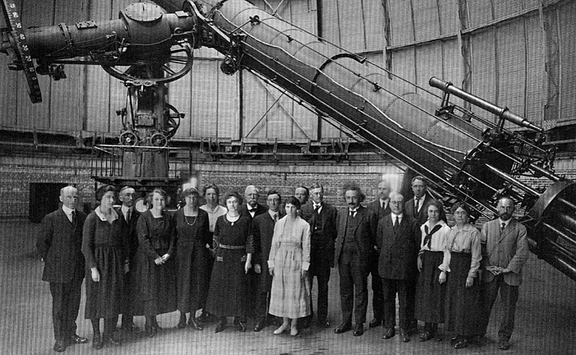


Introduction
For centuries, since ancient times up to the first half of 20th century, astronomy had relied only on optical observations.
Babylonian Mappa Mundi,
700 BC
Moon phases,
Galileo Galilei
1616
Largest achromatic refracting telescope (1.02 m),
Yerkes Observatory (Wisconsin, USA)
End of 19th century

Slide 34

Messengers from the High-Energy Universe
Neutral messengers
Gamma rays
First detection from the Vela satellites in the 1960s
Results of HE processes
Excellent probe to explore extreme environments
Energy ranges:
  Range above few tens of MeV well explored, thanks to the contribution of successful space and ground experiments, i.e. Fermi-LAT and Cherenkov telescopes
  Range between hundreds of keV and few MeV largely unexplored due to lack of sensitivity
Neutrinos
Extremely low interaction cross-section with matter
Necessary very large and very expensive detectors to obtain appreciable event rates
Neutrino astronomy relies mainly on two experiments placed in the two hemispheres:
  IceCube, in Antarctica
  KM3NeT, in the Mediterranean Sea
Gravitational Waves
Distorsions of the space-time
Ripples moving away from their source with $v ≅ c$
Very low amount of energy transferred to matter → GWs able to permeate through their very dense sources
Allow to delve into the non-thermal Universe even without relying on e.m. radiation
Worldwide interferometry network
  LIGO (USA)
  Virgo (Europe)
  KAGRA (Japan)

Slide 35

Gamma-ray instruments for the exploration of CRs sources
Before the 2000s
In space:
First gamma rays revealed by satellite Explorer XI in 1961
8000 photons collected by SAS-2 satellite between 30 MeV and 5 GeV in 1972-73
25 galactic sources of GeV photons detected by COS-B mission between 1975-1982
On the ground:
First indirect measurements of VHE photons from Cygnus X-3 by Cherenkov telescopes of Crimean Observatory in 1972
Indirect observations of UHE photons ($\sim {10}^{15}eV$) from Cygnus X-3 detected by Kiel and Haverah Park EAS in 1980s
Turning point
Compton Gamma-Ray Observatory (CGRO)
  Operational between 1991 – 2000
  4 experiments covering as a whole the range 15 keV – 30 GeV
  EGRET detected 271 gamma-ray sources signing success of the mission
Whipple Cherenkov telescope
  First telescope adopting IACT technique
  Crab nebula detected at $9σ$ above 0.7 TeV
Notes:
Anno:experiment
CGRO: lista esperimenti
Immagini SAS-2 COS-B, mappa EGRET

Slide 36

Gamma-ray instruments for the exploration of CRs sources
Concept of a demonstrator for the MeV regime
Preliminary study for a new concept of Compton telescope, following the electron-tracking approach
Monte Carlo simulations performed with Geant4 package, v.10.04.02
First part of the study involved a large geometry with a tracker composed of 100 layers of silicon (G4_Si) having dimensions $\left(50×50\right){cm}^{2}$
Several values of thickness of the layers taken into account, between $50μm$ and $1 mm$
Calorimeter composed of 1 layer of CsI (G4_CESIUM_IODIDE) with same dimensions of the tracker and thickness of 10 cm
Energies of the primary photon between 250 keV and 50 MeV
Photons impinging perpendicularly at the center of the top layer
$$γ$$
Notes:
Due to the growing interest this field is gaining over time, a certain amount of the PhD project was dedicated to start an R&D activity for the development of a concept of a Compton telescope
For the thickness several values were taken into account between 50 μm and 1 mm, in order to understand which one could represent the best trade-off between the need of material to let the first interaction occur, and the number of layers thin
Aim of the large geometry: study the evolution of the system of particles produced in Compton scattering events, i.e. the recoil electron and the scattered photon, from their emission up to their absorption.

Slide 37

The supernova remnant paradigm
SNR: combination of shock wave, expanding ejecta, swept up ambient gas and turbulent magnetic fields
Many of the high-energy 𝛾-ray emitters correspond positionally to SNRs
1st order Fermi acceleration mechanism or Diffusive Shock Acceleration (DSA) at strong shocks naturally produces a spectrum of cosmic rays close to what is observed, in particular up to the knee ($∼3 ∙ {10}^{6}$ GeV)
SNRs are among the strongest candidates as accelerators of CRs
  Shocks driven by expanding ejecta from supernovae represent ideal candidates for acceleration of Galactic Cosmic Rays through DSA
  Environments providing ideal targets for the interactions with CRs, e.g. molecular clouds and photon fields

Slide 38











Probing CRs acceleration and escape through γ rays: the case of the W44 SNR
The supernova remnant paradigm - Energetics
Another key-point supporting SNRs: equilibrium between the loss of CRs and the energy provided by SN shock waves
Energy release of a core collapse
SN explosion of 10M_{o}
Kinetic energy density of CRs
$$ρ_{CR}=\frac{1}{c}\int_{E_{0}}^{∞}{E\frac{d\left(\frac{N}{AT}\right)}{dE dΩ}dE dΩ} \sim 1{eV}/{{cm}^{3}}$$
${10}^{53}erg$ ($99 \%$ in 𝜐)
Galactic CRs Luminosity
SNe Luminosity
$$E_{0}≃2−3 GeV$$
$$L_{CR}=\frac{V_{D}∙ρ_{CR}}{τ_{esc}}≃6∙{10}^{40}\frac{erg}{s}$$
$$L_{SN}≃η∙f_{SN}∙{10}^{51}≃η∙{10}^{42}\frac{erg}{s}$$
Galactic disk volume
$$f_{SN} \sim {10}^{−9}s^{−1}$$
$$τ_{esc} \sim {10}^{7} yr$$
$$V_{D}=πR_{D}^{2}h ≃4∙{10}^{66}{cm}^{3}$$
$$η \sim a few percent$$
$$R_{D}≃15 kpc$$
$$h≃200 pc$$
1st order Fermi acceleration mechanism

Slide 39


Supernovae
Stars are supported by thermal pressure generated by intense heat of gas
During evolutionary phase, from main sequence to later stages, nuclear reactions keep going on until nuclear fuel is fully depleted
Even after burning Hydrogen and Helium nuclear reactions continue, leading to the formation of heavier nuclei and eventually, for the most massive stars ($M>8M_{⨀}$), Iron
Exhausted nuclear fuel, the core collapses
New stable configuration reached when new form of pressure support emerges
Possible final equilibrium configurations:
  For $M<8M_{⨀}$: white dwarfs
  For $M>8M_{⨀}$: neutron stars and black holes
A huge release of energy accompanies the process of formation of neutron stars and black holes
The violent explosion in which the entire star erupts, ejecting the outer layers at high speeds is known as Supernova
Events occurring in the Milky Way with a rate of 2-3 per century, but some of them too faint to be observed

Slide 40

SNR morphologies
Expanding clouds of dust and gas left behind after SN explosion form the supernova remnant
Currently known supernova remnants are 303 (Green’s catalogue, 2022)
Mainly concentrated in Galactic disk, optical and X-ray emission heavily absorbed → many more exist in the Milky Way than those already detected
Classification based on morphology:
  Shell-type SNRs: spherical shell of shocked matter at the edge of the remnant
  Plerion or filled-center SNRs: filled center dominated by radio and X-ray emissions powered by a pulsar wind nebula.
  Composite SNRs: shell + nebula
  Mixed-morphology SNRs: shell-type in radio, filled-center in X-rays
a
b
CasA
Crab nebula
c
d
Kes79
IC443

Slide 41



SNR evolution
Amount of energy $≈{10}^{53}erg$ released as kinetic energy of the ejecta
Ejecta interact with ISM/CSM → shockwave creating a shell of shock-heated plasma
Interaction ejecta – ambient media marks the birth of the SNR
Four phases schematizing the dynamical evolution
  1. Free expansion: $M_{sw}<M_{ej}$
  star’s envelope ejected at $v\sim {10}^{4}km/s$
  expansion continues as long as $M_{sw}<M_{ej}$
  shock front forms ahead of the expanding shell
T. Padmanabhan (2002)

Slide 42


SNR evolution
  2. Sedov-Taylor: $M_{sw}>M_{ej}$
  explosion energy → internal energy + kinetic energy of the expanding shell
  Expanding sphere begins to decelerate → increased matter density at the boundary
  Formation of an inner shockwave reheating outer shells
  Reverse shockwave propagates inward heating the ejected gas

Slide 43
SNR evolution
  3. Snow-plough
  Expansion continues
  Region behind shock front suffers strong decrease in temperature
  Line emissions from heavy ions become relevant
  Shell forms a dense snow-plough

Slide 44
SNR evolution
  4. Merger
  Blast-wave velocity approaches sound speed
  Shockwave starts to disappear
  Shell expansion becomes subsonic
  Remnant leaves behind a hot plasma bubble

Slide 45





CRs acceleration in SNRs
Since 1930s SNRs believed to be accelerators of CRs
In 1970s development of model of acceleration of CRs, the Diffusive Shock Acceleration (DSA) model or 1st order Fermi acceleration mechanism
Acceleration due to interactions of charged particles with magnetised clouds, i.e. collisionless shocks
  Shockwave where scattering occurs on length scale << $λ$
  Particles’ interaction through emission and absorption of plasma waves
  Particles move between magnetised clouds mutually approaching
  Main results:
    acceleration first order in shock velocity
    power-law spectrum with $γ≈2$
    maximum energy attainable by CRs
$$\left\langle \frac{∆E}{E}\right\rangle =\frac{4}{3}\frac{V}{c}$$
$$N\left(E\right)dE∝E^{−2}dE$$
$$E_{max}=ZeBUL$$

Slide 46
Gamma-ray instruments for the exploration of CRs sources
Fermi-LAT performances
Notes:
backup

Slide 47

Gamma-ray instruments for the exploration of CRs sources
Ground-based observatories for gamma rays
Ground-based experiments → indirect detection of TeV gamma rays (atmosphere opaque to gamma rays)
Lower flux, compensated by bigger collection area
Nature, direction and energy of the primary inferred from measurable properties of Cherenkov flashes (Cherenkov telescopes) or secondary particles (extensive air shower arrays)
Imaging Atmospheric Cherenkov Telescopes (IACTs) powerful instruments, able also to follow-up transients
Examples: currently MAGIC, in the future CTAO
Notes:
backup

Slide 48



Gamma-ray instruments for the exploration of CRs sources
Near future gamma-ray astronomy: the Cherenkov Telescope Array Observatory (CTAO)
Next generation of IAC telescopes
Two sites for full sky coverage:
  Norther Hemisphere
  La Palma, Canary islands
  Southern Hemisphere
  Atacama desert, Chile
Three types of telescopes:
  Large-Size telescopes (LSTs)
  d = 23m – 20 GeV < En < few hundreds of GeV
  Medium-Size telescopes (MSTs)
  d = 12m – 150 GeV < En < 5 TeV
  Small-Size telescopes (SSTs)
  few TeV < En < 300 TeV
  two mirrors
Notes:
backup

Slide 49
Gamma-ray instruments for the exploration of CRs sources
CTAO sensitivity
Notes:
backup

Slide 50
Gamma-ray instruments for the exploration of CRs sources
COMPTEL

Slide 51
Gamma-ray instruments for the exploration of CRs sources
Compton telescopes: contribution of electron tracking
Y Mizumura et al 2014 JINST 9 C05045

Slide 52
Probing CRs acceleration and escape through γ rays: the case of the W44 SNR
Recently published!
A&A, 693 (2025) A255
https://doi.org/10.1051/0004-6361/202449748
New insights on the W44 region: Fermi-LAT analysis
142 months of data (~12 years)
15° Region of Interest centered on W44
Binning
  Space: 0.1 deg per pixel
  Energy: 8 bins per decade
Selected events of SOURCE class
Energy range: 100 MeV – 2 TeV
Dataset divided in 9 components applying cuts in
  Event types
  Energy
  Maximum zenith angle
Analysis in two steps:
  Morphological analysis:
    1 GeV – 2 TeV -> better PSF, reduced source confusion
  Spectral analysis:
    100 MeV – 2 TeV
Model map:
  Included sources within 20° from RoI center from 4th Fermi-LAT catalog v. DR2
  Latest Galactic and Isotropic background models
Notes:
SOURCE class is the recommended selection for steady point-like or moderately extended sources
SCREENSHOT PRIMA PAGINA PAPER
Diminuire informazioni
Accorpare setup fermi e magic

Slide 53



Maximum likelihood analysis
Probing CRs acceleration and escape through γ rays: the case of the W44 SNR
Maximum Likelihood method, based on Poisson statistics used to describe the photon counts distributions
RoI divided in pixels and energy bins: binned likelihood analysis performed with Fermi Science Tools
$$L=\prod_{i,j}{P\left(N_{i,j} ; Λ_{i,j}(α)\right)}$$
$$Λ\left(α\right)=\int_{t_{1}}^{t_{2}}{dt}\int_{E_{1}}^{E_{2}}{dE}\int_{Ω}{d\hat{p} J(E,\hat{p};α)}$$
where
$$\ln{L=\sum_{i,j}{N_{i,j}\ln{Λ_{i,j}(α)}}−\sum_{i,j}{Λ_{i,j}(α)}}−\sum_{i,j}{\ln\left(N_{i,j}!\right)} ⟹$$
$$⇒ \ln{L=\sum_{i,j}{N_{i,j}\ln{Λ_{i,j}\left(α\right)}}−\sum_{i,j}{Λ_{i,j}\left(α\right)}=\sum_{i,j}{N_{i,j}\ln{Λ_{i,j}\left(α\right)}} −}Λ_{tot}(α)$$
Notes:
The method adopted for the statistical analysis of the high energy sky is the maximum likelihood method based on the Poisson statistics used to describe the photon count distributions.
The Region of Interest usually encloses a large number of photons. For this reason the observed region is usually divided in pixels and energy bins in order to perform a so-called binned likelihood analysis
the likelihood function is given by the product of the probabilities of each pixel i and each energy bin j
P is a Poisson distribution with mean value lambda
$Λ$ total number of expected counts; Given a set of values of $α$, $Λ$($α$) represents the true value of counts, i.e. the expectation value of the Poisson distribution followed by the observed counts.
In $Λ$, J represents the observed count rate
In order to find the best values of the parameters (1; ::; k; ::; m), the likelihood function must be maximized with respect to them

Slide 54


Probing CRs acceleration and escape through γ rays: the case of the W44 SNR
Fermi-LAT morphological analysis
Energy range: 1 GeV– 2 TeV
Selected only events belonging to event types PSF2 and PSF3, i.e. events with best reconstruction quality for direction
Re-modelling of inner RoI: 1° deg around the center
  All sources included in this range erased from model
  Algorithm for the identification of sources applied to inner RoI
  Sources having significance higher than threshold added to model map
  Threshold chosen: $TS>25 ≡ 4σ$ significance
Evaluated as test statistics $TS=2\left(lnL_{1}−lnL_{0}\right)$
for a point source $(x,y)$ having power law spectrum
$${dN}/{dE}=N_{0}{(E/{E_{0}})}^{−γ}$$
4 d.o.f. = 2 (localization) + amplitude + spectral index
Notes:
Fondere con la successiva

Slide 55


Probing CRs acceleration and escape through γ rays: the case of the W44 SNR
High energy morphological analysis – extension and curvature tests
Newly added sources tested first for evidence of spatial extension: radial disk and radial gaussian morphologies compared to a point-like source
$${TS}_{ext}=2\left({logL}_{ext} − {logL}_{ps}\right)>25$$
and later for evidence of spectral curvature: log-parabola and broken power law spectra compared to a power law spectrum
$$\left(LP\right) {dN}/{dE}=N_{0}{\left(E/{E_{b}}\right)}^{−\left(α+β\ln{E/{E_{b}}}\right)}$$
$$(BPL) {dN}/{dE}=N_{0}×\left\{\begin{aligned}{(E/{E_{b}})}^{γ_{1}} if E<E_{b} \\ {(E/{E_{b}})}^{γ_{2}} otherwise\end{aligned}\right.$$
$${TS}_{curv}=2\left({logL}_{logP} − {logL}_{PL}\right)>20$$
Akaike Information Criterion (AIC) used to compare different models
$$AIC=2k−2ln⁡(\hat{L})$$

Slide 56

Probing CRs acceleration and escape through γ rays: the case of the W44 SNR
Akaike information criterion
AIC, estimator of the relative quality of statistical models for a given set of data
Given a collection of models for the data, AIC estimates the quality of each model, relative to the quality of the other models, providing a means for model selection
Given a set of candidate models, the preferred model is the one minimizing the AIC value
Relative likelihood of the i-th model
Closely related to likelihood-ratio test (LRT) but while LRT can be used only for nested models, AIC is not characterized by this restriction
For inference of interpretation purposes better use Bayesian Information Criterion (BIC)
$$AIC=2k−2ln⁡(\hat{L})$$
$$\exp{({{AIC}_{MIN}−{AIC}_{i}}/2)}$$
$$BIC=k\ln\left(n\right)−2ln⁡(\hat{L})$$
H. Akaike. A New Look at the Statistical Model Identification, pages 215–222. Springer New York, 1998 (AIC)
G. Schwarz. Estimating the Dimension of a Model. The Annals of Statistics, 6(2):461 – 464, 1978 (BIC)
J. Ding, V. Tarokh and Y. Yang, "Model Selection Techniques: An Overview," in IEEE Signal Processing Magazine, vol. 35, no. 6, pp. 16-34, Nov. 2018 (AIC vs BIC)

Slide 57



Probing CRs acceleration and escape through γ rays: the case of the W44 SNR
W44 Radio template: the Hi / oh / recombination line (thor) survey
The THOR project is a northern Galactic plane survey ($15 < l < 67°{; }\left|b\right|< 1°⁡$) in HI, four OH, and 19 H𝛼 recombination lines as well as in the L-band continuum from 1 to 2 GHz
W44 radio template: 1420MHz (𝛌=21 cm)

Slide 58



Probing CRs acceleration and escape through γ rays: the case of the W44 SNR
CO: tracer of H₂
H₂ is a symmetric molecule : the electric dipole moment is zero → Rotational transitions are forbidden
Quadrupole transitions possible, but very weak. Thanks to the abundance of H₂ some of these transitions have been observed in the mid IR
Due to the lack of H₂ emissions it is hard to map the distribution of molecular hydrogen in galaxies
Solution: CO, second most abundant molecule in Galaxy
CO emission lines $J = 1 → 0$at 2.6 mm
Advantages
  rotational transitions allowed (not a symmetric molecule) – the dipole moment is relatively small and the molecule can be easily excited also in gas with relatively low density
  Used as a tracer of H2
  If the emission is too strong one can use less abundant isotopes, such as 13CO, to obtain optically thin emissions
For this work: data from NRO FUGIN survey (collected with Nobeyama 45-m telescope)

Slide 59
Probing CRs acceleration and escape through γ rays: the case of the W44 SNR
Hints in the TeV regime: MAGIC observations
Observations
  Data collected between April 2013 and August 2014 for 173.7 h after quality cuts
  Zenith angle: 25° - 45°
  Standard wobble distance: 0.4°
Analysis
    MAGIC Analysis and Reconstruction Software (MARS) for low level analysis
    SkyPrism for high-level analysis (spatial likelihood analysis)
  Analysis based on Fermi HE results
  Source region model: HESSJ1857+026, HESSJ1858+020, NW and SE
  NW and SE at same location and extension as in Fermi
  W44 and Diffuse Disk not excluded nor modeled due to their curved spectra in the GeV range

Slide 60



Magnetic field in W44 region
W44 SNR shell asymmetric and elongated
Anisotropic escape scenario strengthened by direction of large-scale magnetic field
NW
SE
(Liu, Hu, Lazarian 2022, https://doi.org/10.1093/mnras/stab3783)
60

Slide 61


Probing CRs acceleration and escape through γ rays: the case of the W44 SNR
A hadronic model: acceleration and escape of CRs from the SNR W44
NW and SE both located along major axis of W44
Development of a model for particles acceleration at W44 forward shock and anisotropic escape following the local magnetic field
Model presented in Celli et al (2019) (full spherical symmetry) adapted to full cylindrical geometry
Instantaneous proton spectrum accelerated at the shock: $f_{sh}(p,t)∝ξ_{cr}p^{−s}e^{−p/p_{max}(t)}$ with $p_{max}=p_{M}{(t/t_{Sedov})}^{−δ}$
External diffusion coefficient: $D_{ext}\left(p\right)=χD_{gal}\left(p\right)$
Assumed SNR features:
  $t_{age}≅2×{10}^{4}yr$ $d=2.2 kpc$
  $E_{SN}={10}^{51} erg$ $n_{0}=10 {cm}^{−3}$
Parameters best-fit values:
  $s=4.2$
  $ξ_{cr}=1.3\%$
  $p_{M}=100 TeV$
  $δ=2$
  $p_{max}\left(t_{age}\right)=44 GeV$

Slide 62



Probing CRs acceleration and escape through γ rays: the case of the W44 SNR
A hadronic model: emissions from the NW and SE clouds
HE emissions from NW and SE well modelled assuming
  Same distance as the SNR: $d=2.2 kpc$
  Distances W44 – clouds: $17.3 pc \left(NW\right), 15.7 pc (SE)$
  $D_{ext}\left(p\right)=0.2 D_{gal}\left(p\right)$
Low energy emission underestimated, necessary to add further component
Broken-shock scenario helps reducing the gap
  Middle-aged SNR expanding in inhomogeneous medium
  Shock surface possibly broken where upstream medium is denser
  Certain amount of particles having energy smaller than $E_{max}⁡(t_{age} )$ able to escape from a small portion $f_{br}$of the shock surface
    $f_{br}=0.2$ (NW), $0.1$ (SE)

Slide 63
Conclusions and outlook
Multi-wavelength (MW) and Multi-messenger (MM) astronomy rapidly growing disciplines thanks to the opening of new observational windows and strategies
  Not only in the e.m. spectrum, observations are a reality also through neutrinos and GWs
  Cosmic Rays, even reaching Earth, are not reliable for original direction reconstruction
  Neutrinos and GWs very challenging to detect
  Gamma rays represent an important probe to study the deep universe and understanding the origin and the production mechanisms of CRs
In the last decades gamma-ray astronomy has grown noticeably thanks to experiments for direct detection (e.g. CGRO, Fermi-LAT) and indirect detection (IACTs) of high-energy photons
  Developments of new detectors, in particular Si-based and finely pixelated will help to explore a field almost untouched, the MeV band, fundamental also for MM studies
  R&D activity started during the PhD for a new concept of electron-tracking MeV telescope
Notes:
Unire con la precedente
Futuro con IACT su SNR o sorgenti galattiche

Slide 64
Conclusions and outlook
Among the most interesting celestial objects, SNRs play a crucial role, being considered the most important factories of CRs in the Galaxy
  A source full of information is the middle-aged SNR W44, providing clear connection between gamma rays and CRs
  Morphological analysis on Fermi-LAT data above 1 GeV:
    Emission from W44 SNR best described by Radio template
    Confirmed presence of clouds at SNR’s opposite sides
  Spectral analysis on Fermi-LAT data carried out above 100 MeV with weighted likelihood procedure for mitigating the effect of systematics
  Observations in VHE band of W44 surroundings, in particular NW region, with MAGIC telescopes:
    No significant detection
    ULs constraining emission models
  Modeling:
    Particles acceleration and escape from W44 forward shock along local magnetic field
    NW and SE emissions due to CRs escaping from the SNR and illuminating nearby clouds
    Broken-shock scenario assumed to fix the inconsistency in the low-energy band

