Slide 1
Time synchronization systems

Slide 2
SECURESYNC 2400 MASTER CLOCK

Slide 3
SECURESYNC 2400 MASTER CLOCK

Slide 4
IRIG timecode
https://www.bodet-time.com/resources/blog/1873-overview-of-the-irig-time-standard.html

Slide 5
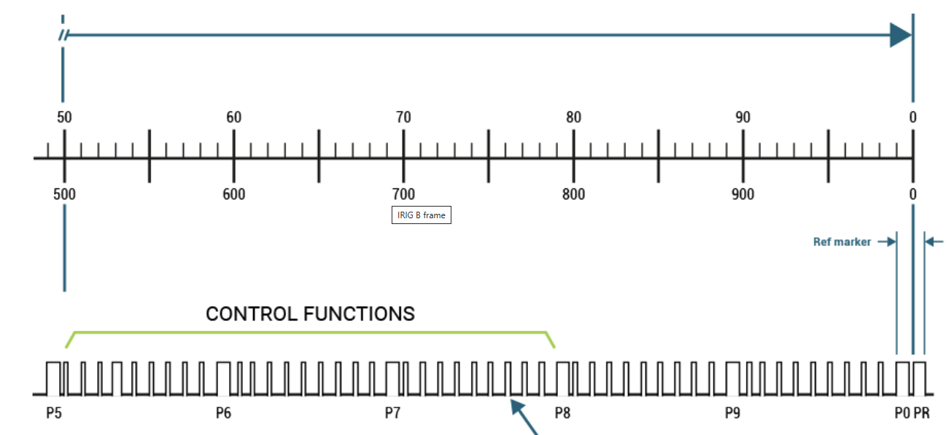
IRIG timecode

Slide 6
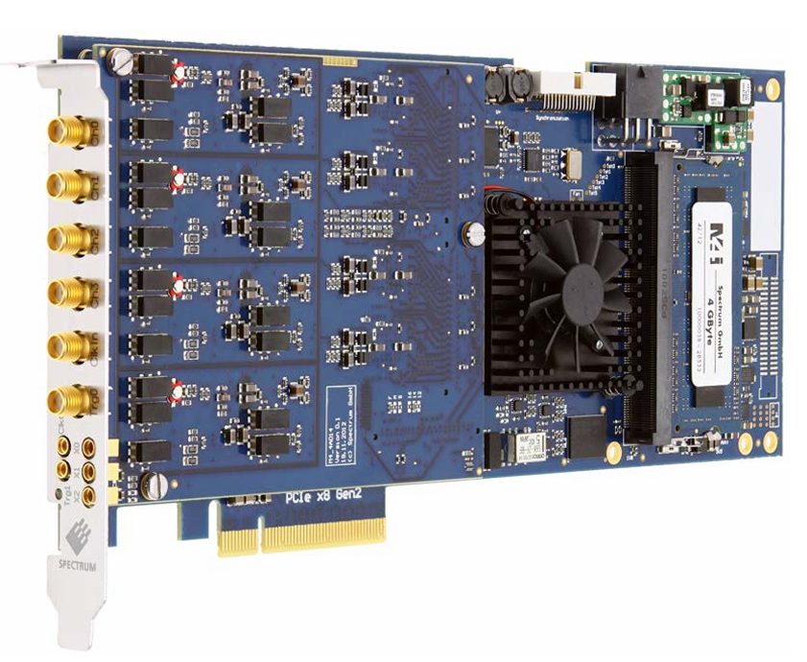
DAQ card?

