Slide 1


ASPIDES meeting 3
Tommaso Floris
04/04/2025

Slide 2
Functions of the dSiPM
Count the number of photons
  parallel counter
Identify the ToA of the first and last photons
  two TDCs and the ANDtree
Reject spurious events
  time over threshold detector with programmable threshold
Possibility to enable and disable the single pixel
  memory element inside each pixel
Global signal to reset and enable the array

Slide 3
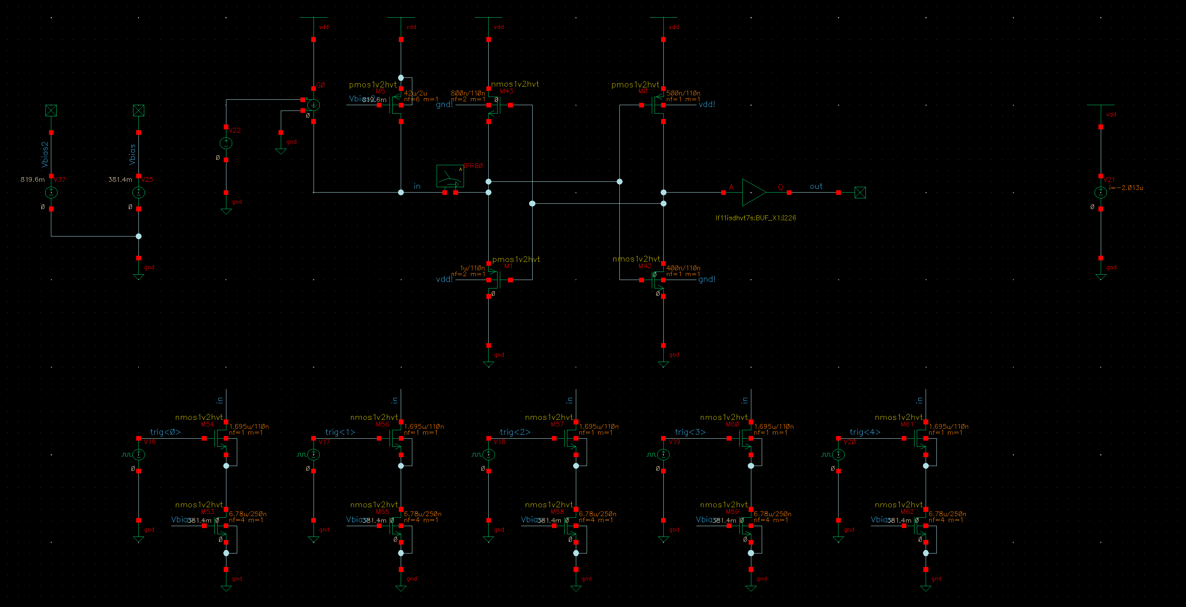
Fired pixel detector

Slide 4
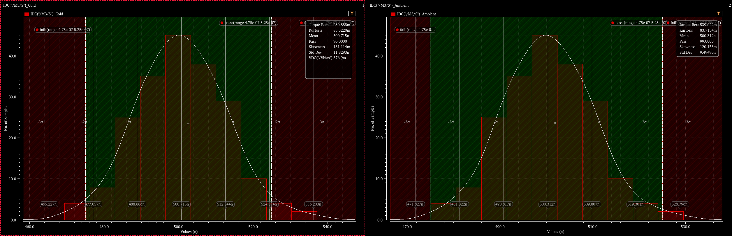
Iref mismatch

Slide 5
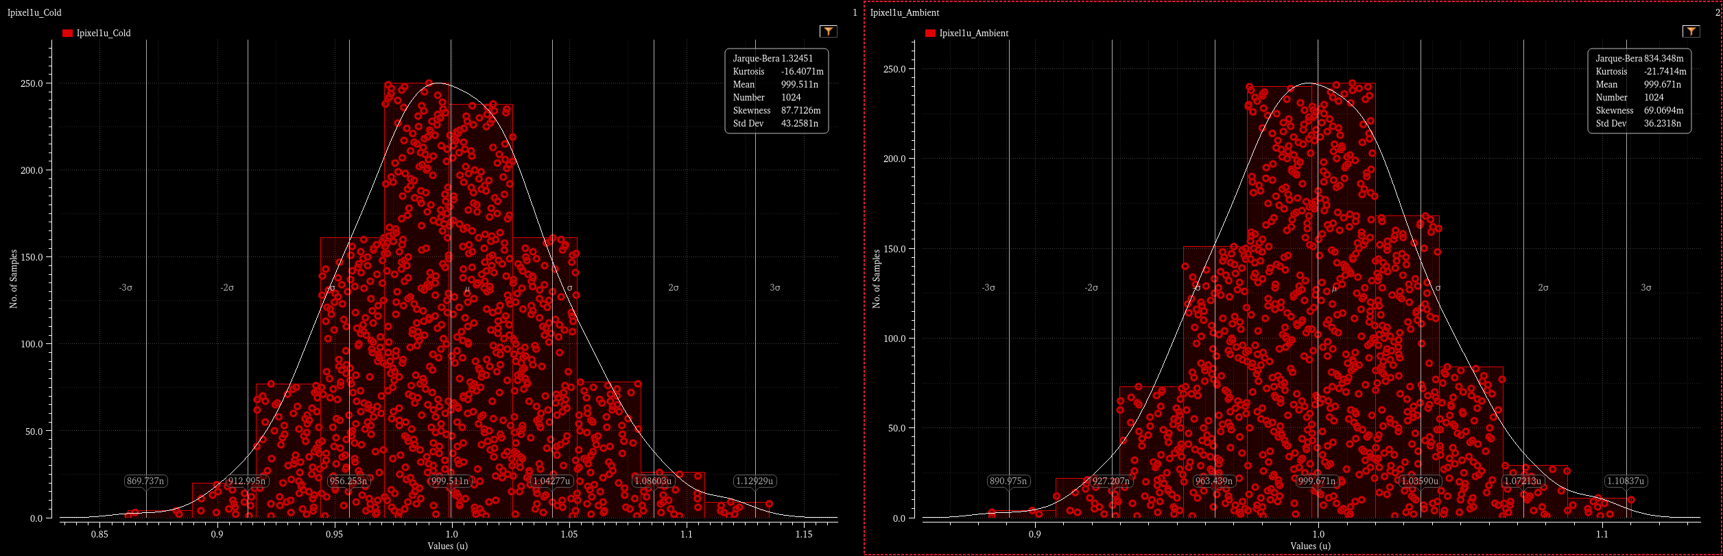
Ipixel mismatch

Slide 6
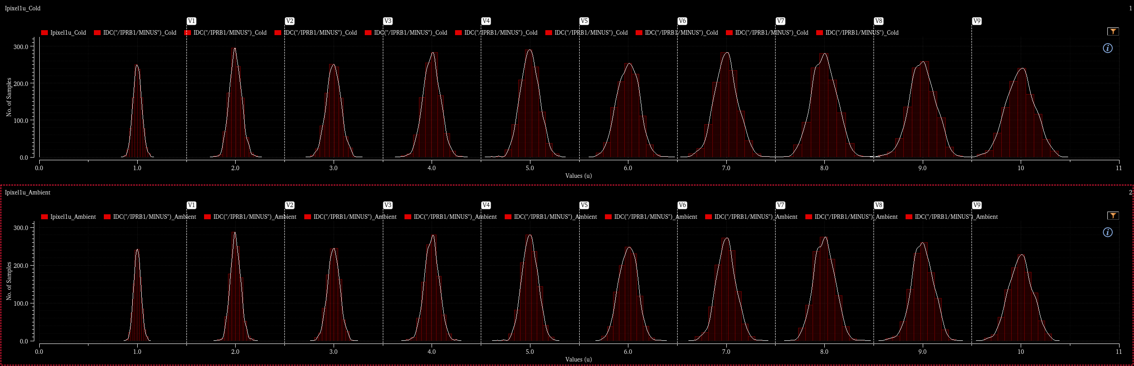
Threshold mismatch

