Slide 1
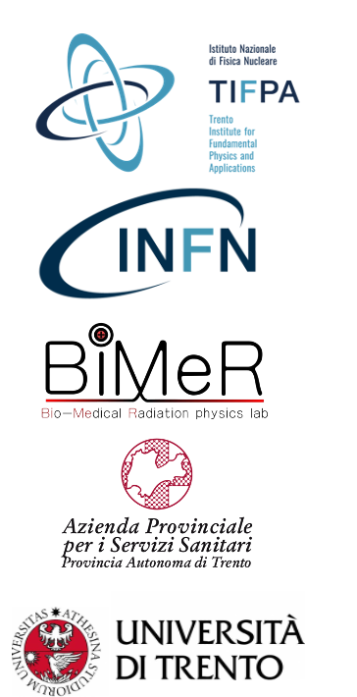
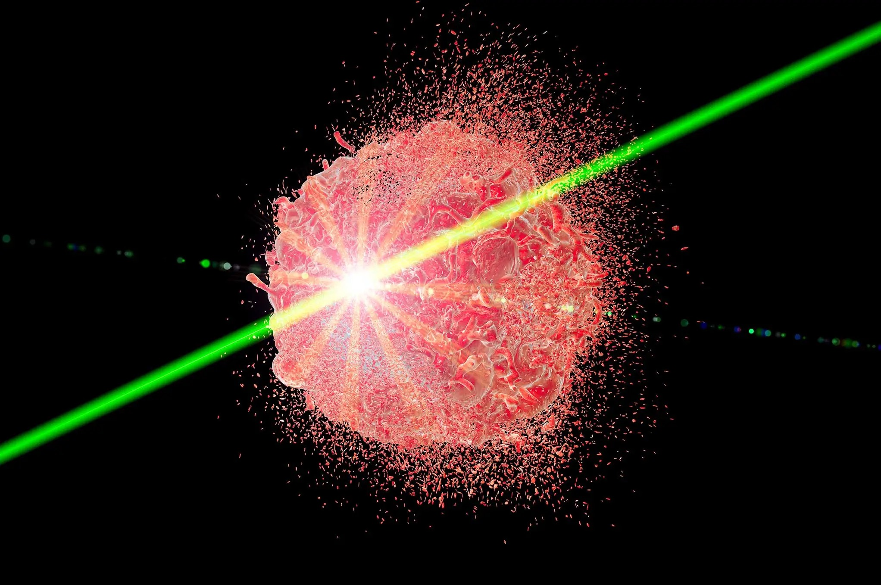
FLASH proton therapy:
Planning and delivery challenges.
Are we close to the clinics?
Alberto Taffelli PhD, April 3rd, 2025

Slide 2
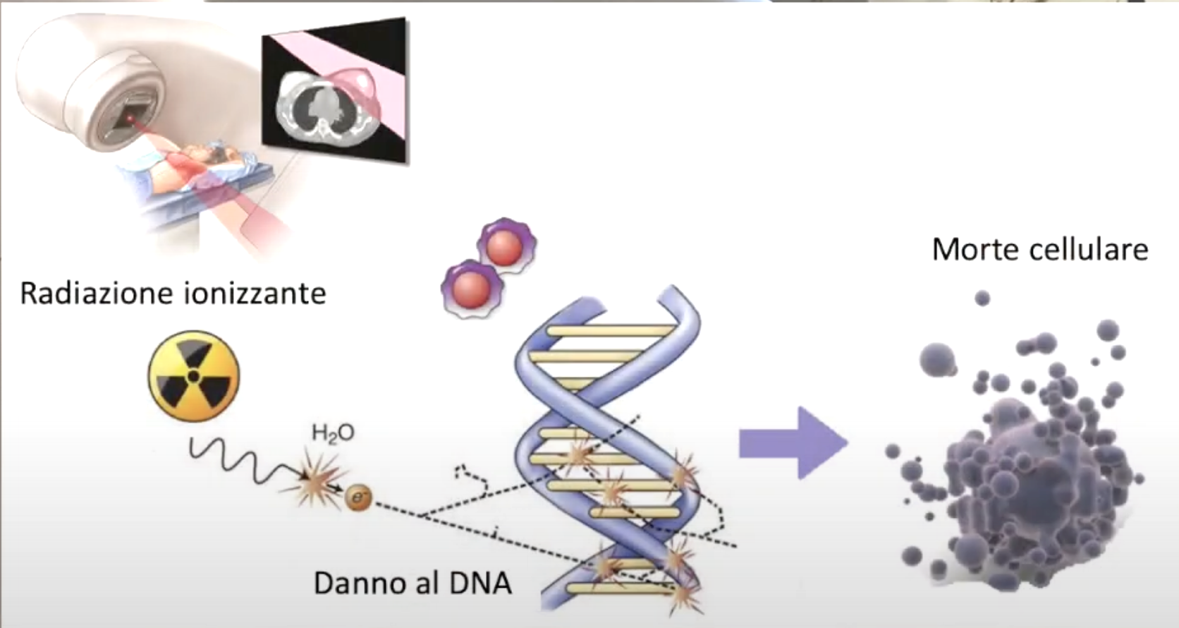
Radiotherapy
“In 2022, there were an estimated 20 million new cancer diagnoses, with approximately 10 million new patients needing radiotherapy … In 2050, GLOBOCAN 2022 data indicated 33.1 million new cancer diagnoses, with 16.5 million new patients needing radiotherapy…”
Zhu et al. 2024, Lancet
Working principle
Dose [Gy]
1Gy = 1J/ 1Kg
Energy deposited per unit mass

Slide 3
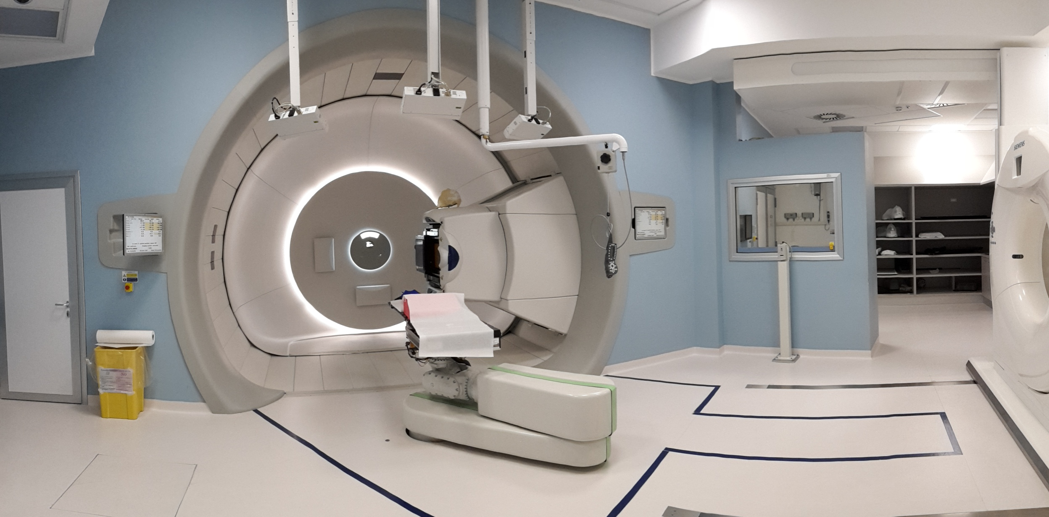
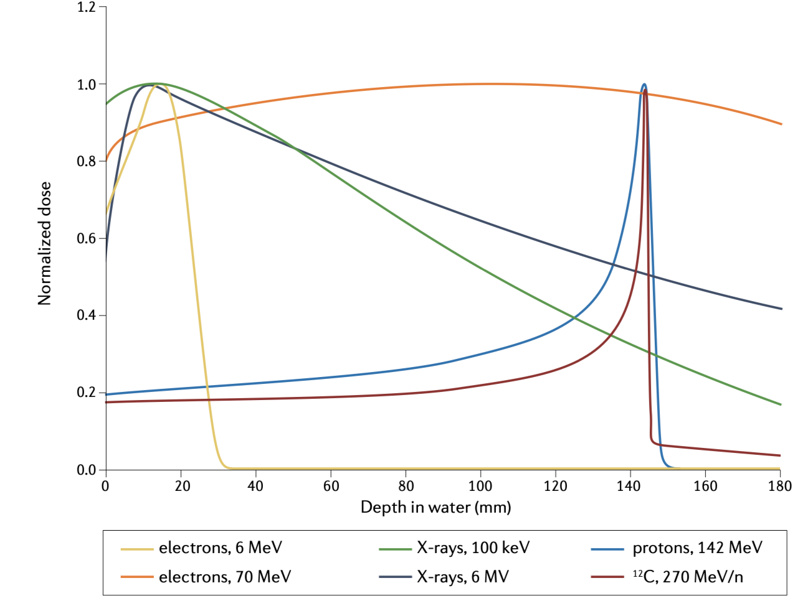
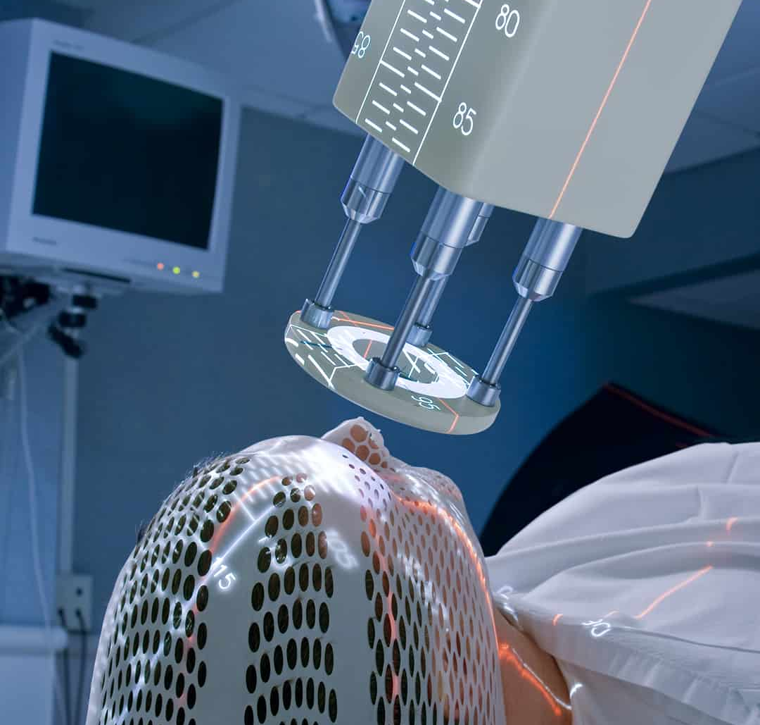
Ionizing radiations in RT
X-rays
Protons
Taffelli Alberto
Heavy ions
Electrons
Vozenin, 2022

Slide 4
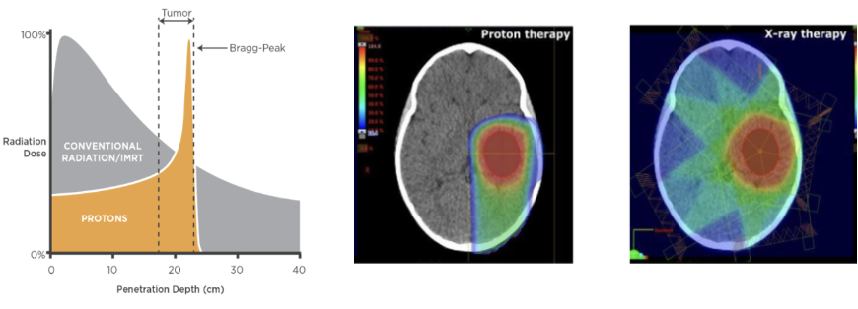


Radiotherapy
Drawback: Toxicity
Ray, 2015
Toxicity
Inflammation
Organ disfunction
Secondary cancer
RT plan
Target
Normal Tissue

Slide 5
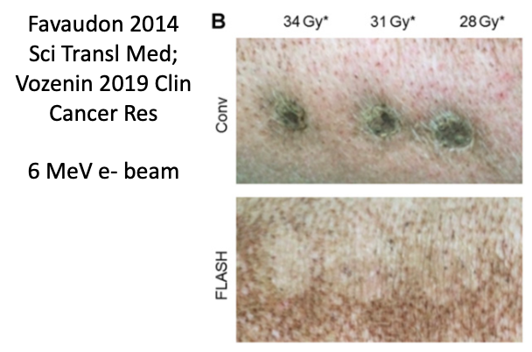
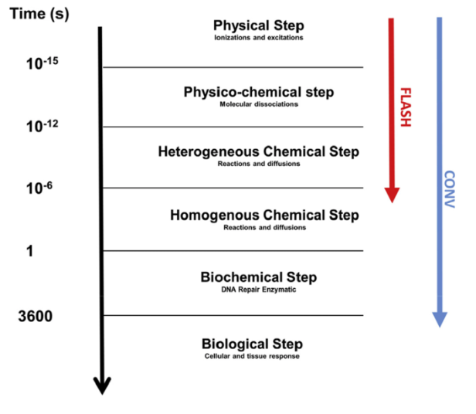
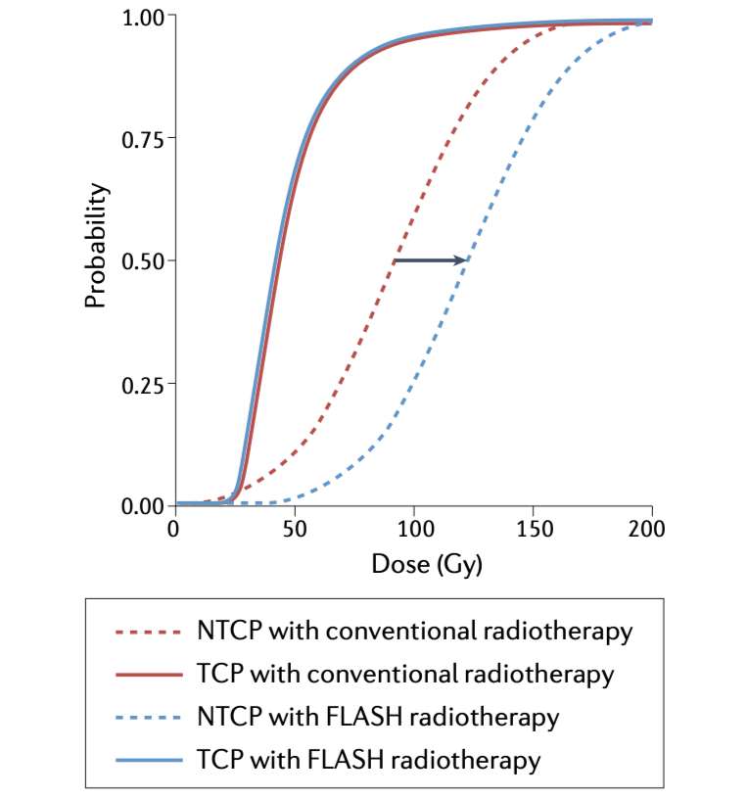

What’s FLASH?
Taffelli Alberto
An effect that occurs when irradiating at Ultra-high dose rates (UHDR > 40Gy/s)
Conventional irradiation is 0.01 Gy/s
There is a protective effect on normal tissues, while maintaining the same efficacy against tumours
The mechanism is still unclear
  Hypoteses:
  Transient hypoxia
  Radical recombination
  Inter-track effects
  Immune system
In RT = increase the therapeutic window
Vozenin, 2022

Slide 6
Ionizing radiations in RT
X-rays
Protons
Taffelli Alberto
Heavy ions
Electrons
Vozenin, 2022

Slide 7
In principle it works for every radiation type
But…

Slide 8
None of them is ready to move to clinical FLASH yet..

Slide 9
Best candidate?
Hard to say
Main issues:
Protons
VHEE/electrons
Photons
Baloon debate FRPT 2022

Slide 10
Best candidate?
Hard to say
Protons
In the near future will be the candidate solution for the flash treatment of deep seated tumours, where OARs sparing would be of major concern
VHEE/electrons
Photons
Baloon debate FRPT 2022

Slide 11

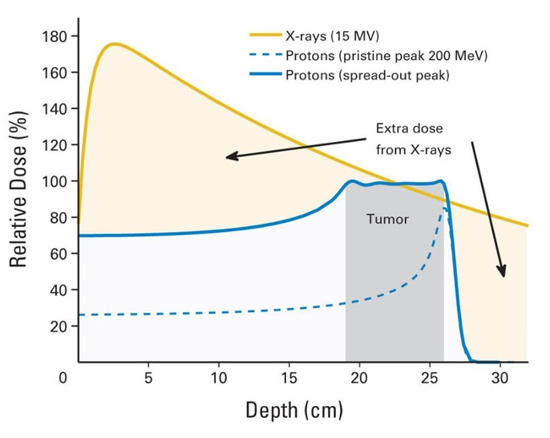

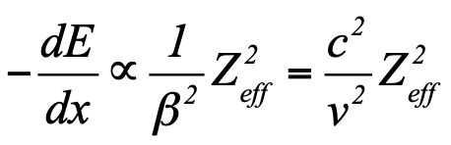
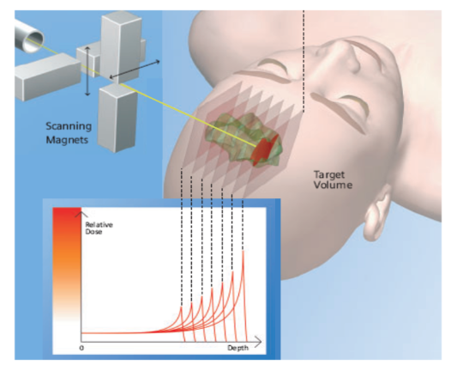
Proton therapy
Protons can deliver dose precisely in deep seated tumours thanks to their peaked dose distribution in depth (Bragg peak), thus sparing normal tissues
Combining different energies it is possible to cover the tumour extension (SOPB)
(Slightly) enhanced biological effectiveness RBE 1.1
The standard approach is the intensity modulated proton therapy (IMPT). Active Pencil beam scanning (PBS) systems make use of different energy layers to optimize the dose uniformity in the target and spare the normal tissues
Desouky 2015

Slide 12
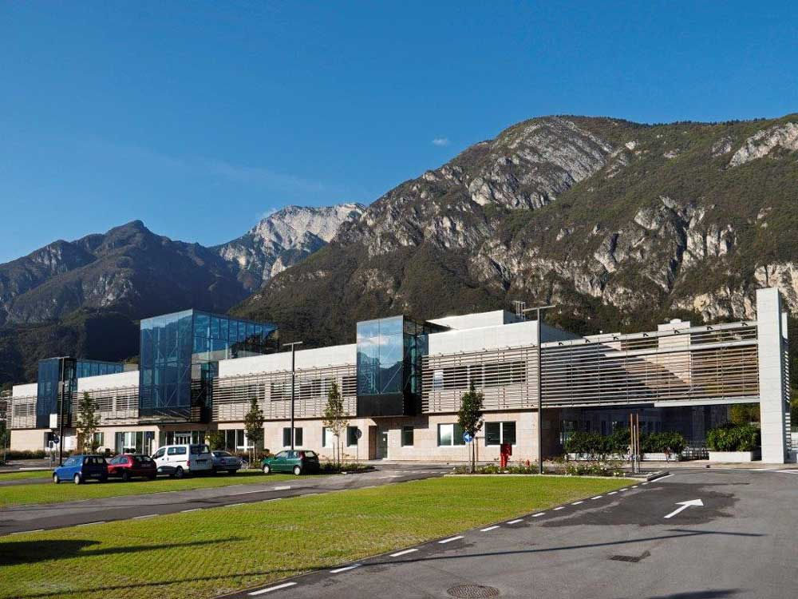
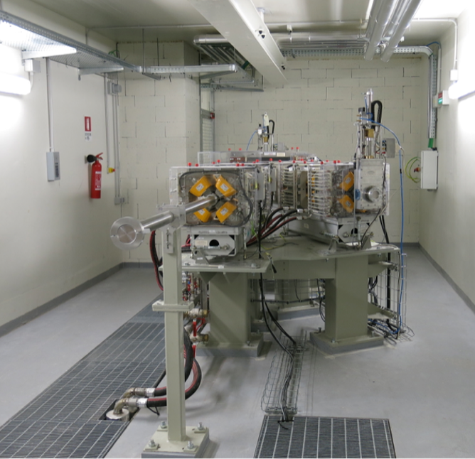
Proton Therapy Center

Slide 13
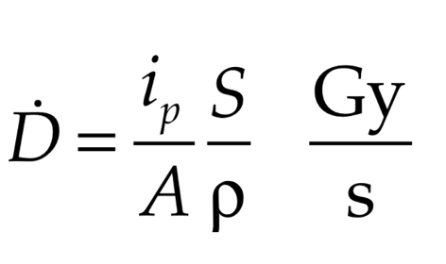
Proton therapy delivery systems
At which rate are the current systems operating?
The proton beam is accelerated by a cyclotron up to energies of 230 MeV
Dose rate:
Dose rate = 0.4 Gy/s
Can we go to FLASH regimes by increasing the Ip up to 200nA?

Slide 14
Yes, we can
In first approximation…

Slide 15

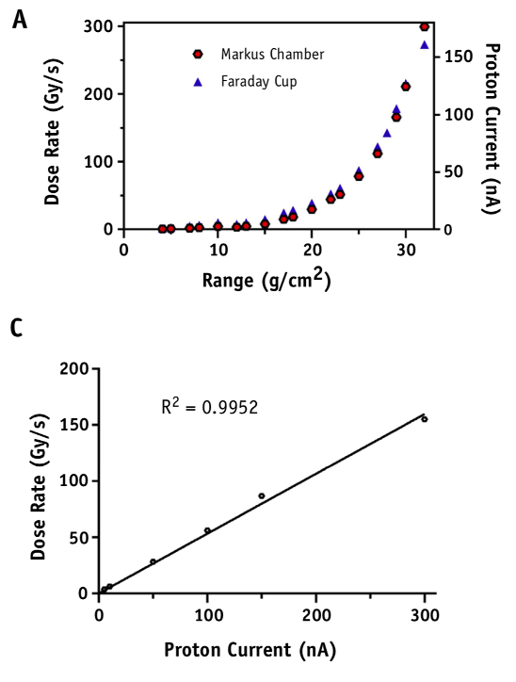
Proton therapy delivery systems
At which rate are the current systems operating?
Dose rate = 0.4 Gy/s
Can we go to FLASH regimes by increasing the Ip up to 200nA?

Slide 16
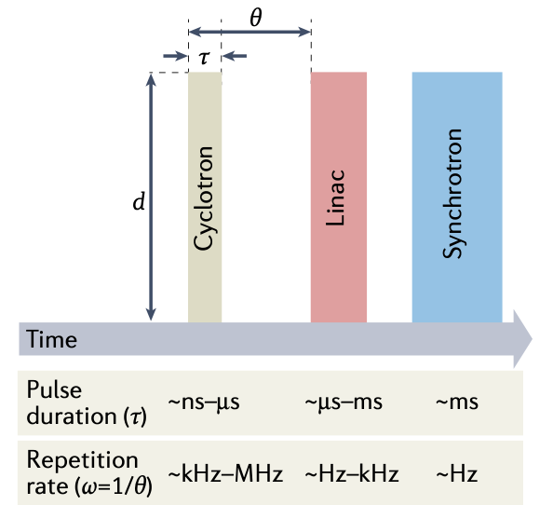
Proton therapy delivery systems
Not every system can work at FLASH regimes
Vozenin, 2022

Slide 17
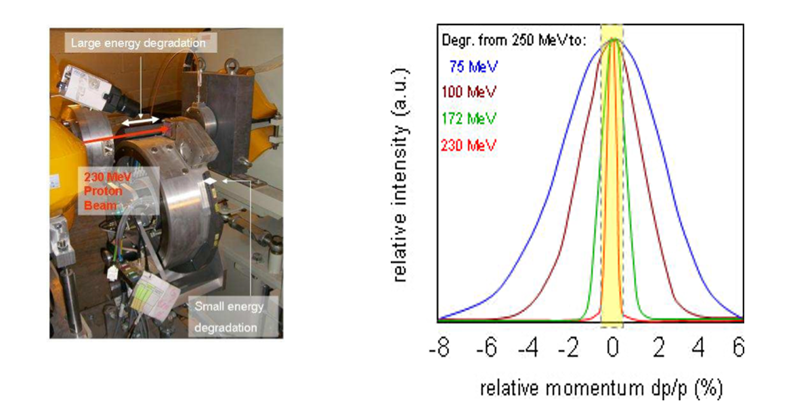
Proton therapy delivery systems
Not all the energies can be transmitted at such high rates
Schippers 2012 Rev Accel Tech
Energy degrading system: The lower the energy, the higher the degradation

Slide 18
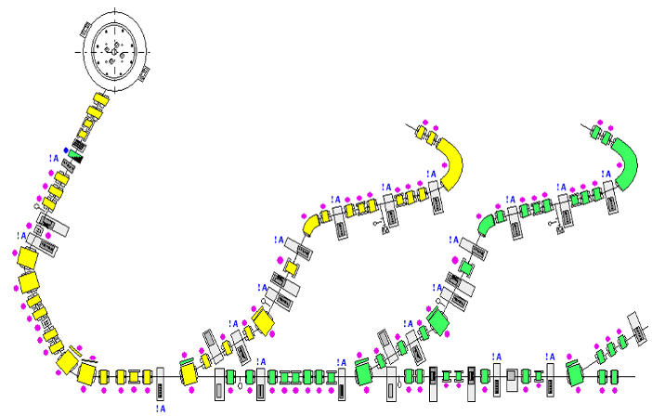
Experimental room characterization
FLASH beam at 228MeV

Slide 19
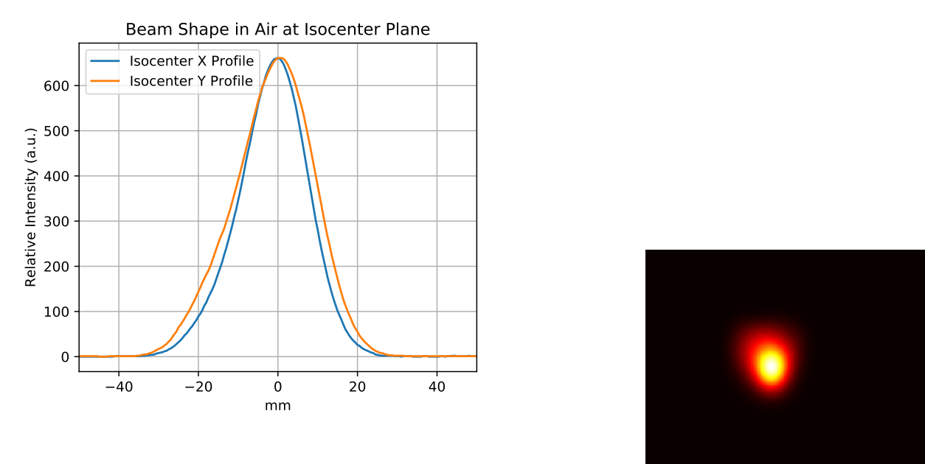
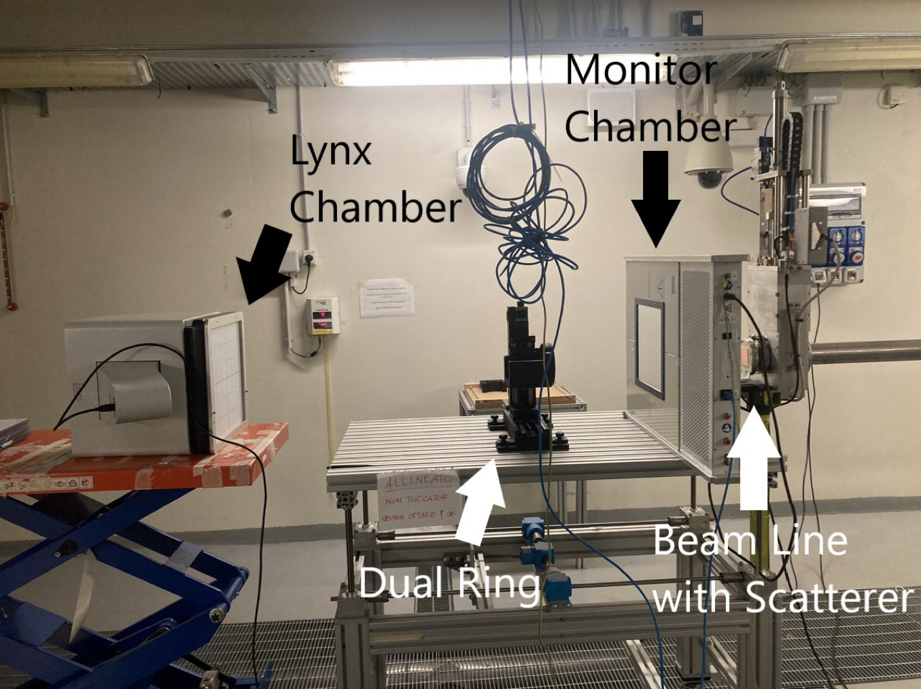
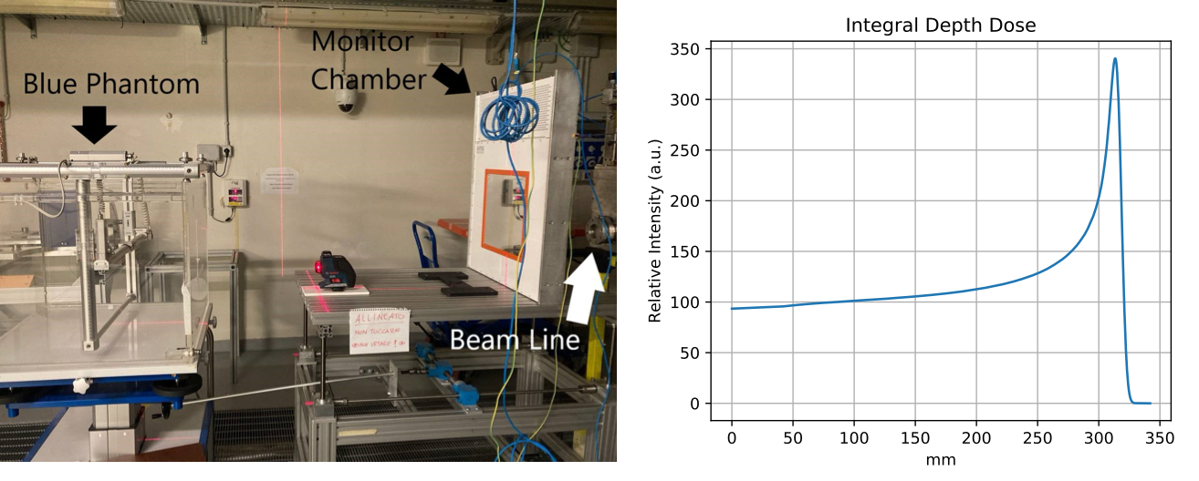
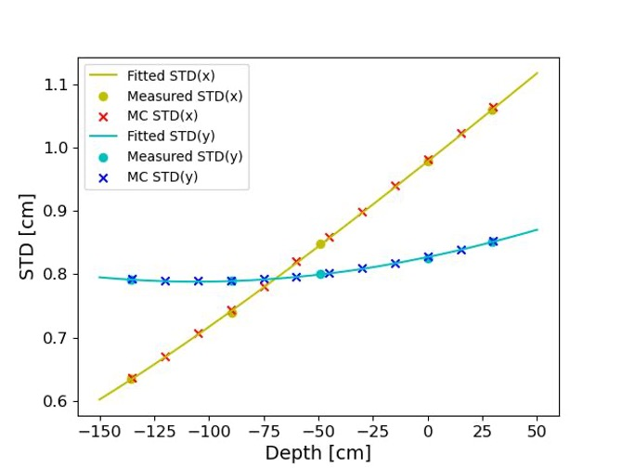
Experimental room characterization
Set up by IBA and characterized by TIFPA
FLASH beam spot
IDD in water at 228MeV
spot at ISO
spot size at different distances

Slide 20
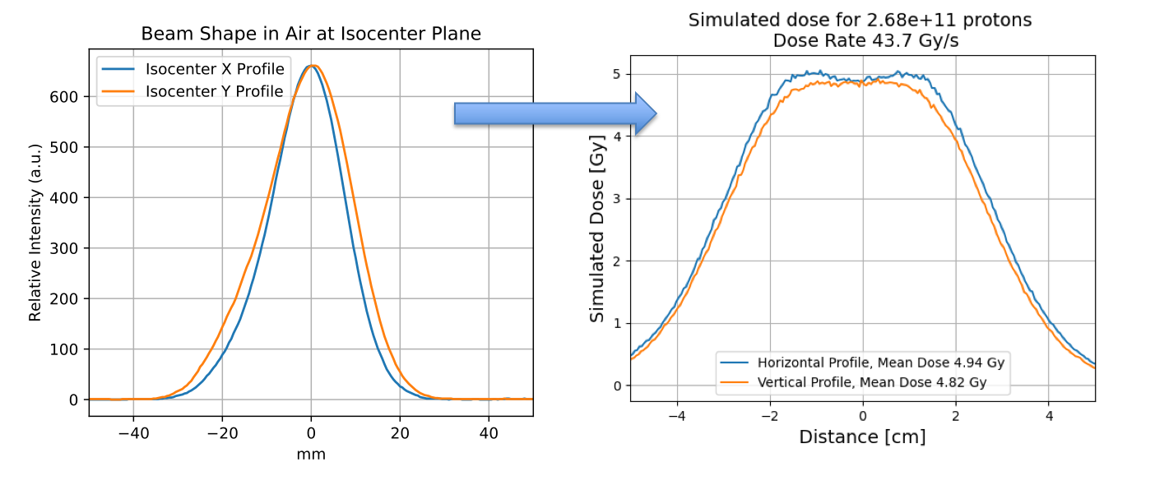
Experimental room characterization
Dual Ring scattering system
To enlarge the spot size to perform experiments
Thanks to A.Fasolini

Slide 21
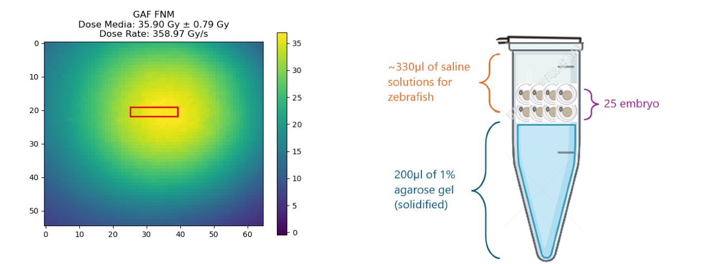
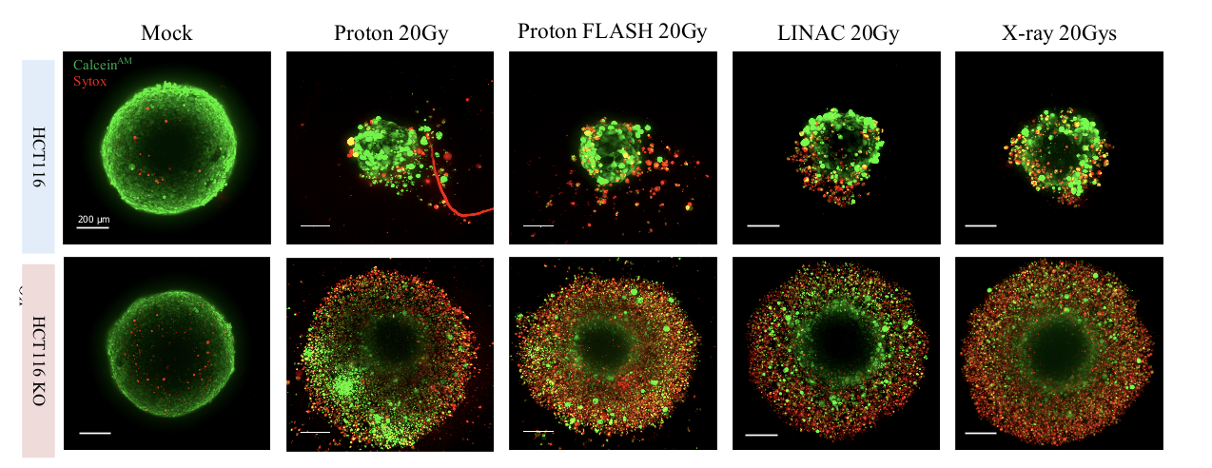
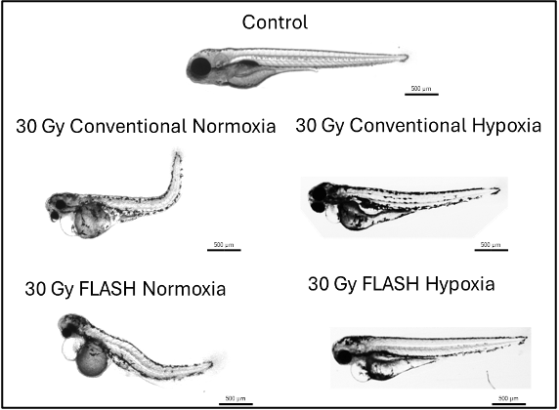
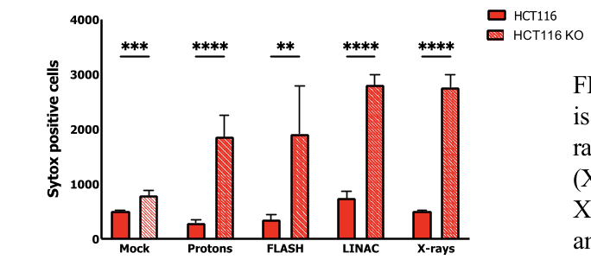
Experimental room
Radiobiological experiments
Spheroids
Zebrafish

Slide 22
Treatment room
(Gantry)
Equipped with active pencil beam scanning

Slide 23
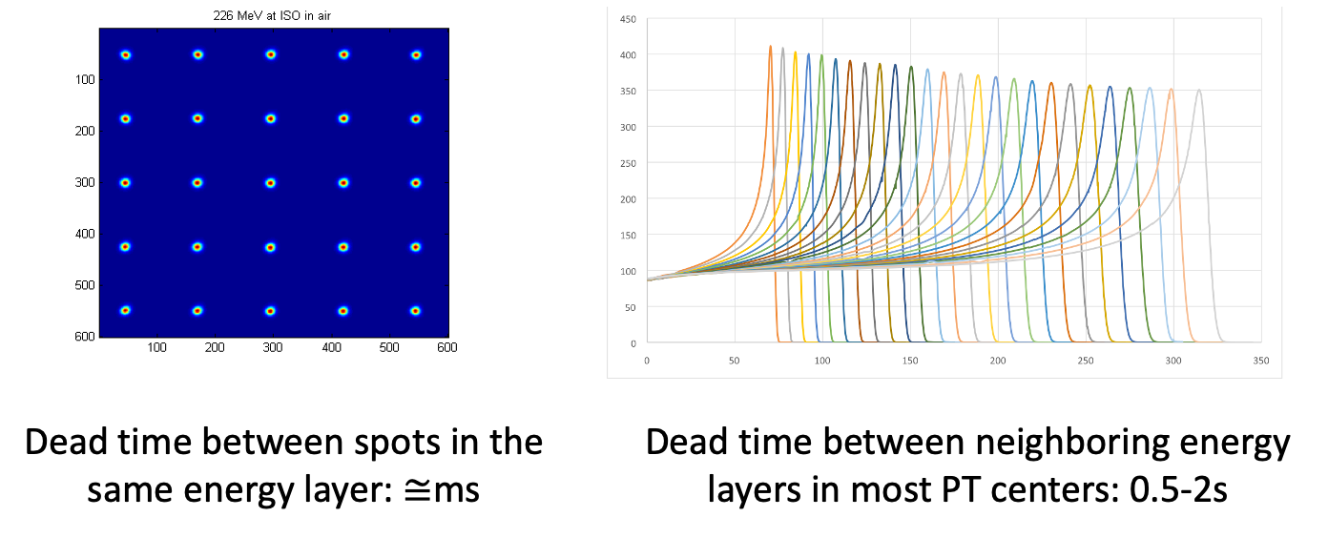
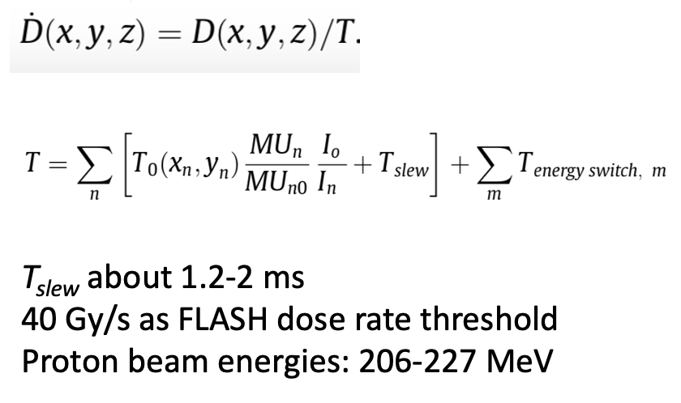

Proton therapy delivery systems
Active PB scanning has issues
Spot scanning t ~ ms
FLASH is incompatible with what we are doing in proton therapy
Energy switching t ~ 0.5-2s

Slide 24
So what?
Should we give up?

Slide 25
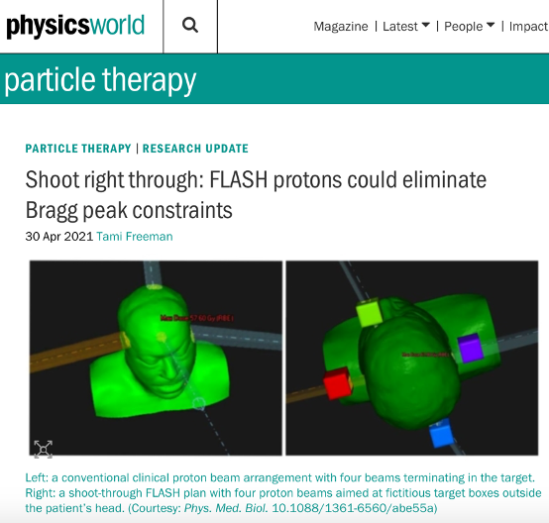
Option 1
Shoot-through

Slide 26
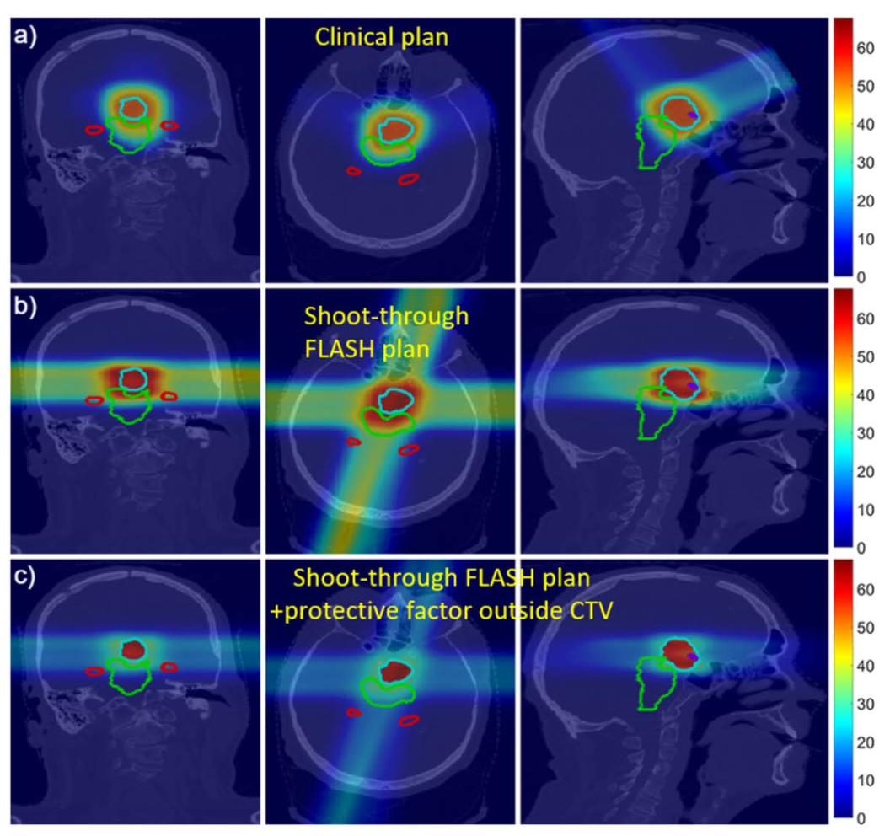
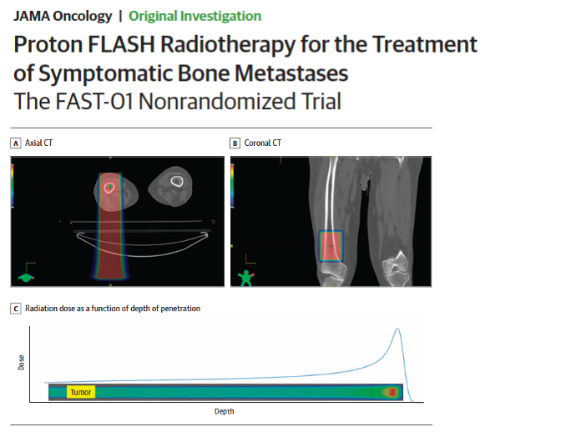
Shoot-through
Forget the Bragg-peak
Protons at 230MeV can travel ~32 cm in water (BP outside the patient)
Use the plateau instead
Approach similar to the X-rays
Verhaegen 2021 PMB

Slide 27
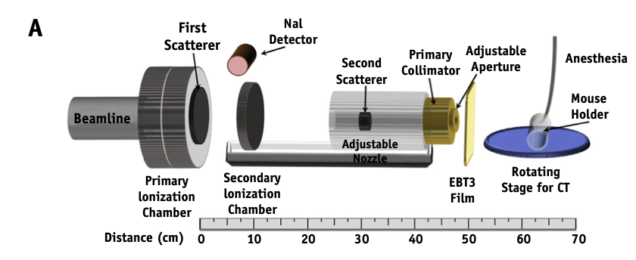

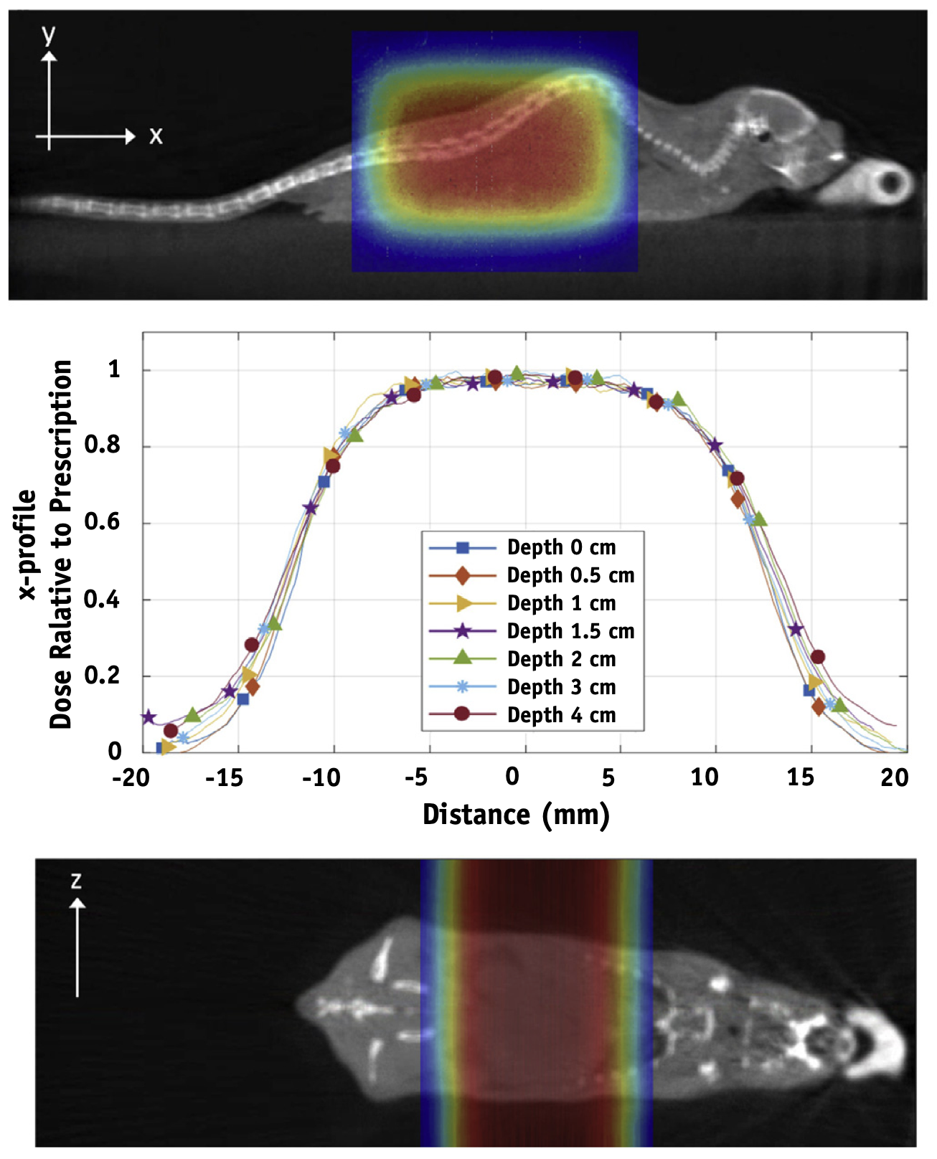
Shoot-through
Proteus Plus system (IBA)
Up to 300 Gy/s at 230MeV
Radiobiological study on small animals
Diffenderfer 2020, IJROB

Slide 28
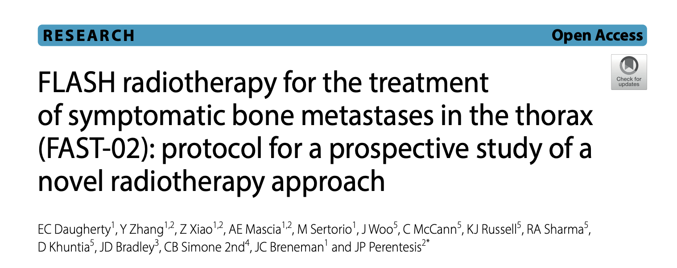
Shoot-through
Proton FLASH trials
..Ongoing

Slide 29
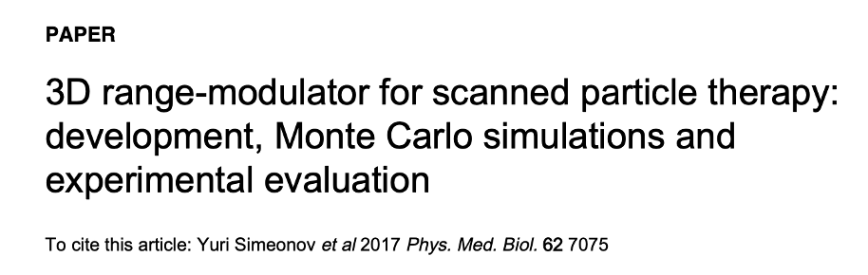
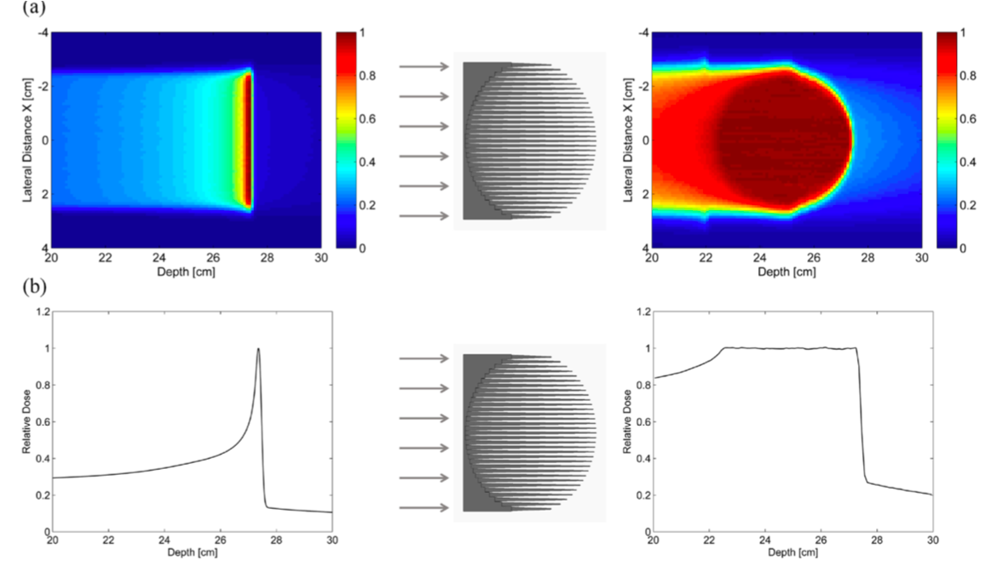
Option 2
3D range modulators (3DRM)

Slide 30
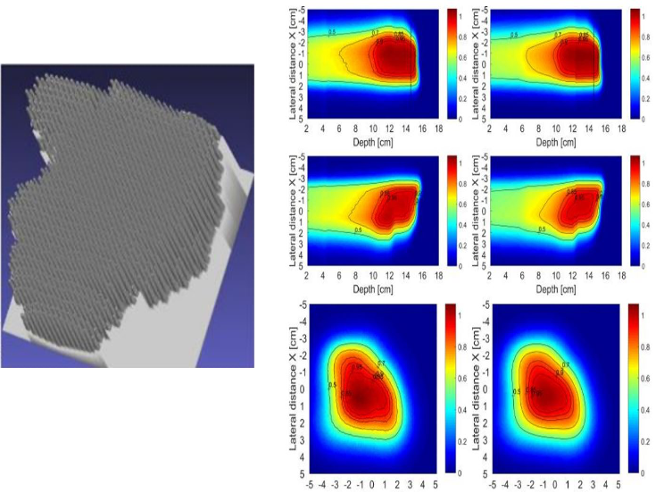
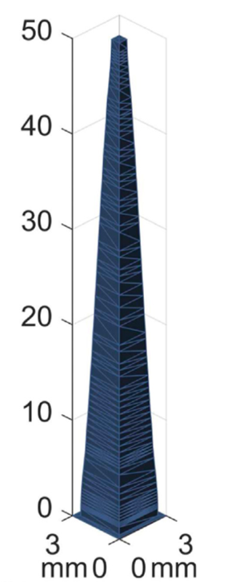
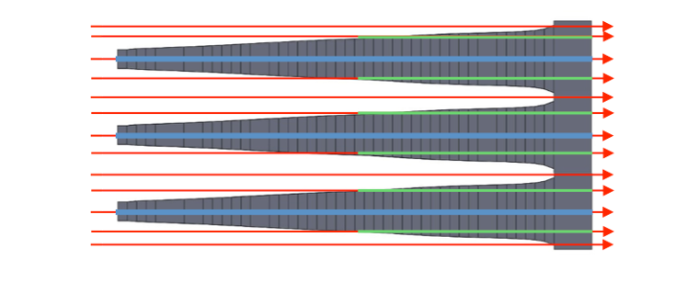


3DRM
Passive energy modulation
Hedgehog or 3D range modulator
Pins are used to passively modulate the proton energy
Optimize the pins to reproduce the objective dose distribution
Non trivial optimization process
~10³-10⁴ parameters

Slide 31
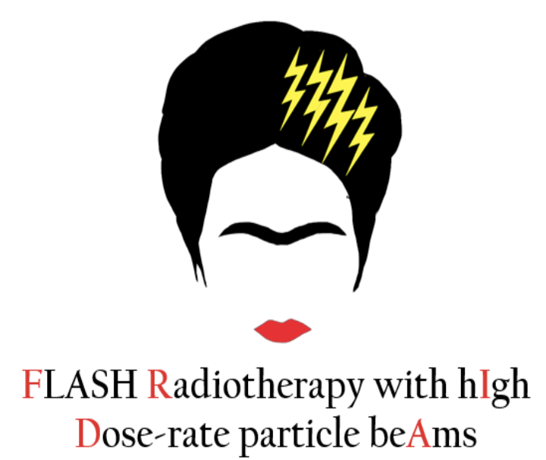
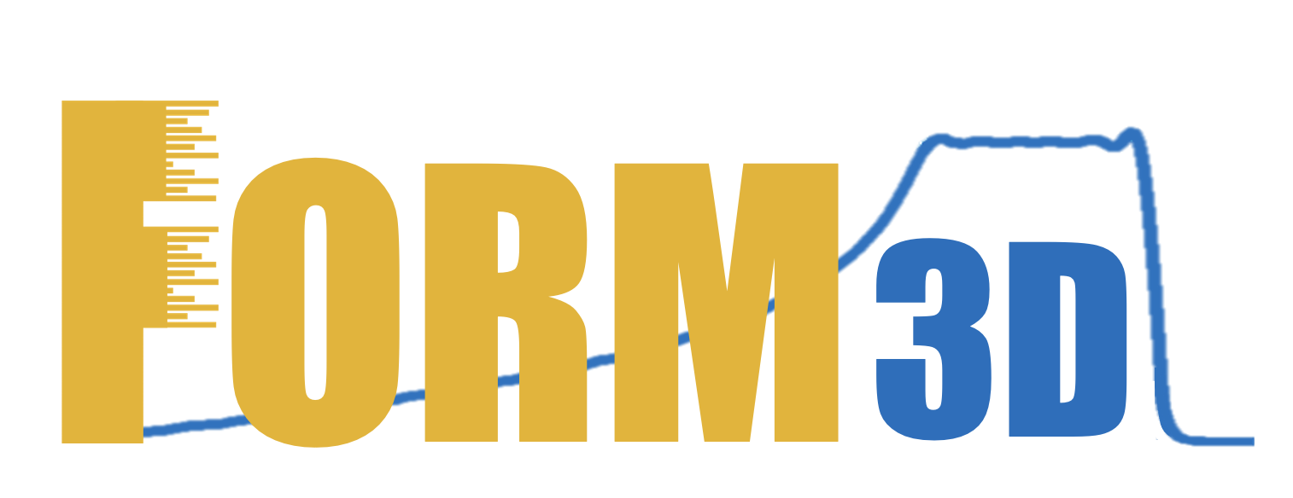
Our way to 3DRM…
1) Beam model implementation in a GPU-MC code (FRED)
2) Validation of the beam model
FRIDA project INFN
3) Design and simulation of the 3DRM
Grant giovani INFN
4) Fabrication and testing of 3DRM

Slide 32
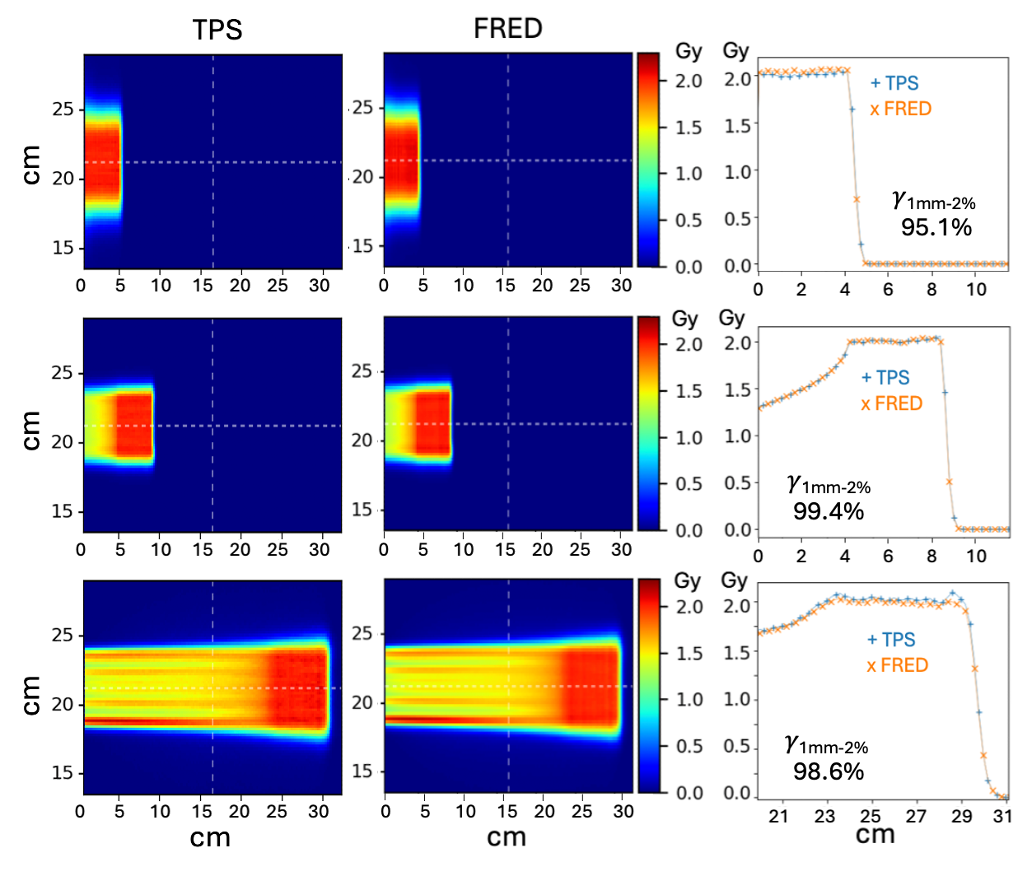
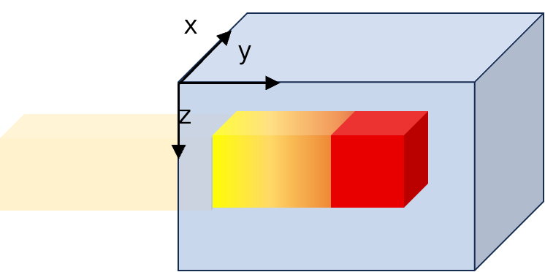

Our way to 3DRM…
2) Validation of the beam model
Simulation of box of dose in water

Slide 33
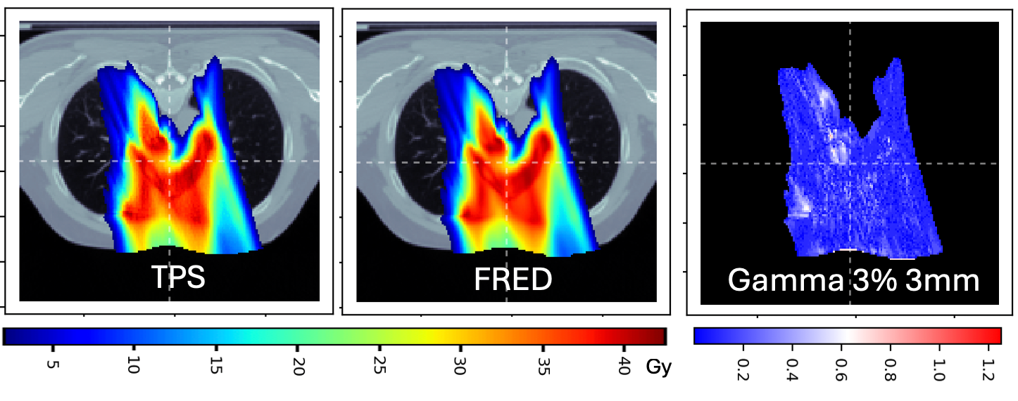
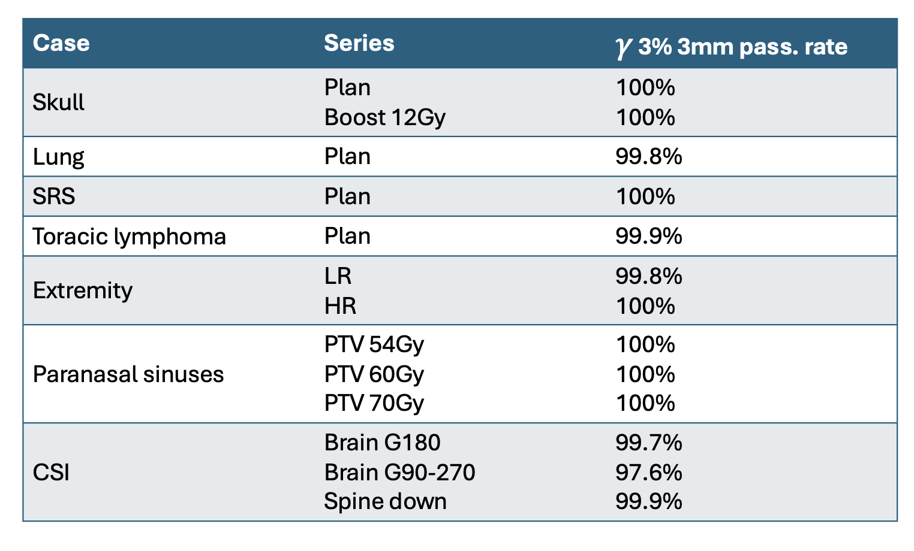
Our way to 3DRM…
2) Validation of the beam model
Validation on real patient cases

Slide 34
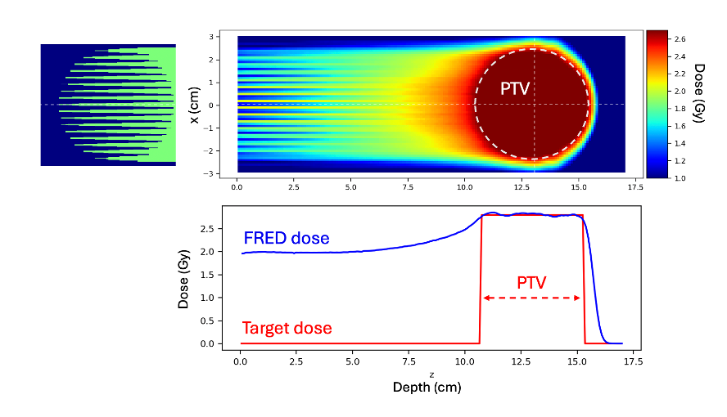
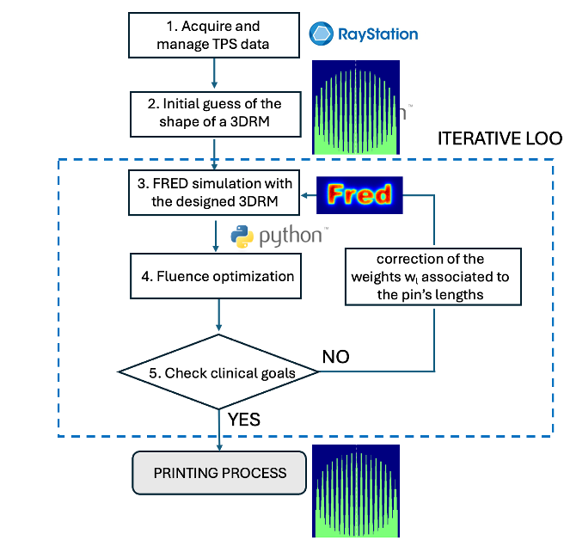

Our way to 3DRM…
3) Design and simulation of the 3DRM
MC based algorithm for 3DRM optimization
3DRM
𝛄3%-3mm
99.9%

Slide 35

Other ways to 3DRM
IBA-Raysearch collaboration
Joint program to create and deliver conformal FLASH treatment plans
FLASH plans are implemented in the TPS via range modulators

Slide 36

FLASH vs Reference Plan (IMPT)
Are the new dose distributons competitive?
3DRM (liver case)
Shoot-through (lung case)
Schwarz 2022, Med Phys

Slide 37
Pros & Cons
Shoot-through
3D Range modulators
Maximize the FLASH potential, since we use the highest energy
Protons are just “very expensive photons”
Some directions might be forbidden, because the Bragg Peak is in the patient
We create conformal dose distributions, exploiting the finite range of protons
Need for non-trivial field specific objects
Lateral penumbra is good enough?
Dose distributions are “inferior” to the IMPT

Slide 38
FLASH
is not for free
Flash needs to compensate at least for the inferior dose conformity

Slide 39






Dose rate definition
Can we agree on the definition of dose rate?
Van der Water 2019
Schwarz 2022
Folkerts 2020

Slide 40

Dose rate definition
Impact of the definition of dose rate

Slide 41

Dose & dose rate threshold
Are FLASH tresholds reliable?
Schwarz 2022, Med Phys

Slide 42




Optimization of scanning pattern
Impact of different scanning patterns
Courtesy of M.Battestini

Slide 43


Conclusions
What do we know?
Current proton sources can be adapted to deliver UHDR
Modalities to deliver FLASH treatments are available (shoot-through/3DRM)
Clinical trials are proceeding (FAST01, FAST02)
Dose metrics are crucial to design a FLASH treatment plan
The dose distributions are inferior to the standard IMPT
What are we missing to go clinical?
Radiobiological insights about the mechanism (experiments, modelling, ..)
Definition of the metrics of importance (dose, dose-rate)
Implementation of the metrics in the TPS optimization process
To understand when it is convenient to go FLASH?

Slide 44


Thanks to the BIMER team:
Francesco Tommasino
Emanuele Scifoni
Alessandra Bisio
Enrico Verroi
Francesco Cordoni
Marta Missiaggia
Elena Fogazzi
Alessia
Marco Battestini
Lorenzo Castelli
Giulio Bordieri
Thanks to the APSS group:
Francesco Fracchiolla
Stafano Lorentini
Thanks to:
Andrea Attili
Angelo Schiavi

