Slide 1





CH4rLiE
Associate Professor. Dr. Daniele Dondi
Director in Laboratory of Radiation Chemistry and EPR Spectroscopy
Department of Chemistry, University of Pavia, 27100, Italy.
Wednesday, April 9th, 2025

Slide 2
Experiments performed
Preparation of Z5-C 20% (10+15g)
Preparation of UCSB-9 zeolite
Preparation of TUT-100
Methane adsorption experiments UCSB-9
Methane adsorption experiments TUT-100

Slide 3
Preparation of UCSB-9 Zeolite
The UCSB-9 zeolite was synthesized based on the literature procedure.
The prepared zeolite were tried to confirm using FTIR.
It is difficult to confirm product formation with FTIR and TGA .
But it is noted the amount of starting material becomes less if more product is formed.
The product formation can only be identified using Powder XRD. Therefore, for both samples PXRD is made.
Ethylene glycol
Ga(NO₃)₃
GeO₂

Slide 4
Preparation of UCSB-9 Zeolite
Zeolite prepared with regular procedure showed similar peaks to Reference data.
But the peaks that were in less intensity in reference data was in more intensity in synthesized material.

Slide 5
Preparation of UCSB-9 Zeolite
Zeolite Prepared with regular procedure showed some similar peaks to modified procedure but with less intensity.
But not all the peaks were matching.

Slide 6
Preparation of UCSB-9 Zeolite
Since the regular procedure showed some peaks that are not in reference data, We modified some things like increase the quantity of the starting material.
And this time product obtained were crystals and the PXRD peaks had less noise and clearer.

Slide 7
Preparation of TUT-100
Based on the literature reviewed TUT-100 a MOF based on Cobalt acetate and organic linkers 4,5-dichloroimidazole and 1-Methylimidazole “ZIF” was prepared.
The prepared material is subjected to PXRD and FTIR for confirmation.
Literature
Prepared

Slide 8
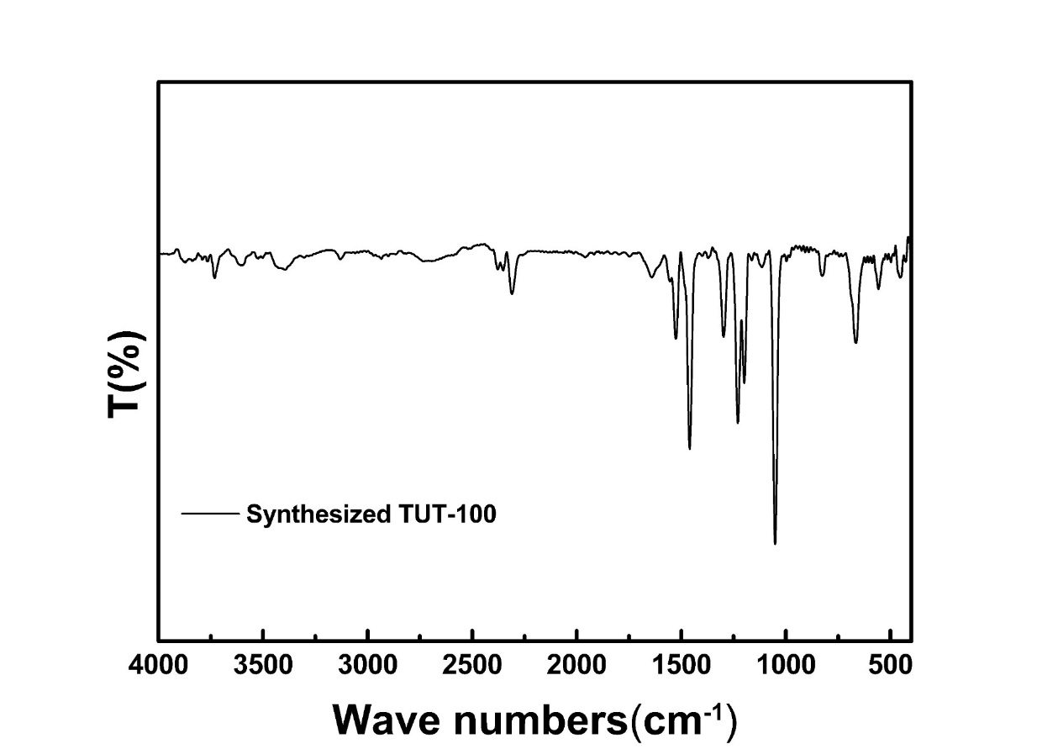
Preparation of TUT-100
The PXRD peaks had peaks similar to the literature.
The FTIR Values matched to some extent.
Yet, repeated preparation are required in order to refine the material.

Slide 9
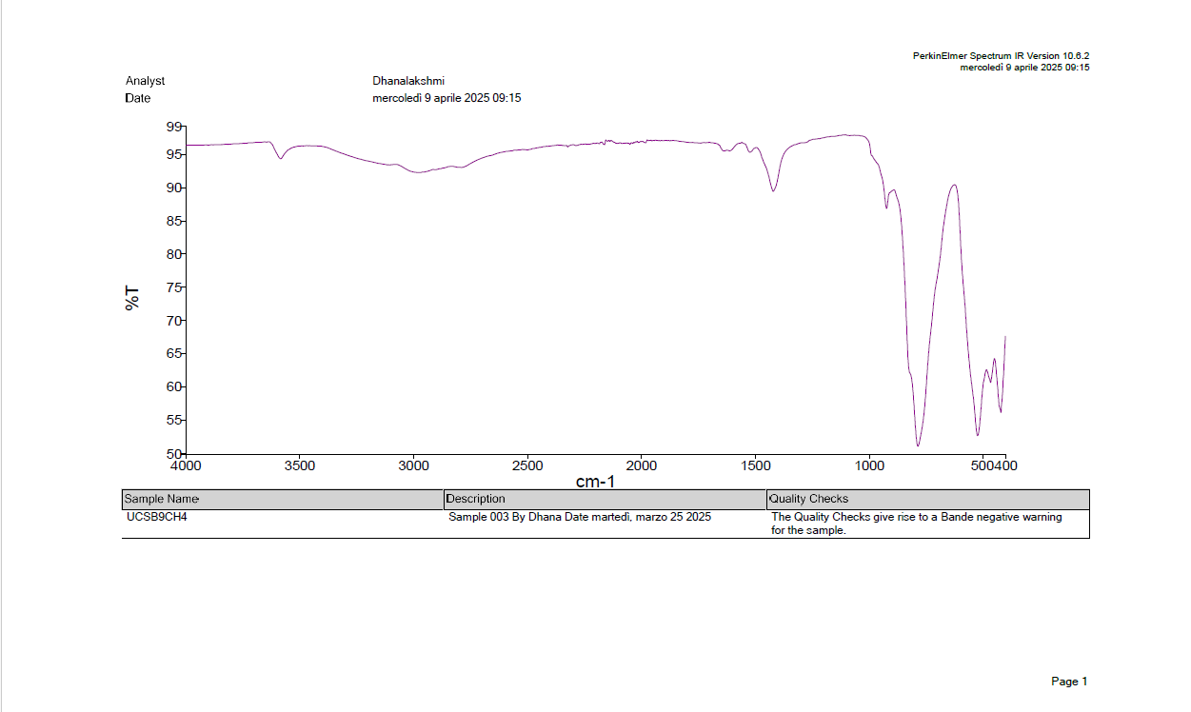
Methane adsorption experiments UCSB-9
In the literature where methane adsorption was observed using FTIR-ATR spectroscopy.
The amount of adsorbed methane was evaluated by integration of the absorbance between 3029 and 2984 cm−1
So, Methane adsorption was tested by making the material under vacuum and methane was made to adsorb and FTIR measurements are taken for the sample.
Methane adsorption in UCSB-9 was difficult to observe.

Slide 10
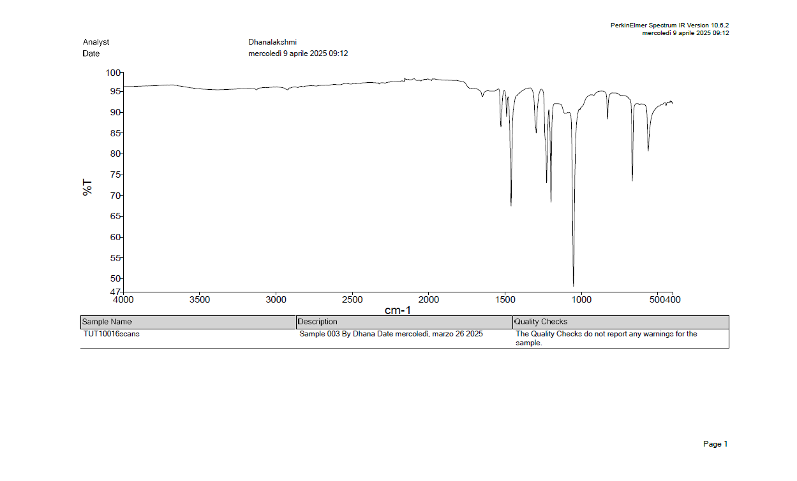
Methane adsorption experiments TUT100
The material was taken FTIR-ATR before methane adsorption experiments.

Slide 11
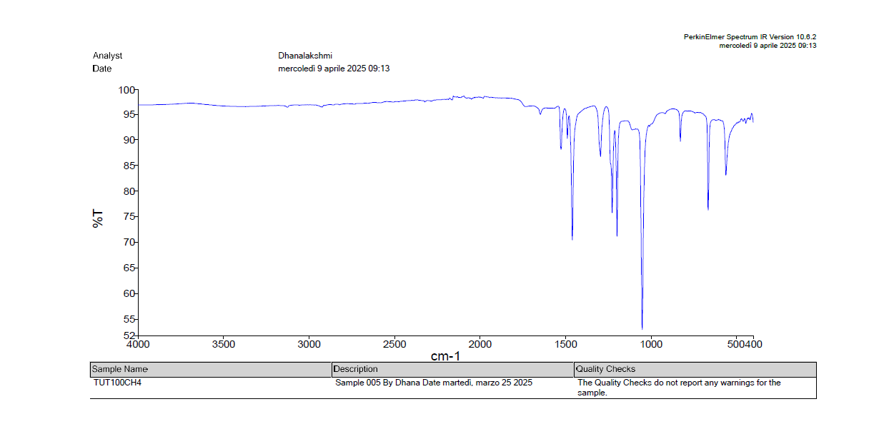
Methane adsorption experiments TUT100
The material measured FTIR-ATR after methane adsorption experiments with 16 scans.

Slide 12
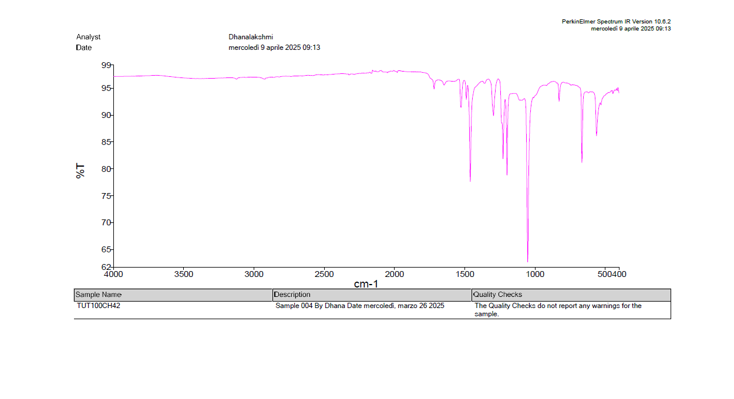
Methane adsorption experiments TUT100
The material was taken FTIR-ATR after methane adsorption experiments increased number of scans to 32.

Slide 13
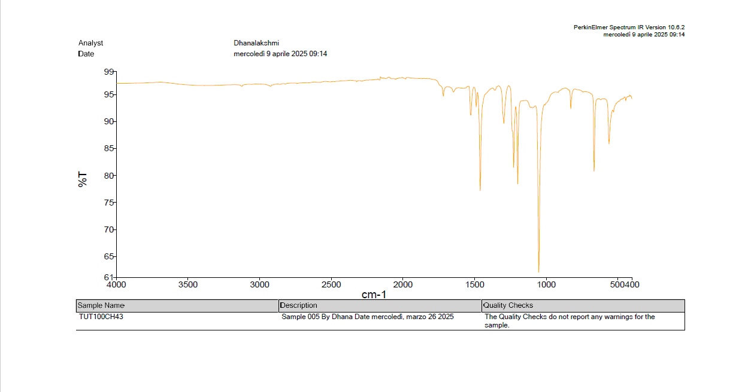
Methane adsorption experiments TUT100
The material was taken FTIR-ATR after methane adsorption experiments increased number of scans to 64.

Slide 14
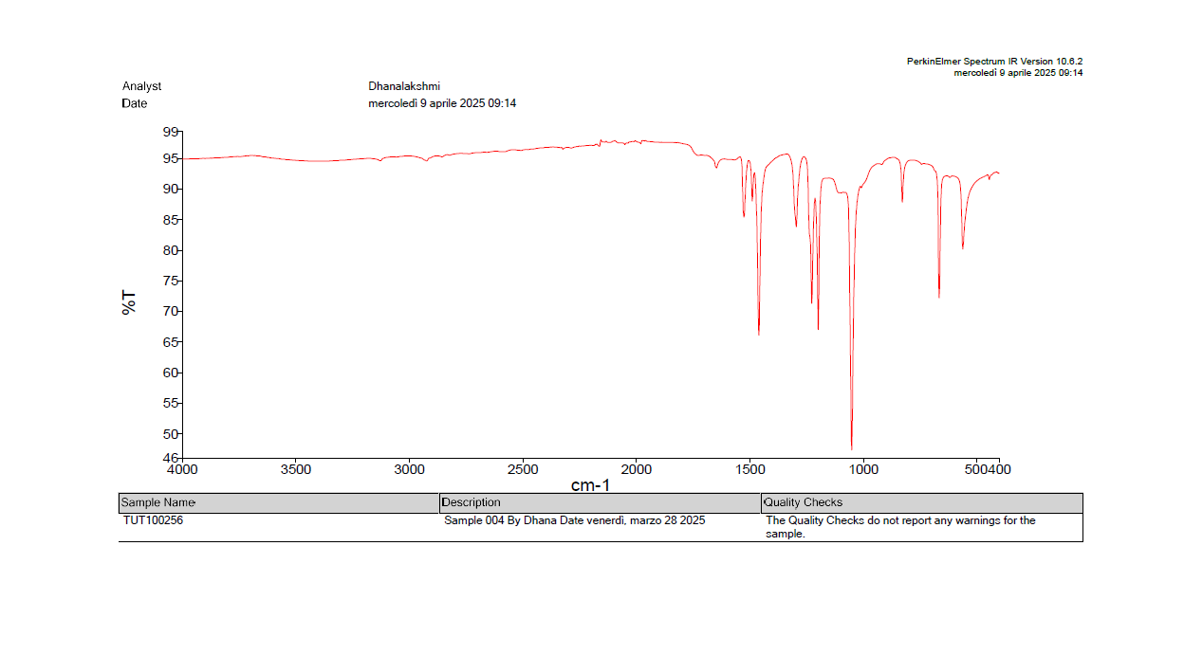
Methane adsorption experiments TUT100
The material was taken FTIR-ATR before methane adsorption experiments increased number of scans to 256.

Slide 15
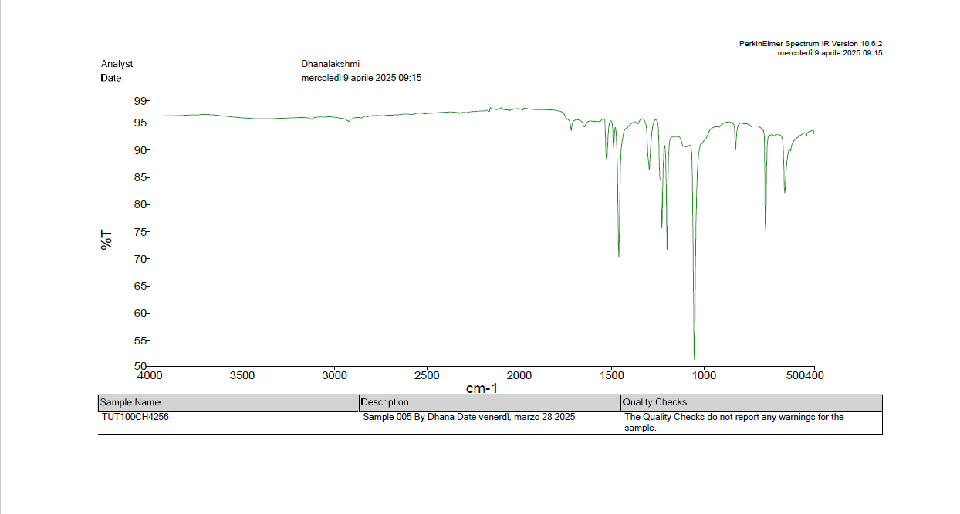
Methane adsorption experiments TUT-100
The material was taken FTIR-ATR after methane adsorption experiments increased number of scans to 256.

Slide 16
Conclusion
Continuing preparation of UCSB-9 Zeolite.
Refining the procedure for TUT-100 synthesis.
Improving the methane adsorption and altering FTIR-ATR identification method.

Slide 17
Acknowledgement
Thank you

