Slide 1
CH4rLiE
Updates
9/4/25

Slide 2
New setup in Pavia lab
Sensor
CH4
100 ppm
CARTRIDGE
vent
Simple setup to test the methane sensor
Empty cartridge
Ar

Slide 3
New setup in Pavia lab
CH4
100 ppm
CARTRIDGE
Sensor
CARTRIDGE
Ar
vent
Setup similar to CERN one
First cartridge for the moisture

Slide 4
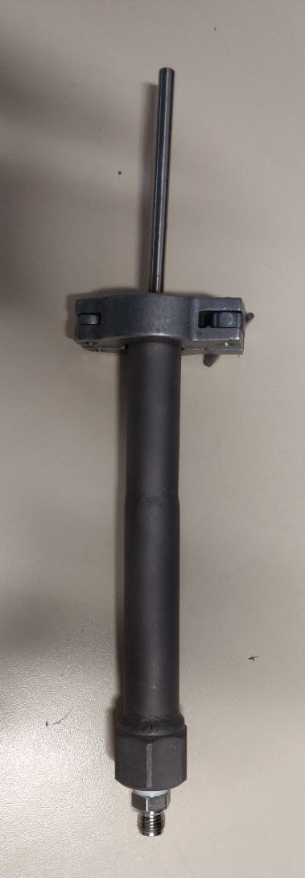
New setup
2 cm
2x smaller cartridge:
Possibility to perfrom test with the methane sensors
Less material needed
Possibility to perform the high temperatue regeneration
18 cm

Slide 5
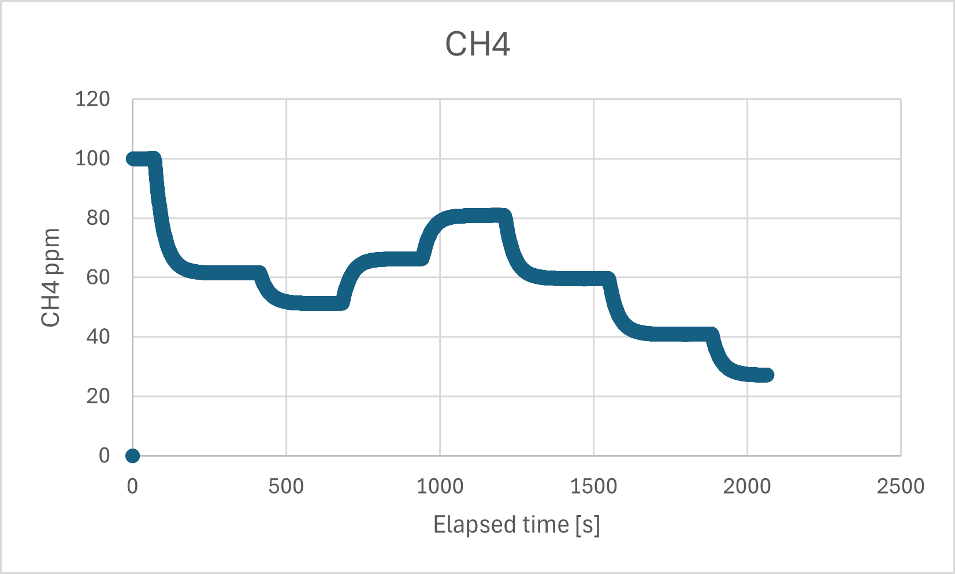
First test with the sensor
Step | CH4 [l/min] | Ar [l/min] | Plateaux [ppm]
1 | 1.3 | 0.0 | 100.03
2 | 1.3 | 1.0 | 61.58
3 | 0.9 | 1.0 | 51.31
4 | 0.9 | 0.5 | 66.50
5 | 0.9 | 0.2 | 81.17
6 | 0.6 | 0.2 | 59.36
7 | 0.6 | 0.5 | 40.60
8 | 0.6 | 1.0 | 27.40
1
5
2
4
6
3
7
8

Slide 6
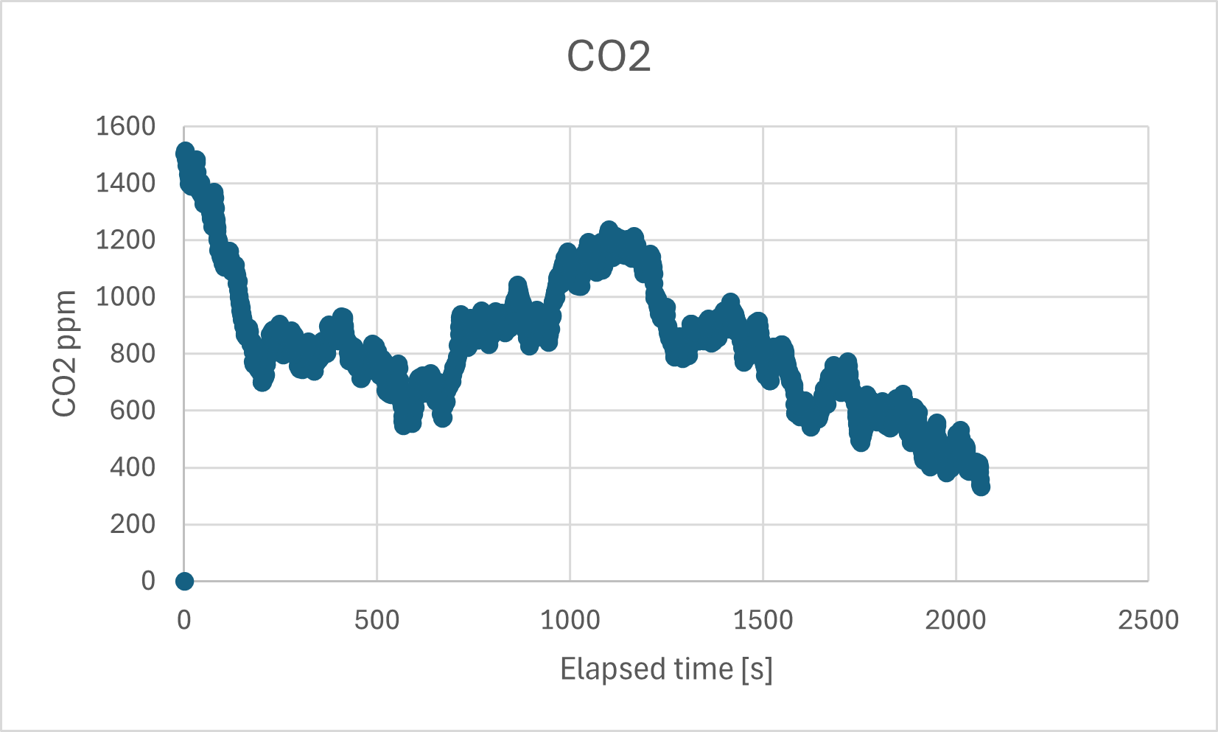
CO2 measure
Unexpected high values of CO2
Test with pure Ar:
Still around 600ppm
Probably an offset

Slide 7
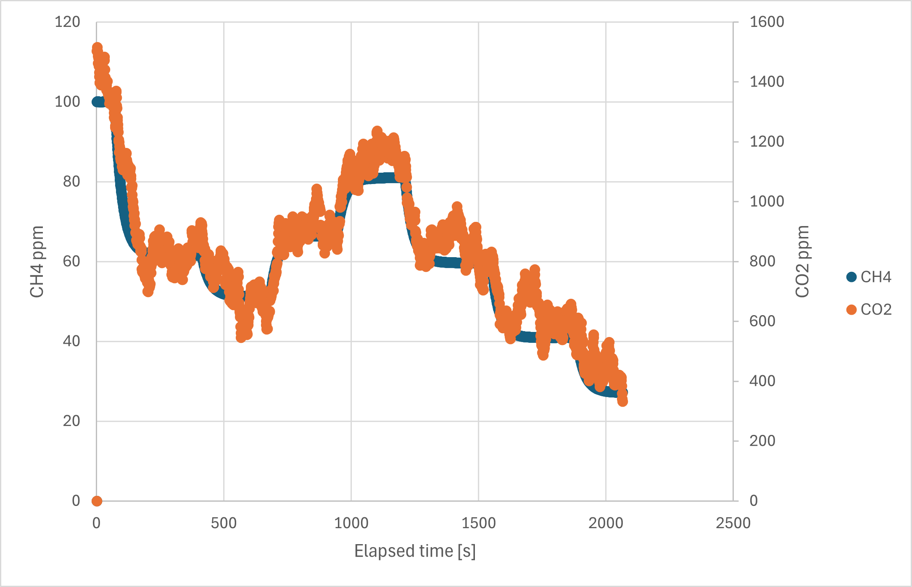
CO2 – CH4 correlation
Unexpected correlation between CO2 and CH4
Not a leak
CO2 in the bottle ?

Slide 8
To do next
Confirm the presence of CO2 in the bottle
Test with different integration time
Test to see if the sensor loose precision if the flux is lower than the recommended one
Prove the feasibility of adsorbtion tests in the lab with this setup
Test the new material

