Slide 1



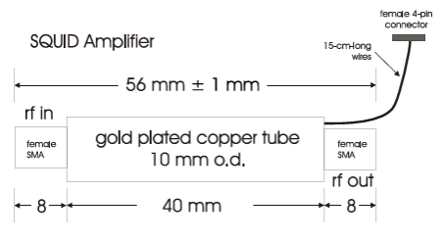
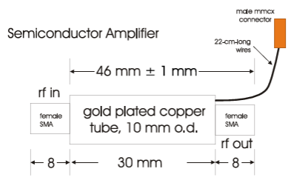
FLASH Technical Design Report
WP4 Signal Amplification and Acquisition
MSA
Cryogenic PostAmp
A Nb shield (not shown) comes with MSA from ezSQUID
MSA cooling through SMA connectors → heat-sink adapter
SS coax cable between MSA and PostAmp
Magnetic shielding → goal 1 mGauss
Input matching network?
Cavity Simulator?
PostAmp cooling trough SMA connectors → heat-sink adapter
P≈3 mW → SS coax cable between MSA and PostAmp
Magnetic shielding?

