Slide 1
ASPIDES meeting 2
Tommaso Floris
21/03/2025

Slide 2
Functions of the dSiPM
Count the number of photons
parallel counter
Identify the ToA of the first and last photons
two TDCs and the ANDtree
Reject spurious events
time over threshold detector with programmable threshold
Possibility to enable and disable the single pixel
memory element inside each pixel
Global signal to reset and enable the array

Slide 3
Overall floorplan
ARRAY
AND tree
TDCs
Last stages of ANDtree and PC
Threshold detector
Parallel
Counter (PC)

Slide 4
2x2 pixel cluster
Pixels organized in 2x2 clusters represent the basic building macro for the matrix
Frontend
SPAD region
Routing region
Digital logic region (dSiPM)

Slide 5
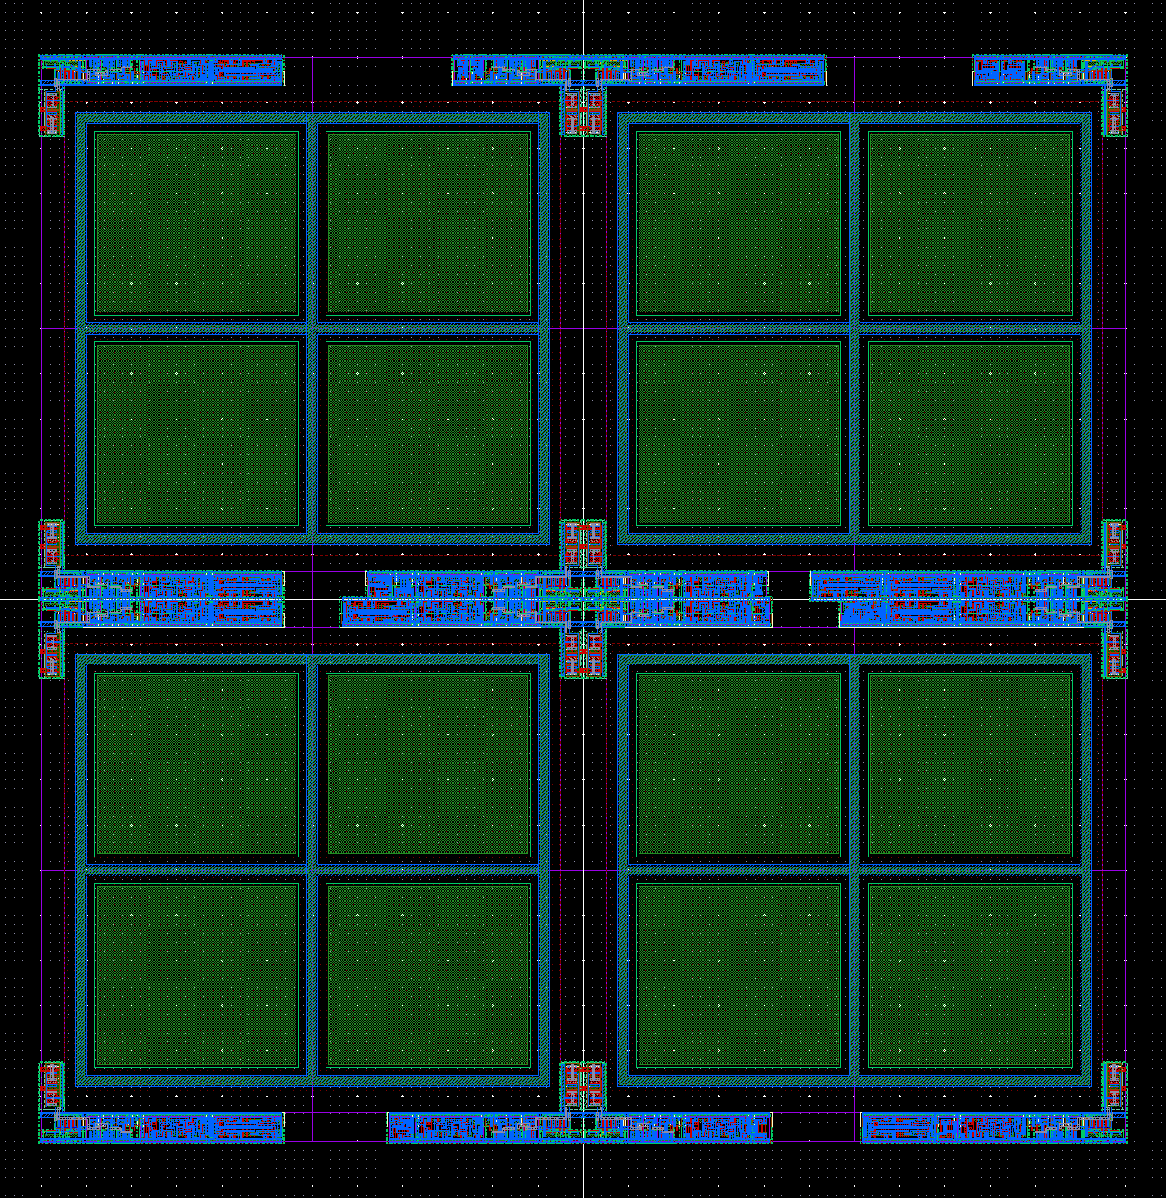
2x2 pixel cluster
The pixel are organized in 2x2 cluster and represents the basic building macro for the matrix
Frontend
SPAD region
Routing region
Digital logic region (dSiPM)
FF = 48 %

Slide 6
Array floorplan detail
In the final array there will be 16 rows of 16 2x2 cluster

Slide 7
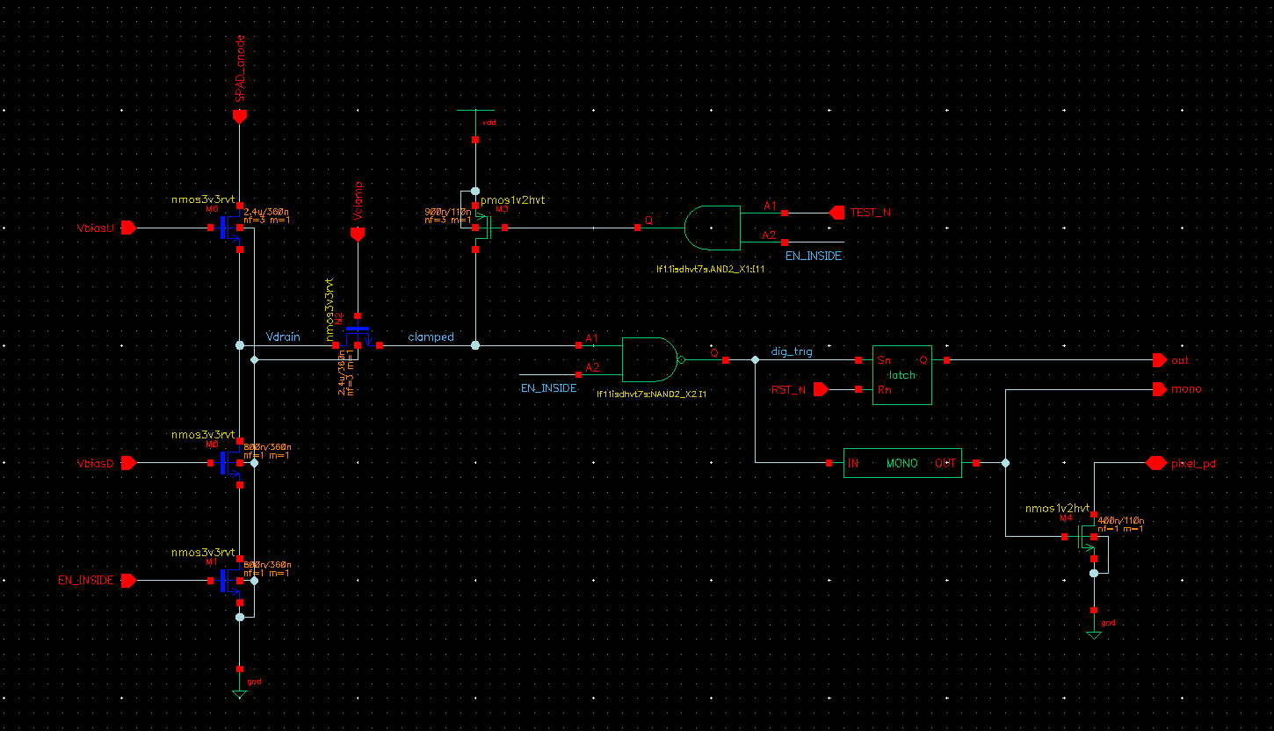
SPAD frontend

Slide 8
AND tree
All input stimulated simultaneously
Changing the pulse width of the input signals

Slide 9
AND tree
One input at a time stimulated with a pulse signal
Looking at how the pulse width changes

Slide 10
AND tree
One input at a time stimulated with a pulse signal
Looking at how the pulse width changes

Slide 11
AND tree
All input stimulated simultaneously performing a transient noise analysis
Looking at how the pulse width changes

Slide 12
AND tree
All input stimulated simultaneously performing a transient noise analysis
Looking at how the pulse width changes

Slide 13
AND tree performance
 | AND2 | AND4 | ANDH
Rising delay | 640,8 ps | 412,2 ps | 506,7 ps
Rising delay (Std Dev) | 12,05 ps + 23,01 fs | 14,35 ps + 10,64 fs | 13,91 ps + 20,06 fs
Falling delay | 754,2 ps | 679 ps | 725,8 ps
Falling delay (Std Dev) | 10,43 ps + 46,12 fs | 28,77 ps + 83,93 fs | 23,19 ps + 53,85 fs
Pulse width (Std Dev) | 1,784 ps + 51 fs | 14,83 ps + 84,35 fs | 10,65 ps + 57,15 fs

