Slide 1
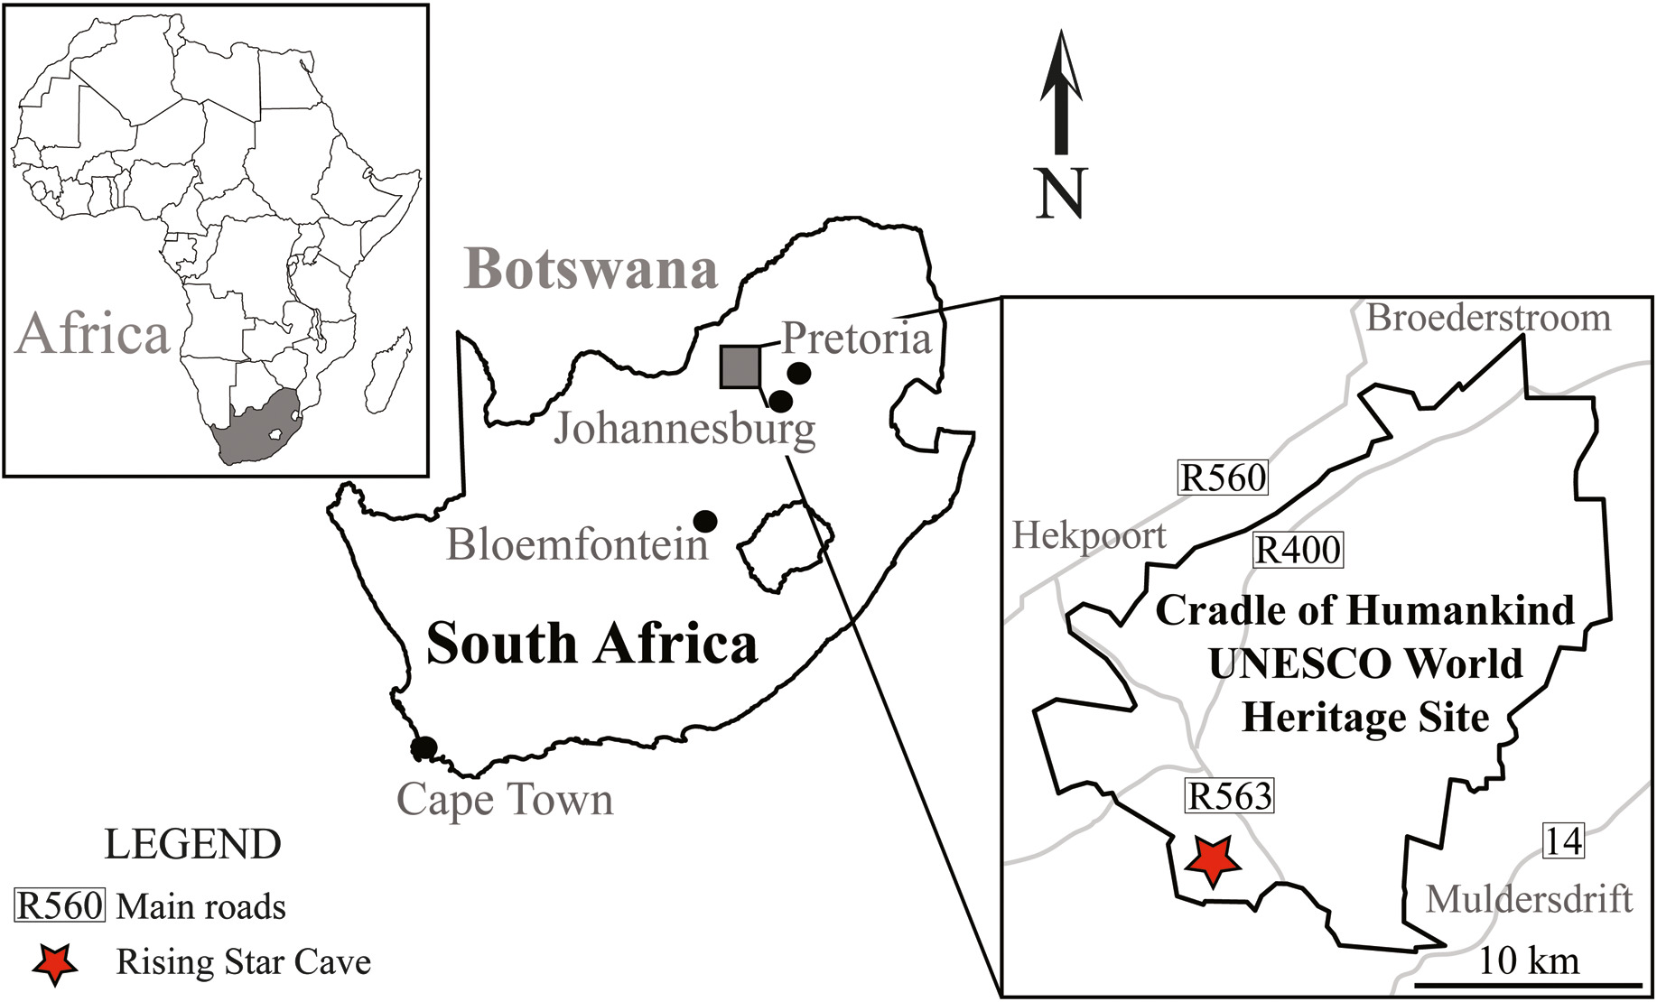
Muography in COHWHS
M. Bruschi - INFN Bologna (ITALY)
Meeting on March 21st 2025

Slide 2
Status of the PoC project
Everything is mostly ready to start
Detector ready for transport
Transport protocols defined
Day/Night temperatures in the tent measured
Infrastructures needed at #105 (Power, internet, cabling …): probably to be still setup, but does not seem a show stopper
CAD geometry at #105 ?
Geodating
Strong and active working group
Proposal for measure at n-Tof ready
Neutron detectors calibration: input from Ithemba are needed to understand possibility to use Bonner spheres and to calibrate the PoliMi detector and to provide the moderator
Most important: MoU
Without MoU with Ithemba and LRBF/NatGeo we can not start
Ithemba: Will be signed in Rome on April 2nd
NatGeo: on progress. Document has been updated and under discussion at NatGeo administration

Slide 3
Backup

Slide 4
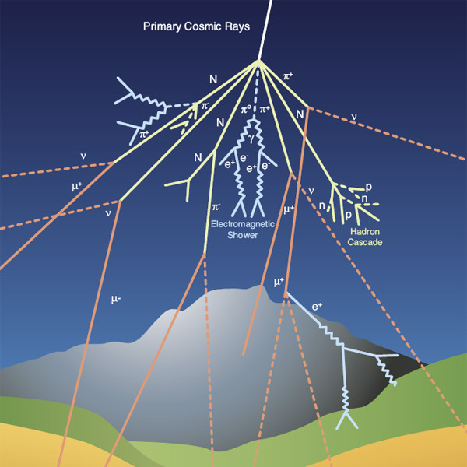
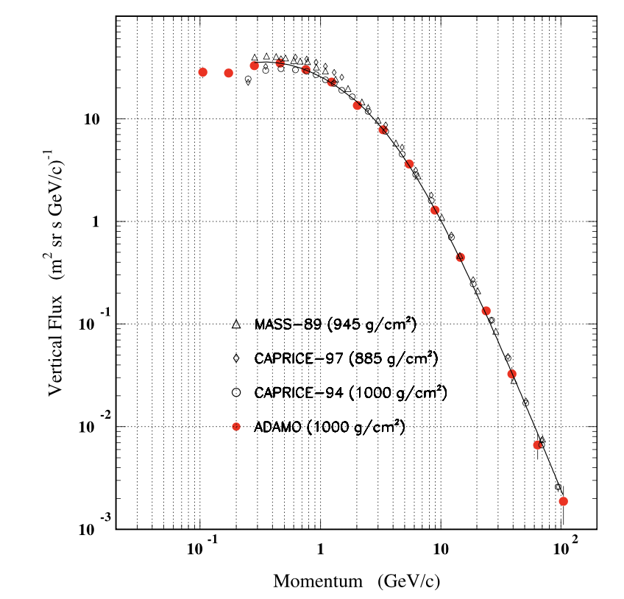
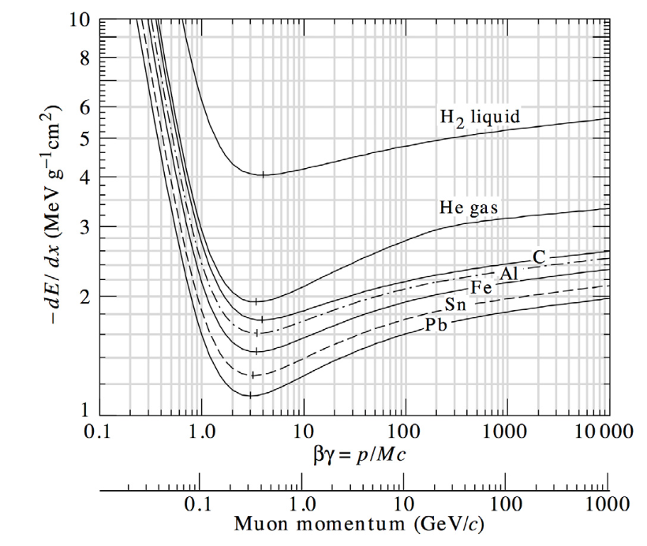
Cosmic rays cascades
Primary cosmic rays
85% protons
12% α particles
3% heavier particles
At altitudes between 15-20 km they interact in the atmosphere with nuclei initiating electromagnetic or hadronic showers
Secondary cosmic rays can survive enough to reach Earth’s surface
At the sea level, 80% of all the charged particles hitting the ground are MUONS
Typical flux of vertical muons: 1/cm²/min
The flux depends on the momentum and the zenith angle θ: I(θ)~I(θ=0) cos² θ at the sea level for muons momenta ~ 3 GeV

Slide 5
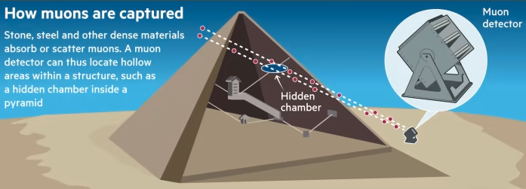
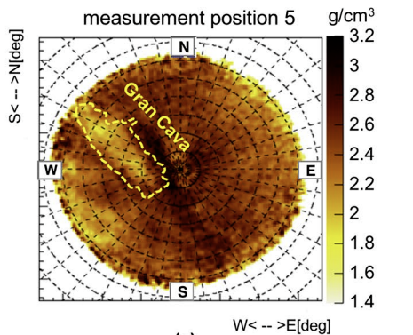
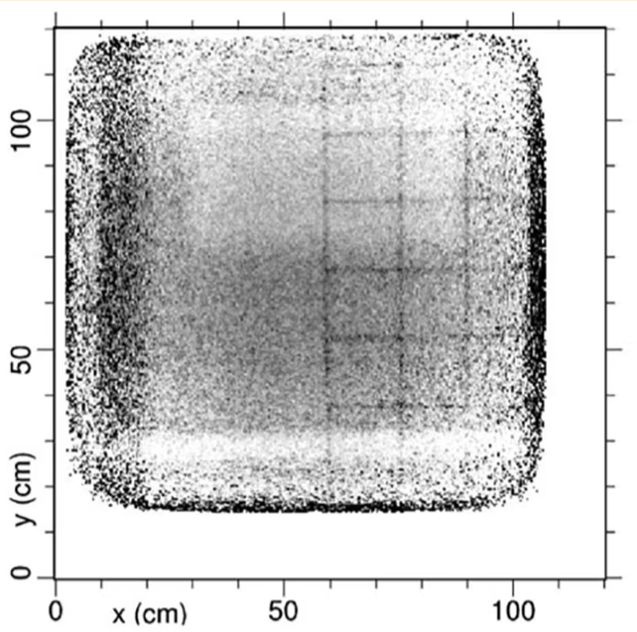
The principle of muography
Natural Imaging Agents
Unlike X-rays that require a source, muons are naturally and abundantly available.
Muons lose energy and get absorbed or deflected when passing through matter.
Capturing Shadows
Detectors placed on opposite sides of an object capture muons after they pass through.
Areas with denser material (like metals or rock) absorb more muons, casting a 'shadow' on the detector.
Creating an Image
By measuring the number of muons passing through different parts of the object, a 2D (or 3D using more detectors) image can be constructed.
Helps in revealing the internal structure without physically opening the object.
Needs comparison with MonteCarlo simulations
Example of muography inside the Temperino mine (Tuscany) by the Florence group(INFN and Uni.)
Areas of lower (hidden caves) or higher densities materials are visible
More about this in the following

Slide 6
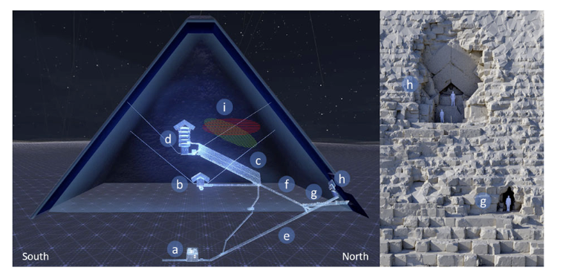
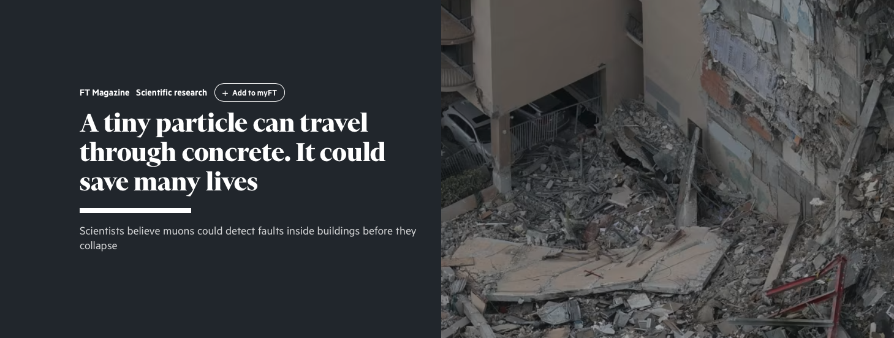
Muography applications
1955: Proposed by Edward George to determine the thickness of snow layers on a mountain
Archaeology
from 1971: Search of unknown burial cavities in the Chephren pyramid (Luis Alvarez and coll.)
Volcanology (lateral)
from 2003: Study of the internal structure of volcanoes (Hiroyouki Tanaka and coll.)
Civil engineering and underground
imaging of concrete structures, bridges, monitoring of historical buildings, tunnel boring machines
Industrial
Process monitoring, Preventive maintenance, production optimization

Slide 7
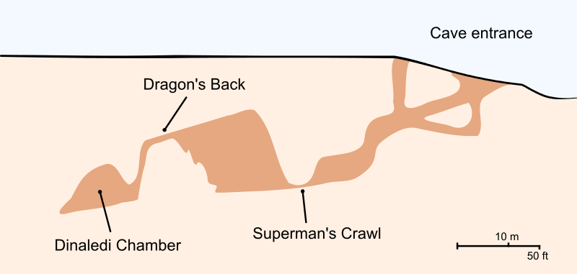
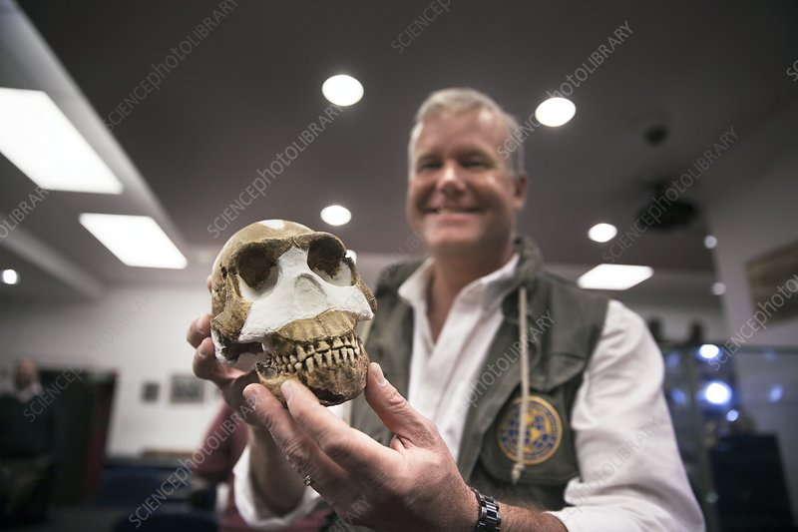
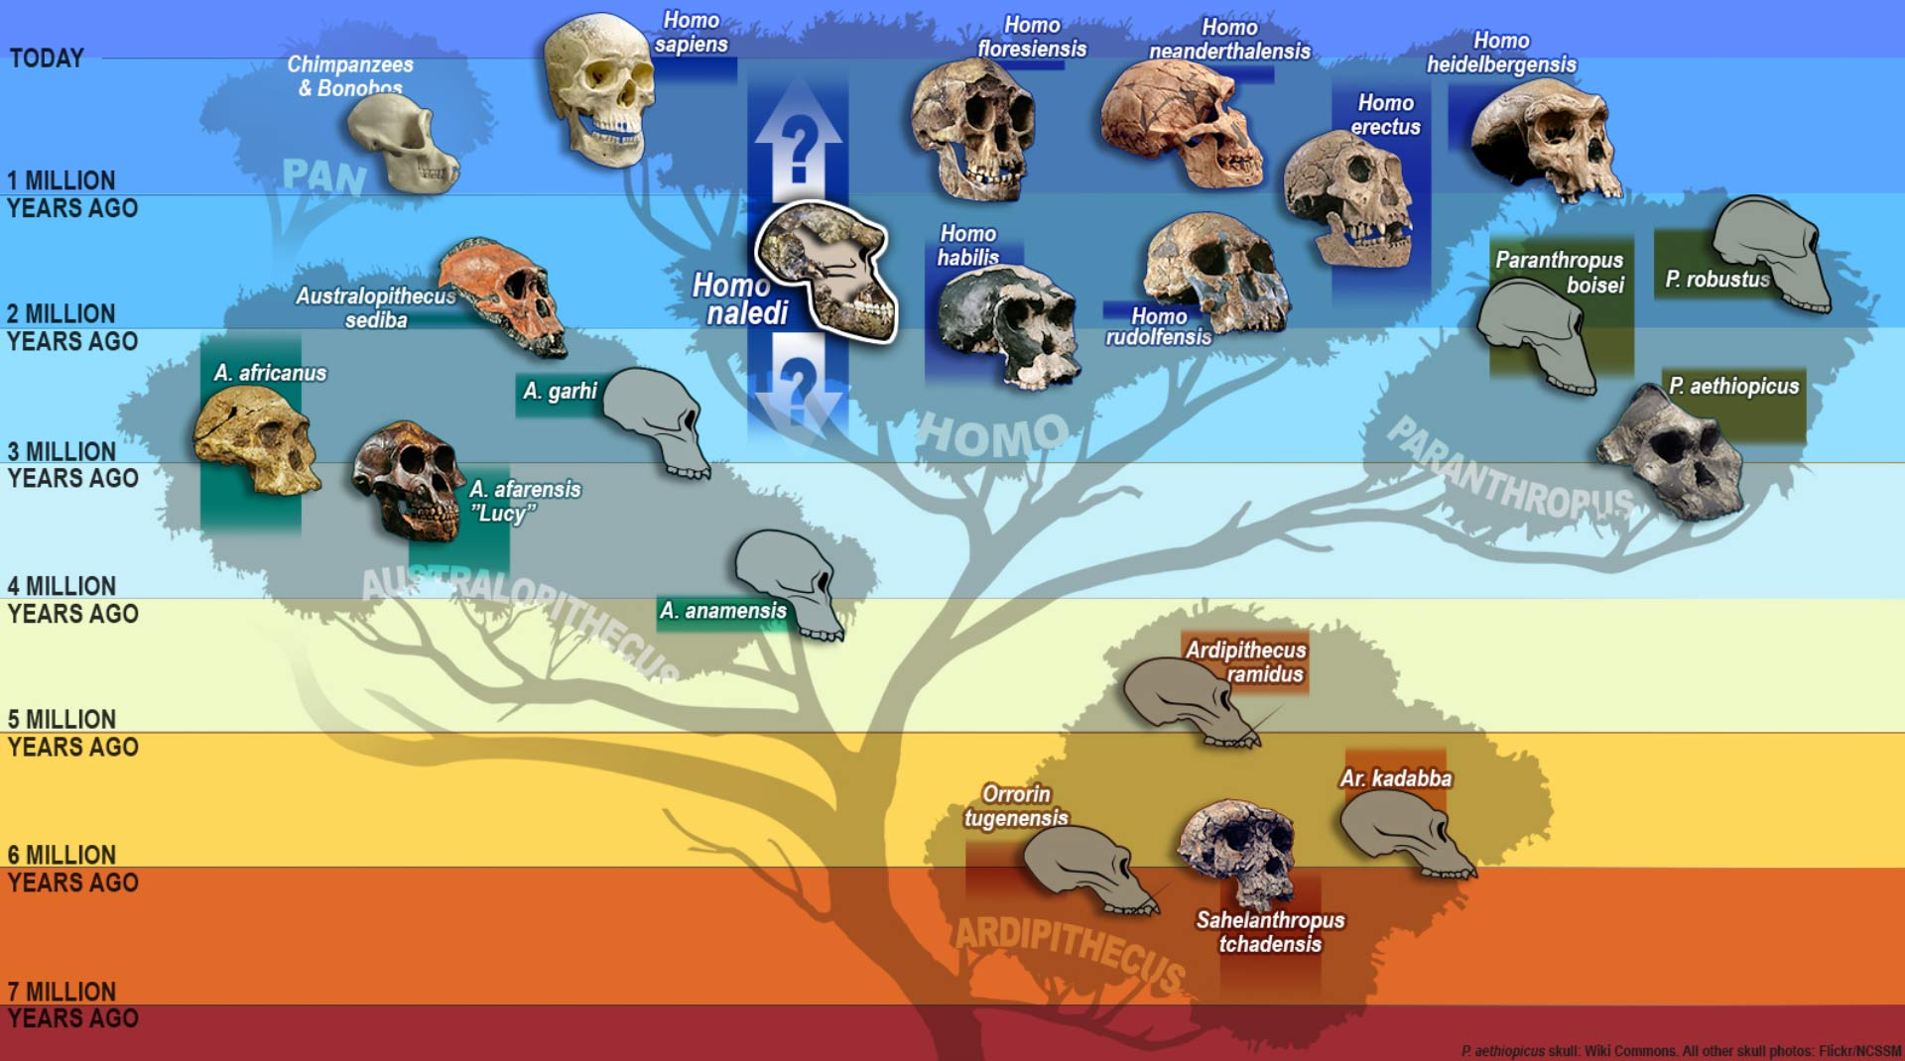
Muon Imaging in the Cradle of Humankind
Introduction:
The Cradle of Humankind UNESCO World Heritage site (COHWHS) is a region rich in karstic dolomite, featuring caves, sinkholes, and subterranean structures.
These formations preserve crucial fossil records, offering insights into human origins and paleoenvironments.
Challenges in Exploration:
Traditional methods have limitations in uncovering the full extent of these karstic systems.
Recent surveys have revealed hundreds of cave systems and fossil-bearing deposits, indicating a need for more advanced exploration methods.
Potential of Muon Imaging:
Muon Imaging presents a promising solution for discovering and exploring these subterranean spaces.
The technique uses naturally occurring muons to create detailed images of the interior of structures, capable of revealing hidden chambers and passages.

Slide 8
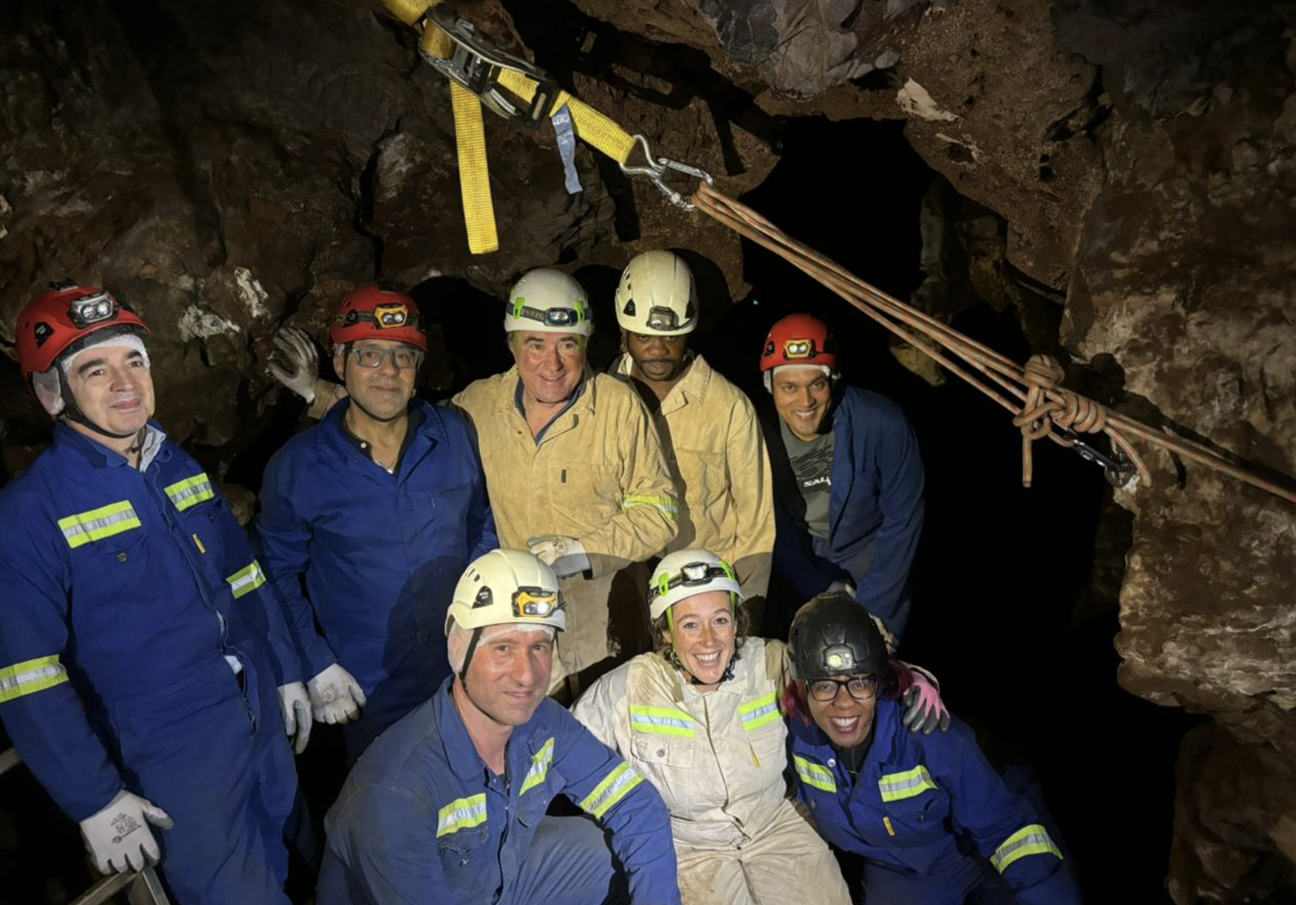
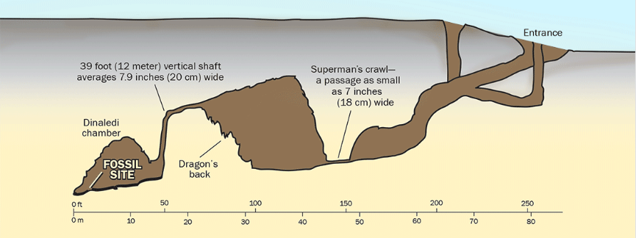
Proposed experiments with Muon Imaging in COHWHS
POC: Muography of the RS site 105
appropriate position
ideal for an initial muographic experiment
These first results will have already a big scientific impact
Exploring for alternative access points to the Rising Star subsystem
hypothesis based on the discovery of numerous remains of Naledi man in the cave system
Presently hardly accessible
The Rising Star subsystem floor sits at 30-35m depth good for MI
Positioning the detectors in different areas in the cave could be used to discover any spaces or passages that are now sealed off from the main chambers

Slide 9
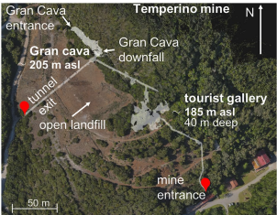
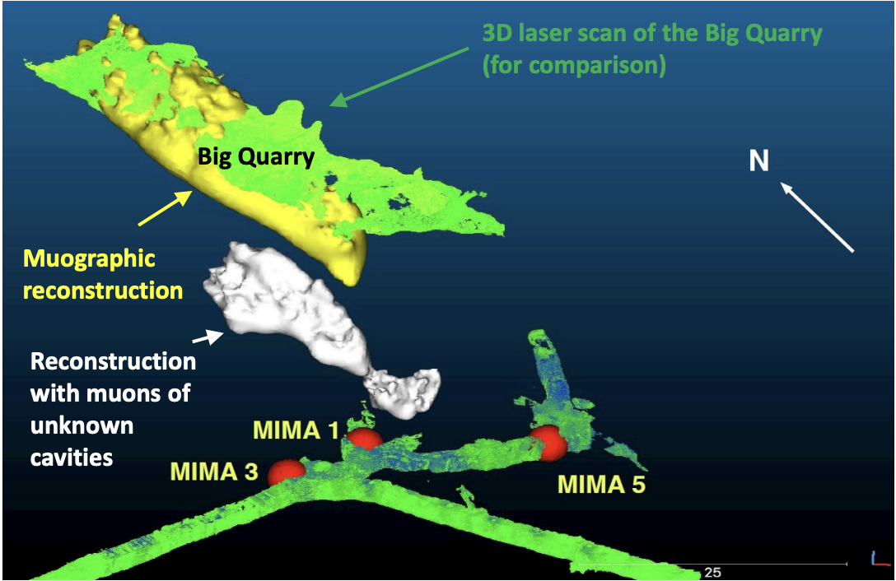
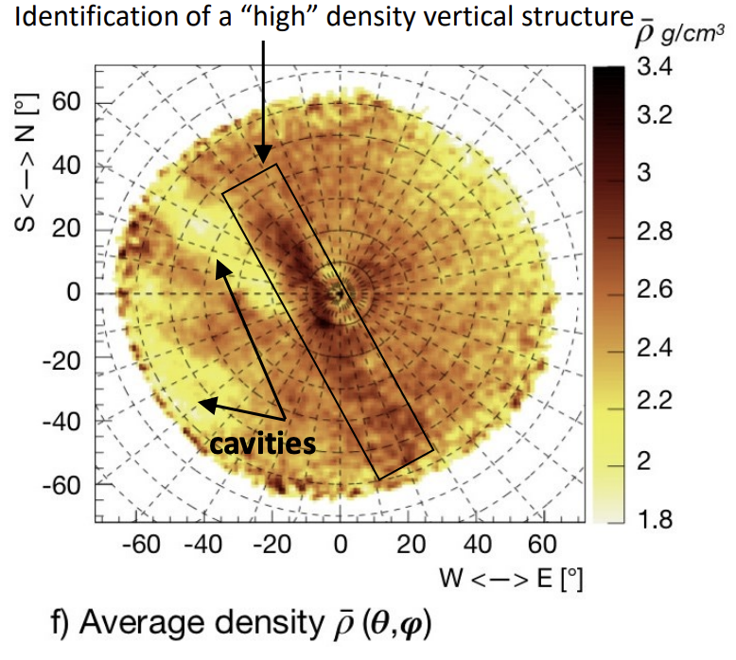
Typical measurement time
https://www.nature.com/articles/s41598-022-26393-7
Temperino mine (Tuscany, Italy)
In cave, 30-50 m rocky overburden, difficult access, MIMA-like detector (40x40 cm2), 4 weeks for each measurement point.
Palazzone necropolis site (Perugia, Italy)
Side protected towards the hill
used MIMA, measurement time 6-8 weeks (more inclined and greater thickness of rock to cross).
Using other types of detector
MIMONE type (64x64cm2) reduces a factor of 2.5 the measurement time
BLEMAB type (80x80cm2) reduces a factor of 4 the measurement time

Slide 10
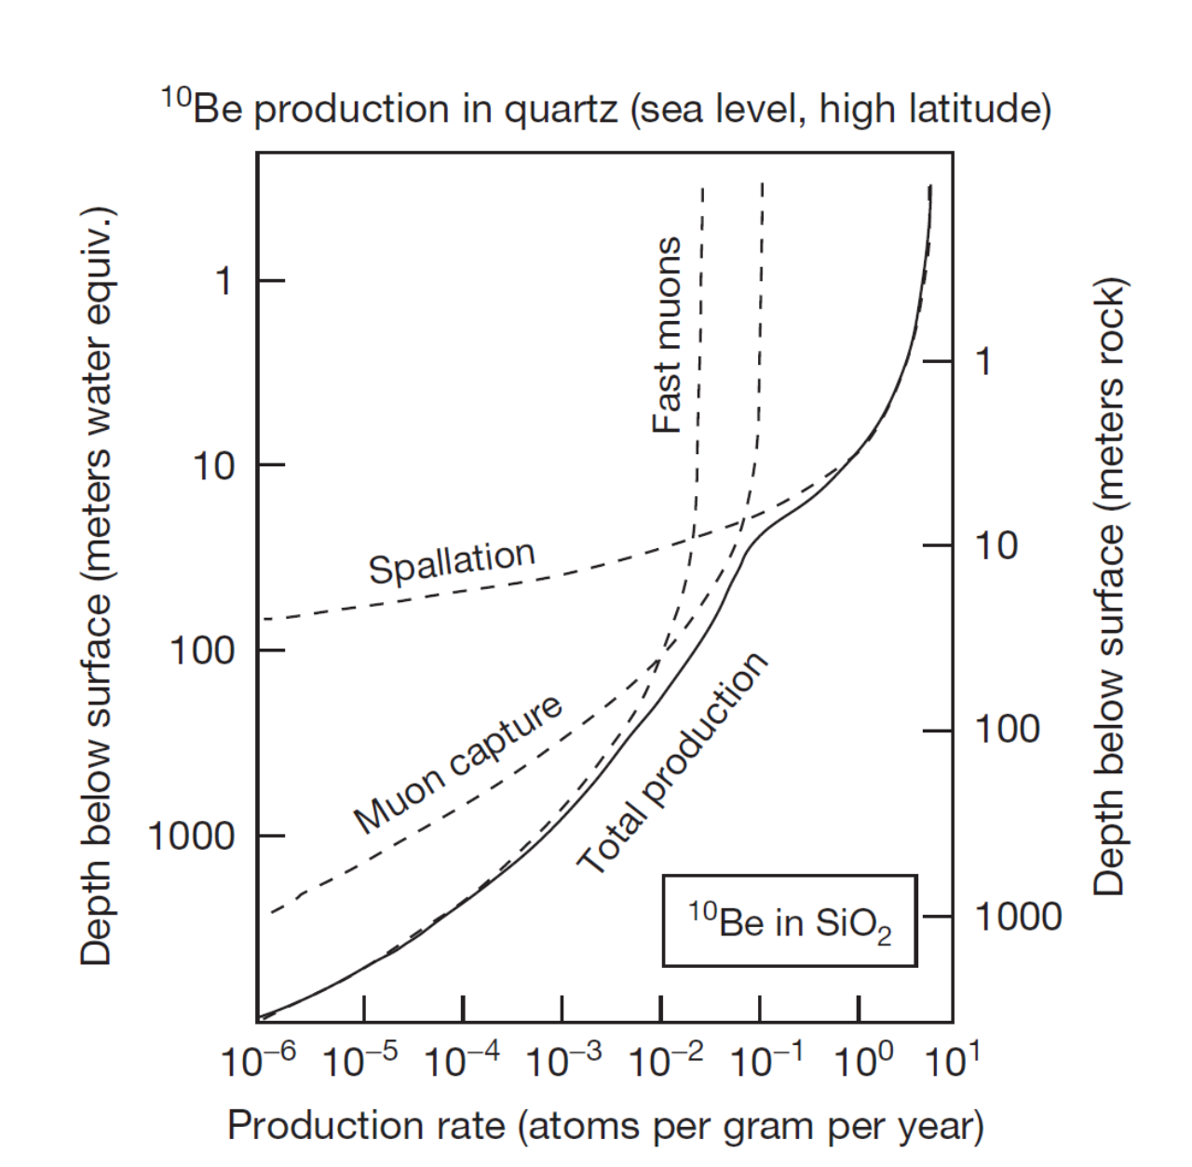
Muography and geodating
Cosmic rays products reaching the soil can produce nuclides
Spallation of high energy neutrons
¹⁶O(n,4p3n)¹⁰Be
²⁸Si(n,p2n)²⁶Al
Slow neutron capture
Slow μ⁻ capture
Fast muon interaction → BS – photons → photoneutrons (depth > 20m)
Measuring the relative abundance and the ratio of long-lived nuclides as ¹⁰Be (1.4 Myears) or ²⁶Al (0.71 Myears) is a commonly used technique for geodating
Experimental measurement of the muon fluxes (and spectra) at the surface and in cave are needed (together to MC modeling) to extract the dating
Measure initially proposed by Dr. T. Makhubela, Geology dpt. of Uni. of Johannesburg
Feasibility using only muon flux measurements on surface and in cave must be studied
Other groups interested
Univ of Johannesburg
INFN Bologna
Ithemba/Wits
Precision needed for dating must be assessed and then feasibility studies must be performed

Slide 11
Geodating measuring Neutron Flux
The geodating using the measurement of muon flux caught the attention of experts in Bologna and Firenze
A very efficient working group is active on this since more than 1 year
The group is now concentrated in the geodating determination using the flux of ultrafast neutrons from cosmic rays
PoliMi and Ithemba Labs will provide the instruments to measure surface ultrafast neutron flux during the PoC
Contacts with the CIRCE AMS facility are started

Slide 12
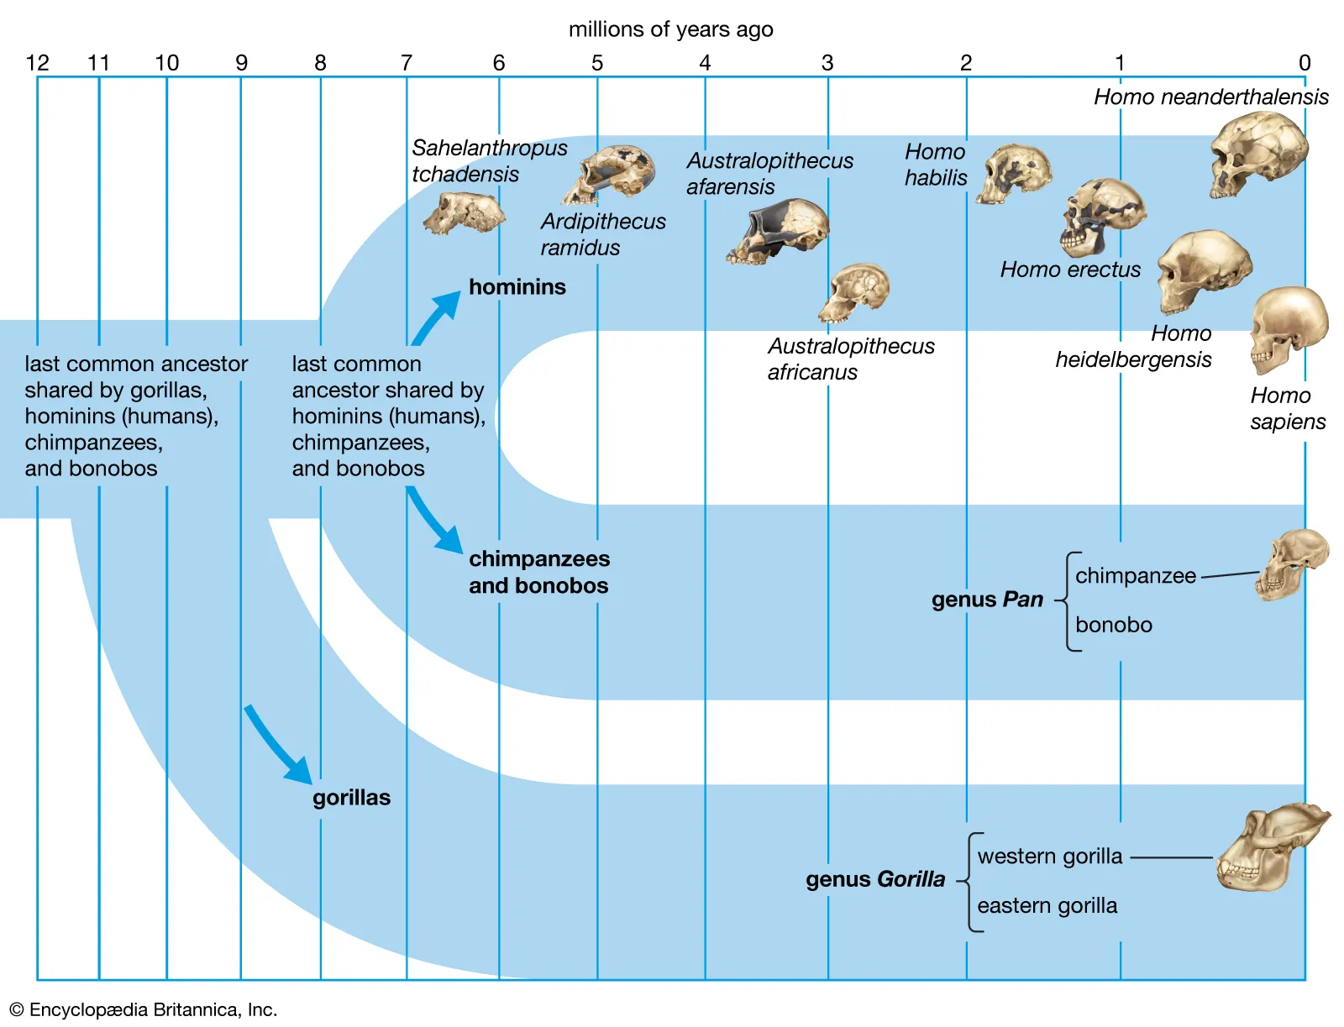
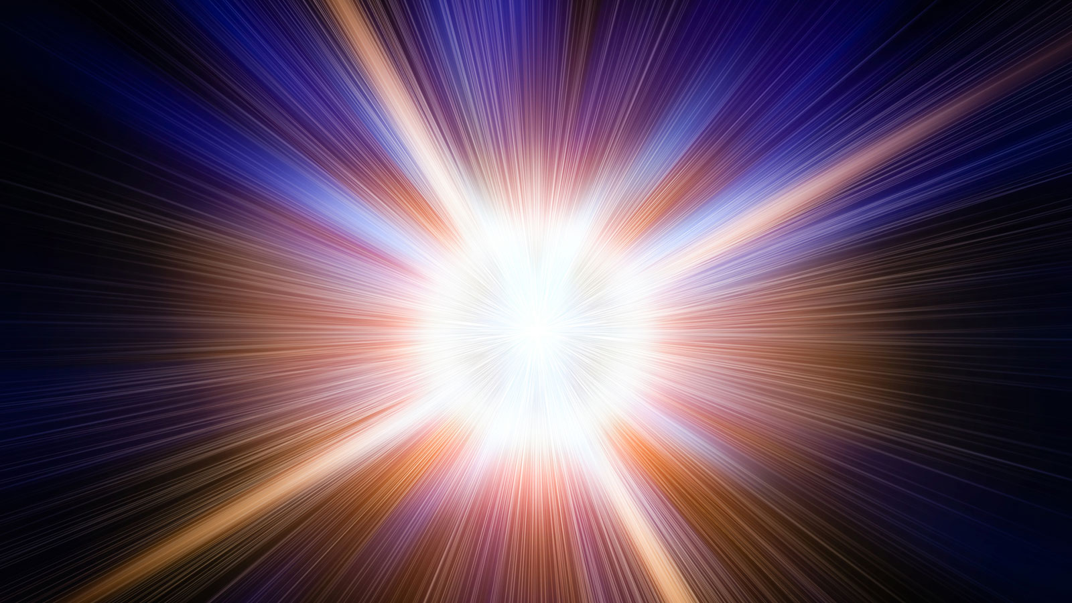
Scientific Impact of this project
The Big Bang: The Universe's Origin
Understanding the Big Bang helps scientists explore fundamental questions about the universe's origin, composition, and eventual fate.
Emergence of Humanoids: The Human Big Bang
Studying the 'human Big Bang' sheds light on human nature, social structures, and the development of civilizations.
Common points
Both events represent critical thresholds that led to vast expansions in complexity and diversity — in the universe at large and within the realm of human ancestry.
Scientific impact
Studying these pivotal moments not only enhances our understanding of the cosmos and ourselves but also underscores the interconnectedness of all things in the mosaic of existence.
Muon imaging, in its capacity to unveil hidden chambers within the Rising Star cave system, is as revolutionary to paleontology as the LHC it has been for the discovery of the Higgs Boson in particle physics!
Muon Imaging in the Rising Star cave systems gives a unique opportunity to all of this!

Slide 13
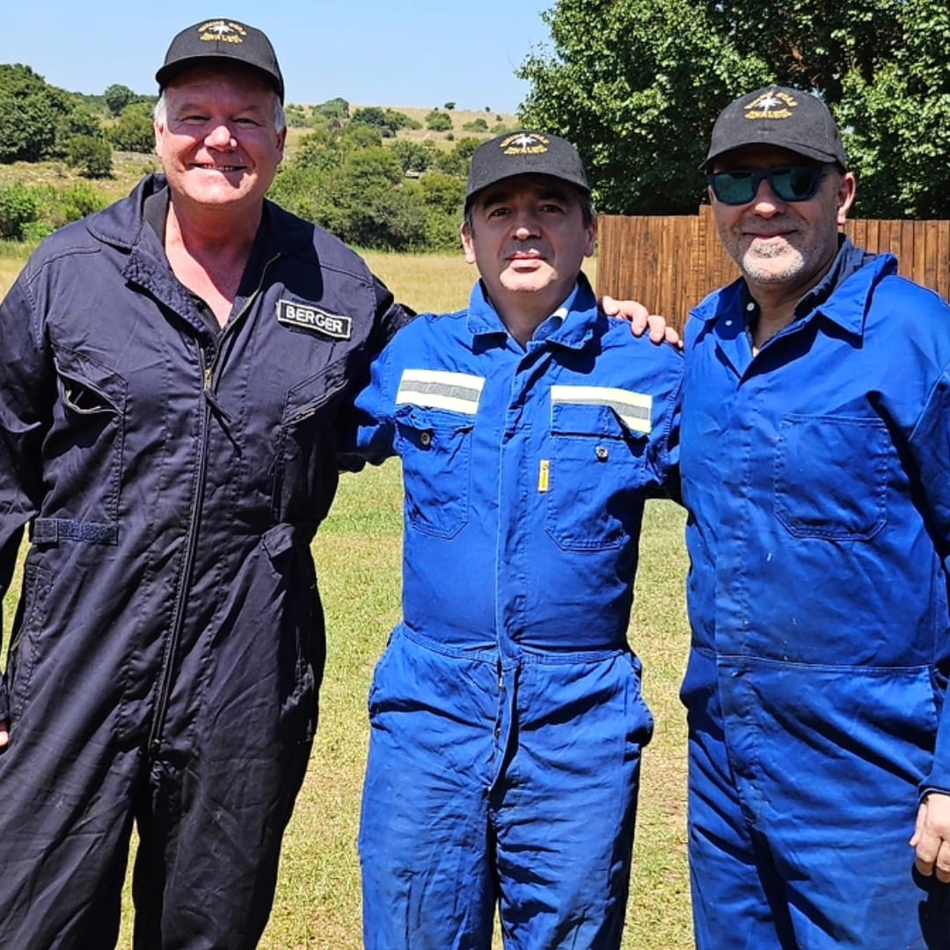
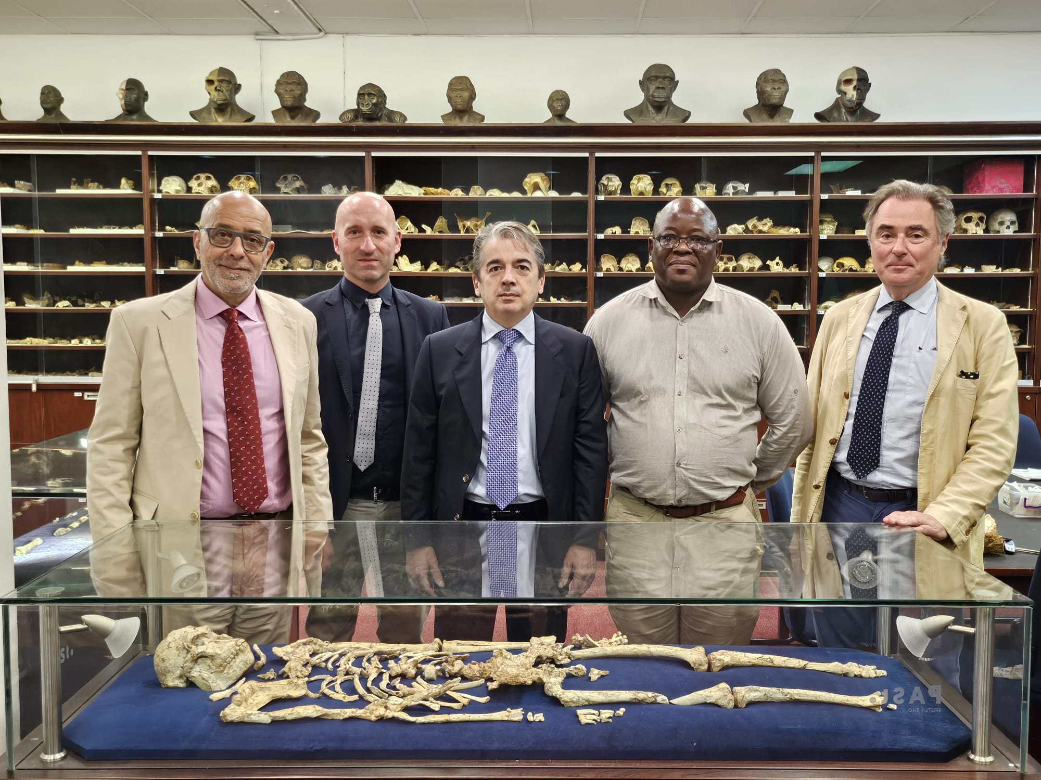
Present interested groups composition
INFN
Supported by the directors of Bologna, Firenze and LNL: E. Scapparone, G. Passaleva, F. Azaiez
Bologna
MB, B. Giacobbe, S. Rabaglia, M. Sioli
Firenze
L. Bonechi , D. Borselli, R. D’Alessandro, C. Frosin
Big world experts in palaeontology, archaeology and anthropology express a strong interest to participate
Prof. Lee Berger (NG), Prof. John Hawks (Wisconsin Uni.), Prof. Tracy Kivell (MPI)
Regular meetings started since October 2023

Slide 14
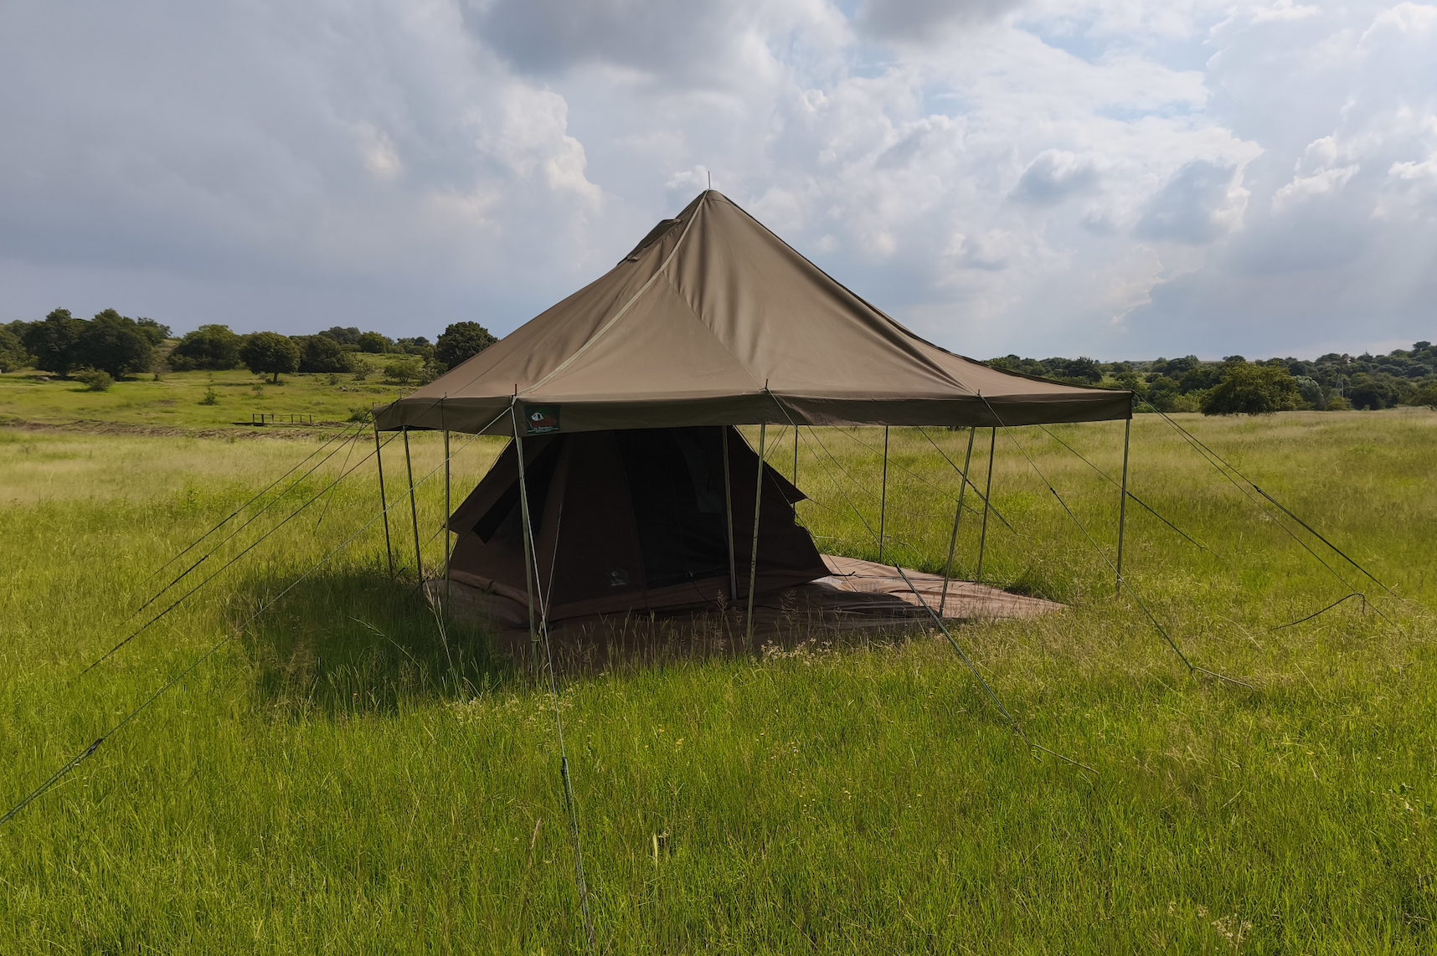
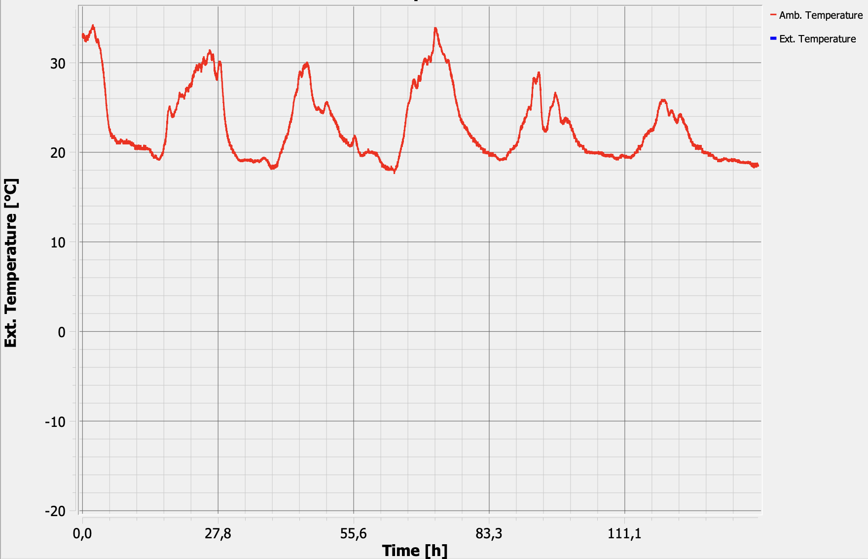
Stato del progetto
Il 2024 ha visto uno sviluppo rapido e consistente della collaborazione MUSTAR.
Organizzazione, in tutti i dettagli, della Proof of Concept (POC), che sarà realizzata prossimamente nel sito patrimonio UNESCO “Cradle of Humankind”
Inoltre, e’ emersa una interessante attività parallela finalizzata alla geodatazione del territorio mediante dati muografici. Questa attività sta avanzando rapidamente grazie all'interesse e al supporto ricevuti dalla Sezione di Bologna.
Programmazione della POC, il progetto è in fase avanzata grazie al supporto ricevuto da INFN Firenze, Ithemba Labs e Lee Berger Foundation/National Geographic (LBF/NatGeo)
Tutto è già pronto per l’avvio. L’unico ostacolo rimasto è la finalizzazione dei MoU
Ithemba Labs: Firma il 2 Aprile p.v. a Roma
NatGeo: La versione fornita dall’ INFN ad Agosto 2024 e’ stata presa in carico attivamente dal NatGeo a inizio Gennaio. La revisione dovrebbe essere pronta in qualche settimana

Slide 15
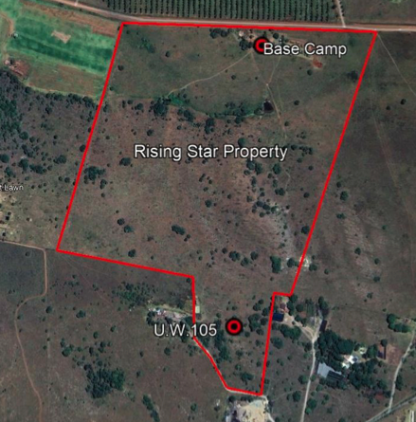
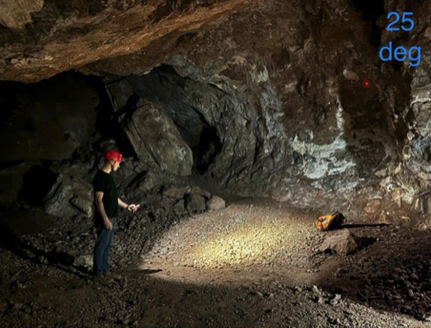
MuStar PoC Timeline

Slide 16
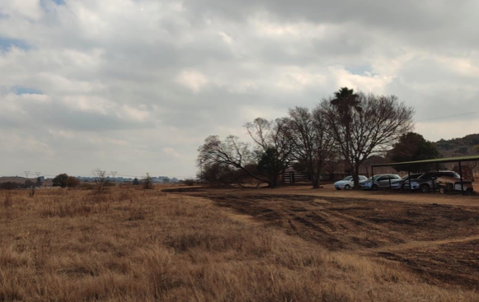
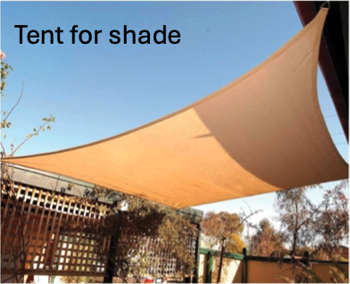
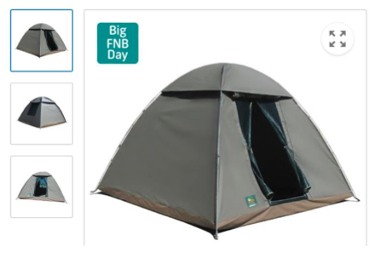
Aspetti finanziari
Nel 2024 il Progetto e’ stato finanziato da INFN ENERGIA
Sezione di Bologna
Sigla: Infn_e/Mustar-Bo
Rimborsi Viaggio 8000,00€
Sezione di Firenze
Infn_e/Mustar-Fi
Strumentazione: 15.700€
Rimborsi viaggio 12.000,00€
Trasporti 5.300€
Nel Dicembre 2024 e’ stata chiesta la riassegnazione dei fondi
le ri-assegnazioni sulla sigla avverranno con la disponibilita’ dell’avanzo libero a Maggio 2025
Situazione non ideale, pero’ i direttori di Bologna e Firenze supporteranno con anticipi nel caso si dovesse cominciare prima
I 50k ottenuti in prima istanza da INFN Energia sono sufficienti per la PoC e al momento non si prevedono ulteriori richieste
La geodatazione con neutroni, non presente nelle richieste del 2024, potrebbe richiedere, in caso, una richiesta integrativa di poche migliaia di euro

Slide 17
Summary of MUSTAR Project
Project Overview
Utilizing muon radiography for non-invasive imaging.
Applications in archaeology, paleontology, and geology.
Focus on Rising Star Cave (Cradle of Humankind, UNESCO site)
Objectives
Detect hidden cavities and chambers.
Identify alternative access points.
Cosmic Muon and Neutrons flux dating for geological formations
Project Status and Next Steps
✅ Everything ready to start a PoC planned for COHWHS site #105
✅ Very interesting and innovative developments in using muons data to get the geological area age
Now also using cosmic rays neutrons flux detected with PoliMi scintillators
✅ €50k INFN Energia funding asked to be reassigned this year
Delay due to MoU with Ithemba Labs and NatGeo
✅ Partnerships: INFN, Ithemba Labs, NatGeo. 🔜 MoUs pending finalization (April 2025)

Slide 18
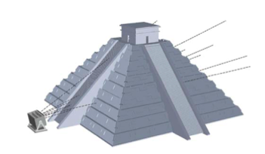
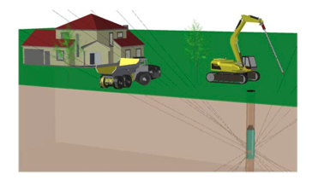
Types of Muography
Depending on the specific situation, three types of radiographic setup can be used
to map the overburden of natural or artificial cavities such as caverns or tunnels
search for hidden chambers in pyramids in Egypt and Mexico
longer data taking
A borehole can be used to host a small sized muon detector with cylindrical shape

Slide 19
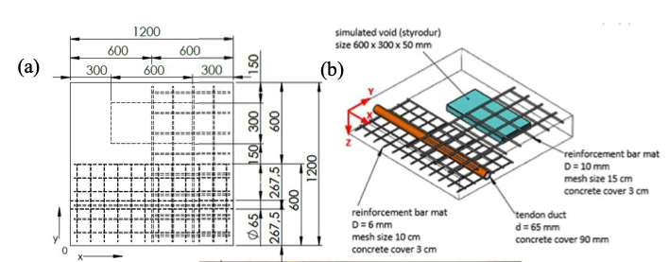
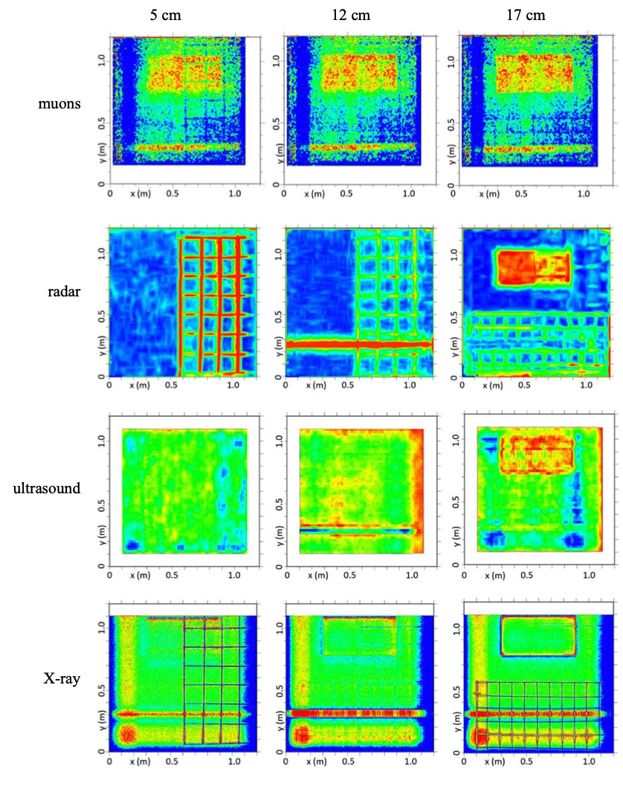
Advantages of muography wrt other techniques
Conventional Techniques & Their Boundaries:
Radar: Effective but limited to a penetration depth of about two meters. Inadequate for imaging thick walls, deep pipelines, or structures buried beyond this depth.
Ultrasound: Offers detailed insights but can be noisy and prone to echoes and self-interference, especially in dense materials, leading to unclear images.
X-rays: Provide crisp, detailed images quickly but pose significant health risks due to radiation exposure. Needs extensive paperwork for safety permits.
Not suitable for penetrating dense and extended materials
FROM: IAEA REPORT IAEA-TECDOC-2012

Slide 20
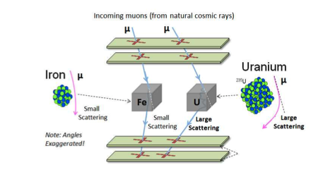
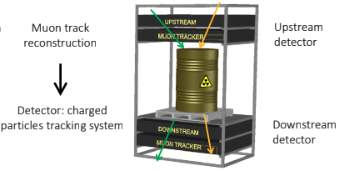
Muon Scattering Tomography
Introduction to MST:
Developed in 2003, Muon Scattering Tomography (MST) is a relatively recent technique compared to muography, offering high-precision imaging by exploiting Coulomb scattering of muons.
Utilized in fields requiring the distinction between high-Z (atomic number) and low-Z materials, such as cargo scanning for nuclear material prevention and interrogation of nuclear waste casks.
Working Principle:
MST is based on the interaction of muons with nuclei. As muons pass close to a nucleus, they experience significant electromagnetic interaction, a concept known for over a century since the experiments of Geiger, Marsden, and Rutherford.
The strength of this interaction varies with the electric charge of the nucleus, making it possible to distinguish between different materials based on the root-mean-square deflection of muons.
Applications and Advantages:
MST's intrinsic ability to discriminate materials by atomic number makes it invaluable for nuclear waste characterization, security, and material control.
Used in the development of 'muon portals' for cargo scanning and nuclear waste interrogation, enhancing safety and security in crucial sectors.

Slide 21
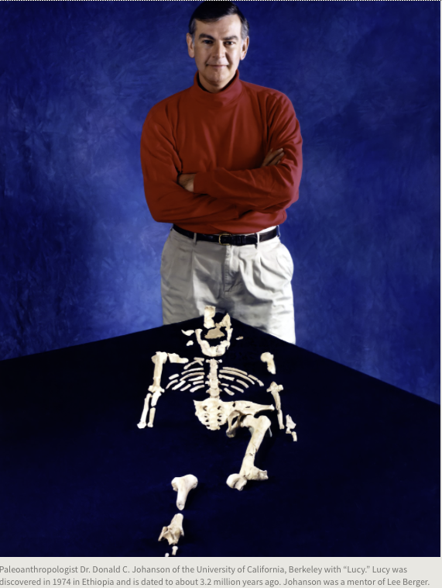
Something about our Palaeontology counterpart
Lee ”Rod” Berger is a world-famous and prizes-winner palaeontologist
His CV and carrier scientific achievements can be found here
In 2008 he discovered some rests of hominid later classified as Australopithecus sediba
transitional stage between Australopithecus Africanus and Homo erectus
In Autumn 2013, Lee Berger led an excavation at the Rising Star cave complex in the Cradle of Humankind, and recovered more than 1500 hominid fossils, representing 15 or more individuals
They belong to an unknown hominid species named Homo Naledi (200-300 kY old) , whose characteristics do not fit in the present scheme of the human evolution
In March 2023, Berger was appointed National Geographic Society Explorer in Residence and staff member.

Slide 22
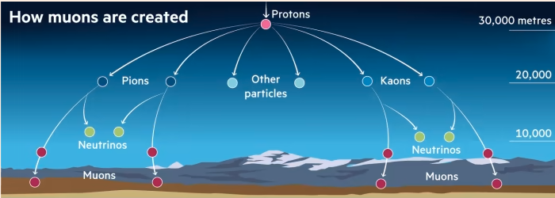
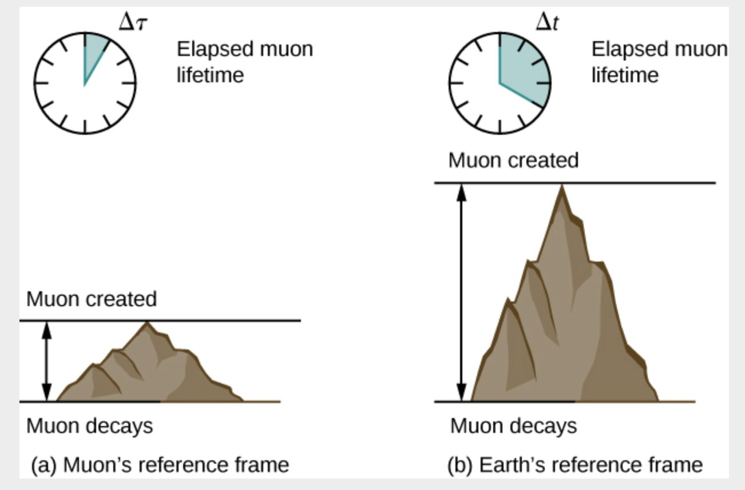
What are muons?
Muons: The Cosmic Messengers
Muons are subatomic particles similar to electrons but heavier.
Originating from cosmic rays that constantly bombard Earth from space.
Penetrating Power
Muons can penetrate through materials like rock, metal, and other dense substances.
Their ability to pass through objects makes them useful for imaging.
Remarkable Lifetime
Despite being unstable, muons have a relatively long lifetime (2.2 microseconds) at rest, allowing them to reach the Earth's surface from the upper atmosphere.
Their longevity at high speed enable them to travel significant distances (even kilometers!) before decaying, making them excellent probes for imaging.

Slide 25
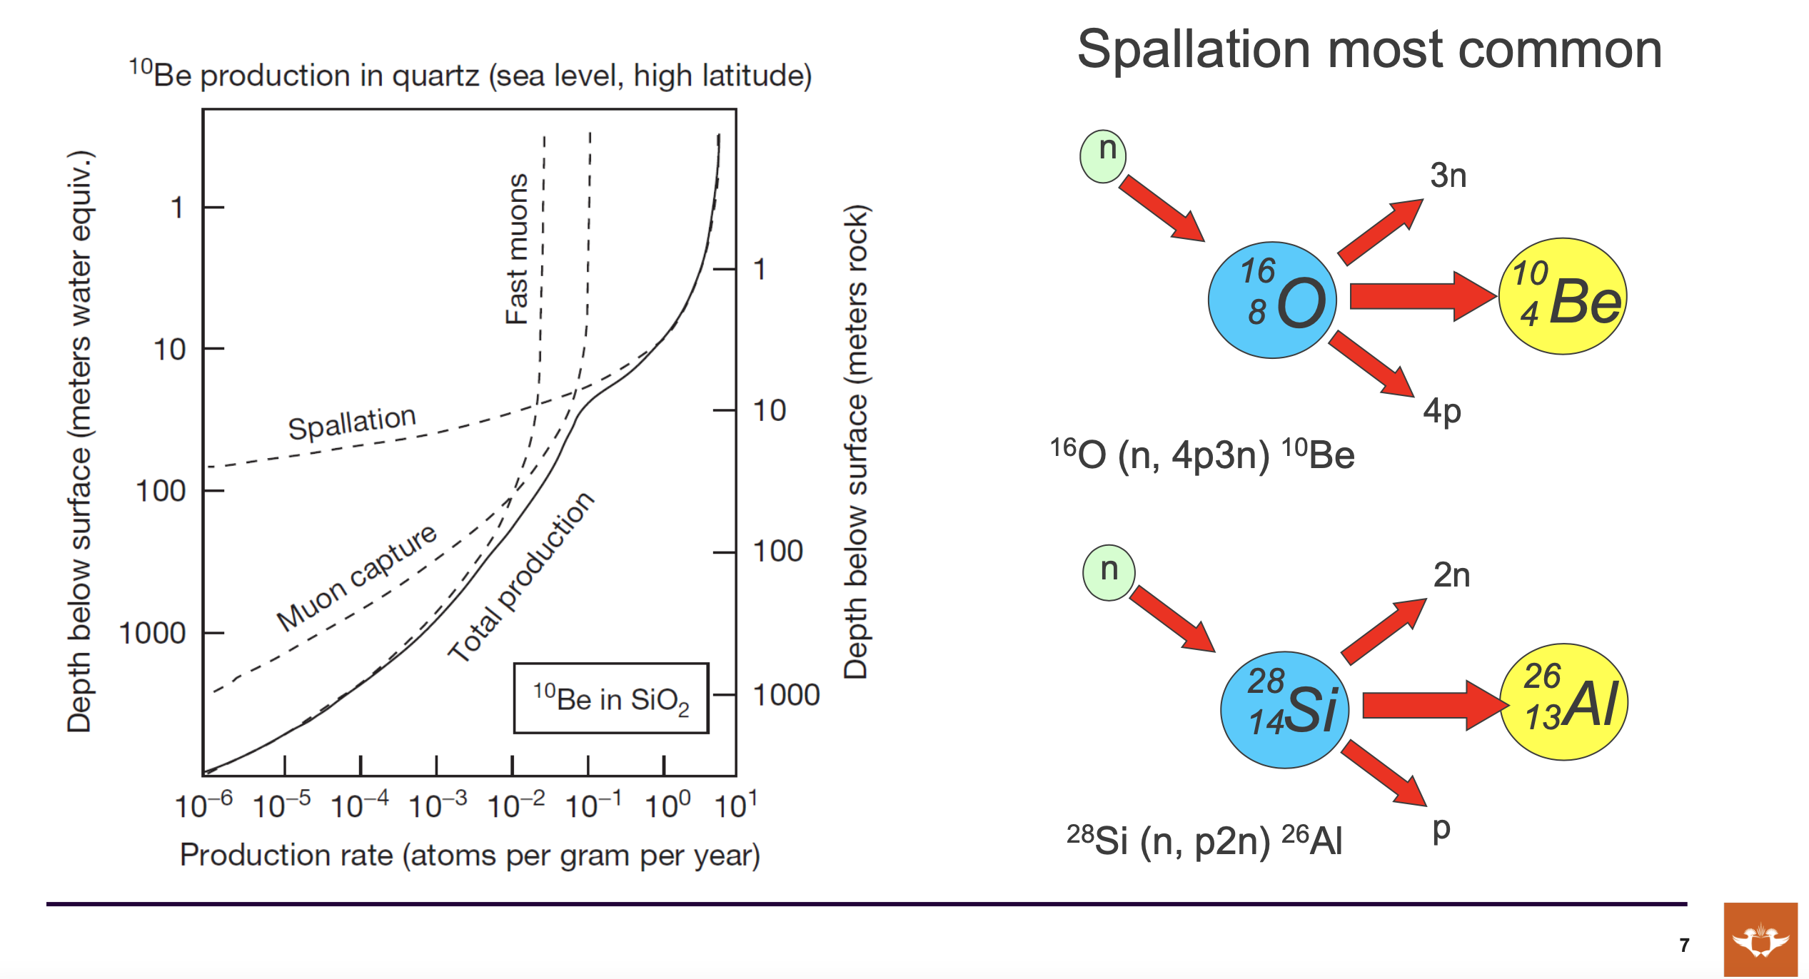

Slide 26
Collaboration INFN-ITHEMBA LABS
Since September 2022 there is an updated (after the 2013 one) and agreed MoU between INFN and ITHEMBA LABS
Joint research on new topics may be included in this collaboration program after mutual discussion and approval by both Parties, in line with the period of this MoU
The existence of this MoU will make easier the possibility collaboration between the two groups
possibility to have a space where to store and test the detector before the measurement starts
This project gives a great opportunity to start a fruitful collaboration between the two parts
The part concerning the geodating using muons is most likely the most promising

Slide 27
WP structure (3Y, Preliminary)

Slide 28
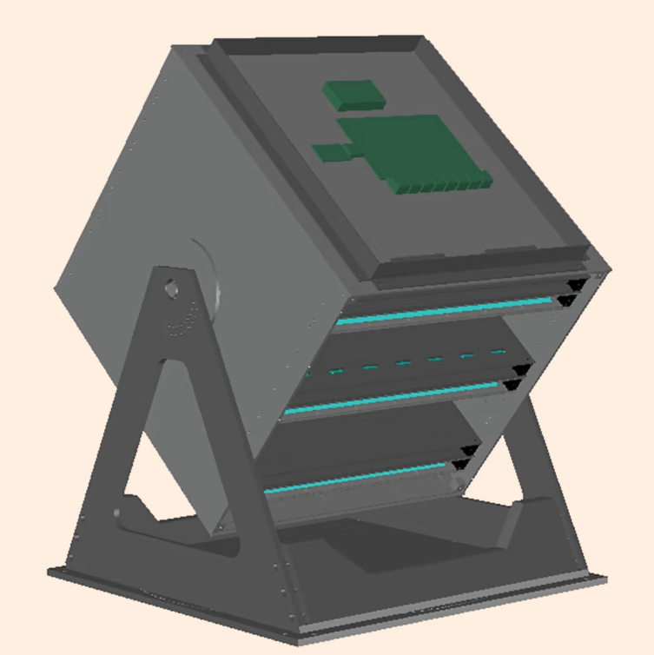
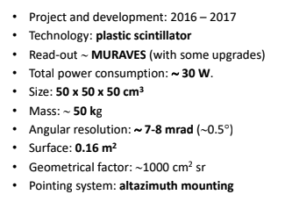
How much can cost [€] one POC
INFN in-kind
detector
Infrastructures (15k)
Detector adapting (5k)
In-situ (10k) Protective case, UPS, Cabling, Internet ....
Personpower (~ 60 k)
2 AdR
BOLOGNA ~ 25k
FIRENZE ~ 35k
Travel expenses (~20 k)
2 people for 2 weeks to start the activity ~ 10 k
2 people for 2 weeks to close the activity ~ 10 k
Detector transportation + Insurance (~20 k)
Dissemination (INFN): 5k
Total ~ 120 k
custom
From April 2024: Detector available

