Slide 1
Update on code analysis Hadi Hashamipour

Slide 2
Minor revision of Previous plots
These plots seemed alright, but there was some minor changes.

Slide 3
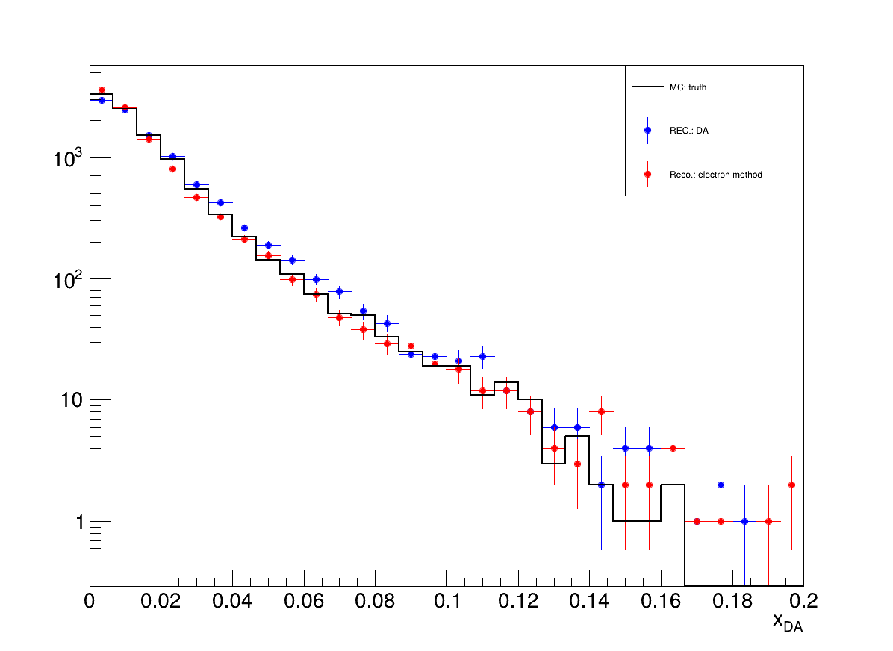
Plots from before

Slide 4
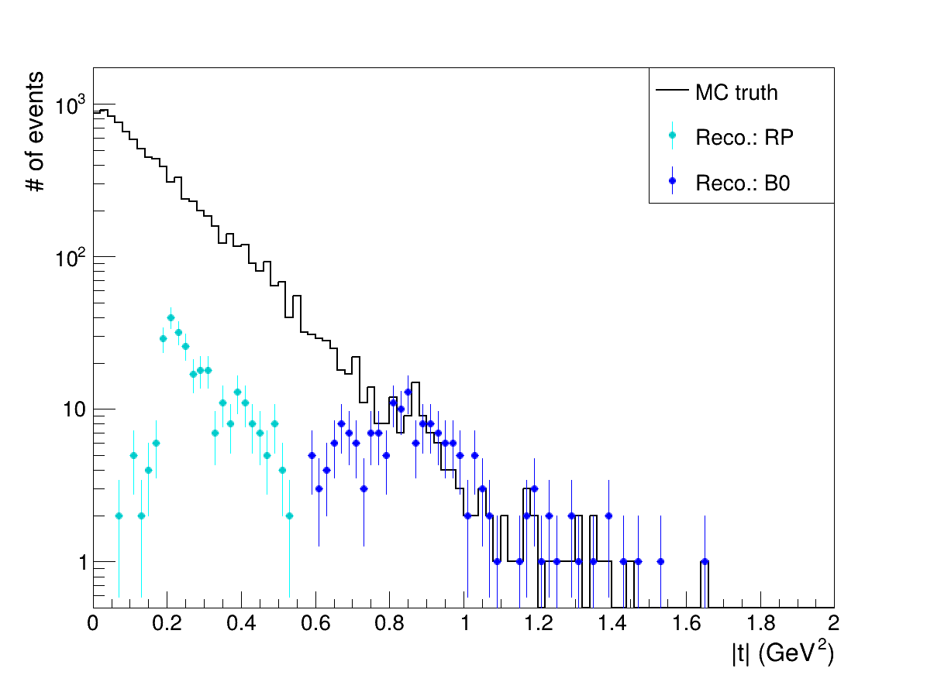
Plots from before

Slide 5
Plots from before

Slide 6
Recap
There was an inconsistency between the proton hit distribution in RPs plotted in px-py plane and in \eta-\phi plane.

Slide 7
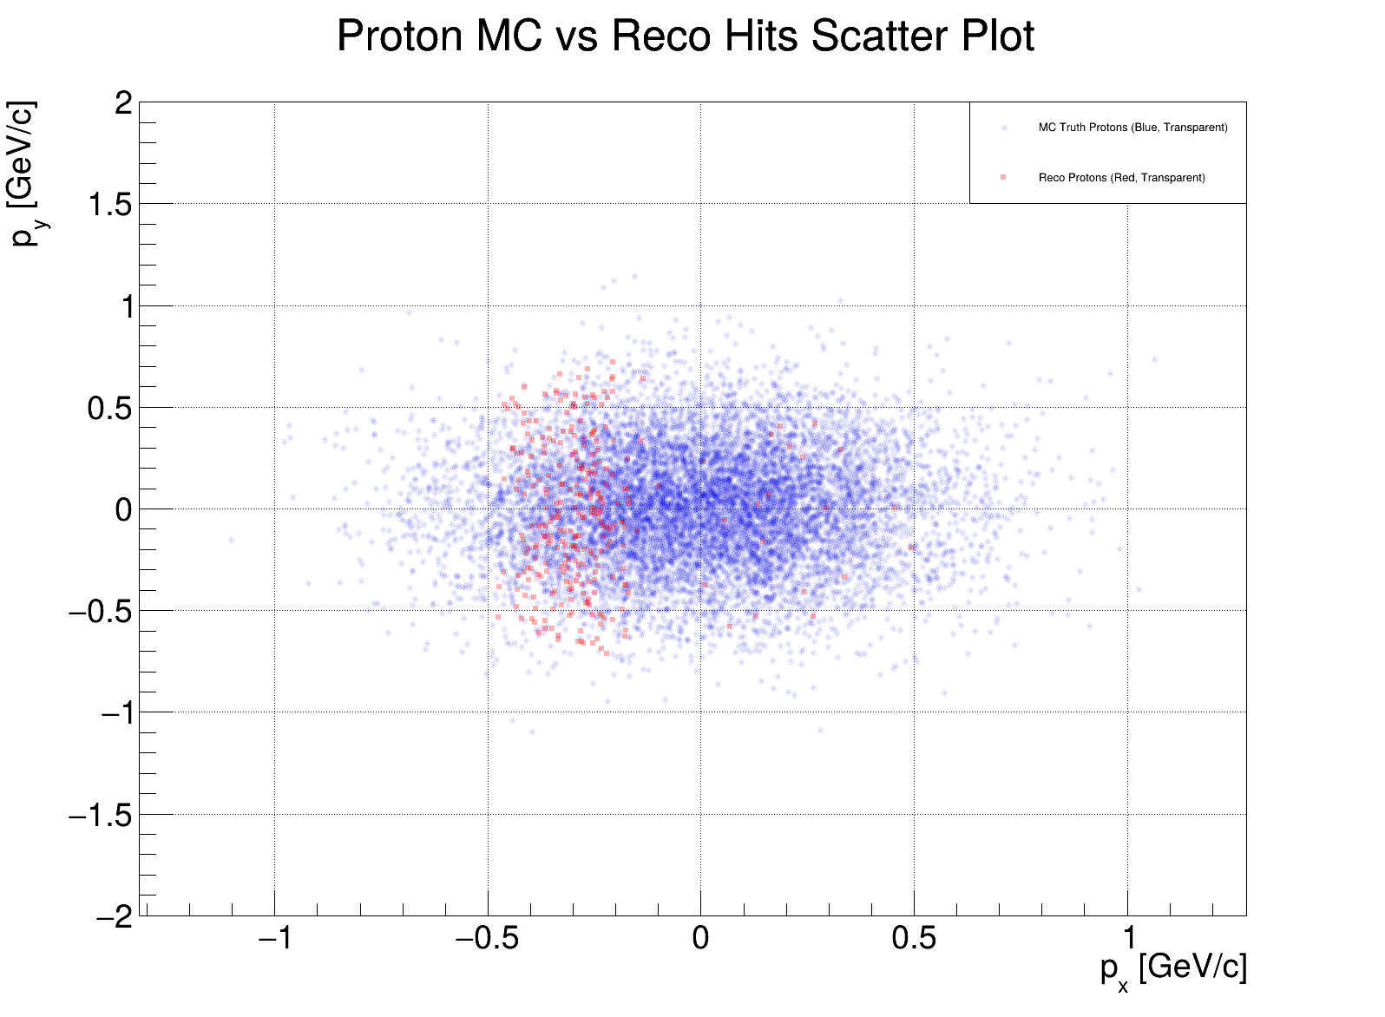
New plots

Slide 8
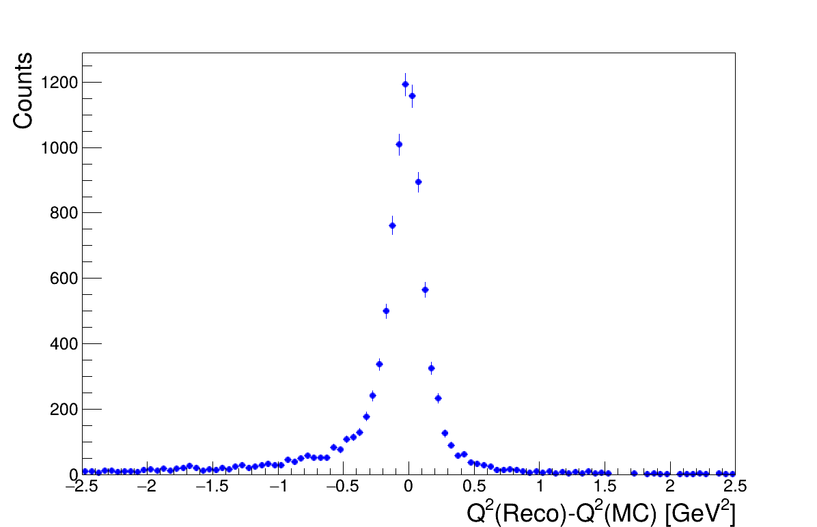
New plots: absolute resolution

Slide 9
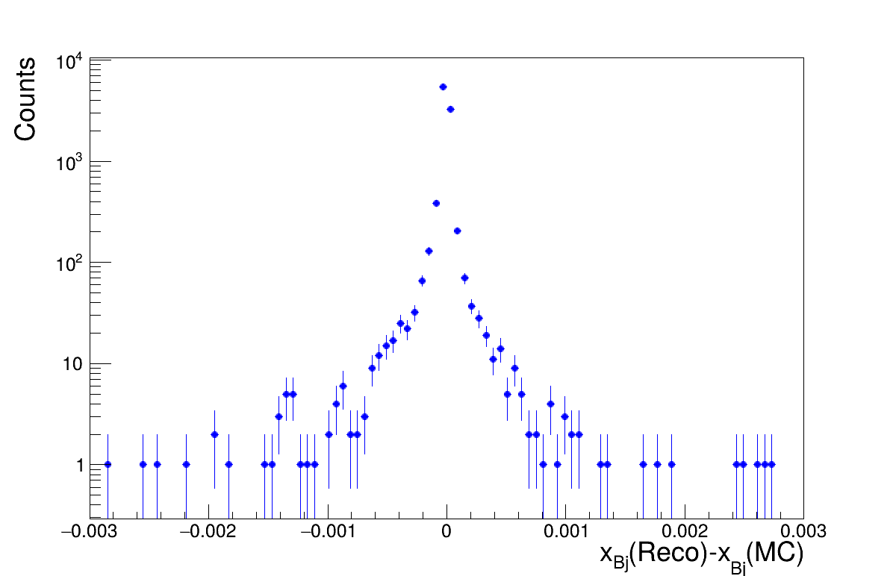
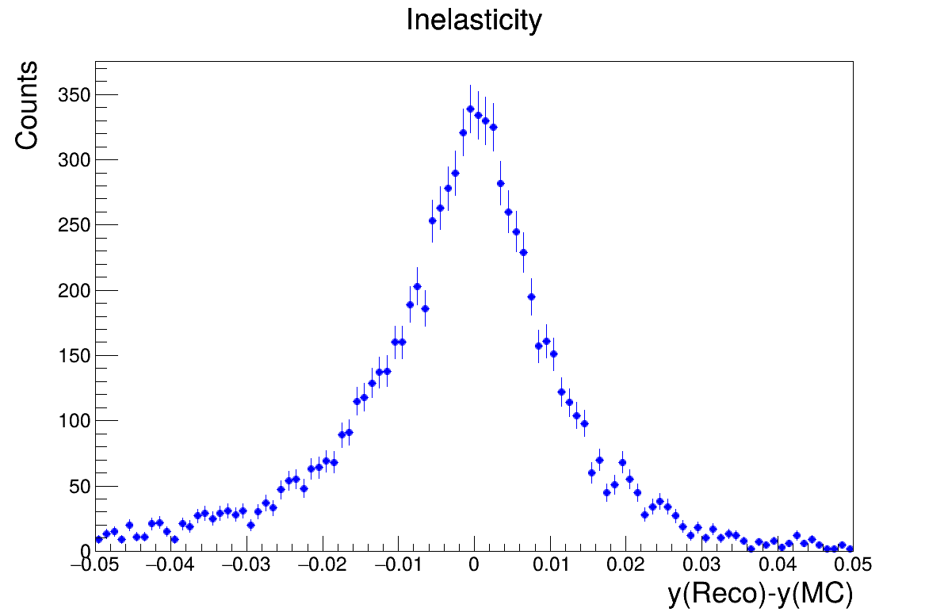
New plots: absolute resolution

Slide 10
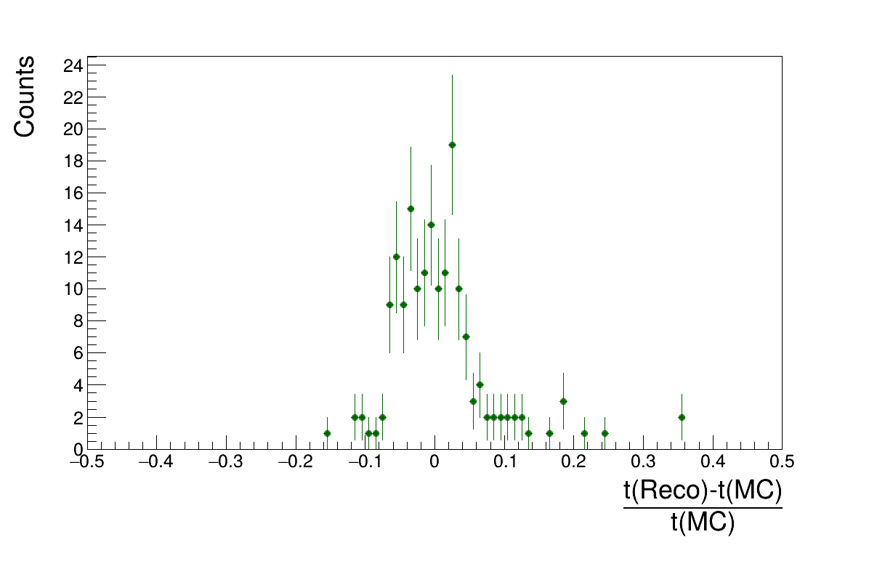
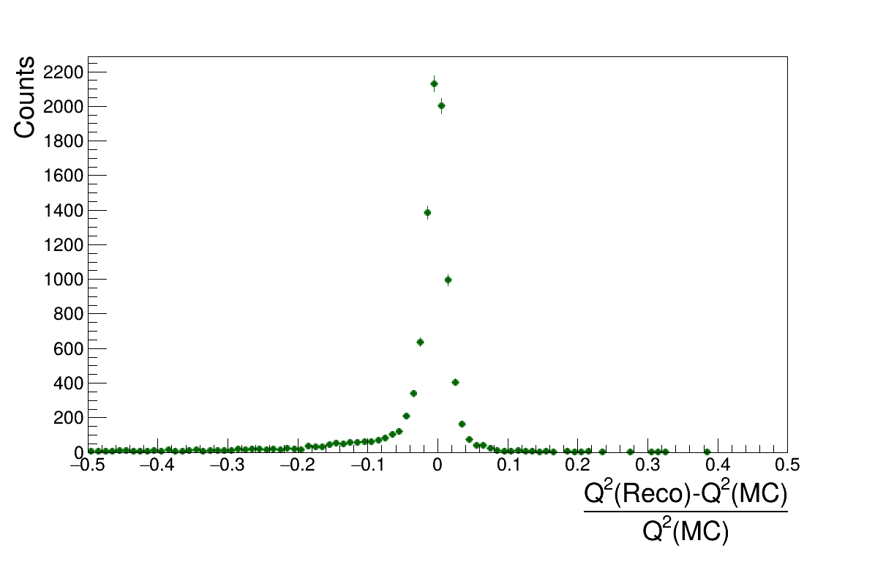
New plots: Relative resolution

Slide 11
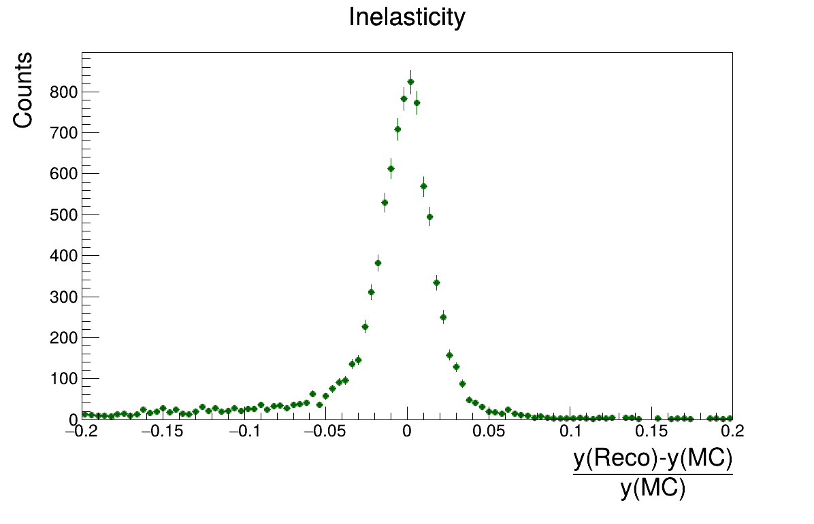
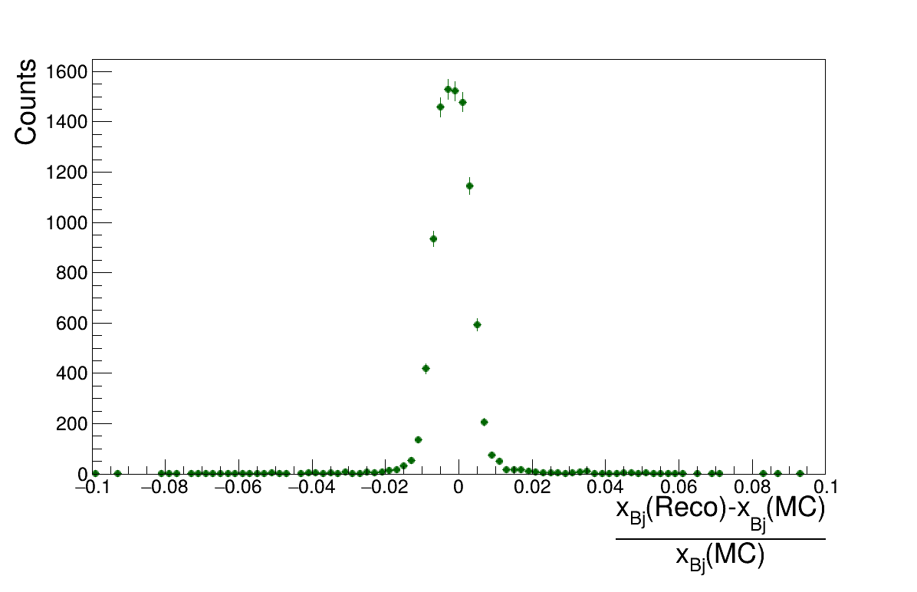
New plots: Relative resolution

Slide 12
Final tips & takeaways
Old ones seem OK
After meeting I contacted Alex Jentsch, and the problem of inconsistancy is solved. The problem was that I should have used another version of detector settings file.
It was decided that event size of 10K used for these plots is not enough.
Binned relative(?) resolution plots was suggested to be added to these plots.
Study of detector parts is needed for interpretation of results.

Slide 13
Thank you

