Slide 1
Optimization of FEL performance using modern LLRF systems
Phani Deep Meruga
July ${14}^{th}$, 2025
Email: phanideep.meruga@i-tech.si
This project has received funding from the European Union‘s Horizon Europe research and innovation programme under grant agreement no. 101073480.

Slide 2
Outline:
Introduction to Free Electron Lasers
Architecture of RF control system (LLRF)
Control Strategies in Modern LLRF Systems
LLRF Impact on FEL operation
Development Platform - EuPRAXIA
EuPRAXIA – X Band Low Level RF
Future trends and R&D in LLRF Systems
EuPRAXIA-DN Camp II: Science, Lisbon
2

Slide 3
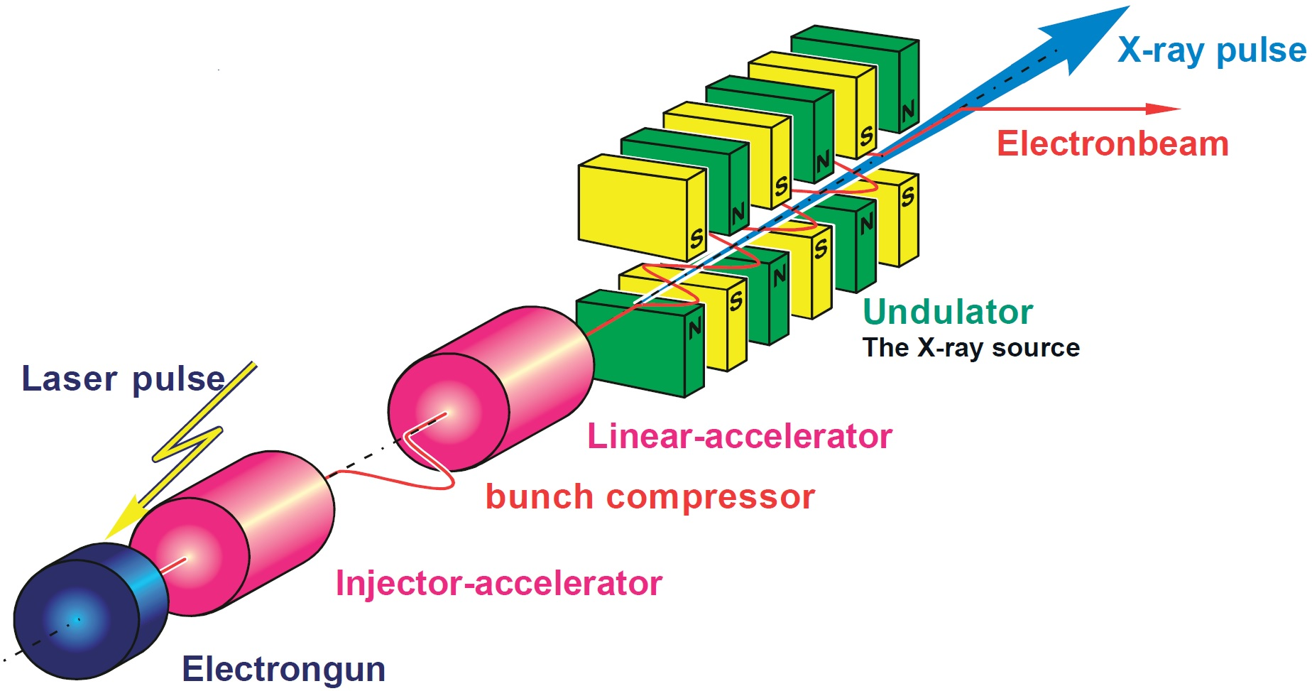
Introduction to Free Electron Lasers (I)
FELs use relativistic electron beams and undulators to produce intense, coherent radiation.
Radiation wavelength is tunable and can reach X-ray and EUV regimes.
Shorter bunch lengths and high peak currents are critical for femtosecond-level experiments.
Small phase/amplitude errors in the beam lead to large variations in lasing output.
Reference: SwissFEL
EuPRAXIA-DN Camp II: Science, Lisbon
3

Slide 4
Introduction to Free Electron Lasers (II)
Beam energy spread and emittance impact coherence and spectral brightness.
Stability becomes more critical as FELs push toward shorter wavelengths and higher repetition rates.
Applications:
Ultrafast X-ray imaging of atomic and molecular processes.
Imaging of proteins, viruses, and cellular mechanisms.
Medical and industrial prospects, etc.,
FEL performance strongly depends on electron beam quality and control.
Reference: SwissFEL
EuPRAXIA-DN Camp II: Science, Lisbon
4

Slide 5
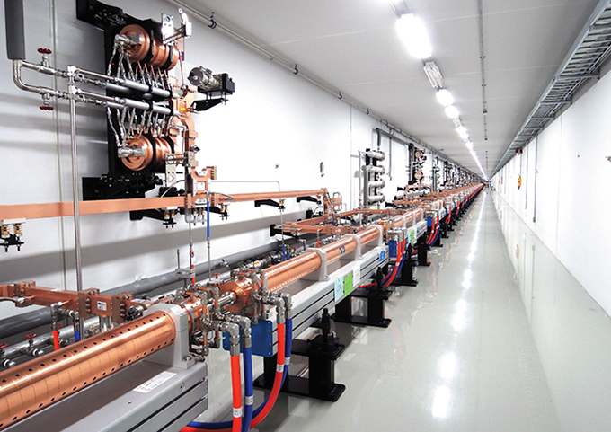
LINAC‘s in FEL operation
Linacs accelerate electrons to relativistic energies required for lasing.
Stability of RF fields in linacs determines final beam energy and timing.
Beam properties (emittance, energy spread, bunch length) are largely shaped in the linac
Timing synchronization of RF Linac and seed laser is essential for seeded FELs
Linac-to-undulator transport requires high stability to preserve beam quality.
RF systems driving the linac directly influence FEL output performance
Reference: PAL-XFEL
EuPRAXIA-DN Camp II: Science, Lisbon
5

Slide 6
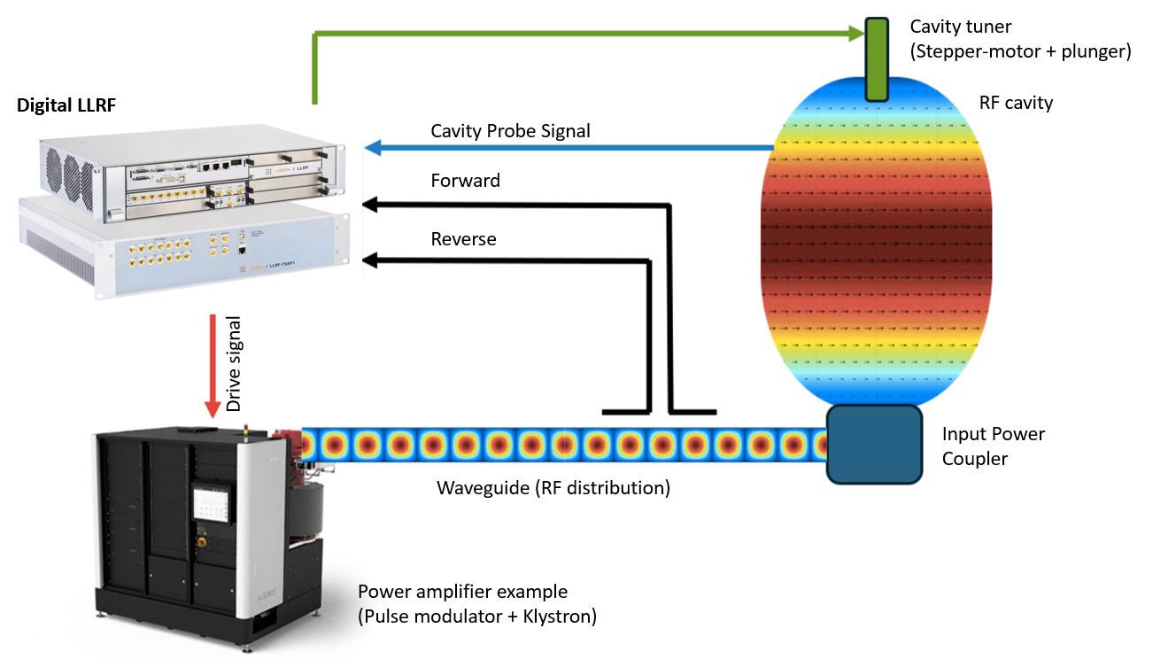
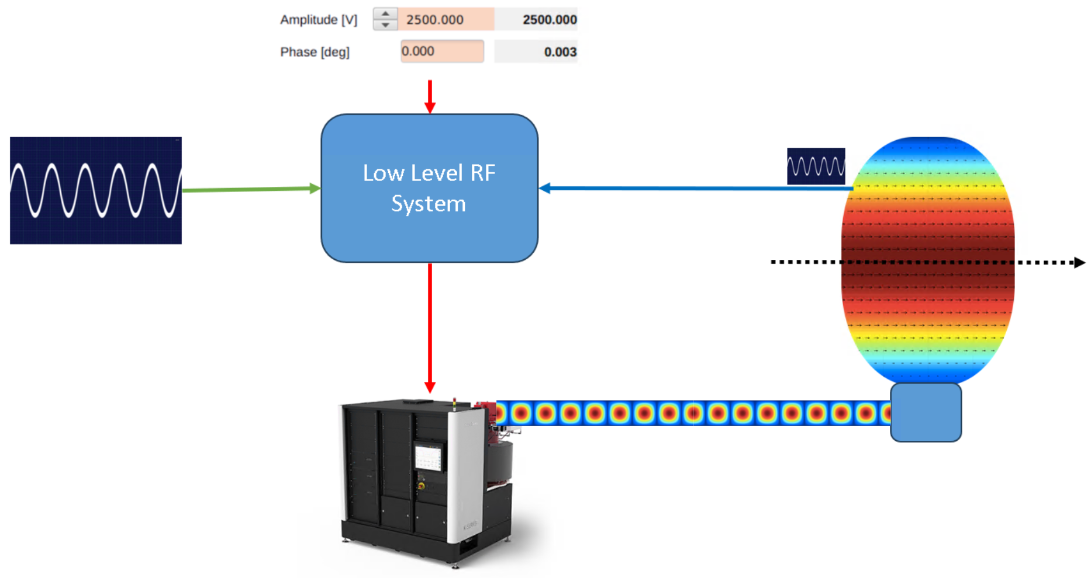
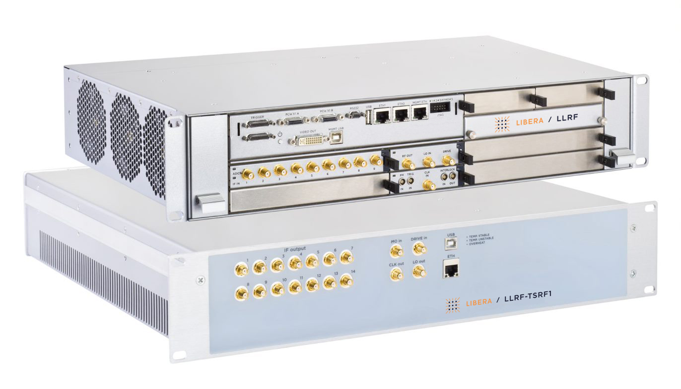
Architecture of RF control system (LLRF)
User Defined Set-Point values
LLRF control for each RF station (cavity)
Subsystem of Radio Frequency (RF) system.
Maintain stability and control of cavity‘s frequency, phase and amplitude.
LLRF continuously measures the characteristics of the RF field in the RF structures and calculates its amplitude and phase of the signal.
Deviation between the measured signal and the reference is compensated by feedback control system.
RF cavity
Cavity Probe Signal
Beam
Master Oscillator reference
Drive signal
Input Power
Coupler
Waveguide (RF distribution)
Power amplifier example
(Pulse modulator + Klystron)
Measure the cavity resonant frequency and control the cavity tuning.
EuPRAXIA-DN Camp II: Science, Lisbon
6

Slide 7
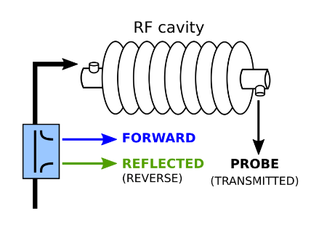
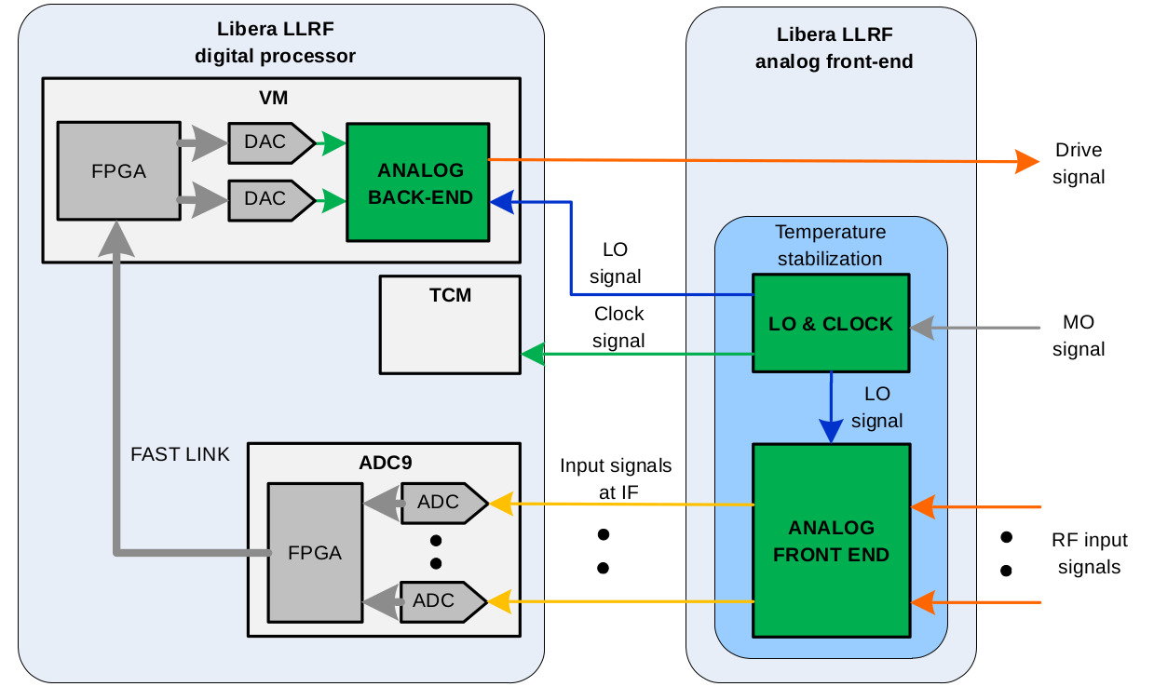
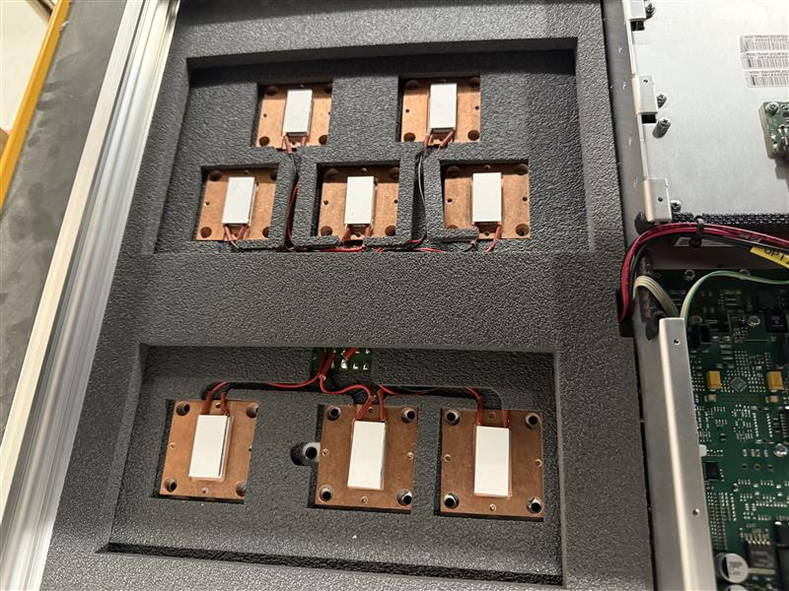
Modern Low-Level RF Architecture
Temperature Stabilized Front-End to overcome thermal fluctuations.
The downconverted RF signals (typically IF ~ tens of MHz) are sampled with >100MHz ADCs
FPGAs generate pulsed signals & implement IQ demodulation, digital filtering, and feedback control.
DACs generate RF drive signals with high fidelity.
Timing module ensures synchronization with machine reference clock
EuPRAXIA-DN Camp II: Science, Lisbon
7

Slide 8
Control Strategies in Modern LLRF Systems (I)
Feedback Control:
Real-time correction of cavity field amplitude and phase
Implements PI or model-based control algorithms in FPGA
Suppresses thermal drift, mechanical vibrations, and noise
Essential for maintaining stability during beam acceleration
EuPRAXIA-DN Camp II: Science, Lisbon
8

Slide 9
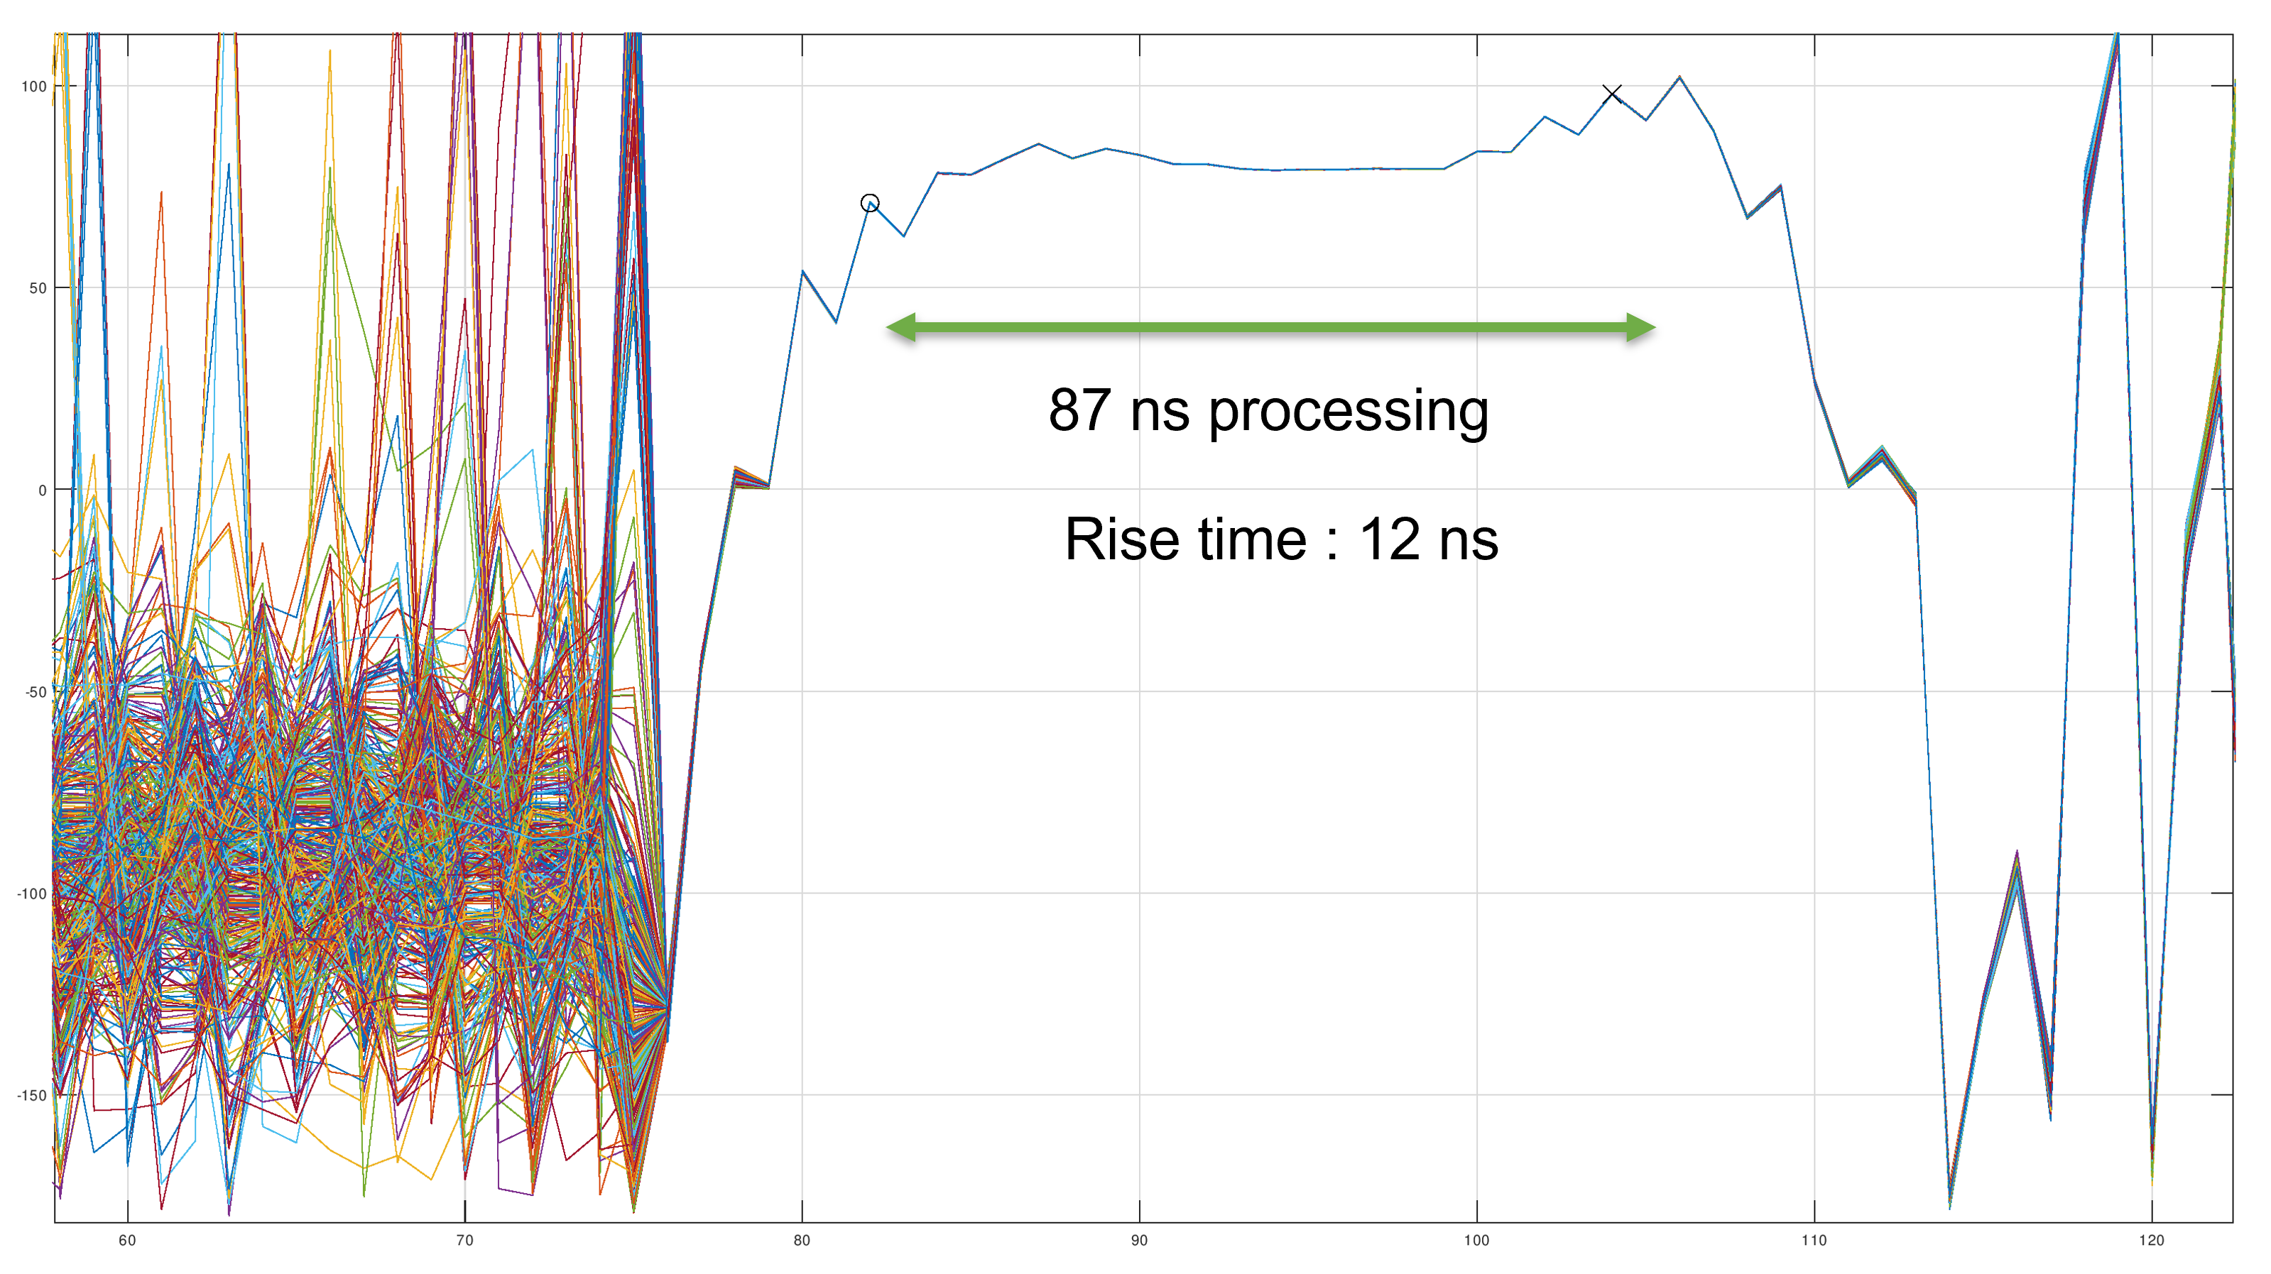
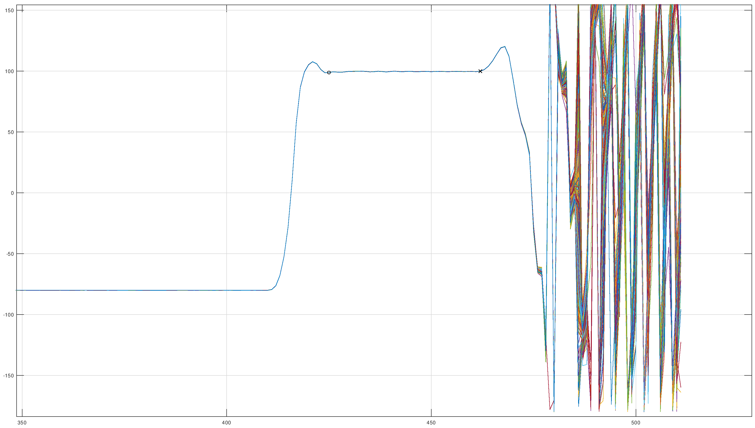
Control Strategies in Modern LLRF Systems (II)
Feedforward Control:
Pre-compensates known effects like beam loading and pulse distortion
Improves rise time and suppresses overshoot in pulsed systems
Key for shaping RF pulses in high-gradient structures
EuPRAXIA-DN Camp II: Science, Lisbon
9

Slide 10
Control Strategies in Modern LLRF Systems (III)
Advanced & Adaptive Strategies:
Adaptive gain control adjusts controller parameters during operation
Model-based control predicts cavity behaviour and adjusts proactively
Integration with beam diagnostics enables open & closed-loop beam-based tuning
Reduces human intervention & improves long-term reproducibility
Experimental use of machine learning algorithms to optimize cavity parameters dynamically (e.g., Pulse shaping, gradient, detuning)
EuPRAXIA-DN Camp II: Science, Lisbon
10

Slide 11
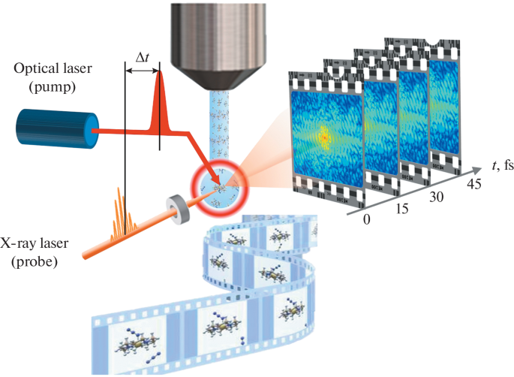
LLRF Impact on FEL Beam Quality
Stable RF fields lead to consistent energy gain across bunches & uniform bunch acceleration.
Reduced energy spread ⇒ better spectral quality of FEL pulse
Lower timing jitter improves overlap between laser and beam at undulators
Synchronization between beam, seed lasers, and RF enables pump-probe experiments
Supports operation at higher rep rates and shorter pulses
Higher peak brightness & pulse energy with greater flexibility in FEL pulse shaping
Reference: European XFEL
EuPRAXIA-DN Camp II: Science, Lisbon
11

Slide 12
Development Platform – EuPRAXIA
EuPRAXIA aims to develop a compact, high-performance FEL facility based on X-band linacs and plasma accelerators.
Strong emphasis on ultra-short, high-brightness electron bunches
Pushes the limits of precision and timing control in RF and beam delivery
Development of accelerator technology at higher frequencies up to X-Band allows high accelerating gradients [MV/m] and shorter accelerating structures (compact machines).
Reference: EuPRAXIA SPARC LAB
EuPRAXIA-DN Camp II: Science, Lisbon
12

Slide 13
EuPRAXIA – X Band Low Level RF (I)
Challenge of controlling RF parameters (amplitude and phase) at high frequencies and for very short pulses (100ns).
LLRF system stability influenced by temperature drifts from RF systems at higher frequencies.
Development an X-Band LLRF prototype in the the context of EuPRAXIA-DN is in progress.
Parameter | Desired Value
Mode of operation | Pulsed
LLRF Frequency | 11.9942 GHz
MO input level | 0 dBm
Nominal Pulse length | 1.55µs
Averaging window | final 0.15 µs of the RF pulse
Sampling rate | >230 MHz
RF pulse max. repetition rate | ≥ 400 Hz
Front-End pulse-to-pulse detectable amplitude noise (400 pulses) | ≤ 0.015% RMS
Front-End pulse-to-pulse detectable phase noise (400 pulses) | ≤ 0.015° RMS
Back-end pulse-to-pulse added amplitude noise (400 pulses) | ≤ 0.015% RMS
Back-end pulse-to-pulse added phase noise (400 pulses) | ≤ 0.015° RMS (< 3.5 fs)
EuPRAXIA-DN Camp II: Science, Lisbon
13

Slide 14
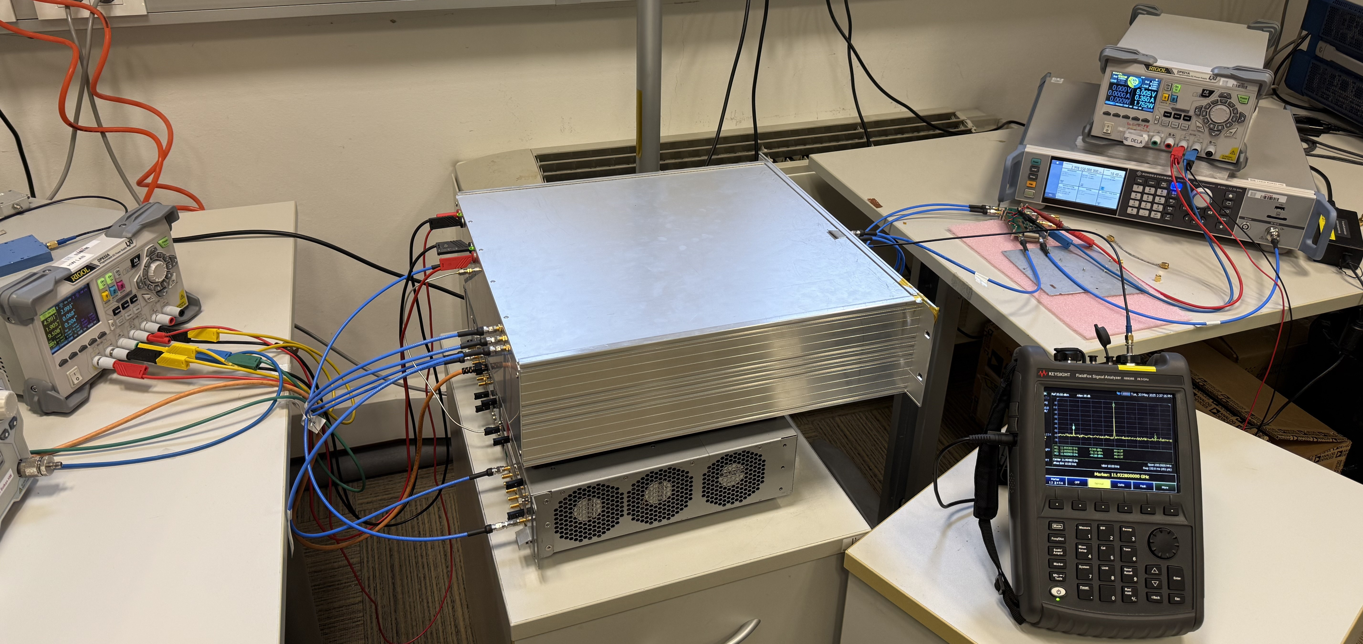
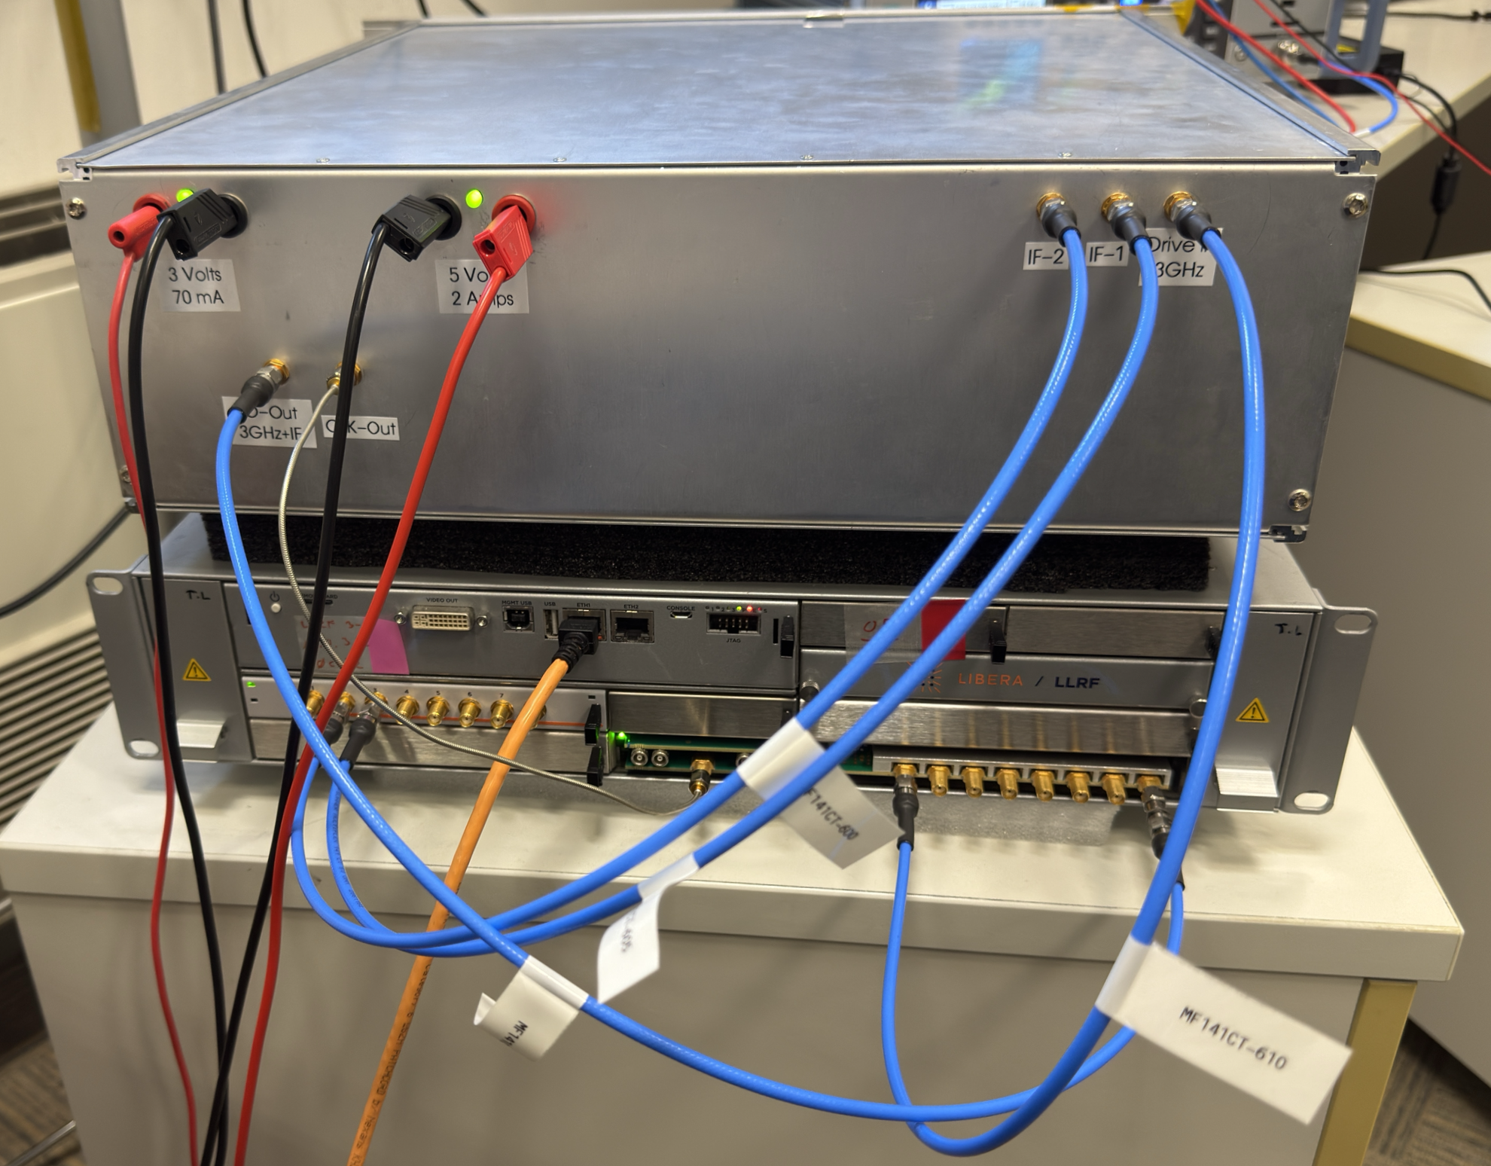
EuPRAXIA – X Band Low Level RF (II)
Demonstrated excellent amplitude and phase stability in both front-end and back-end sections
Front-End Stability:
RMS amplitude noise: 0.0104%
RMS phase jitter: 0.0063°
Back-End Stability:
RMS amplitude noise: 0.011%
RMS phase jitter: 0.008° (1.95 fs)
Results meet or exceed the stringent stability requirements of the FEL LLRF application.
Validates the robustness of the system architecture and signal chain integrity.
Next step: Evaluation on an X-band test bench at the TEX facility, INFN-LNF, Frascati, Italy
EuPRAXIA-DN Camp II: Science, Lisbon
14

Slide 15
Future trends and R&D in LLRF Systems
Hardware Advancements
Faster, higher-resolution ADCs/DACs (≥16-bit, multi-GSPS)
More powerful and compact FPGAs and SoCs
Integration of RF, digital, and timing on modular platforms (e.g., MicroTCA)
Smarter Control
Adaptive & Beam-based feedback algorithms for real-time optimization
Initial applications of ML for drift correction and automated tuning
System-Level Innovations
Self-calibrating, diagnostic-enabled control modules
Enhanced support for high-rep-rate and compact FEL system
Application Outlook
Push toward scalable, low-latency, intelligent LLRF for next-gen FEL facilities
EuPRAXIA-DN Camp II: Science, Lisbon
15

Slide 16
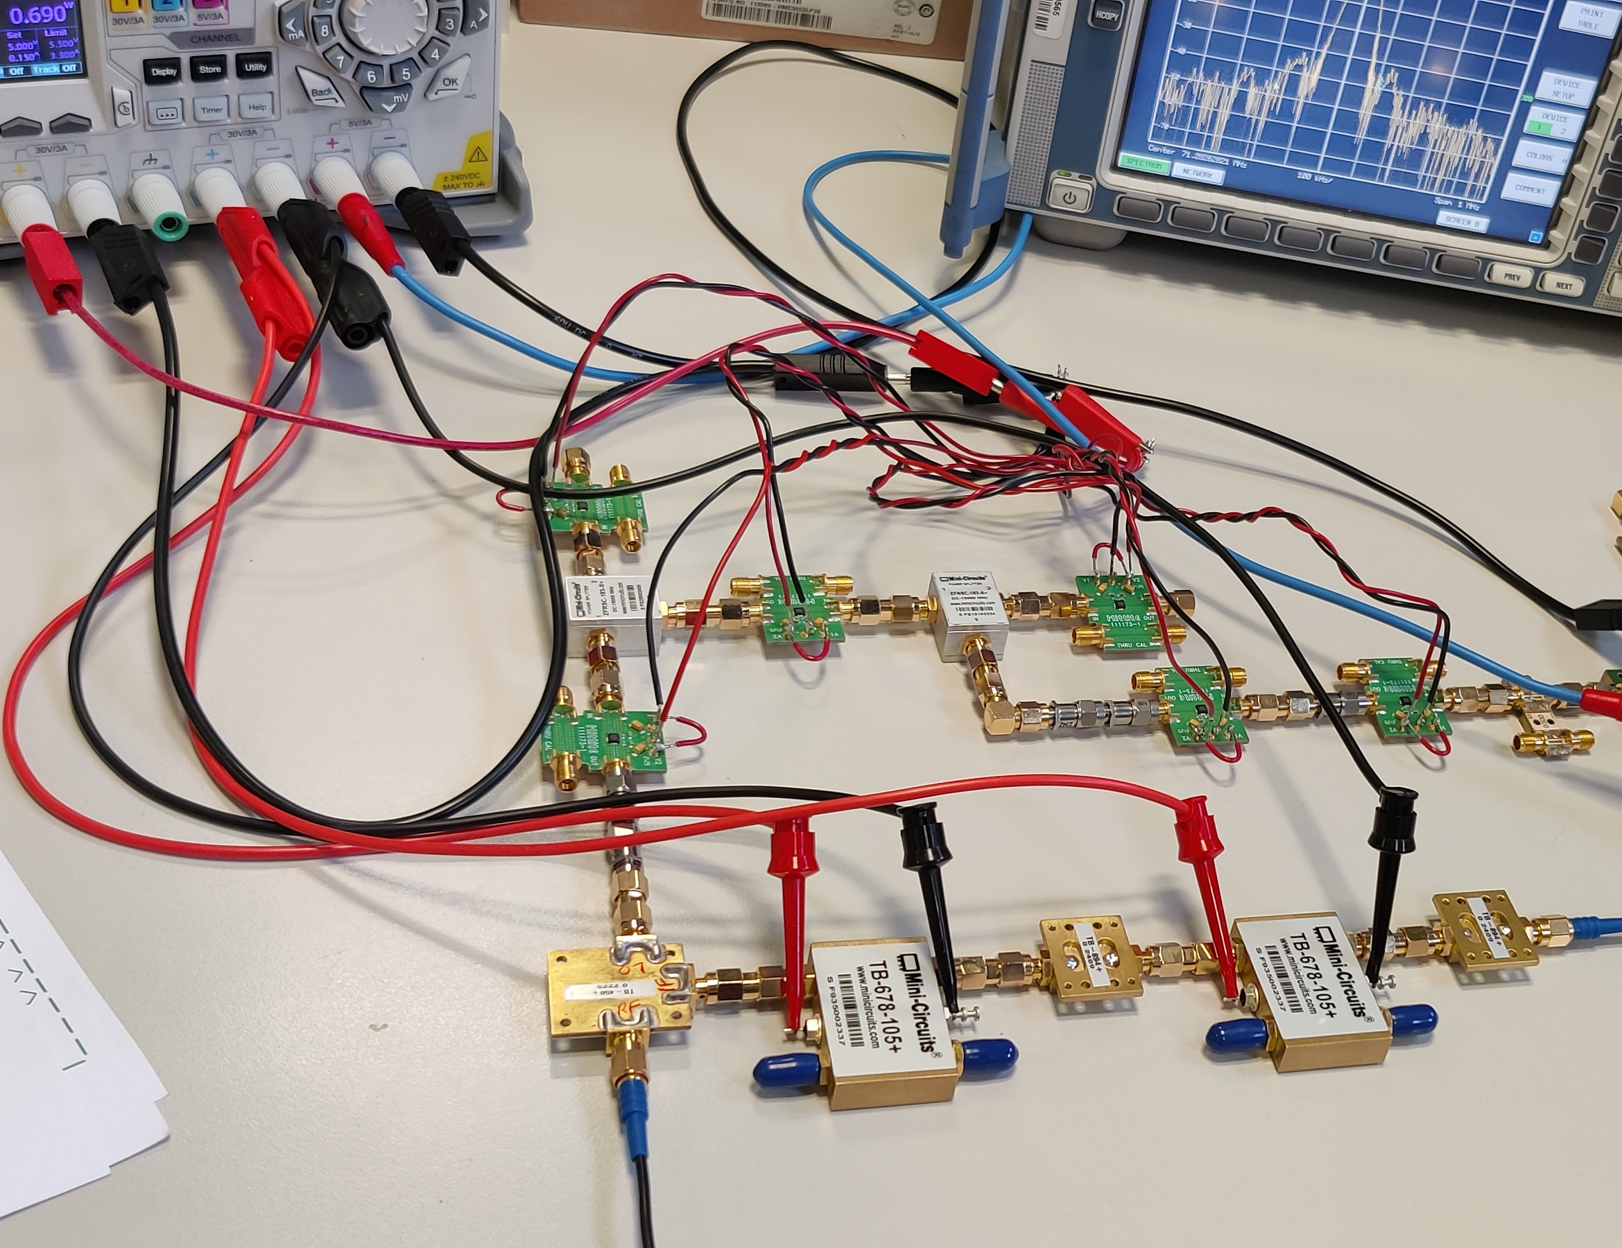
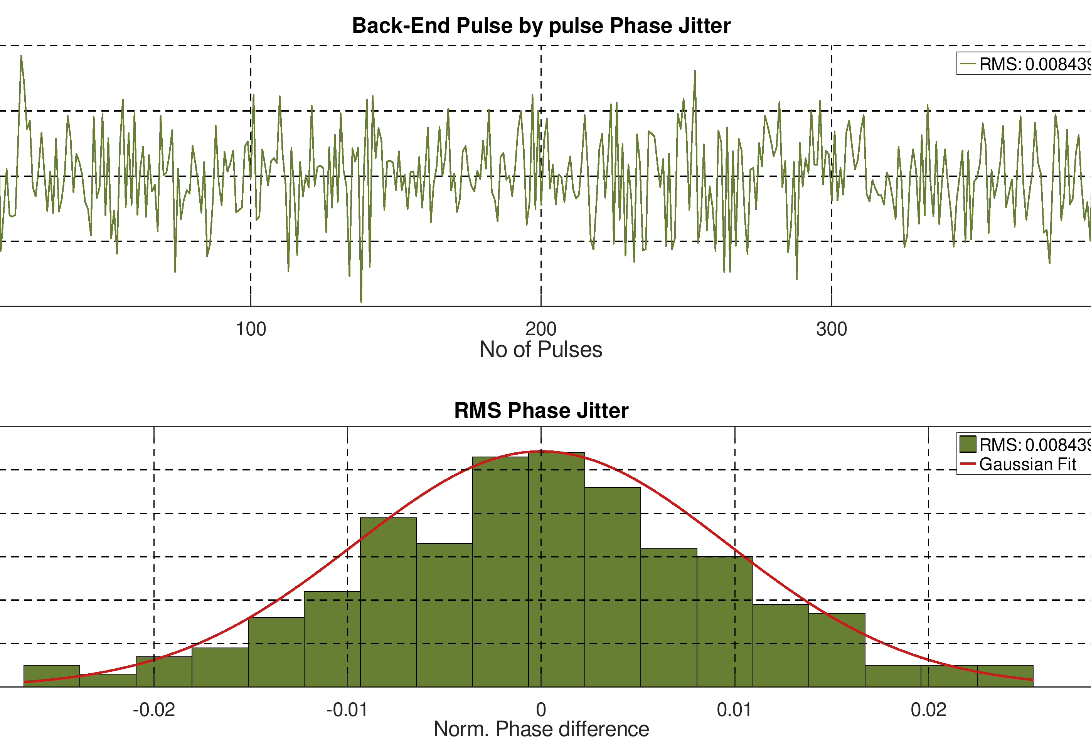
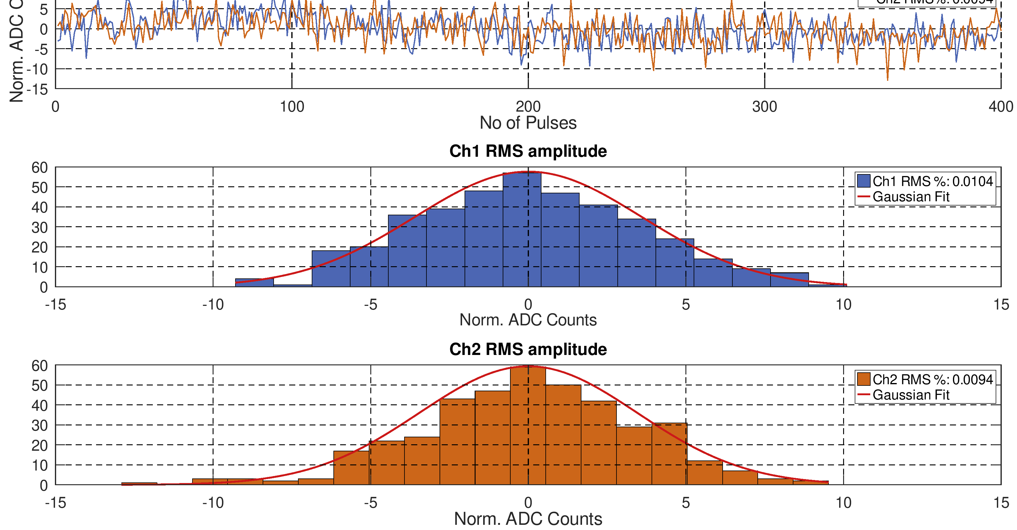
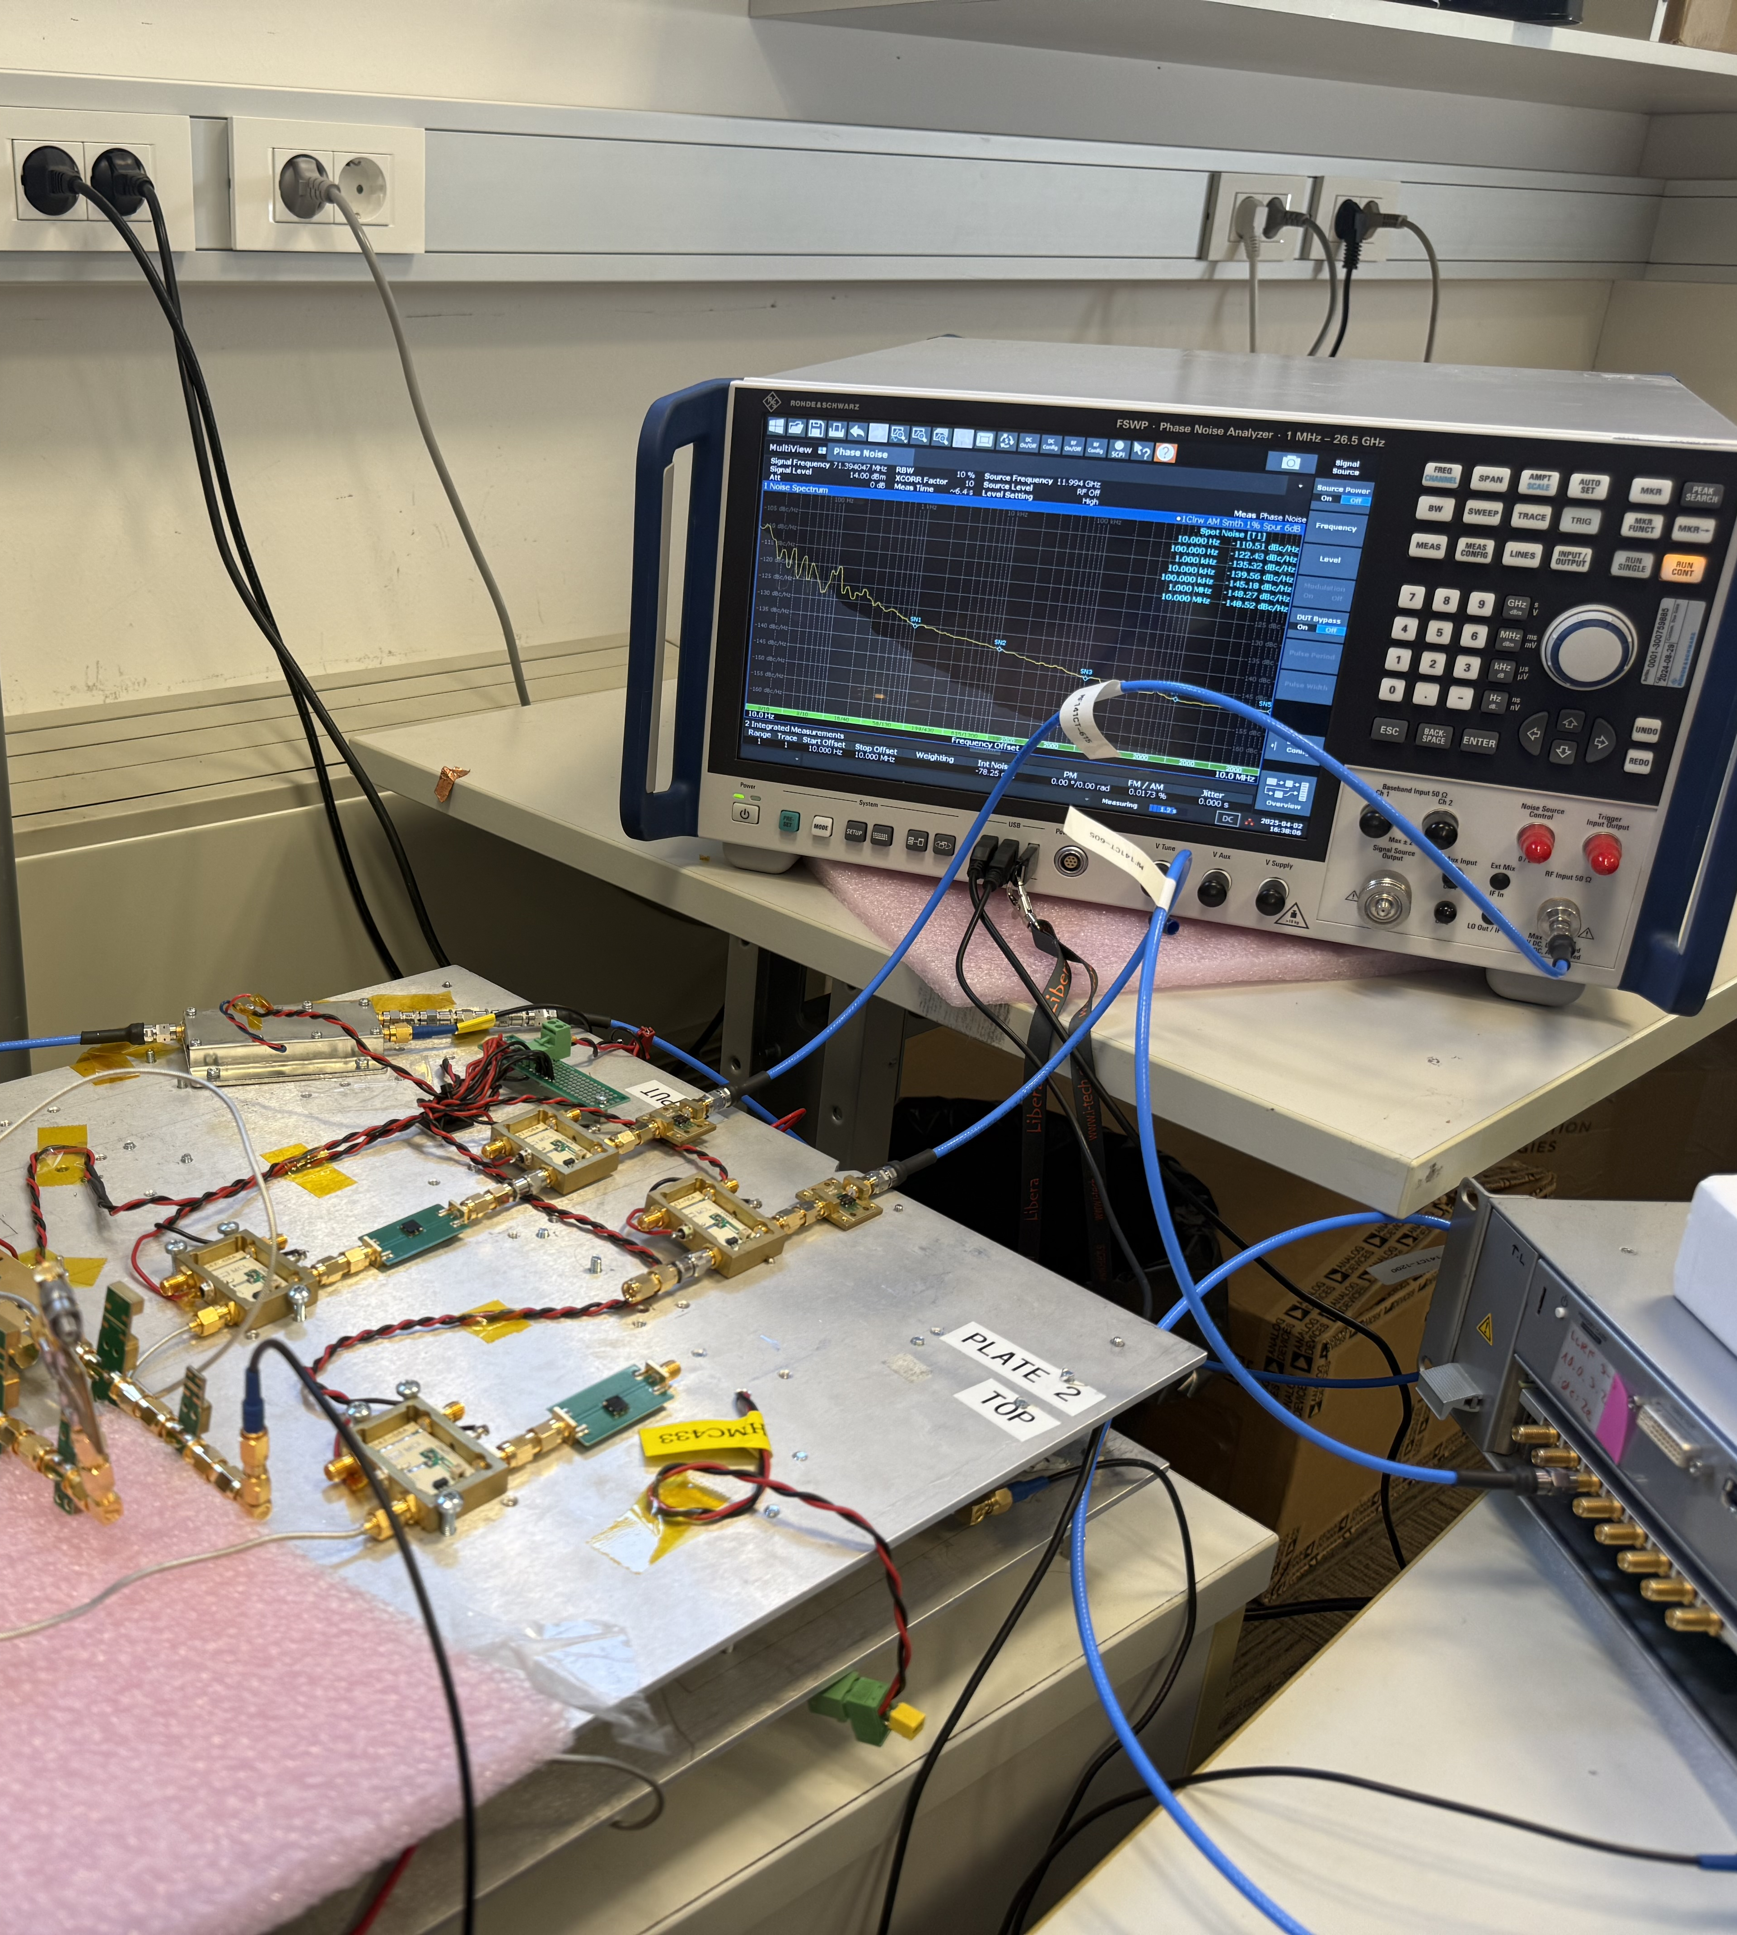
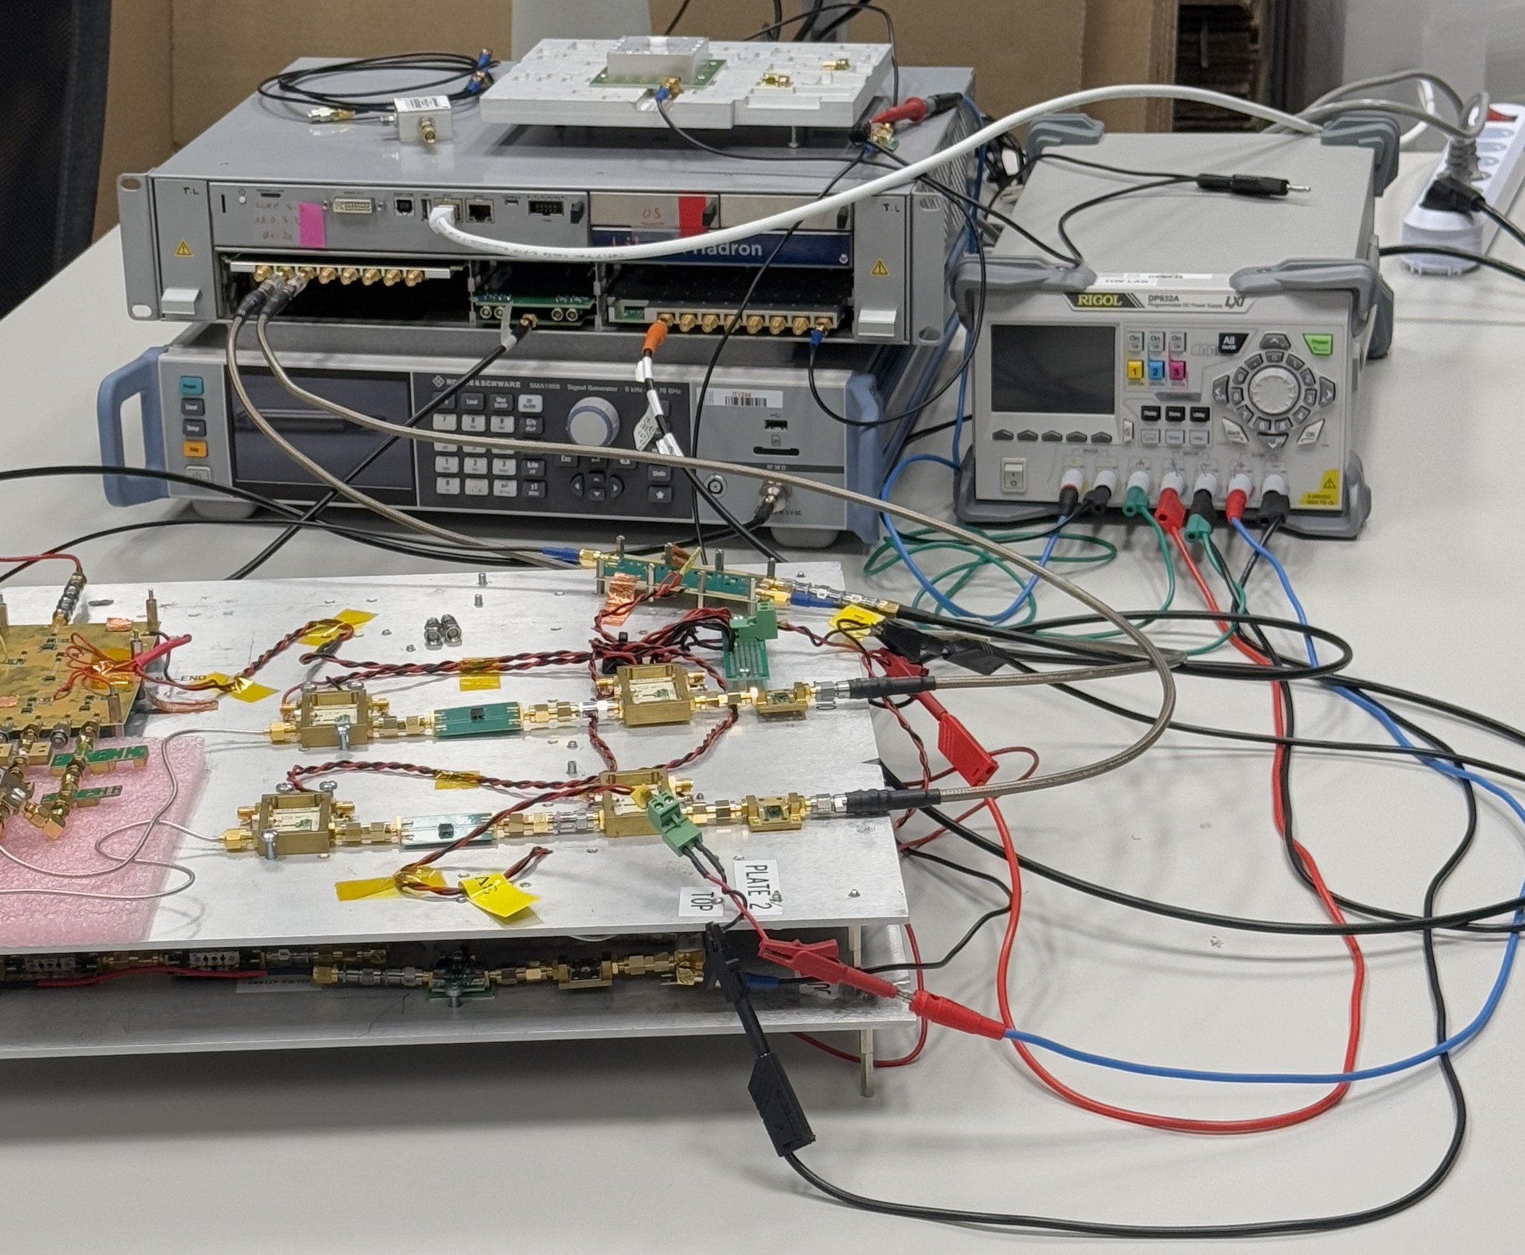
Thank You!

