Slide 1

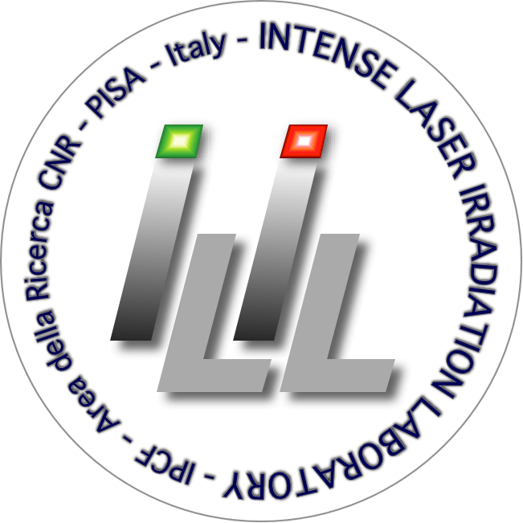



Wavefront Reconstruction as a Gateway to Precision Science at EuPRAXIA
David Gregocki
david.gregocki@ino.cnr.it
Consiglio Nazionale delle Ricerche (CNR), Istituto Nazionale di Ottica, Pisa, Italy
Dipartimento di Fisica, Università di Pisa, Pisa, Italy
EuPRAXIA-DN Camp II: Science, Instituto Superior Técnico, Lisbon, 14-15 July 2025

Slide 2

Table of contents
01 – Wavefront sensing in high-power laser facilities
Motivation
02 – Shack-Hartmann wavefront sensors & Deformable mirrors
Fundamental working principle
03 – Toward high quality beams
Laser wavefront correction procedure at ILIL
Deformable mirrors as an important part of the wavefront correction
The Converge software by Dynamic Optics – Further improvements in collaboration with ILIL
EuPRAXIA-DN Camp II: Science, Instituto Superior Técnico, Lisbon, 14-15 July 2025

Slide 3
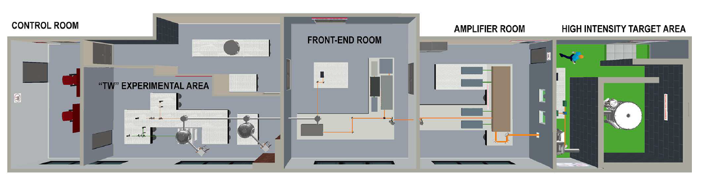
01 - Wavefront sensing in high-power laser facilities
Spatial quality in ultrashort, ultra-Intense laser pulses
Importance of wavefront control
  Spatial quality, especially wavefront integrity, is key to peak laser performance.
  High-power laser beamlines (e.g., at ILIL, CNR-INO) span hundreds of meters with many optical components.
Overall:
~220 TW laser system
From: 1.5 mm in diameter, 600 mJ at 800 nm
To: 10 cm in diameter 8.0 J at 800 nm
Total length: ~100m (to the main copressor)
4 mirrors and an OAP after
EuPRAXIA-DN Camp II: Science, Instituto Superior Técnico, Lisbon, 14-15 July 2025

Slide 4
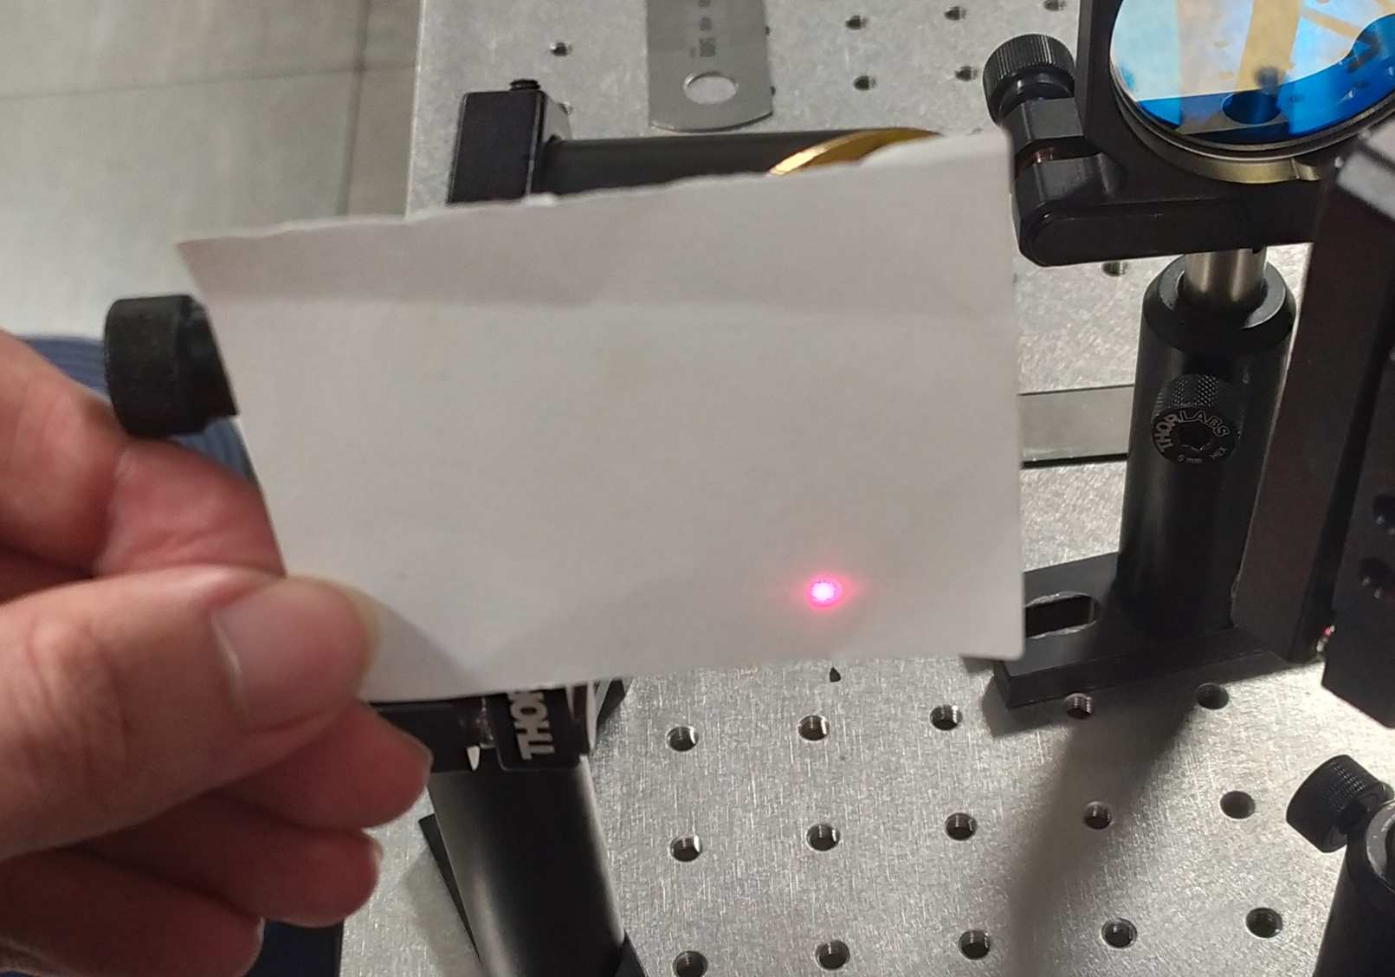
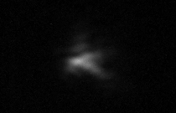
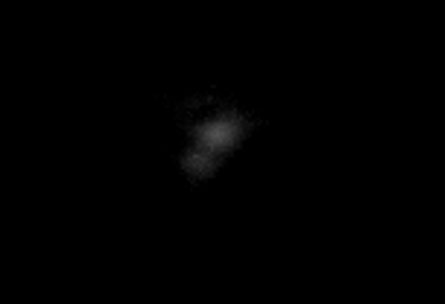
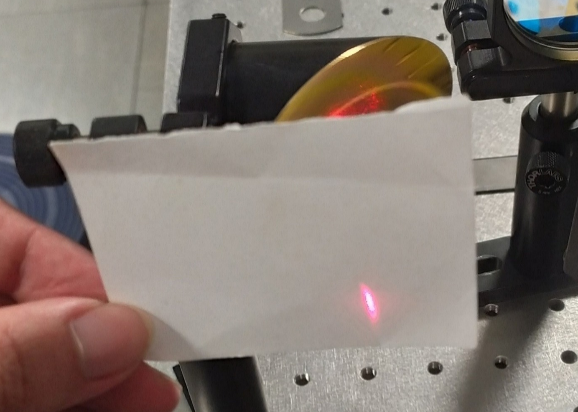
01 - Wavefront sensing in high-power laser facilities
Challenges along the beam path
Optical imperfections, misalignments, vibrations, and thermal effects accumulate.
Accumulated imprefections degrade focusability and reduce peak intensity.
Example 3
(Misaligned OAP only):
Example 1:
(Atmospheric turbulences
+ long beamline )
Example 2:
(Atmospheric turbulences
+ long beamline )
EuPRAXIA-DN Camp II: Science, Instituto Superior Técnico, Lisbon, 14-15 July 2025

Slide 5
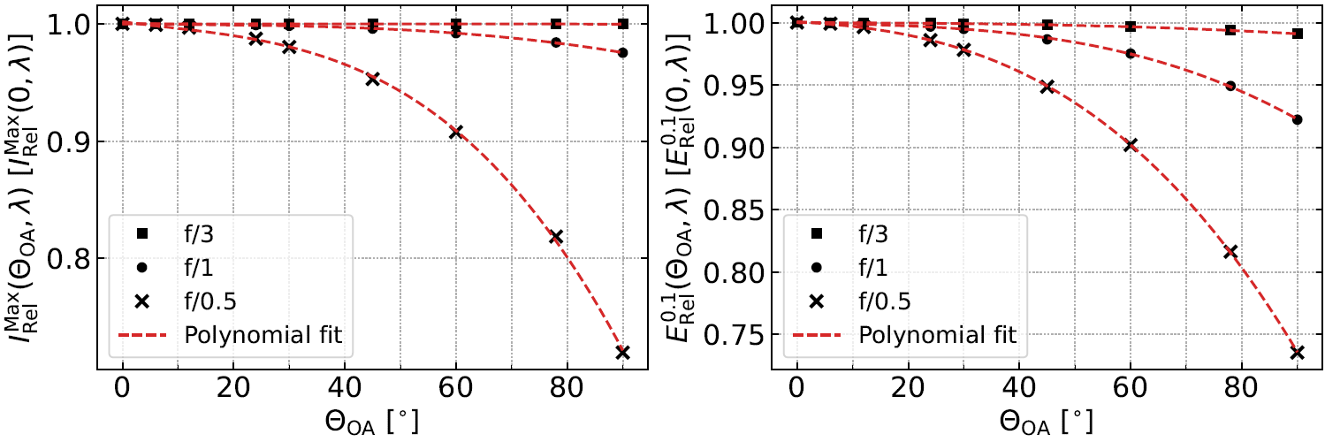
01 - Wavefront sensing in high-power laser facilities
Critical Zone: Final focusing stage
Flat wavefront required for optimal focusing
Off-Axis Parabolic (OAP) mirrors used to focus pulses to micron-scale spots.
Left: Relative laser peak intensities $I_{\text{Rel}}^{\text{Max}}\left(θ_{\text{OA}},λ\right)$ for $θ_{\text{OA}}$ and $f/\#$, normalized to the peak intensity of the laser focused by an on-axis parabola $I_{\text{Rel}}^{\text{Max}}\left(0,λ\right)$. Right: Relative energies contained within the zero maximum $E_{\text{Rel}}^{\text{0.1}}\left(θ_{\text{OA}},λ\right)$ for a given $θ_{\text{OA}}$ and $f/\#$, normalized to $E_{\text{Rel}}^{\text{0.1}}\left(0,λ\right)$, i.e., where $θ_{\text{OA}}=0^{∘}$.
EuPRAXIA-DN Camp II: Science, Instituto Superior Técnico, Lisbon, 14-15 July 2025

Slide 6
01 - Wavefront sensing in high-power laser facilities
Wavefront errors & Impact on applications (e.g., LWFA)
Consequences of aberrations
Irregular focal spots, reduced intensity.
In Laser Wakefield Acceleration (LWFA):
  Leads to beam asymmetry, reduced particle beam quality, and pointing instability.
  [1]
  [2]
  [3]
  [4]
  [5]
POPP, A.; VIEIRA, J.; OSTERHOFF, J., et al. All-Optical Steering of Laser-Wakefield-Accelerated Electron Beams. Phys. Rev. Lett. 2010, vol. 105, p. 215001. Available from doi: 10.1103/PhysRevLett.105.215001
ZEIL, K.; METZKES, J.; KLUGE, T., et al. Direct observation of prompt pre-thermal laser ion sheath acceleration. Phys. Rev. Lett. 2012, vol. 3, p. 874. Available from doi: 10.1038/ncomms1883
THEVENET, M.; MITTELBERGER, D. E.; NAKAMURA, K., et al. Pulse front tilt steering in laser plasma accelerators. Phys. Rev. Accel. Beams. 2019, vol. 22, p. 071301. Available from doi: 10.1103/PhysRevAccelBeams.22.071301.
MITTELBERGER, D. E.; THEVENET, M.; NAKAMURA, K., et al. Laser and electron deflection from transverse asymmetries in laser-plasma accelerators. Phys. Rev. E. 2019, vol. 100, p. 063208. Available from doi: 10.1103/PhysRevE.100.063208.
ZHU, C.; WANG, J.; OTHERS, Y. Li ond. Optical steering of electron beam in laser plasma accelerators. Opt. Express. 2020, vol. 28, pp. 11609–11617. Available from doi: 10.1364/OE.380842.
EuPRAXIA-DN Camp II: Science, Instituto Superior Técnico, Lisbon, 14-15 July 2025

Slide 7
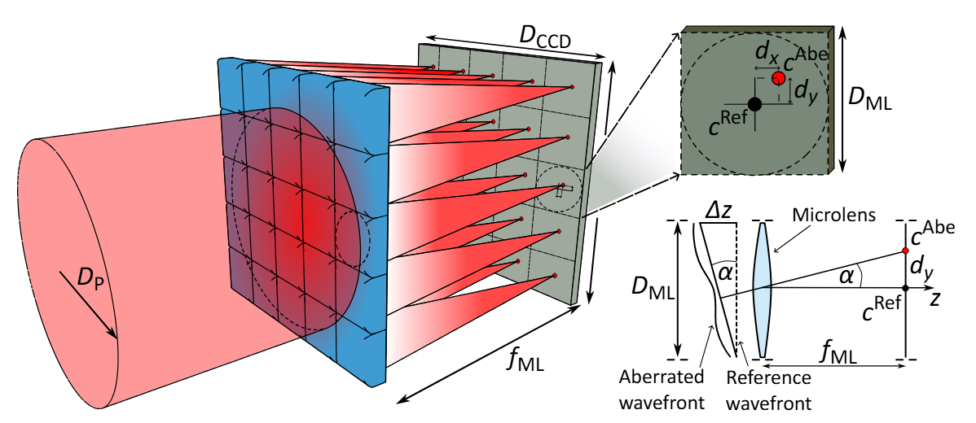
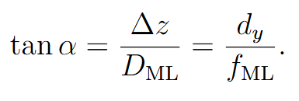
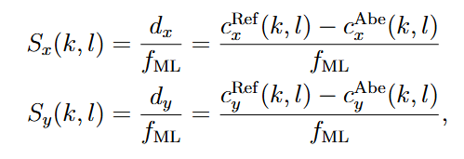
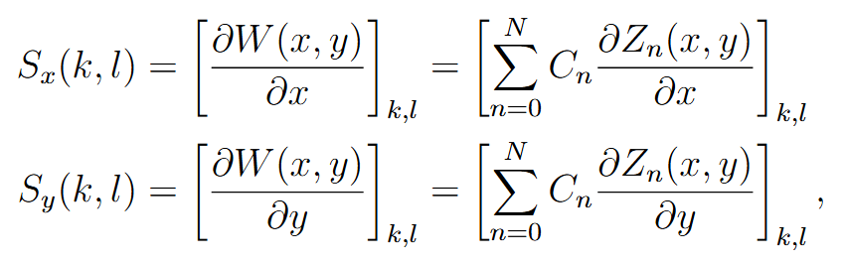
02 - Shack-Hartmann wavefront sensors & Deformable mirrors
Fundamental working principle
Illustration of the Shack-Hartmann sensor demonstrating its working principle. Shifts of the focus spots from the reference position, caused by changing wavefront slope, are being measured to retrieve the wavefront of the aberrated beam $W(x,y)$.
EuPRAXIA-DN Camp II: Science, Instituto Superior Técnico, Lisbon, 14-15 July 2025

Slide 8
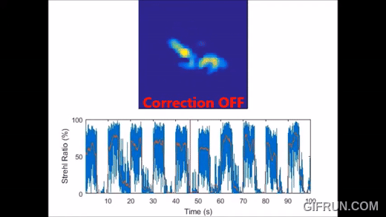
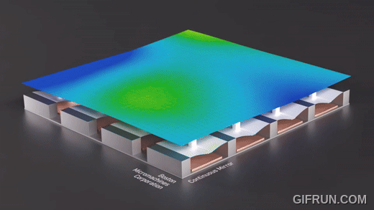
02 - Shack-Hartmann wavefront sensors & Deformable mirrors
Fundamental working principle
Wavefront correction via deformable mirrors:
Mirror surface is adjusted via actuators (e.g., piezoelectric, Micro-Electro- Mechanical Systems).
Actuator positions deform the mirror to counteract wavefront errors.
Goal: Flatten the wavefront to restore beam quality.
Closed-Loop Feedback System:
Continuous loop between SHWS and mirror.
Real-time updates ensure dynamic compensation of aberrations.
Credit: Dynamic Optics
Credit: Boston Micromachines Corporation
EuPRAXIA-DN Camp II: Science, Instituto Superior Técnico, Lisbon, 14-15 July 2025

Slide 9
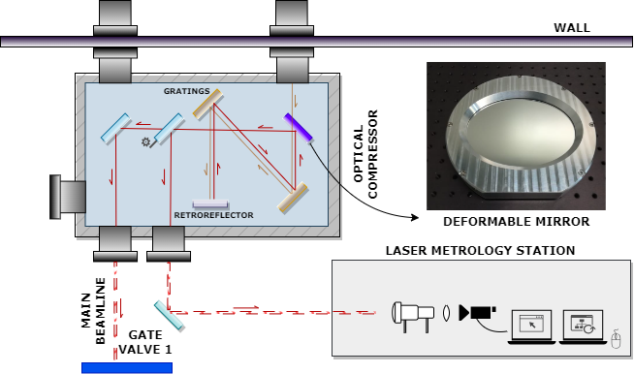
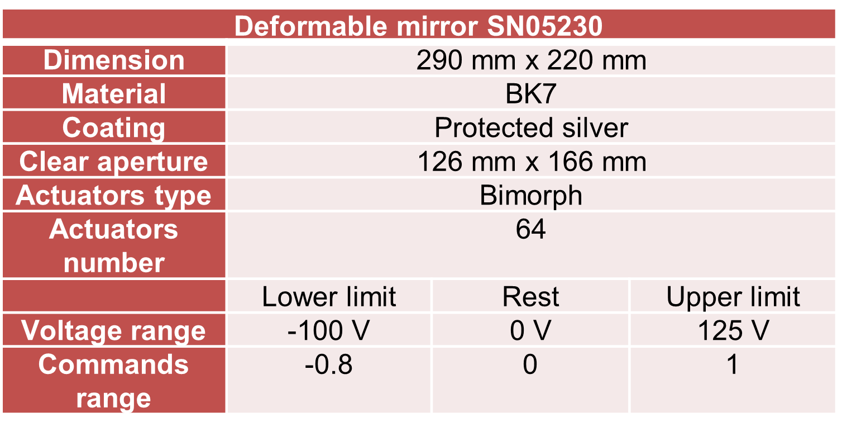
03 - Toward high quality beams
Laser wavefront correction procedure at ILIL:
1st stage
Redirecting a laser pulse to the metrology station
Measurement of distorted laser wavefront by a sensor
Calibration of actuators by PHOTONLOOP software (Dynamic Optics)
  In closed loop with specific pattern sequence
Feed from calibration is sent to deformable mirror
  The position of actuators relative to laser beam is assessed
1st stage ends with calibrated actuators and flat laser wavefront
EuPRAXIA-DN Camp II: Science, Instituto Superior Técnico, Lisbon, 14-15 July 2025

Slide 10

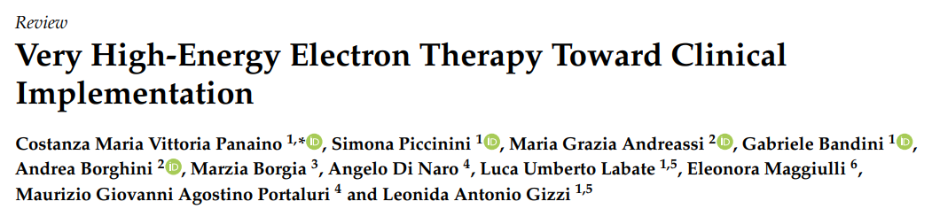
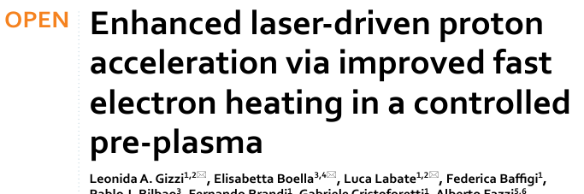
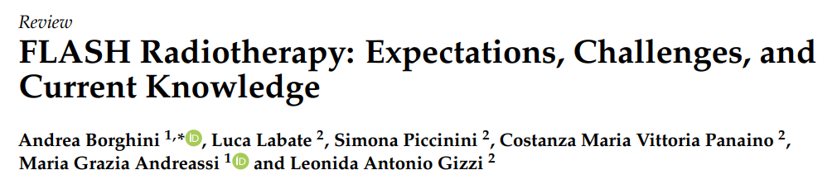
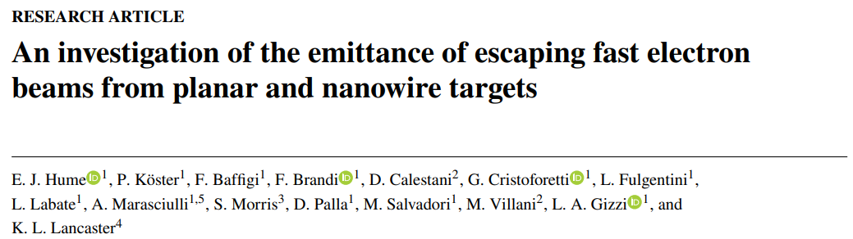
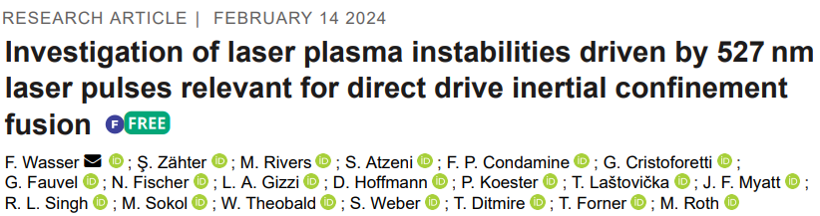
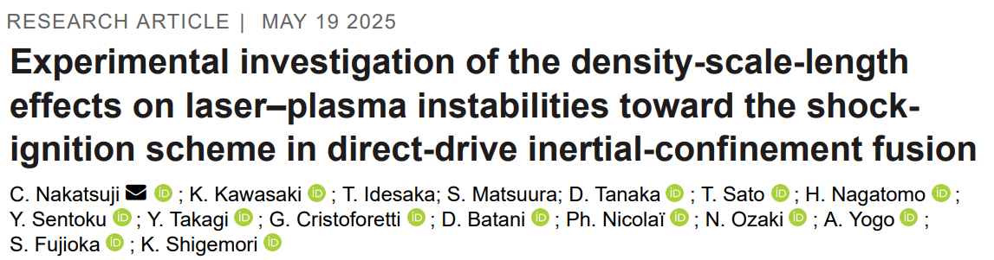
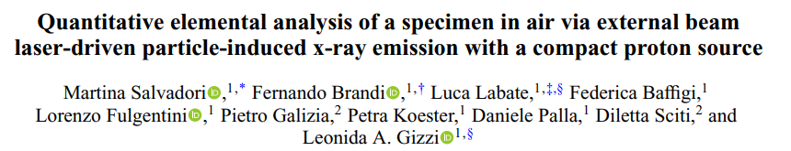
03 - Toward high quality beams
Light ion acceleration
Table-Top 100’s MeV accelerator for radiotherapy
What can we do
As a result?
Studies on inertial confinement fusion/plasma instabilities and shock ignition
Studies on novel X-ray sources
EuPRAXIA-DN Camp II: Science, Instituto Superior Técnico, Lisbon, 14-15 July 2025

Slide 11
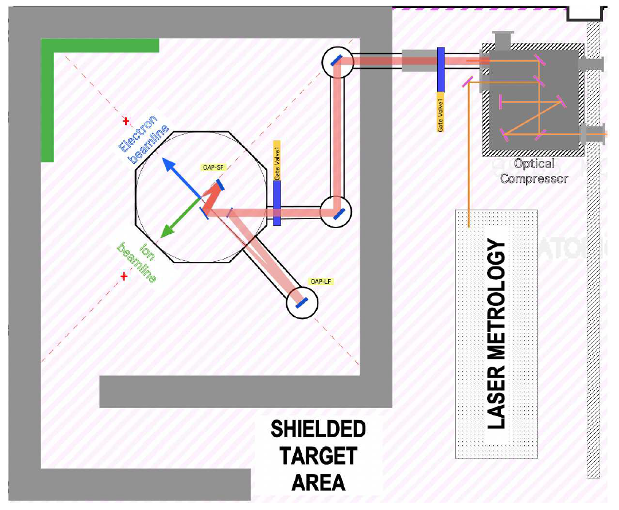
03 - Toward high quality beams
However:
After the compressor chamber
There are 3 main mirrors and OAP mirror
Can lead to distortion of flat top wavefront
Additional aberrations requires further correction
        Therefore …
Laser Wavefront Tailoring Procedure at ILIL:
2nd stage
Further optimization with the Converge Software (Dynamic Optics) utilized for finding and setting best laser focus
Objective: Small spot diameter with no destructive aberrations
Procedure:
  Starts with PHOTONLOOP output data
  Interpolates measured wavefront spots
  Finds optimal focus spot by sensing highest intensity (average pixel intensity)
M.1
M.3
M.2
OAP
EuPRAXIA-DN Camp II: Science, Instituto Superior Técnico, Lisbon, 14-15 July 2025

Slide 12
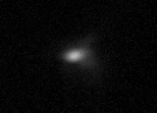
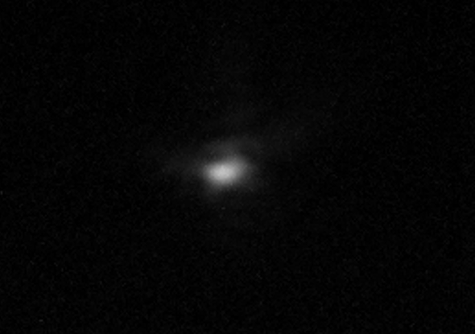
03 - Toward high quality beams
Before Converge optimization
After Converge optimization
Entire pulse intensity is focused into one undisturbed spot
Such coma-like aberrations can lead to an intensity decrease and unwanted electron beam steering.
EuPRAXIA-DN Camp II: Science, Instituto Superior Técnico, Lisbon, 14-15 July 2025

Slide 13
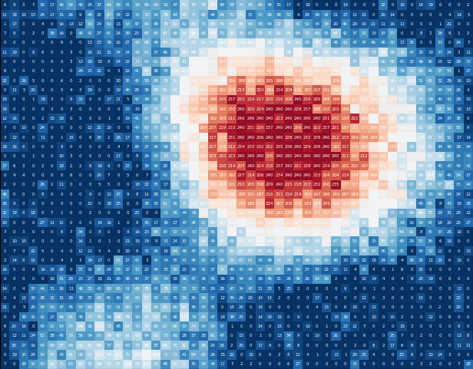
03 - Toward high quality beams
The Converge software by Dynamic Optics – Further improvements in collaboration with ILIL
Illustrative example (simulation)
Does not require real-time feedback from a wavefront sensor.
Iterative optimization: Uses hill-climbing algorithm to find the best shape of the deformable mirror that improves image or beam quality.
Merit Function: Takes pixel intensity as the input to drive optimization.
However, the intensity distribution of the ultrashort and ultra-intense laser pulse quickly fluctuates even for low magnitudes of aberrations.
  Thermal lensing
  Modulation artifacts from acousto-optic modulators and electro-optic modulators
  Vibrations and atmospheric turbulences
These fluctuations can confuse the Converge algorithm
Possible solutions: Implementing a merit function based on a different quantity -> Dynamic Optics & ILIL collaboration
[6] BOOTH M. J. Opt. Lett. 2007, vol. 32, p. 5-7. Available from doi: 10.1364/OL.32.000005
[7] BUENO J. M., et al. Opt. Express. 2018, vol. 26, p. 14278-14287. Available from doi: 10.1364/OE.26.014278
EuPRAXIA-DN Camp II: Science, Instituto Superior Técnico, Lisbon, 14-15 July 2025

Slide 14
Summary
Ultrashort and ultra-intense laser pulses can be used to accelerate electrons up to relativistic energies
Reduced cost and size of laser-plasma accelerators enables widespread application.
  In radiobiology, material studies, nuclear physics, ...
However, the quality and shot-to-shot stability can and need to be improved
Adaptive optics can enhance the pointing stability.
The Converge software by Dynamic Optics goes even further and ensures the highest peak intensity in the focus.
Currently the merit function of the Converge software is being improved in collaboration with Dynamic Optics (aiming to publish a paper)
EuPRAXIA-DN Camp II: Science, Instituto Superior Técnico, Lisbon, 14-15 July 2025

Slide 15

Acknowledgement:
This project has received funding from the European Union MSCA network “EuPRAXIA- DN” (grant agreement no. 101073480) and the UKRI guarantee funds.
Thank you!
david.gregocki@ino.cnr.it
#EuPRAXIA
EuPRAXIA-DN Camp II: Science, Instituto Superior Técnico, Lisbon, 14-15 July 2025

