Slide 1
Diagnostics for ultrashort electron bunches in LWFA-driven FELs
Ana Guisao-Betancur^{1,2}
A.M.Guisao-Betancur@liverpool.ac.uk
¹. Department of Physics, University of Liverpool, Liverpool L69 7ZX, UK
². Cockcroft Institute, Sci-Tech Daresbury, Daresbury WA4 4AD, UK

Slide 2
Contents
Introduction to LWFAs for FELs.
Diagnostic requirements.
Available diagnostics.
Conclusions.

Slide 3
1. Introduction to LWFAs for FELs

Slide 4
1. Introduction to LWFAs for FELs
Quick overview of plasma accelerators for Free Electron Lasers (FELs)
Laser-driven wakefield accelerator
Array of magnets of alternating polarity causing the beam to oscillate transversely and emit radiation.
Particle-driven wakefield accelerator
Provide the needed high-energy beams with reduced footprint.
The electrons, which become bunched along the undulator, amplify the light intensity.
Figure 1: A plasma-stage scheme in LWFA and PWFA configurations*.
*Image from [1]: https://doi.org/10.1038/s41566-024-01474-3

Slide 5
2. Diagnostic requirements

Slide 6
2. Diagnostic requirements
FEL operation requirements and LWFA [1-4]
FELs operating in the X-ray region require e-beams with:
High energy.
Low energy spread.
Low emittance.
Beam manipulation strategies.
Enabled by
Advanced beam-plasma diagnostics.
The essential parameters have not been attained concurrently by LWFAs [1].
Requires:
Active control techniques (and even machine learning) for feedback: tunning of the longitudinal phase space (LPS).
Technologies to analyze fs-length bunches in their spatiotemporal structures.

Slide 7
2. Diagnostic requirements
The need for high-brightness e-beams
The (six-dimensional) e-beam brightness can be written as [5]:
$$B=\frac{Q}{ε_{n,x}ε_{n,y}ε_{n,s}}≈\frac{I}{ε_{n,x}ε_{n,y}cσ_{E}}$$
Enhancing the brightness of the e-beam through:
Smaller transverse emittances.
Smaller energy spread.
Higher current.
$Q$: electron bunch charge
$ε_{n,x}$: horizontal normalized emittance
$ε_{n,y}$: vertical normalized emittance
$ε_{n,s}$: longitudinal emittance
$$I=\frac{Q}{σ_{t}}$$
$I$: electron beam peak current
$c$: speed of light
$σ_{E}$: (uncorrelated) energy spread
Specific challenges in LWFA-FELs [1]:
How to obtain high-peak current with sufficient charge, low energy spread and low emittance.
Stability and reproducibility.
Maintain properties during transport post-acceleration.
$σ_{t}$: beam duration (bunch length)

Slide 8
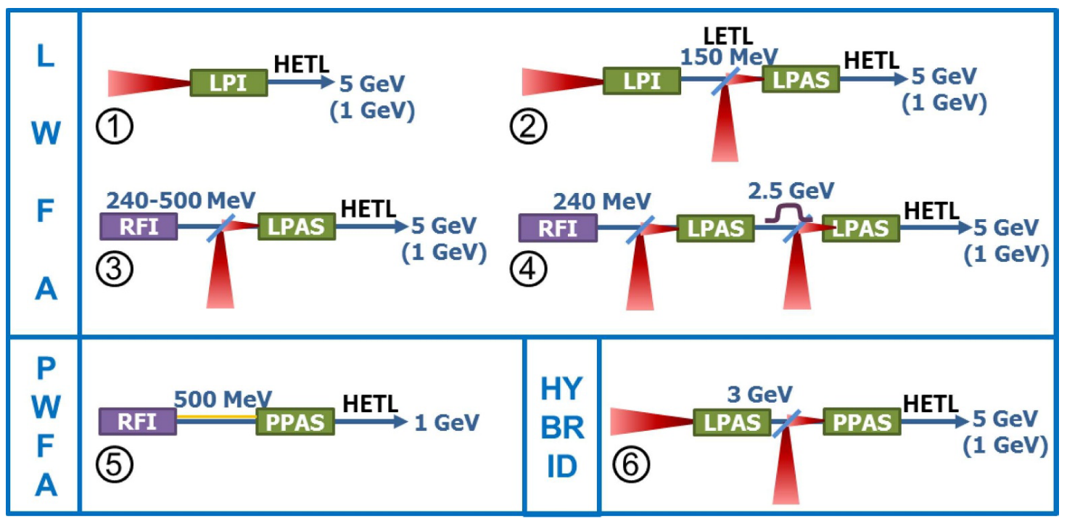
2. Diagnostic requirements
Examples of what is expected in LWFA bunch profiles
complex shapes
Figure 2: Beam distribution and acceleration configurations under consideration for the various EuPRAXIA beamlines*.
micro structures
Figure 3: Evolution of the longitudinal phase space of the externally injected electron beam along the beamline*.
Bunch profile: length and sub-structures.
*Images from [6] EuPRAXIA Conceptual Design Report

Slide 9
3. Available diagnostics

Slide 10
3. Available diagnostics
X-band radio frequency (RF) transverse deflecting structure (TDS) with variable polarization.
[7] E. Prat et al., “Attosecond time-resolved measurements of electron and photon beams with a variable polarization X-band radiofrequency deflector at an X-ray free-electron laser,” Adv. Photonics, vol. 7, no. 02, pp. 1–9, Feb. 2025, doi: 10.1117/1.AP.7.2.026002.
Quadrupoles are used to optimize the optics for the different measurements, e.g.:
Current profile, slice emittance at S1.
Longitudinal phase space (LPS) characterization at S2
Advantages:
Measure the e-beam in all its dimensions.
Location (after undulator) allows for photon-beam measurements.
XBOC: RF pulse compressor
PSX: Phase shifters. Used to change polarizations (PS1-2) and PS3 to synchronize.
Limitations:
Big footprint for a compact FEL.
Destructive of the e-beam.
TDSX: Transverse deflectors
Figure 4: Schematic layout of the TDS diagnostic section. The overall length is $∼35 m$.
@ SwissFEL after the undulator of the soft X-ray beamline ATHOS.

Slide 11
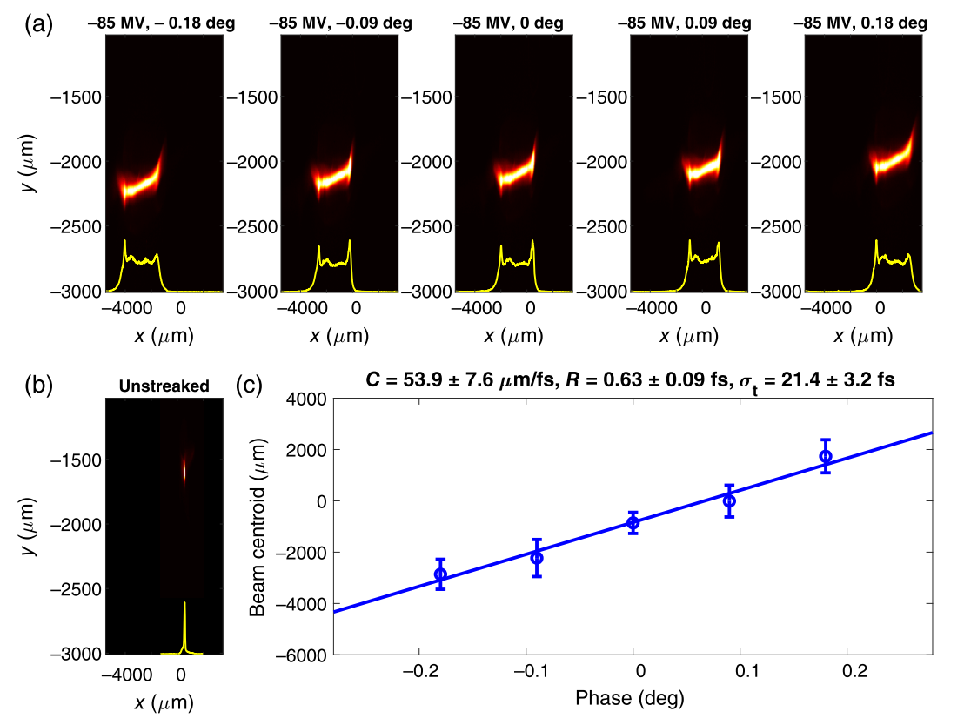
3. Available diagnostics
X-band radio frequency (RF) transverse deflecting structure (TDS) with variable polarization.
[7] E. Prat et al., “Attosecond time-resolved measurements of electron and photon beams with a variable polarization X-band radiofrequency deflector at an X-ray free-electron laser,” Adv. Photonics, vol. 7, no. 02, pp. 1–9, Feb. 2025, doi: 10.1117/1.AP.7.2.026002.
Single-shot streaked images for different RF TDS phases.
Single-shot unstreaked image.
Measured and fitted beam centroid variation as a function of the RF TDS phase.
Advantages:
Measure the e-beam in all its dimensions.
Location (after undulator) allows for photon-beam measurements.
Limit reached attosecond resolution.
Bunch length: $σ_{t}=\left(21.4±3.2\right) fs$
Resolution: $R=(0.63 ±0.09) fs$
Limitations:
Big footprint for a compact FEL.
Destructive of the e-beam.
Figure 5: Sub-femtosecond resolution measurement.
@ SwissFEL after the undulator of the soft X-ray beamline ATHOS.

Slide 12
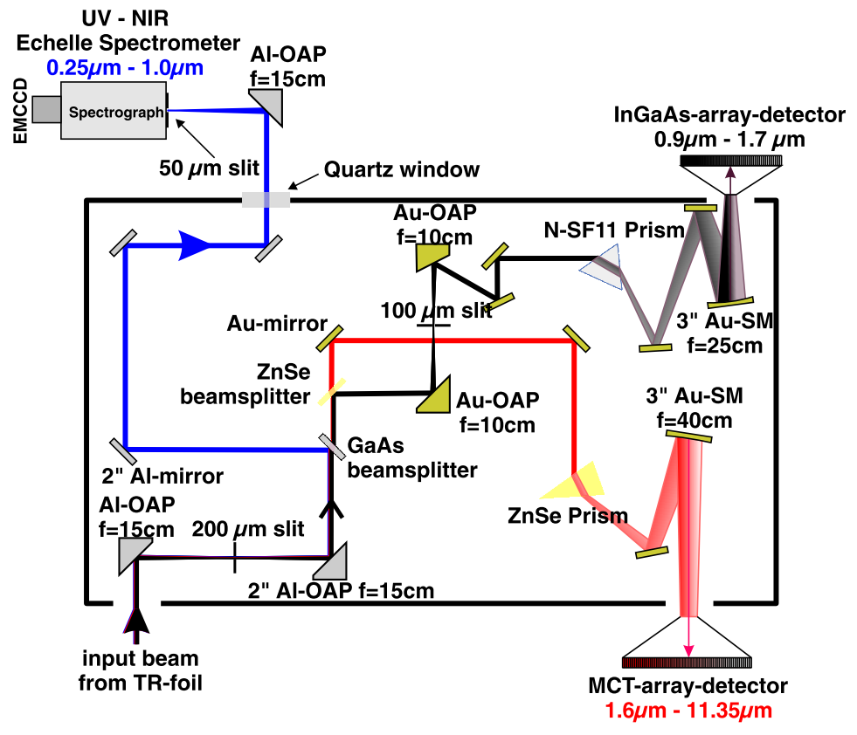
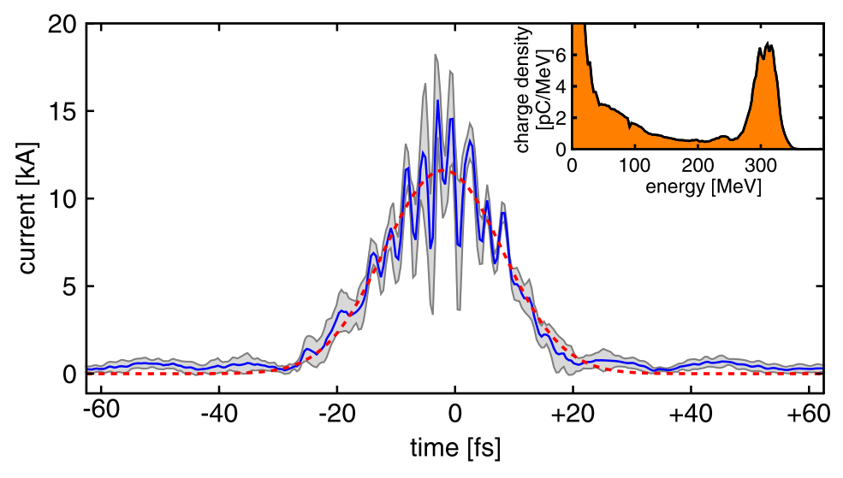
3. Available diagnostics
[8] O. Zarini et al., “Multioctave high-dynamic range optical spectrometer for single-pulse, longitudinal characterization of ultrashort electron bunches,” Phys. Rev. Accel. Beams, vol. 25, no. 1, pp. 1–19, 2022, doi: 10.1103/PhysRevAccelBeams.25.012801.
Using polarization radiation: coherent transition radiation (CTR)
Advantages:
Small footprint.
Potentially non-invasive.
Performed at any position in a beam transport line.
Broad spectral range ($5.5$ octaves, $250 nm$ to $11.35 μm$) at single shot.
Kramers-Kronig (KK) reconstruction procedure
Figure 7: Combined measured coherent transition radiation spectrum.
Limitations:
Main structure vs. sub-structures.
Phase retrieval.
Bunch length: $σ_{t}=\left( 9.78±0.77 \right) fs$rms
Peak current: $I_{e}=\left(9.40±0.66\right) kA$
Sub-structure: $∼3.0 fs$ periodicity
Where my research fits:
Bunch profile reconstruction from broadband CTR images (instead of spectra) with deep learning.
Figure 6: Main components of the CTR spectrometer showing a schematic top-view and highlighting the three main light paths.
Figure 8: Reconstructed LWFA-accelerated bunch based on the CTR spectrum at single-shot.
@ HZDR using the 100 TW DRACO laser system.

Slide 13
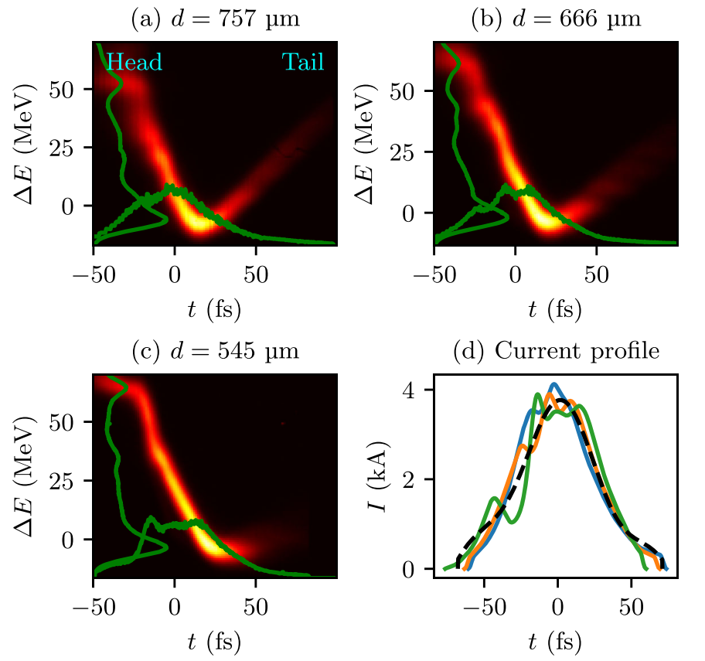
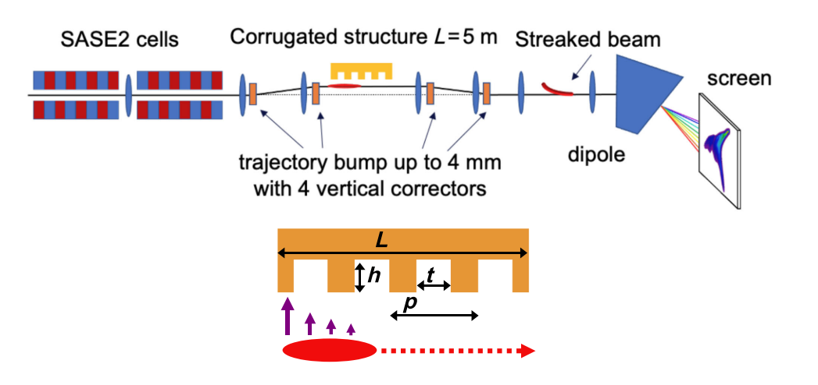
3. Available diagnostics
[11] P. Dijkstal, W. Qin, and S. Tomin, “Longitudinal phase space diagnostics with a nonmovable corrugated passive wakefield streaker,” Phys. Rev. Accel. Beams, vol. 27, no. 5, p. 050702, May 2024, doi: 10.1103/PhysRevAccelBeams.27.050702.
Cost-effective LPS measurements with a passive streaker
LPS measurements with corrugated passive wakefield streaker (PS) using the non-invasive CRISP (Coherent radiation intensity spectrometer) diagnostics for calibration of the e-beam trajectory.
Advantages:
Higher cost-effectiveness over TDS diagnostics.
distance $d$ between beam and plate
Limitations:
Some properties of the LPS cannot be resolved.
The growing wakefield forces along the bunch are indicated by purple arrows.
Figure 9: Layout of the diagnostic and geometry of the corrugated plate $∼5 m$.
Bunch length down to $σ_{t}=\left( 5.4 \right) fs$rms
Figure 10: Three LPS measurements acquired under the same beam conditions current profiles from the PS (colors) and from CRISP (dashed).
@ EuXFEL after the SASE2 undulator.

Slide 14
3. Available diagnostics
[12] J. Zhu, N. M. Lockmann, M. K. Czwalinna, and H. Schlarb, “Mixed Diagnostics for Longitudinal Properties of Electron Bunches in a Free-Electron Laser,” Front. Phys., vol. 10, no. July, pp. 1–10, Jul. 2022, doi: 10.3389/fphy.2022.903559.
Mixed diagnostics for longitudinal properties
Combined virtual and real diagnostics for heterogeneous and reliable mixed diagnostics.
Advantages:
Works with machine parameters.
Multimodal diagnostics.
Virtual diagnostics.
Figure 13: Schematic of the FLASH1 beamline.
Mean squared error (MSE):
$$3.9×{10}^{−4} ± 3.2×{10}^{−3}$$
Data-driven technique
LPS structural similarity index measure (SSIM):
$$0.9801 ± 0.00978$$
Figure 11: Applications of the encoder-decoder neural network models.
@ DESY FLASH1 beamline.

Slide 15
4. Conclusions

Slide 16
4. Conclusions
Comprehensive profile monitoring needed for stable FEL operation.
Considerations for the implementation of the necessary diagnostics:
Compact footprint compatible with LWFA beamlines.
Single-shot capability.
Feedback and synchronization.
Reaching attosecond resolution (for sub-structures).
Options with multimodal diagnostics, e.g., TDS or streaking + CXR.

Slide 17
References
M. Galletti et al., “Prospects for free-electron lasers powered by plasma-wakefield-accelerated beams,” Nat. Photonics, vol. 18, no. 8, pp. 780–791, Aug. 2024, doi: 10.1038/s41566-024-01474-3.
J. van Tilborg, S. K. Barber, F. Isono, C. B. Schroeder, E. Esarey, and W. P. Leemans, “Free-electron lasers driven by laser plasma accelerators,” in AIP Conference Proceedings, 2017, vol. 1812, no. January, p. 020002, doi: 10.1063/1.4975838.
C. Emma et al., “Free electron lasers driven by plasma accelerators: status and near-term prospects,” High Power Laser Sci. Eng., vol. 9, p. e57, Sep. 2021, doi: 10.1017/hpl.2021.39.
K. Feng et al., “High-quality electron beam generation from laser wakefield accelerators for driving compact free electron lasers,” Jan. 2025, [Online]. Available: http://arxiv.org/abs/2501.09916.
E. Prat et al., “Experimental characterization of the optical klystron effect to measure the intrinsic energy spread of high-brightness electron beams,” Phys. Rev. Accel. Beams, vol. 27, no. 3, p. 30701, 2024, doi: 10.1103/PhysRevAccelBeams.27.030701.
R. W. Assmann et al., “EuPRAXIA Conceptual Design Report,” Eur. Phys. J. Spec. Top., vol. 229, no. 24, pp. 3675–4284, Dec. 2020, doi: 10.1140/epjst/e2020-000127-8.
E. Prat et al., “Attosecond time-resolved measurements of electron and photon beams with a variable polarization X-band radiofrequency deflector at an X-ray free-electron laser,” Adv. Photonics, vol. 7, no. 02, pp. 1–9, Feb. 2025, doi: 10.1117/1.AP.7.2.026002.
O. Zarini et al., “Multioctave high-dynamic range optical spectrometer for single-pulse, longitudinal characterization of ultrashort electron bunches,” Phys. Rev. Accel. Beams, vol. 25, no. 1, pp. 1–19, 2022, doi: 10.1103/PhysRevAccelBeams.25.012801.
K. Huang, Z. Jin, N. Nakanii, T. Hosokai, and M. Kando, “Electro-optic 3D snapshot of a laser wakefield accelerated kilo-ampere electron bunch,” Light Sci. Appl., vol. 13, no. 1, 2024, doi: 10.1038/s41377-024-01440-2.
A. Döpp, “Snapshot imaging of ultrashort electron bunches,” Light Sci. Appl., vol. 13, no. 1, pp. 24–26, 2024, doi: 10.1038/s41377-024-01489-z.
P. Dijkstal, W. Qin, and S. Tomin, “Longitudinal phase space diagnostics with a nonmovable corrugated passive wakefield streaker,” Phys. Rev. Accel. Beams, vol. 27, no. 5, p. 050702, May 2024, doi: 10.1103/PhysRevAccelBeams.27.050702.
J. Zhu, N. M. Lockmann, M. K. Czwalinna, and H. Schlarb, “Mixed Diagnostics for Longitudinal Properties of Electron Bunches in a Free-Electron Laser,” Front. Phys., vol. 10, no. July, pp. 1–10, Jul. 2022, doi: 10.3389/fphy.2022.903559.

Slide 18
Thank you!
Any questions?
Ana Guisao-Betancur^{1,2}
A.M.Guisao-Betancur@liverpool.ac.uk
¹. Department of Physics, University of Liverpool, Liverpool L69 7ZX, UK
². Cockcroft Institute, Sci-Tech Daresbury, Daresbury WA4 4AD, UK

Slide 19
More e-beam quality measures
Unitless FEL Pierce parameter [1]:
$$ρ={\left(\frac{1}{16}\frac{Q/σ_{t}}{I_{A}}\frac{K^{2}[JJ]^{2}}{γ^{3}σ_{r}^{2}k_{u}^{2}}\right)}^{1/3}$$
1D FEL gain length:
$$L_{g,1D}=\frac{λ_{u}}{4\sqrt{3}πρ}$$
Affected by energy spread and 3D effects (diffraction and emittance):
$$L_{g,3D}=L_{g,1D}\left(1+Λ\right)$$
e: the unit of charge
c: the vacuum speed of light
$r_{e}$: the classical electron radius
$I_{A}=ec/r_{e}≅17kA$: the Alfvén current
$λ_{u}:$ the undulator period with $k_{u}=2π/λ_{u}$
$[JJ]$: a $K$-dependent parameter of order unity
$K:$ the normalized undulator field strength
$γ≃{E_{MeV}}/{0.511}$: Lorentz factor and electron energy
$Q$: electron bunch charge
$σ_{t}$: beam duration (bunch length)
$σ_{r}$: transverse beam size
$$I=\frac{Q}{σ_{t}}$$
$I$: electron beam peak current

