Slide 1

Andrés Leiva Genre
Unlocking atomic motion: Dielectric THz-driven Accelerators for Ultrafast Electron Diffraction
University of Pécs
Szentágothai Research Center
Supervisor: Dr. Szabolcs Turnár
Prof. Dr. Gábor Almási
15 July 2025
Notes:
Good afternoon! Today I will talk about how DTAs could boost the field of UED, reaching new horizons in Material Science, Chemistry & Biology

Slide 2
Outline
Quick overview of Dielectric Laser-driven Accelerators (DLAs)
Ultrafast Electron Diffraction (UED)
  Main ideas and figure of merits
  THz pulses: Setups & their Benefits in UED
  Dielectric THz-driven Accelerators (DTAs)
  Fundamental Science Drivers for UED
Notes:
First, I will shortly introduce you the novel accelerators known as Dielectric Laser-driven Accelerators
After this, we will continue with the main topic of this presentation. We will explore (read quickly the contents)

Slide 3
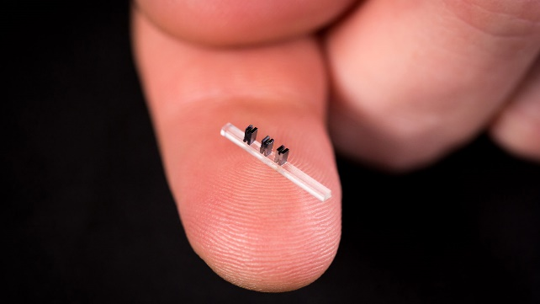
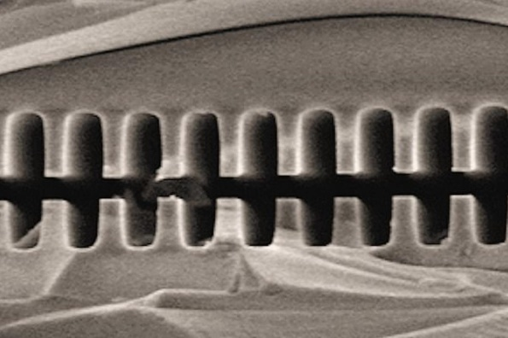
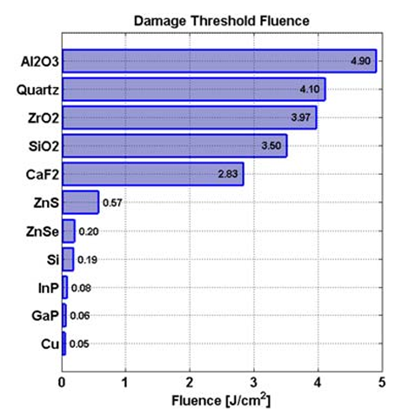
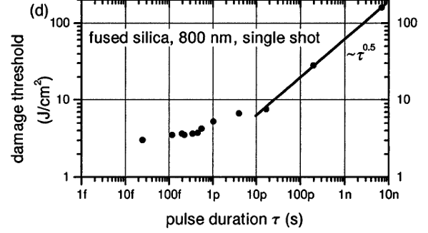
MOTIVATION
SIZE
POWER LIMITATION
Accelerating dielectric microstructures. Images from achip.standford.edu.
Left: Ken Soong et. al.; Laser damage threshold measurements of optical materials for direct laser accelerators. AIP Conf. Proc. 21 December 2012; 1507 (1): 511–515
Right: Tien, An-Chun, et al. "Short-pulse laser damage in transparent materials as a function of pulse duration." Physical Review Letters 82.19 (1999): 3883.
Notes:
… is to employ dielectric instead of metals. Dielectric materials present Damage Threshold Fluence one to two order-of-magnitudes greater than metals in the optical/IR spectrum.
Additionally, we are able to shape and fabricate dielectric/semiconductor microstructures thanks to the advance in the last decades of the manufacturing and nanofabrication techniques developed by material science.
These accelerators are SO, SO small that they can fit on the tip of our fingers!!
How do these accelerators work?

Slide 4

DTA: ACCELERATION CONCEPT
Acceleration is attained by the near-fields provided by the dielectric structure.
Accelerator on a chip: How it works, SLAC National Accelerator Laboratory. Video from achip.standford.edu.
Notes:
Given a high-intensity laser and appropriate optical system, acceleration can be attained by the interaction of the laser with the microstructure, which provide the means to accelerate charged particles.
We can better understand the acceleration concept by watching this illustrative clip made by SLAC…
Imagine a plane wave-like laser pulse reaching the acceleration vacuum channel gap. By modifying the dielectric structure, we can alter the field amplitude along the channel. There are clearly two regions: high and low-field regions. When an electron is timely injected, it will experience both acceleration and deceleration. But because of the stronger interaction with green arrows (compared with weaker, smaller red arrows), the travelling electron gains more energy than it losses. At the end of the process, a positive net energy gain is achieved. (Short Pause)
Now, let’s proceed with…

Slide 5
Ultrafast Electron Diffraction (UED)
Notes:
…our topic of interest: UED

Slide 6
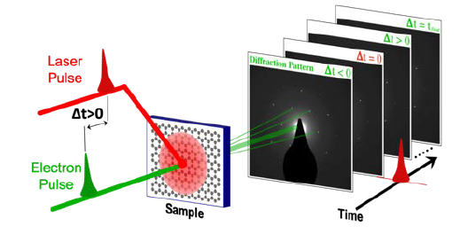
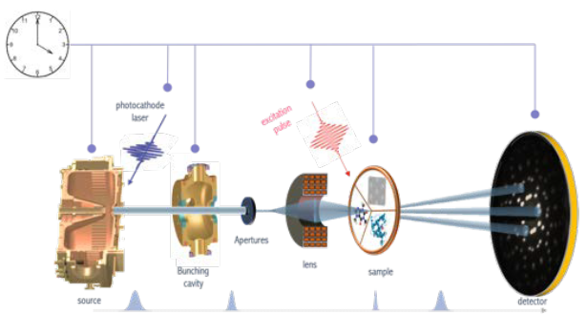


Ultrafast Electron Diffraction (UED)
$$Δs=\frac{2π}{L_{coh}}, L_{coh}=\frac{ħ}{m_{e}c}\frac{σ_{x}}{ε_{x}}$$
Temporal resolution 100 fs – 1 ps (jitter < 100 fs)
Spatial resolution: Δs < 0.01 Å⁻¹
Bragg’s Law: |s| = 2|k|sinθ
$$B_{6D}=\frac{Ne}{ε_{n,x}ε_{n,y}ε_{n,z}}$$
$=\frac{I_{rms}}{ε_{n,x}ε_{n,y}\frac{σ_{E}}{mc}}$
Filippetto, Daniele, et al. "Ultrafast electron diffraction: Visualizing dynamic states of matter." Reviews of modern physics 94.4 (2022): 045004.
Notes:
Ultrafast electron diffraction (UED) is a pump–probe technique that uses sub-picosecond electron pulses to record snapshots of a material’s atomic structure in reciprocal space. In essence, we extract electrons from a photocathode, accelerate them to several tens or hundreds of keV, compress them to ∼100 fs duration, then scatter them off a thin sample. By measuring changes in the intensity and position of Bragg peaks—via Bragg’s law, we directly track lattice expansions, phase transitions with sub-Å spatial precision.
The two figures of merit are 6D brightness and reciprocal-space resolution. The 6D brightness, tells us how many electrons we deliver per unit area and solid angle: higher brightness translates as a better diffraction signal. The normalized emittances depend on the cathode field, laser spot size, and the beam’s thermal emittance.
The reciprocal-space resolution, with transverse coherence length dictates the smallest momentum change you can resolve. Lower emittance and tighter focusing yield longer coherence lengths, shrinking Δs and enabling detection of sub-Å shifts in diffraction peaks.

Slide 7
THz Fields for UED
Jitter-free: The terahertz pulse is driven by the pump laser system, generally used for illuminating photocathodes.
Higher accelerating gradients, and convenient for manipulation.
Low emittance, ultrashort electron pulses.
Compactness.
Notes:
THz acceleration and manipulation offers a set of compelling advantages to the field of UED.
Jitter-free. Laser-driven intense THz sources integrates favorably to pump-probe set-ups used in UED.
By leveraging THz‐driven dielectric accelerators, we can push the accelerating field above 1 GV/m, reduce the emittances to the single‐nm·rad level, and produce intrinsically synchronized, few-fs pulses. This translates directly into higher brightness, better coherence (smaller Δs), and ultimately sub-10 fs time resolution, opening the door to capturing the fastest atomic and electronic motions.
Lastly, because the accelerator’s length are proportional to the operating wavelength, using THz pulses instead of RF enables compactness for UED setups.

Slide 8
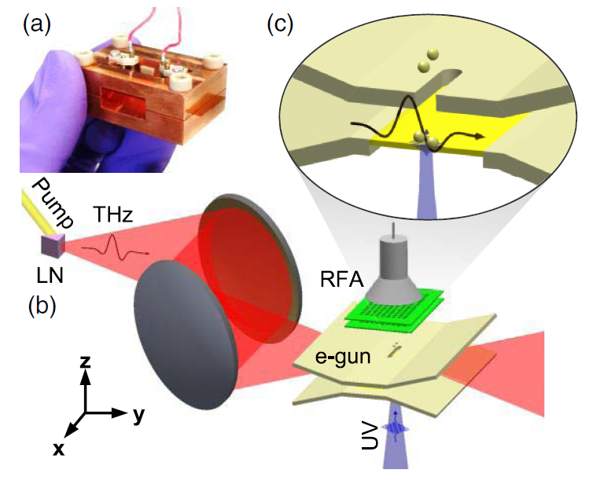
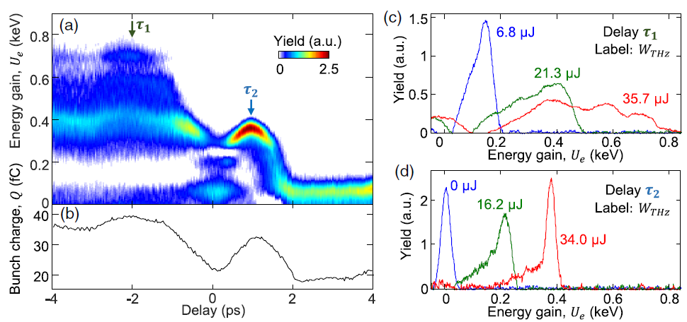
THz-driven electron gun
High Field (> 300 MV/m).
Few percentage energy spread.
~ tens of fC electron bunches.
LEED.
Ronny Huang, W., et al. "Terahertz-driven, all-optical electron gun." Optica 3.11 (2016): 1209-1212.
Notes:
For example, this paper reports an all-optical THz-driven electron gun based on a copper parallel-plate waveguide (PPWG) with a 75 µm gap, into which a single-cycle THz pulse is coupled via a tapered input to produce a uniform field enhancement from ~153 MV/m in free space to ~350 MV/m inside the gun . A UV pulse, back-illuminating the bottom plate, photo-emits electrons that are then accelerated across the PPWG and extracted through a slit in the anode.
There are two characteristic time delays between the UV emission and THz phase. As depicted in this figure, the device yields quasi-monoenergetic 0.4–0.8 keV bunches with 32–40 fC charge and percent-level energy spread . Critically, because the THz and UV pulses originate from the same laser, the gun achieves intrinsic timing stability (jitter ≪ 100 fs) and compact GV/m acceleration.

Slide 9
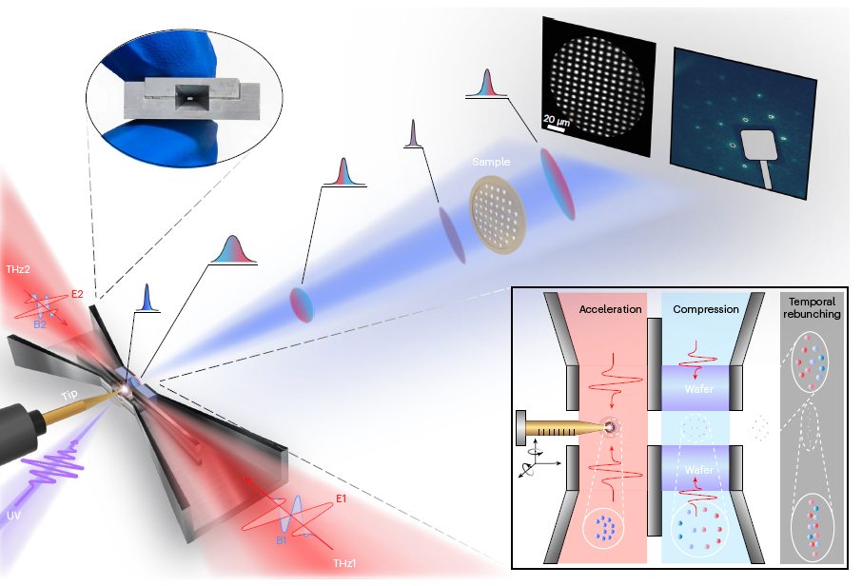
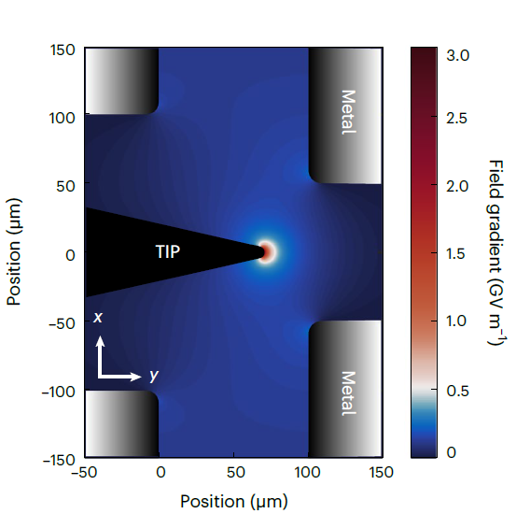
THz-driven ultrafast photogun
Ten-fold enhancement thanks to the tip
Peak acceleration fields ~ 3 GV/m!
Beam diameter lower thn 90 μm
Trasv. Emit. < 0.015 mm mrad
Ying, Jianwei, et al. "High gradient terahertz-driven ultrafast photogun." Nature Photonics 18.7 (2024): 758-765.
Notes:
A more advanced THz-driven ultrafast photogun was developed last year. The electron source geometry and extraction process dictate the emittance of the released electrons.
Incorporating a mobile tip permits a more accurate interaction of the electrons with the cathode and the THz pulse, achieving high-quality electron beams.
Acceleration and compression are done with two counter-propagating THz pulses, canceling the magnetic field, and enhancing the kick to the electron bunch.
Outstanding beam parameters were obtained: 3 GV/m peak acceleration, and few nanometers radian transverse emittances.

Slide 10
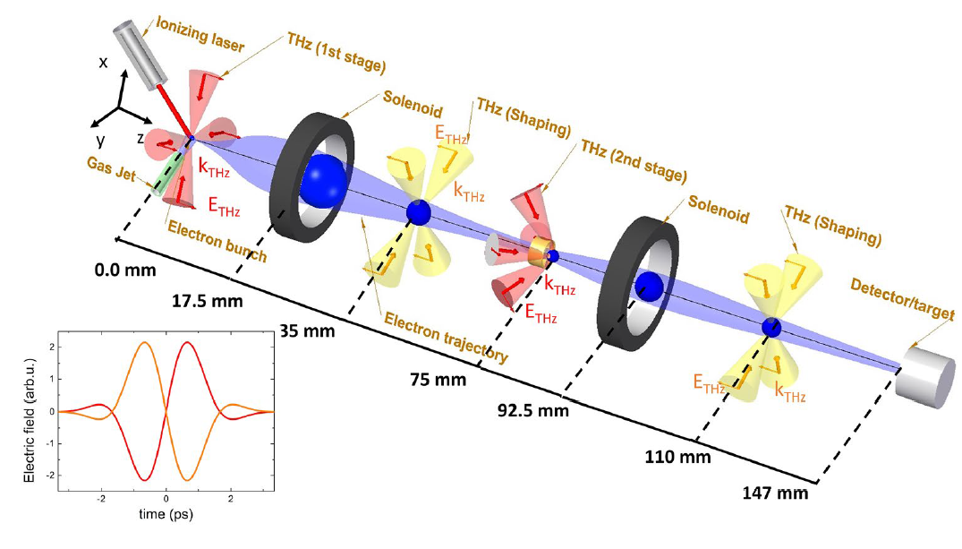
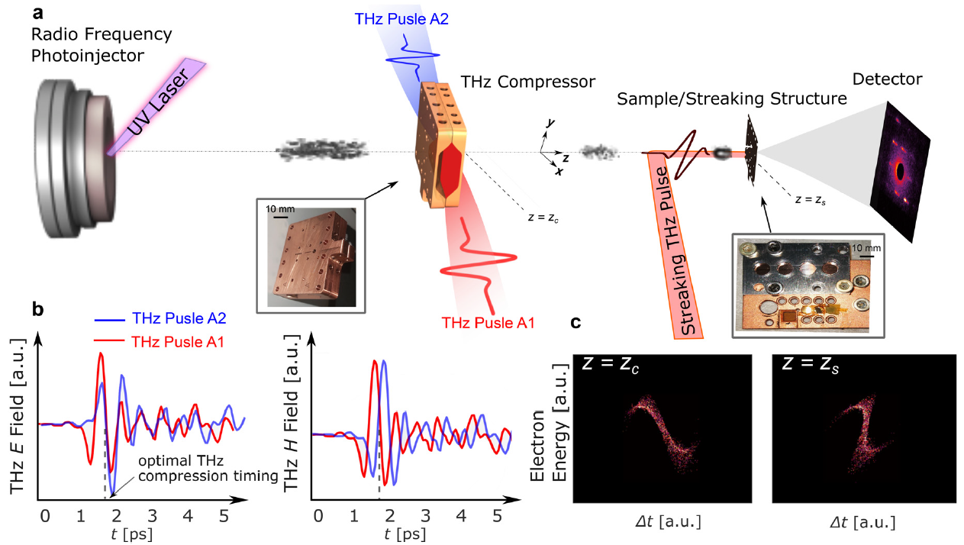
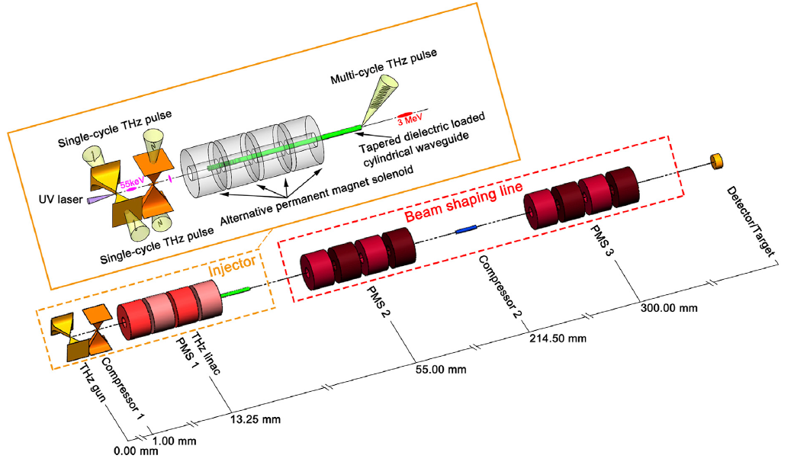
Compact THz-driven electron source
THz-driven relativistic source
Electron bunches for MeV-UED
Compact THz-driven
electron source
Turnár, Sz, et al. "Design of a THz-driven compact relativistic electron source." Applied Physics B 127 (2021): 1-7.
Time-stamping – pixel by pixel representation of temporal dynamics
Othman, Mohamed AK, et al. "Improved temporal resolution in ultrafast electron diffraction measurements through THz compression and time-stamping." Structural Dynamics 11.2 (2024).
Xu, Hanxun, et al. "Towards a compact all-optical terahertz-driven electron source." Frontiers in Physics 11 (2023): 1292194.
Notes:
Needless to say, dozens of THz-driven electron sources for UED were proposed during the past decade, and it is still a very active research area. (Pause)
But now, let’s explore…

Slide 11
Subrelativistic acceleration by DTA
Notes:
… how dielectric THz-driven accelerators could be employed for UED.
Typical electron sources emitted energies are centered around a few keV, we have to deal with acceleration of subrelativistic electrons.

Slide 12
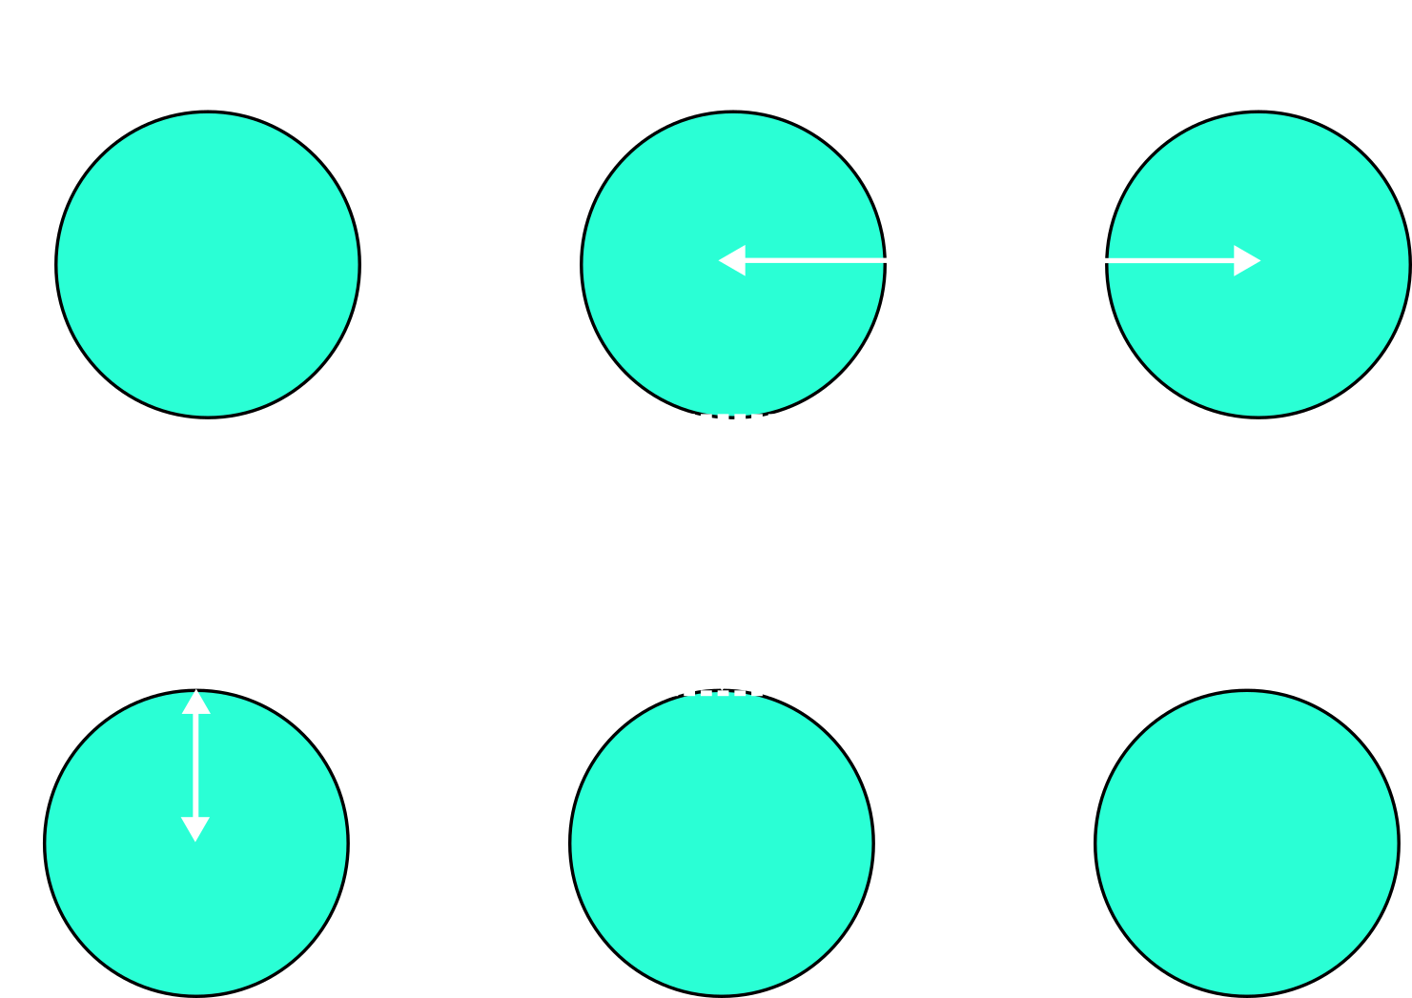
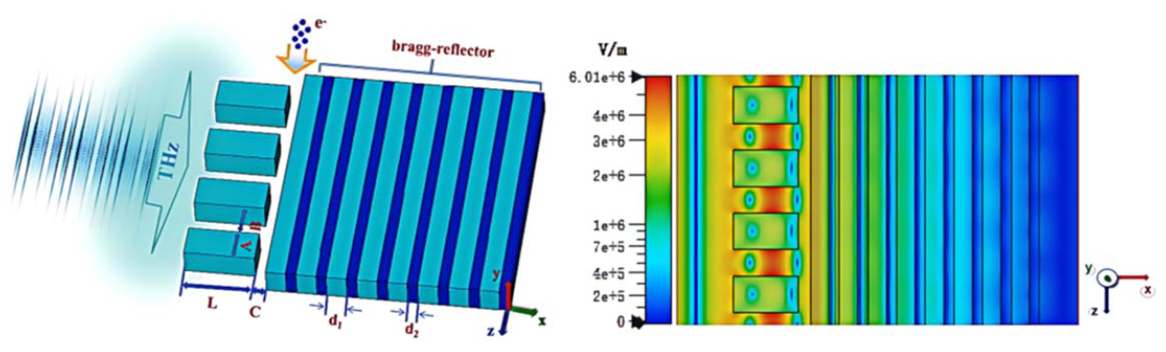



Subrelativistic acceleration by DTA
$$G_{0}= \frac{q}{λ_{g}}\int_{0}^{λ_{g}}{E_{z}\left(z\left(t\right),φ\right)dz, }$$
$$λ_{g}=βλ_{THz}$$
$$AF= \frac{G_{0}}{E_{max}}$$
Wei, Y., et al. "Investigations into dual-grating THz-driven accelerators." Nuclear Instruments and Methods in Physics Research Section A: Accelerators, Spectrometers, Detectors and Associated Equipment 877 (2018): 173-177.
Xiriai, M., et al. "Numerical investigation of a THz-driven dielectric accelerator with a Bragg-reflector for accelerating sub-relativistic electron beams." Physica Scripta 99.7 (2024): 075515.
Notes:
Dual-pillar grating DTA structures can be shaped and optimized for acceleration of sub-relativistic particles.
The acceleration gradient and the acceleration factor (calculated in one grating period) are two critical figure of merits for the design of DTAs. For subrelativistic acceleration, the matching condition is given by matching the grating period with the electron’s velocity and accelerating wavelength. The dielectric microstructure is shaped changing the pillars’ height, width, radius (if cylindrical), vacuum channel gap, offset, etc.
Reported subrelativistic DTA acceleration gradients are a few hundred of MeV/m, surpassing conventional accelerators.
Moreover, the performance of dielectric micro-accelerators can be improved, for example, by introducing a distributed Bragg reflector (DBR) to constructively interfere the THz fields along the accelerating channel, as we can observe here (figure).

Slide 13
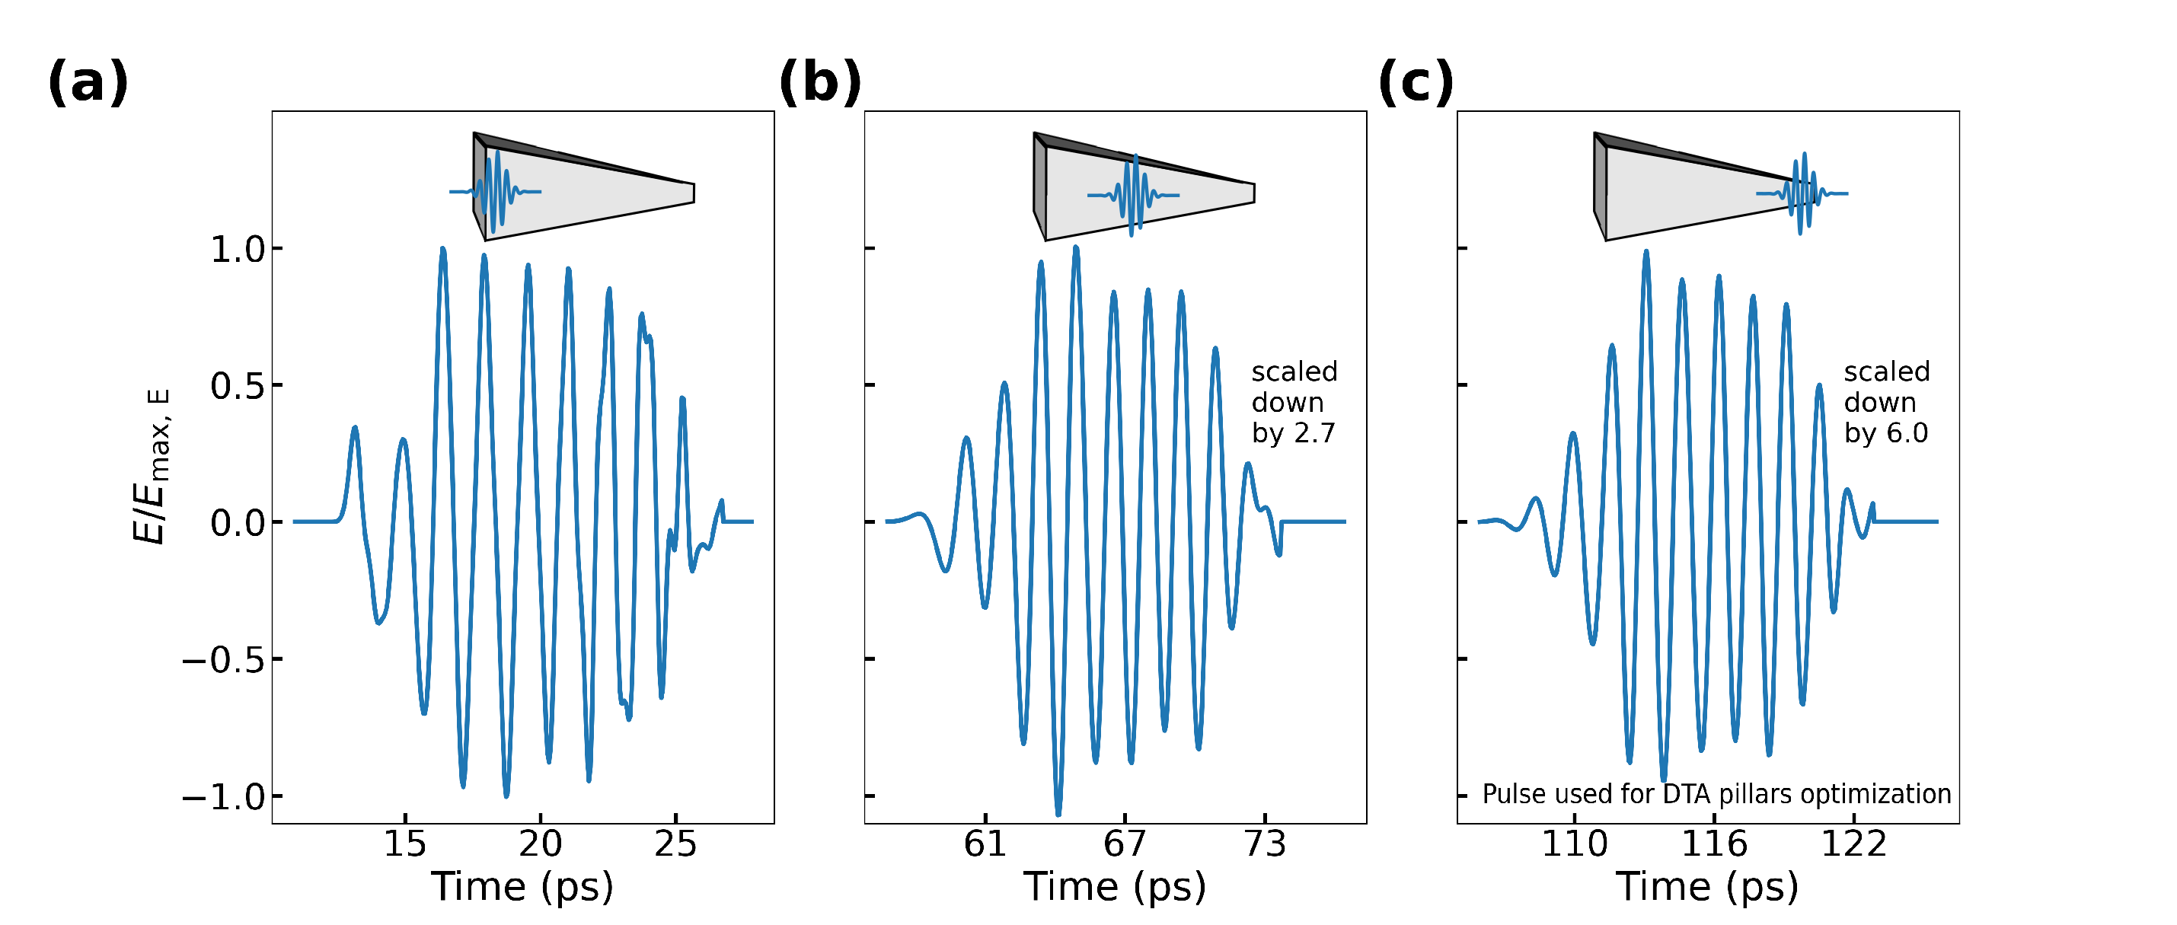
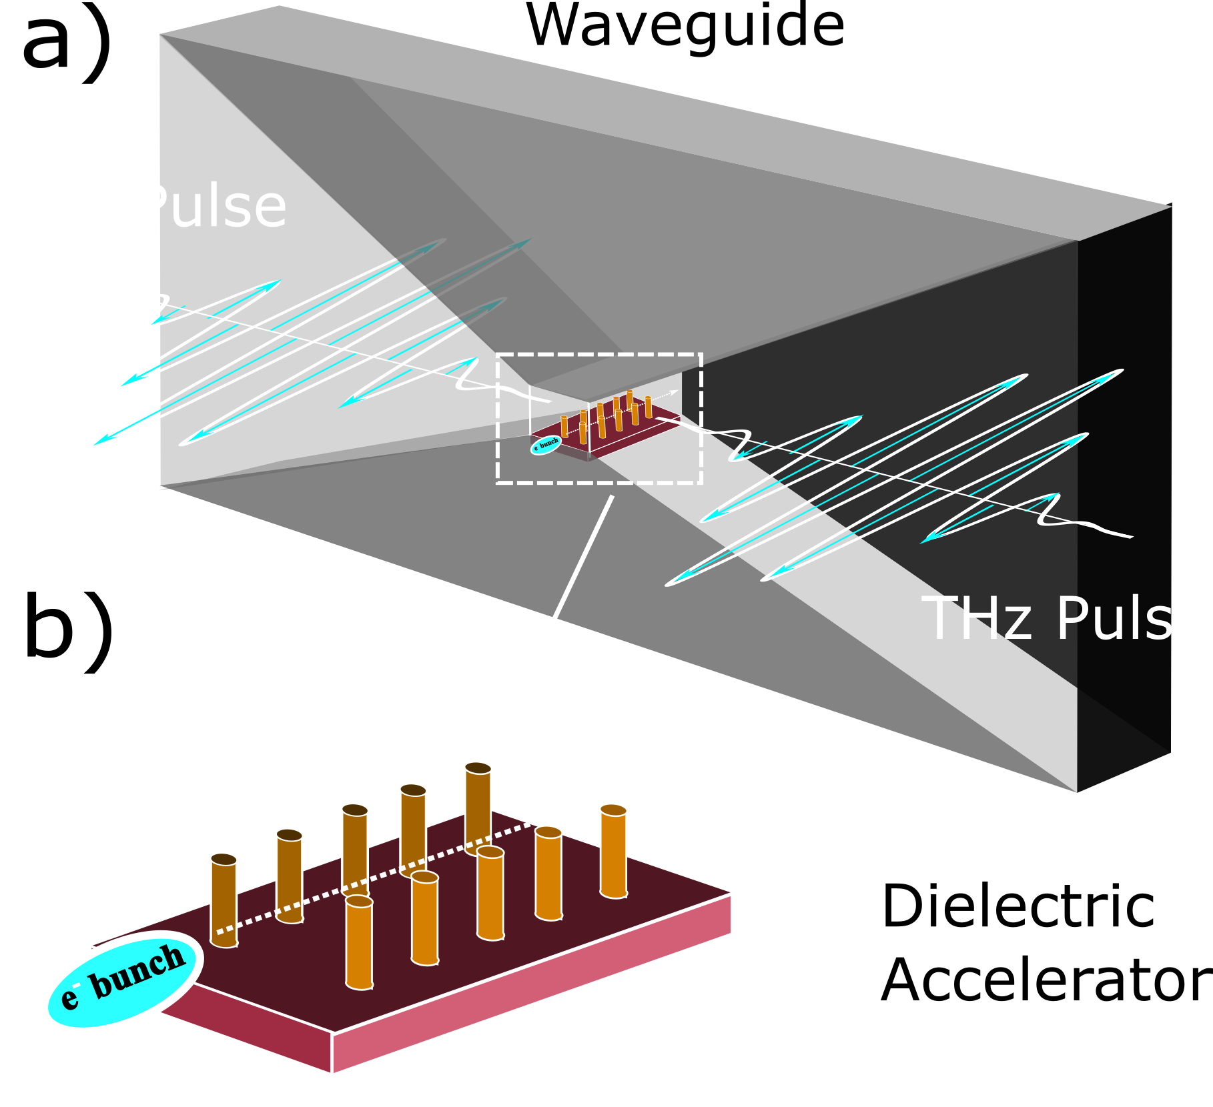
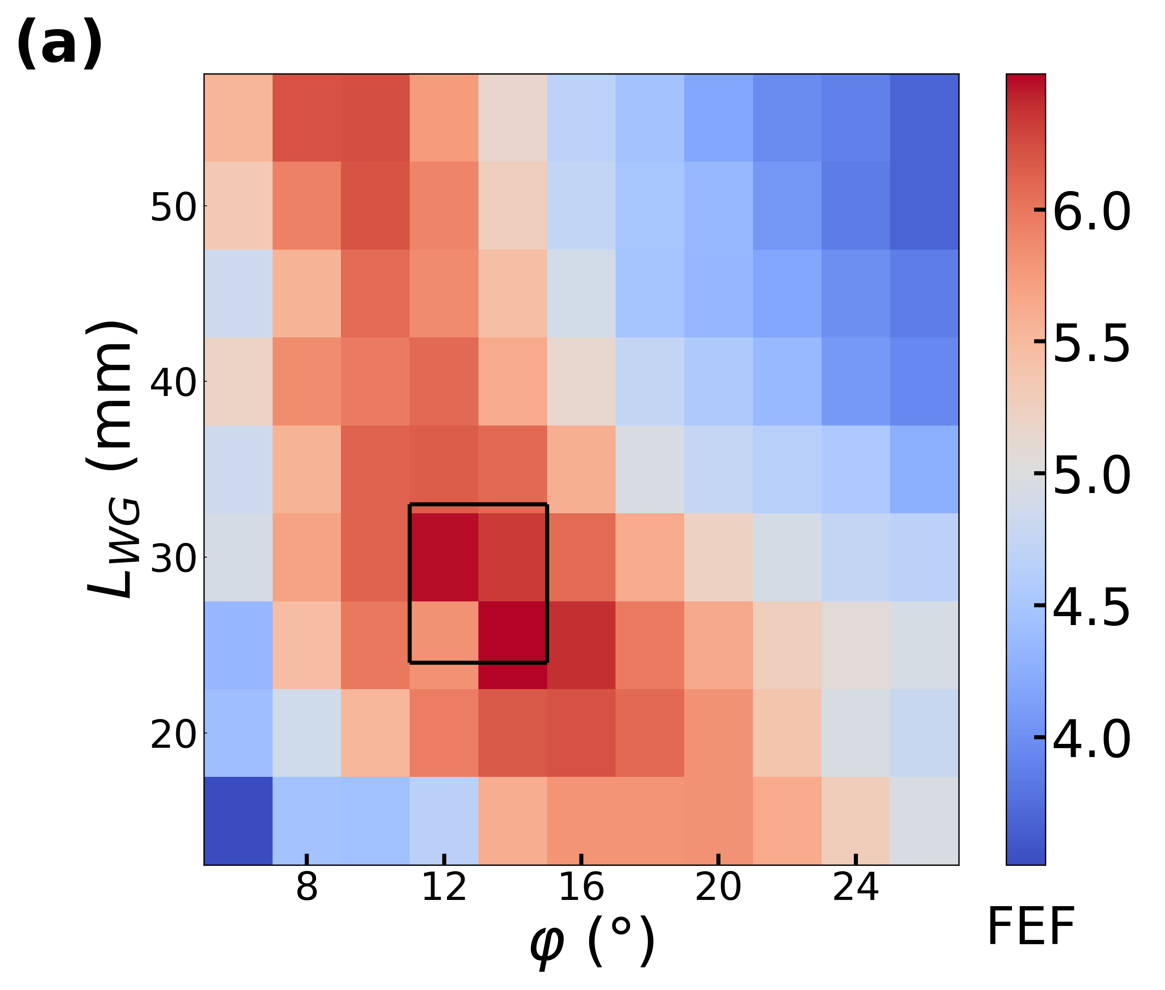
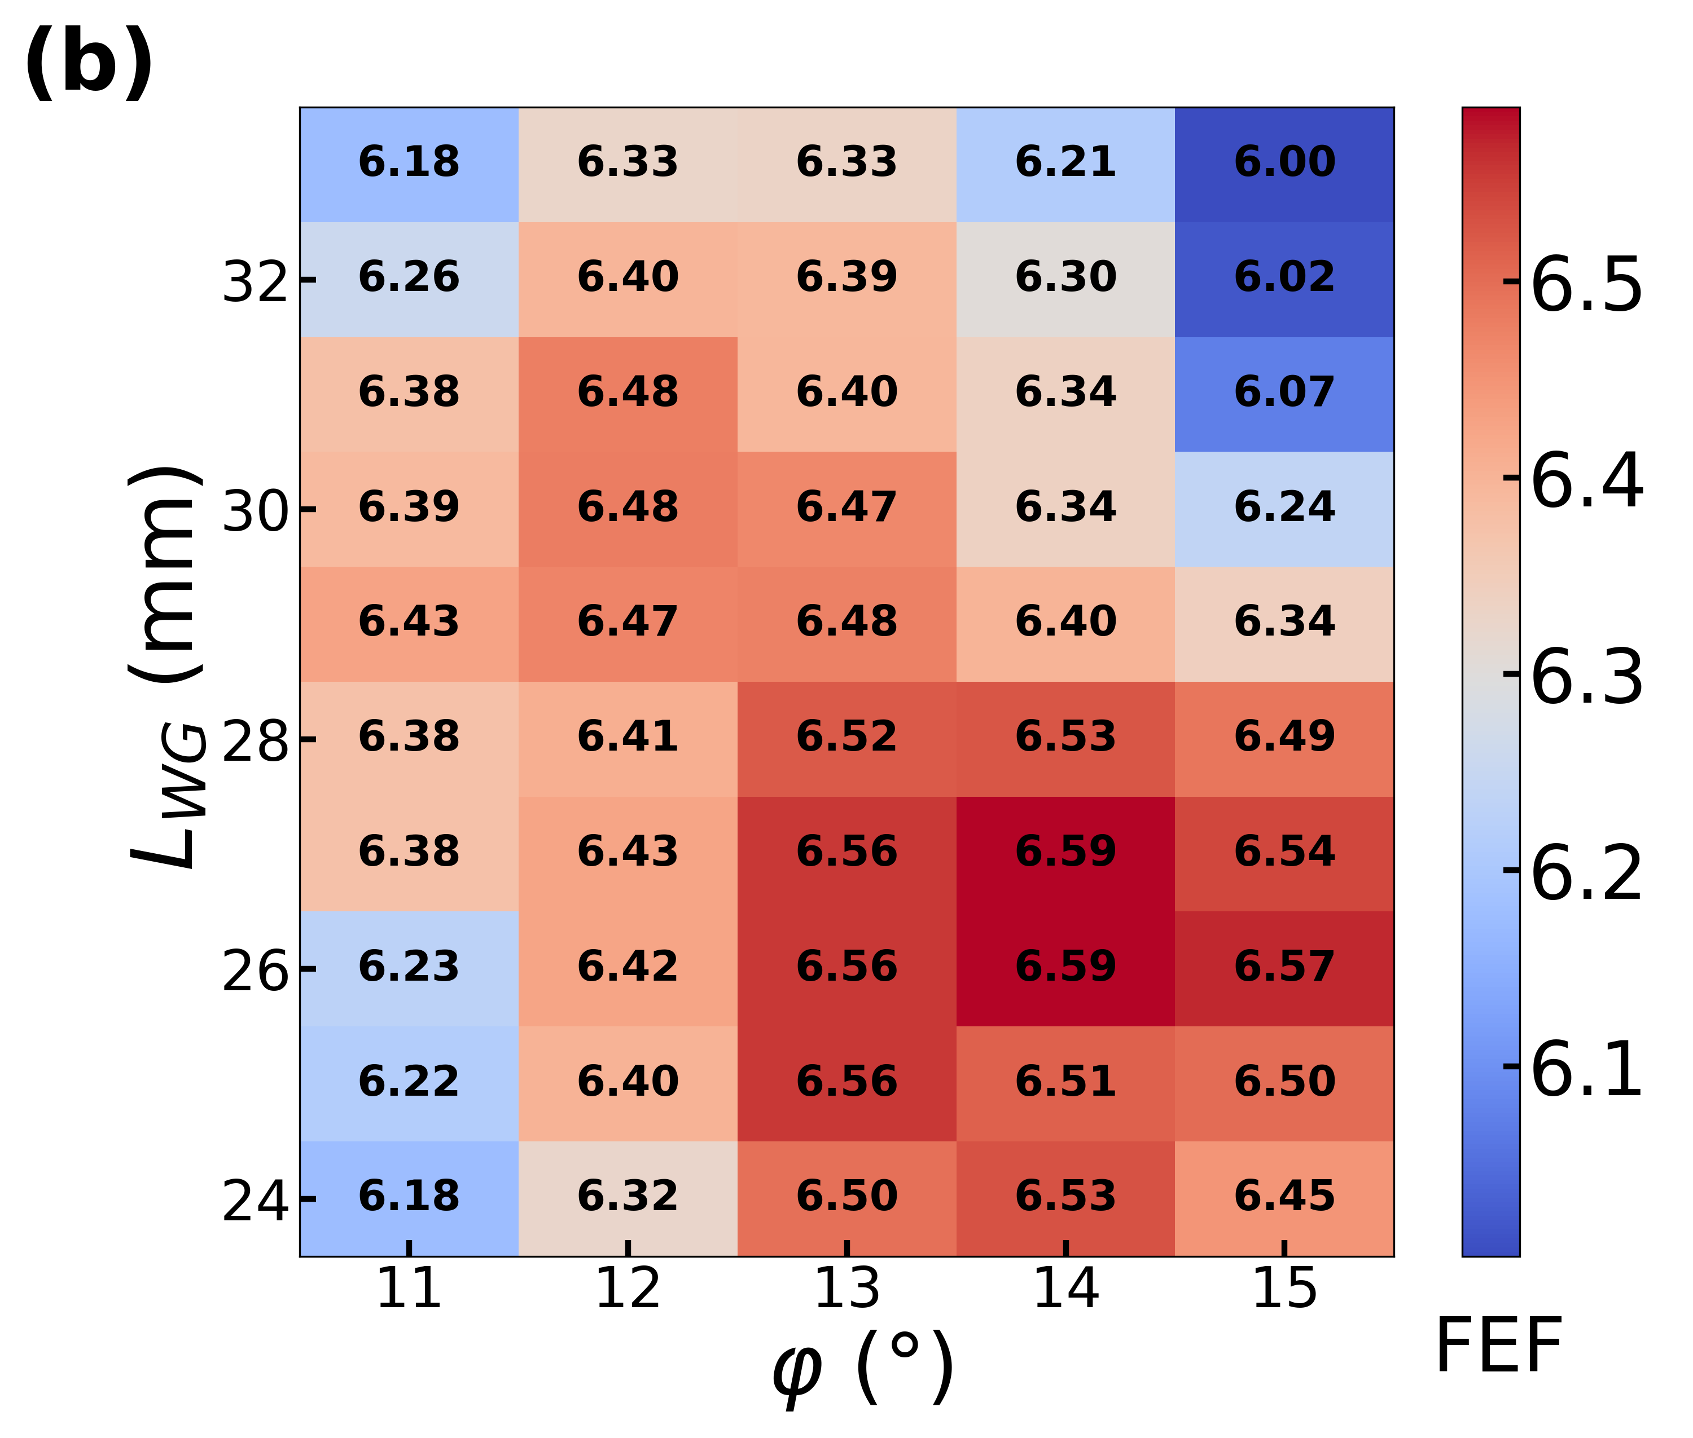
Parallel-plate Waveguide + DTA
Tapered Parallel-plate Waveguide
Dielectric Accelerator
Field Enhancement
Efficient Coupling
Phase-mask (for net acceleration)
Transverse and longitudinal focusing (dual-pillar gratings
Top: THz pulse at different positions along the waveguide
Bottom: Field enhancement factor colormap for the structure parameters waveguide length L_{WG} and angle ϕ
Leiva Genre et. al. 2025, Optics & Laser Technology JOLT-D-25-02556 (Under Review)
Notes:
Another convenient way to enrich UED setups is by combining DTAs with PPWGs.
The PPWG offers some benefits: It couples the THz fields into the dielectric microstructure, it amplifies the arriving signal (mitigating the low conversion efficiencies present in high-intensity THz generation techniques), and they are easy to produce and fabrication tolerances are well below to cause any performance issue. Actually, the TPPWG shape could be designed and optimized according to the THz generation technique, the imaging system and the dielectric accelerator (Future work)
The DTA allows longer interaction lengths and provide high accelerating fields to propel the particles.
There are still some…

Slide 14
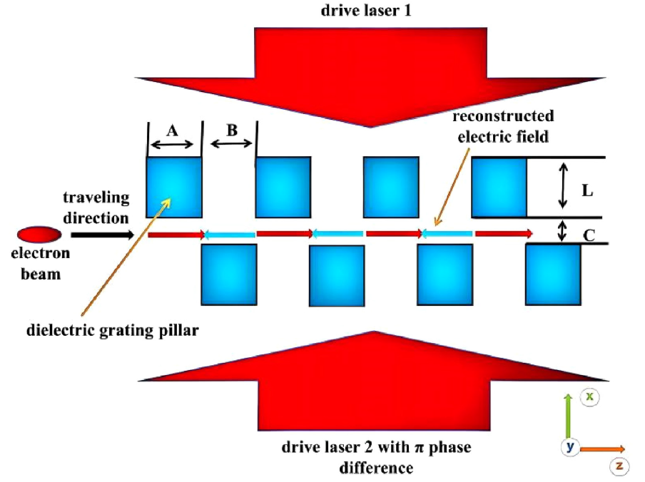
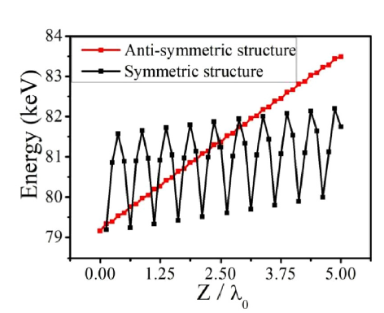
Subrelativistic accelerator: Improved gradient
Xiriai, M., et al. "Numerical investigation of an anti-symmetric nanophotonic structure for accelerating sub-relativistic electron beams." Journal of Applied Physics 137.3 (2025).
Notes:
…. new schemes been tested. For example, we could reshape the grating by providing an alternating pillar profile and manipulating the relative phase of the driven laser pulses.
As reported in this study, the energy gain along the accelerator was greatly improved in this setup, increasing the performance of DLAs for subrelativistic acceleration.
It is worth mentioning there are other kind of geometries and ideas that could be helpful for UED. Photonic-crystal-based DTA, photonic waveguides (THz slot waveguide), ICR-DTA based on prisms, and pure-dielectric DBR wakefield accelerators!
So, a possible UED setup…

Slide 15
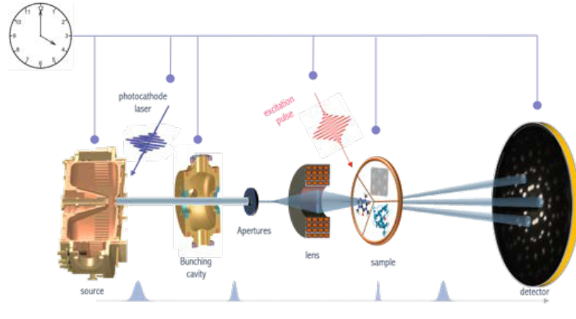
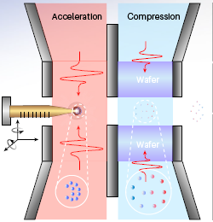
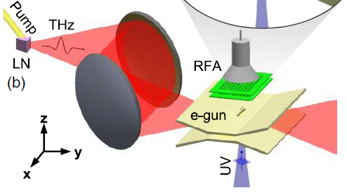
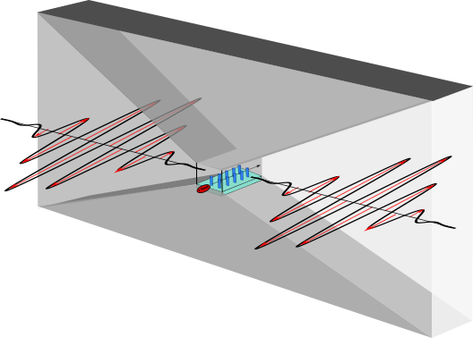
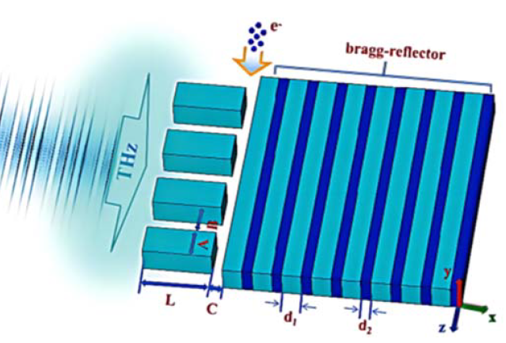
Proposed setup using DTA
Source
THz Acc
Notes:
… based on DTA could looks as follows: the laser pump is splitted for photoemission, THz generation, and excite the sample!
(Explain THz advantages here!)
DTA-based UED setups could be used to study the following phenomena in Material Science…

Slide 16
Solid State: ordering, excitation and emergent phenomena in materials
Study of macroscopic properties and ordered phase of materials: Interplay of charges, spin, orbital and lattice-structural degrees of freedom
Condensed matter: Excitation interaction (phonons, charge carriers)
Structures, dynamics and non-equilibrium properties of materials
Notes:
(Just read the slide)

Slide 17
Photochemistry and photobiology
Molecule light-response: Photosynthesis, vision, DNA photo-damage, light harvesting and storage devices
Coherent nuclear motion of vibrational wavepackets along both ground and excited states
Investigation coupled-nuclear electronic motion in excited states
Capturing relaxation dynamics
Direct retrieval of three-dimensional structure from diffraction measurements
Notes:
(Just read the slide)

Slide 18
Conclusions
THz-driven electron sources enable compact, table-top electron sources with high accelerating gradients (GV/m scale), reducing system size while improving performance.
These accelerators can potentially provide sub-100 femtosecond, low-emittance, and high-brightness electron beams.
THz-driven beam compression and synchronization techniques also improve temporal precision, enabling direct observation of non-equilibrium states in matter with femtosecond clarity.
Such enhanced beam parameters open access to previously unresolvable ultrafast processes in:
  Materials science (ferroelectric switching, phase transitions, coherent phonons),
  Chemistry (bond breaking/forming, reaction intermediates),
  Biology (conformational protein dynamics, enzyme activity).
18

Slide 19
Closing thoughts
“With an extremely fast ‘electron camera’ … researchers have made the first high‑definition ‘movie’ of ring‑shaped molecules breaking open in response to light. … The fact that we can now directly measure changes in bond distances during chemical reactions allows us to ask new questions about fundamental processes stimulated by light.” https://www6.slac.stanford.edu/news/2019-04-15-slacs-high-speed-electron-camera-films-molecular-movie-hd
“The electron motion in atoms and molecules is at the heart of all phenomena in nature that occur outside the nucleus” Hui et. Al., Attosecond electron microscopy

Slide 20
Closing thoughts
“With an extremely fast ‘electron camera’ … researchers have made the first high‑definition ‘movie’ of ring‑shaped molecules breaking open in response to light. … The fact that we can now directly measure changes in bond distances during chemical reactions allows us to ask new questions about fundamental processes stimulated by light.” https://www6.slac.stanford.edu/news/2019-04-15-slacs-high-speed-electron-camera-films-molecular-movie-hd
“The electron motion in atoms and molecules is at the heart of all phenomena in nature that occur outside the nucleus” Hui et. Al., Attosecond electron microscopy
“Accelerator science influenced 28 % of the physics research carried out between the 1938 and 2009, and, in average, it contributed to Nobel prizes in Physics every 2.9 years”
(Haussacker, E.F., Chao, A.W., The influence of accelerator science on Physics research, Phys. Perspect. 13, 146, 2011)

Slide 21



This project has received funding from the European Union´s Horizon Europe research and innovation programme under grant agreement no. 101073480.
The project has been supported by the TKP2021 funding scheme – (TKP2021 – EGA17).
The project 2024-2.1.1-EKÖP funded by the ministry of culture and innovation, national fund for research, development and innovation, under the University research grant programme EKÖP-24-4 (Szabolcs Turnár).

Slide 23
SPARE SLIDES

Slide 24
Acquisition Modes in Ultrafast Electron Diffraction: Stroboscopic vs. Single-Shot
Stroboscopic mode
Single-shot mode
Repetition rate: kHz – MHz
Electron per pulse: << 1 e-
Temporal resolution: 100 fs
Sensitivity: 106 – 109 shots, Itot ~ N Isingle
Spatial resolution: sub-pm
Trade-offs: long integration times demand sample stability, robust drift control, and mitigation of laser pointing noise
Electron per pulse: 103 – 105 e-
Temporal resolution: Limited by space-charge broadening Δt ~ (Q/Eacc)1/2
Signal-to-noise: maximized per shot, no averaging needed
Trade-offs: Higher emittance and jitter, spatial/coherence degradation, resolution 1-10 ps without compression

Slide 25
Acquisition Modes in Ultrafast Electron Diffraction: Transmission vs Reflection
Transmission UED
Reflection UED
Sample: thin film (10 – 200 nm up to 1 um) or gas jet
Probe energy : keV – MeV
Observables: Bragg spots, diffuse scattering, pair distributions
Temporal resolution: 100 fs – 1 ps
Spatial resolution: ~ 1 Angstrom
Sample: single crystal or 2D film on substrate
Probe energy: 30 – 100 keV
Observables: Surface Bragg peaks, Laue zones
Surface sensitivity: sub-Angstroms lattice displacements

Slide 26
Optical DLA challenges
The characteristics of IR and optical lasers naturally cause some drawbacks¹:
LOW BUNCH CHARGES
SUB-MICRON TOLERANCES
SUB-FEMTOSECONDS TIMING REQUIREMENTS
¹ Nanni, Emilio A., et al. "Terahertz-driven linear electron acceleration." Nature communications 6.1 (2015): 8486.

Slide 27
Advantages of THz-driven acceleration and manipulation
Shorter wavelengths than RF (reduce the accelerator’s size – table-top footprint)
Supports whole-bunch acceleration
Facilitates Structure Manufacturation and Gaps dimensions, allowing greater bunch charges than DLAs
THz pulses suited for ultrashort high-charge electron bunches and effective beam manipulation

Slide 28
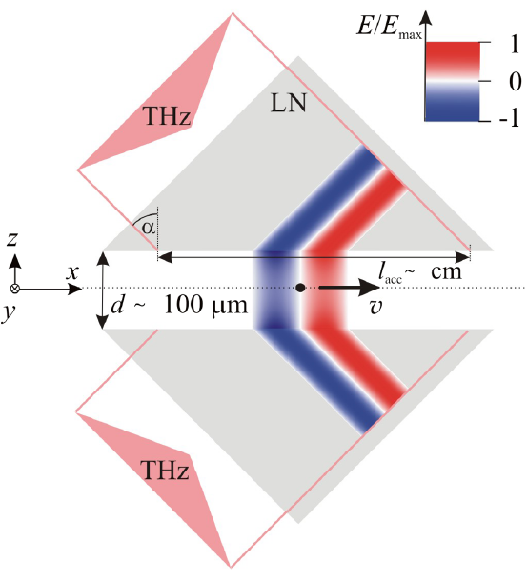
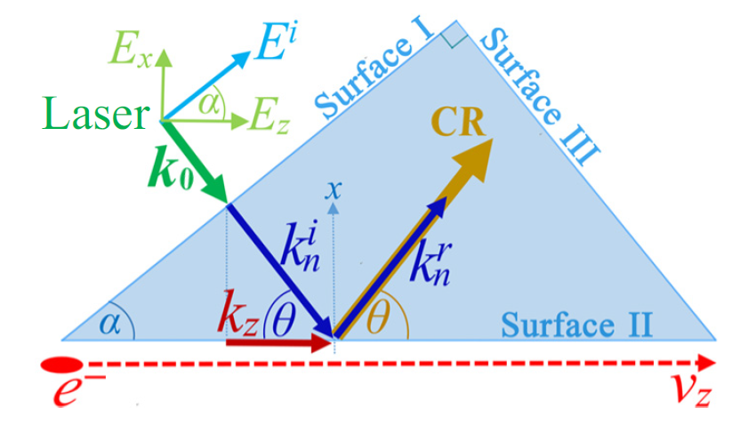

Inverse-Cherenkov Radiation (ICR) DLA
Synchronous condition
$$v_{p}=\frac{ω}{k_{z}^{p}}=\frac{ω}{k_{n}^{i}\sin{α}}= \frac{c}{\sqrt{ε_{r}\sin{α}}}=v_{z}$$
Pálfalvi, L., et al. "Evanescent-wave proton postaccelerator driven by intense THz pulse." Physical Review Special Topics-Accelerators and Beams 17.3 (2014): 031301.
Liu, Weihao, et al. "Microscale laser-driven particle accelerator using the inverse Cherenkov effect." Physical Review Applied 14.1 (2020): 014018.

Slide 29
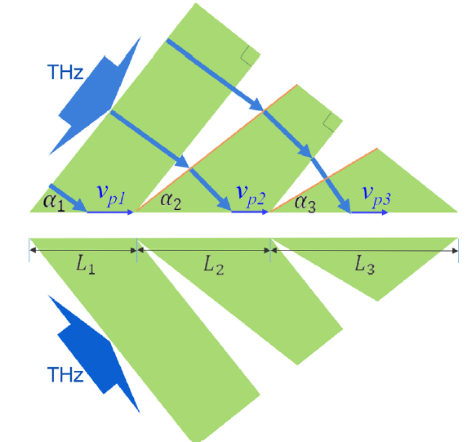
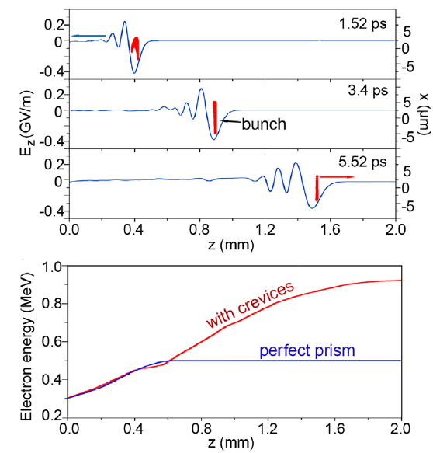
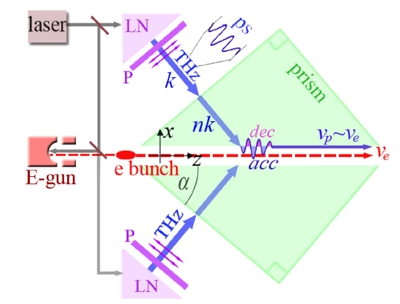
ICR-DTA Prism Structure
Geometry can be optimized to match electron velocity while gaining energy
Liu, Weihao, et al. "THz-driven dielectric particle accelerator on chip." Optics Letters 46.17 (2021): 4398-4401.

Slide 30
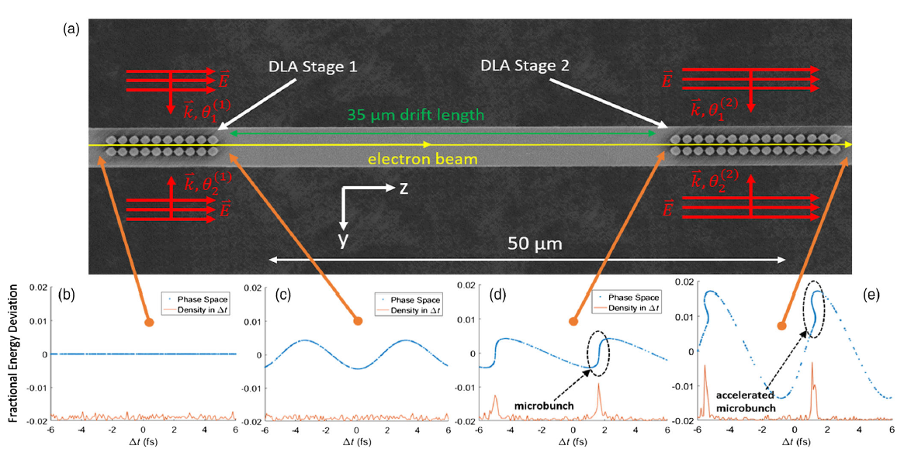
Optical DLAs: Attosecond bunching
Black, Dylan S., et al. "Net acceleration and direct measurement of attosecond electron pulses in a silicon dielectric laser accelerator." Physical review letters 123.26 (2019): 264802.

Slide 31
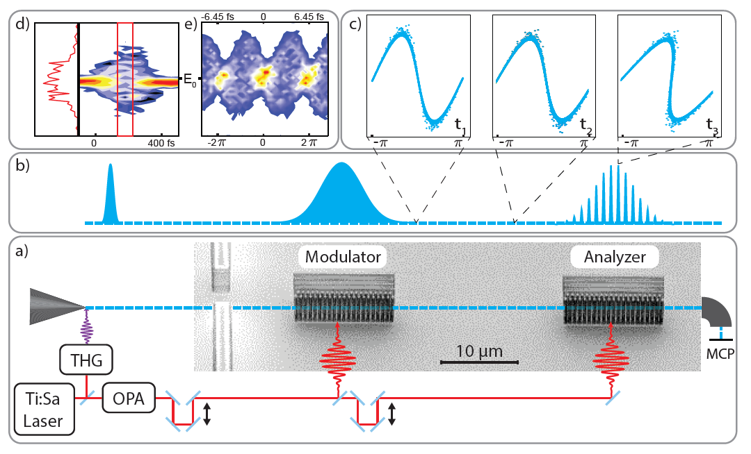
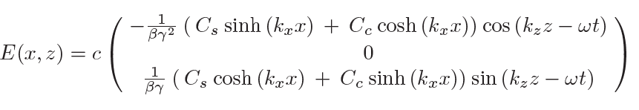

Optical Attosecond Microbunching
$$σ_{FWHM}=\left(270±80\right) as$$
Schönenberger, Norbert, et al. "Generation and characterization of attosecond microbunched electron pulse trains via dielectric laser acceleration." Physical review letters 123.26 (2019): 264803.

Slide 32
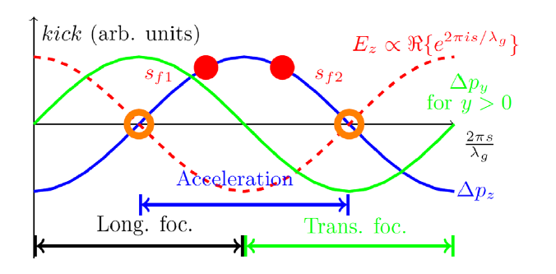
Transversal focusing
Overview of electron acceleration and focusing properties as a function of phase. The circles denote the fixed points for different synchronous phase.
Niedermayer, Uwe, et al. "Alternating-phase focusing for dielectric-laser acceleration." Physical review letters 121.21 (2018): 214801.

Slide 33
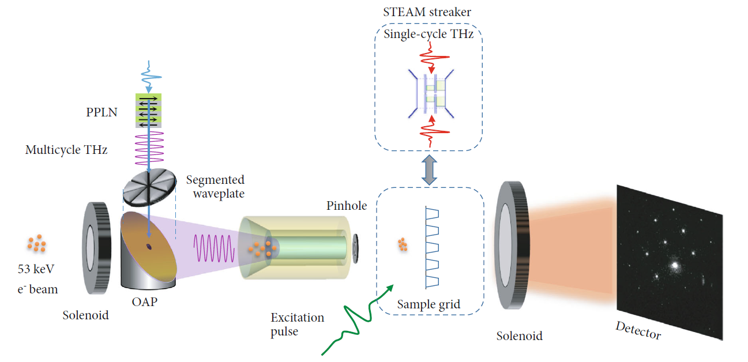
THz-driven ultrafast electron source
180 fs (FWHM).
~ 1 fC.
1 kHz repetition rate.
MeV, sub-30 fs, 10 fC at kHz. repetition rates are predicted.
Zhang, Dongfang, et al. "THz-enhanced DC ultrafast electron diffractometer." Ultrafast Science (2021).
Notes:
In this study, The author integrate a conventional 53 keV DC electron gun with a THz‐powered, dielectrically lined waveguide (DLW) compressor to overcome space‐charge broadening and achieve sub‐200 fs bunches at practical charges. A multicycle THz pulse—generated via difference‐frequency mixing in PPLN and coupled into the DLW—imparts a velocity‐chirp that compresses 10,000 e⁻/pulse to ∼180 fs (FWHM), corresponding to a tenfold shortening compared with the uncompressed beam . Because the THz and UV photoemission pulses share the same laser, timing jitter is intrinsically low (< 5 fs RMS), enabling high‐fidelity pump–probe UED at 1 kHz.

Slide 34
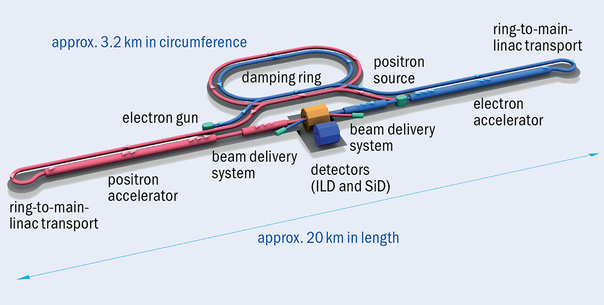
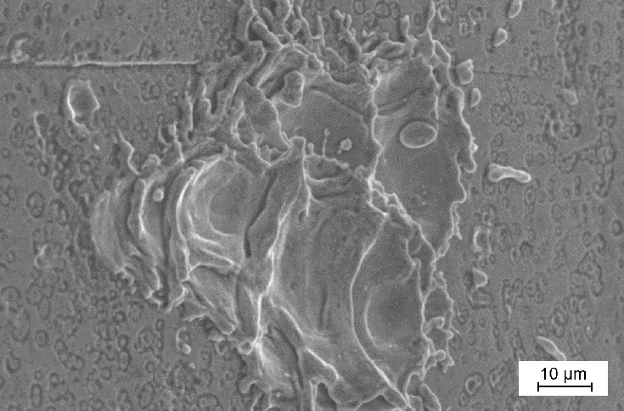
DLA: MOTIVATION
SIZE
POWER LIMITATION
Obermair, Christoph, et al. "Explainable machine learning for breakdown prediction in high gradient rf cavities." Physical Review Accelerators and Beams 25.10 (2022): 104601.
Image taken from CERN Courier. Credit: R Hori / KEK
Notes:
RF-based accelerators possess mainly two limitations: First, the power injected to the cavity must be limited to avoid arcing or breakdown, damaging the accelerating structure and impairing its functionality. (Image)
Secondly, the size (and by extent, their cost) of the accelerator grow very long. For example, the ILC is estimated to be 20 km-long!!
If I would have to explain to an Argentine fellowman this…

Slide 35
MOTIVATION
SIZE
POWER LIMITATION
The equivalent to 200 football pitches!!!
Obermair, Christoph, et al. "Explainable machine learning for breakdown prediction in high gradient rf cavities." Physical Review Accelerators and Beams 25.10 (2022): 104601.
Image taken from CERN Courier. Credit: R Hori / KEK
Notes:
…I would tell him that it is the equivalent of 200 football pitches!!! As a consequence of their colossal lengths, advanced Accelerator facilities are quite difficult to access worldwide.
One way to circumvent these two issues…

