Slide 1

Plasma-based particle acceleration
Raoul Trines
Central Laser Facility
Rutherford Appleton Laboratory

Slide 2
Intro to particle acceleration in plasma
The good news:
Maximum E-field strength in vacuum: 10 MeV/m
Maximum E-field strength in plasma: 10 GeV/m
Thus: plasma-based accelerators can be much more compact than “classical” accelerators using vacuum tubes
The bad news:
Plasma is an unstable, uncooperative medium
Difficult to get accelerated particle beams with good quality (high charge, short duration, low energy spread, low emittance); also high shot-to-shot variability
Difficult to get drivers for the plasma wave that are short enough
Drivers for the plasma wave: photons (laser), electrons, protons
Accelerated particles: electrons, protons, photons
See also: C. Joshi, Phys. Plasmas 14, 055501 (2007)

Slide 3
The scheme of plasma-based acceleration
Plasma: electrons are light, ions are heavy
Driver blasts electrons out of the way
Electrons return after driver has passed, strong plasma wave results
Particles to be accelerated ”ride” this plasma wave
Driver:
electrons,
photons or
protons
Accelerated particles
M. Hogan et al., E164 High Gradient Plasma-Wakefield Acceleration Using Ultrashort Electron Bunches

Slide 4
Laser pulse accelerating electrons
Origin: T. Tajima and J. Dawson, Phys. Rev. Lett. 43, 267 (1979)
Issue: back then, laser pulses were not short enough
Solutions:
Laser beat wave accelerator, CO₂ laser with two spectral lines that drive a plasma wave between them (plasma frequency resonant with laser freq. difference)
Self-modulated LWFA: long laser pulse (many plasma periods) drives a plasma wave and is itself modulated into a sequence of short “pulse-lets” by that plasma wave. These two processes reinforce each other
A good summary: C. Joshi, Phys. Plasmas 14, 055501 (2007).
Forced laser-wakefield regime (pulse as short as one plasma period):
Strickland and Mourou (1985): Chirped Pulse Amplification for ultrashort laser pulses (Nobel Prize in Physics, 2018)
High energy but high spread: V. Malka et al., Science 298, 1596 (2002).
Bubble-shaped wakefield for low energy spread: A. Pukhov and J. Meyer-ter-Vehn, Appl. Phys. B 74, 355 (2002), numerical simulations

Slide 5
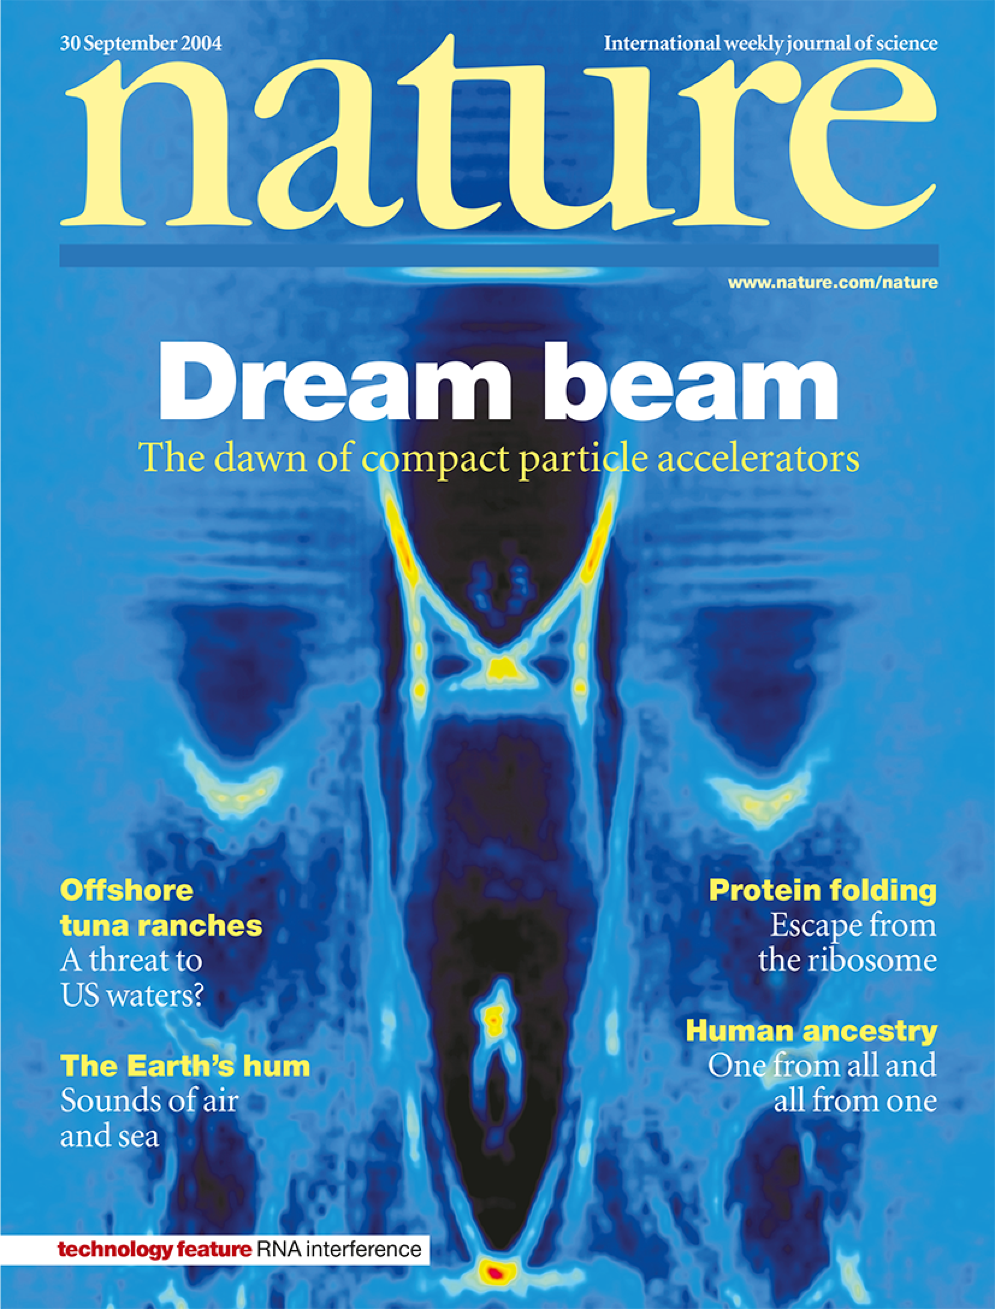
The Dream Beam
Use Ti:sapphire laser system with pulses that are strong and
short enough to drive bubble-shaped wakefields in experiments
Three papers in the same issue of Nature, plus front cover:
S. P. D. Mangles et al., Nature 431, 535–538 (2004).
C. G. R. Geddes et al., Nature 431, 538–541 (2004).
J. Faure et al., Nature 431, 541–544 (2004).
Results reproduced by about 10 groups within a year
Continuous improvement since then
Best results to date: up to 10 GeV, by
E. Rockafellow et al., Phys. Plasmas 32, 053102 (2025)
Expect this record to be broken soon

Slide 6
Scaling with laser energy and power
Johannes Wenz, Stefan Karsch, Proceedings of the 2019 CERN–Accelerator–School course on High Gradient Wakefield Accelerators, Sesimbra, (Portugal), arXiv:2007.04622 (2020)
The bigger your laser, the better your result (duh)
Records are there to be broken
Further reading: C. Joshi, Phys. Plasmas 14, 055501 (2007)

Slide 7
Further tricks
Channel guiding (laser pulse confined to a density channel in the plasma):
C. Geddes et al., Nature 431, 538 (2004).
S. M. Hooker, Nature Photonics 7, 775 (2013)
J. E. Shrock et al., Phys. Rev. Lett. 133, 045002 (2024).
Use Machine Learning to improve bunch quality:
M. Streeter et al., High Power Laser Science and Engineering 11, e9 (2023).
Multiple stages to beat dephasing and thus reach higher energies:
J. Lawson, R. Bingham et al., RAL report RL-83-057 (1983).
Carl A. Lindstrøm, Phys. Rev. Accel. Beams 24, 014801 (2021).
F. M. Foerster et al., Phys. Rev. X 12, 041016 (2022).
A. Knetsch et al., Phys. Rev. Lett. 131, 135001 (2023).
“Flying focus”: speed of laser pulse envelope decoupled from group speed, for faster wakefield speed and thus more energy gain:
J. P. Palastro et al., Phys. Rev. Lett. 124, 134802 (2020).

Slide 8
Electron transverse motion
Electrons perform transverse oscillations in bubble during acceleration: “betatron motion”
Electrons in a short, compact bunch oscillate mostly in phase
The resulting radiation (x-rays) is mostly coherent, and thus very suitable for x-ray analysis of targets
A. Rousse et al., Phys. Rev. Lett. 93, 135005 (2004).
S. Kneip et al., Nature Phys. 6, 980 (2010).
J. M. Cole et al., Scientific Reports 5, 13244 (2015).
Direct laser acceleration: (i) an electron oscillates in a transverse laser field, (ii) when in a channel, it also oscillates in the “static” fields of the channel, (iii) when these two oscillations are (nearly) resonant, the electron feels a strong, accelerating force
A. Pukhov et al., Phys. Plasmas 6, 2847 (1999).
A. Arefiev et al., Phys. Rev. Lett. 108, 145004 (2012).
A E Hussein et al., New J. Phys. 23, 023031 (2021).
K. Weichman et al., Phys. Rev. Research 4, L042017 (2022).
K. Weichman et al., Phys. Plasmas 29, 053104 (2022).

Slide 9
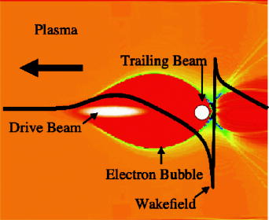
Electron beam accelerating electrons
Laser pulse has low effective Lorentz factor? Use an ultra-relativistic electron beam to drive your wakefield. Such electron beams are available at e.g. Argonne, Fermilab and Brookhaven National Labs, or at the Stanford Linear Accelerator Center (SLAC)
Early efforts by J. Rosenzweig at UCLA and Argonne National Lab
J. Rosenzweig et al., Phys. Rev. Lett. 61, 98 (1988).
Chicane to shorten the electron beam. To mimic a proper “forced LWFA”, the electron bunch must be shortened to a single plasma period
P. Emma et al., SLAC Internal Report SLAC-PUB-8850 (2001).
The “bubble” regime (2002) was actually discovered for beam-
driven wakefields in 2001 but called the “blow-out” regime
J. Rosenzweig et al., Phys. Rev. A 44, R6189( (1991).
C. Joshi review paper
Original image from PRA paper

Slide 10
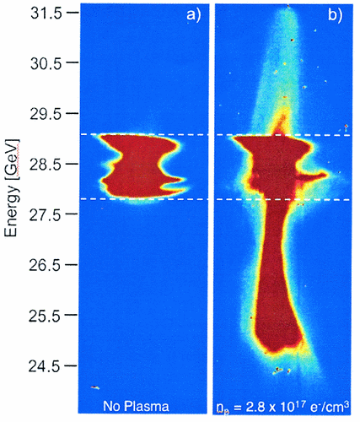
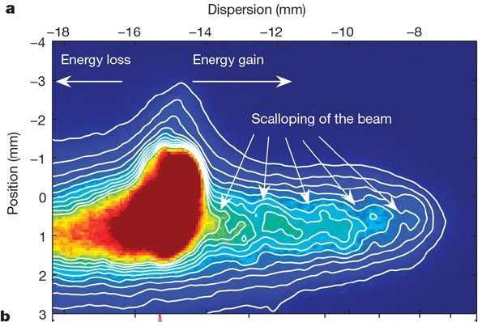
Electron beam accelerating electrons
2 GeV gain at SLAC (28.5 GeV SLAC beam as driver)
First time energy gain over 1 GeV
M. Hogan et al., Phys. Rev. Lett. 95, 054802 (2005).
Energy doubler experiment: from 43 to 85 GeV
I. Blumenfeld et al., Nature 445, 741 (2007).
Recent experiments aim to preserve or reduce energy spread, bunch charge and bunch emittance
C. Lindstrøm et al., PRL 126, 014801 (2021).
Yipeng Wu et al., N. Phys. 17, 801 (2021).
C. Lindstrøm et al., N. Comms. 15, 6097 (2024)

Slide 11
Proton beam accelerating electrons
Proton beam to drive wakefield, since protons are very “stiff” and lose less energy through radiation
Early theory with 0.1 mm proton bunches: A. Caldwell et al., N. Phys. 5, 363 (2009).
Such short bunches unavailable: CERN SPS bunches are 112 mm, km-long chicane would be needed to compress them, oops
Alternative: use long proton beams, drive wakefield via self-modulation
N. Kumar, A. Pukhov and K. Lotov, Phys. Rev. Lett. 104, 255003 (2010).
A. Pukhov et al., Phys. Rev. Lett. 107, 145003 (2011).
And beware: the proton bunch is so long that your background ions will start moving!
J. Vieira et al., Phys. Rev. Lett. 109, 145005 (2012).

Slide 12
The AWAKE project
Advanced Proton Driven Plasma Wakefield Acceleration Experiment (AWAKE): an accelerator R&D project based at CERN (SPS proton beam)
https://awake.web.cern.ch/
A laser pulse may precede the proton bunch to kick-start the self-modulation
R Assmann et al., Plasma Phys. Control. Fusion 56, 084013 (2014).
C. Bracco et al., Nuclear and Particle Physics Proceedings 273–275, 175 (2016).
A. Caldwell et al., Nucl. Inst. Meth. A 829, 3 (2016).
E. Gschwendtner et al., Nucl. Inst. Meth. A 829, 76 (2016).
Best results so far, on CERN SPS proton beam:
Electrons accelerated up to 2 GeV: E. Adli et al., Nature 561, 363 (2018).
Wakefield observed: M. Turner et al., Phys. Rev. Lett. 122, 054801 (2019).
See also: https://twiki.cern.ch/twiki/bin/view/AWAKE/AwakePublic
Future prospects: E. Gschwendtner et al., Symmetry 14, 1680 (2022).

Slide 13
Laser beam accelerating protons
Proton acceleration by conventional accelerators:
Excellent beam quality, very reproducible and reliable
But: need a large, expensive facility to produce those proton beams
Proton acceleration in plasma:
Protons are slow, electron or proton beams or wakefields are fast, oops
But: a laser pulse in a dense foil is also slow
Proton acceleration by high power lasers:
Beam quality not so good: beam properties only as reliable and reproducible as the driving laser (which is not very reproducible at the moment)
But: in a small lab next to the facility (hospital?) where protons are needed
Applications: inertial confinement fusion, proton probing of plasma waves and wakefields (Borghesi et al., Phys. Plasmas 9, 2214 (2002)), precise radiation therapy (tumour treatment) in hospitals
Protons have much more localised energy deposition than photons or electrons, so more damage to the tumour and less to the surrounding tissue

Slide 14
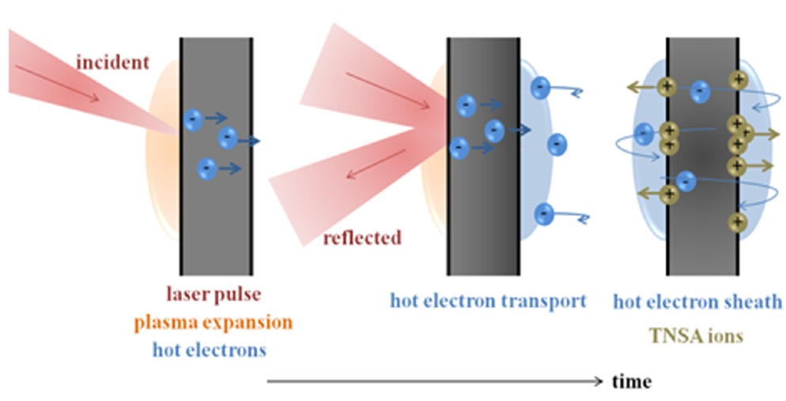
Laser beam accelerating protons
Basic theory:
A laser beam hits a solid foil and interacts mostly with the electrons in that foil
When the electrons are displaced, charge separation leads to strong electric fields
The electric fields drag the ions out of the foil
Target-normal sheath acceleration (TNSA), most common mechanism
Maksimchuk et al., PRL 84, 4108 (2000) and Clark et al., PRL 85, 1654 (2000).
Laser accelerates electrons, which leave the back of the foil and form a sheath
Charge separation leads to strong sheath E-fields
Ions (protons) are pulled off the rear surface and accelerated
Proton beams have large energy spread and divergence

Slide 15
Radiation pressure acceleration (RPA)
Radiation pressure acceleration (RPA):
For very “clean” laser pulses with high contrast and circular polarisation
Deliver a sharp “hammer blow” to the foil target
This blow accelerates electrons and ions together. Acceleration speed set by heaviest ion species
C. Palmer et al., Phys. Rev. Lett. 106, 014801 (2011).
I. J. Kim et al., Phys. Plasmas 23, 070701 (2016).
Light-sail RPA
For high-density thin foils, tears a piece out of that foil
Suffers from transverse instabilities (filamentation etc.)
Tough requirements on the driving laser pulse
May need to “sacrifice” beam quality of heavy ion species to get good quality proton beams
A. P. L. Robinson et al., New J. Phys. 10, 013021 (2008).
S. Steinke et al., Phys. Rev. ST Accel. Beams 16, 011303 (2013).
Hole-boring RPA
Lower-density foil with sharp density “edge”
Ion acceleration via “snow plough” effect on electrons
Proton acceleration up to 100 MeV with narrow energy spread
A. P. L. Robinson et al., Plasma Phys. Control. Fusion 54, 115001 (2012).

Slide 16
Laser beam accelerating protons
Best results so far:
Ziegler et al., N. Phys. 20, 1211 (2024): 22.5 J laser in 30 fs on foil target
Obtained >100 MeV protons, maybe up to 150 MeV
Scaling predicts 250 MeV protons within reach with a bigger laser
Heavy ions: Nishiuchi et al., PRRes. 2, 033081 (2020), silver ions with 20 MeV/u
Transverse flying focus (pulse envelope moves sideways): simulations promise “a proton beam with 23.1 pC charge, 1.6 GeV peak energy, and 3.7% energy spread”
Zheng Gong et al., Phys. Rev. Lett. 133, 265002 (2024).
Future prospects:
Higher energy per proton, with bigger lasers
Better proton beam quality and reproducibility, with higher quality lasers
Heavy ions: more energy per nucleon
Like in electron acceleration: continuous improvement, records exist to be broken
Novel schemes, like the “transverse flying focus”

Slide 17
Laser beam accelerating photons (yes)
Photon acceleration? Are you crazy? Photons always go at speed c, right?
Yes, in vacuum. Group speed in plasma less than c, so you can accelerate them!
Photons move away from regions of higher electron density, so you can push them.
Early papers:
Photon acceleration in a wakefield:
S. C. Wilks et al., Phys. Rev. Lett. 62, 2600 (1989).
By a co-propagating ionisation front (can also push the photons):
B. M. Penetrante et al., JOSA B 9, 2032 (1992).
J. M. Dias et al., Phys. Rev. Lett. 78, 4773 (1997).
By relativistic shifts in the plasma frequency (self-phase modulation):
I. Watts et al., Phys. Rev. E 66, 036409 (2002).
Review: W. Mori, IEEE J. Quantum Electron. 33, 1942 (1997).
Book: J. T. Mendonça, “Theory of Photon Acceleration” (CRC Press, 2001)

Slide 18
Particles are also waves are also particles
Individual
particles
Distribution
function
Wigner
function
Wave
function
J.J. Thompson: “Cathode rays are not waves, but a stream of particles (electrons).” Nobel Prize, 1906.
G.P. Thompson: “Sorry Dad, but electrons are waves after all.” Nobel Prize, 1937.
A. Einstein: “Photons are particles.” Nobel Prize, 1921.
This presentation: “Photons are particles and can be accelerated. The same applies to other types of waves.”

Slide 19
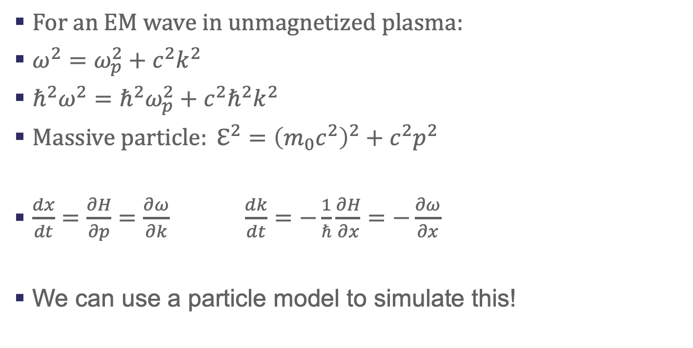
The mathematics behind it
For an EM wave in unmagnetized plasma:
$ω^{2}=ω_{p}^{2}+c^{2}k^{2}$
$ℏ^{2}ω^{2}={ℏ^{2}ω}_{p}^{2}+c^{2}ℏ^{2}k^{2}$
${Massive particle: ℇ}^{2}={\left(m_{0}c^{2}\right)}^{2}+c^{2}p^{2}$
$\begin{matrix}\frac{dx}{dt}=\frac{∂H}{∂p}=\frac{∂ω}{∂k} & & \frac{dk}{dt}=−\frac{1}{ℏ}\frac{∂H}{∂x}=−\frac{∂ω}{∂x}\end{matrix}$
We can use a particle model to simulate this!

Slide 20
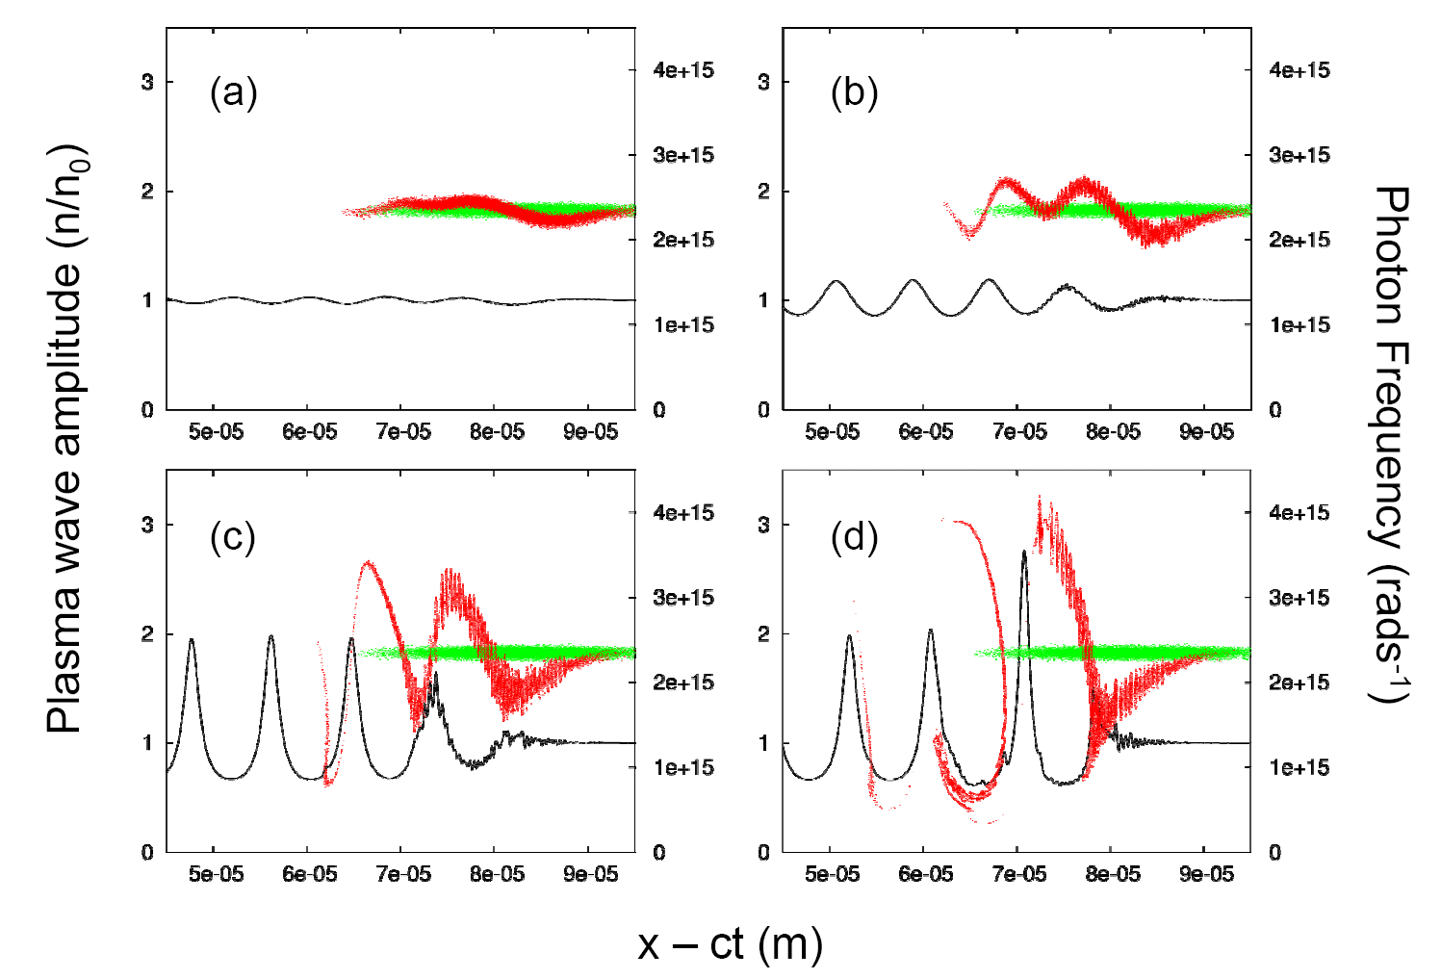
Wigner function
Photons vs electrons in a wakefield: how similar these spectra are!
(x,ω) spectrum for photons
(x,ℇ) spectrum for electrons
Final photon
distribution
Wakefield
Scaled electron density
Photon frequency (rad/s)
Initial photon
distribution
x – ct (m)
S. F. Martins et al., Nature Physics 6, 311 (2010).

Slide 21
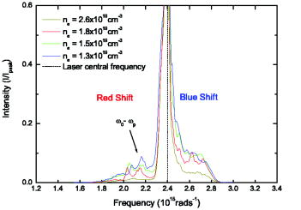
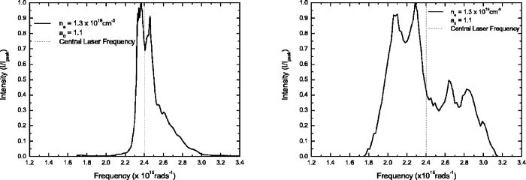
Experimental confirmation
Experimental laser spectra
Photon acceleration in laser wakefield experiments:
C. D. Murphy et al., Phys. Plasmas 13, 033108 (2006)
This campaign was spawned by one of the “Dream Beam” experiments
Experimental and simulated spectra, showing a blue-shifted “shoulder” and a split main peak

Slide 22
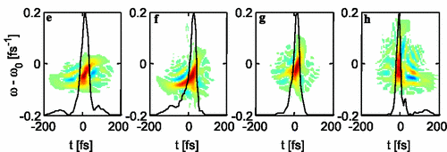
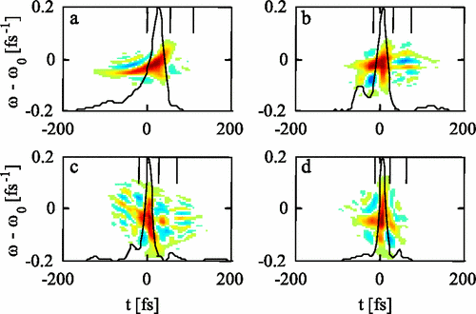
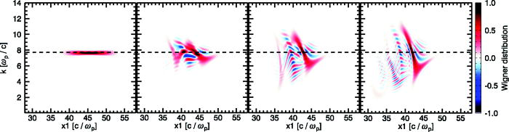
Experimental confirmation
Experiments by J. Schreiber et al., Phys. Rev. Lett. 105, 235003 (2010)
Wigner function from PIC simulations and from experiments, which know nothing of photon kinetic theory
Note that pulse moves right in simulations, left in experiments
The idea may be crazy, but not wrong
Simulations by Murphy et al., PoP (2006)

Slide 23
Photon acceleration for grown-ups
Photon acceleration with the flying focus. Photons may be fast, but the flying focus is faster. With a superluminal ionisation front (not a problem).
A. J. Howard et al., Phys. Rev. Lett. 123, 124801 (2019).
Electron beam driving a wakefield to accelerate photons:
Sandberg and Thomas, Phys. Rev. Lett. 130, 085001 (2023); Phys. Plasmas 30, 113105 (2023); Phys. Rev. E 109, 025210 (2024)
Photon acceleration of an entire Laguerre-Gaussian pulse (complex phase topology). Boost the frequency, preserve the (low) OAM level. Even for circular polarisation. Standard high harmonic generation will never give you that.
Kyle Miller et al., Communications Physics 8, 229 (2025).

Slide 24
Bonus: positron acceleration
Plasma-based acceleration of electrons, so why not positrons?
Bubble-shaped wakefield: the bubble is accelerating and focusing for electrons
Thus: decelerating and defocusing for positrons, oops
Solutions:
Use a ring-shaped laser pulse to drive a ring-shaped wakefield
High electron density on-axis keeps the positrons focused
Simulations: J. Vieira and J. T. Mendonça, Phys. Rev. Lett. 112, 215001 (2014).
Wakefield driven by positron beam to accelerate positrons
Counterpart of SLAC e-beam to accelerate electrons
Review: C. Joshi, W. Mori and M. Hogan, Nature Physics 21, 885 (2025).

Slide 25
Bonus: complex wakefields
Use a complex driving laser pulse to generate a wakefield with complex structure.
This complex structure will then be transferred to the accelerated electrons
Driving laser pulse: two modes with a small frequency difference and different OAM levels
Plasma with resonant plasma frequency, driven via the “beat wave” mechanism
Because of the OAM difference, the plasma wave will acquire OAM also
Twisted electron beam accelerated by a twisted plasma wave:
J. Vieira et al., Phys. Rev. Lett. 121, 054801 (2018).
Twisted plasma wave with strong axial magnetic field:
Y. Shi et al., Phys. Rev. Lett. 121, 145002 (2018).
There is much more I could say here but I do not have the time.

Slide 26
Conclusions
Plasma-based particle acceleration:
Much higher gradient to accelerate electrons or protons
Can accelerate photons, unlike a conventional accelerator
A laser driver can accelerate electrons, protons and photons
An electron driver can accelerate electrons and photons
A proton driver may be able to accelerate electrons and photons
An accelerator preserves the transverse topology of the accelerated bunch. This can be exploited to accelerate LG pulses, complex electron beams, …
This is a field in progress. New schemes are being developed all the time. Records will be broken. Watch this space

Slide 27
Thank you
Facebook: Science and Technology Facilities Council
Twitter:@STFC_matters
YouTube: Science and Technology Facilities Council

