Slide 1
Welcome!
EuPRAXIA Camp II - Science
Carsten P Welsch
INFN-LNF and U Liverpool/CI

Slide 2



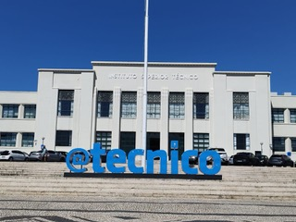


EuPRAXIA-DN Camp II: Science
14th-15th July, Lisbon, Portugal
Meeting Venue
Overview of Activities
Anfiteatro Abreu Faro
Instituto Superior Técnico (IST)
Av. Rovisco Pais 1
11049-001 Lisbon
Portugal
Entrance to the site
Sunday 13th July, IST (Anfiteatro Abreu Faro)
Welcome Reception from 18:00
Monday 14th July, IST (Anfiteatro Abreu Faro, Cantinho do Avillez)
Registration from 8:30
Camp Start 9:00
Dinner at Cantinho do Avillez 19:00
Tuesday 15th July, IST (Anfiteatro Abreu Faro)
Camp Start 9:00
Camp ends 16:20
Please see Indico for the full agenda.
This project has received funding from the European Union´s Horizon Europe research and innovation programme under grant agreement
no. 101073480 and the UKRI guarantee funds.

Slide 3

EuPRAXIA-DN Camp II: Science
14th-15th July, Lisbon, Portugal
WIFI @ IST
Dinner
A temporary guest network will be available, accessible through the tecnico-guest network.
The account name is EuPRAXIA Camp II
The password is: A7jZn3
Monday 14th July, from 19:00
Cantinho do Avillez
Rua dos Duques
de Bragança,
7 1200-162,
Lisbon
The restaurant is located here. Please use Google Maps to research appropriate walking/public transportation routes.
This project has received funding from the European Union´s Horizon Europe research and innovation programme under grant agreement
no. 101073480 and the UKRI guarantee funds.

Slide 4
Overview
EuPRAXIA Doctoral Network
Carsten P Welsch
INFN-LNF and U Liverpool/CI

Slide 5






A bit of history…
  (Beam Diagnostics, Physics)
  4.2 M€, 22 Fellows, 32 partners
  (Laser Applications, Engineering)
  4.6 M€, 22 Fellows, 38 partners
  (Accelerator Optimization, Physics)
  6 M€, 23 Fellows, 35 partners
  (Medical Applications, Life Sciences)
  3.9 M€, 15 Fellows, 31 partners
  (Antimatter R&D, Physics)
  4.0 M€, 15 Fellows, 24 partners
  (Plasma AcceleratorR&D, Physics)
  3.2 M€, 12 Fellows, 23 partners
Largest portfolio of MSCA networks in any scientific area; around 25M€ of funding and more than 100 Fellows!
Also: Chair of STFC ETCC, member of UKRI TSAG and Director of two CDTs.

Slide 6
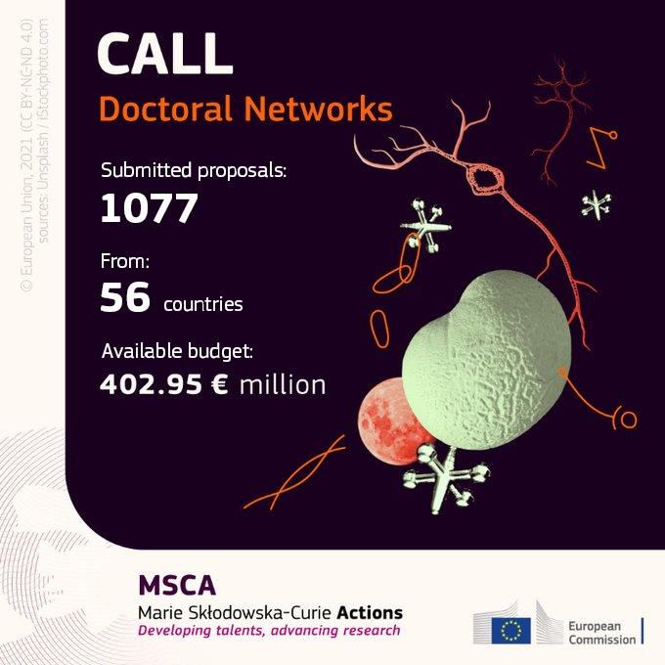
The 2021 MSCA-DN Call
897 proposals for standard doctoral networks
In PHY: 83 proposals – only 10 networks were selected! Success rate was only 12 %.
Complicated start…but we got there! (Brexit, visa issues,…)
With 3.2M€ EuPRAXIA-DN is one of the largest networks, training 12 Fellows.

Slide 7
What is EuPRAXIA-DN?
12 high-level Fellowships (10 Fellows are funded by the EU, another two by the UKRI Guarantee Funds);
Interdisciplinary and cross-sector plasma accelerator research and training program carried out between universities, research centres and industry;
Organizes a (large) number of international events for the wider community;
Recognized importance of plasma accelerator R&D at European level!

Slide 8









Beneficiaries

Slide 9













Partner Organizations

Slide 10



Research
Laser & Plasma
Facility Design & Optimization
Applications
The network's main scientific and technological objectives are split into three closely interlinked work packages.

Slide 11
Training & Events
International School on plasma accelerators;
EuPRAXIA Camps on focused research topics – always across the different project work packages.
Researcher skills trainings designed to prepare all Fellows for their future careers and make them attractive for employers in academia and industry;
Final conference and outreach symposium to present project results.
Events are open to all Fellows and wider community!

Slide 12
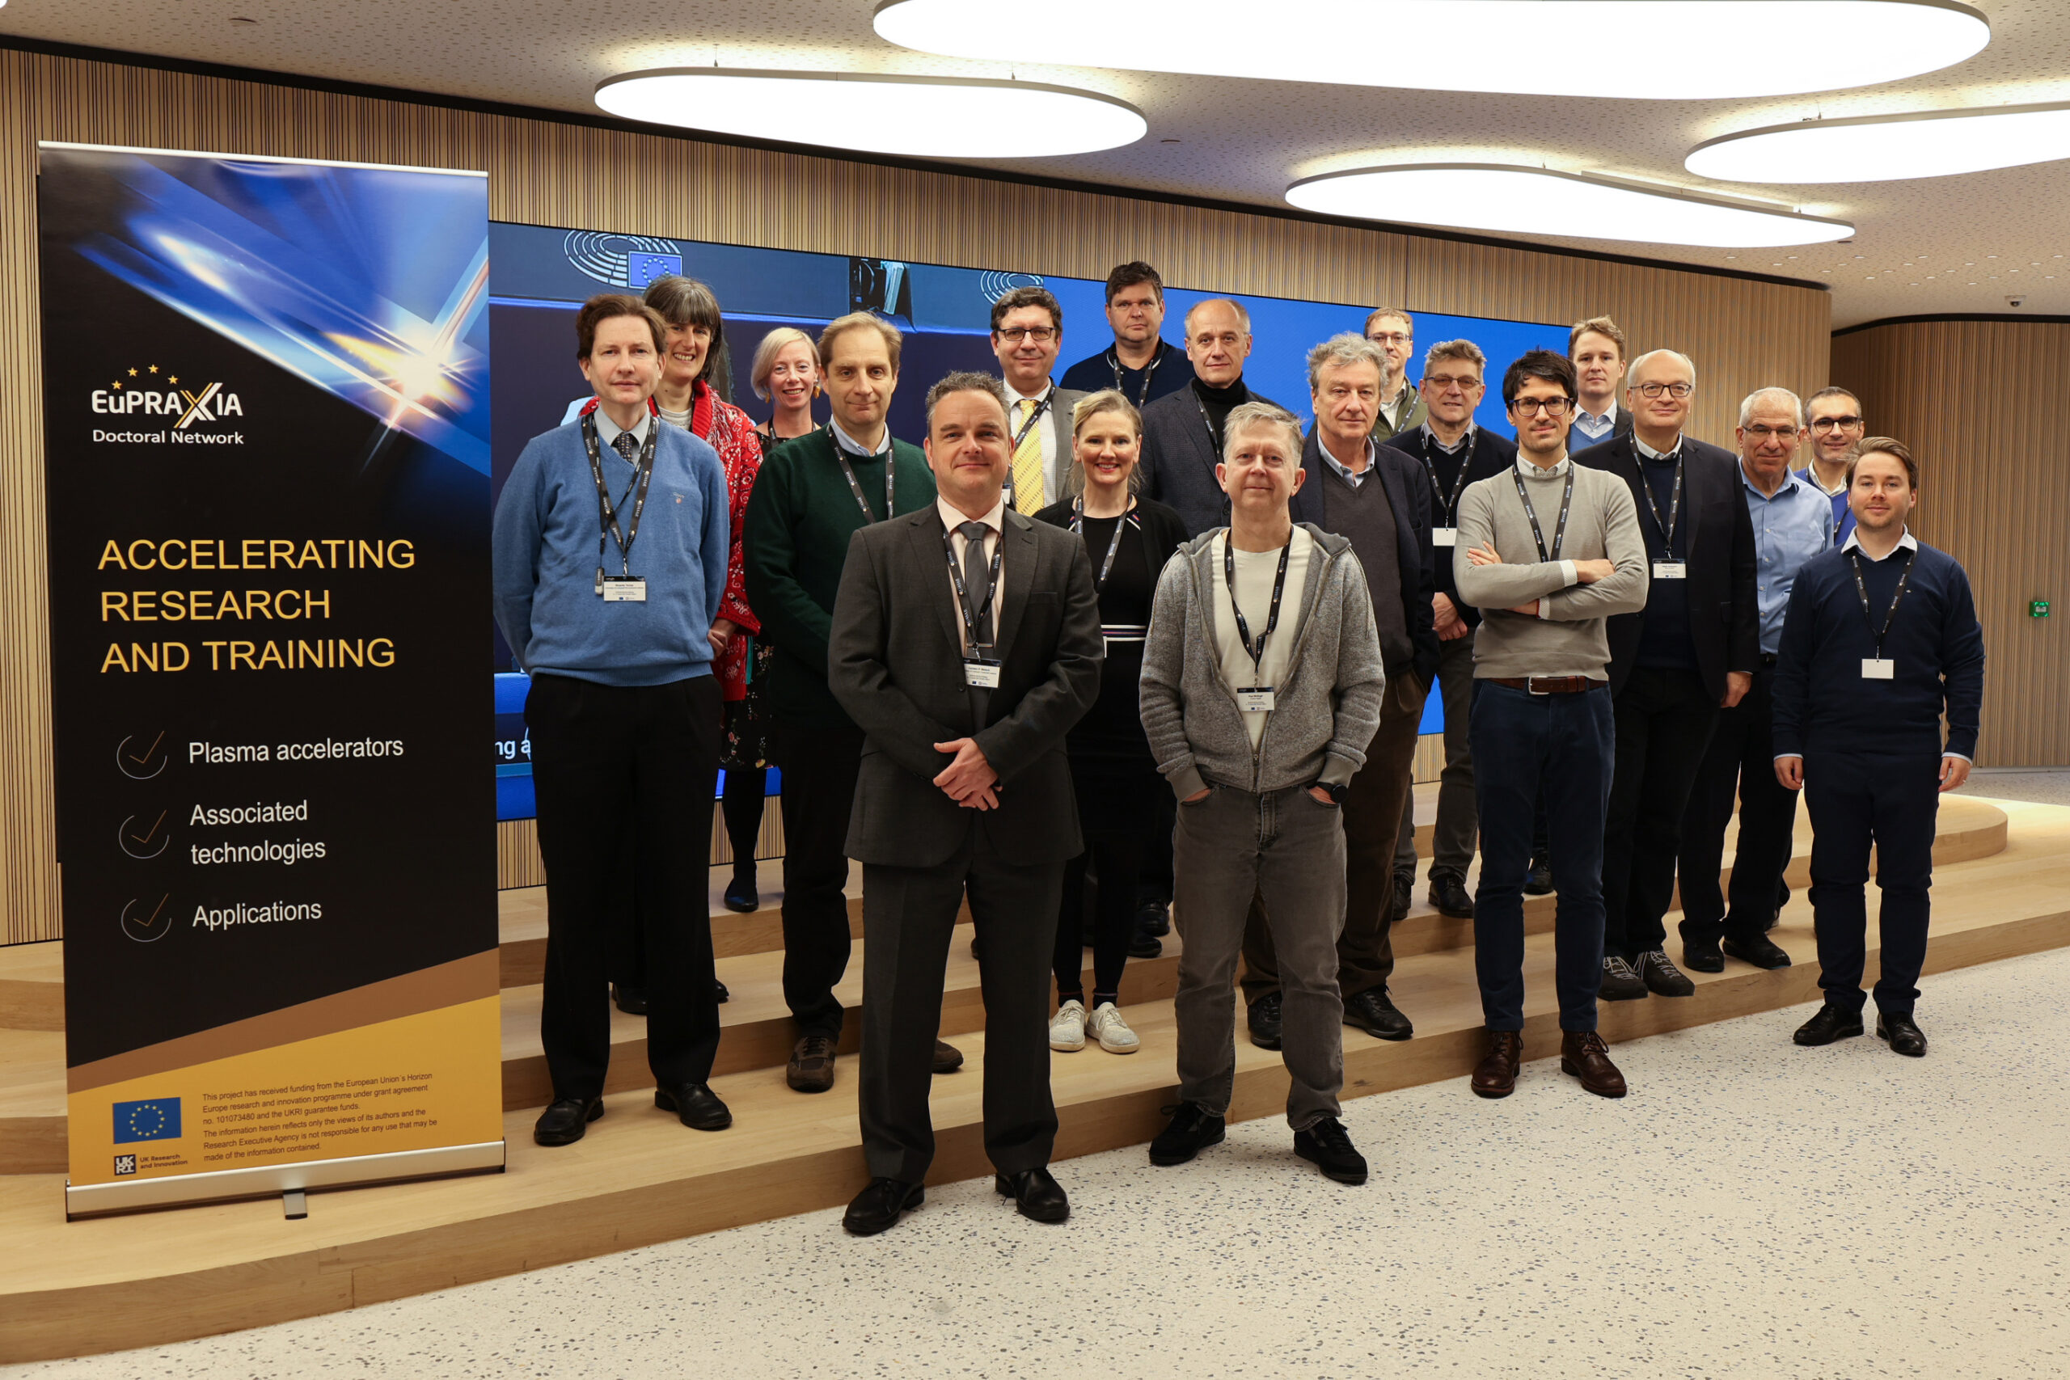
Kick-off Meeting
https://indico.cern.ch/event/1200106/

Slide 13

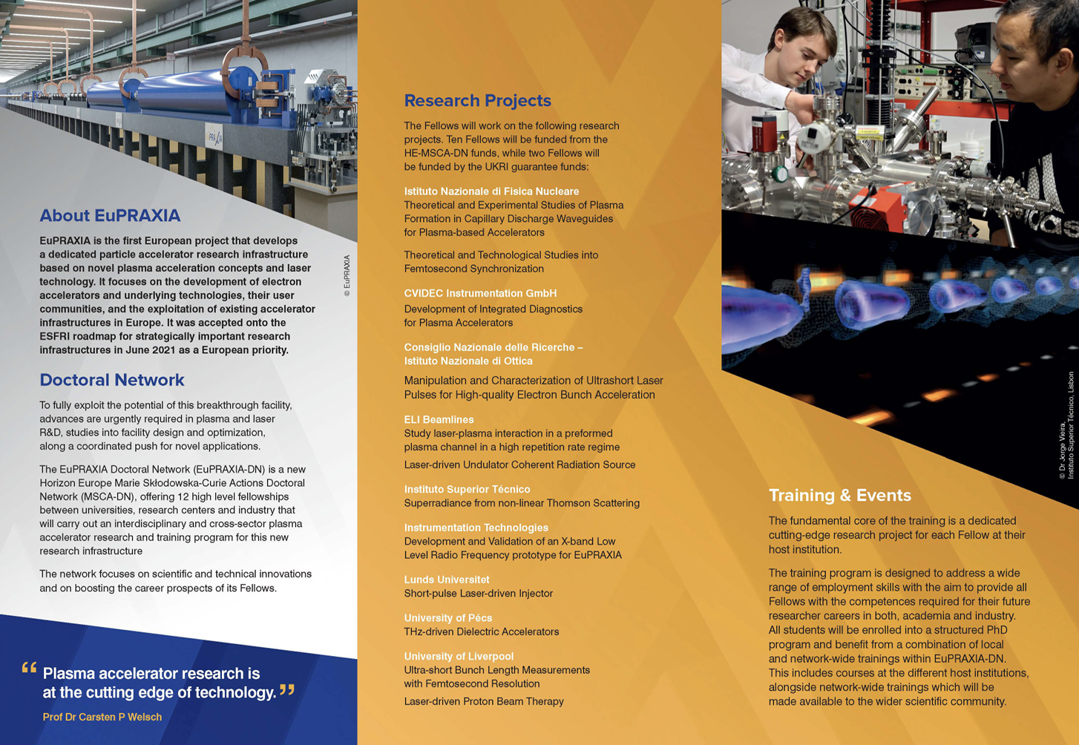
EuPRAXIA-DN Leaflet

Slide 14
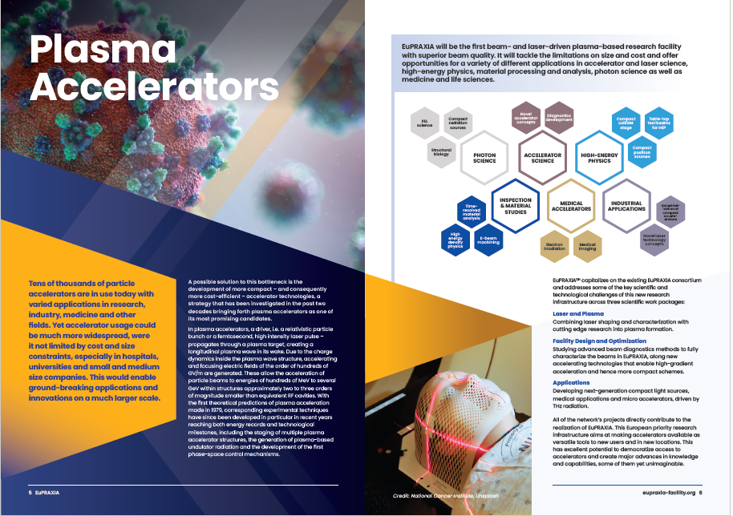
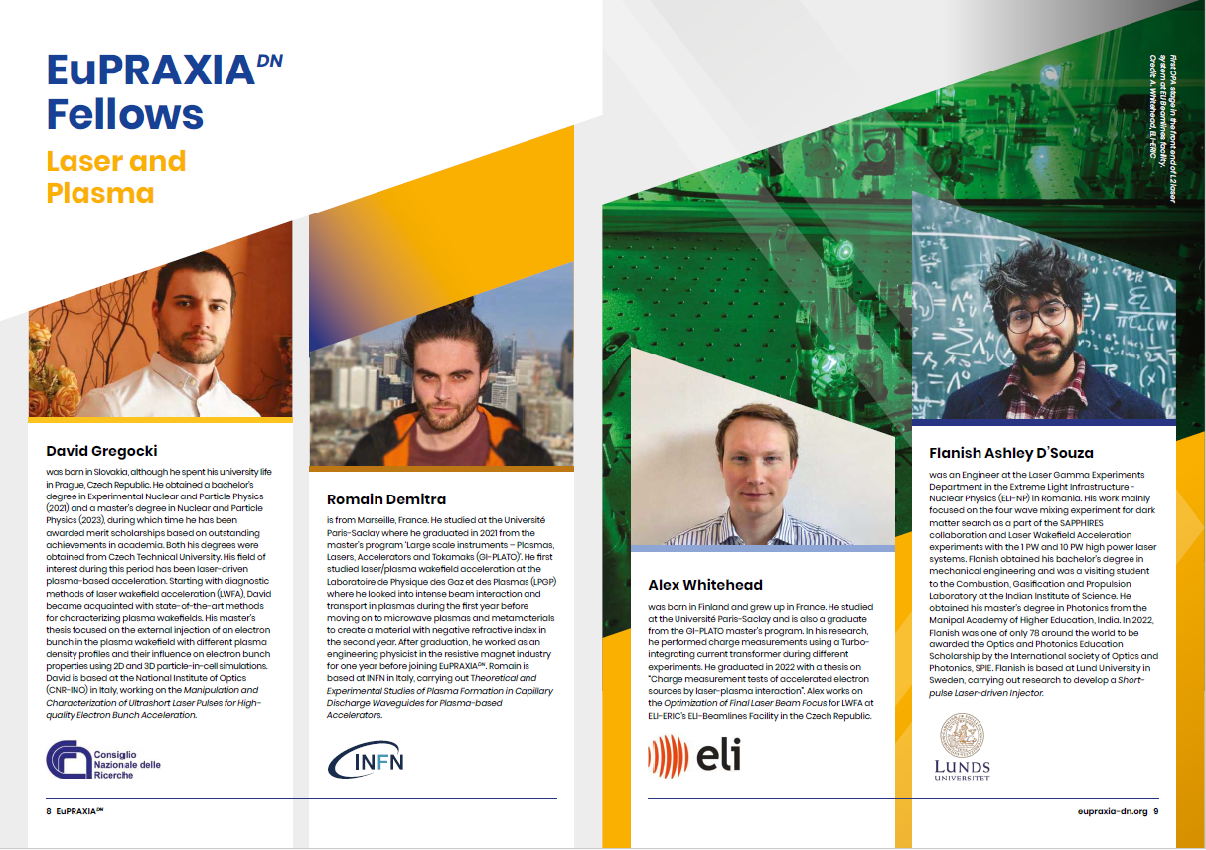
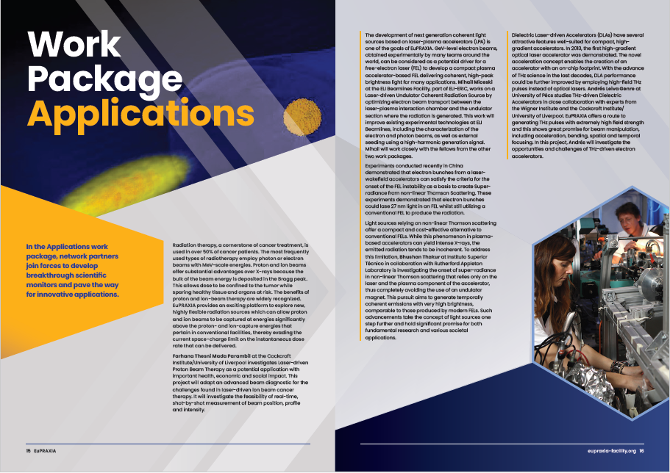
EuPRAXIA-DN Brochure

Slide 15
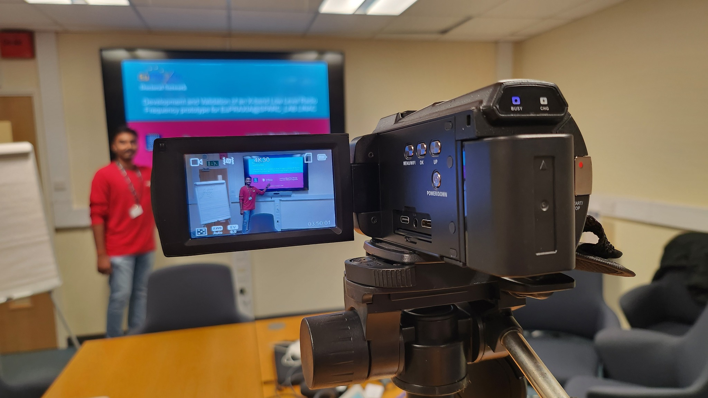
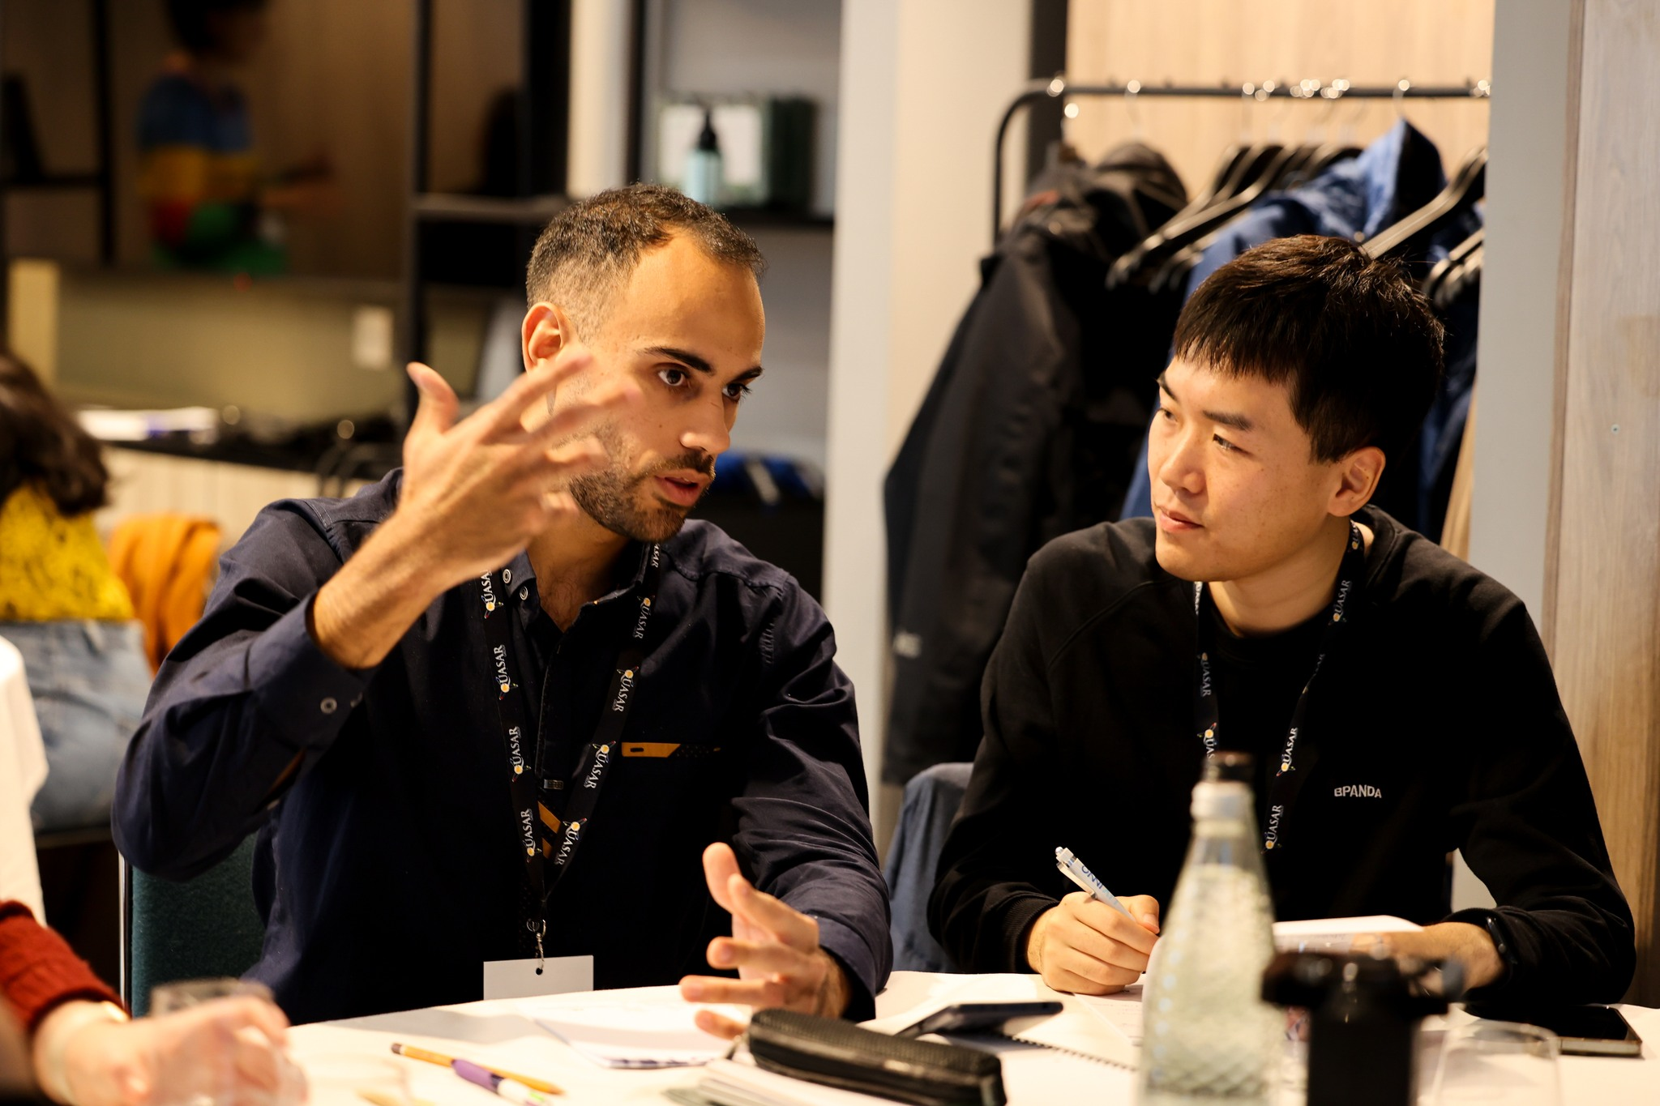
Skills School
PhD project-specific part
  Presentation skills
  Scientific writing
  Project management
Generic skills through outreach project
  Team working
  Proposal writing
  Peer review
  Working under (time) pressure
“I hadn’t really thought of myself
as a project manager until today!”

Slide 16
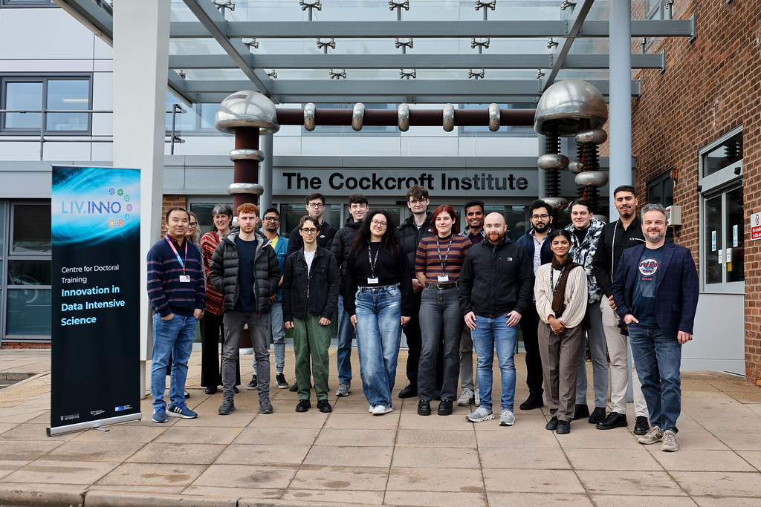
Skills School

Slide 17
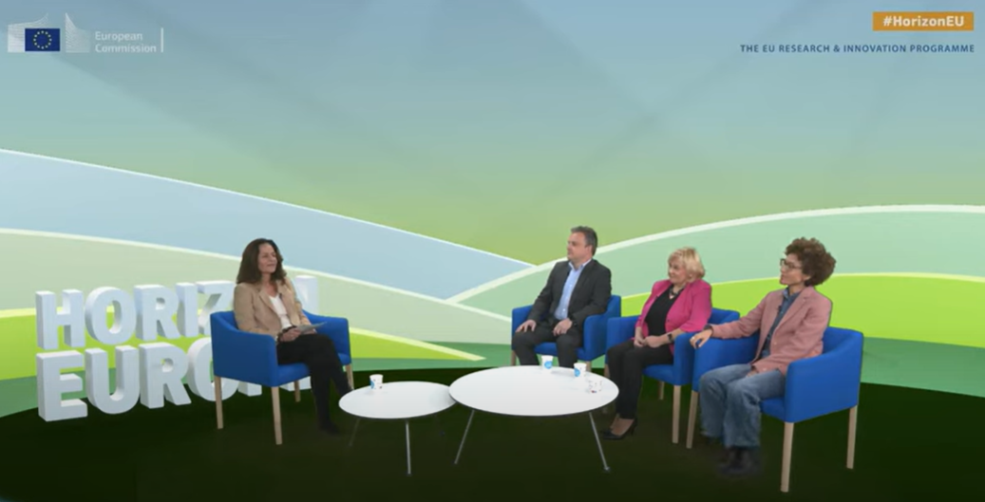
MSCA Info Day 2023
Brussels, 8/9 November 2023: Exemplary exploitation of synergies!

Slide 18

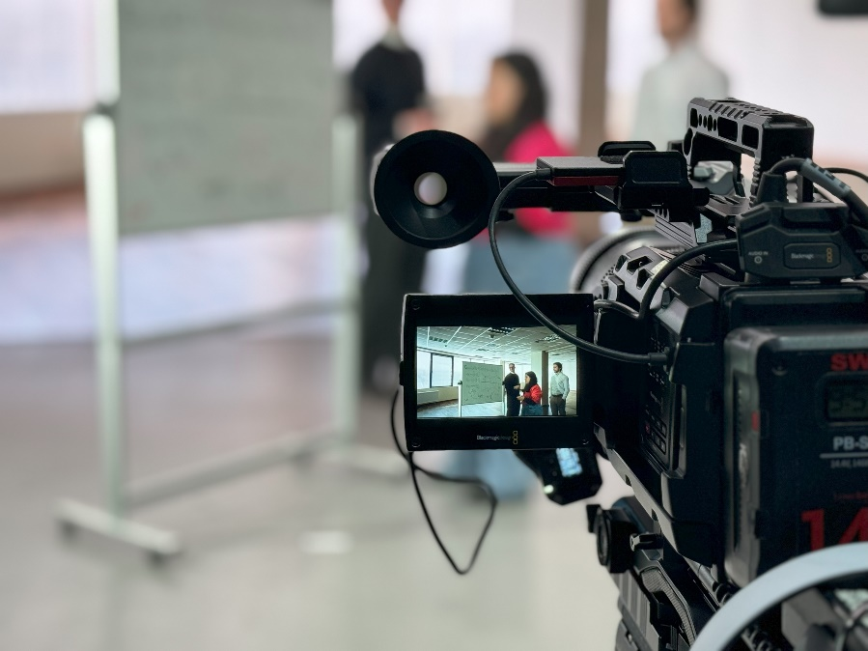
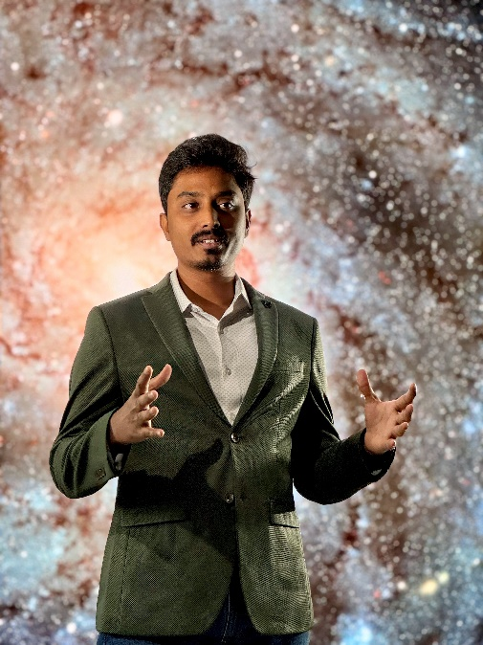
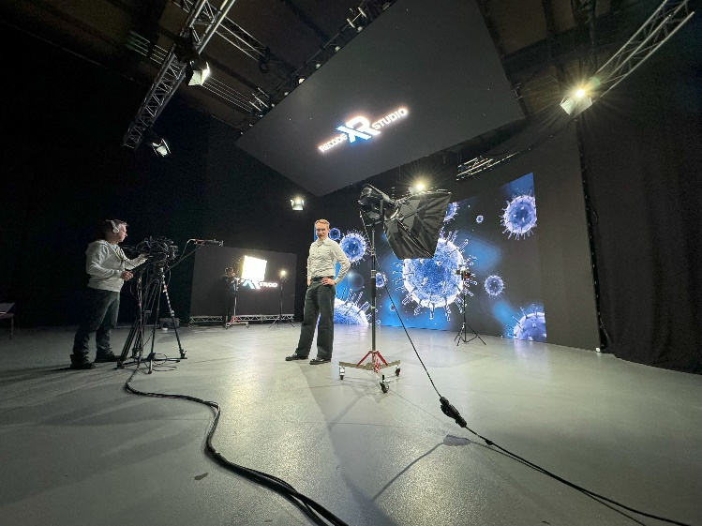
Media Skills School

Slide 19


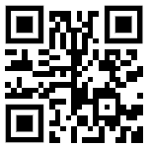
EuPRAXIA-DN Film
Thus far ~20,000 views
Sustainable video production, use of AI, recognized as EU success story.
https://youtu.be/6NPgxCdffrE

Slide 20


Slide 21
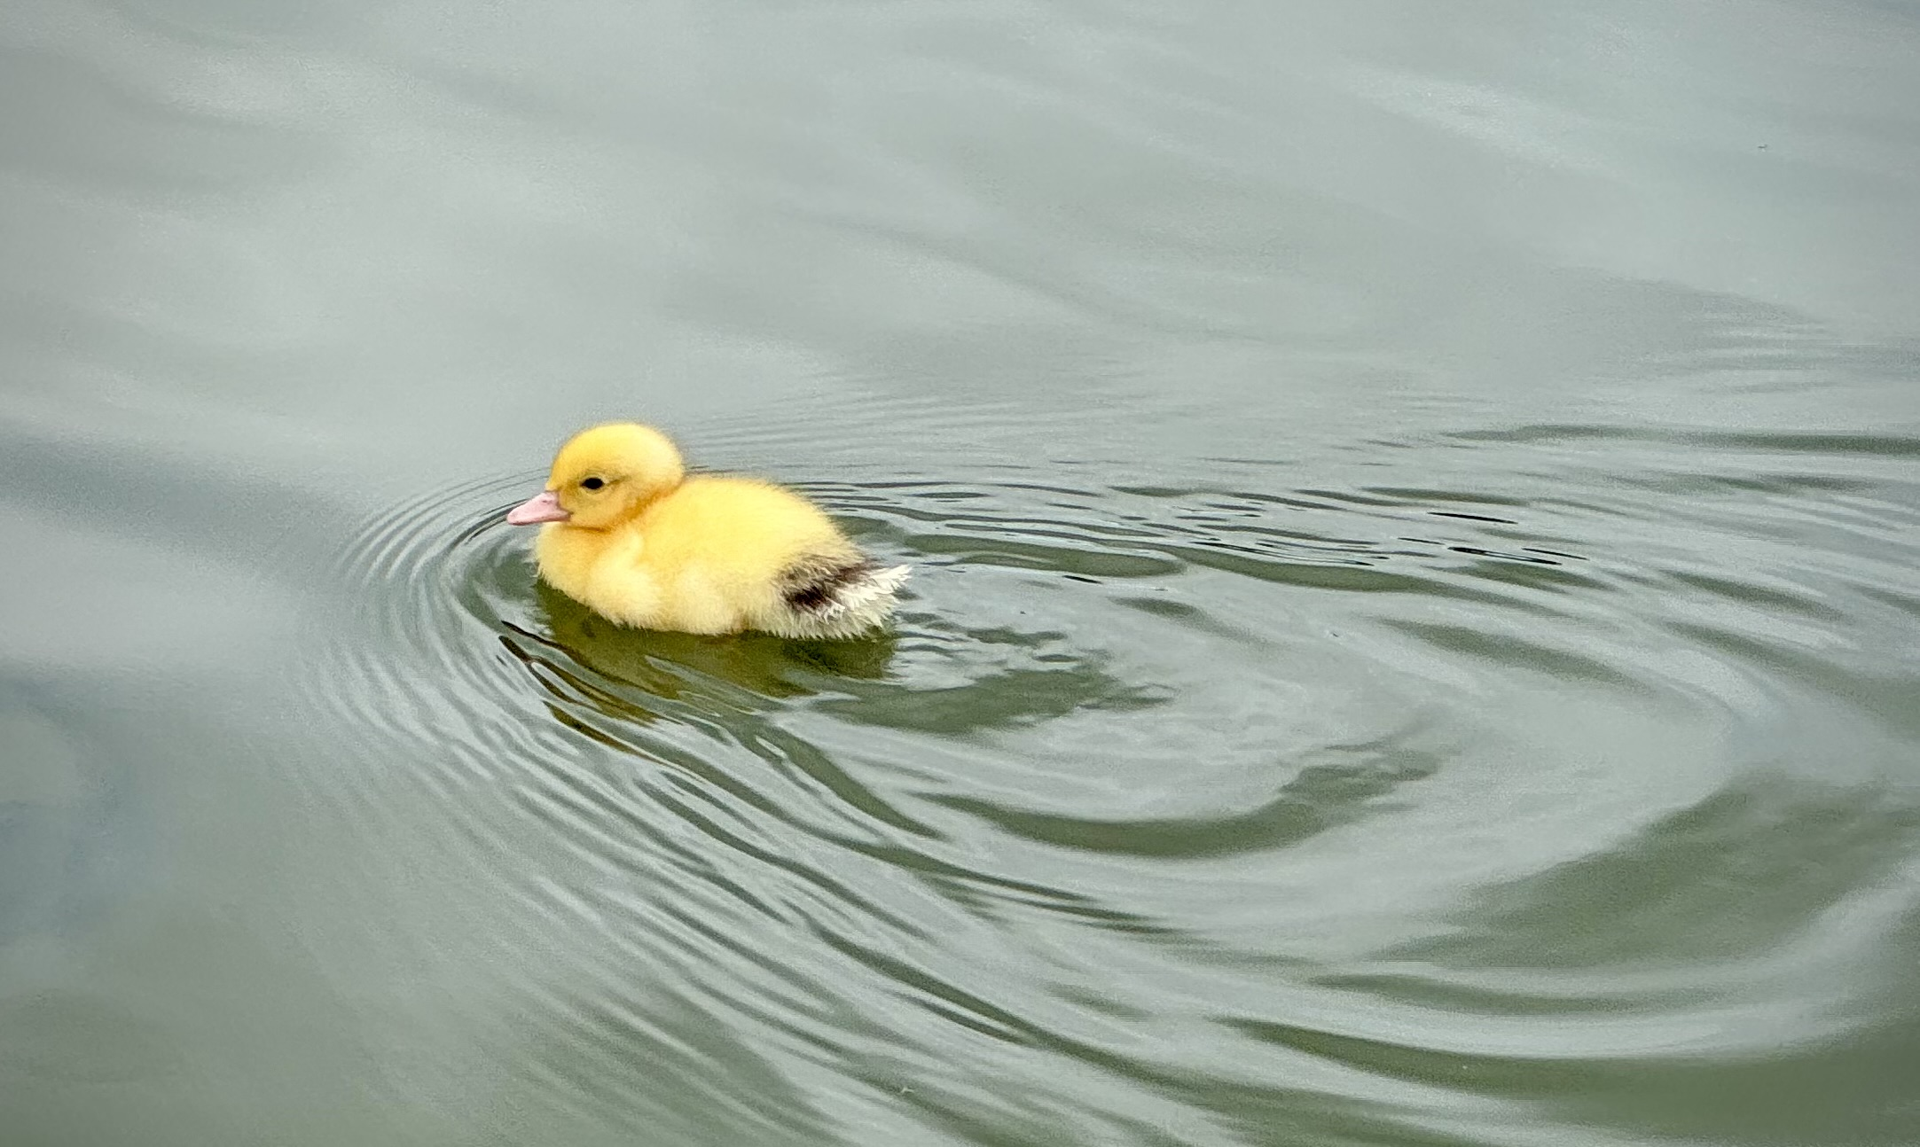

Slide 22
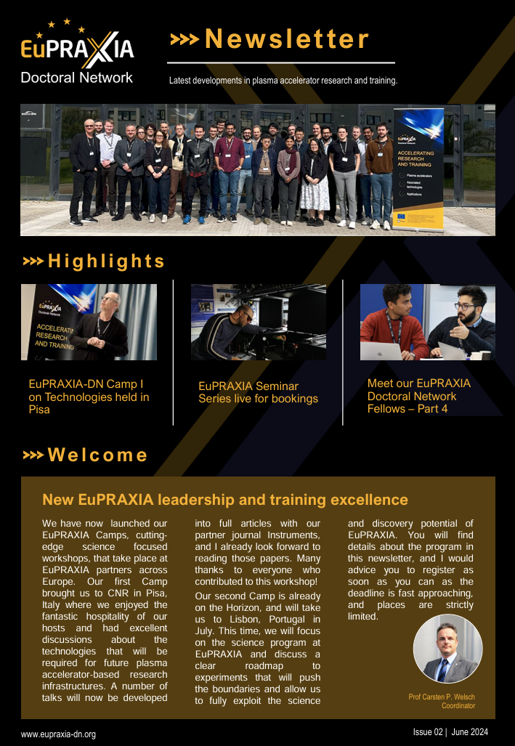
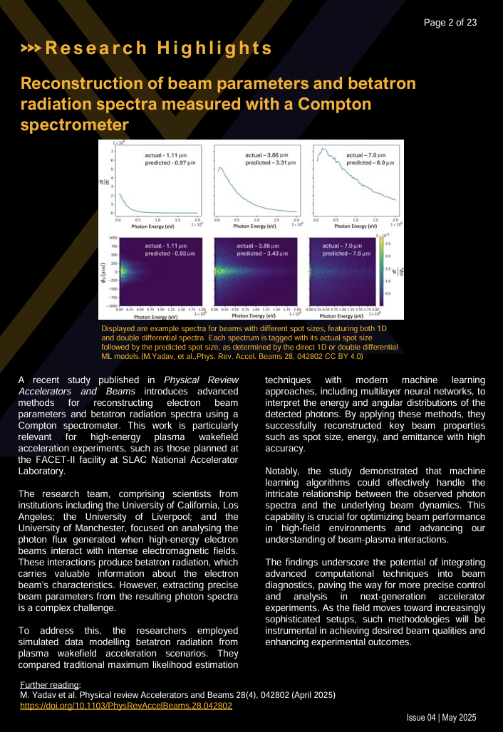
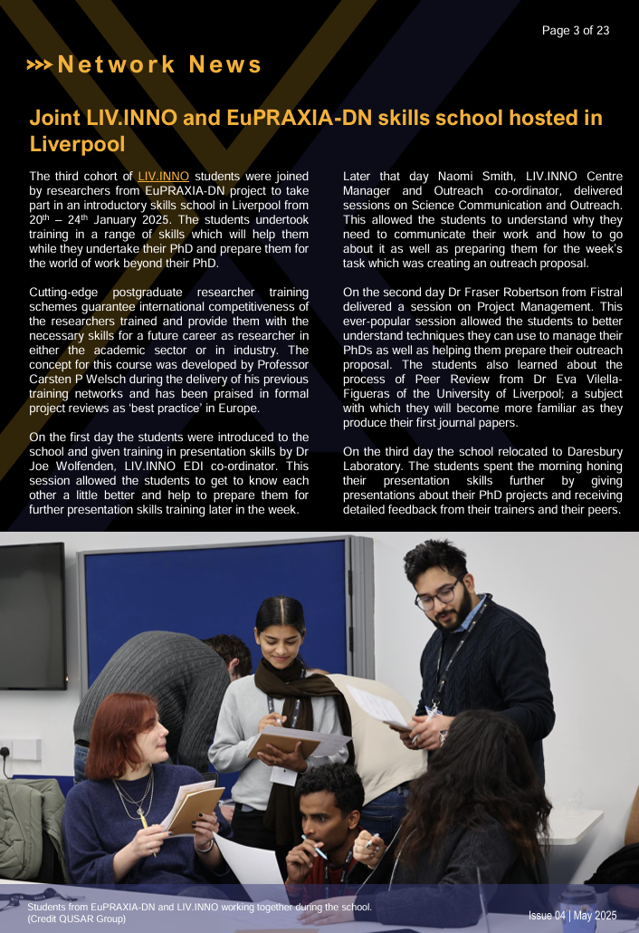
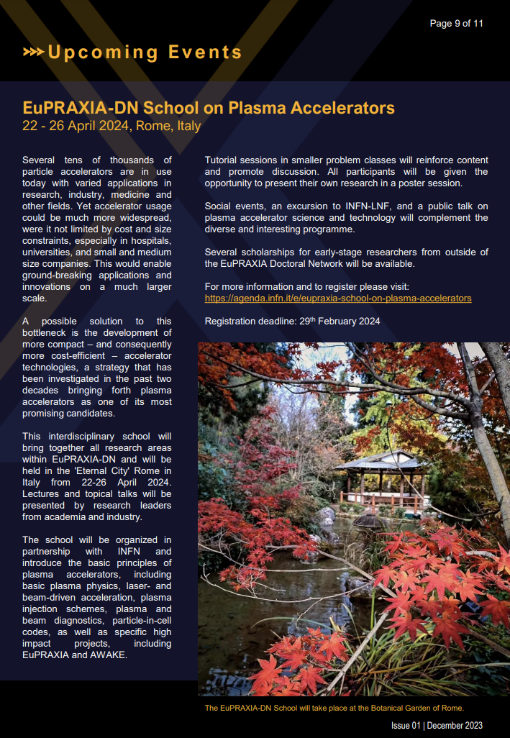
EuPRAXIA-DN Newsletter
https://www.eupraxia-dn.org/newsletter

Slide 23
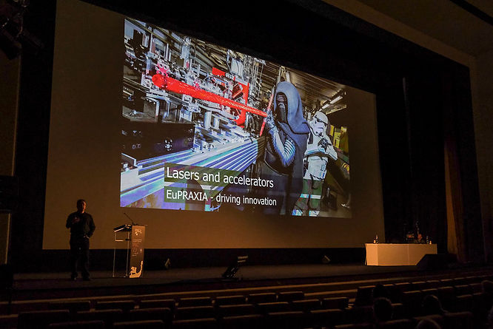
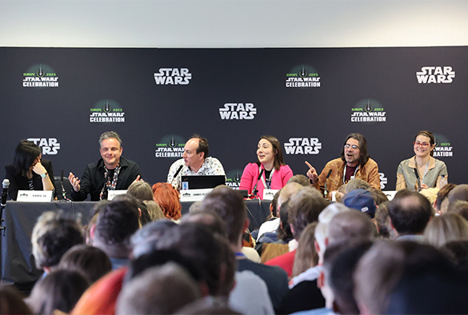

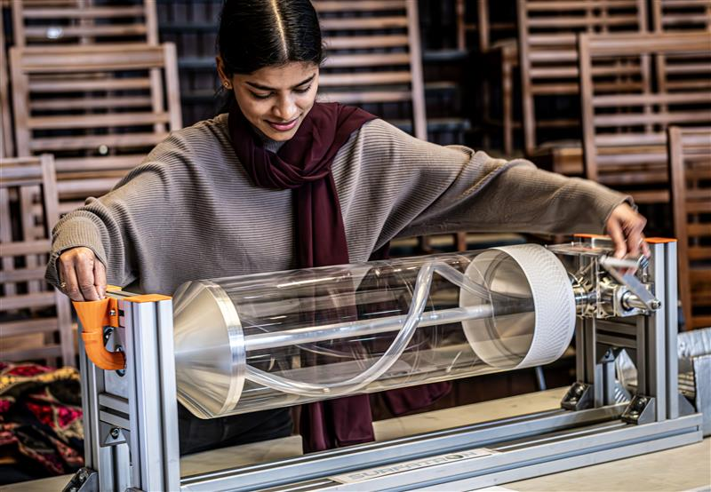

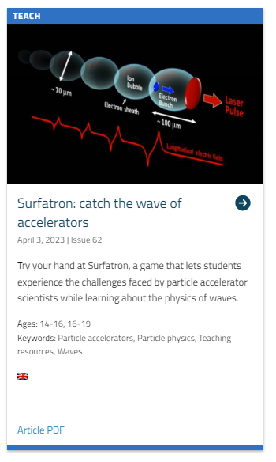
Outreach
International successes:
Physics of Star Wars
Surfatron

Slide 24



Social Media
All communication activities are supported by established social media channels:
    @TheQuasarGroup, @lnf.infn.it, @infn.lnf
    @quasar_6roup, @lnf_infn, @livuniphysics
    EuPRAXIA, QUASAR Group Project T.E.A.M

Slide 25
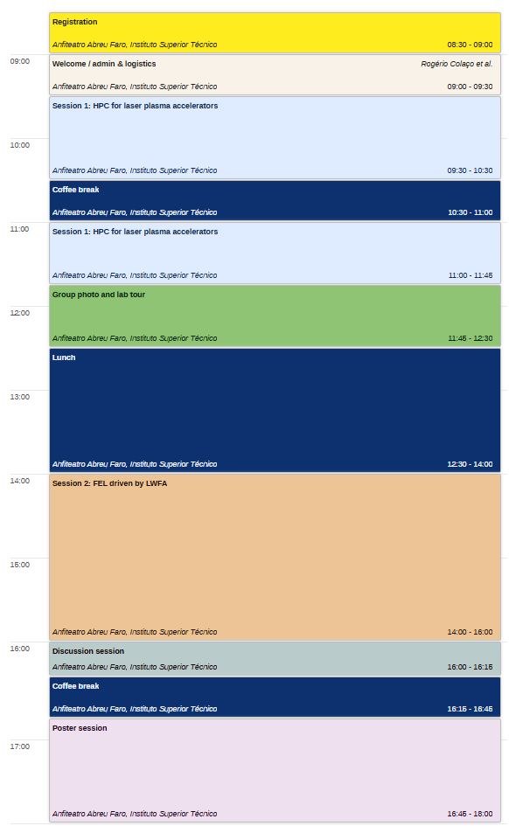
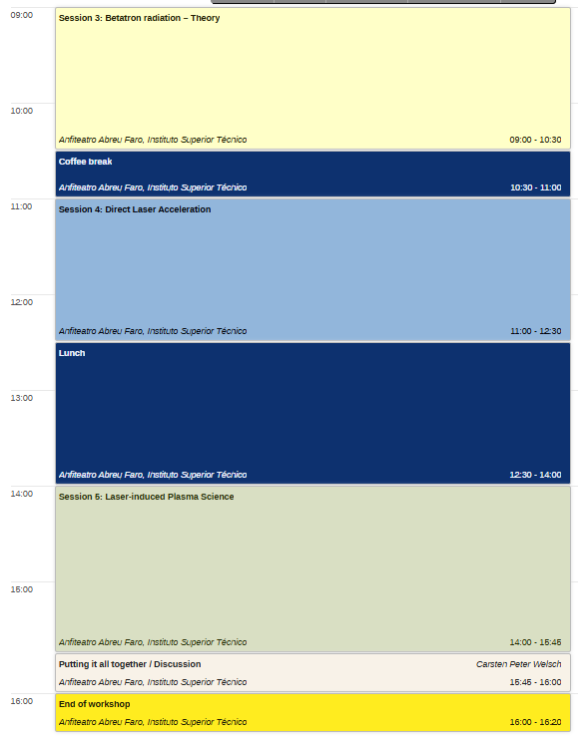

Workshop overview
Contact in case
of Emergency
Carsten
Alexandra
+44 79 73 24 79 82
+44 75 51 91 48 31

Slide 26
Camp II – Overview
In this challenge-led workshop we will look into the fundamental science that is enabled by plasma accelerators.
There will be keynote talks in each session to “set the scene”
These will be followed by R&D talks about the latest research, with plenty of time for discussion. A poster session this afternoon will cover an even wider area.
Important: Get to know other participants – network, and become part of the EuPRAXIA family. Also: Get out of your comfort zone!
Enjoy the Camp!

Slide 27



This project has received funding from the European Union´s Horizon Europe research and innovation programme under grant agreement no. 101073480.

