Slide 1
Einstein Telescope
PM management tools, present status and future battle plan
Project Office Annual Meeting. March 27 and 28th

Slide 2
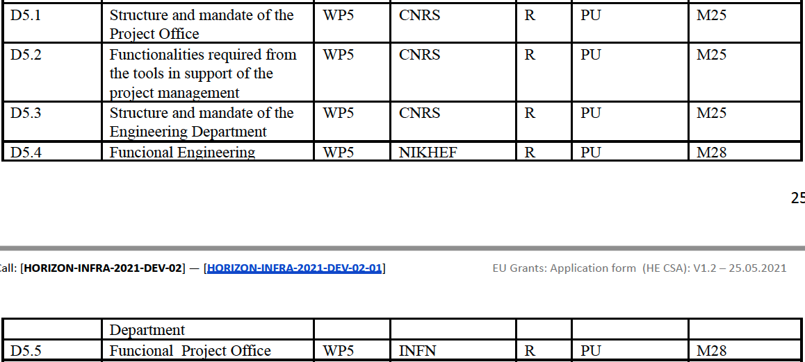
Einstein Telescope
WP5 Deliverables (1)

Slide 3
Einstein Telescope
WP5 Deliverables (2)
Milestone: May 15th review with individual review for each WP

Slide 4
Einstein Telescope
ET-PP WP5 - December 19, 2024
D5.2: Funtionalities required from the tools (1)
In this document, we describe the functionality requirements and we describe in detail the tool evaluation processes for each project management theme or expertise and the compliance with the specifications identified for the Einstein Telescope project.
The goal is to identify if commercial solutions respecting the ET requirements exist The final choice of these software tools will be made by ET management during the next phase of the project, based on this requirement identification and tool list which answers to the requirements list.

Slide 5
Einstein Telescope
ET-PP WP5 - December 19, 2024
D5.2: Funtionalities required from the tools (2)
Document structure:
For each topic, list of requirements
With summary table showing compliance with requirements for each tool assessed
Including preliminary conclusions on the today choice or proposal
For last version at the end of ET-PP phase, conclusion on each tool proposal to next step -> ET project management tool.

Slide 6
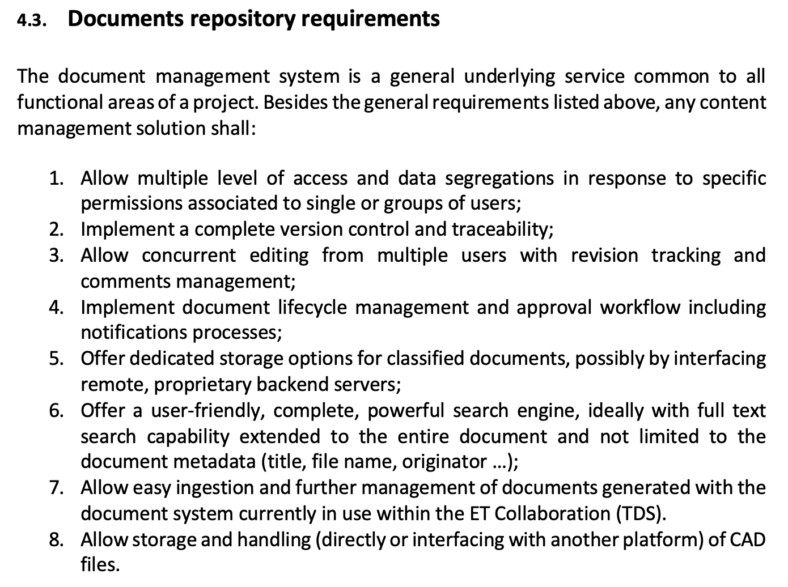
Einstein Telescope
ET-PP WP5 - December 19, 2024
D5.2: Funtionalities required from the tools (3)
Example on Documents repository requirements list

Slide 7
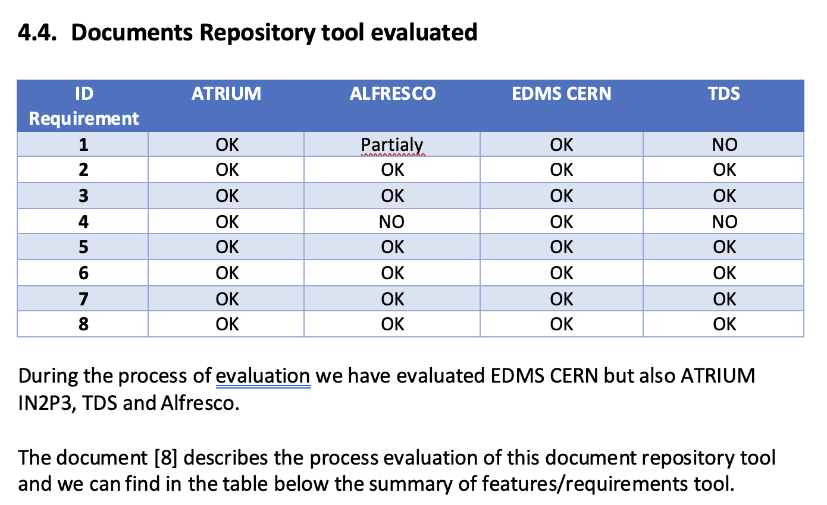
Einstein Telescope
ET-PP WP5 - December 19, 2024
D5.2: Funtionalities required from the tools (4)
Example on Documents repository tools evaluated

Slide 8
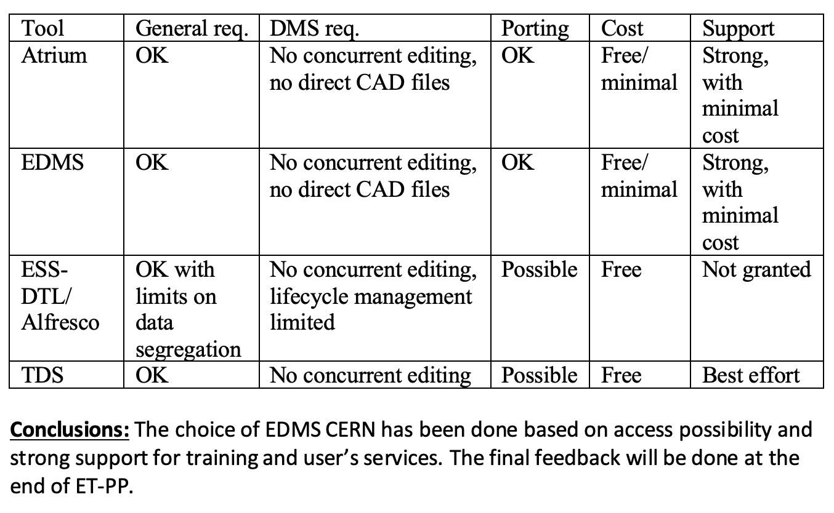
Einstein Telescope
ET-PP WP5 - December 19, 2024
D5.2: Funtionalities required from the tools (5)
Example on Document justifying choice
And
Preliminary conclusions (final conclusions at the end of ET-PP)

Slide 9
Einstein Telescope
ET-PP WP5 - December 19, 2024
D5.2: Funtionalities required from the tools (6)
Conclusions:
Bear in mind the objective of providing and justifying an evaluated, even tested, tool for each expertise domain.
The final choice (for next step of ET project) will be done by ET management team based and these proposals.
The final proposal for each domain will have an huge impact on processes deployement and in final use all along the project life.
Consistency in the choice of tools and their deployment will strongly support the conclusions reached at the end of the ET-PP phase, and hence the positive opinions that will (we hope) be given by the European reviewers to the ministries of the various countries involved in the ET project.

